Slide 1
(some) Applications of the Medipix and Timepix ASICs in life science and biology
M. Campbell¹, J. Alozy, R. Ballabriga, F. Bandi, P. Christodoulou,
A. Dorda, E.H.M. Heijne, I. Kremastiotis, X. Llopart, M. Piller, V. Sriskaran, and L.Tlustos
CERN, EP Department
1211 Geneva 23
Switzerland
¹ Honorary Professor at Glasgow University
Notes:
I am going to talk about the hybrid pixel detector readout chips that have been designed at CERN in the framework of the Medipix2 and 3 collaborations.

Slide 2
Medipix2 (1999 -> ) | Medipix3 (2005 -> ) | Medipix4 (2016 -> )
Albert-Ludwig Universität Freiburg, Germany | Albert-Ludwig Universität Freiburg, Germany | CEA, Paris, France
CEA, Paris, France | AMOLF, Amsterdam, The Netherlands | CERN, Geneva, Switzerland
CERN, Geneva, Switzerland | Brazilian Light Source, Campinas, Brazil | DESY-Hamburg, Germany
Czech Academy of Sciences, Prague, Czechia | CEA, Paris, France | Diamond Light Source, England, UK
ESRF, Grenoble, France | CERN, Geneva, Switzerland | IEAP, Czech Technical University, Prague, Czeciah
IEAP, Czech Technical University, Prague, Czech Republic | DESY-Hamburg, Germany | IFAE, Barcelona, Spain
IFAE, Barcelona, Spain | Diamond Light Source, England, UK | JINR, Dubna, Russian Federation
Mid Sweden University, Sundsvall, Sweden | ESRF, Grenoble, France | NIKHEF, Amsterdam, The Netherlands
MRC-LMB Cambridge, England, UK | IEAP, Czech Technical University, Prague, Czech Republic | University of California, Berkeley, USA
NIKHEF, Amsterdam, The Netherlands | KIT/ANKA, Forschungszentrum Karlsruhe, Germany | University of Canterbury, Christchurch, New Zealand
University of California, Berkeley, USA | Mid Sweden University, Sundsvall, Sweden | University of Geneva, Switzerland
Universität Erlangen-Nurnberg, Erlangen, German | NIKHEF, Amsterdam, The Netherlands | University of Glasgow, Scotland, UK
University of Glasgow, Scotland, UK | Univesridad de los Andes, Bogota, Columbia | University of Houston, USA
University of Houston, USA | University of Bonn, Germany | University of Maastricht, The Netherlands
University and INFN Section of Cagliari, Italy | University of California, Berkeley, USA | University of Oxford, England, UK
University and INFN Section of Pisa, Italy | University of Canterbury, Christchurch, New Zealand | INFN, Italy
University and INFN Section of Napoli, Italy | Universität Erlangen-Nurnberg, Erlangen, German
 | University of Glasgow, Scotland, UK
 | University of Houston, USA
 | University of Leiden, The Netherlands
 | Technical University of Munich, Germany
 | VTT Information Technology, Espoo, Finland

Slide 3
Acknowledgements – Commercial Partners
COLLABORATION NAME | Medipix2 |  |  | Medipix3 |  | Medipix4
ASICS | Medipix2 | Timepix | Timepix2 | Medipix3 | Timepix3 | Medipix4 | Timepix4
ADVACAM s.r.o., Czech Republic | X | X | X | X | X
Amsterdam Scientific Instruments, The Netherlands | X | X | X | X | X
Kromek, UK | X | X | X
Malvern-Panalytical, The Netherlands | X | X | X | X
MARS Bio Imaging, New Zealand |  |  |  | X
Pitec, Brasil |  |  |  | X
Quantum Detectors, UK |  |  |  | X
X-ray Imaging Europe, Germany | X | X | X
X-spectrum, Germany |  |  |  | X

Slide 4
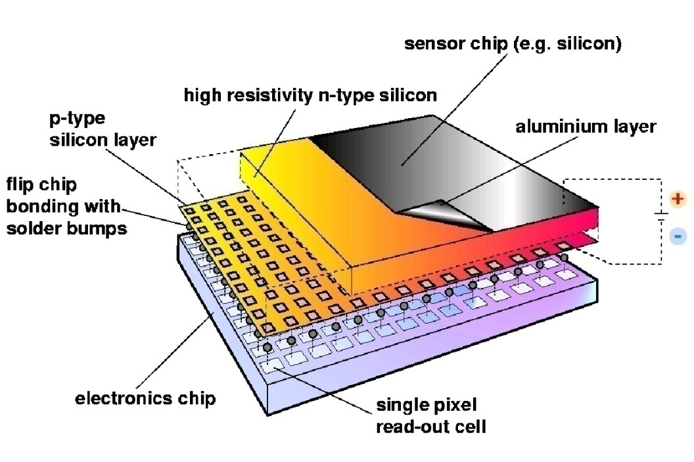
Hybrid Silicon Pixel Detectors
Noise-hit free images possible (high ratio of threshold/noise)
Standard CMOS can be used allowing on-pixel signal processing
Sensor material can be changed (Si, GaAs, CdTe..)
Semiconductor sensor can be replaced by a gas gain grid or MCP
Notes:
Mention signal generation Add X section?

Slide 5
Outline
Medipix3
Spectroscopic imaging in medicine
TEM , STEM and Cyro-EM
Timepix3
Imaging Time of Flight mass spectrometry
Thyropix – single chip SPECT
Timepix4 and Medipix4
Looking further ahead

Slide 6
What if…
Each pixel counted incoming hits to make an image?
Each pixel measured the charge of those hits?
Could we make ‘colour’ X-ray images?
This led to the Medipix chip family

Slide 7
Medipix3 chip for high rate spectroscopic X-ray imaging
Collaboration started in 2005
Large matrix (256 x 256) with fine pixel pitch (55μm)
Selectable sensor pixel pitch (55μm or 110μm)
Inter-pixel charge summing logic > mitigate charge sharing in sensor
Up to 8 counters per (110μm) pixel
Camera logic (open shutter > count > close shutter > read out image)
Possibility of continuous read/write
Material | N | k-edge (keV) | Kα energy (keV) | dα (μm) | η [%]
Si | 14 | 1.84 | 1.74 | 12 | 5
Ge | 32 | 11.11 | 9.89 | 51 | 55
GaAs:
Ga | 31 | 10.38 | 9.25 | 42 | 51
As | 33 | 11.87 | 10.54 | 16 | 57
CdTe:
Cd | 48 | 26.73 | 23.17 | 128 | 84
Te | 52 | 31.82 | 27.47 | 64 | 87

Slide 8
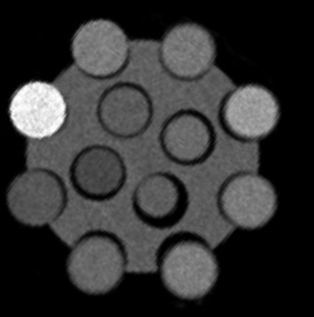
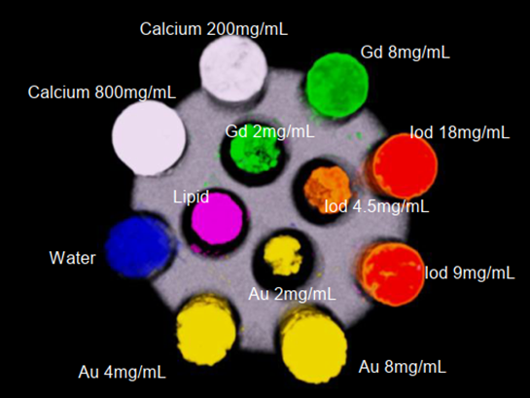

Grayscale to Material Imaging
Spectral imaging using Medipix3RX allows you to identify and quantify different materials
  a separate map (data channel) is made for each material
  each map gives the partial density (g/cm³) for the material
  each material is then assigned a colour for easy visualisation
Single Energy detector
MARS Spectral detector
A phantom containing Au, Gd, iodine, lipid, water and hydroxyapatite
https://www.marsbioimaging.com/mars/

Slide 9
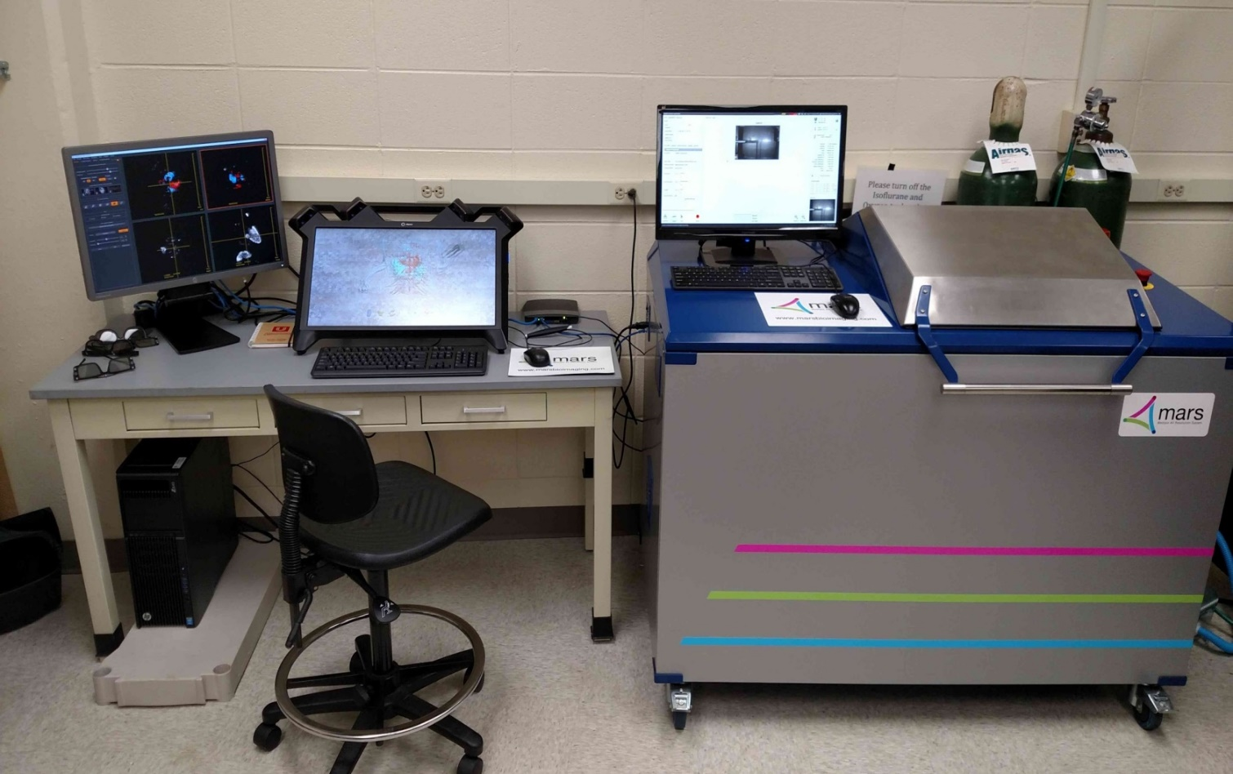
MARS small animal scanner
Notre Dame imaging lab
Slide courtesy of A. Butler, University of Canterbury

Slide 10
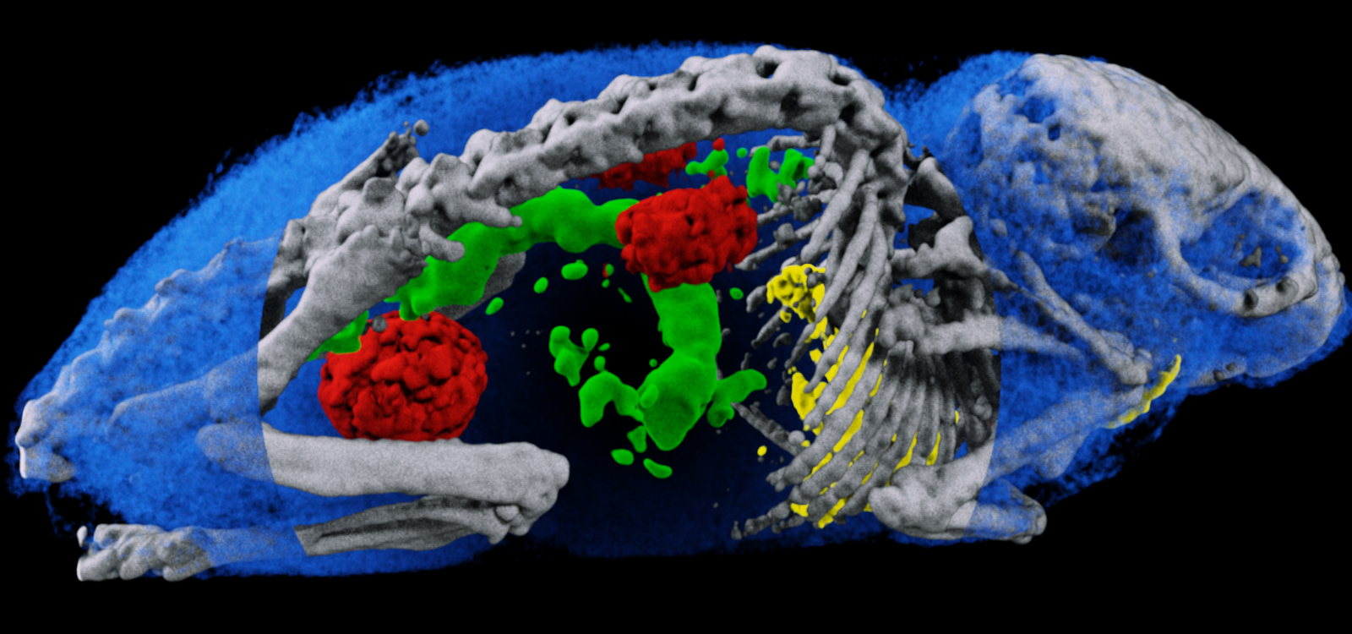
First material separation small animal image
The water has been partly cut away to reveal the bone, gold, gadolinium and iodine
Here the metals are used as contrast agents. The big quesstion is whether we can develop and image bio-markers for functional imaging (replacing PET is some circumstances).

Slide 11
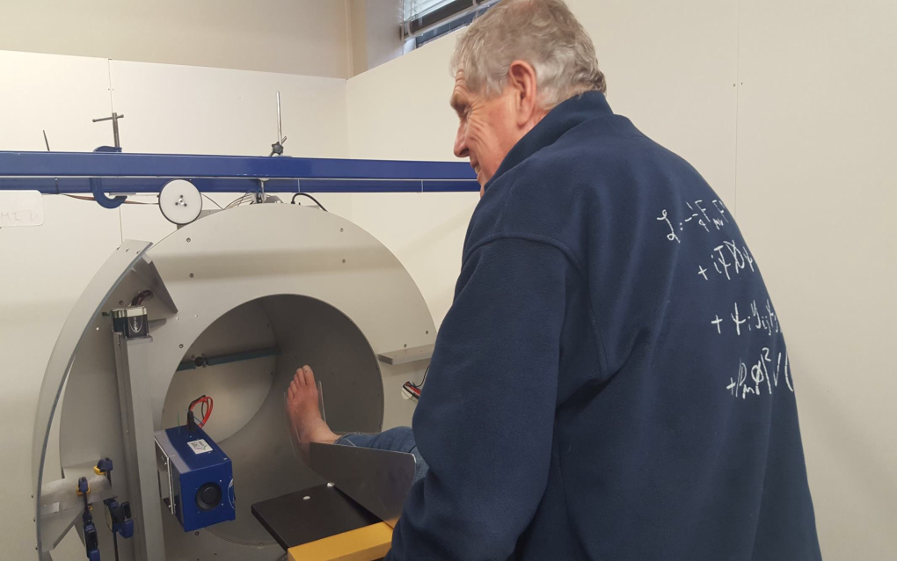
First living human scan…
Phil Butler, CEO of MARS Bio Imaging

Slide 12
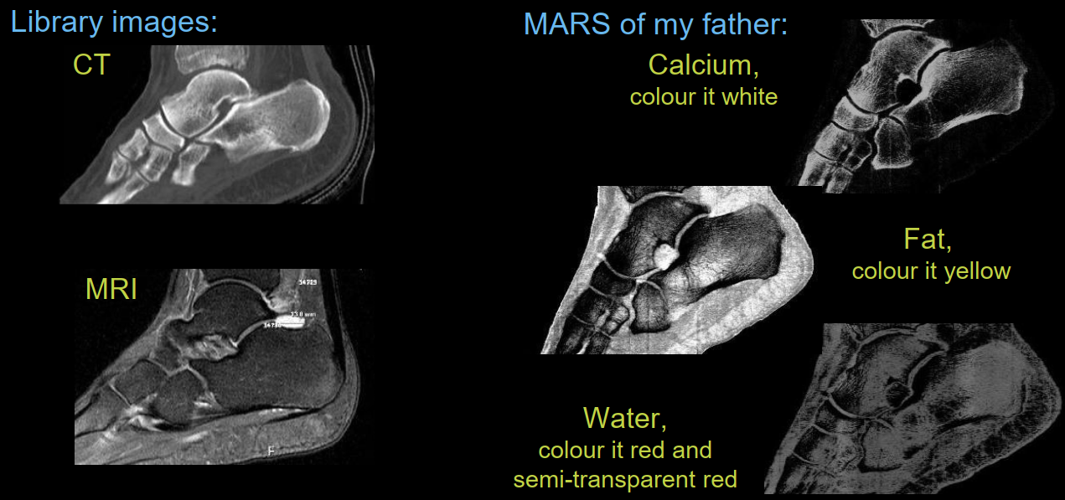
Slice through Phil’s ankle
Conventional imagers MARS CT

Slide 13
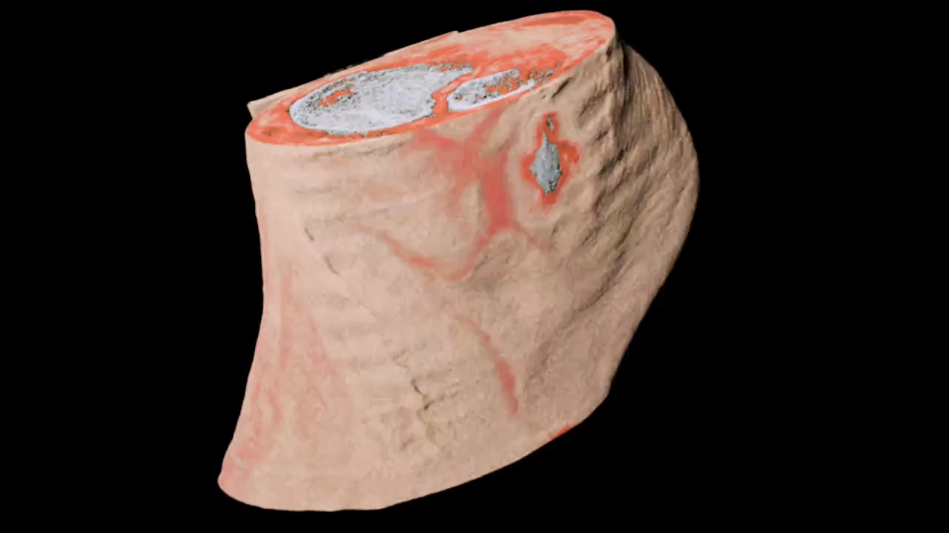
Movie Slice through Phil’s ankle

Slide 14
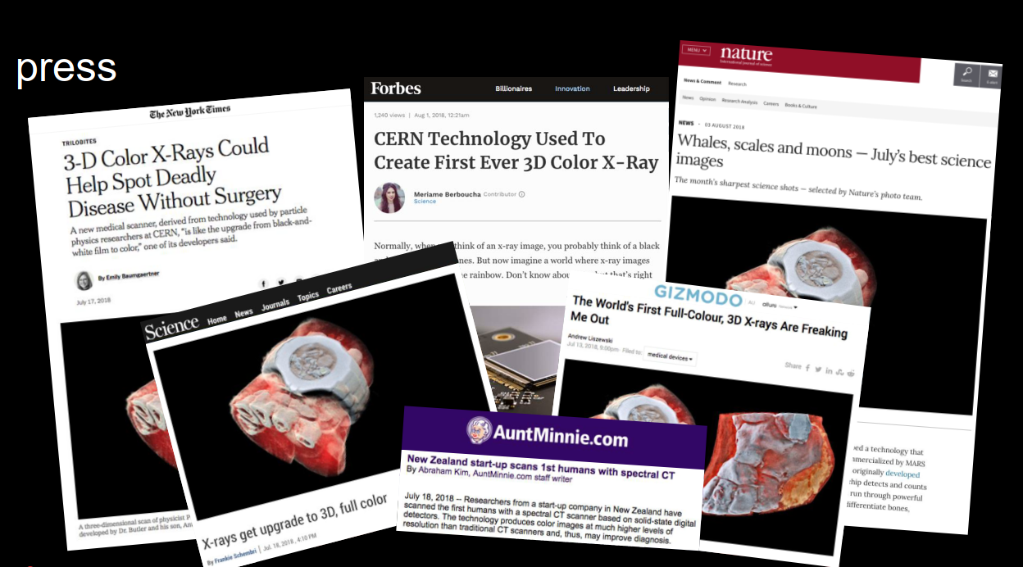
Press Impact
Image viewed over 40 M times on Twitter
Highest number of hits on CERN website since the Higgs announcement

Slide 15
MARS scan of diseased carotid artery

Slide 16
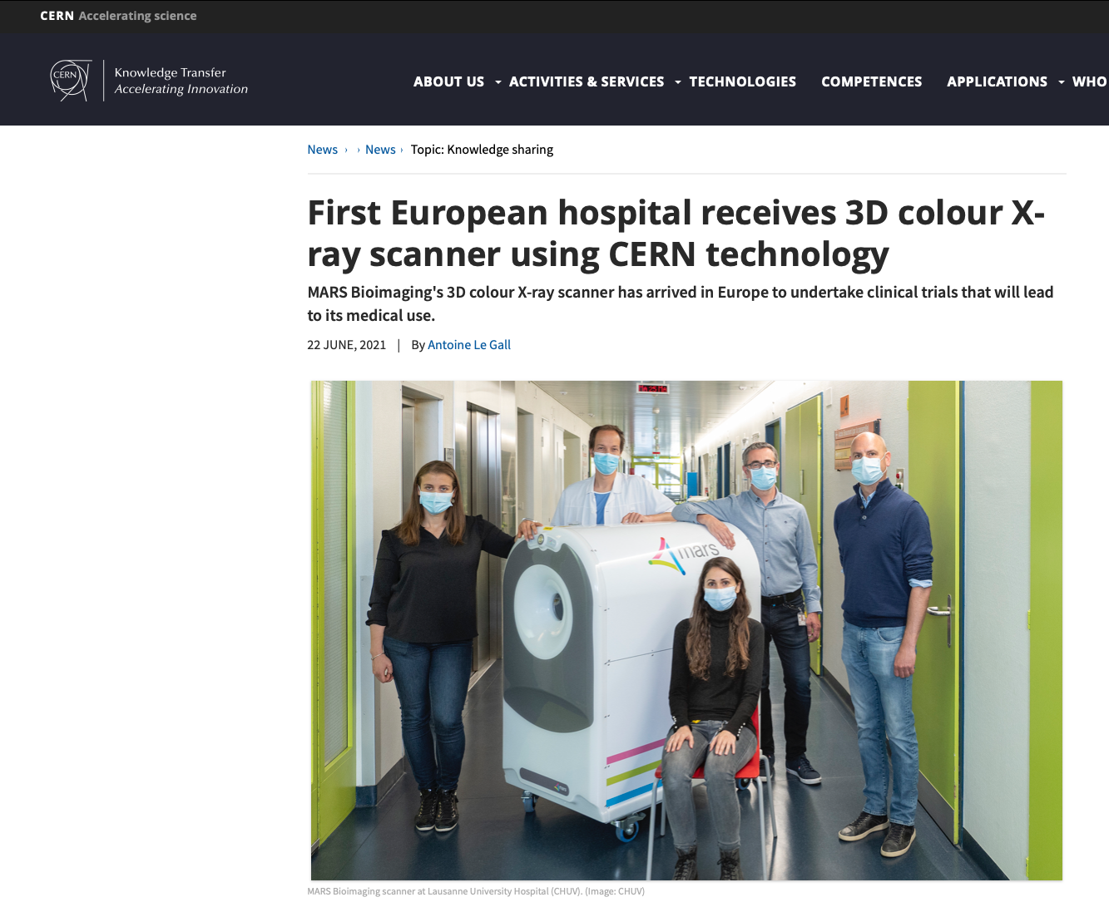

Slide 17
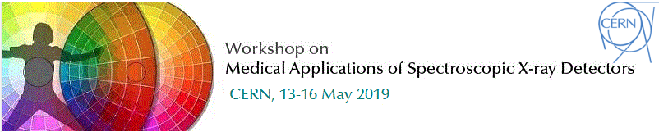
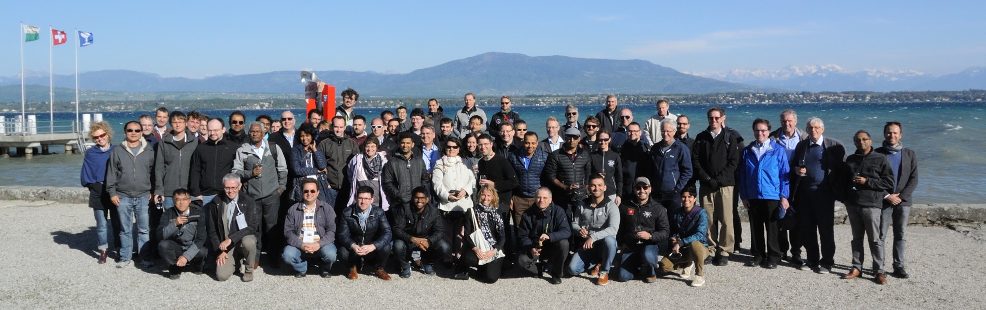
~120 invited participants of which ~50 were from industry
All large medical equipment suppliers represented: Canon, GE, Philips, Siemens
Also major research institutes present :Johns Hopkins, Massachusetts General Hospital, Mayo Clinic, Royal Marsden, TU Munich etc
Medipix Collaboration plays a ‘pathfinding’ role in this community

Slide 18
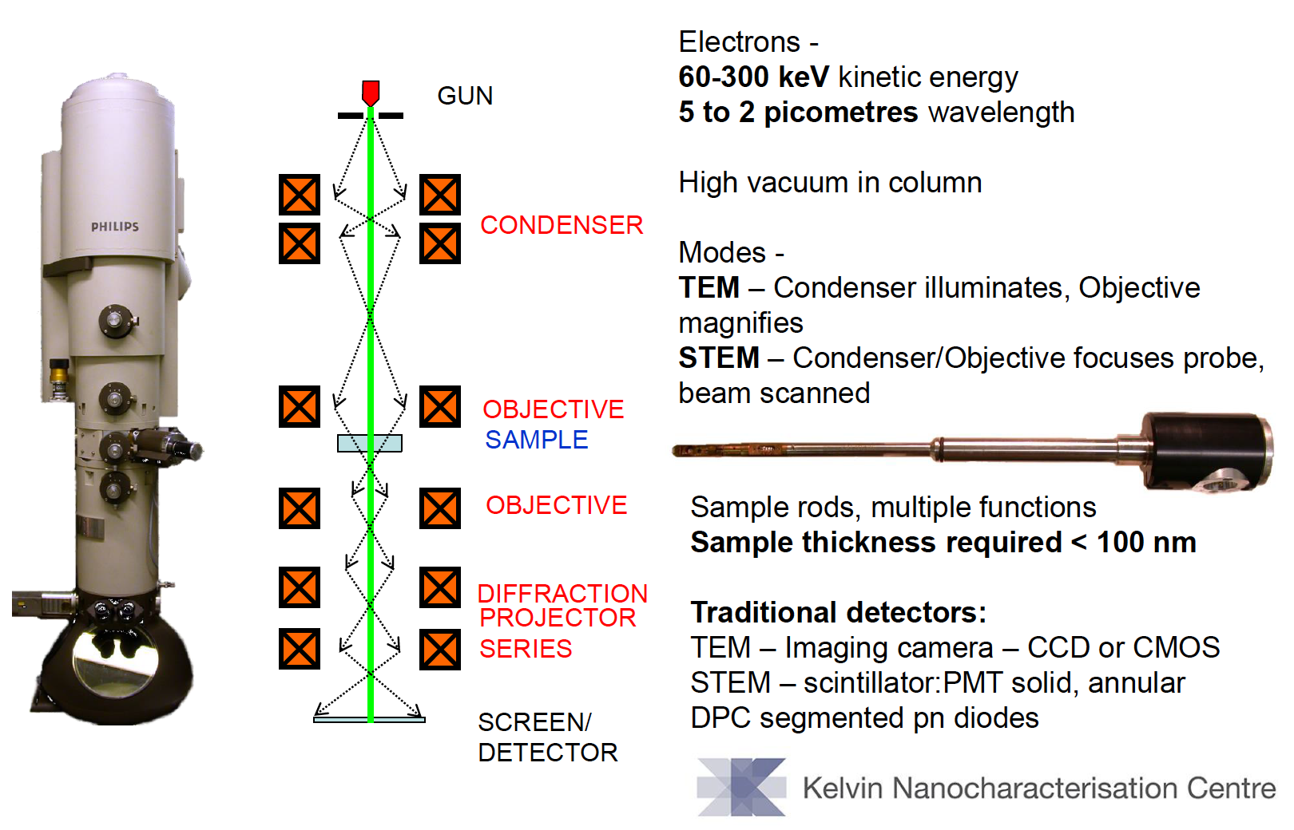
TEM, STEM and cryo-EM
Courtesy of D. M^{c}Grouther, Glasgow

Slide 19
Detection of 60keV electrons (300μm thick Si)
Modulation Tranfer Function
Detective Quantum Efficiency
Single Pixel Mode
Charge Summing Mode
J.A. Mir et al., Ultramicroscopy (2017) 182 44-53

Slide 20
Detection of 120keV electrons (300μm thick GaAs)
Modulation Tranfer Function
Detective Quantum Efficiency
Single Pixel Mode
Charge Summing Mode
Kirsty A. Paton et al., Ultramicroscopy (2021) 227 113298

Slide 21
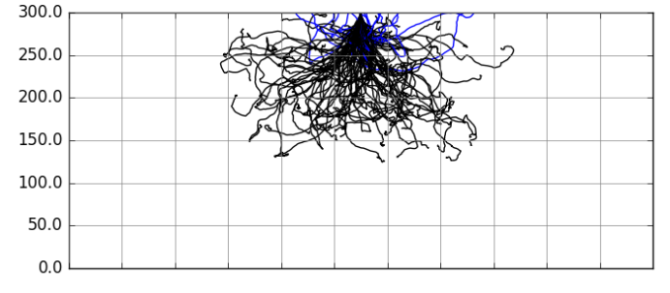
Simulation of 200keV electron impinging on 300μm thick Si
Courtesy of J. P. van Schayck, Maastricht

Slide 22
Timepix3 – single particle detection
CMOS node | 130nm
Pixel Array | 256 x 256
Pixel pitch | 55μm
Charge collection | e⁻, h⁺
Pixel functionality | TOT (Energy) and TOA (Arrival time)
Preamp Gain | ~47mV/ke⁻
ENC | ~60e⁻
FE Linearity | Up to 12ke⁻
TOT linearity (resolution) | Up to 200ke⁻ (<5%)
TOA resolution* | Down to 1.6ns
Time-walk | <20ns
Minimum detectable charge | ~500e⁻ → 2 KeV (Si Sensor)
Power power (1.5V) | 700 mW/cm²
Maximum hit rate | 80Mhits/cm²/sec (in data driven)
Readout | Data driven (44-bits/hit @ 5Gbps)
* Thanks to V. Gromov, et al. Nikhef, C. Brezina et al., Bonn

Slide 23
Using charge collection time to track in a single Si layer

Slide 24
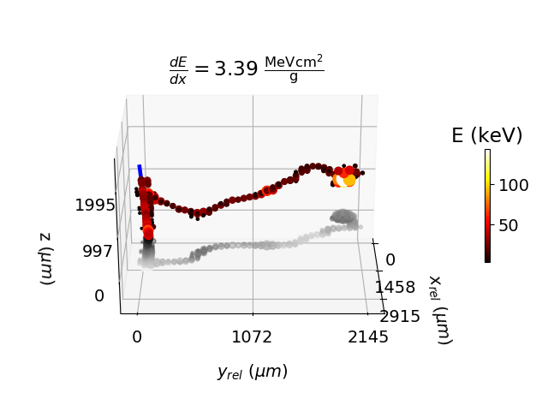
3D rendering of traversing particle with delta electron
45 deg
CdTe sensor
2mm thick
V_{bias} = 130V
Colour (and diameter) indicate charge
Slide courtesy of B. Bergmann, S. Pospisil, IEAP, CTU, Prague

Slide 25
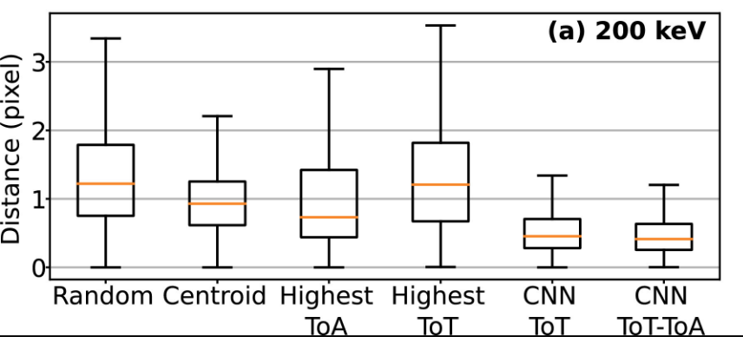
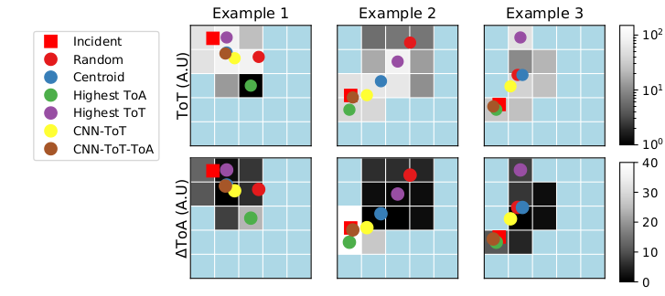
Use simulated data to train a CNN to identify impact point
Courtesy of J. P. van Schayck Maastricht
J. Paul van Schayck et al., Ultramicroscopy (2020) 218 113092

Slide 26
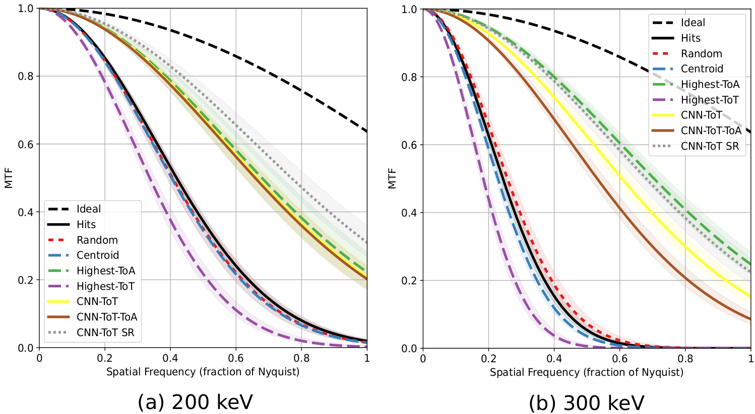
Comparison of the performance of different algorithms
Courtesy of J. P. van Schayck Maastricht
J. Paul van Schayck et al., Ultramicroscopy (2020) 218 113092

Slide 27
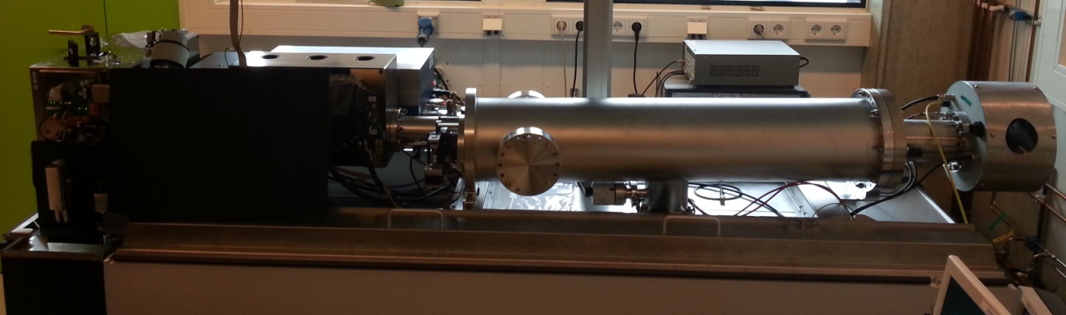
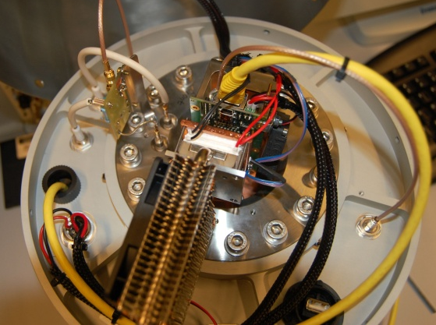
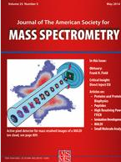
Mass spectrometry enhanced with segmented Timepix MCP Readout
MCP decoupling
ReLaXd readout board
Delay generator and MCP power supplies
Timepix assembly
Bruker Ultraflex III
Two spectra per laser shot:
1- Timepix (position and time)
2- ADC (time, multihit)
Ellis et al. J. Am. Soc. Mass Spec. (2014) 25 809-819
Notes:
2 days on other instruments

Slide 28
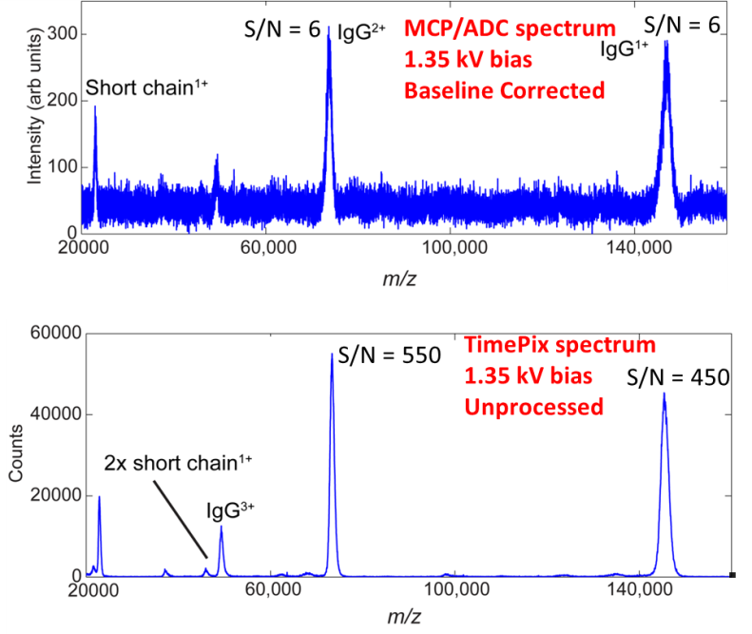
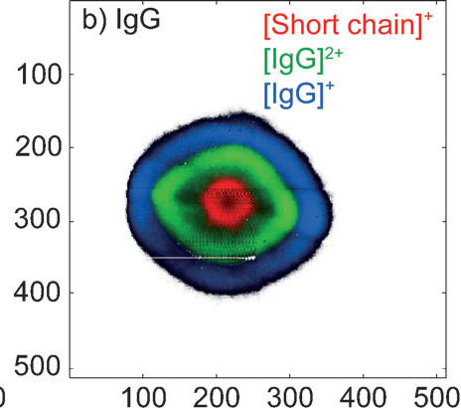
Improved High Mass Sensitivity
Courtesy of R, Heeren, Maastricht
Ang. Chemie. Int. Ed. (2013) 52 11261-11264
Notes:
2 days on other instruments

Slide 29
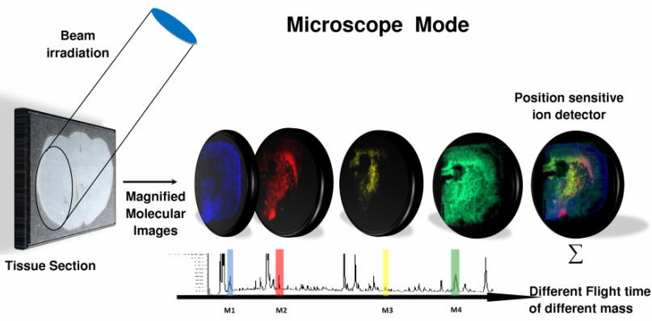
Microscope-based imaging Mass Spectrometry
Courtesy of R, Heeren, Maastricht

Slide 30
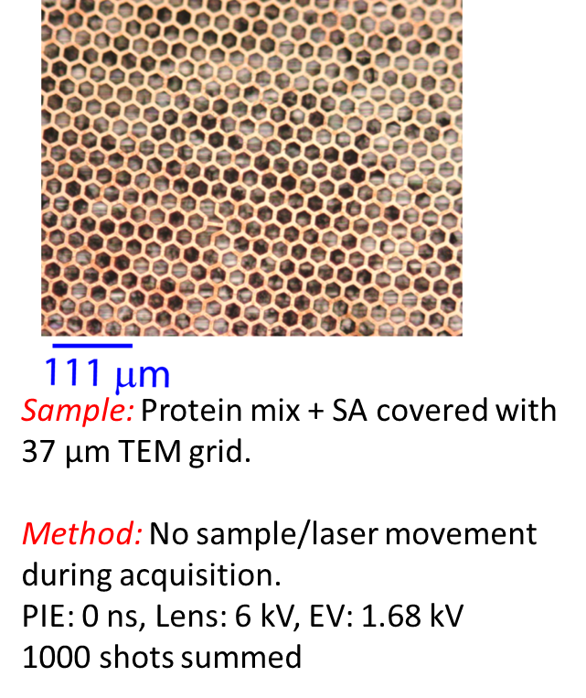
Does it really work?
Courtesy of R, Heeren, Maastricht
Notes:
2 days on other instruments

Slide 31
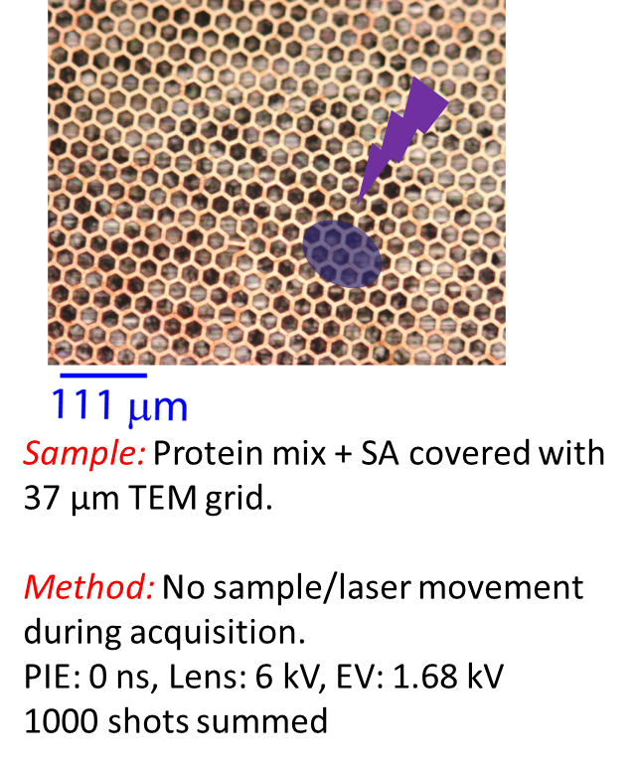
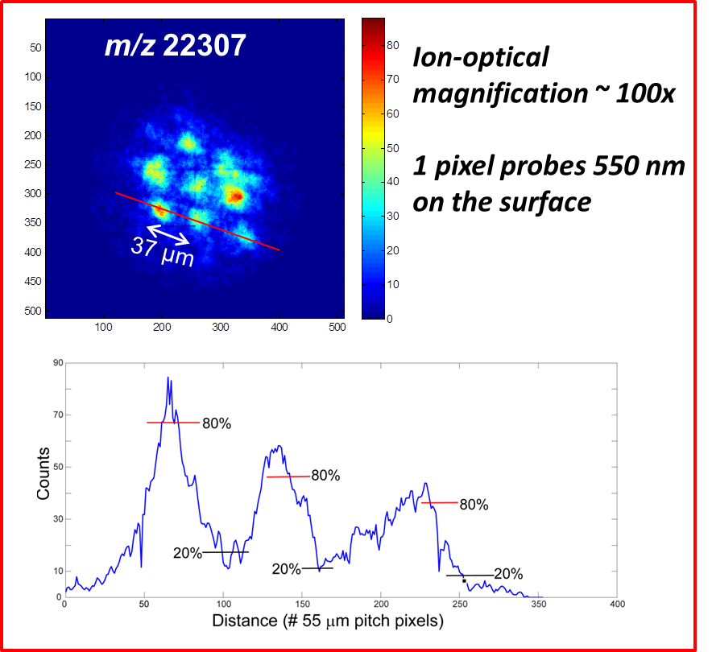
Does it really work?
Courtesy of R, Heeren, Maastricht
Notes:
2 days on other instruments

Slide 32
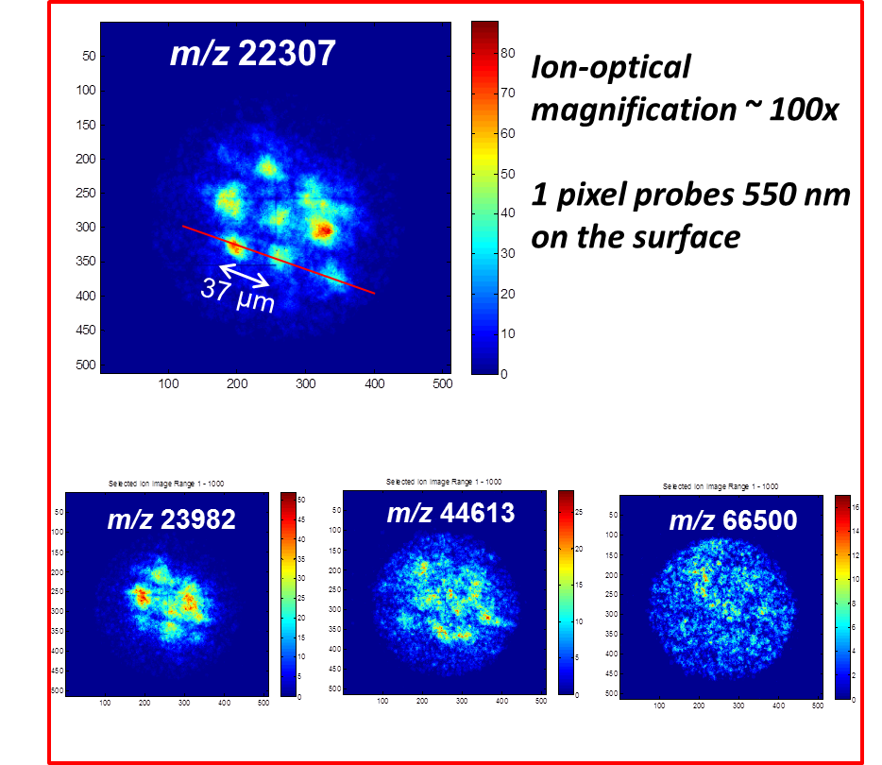
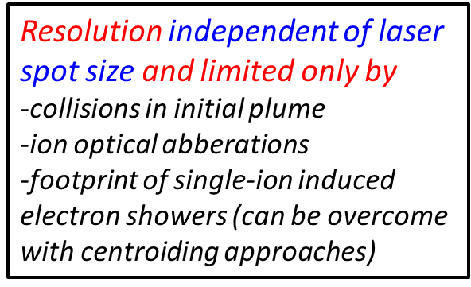
Does it really work?
Courtesy of R, Heeren, Maastricht
Notes:
2 days on other instruments

Slide 33
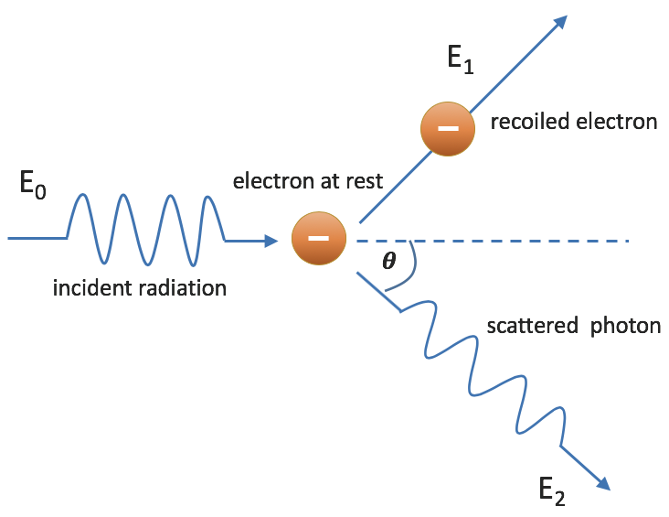
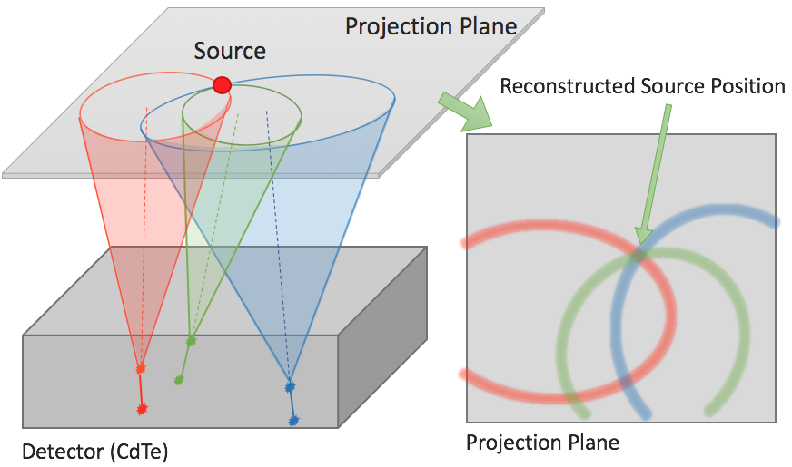
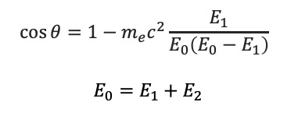
Single Layer Compton Camera with MiniPIX TPX3
Compton camera principle
Typical two detectors
primary gamma is scattered in first detector (position and energy recorded), scattered gamma continues to second detector (absorbed, position and energy recorded)
from energies - > scattering angle calculated
from position and energies -> possible position of the source on the surface of a cone
Multiple cones intersection - > source position
Single Timepix3 layer camera
  Instead of 2 detectors, only single TPX3
  Using time of charge collection to determine relative depth
$$\cos{θ=1−m_{e}c^{2}\frac{E_{1}}{E_{0}\left(E_{0}−E_{1}\right)} }$$
$$E_{0}=E_{1}+E_{2}$$
Courtesy of D. Turecek, Advacam s.r.o

Slide 34
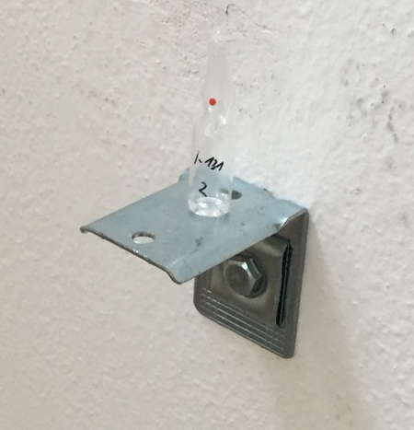
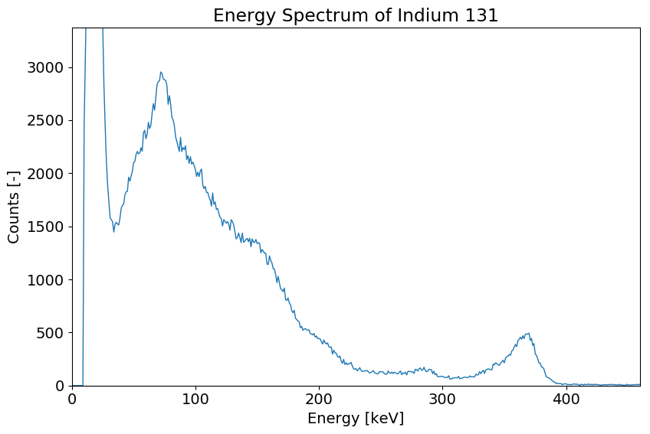
Single Layer Compton Camera with MiniPIX TPX3
¹³¹Iodine gamma source
3 different Iodine solution in small bottles positioned in a room at different positions
Distance from detector 3.5 m (activity 10’s of MBq)
Mapped on photograph of the room
Sources located correctly within minutes
Image took hours to collect
Energy Spectrum of ¹³¹I
Reconstruction of position of three ¹³¹I gamma sources (364 keV)
Courtesy of D. Turecek, Advacam s.r.o

Slide 35
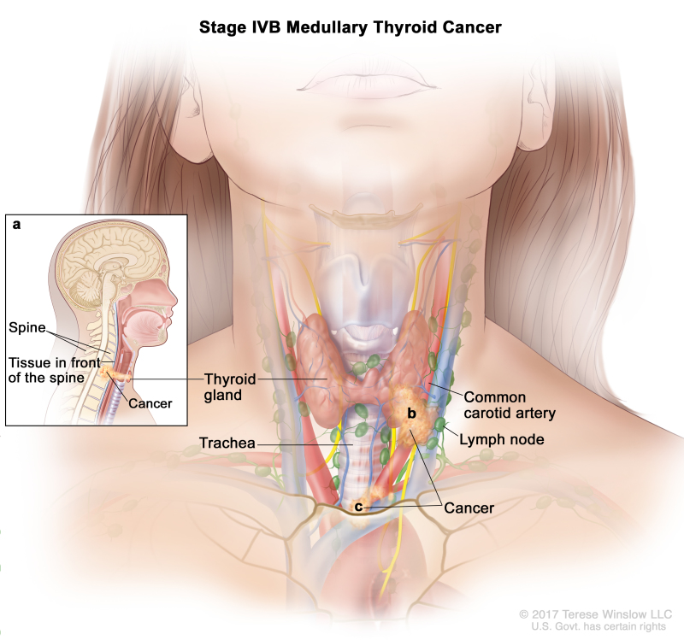
Gamma camera application: Thyroid diagnostics
Thyroid cancer diagnostics and treatment monitoring:
The second most frequent cancer for women (after breast cancer)
Current imaging methods offer resolution of about 12 mm in 2D
Our technology allows
  5 times better resolution and 3D (2.5 mm)
  4 times lower dose
Courtesy of D. Turecek, Advacam s.r.o

Slide 36
Timepix readout chips - single particle detection
 | Timepix | Timepix2 | Timepix3
Tech. node (nm) | 250 | 130 | 130
Year | 2005 | 2018 | 2014
Pixel size (μm) | 55 | 55 | 55
# pixels (x x y) | 256 x 256 | 256 x 256 | 256 x 256
Time bin (bin size in ns) | 10 | 10 | 1.5
Readout architecture | Frame based (sequential R/W) | Frame based (sequential or continuous R/W) | Data driven or Frame based (sequential R/W)
Number of sides for tiling | 3 | 3 | 3

Slide 37
Timepix readout chips - single particle detection
 | Timepix | Timepix2 | Timepix3 | Timepix4
Tech. node (nm) | 250 | 130 | 130 | 65
Year | 2005 | 2018 | 2014 | 2019
Pixel size (μm) | 55 | 55 | 55 | 55
# pixels (x x y) | 256 x 256 | 256 x 256 | 256 x 256 | 448 x 512
Time bin (bin size in ns) | 10 | 10 | 1.5 | 200ps
Readout architecture | Frame based (sequential R/W) | Frame based (sequential or continuous R/W) | Data driven or Frame based (sequential R/W) | Data driven or Frame-base (sequential or continuous R/W)
Number of sides for tiling | 3 | 3 | 3 | 4

Slide 38
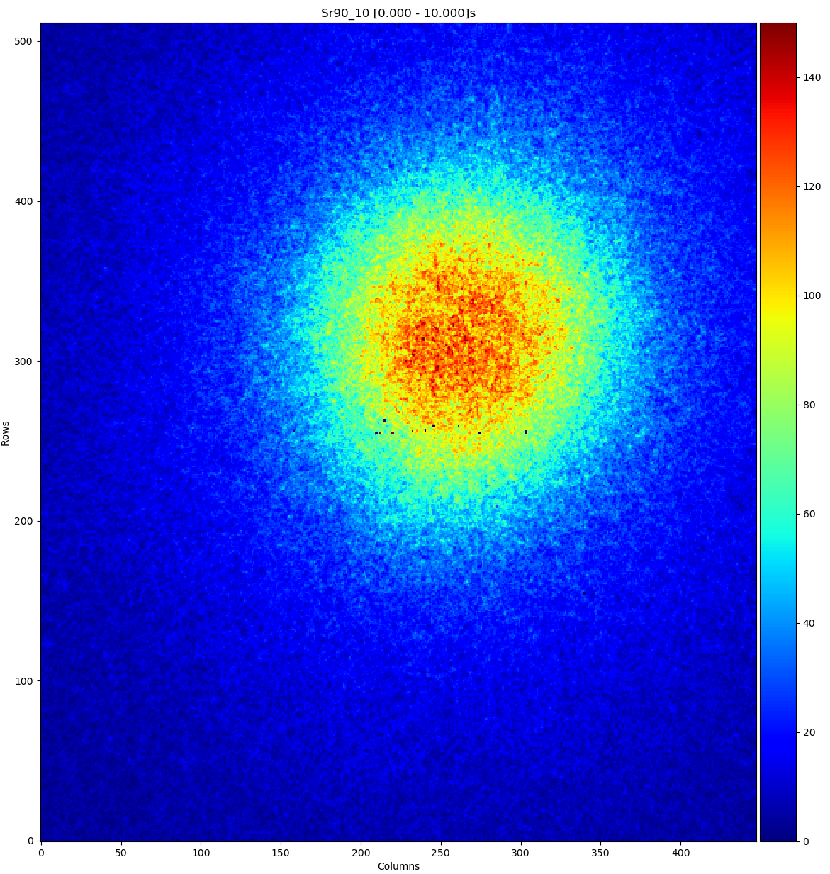
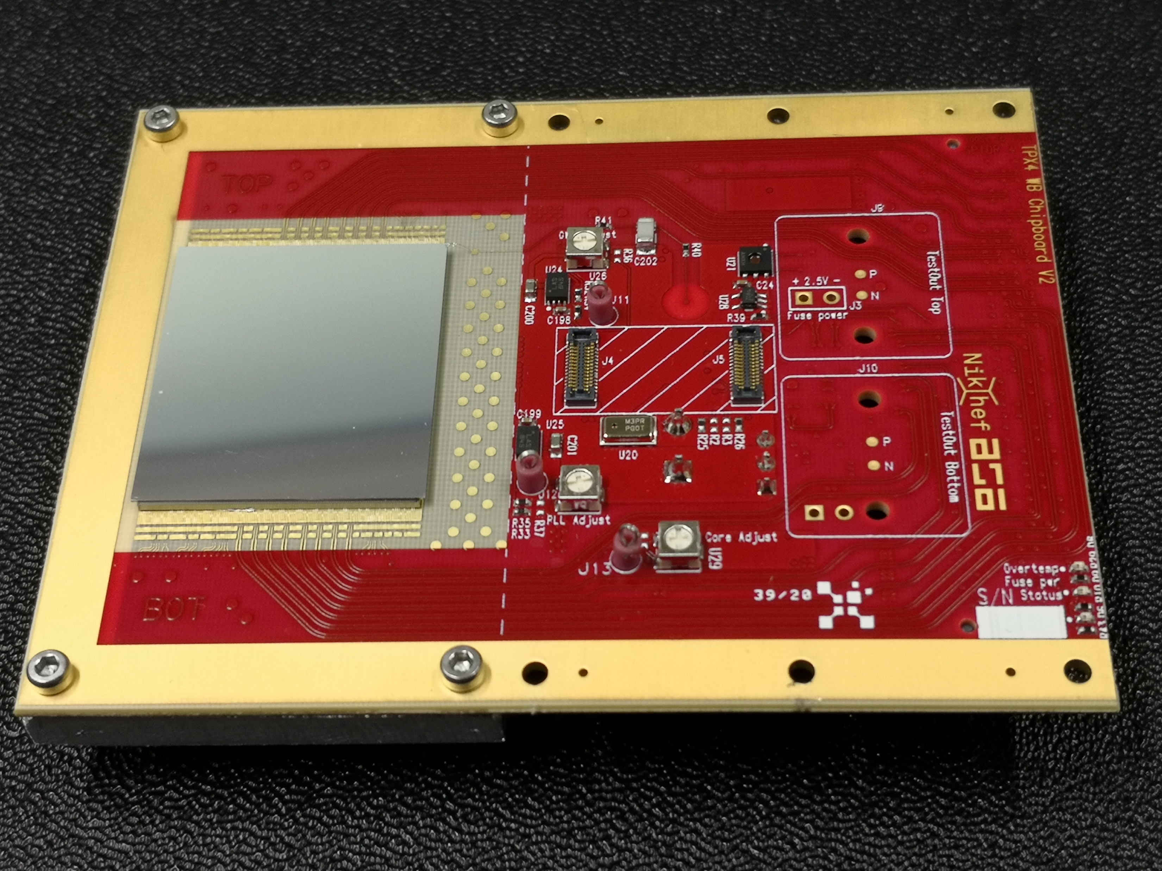
Timepix4 – works! ☺
10s exp. ⁹⁰Sr
Threshold ~ 800e⁻
6.1 M packets @ 5 Gbps
For details see talk of D Pennicard on Monday

Slide 39

Can be (better) handle the data deluge?

Slide 40
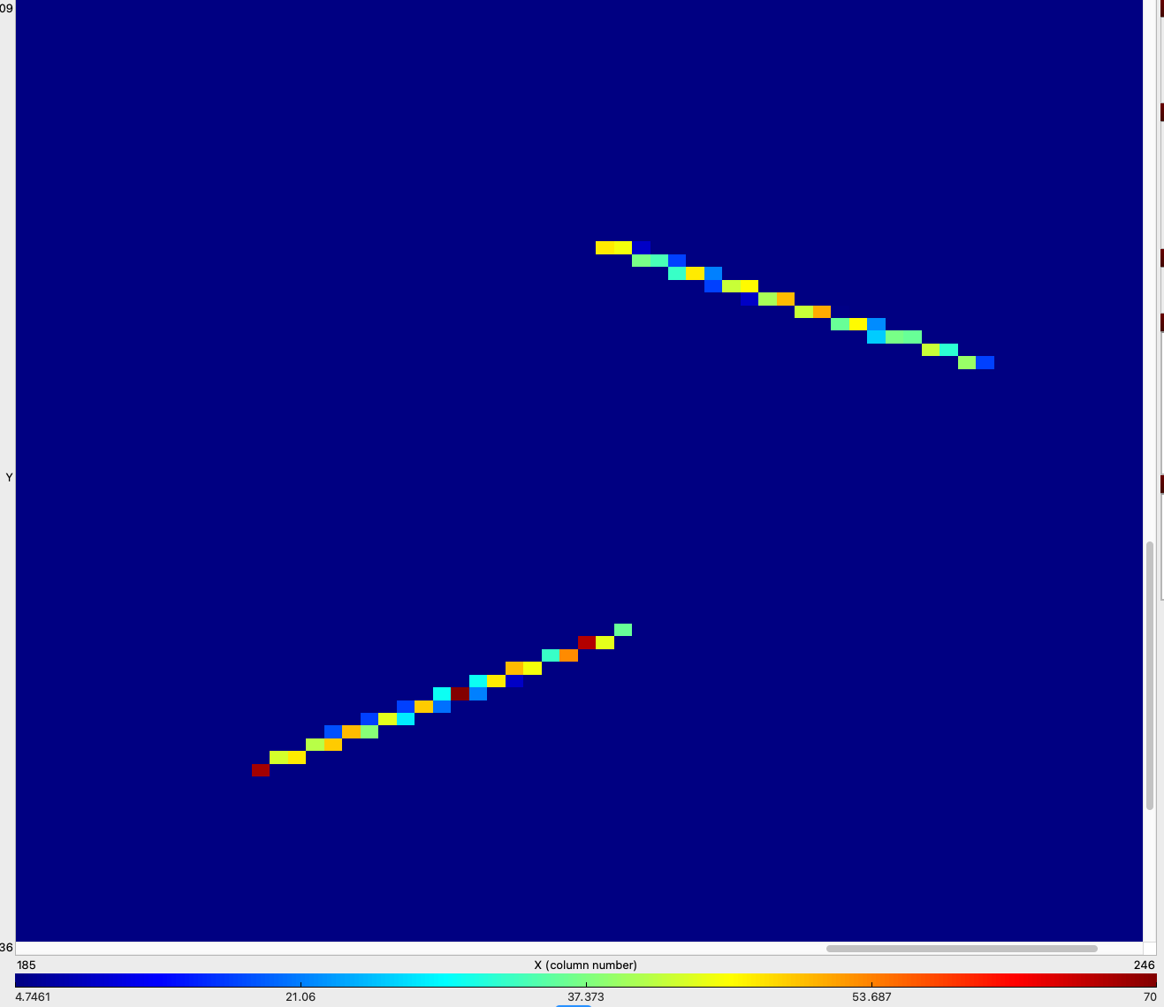
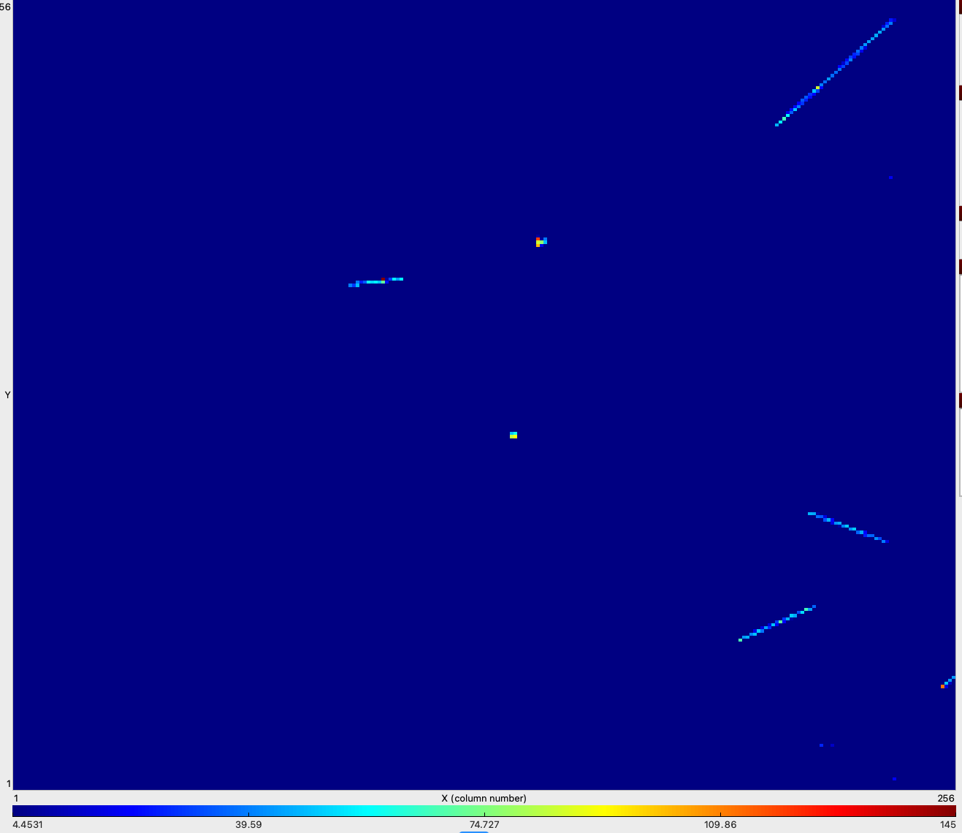
How can 28nm CMOS help (1)?
Increased component density and power efficiency can lead to further improved time-tagging (ultimately limited by the detector) 200ps -> 50ps??
Can we develop on-pixel logic which helps ‘keep clusters together’?
Before readout is initiated after, say, 1 clock cycle (or more if needed), a pixel asserts a readout request if and only if it is e.g. the leftmost in a cluster (or alone)
It the passes the right to be read out (a token) to it’s neighbour(s) to the right
Only when a full cluster is read out can a new cluster start from a given column

Slide 41
How can 28nm CMOS help (2)?
Each periphery (or sub periphery) could contain a cluster processor Reduced Instruction Set Computer processor (e.g. RISC -V) and/or CNN(?)
This processor can be trained/programmed to identify particular cluster shapes: single hits, small clusters, stiff tracks (high p_{T}), long straight tracks (MIPS, charged particles), long squiggly tracks (electrons), blobs (alphas)
The processor could be programmed to send out only a subset of information about a given cluster (e.g. timestamp, entry pixel, exit pixel for a MIP; timestamp, entry point, energy(?) for an electron; centre of gravity, total energy for an alpha etc)
Potential for massive data reduction and ultimate efficiency in use of of-chip bandwidth. Simplified readout even in extreme conditions.

Slide 42
Examples of other applications of Timepix/Medipix
Large area X-ray cameras for synchrotrons
X-ray materials analysis
Art authentication
X-ray non-destructive testing
X-ray dosimetry - dosepix chip development
High resolution neutron detection and imaging
Low Energy Electron Microscopy
Electron Backscattering diffraction (EBSD)
Dose deposition tracking in hadron therapy
Gamma (and Compton) camera for power plant decommissioning and homeland security
Tpix3Cam and 4D photon projects
Mixed field radiation monitoring on the International Space Station
Various space weather satellites
Lunar radiation measurements
Use in classrooms
X-rays
Neutrons
Electrons
Hadrons
Gammas
Visible
Mixed field

Slide 43
Applications for CERN/Physics
  LHCb VELOpix chip is directly derived from Timepix3
  LHCb Timepix3 telescope – 80 Mhits/cm²/sec
  Sensor studies for CLIC/LHCb
  Background radiation monitoring at ATLAS and CMS
  Beam monitoring in UA9
  Positron annihilation in Aegis
  ASACUSA experiment
  Beam Gas Interaction real time monitor at SPS
  Breit-Wheeler experiment at RAL
  Beta particle channeling in ISOLDE
  Axion search at CAST (with InGrid)
  Large area TPC (with InGrid)
  Transition radiation measurements for ATLAS
  GEMPIX development for radiation therapy beam monitoring
  GEMPIX for ⁵⁵Fe waste management
  Developments for CLIC: CLICpix, CLICpix2, C3PD
  Large area dual-phase Li:Ag TPC readout

Slide 44
Conclusions
The Medipix and Timepix chips have been used in multiple applications (both foreseen and otherwise)
This talk highlighted spectroscopic X-ray imaging, TEM/STEM, Imaging ToF mass spectrometry, SPECT
Their strength lies in their great versatility (not so ASIC ☺) and a large community of motivated expert researchers and licensees
The Timepix4 and Medipix4 chips seek to tile large areas seamlessly using TSVs
We presented some ideas which could go into a future Timepix5 device
  On pixel clustering
  On chip particle identification
  Optimum use of offf-chip bandwidth with much simplified readout
  Even more programmable and versatile than previous versions.

Slide 45
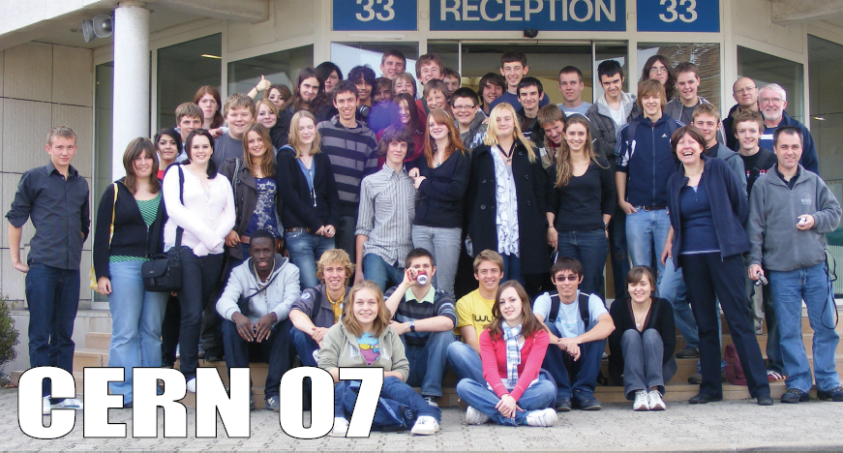
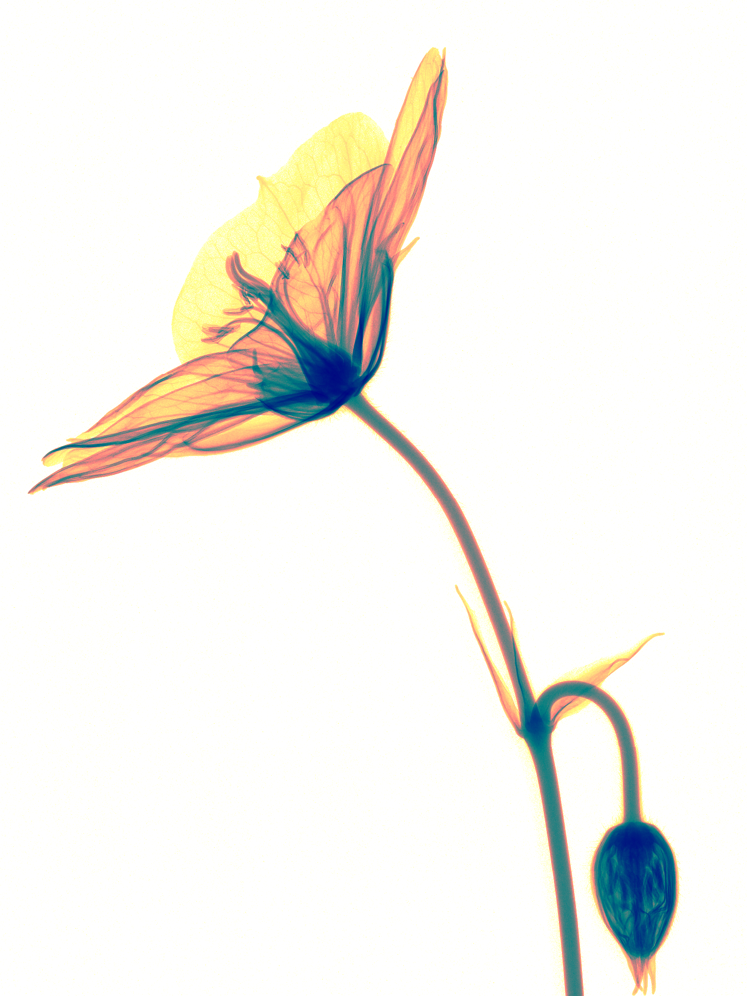
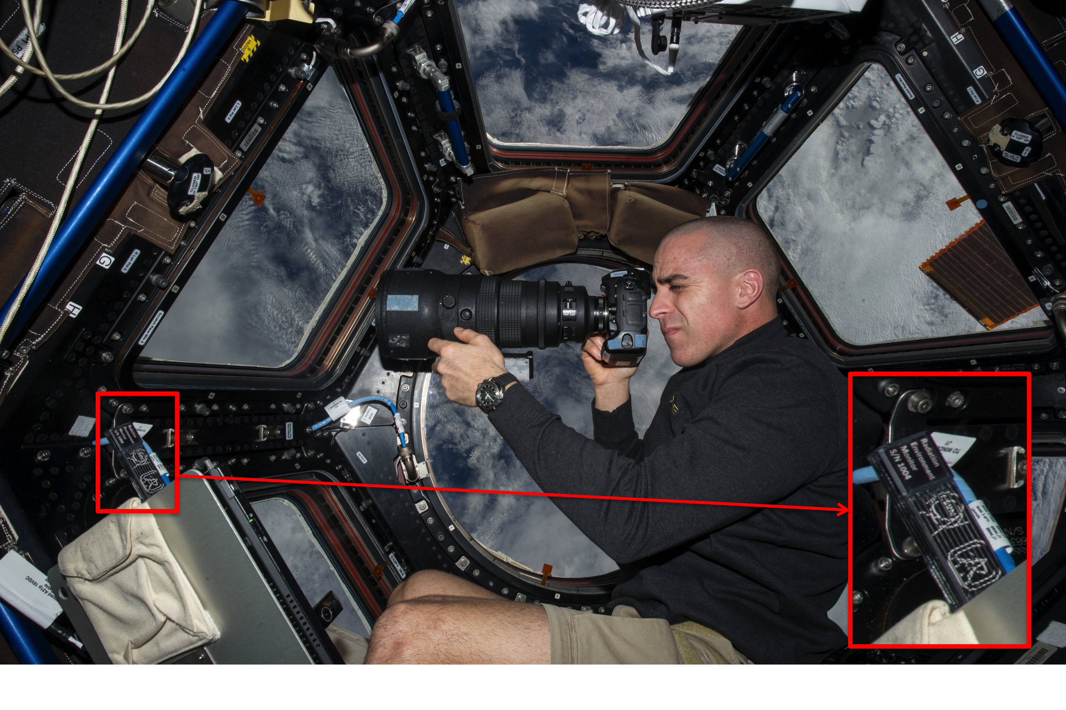
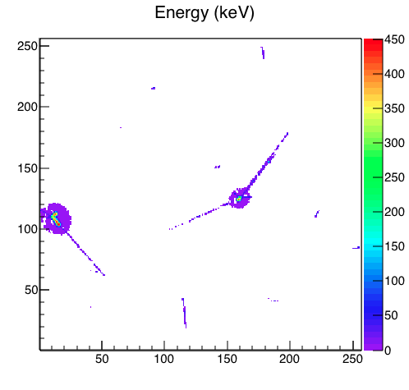
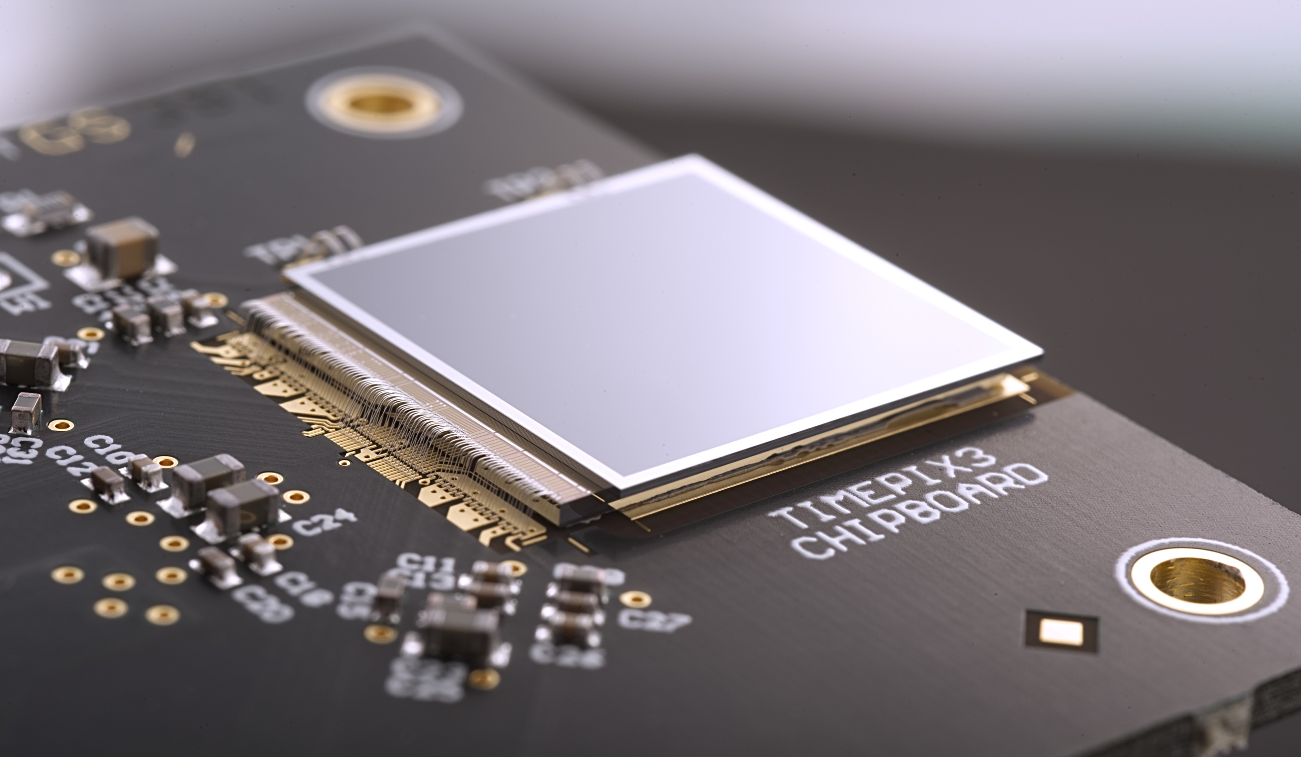
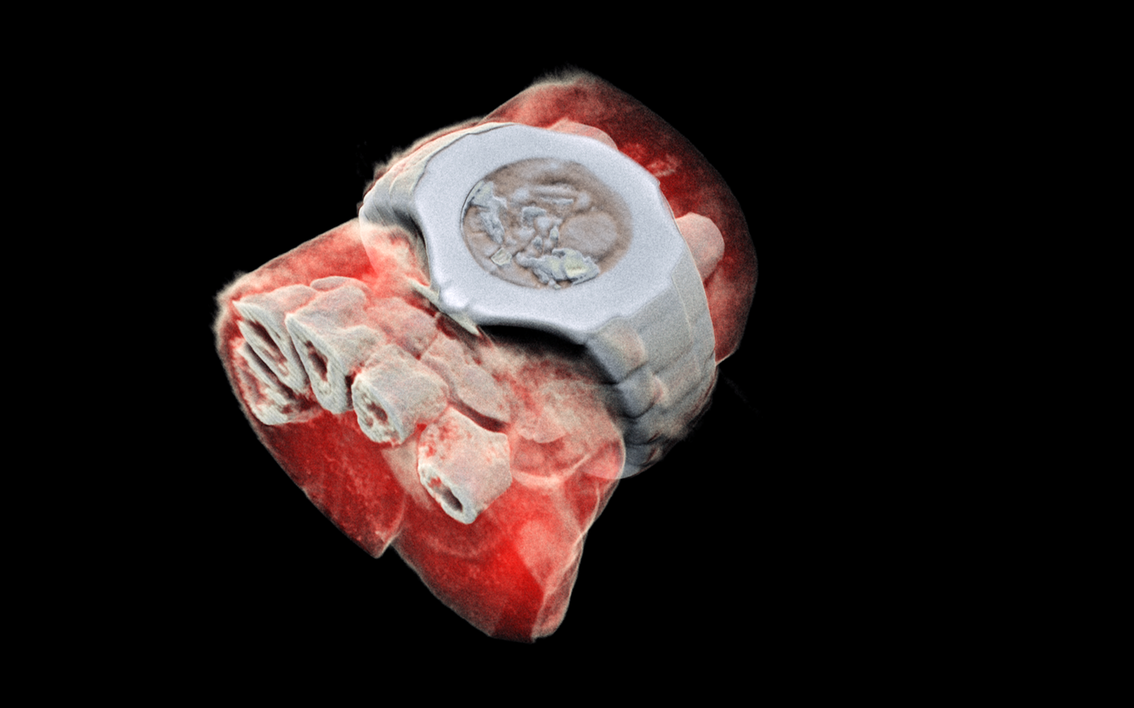
Thank you for your attention!
Notes:
Mention signal generation Add X section?

Slide 46
Backup slides

Slide 47
Cross section of a Hybrid Pixel Detector system (X-ray photon energy deposition)
γ
Sensor dimensions to scale:
55μm pixel pitch
300μm thick sensor
Notes:
Double counting or missing hits

Slide 48
Fluorescence in high-Z materials
γ
γ_{f}
Sensor dimensions to scale:
55μm pixel pitch
300μm thick sensor
Notes:
Energy resolution degradation AND missed or double counted hits

Slide 49
Fluorescence in high-Z detectors
 | N | k-edge (keV) | Kα energy (keV) | dα (μm) | η [%]
Si | 14 | 1.84 | 1.74 | 12 | 5
Ge | 32 | 11.11 | 9.89 | 51 | 55
GaAs:
Ga | 31 | 10.38 | 9.25 | 42 | 51
As | 33 | 11.87 | 10.54 | 16 | 57
CdTe:
Cd | 48 | 26.73 | 23.17 | 128 | 84
Te | 52 | 31.82 | 27.47 | 64 | 87
Journal of Instrumentation Volume 6 June 2011
D Pennicard and H Graafsma 2011 JINST 6 P06007
doi:10.1088/1748-0221/6/06/P06007

Slide 50
The algorithm for charge reconstruction and hit allocation: Charge Summing Mode
Notes:
Note
The analog charge reconstruction (no thresholding before summing).
That as long as the full charge is deposited in a cluster of 2x2 elements it will be correctly reconstructed.

