Slide 1

Position Sensitive Timing Detectors
An overview of a booming field

Slide 2
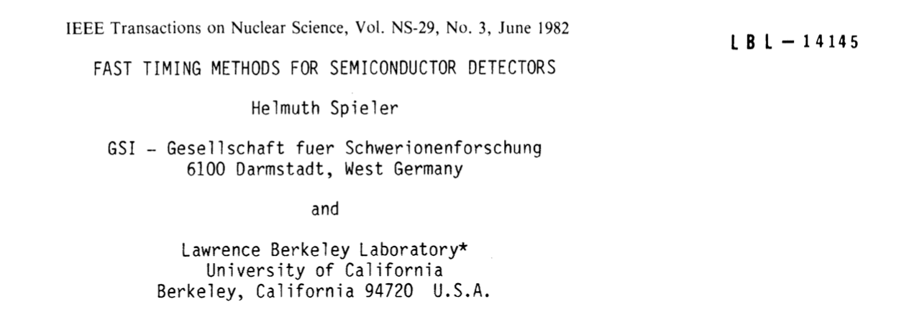
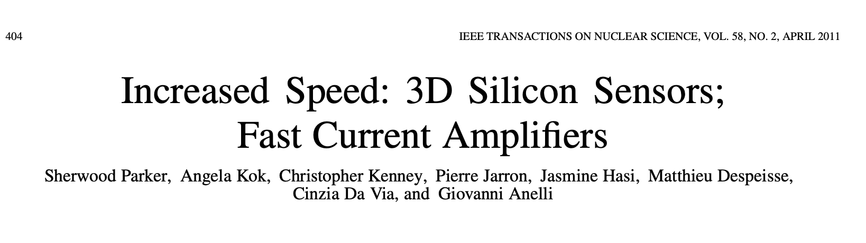
Silicon sensors as accurate timing detectors
Up to about 10 years ago, silicon sensors were not considered mainstream MIP timing detectors
Presently, they are considered the most likely (only?) solution for 4D trackers
I will present this change in the presentation
Two inspiring early papers

Slide 3
Silicon time-tagging detector
Sensors produce a current pulse
The read-out measure the time of arrival
Sensors and read-out are two parts of a single object, sometimes even on the same substrate (monolithic option).
Sensors and electronics succeed (or eventualy fail) together
In “timing circuits”, things can go wrong very rapidly (quote stolen from a chip designer)
==> this is not a simple evolution of what we know how to do.

Slide 4
Timing layers and 4D tracking
By “4D tracking” we mean the process of assigning a space and a time coordinate to a hit.
Timing
Timing can be available at different levels of the event reconstruction:
Timing in a single point (timing layer ATLAS,CMS)
Timing at some points along the track
Timing at each point along the track

Slide 5
Timing layers and 4D tracking
By “4D tracking” we mean the process of assigning a space and a time coordinate to a hit.
Timing
Timing can be available at different levels of the event reconstruction:
Timing in a single point (timing layer ATLAS,CMS)
More timing coordinates yields to more performing systems, but require a much more complex read-out system.
Some projects will be perfectly fine with having a smaller set of timing points
Timing at some points along the track
Timing at each point along the track

Slide 6
Systems designed for accurate timing
In a large detector system, good temporal resolution has many parts:
The sensor
The design of the ASIC:
  Technology (process, BW..)
  Money
  Power available
Detector design:
  Cabling, module quality, noise rejection
  quality of power supply etc
Infrastructure:
  Clock distribution
  Cooling
  Data transfer
A detector for timing needs very strong R&Ds in many additional aspects
(these challenges are now faced by the ATLAS and CMS timing layers)

Slide 7

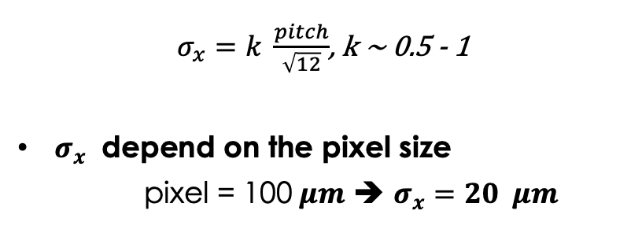
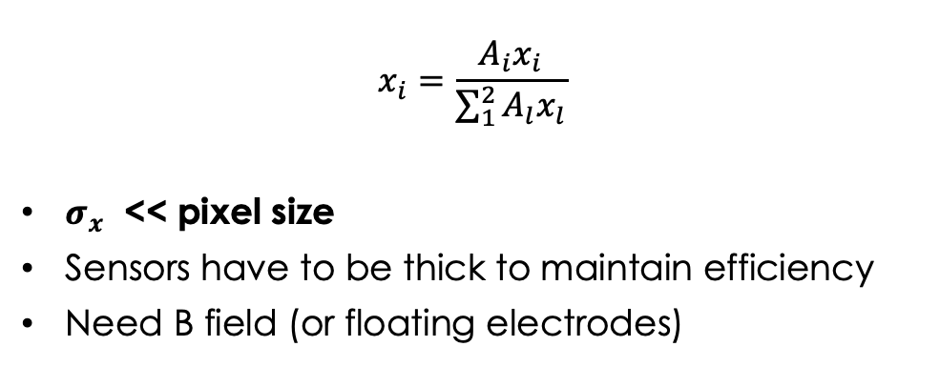
Position sensitive: single and multi pixels read-out
Single pixel
where the charge is collected by one pixel
Multi pixels
where the charge is collected by a few pixels
Pixel size
---
++++
---
--
++
+++
++++
-
-
-
Lorentz angle
$$θ$$
$$x_{i}=\frac{A_{i}x_{i}}{\sum_{1}^{2}{A_{l}x_{l}}}$$
$σ_{x}$ << pixel size
Sensors have to be thick to maintain efficiency
Need B field (or floating electrodes)
$σ_{x}=k \frac{pitch}{\sqrt{12}}$, k ~ 0.5 - 1
$σ_{x}$ depend on the pixel size
pixel = 100$μm$ ➔ $σ_{x}=20 μm$

Slide 8

Position sensitive: single and multi pixels read-out
Single pixel
where the charge is collected by one pixel
In single pixel architecture, the pixel size determines the position accuracy
This fact has tumultuous consequences on the
design of the electronics and on the power consumption
Pixel size
---
++++
---
--
++
+++
++++
-
-
-
Lorentz angle
$$θ$$
ASIC
Sensor

Slide 9
Presently explored options
The present R&D in position sensitive timing detectors shows the same variety that is present in standard silicon sensors. In the following, I will cover a few examples from this chart.
Hybrid
Monolithic
Low-gain (LGADs)
No gain
Low-gain (LGADs)
No gain
DC-coupled
Resistive/
AC-coupled
Planar
3D
Si/Diamond
BiCMOS
(SiGe)
BiCMOS
(SiGe)
CMOS

Slide 10
Presently explored options: without internal gain
Hybrid
Monolithic
No gain
No gain
Planar
3D
Si/Diamond
BiCMOS
(SiGe)
CMOS

Slide 11
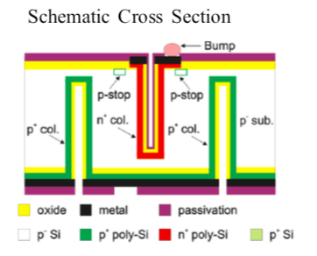
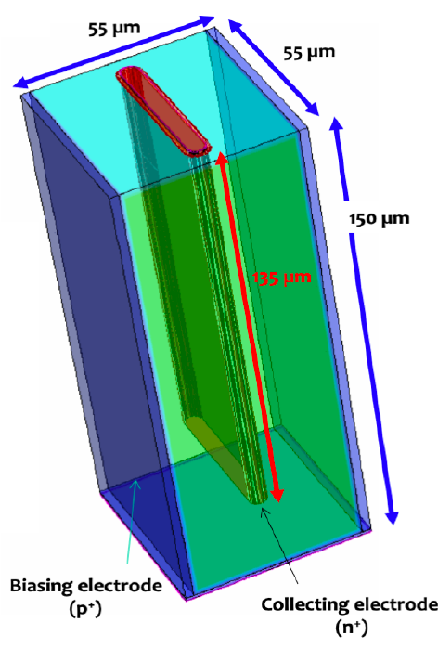
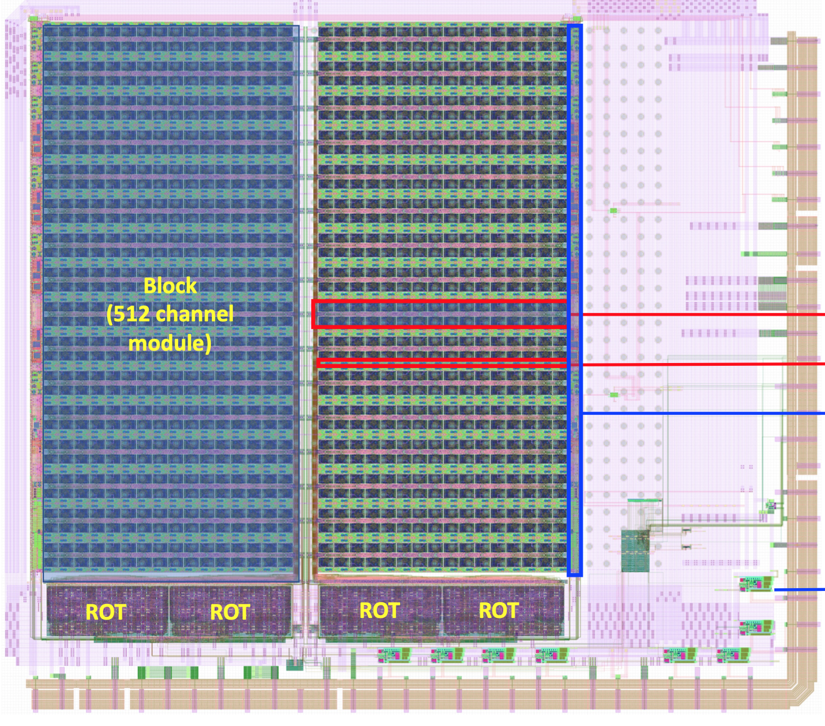
Presently explored options: without internal gain
Hybrid
Two possible options:
Column
Trenches
The amount of charge is
controlled by the sensor
thickness (~1-2 fC)
Both requires small pixels to achieve good temporal precision
==> very good position resolution
No gain
Timespot1: 28 nm ASIC
Pixels size = 55 μm
Resolution ~ 30 ps for single channel
3D
Si/Diamond

Slide 12
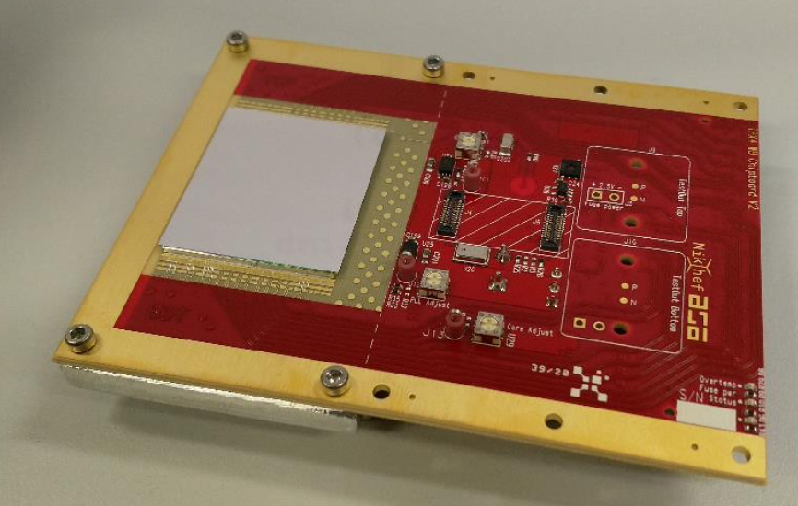
Presently explored options: without internal gain
The ASIC Timepix family
Last addition:
Timepix4: 65 nm ASIC, 512 x 448 pixels
Pixels size = 55 μm
Resolution in line with expectations ~ 150 ps RMS
Probably the best example so far of a full 4D tracking system
Hybrid
No gain
Planar
3D
Si/Diamond

Slide 13
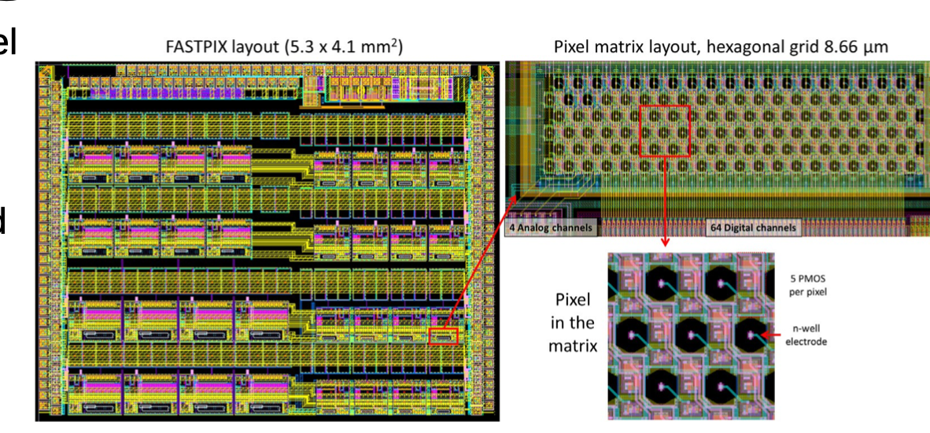
Presently explored options: without internal gain
FASTPIX is a CMOS monolith project aiming at combining temporal stamping with excellent position precision
Resolution of about ~ 100 ps,
Very small pixels
Monolithic
No gain
CMOS

Slide 14
Presently explored options: without internal gain
MonPicoAD project
Exploit SiGe performances
Exagonal pads, 65 μm
About 25 μm depletion
Thinned to 60 μm
Resolution of about ~ 38 ps,
Very small pixels
Monolithic
No gain
BiCMOS
(SiGe)

Slide 15
Presently explored options: with internal gain
Hybrid
Monolithic
Low-gain (LGADs)
Low-gain (LGADs)
DC-coupled
Resistive/
AC-coupled
BiCMOS
(SiGe)

Slide 16
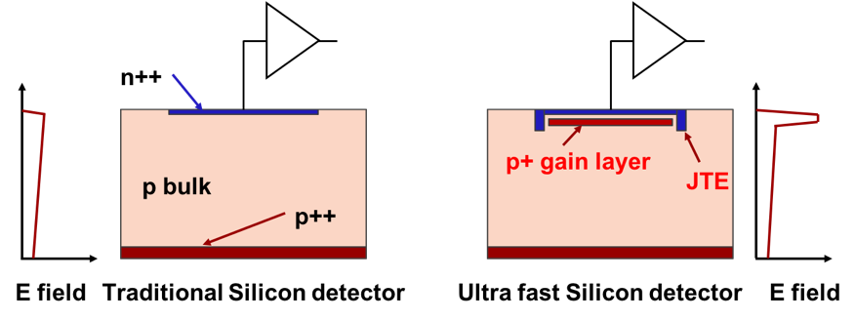
Presently explored options: with internal gain
First design innovation: low-gain avalanche diodes
Hybrid
zoom
Drift area with gain
0.5 – 2 um long
Gain implant
Low-gain (LGADs)
The low-gain mechanism, obtained with a moderately doped p-implant, is the defining feature of the design.
The low gain allows segmenting and keeping the shot noise below the electronic noise, since the leakage current is low.
DC-coupled
Resistive/
AC-coupled
Low gain minimizes jitter, it is the key ingredient to good temporal resolution

Slide 17
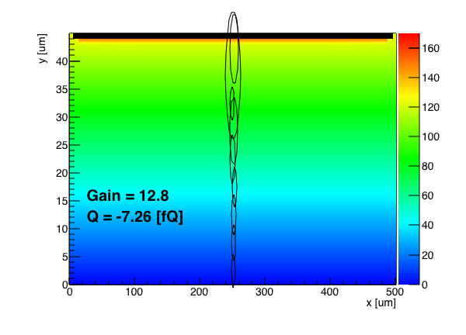
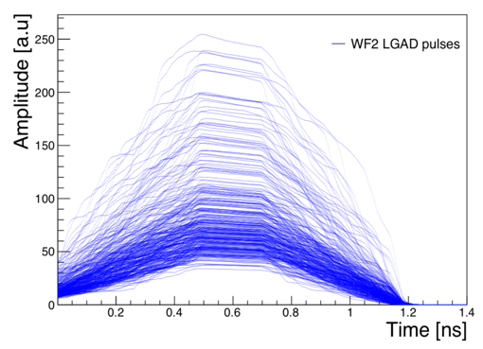
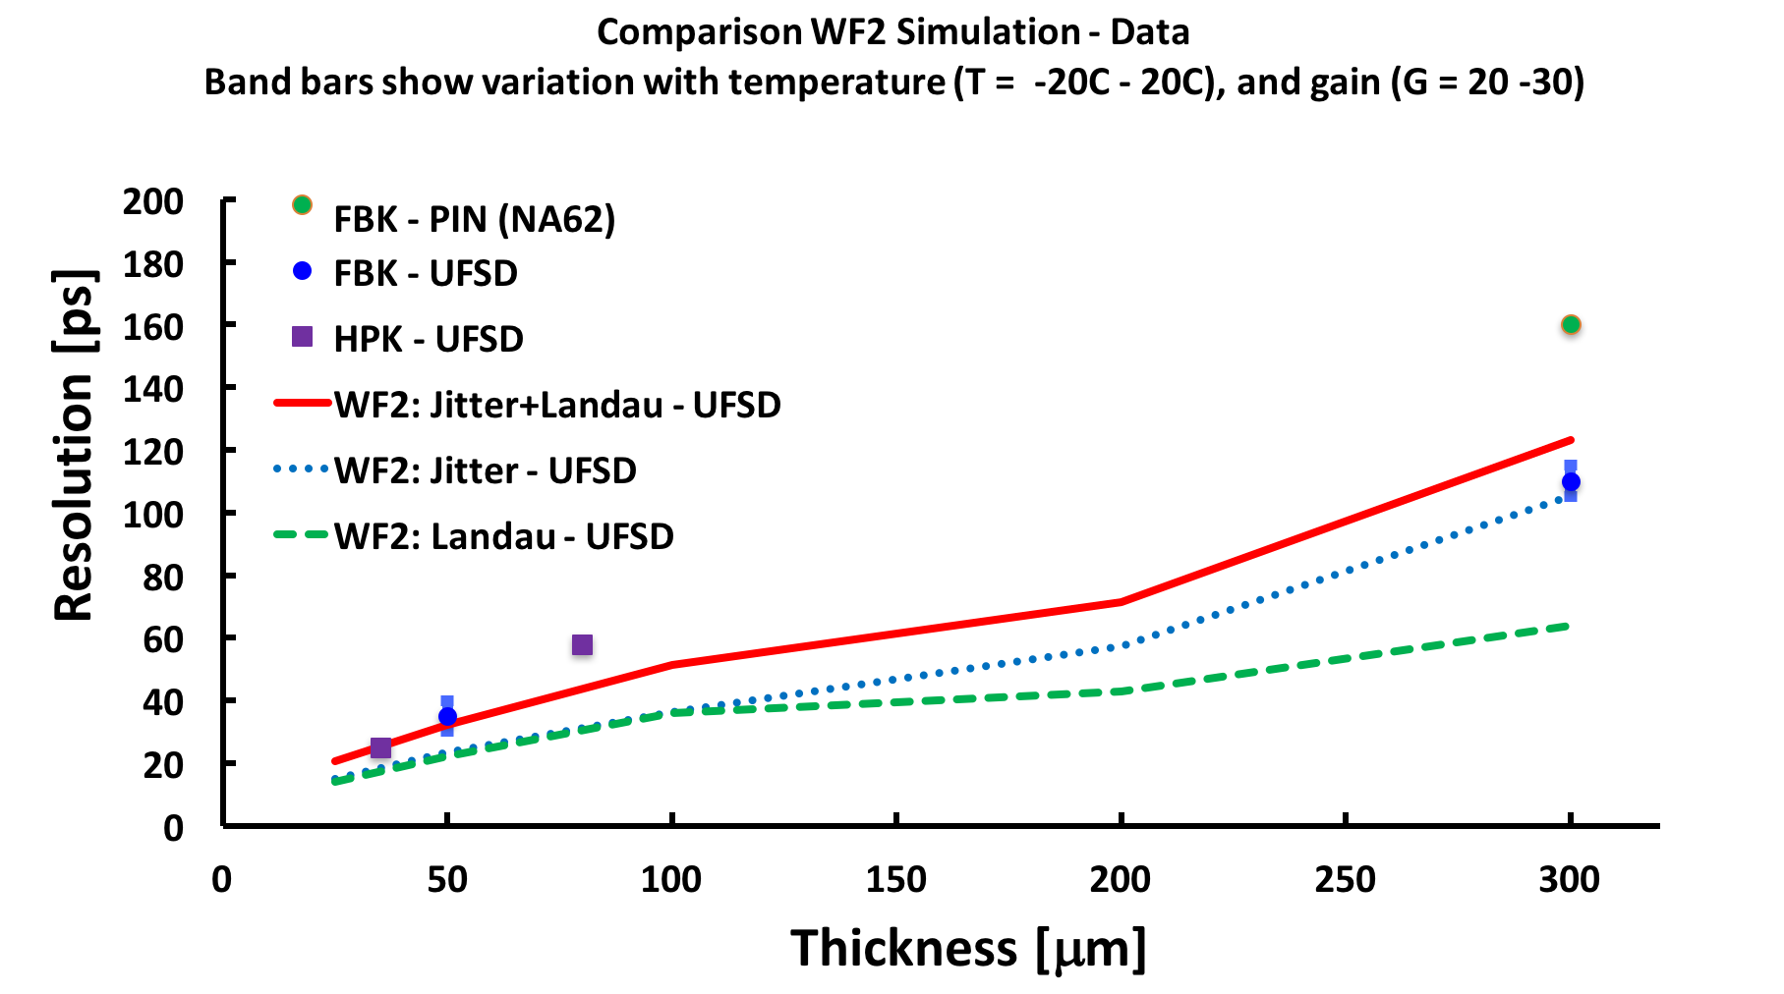

UFSD temporal resolution limit: non uniform ionization
Simulation of signals in 50-um LGAD
$$σ_{t}^{2}={\left(\frac{Noise}{dV/dt}\right)}^{2}+{\left(∆ionization\right)}^{2}$$
Shape distortion
Amplitude variation
Non-uniform ionization
Large dV/dt,
➔ small jitter
Non uniform ionization:
Physical limit of UFSD sensors
There are now hundreds of measurements on 45-55 μm-thick UFSDs
(Ultra Fast Silicon Detector: LGAD optimized for timing)
➔ Current sensor choice for the ATLAS and CMS timing layers

Slide 18
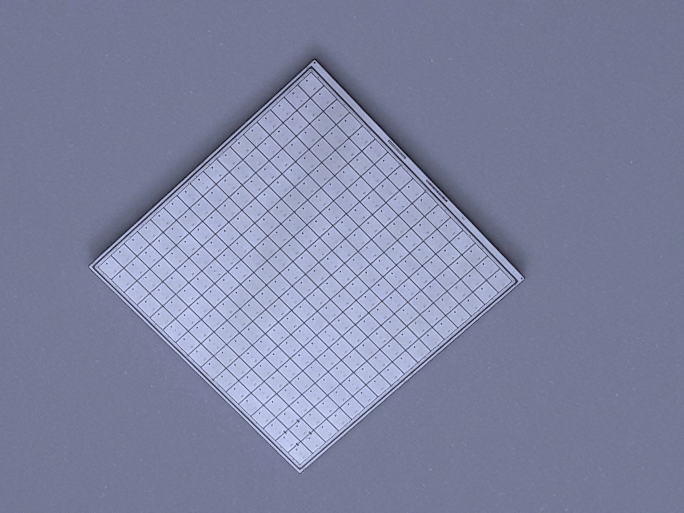
State-of-the-art: sensors for ATLAS and CMS
No gain
50-80 μm
oxide
Gain layer
p-stop
JTE
JTE
Epi p-bulk
Handle wafer
The ATLAS and CMS timing layers will use about 25 m² of UFSD sensors
Very well tested
Will be used up to ~ 2 E15 n_{eq}/cm²
Gain ~ up to 40 when new ==> up to 20 fC
Signal duration ~ 1 ns
Low noise
Rate ~ 50-100 MHz
Excellent production uniformity
Prototype of the final CMS sensor
V_{Bias}
2.1 cm
HPK2
16x16 array

Slide 19
State-of-the-art: sensors for ATLAS and CMS
No gain
50-80 μm
oxide
Gain layer
p-stop
JTE
JTE
Epi p-bulk
Handle wafer
The ATLAS and CMS timing layers will use about 25 m² of UFSD sensors
Very well tested
Will be used up to ~ 2 E15 n_{eq}/cm²
Gain ~ up to 40 when new ==> up to 20 fC
Signal duration ~ 1 ns
Low noise
Rate ~ 50-100 MHz
Excellent production uniformity
V_{Bias}
Shortcomings:
Large no-gain area between pads ==> not suitable for 4D tracking
Intrinsic temporal resolution ~ 25-30 ps due to Landau noise
Poor spatial resolution

Slide 20
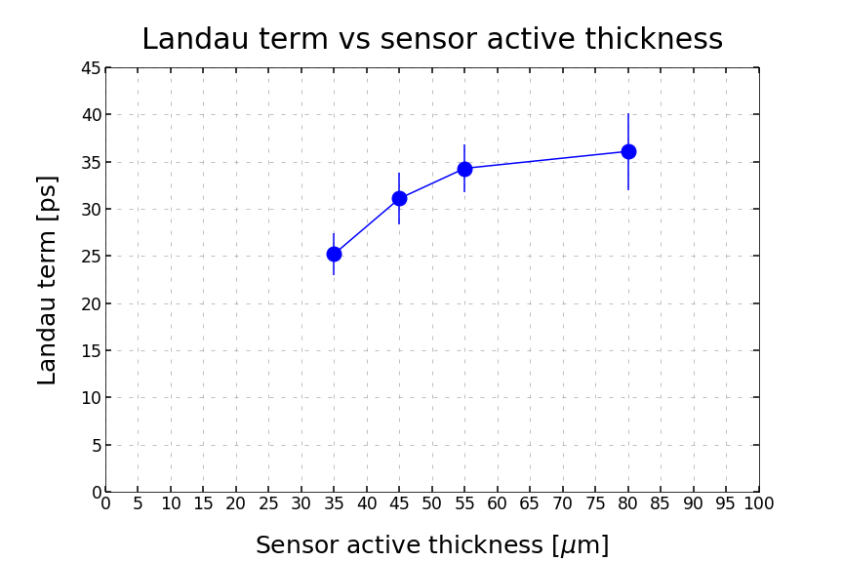
UFSD temporal resolution in thinner sensors
UFSD minimum temporal resolution improves in thinner sensors: reasonable to expect 10-20 ps for 10-20 μm thick sensors.
Be aware: very difficult to do timing with small signals…
FBK UFSD32 production
Non uniform ionization:
Physical limit of UFSD sensors

Slide 21
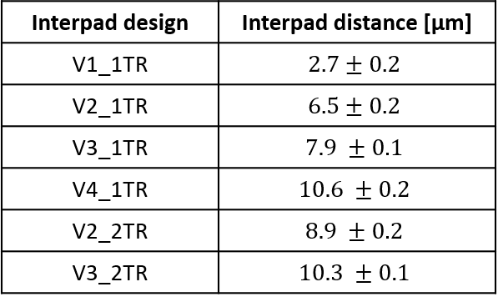
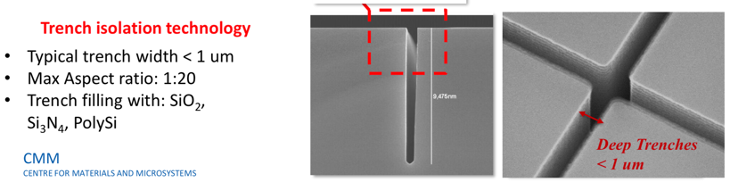
LGAD Trench Isolated: enabling small UFSD pixels
No gain
50-80 μm
No-gain region ~ 50-80 μm
➔ cannot use for small pixels
oxide
Gain layer
p-stop
Solution: use trenches for pad isolation
➔ No-gain region ~ 0 – 10 μm
JTE
JTE
p bulk
RD50-TI production
V_{Bias}
No gain
5-10 μm
oxide
Gain layer
trench
trench
JTE
p bulk
V_{Bias}
→ The R&D to achieve small pixels is clear

Slide 22
Presently explored options: with internal gain
Monolithic
Low-gain (LGADs)
This is a very powerful research path pursued by the “Monolith” project.
Looking forward to the first results
See talk by M. Munker on Monday
BiCMOS
(SiGe)

Slide 23
Position Sensitive Timing detectors
”Position sensitive” is a much more difficult task than simply “silicon timing detectors”
Good position resolution requires small pixels
A lot of small pixels consume too much power
Consider the ATLAS-CMS timing layer:
  Pixel size: 1.3 x 1.3 mm²
  ~ 40 ps precision
  Power: 0.3 W/cm²
TimeSpot1 ASIC (28 nm):
  Pixel size: 55 x 55 μm²
  ~ 30 ps precision
  Power: 5-10 W/cm²
Even with a much smaller technological node, precision timing with small pixels requires a lot of power
Bonus: internal gain decreases the need of power

Slide 24
Second design innovation: resistive read-out
Innovative design: resistive silicon detectors (RSD or AC-LGAD), as in RPC et al.
The signal is formed on the n+ electrode
The AC pads offer the smallest impedance to ground for the fast signal
The signal discharges to ground
short RC
short RC
Fast signal
Fast signal
long RC
long RC
-+
-+
-+
-+
-+
-+
In resistive readout the signal is naturally shared among pads (4-6) without the need of B field or floating pads
Thanks to the internal gain, full efficiency even with sharing
Results presented here are from the FBK RSD1 production

Slide 25
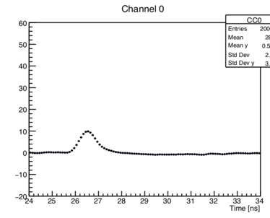
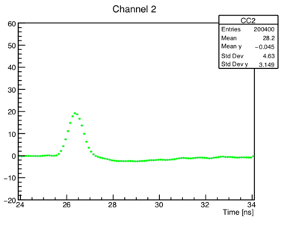
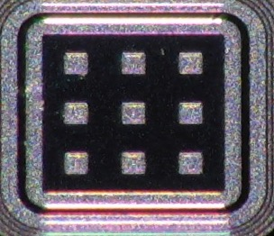
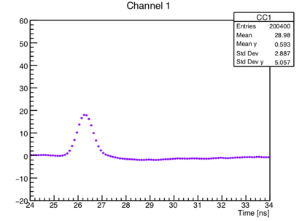
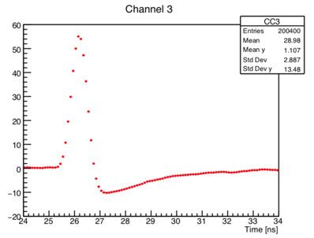
Resistive Silicon detector: example of signal sharing
P 1
Pad 1
60
40
20
0
-20
60
40
20
0
-20
Pad 1
Pad 2
Amplitude [mV]
50-mm thick RSD,
Gain ~ 20
0 2 4 6 8 10
0 2 4 6 8 10
1
2
60
40
20
0
-20
60
40
20
0
-20
Pad 3
Pad 4
3
4
Amplitude [mV]
0 2 4 6 8
0 2 4 6 8 10
Time [ns]
Time [ns]
The laser is shot at the position of the red dot: the signal is seen in 4 pads

Slide 26
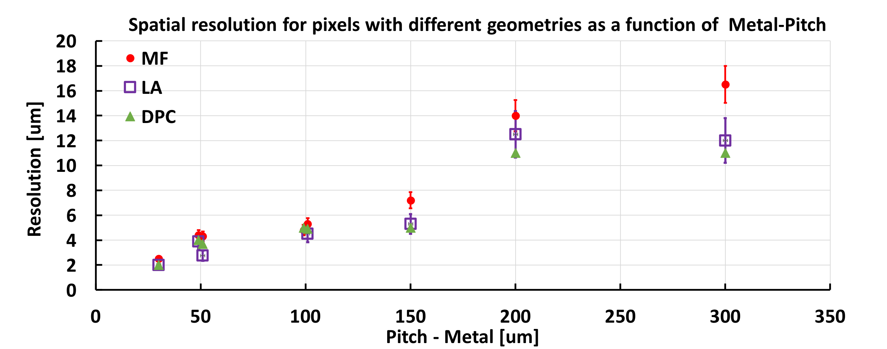
Laser study: position resolution vs pixel geometry
3 different position reconstruction methods
150 - 300
50 -100
150 - 200
100 - 200
300 - 500
200 - 500
70-100
RSDs reach a spatial resolution that is about 5% of the inter-pad distance
➔ ~ 5 μm resolution with 150 μm pitch
RSDs have the “usual” UFSD temporal resolution of 30-40 ps

Slide 27
Present and future
Under construction:
The two large timing layers (25 m² ) of the ATLAS-CMS collaboration
1.3 x 1.3 mm² pads UFSD, ALTIROC & ETIROC ASICs, 200-300 mW/cm², resolution ~ 45 ps/hit
Advanced prototypes:
Timepix4 soon to be coupled with TI-LGAD
55 x 55 μm² pixels, ~ 0.6 mW/cm², target resolution <100 ps/hit
TIMESPOT1 with trenched detectors
55 x 55 μm² pixels, ~ 5-10 W/cm², resolution ~ 30 ps/hit
Demonstrators:
FASTPIX (CMOS), MonPicoAD (SiGe), Resistive readout (large pixels, excellent spatial and temporal resolution)
New kids on the block:
Monolith (SiGe+LGAD)

Slide 28
Wrap-up
4D tracking is a very young booming field, hybrid and monolithic approaches are yielding very good results
The paste of innovation is very fast (especially considering that silicon sensors is a very mature field)
Several demonstrators with temporal precision of about 30 ps are available. Not unreasonable to expect 10-15 ps in the next few years.
In my view, the most difficult part is in the design of the electronics.
Temporal resolution degrades very quickly if the whole system is not “perfect”
It is very difficult to combine very good position precision, <5 μm, with good temporal resolution using the “single pixel” design. Charge sharing might be the key to solve this problem.

Slide 29
It takes a village
The path to 4D tracking is complex, with many different communities working on various aspects. Their contributions are of fundamental importance to reach the end goal.

Slide 30
Acknowledgement
We kindly acknowledge the following funding agencies, collaborations:
RD50 collaboration
INFN - Gruppo V, UFSD and RSD projects
INFN – FBK agreement on sensor production (convenzione INFN-FBK)
Horizon 2020, grant UFSD669529
U.S. Department of Energy grant number DE-SC0010107
Dipartimenti di Eccellenza, Univ. of Torino (ex L. 232/2016, art. 1, cc. 314, 337)
Ministero della Ricerca, Italia , PRIN 2017, progetto 2017L2XKTJ – 4DinSiDe
Ministero della Ricerca, Italia, FARE, R165xr8frt_fare

Slide 31
Collection of extra sides

Slide 32
UFSD Summary: more gaining and more sharing
Physicist
No gain area ~ 50 um
No gain area ~ 5 um
JTE + p-stop design Trench-isolated design RSD -- AC-LGAD
JTE/p-stop UFSD
CMS && ATLAS choice
Signal in a single pixel
Not 100% fill factor
Very well tested
High Occupancy OK
Rate ~ 50-100 MHz
Rad hardness ~ 2-3E15 n/cm2
UFSD evolution: use trenches
Signal in a single pixel
Almost 100% fill factor
Temporal resolution (50 μm) : 35-40 ps
High Occupancy OK
Rate ~ 50-100 MHz
Rad hardness: to be studied
RSD evolution: resistive readout
Signal in many pixels
100% fill factor
Excellent position resolution:
  ~ 5 μm with large pixels
Temporal resolution (50 μm) : 35-40 ps
Rate ~ 10-50 MHz
Rad hardness: to be studied
2.1 cm
HPK2
16x16 array

Slide 33
3D sensors for timing applications
3D sensors for timing have the same underlying features of standard 3D detectors: very good radiation resistance
The design in insensitive to non-uniform charge deposition
++++++
-----
CNM-Ljubliana studies: use column geometry
In their “column” geometry, they cannot, the Efield is not uniform enough
E field
Timespot approach
using trenches gives a parallel plate geometry,
and a weighting field ~ 1/d
E field

Slide 34
Reduced material budget
The active thickness of UFSD sensor is rather small ~ 50 um.
In the present prototypes, the active part is attached to a thick “handle wafer”
There is a clear path leading to < 100 μm material:
ASIC
~1 μm glue
~150 μm
~50 μm
ASIC
25 um
~50 μm
50 um
ASIC
50 μm
25 μm
50 μm
Silicon beam
~200 μm
Thinned handle wafer:
  500 um ➔ 10-20 um
Thinned handle wafer:
500 um ➔ 10-20 um
Thinned active area:
50 um ➔ 25 um
50 ps ➔ 25 ps
Present design: no material budget optimization

Slide 35
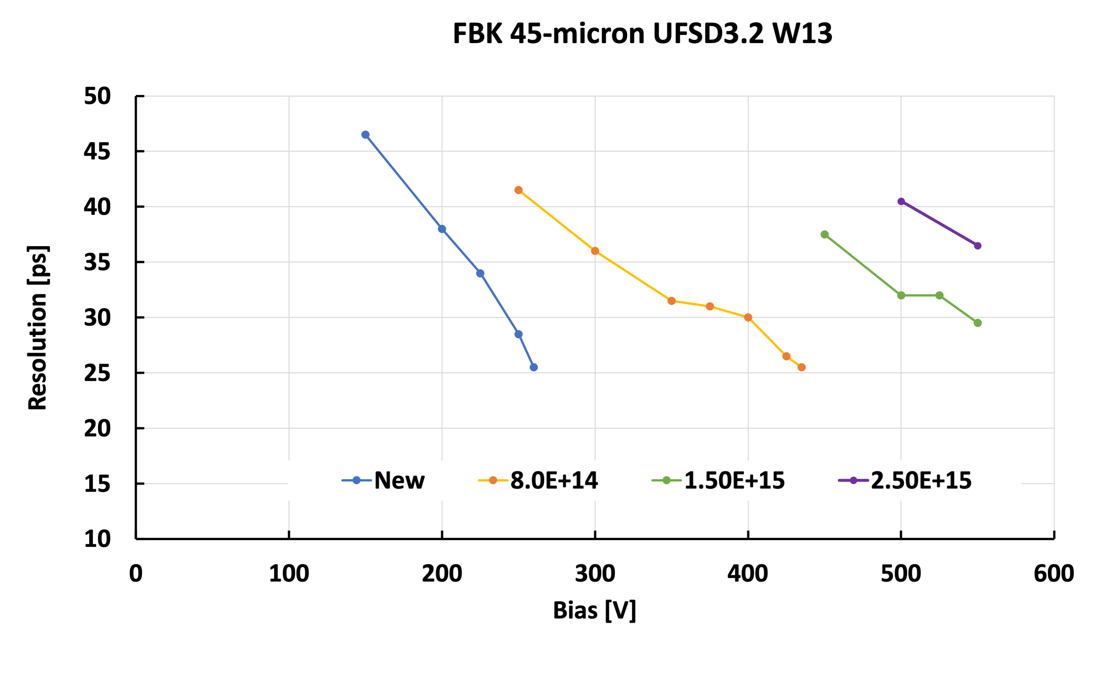
UFSD radiation hardness
Evolution with radiation of the biasing working point for a 45-micron thick LGAD with a carbonated gain layer
Present LGAD design assures better than 40 ps up to 2.5E15 n_{eq}/cm²

Slide 36
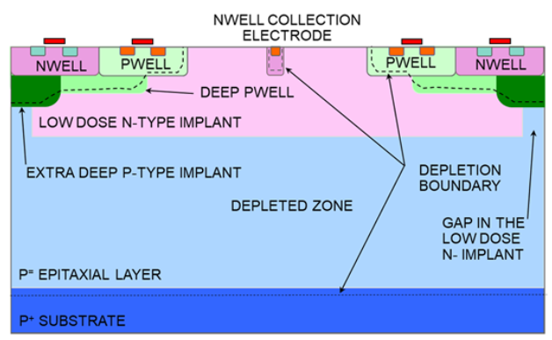
FASTPIX approach
“In the ATTRACT project FASTPIX we investigate monolithic pixel sensors with small collection electrodes in CMOS technologies for fast signal collection and precise timing in the sub-nanosecond range.”
Evolution of the process used for MALTA: speeding up the electron lateral drift
Small pixel pitches (~10 μm)
Very low electrode capacitance (< 1fF)
Expected jitter (electronics): 20ps @ Q_{in} =1000 e⁻
Estimated resolution: sub-ns (a few hundred ps)
T. Kugathasan et al., Nucl. Inst. Meth. A Vol. 979, Nov. 2020

Slide 37
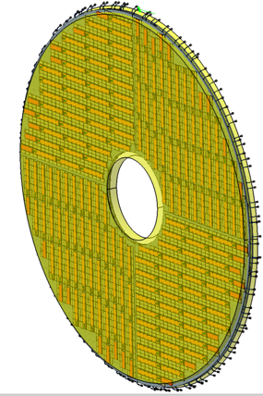
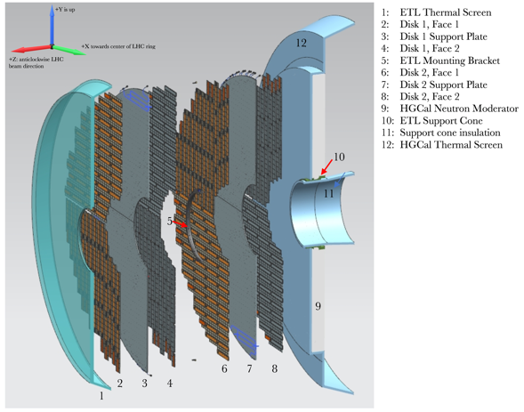
Present status of ATLAS-CMS timing layer
UFSD are available from many vendors: HPK, FBK, CNM, BNL
and several more are coming on line: Micron, NDL (China), IHEP (China)
ATLAS and CMS are planning to use ~ 20-30 m²
➔ Mature technology
Installation: 2023-2025
CMS: 2 layers, covering the full endcap 1.6 < eta < 3
ATLAS: 2 ½ - 3 layers, covering high rapidity 2.5 < eta < 4
CMS: 7 m² of sensors on each side
2.1 cm
HPK2
16x16 array

Slide 38
Read-out chips for UFSDs
In the past 3-4 years, the ATLAS and CMS collaborations poured a considerable amount of resources into designing the read-out chips for their respective timing layers.
ATLAS: ALTIROC, TSMC 130 nm, 15x15 pads,
CMS: ETROC, CMOS 65 nm, 16x16 pads
For both: input load about 4 pF, jitter ~ 20ps at 10fC of input charge
Power:
ALTIROC ~ 3.5 mW/ch, 2-300 mW/cm²
ETROC~ 3 mW/ch
As a comparison, the RD53 readout chip for pixel detectors for tracking (i.e. no timing) at the HL-LHC with 50 x 50 um2 and 25 x 100 um² feature sizes is estimated to have a power density of about 1 W / cm²
A timing layer with large pixels needs less power than a layer of small traditional pixels

Slide 39
I-LGAD: a new desgin for 100% fill factor
i-LGAD
p-side segmentation
Signal in a single pixel
100% fill factor
Thin i-LGAD with single side processing under development (using trenches)
=> done with TCAD simulation, run starting in spring 2021 @ CNM
High Occupancy OK
Rate ~ 50-100 MHz
Rad hardness ~ 2-3E15 n/cm2

Slide 40
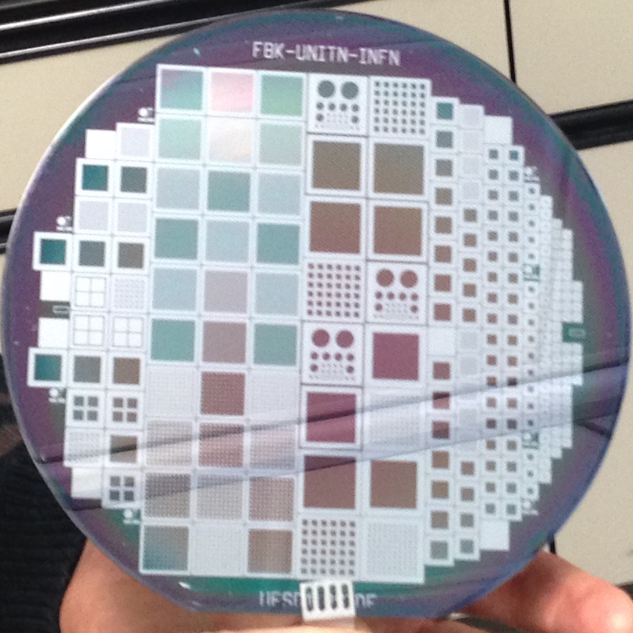
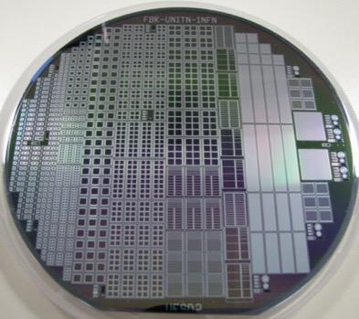
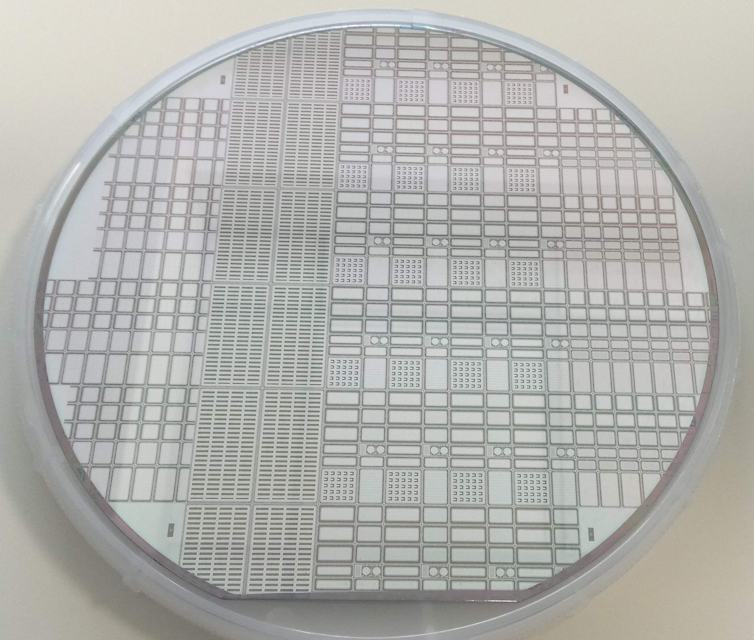
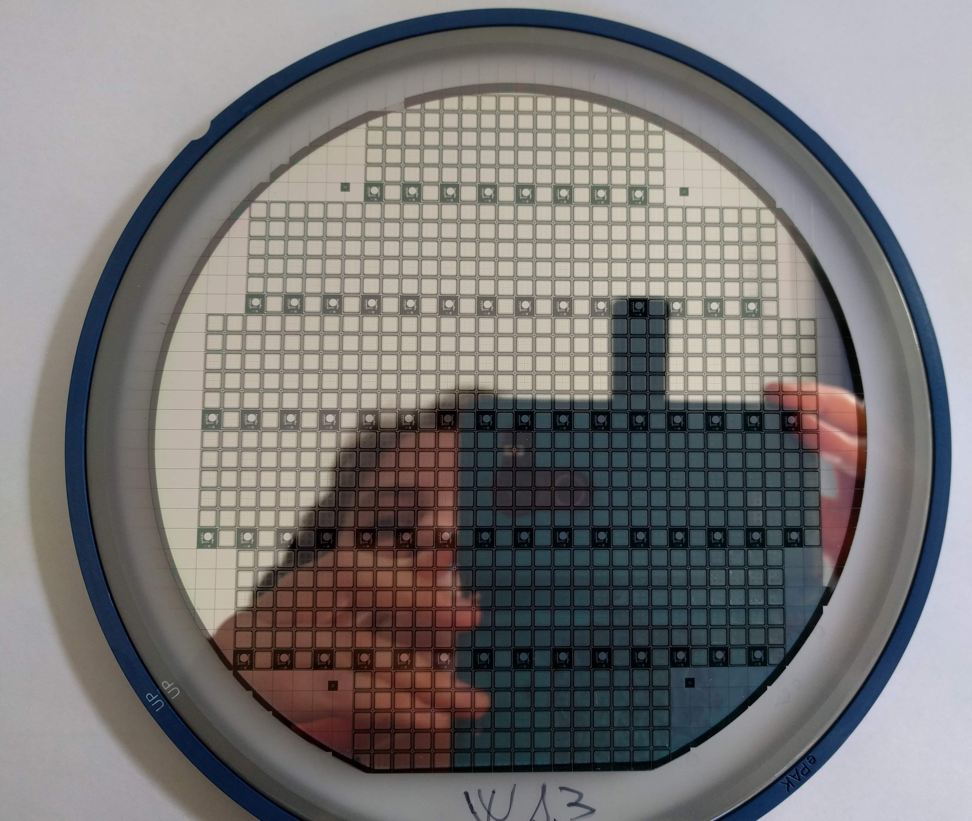
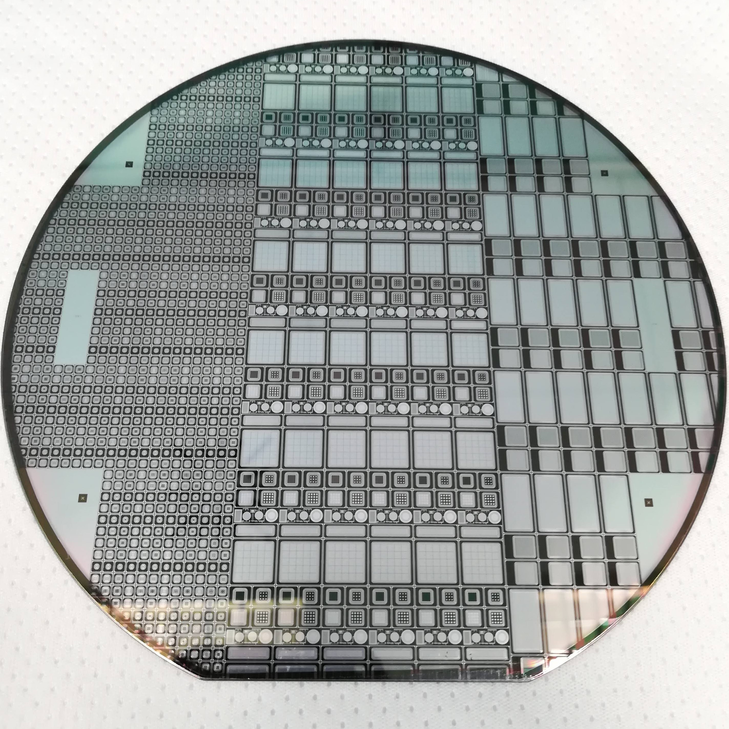
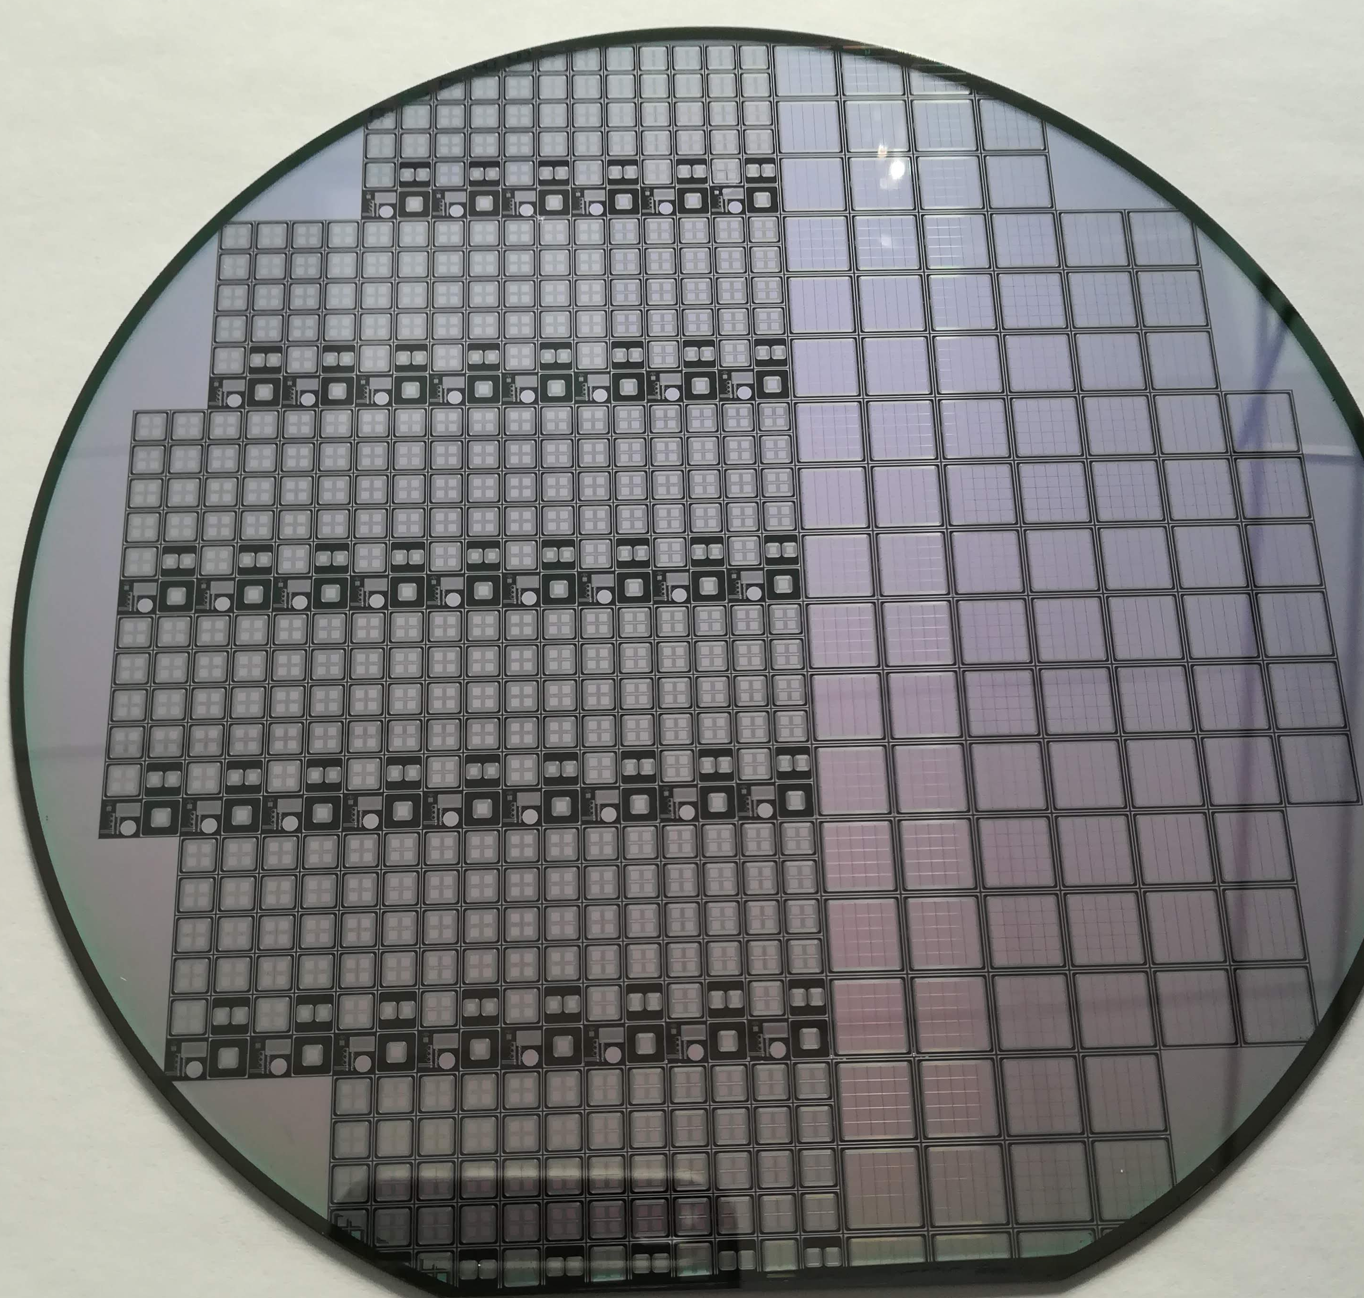
The UFSD project: brief history
Aim: develop sensors with excellent temporal and spatial resolutions via a series of productions and design refinements
Long term R&D, Not for a specific experiments
UFSD1
UFSD2
2016: UFSD1 First 300 μm thick LGAD (FBK 6” wafer )
2017: UFSD2 First 50 μm thick LGAD (FBK 6” wafer )
Gain layer doping: Boron, Gallium, Boron + Carbon,
3. Fall 2018: UFSD3 50 μm LGAD (FBK 6” wafer), produced with the stepper (many Carbon levels, studies of interpad design)
4. June 2019: UFSD3.1 50 μm LGAD (internal FBK) interpad design.
5. June 2019 RSD1 Resistive AC-LGAD (FBK 6” wafer
6. June 2020: UFSD3.2 25, 35, 45, and 55 μm LGAD, carbon studies, deep, shallow gain implant (FBK 6” wafer
UFSD3
UFSD3.1
UFSD3.2
7. Q1/2021: UFSD3.3 (FBK 6” wafer)
8. Q1/2021: Trench-Isolated (FBK 6” wafer)
9. Q2/2021: RSD2 (FBK 6” wafer)
10. Q2/2021: ExFlux -> optimized for extreme fluence
Project fully funded for 3 more years
RSD1

Slide 41
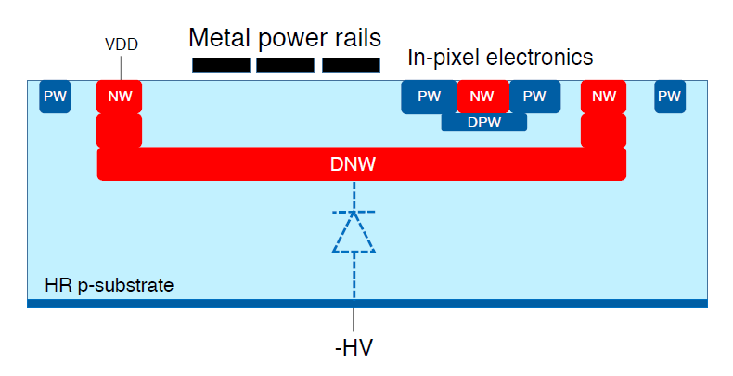
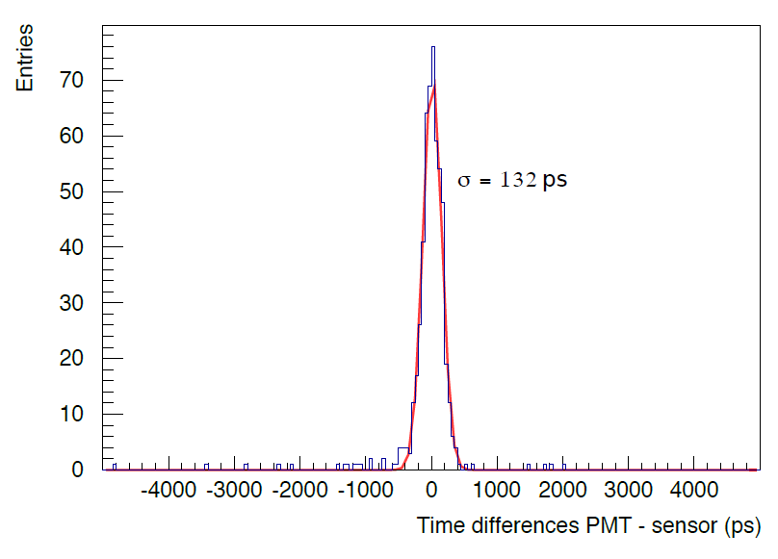
HV-CMOS approach: CACTUS
CMOS LFoundry 150 nm
Deep nwell collection diode, fully depleted
FE electronics inside the pixel
Fast and uniform charge collection
Substrate thickness: 200um
Pixel size: 0.5 – 1 mm²
Pixel capacitance: 1 – 1.5 pF
Res: 278 ps at 1.7 MIPS, 303 ps at 1 MIP
Noise can be reduced by moving the readout electronics outside the pixels: capacitance reduction
⁹⁰Sr source
2.7 MIP threshold
Y. Degerli et al., 2020 JINST 15 P06011

Slide 42
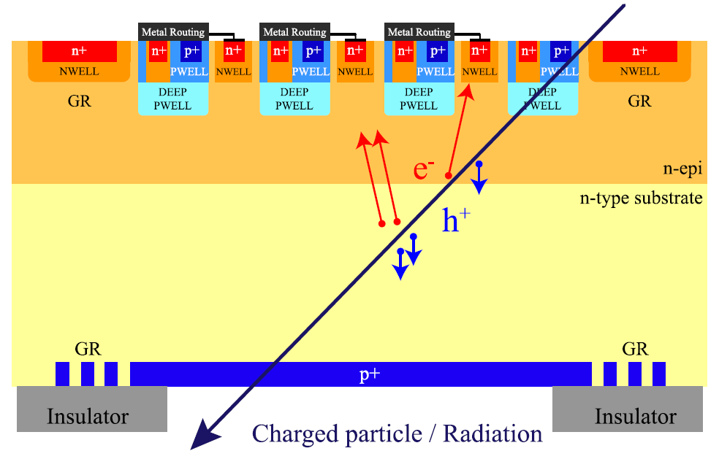
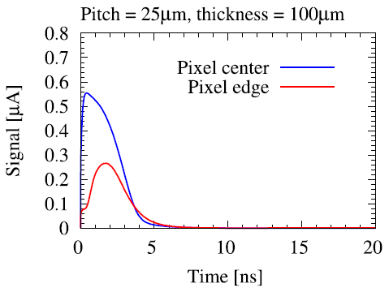
ARCADIA
MAPS 110-nm CMOS
Fully depleted substrate: charge collection by drift
Process validated on 100 – 300μm thick substrates, 25 and 50μm pitch
New test structures with 10μm pitch on 50μm substrate being designed: ~ 1ns charge collection time
L. Pancheri et al., IEEE Tran. Electron Dev.,
Vol. 67, No. 6, June 2020

Slide 43
R&D in progress at the University of Geneva
MONOLITH Project:
ERC advanced for the development of monolithic silicon pixel sensors in SiGe BiCMOS with picosecond time resolution. Sensor design based on PicoAD concept of the University of Geneva.
FASER :
SNSF project to build of a new pre-shower module for FASER experiment at LHC based on monolithic pixels in SiGe BiCMOS with very large dynamic range, 100 µm pixel size and 100ps time resolution.
100 µPET:
SNSF project to build a small animal PET scanner with 100 µm resolution based on monolithic silicon pixel sensors in SiGe BiCMOS.

