Slide 1
Monolithic pixel development in TowerJazz 180nm CMOS for the outer pixel layers in the ATLAS experiment
The 11th International Conference on Position Sensitive Detectors
Milton Keynes, UK
05/09/2017
I. Berdalovicª, R. Bates^{c}, C. Buttar^{c}, R. Cardellaª, N. Egidos Plajaª, T. Hemperek^{b}, B. Hiti^{d}, J. W. Van Hoorneª, T. Kugathasanª, I. Mandic^{d}, D. Maneuski^{c}, C. A. Marin Tobonª, L. Musaª, K. Moustakas^{b}, H. Perneggerª, P. Riedlerª, C. Riegelª, D. Schaeferª, E. J. Schioppaª, A. Sharmaª, W. Snoeysª, C. Solans Sanchezª, T. Wang^{b}, N. Wermes^{b}
E-mail: ivan.berdalovic@cern.ch
a. CERN Experimental Physics Department, CH-121 Geneve 23, Switzerland
b. Physikalisches Institut, Rheinische Friedrich-Wilhelms-Universität Bonn, Bonn, Germany
c. SUPA School of Physics and Astronomy, University of Glasgow, Glasgow, G12 8QQ, United Kingdom
d. Institute Jozef Stefan, SI-1000 Ljubljana, Slovenia

Slide 2
Outline
Introduction
Monolithic active pixel sensor characterisation
  The TowerJazz Investigator chip
  Charge collection measurements
  Irradiation results
  Beam test results
Design of large-scale monolithic demonstrators
  The “MALTA” chip
  The “TJ-Monopix” chip
Summary

Slide 3
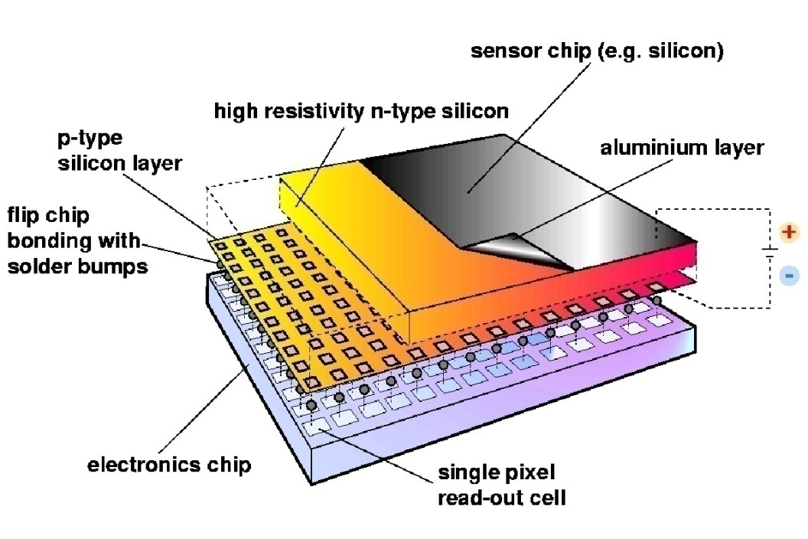
Pixel detectors
The first measurement layers in ATLAS (closest to the particle collision point)
Used to reconstruct charged particle tracks
Hybrid pixel detectors
  Used in the majority of presently installed systems
  Sensor and readout circuitry on separate chips (can be optimised separately)
  Fast, radiation hard, but complex assembly
Monolithic pixel detectors
  Sensor and readout integrated into the same chip
  Potentially better power-performance ratio and strong impact on material budget
  High resolution, low cost, recent progress in radiation hardness

Slide 4
Radiation hard monolithic sensors
Target: development of CMOS sensors for potential use in ITK pixel layers
Requirements:
  fast time resolution (< 25 ns bunch crossing time)
  short dead time because of high particle rates (< ~1 μs)
  low power consumption
  tolerance to ionising and non-ionising radiation
                ↓
                charge collection by drift rather than diffusion
 | STAR | ALICE-LHC | ILC | ATLAS-HL-LHC
 |  |  |  | Outer | Inner
Required Time Res. [ns] | 110 | 20 000 | 350 | 25
Particle Rate [kHz/mm²] | 4 | 10 | 250 | 1000 | 10 000
Fluence [n_{eq}/cm²] | > 10¹² | >10¹³ | 10¹² | 10¹⁵ | 10¹⁶
Ion. Dose [Mrad] | 0.2 | 0.7 | 0.4 | 50 | 1000

Slide 5

Sensor technology
TowerJazz 180nm CMOS imaging process
High resistivity (> 1kΩ cm) p-type epitaxial layer (25 µm thick)
Deep PWELL shielding NWELL allowing in-pixel PMOS
2-3 µm → small C!
$$\frac{Q}{C}↗$$
better analog performance
lower power consumption
Reverse bias to further reduce input capacitance and increase depletion volume (still difficult to deplete under deep PWELL)

Slide 6
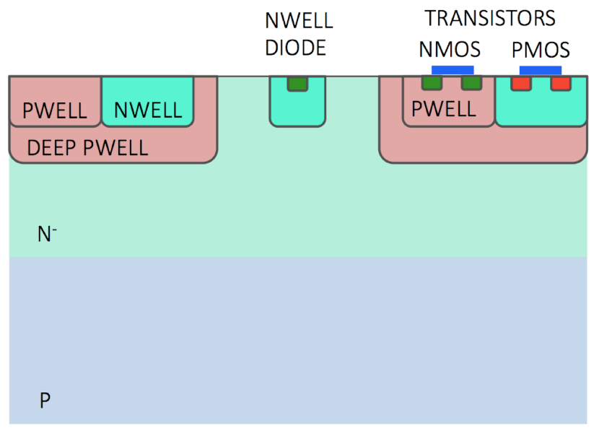
Modified process
Novel modified process developed in collaboration with the foundry
Adding a planar n-type layer significantly improves depletion under deep PWELL
Increased depletion volume → fast charge collection by drift
↓
better time resolution
reduced probability of charge trapping (radiation hardness)
Possibility to fully deplete sensing volume
No significant circuit or layout changes required
W. Snoeys et al.
DOI 10.1016/j.nima.2017.07.046

Slide 7
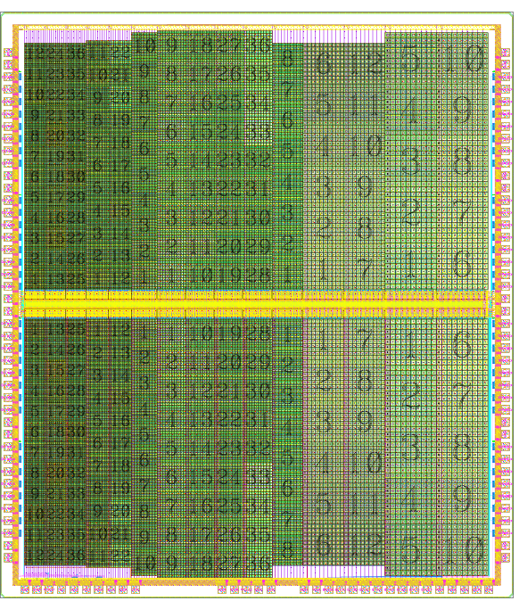
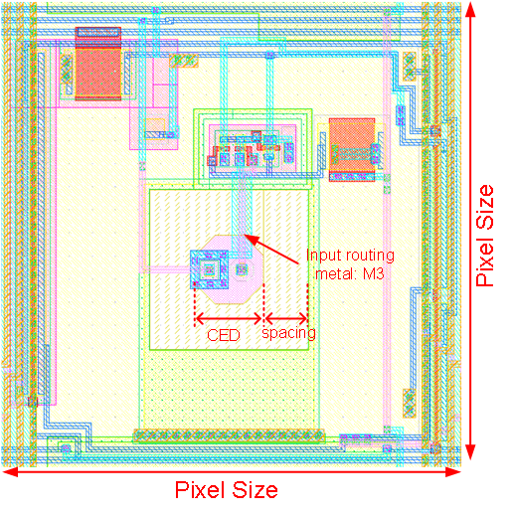
The TowerJazz Investigator chip
Developed by ALICE as test chip for the ITS upgrade development
134 pixel sub-matrices of different designs (electrode size, PWELL spacing)
Each sub-matrix contains 8x8 pixels surrounded by dummies
Possibility of simultaneously measuring the analog signals on 64 pixels
Investigator-1 layout
Mini-matrix
Pixel layout
5.0 mm x 5.7 mm
Mini-Matrix number | Pixel size
0 – 35 | 20 by 20 um²
36 – 57 | 22 by 22 um²
58 – 67 | 25 by 25 um²
68 – 103 | 28 by 28 um²
104 – 111 | 30 by 30 um²
112 – 123 | 40 by 40 um²
124 – 133 | 50 by 50 um²
C. Gao et al.
DOI 10.1016/j.nima.2016.03.074

Slide 8
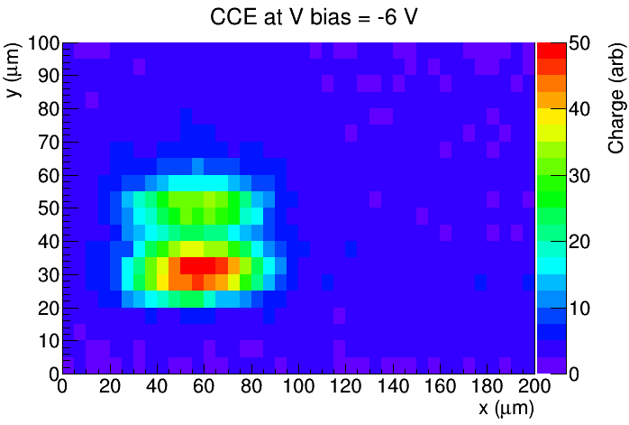
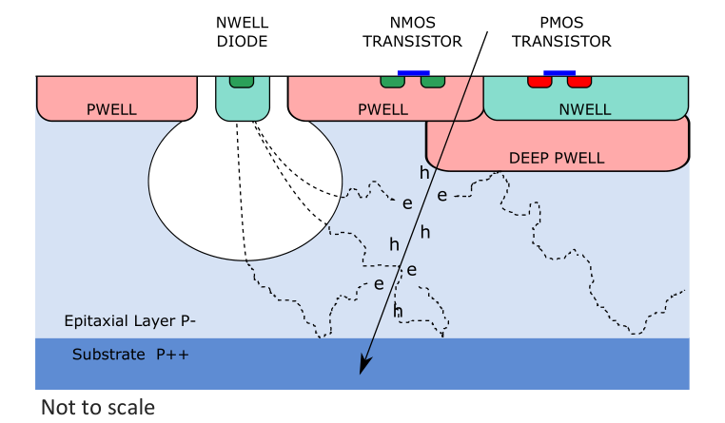
Charge collection measurements
Edge-TCT: used to study charge collection uniformity within the pixel
Tests on Investigator chip done in IJS, Ljubljana on two structures:
  20x20 μm² pixel size
  50x50 μm² pixel size
Chip surface
beam
depth
beam
depth

Slide 9
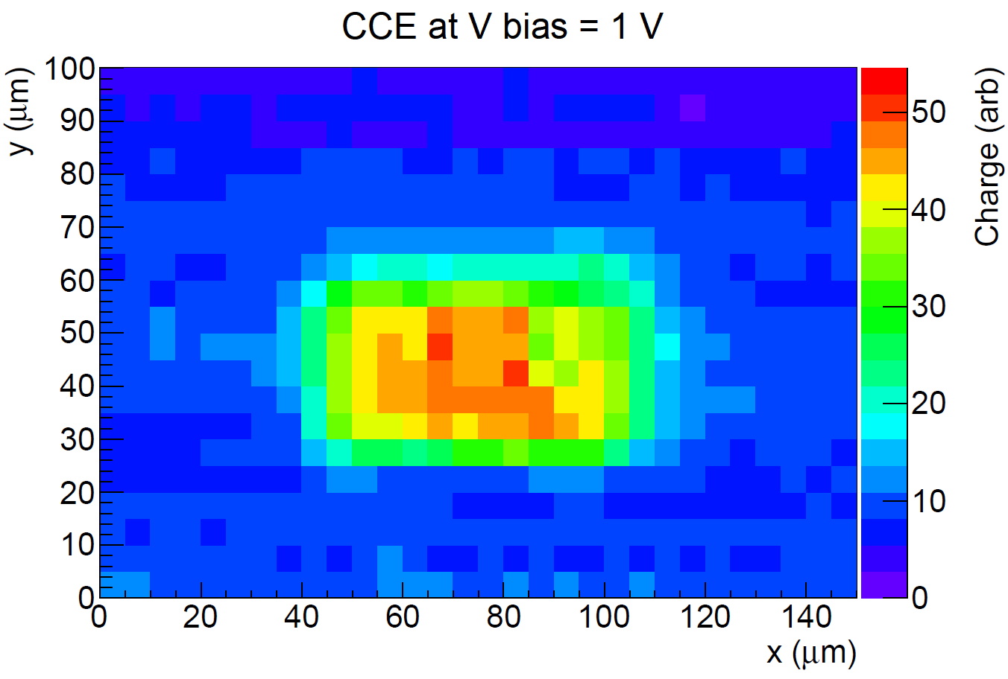
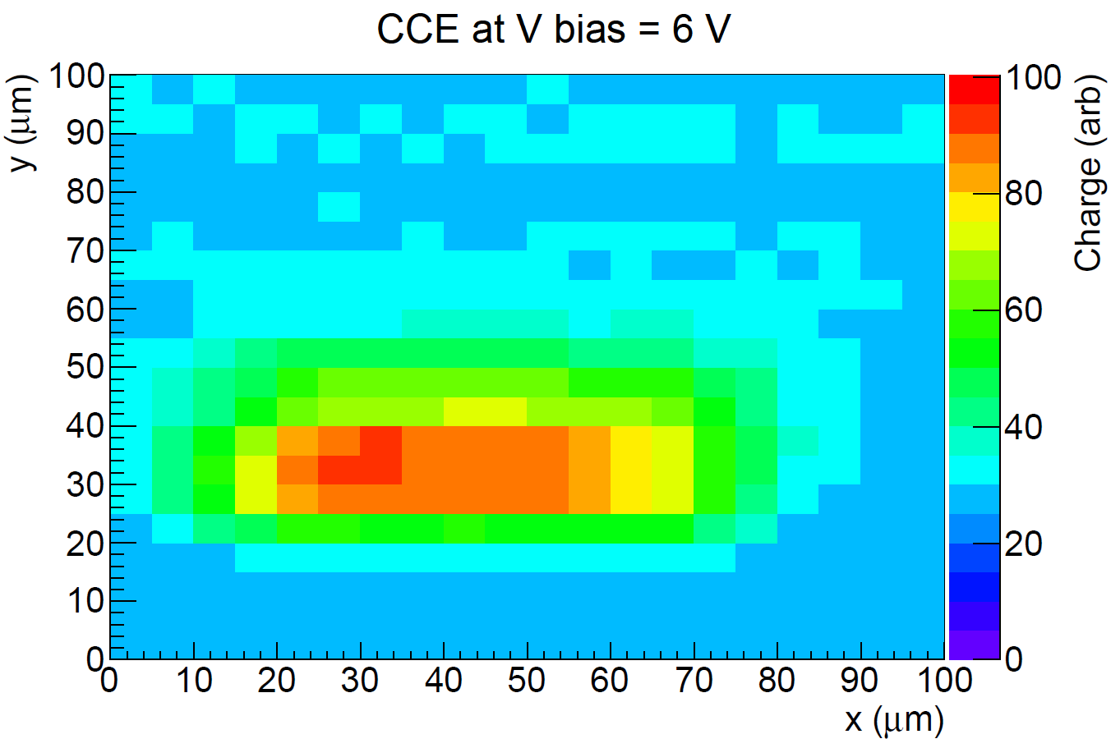
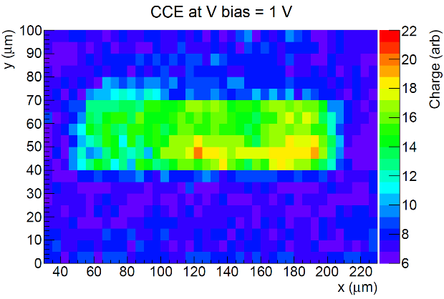
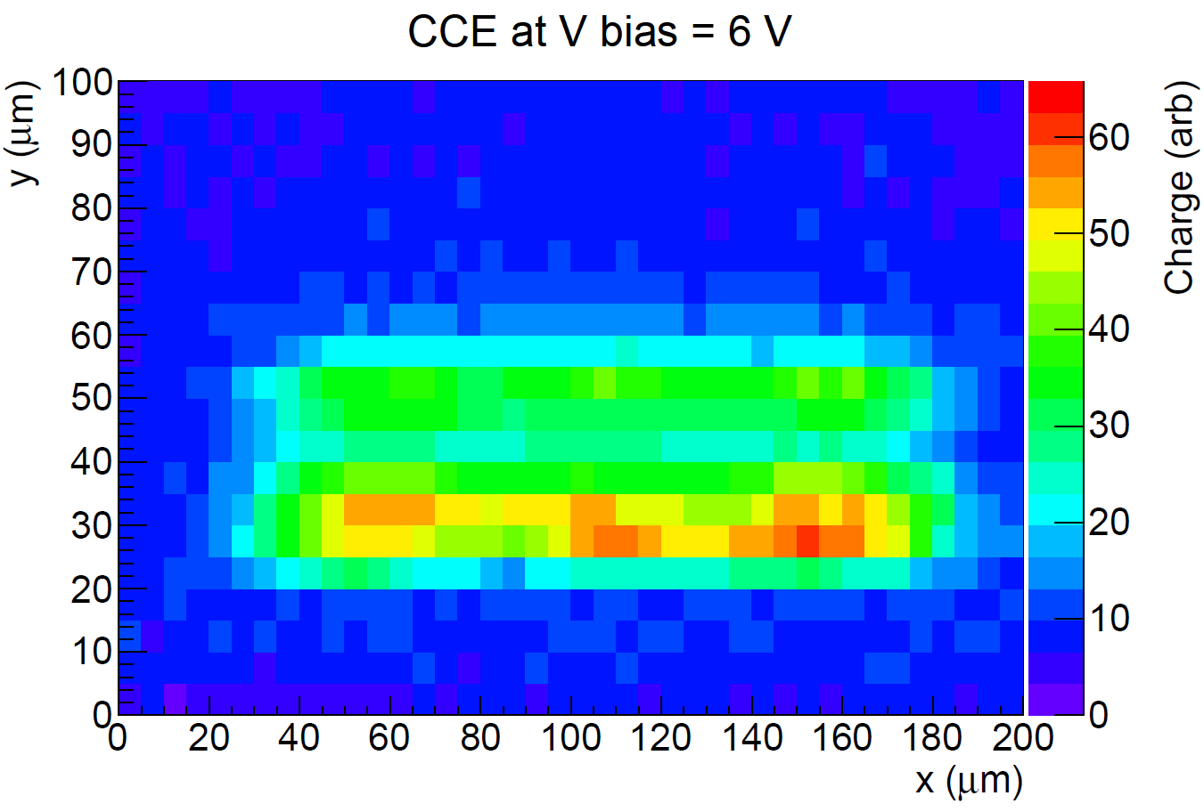
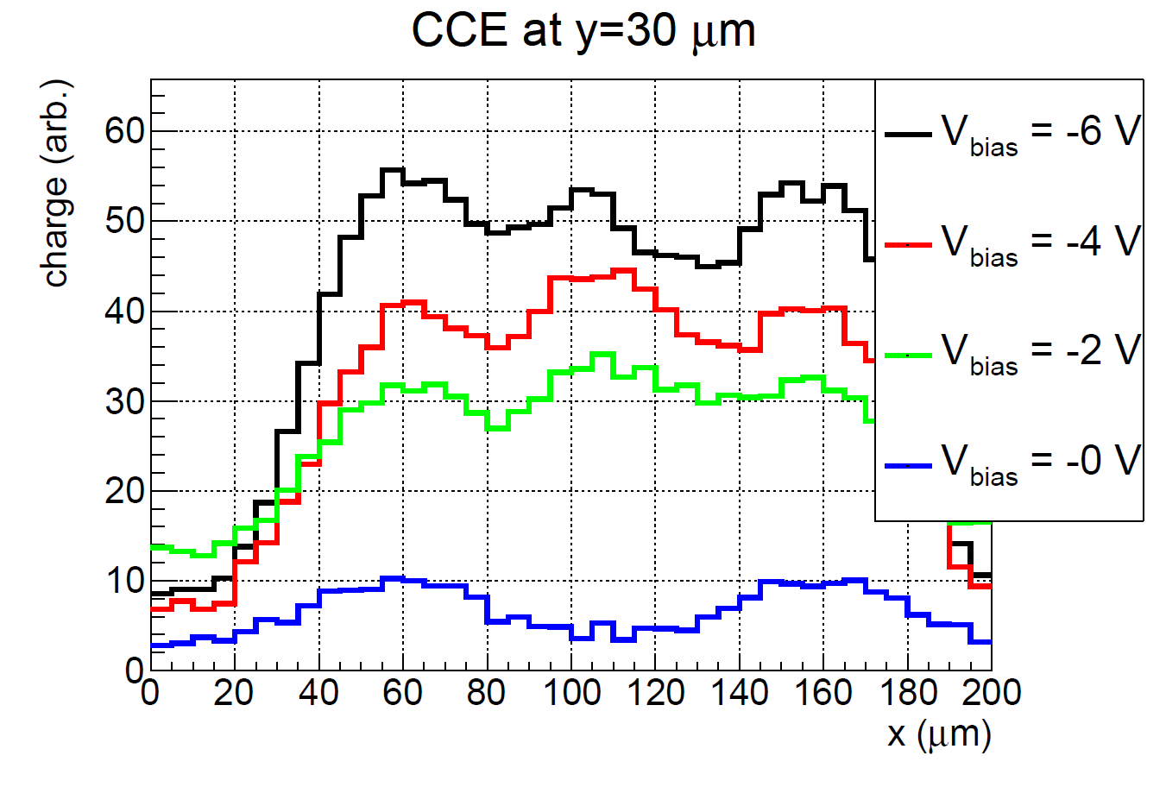
Charge collection measurements
e-TCT measurements show depletion of epi layer even after 10¹⁵ n_{eq}/cm² at -6V
Signal collection after 10¹⁵ n_{eq}/cm² irradiation also directly under deep PWELL
↓
with process modification the full pixel is depleted!
20x20
unirrad.
1e15
50x50
unirrad.
1e15
Chip surface
50x50 μm² after 1e15
FWHM=
155 μm

Slide 10
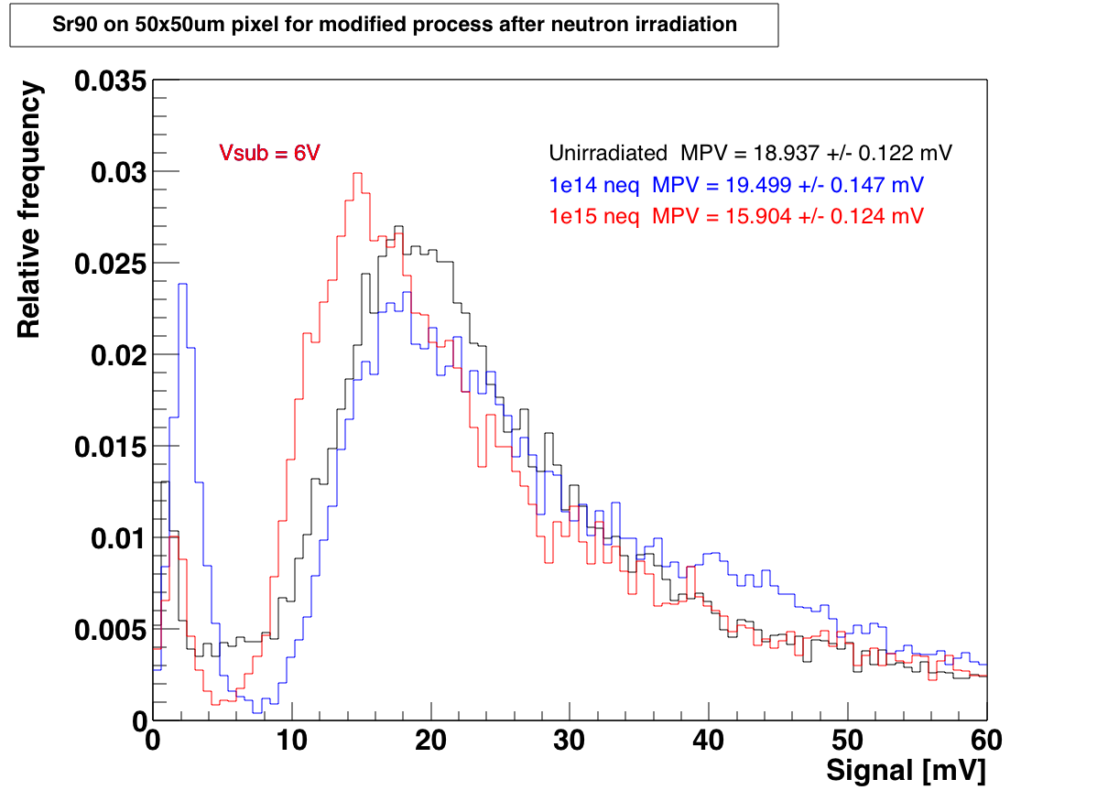
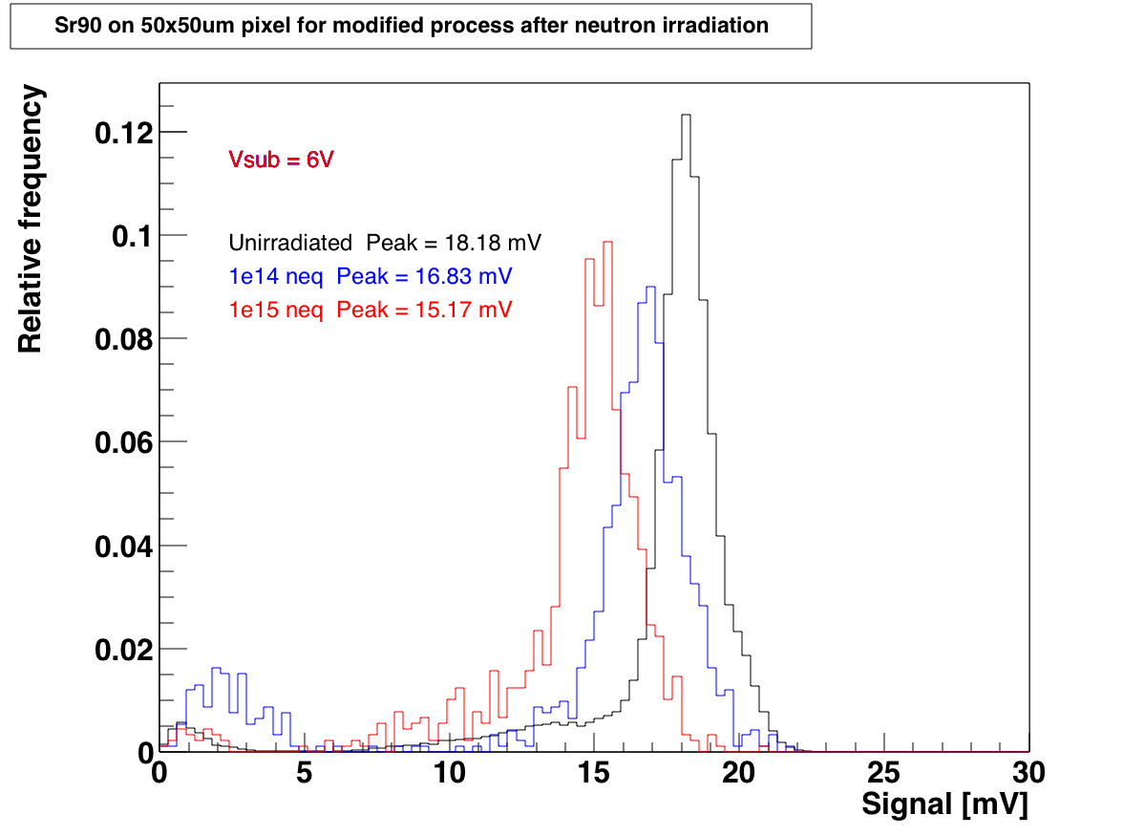
Irradiation results
Investigator irradiated up to 10¹⁵ n_{eq}/cm² and 1 Mrad in several steps
Little change in signal after irradiation
Signal well separated from noise
⁹⁰Sr source
⁵⁵Fe
source
H. Pernegger et al., DOI 10.1088/1748-0221/12/06/P06008

Slide 11
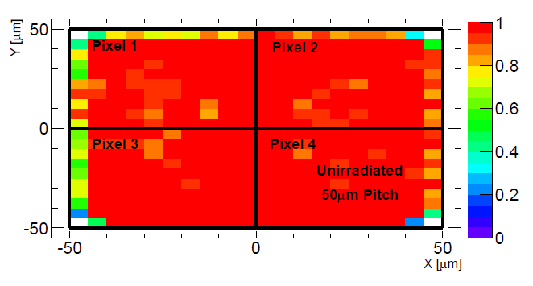
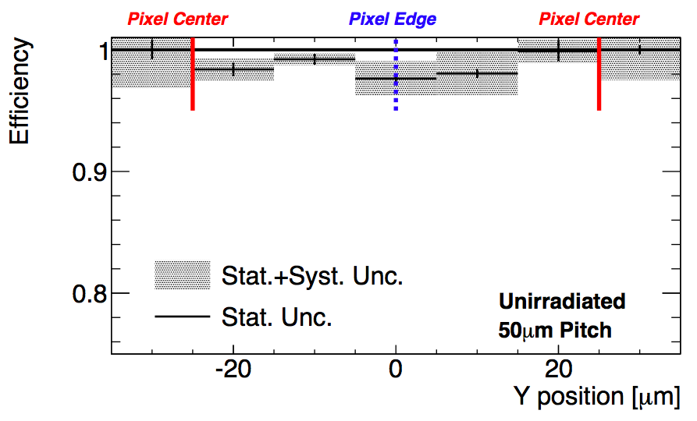
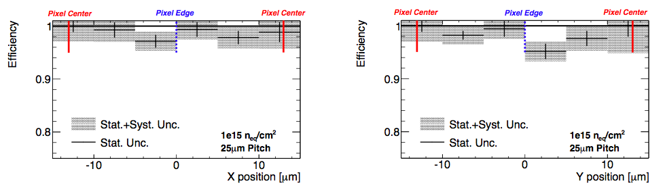
Beam test results
Unirradiated sensor efficiency 98.5% ± 0.5% (stat.) ± 0.5% (sys.) (50x50 μm²)
Irradiated sensor also shows uniform efficiency across 25x25 μm² pixel
98.5% ± 1.5% (stat.) ± 1.2% (syst.)

Slide 12
Design of large-scale demonstrators
Measurement results show improved radiation hardness for sensors manufactured using the modified process
              ↓
Design of two full-scale demonstrators to match
ATLAS specifications for outer pixel layers
The “MALTA” chip
  Analog front-end based on a previous design for the ALICE experiment
  Novel asynchronous readout architecture to reduce digital power consumption and increase hit rate capability in the matrix
The “TJ-Monopix” chip
  Front-end similar to the “MALTA” chip
  Uses the well-established column drain readout architecture (experience from LF-Monopix design)

Slide 13
The “MALTA” chip
“MALTA” (Monolithic from ALICE To ATLAS) chip under development at CERN
ACTIVE MATRIX
(512x512 pixels)
CMOS input/output pads
8 sectors (different collection electrode size and deep PWELL spacing)
18.6 mm
power pads
pixel size 36.4x36.4 µm
DACs for analog biases
digital periphery
regular pads
LVDS driver

Slide 14
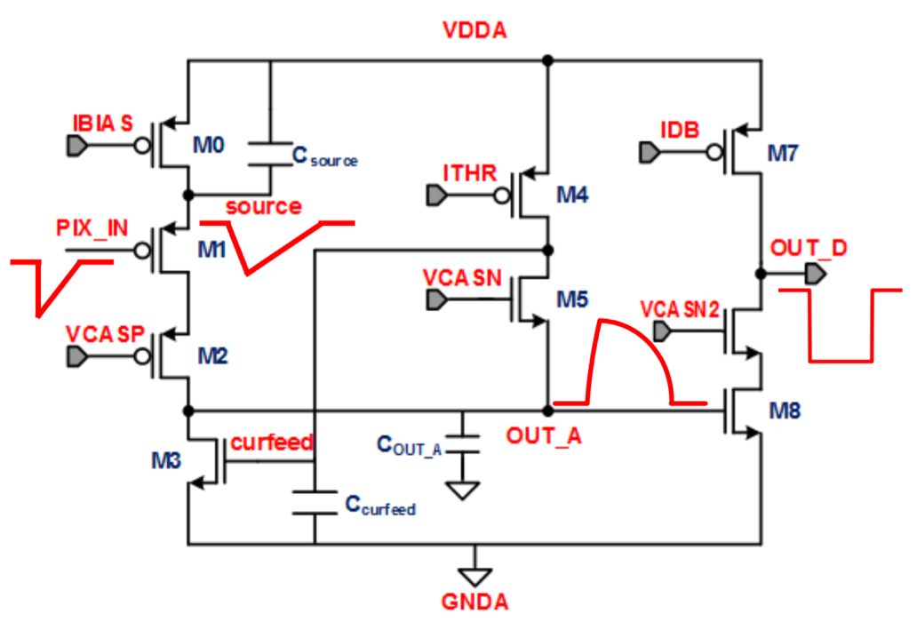
Analog front-end
Based on the front-end of the ALPIDE chip (previously developed for the upgrade of the ALICE experiment)
1 – amplification
2 – discrimination
1
2
digital architecture
D. Kim et al.
DOI 10.1088/1748-0221/11/02/C02042
Improvement for fast timing (< 25 ns) and hit rate capability by increasing current consumption (250-500 nA/pixel, < 1 μW/pixel)

Slide 15
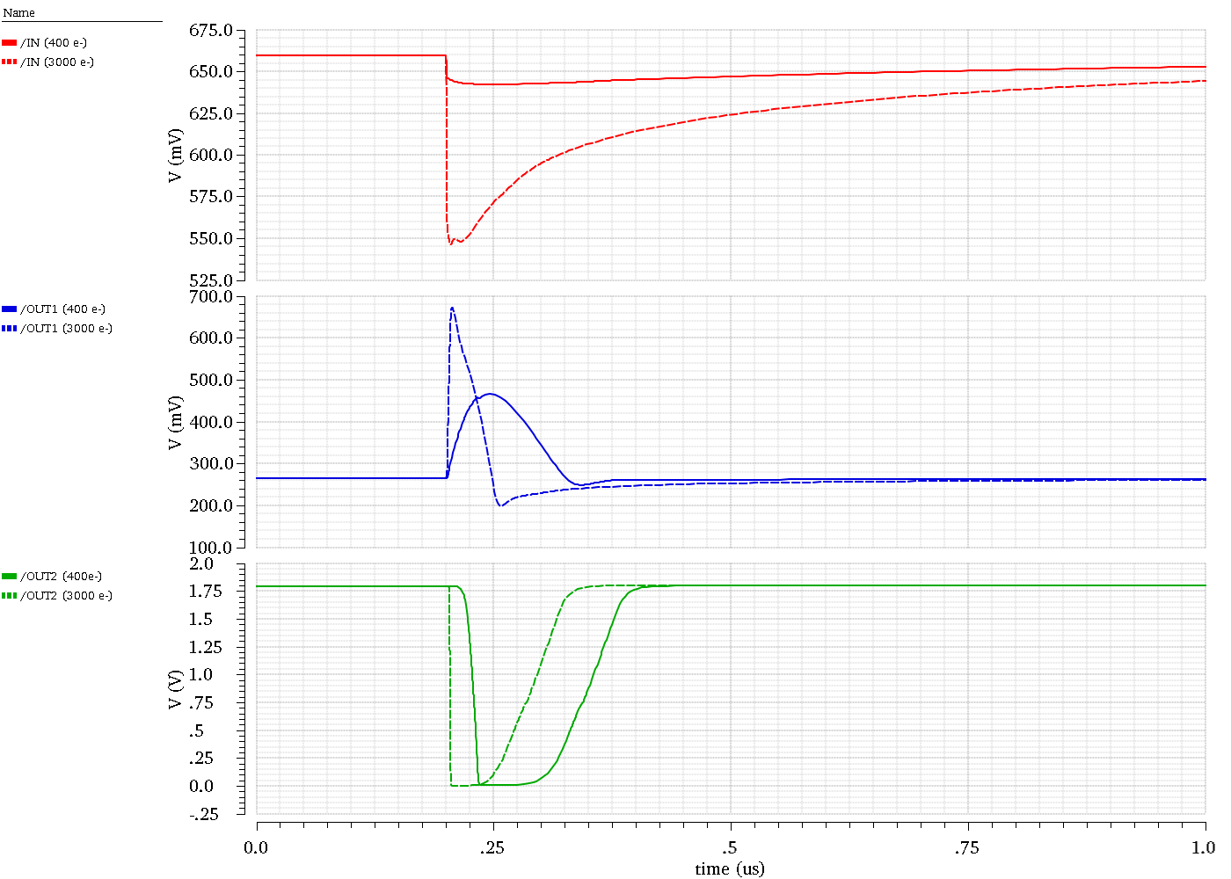
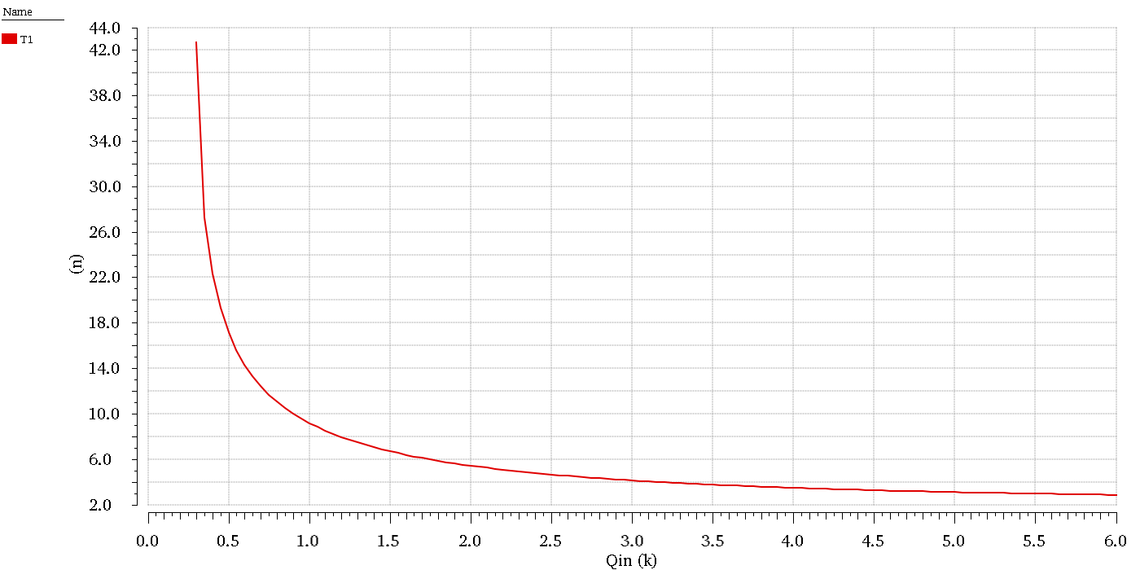
Front-end timing optimisation
Q_{TH}=300 e⁻
pulse duration clipping
time-walk curve
time walk
dead time
simulated analog signals of the front-end
delay of leading edge (ns)
input charge (ke-)

Slide 16
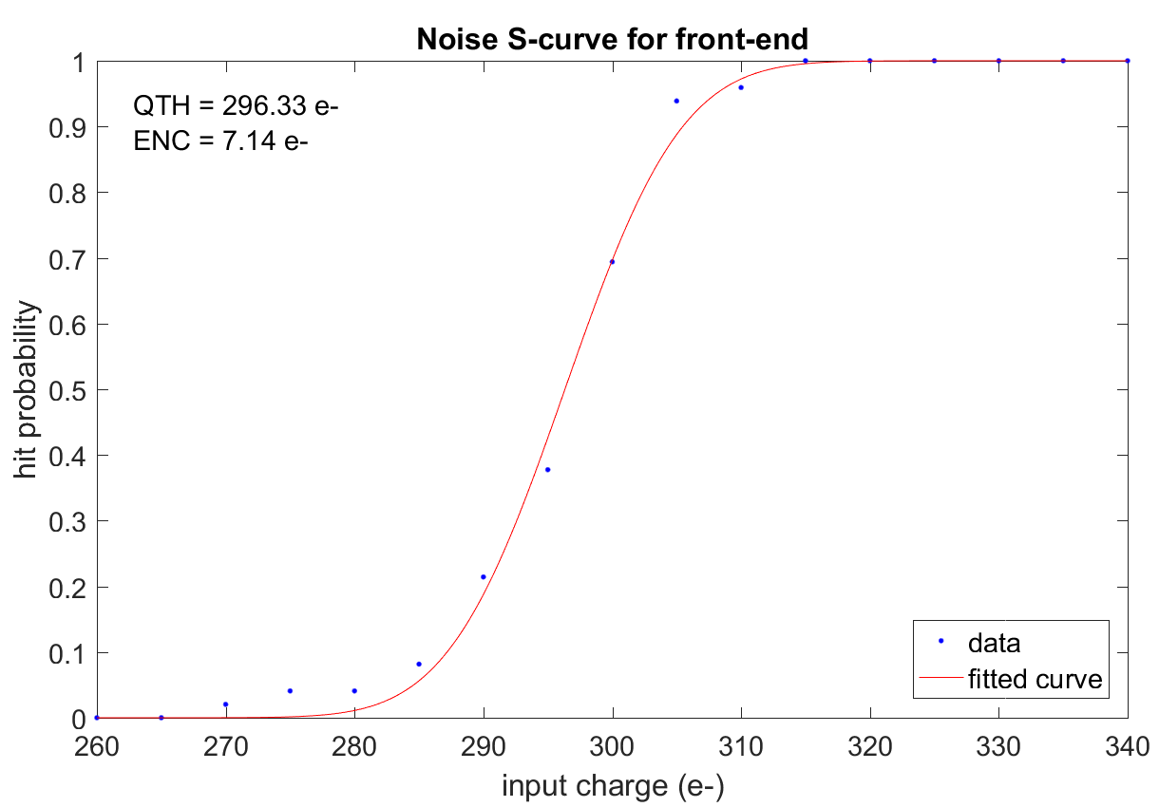
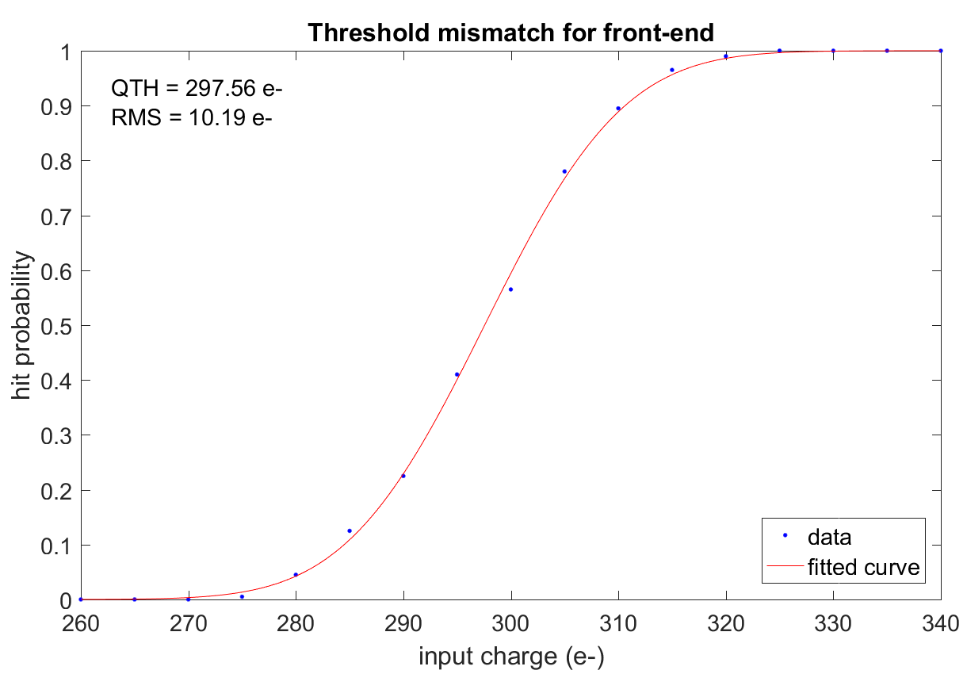
Noise and mismatch
Noise and transistor mismatch cause a variation in the charge threshold of the front-end (S-curve)
threshold/noise > 10 ✓
good threshold uniformity,
no need for in-pixel tuning

Slide 17
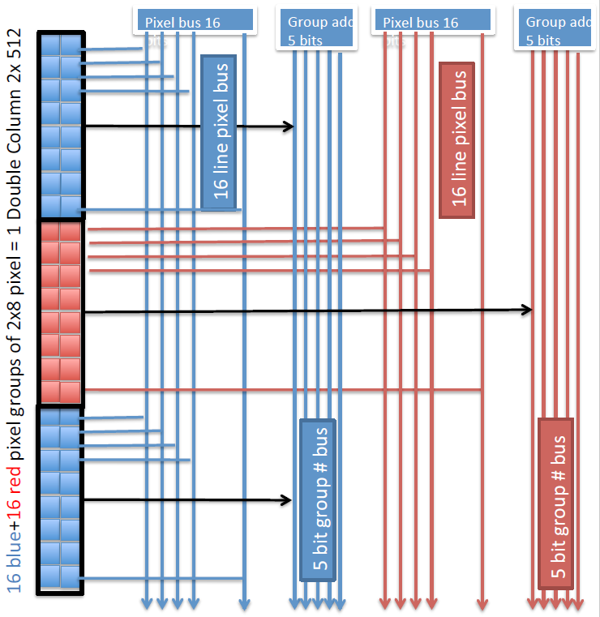
Digital readout architecture
Front-end output injected into double-column digital readout logic
Hits are stored using in-pixel flip-flops and transmitted asynchronously over high-speed buses to the end-of-column logic (digital periphery)
No clock distribution over the active matrix – reduces power consumption!
Double-column divided into groups of 2x8 pixels (“red” and “blue”)
Buses shared by all groups of the same colour in the double-column
Group number encoded on 5-bit group address bus

Slide 18
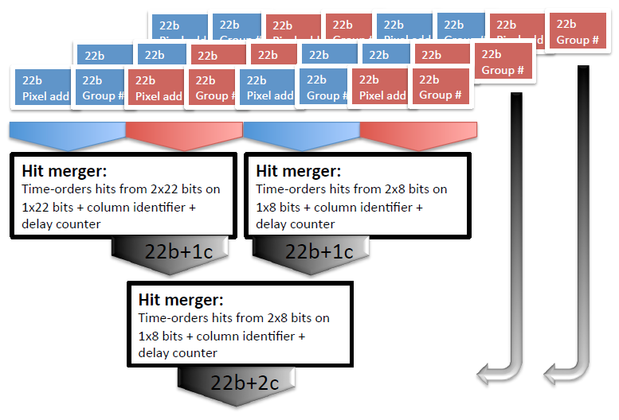
Digital end-of-column logic
At the periphery, signals of red and blue groups are merged together
Simultaneous signals on two buses require additional arbitration logic (blue signal is given priority, red is delayed)
Merging is repeated for all the double-columns and then continued until all outputs are merged into one parallel bus
x256 double-columns
…
…
x10 levels of merging for full matrix

Slide 19
The “TJ-Monopix” chip
Produced on the same reticle as the “MALTA” chip
“MALTA” front-end modified to provide ToT information
Well established column-drain architecture:
  Time stamp distributed in pixel array
  Hit information stored in the pixel
  Hit read out following a priority scan
- PMOS reset
- In-pixel RAM r/o by CMOS inverter
- PMOS reset
- In-pixel RAM r/o by source follower
- PMOS reset with leakage compensation
- Front HV bias
- AC coupled to FE
~ 1 cm
T. Wang et al.
iWoRiD 2017
~ 2 cm

Slide 20
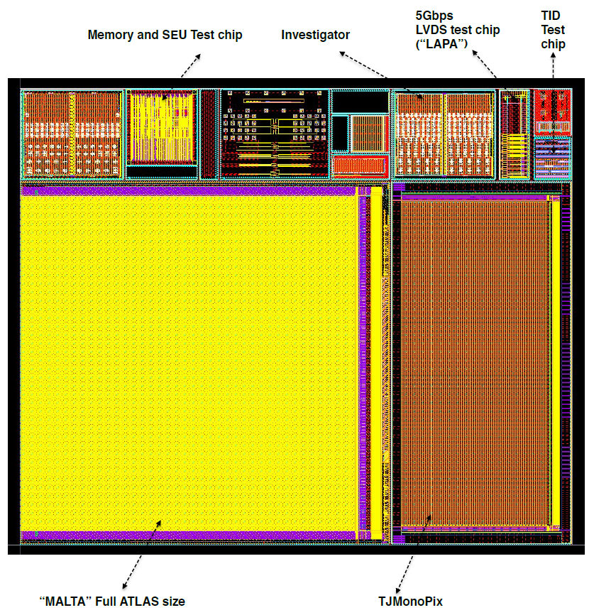
Summary
The possibility of using a monolithic pixel sensor for the outer layers of the ATLAS experiment was investigated using the TowerJazz Investigator test chip
Measurement results of sensors produced using a novel modified process, which combines high Q/C with radiation tolerance, show good performance and high efficiency even after irradiation
This has opened the way for the design of two large-scale demonstrators with different readout architectures

