Slide 1
First results of the MYTHEN-III strip detector prototype
Roberto Dinapoli :: SLS Detector Group :: Paul Scherrer Institut
PSD11 :: 07.09.2017

Slide 2
Outline
Why strip detectors
MYTHEN
  Description
  Performance
  Experimental issues
MYTHEN III
  Design specifications
  MYTHEN III 0.1 prototype
  Preliminary measurements
Perspectives
SLS
(Swiss Light Source)

Slide 3
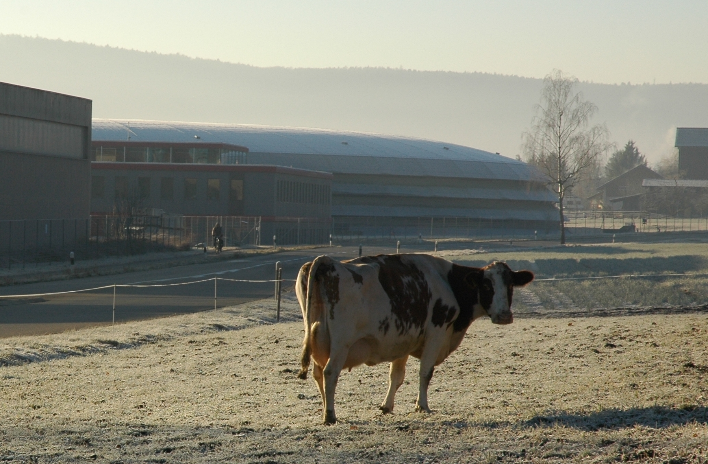
Outline
Why strip detectors
MYTHEN
  Description
  Performance
  Experimental issues
MYTHEN III
  Design specifications
  MYTHEN III 0.1 prototype
  Preliminary measurements
Perspectives
SLS
(Swiss Light Source)
SMS
(Swiss Milk Source)

Slide 4
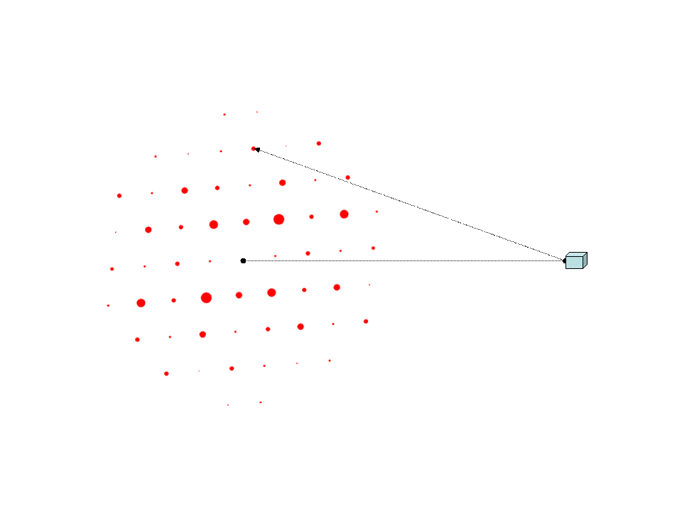
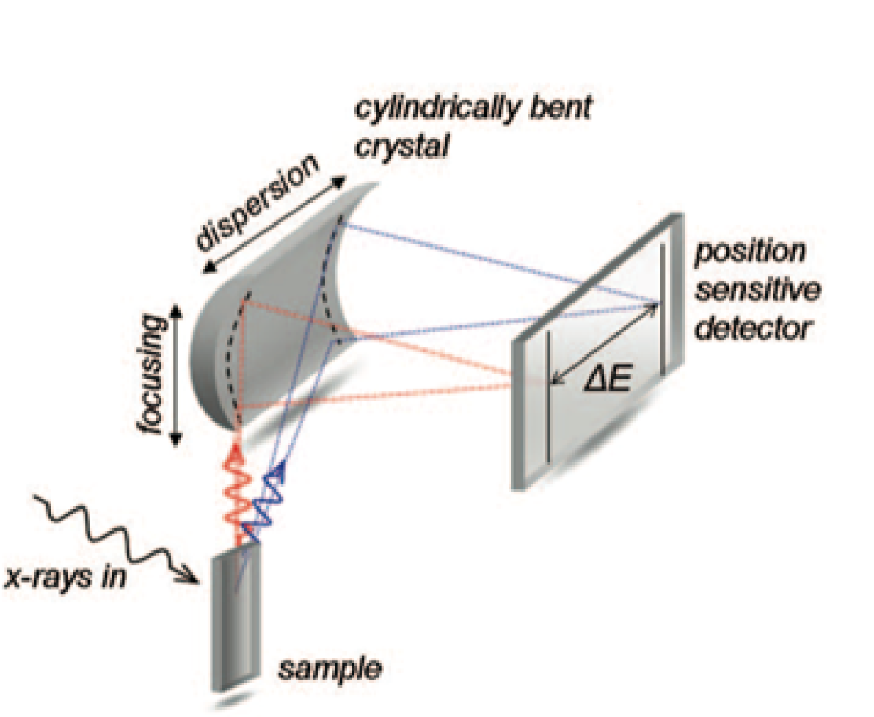
Why strips?
1D Applications don’t require pixels
X-Ray powder diffraction
(XRPD)
X-Ray emission spectrometers

Slide 5
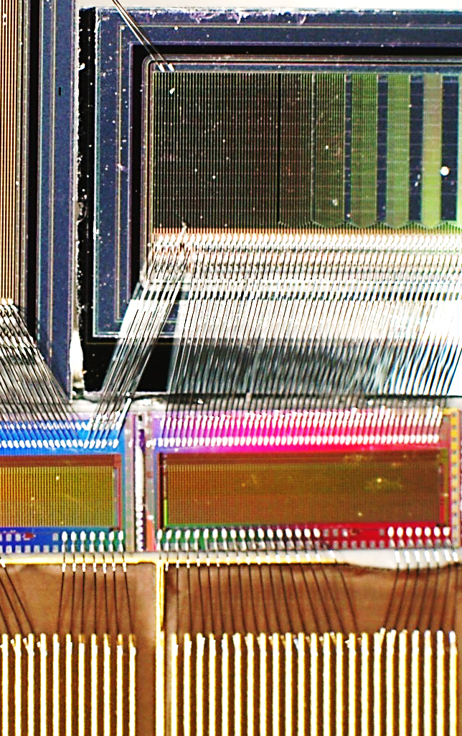
Why strips? Chip designer’s view
1D arrangement makes ASIC design less challenging
Smaller ASIC required (easier, cheaper, faster)
Simpler control/readout logic
Less channels per area
    Faster frame rate
    Smaller data throughput
    Resources much less critical
Big system much simpler than 2D detectors
Wire- instead of bump- bonding
    Cheaper
    Smaller pitches possible
    Simpler
    More input capacitance (noise)

Slide 6
MYTHEN
Microstrip sYstem for Time rEsolved experimeNts
Direct conversion in the sensor
Standard sensor:
  320 µm thick silicon sensor
  50 µm pitch
  8 mm long strips
  4 mdeg at 76 cm distance
Sensor material and characteristics can be changed
ROCs
Sensor
X-rays
Single photon counting architecture
  “Noiseless”
  Large dynamic range
  Fluorescence suppression
  Pump-probe experiments
threshold
24 bit counter
Amplifier and
Shaper
Comparator
+1
From detector

Slide 7
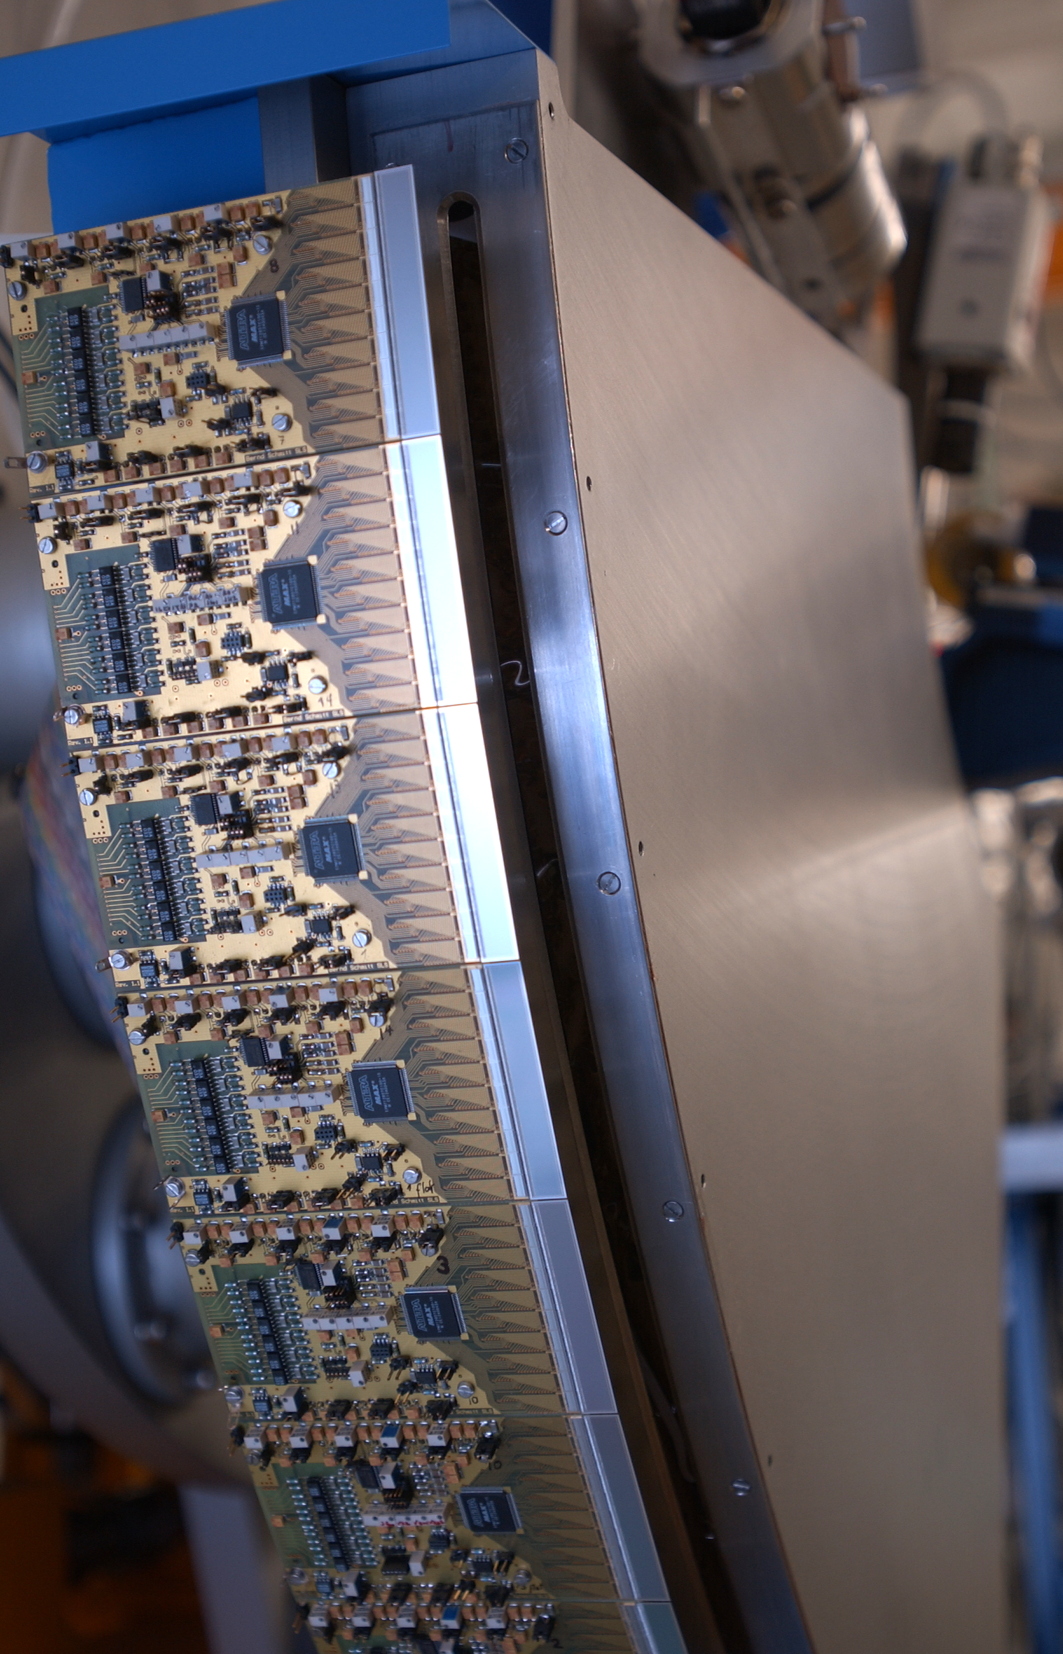
MYTHEN I
At the Material Science beamline (2001 until 2007)
Covering 60 degrees (15k channels)
DMILL technology
XRPD pattern acquisition faster than 1 minute instead of 1 hour as with the high resolution scanning detector
  Counter giving random counts and other minor issues
  By redundant measurements and data correction it could be used at the beamline for fast and time resolved measurements
B Schmitt,et al,
Nucl. Instr. . Meth. .Phys. Res. A 501 (2003), 267-272,
doi: 10.1016/S0168-9002(02)02045-4

Slide 8
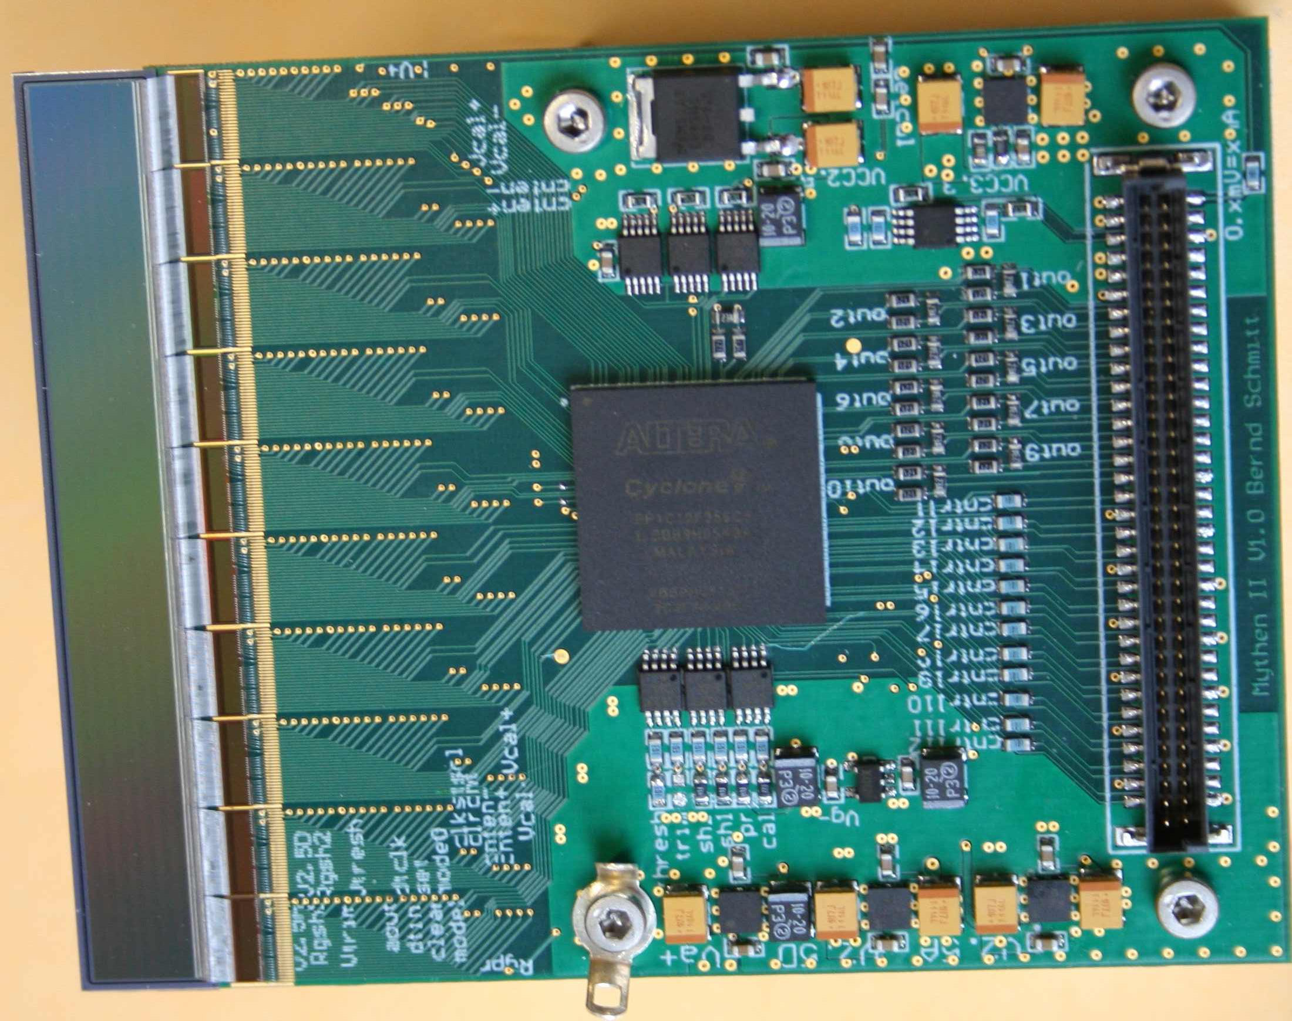
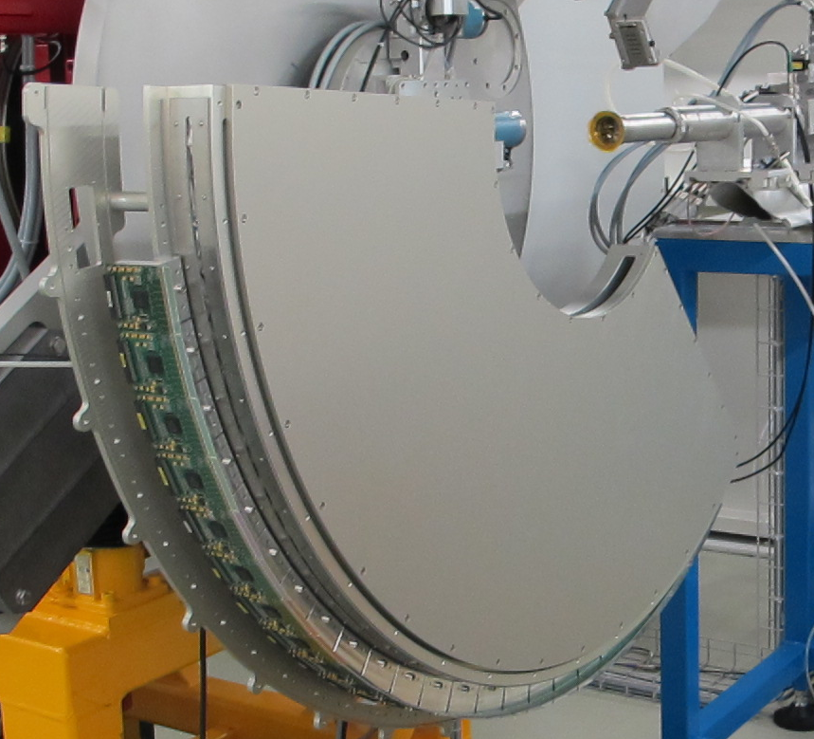
MYTHEN II
Read Out chip
  0.25um UMC
  128 channels, 50µm pitch
  24 bit counter (configurable 16-8-4-1 bit)
  < 100us read out time
  200-300 e- noise
  100-700 ns “shaping” (dead) time
Modules
  1280 channels, 6.4 cm
  Needs controller board
Systems
  Multi module boards
  Embedded Linux system and FPGAs
  100 Mbs Ethernet, TCP/IP data transfer
  Continuous frame rate up to 20 Hz - 1 kHz
  Depending on dynamic and angular range
  Burst mode up to 10 kHz, 32 frames
A. Bergamaschi al., J. Synchrotron Rad. 17, 653-668 (2010)
http://dx.doi.org/10.1107/S0909049510026051

Slide 9
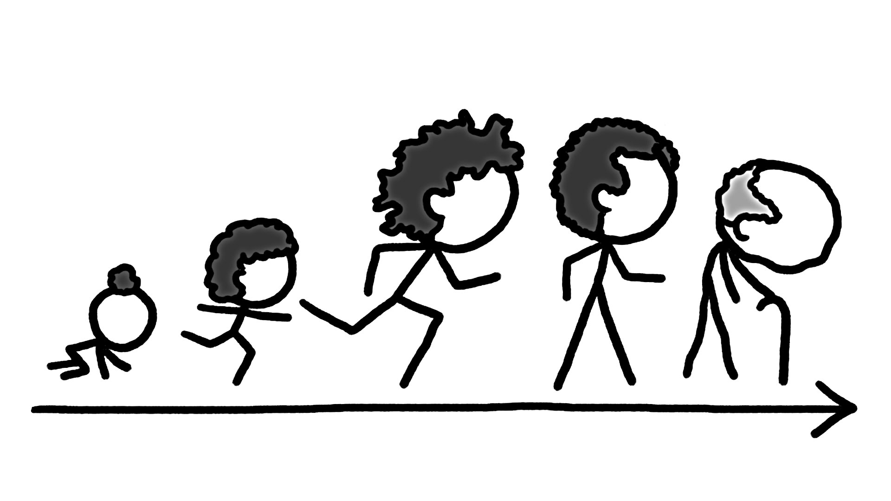
Why MYTHEN III?
It’s getting old!

Slide 10
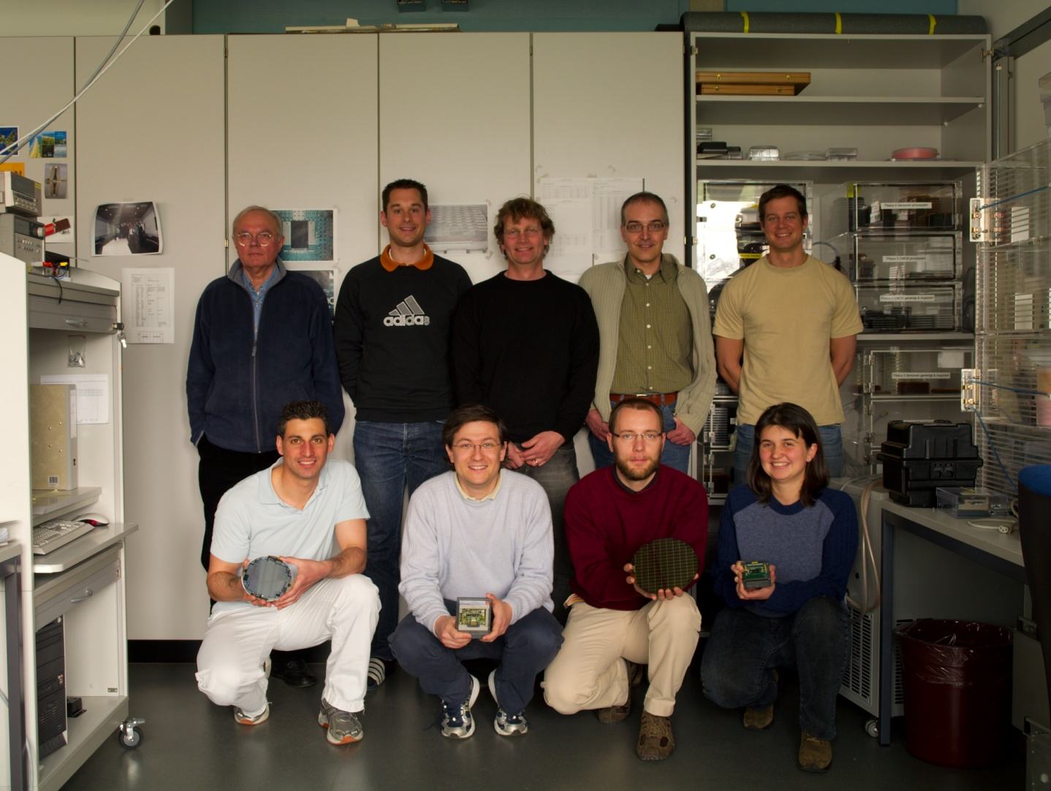
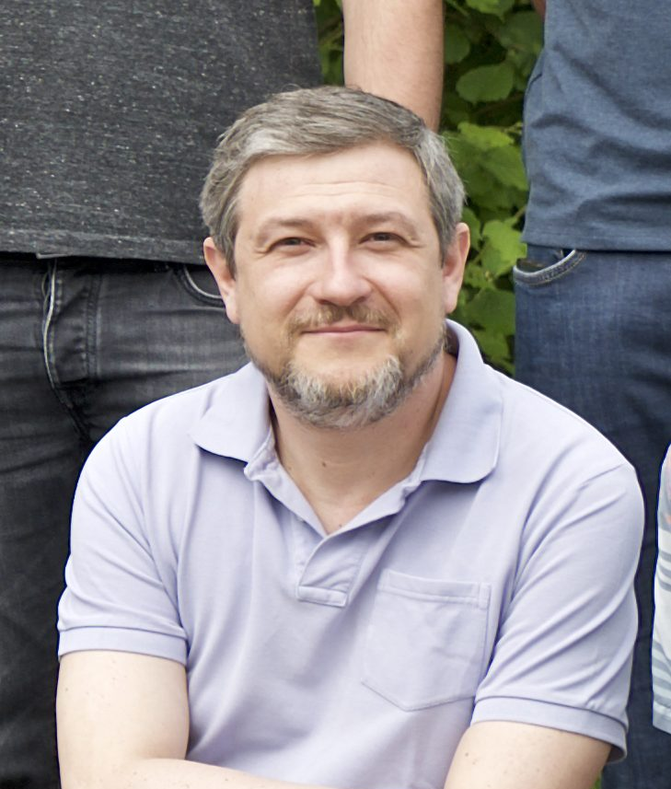
Why MYTHEN III?
It’s getting old!
Acquisition system outdated
Electronics components not available any longer

Slide 11
Why MYTHEN III?
It’s growing!

Slide 12
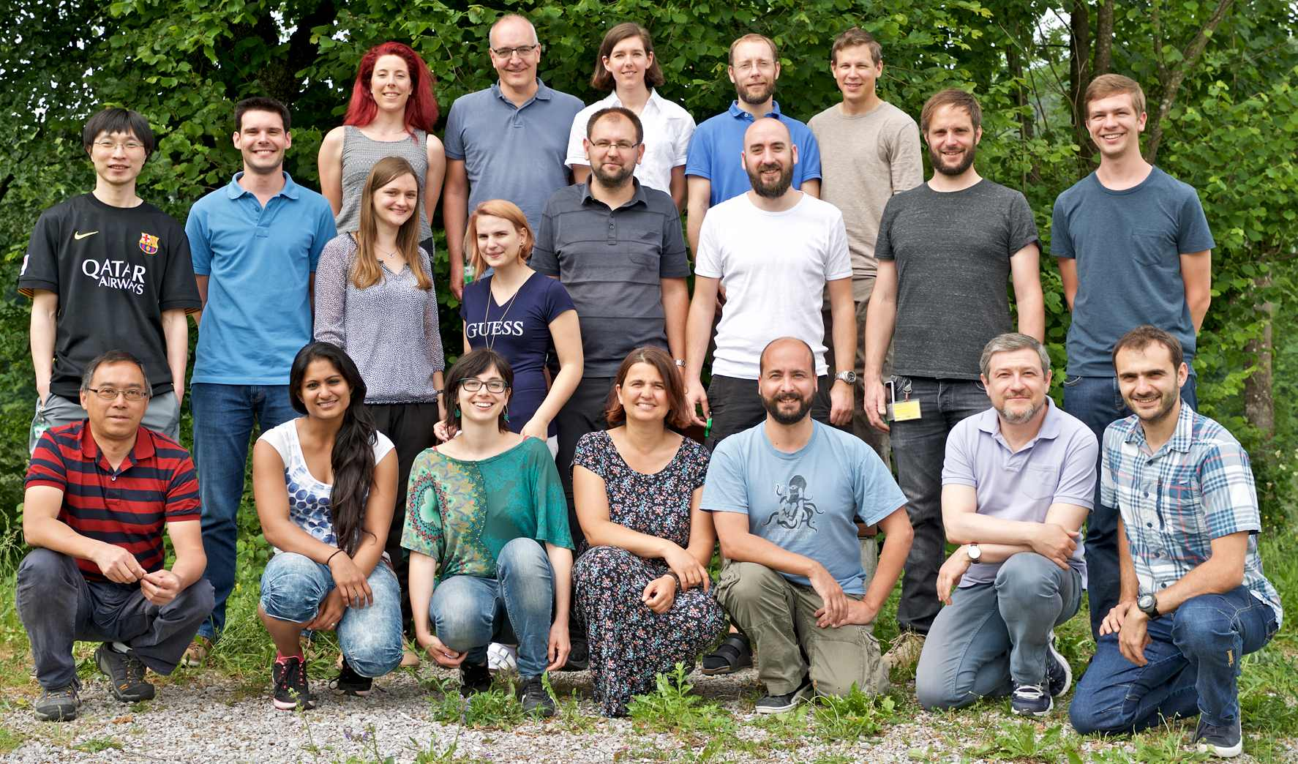
Why MYTHEN III?
It’s growing!
Take advantage of technological progress
Improve data quality
More flexibility for more applications
SLS detectors group
MYTHEN group

Slide 13
Why MYTHEN III?
It’s growing!
Take advantage of technological advances
Improve data quality
More flexibility for more applications
Get rid of pixels for a while…
SLS detectors group
MYTHEN group

Slide 14
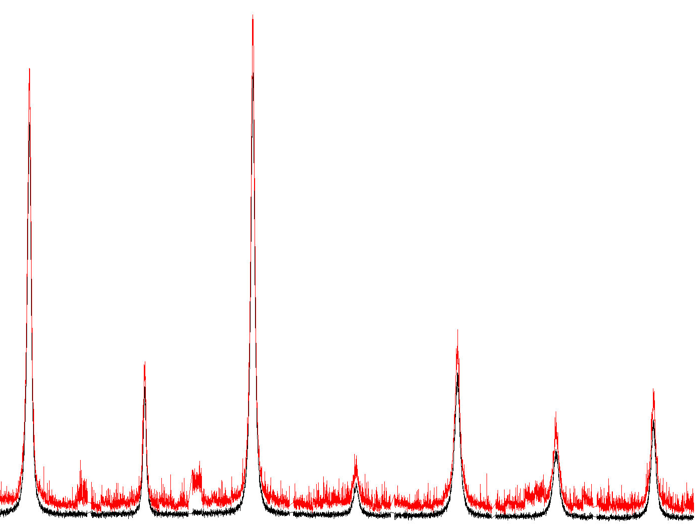
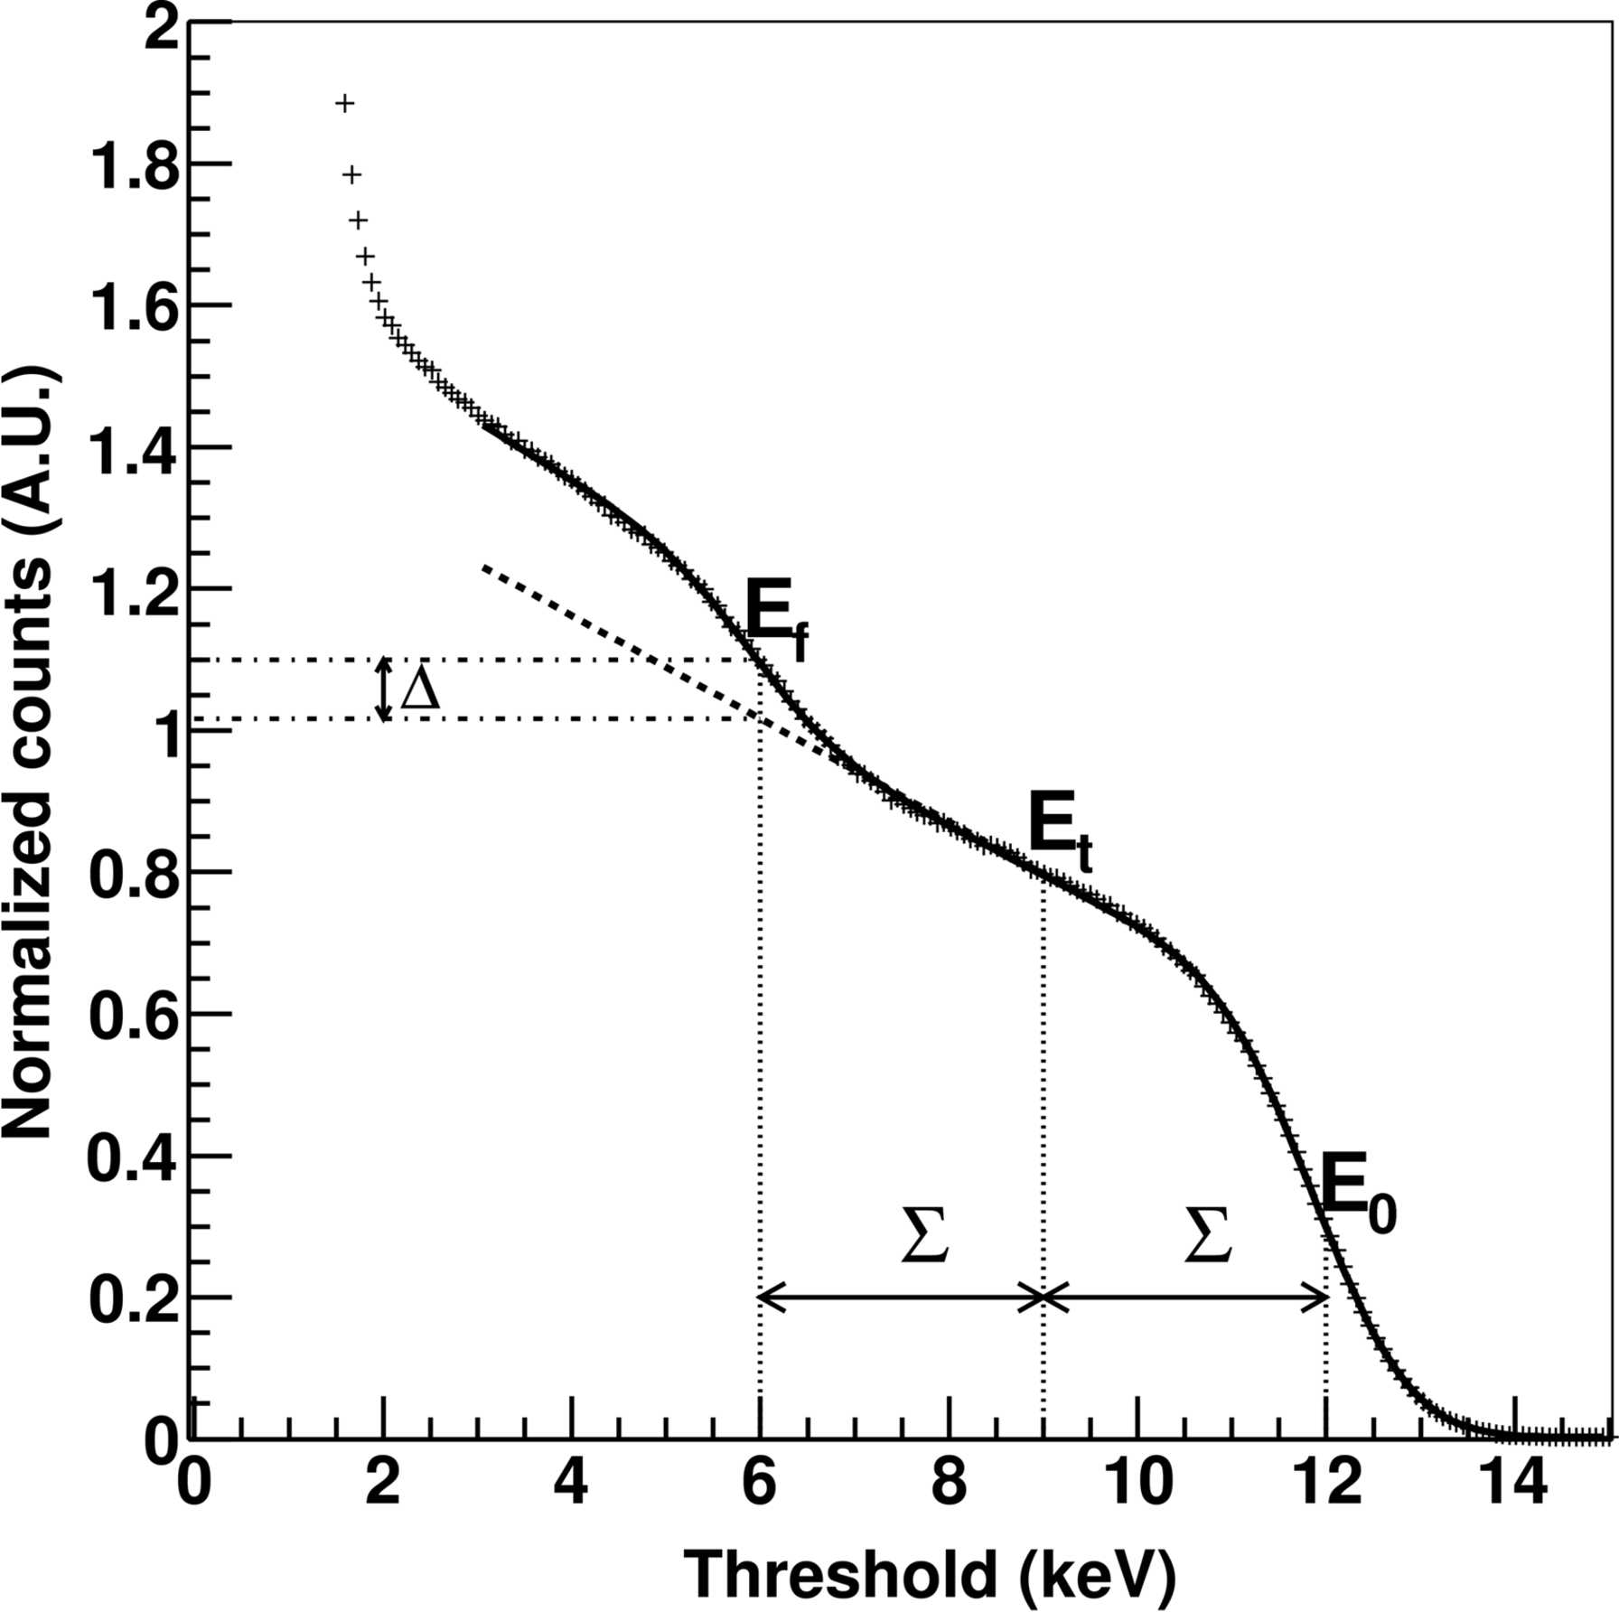
Fluorescence suppression
Sample containing iron
Threshold
6 keV
9 keV
counts
Channel number
Fluorescence is not flat field correctable and must be suppressed
Distance between beam, threshold and fluorescence line should
be 3-5 x noise
Difficult energy/threshold choice for complex samples
Reduce the noise -> 100-200 electrons

Slide 15
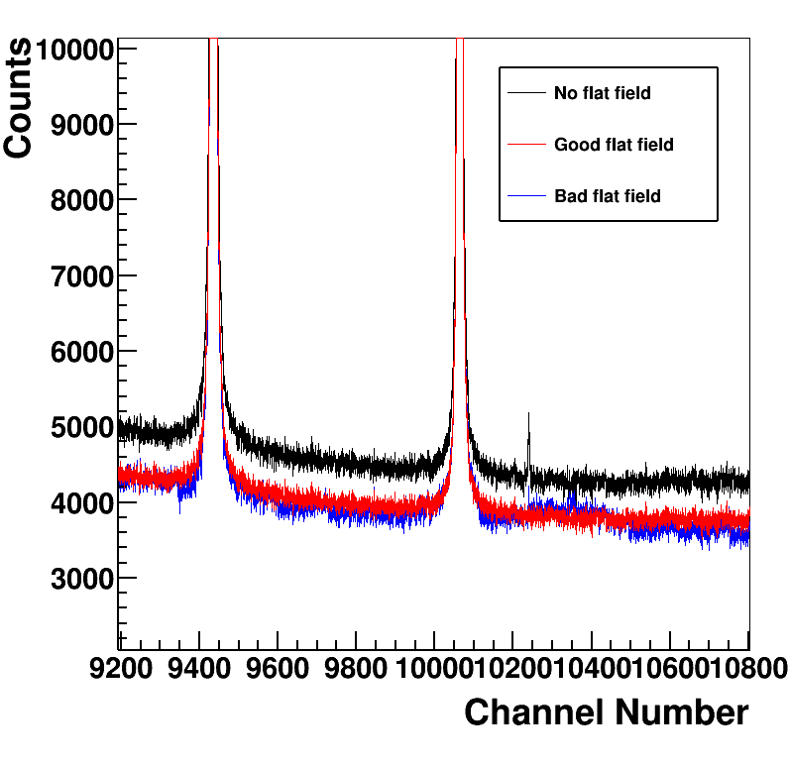
Flat field acquisition
Flat field is necessary in XRPD to get accuracy better than 1%
Annoying and time consuming flat field acquisition for each pair of X-ray and threshold energy
  Large statistics, must be retaken periodically
Reduce the threshold dispersion -> <10 electrons

Slide 16
High intensity peaks (high photon flux)
PILEUP EFFECT
Pileup can be corrected, but within limits!
  Much less for high gain settings
For better data quality reduce the flux and avoid rate corrections
Increase the analog speed-> Dead time 40-200 ns

Slide 17
MYTHEN III: the chip
110 nm-Al UMC technology, with enclosed layout
Dual selectable polarity
>40 kHz frame rate
Multiple comparators with separate thresholds, 6 trimbits/comparator, independently gatable
Multiple 24bit counters with possible partial readout
Dead time free operation
Several operation modes

Slide 18
The channel
serialIN,
Control signals
Status register (3x6TB,3x1Mask,3 dummy)
21
Control and readout logic
Counting
logic
TBs3
7
Counter 3
Vth3
6
Chsel3
TBs2
7
Counter 2
Vth2
6
ChSel2
Analog Pulsing
TBs1
7
Counter 1
6
Vth1
EN1,EN2,EN3
PUMPPROBE
DIGPULSING
POLARITY
ChSel1
serialOUT

Slide 19
Modes of operation
Chip modes of operation
The chip can work in different modes of operation:
Normal counting mode
  Standard
  With multi-threshold rate correction
  With energy windowing
Pump-probe mode
Time over threshold (with external reference clock)
Analog pulsing mode
Digital pulsing mode
Trim bits load mode

Slide 20
Normal mode configuration
serialIN,
Control signals
Status register (3x6TB,3x1Mask,3 dummy)
21
Control and readout logic
TBs2
7
Counter 2
Vth2
6
EN
Analog Pulsing
POLARITY
serialOUT

Slide 21
Energy windowing configuration
serialIN,
Control signals
Status register (3x6TB,3x1Mask,3 dummy)
21
Control and readout logic
TBs3
7
Counter 3
Vth3
6
EN
TBs2
7
Counter 2
Vth2
6
EN
Analog Pulsing
TBs1
7
Counter 1
6
Vth1
One comparator per counter
POLARITY
EN
serialOUT

Slide 22
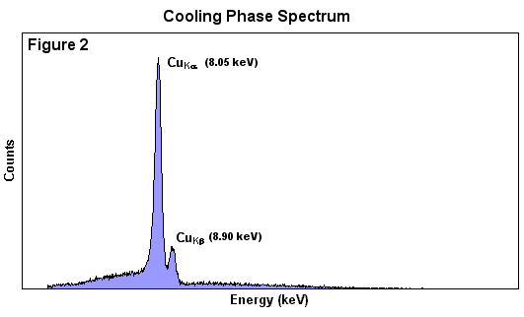
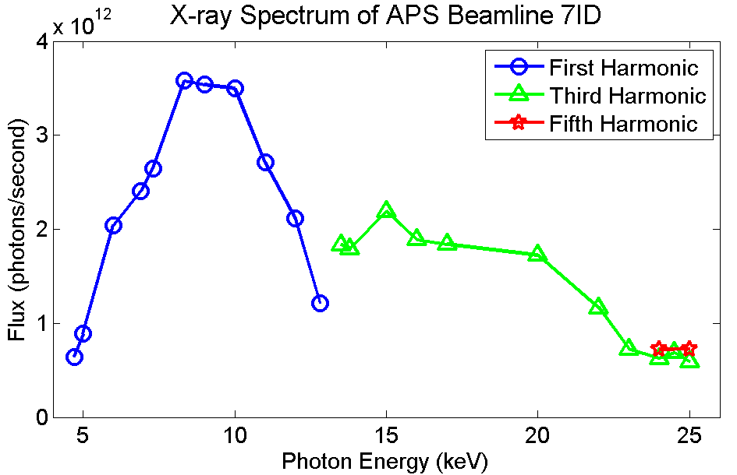
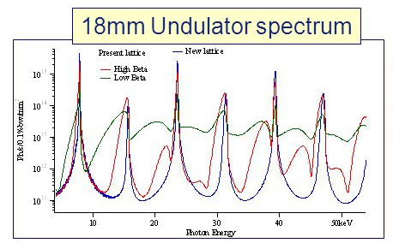
Energy windowing configuration
One comparator per counter (same gate, different thresholds)
  Selection of the
  characteristic line
  Monochromator-free operation at undulator beamlines
  Higher harmonic suppression
ESRF

Slide 23
Energy windowing configuration
One comparator per counter (same gate, different thresholds)
Well, let’s be more realistic…
  Selection of the
  characteristic line
  Monochromator-free operation at undulator beamlines
  Higher harmonic suppression
ESRF

Slide 24
Rate correction using multiple thresholds
Same configuration as for energy windowing (one comparator per counter, every comparator with independent threshold)
Threshold =2.5 E
Threshold =1.5 E
Threshold =0.5 E
Multiple thresholds set at (0.5+n)*E
We are exploring possibilities in simulations, Mythen III enables us to compare simulation results with real data
24

Slide 25
Pump-Probe configuration
serialIN,
Control signals
Status register (3x6TB,3x1Mask,3 dummy)
21
Control and readout logic
Counter 3
EN3
TBs2
7
Counter 2
Vth2
6
POLARITY
EN2
Analog Pulsing
Counter 1
One comparator, several counters with different enable windows
EN1
serialOUT

Slide 26
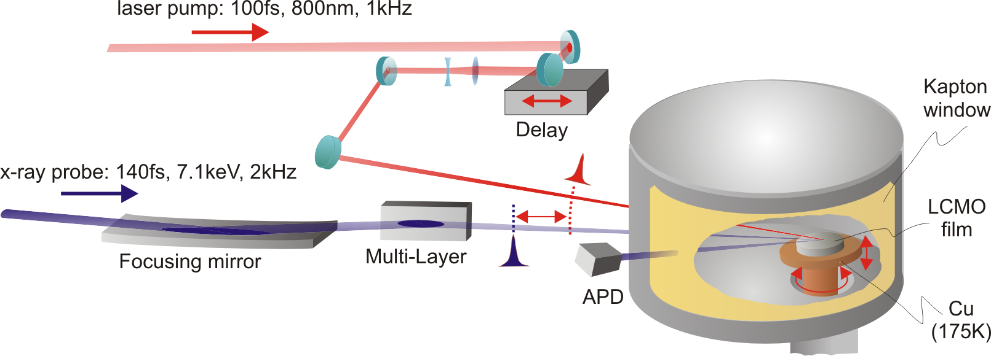
Pump-probe operation
One comparator, several counters with different enable windows
  Pumped-unpumped measurements
  with isolated/sliced bunch
  Stroboscopic measurements with multiple counting slots
  Piezo crystal with hysteresis
Sample
V
Laser (pump)
Gate 2
V
Gate1
Isolated Bunch (probe)
Gate 3
time

Slide 27
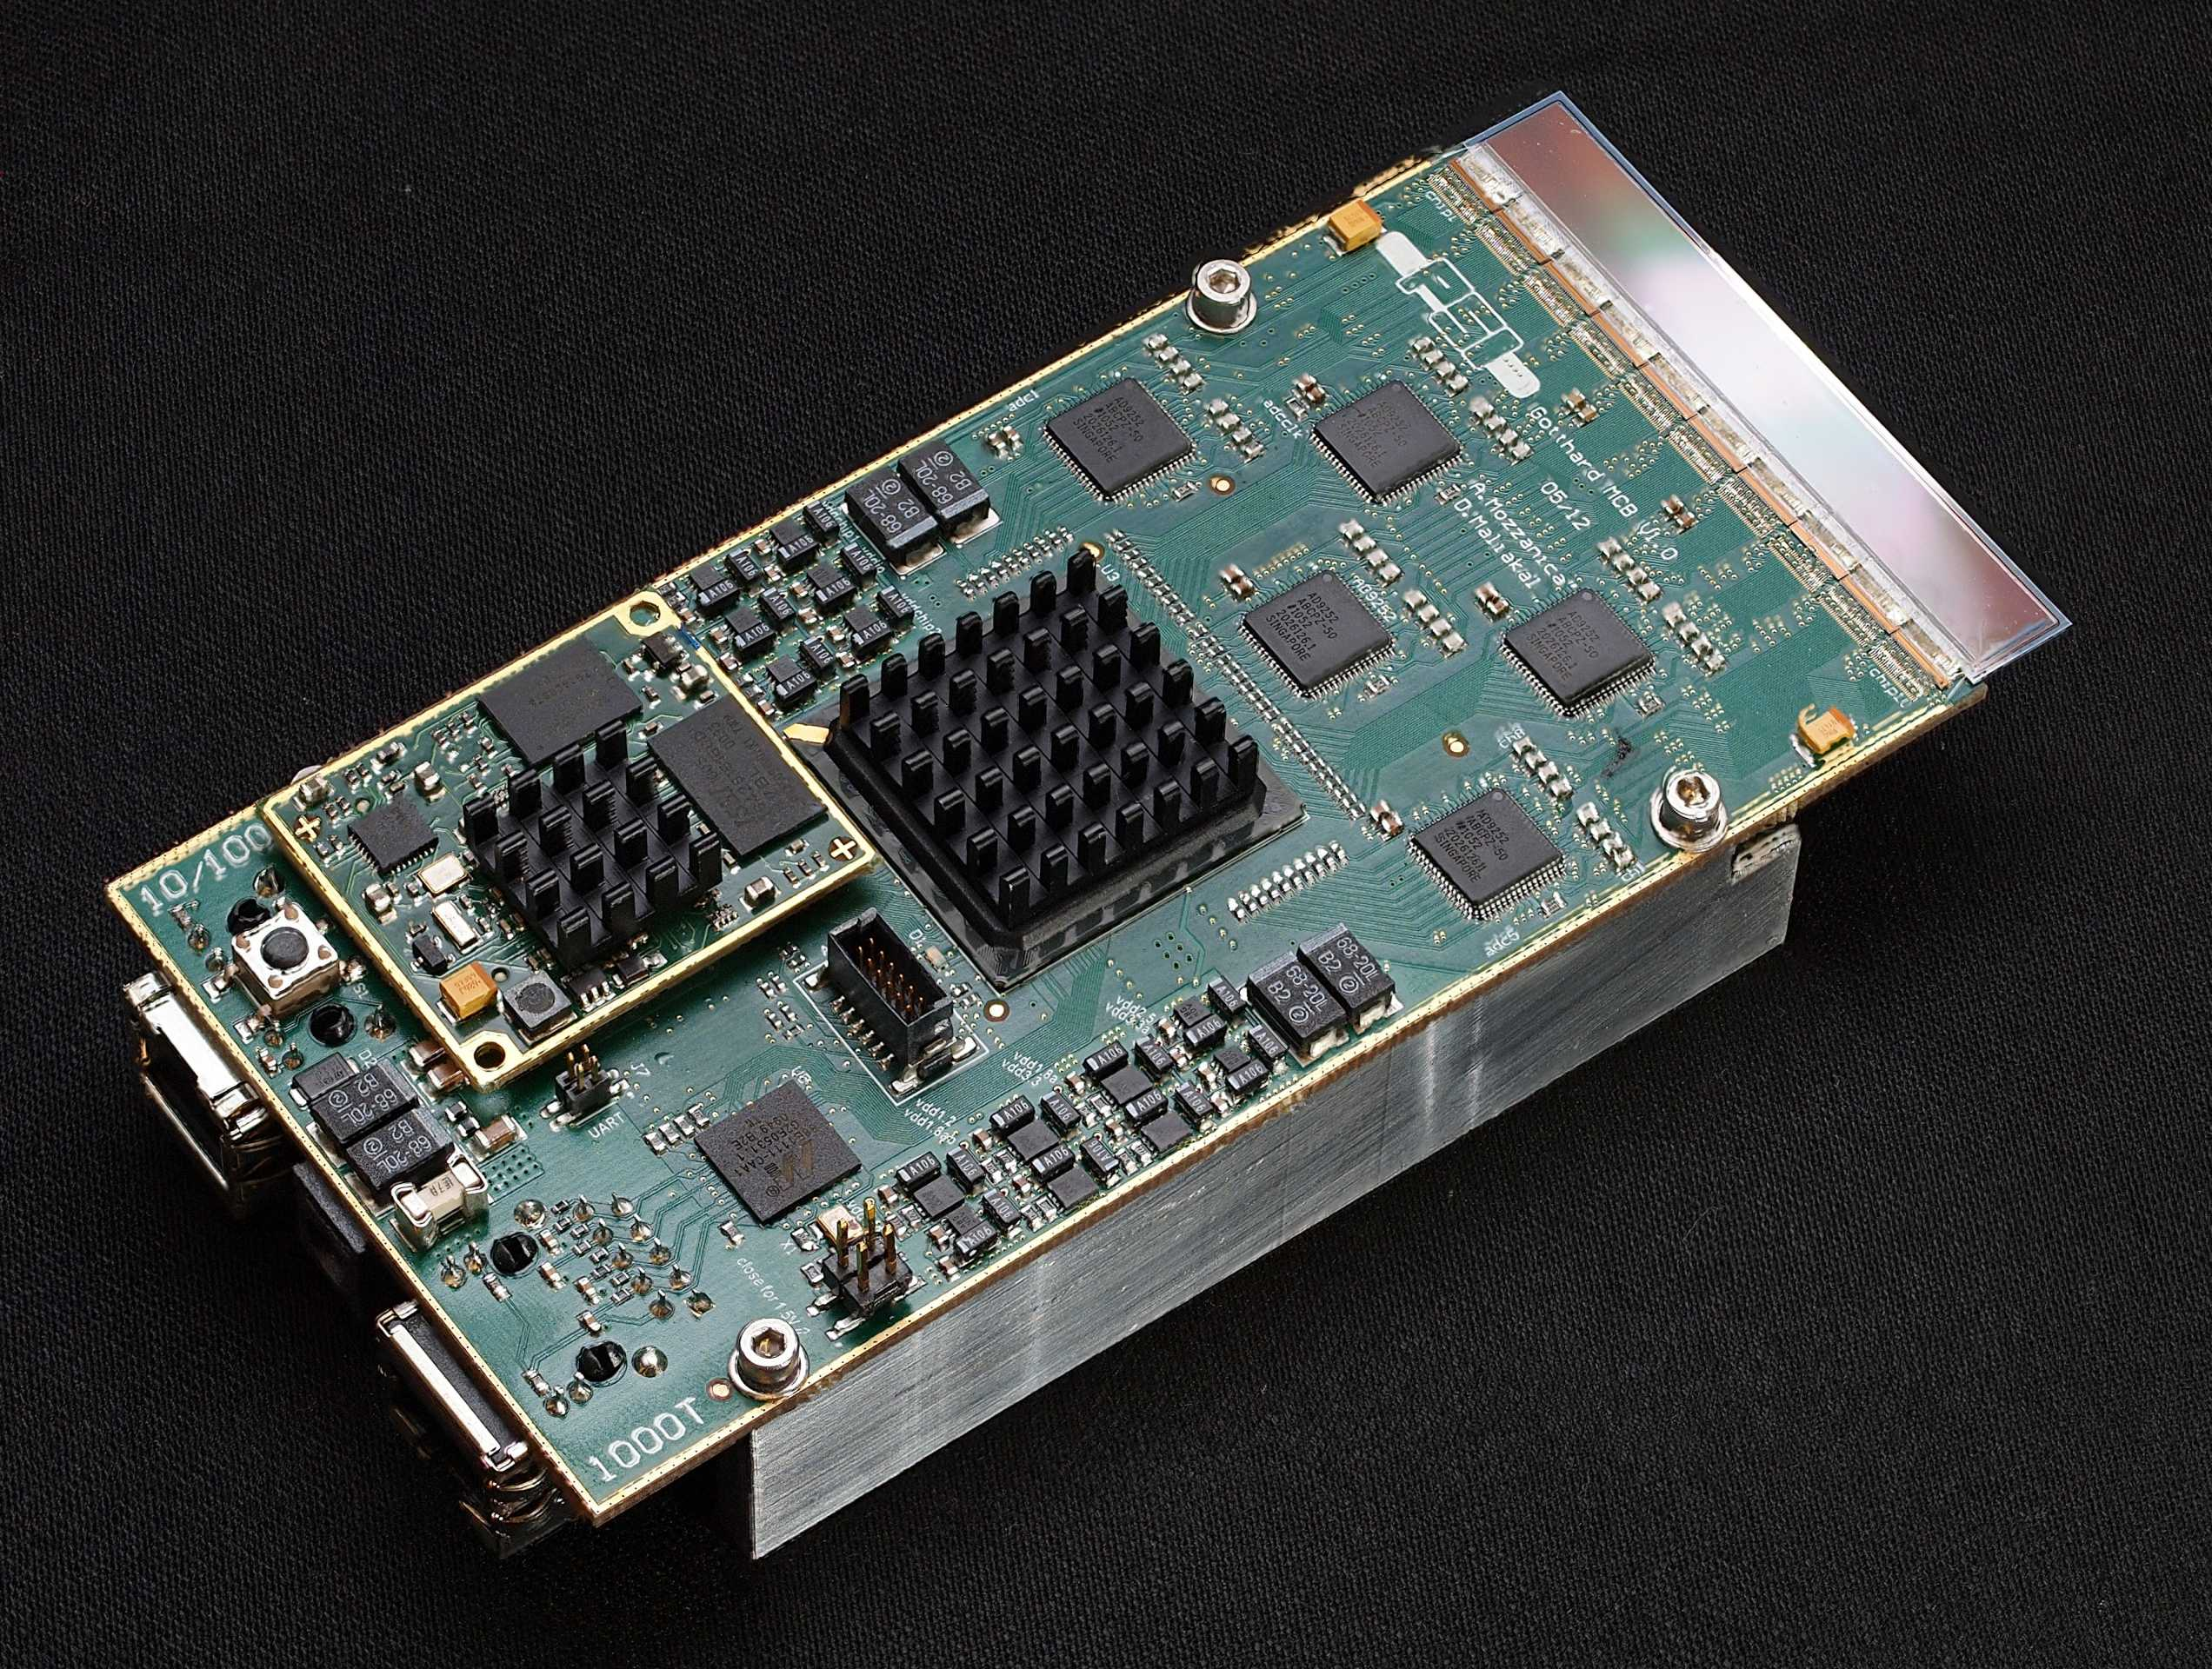
MYTHEN 3 DAQ system
GOTTHARD/JUNGFRAU based readout board
Use same DAQ architecture as all other SLS detectors
  Common control software to facilitate integration at beamlines
    TCP/IP controls
  UDP data streaming
    ~10kByte/frame (worst case)
    1 or 10 Gbit/s data throughput / module
Fully parallel controls and data streaming
  Detector size independent frame rate

Slide 28
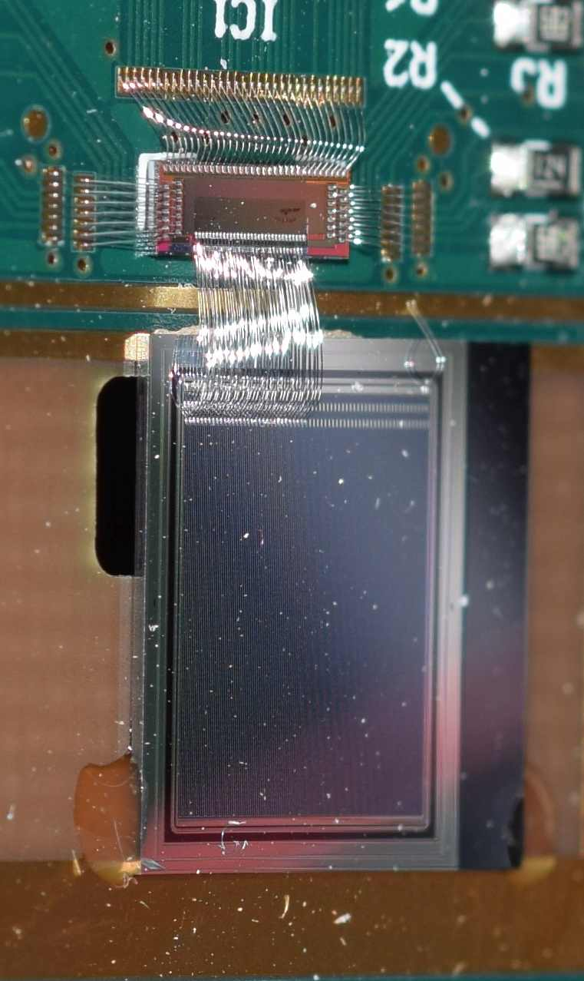
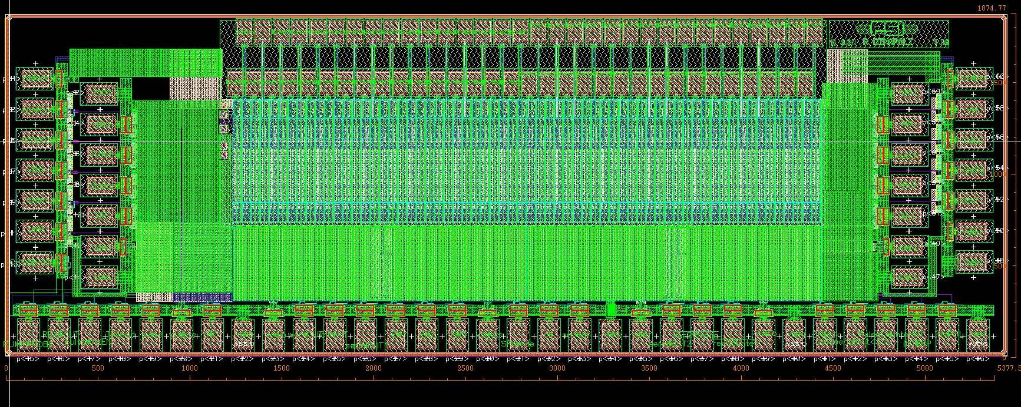
MYTHEN III 0.1 prototype
Two groups of 32 channels with different preamplifier architectures
  Characterize performance
  Test logic and RO
  Debugging for submission of the final chip
ASIC
SENSOR
ASIC, LAYOUT VIEW

Slide 29
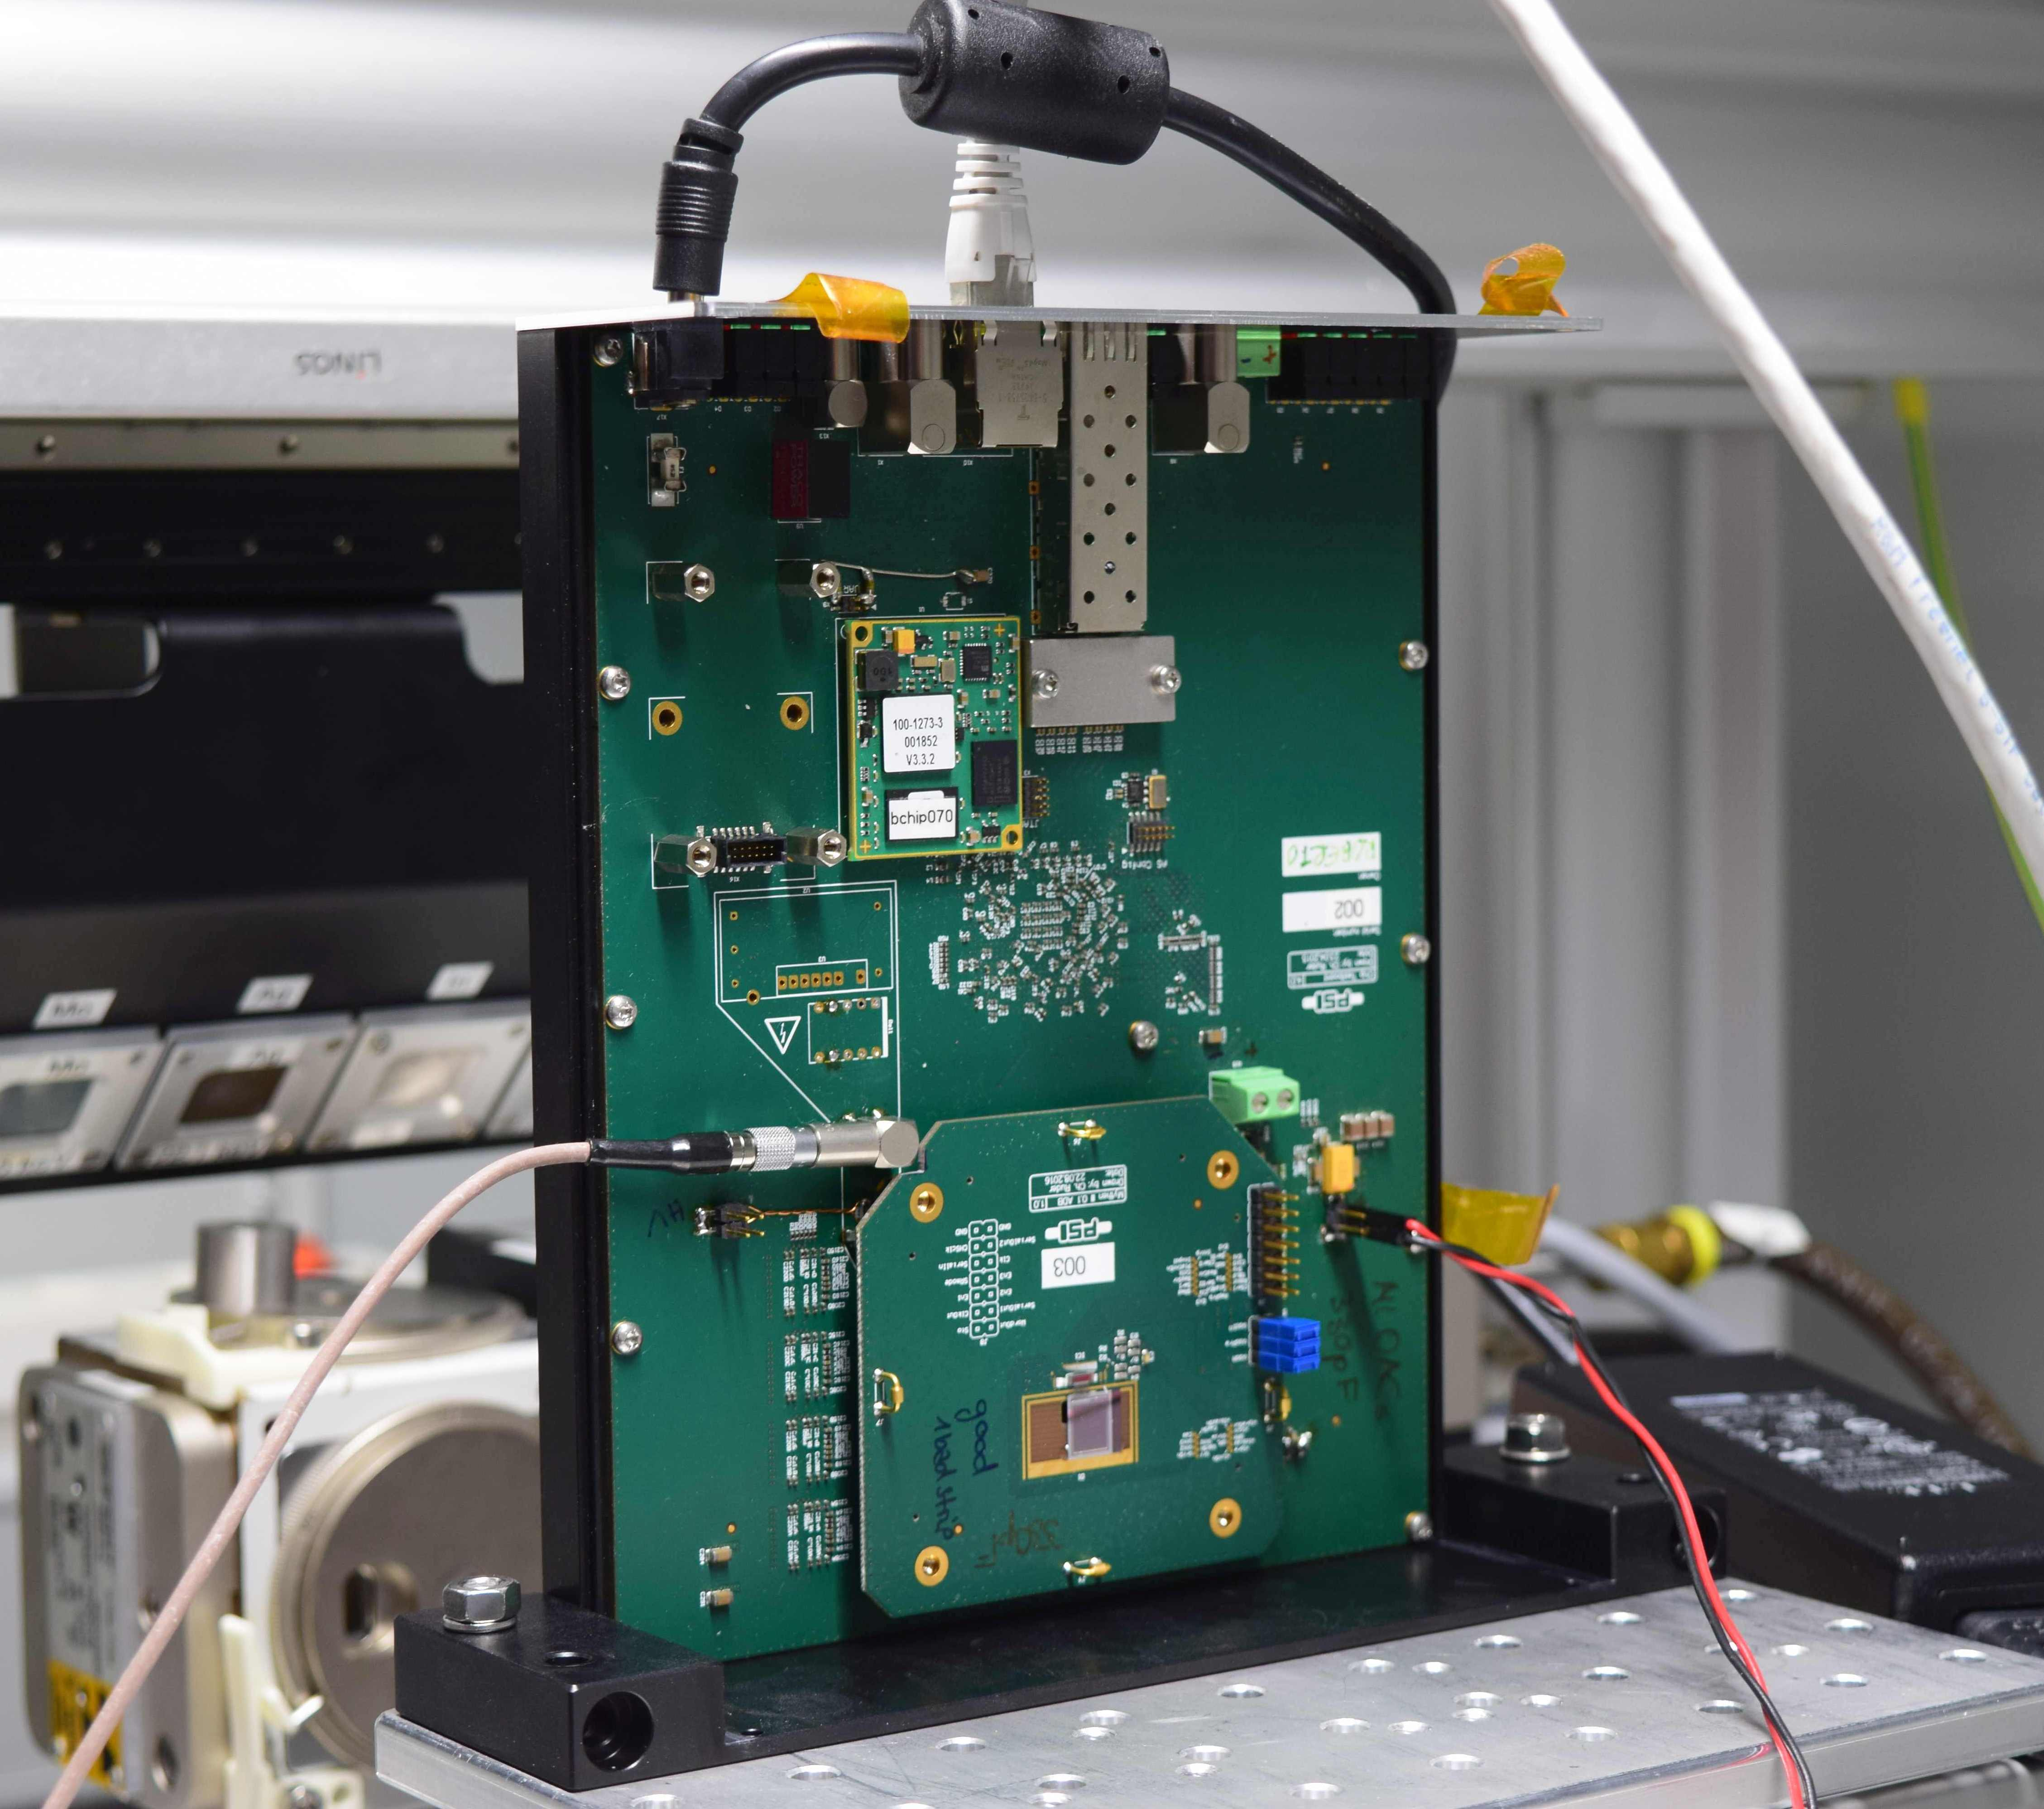
MYTHEN III 0.1 performances
Prototype fully functional
Tested in the X-ray box and at the beamline (SLS and ELETTRA)
Readout/control logic tested up to 100MHz clk
Dead time free operation working
CHIPTEST BOARD

Slide 30
Calibration
Vrf
Vrs
x
x
gain
x
x
x
x
x
x
1. Take threshold scans at different photon energies
Extract the inflection points
Calculate the gain [DACunits/keV]
Repeat procedure for all Vrf-settings

Slide 31
Noise performance
PRELIMINARY
Charge sharing C_{s}
N₀
Noise
Inflection point E_{γ}
  New chiptest board needs to be further debugged!
  Simulations suggest improvements still possible

Slide 32
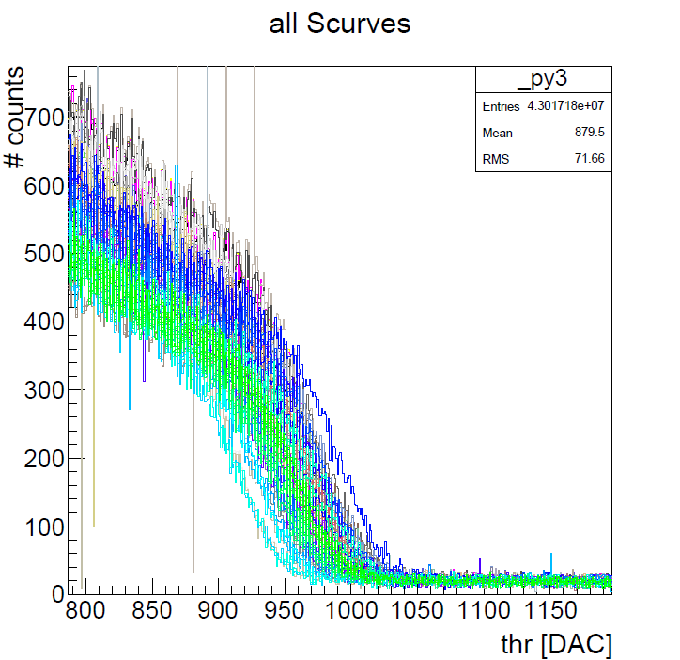
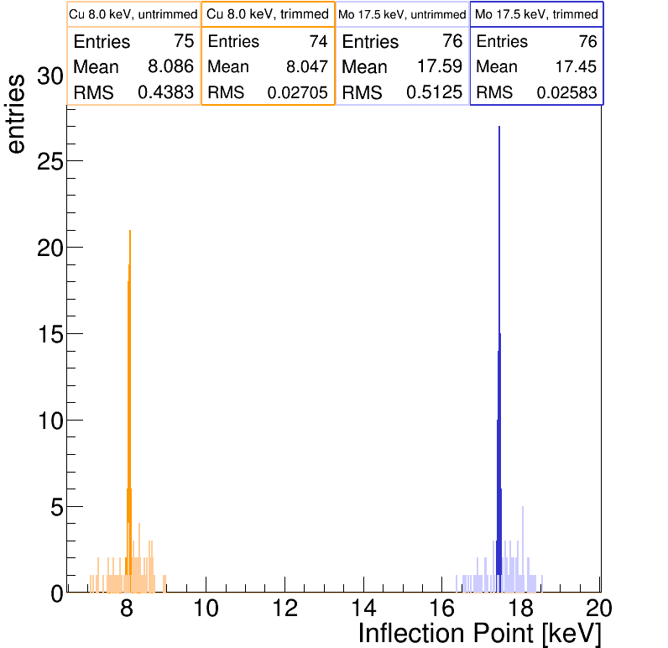
Threshold dispersion
Cu
Untrimmed: 121 e-
Trimmed: 6.5e-
Find inflection points for all channels
Calculate and apply trim bits to reduce dispersion
Mo
Untrimmed: 142 e-
Trimmed: 7.2 e-

Slide 33
Rate capability
1. Plot the measured rate vs the reference rate I₀
Estimate the ideal theoretical rate with a linear fit
Fit the ratio ε of the measured and theoretical rate Φ
to find the dead time τ_{d} (paralyzable counter): ε=exp(-τ_{d}Φ)
158ns
87ns
60ns
40ns
49ns
35ns

Slide 34
Noise vs dead time
PRELIMINARY

Slide 35
Perspectives and conclusions
With respect to previous generation (MYTHEN II):
Lower noise
  Easier choice of energy/threshold
Improved threshold dispersion
  Smaller flat field corrections
Faster readout (>40kHz)
Higher count rates
Three independent counters
  Dead time free
  Pump-probe with multiple gates
  Energy windowing
…and more ideas
Development of MYTHEN3 just started
  First prototype under test
  Final chip end 2017
  Modules end 2018
  Detector system at SLS in 2019

Slide 36
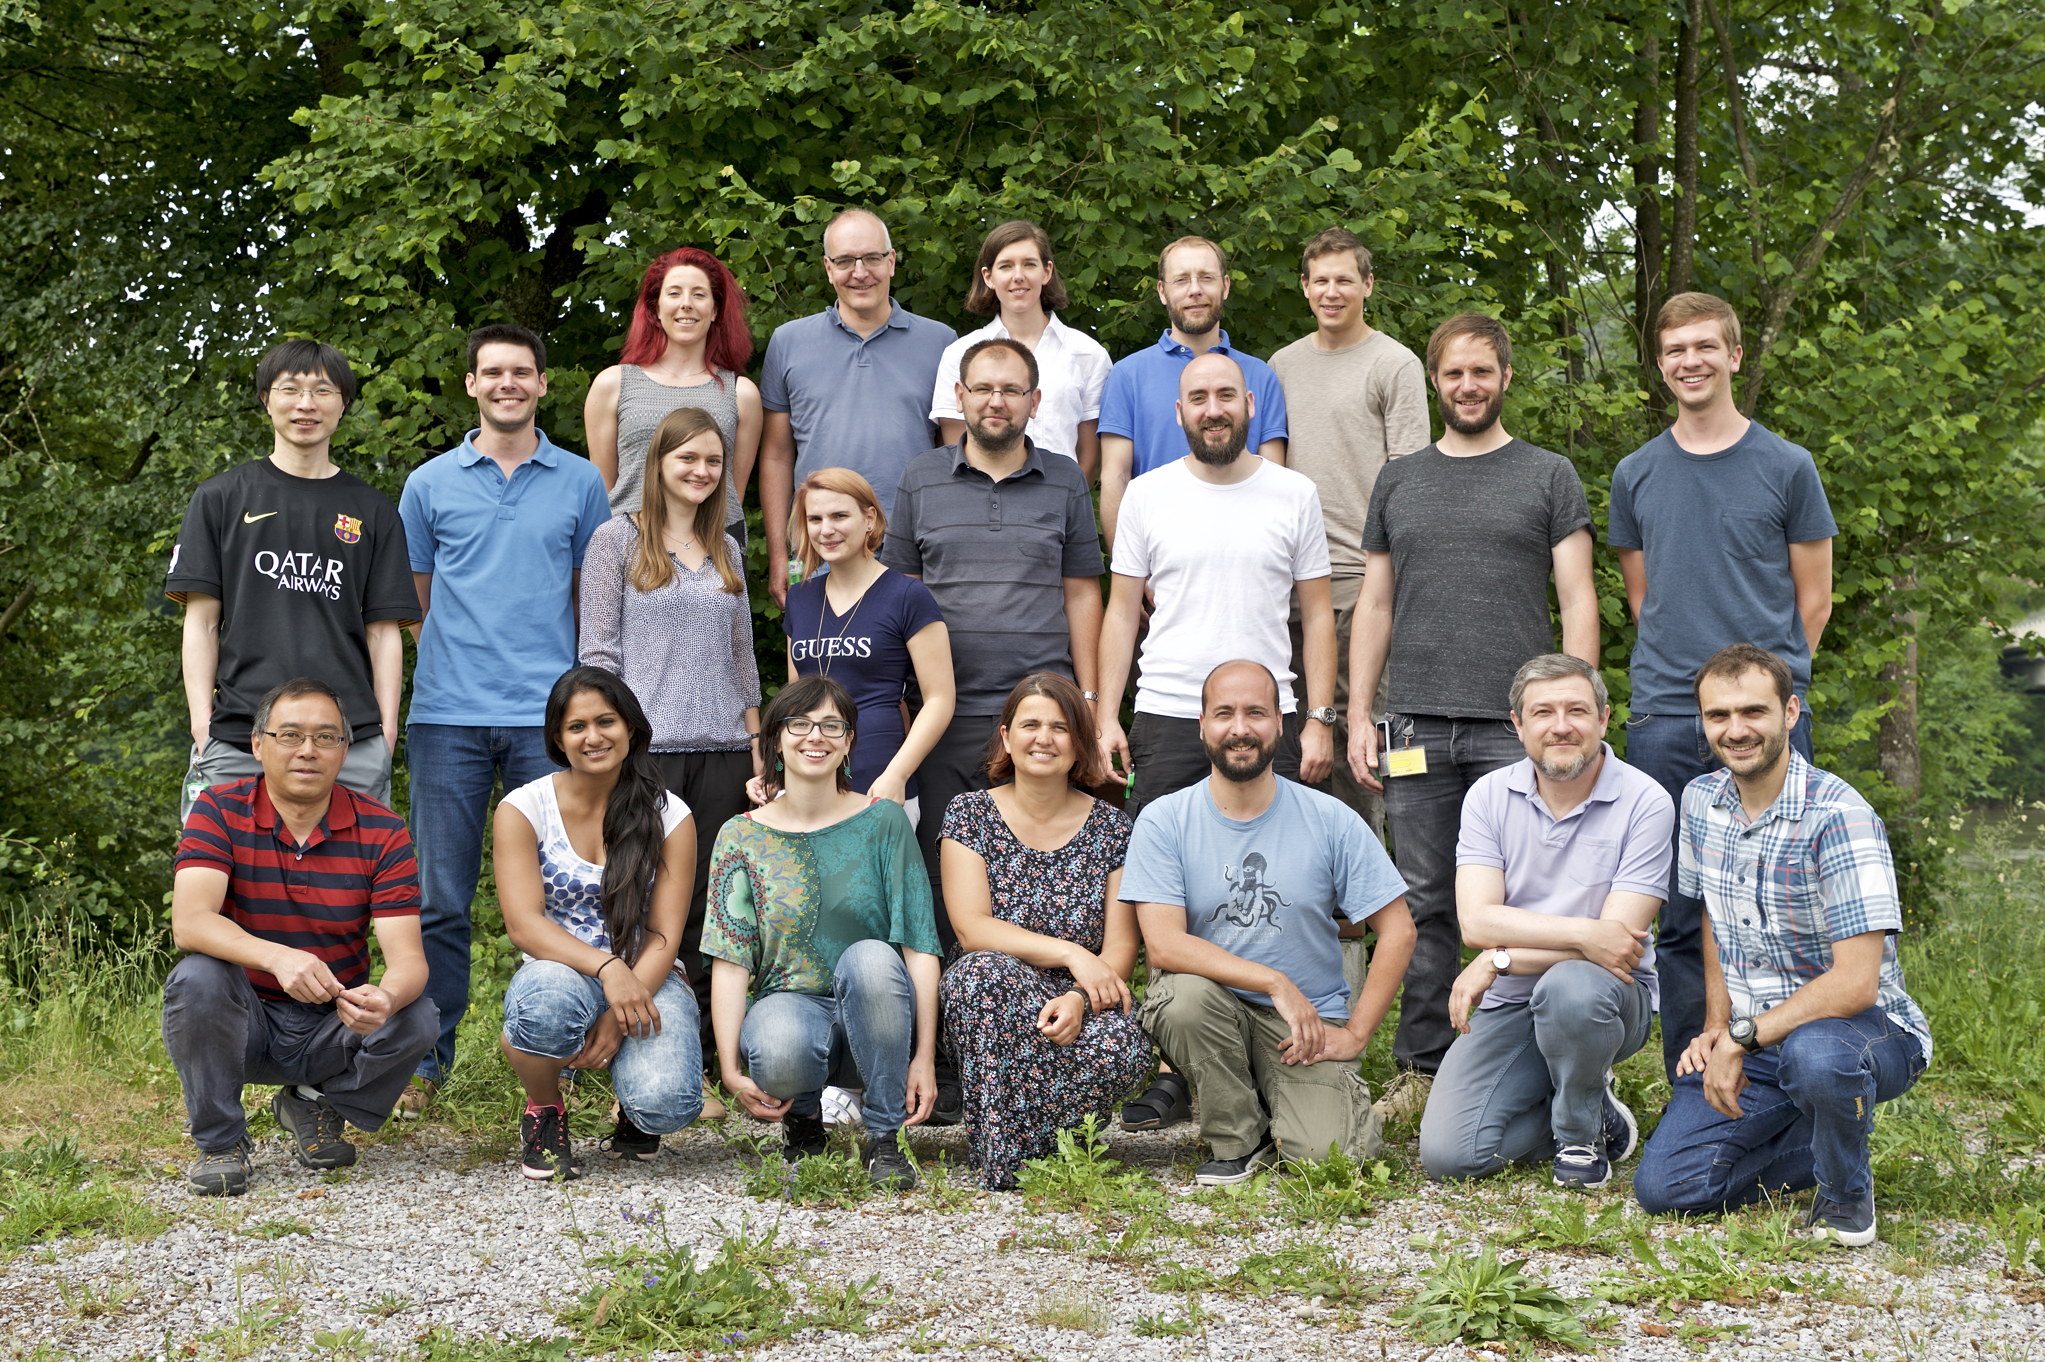
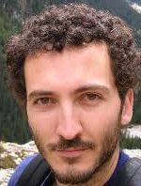

Acknowledgements
MS
beamline
Nicola
Casati
Antonio Cervellino
Back: Marie Ruat, Bernd Schmitt, Sophie Redford, Aldo Mozzanica, Erik Fröjdh.
Middle: Jiaguo Zhang, Carlos Lopez, Marie Andrae, Rebecca Barten, Martin Brueckner, Christian Ruder,
Dominic Greiffenberg, Seraphin Vetter.
Front: Xintian Shi, Dhanya Thattil, Gemma Tinti, Anna Bergamaschi, Marco Ramilli, Roberto Dinapoli, Davide Mezza.

Slide 37
Thank you!
OPEN POSITIONS: https://www.psi.ch/pa/job-opportunities/1525

