Slide 1




Characterisation of GaAs:Cr Detector Systems for High Flux X-Ray Imaging
M. C. Veale*, B. Cline, J. Coughlan, M. Hart, T. Nicholls,
A. Schneider, P. Seller, G. Carini, P. Hart, I. Horswell,
E. Gimenez-Navarro, I. Pape, K. Sawhney, N. Tartoni,
A. D. Lozinskaya, V. A. Novikov, O. P. Tolbanov, A. Tyazhev and A. N. Zarubin

Slide 2


Slide 3
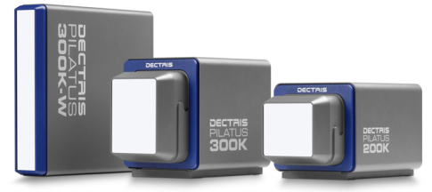
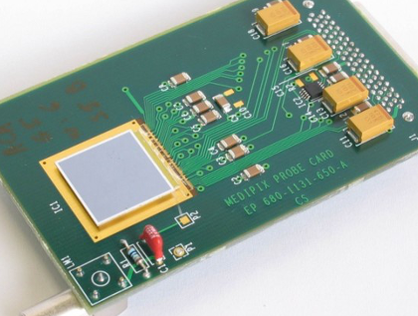

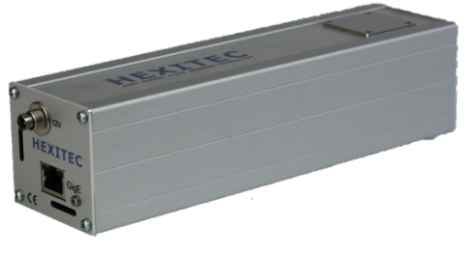
Synchrotron Light Sources
Pilatus
Medipix
HEXITEC

Slide 4
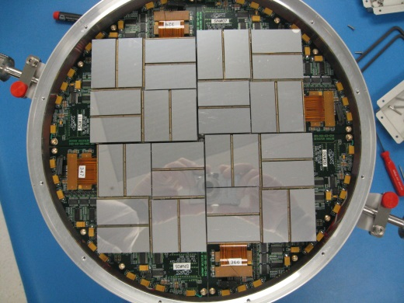

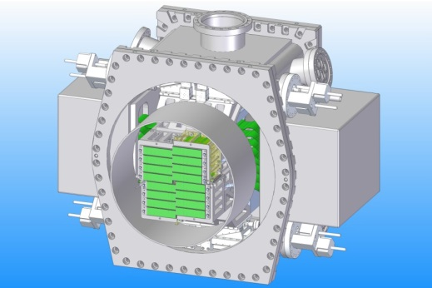

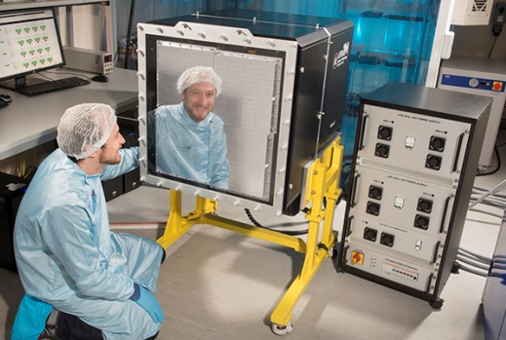
Free Electon Lasers
CSPAD
AGIPD
LPD

Slide 5
Free Electon Lasers
CSPAD
Where Next?
AGIPD
LPD

Slide 6




FEL Upgrades
LCLS II < 30 keV
MaRIE > 40 keV
Matter-Radiation Interaction in Extremes

Slide 7
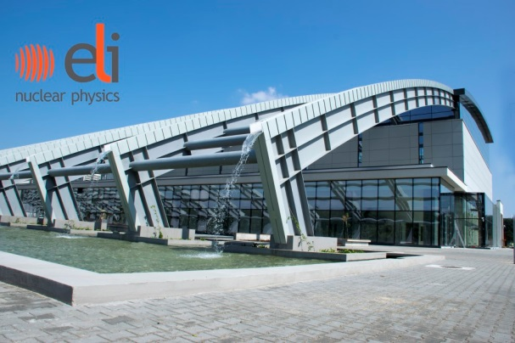
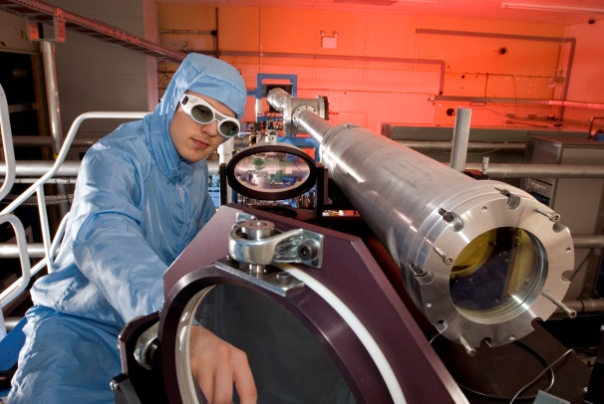
Laser-Driven Radiation Sources
ELI-NP (Romania)
γ-rays 0.1 -20 MeV
CLF (UK) & Others
Exotic Beams (γ, n, e⁻, p⁺…)

Slide 8
Laser-Driven Radiation Sources
ELI-NP (Romania)
γ-rays 0.1 -20 MeV
What About Detectors??
CLF (UK) & Others
Exotic Beams (γ, n, e⁻, p⁺…)

Slide 9
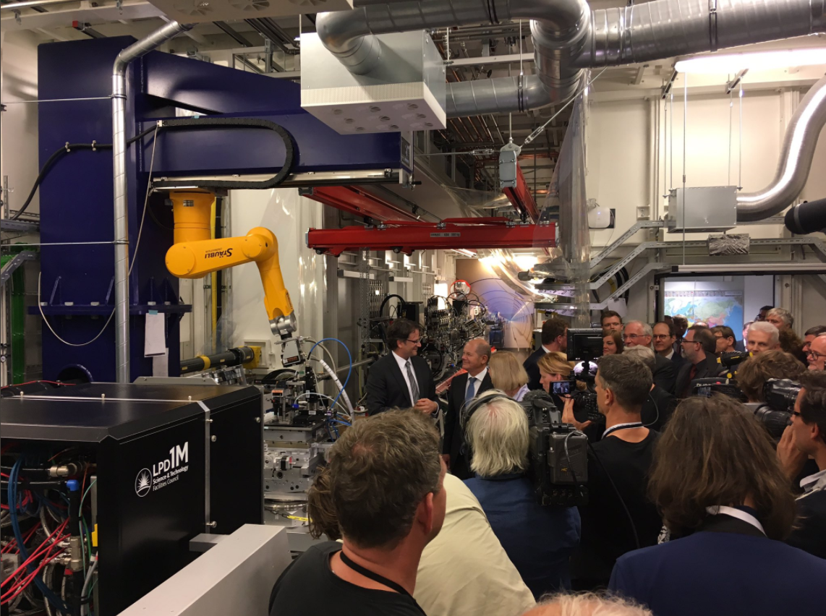
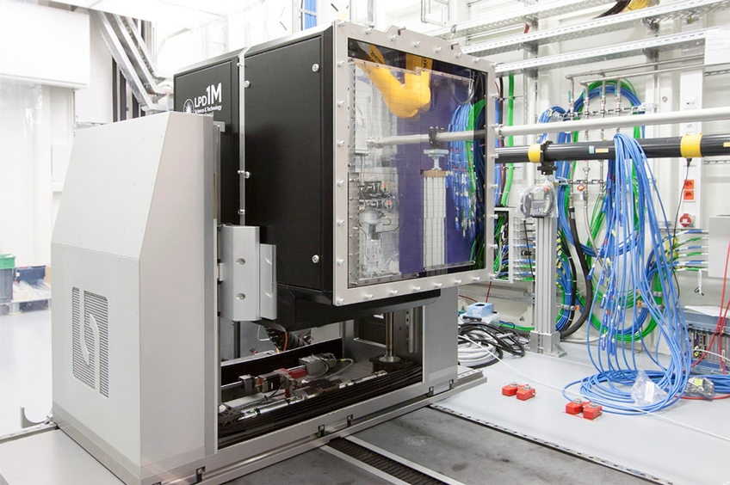
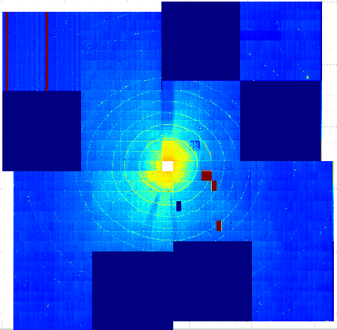
The Large Pixel Detector

Slide 10
10%
Transmission

Slide 11
75%
Transmission

Slide 12
GaAs:Cr Testing @ STFC
GaAs:Cr HEXITEC.
E < 40 keV FWHM is similar to CdTe.

Slide 13
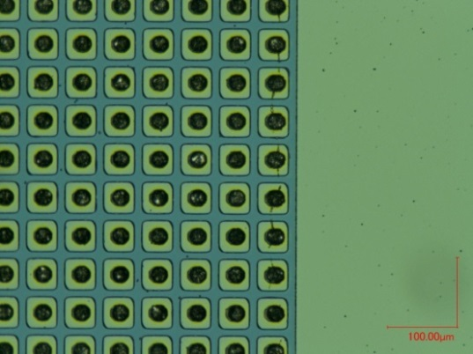
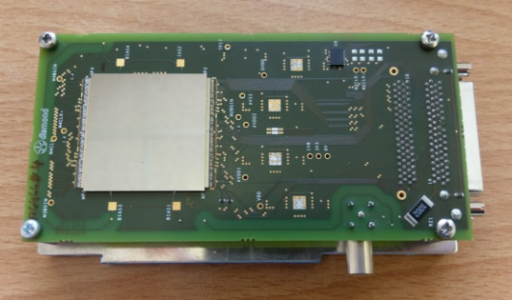
GaAs:Cr Testing @ STFC
GaAs:Cr HEXITEC.
E < 40 keV FWHM is similar to CdTe.
STFC Assembled Medipix detectors.
Fine-pitch indium bonding @ STFC.
Good imaging performance.

Slide 14
GaAs:Cr Testing @ STFC
GaAs:Cr HEXITEC.
E < 40 keV FWHM is similar to CdTe.
STFC Assembled Medipix detectors.
Fine-pitch indium bonding @ STFC.
Good imaging performance.
High Flux Performance?

Slide 15
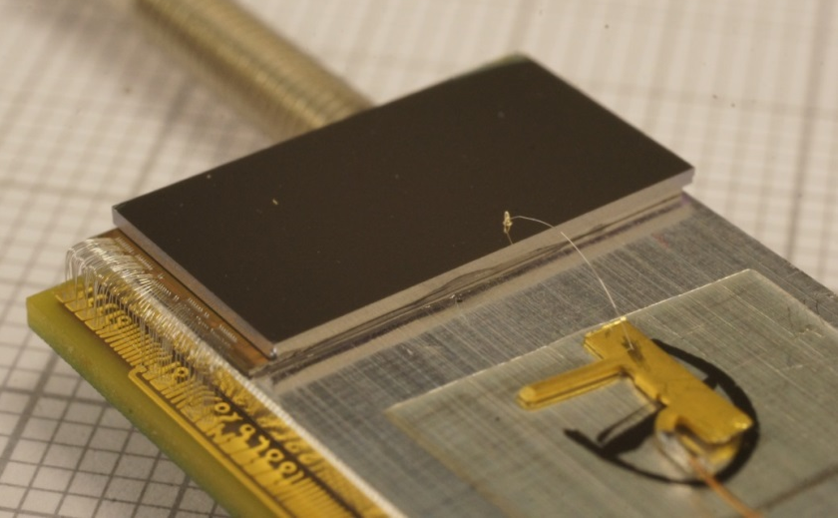
GaAs:Cr LPD Modules
Fabrication of GaAs:Cr LPD sensors by TSU.
Direct attach to LPD ASIC.
X Pixel Pitch = 400 μm
Y Pixel Pitch = 250 μm
500 μm thick.
-1000 V (electron readout)
Readout using an LPD super-module DAQ.

Slide 16
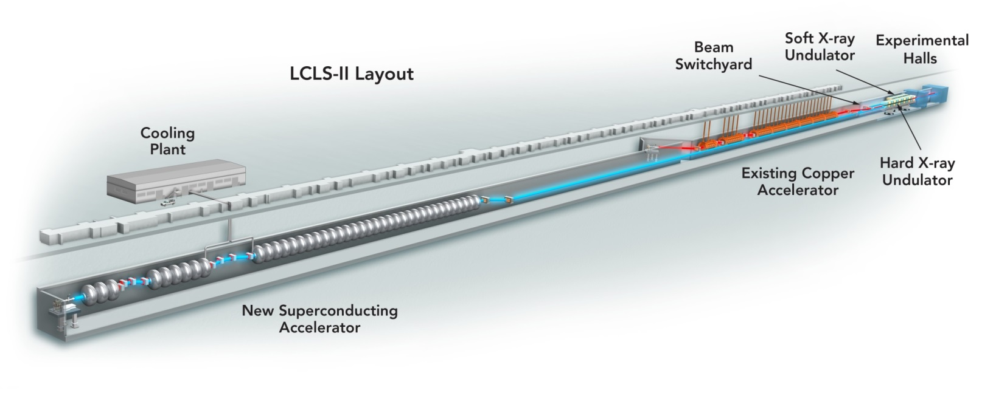
The FEL Setup
GaAs:Cr sensors tested at the LCLS FEL (USA)
Experiment on MFX Dec ‘16.
500μm thick Si & GaAs:Cr LPD sensors.
Compared to 500μm CSPAD.
First known test of high-Z detectors at a FEL.

Slide 17
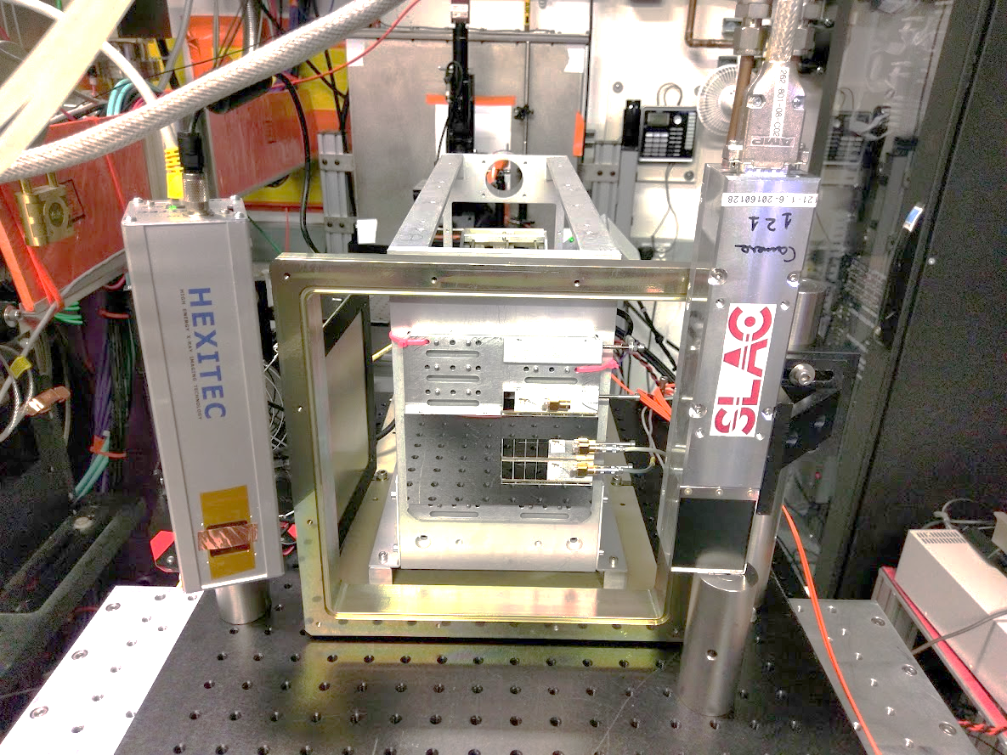
GaAs:Cr LPD

Slide 18
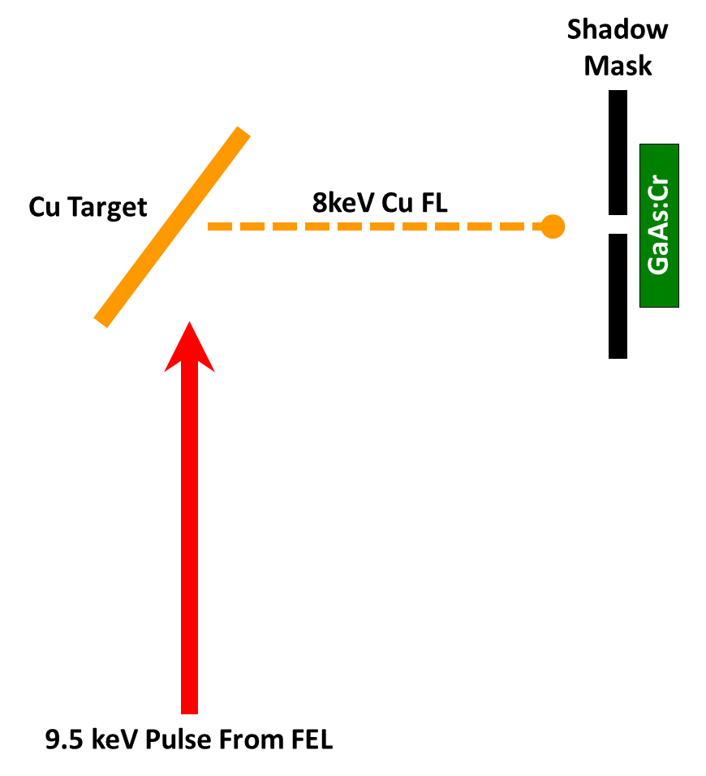
Detector Uniformity
Beam energy 9.5 keV.
Repetition Rate = 30 Hz
Cu (8 keV) flat field at 90º.
Gain = x100 5pF (Highest)
LPD Frame Rate = 4.5 MHz
The challenge: no two pulses are alike! (+/- 100%)

Slide 19
Si: Intensity Histograms

Slide 20
Si Flux Calculation
Si LPD Calibration = 0.425 keV ADU⁻¹
Average Energy Per Pixel = 303 keV
Average Flux per Pulse = 1.2 MeV mm⁻²

Slide 21

GaAs:Cr Flux Calculation
GaAs:Cr LPD Calibration = 0.507 keV ADU⁻¹
Average Energy Per Pixel = 140 keV
Average Flux per Pulse = 1.4 MeV mm⁻²
1.2 MeV mm⁻² (Si)

Slide 22
Detector Material | Flux (keV mm⁻²) | FWHM (%)
Si | 1221 | 49
GaAs:Cr | 1405 | 64
GaAs:Cr greater pixel to pixel variation.

Slide 23
Comparison with CSPAD

Slide 25
n x n | Area (mm) | r²
1 x 1 | 0.25 x 0.40 | 0.15
2 x 2 | 0.50 x 0.80 | 0.58
4 x 4 | 1.00 x 1.60 | 0.80

Slide 26
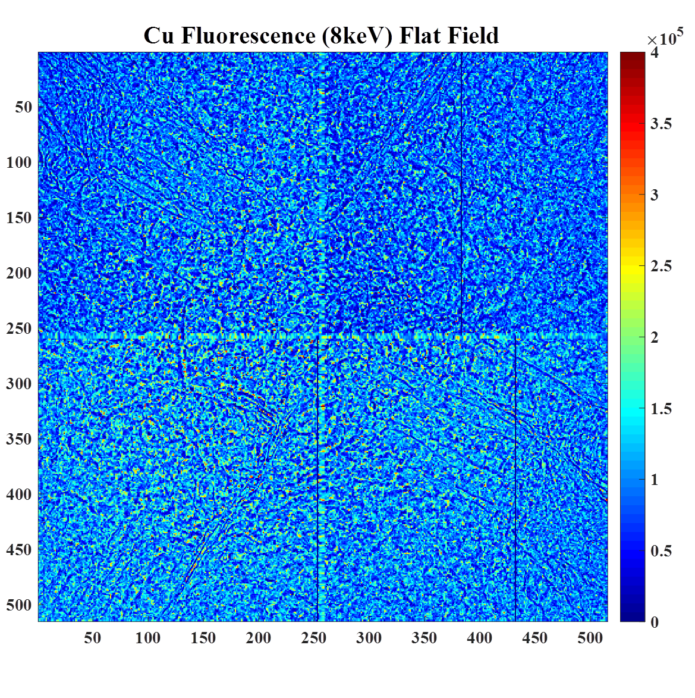
n x n | Area (mm) | r²
1 x 1 | 0.25 x 0.40 | 0.15
2 x 2 | 0.50 x 0.80 | 0.58
4 x 4 | 1.00 x 1.60 | 0.80
GaAs:Cr Medipix

Slide 27
Direct Irradiation
GaAs:Cr
Flat field measurements still at low flux ~ 10¹ ph.
Direct irradiation of the sensor.
Flux per pulse ~ 1 x 10¹¹.
Energy per pulse ~ 1 PeV (0.2 mJ).
Attenuation of beam to avoid ablation of sensors!
Attenuator
9.5 keV X-Rays

Slide 28
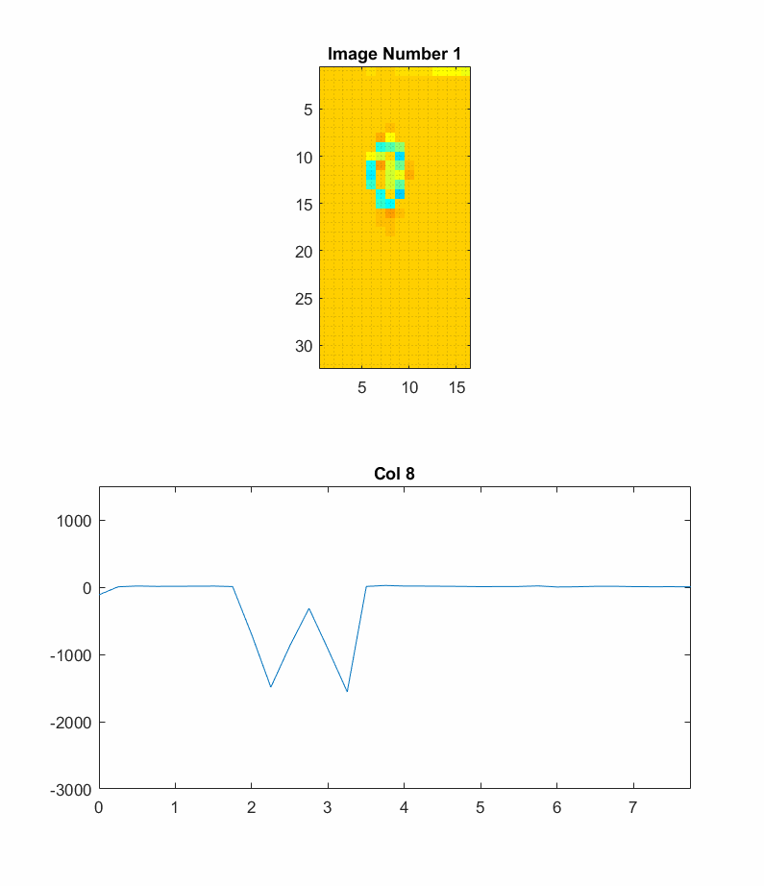
4.5 MHz Imaging
Low gain mode (5pF x1)
Clear intensity variations.
Intensity (ADU)
~ 1.5 mm
Y (mm)

Slide 29
Highest intensity signals show “positive” signals.
Modification and collapse of electric field.
Dark image correction fails.

Slide 30
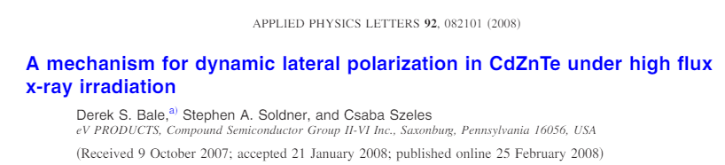
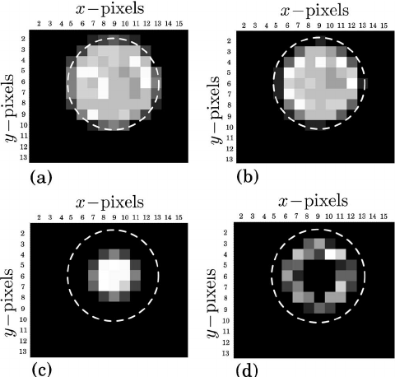
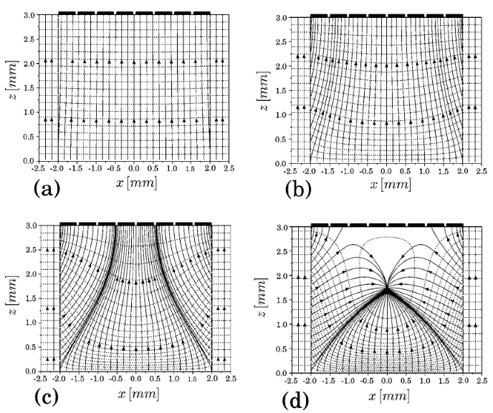
Cause = ~ 1 ns hole lifetime

Slide 31
CdZnTe
GaAs:Cr
What Flux???

Slide 32
Direct Irradiation of Si Sensors

Slide 33
Direct Irradiation of Si Sensors
Low gain mode.
~ 350 keV ADU⁻¹
550 – 750 MeV per pixel.
~ 3 GeV mm⁻² per pulse.
~ 250 MeV per GaAs:Cr pixel.

Slide 34
Conclusions
Development of extreme flux and extreme energy facilities.
These next generation facilities are pushing detector limits!
Technologies beyond Si needed…

Slide 35

Conclusions
Development of extreme flux and extreme energy facilities.
These next generation facilities are pushing detector limits!
Technologies beyond Si needed…
GaAs:Cr is far from perfect
Pixel to pixel variations. Polarisation @ GeV mm⁻²
High-Flux CdZnTe an alternative?
B. Thomas Poster [102]

Slide 36
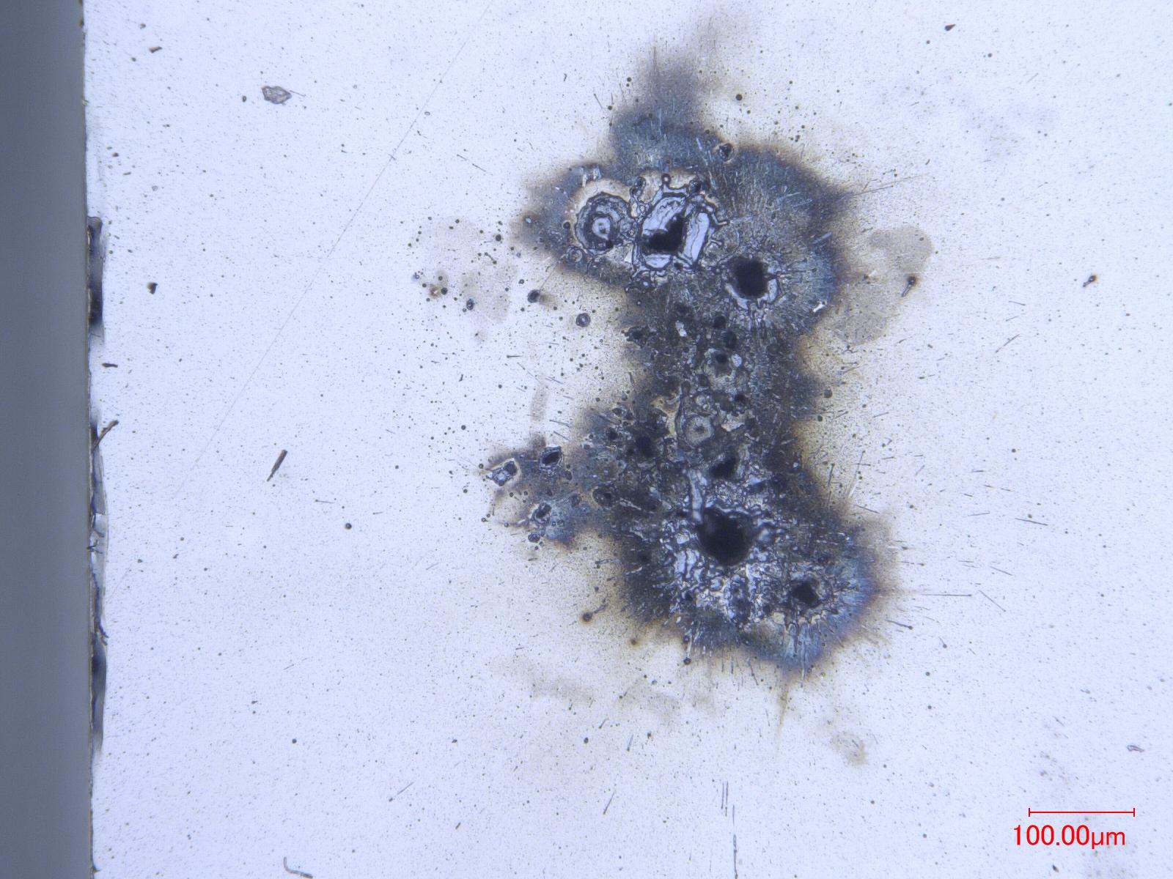
FEL “Micro-Structuring” of GaAs:Cr
*1 PeV pulses directly on to detector

Slide 37

Any Questions?

