Slide 1

Trap Pumping for Euclid
Identifying radiation induced traps in-orbit
Centre for Electronic Imaging
Jesper Skottfelt
David Hall, Ben Dryer, Nathan Bush, Julia Campa, Andrew Holland
Position Sensitive Detectors 11, Open University, 5th September 2017

Slide 2
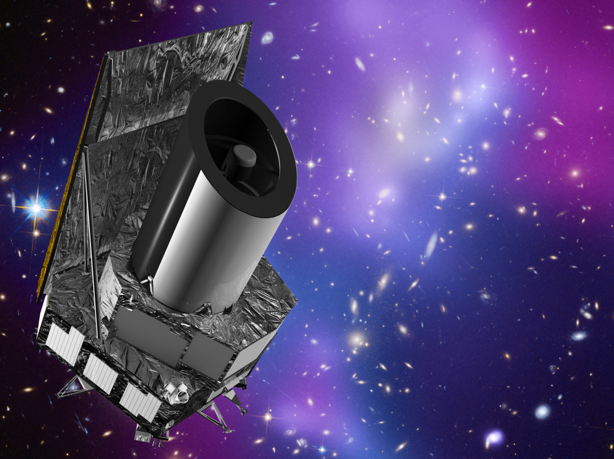
Euclid
ESA M2 mission
  ‘Mapping the Dark Universe’
  Dark Matter and Dark Energy
  Two instruments (VIS and NIR)
VIS instrument (weak lensing)
  Measure shapes of galaxies of large part of the sky down to R~24.5
  Use these data to infer Dark Matter distribution
  Large focal plane
    36 CCDs (4k x 4k)
    Over half billion pixels
    0.01 arcsec pixel scale
    0.5 deg² Field of View

Slide 3
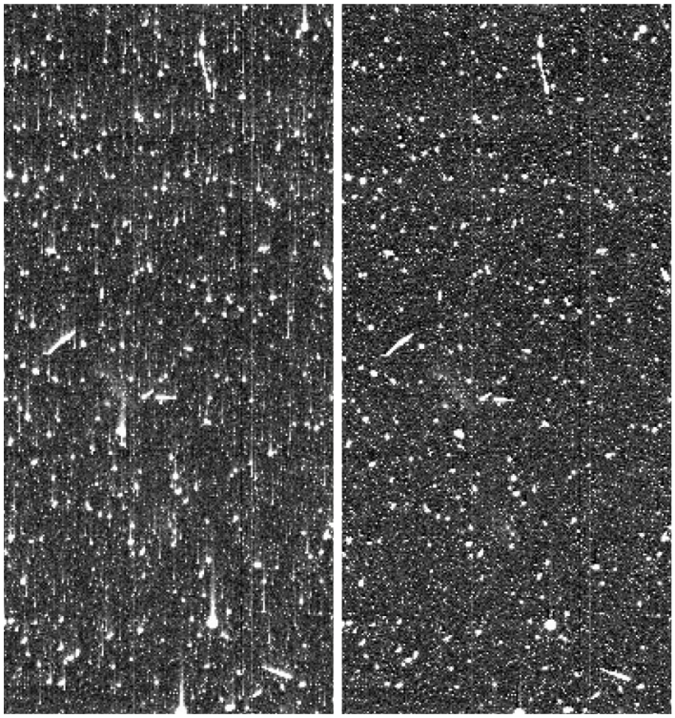
Radiation damage
High energetic particles from the Sun can damage the silicon lattice in the CCD
  Creates defects
These defects (or traps) can capture electrons and release them later in time
  Leads to smearing of the data
For Euclid radiation damage over 6 year mission will be major issue
  High level of correction is needed
  Requires improved knowledge of trap species and parameters
Trap pumping method can identify and characterise single defects (or traps)
Trap pumping will be used in-orbit for Euclid
Before Correction
After Correction
From: Massey et al. (2010)

Slide 4
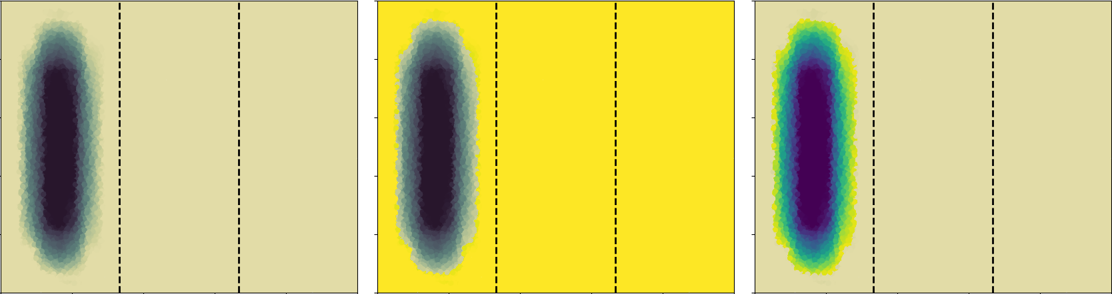
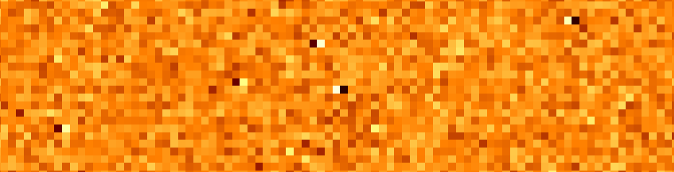

Trap pumping theory
Trap pumping works by clocking charge back and forth between phases
If the phase time ($t_{ph}$) resonates with the emission time constant ($τ_{e}$) of the trap
  Charge will be effectively shuffled from one pixel to the other
Repeating this cycle a number of times ($N$) will result in a dipole for each trap
Pixel
Φ1
Φ2
Φ3
Φ1
Φ2
Φ3
Φ1
Φ2
Φ3

Slide 5
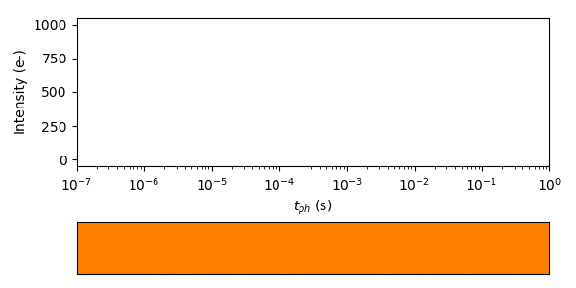
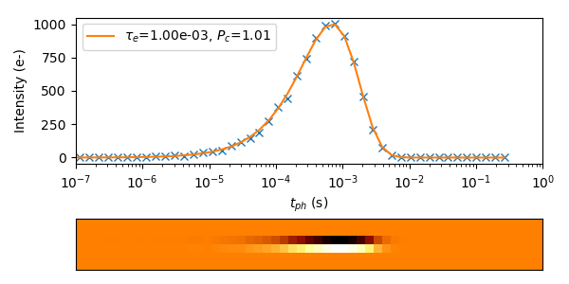
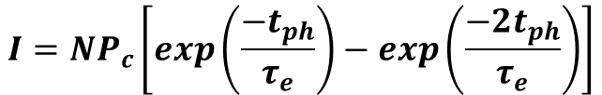
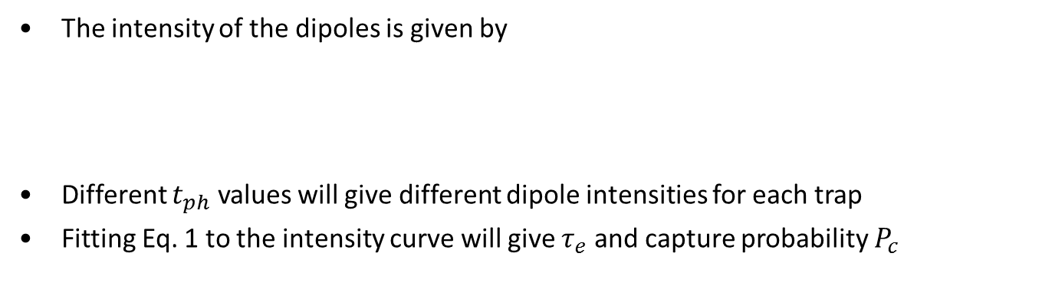
Trap pumping theory
The intensity of the dipoles is given by
Different $t_{ph}$ values will give different dipole intensities for each trap
Fitting Eq. 1 to the intensity curve will give $τ_{e}$ and capture probability $P_{c}$
$$I=NP_{c}\left[exp\left(\frac{−t_{ph}}{τ_{e}}\right)−exp\left(\frac{−2t_{ph}}{τ_{e}}\right)\right]$$
(Eq. 1)

Slide 6
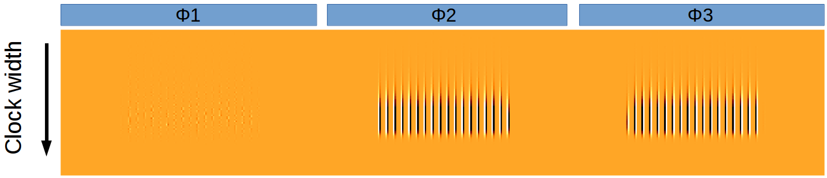
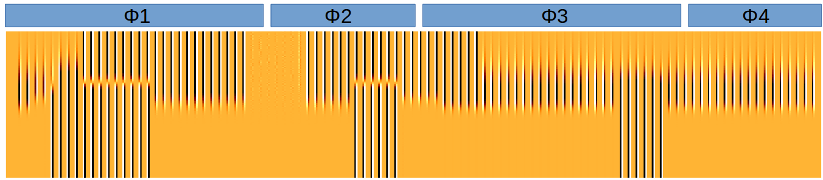


Simulating trap positions
Dipole intensities also depends on position of the trap in the pixel, signal size, clocking scheme, pixel geometry, etc.
All these parameters can be simulated using the CEI CCD Charge Transfer Model (C3TM) developed for simulating CTI effects in CCDs (Skottfelt et al. 2017)
Simulating 3 phase device with standard clocking scheme
  Single trap under $Φ3$
  Single trap under $Φ2$
  Single trap under $Φ1$
Direction and shape of dipole can thus give subpixel information
Simulating all subpixel positions to get map of dipoles for traps across the pixel
Comes in handy in more complex situations
Pixel
$t_{ph}$

Slide 7
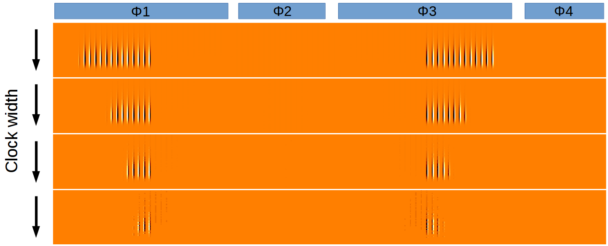
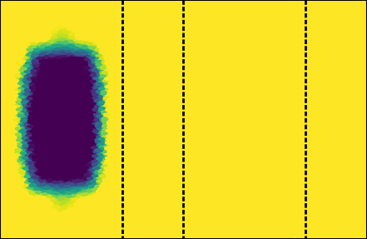
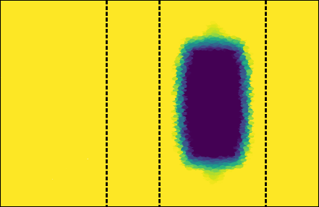
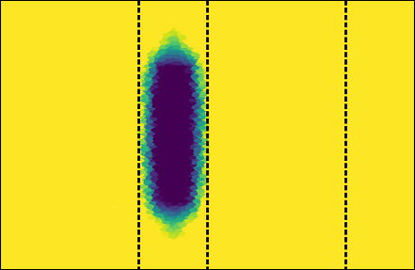
Sub-pixel clocking scheme
Euclid CCD273 device has 4 phases and alternative clocking scheme thus needed
Number of possible clocking schemes simulated and tested in lab
Sub-pixel pumping scheme (1-2-3-2-1) chosen because of its simplicity
Small part of pixel probed, but low risk of dipoles cancelling
Direction of dipole can give sub-pixel and sub-phase positions
100k e⁻
10k e⁻
1k e⁻
100 e⁻

Slide 8
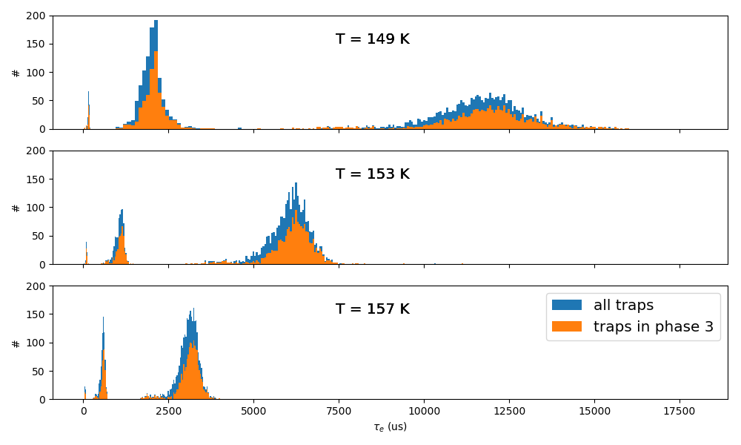

Trap pumping analysis
CCD273 devices tested at OU as part of irradiation campaign for Euclid
This shows data from pre-irradiated devices (1600 e⁻)
3 peaks
$τ_{e}$ scales with temperature

Slide 9
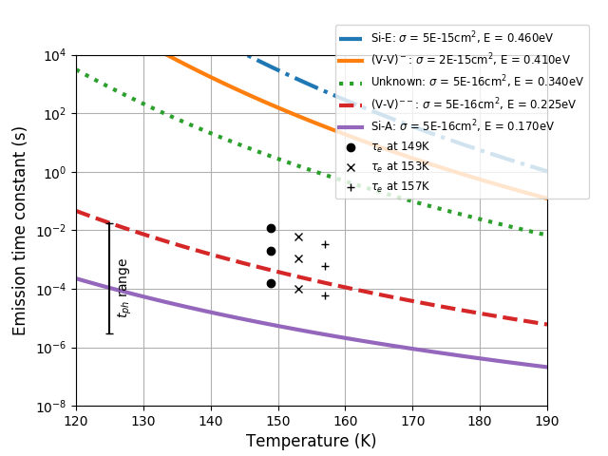

Trap species
Plotting the peaks found at the three different temperatures
$τ_{e}$ peaks matches defects from Phosphorus and Boron (used as dopants)
mixed with Carbon and Oxygen impurities
  C_{i}P_{s} (0.23, 0.26 eV)
  B_{i}O_{i} (0.24 - 0.27 eV)
(Pichler, 2004)
Results similar to the
the p-channel study
(Talk by Ben Dryer)

Slide 10
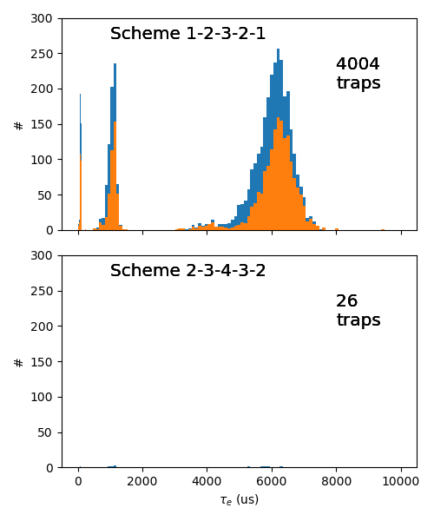
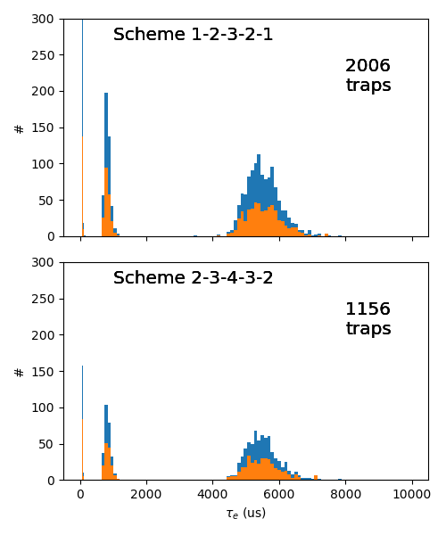
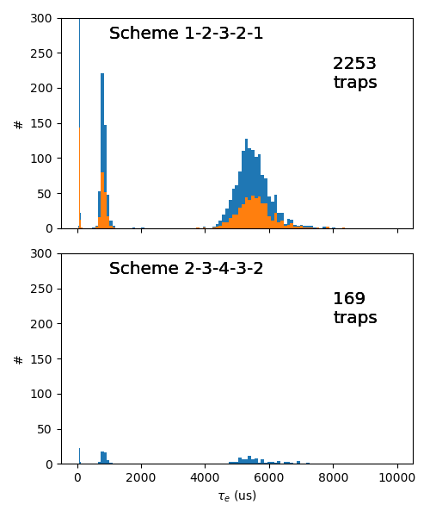
Electrode widths
Lab test show that when pumping 2-3-4-3-2 almost no traps are detected
Possible explanation for this is that electrode widths are slightly skewed
Simulation of TP with different widths for Φ1 and Φ3 gives similar effect
Infer knowledge about the electrode widths
Φ1 = 4 µm
Φ2 = 2 µm
Φ3 = 4 µm
Φ4 = 2 µm
Φ1 = 4.5 µm
Φ2 = 2 µm
Φ3 = 3.5 µm
Φ4 = 2 µm
Simulated data
Lab data
Φ1 = 4 µm, Φ3 = 4 µm
Φ1 = 4.5 µm, Φ3 = 3.5 µm

Slide 11

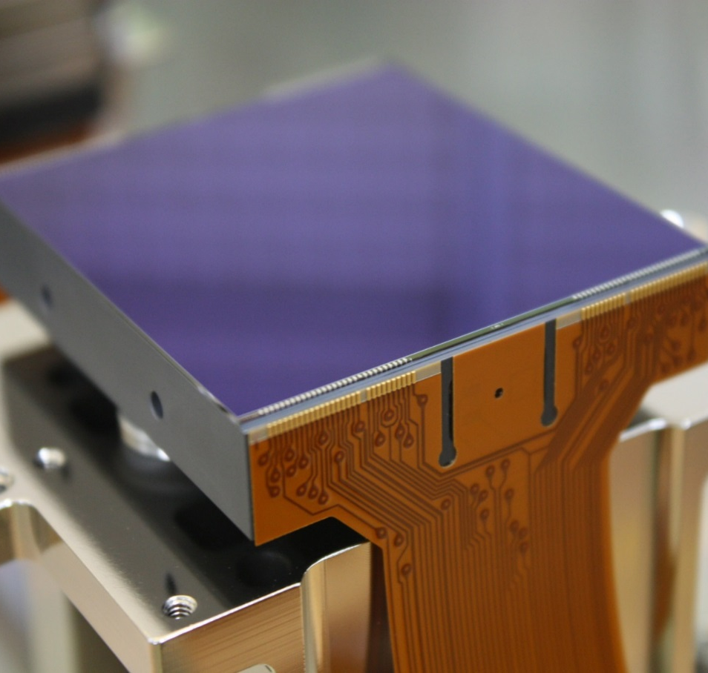


Summary
Weak lensing experiment on Euclid mission requires high resolution imaging
Radiation damage degrades the data and therefore needs to be corrected for
Trap pumping method can identify and characterise single traps in silicon lattice
  Will be used by Euclid in orbit
Trap pumping scheme chosen for Euclid
  Gives subpixel and even sub-phase positional information
  Reveals defects from dopants and
  impurities (pre-irradiated devices)
Information about electrode width can be
inferred from the by comparing lab and
simulated trap pumping data

Slide 12

Information from LOC
The conference BBQ this evening will still take place, but it will be moved indoor if the weather does not improve

