Slide 1
Cadmium Telluride Spectroscopic X-Ray Imaging Detectors
M. C. Veale^{1*}, S. J. Bell^{1,2}, D. D. Duarte^{1,2}, A. Schneider¹, P. Seller¹ and M. D. Wilson¹
STFC Rutherford Appleton Laboratory, Oxfordshire. OX11 0QX
Faculty of Engineering and Physical Sciences, University of Surrey. GU2 7XH.
Notes:
Good Morning.
My name is Matthew Veale and today I will be presenting our recent work on the use of CdTe detectors for the production of large area, spectroscopic, X-ray imaging cameras.

Slide 2
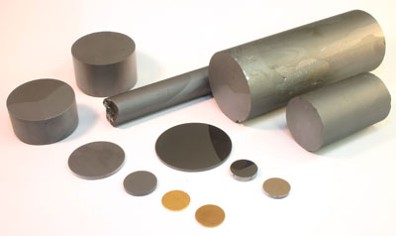
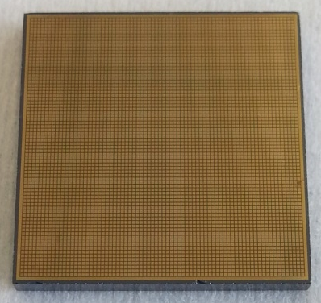

Cadmium Telluride (CdTe)
An alternative to Si or HPGe.
Room temperature operation.
High X-Ray stopping power ( > 20 keV).
Good electron transport.
Recent advances in volume and quality.
2.0 cm
Notes:
The compound semiconductor CdTe has been under development for many decades due to many of its advantageous properties.
Its relatively large band gap means that, unlike Ge detectors, it is capable of room temperature operation.
This removes the need for bulky and expensive cooling systems.
It also has a higher density compared to silicon and germanium meaning the X-ray stopping power is much greater at hard X-ray energies.
Combined with its good electron transport properties, this makes it ideal for the production of hard X-ray imaging cameras.
Recent advances in the growth and fabrication of CdTe mean that the production of large area detectors is now feasible.

Slide 3

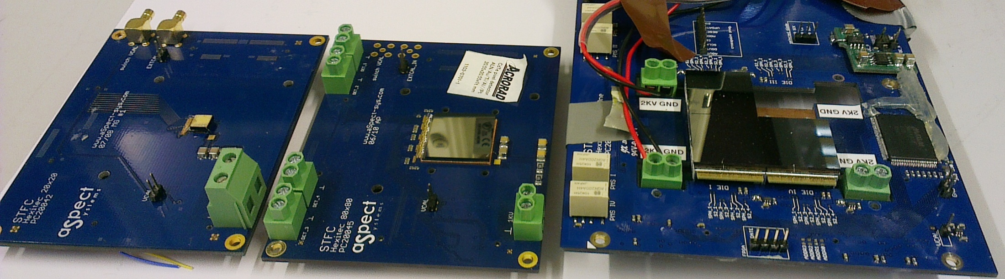

HEXITEC – A History
1G ASIC Fabricated 2008.
20*20 250μm Pix = 0.25 cm²
CdZnTe FWHM_{@60 keV} = 1keV
2G ASIC Fabricated 2010.
80*80 250μm Pix = 4.0 cm²
CdTe FWHM_{@60keV} = 0.8 keV
M.D.Wilson et al, NIMA 652, 2011, 158-161
M.C.Veale et al, JINST 7, 2012, C01035
0.5 cm
2.0 cm
4.0 cm
Notes:
In 2008 we established the HEXITEC, or High Energy X-Ray Imaging Technology, collaboration to focus on the production of CdTe detectors.
Consisting of UK universities and the research councils, the aim of the collaboration was to establish a UK capability in high energy X-ray imaging.
As part of this project we produced our first prototype ASIC in 2008 which you can see in the left hand image.
This ASIC consisted of 20 x 20 pixels on a 250 mm pitch with each pixel capable of detecting both the position and energy of an X-ray interaction.
Initial measurements with CdZnTe material showed we were able to achieve a FWHM of 1 keV, a world leading result.
Based on this success we produced a second generation ASIC with 80 x 80 pixels on the same 250 um pitch which you can see in the centre of the image.
These detectors were tested with Acrorad CdTe detectors and demonstrated an exceptional 800 eV FWHM.
Most recently we have started to look seriously at the production of large area detectors and here in the right of the image you can see an early attempt to build a 2 x 2 array.

Slide 4
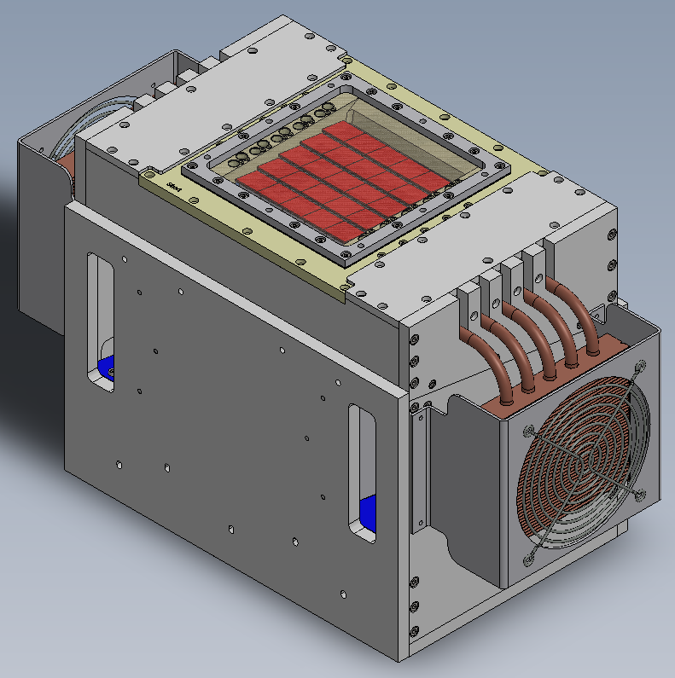
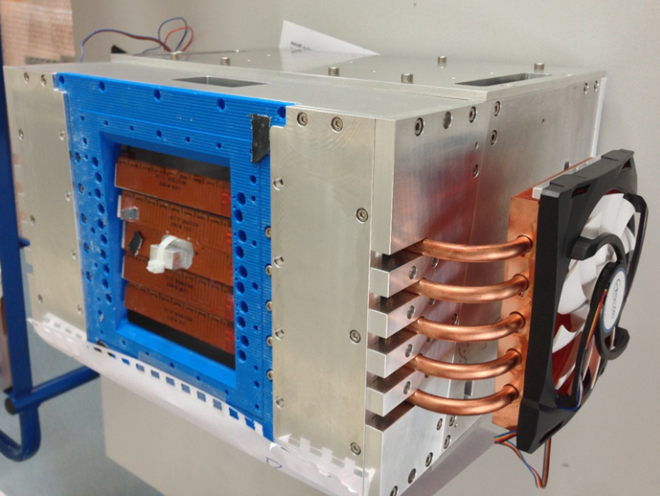
Large Area Detectors
Large Area Detectors for Imaging Applications.
Recently developed a 100 cm² CdTe camera.
25 CdTe modules.
5 x 5 array – 3 pixel dead area.
Each module characterised individually.
10 cm
Seller et al, Large area CdTe based spectroscopic X-ray imaging detector, Thurs 9:50 AM
Notes:
Over the last year we have been developing a large area detector based on the Hexitec technology.
This detector has a 100 cm2 active area which is suitable for applications such as medical imaging, industrial inspection and homeland security.
More information on this detector system will be presented by my colleague on Thursday.
The detector itself is made up of 25 individual CdTe modules mounted in a 5 x 5 tiled array.
Each module is separated by 150 um giving a dead area of 3 pixels between each element.
Each module has been bonded and tested individually before incorporation in the large array.

Slide 5
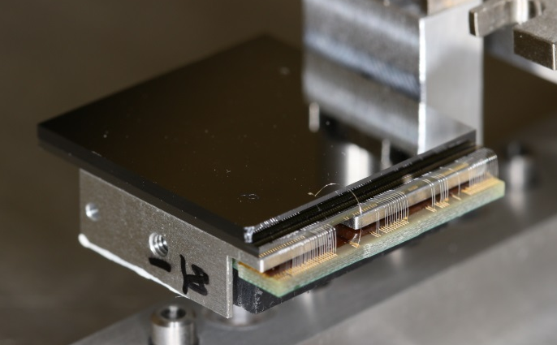
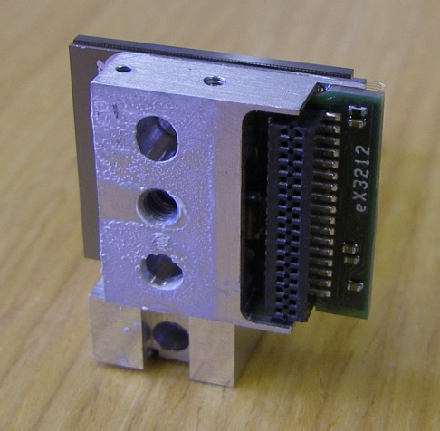
CdTe Detector Modules
Acrorad Al-Schottky Anode CdTe.
80 x 80 pixels on 250 μm pitch.
20.35 mm x 20.45 mm x 1.00 mm.
Flip-chip-bonded to HEXITEC ASICs.
Mounted on Al carrier and wedge bonded.
3-side-buttable design.
Schneider et al, Interconnect and bonding techniques for pixelated X-ray and gamma ray detectors, Weds 3:00 PM
Notes:
The CdTe detectors used in this system were produced by Acrorad in Japan and have Schottky aluminium anodes that are used due to their low leakage current.
Each of the detectors have 80 x 80 pixels on a 250 um pitch giving dimensions of ~ 2 cm x 2 cm and are 1 mm thick.
Detectors were flip-chip-bonded to the HEXITEC ASIC using a low temperature curing silver epoxy and were mounted on aluminium carriers.
You can see images of the detectors during and after assembly to the left.
For more information on this process I would refer you to my colleagues poster later in the week.

Slide 6
CdTe Detector Testing
High Operating Voltage
(>300V)
Stable Current
(σ<2nA)
Good Bond Yield
(>99%)
90% < 2keV
(FWHM_{@60keV})
Notes:
So once mounted, each detector is tested individually.
To be included in the final array, detectors have to meet a series of standards.
These include the ability to operate at high bias voltages while drawing a stable leakage current,
A bond yield of better than 99 %,
And, finally, over 90 % of pixels must have FWHMs of < 2 keV.

Slide 7
Bias Voltage Effect
Operating voltage has a large effect on spectroscopic performance.
Poor spectroscopic performance observed for voltages < 300 V.
At higher voltages additional noise is observed in the spectra.
Only detectors where V_{opp} > - 300V are included in the detector.
Notes:
The first test that any module goes through is a measurement of its electrical performance.
Using the correct bias voltage is important for the quality of the detector performance.
If a low bias voltage is used then the spectroscopic performance will be poor and the electric field within the detector will be unstable.
If the bias voltage is too high then the leakage current introduces additional noise.
Shown on the left is a set of ²⁴¹Am γ-ray spectra that were collected for 60 s at different bias voltages.
For the low voltages the spectroscopic performance is poor and the lower energy lines in the spectrum cannot be resolved.
Above ~ 300 V the spectroscopic performance is greatly improved producing well resolved spectral lines.
The low energy noise edge observed in the 500 V spectrum is a result of the high leakage currents observed at the highest voltages.

Slide 8
Electrical Characterisation
Detector temperature held at 20ºC.
Keithley 2410 Sourcemeter.
Optimal operating bias defined as:
“the highest voltage achievable for < 2nA of variation over 5 minutes”
Operating bias calculated for each module.
Notes:
To determine the optimal operating bias each module is mounted in the Hexitec test system and its temperature maintained at 20oC.
The bias voltage is varied in 50 V steps and the current measured over 5 minutes at each voltage.
In the top image you can see two current plots. In black is the current measured at 300 V while in the red is 600 V.
At higher voltages you can see that the device breaks down due to large leakage currents occurring at the crystal edges.
It is this leakage current that contributes to the low energy noise observed in the spectrum in the previous slide.
We have defined an optimal operating voltage as the highest voltage achievable at which < 2nA of variation is observed over a 5 minute period.
In the lower plot you can see the reverse bias I-V plot for a typical device, the operating bias has been marked on the plot.

Slide 9
Operating Voltage
Notes:
In total 36 detectors were tested and the histogram in this slide shows the optimal operating voltages that were measured.
4 of the detectors that were tested broke down at voltages, < 300 V, making them unsuitable for inclusion in the final detector.
The remaining 32 detectors showed good performance under high voltage operation.

Slide 10
Spectroscopic Performance
180 MBq ²⁴¹Am sealed source.
γ-rays at 59.5 and 26.0 keV.
FWHM calculated for all 6,400 pixels at the optimal operating bias.
Average FWHM ~ 0.9 +/- 0.4 keV.
Notes:
Once the optimal operating bias has been determined the spectroscopic performance is assessed using a 180MBq 241Am source.
An example of a single pixel spectrum can be seen in the top plot.
The source produces a series of g-rays and x-rays that can be used to energy calibrate each of the 6,400 pixels for future use.
The quality of each detector is determined from the distribution of FWHM values measured for the 60 keV photo-peak.
The bottom plot shows a typical distribution of FWHM values for a single module.
In this instance an average FWHM of 1.0 keV is measured with a distribution of ~ +/- 0.5 keV.
In this detector over 99 % of pixels meet the better than 2 keV FWHM specification.

Slide 11
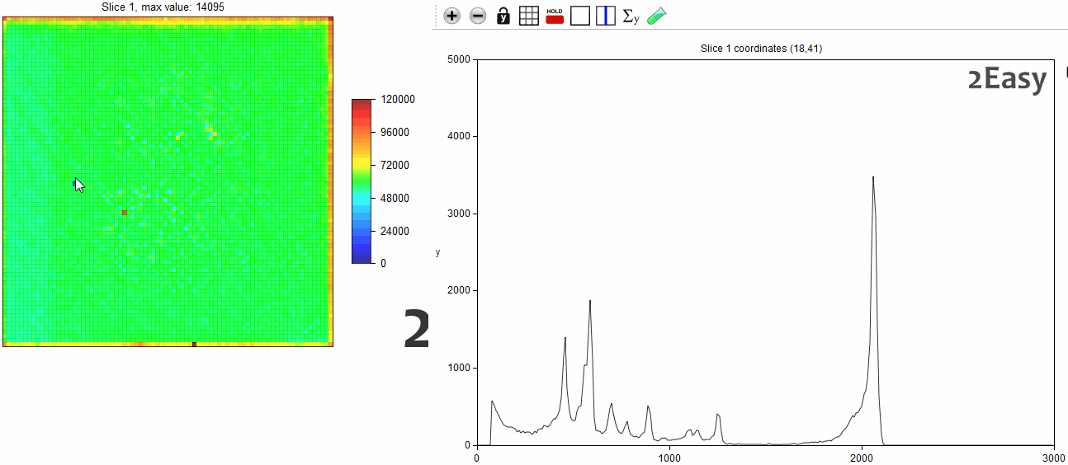
Detector Uniformity
RAW Data
Notes:
This movie illustrates the uniformity of the CdTe detectors.
On the left is a pixel map of the total number of events measured while on the right is the spectrum measured in individual pixels.
As we move from pixel to pixel it is clear that there is a uniform response across the detector.

Slide 12
Detector Uniformity
97.7 % of Pixels
In Specification
Crystalline Defects
Notes:
If the measured FWHM is averaged over all of the detectors tested then an average distribution can be calculated.
This distribution is shown in the image although please take note of the LOG scale used in the image.
The results show that an excellent 97.7 % of pixels meet the 2 keV FWHM specification set for the large area detector.
The remaining 2.3 % of pixels show a broad distribution of FWHM values.
There are a number of phenomena that could be the source of these poor performance pixels.

Slide 13
Poor Pixel
Performance
Just outside spec:
2 – 3 keV
Poor pixels:
3 – 6 keV
Severely degraded pixels: 6+ keV
Notes:
The map in the bottom right of this slide shows the physical location of poor pixels in one of the modules.
The poor pixels can be separated in to 3 broad groups,
Those that are just outside of specification with FWHM of 2 – 3 keV.
Those with poor FWHM of 3 – 6 keV,
And those with FWHM greater than 6 keV that show severe degradation in spectroscopic performance.

Slide 14
Typically located at the detector edge.
Increased leakage current -> noise.
Variations in charge transport properties.
1.4 % of Pixels
Notes:
The vast majority of the poor performance pixels have FWHM values in the range 2 – 3 keV.
The spectrum in this image shows an example of one such pixel.
The spectrum still shows the clearly resolvable photo-peaks although the energy resolution is clearly worse.
These pixels are typically located close to the edge of the detector where additional leakage current and charge loss reduce the spectroscopic performance.

Slide 15
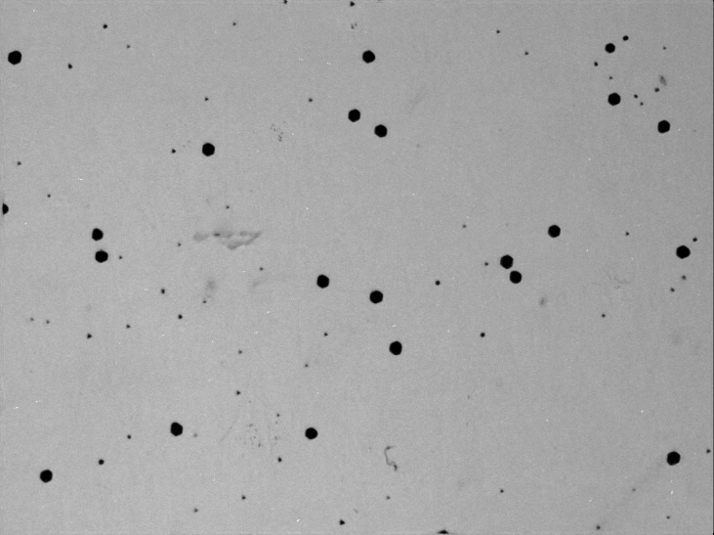
Te Inclusions
~100μm
γ
0.5 % of Pixels
Notes:
The second type of poor pixels shows gross changes in the Am-241 spectrum as seen in this example.
These sorts of changes are characteristic of charge loss due to the presence of discrete crystalline defects known as tellurium inclusions.
In the top right infra-red transmission image of a CdTe crystal show the distribution of inclusions which appear dark in the image.
These inclusions are created when bubbles of tellurium are trapped at the growth interface during the production of the crystal.
They act as centres of electron trapping and their effect on the pixel response is dependant on their position within the crystal.
In this instance the inclusion only partially fills the pixel volume so only some of the charge created by an interaction is trapped.

Slide 16
Te Inclusions
~100μm
γ
<0.1 % of Pixels
Notes:
In the worst performing pixels the spectra show large distortions like the one shown although these only account for a very small portion of the total.
In this instance the inclusions are likely to be completely contained within the pixel volume leading to significant charge loss.

Slide 17
Crystalline Defects
Notes:
The total number of poor pixels was calculated for each of the CdTe detectors tested.
This histogram shows the distribution of these pixels across the detectors studied.
On average ~ 2.3 % of pixels were found to be outside specification.

Slide 18
Crystalline Defects
> 93 % of Pixels Meet Specification
Notes:
Most importantly over all the detectors tested each one had over 93 % of pixels within the specification.

Slide 19
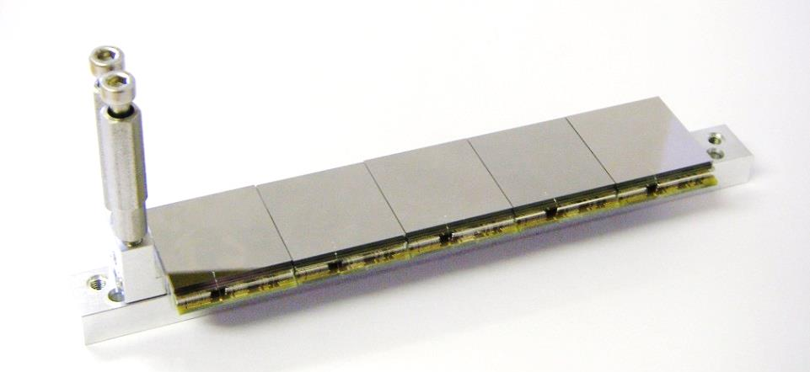
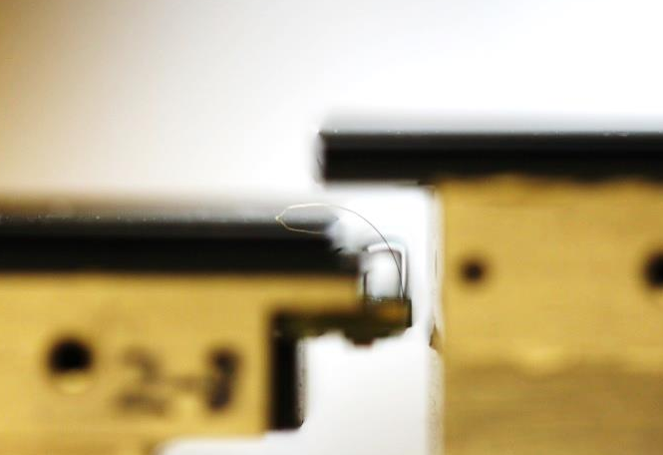
Final System Assembly
25 Detectors Assembled.
“Roof-Tile” Arrangement.
160K Pixels.
Operating Temperature = 20ºC.
Operating Voltage = - 300 V
> 95 % FWHM_{@60keV} < 2 keV.
Commissioning Sept ‘14.
Seller et al, Large area CdTe based spectroscopic X-ray imaging detector, Thurs 9:50 AM
Notes:
Testing of these detectors is now complete and recently they have been mounted in our 5 x 5 array.
As the image shows on the left, detectors are mounted in rows of 5 x 1.
These rows are then stacked in a roof tile geometry to produce the large area.
Based on the characterisation measurements we have chosen to operate the camera at room temperature with a bias voltage of 300 V.
This detector head has a total of 160K pixels with over 95 % of these pixels having a FWHM @ 60 keV better than 2 keV.
Commissioning of this detector begins in the next month and we will be presenting the first imaging results at this years IEEE conference in Seattle.

Slide 20
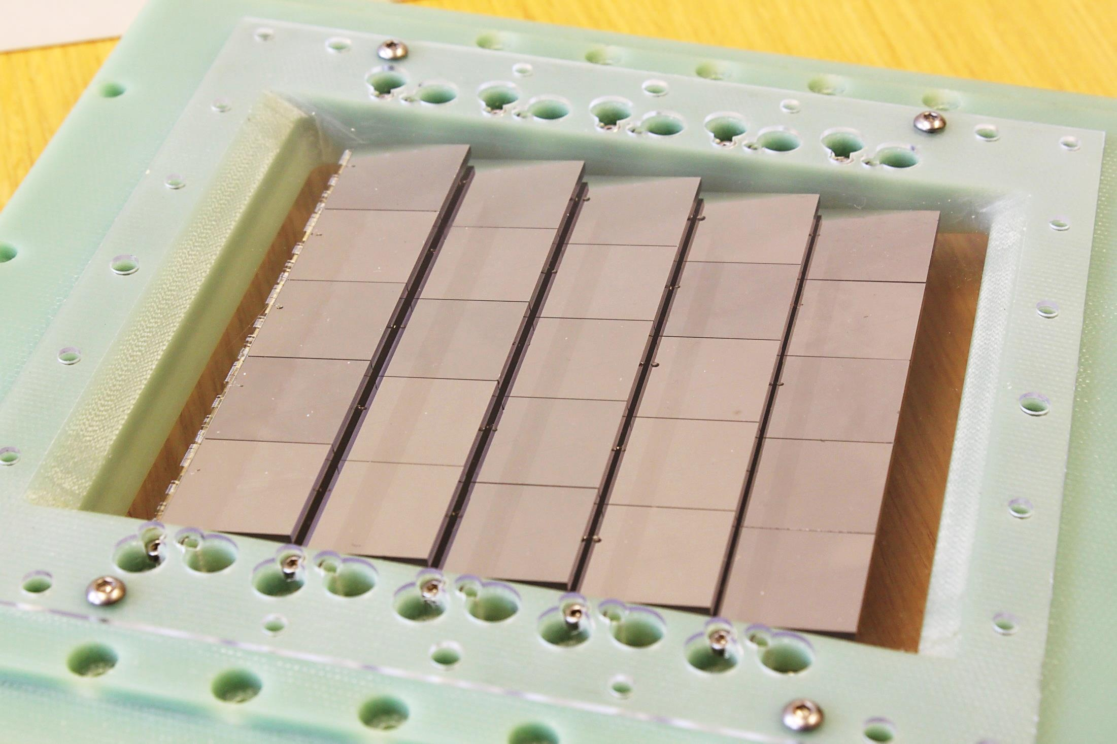

10 cm
10 cm
Notes:
And here I’m happy to show you the first images of the fully assembled detector head!

Slide 21
For More Information on HEXITEC and it’s applications:
Wednesday – Session 10 @ 15:00
Duarte et al, Influence of edge surface leakage current on the performance of pixelated CdTe radiation detectors.
Thursday – Session 12 @ 11:40
Scuffham et al, Imaging of Ra-223 with a small-pixel CdTe detector: potential for improved image quantification for radionuclide dosimetry.
Thursday – Session 14 @ 17:10
Pani et al, Dual-energy mammography with a pixellated spectroscopic detector.
Notes:
That brings me to the end of my talk, thank you for listening and are there any questions?

