Slide 1
Adaptive Gain Integrating Pixel Detector
“AGIPD, a high dynamic range fast
detector for the European XFEL”
Alexander Klyuev for the AGIPD collaboration
10th International Conference on Position Sensitive Detectors

Slide 2
Outline
  Intro – detector challenges
  AGIPD concepts
  ASIC
  Experiments
  Summary

Slide 3
Detector challenges
Constraints and challenges for the detector:
  Sufficient radiation hardness (>10 MGy)
  Low noise (<500 e)
  High dynamic range (up to 10⁴ 12 keV photons)
  XFEL timing compliant
  Lowest possible dead area
  Vacuum compatible
  Central hole
Single photons
Key features of the European XFEL
Very high peak brilliance and intensity (>10³² pht/pulse)
Highly coherent fast pulses (< 100 fs)
4.5 MHz pulse repetion rate
2700 images per train
Several 100 pictures
10⁴ photons
@ 12keV
1k x 1k pixels
4.5 MHz

Slide 4
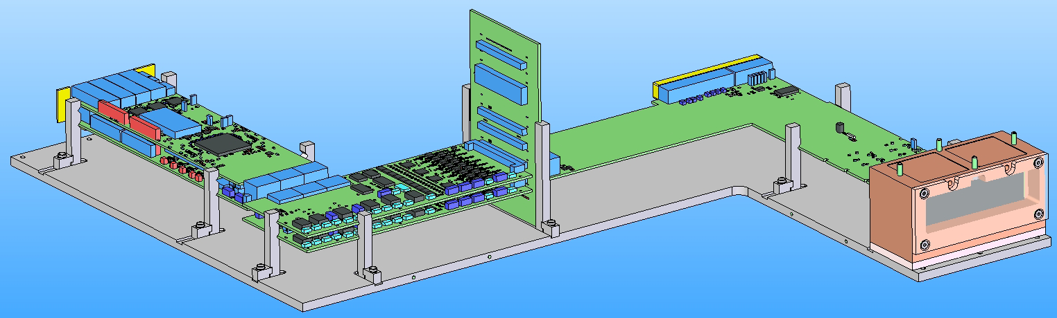
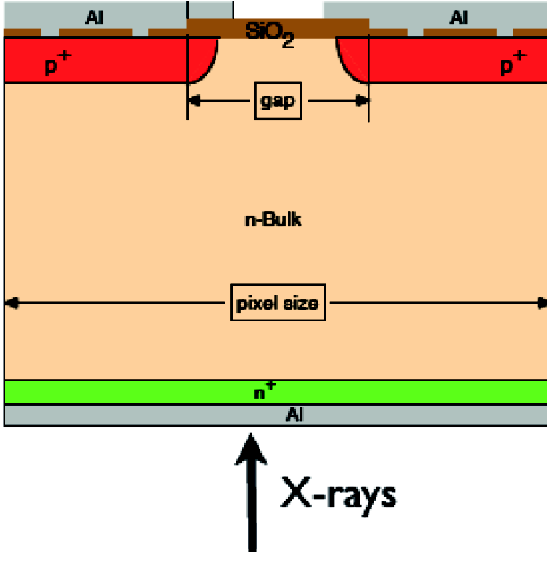
Detector structure
AGIPD 1M consists of 16 detector modules:
Digital part:
FPGA daughter board on carrier board
Analogue part:
64 ADC
channels on a two board system
Vacuum board
with a flexible
connection
Detector head: 512x128 pixel sensor bump bonded to
8x2 ASICs
Data transfer on one of 4
10G compatible standard ethernet links via
TCP/UDP
ASIC with charge integrating readout and
analogue frame storage behind each pixel
Si-Sensor with (200μm)² pixels
Analog ADC
boards, also
two board
system
Vacuum board
with a flexible
connection

Slide 5
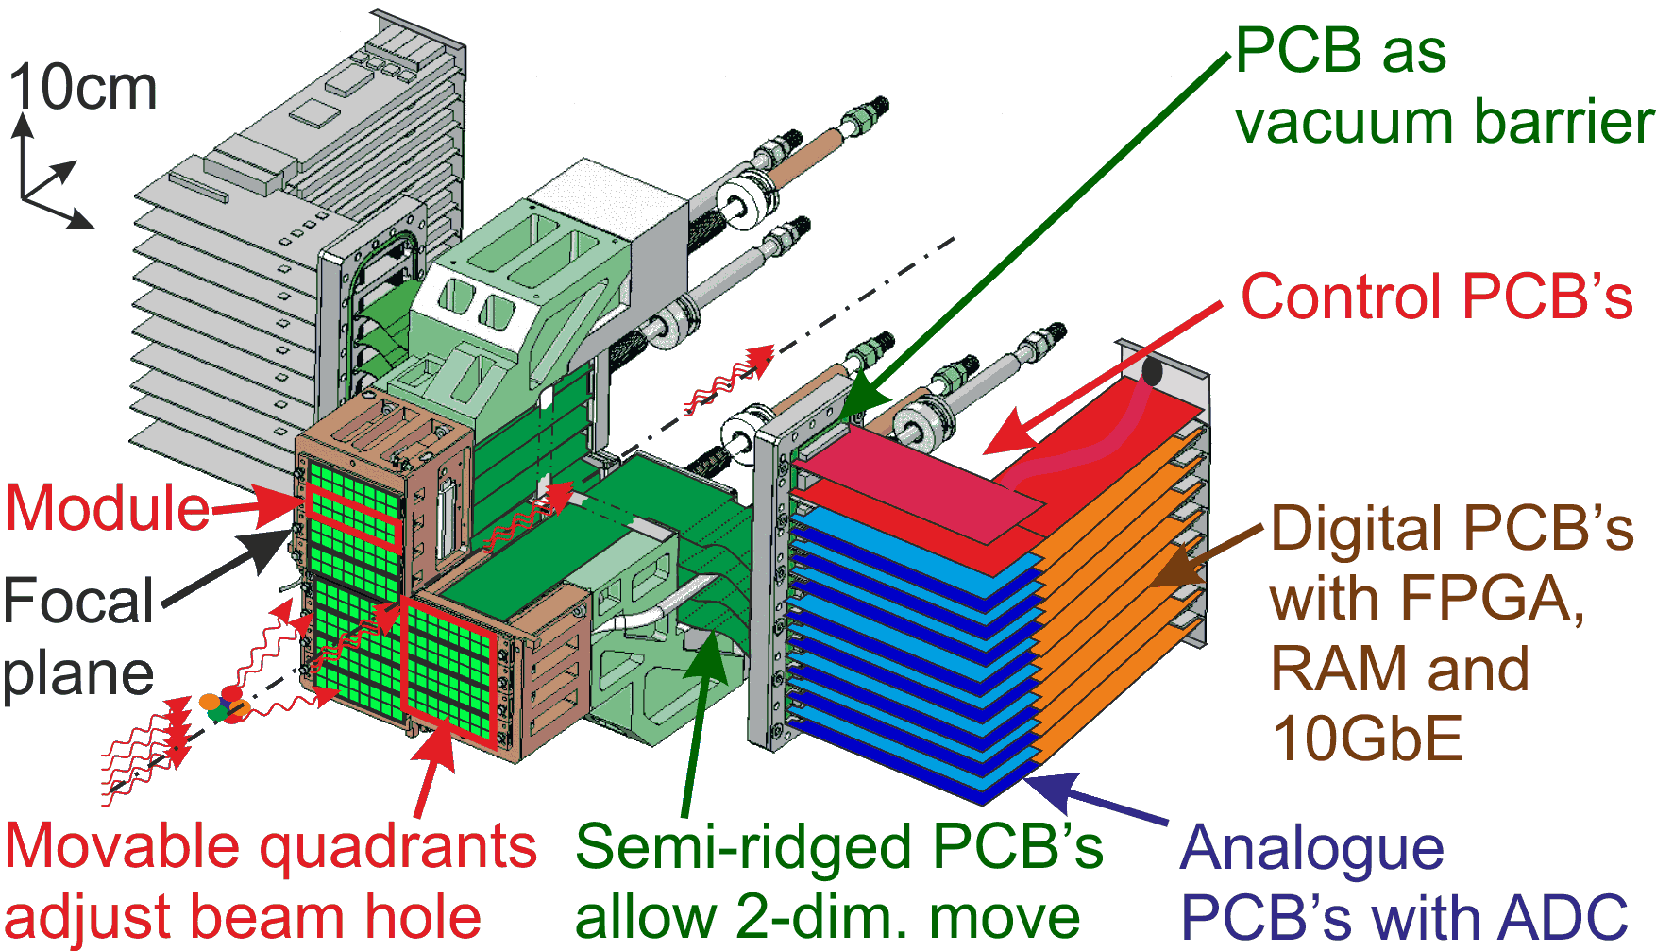
Mechanical concept
to

Slide 6
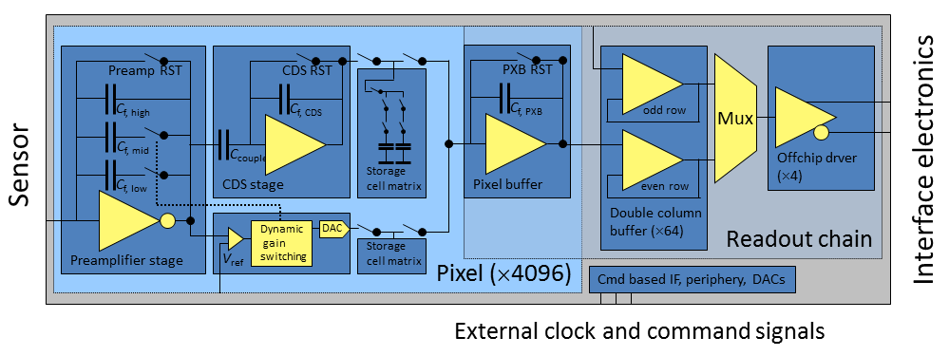
ASIC: structure
Each readout chip contains a square matrix of 64 x 64 pixels, read out on four ports
Discriminator
Double column buffer (interleaved, precharging signal to bus)
CDS buffer
Analogue memory of 2 x 352 cells (value and gain)
Analogue multiplexer
Writing chain
Charge sensitive preamplifier
Pixel buffer
(charge sensitive)
Offchip driver
(Fully differential Amplifier)
Charge sensitive preamplifier
with 3 selectable gains
Gain switching control circuit and a DAC to encode the switch settings
Command line based interface
(Digital control circuit)

Slide 7
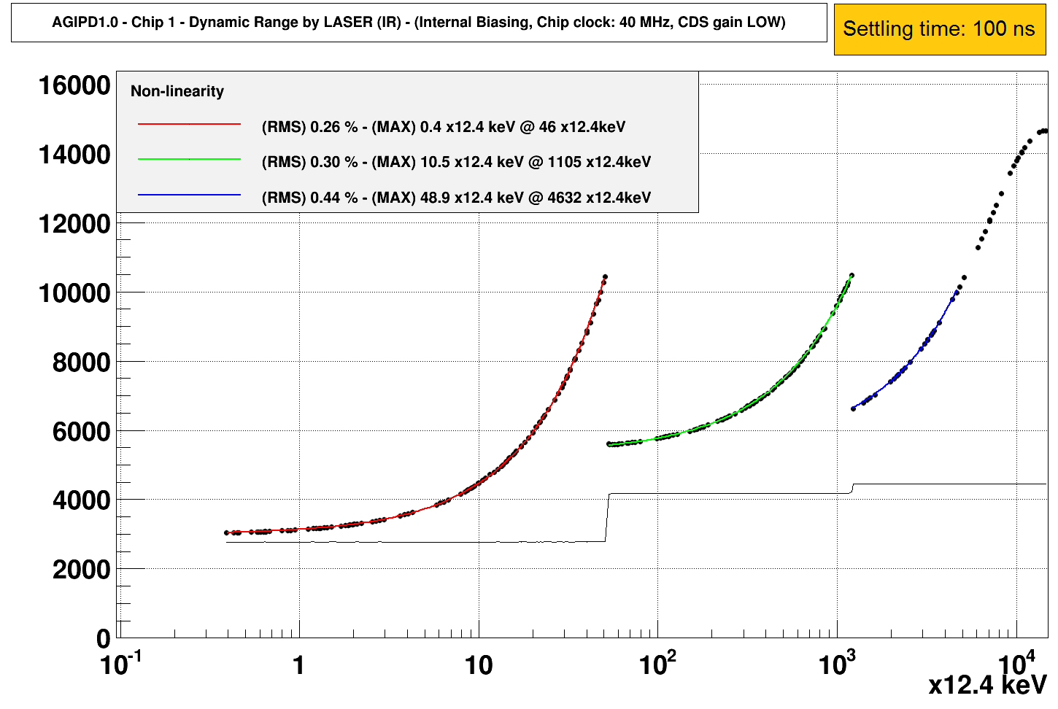
ASIC: characterization
Vth,comp
LOW gain range
(x12.4 keV): 5000 (+5000)
MED gain range
(x12.4 keV): 1200
HIGH gain range (x12.4 keV): 50
LOW gain range
(x12.4 keV): 5000
(+5000)
MED gain range
(x12.4 keV): 1200

Slide 8
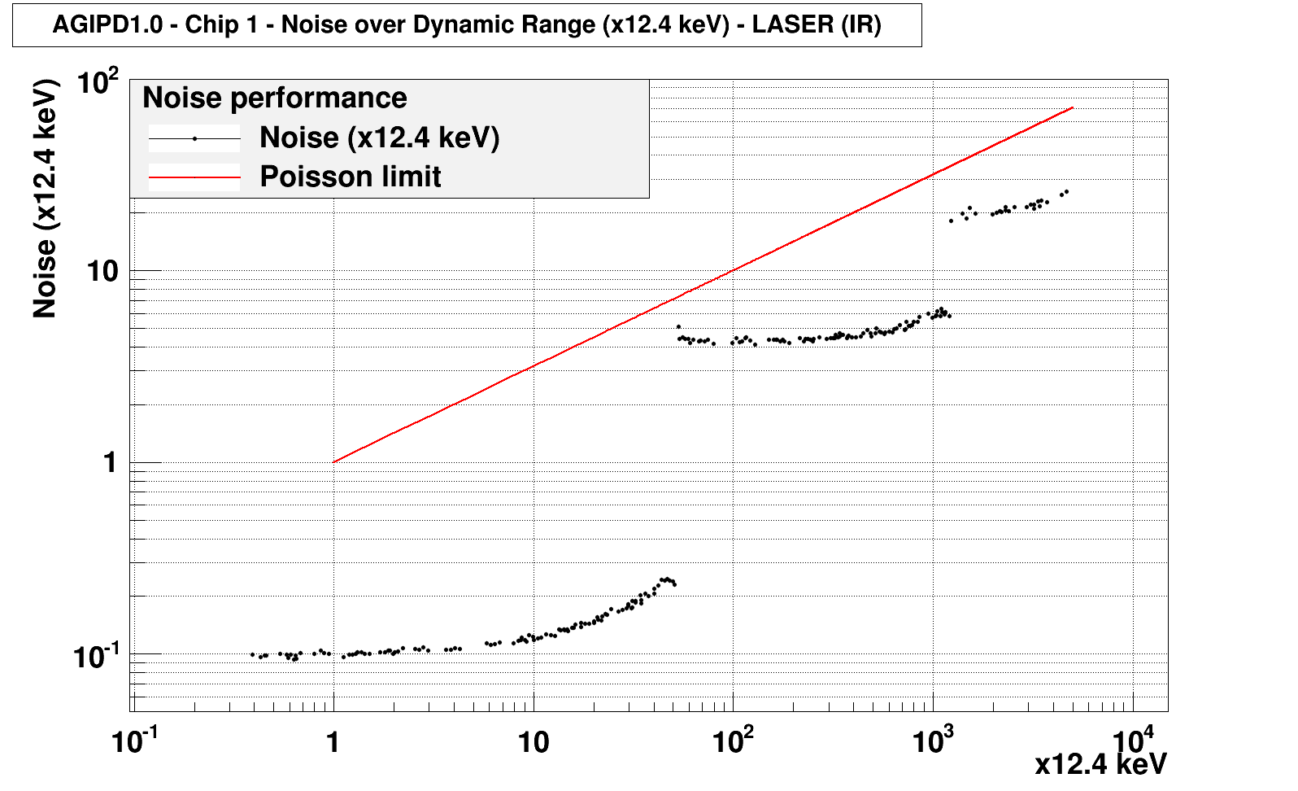
ASIC: characterization
5 %
Shot-to-Shot fluctuation
ENC = 265e- RMS
5 %
Shot-to-Shot fluctuation

Slide 9
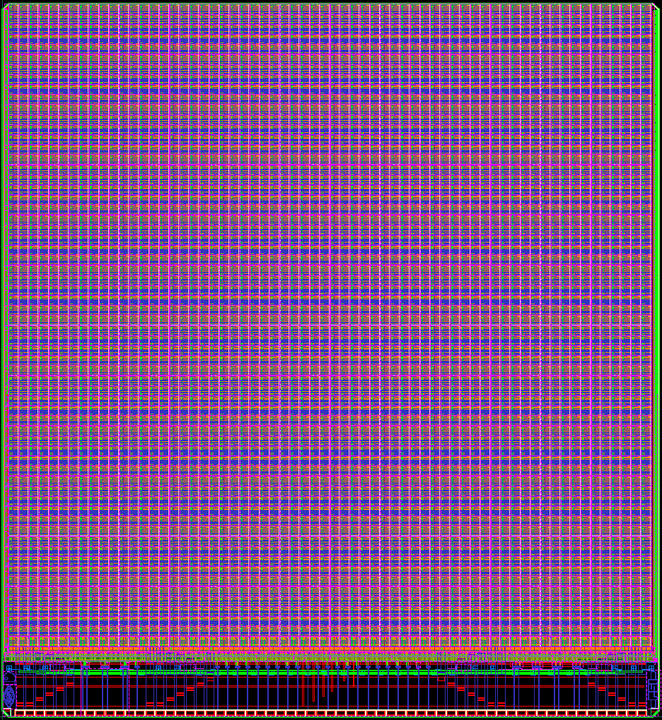
ASIC: AGIPD 1.0 layout
13 mm
Single pixel of
(200μm)² with bump bonds
Analogue multiplexer and buffers, power buses
Digital buffers, power buses
14.2 mm
I/O ports - LVDS input, differential output, bias DACs, digital control circuit
Interface pads 200x80 μm rectangle – convenient wirebonding

Slide 10
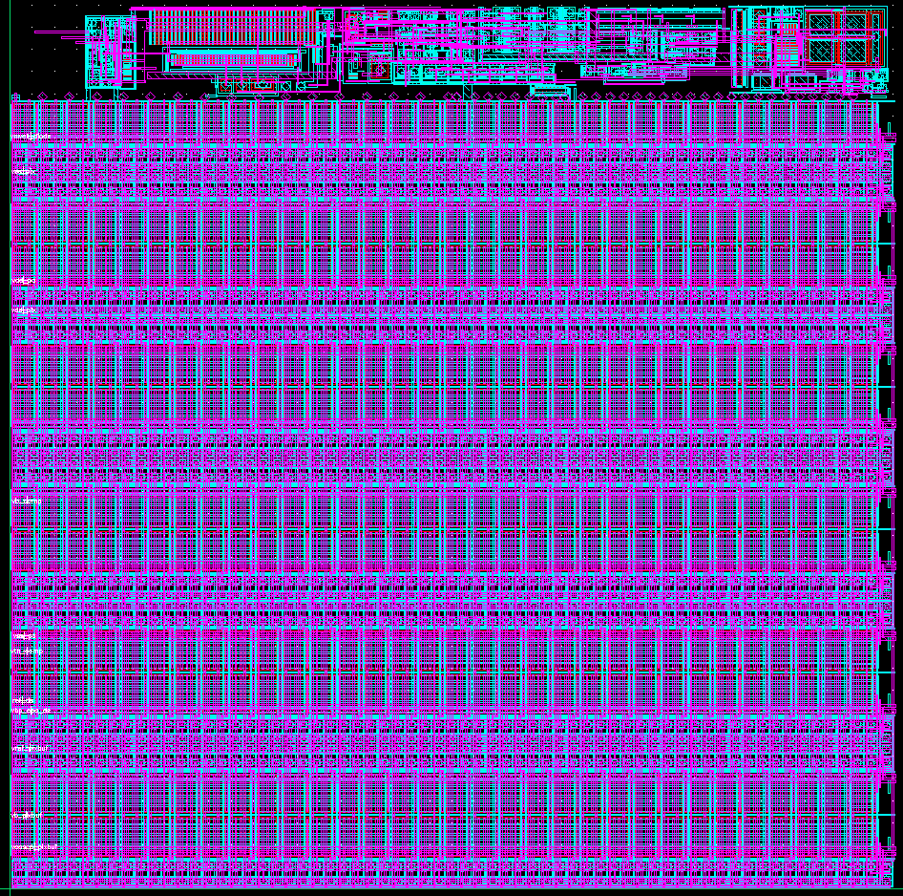
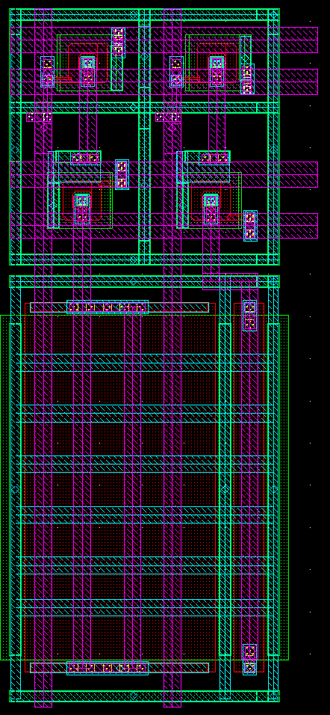
ASIC: Pixel layout
200 µm
Analogue channel – CSA, CDS, discriminator, gain bit logic, switches, pixel buffer
Column switch
Memory cell switches
Analogue value capacitor
200 µm
Memory array 352 cells
Memory cell
Gain bit
capacitor

Slide 11
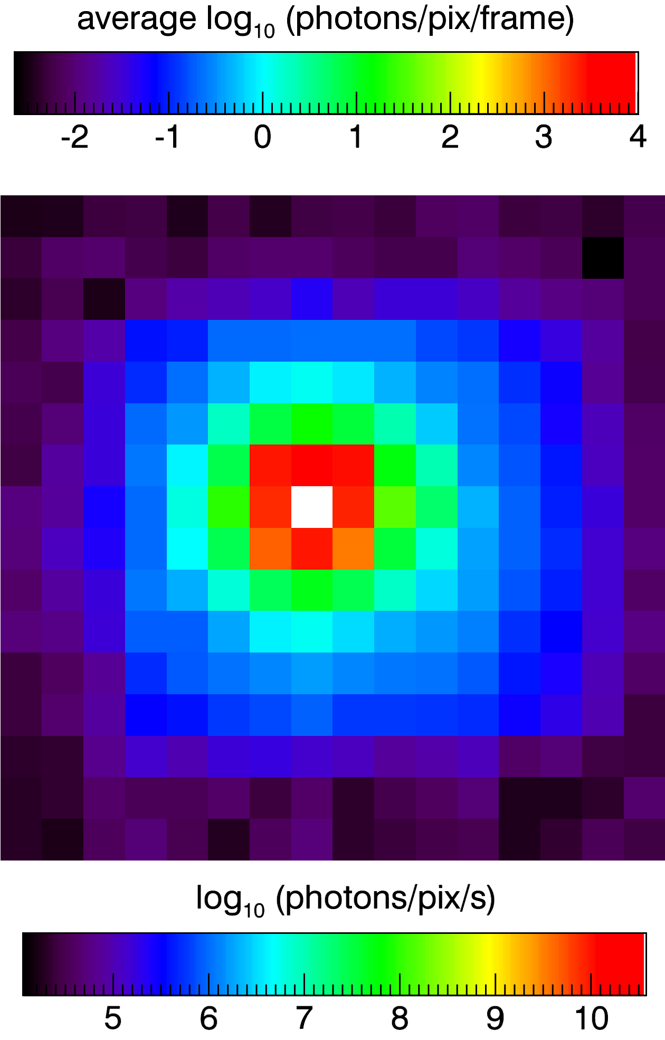
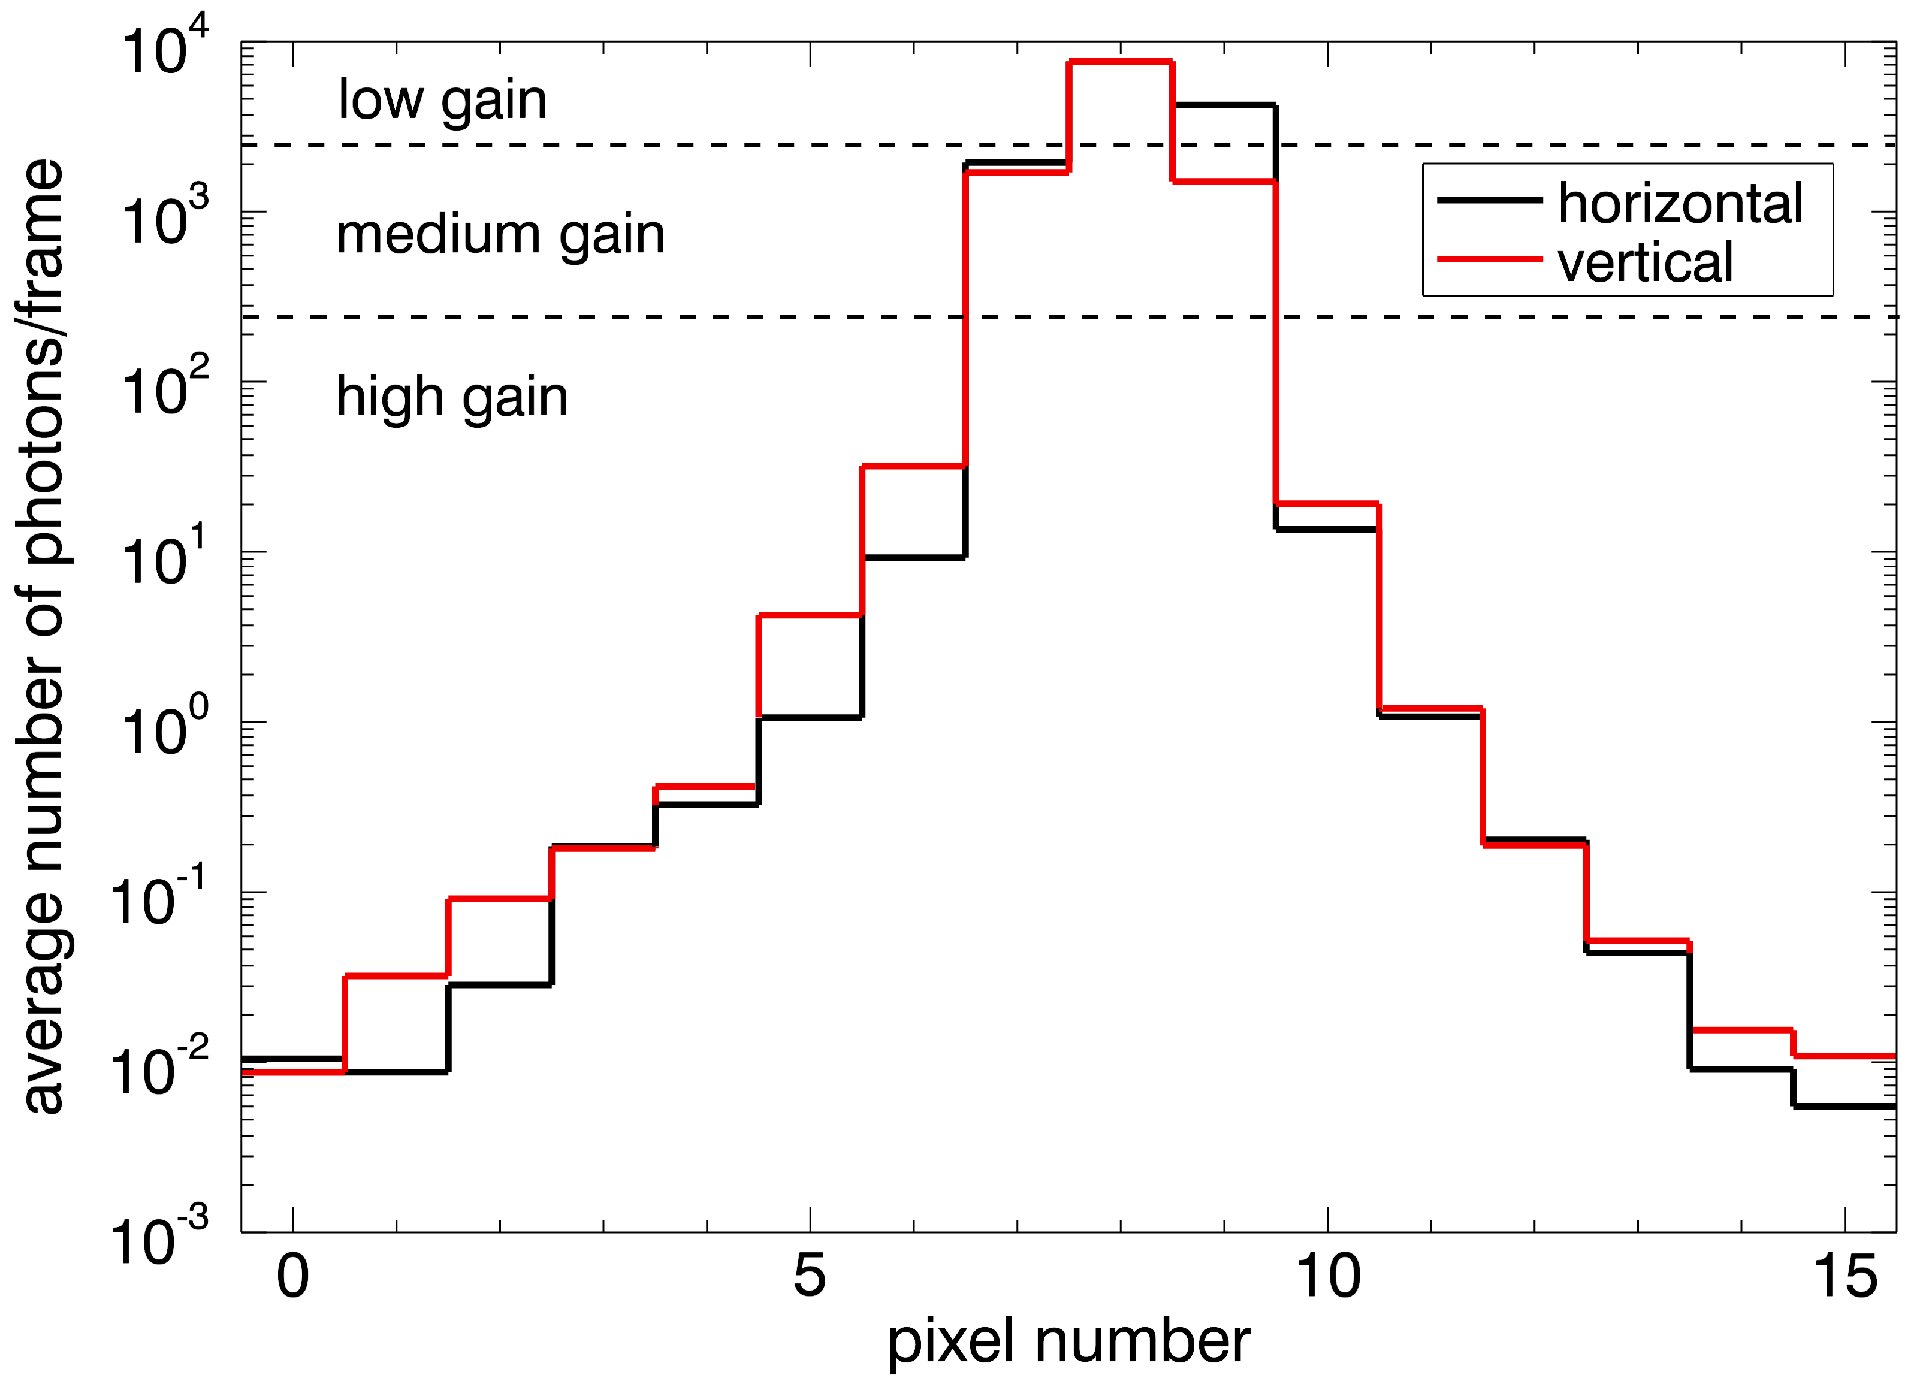
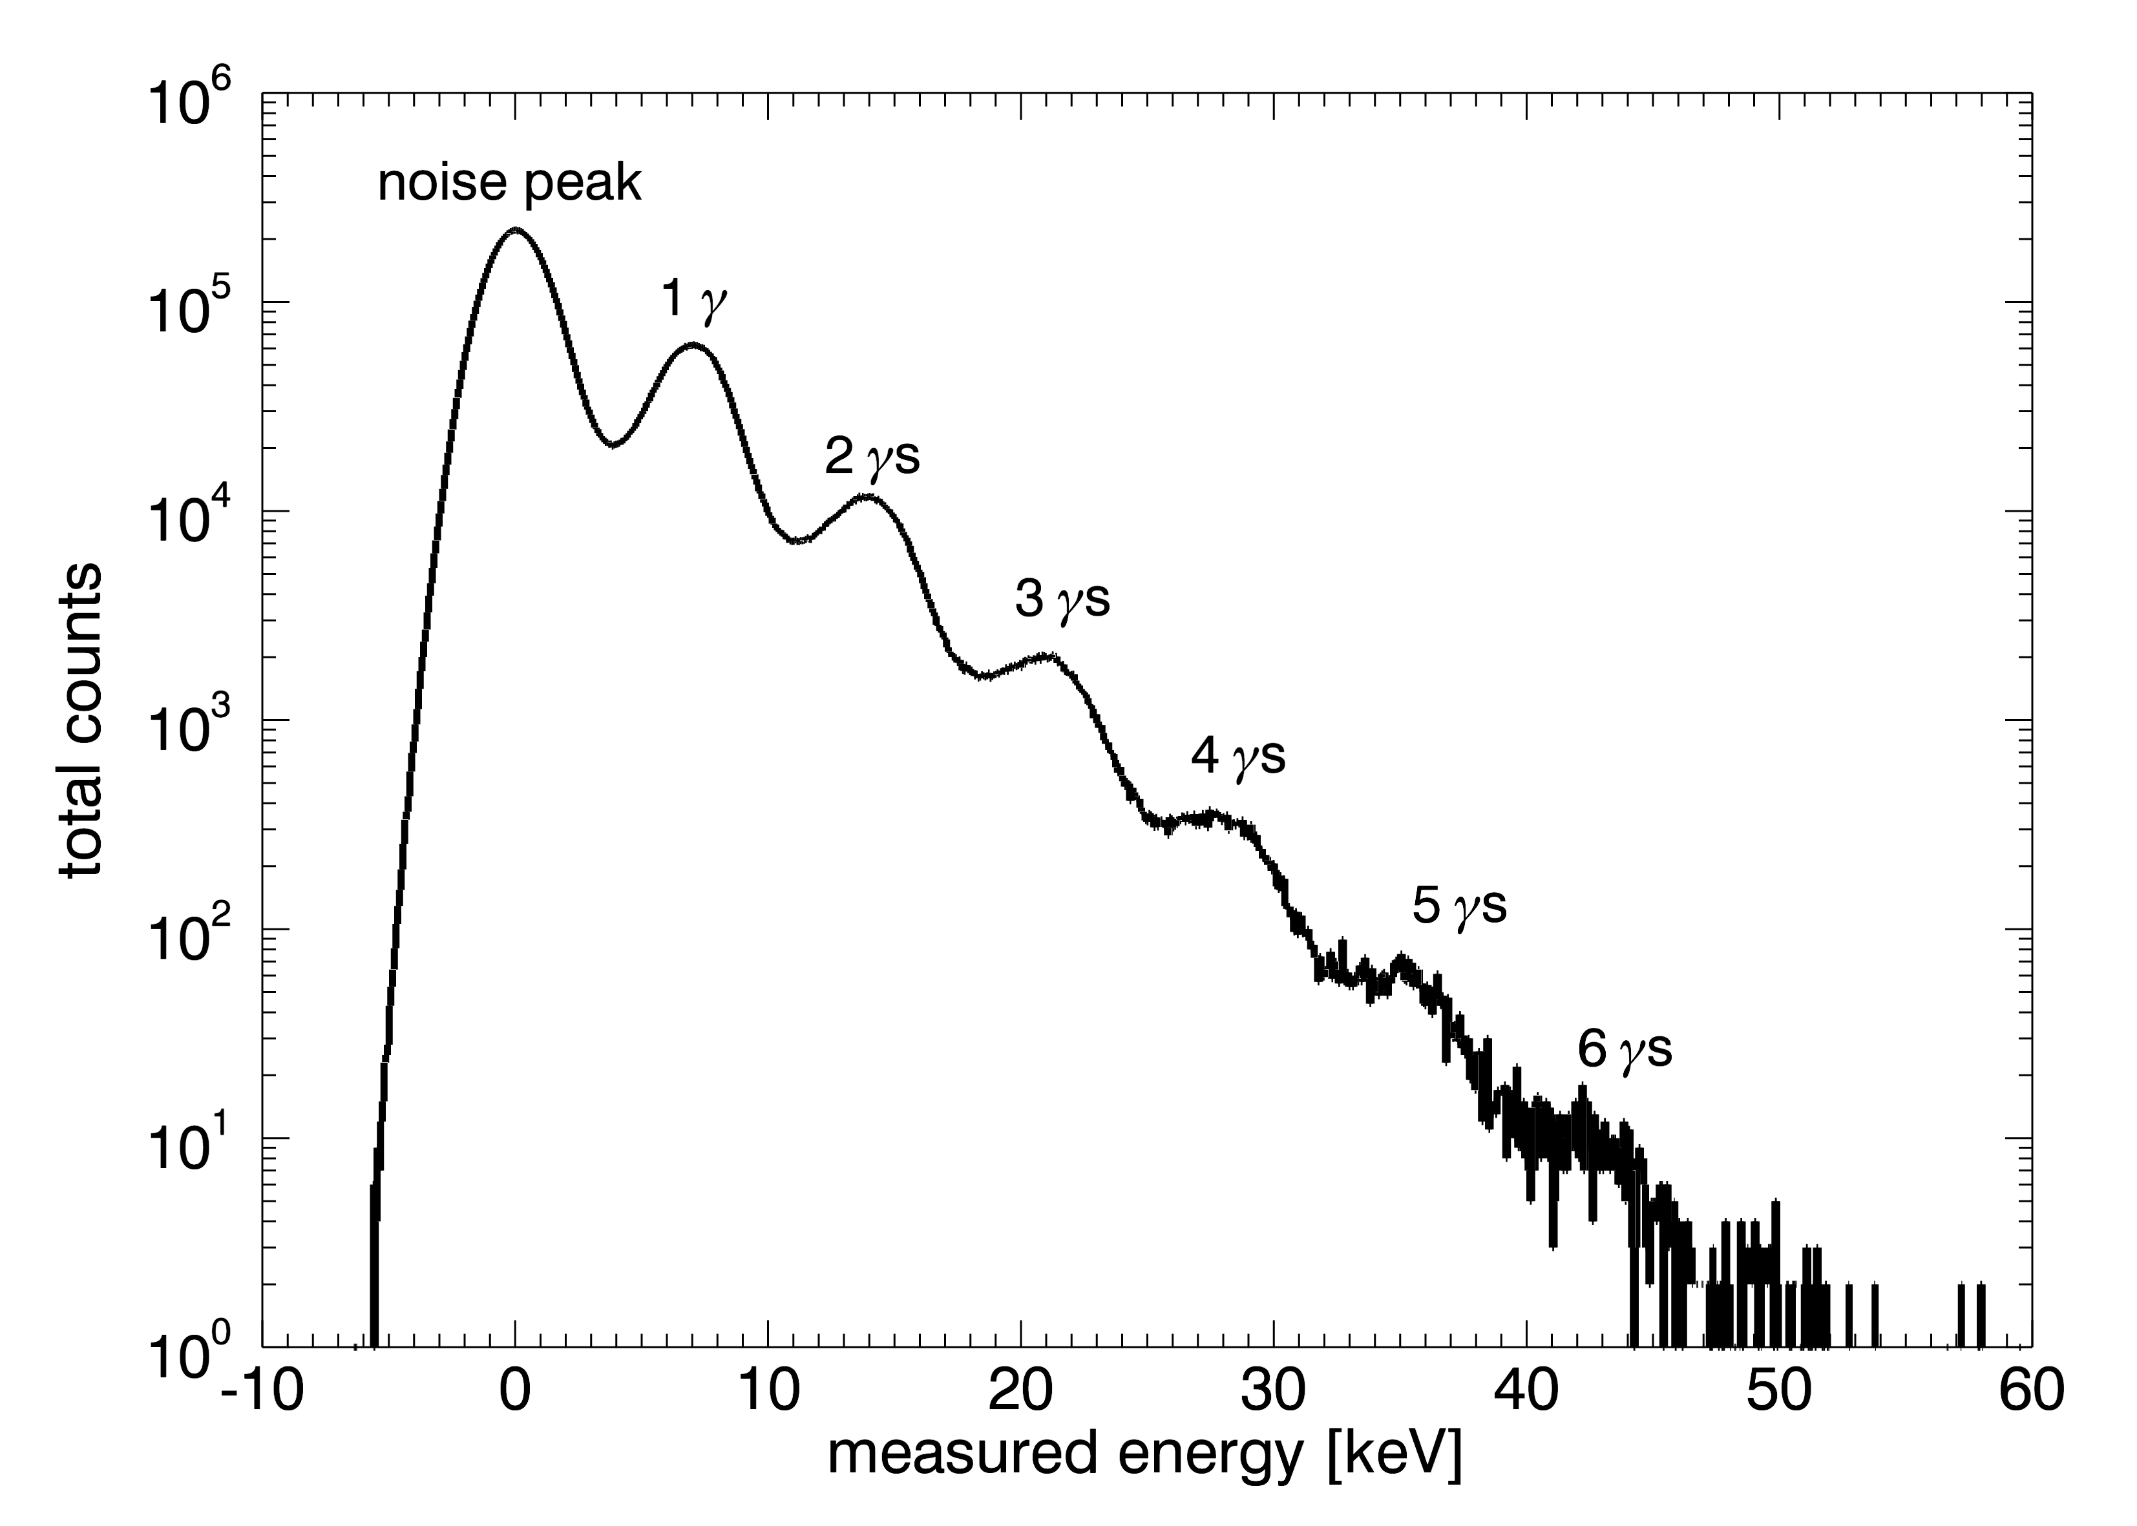
Experiments: AGIPD 0.4 @P10
Gain switching
experimentally proven
Image of the direct beam
Image of the direct beam
Single photon sensitivity @7.05 keV
Average intensity: 0.3 photons per 200 ns
Count rate: 1.5 Mcps/pixel or 37.5 Mcps/mm²
RMS noise of this pixel: 320 electrons.
Average intensity: 0.3 photons per 200 ns
Count rate: 1.5 Mcps/pixel or 37.5 Mcps/mm²
RMS noise of this pixel: 320 electrons.
Average intensity: 0.3 photons per 200 ns
Count rate: 1.5 Mcps/pixel or 37.5 Mcps/mm²
RMS noise of this pixel: 320 electrons.
Average intensity: 0.3 photons per 200 ns
Count rate: 1.5 Mcps/pixel or 37.5 Mcps/mm²
RMS noise of this pixel: 320 electrons.

Slide 12
Experiments: AGIPD 0.4 @P01
40 bunch mode (192 ns bunch spacing)
Photon energy: 14.4 keV
High-resolution monochromator and KB-mirror used
Single pulse imaging
Average of 331,000 single pulses
“Intensity Interferometry of Single X-Ray Pulses from a Synchrotron Storage Ring”, PRL 113, 064801 (2014),
DOI: 10.1103/PhysRevLett.113.064801, preprint: http://arxiv.org/abs/1402.3092

Slide 13
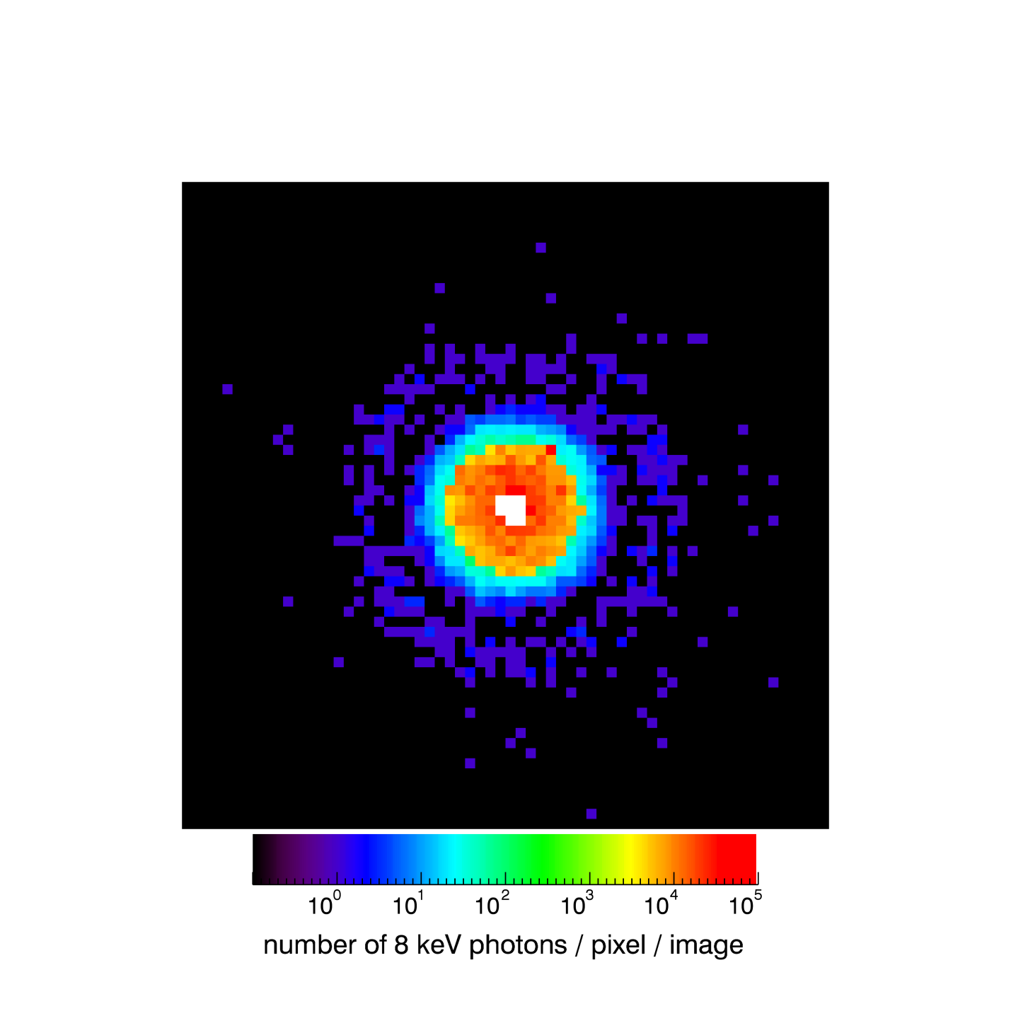
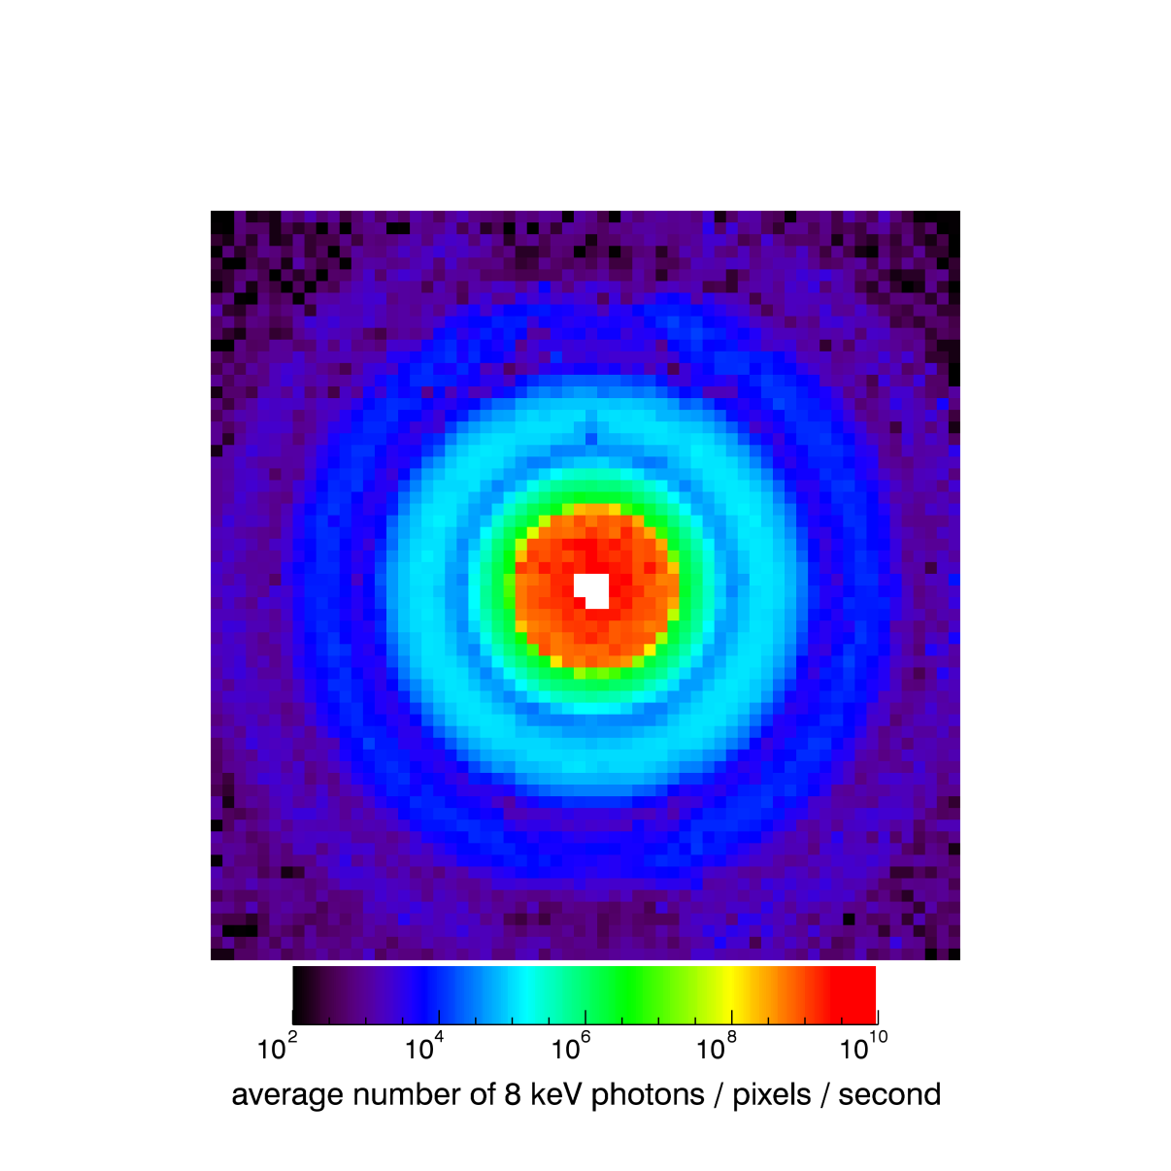
Experiments: AGIPD 1.0 @P10
From prototypes to the full scale ASIC
Single shot imaging synchronized
to PETRA III running at 5.2 MHz
Averaged image

Slide 14
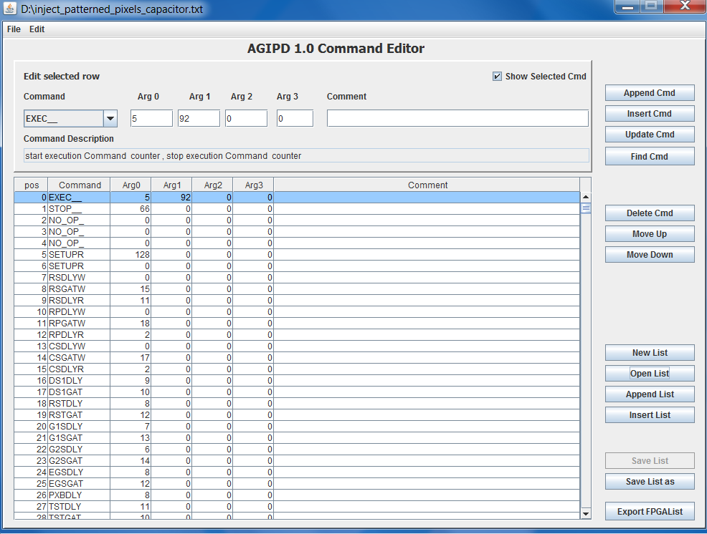
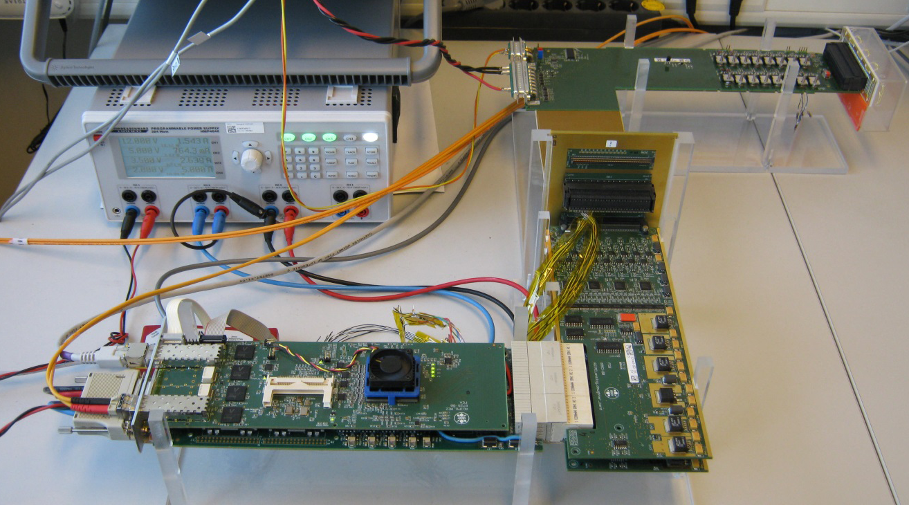
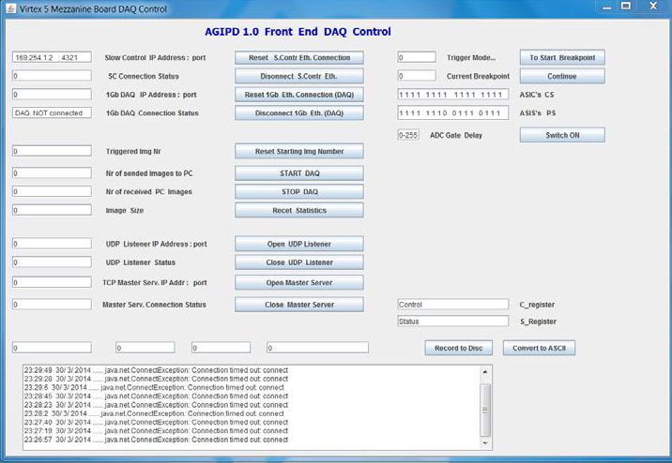
Experiments: AGIPD module @APS
Single module test system
and DAQ software

Slide 15
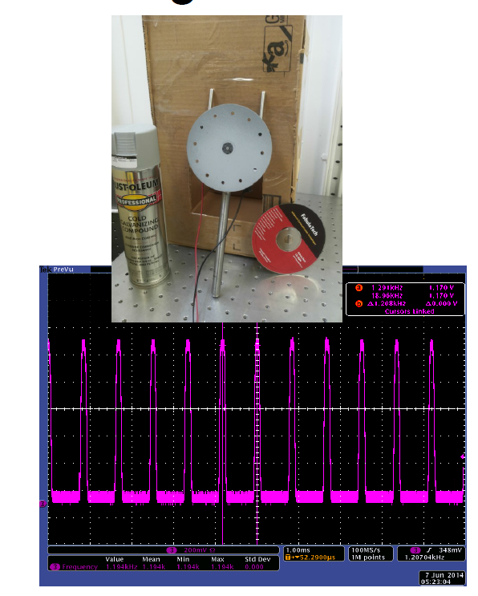
Experiments: AGIPD module @APS
Single bunch imaging – a challenge to find processes fast enough
Experimental setup
Drilled equidistant holes into a DVD
DVD covered with zinc paint to
increase absorption
Mounted DVD on a fast electric motor
Measurement of hole to hole frequency
with diode and oscilloscope: 1.208kHz

Slide 16

Experiments: AGIPD module @APS
Calculation for burst imaging
Result from laser measurement
APS bunch spacing: t = 154ns
Number of pixels crossed
during burst of 352 images: ~ 8
Pixel size: 200µm
Vdisc, AGIPD = 29.51m/s
͌
Vdisc, Laser = 29.83m/s
Single bunch imaging is possible even at a repetition rate of 6.5MHz!!

Slide 17

Experiments: AGIPD module @APS
Calculation for burst imaging
Result from laser measurement
APS bunch spacing: t = 154ns
Number of pixels crossed
during burst of 352 images: ~ 8
Pixel size: 200µm
Vdisc,agipd = 29.51m/s
͌
Vdisc,Laser = 29.83m/s
First frame
Last frame
Single bunch imaging is possible even at a repetition rate of 6.5MHz!!

Slide 18
AGIPD systems
First 1M, SPB beamline
Second 1M, MID beamline
  Carbon copy of 1st 1M system with flange adapter
AGIPD 4M, SFX station on SPB beamline
  Needs redesign of boards
  New/revised mechanics needed
2-module downstream detector
  Only for SPB beamline
Single module systems
  Mechanics can be a lot simpler (no moving parts)
Dedicated PETRA/PSI systems?
  Would single modules be sufficient?
AGIPD 2.0?
  New ASIC?
  New sensor?

Slide 19
Summary
● Adaptive gain approach is tested and working
● High dynamic range allows for direct imaging of the synchrotron beam along with single photon sensitivity
● Burst imaging up to 6.5 MHz frame rate
● First single module system successfully tested at APS
Ongoing activities:
Wafer testing
Edgeless sensors (talk by Jiaguo Zhang) and TSVs
Design of additional boards and mechanics for different AGIPD systems
ASIC developments

Slide 20

Acknowledgements
Aschkan Allahgholi², Julian Becker², Laura Bianco², Annette Delfs², Roberto Dinapoli¹, Peter Goettlicher², Heinz Graafsma^{2,5}, Dominic Greiffenberg¹, Helmut Hirsemann², Stefanie Jack², Robert Klanner³,
Alexander Klyuev², Hans Krueger⁴, Sabine Lange², Alessandro Marras², Davide Mezza1, Aldo Mozzanica¹, Seungyu Rah², Qingqing Xia², Bernd Schmitt¹, Joern Schwandt3, Igor Sheviakov², Xintian Shi¹,
Sergey Smoljanin², Ulrich Trunk², Jiaguo Zhang², Manfred Zimmer²
1 Paul-Scherrer-Institut (PSI), SLS Detector Group, Villigen, Switzerland
2 DESY, Hamburg, Germany
3 University of Hamburg, Hamburg, Germany
4 University of Bonn, Bonn, Germany
5 Mid Sweden University, Sundsvall, Sweden
PETRA P10: Michael Sprung, Fabian Westermeier
PETRA P01: A. Singer, U. Lorenz, A. Marras, K. Schlage, P. Skopintsev, O. Gorobtsov, A. Shabalin, H.-C. Wille, H. Franz, I. A. Vartanyants
APS BM-1: Robert Bradford, David M. Kline, Stanislav Stoupin
There are open positions for PostDocs and Master/PhD students!
http://photon-science.desy.de/research/technical_groups/detectors/index_eng.html

Slide 21
Backup

Slide 22
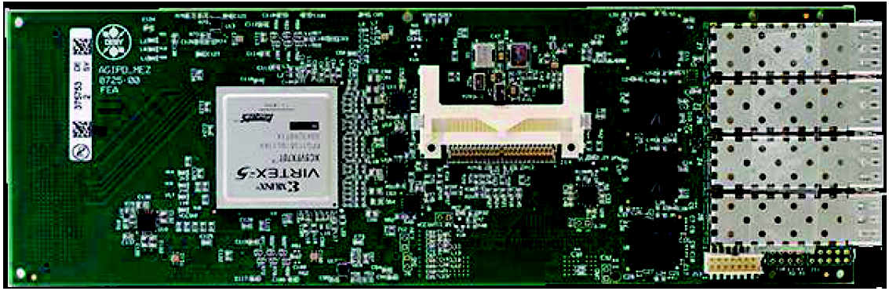
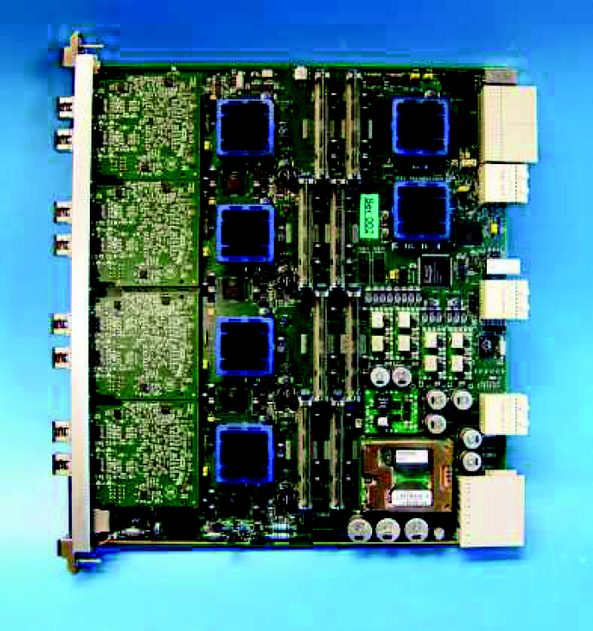
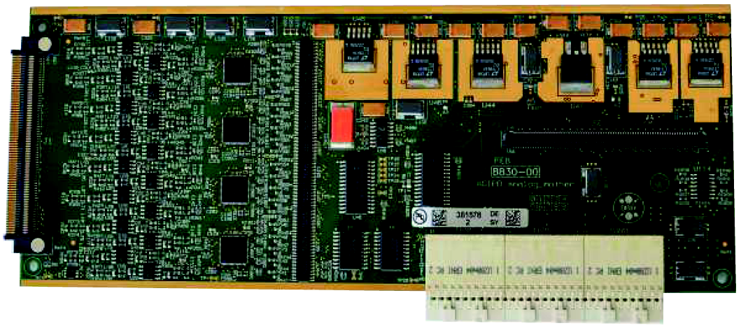
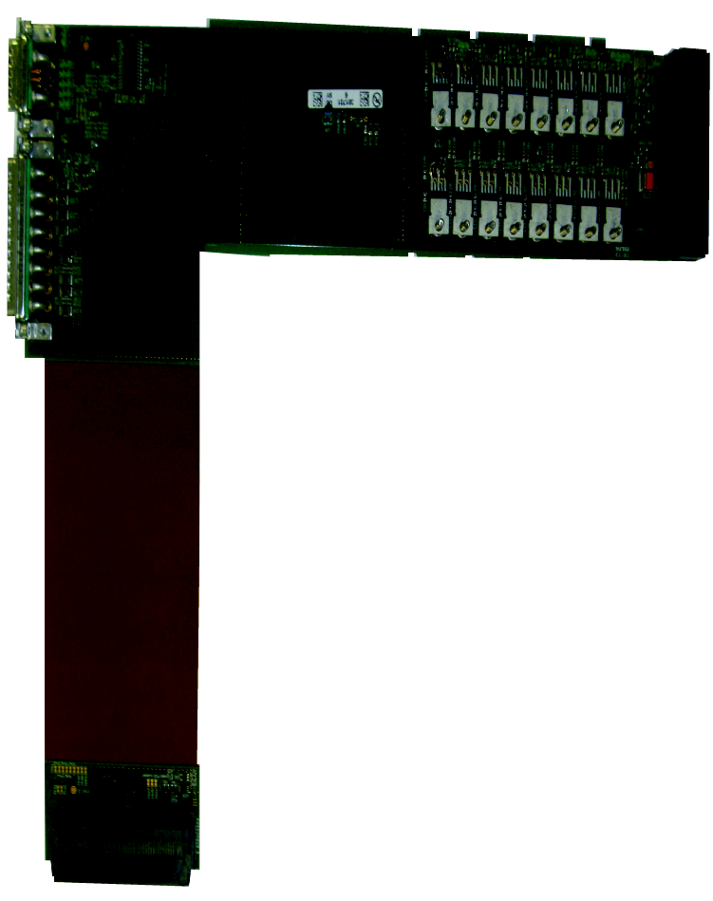
Detector structure
Si-Sensor with pixels 200μm squared
Digital PCBs for preprocessing and data transfer adapted to train cycle
Analogue PCBs
for filtering and digitization
Interconnections and power board
to adapt to mechanical needs
and provide power
Off detector
DAQ for data handling
ASIC with electronics
behind each pixel to store
the value of the charge

Slide 23
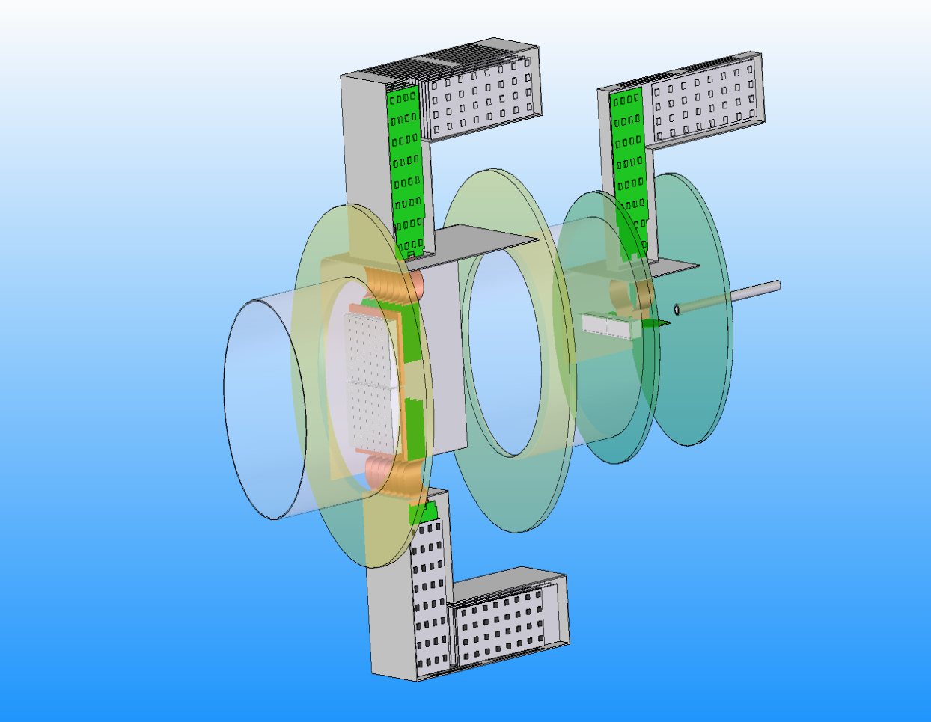
Mechanical concept
Wing layout and downstream detector
One megapixel system without vacuum tank
quadrant
8 chips
2 chips
module
4 modules per quadrant
Modules and quadrants
For operation at the European XFEL it is currently foreseen to have an AGIPD 1M system at the SPB beamline, followed by a second 1M system for the MID beamline. In order to increase the angular coverage towards the central beam, the SPB beamline at the European XFEL will additionally employ a 128k downstream detector consisting of 2 modules. Installing a 4M system, and/or single module systems at a later date is currently under discussion.
AGIPD 1M system is subdivided into 4 independently movable quadrants that will allow the user to define arbitrary hole sizes within the 25 mm by 25 mm limit of the system. Each individual quadrant carries 4 detector modules, the basic building blocks of the system. In order to reduce the amount of space occupied along the beam axis, the electronics was designed in an angled shape, and form so called wings.
The basic building block of the detector system is the module, where each module is, in principle, an independent detector unit. A hybrid is formed by an array of 2 x 8 ASICs which are bump bonded to the monolithic pixelated silicon sensor. The hybrid is then glued onto a sensor board made from low temperature co-fired ceramics (LTCC). Then the hybrid is electrically connected to this LTCC board by wirebonding to form the bare module.

Slide 24
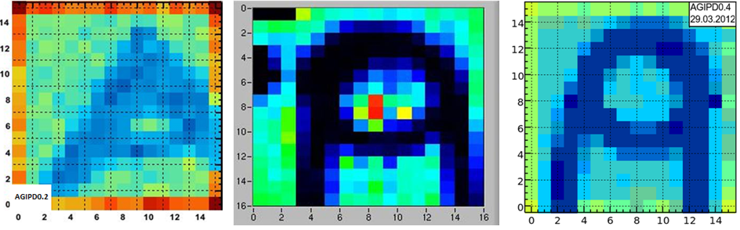
ASIC: prototype development
AGIPD 0.1 Jan. 2009
AGIPD 0.2 May 2009
AGIPD 0.3 Nov. 2010
AGIPD 0.4 Nov. 2011
AGIPD 1.0 Apr. 2013
• No pixels
• 3 readout blocks consisting of:
- Readout chain (Preamp + CDS stage)
- 3 different kinds of leakage current
compensation
• 16 x 16 pixels
• 100 storage cells
• No leakage current compensation
• Different combinations of preamps and storage cell architectures
• 16 x 16 pixels
• 200 storage cells
• Radiation hard storage cell design
• High speed command based control interface
• Improved discriminator and CDS buffer
• 16 x 16 pixels
• High sensitivity preamp (Cf = 60 fF)
• 352 storage cells
• Double-column readout
• New multiplexer
• New off-chip buffer
• No command based control circuit
Full-scale chip:
• 64 x 64 pixels
• High sensitivity preamp (Cf = 60 fF)
• 352 storage cells
• Double-column readout
• High speed command based control interface
Ready for TSV
First imaging tests with the AGIPD prototype chips in an X-Ray box. The 'A' was made from copper. From left to right: AGIPD0.2, AGIPD0.3, AGIPD0.4, AGIPD1.0 – AGIPD0.2 „A“ in addition to the fragment of an AGIPD logo made of Sn soldering wire.

Slide 25
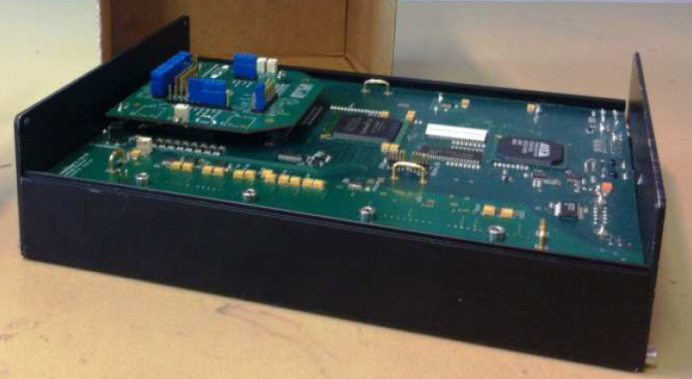
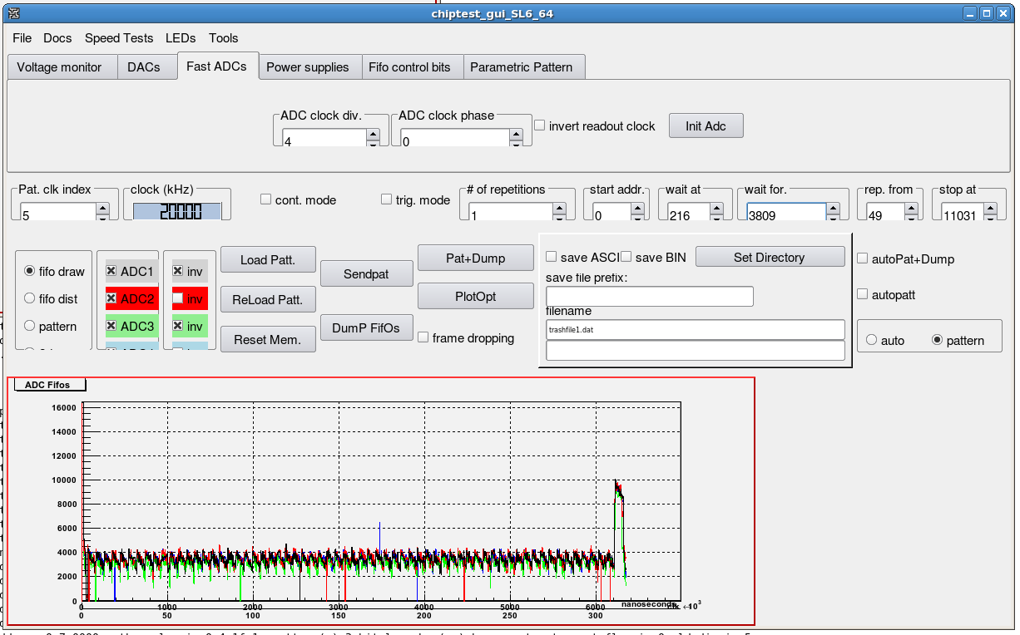
ASIC: characterization
Values measured with chiptester box

Slide 26
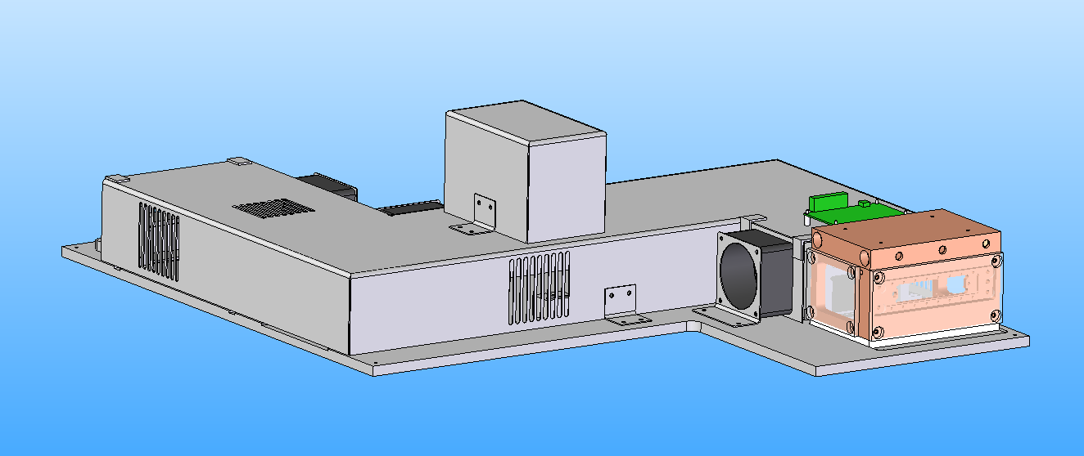
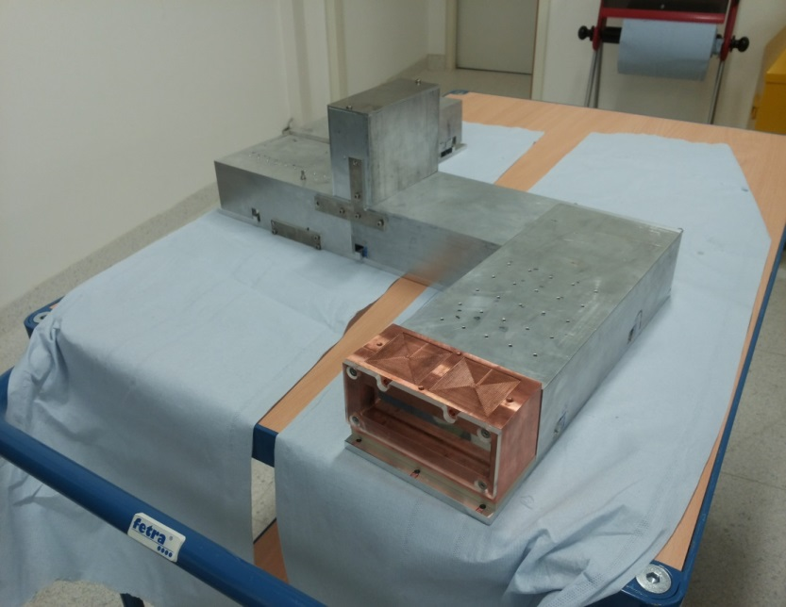
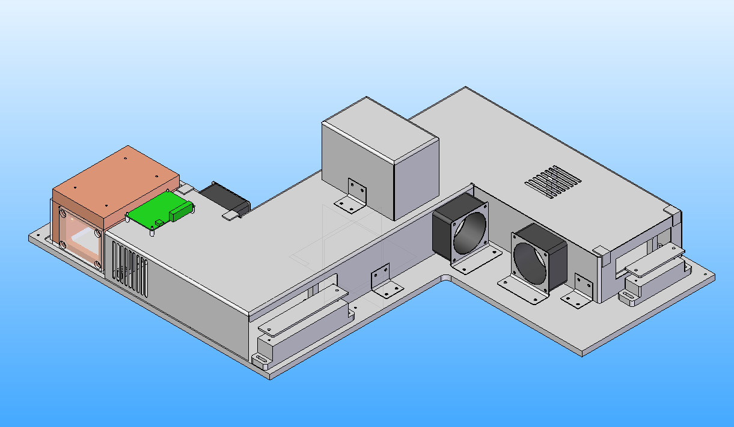
Single module test system
Single module system in the lab with housing – existing and new design
New design
Front
Old
New cooling block
Fans
Back

Slide 27
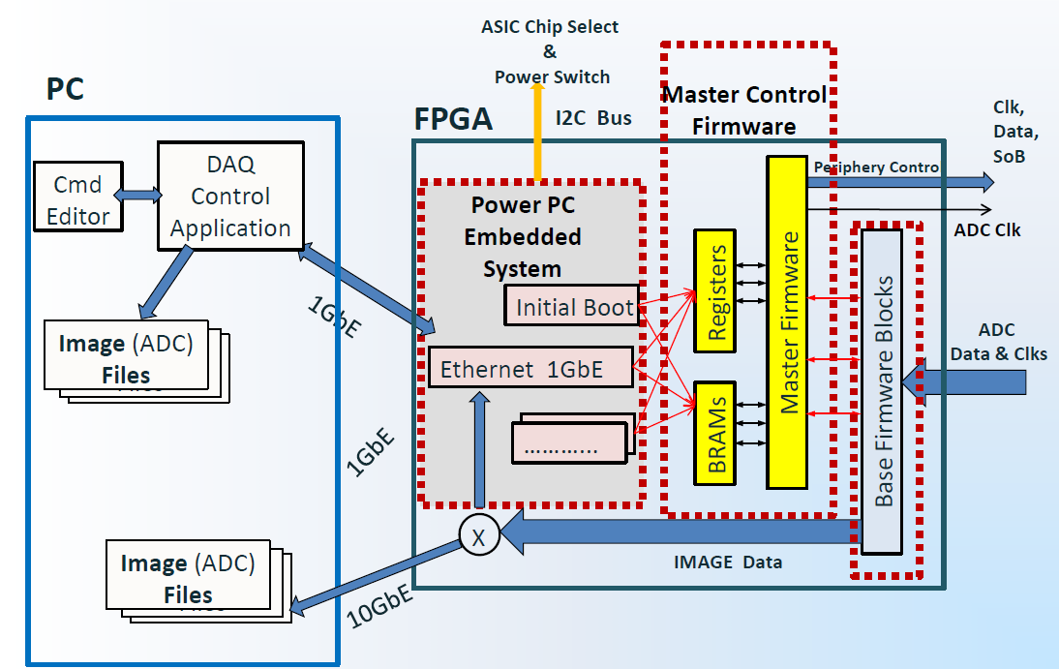
DAQ system: concept

Slide 28
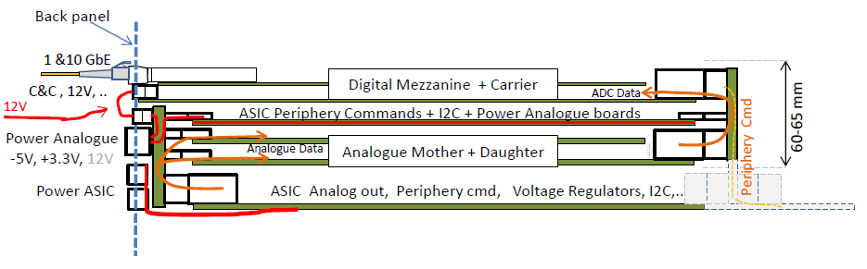
Other AGIPD systems
AGIPD single module compact design
LTCC
module

