Slide 1


PGRIS:
Towards portable Compton Camera Imaging
Samantha Colosimo∗, Andrew Boston∗, Helen Boston∗,
Laura Harkness-Brennan∗, Daniel Judson∗, Ian Lazurus†, Paul Nolan∗, Paul Seller‡, John Simpson†, and Matthew Veale‡
∗Department of Physics, University of Liverpool, Liverpool L69 7ZE, UK
†STFC Daresbury Laboratory, Daresbury, Warrington WA4 4AD, UK
‡STFC Rutherford Appleton Laboratory, Harwell Science and Innovation Campus, Didcot OX11 0QX, UK

Slide 2

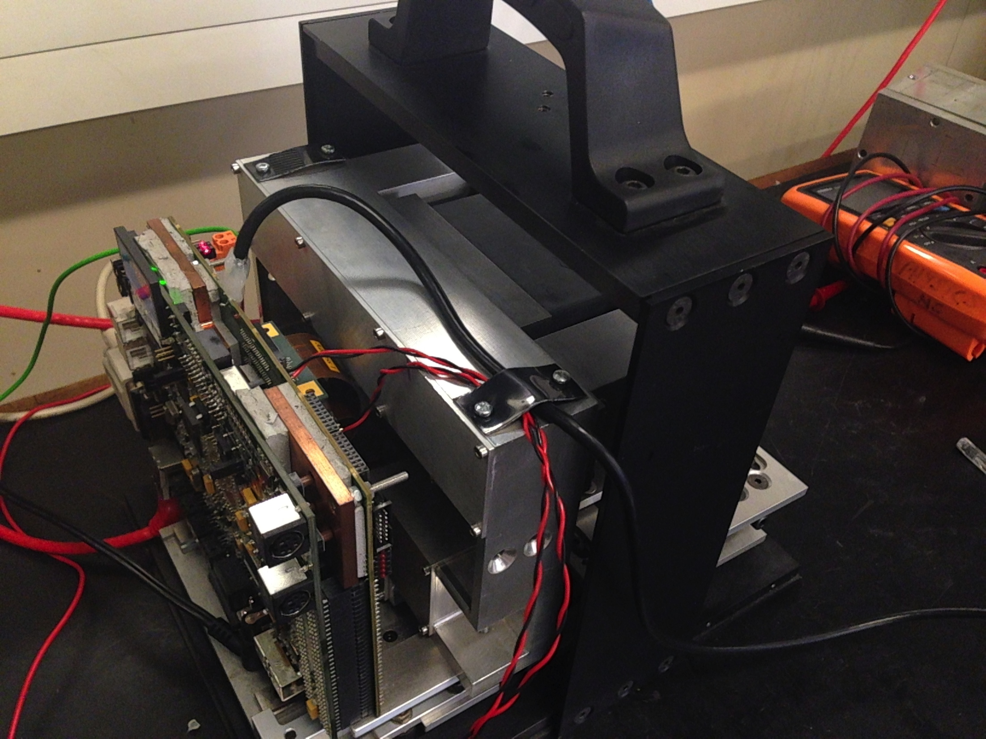
Overview
Portable Imaging and Spectroscopy
Compton Camera Principle
PorGamRays Project
Image Reconstruction
The PGRIS detectors and ASICs
Future characterization work

Slide 3
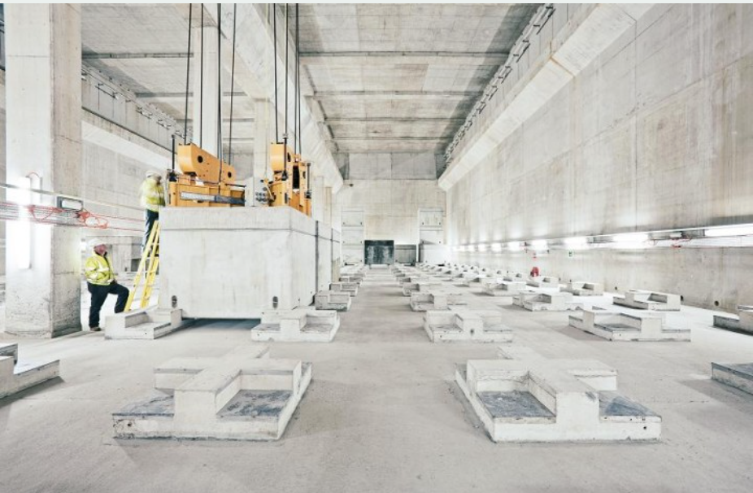
Portable Imaging
Aim – To create a portable gamma-ray spectroscopy and imaging system for decommissioning, security, and medical applications.
System will be:
Handheld and battery operated
Able to work at room temperature
Capable of isotope identification
Detect sources in 3D space
Waste storage at Nuclear Decommissioning Authority. http://www.nda.gov.uk

Slide 4
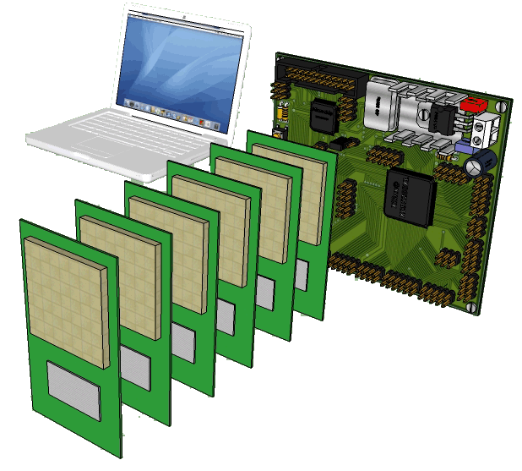
Portable Imaging
Detecting sensors chosen to operate in a modular system – No cooling
Need excellent spectroscopic performance.
3D Imaging will be performed based on the Compton camera principle.
Radioactive material found quickly, reducing cost, false alarms and search times while increasing cargo throughput
Portable imaging and spectroscopy
device.

Slide 5
Compton Camera Principle
The Compton camera principle relies on projecting Cones of Response into imaging space.
Gamma-ray energy will be deposited in a detector through Compton scattering and then absorbed in a second detector via the photoelectric effect.
Cones are projected using the Compton scattering equation.
Require a knowledge of energy, position and time.

Slide 6
Compton Camera
The cone axis is determined through the interaction positions in the scatter and absorber detectors.
The energy deposited determines θ.
From these parameters a cone is reconstructed.
θ
Source

Slide 7
Compton Camera
From the overlap of multiple cones, the source location can be found.
Source

Slide 8
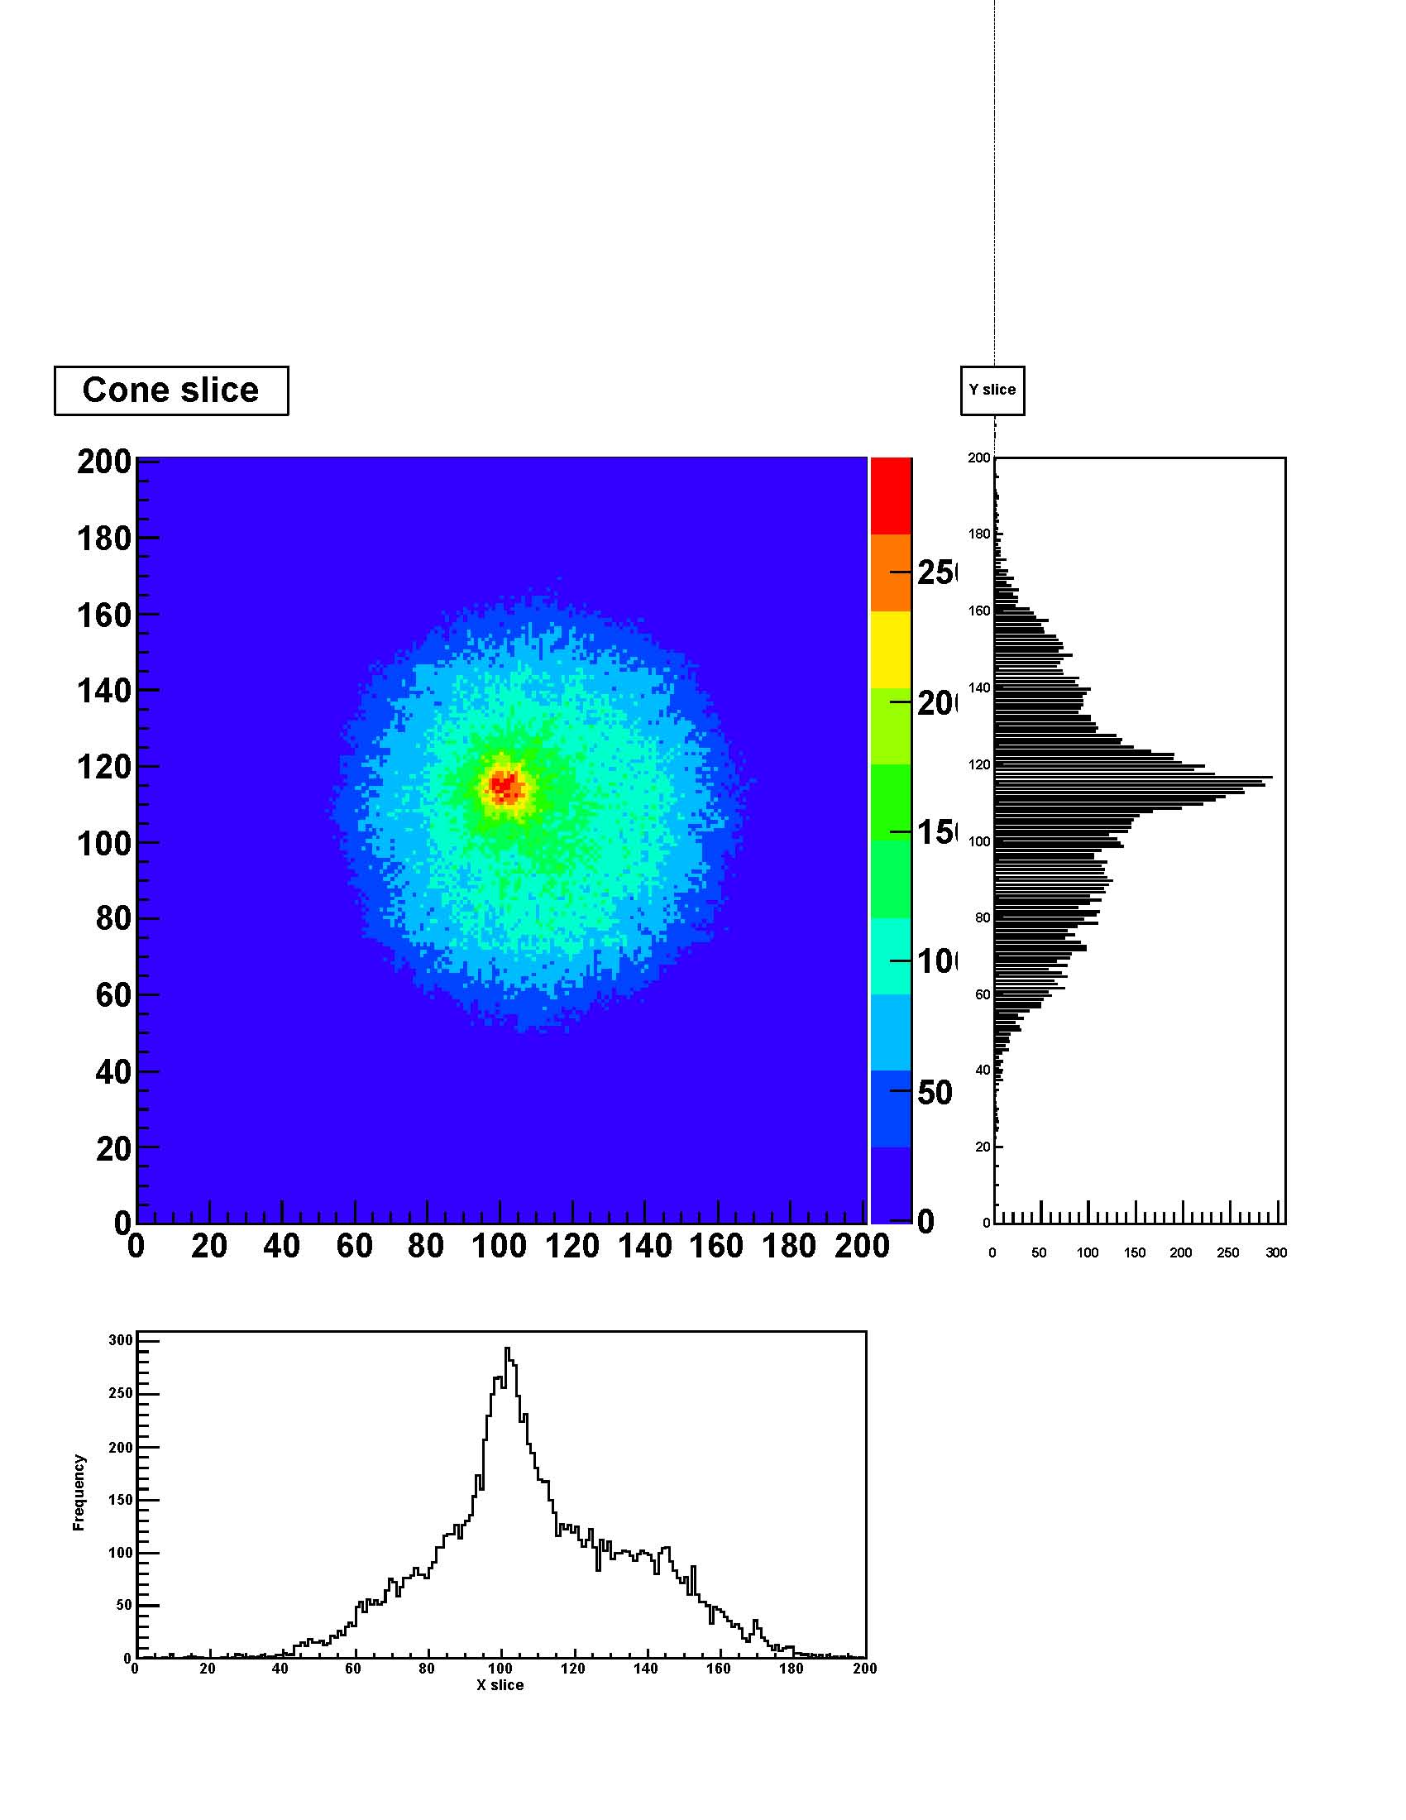
PorGamRays
The PorGamRays system was designed to prove the possibility of near field imaging with CZT & Si detector based Compton camera¹.
Original design of CZT – ideal due to wide band gap detector stack with 5 mm separation in a modular design.
Spectroscopy and imaging capabilities proven.
  ³³Ba - 357 keV photon = FHWM ~ 20 mm
y (mm)
x (mm)
D.S. Judson et al. Nuclear Instruments and Methods in Physics Research A, 652 (2011), p. 587

Slide 9
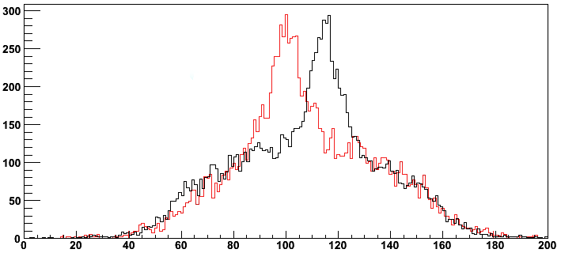
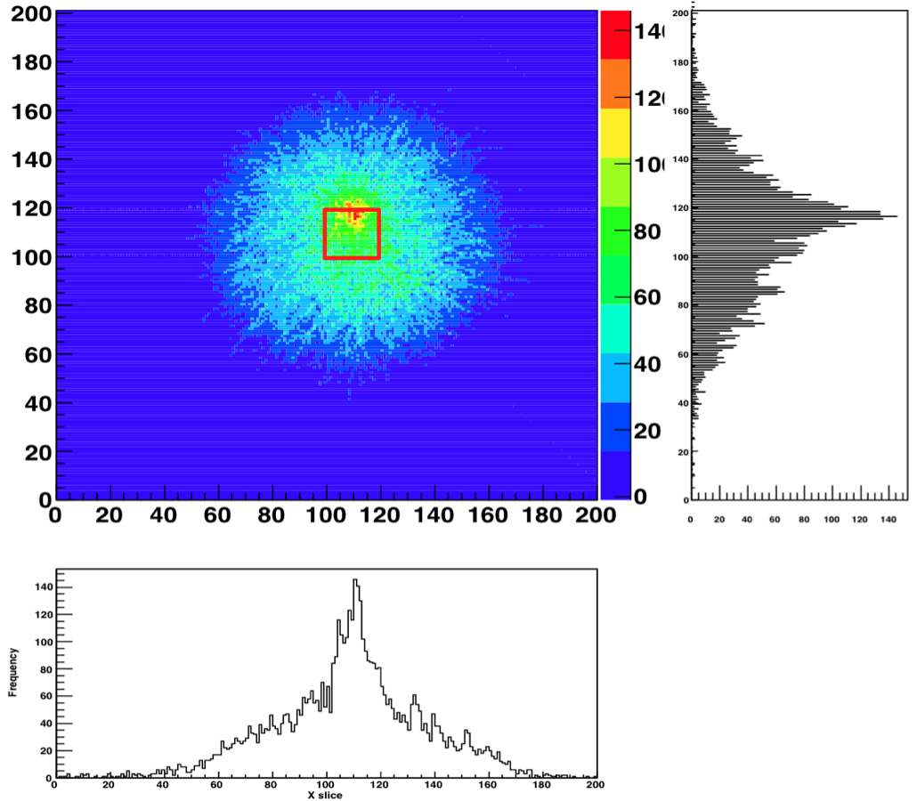
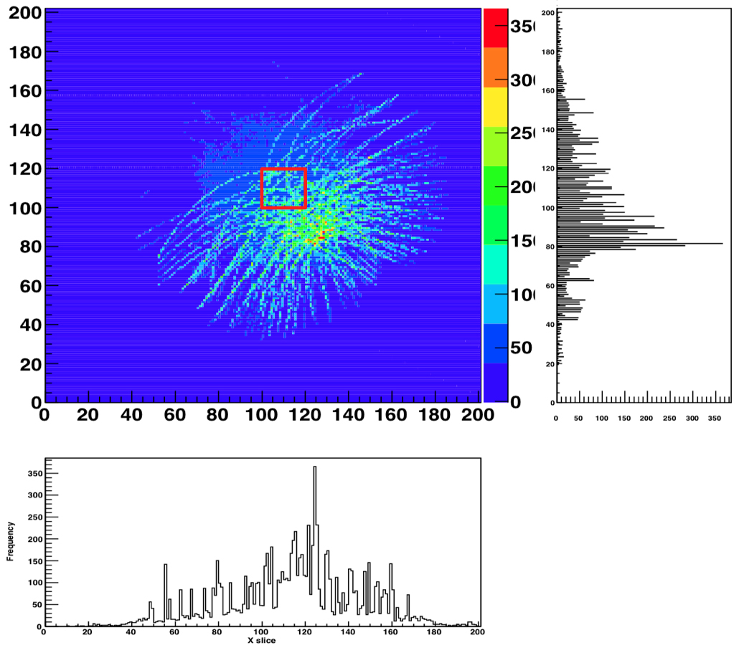
PorGamRays
x = 115 mm
x = 95 mm
Measured changes in the source position of 10 mm.
Multi source imaging
  Ba¹³³ (356 keV) and Co⁵⁷ (151 keV).
PorGamRays was limited by the use of NUCAM II ASICS¹ available at the time,
  Limited energy range (up to ~350 keV).
  Not able to readout multiple channels to account for the charge sharing between segments -> leading to poor energy resolution
x position (mm)
¹³³Ba (356 keV) ⁵⁷Co (121 keV)
x = 110, y = 120 mm, x = 130 mm, y =85 mm
P. Seller et. al., IEEE Nuclear Symposium Conf. Rec., V6, 3786, ’06
D. Judson at Imaging 2010

Slide 10
Developments after PorGamRays
Imaging Methods – D. Judson
  Real time imaging capability has been developed.
  An iterative reconstruction algorithm has been developed at the Liverpool.
New detectors modules
  New CZT and Si detectors.
  New ASICs which will increase the energy range and allow for multichannel readout.

Slide 11
Image Reconstruction
Image reconstruction can be performed using both analytical and iterative algorithms (OSEM, MLEM).
Analytical reconstruction was employed in the PorGamRays project.
The iterative method has been employed on the data.
  ¹³³Ba:

Slide 12
Portable Gamma-Ray Imaging Spectrometer - PGRIS
PGRIS is being developed to expand the capabilities of the system.
  Modular design
  New detector modules (CZT and Si), which will posses an imaging range of 60 keV – 1.5 MeV.
  Specially developed PGRIS ASICs, which are capable to allow spectroscopy on photon energies ranging from 60 keV to ∼8 MeV.

Slide 13
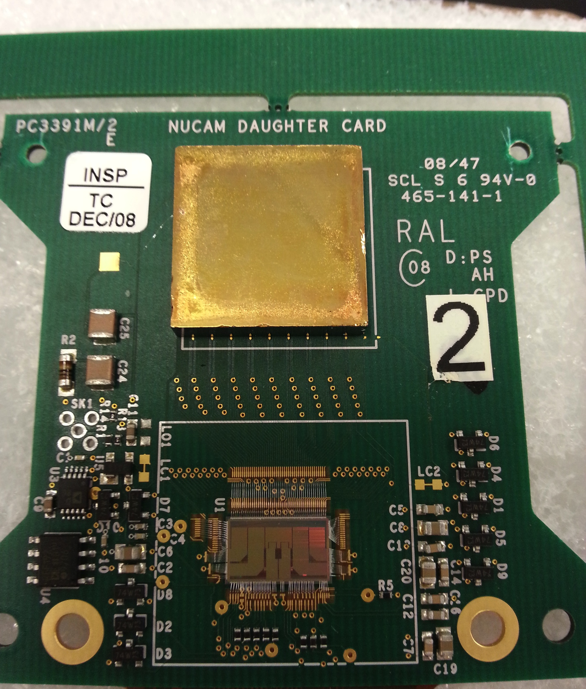
PGRIS Detectors
CZT Detectors:
  Provided by STFC RAL.
  Ideal for High Resolution gamma-ray spectroscopy
  20 x 20 mm detectors
  2 mm thick detector, 2x2x2 mm, 8 mm³ voxels.
  5 mm thick detector, 5x2x2 mm, 20 mm³ voxels.
  Si Detector:
    20 x 20 mm, 1000 μm thick
    Manufactured by Micron Semiconductors
    100 pixels
    Image photons down to the 60 keV.
Fig. PGRIS 5 mm CZT Detector mounted on daughter card with NUCAM II ASIC

Slide 14
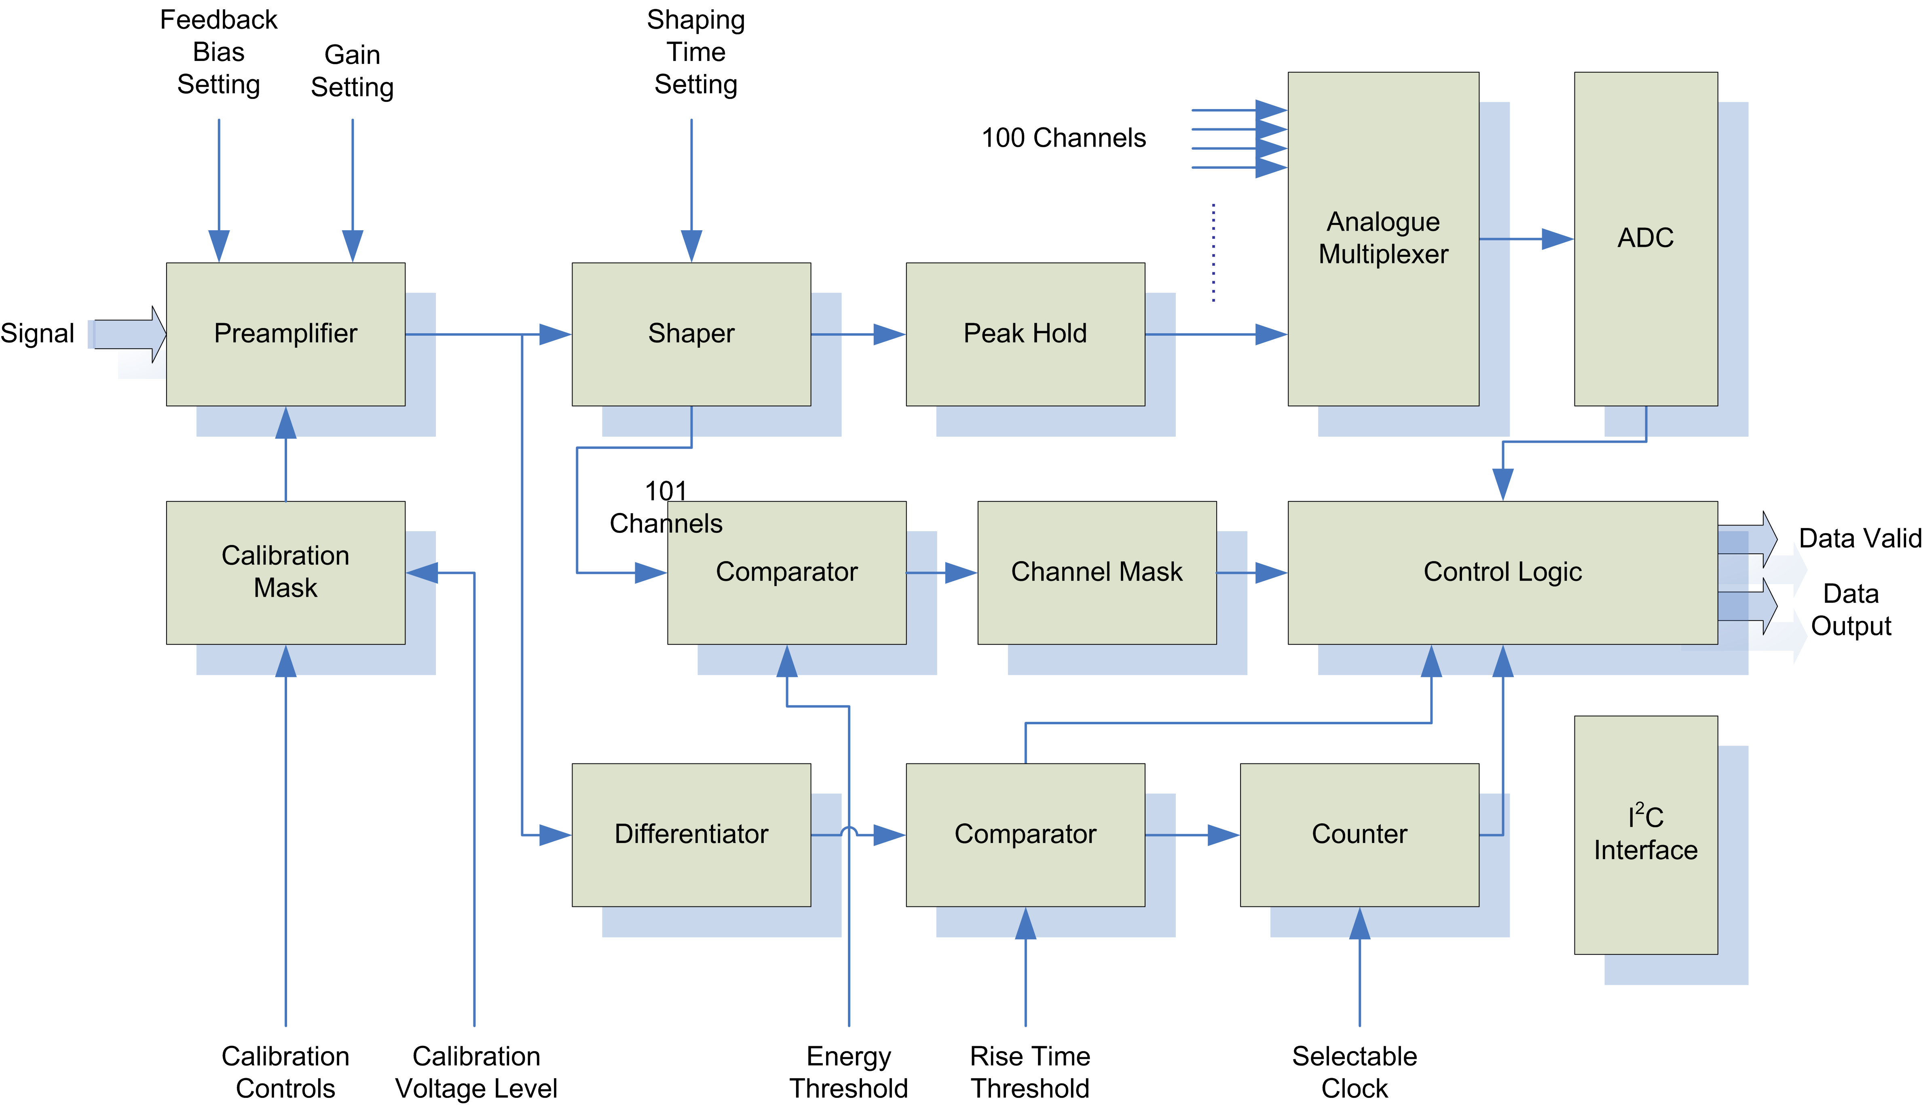
PGRIS ASICs
Some Functional Specs:
Power supply: 3.3V
Clock frequency: 32MHz
100 data channels
One further channel for timestamp monitoring
DC input coupling
Leakage current compensation: up to 150nA
Selectable gain - input range: 80k or 400k electrons
Selectable shaping time: 0.5μs to 7.5μs - 4bit resolution
For every event above an externally defined energy threshold, channel number, amplitude, charge collection time and timestamp are transmitted.
The threshold is externally adjustable.
The PGRIS ASIC has two outputs: external ADC and internal ADC on daughter cards which can send data to the readout FPGA.
Designed for higher energy events, which will improve upon the previous issues with charge sharing.
Data from neighbouring channels are also read out as part of the same event.

Slide 15
Modification of PGRIS motherboard
Test and characterize the new CZT detectors, which have been mounted onto NUCAM2 daughter boards.
In order to power two CZTs of difference widths, a modification to the motherboard will be made.
Detectors require field strength of 4,000 – 5,000 V cm⁻¹.
2 mm ~ 800 - 1000 V
5 mm ~ 2000 - 2,500 V
The power supply will need to be changed to power two detectors simultaneously with different bias voltages.

Slide 16
Next steps
Test and characterize the new CZT detectors with radiation
  -> these are currently mounted onto NUCAM2 daughter boards and awaiting testing.
The second stage is to mount these detectors with the purpose built PGRIS ASICs.
Test system with new Silicon detector, mounted to PGRIS ASICs.
Produce Compton images with the analytical and iterative imaging algorithms.

Slide 17
Summary
A portable Compton Camera device is being developed at the University of Liverpool.
The proof of principle work developed by the PorGamRays system will be improved upon with the use of new detectors and ASIC modules, expanding the capability of the system.
Characterisation work will be performed with the new detectors along with the purpose built PGRIS ASICS.

Slide 18
PGRIS:
Towards portable Compton Camera Imaging
Samantha Colosimo∗, Andrew Boston∗, Helen Boston∗,
Laura Harkness-Brennan∗, Daniel Judson∗, Ian Lazurus†, Paul Nolan∗, Paul Seller‡, John Simpson†, and Matthew Veale‡
∗Department of Physics, University of Liverpool, Liverpool L69 7ZE, UK
†STFC Daresbury Laboratory, Daresbury, Warrington WA4 4AD, UK
‡STFC Rutherford Appleton Laboratory, Harwell Science and Innovation Campus, Didcot OX11 0QX, UK

