Slide 1


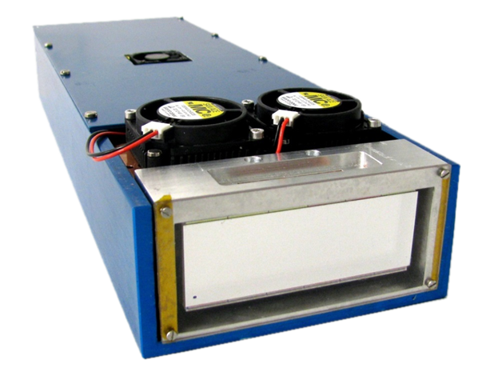
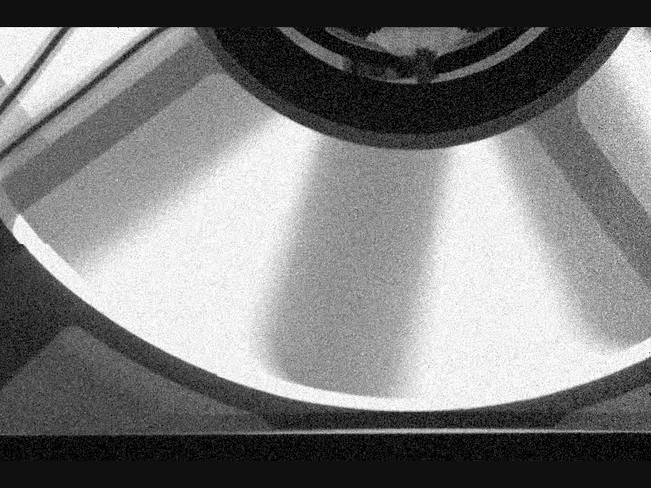
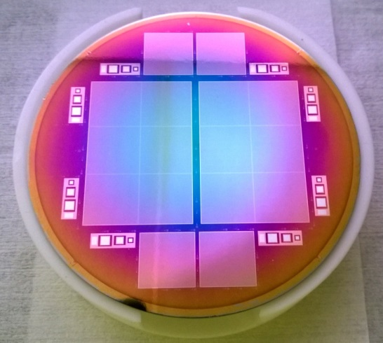
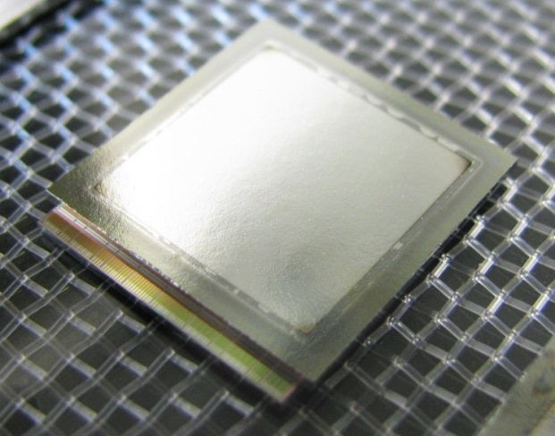
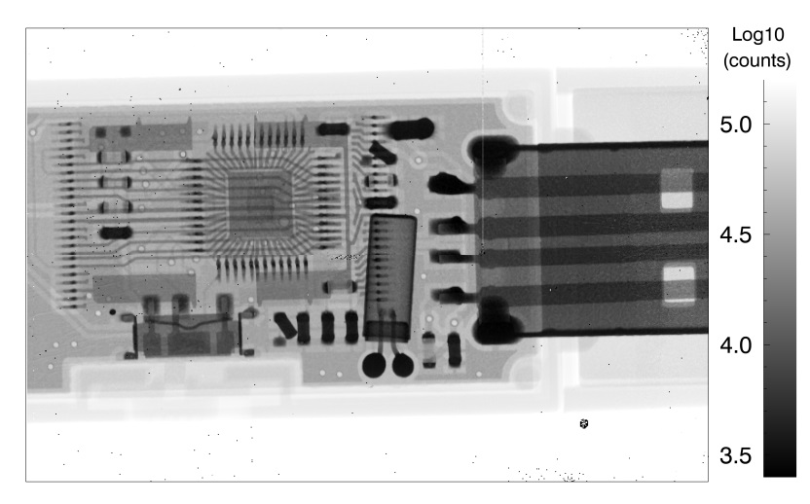
The LAMBDA pixel detector with high-Z sensors
David Pennicard, Sergej Smoljanin, Milija Sarajlic, Jiaguo Zhang, Helmut Hirsemann, Bernd Struth, Heinz Graafsma – DESY, Hamburg
Notes:
X-ray detector system, based on the Medipix3 readout chip

Slide 2
Overview
LAMBDA (Large Area Medipix3-Based Detector Array)
High-Z hybrid pixel detector development
  Gallium Arsenide
  Cadmium Telluride
  Germanium
Notes:
Stress first two materials built into practical systems, Germanium as new development

Slide 3
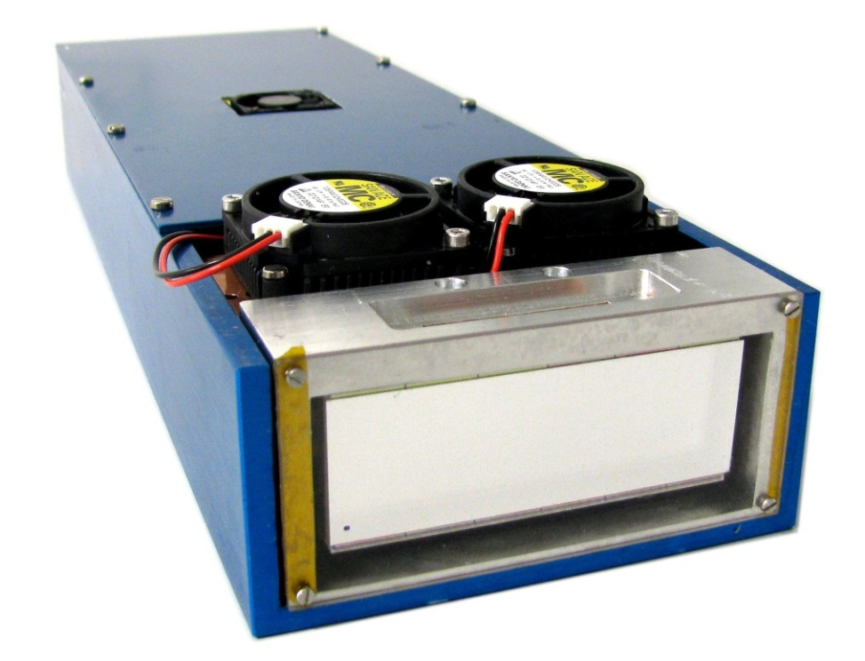
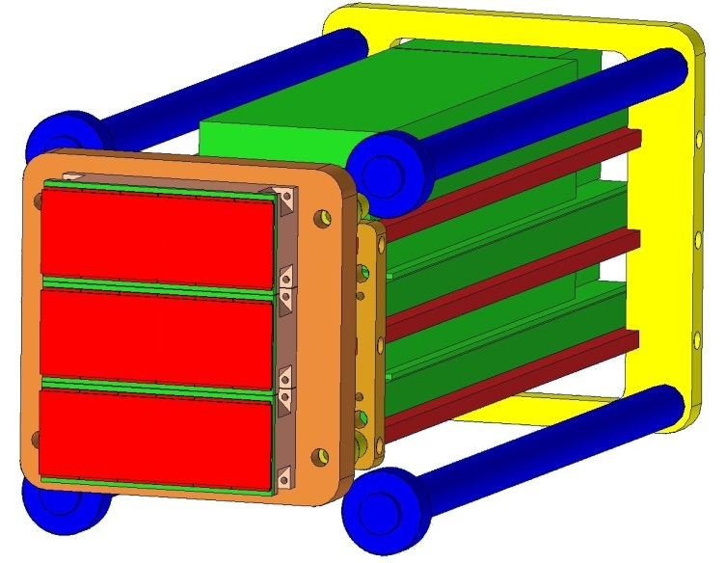
Large Area Medipix3-Based Detector Array (LAMBDA)
Aimed at X-ray scattering and imaging at synchrotrons
Photon-counting system using Medipix3 chip
Small pixel size – 55 µm
Large tileable module layout
High-speed readout
  2000 fps with no dead time
Compatible with high-Z materials
3-module design
Notes:
Tileable module design – Question of demand from beamlines

Slide 4
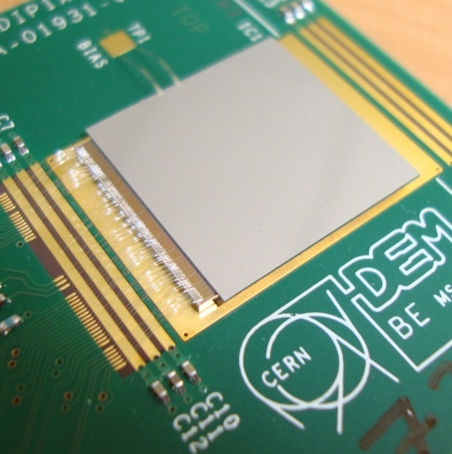
Medipix3 readout chip
Collaboration of ~20 groups led by CERN
  Talk by Michael Campbell later
Flexible pixel design
  2 counters and thresholds per 55µm pixel, plus interpixel communication
Major applications:
  Fast, deadtime-free frame readout
    2000 fps @ 12 bit depth
  “Colour imaging”
    Photon hits divided into energy bins
Notes:
Michael Campbell

Slide 5

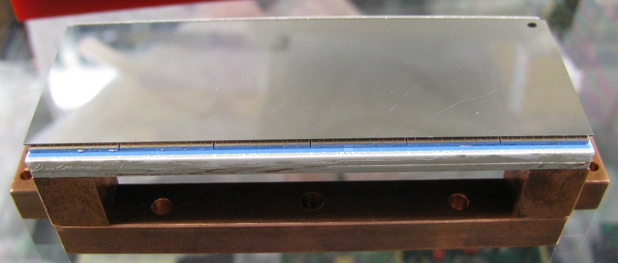
System design
12 readout chips bonded to large Si sensor (or smaller high-Z)
1.5k x 1.5 k multi-module
256 x 256 chip
1536 x 512 module (750k)
85 mm
14mm
28 mm
Common DESY high-speed readout card
  FPGA with PowerPC for control, up to 4 x 10 Gigabit Ethernet links
  See AGIPD and Percival talks in synchrotron session
Notes:
What about edgeless talk etc?

Slide 6
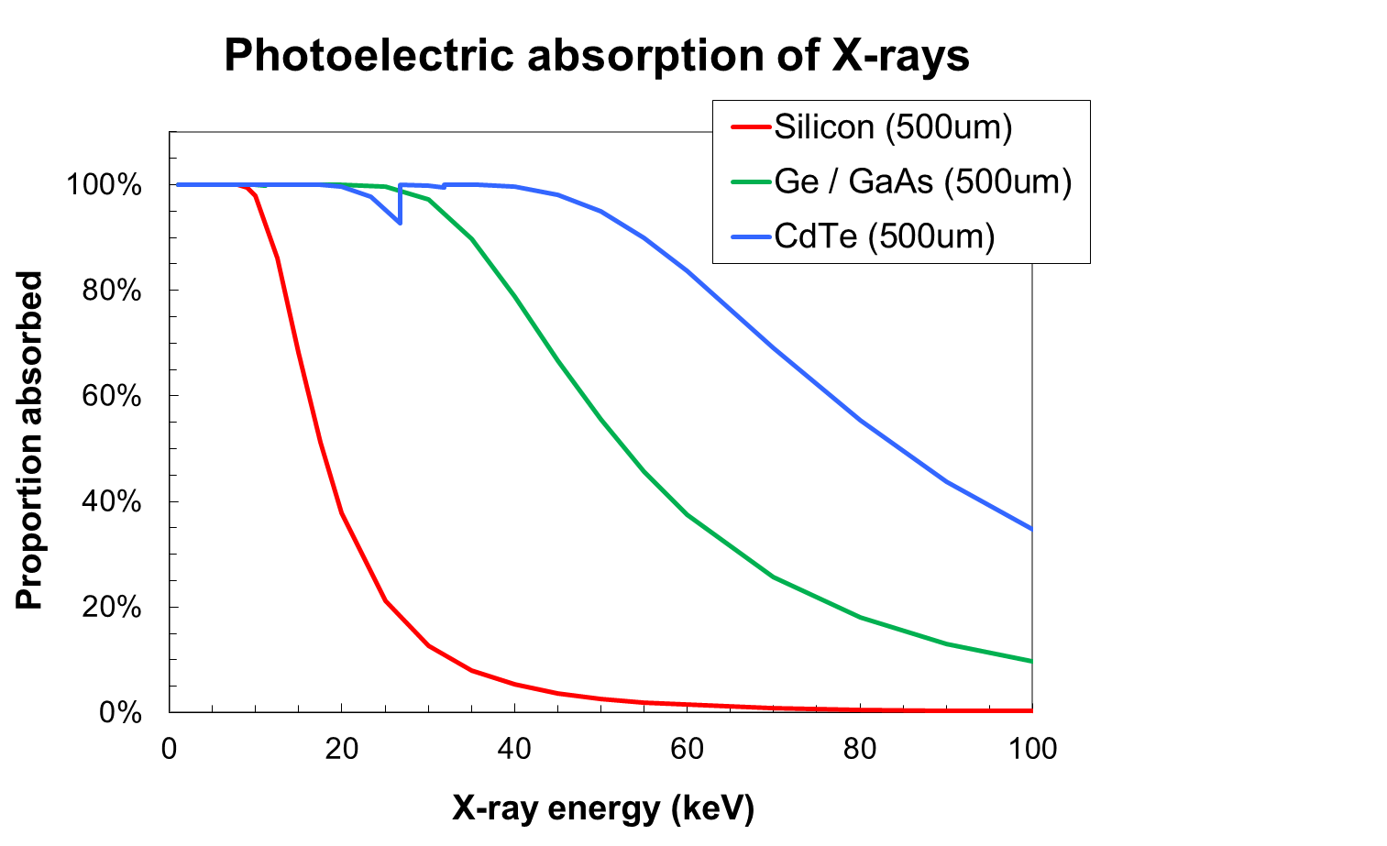
High-Z pixel detectors
Aim: Increase quantum efficiency at hard X-ray beamlines
  Replace silicon sensor in LAMBDA with high-Z semiconductor
Investigating different materials in collaboration with other institutes and industry
  Gallium arsenide
  Cadmium telluride
  Germanium
Notes:
CdTe – most well-established, but still not perfect
Ge – new development
GaAs – Bit of both – recent fast progress

Slide 7
Overview
LAMBDA (Large Area Medipix3-Based Detector Array)
High-Z hybrid pixel detector development
  Gallium Arsenide
  Cadmium Telluride
  Germanium
Notes:
First full system built, been testing on beamlines

Slide 8
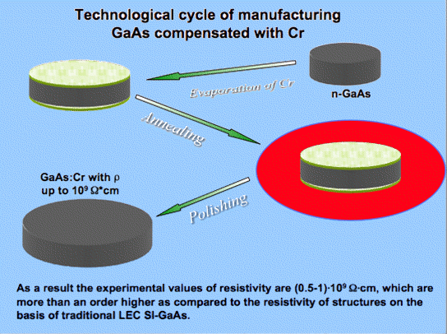
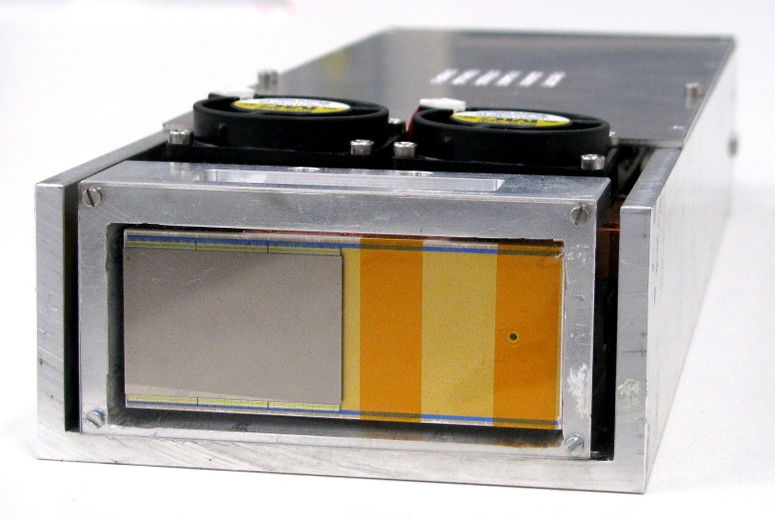
Gallium Arsenide
6 chip layout (768 x 512 pixel, 55um pixel size)
Cr-compensated GaAs from RID Ltd, Tomsk - 500 µm thick
  High-resistivity material with reasonable electron lifetime (~10 ns)
  Cr compensation and ohmic pixelation done at RID - electron readout
Bump bonding at University of Freiburg

Slide 9
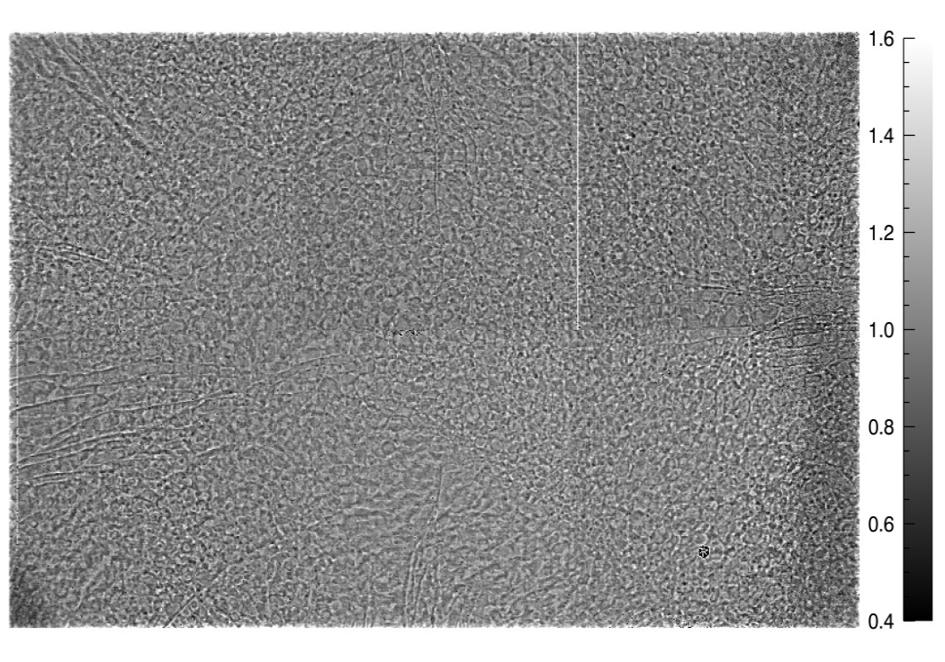
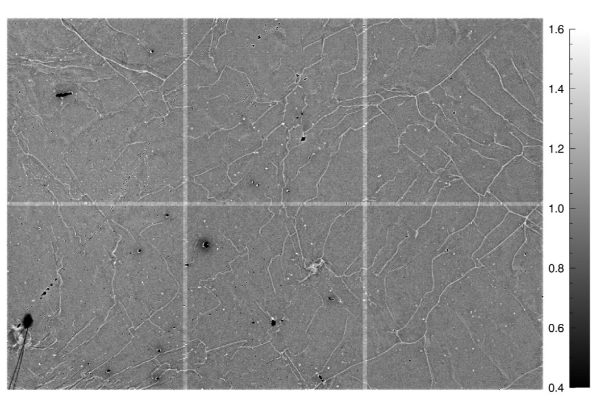
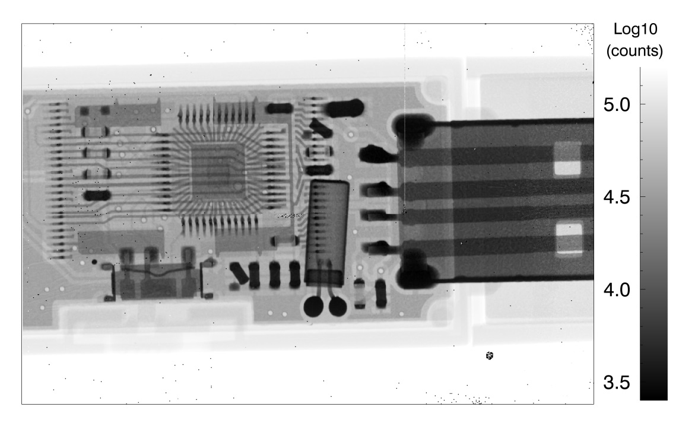
Gallium Arsenide – imaging performance
Cellular nonuniformity structure
0.16% dark pixels (640), 0.08% hot pixels (300) excluding chip errors
Flat field (Mo tube @ 40kV, -300V bias)
USB stick, FF corrected
1.6
0.4
Good time stability – see Elias Hamann (2013), Characterization of High Resistivity GaAs as Sensor Material for Photon Counting Semiconductor Pixel Detectors
Notes:
Should give info on non-functional pixel number, and also X-ray tube conditions

Slide 10
Gallium Arsenide – imaging performance
Cellular nonuniformity structure
0.16% dark pixels (640), 0.08% hot pixels (300) excluding chip errors
Flat field (Mo tube @ 40kV, -300V bias)
USB stick, FF corrected
1.6
0.4
Good time stability – see Elias Hamann (2013), Characterization of High Resistivity GaAs as Sensor Material for Photon Counting Semiconductor Pixel Detectors
Notes:
Should give info on non-functional pixel number, and also X-ray tube conditions

Slide 11
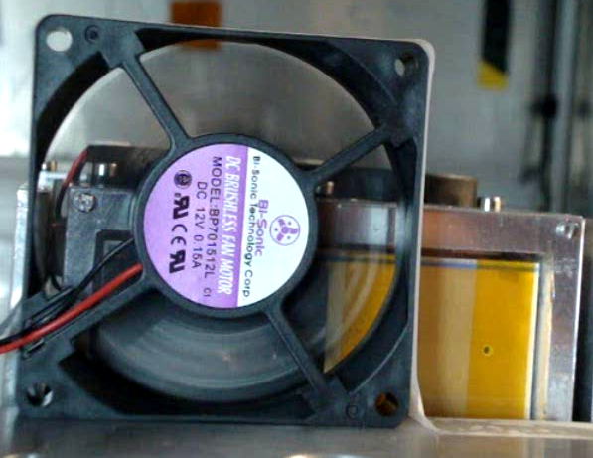
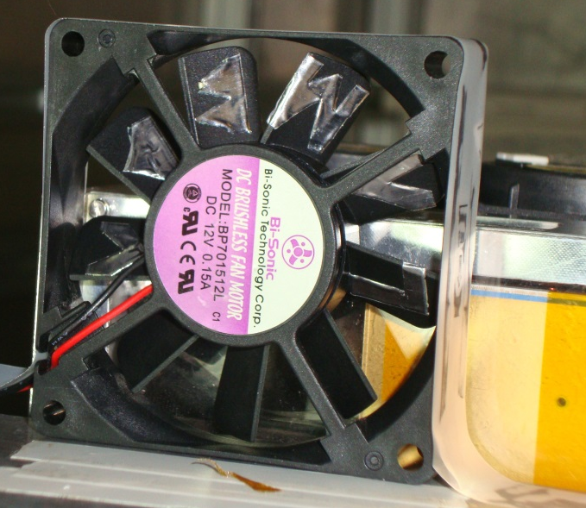
High-speed imaging with GaAs (1000 fps)
1000 fps X-ray imaging, 20 fps playback ( x 50 slowdown)
Mo X-ray tube at 60kV (approx 80 counts in light regions), flat-field corrected and single bad pixels filtered

Slide 12
Overview
LAMBDA (Large Area Medipix3-Based Detector Array)
High-Z hybrid pixel detector development
  Gallium Arsenide
  Cadmium Telluride
  Germanium
Notes:
First full system built, been testing on beamlines

Slide 13
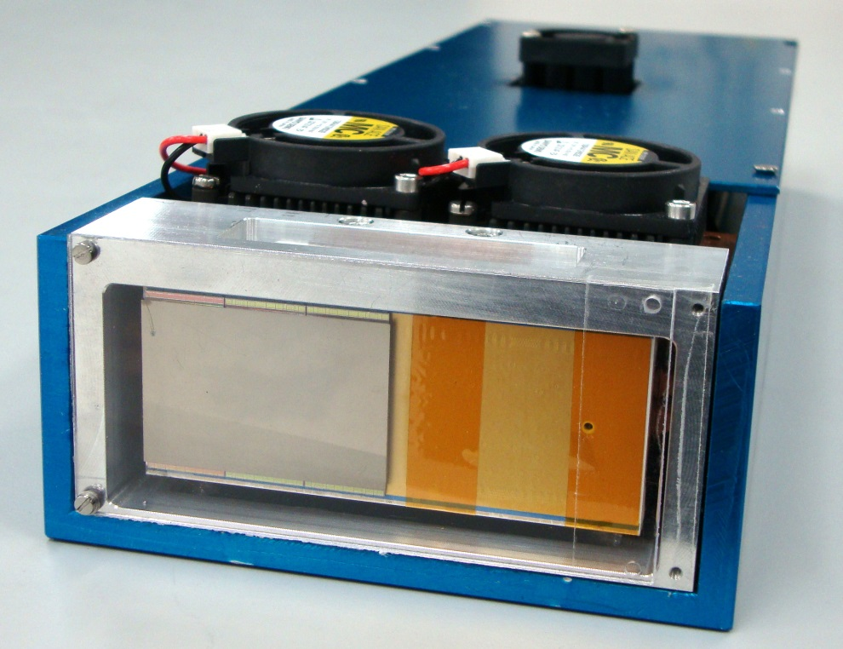
Cadmium Telluride
6-chip layout (768 x 512 pixel, 55um pixel size)
1 mm-thick CdTe from Acrorad
Ohmic pixel contacts and bump bonding at University of Freiburg – electron readout
  Higher leakage current than Schottky, but typically less polarisation

Slide 14
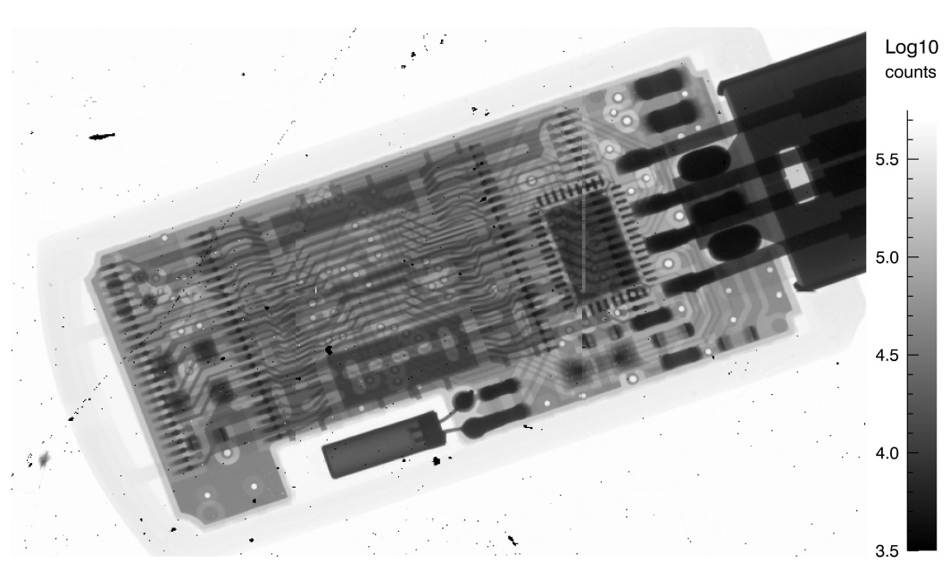
Cadmium Telluride – imaging performance
Some insensitive blobs, network structure
0.28% dark pixels (1116), 0.015% hot pixels (60)
Flat field (Mo tube @ 40kV, -300V bias)
USB stick, FF corrected

Slide 15
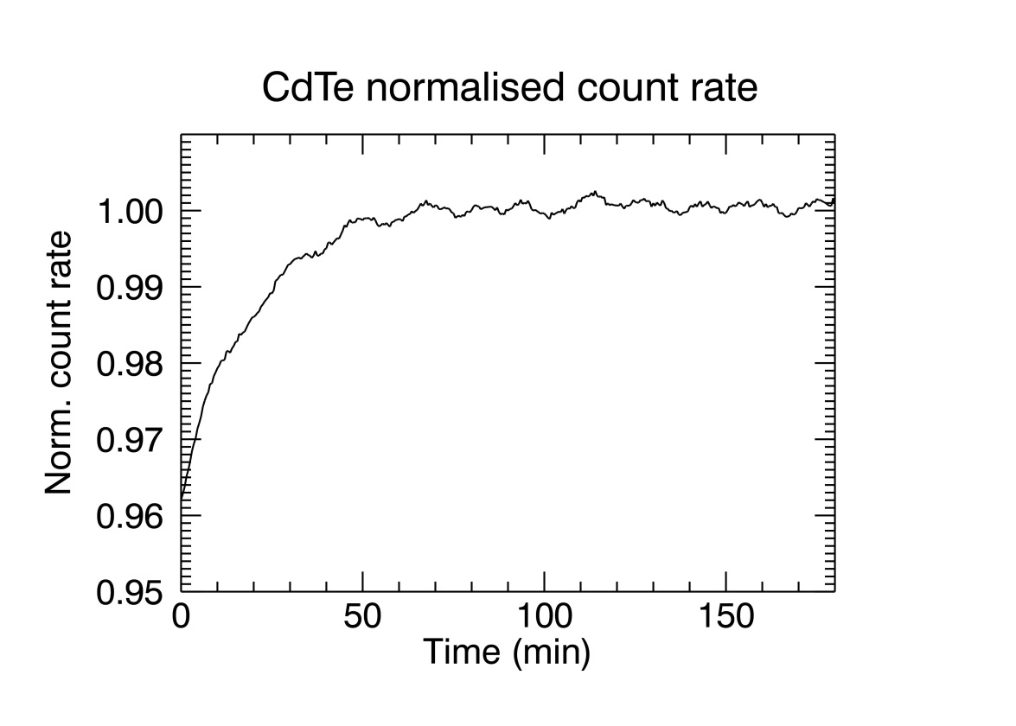
Cadmium Telluride – time variation
Tested at ESRF ID15C with scattered background for 10 hours
+4% over first hour

Slide 16
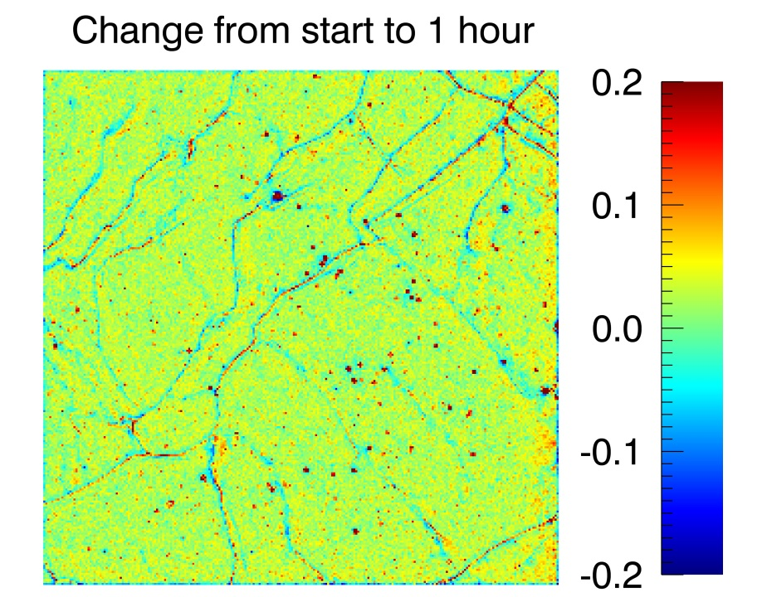
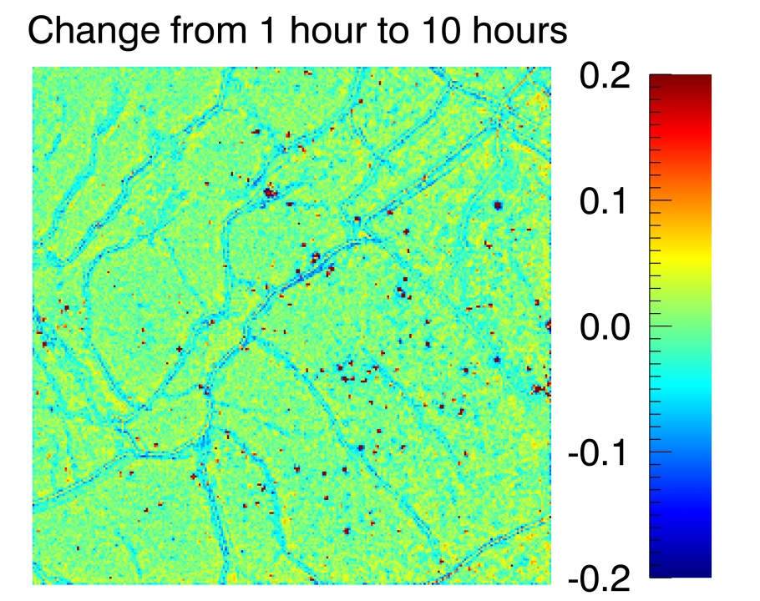
Cadmium Telluride – time variation
Tested at ESRF ID15C with scattered background for 10 hours
+4% over first hour
Notes:
INTENSITY of defect pattern changes

Slide 17
Overview
LAMBDA (Large Area Medipix3-Based Detector Array)
High-Z hybrid pixel detector development
  Gallium Arsenide
  Cadmium Telluride
  Germanium
Notes:
First full system built, been testing on beamlines

Slide 18

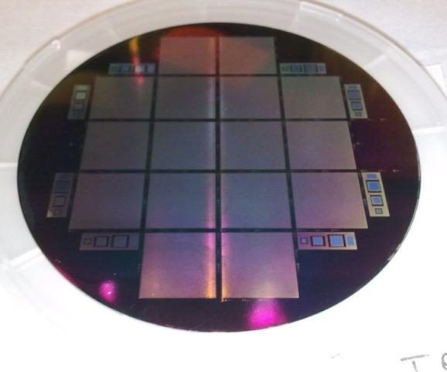
Germanium pixel detector development
Advantages and disadvantages
  High-purity, high uniformity wafers of 90 – 110 mm
  Cooling needed to reduce leakage current
    Operation around -100ºC
    ~1W per chip power
Sensor development at Canberra France
  Photodiode structure with n-side readout
  55 µm pixel size, 700 µm sensor thickness
  Single Medipix3 layout – 256 x 256 pixels
2 high-purity Ge wafers produced
  16 sensors on each wafer
M. Zuvic, M.-O. Lampert
Notes:
Need to rethink the introduction slide – need to think this through!
Note – developing germanium pixel detectors –
Detectors being produced by Canberra Lingolsheim
Also collaborating with IZM to develop bump bonding processes
Germanium is a delicate material!

Slide 19


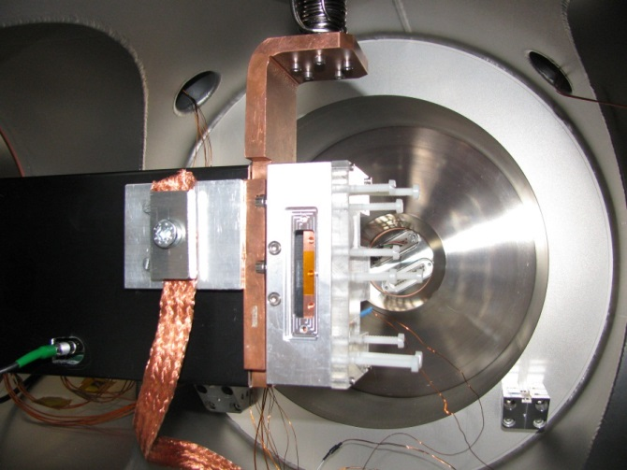
Germanium pixel detector development
Indium bump bonding at Fraunhofer IZM (Berlin)
  Ductility of In allows safe low-temperature cooling
  Low temperature processing (<100ºC)
Test setup at DESY
  LAMBDA uses ceramic circuit board to avoid thermal stresses during cooling
  Sensor assembly and electronics mounted in vacuum chamber for prototype tests
  Cryotiger cooling to -100ºC
T. Fritzsch, M. Rothermund

Slide 20
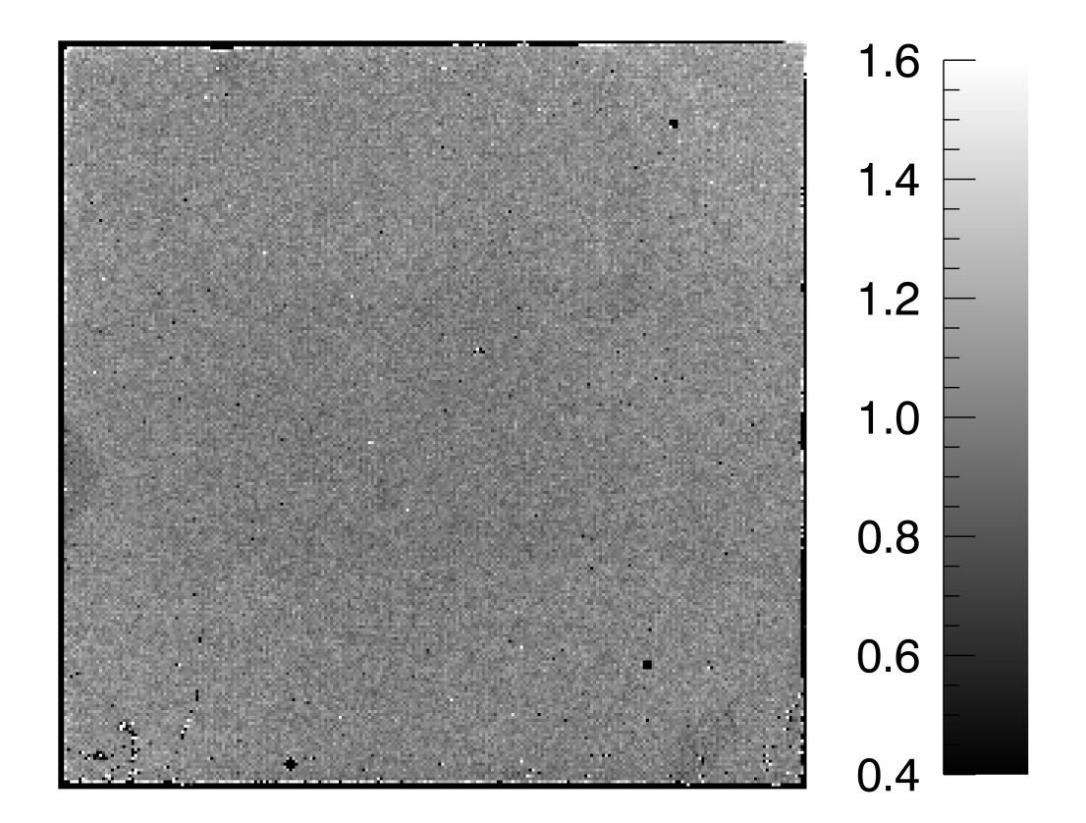
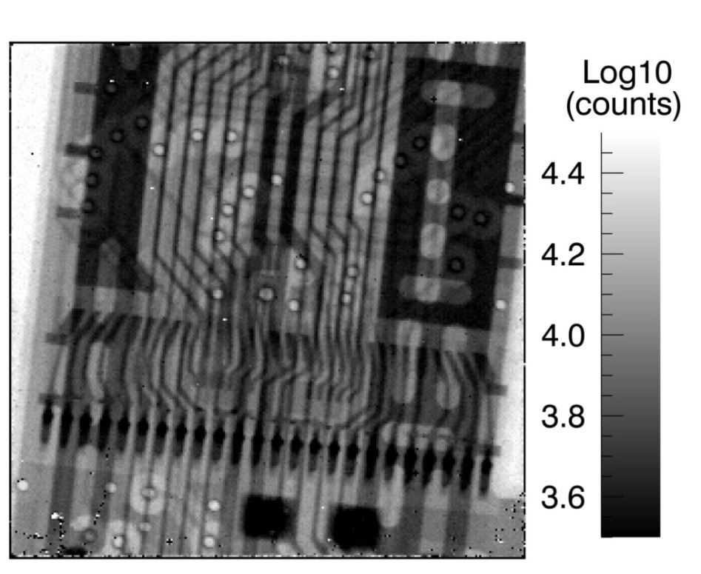
Test results from prototype sensors
Generally uniform response
  Edge pixels nonfunctional due to high leakage current. In central region have 0.23% bad pixels (very similar to GaAs)
Flat field from 50kV Ag tube
USB stick (uncorrected)
Notes:
About 2keV threshold dispersion (i.e. range), 100e RMS expected noise (but not properly tested, since no monochromatic tests yet).

Slide 21
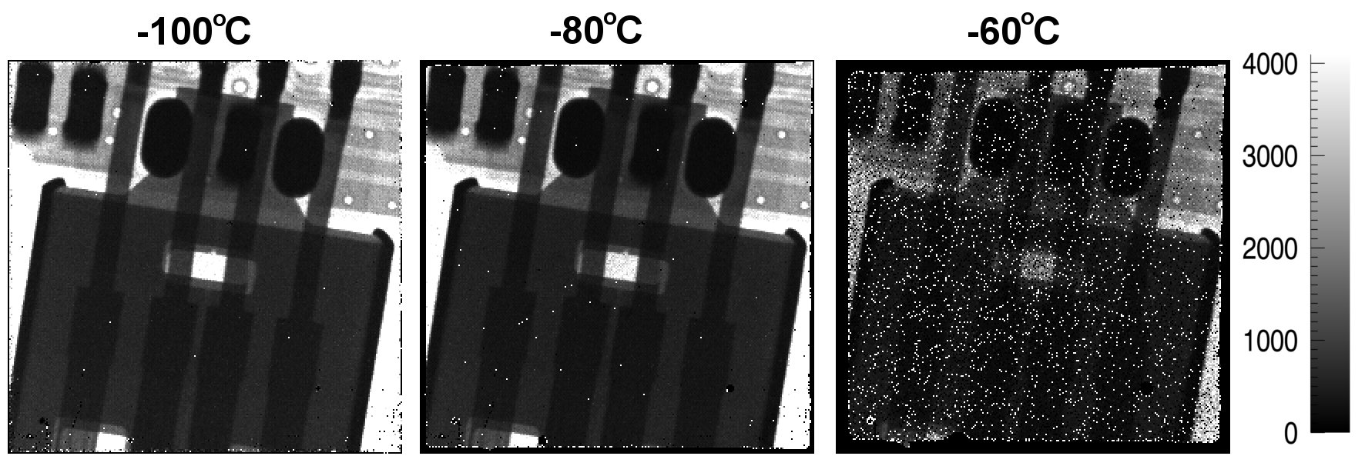
Effects of temperature
At warmer temps, current-saturated region at edge grows
Pixels become noisy with operating point shift (NB – not readjusted)
2.2 mA current!

Slide 22

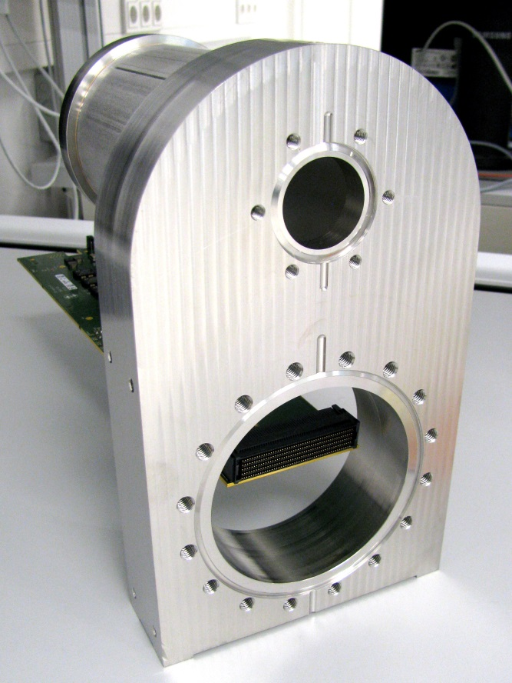
Further work on Germanium
6-chip-layout Ge sensors produced at Canberra
  Currently being bump-bonded at IZM
Portable cooling and vacuum system in development

Slide 23
Conclusions
LAMBDA readout system - high-speed readout of large high-Z sensors
Gallium Arsenide sensors - good pixel yield and stability, acceptable results after flat-field correction
Cadmium Telluride - best QE at high energies, acceptable image quality
Germanium single chips show promising results with higher uniformity

Slide 24
Thanks for listening
There are open positions for PostDocs and Master/PhD students
  http://photon-science.desy.de/research/technical_groups/detectors/index_eng.html
Notes:
Need to check for a list of what we’re looking for!

Slide 25
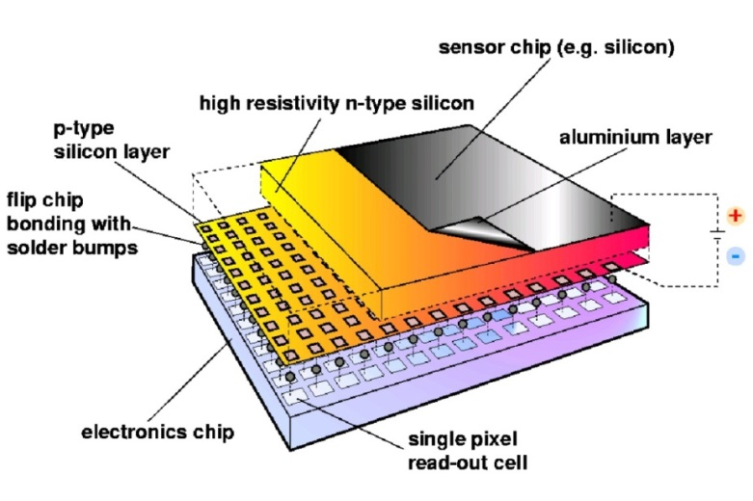
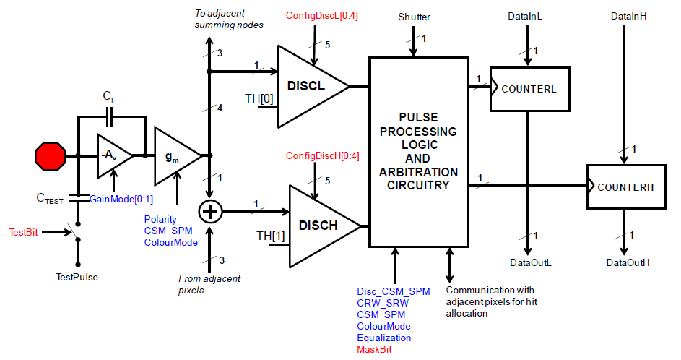
Medipix3 readout chip
CERN-led collaboration (~20 institutes)
  Flexible design
  256 by 256 array of 55µm pixels
2 photon-counting thresholds available
Interpixel communication
2-stage amplifier
2 x 12-bit counters per pixel
Notes:
Assigns the full signal from each hit to whichever pixel received the greatest signal.

Slide 26
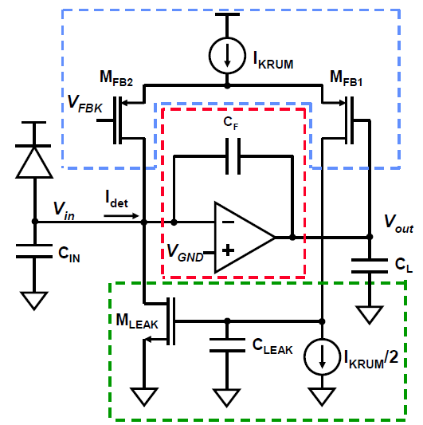
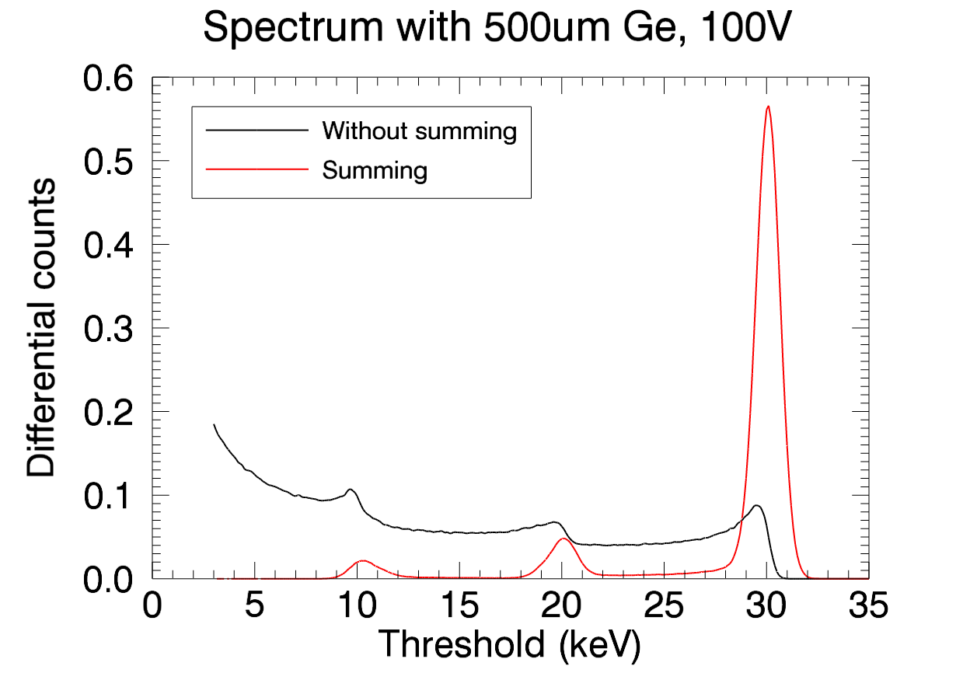
Medipix3 design and high-Z compatibility
Bipolar input preamp with leakage compensation (followed by shaper)
Gain selection
Charge summing (beneficial for thick sensors with fluorescence)
Bipolar discharge circuit
Leakage compensation circuit
Rafael Ballabriga Suñé, CERN Thesis 2010-055
Notes:
Maybe show spectral results with and without charge summing (simulated)?
Do I show these superimposed? If not, do this!

Slide 27
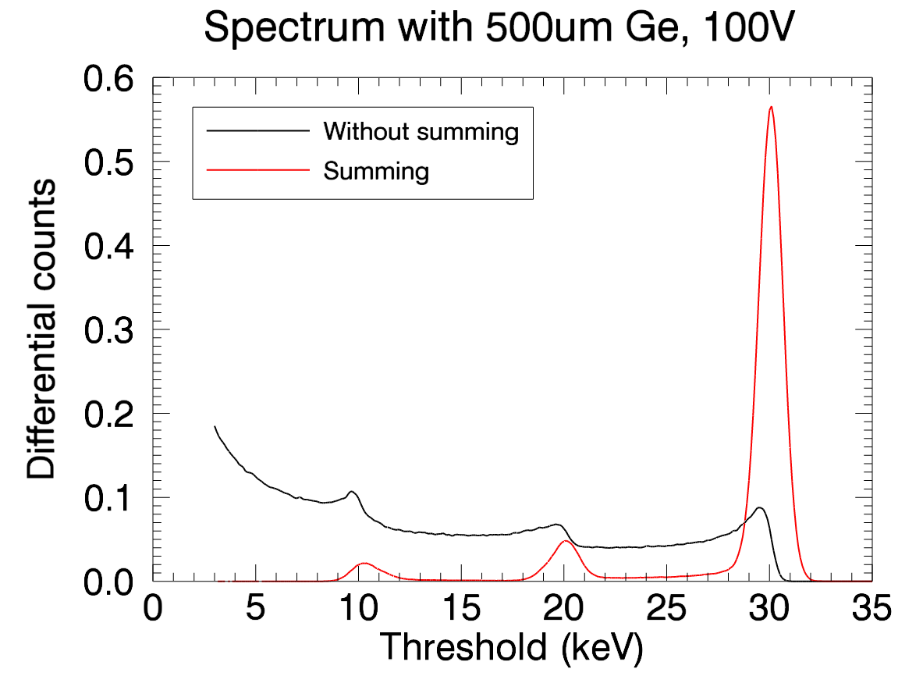
Medipix3 design and high-Z compatibility
Charge summing (avoids double / lost counts, better discrimination)
Medipix3 RX charge summing
Simulated spectrum - Ge, 100V
Arbitration
√
Summing
Notes:
Maybe show spectral results with and without charge summing (simulated)?
Do I show these superimposed? If not, do this!
Gain selection not very interesting - omit

Slide 28
Medipix3: features and possible operating modes
Continuous read-write: deadtime-free readout with 12 bit depth
  2 x frame rate possible with 6 bit depth
24-bit mode (but with deadtime between frames)
2 independent counters and thresholds
  Energy discrimination
  Pump-probe operation
With 110µm pixel sensor
  Up to 8 energy bins
  Or, 4 with charge sharing compensation and CRW

Slide 29
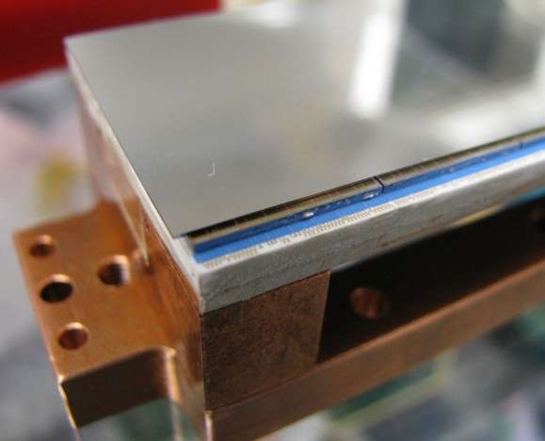
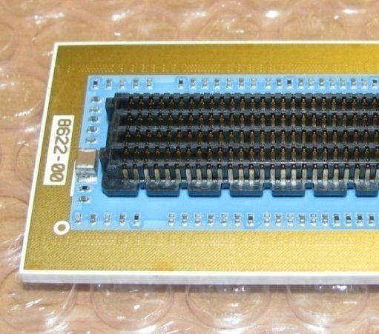
Detector head
6 by 2 chips (1536 by 512 pixels)
  Large Si sensor
    300µm Si sensor here
  2 x “Hexa” high-Z sensors
Ceramic circuit board (LTCC)
  Good match to semiconductor CTE
  Cooling through thermal vias
500-pin connector on board
  Full parallel readout (8 LVDS data outputs per chip)
6 x 2 Medipix3 chips
LTCC board
Notes:
Approximately 200 output, 100 other signals, over 100 ground pins (improving LVDS), then other things like power
More about edge area could be added
Maybe additional slide? Wire bonding issues? Could be helpful, but not critical – non-uniform layout of pads – useful to mention, perhaps show.
(More about ceramic?)

Slide 30
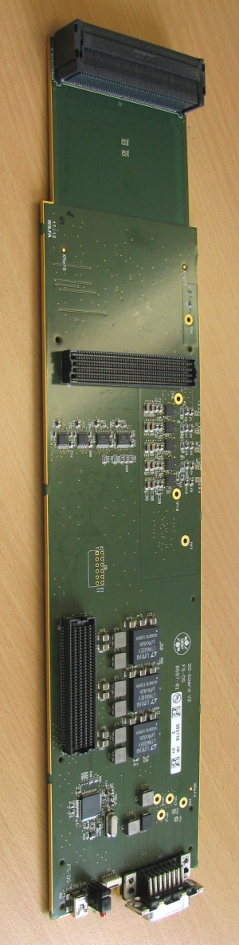
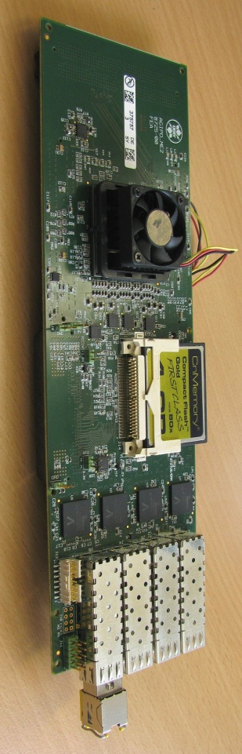
High-speed electronics
DESY high-speed readout card (also used for AGIPD and PERCIVAL)
  Virtex-5 FPGA with PowerPC
  Up to 4 * 10 Gigabit Ethernet links
  DDR2 RAM (8GB)
“Signal distribution” board connects to det. head
  Space for vacuum barrier with germanium detector
Connector to det. head
Space for vacuum barrier
FPGA
Vregs, ADC/DAC
10GE links
Power / trigger in
Notes:
Single 10GE allows up to 500fps, memory burst mode – 4 could allow continuous at 2000 fps.

Slide 31
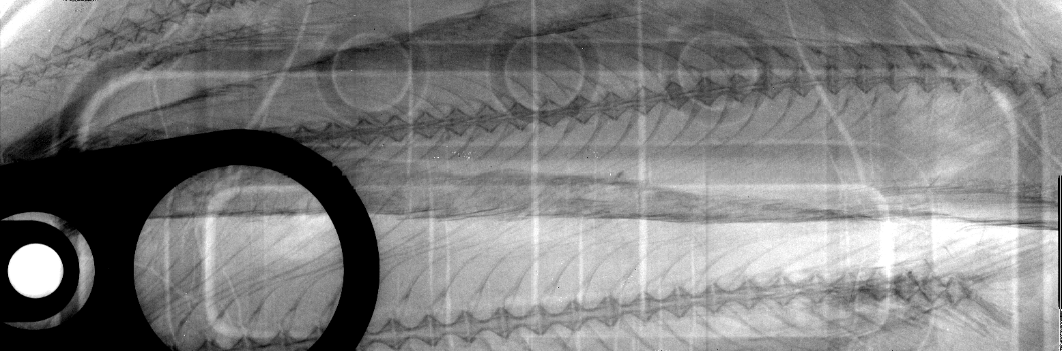
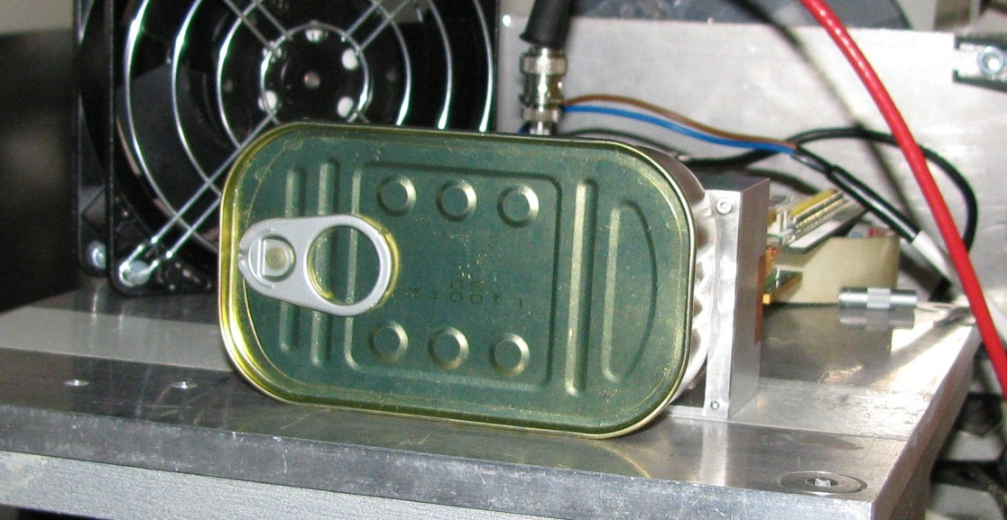
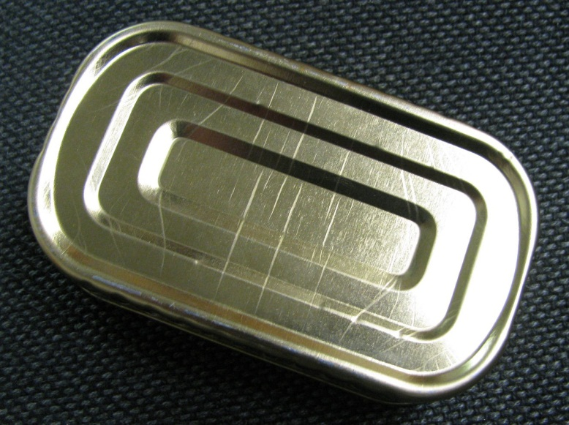
Test results with Si module

Slide 32
Comparison of materials
GaAs
CdTe
Ge

Slide 33
Application at synchrotrons
Scattering from CeO₂ standard, 42 keV, 1ms
Powder diffraction patterns measured at PETRA-III P02 (42 keV)
Standard sample (CeO₂) gives usable diffraction pattern in 1 ms
Possibility of time-resolved and high-speed measurements (e.g. effects of rapid heating or pressure)
Diffractogram

Slide 34
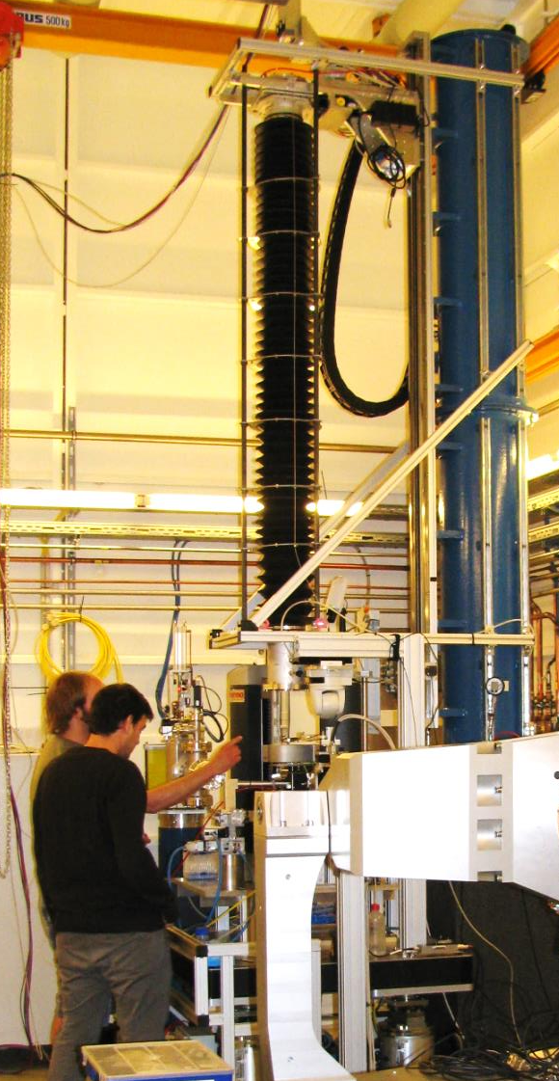
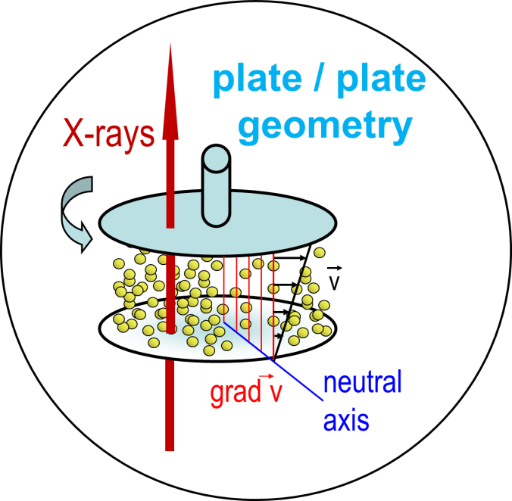
Experimental use at PETRA-III
Example – Rheology at PETRA-III P10
  Investigates structure changes and particle dynamics in fluids under shear forces
  Requires high frame rate, high SNR, small pixel size
Part of speckle pattern
Notes:
Pretty pictures ONLY! NO EXPLANATION!

Slide 35
Rheology with XPCS – PETRA-III P10
PRELIMINARY results:
  XPCS measurements demonstrated in rheometer setup
  Sample decorrelates more quickly with increasing shear applied
Autocorrelation function
10⁻²
10⁻¹
Tau (s)
10⁰
10¹

Slide 36
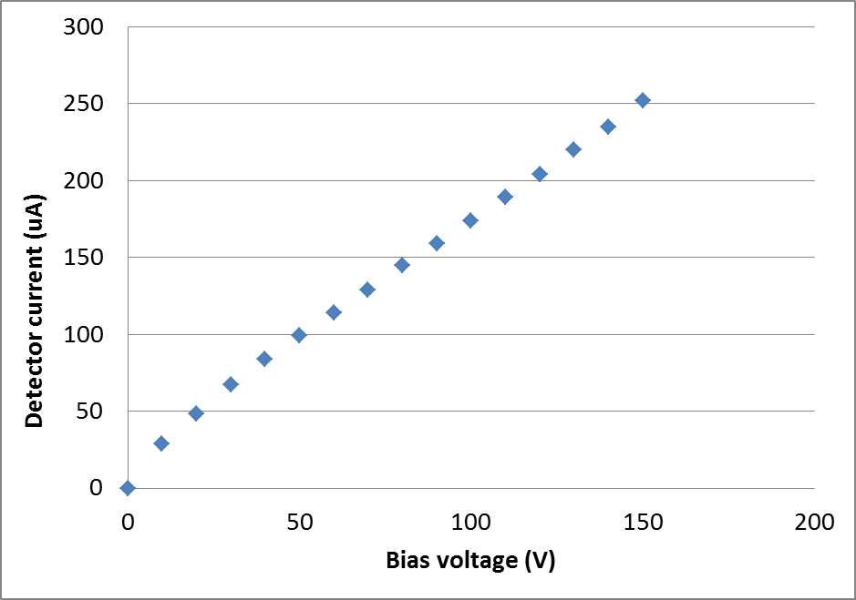
Ge sensor behaviour
Relatively high current (measured at -110C) dominated by guard ring
  Ikrum tests of previous sensor at -70C showed < 1nA in working pixels

