Slide 1

Proton tracking for medical imaging and dosimetry
J.Taylor,
P.Allport, G.Casse, N.A.Smith, I.Tsurin
For the PRaVDA Consortium

Slide 2

Talk Overview
Background
Silicon detectors at Liverpool University Physics Dept.
PRaVDA setup and microstrip tracker
Detector design and testing
Sensor & ASIC design
Preliminary results with charged particles
Simulation work
- Simulating efficiency
GEANT4 simulation and tracking
Summary and further work

Slide 3
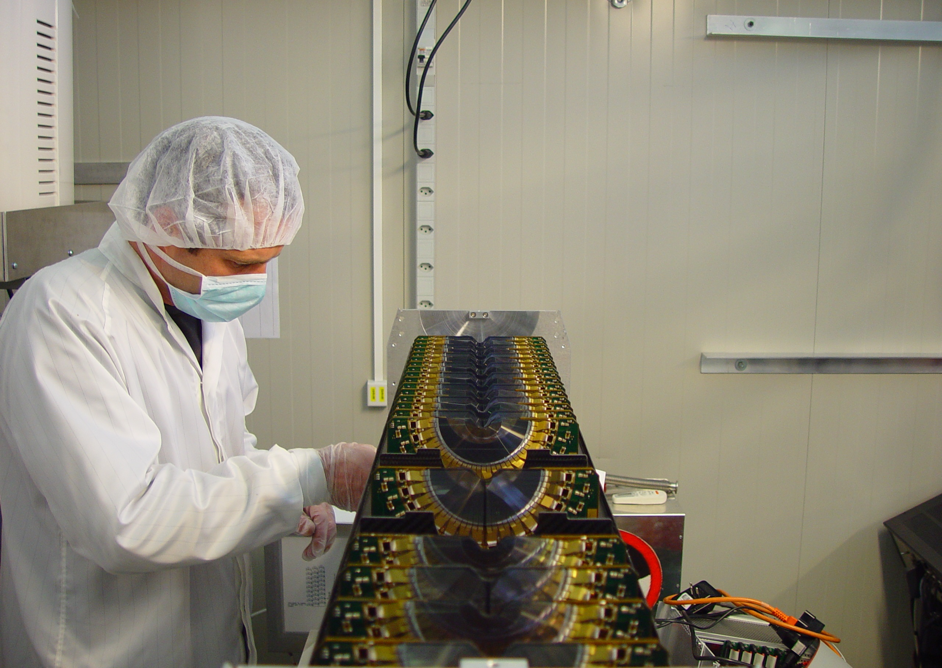
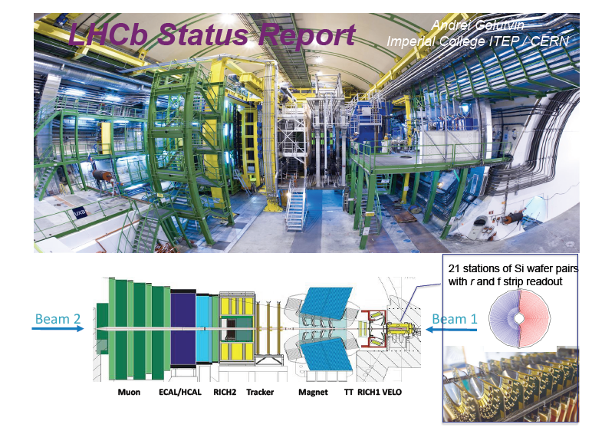
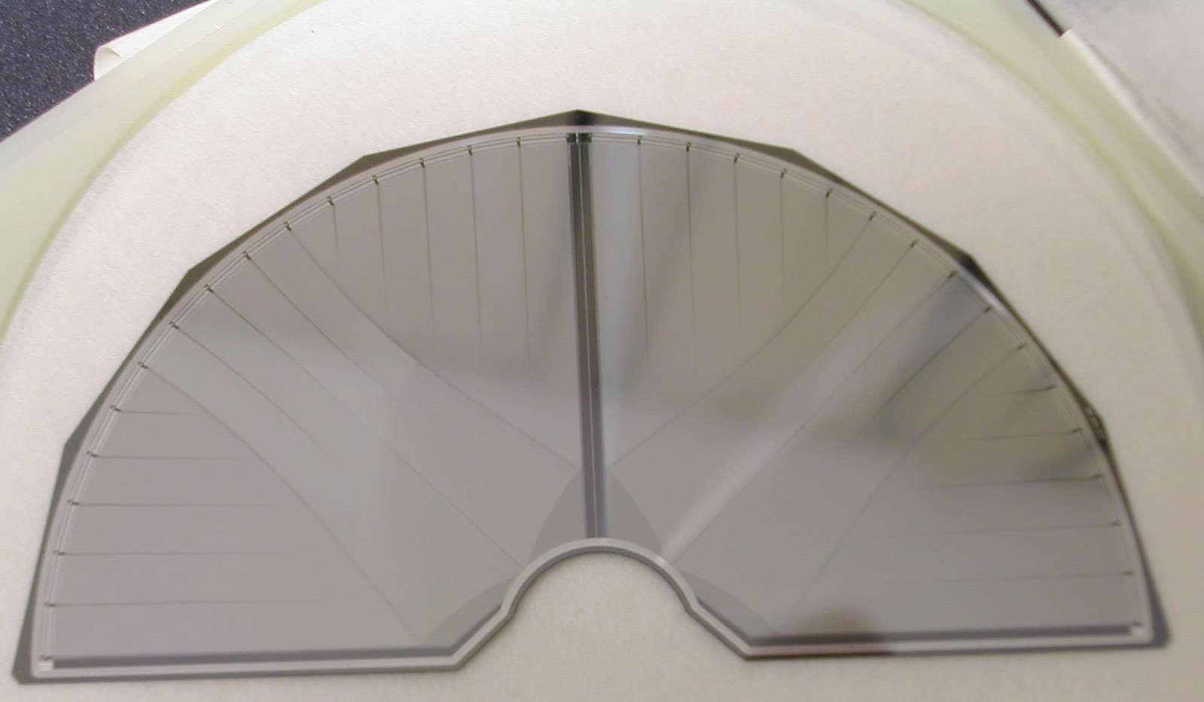
The LHCb VErtex LOcator

Slide 4
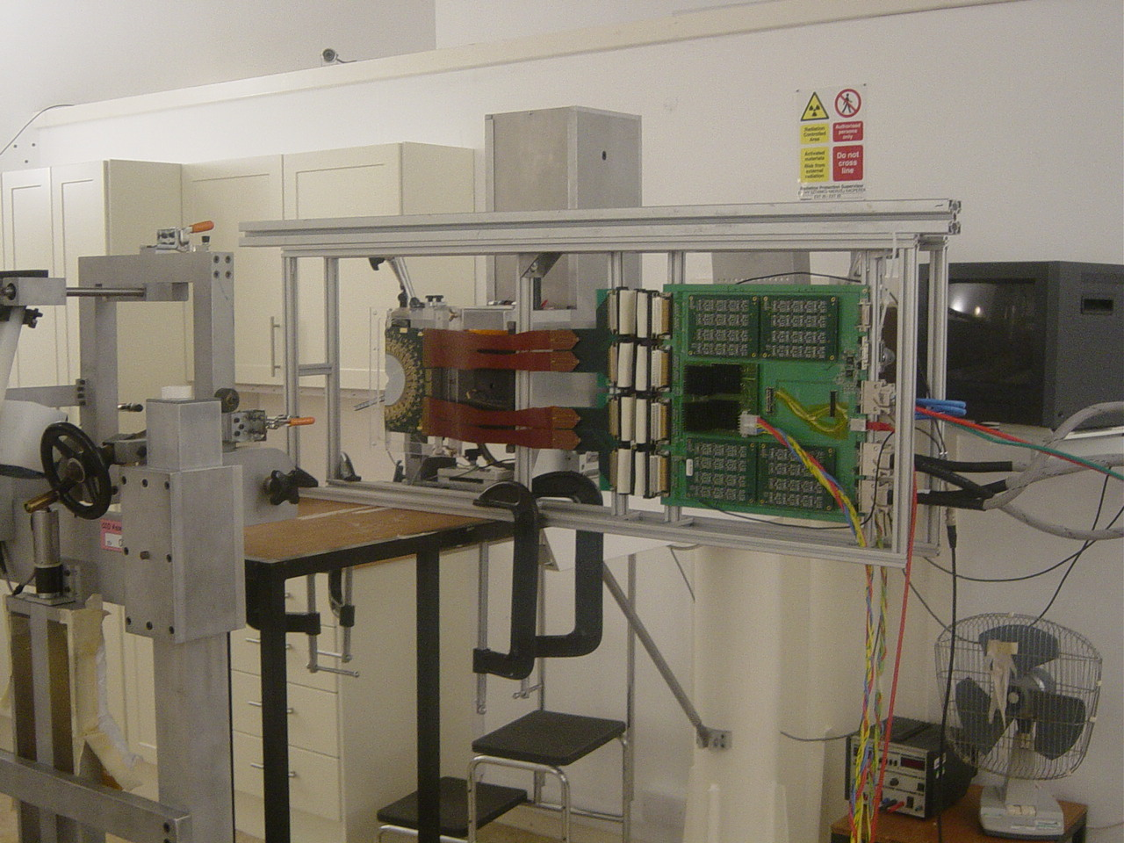
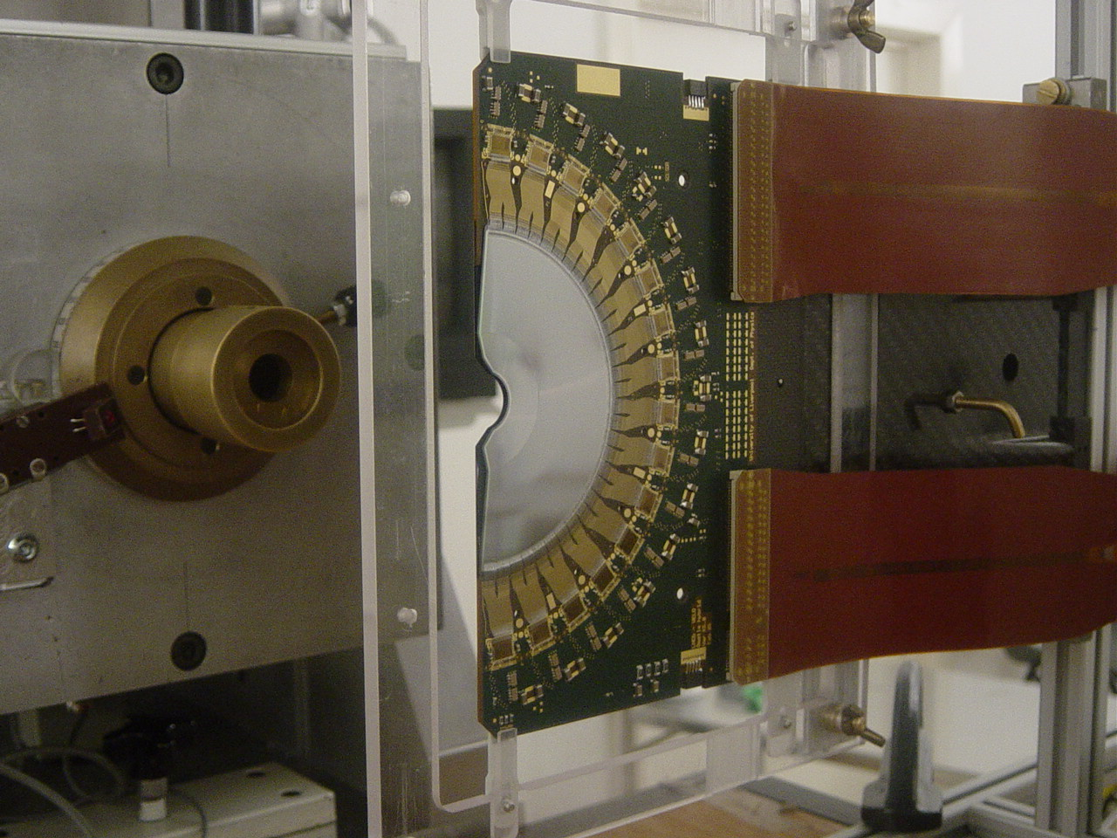
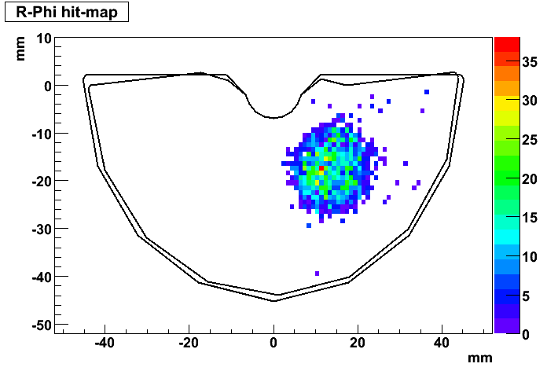
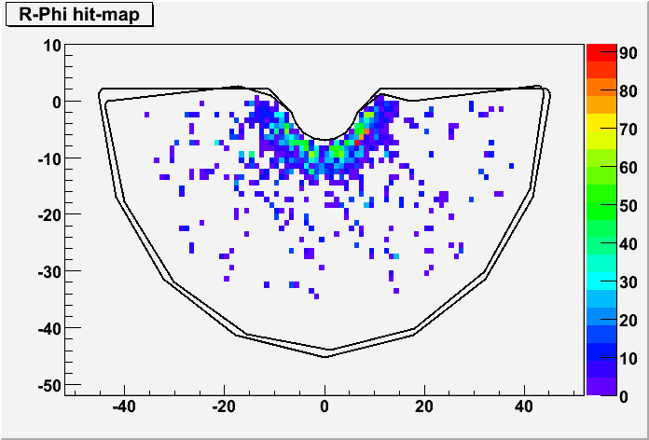
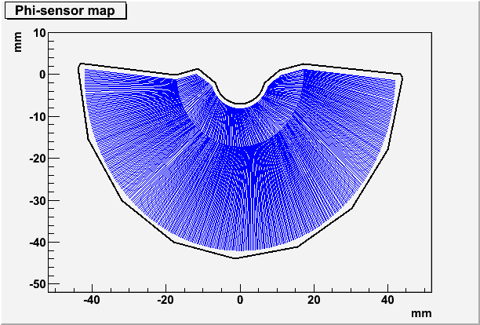
LHCb VELO Module as Beam Halo Monitor
Clatterbridge Centre for Oncology
Proton Therapy Facility
With thanks to Andrzej Kacperek
LHCb Back-to-Back Sensor Module

Slide 5
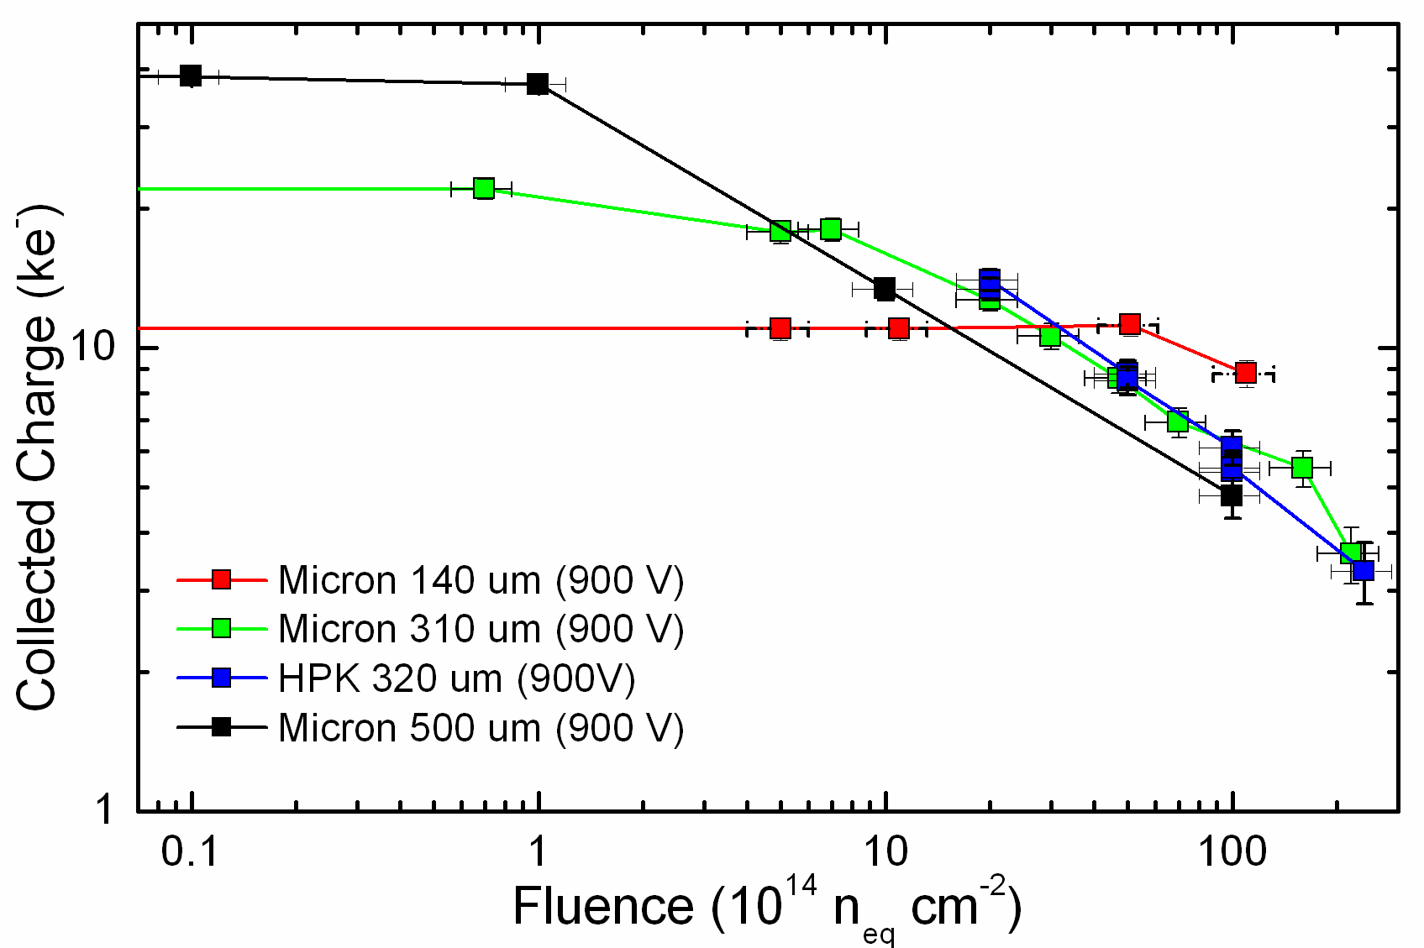
Radiation hardness studies
CERN RD50 collaboration has shown radiation hardness of thin n-in-p detectors up to at least 10¹⁶ n eq/cm².
This allows design of detectors that are very rad hard for applications with clinical beams.
RD50
Thin n-in-p
Thin detectors can be present in the beam for doses up to 5 x 10¹⁵ n eq/cm² without requiring re-calibration due to radiation damage effects.

Slide 6
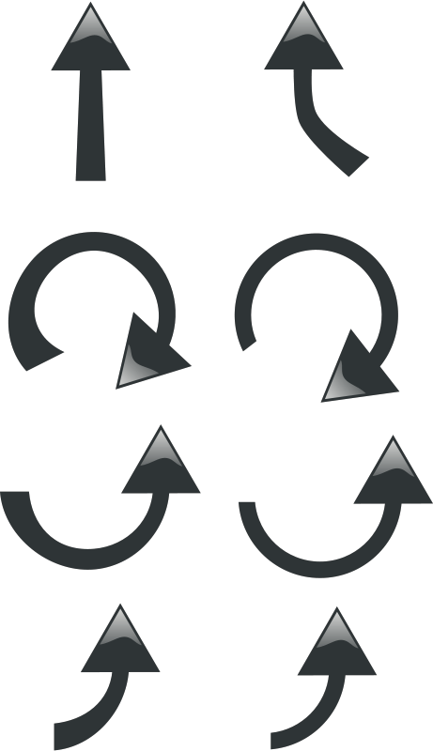

System Overview
Each 150um thick silicon detector has 2048 strips, 1024 read out on each side of the detector.
x - outputs
x - outputs
Each station of strip modules has three detectors crossed at 60º in an (x,u,v) configuration to resolve ambiguities at high particle rate.
24 CMOS detectors
v-outputs
v - outputs
u - outputs
u-outputs
x - outputs
x - outputs
Range Telescope
Beam stop during treatment mode
4 sets of 3 strip detectors
100 – 200 MeV protons

Slide 7
Operating Modes
Treatment Mode
(High Current)
Field size: 5cm collimated treatment beam
Energy: 60 - 191 MeV
Flux: ~10⁷ protons/cm²/s
Use Strip Tracker to..
Check beam profile – reconstruct 1D & 2D histograms
Measure dose
Requirements:
- Proton counting
- 1D histograms
- 2D beam profile
Patient Imaging Mode
(Low Current)
Field size: 10cm (max.)
Energy: 191 MeV
Flux: ~10⁵ protons/cm²/s
Use Strip Tracker to..
Track individual protons in (x,u,v) layers
Use Range Telescope to..
Measure positions and energies of each proton
Requirements:
- Accurate Tracking
- High Efficiency

Slide 8
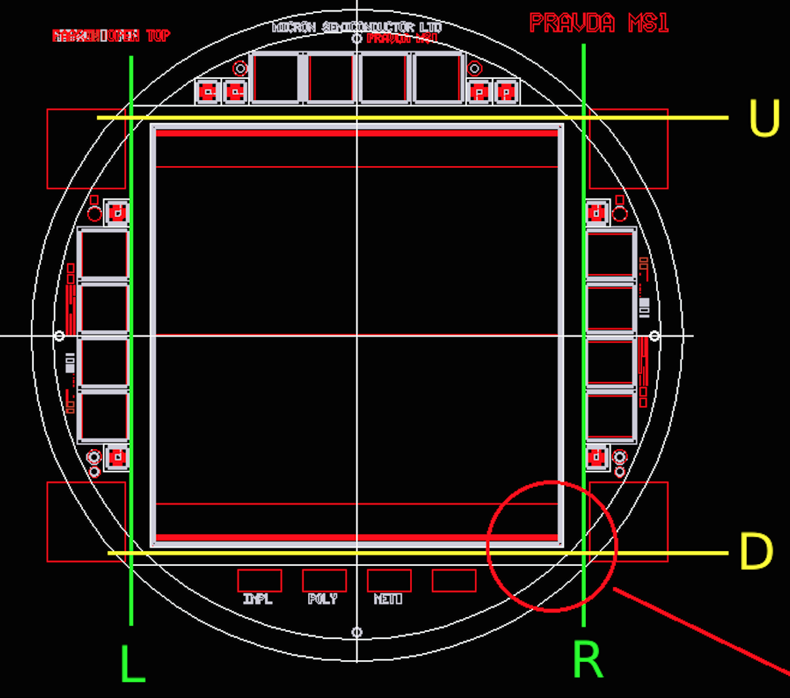
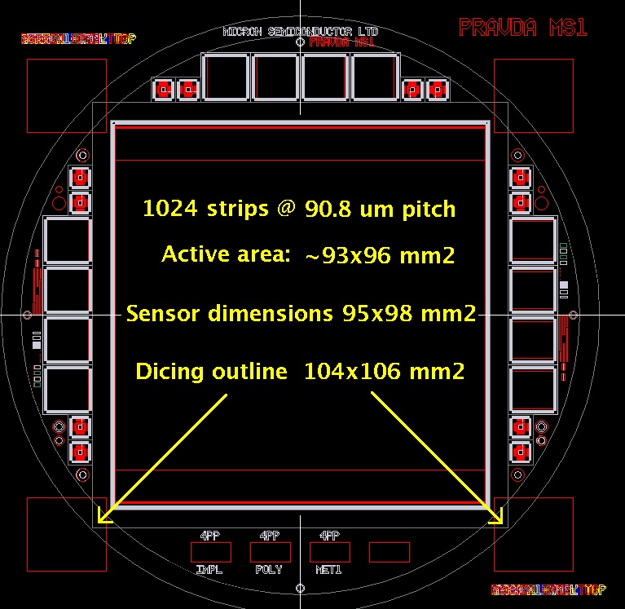
Sensor & ASIC Design
ASIC design carried out by ISDI CMOS Ltd. Binary chip allowing:
Treatment Mode: Read out all strips every 100us for 1D & 2D beam profile histograms and dosimetry map
Two thresholds per channel allow for high occupancy
Patient Imaging Mode: Read out up to 4 strips per ASIC with signal over threshold possible at 26MHz
(beam spill repetition rate at iThemba)
ASIC was fabricated in August 2014, testing now underway
Hybrid design by N.A. Smith at Liverpool
93 mm
96 mm
Designed by I.Tsurin, P.Allport, G.Casse, J. Taylor produced by Micron Semiconductor Ltd.

Slide 9
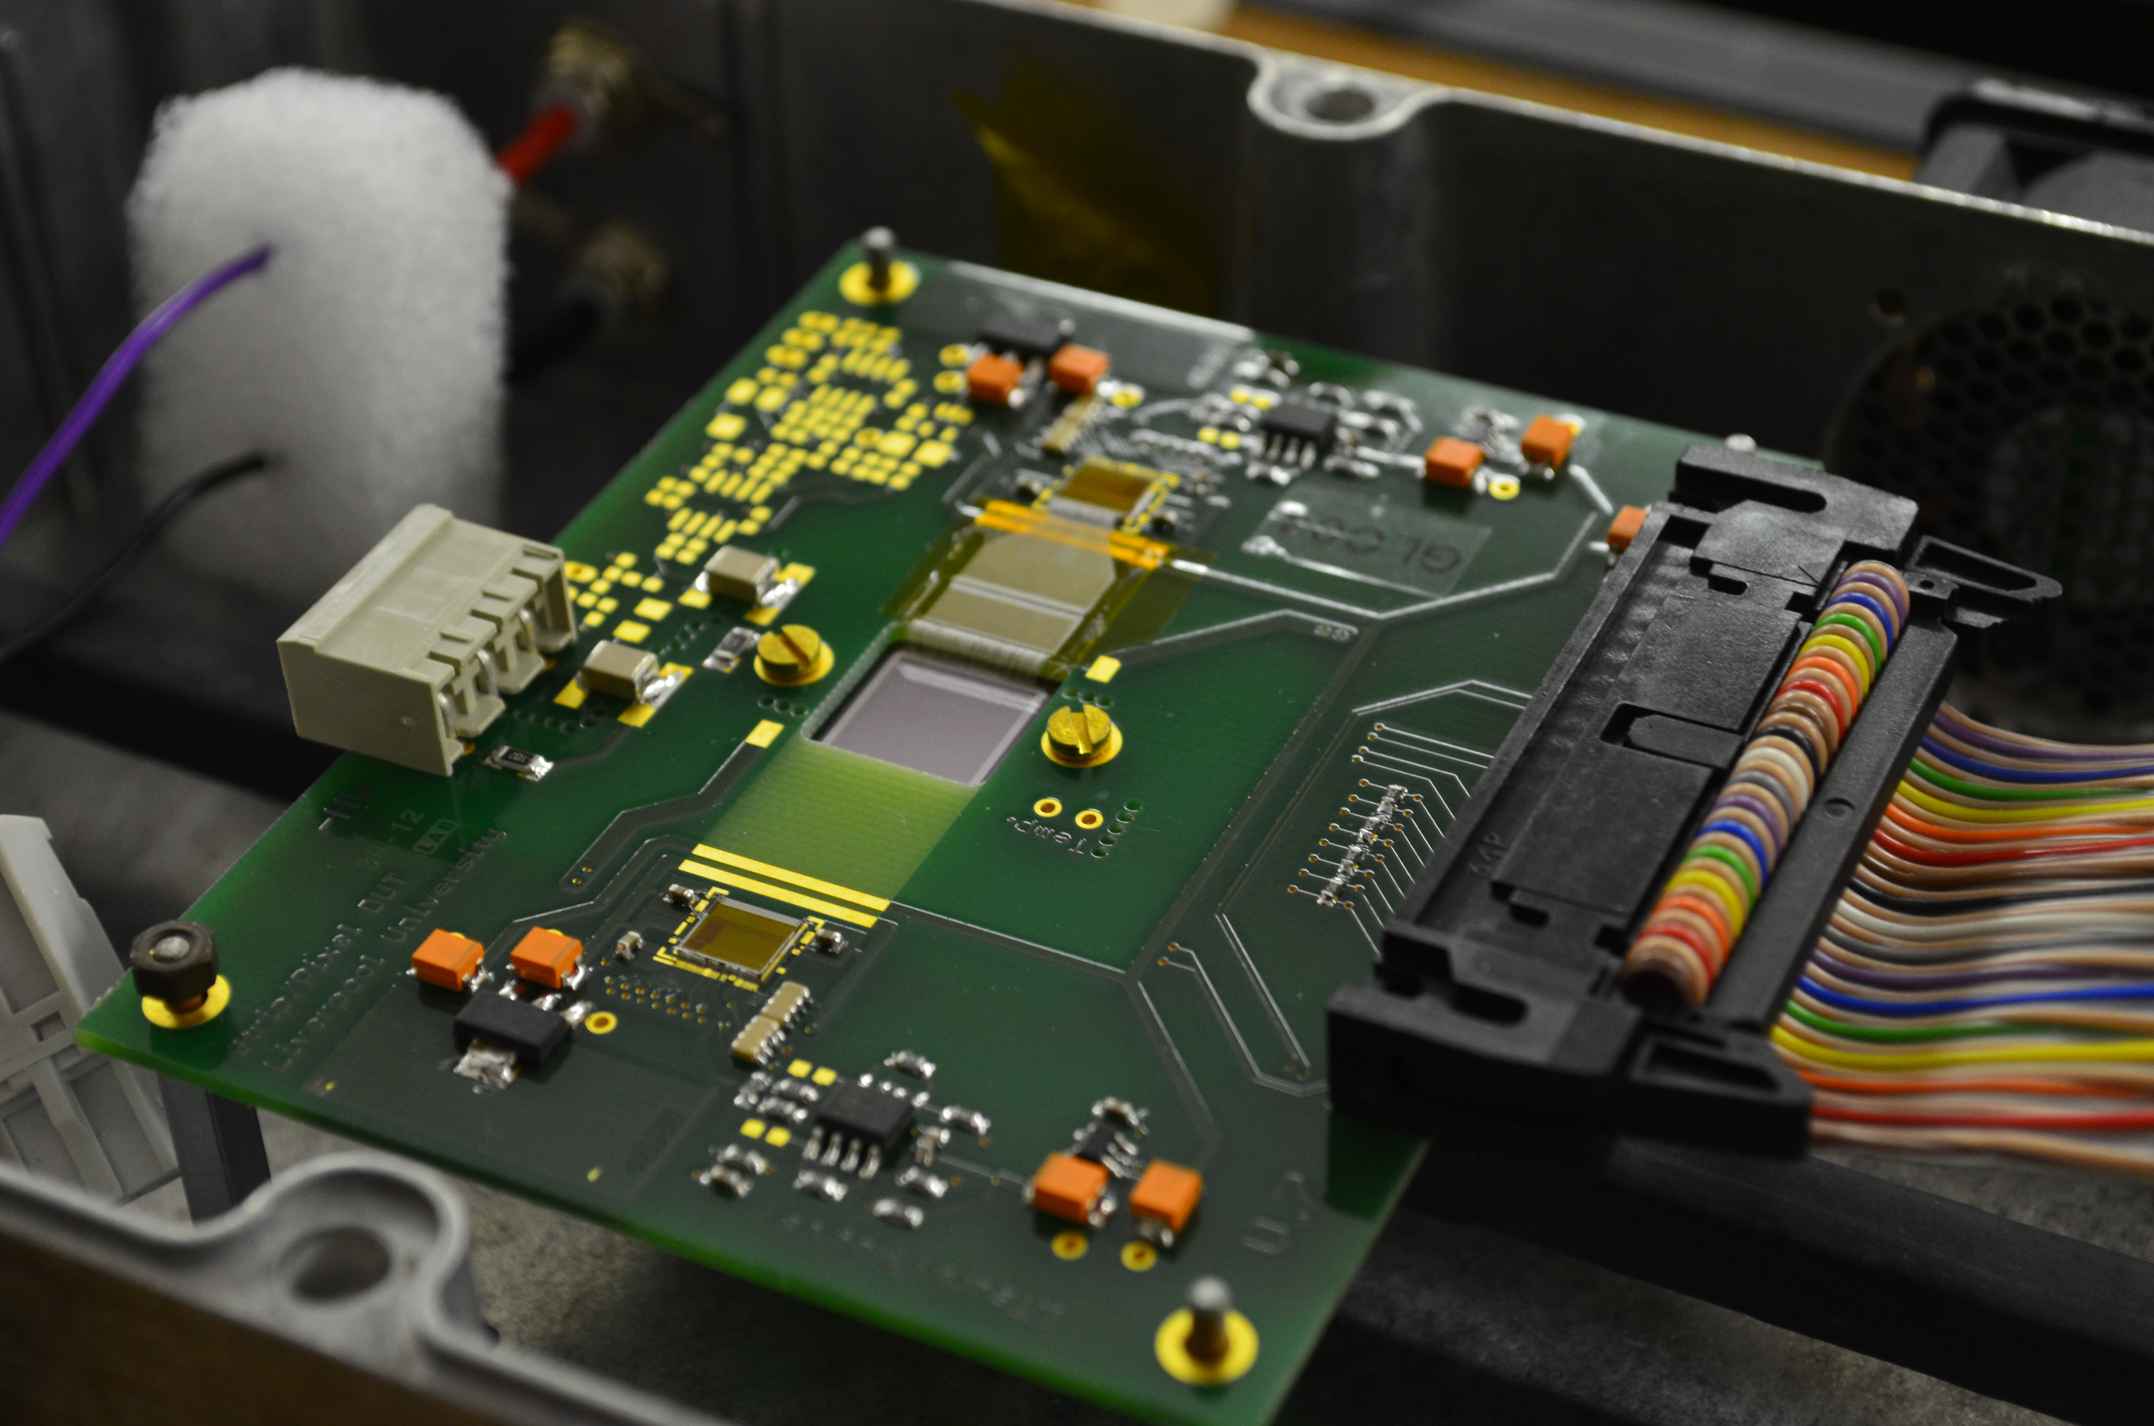
Sensor & ASIC Design
1cm x 1cm x 150um silicon strip detector with 128 channels and 80um strip pitch
Sensor wire bonded to rad-hard BEETLE ASIC (LHCb experiment) with 40 MHz clock
ALiBaVa readout motherboard capable of much slower 300 Hz readout using scintillator trigger behind sensor
191 MeV protons (typical proton energy before phantom)
Proton cluster width vs threshold

Slide 10
Sensor & ASIC Design
1cm x 1cm x 150um silicon strip detector with 128 channels and 80um strip pitch
Sensor wire bonded to rad-hard BEETLE ASIC (LHCb experiment) with 40 MHz clock
ALiBaVa readout motherboard capable of much slower 300 Hz readout using scintillator trigger behind sensor
60 MeV protons (typical proton energy after phantom)
Proton cluster width vs threshold

Slide 11
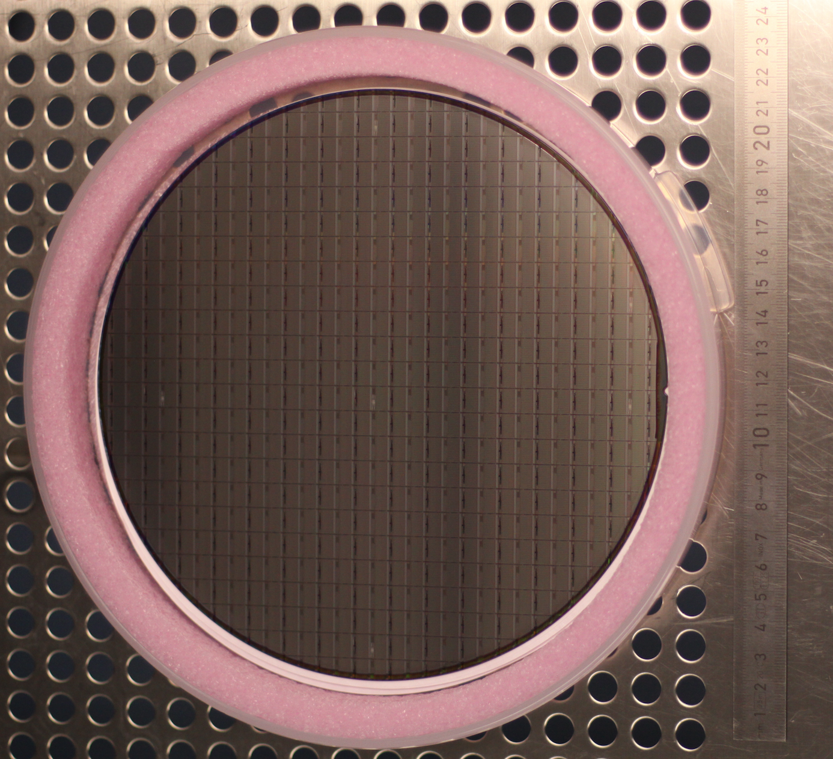
RHEA ASIC
Rapid high-speed extended ASIC (RHEA)
Commercially designed ASIC from ISDI Ltd.
Binary chip with two tunable thresholds:
Threshold range 1: 2,000 – 10,000 e-
Threshold range 2: 20,000 – 160,000 e-
Expected equivalent noise charge 700e-
128 channels with a bonding pitch of 60um
Diced chips will be ready this month for testing and wire bonding to the PRaVDA sensors (18 currently available)

Slide 12
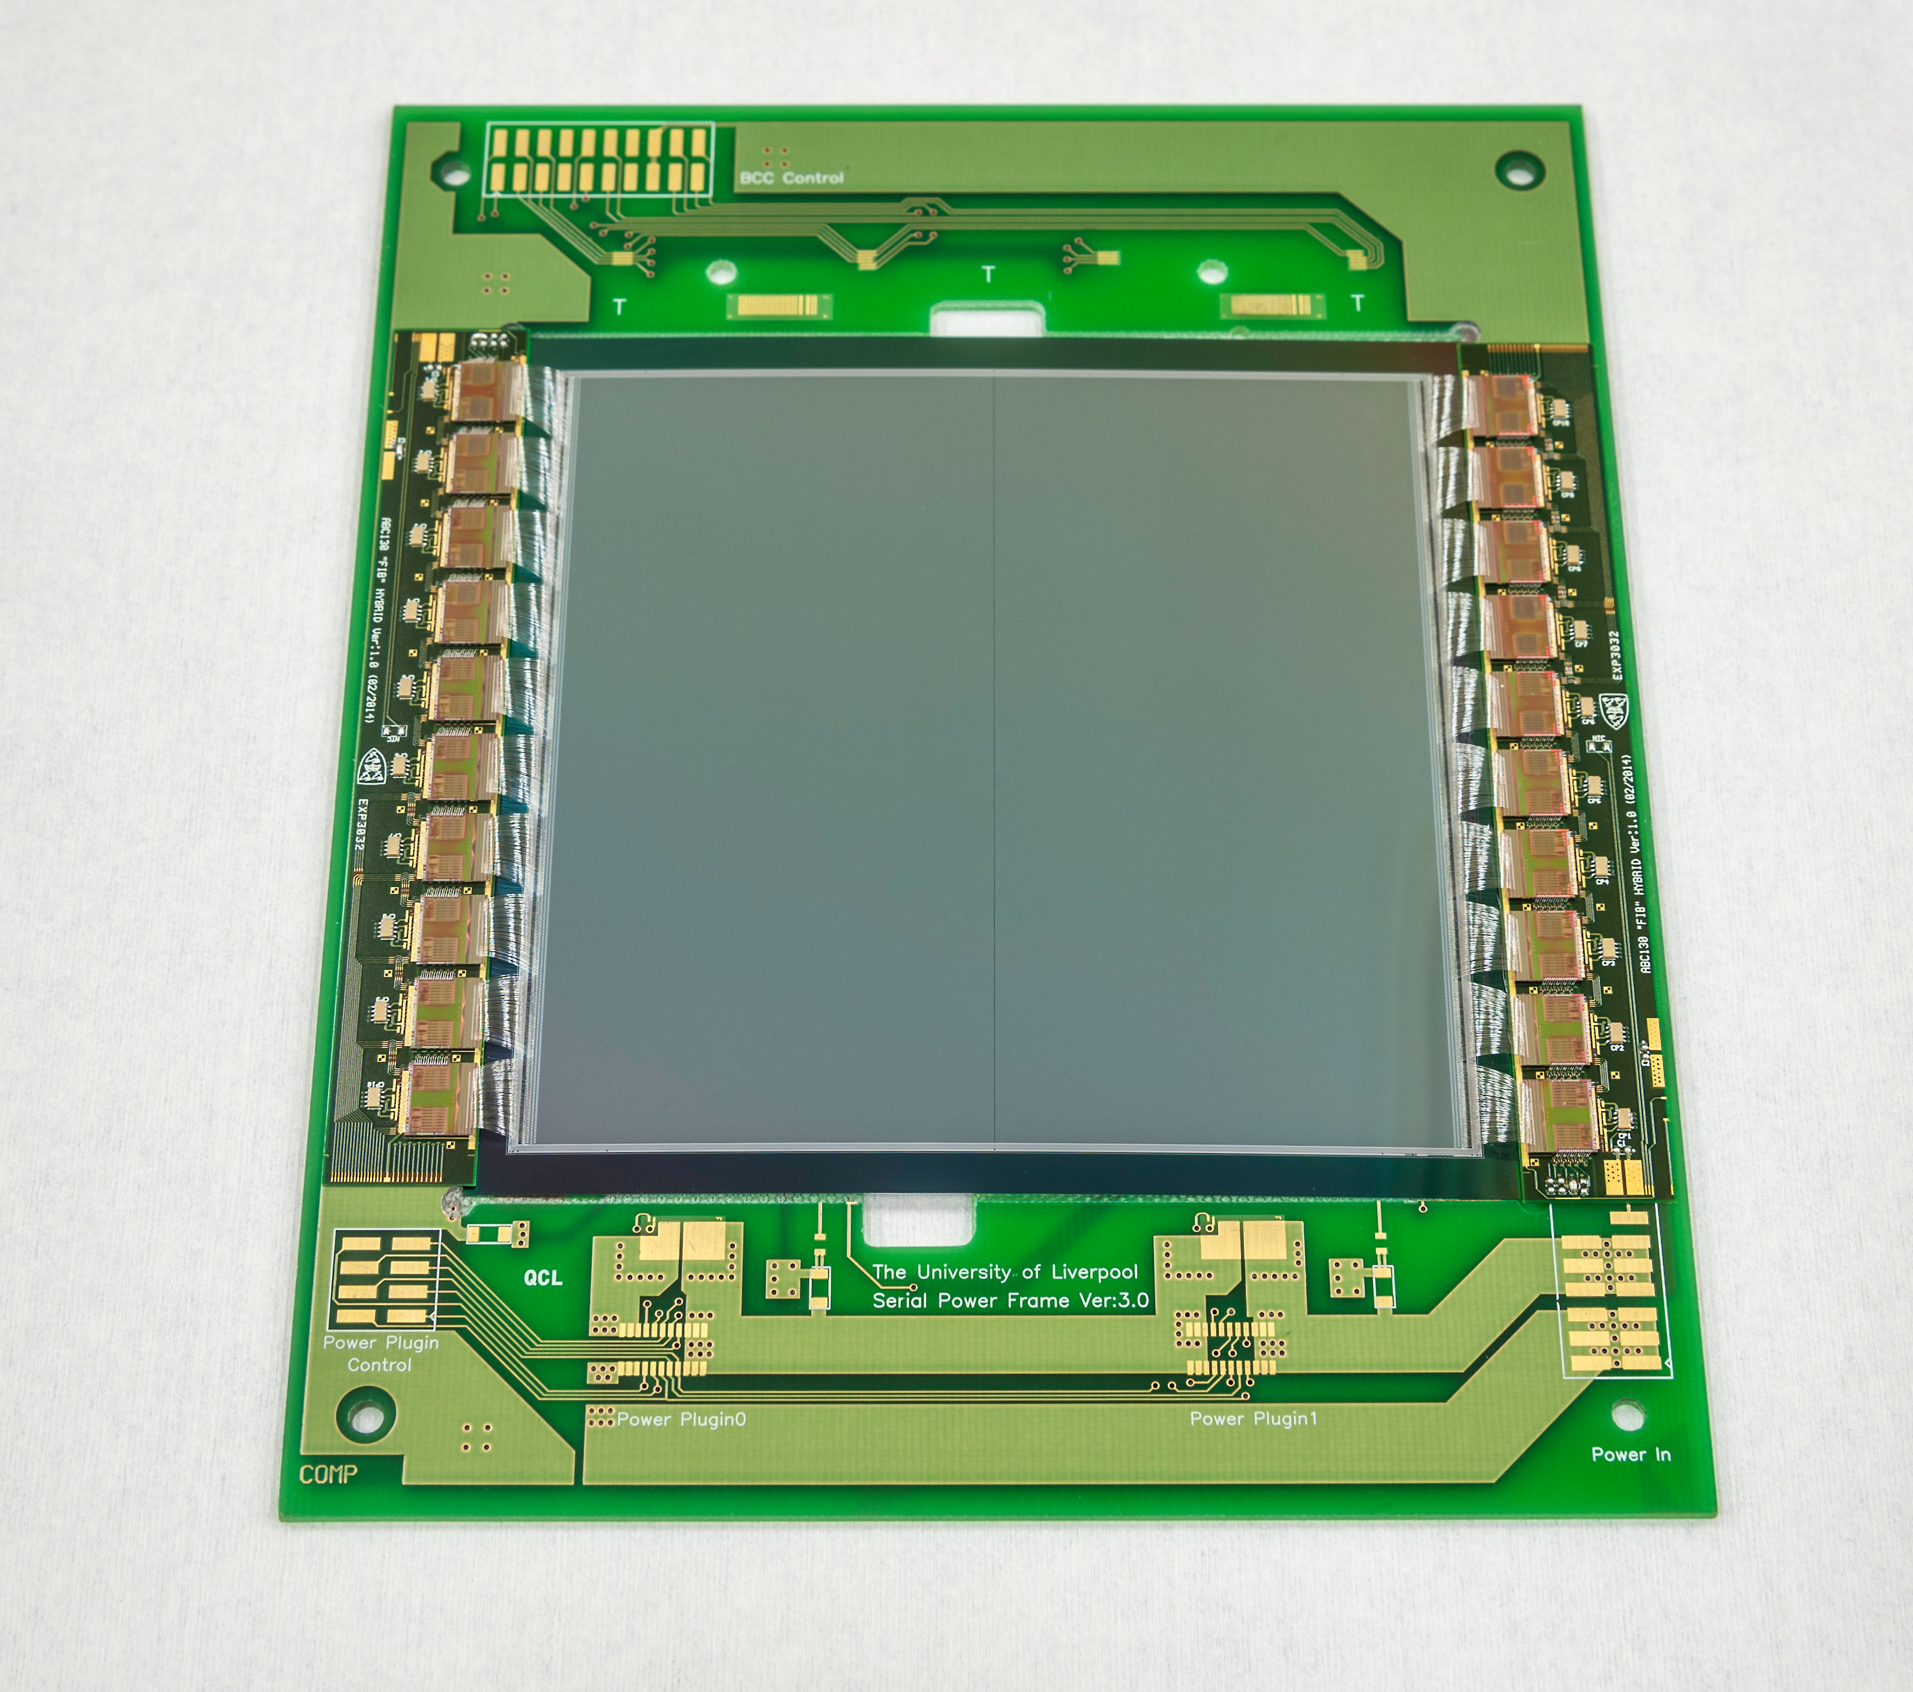

PRaVDA Sensor
PRaVDA module mock-up for bonding trials and RS exhibit
Left and right sides each contain 1024 strips with a pitch of 90.8um. Each station of strip modules will have three planes crossed at 60º in an (x,u,v) configuration to allow high particle rate.
Silicon microstrip sensor using 150µm thick n-in-p technology developed for the ATLAS Experiment at the High Luminosity LHC
12 strip modules will be used to make 4 tracking stations, 2 before and 2 after the patient

Slide 13
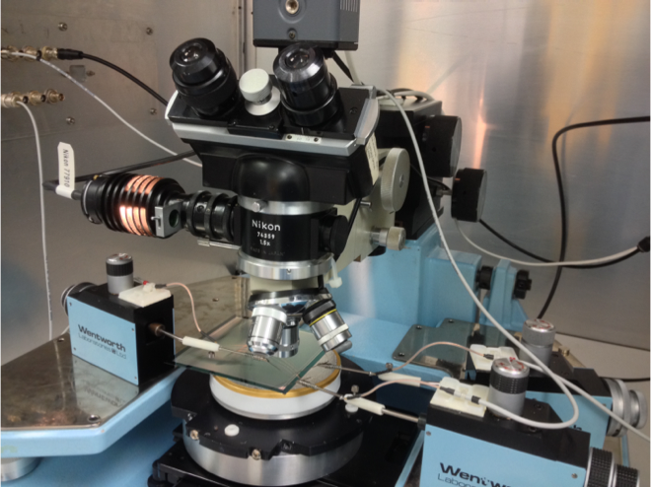
Sensor QA
Depletion voltage
QA on detectors carried out using manual and automatic probe stations to measure global IV and then to measure individual strip characteristics.
Leakage currents for sensors are typically a few uA even at several times depletion voltage.

Slide 14
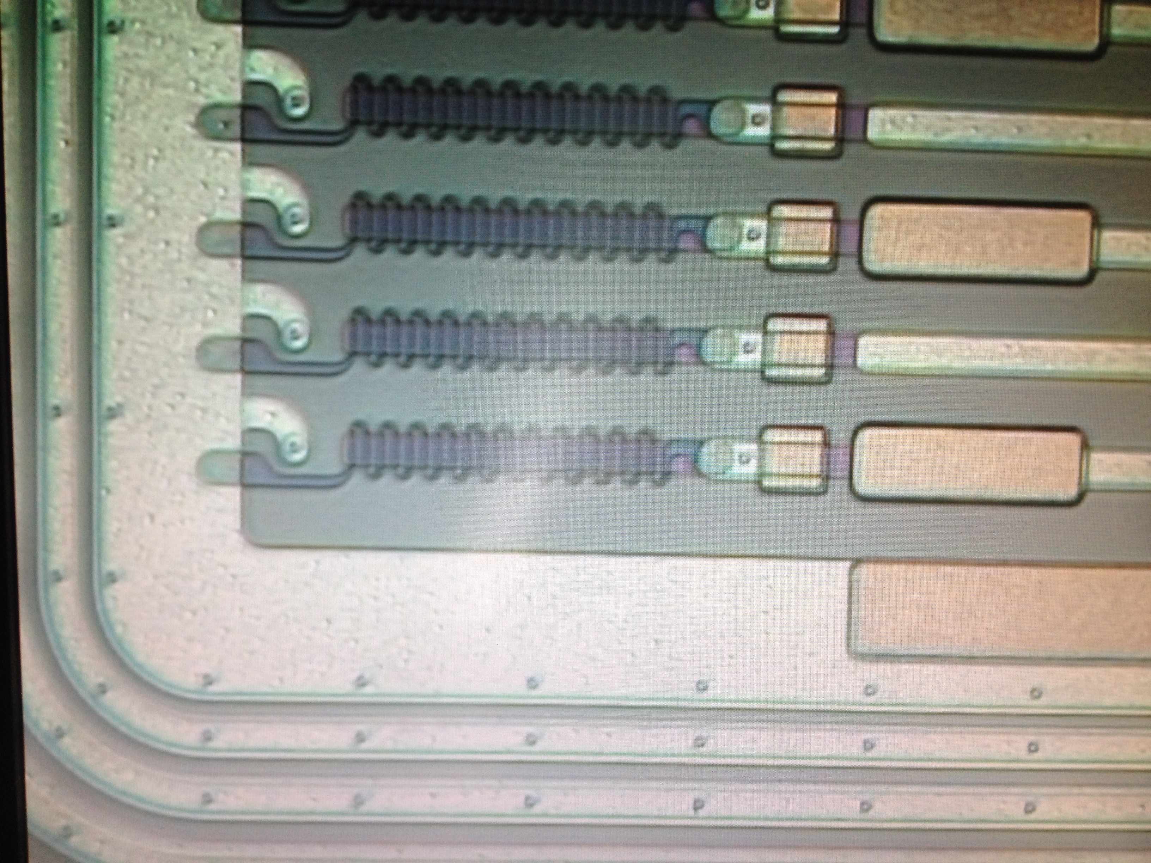
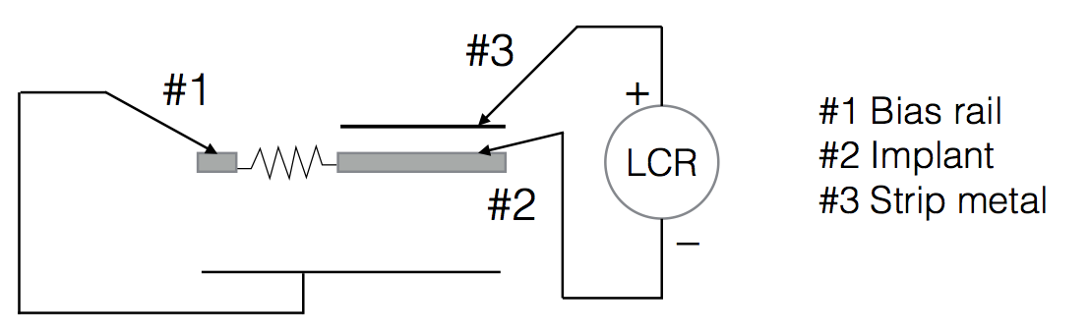
Sensor QA
#2
#3
#1
#2
#3
#1
Measurements with probes:
Parameter | Measured value | Spec. value
Polysilicon bias resistor | 6 MΩ | >2 MΩ
Coupling capacitance | 122 pF | 125 pF

Slide 15
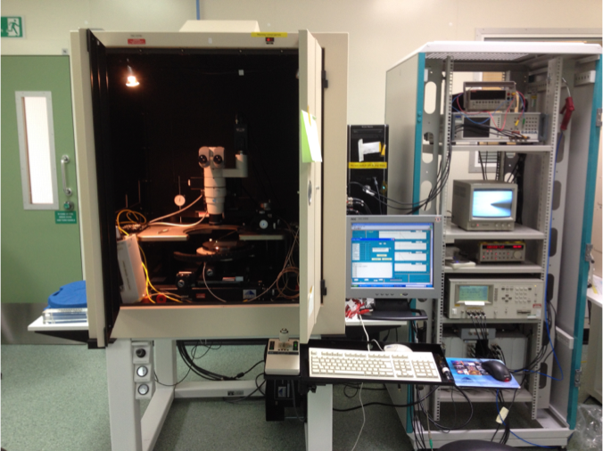
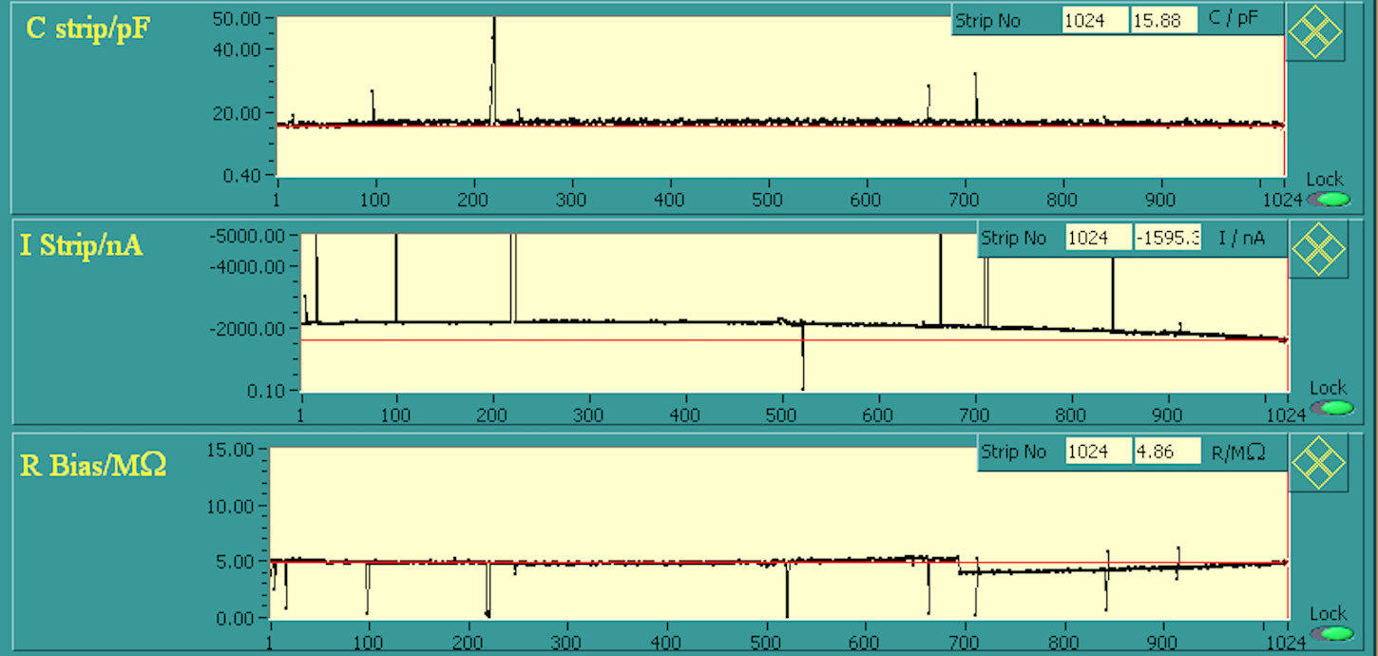
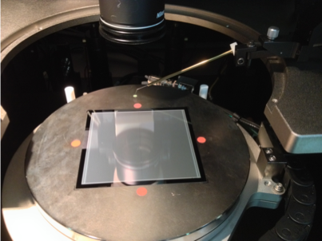
Sensor QA
Using an LCR meter and an automatic probe station we can probe the complex impedance for all strips on both sides of a detector
Detectors show at least 99% good strips per side.

Slide 16
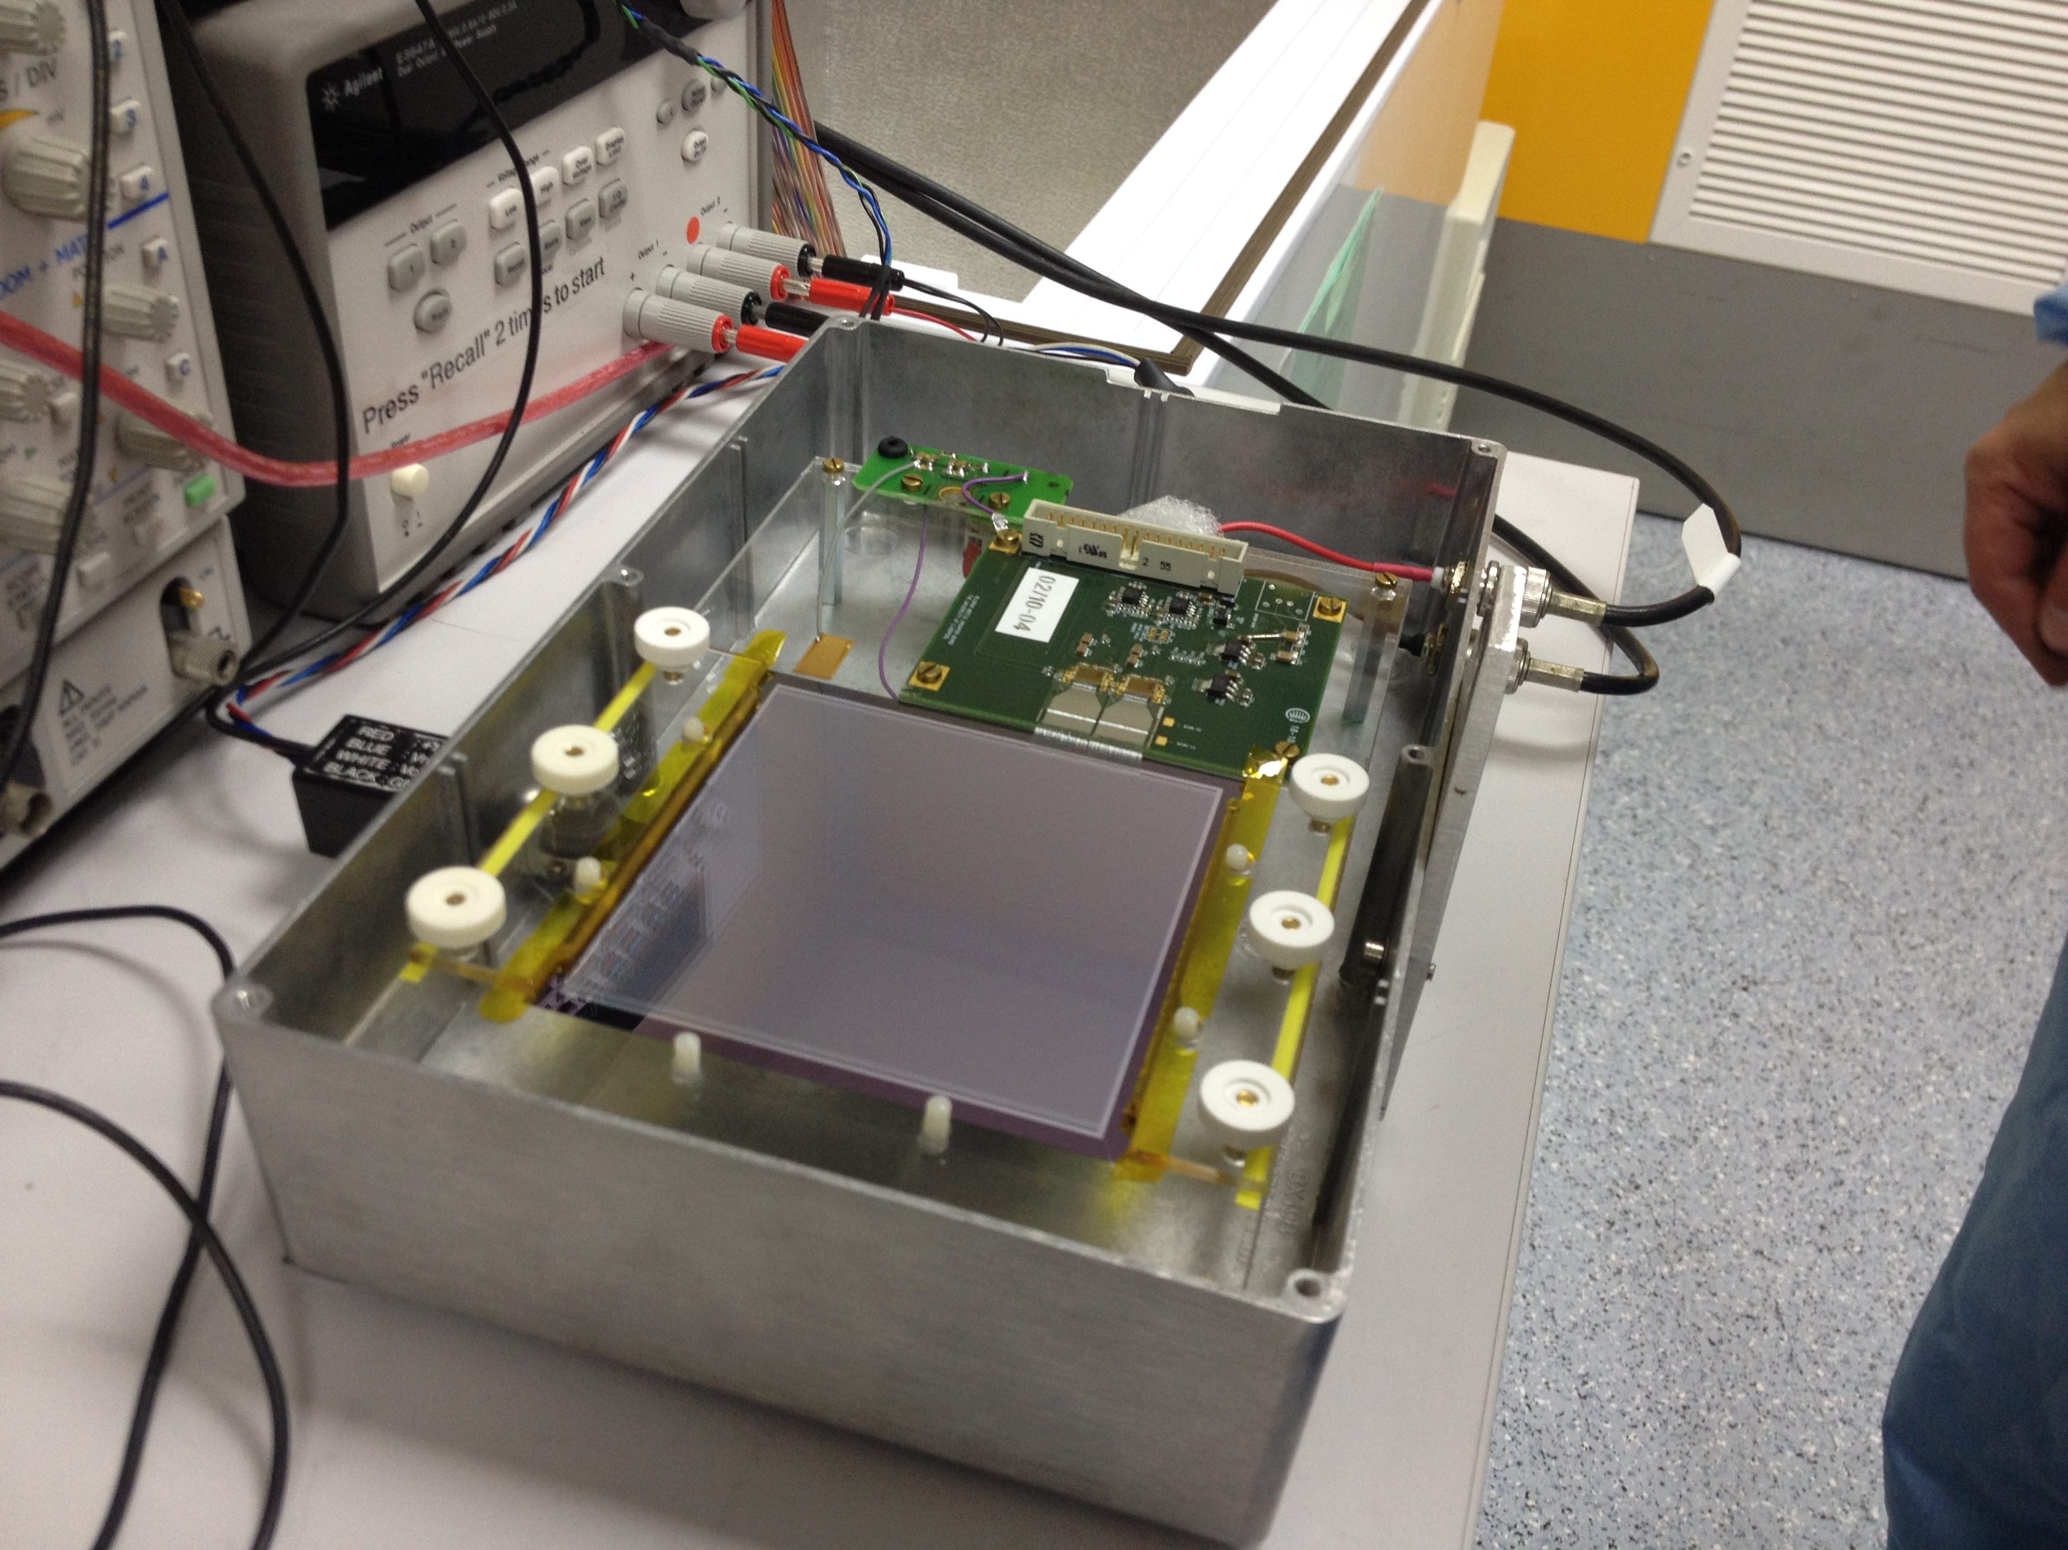
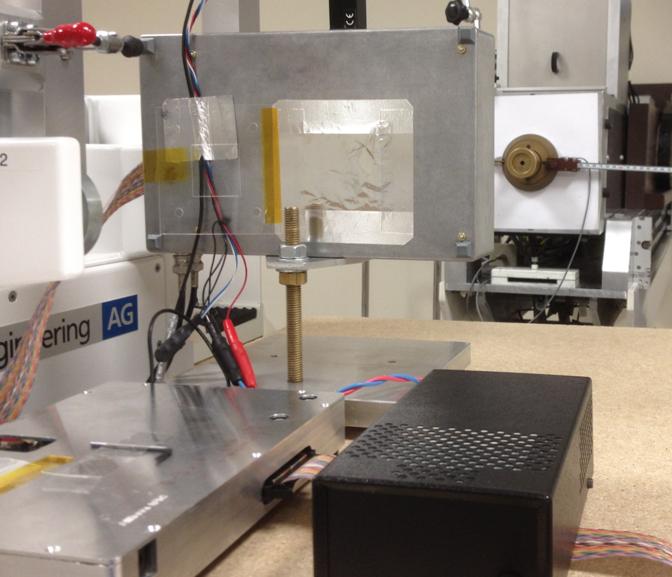
Test setup for charged particles
With thanks to Andrzej Kacperek
Beta Source test
Clatterbridge
Wire-bonded 256 strips (12.5% of total detector) which allows a beam size of up to ~20 mm to be studied (and laboratory source measurements)
Readout using BEETLE ASIC (LHCb) and ALiBaVa DAQ
Thin beam entrance and exit windows to prevent degrading of energy before detector and backscatter after it

Slide 17
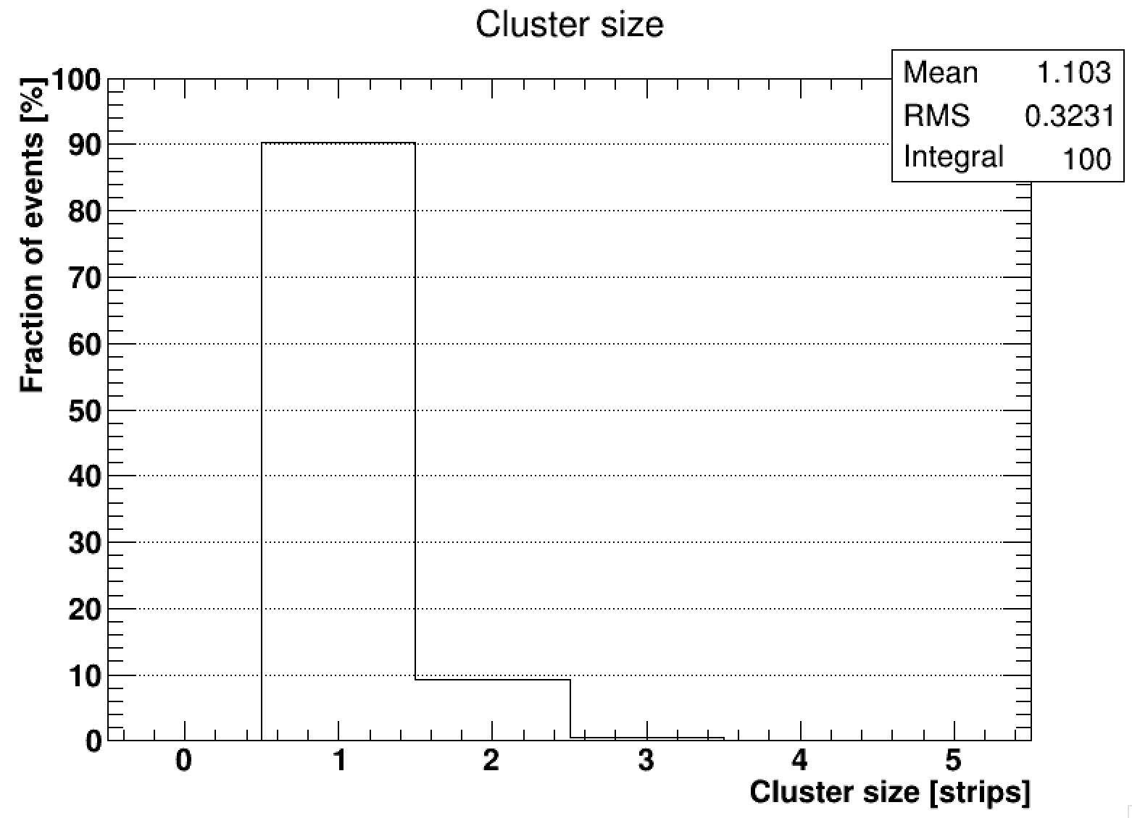
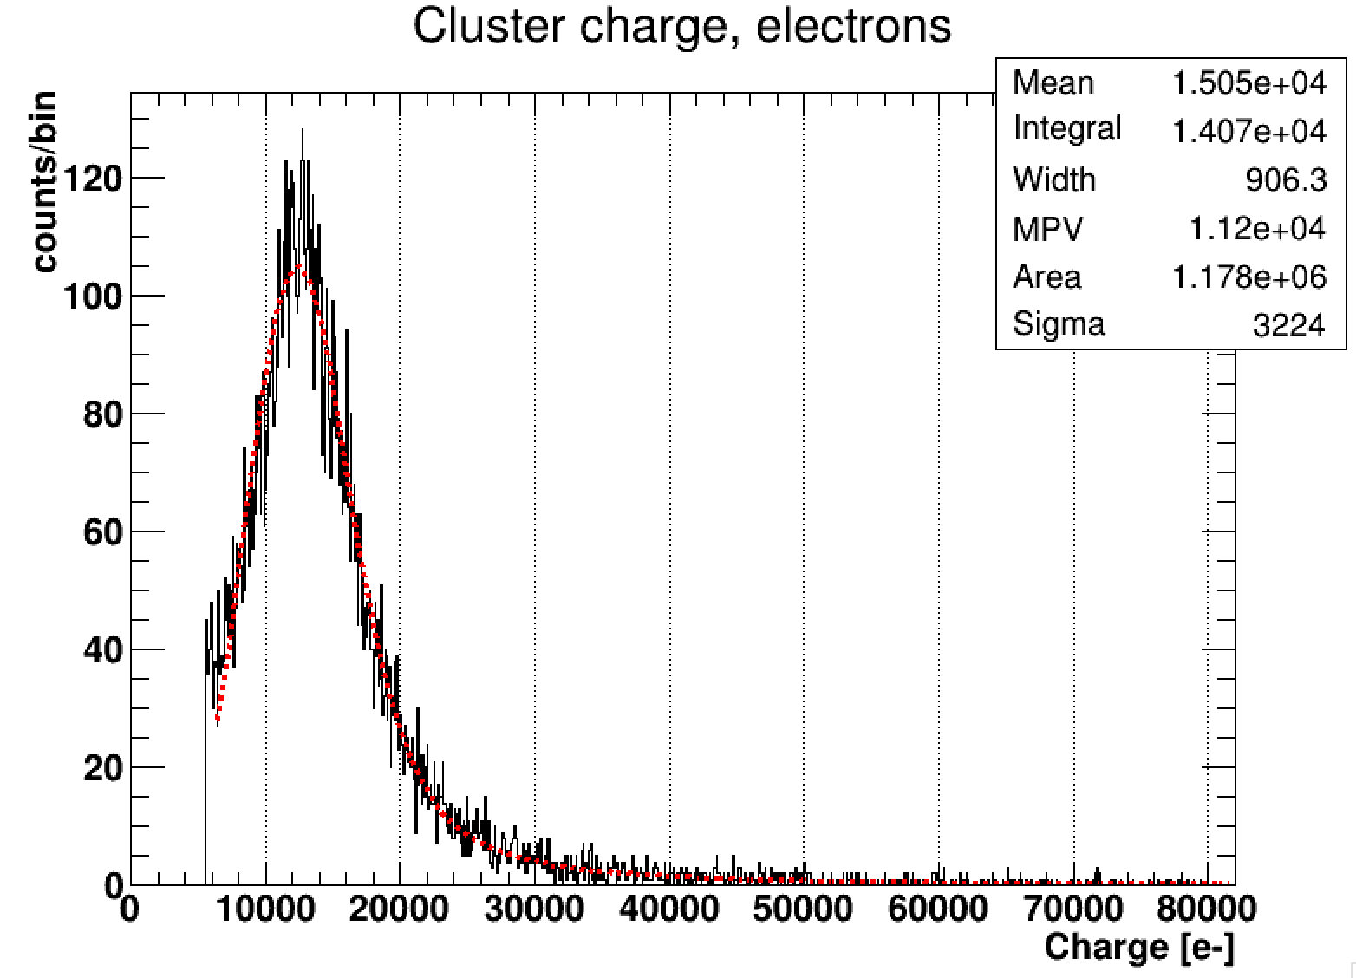
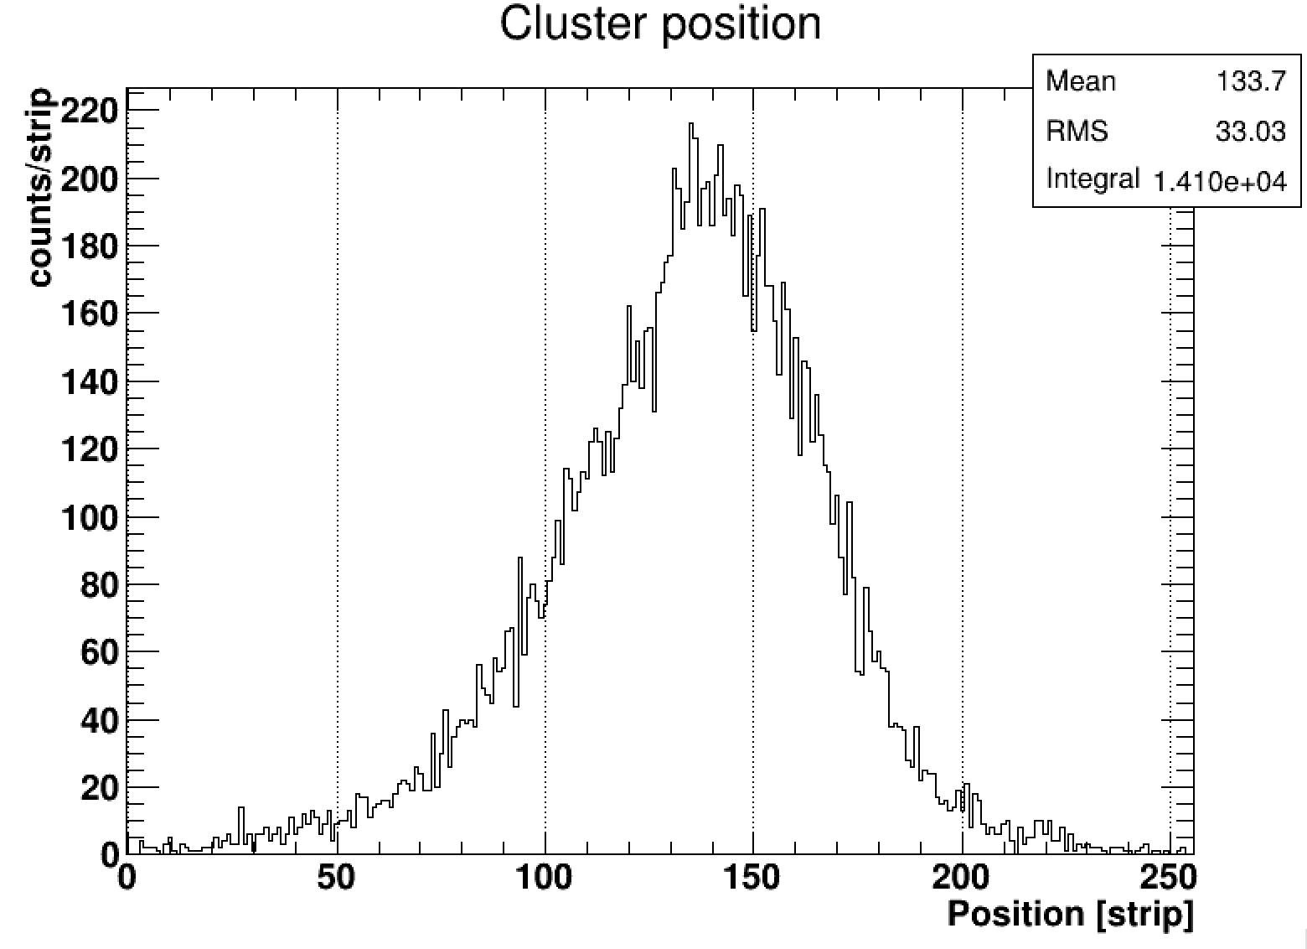
Testing the sensor with MIPs
1 strip clusters: 90.2%
2 strip clusters: 9.3%
3 strip clusters: 0.5%
Threshold on all strips set to 5.5ke-

Slide 18

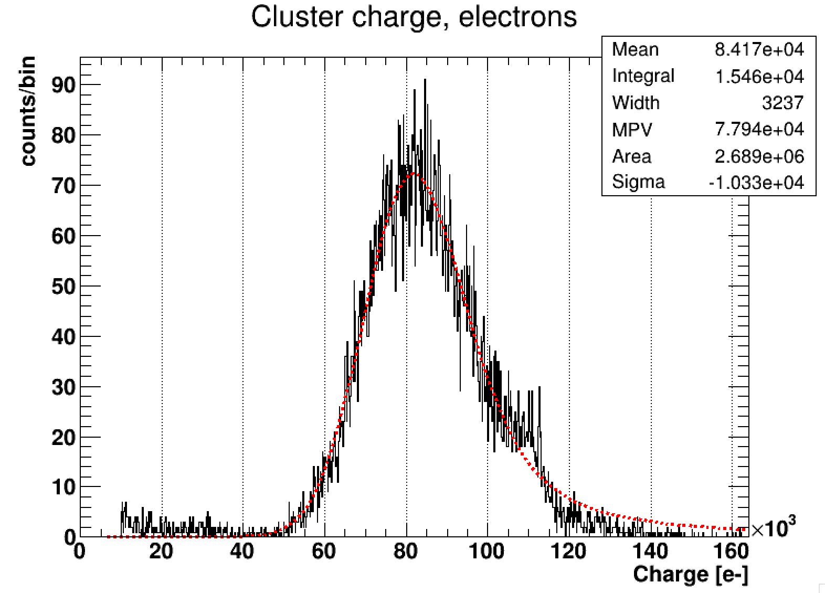
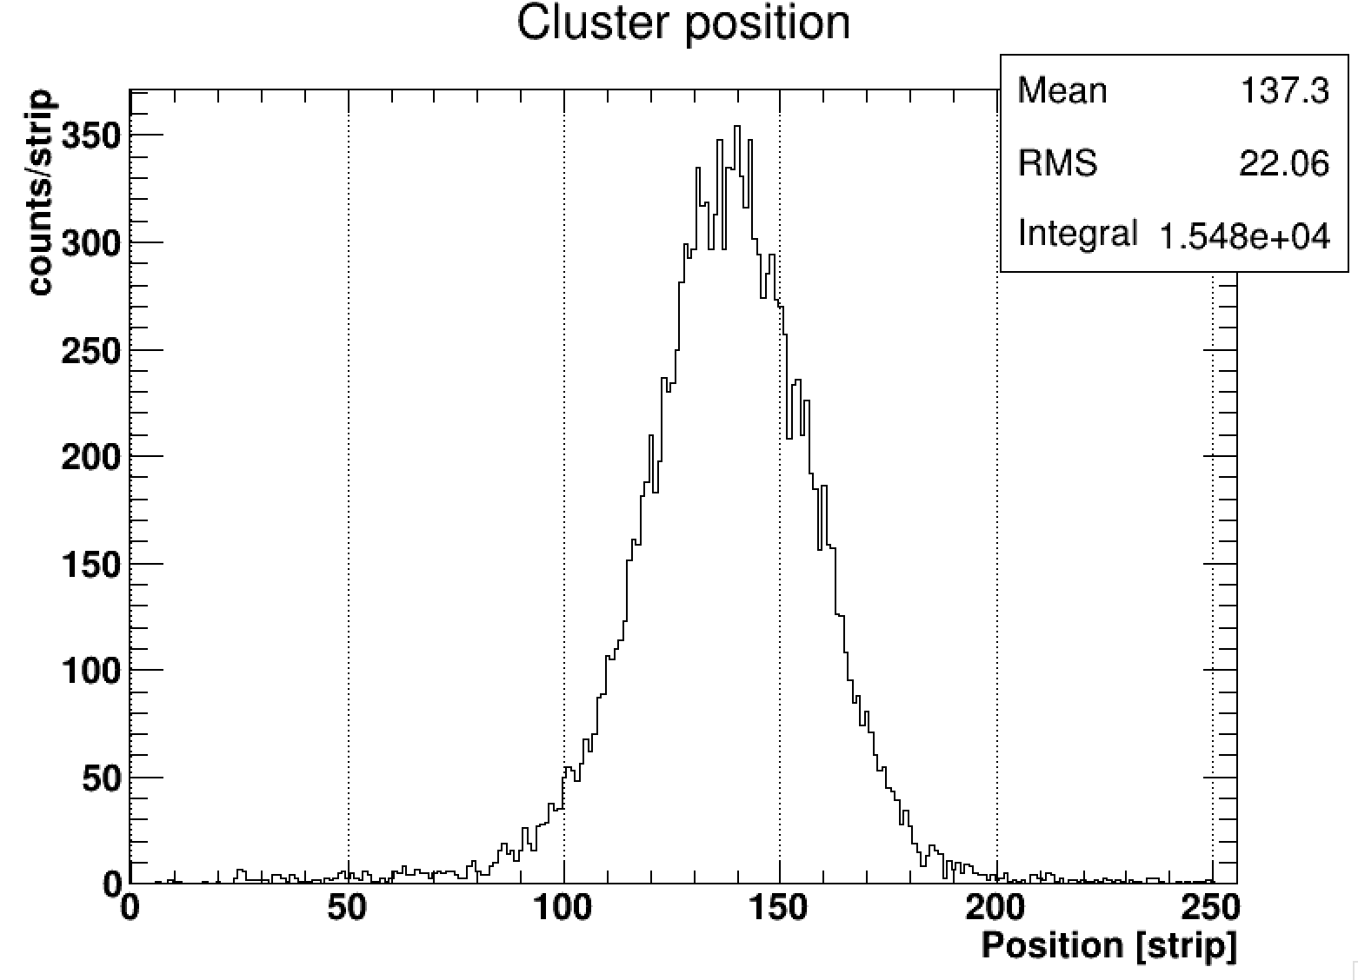
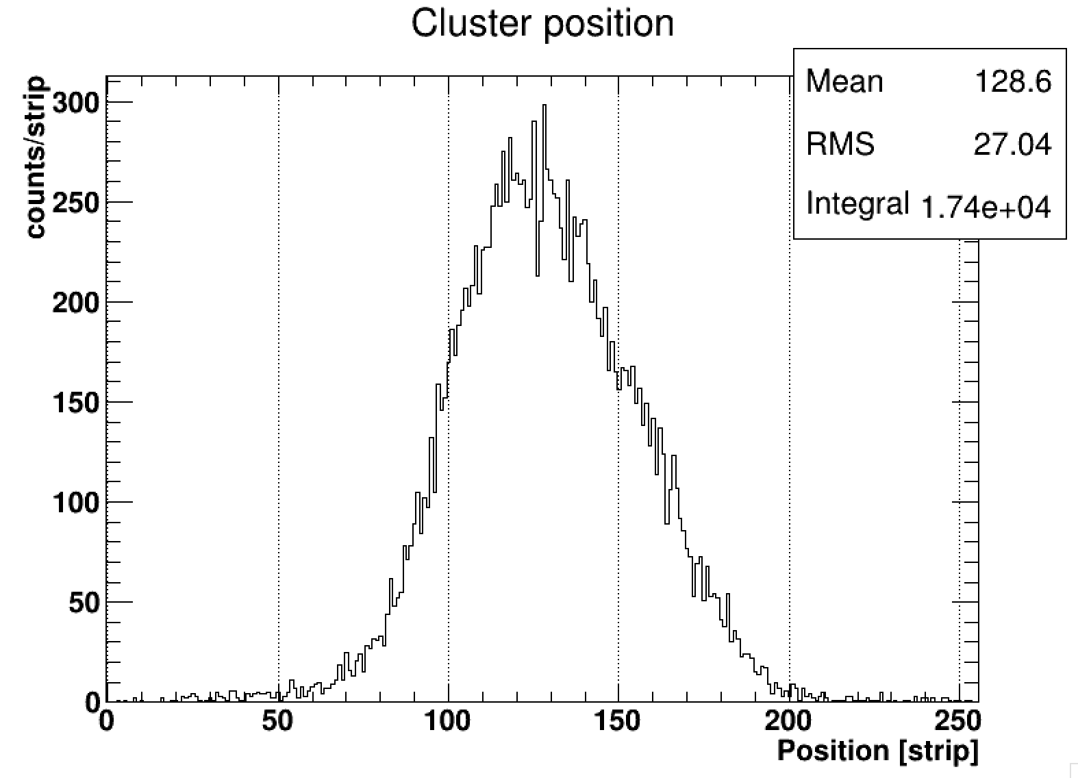
Testing the sensor with 60 MeV protons
1 strip clusters: 69%
2 strip clusters: 30.6%
3 strip clusters: 0.4%
3 mm collimator
7 mm collimator
Threshold on all strips of 10 ke-

Slide 19
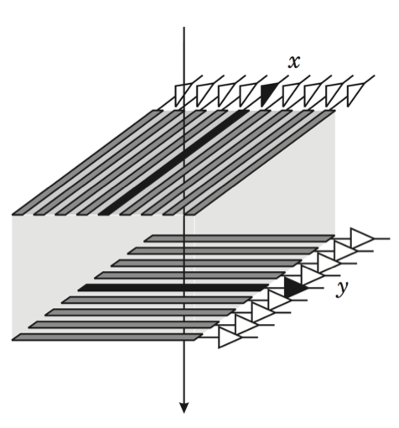
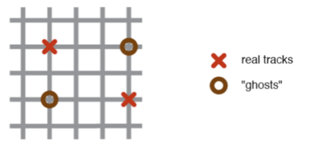
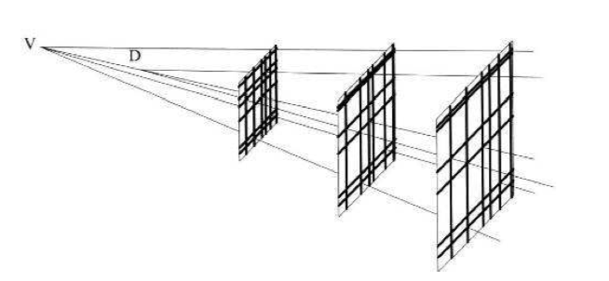
Simulating the Efficiency of the (x,u,v) configuration
How efficient is the tracker at distinguishing hits in a multi-hit environment in both Treatment and
Patient Imaging mode?
For a strip detector with orthogonal strips and N hits, there are: N² - N ‘Ghost-hits’ or ambiguities generated

Slide 20
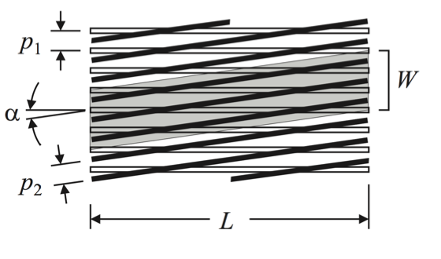
Simulating the Efficiency of the (x,u,v) configuration
Tilt planes of strips at a (stereo) angle w.r.t other planes to prevent strip from one plane crossing all strips in the next plane.
u
v
x
Tracker module design
Each station has strips
crossed at 60º to one
another in (x,u,v)
configuration allowing
higher particle rate.
x - outputs
x - outputs
A smaller stereo angle would reduce the ambiguities further, but doesn’t offer same resolution in all directions

Slide 21
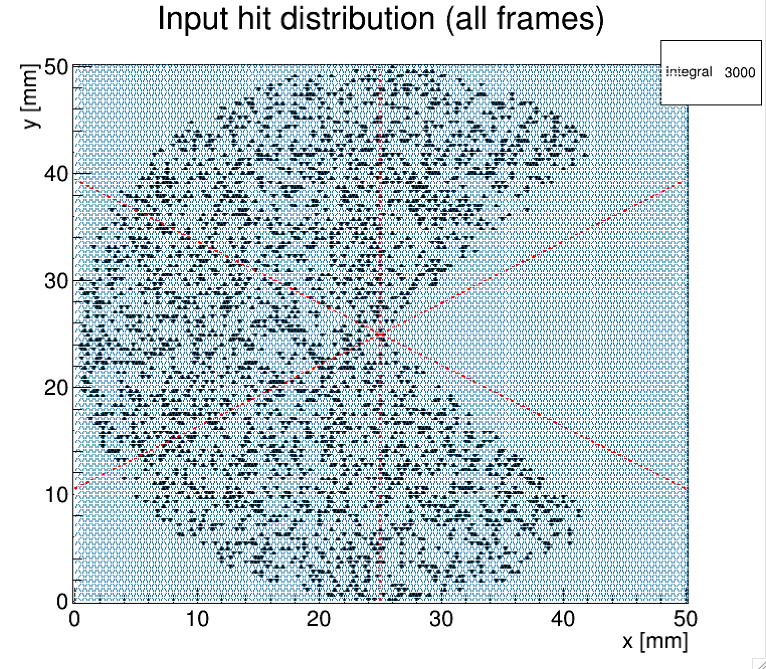
Simulated Efficiency in Treatment Mode
Pacman Input Distribution
Determine efficiency of (x,u,v) configuration in treatment mode using simple Monte Carlo
A concave distribution is a good test of how well we can reconstruct the beam profile without introducing artifacts
Events/Frame | Ambiguity Rate | >1 hit per strip | >2 hits per strip
30 | 8.1% | 4.7% | 0.0%
60 | 62.1% | 10.5% | 0.3%
120 | 811.1% | 18.1% | 1.2%
Ambiguity rate = total ambiguous hits/ total real hits

Slide 22
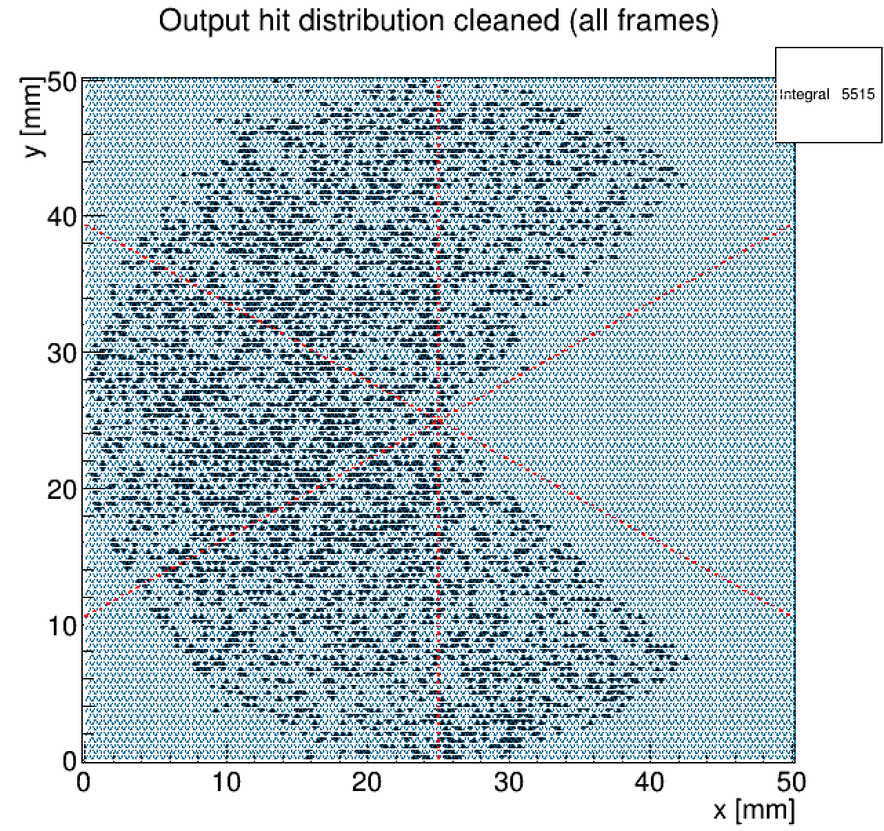
Simulated Efficiency in Treatment Mode
Output Distribution
(x,u,v) Output Distributions
60 protons/frame 1D & 2D output distributions

Slide 23
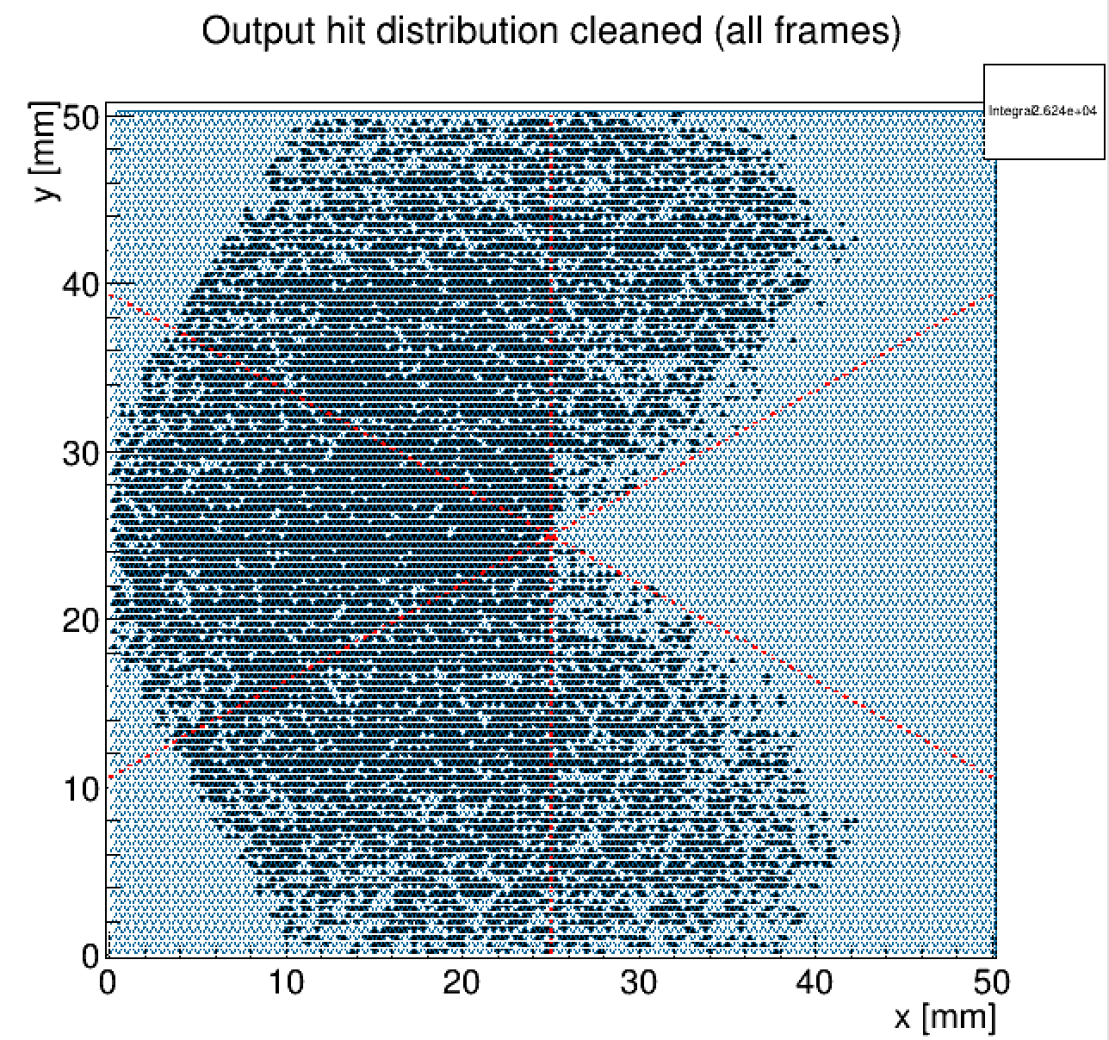
Simulated Efficiency in Treatment Mode
Output Distribution
(x,u,v) Output Distributions
120 protons/frame 1D & 2D output distributions
Proton counting and 1D histogramming – Possible up 120 protons/frame with only small error in calculated dose since 2 thresholds and only 1.2 % > 2 hits per strip.
2D proton beam profile – Large distortions in a concave beam profile appear at 120 protons/frame

Slide 24
Simulated Efficiency in Patient Imaging Mode
Flux in patient imaging (pCT) mode is 100 times less than treatment mode therefore ambiguity rates are very low (at iThemba only expect 0.04 events/frame)
Events/Frame | Ambiguity Rate | >1 hit per strip | >2 hits per strip
5 | 0.6% | 0.8% | <0.1%
10 | 1.6% | 1.4% | <0.1%
Ambiguity rate = total ambiguous hits/ total real hits
High Efficiency – The detector is highly efficient for patient imaging with >99% hits unambiguous at well over 10 times planned iThemba pCT mode rates

Slide 25
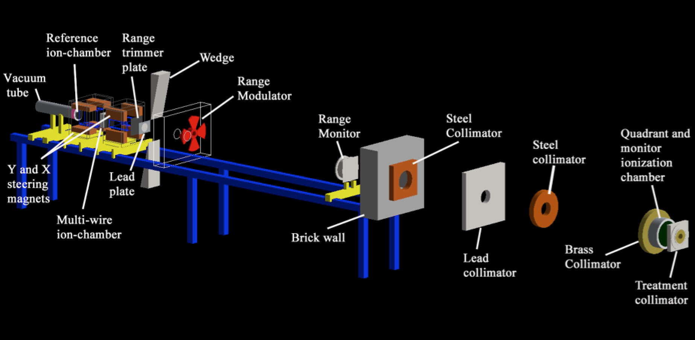
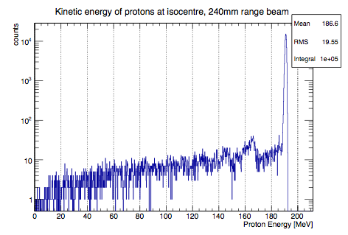
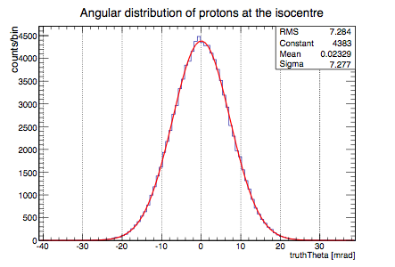
iThemba GEANT4 Simulation
S.Jeyasugithtan & S.Peterson UCT, T.Price UoB
iThemba beamline code used as input for GEANT4 simulations of silicon strip tracker
(x,u,v) triplets of 150um Si with 90.8um strip pitch simulated
Simulation provided output for detector/ASIC design and (soon) output for CT reconstruction codes written by University of Surrey

Slide 26
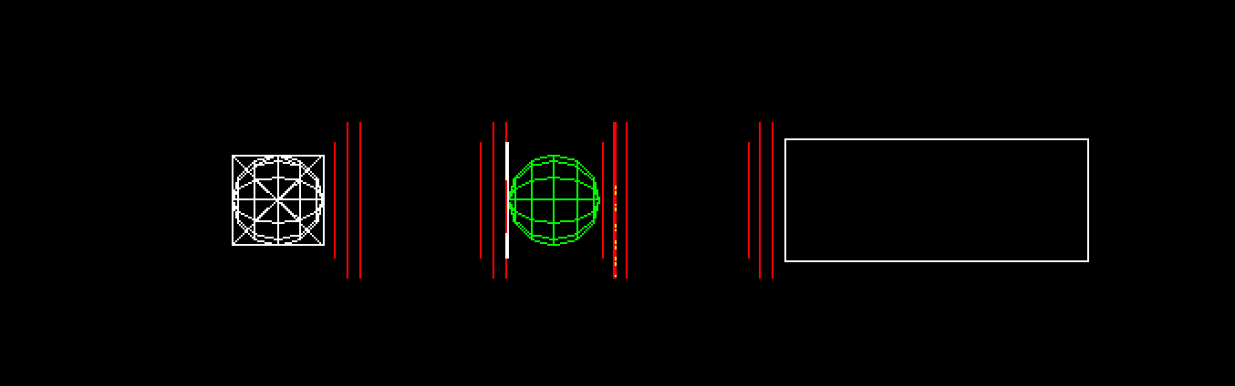
GEANT4 Simulation of tracker
Phantom
Range Compensator
Calorimeter
GEANT4 Simulation of the tracker uses the iThemba beamline simulation on the previous slide as an input. The tracker simulation consists of:
There are 8 planes before and after the phantom:
- 6 silicon planes arranged into two (x,u,v) modules
- 2 air planes used to provide truth information
Each plane uses G4VDigitizerModule to store sensitive detector information into strips
Charge sharing is implemented to provide realistic cluster width distributions for comparison with measured distributions and input to tracking algorithm

Slide 27
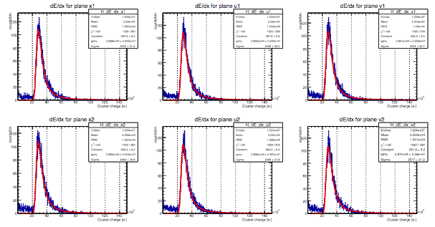
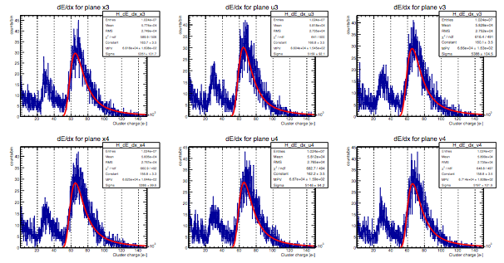
Simulated dE/dx distributions

Slide 28
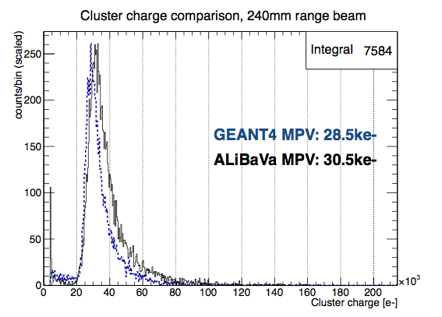
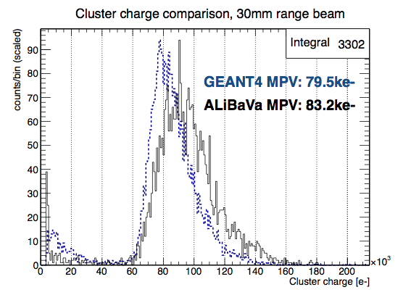
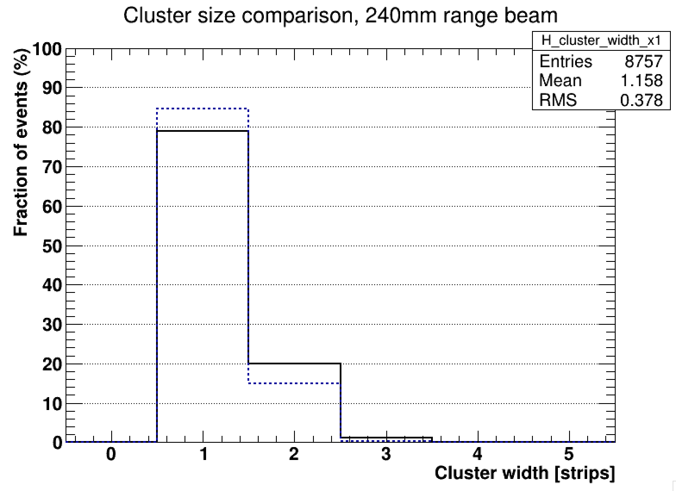
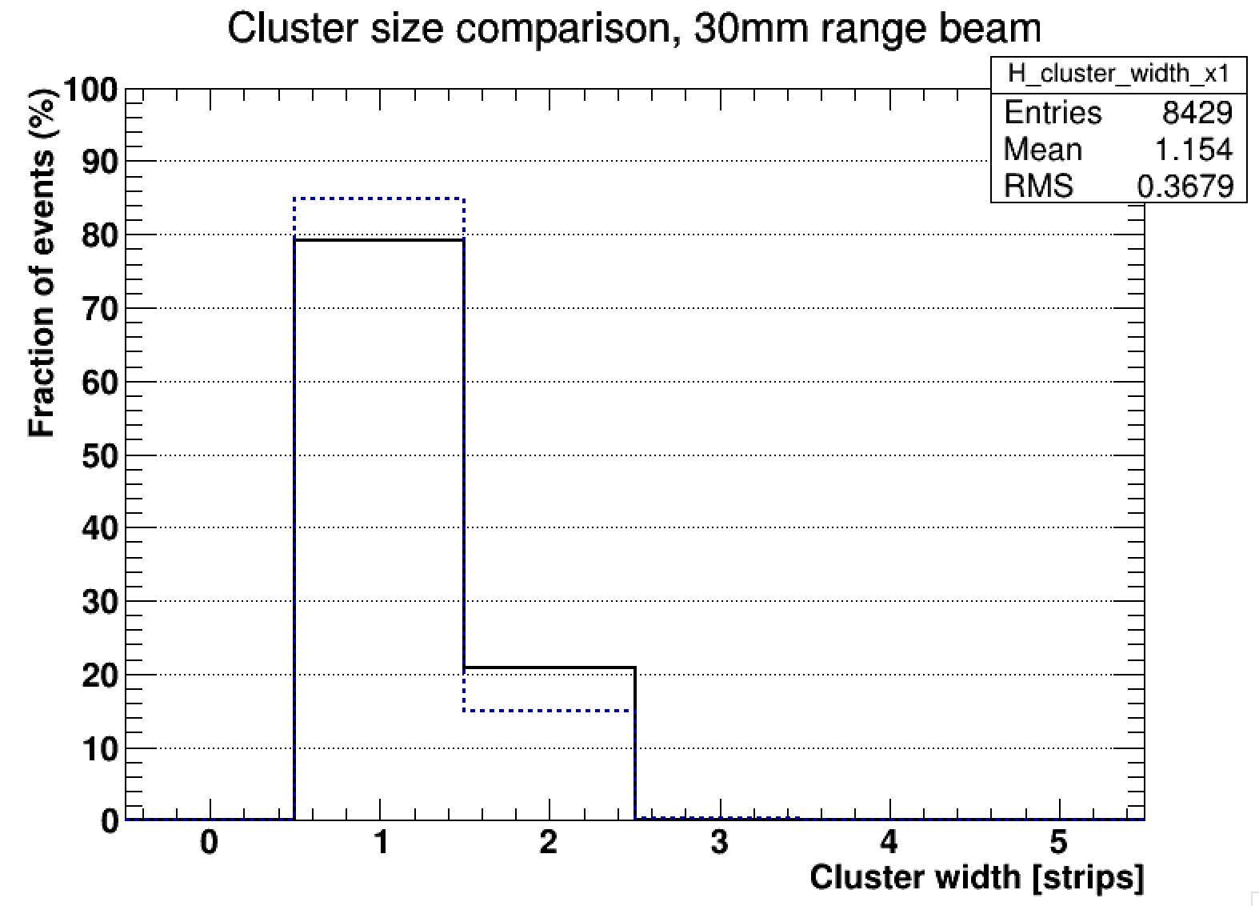
GEANT4 validation
Measured data agrees with GEANT4 simulation to within <10%

Slide 29
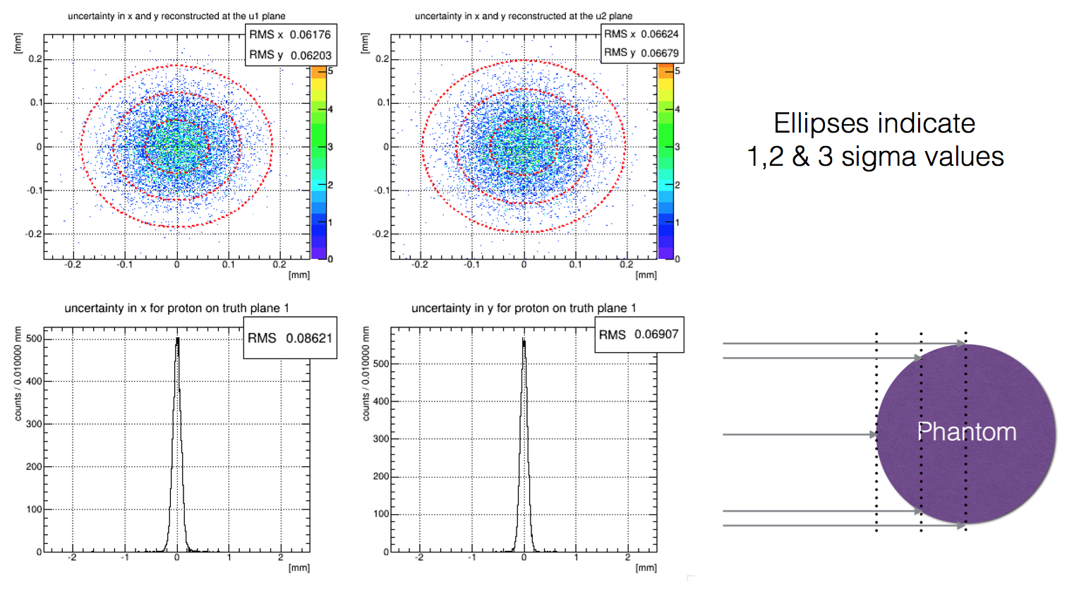
Tracking algorithm
Ellipses indicate 1,2 & 3 sigma values for reconstructed position – truth position
The uncertainty on the projected track depends on its length, ie the distance to the phantom surface.

Slide 30
Summary
The PRaVDA system will enable proton CT and real-time beam monitoring with dosimetry making proton therapy safer and more accurate
A tracker has been designed for the PRaVDA system using 150µm thick silicon microstrip sensors with radiation-hard n-in-p technology developed for the ATLAS Experiment at the High Luminosity LHC
The tracker is capable of fast and precise proton tracking for Patient Imaging and accurate dosimetry up to the high beam currents used during Patient Treatment
Preliminary data has been taken with 150um silicon strip strip detectors and charged particles of varying energies
Simulation together with preliminary measurements has been used to inform design of a new silicon sensor, ASIC, hybrid and DAQ
Tracking software and analysis algorithms are currently under development using simulated data from GEANT4 which has been validated with measurments
Full system to be assembled early next year for beam tests at iThemba LABS, South Africa

Slide 31











Thanks for Listening!
And many thanks to:
P.Allport, G.Casse, N.A.Smith, I.Tsurin
and..

