Slide 1
Radiation-hard Active Pixel Sensors for HL-LHC Detector Upgrades based on HV/HR-CMOS Technology
Malte Backhaus – on behalf of the ATLAS Smart CMOS Pixel collaboration

Slide 2
Outline
Sensor
FE chip
Chip to chip bump bonding
Motivation
HV2FEI4 introduction
  “Sensor”
  Readout chip
Lab results
Test beam results
Irradiation studies
Edge TCT results
Outlook
  Alternative submissions
  Summary
  ATLAS Smart CMOS Pixel Collaboration
Sensor
Analog
tier
Digital
tier
Chip to chip
bump bonding
Wafer to wafer
bonding
Diode + Amp + Digital
Diode + full analog processing
Digital only FE chip
Wafer to wafer
bonding
PSD10 – 11/09/2014

Slide 3
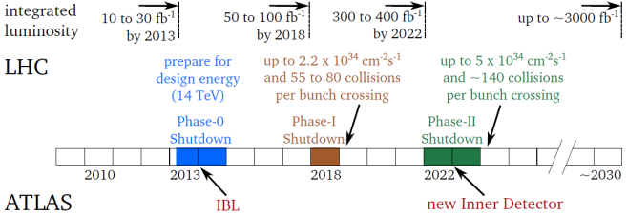
Motivation
Hybrid pixels:
Depleted bulk
→ Signal collected by drift
→ Extreme radiation hard
Optimised R/O chips, full CMOS
High cost (two silicon layers + interconnection)
Large material budget
MAPS:
Undepleted epi layer
→ Diffusion signal
→ Moderate rad. Hardness
Usually not full CMOS
(or with constraints)
Low cost (industrial process, single layer)
Low material budget

Slide 4
Motivation
Hybrid pixels:
Depleted bulk
→ Signal collected by drift
→ Extreme radiation hard
Optimised R/O chips, full CMOS
High cost (two silicon layers + interconnection)
Large material budget
MAPS:
Undepleted epi layer
→ Diffusion signal
→ Moderate rad. Hardness
Usually not full CMOS
(or with constraints)
Low cost (industrial process, single layer)
Low material budget
Achieve radiation hardness in industrial process → low cost, large wafer
High R/O complexity requires dedicated R/O chip
Analog R/O in sensor, simplified hybridisation → potential for cost reduction

Slide 5
Motivation
Hybrid pixels:
Depleted bulk
→ Signal collected by drift
→ Extreme radiation hard
Optimised R/O chips, full CMOS
High cost (two silicon layers + interconnection)
Large material budget
MAPS:
Undepleted epi layer
→ Diffusion signal
→ Moderate rad. Hardness
Usually not full CMOS
(or with constraints)
Low cost (industrial process, single layer)
Low material budget
Diode + full analog processing
Digital only FE chip
Wafer to wafer
bonding
Achieve radiation hardness in industrial process → low cost, large wafer
High R/O complexity requires dedicated R/O chip
Analog R/O in sensor, simplified hybridisation → potential for cost reduction

Slide 6
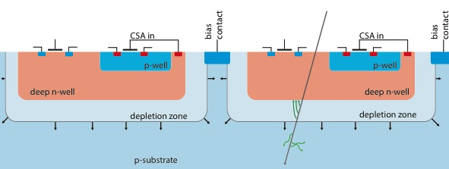
HV2FEI4 Concept
Use bulk of commercial HV/HR-CMOS process as sensor
Deep n-well → collection electrode
  PMOS transistors unshielded from charges
  → design constraints
  p-well used for NMOS transistors
AMS prototypes in characterization (HV2FEI4)
10 – 15 μm

Slide 7
HV2FEI4 Sensor
Limited logic implementation in sensor:
  CSA + Discriminator
  Adjustable sub-pixel output pulse (for AC coupled signal to FE)
  Adding of sub-pixel pulses
FE-I4 pixel dimensions
250 μm
+
Smart Sensor
(HV2FEI4)
50 μm
Readout Chip (FE-I4)

Slide 8
HV2FEI4 Sensor
Limited logic implementation in sensor:
  CSA + Discriminator
  Adjustable sub-pixel output pulse (for AC coupled signal to FE)
  Adding of sub-pixel pulses
Six sub-pixels connect to two FE pixels
Sensor pixel dimensions
125 μm
+
Smart Sensor
(HV2FEI4)
33 μm
Readout Chip (FE-I4)

Slide 9
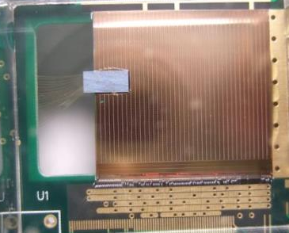
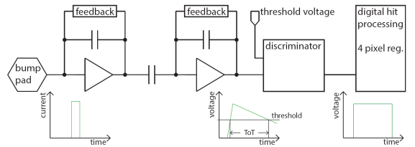
Readout Chip – FE-I4
Use IBL readout chip: FE-I4
Huge complexity
Designed for passive sensor
Pixel size 50 x 250 µm
→ area of 3 „sensor“ chips
„Smart sensor“ glued to FE-I4
Analog information (TOT)
→ Can be used for sub-pixel decoding

Slide 10
Source Scan Occupancy
⁹⁰Sr
Full FE-I4 Hit Map
HVCMOS Hit Map
Full FE-I4 pixel matrix active
Charges generated in sensor transmitted to FE-I4 (AC coupled)

Slide 11
AC Coupled Signal Transmission
⁹⁰Sr
Mean ToT Map
Mean ToT Projection
ToT indicator for AC coupling strength
Tilt of sensor

Slide 12
Source Hit Timing and Cluster
⁹⁰Sr
Hit Timing Resolution
Hit Cluster Size
Hits with significant delay recorded, time-walk sources present twice
Sub-pixel resolution + dedicated algorithm mandatory for investigation
Large hit clusters present

Slide 13
Sub-Pixel Resolution
Puls adding disabled, test charge injections
Out-Pulse to ToT Calibration
Sub-Pixel ToT Response
Distinct ToT peaks → sub-pixel resolution demonstrated
Tuning algorithm and test beam necessary for spatial resolution measurement

Slide 14
Test Beam Results – Introduction
Tuning algorithm for “full matrix sub-pixel reconstruction” under development
No sub-pixel reconstruction serious challenge for test beam measurements (temporally):
→ Alternating pixel connection pattern → challenging alignment
→ Sub-pixel resolution mandatory for in-pixel efficiency measurements
→ Careful conclusions on radiation hardness from
test beam / lab results, although very promising
(samples “alive” after up to 10¹⁶ n_{eq} cm⁻²)

Slide 15
Test Beam Results – Bias Voltage Scan
Bias Voltage Scan
DESY test beam, 4 GeV e
HVCMOS
n-irradiated
10¹⁵ n_{eq}
Bias voltage increases efficiency

Slide 16
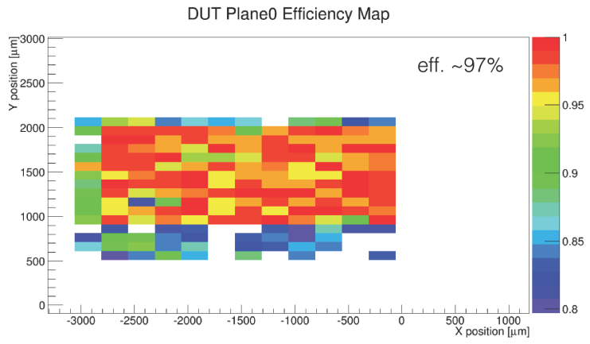
Test Beam Results – Mean Efficiency
Preliminary
CERN PS test beam ,
August 2014, 10 GeV, mixed beam (mostly p)
HVCMOS
unirradiated
Reduced efficiency under investigation
→ in-pixel inefficiencies → need sub pixel resolution
→ high threshold → improve tuning algorithm

Slide 17
Irradiation Studies – Electronics
2 hour @ 70 C
annealing
every 100 Mrad
10 days @ 22 C
annealing
Adjustment of
settings
Decrease of Preamplifier gain with irradiation
Annealing periods observable
Parameter tuning recovers to 90 % gain after ~ 900 Mrad

Slide 18
Edge TCT - Introduction
Shoot infrared laser pulses through polished edge
Generate charges in known position and thickness
→ Scan over positions
Analyse signal shape of passive diode with oscilloscope
z
y
Good tool for studies of
  Geometry of depletion zone
  Signal composition: drift / diffusion

Slide 19
Edge TCT – Depletion Zone Geometry
Signal composed of
  Drift
  (faster than 3 ns)
  Diffusion
  (slower than 3 ns)
Contribution of
Drift / Diffusion depends on
position
Signal Size [a.u.]
Time [ns]

Slide 20
Edge TCT – Depletion Zone Geometry
z
HVCMOS
unirradiated
x
x
Depleted region with thickness of 10 - 15 µm
Large area with diffusion signal below the depleted region

Slide 21
Edge TCT – Depletion Zone Geometry
z
HVCMOS
10¹⁵ n_{eq}cm⁻²
x
x
Drift signal unchanged after irradiation
Diffusion signal disappears due to trapping

Slide 22
Edge TCT – Signal Composition
Signal in depleted region
→ drift, no trapping
Signal in un-depleted region
→ diffusion, trapping after irr.
Signal Size [a.u.]
Unirradiated
Unirradiated
10¹⁵ n_{eq}cm⁻²
10¹⁵ n_{eq}cm⁻²
Time [ns]
Time [ns]
Several 10% of traversing particle signal due to diffsion before irradiation
[see also: Simon Feigl, TIPP2014]

Slide 23
Smart CMOS Pixel Submissions Overview
Submissions targeting R&D with FE-I4 readout
HVCMOS:
AMS 180 nm – V1: First prototype In test
AMS 180 nm – V2: Radiation hard electr. design In test
AMS 180 nm – V3/4: Radiation hard electr. design test started
GF 130 nm – V1: First prototype In test, promising up to 1 Grad!
HRCMOS:
GF 130 nm – V2: HR prototype, impr. electr. In test, expct. up to 1 Grad!
LFoundry 150 nm: First prototype Submitted
AMS 320 nm: High resistivity substrate Planned
Large scale demonstrator program started
→ comparison of most promising technologies planned
DMAPs submissions
Several technologies under investigation with monolithic R/O architecture. Esp. promising candidates for demonstrator program (FE-I4 readout):
ESPROS 150 nm, HR bulk: V1 in test, good results, V2 submitted
XFAB 180 nm, SOI, HR bulk possible: V1 in test, good rad. hardness of trans., V2 submitted

Slide 24
Conclusions
Promising HVCMOS and HRCMOS prototypes submitted and in hand
Large step towards on sensor analog signal processing + digital FE
→ Step towards HL-LHC requirements in strip and outer pixel layers
AC coupled signal transmission demonstrated
→ Research on gluing techniques started
Sub-pixel resolution possible
→ Detailed characterization to come
→ Complex tuning and reconstruction
algorithms under development
Radiation hardness of process very promising
→ Hits detected after several
hundred Mrad (not shown here)
→ Radiation hard electronics for LHC environment
feasible
Intense signal collection studies started, significant drift
as well as diffusion contribution
A lot achieved – more work ahead!

Slide 25
ATLAS Smart CMOS Pixel Collaboration
University of Bonn:
L. Gonella, T. Hemperek, T. Hirono, F. Hügging, J. Janssen, H. Krüger, T. Obermann,
N. Wermes
LBNL:
M. Garcia-Sciveres
CERN:
M. Backhaus, M. Capeans, S. Feigl, S. Fernandez-Perez, M. Nessi, H. Pernegger, B. Ristic
University of Geneva:
S. Gonzales-Sevilla, D. Ferrere, G. Iacobucci, A. La Rosa, A. Miucci, D. Muenstermann, J. Bilbao de Mendizabal
University of Göttingen:
M. George, J. Grosse-Knetter, A. Quadt, J. Rieger, J. Weingarten
University of Glasgow:
R. Bates, A. Blue, C. Buttar, D. Hynds
University of Heidelberg:
C. Kreidl, I. Peric
CPPM:
P. Breugnon, P. Pangeaud, S. Godiot-Basolo, D. Fougeron, F. Bompard, J.C. Clemens, J. Liu, M. Barbero, A. Rozanov

Slide 26
Backup

Slide 27
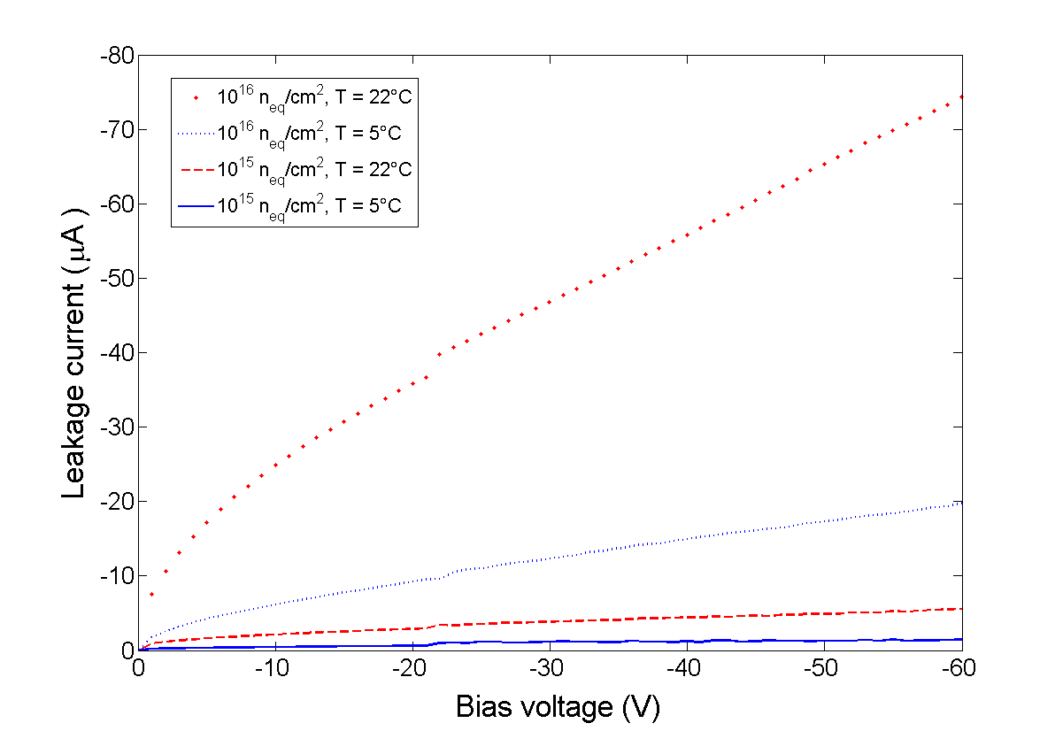
Irradiation Studies – Bulk Damage
HVCMOS
n-irradiated
10¹⁶ n_{eq}
HVCMOS
n-irradiated
10¹⁵ n_{eq}
Reasonable leakage current increase with
- Dose, - Temperature
Need further results for CCE, hit efficiency, etc.

Slide 28
Test Beam Results – Timing Resolution
DESY test beam, 4 GeV e
Hit Timing Resolution
Hit Timing Resolution
HVCMOS
unirradiated
Reference
Hits with delayed detection

Slide 29
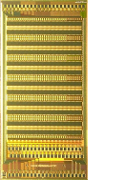
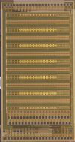
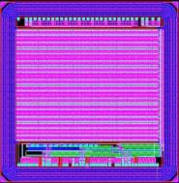
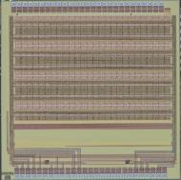
HV2FEI4 chips
2011
AMS 0.18µ HV
3mm x 4mm
CCPD_AMS V1
ρ : 10 Ω.cm
HV : 60V
Few MRads
2012
AMS 0.18µ HV
3mm x 4mm
CCPD_AMS V2
ρ : 10 Ω.cm
HV : 60V
860 MRads
2013-2014
AMS 0.18µ HV
3mm x 4mm
CCPD_AMS V3-4
ρ : 10 Ω.cm
HV : 60V
?
RAD-HARD
RAD-HARD
2014
LF 0.15µ
3mm x 3mm
CCPD_LF V1
1k-3k Ω.cm
10V
? GRads
RAD-HARD & EFFICENTY
2013
GF 0.13µ BCDLite
3mm x 3mm
CCPD_GF V1
10 Ω.cm
HV : 30V
1 GRads
2014
GF 0.13µ LP
3mm x 3mm
CCPD_GF V2
1K- 3k Ω.cm
HV : 30V
1 Grads?
RAD-HARD & EFFICENTY

