Slide 1
A CMOS Active Pixel Sensor for
high resolution imaging of
the Jovian system
Matthew Soman, Andrew D. Holland, Konstantin D. Stefanov, Jason P. Gow, Mark Leese
Centre for Electronic Imaging, The Open University, MK7 6AA, UK
Jérôme Pratlong, Peter Turner
e2v technologies plc., 106 Waterhouse Lane, Chelmsford, Essex, CM1 2QU, UK

Slide 2
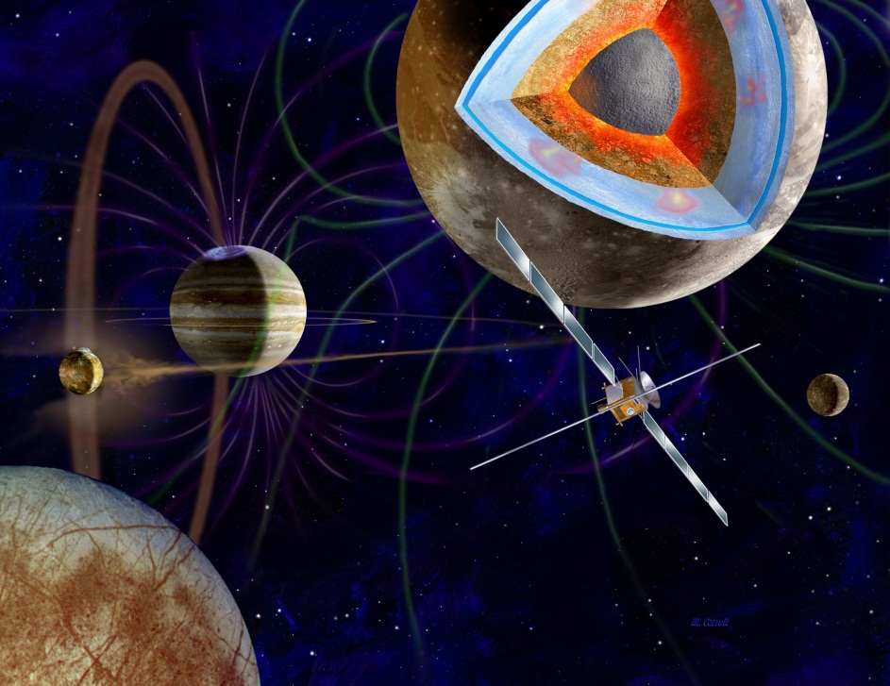
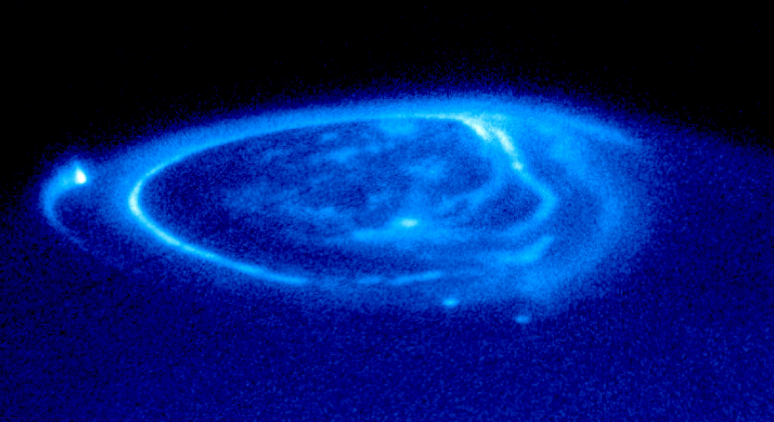
Jovian system
67 known natural satellites
  4 largest are ‘Galilean’ moons:
  Europa, Ganymede, Callisto and Io
Io
Harsh radiation environment
Gammas
Protons
Heavy ions
Electrons
Europa
Ganymede
UV aurora. Image credit: NASA

Slide 3
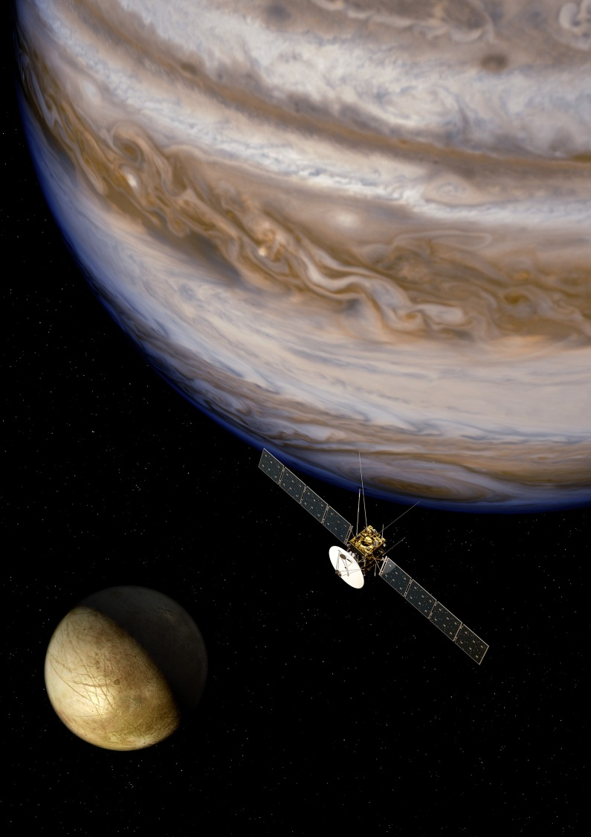
Jupiter Icy Moon Explorer
1900 kg dry mass
2900 kg of chemical propellant
Launch 2022
8 year cruise phase
3 years of observations in the Jovian system (2030 to 2033)
  Jupiter
  Ganymede
  Europa
  Callisto
  Jovian rings, Io and other satellites
O. Grasset et al. “JUpiter ICy moons Explorer (JUICE): An ESA mission to orbit Ganymede and to characterise the Jupiter system,” (2013) Planetary and Space Science, 78, 1-21.
Image credit: ESA

Slide 4
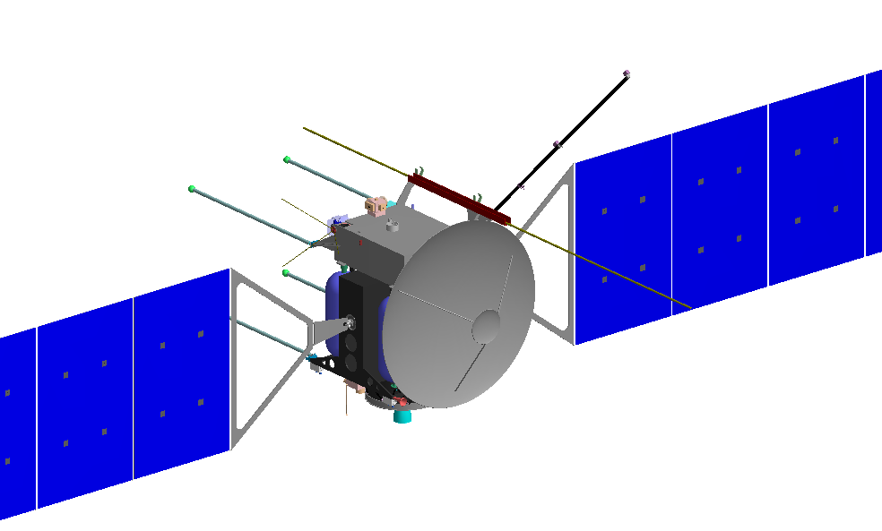
JUICE instruments
11 Instruments with a total mass of around∼104 kg
  JUICE dry mass ∼1900 kg
  Propellant mass ∼2900 kg
MAJIS - Moons and Jupiter Imaging Spectrometer
UVS - UV imaging Spectrograph
SWI - Sub-millimeter Wave Instrument
GALA - GAnymede Laser Altimeter
RIME - Radar for Icy Moons Exploration
J-MAG - A magnetometer for JUICE
PEP - Particle Environment Package
RPWI - Radio & Plasma Wave Investigation
3GM - Gravity & Geophysics of Jupiter and Galilean Moons
PRIDE - Planetary Radio Interferometer & Doppler Experiment
JANUS - Camera system
  An optical camera to study global, regional and local morphology and processes on the moons, and to perform mapping of the clouds on Jupiter.
Image credit: ESA

Slide 5











Optical Imager: JANUS
“JANUS will conduct … an in-depth comparative study of Ganymede, Callisto and Europa, and explore most of the Jovian system and Jupiter itself.”

Slide 6
J ANUS
Jovis, Amorum ac Natorum Undique Scrutator
Camera Parameter | Units | Value
Sensitive Wavelength | nm | 350 to 1064
Filters | - | 14
Entrance pupil diameter | mm | 100
Field of view | degrees² | 1.72 × 1.29
 | pixels² | 2000 × 1504
Best case mapping resolution (Ganymede closest approach) | m pixel⁻¹ | <10
Sensor temperature | °C | -50±5
Sensor expected end of life radiation dose | krad (Si) | 100
 | 10 MeV protons equivalent cm⁻² | 10¹⁰
JANUS is an optical camera to study global, regional and local morphology and processes on the moons, and to perform mapping of the clouds on Jupiter.

Slide 7
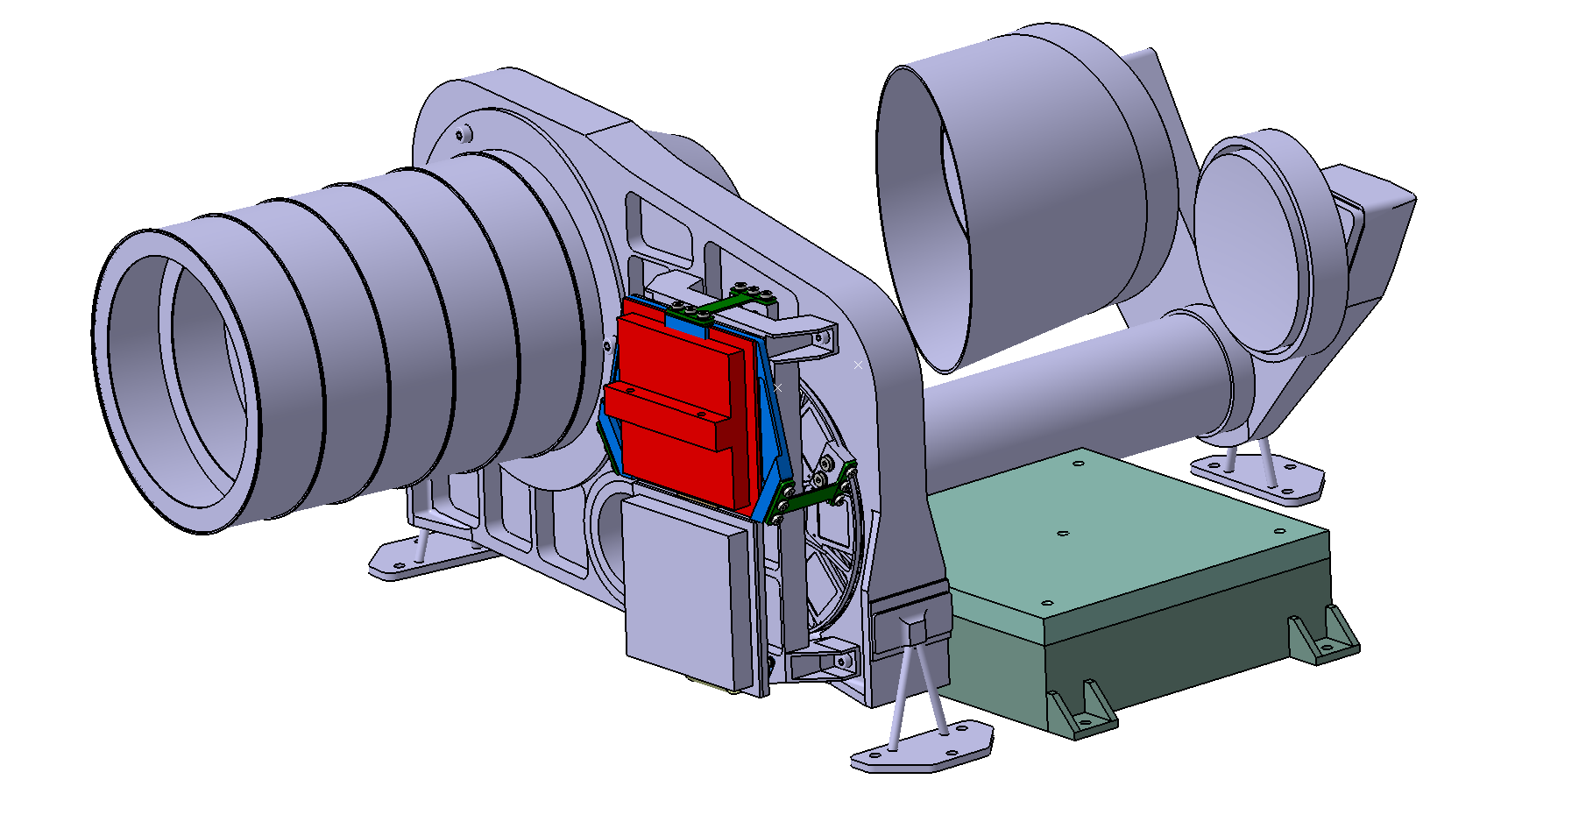
J ANUS camera model
M1
Baffle
M3
Tubular
mechanical
support
Primary Electronics Unit
Focal Plane Module
(including detector)
Proximity electronics
Filter wheel
Image credit: JANUS consortium

Slide 8
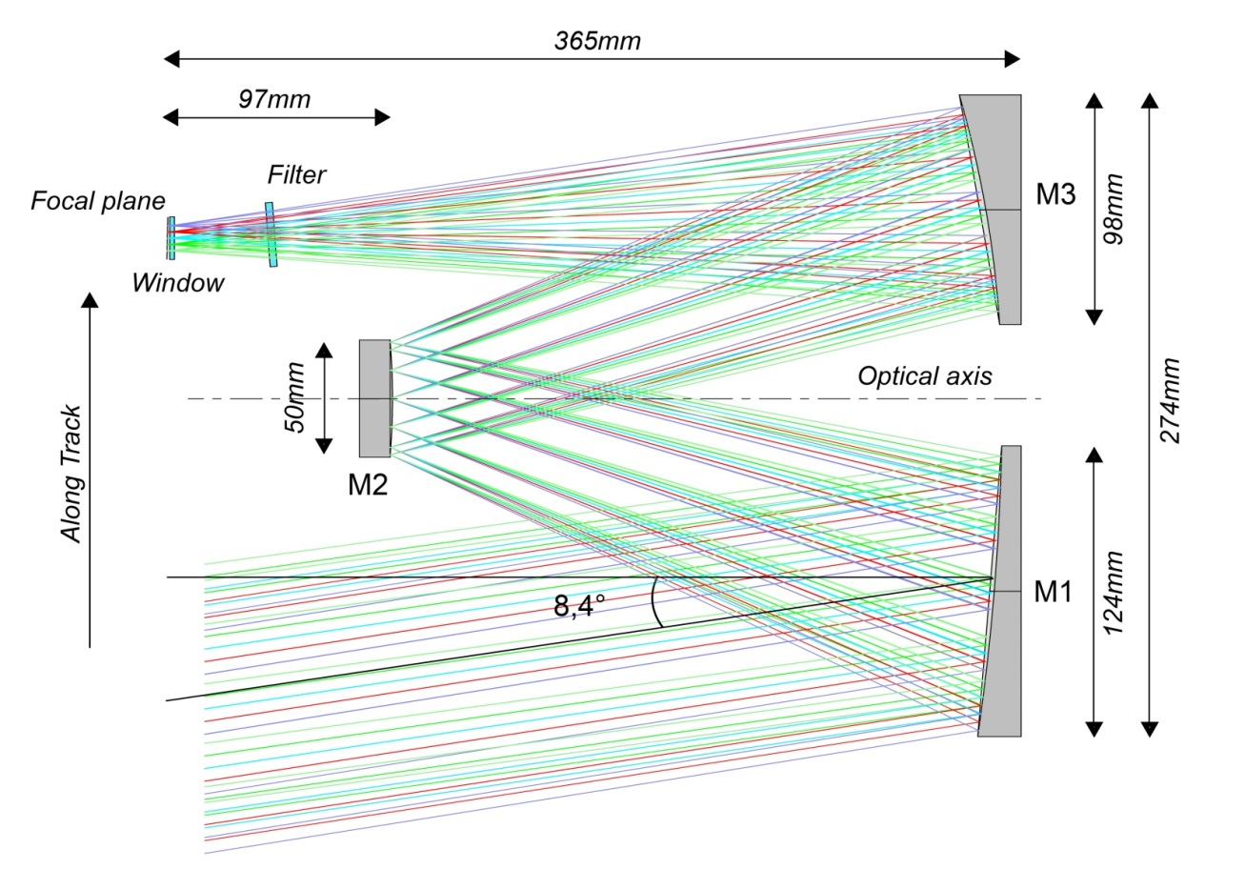
J ANUS optical design
Three Mirrors Anastigmat (off-axis field, on-axis pupil)
Detector
D. Greggio et al. "A preliminary optical design for the JANUS camera of ESA's space mission JUICE,”
(2014) Proc. SPIE 9143

Slide 9
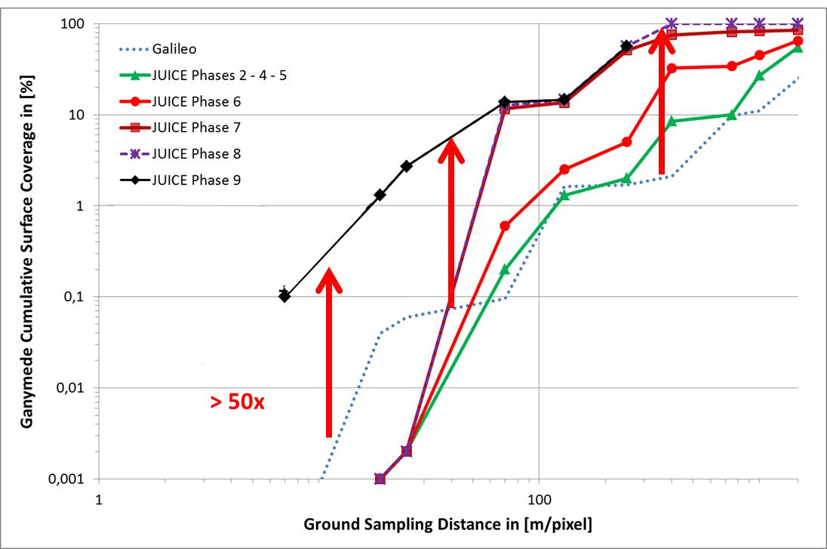
Predicted performance: Ganymede
The surface coverage of Ganymede expected >50x improvement over Galileo but will be limited by telemetry requirements
P. Palumbo et al., “JANUS: The Visible Camera Onboard the ESA JUICE Mission to the Jovian System”,
45th Lunar and Planetary Science Conference 2014

Slide 10
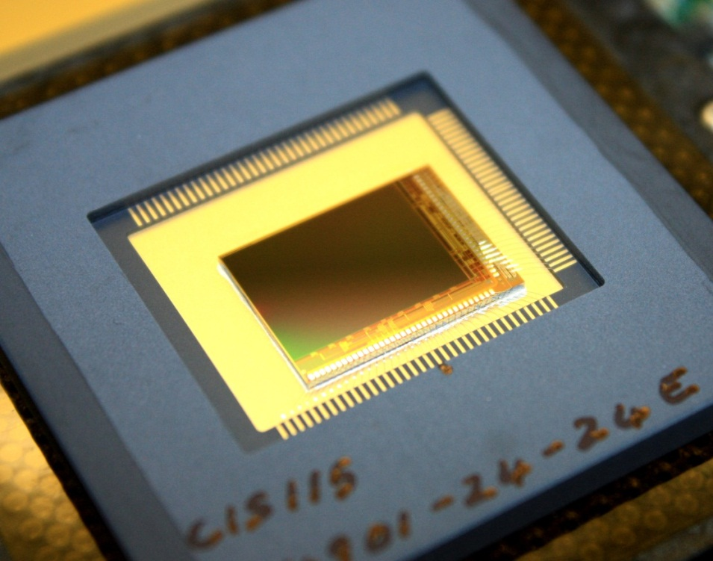
New CMOS sensor for JANUS
The prime sensor selected for JANUS is a back-illuminated (BI) CIS115. This is a monolithic silicon CMOS Active Pixel Sensor.
Developed by e2v technologies following gamma and proton radiations and characterisation of the best performing pixel and output driver design from a test device with the same format (CIS107).
A front-illuminated CIS115

Slide 11
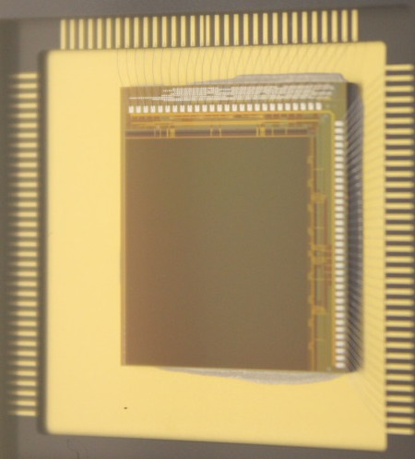
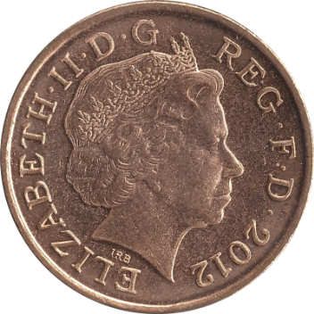
CIS115: Monolithic CMOS APS
CMOS image sensor with a 4-Transistor pixel design (7 µm pitch).
Image area is divided into 4 section, each with its own analogue output, capable of a readout rate of up to 10 MPixel s⁻¹.
Designed by e2v and manufactured using Tower 018 Imaging Sensor process.
Device is back-illuminated, thinned to approximately 9 µm thick, and an anti-reflective coating is applied by e2v technologies to optimise its optical sensitivity
CIS115
photosensitive area
(14 x 10.5 mm²)
British penny
(Ø 20.3 mm)

Slide 12
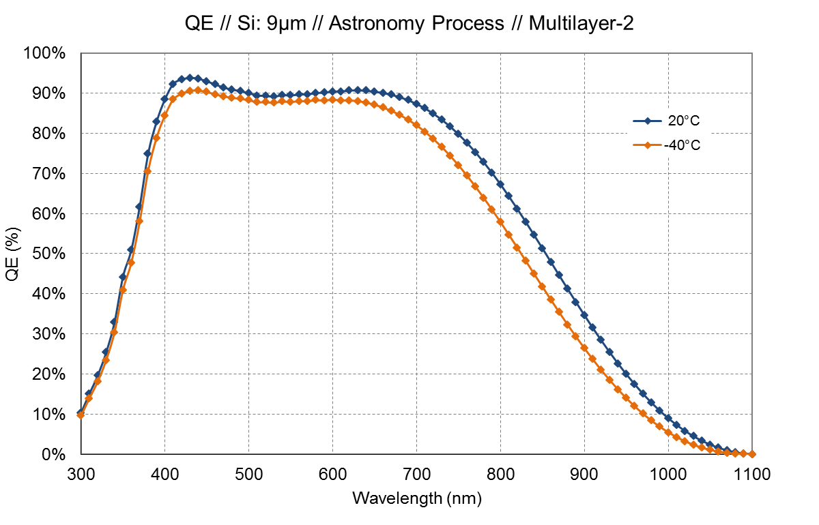
Sensor expected quantum efficiency
The predicted QE performance of the back-illuminated CIS115 when coated using e2v’s Multilayer-2 anti‑reflective coating, assuming 9 µm thick silicon.

Slide 13
CIS115 readout
CIS115 image area is divided into 4 sections that are each read out simultaneously.
The image area is read out in a rolling shutter mode, row by row.
1504 columns
Row 1
2000 rows
376 columns

Slide 14
CIS115 readout
CIS115 image area is divided into 4 sections that are each read out simultaneously.
The image area is read out in a rolling shutter mode, row by row.
1504 columns
Row 2
2000 rows
376 columns

Slide 15
4T pixel and readout architecture
Reset
Transfer
In-pixel
source
follower
Column selector
Column buffer
Output
buffer
Initial
buffering
Row selection
ADC
To computer
Pinned
photodiode
One pixel
‘CDS buffer’ for storage of reset and signal levels
Differential amplifier for reset level subtraction
On chip
Off chip
M. Soman et al., “Design and characterisation of the new CIS115 sensor for JANUS, the high resolution camera on JUICE”,
(2014) Proc. SPIE 9154

Slide 16


Delivery pathway for CIS115
Test device (CIS107) characterisation including:
gamma up to 150 krad(Si)
2×10¹⁰ protons cm⁻² (58.8 MeV)
Now
CIS115 design and manufacture
Camera commissioning &
FI CIS115 characterisation
BI CIS115 characterisation
BI CIS115 radiation campaigns
May 2014
First FI CIS115 received
October 2014
BI CIS115 to be delivered
mid 2015

Slide 17
CIS107 proton irradiation
e2v technologies have completed a proton irradiation campaign on CIS107 at Paul Scherrer Institute using 58.8 MeV protons with an average flux of 7.8x10⁷ p cm⁻² s⁻¹ to provide a fluence of 2x10¹⁰ p cm⁻².
Effects of irradiation on pixel variant 1 of back-illuminated, high resistivity CIS107s represent the results expected with the CIS115:
 | Units | Pre-irradiation | Post-irradiation | Change
Charge to Voltage Factor (CVF) | µV e⁻¹ | 36.6 | 41.2 | 12.6%
Read-out noise | e⁻ rms. | 8.7 | 9.5 | 9.2%
Dark current (20°C) | e⁻ pix⁻¹ s⁻¹ | 65.5 | 1240 | x19
The change in CVF cannot currently be explained. The other changes are probably a result of increased trap densities.
Lag, QE and linearity performance show no change following proton irradiation.

Slide 18
CIS107 gamma irradiation
e2v technologies completed an irradiation campaign on CIS107s at Harwell’s Co⁶⁰ source in Oxford (UK). Sensors were biased and clocked during irradiation to 20, 50, 100 and 150 krad(Si). These doses are comparable to the expected end of life dose of the JANUS sensor (100 krad(Si)).
Linearity, QE, and lag show no change up to the 150 krad(Si) dose.
Results are not as expected. The increase of dark current is generally higher with ionising radiation through the generation of surface effects, but in the case of these devices the proton irradiation has given the largest change. The subsequent irradiation campaign on the CIS115 will investigate these effects further.
 | Units | Pre-irradiation | Post-irradiation
Read-out noise | e⁻ rms. | 6.3 | 11.5 (150 krad)
Dark current (20°C) | e⁻ pix⁻¹ s⁻¹ | 37 | 100 (100 krad)

Slide 19
CIS115 irradiation campaign
A broad and detailed irradiation test campaign is planned for the BI CIS115s:
Particle flavour | Planned source details | Irradiation level | Number of devices | Device status during irradiation
Gamma | ESTEC Co^{60,} Noordwijk | 0 (control) | 1 | Biased and clocked
 |  | 50 krad(Si) | 2
 |  | EOL: 100 krad(Si) | 2
 |  | 200 krad(Si) | 1
Proton | 10 MeV or equivalent | 0 (control) | 1 | Devices placed in a shorting jig
 |  | 5×10⁹ p cm⁻² | 1
 |  | EOL: 1×10¹⁰ p cm⁻² | 1
 |  | 2×10¹⁰ p cm⁻² | 1
Heavy ion | Cyclotron Resource Centre at Louvain‑la‑Neuve | Control | 1 | Latch-up monitoring
 |  | LET range of 1 to 70 MeV mg^{‑1} cm⁻² | 3
Electrons | 10 MeV (TBC) | (TBC) | 3

Slide 20
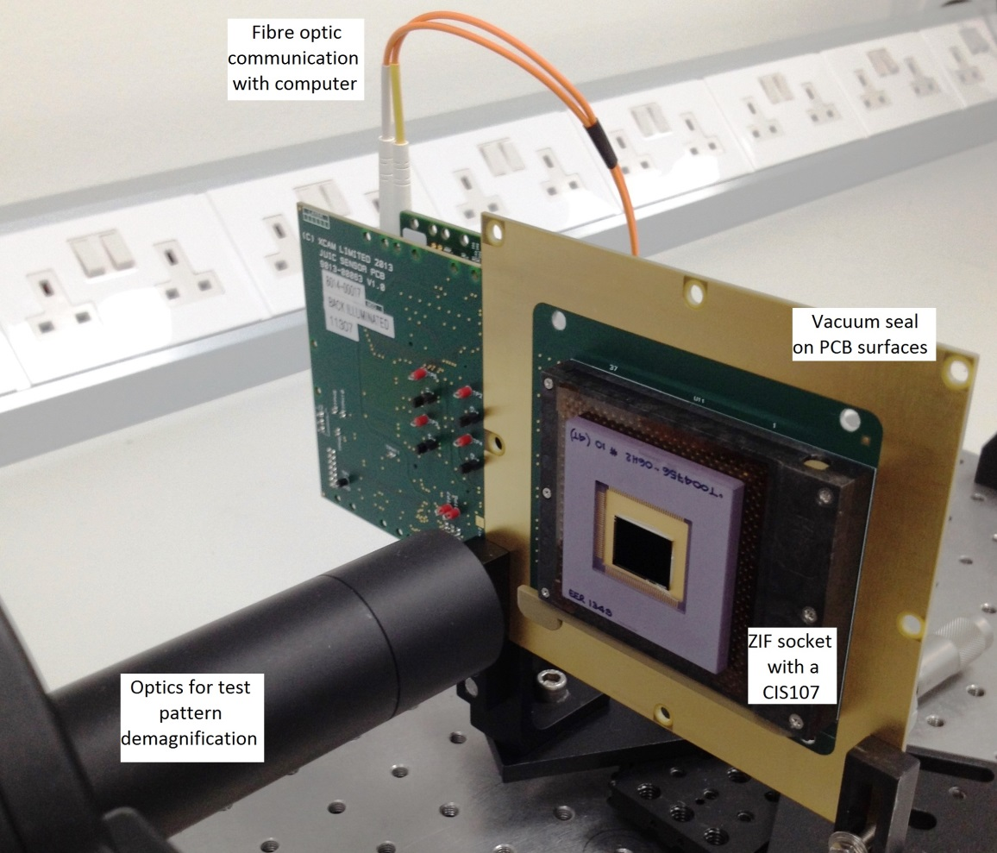
Testing at the Open University
A CMOS drive system is used to characterise the FI and BI CIS107s and CIS115s.
Bias levels and clocks are generated in a PCB stack with a ZIF socket for connecting the sensor
A de-magnifying optical setup using masks and 3-axis translational stages allows for optical characterisation
Metalwork flanges can clamp around the PCB stack for evacuation and cooling

Slide 21
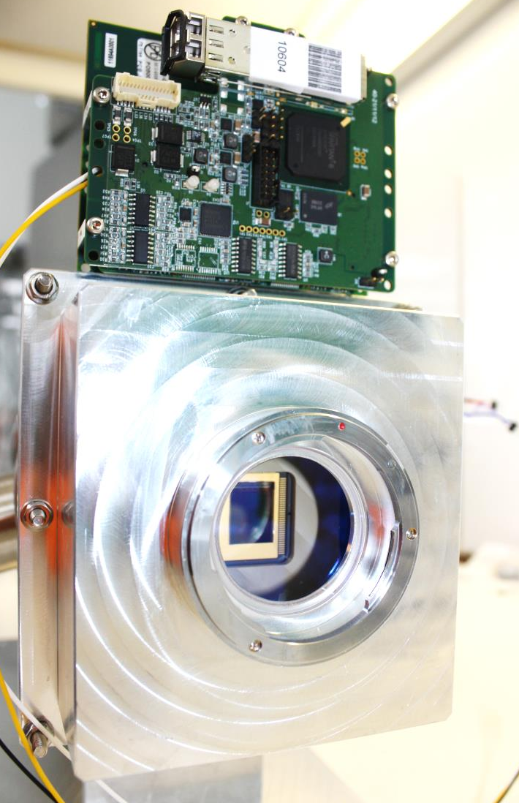
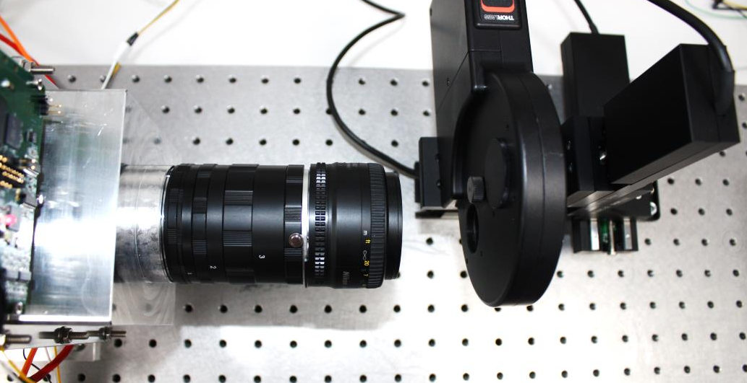
CMOS cryogenic testing
PCB stack with fibre optic communication to camera control unit
Metalwork flange forming vacuum seal around PCB stack.
CIS107 mounted in its vacuum chamber housing with cold finger making contact on the back of the ceramic package

Slide 22
Sensor parameters
Parameter | Units | Relevant pixel variant from CIS107 | CIS115
 |  | Measured | Goal | Measured
Columns | pixels | 1504
Rows | pixels | 2000
Pixel pitch | µm | 7
Image area | mm | 10.528 × 14.000
Outputs | - | 4
Maximum output | V | 1.8
Readout rate | MPixel s⁻¹ output⁻¹ | ≤10
Responsivity | µV electron⁻¹ | 34.1 | 45 | 48.3
Readout Noise (at 5 MPixel s^{‑1} output⁻¹) | electrons rms | 5.6 | <8 | 4.25
Full well capacity | electrons | 55k | 39k | -
Dark current (21°C) | electrons pixel⁻¹ s⁻¹ | 51 | 30 | 22
Radiation performance | krad (Si) | Measured up to 150 | >200 | TBM
 | protons | Measured at 2 × 10¹⁰ (58.8 MeV) | >2 × 10¹⁰ (10 MeV equivalent) | TBM
TBM = To Be Measured

Slide 23
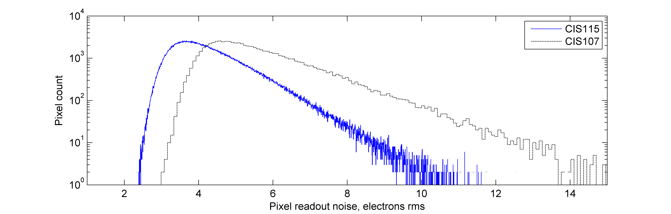
Improved pixel readout noise
Readout noise spectrum shows the improved performance of the CIS115 (average of 4.25 e⁻ rms) following modifications made to the original the CIS107 design (average of 5.6 e⁻ rms).
These measurements have been made whilst operating at 5 MPixel s⁻¹ output⁻¹.

Slide 24
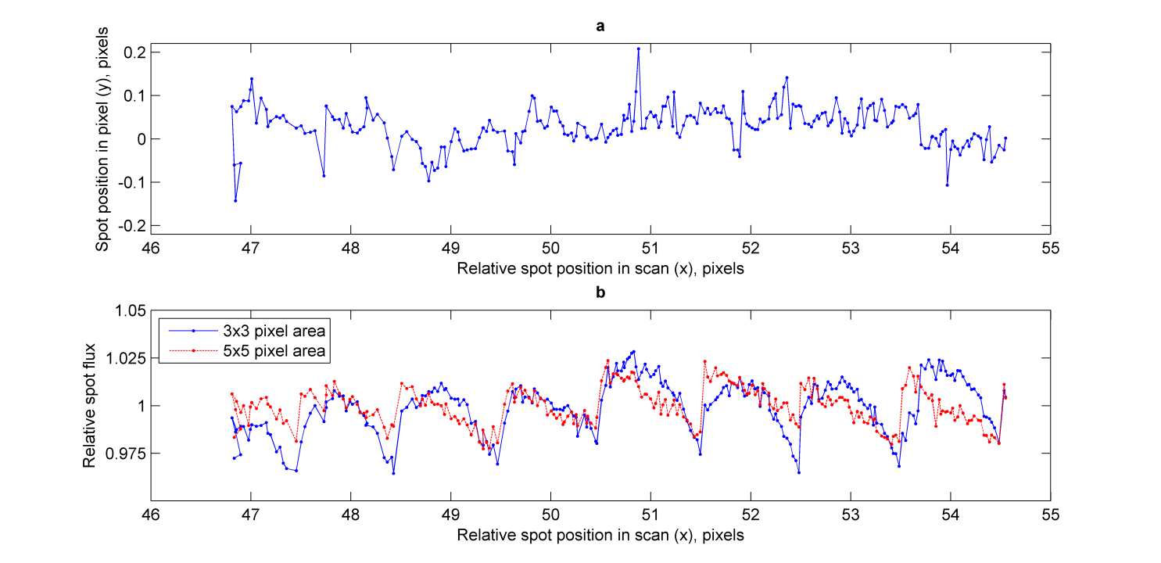
Optical spot scan

Slide 25
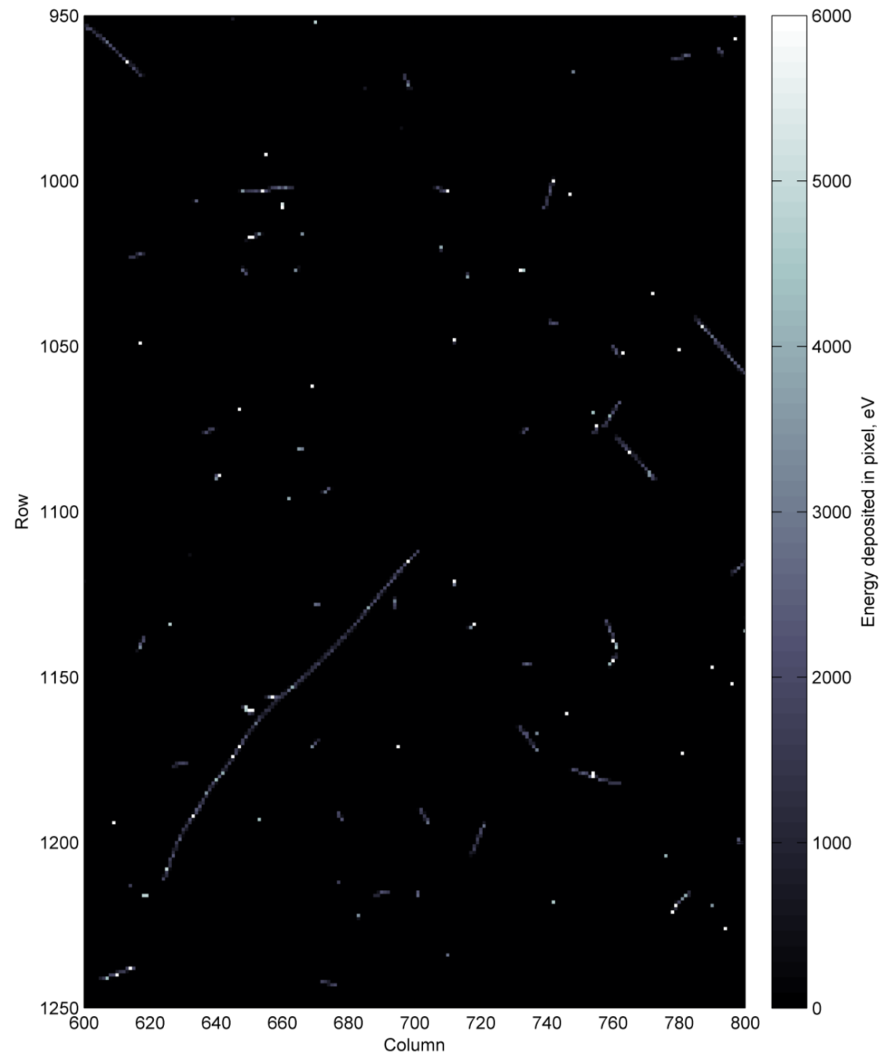
Simulation of Transient Electrons
High energy electrons trapped in the Jovian magnetosphere can penetrate the spacecraft to the focal plane, contributing to the background signal.
Early Geant4-based simulation suggest that <0.5% pixels may be affected per image
(at worst-case expected electron flux levels, with 1 s integration time).
Energy deposited per pixel, eV

Slide 26
Initial Experimental Electron Imaging
Exposing detector to Sr-90
Beta particle decay energies: <0.546 MeV and <2.28 MeV
Signal, DN

Slide 27
Summary and Conclusions
The CIS115 has been baselined as the sensor for JANUS, the high-resolution wide-angle camera for JUICE.
The CIS115 is a variant from a test device, the CIS107, which has gamma and proton irradiation test heritage.
An optical test bench is being commissioned at the CEI to perform detailed characterisation of the sensors.
The first CIS115s have been received (front illuminated) and initial tests show expected performance levels:
  readout noise (average of 4.25 e⁻ rms);
  responsivity (48.3 µV electron⁻¹);
  dark current (22 e⁻ pixel⁻¹ s⁻¹ @ 21°C).
BI CIS115s are due in October, and a rigorous radiation campaign is planned to measure the performance following exposure to worse than end of life dose levels.

