Slide 1


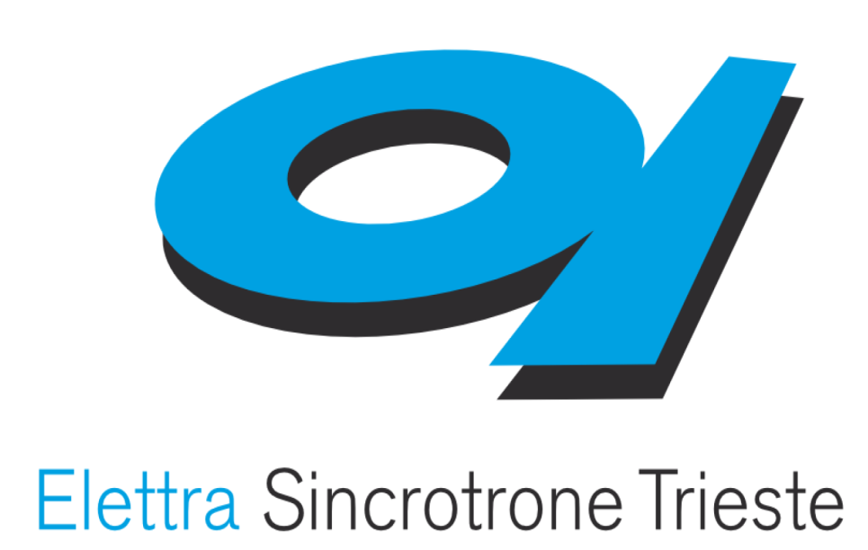

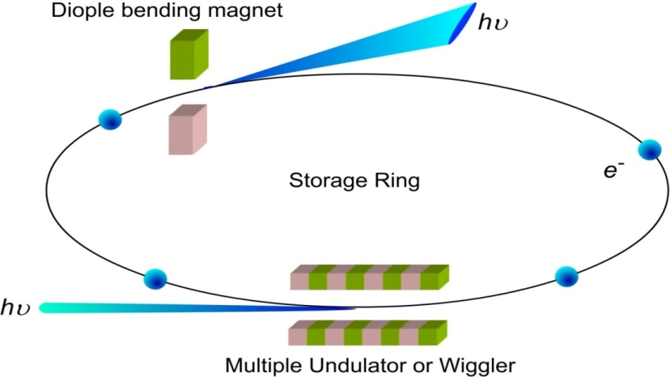
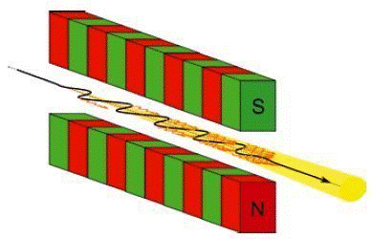
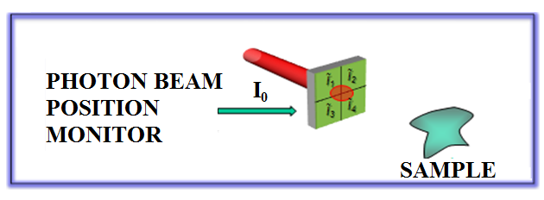
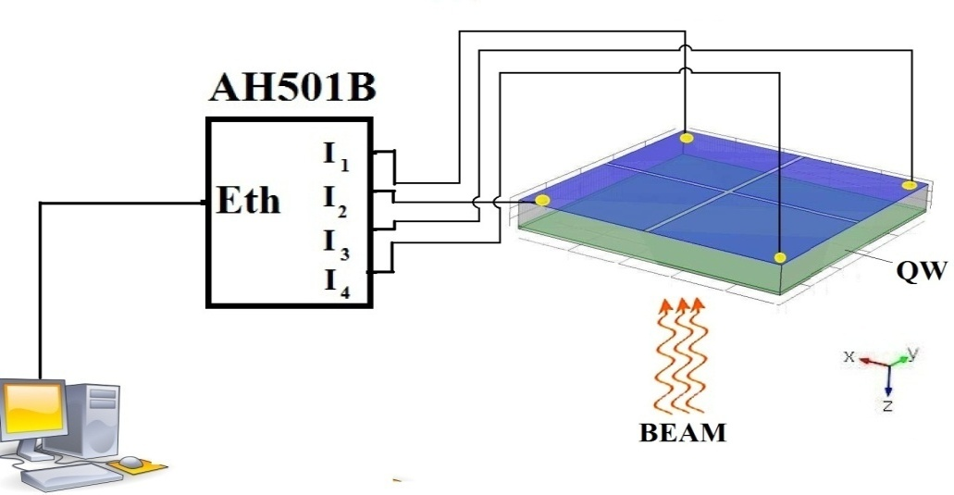
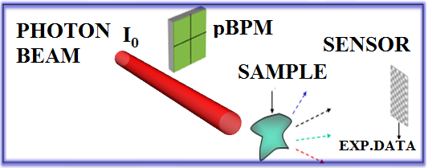
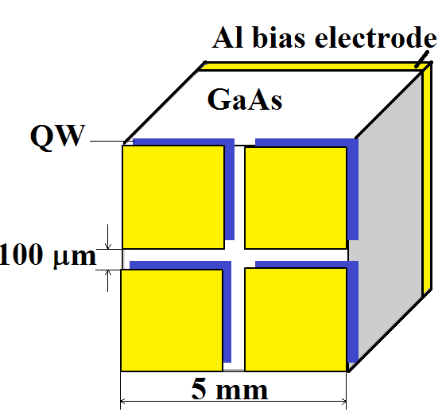
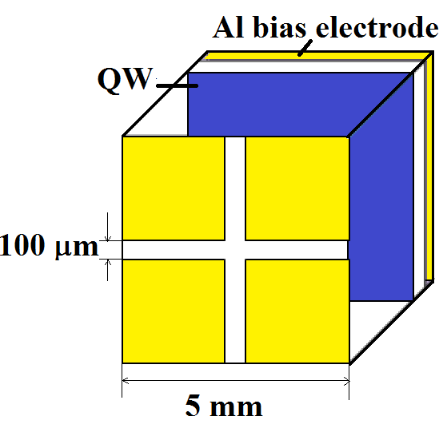
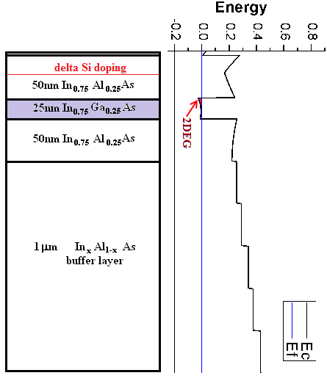
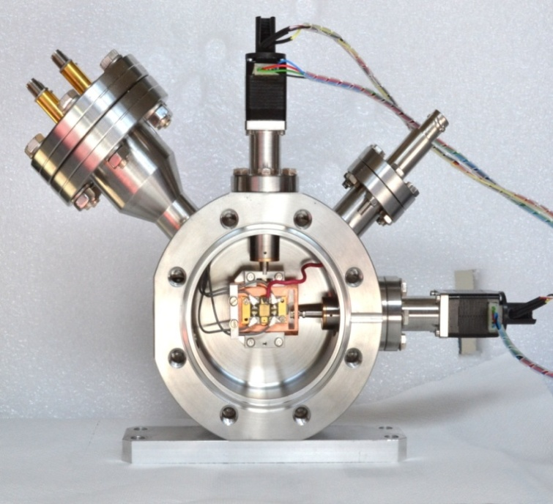
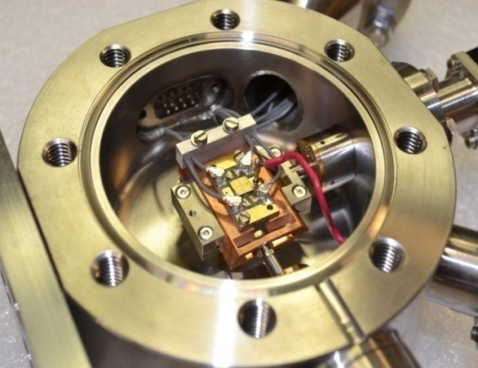
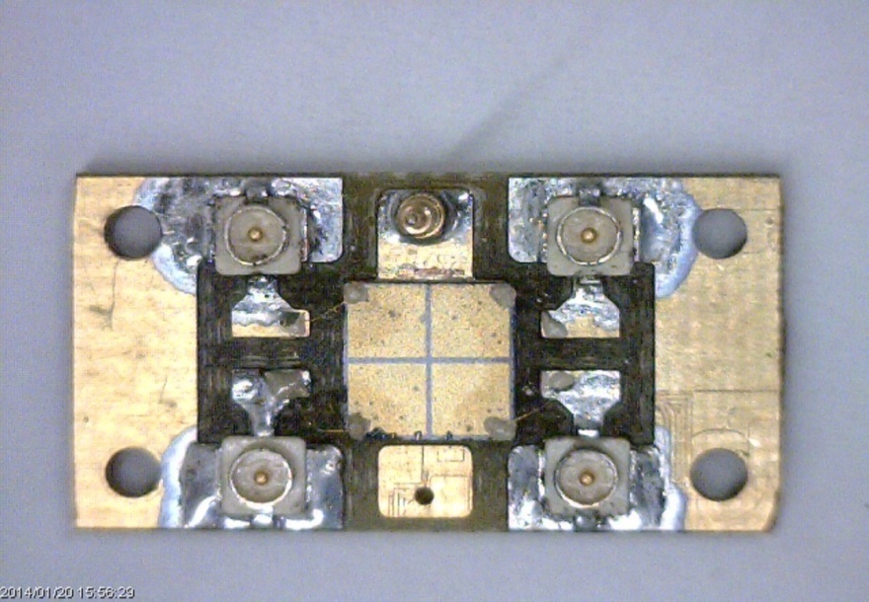
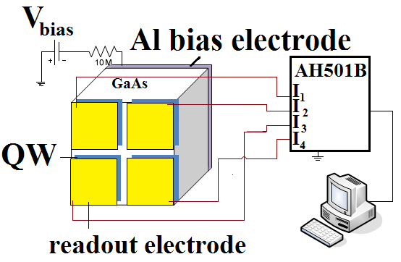
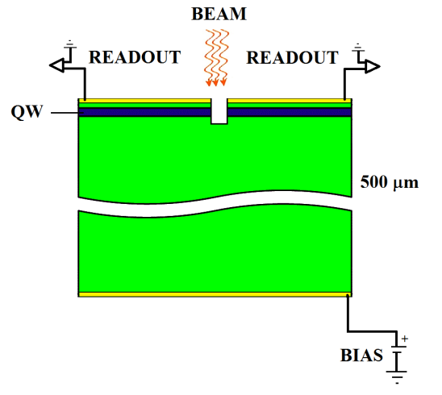
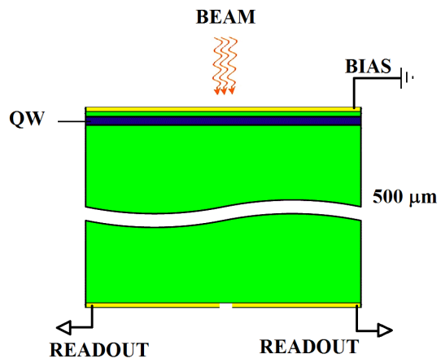
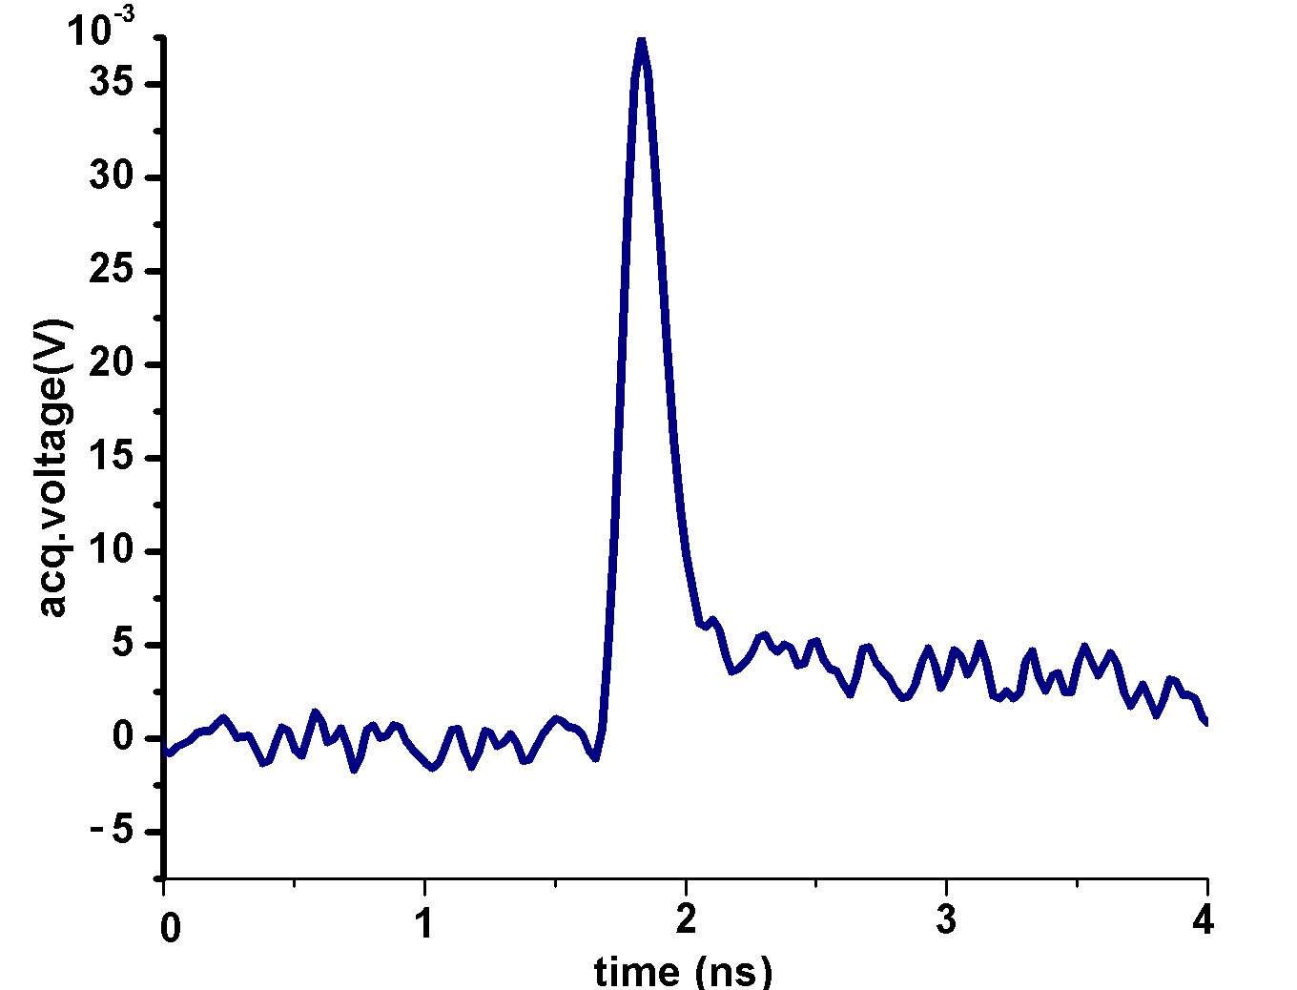
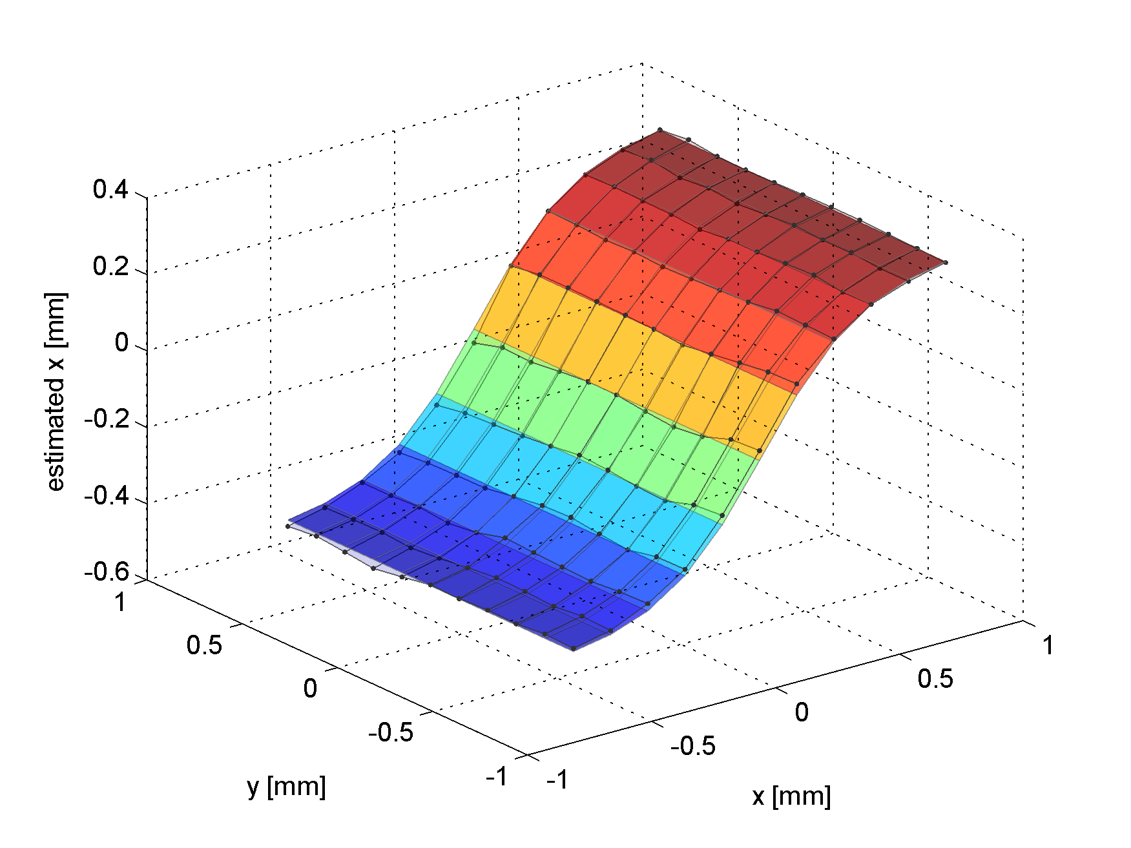
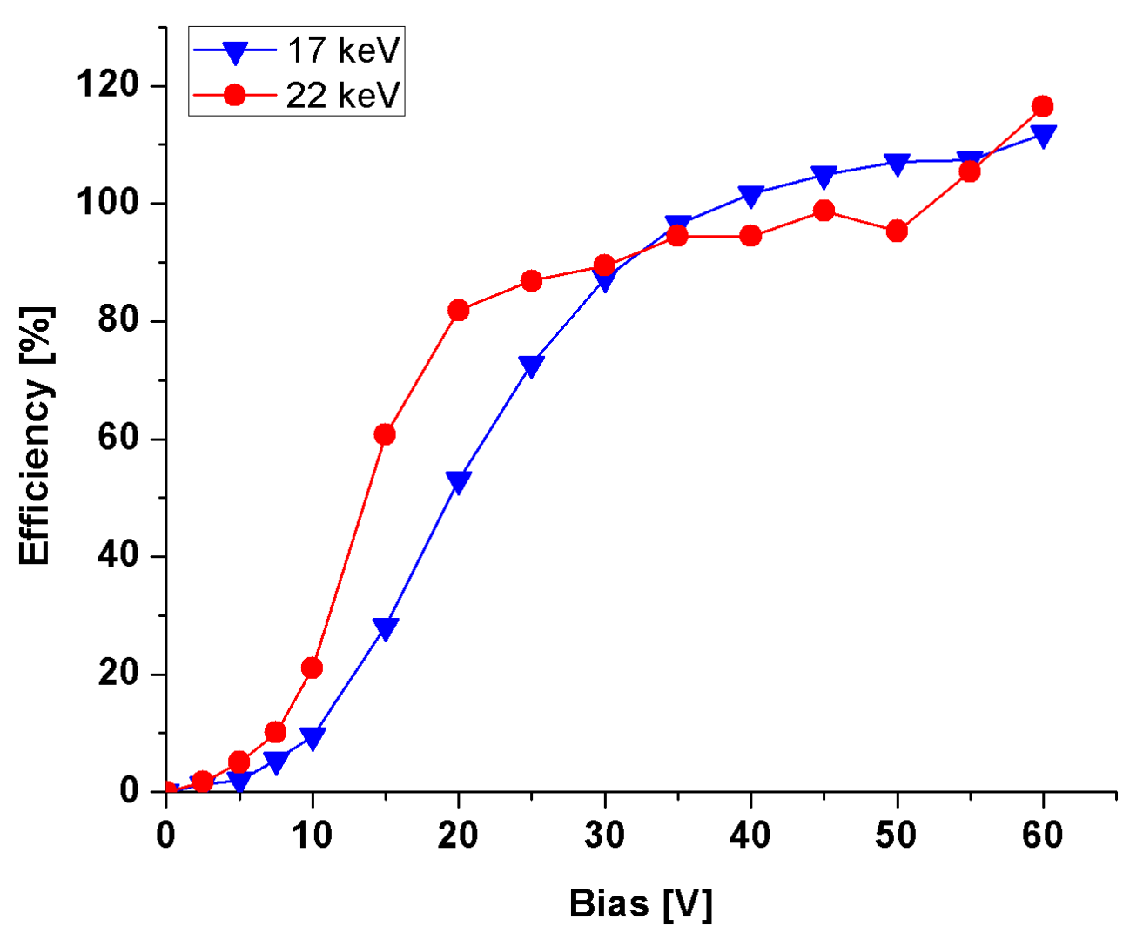
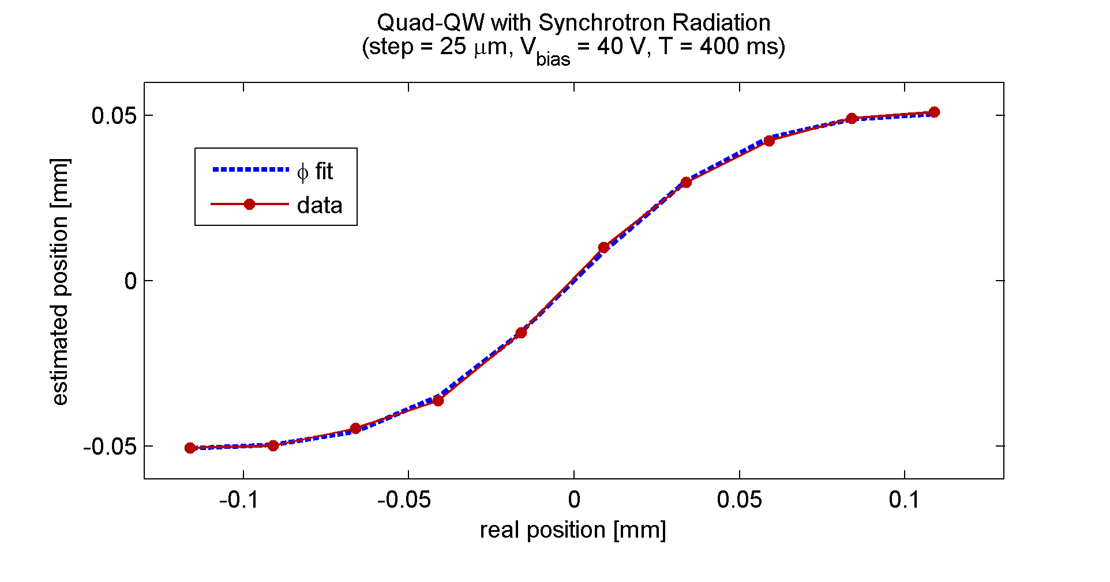
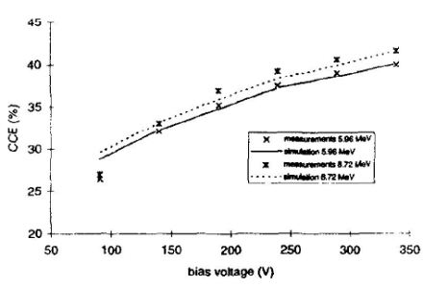
PHD school in Nanotechnology
Position sensitive photon detectors using
epitaxial InGaAs/InAlAs quantum- well
T. Ganbold^{a,b} , M. Antonelli^{c,} G.Biasiol^{b,} G.Cautero^{c,} H. Jark^{c}, D. M. Eichert^{c}, R.Cucini^{c} and R.H. Menk^{c}
¹ IOM CNR, Laboratorio TASC, Area Science Park, Trieste, Italy
² School in Nanotechnology, University of Trieste, Italy
³Elettra – Sincrotrone Trieste S.C.p.A., Trieste, Italy
Synchrotron Radiation (SR)
INTRODUCTION
STATE OF THE ART
New generation Synchrotron Radiation (SR) sources and Free Electron Lasers (FEL) require novel concepts of beam diagnostics to keep photon beams under surveillance, asking for simultaneous position and intensity monitoring [1]. This work deals with investigation of novel position-sensitive devices based on InGaAs/InAlAs Quantum Well (QW) for several applications of either synchrotron or conventional light sources.
Due to their direct, low-energy band gap and their high electron mobility, InGaAs/InAlAs quantum-well (QW) devices operated at room temperature (RT) may be used as fast detectors for photons ranging from visible light to hard X-rays. Epitaxially grown devices are more homogenous, reproducible and need lower bias with respect to other solid state position sensitive detectors [2]. Photo-generated currents obtained from each electrode allow both the position and the intensity of the impinging beam to be monitored.
        Free Electron Laser (FEL)
Working principle of solid state position estimation detector
MEASURE THE CURRENTS
ESTIMATE POSITION
OF A BEAM
PERFORM MEASUREMENTS ON A SAMPLE
InGaAs/InAlAs QUANTUM WELL DETECTORS
Fig 1. Schematic view of the fabricated devices
25-nm-thick QW, Si-δ-doped [2]
2D Electron Gas (2DEG) inside QW with
Carrier density
n = 7.7x10¹¹ cm⁻²
Carrier mobility
µ = 1.1x10⁴ cm² V^{–1} s^{–1}
at room temperature
 | Device #1 | Device #2
Quantum-well segmentation | Yes | no
Clearance | 100 µm | 100 µm
Read out electrodes (segmented) | 50nm Al on QW side | 20/60/130 nm Ni/Ge/Au on back side
Single electrode as surface biasing | 400nm Al on back side | 400nm Al on QW side
Photo-generated carriers can be collected at the readout electrodes by biasing form either the QW side or the back side of the devices during beam exposure.
Individual currents obtained from each electrode allow to monitor both the position and the intensity of the impinging beam for photon energies ranging from visible to hard X-ray [3].
Fig.2. Layout of the sample structure with band structure
RESULTS
Fastness of the device
rise time:
100 ps
Position estimation of Synchrotron light
Device#1 was tested with a 400-nm, 100-fs table-top laser. The device responded with 100-ps rise-times to such ultra-fast laser pulses (Fig.3).
Device #2 was tested by SR in the range of energies from 2 keV to 10 keV, in order to estimate the position of the beam with different spot sizes of 70 μm and 500 μm.
Fig.5.Current trends along a yellow-square-shaped path around the surface of the QW device at 2 keV.
Fig 3. Sub-ns response to near UV laser pulses
Photo-generated charge collection efficiency
The position of the beam was estimated with precisions of ~10 μm with 500-μm spot (Fig.6) and ~0.8 μm with 70-μm spot (Fig7).
The results obtained with X-ray SR at 17 keV and 22 keV show how these devices exhibit high charge collection efficiencies, which can be imputed to the charge-multiplication effect of the 2DEG inside the QW (Fig.4).
[4]
Fig.7. Vertical-position estimation (at 7 keV)
Fig.6. Horizontal-position estimation in terms of real beam position. Data (marked by dots) are fitted with a sigmoidal function (at 10 keV)
σ_{y} ≈ 0.8 μm
Fig 4. Photo-generated charge collection efficiency of QW samples compared with bulk GaAs solid detectors [4]
Conclusions and Significance
References:
1. A. Galimberti et al., Nucl. Instrum. Meth. A 477, 317-322 (2002).
2. F. Capotondi et al., Thin Solid Films 484, 400-407 (2005).
3. M. Antonelli, et al., Journal of Instrumentation, 9, 05034 (2014).
4. J. Morse et al., J. Synchrotron Rad. 17, 456-464 (2010).
InGaAs/InAlAs quantum-well devices were tested with Synchrotron Radiation (SR) and 400-nm laser light. Those devices responded with 100-ps rise-times to such ultra-fast laser pulses and showed enhanced collection efficiency for photo-generated charges. In SR measurement, we have estimated the beam position with spatial precision ~0.8μm with pink needle beam (size-70μm).

