Slide 1




The TORCH PMT:
A close packing, multi-anode, long life MCP-PMT for Cherenkov applications

Slide 2
Contents
TORCH Background/Detector Requirements
ALD Gain/Uniformity results
Hybrid multi-anode charge sharing Anode Simulation
Electronics Coupling - Anisotropic Conductive Film
2” Square MCP detector

Slide 3
The TORCH project

Slide 4
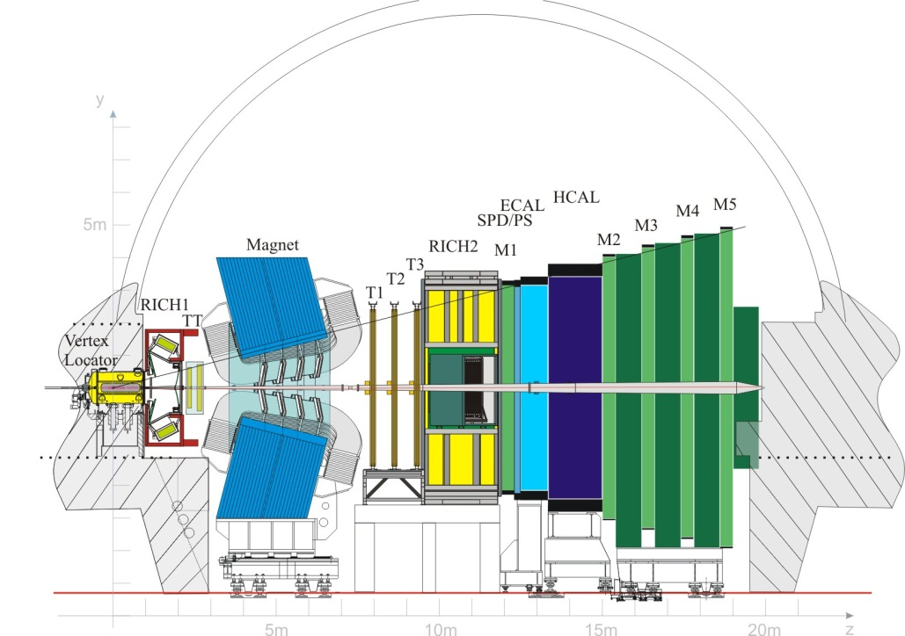
TORCH - Motivation
The Timing Of internally Reflected Cherenkov light (TORCH) is an ERC funded R&D project
Proposal to upgrade LHCb Particle ID capabilities in 2-10 GeV/c region
Notes:
TORCH is a proposed upgrade to the LHCb detector at CERN, to supplement the particle ID capabilities in the momentum range 2-10GeV/c
Particle are identified by measuring their time of flight from the interaction point, which allows calculation of their mass (hence their identity) since momentum is known from other detectors in LHCb.

Slide 5
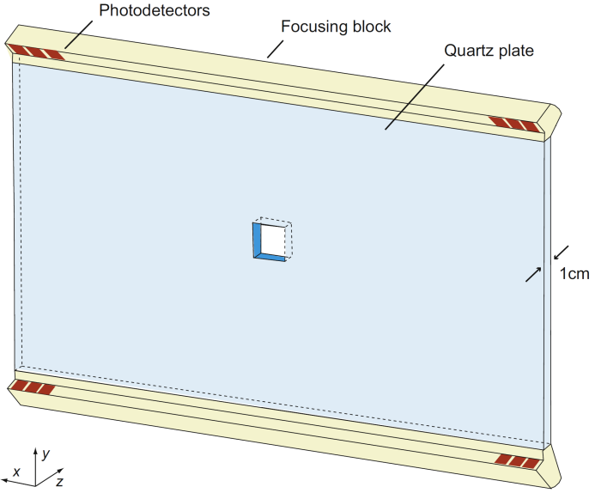
TORCH – TOF Concept
TORCH aims to achieve 10-15ps timing per particle over a large area
Utilises Cherenkov light for fast signal production
Cherenkov light transported to photon detectors via total internal reflection
Focussing optics along edges converts Cherenkov angle to position on focal plane
Notes:
The TOF measurement requires 10-15ps timing per particle to achieve the particle ID
To achieve this Cerenkov light from particle traversing a quartz plate surrounding the LHC beam is projected on to a bank of Microchannel plate photon detectors at the top/bottom of the plate, tightly packed along one direction. Here a focusing blocks convert the cherenkov cone angle (related to particle velocity) to a spatial co-ordinate on the photodetector’s focal plane.

Slide 6
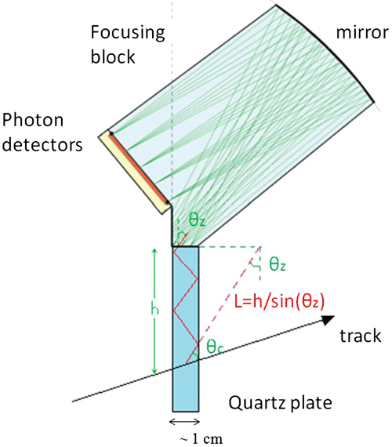
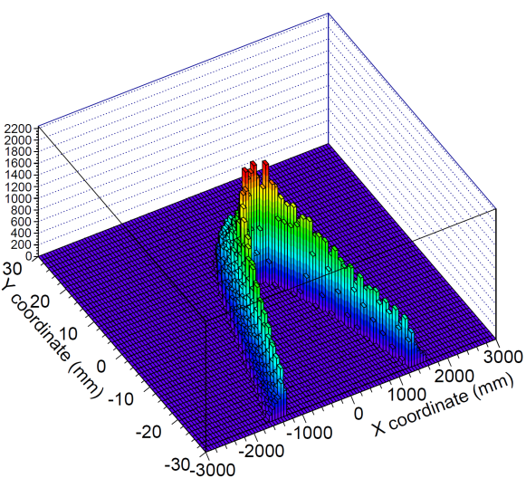
Photon Detector - Spatial
Photon propagation angle converted into position on focal plane
Produces “smile” corresponding to the Cherenkov ring
  One axis has long arm → coarse spatial resolution
  One axis has short arm → fine spatial resolution
For 2” square tube, and 1 mrad angle resolution
  128 pixels for fine axis, 0.41 mm pitch
  8 pixels for coarse axis, 6.63 mm pitch
L = h/cos θ_{z}
Notes:
The cherenkov ring projection creates a smile/frown of the photodetector plane. In the horizontal direction, due to a long lever arm the “smile” extends across a large area (approximately 6m), whilst in the vertical plane it is spread over approx 6cm. Hence each individual 2” square photodetector requires a coarse pixel pitch of 6 ½ mm in the horizontal direction, and a much finer pitch of 0.41 mm in the vertical direction.

Slide 7
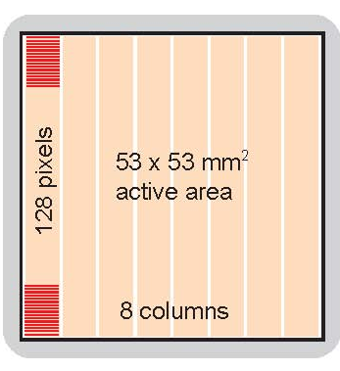
Photon Detector - Spatial
We plan to use a hybrid charge sharing/multi-anode design
  Reduces number of required channels
  Well defined charge footprint
  No vacuum feed-throughs
The 36 MHz/cm² TORCH rate limits degree of charge sharing due to occupancy issues (no more than 3 pads at once)

Slide 8
Photon Detector - Timing
Pion-Kaon time-of-flight difference ~35ps over 9.5m
  3σ separation requires 10-15 ps timing per particle
  Each particle produces ~30 detected photons
Hence need 50ps timing from detector/electronics combined
Fit σ = 23 ps
L. Castillo García, “Timing performance of a MCP photon detector read out with multi-channel electronics for the TORCH system”, 14th ICATPP Conference, 25 September 2013, Villa Olmo, Italy.

Slide 9
Photon Detector - Lifetime
Over 5 years of operation expected cumulative charge extracted from MCP is 5 C/cm²
Required new technology to extend lifetime of MCP detector from <0.1 C/cm² (due to photocathode damage)

Slide 10
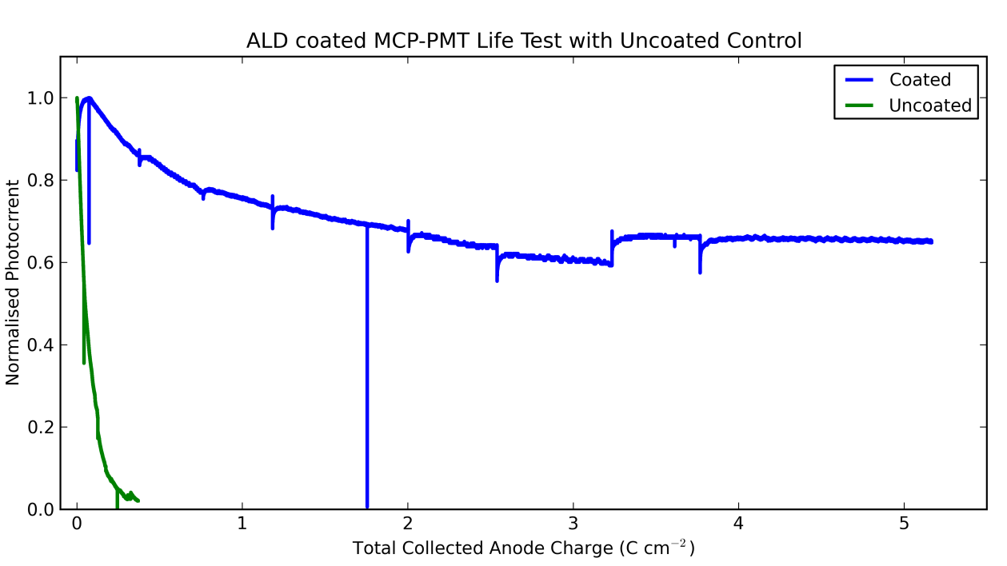
Photon Detector - Lifetime
Using Atomic Layer Deposition to deposit Al₂O₃
  prevents ion feedback (seals MCP surface)
  improves MCP gain (higher Secondary Electron Yield)

Slide 11

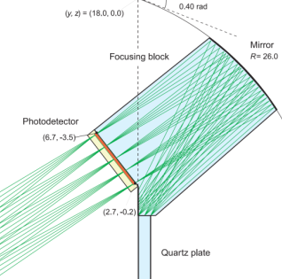

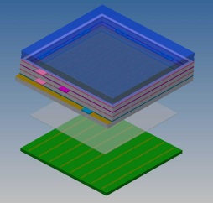
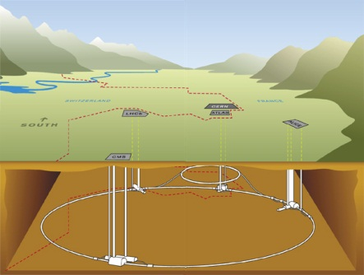
For further TORCH details see
M.W.U van Dijk et al., TORCH - a Cherenkov based time-of-flight detector, DOI: 10.1016/j.nima.2014.04.083

Slide 12
Charge Sharing Anode

Slide 13

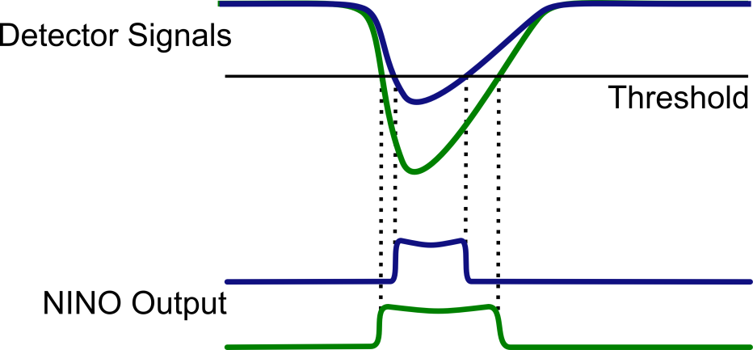
Photon Detectors
Micro Channel Plate PMT
Anode pad structure equivalent to 8x128 pixels
Using NINO ASIC a time-over-threshold amplifier/discriminator with HPTDC time to digital converter
Schematic layout of MCP-PMT. Charge footprint shown enlarged.

Slide 14
Charge Sharing Simulation
Performance of charge sharing heavily reliant on detector/electronics parameters
  Exact geometric structure of charge sharing anode
  Size of charge cloud footprint from MCP
  Detector Gain
  Electronics Threshold/Noise
Due to occupancy issues have 8×64 physical readout anodes to provide a 8×128 pixel resolution detector

Slide 15
Charge Sharing Simulation
Monte Carlo model developed which simulates
  Current pulse output from MCP
  Detector gain distribution, including mean charge footprint size
  Charge sharing anode design parameters
  Response of NINO time-over-threshold discriminator (noise, charge measurement non-linearity)
  TDC digitisation resolution

Slide 16
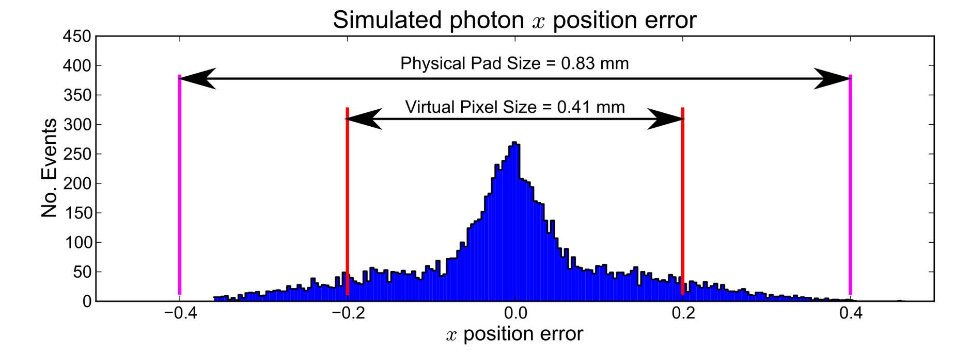
Charge Sharing Simulation
For each simulated photon determine position error
RMS of photon error distribution is the key parameter
  < 0.21 mm for 2σ reconstruction of 128 pixels

Slide 17
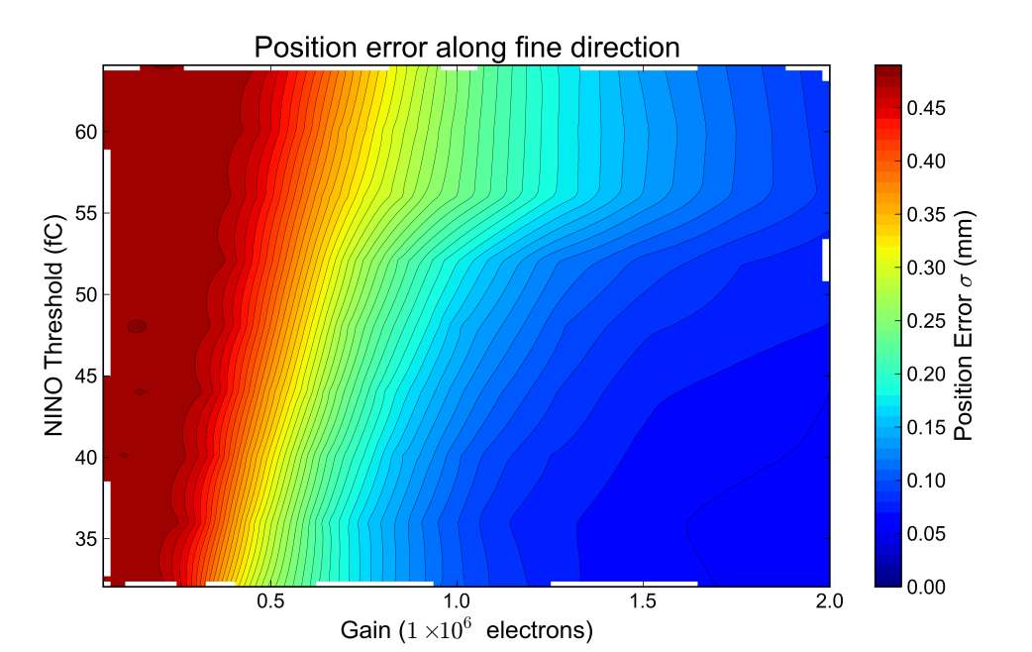
Charge Simulation
Strongly depends on MCP gain and NINO threshold
Require ~10⁶ gain
Per photon event mean number of pads above threshold is 1.8 to 2.5

Slide 18
Charge Sharing Prototypes
First prototypes due this week
  Equivalent to a quarter of the final 2” square tube in circular envelope
  32×32 array of readout pads
  In one dimension 8 pads connected for 4×32 readout in TORCH application

Slide 19
Electronics interface ACF Film

Slide 20
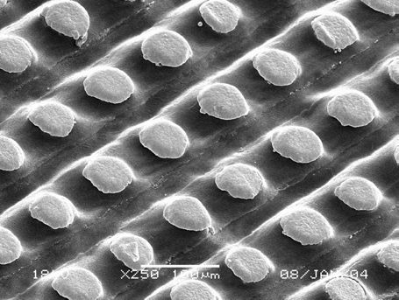
Electronics Interface
High density multi-anode output requires space efficient connection to readout electronics
Anisotropic Conductive Film (ACF) is the current chosen solution
Thin Si polymer film, with embedded wires
100 µm wire pitch
Shin-Etsu Polymer MT-P Datasheet

Slide 21
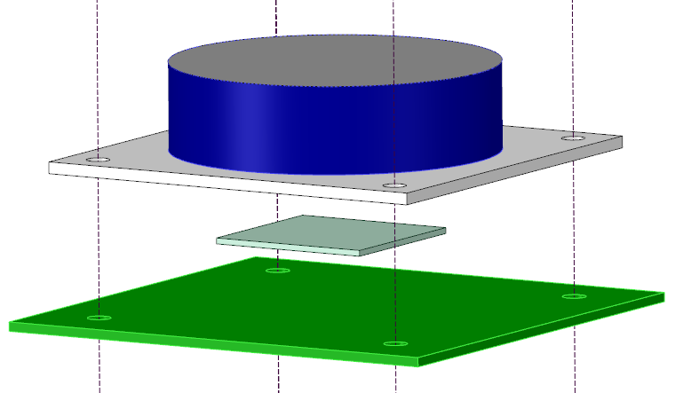
Electronics Interface
Sandwich ACF film between detector and readout PCB
Minimum 10 contacts per pad
  0.1mm² contact area required
Requires 100 MPa pressure applied to rear of detector
Applied Pressure

Slide 22
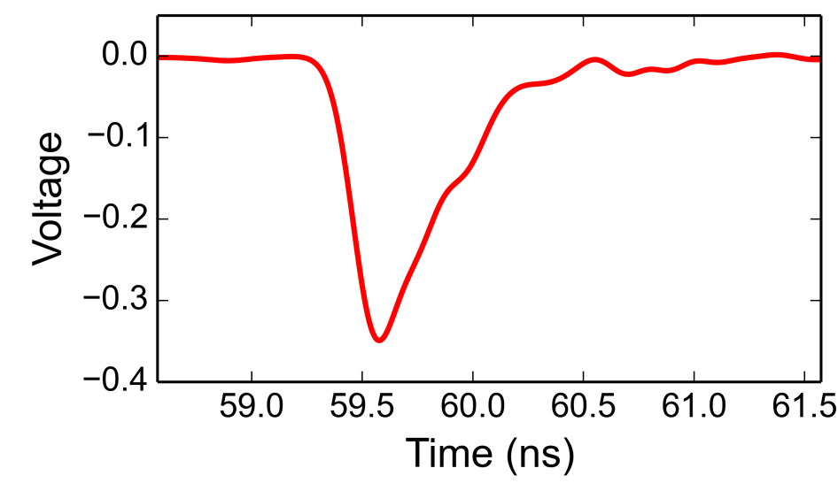
ACF Tests - IRPICS
Using IRPICs detector as test bench
  32x32 multi-anode MCP detector
  0.8 mm pitch
  0.2 mm² contact pads
Tested ACF readout using LeCroy scope (5 GHz, 20 GS/s)

Slide 23
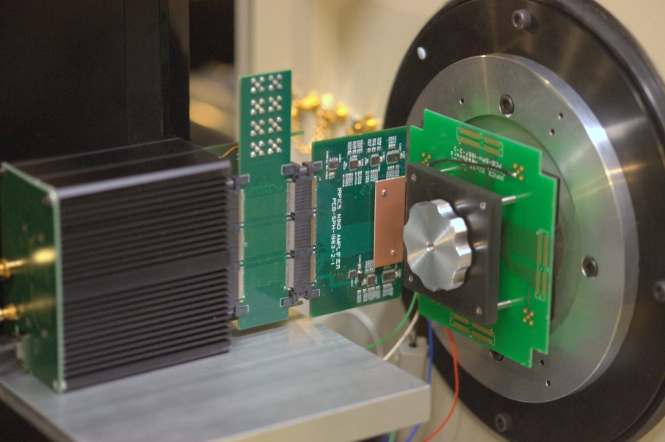
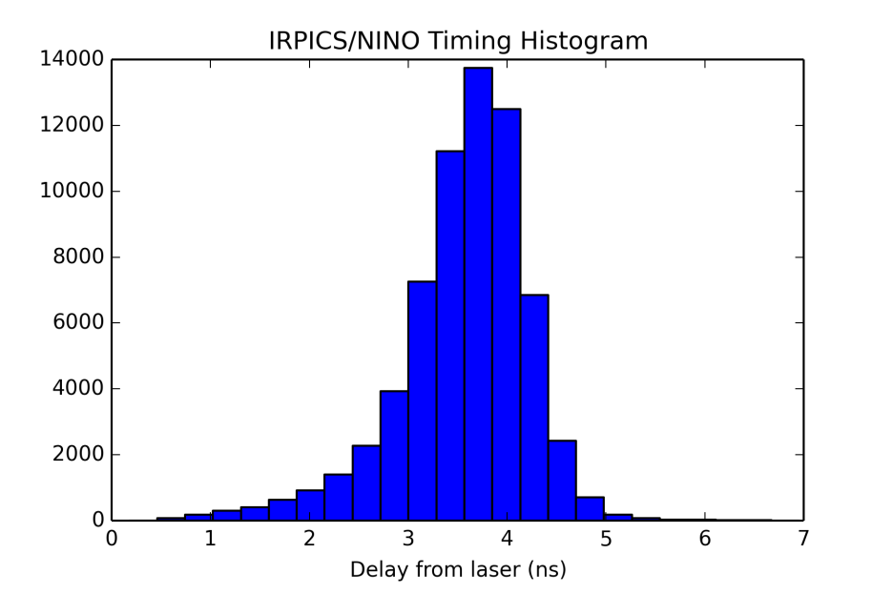
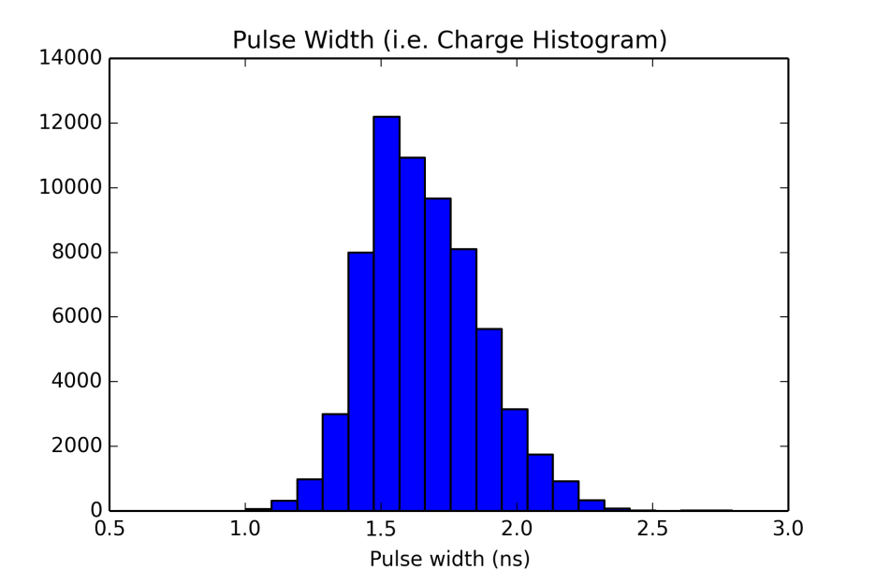
ACF Tests – IRPICS + NINO
(Preliminary Results)
Tested NINO readout using scope to measure NINO output
No amplitude walk correction!

Slide 24
Square detector developments

Slide 25
Square Detector
Producing square, tightly packed MCP detectors have a number of challenges
  Uneven stresses on detector body
  Maximising active area required thin walls
  Changes to sealing photocathode compared to a round detector body
Experimented with
  Wall thickness
  Ceramic to ceramic seal for anode
  Different Indium alloys for photocathode seal

Slide 26
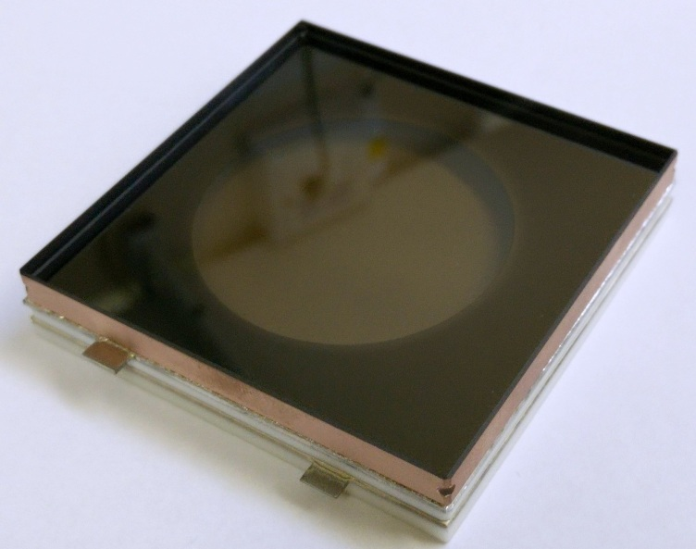
Sealing Square Test Cells
Successfully produced 2” square test cells, with 1mm thick wall and LNS20 photocathode
QE stable over 4 month period
Notes:
Final delivery of full detector with a 2” square form factor, <50ps photon timing, spatial resolution and ALD coated plates for long lifetime due November 2015, with subsequent beam tests to prove the viability of the TORCH detector to follow.

Slide 27
Conclusion
Novel anode design combining parallel multi-anode readout with improved resolution using charge sharing information simulated, with prototype results soon
Proved viability of ACF film for high density interconnects on MCP detectors
Produced 2” square test cells with stable photocathodes

Slide 28
Future Work
Test prototype detectors
  Characterisation of anode design at Photek
  Test TORCH concept with small scale quartz plate and MCP detector prototypes at test beam
Build fully functioning 2” square detector

Slide 29

With thanks to…
Members of the TORCH collaboration at
and Jon Lapington at the University of Leicester
The TORCH project is funded by an ERC Advanced Grant under the Seventh Framework Programme (FP7), code ERC-2011-ADG proposal 299175.

