Slide 1



Improving the Design of
CZT Ring-Drift Detectors with Sentaurus TCAD
V. Boothman, A. Alruhaili, A. Lohstroh, P. Sellin, V. Perumal, K. Sawhney*, and S. Kachanov*
Dept. of Physics, University of Surrey, Guildford, GU2 7XH
*Diamond Light Source Ltd., Harwell Science and Innovation Campus, Didcot, Oxfordshire OX11 0DE
Notes:
Good morning
My name is Victoria Boothman and my subject is Cadmium Zinc Telluride ring-drift detectors. The AWE is funding this project.
The purpose of the detectors is to identify contaminating heavy nuclear materials, at distances of cm to several metres, mostly through air.
At such long distances, only their hard K-shell x-ray emissions are detectable, at 70-90 keV
Therefore, we need devices with good energy resolution in this range to identify the isotopes
and high sensitivity to distinguish their weak signal from background.

Slide 2
Contents
What is a Ring-Drift detector?
Introduction to 3-ring CZT prototype
Microbeam linescans of prototype
Modelling Ring-Drift devices with Sentaurus TCAD
Simulation of Linescans: methods & analysis
Experimental vs. Simulated results
Simulating varying ring geometry, interaction depth and bias conditions
Conclusions and future work
[If time remains] Modelling CZT material
Notes:
My task is to study the geometry and operating parameters of this detector configuration, and then to optimise them.
I am not going to talk about CZT material in any detail.
I will briefly explain what a ring-drift detector is and why it is suitable for this purpose.
I will describe our prototype device and its performance.
My main topic today is the modelling and simulation of this device and the effects of modifying the model's parameters.
This work is still in progress.

Slide 3
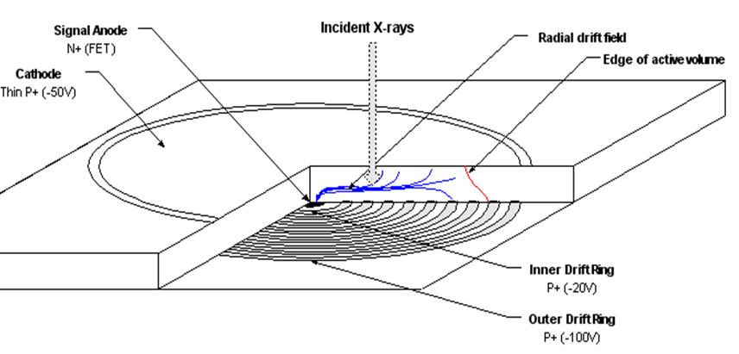
What is a Ring-Drift Detector?
X-rays
Electron trajectories
Planar cathode covers one face (-ve)
‘Point’ anode at centre of other face (ground).
lateral electric field is applied by biasing concentric rings around anode
to form a potential ‘funnel’.
Anode 0V
Cathode
Edge of active volume
Innermost ring -20V
Outermost ring
-150V
‘Super Silicon Drift Detector’ 25mm²
[1]Amptek Inc. (2013)
-150V
State-of-the-art for silicon soft x-ray detectors:
lower capacitance and leakage than pn diodes.
Cathode
Potential [V]
Why use CZT?
High-Z material for hard x-rays (25-150keV).
Room-temperature operation.
CZT has poor hole mobility →Ring-drift is most effective for single-carrier sensing.
Our CZT is produced by Redlen Technologies [3]
Drift-ring locations
0V
Anode
Depth
Distance across diameter
[2]Lechner, P., et al (1996)
Notes:
The drift principle has been used in silicon since the 1980s.
It was discovered that, if the n+ contact of a pn diode is reduced to a small ‘point’ and the p+ contact extended over both faces,
full depletion occurs at ¼ bias usually required and capacitance falls..
If the p+ contact is divided into strips or concentric rings about the anode, they can be biased to form a potential ‘staircase’ or ‘funnel’ channelling electrons towards it.
This extremely low-noise configuration is common in the best modern soft x-ray detectors such as this Amptek product. It has a plane full-face cathode and many narrow rings surrounding the anode. The outermost rings are more negative than the cathode to create a steep potential funnel to the anode.
Now we want to apply this design to a high-Z material for hard x-rays.
CZT crystal quality has improved in the last decade so it is becoming useful for room-temperature detection with minimal leakage, lower than CdTe.
Its chief flaw is poor hole mobility, but ring-drift is among the best single-carrier sensing designs so this does not matter.

Slide 4
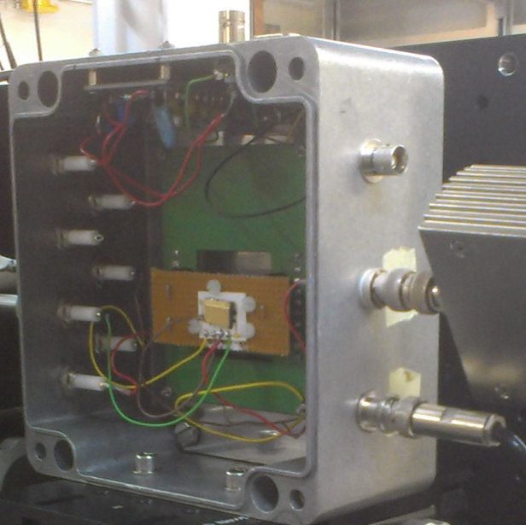
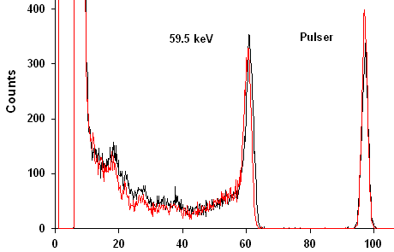
Prototype 3-Ring CZT device
Bonded rings-down to gold contacts on special tile.
Each ring and the cathode independently biased.
Anode grounded through CoolFET preamp
Irradiation through planar cathode.
Gold
Guard ring
Ring 3
CZT surface
Ring 2
Am-241 photopeak
59.5keV
FWHM 3.3keV at room temp.
3.1keV at -15C
Ring 1
Pulser
FWHM 2keV
Anode
0.25mm
0.75
1.25
1.75
2.25
2.75
3.25
3.75
5.5mm
CZT Wafer 10 x 11 x 2.3mm.
0.5mm ring and gap widths.
Energy (keV)
[4] Alruhaili, A. (2013)
Notes:
We have tested a CZT device. It is about 7mm across and has only 3 rings, making it larger and coarser than typical 15-ring silicon devices.
The reason is that these electrodes have to be glued face-down to matching contact rings on a special tile and this is not feasible for anything narrower than point 2 mm.
Silicon devices have implanted conducting channels for contact.
Irradiation is through the plane back cathode as usual.
Each drift-ring and the cathode are independently biased, allowing unlimited variation in bulk and lateral (drift) fields. The guard ring is left floating.
As this spectrum shows, cooling from room temp to -15degC scarcely affects resolution because leakage noise is negligible. Energy resolution is limited by electronic noise.
‘Tailing’ caused by slow hole motion was not observed, showing that this is an effective single-carrier sensor.
(-150V, -300V, -450V)-500V

Slide 5
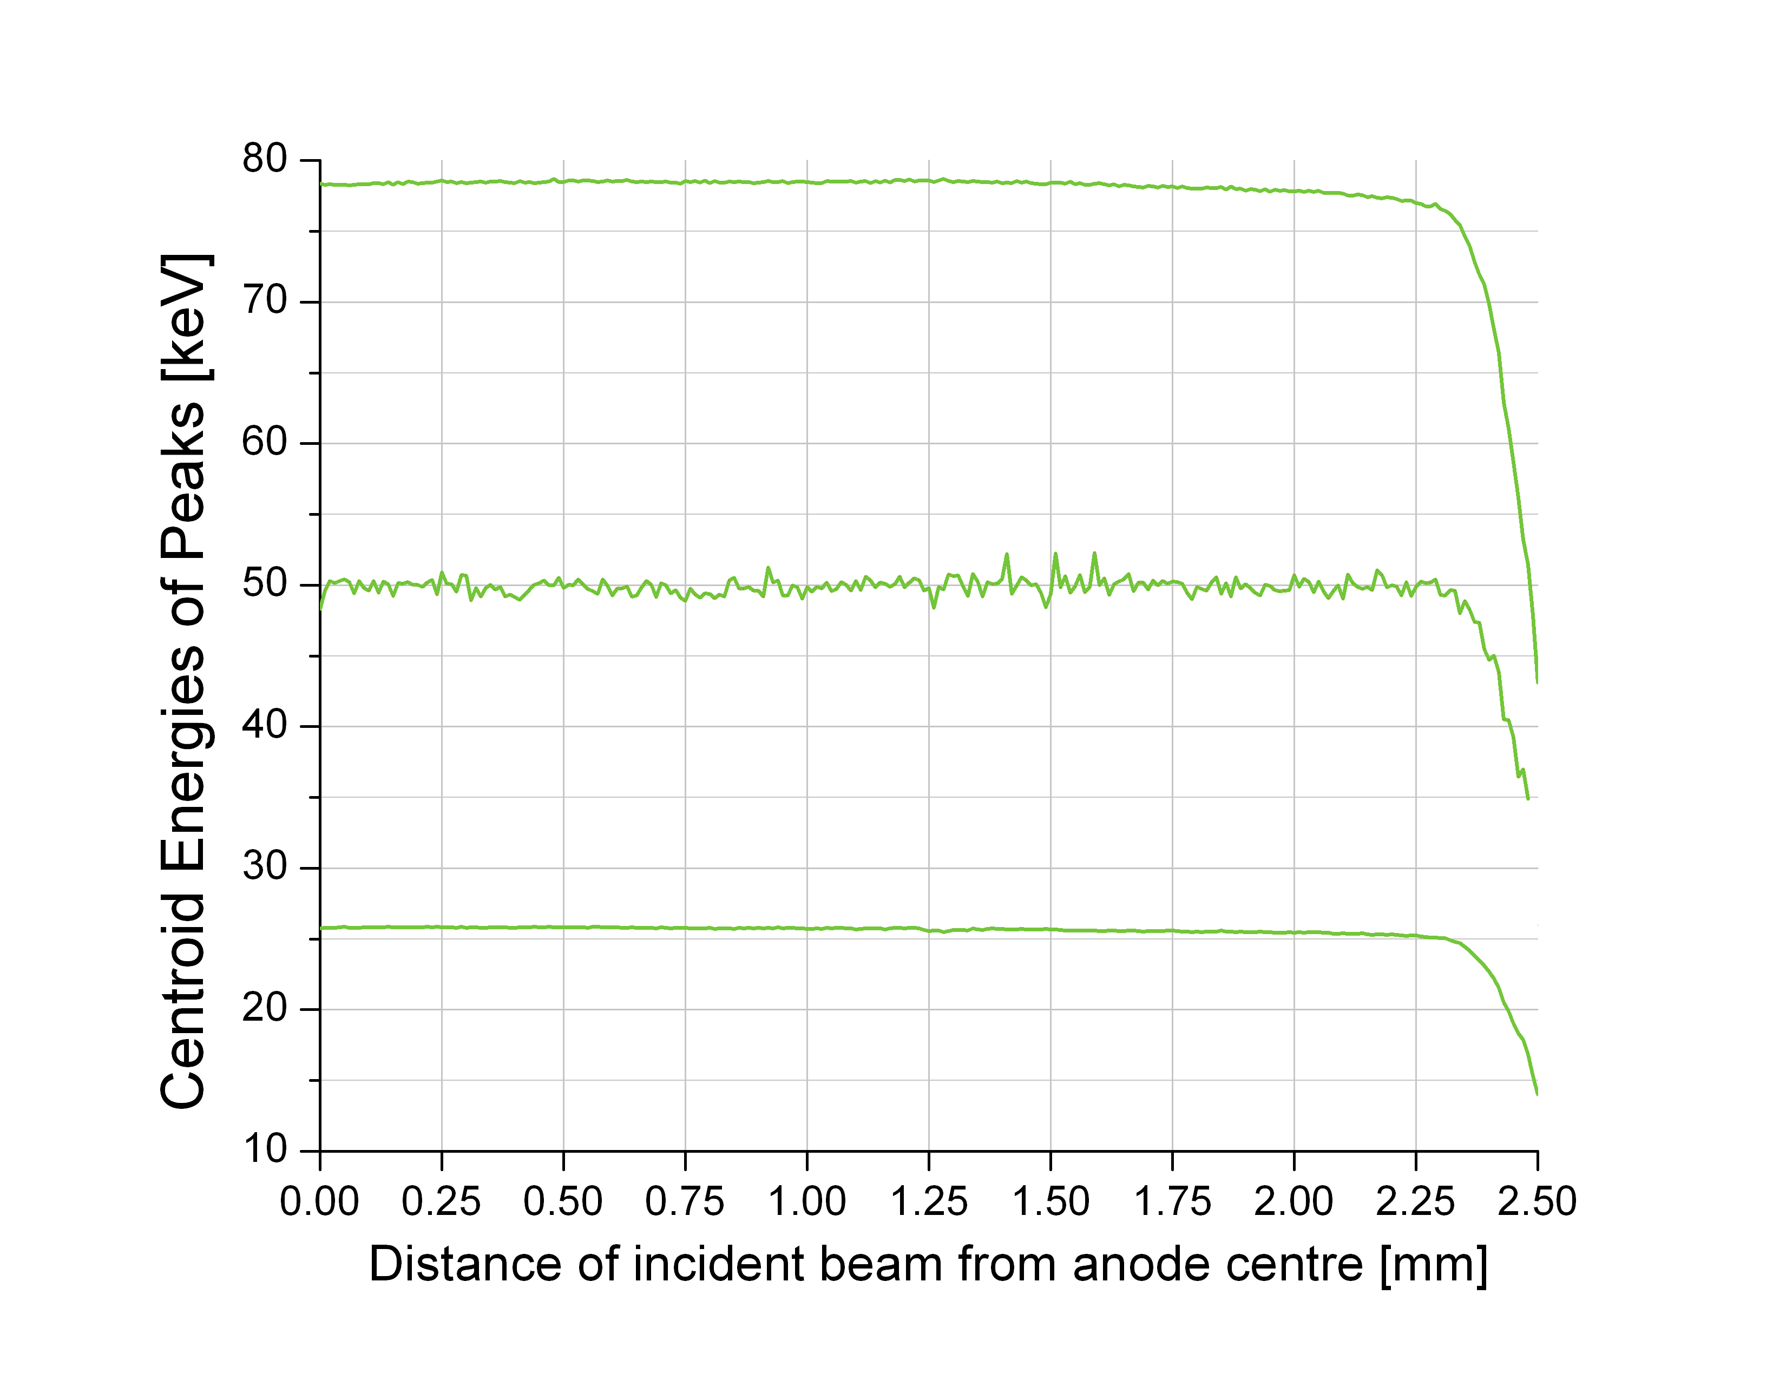
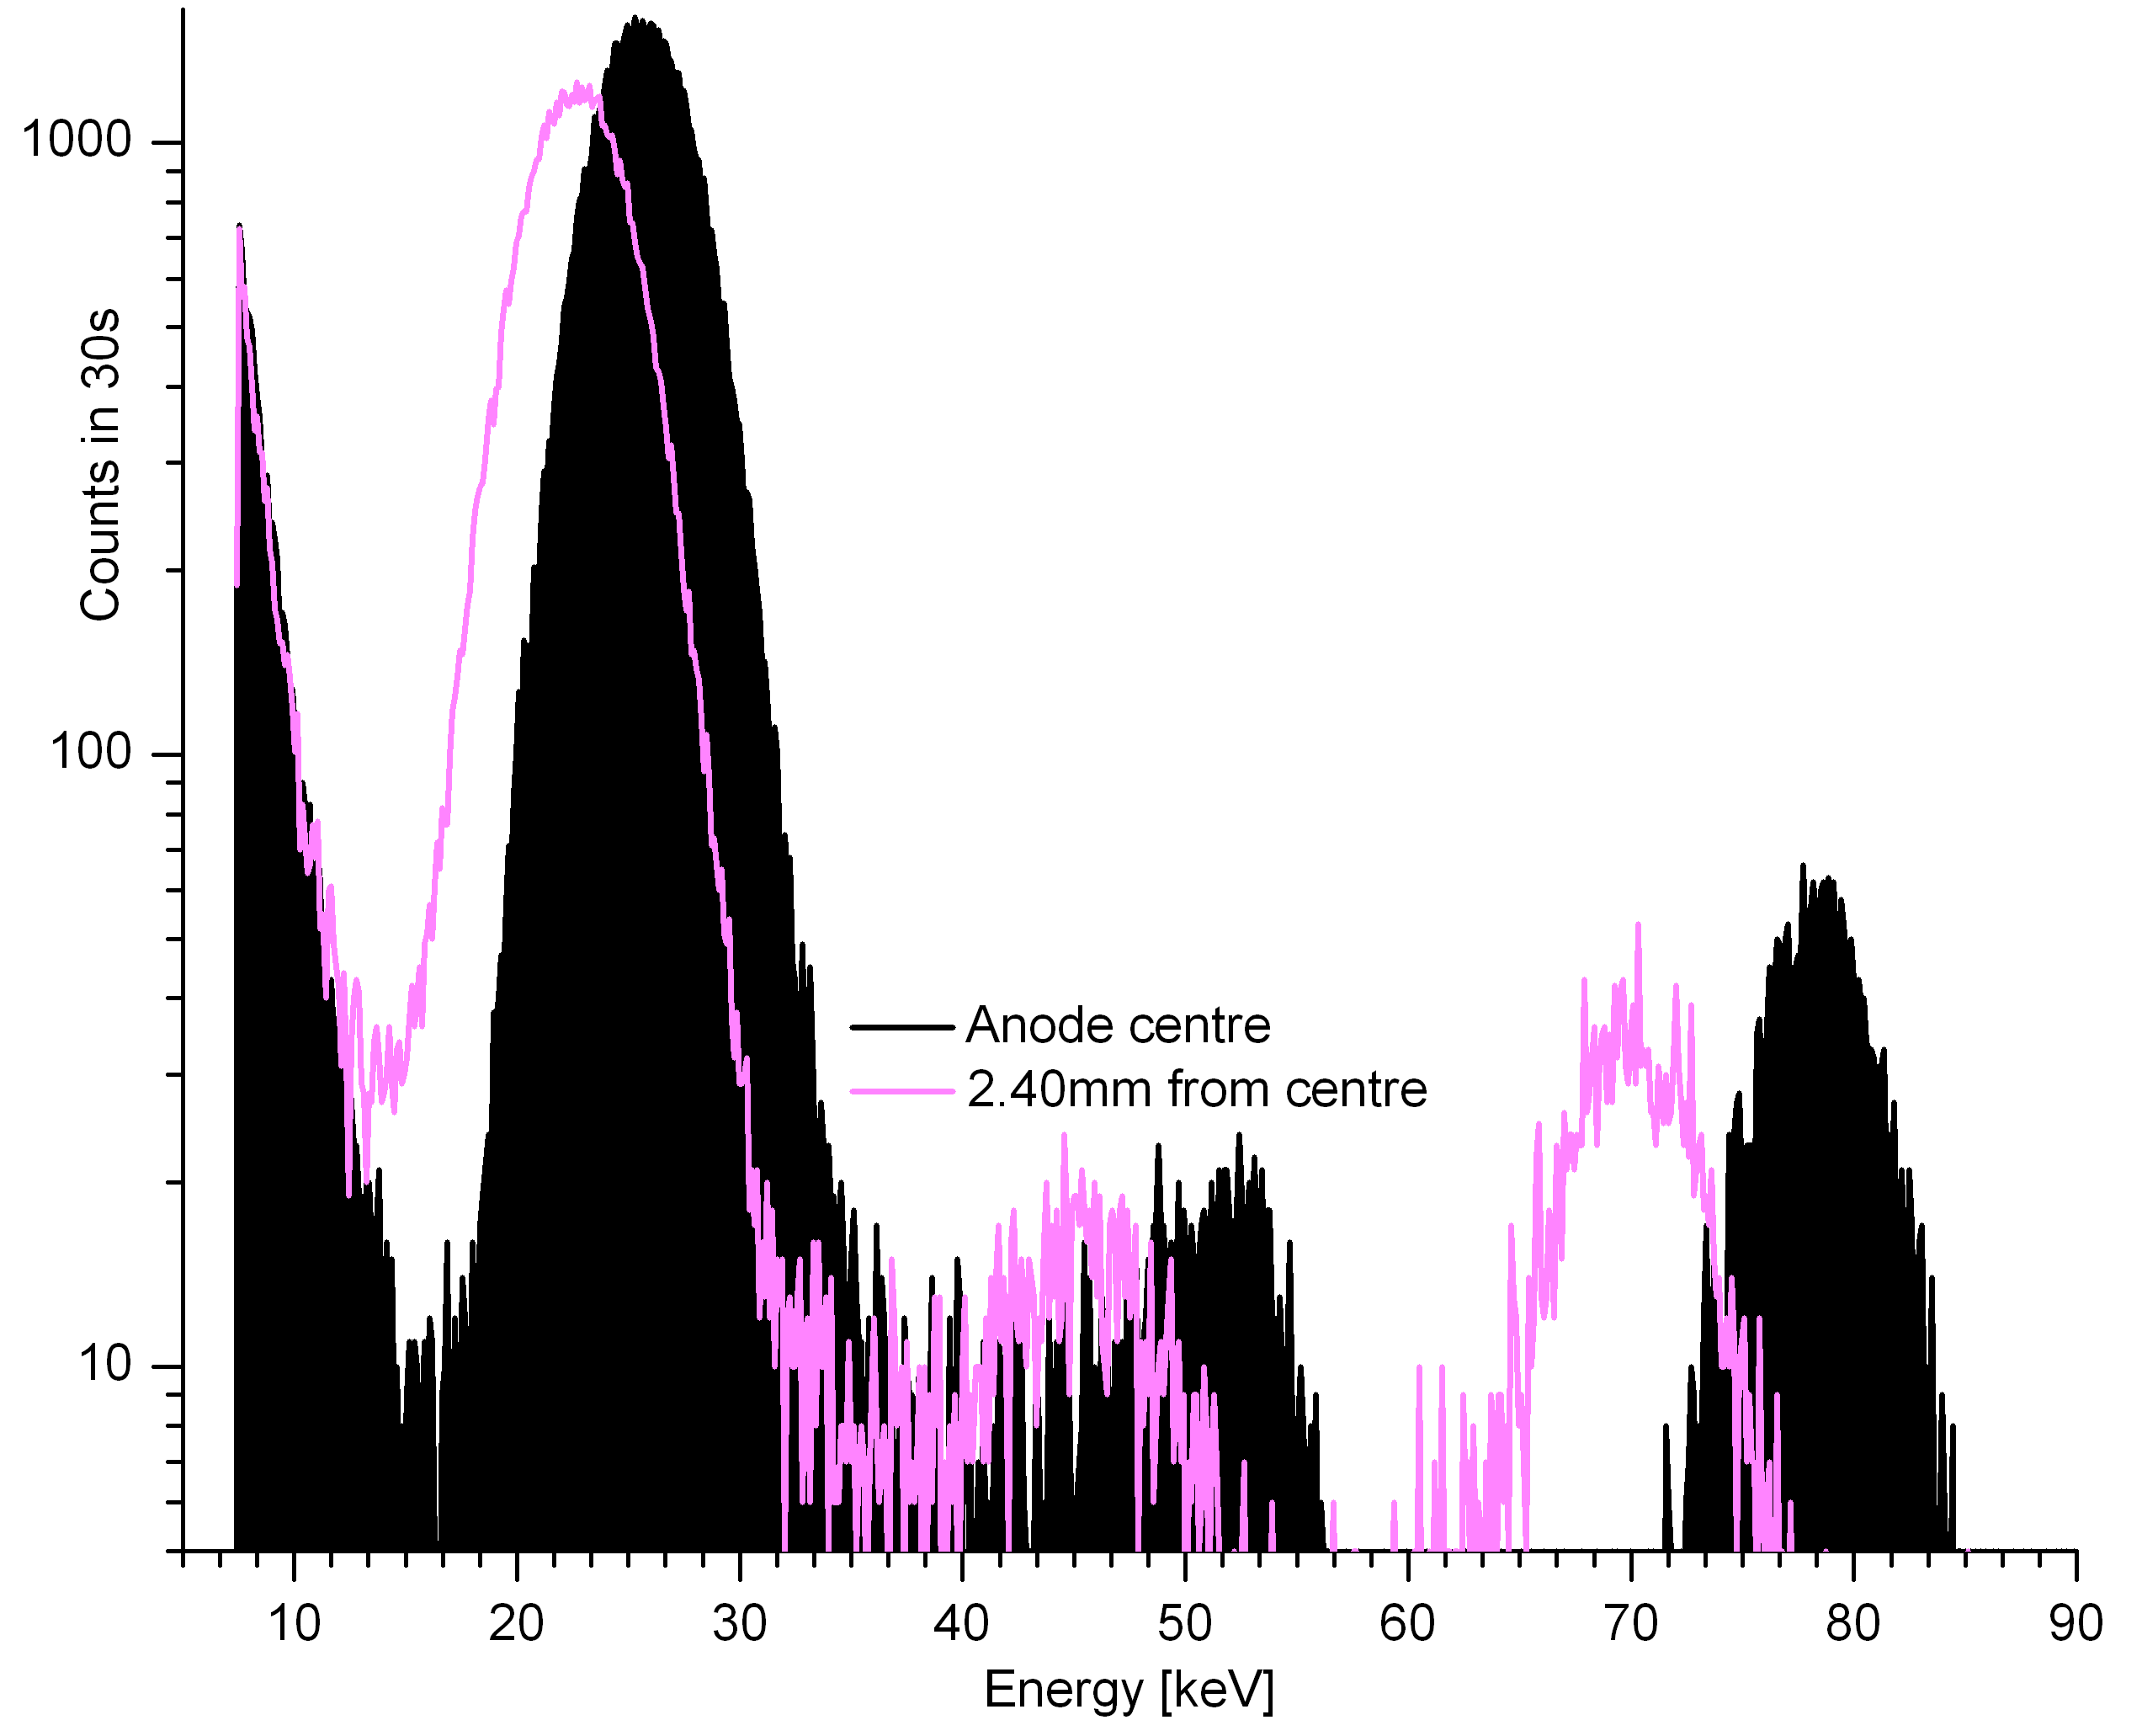
Microbeam Linescans of 3-Ring Prototype
10μm 25keV x-ray microbeam was scanned across the device radius.
[5] Diamond Light Source Ltd.
Spectra recorded
at 10-100μm intervals.
Resolution dominated by electronic noise.
Bias conditions were varied.
Increasing lateral field as a fraction of bulk
(up to R3=Cathode voltage) increased active area and sensitivity.
Increasing both fields while maintaining their ratio caused further improvement.
Raising the bulk field alone did not improve performance.
3rd harmonic
Anode=0V
R1= -500V
R2= -600V
R3= -700V
Cathode=-700V
2nd harmonic
Primary beam energy
Anode
Ring 1
Ring 2
Correct spectrum: beam on anode centre
Shifted spectrum: beam 2.40mm from centre
Energy [keV]
Notes:
We took this device to the Diamond Light Source to map its spatial response with a 10um beam.
As the incident beam is moved away from the anode centre, at some point the spectrum begins to shift downwards in energy (point). This is defined as the edge of the active area. (pause)
We repeated the experiment with many bias conditions. With low field strengths, only the anode was active.
We observed these trends in performance.
Maximum sensitive radius extended beyond Ring 2 under these conditions, among the highest voltages we had available.

Slide 6
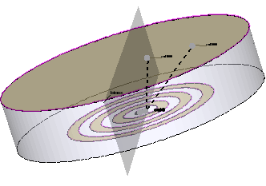
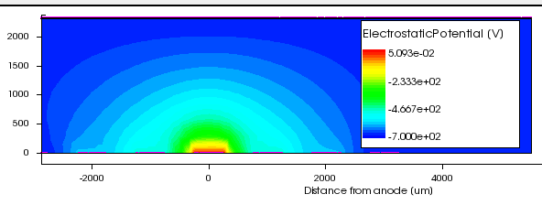
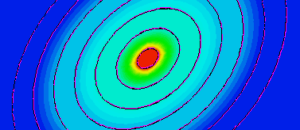
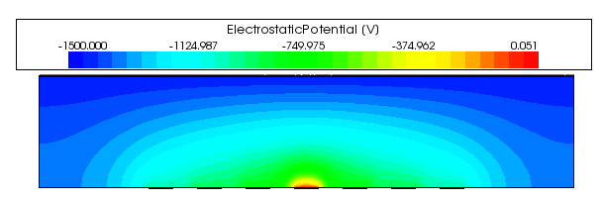
Modelling Ring-Drift Devices
TCAD enables material customisation, fully 3D simulation and visualisation of all electrode signals, fields, potentials, charge densities and velocities and trapping.
A model was constructed of user-defined CZT with variable ring size, number and spacing.
Planar cathode -700V
0
-230
-460
-700
Ring 3
Applied bias [V]
Ring 2
-600
Ring 1
-500
Anode
0
Ring 1
-500
Ring 2
-600
Ring 3
-700
-1500
-1125
-750
-375
0
-1500V
Sections through 3D datasets
illustrating Potential field
under two different bias schemes.
Applied bias [V]
-1000
-900
-800
0
-800
-900
-1000
Notes:
I had to adapt a built-in model of CdTe to give it the relevant properties of CZT, chiefly the mobility- lifetime product for charge transport . This was done by introducing traps.
When I had defined and tested this custom material, I modelled our prototype with adjustable geometric parameters.
These are examples of a visualisation tool showing the potential field on cross-sections through the device. Fields along any trajectory can also be plotted.
There is no guard ring in the model
Simulations will then be repeated with varying ring size, spacing, number and bias to optimise the device.

Slide 7
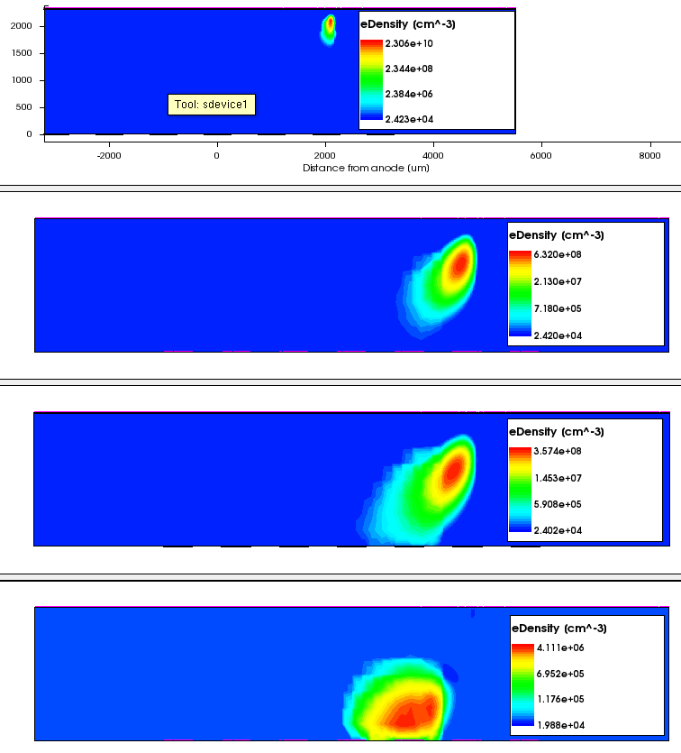
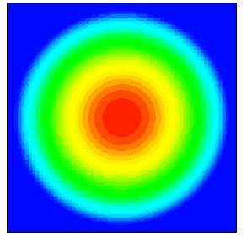

Simulation of Linescans: Methods
A charge density deposition profile was defined for a 25keV photon.
50ns after interaction
Spherical Gaussian charge density represents average photoelectron path.
Anode
Ring 1
Ring 2
200ns
2) Photon was deposited at a chosen radius and depth. 80μm was selected as the most probable depth at 25keV.
Anode
250ns
Electrode current signals
and 3D datasets of fields and charge densities
were recorded during deposition and drift.
Electron charge cloud
after 25 keV interaction
at 2200μm radius.
In this example,
charge is shared between the Anode and Ring 1
Anode
450ns
Notes:
I devised a method of simulating the way charge density is deposited (point) by photoelectric interaction of an x-ray photon.
Interactions were placed at chosen depths and radii, such as this example.
The next slide shows the electrode current signals corresponding to these 3D electron density plots .
TCAD cannot produce spectra as in experiment, therefore the spatial response had to be analysed by a different method.
Mesh was automatically redesigned for each chosen interaction site
to enclose regions of highest charge density in the finest mesh.

Slide 8
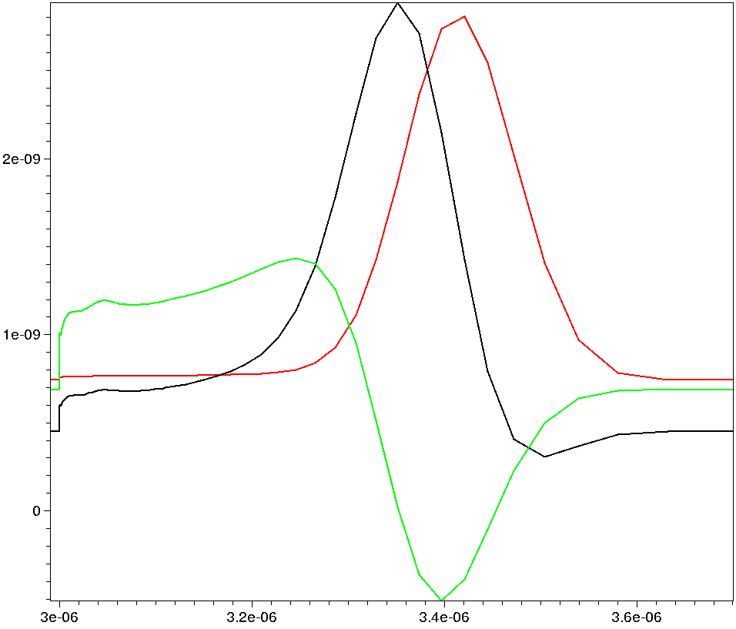
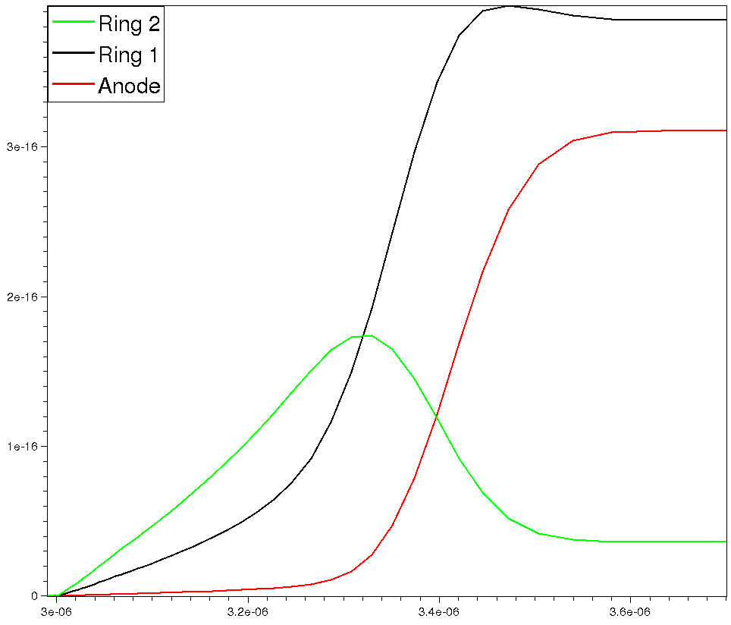
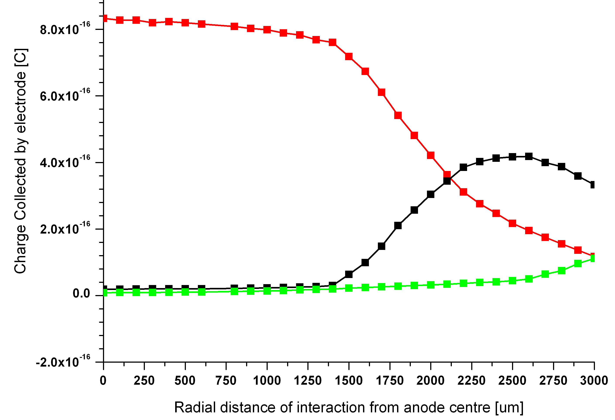
Simulation of Linescans: Analysis
Current signals recorded during simulation
2
Below: Charge collection as a function of interaction radius
Detector performance is represented by ANODE charge collection.
Magnitude → sensitivity
Profile of decline with interaction radius → active area and resolution
Electrode Current [nA]
1
0
Integrate over time
0
200
400
600
Time since interaction [ns]
Charge collection by Anode
Charge signals
Charge collection by Ring 1
Charge induced on electrode [C]
Charge collected by electrode [C]
Charge collected by electrode[C]
Charge collection by Ring 2
Anode
Ring 1
Ring 2
Ring 3
0
200
400
600
0
Radial distance of interaction from anode centre [um]
Time since interaction [ns]
Radial distance of interaction from anode centre [um]
Notes:
Current signals point are recorded for all electrodes.
We integrate these point to find the total charge collected by each electrode when drift is complete.
Only the anode signal red represents charge that would appear in our spectrum, but we examine the others to aid understanding.
As we saw inprevious slide, this simulation ended with charge split between the anode and R1 with a little on R2.
Ideally, all the charge would end on the anode so this red line would be high and the green and black at zero.
The simulation is repeated with the photon at different radial positions, like an experimental linescan, so we get this radial profile that characterises the detector. When bias conditions or ring geometries are changed, this profile will change.
The ideal detector would have a flat, high anode response over its whole radius.

Slide 9
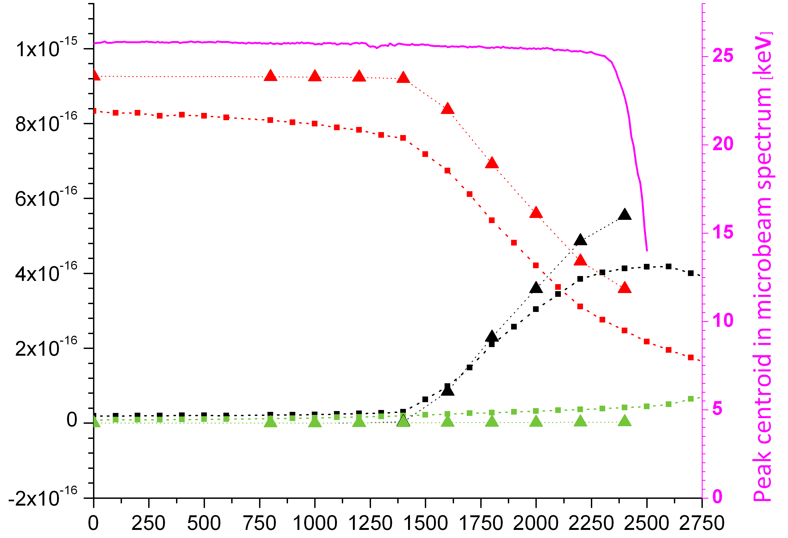
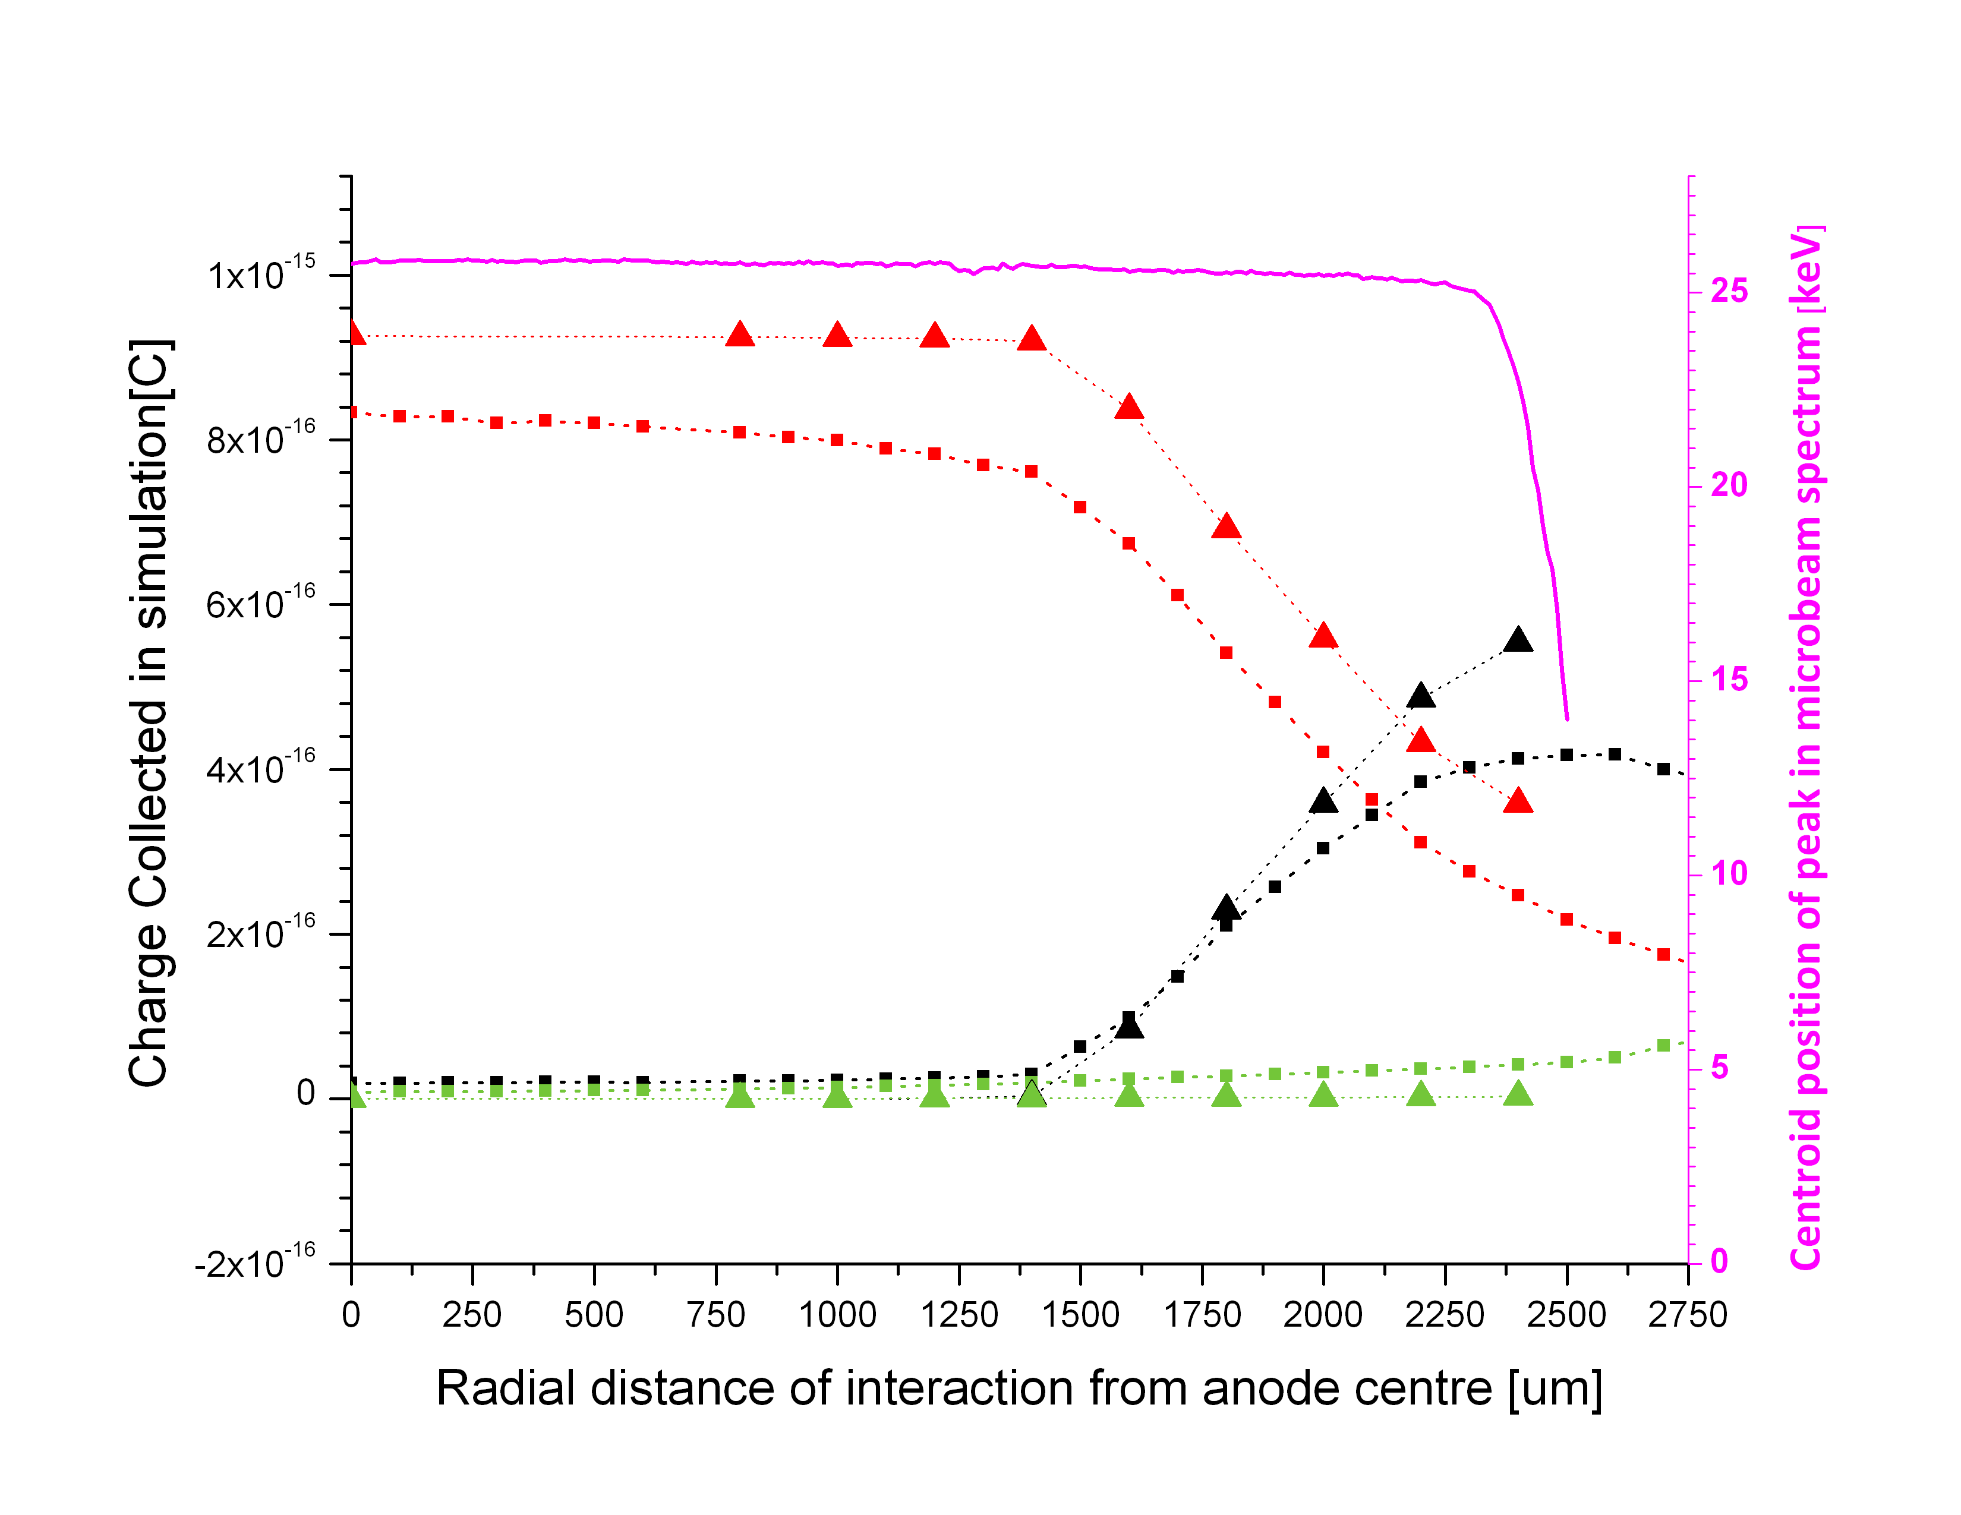
Experimental vs. Simulated results
Current model has a smaller active radius than the real device.
Model anode charge collection declines gradually at moderate radius.
The real device maintains a flat response until beyond Ring 2, then declines steeply.
Experimental data
Reducing trap concentration improves charge collection
but does not alter the response profile.
Simulation data
Donor Concentration:
N₀ = 10⁹ cm⁻³
N₀ = 5 x 10⁷ cm⁻³
Charge collected in simulation[C]
Anode=0V
Ring 1= -500V
Ring 2= -600V
Ring 3= -700V
Cathode=-700V
Anode
Ring 1
Ring 2
Radial distance of interaction from anode centre [um]
Notes:
Simulations were run under the same bias conditions used in experiment.
The fall in simulated anode charge collection corresponds to peaks shifting downwards.
Observed trends in charge collection and active area with varying bias were reproduced
But the model had unrealistically poor performance under all conditions, as shown by its reponse profile.
This is thought to be a fault in the material model. Altering the trap concentration to increase mu-tau did not correct the profile. A solution is still being sought.
Meanwhile, simulations have proceeded with the faulty material to study the effects of other parameters.
Many events are mis-registered at too low an energy

Slide 10
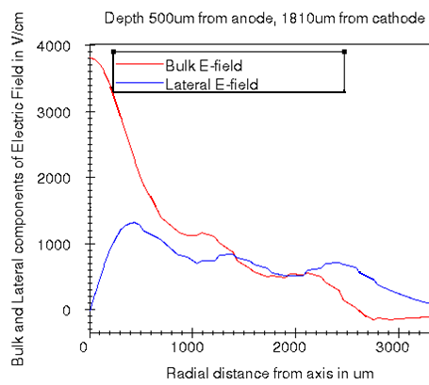
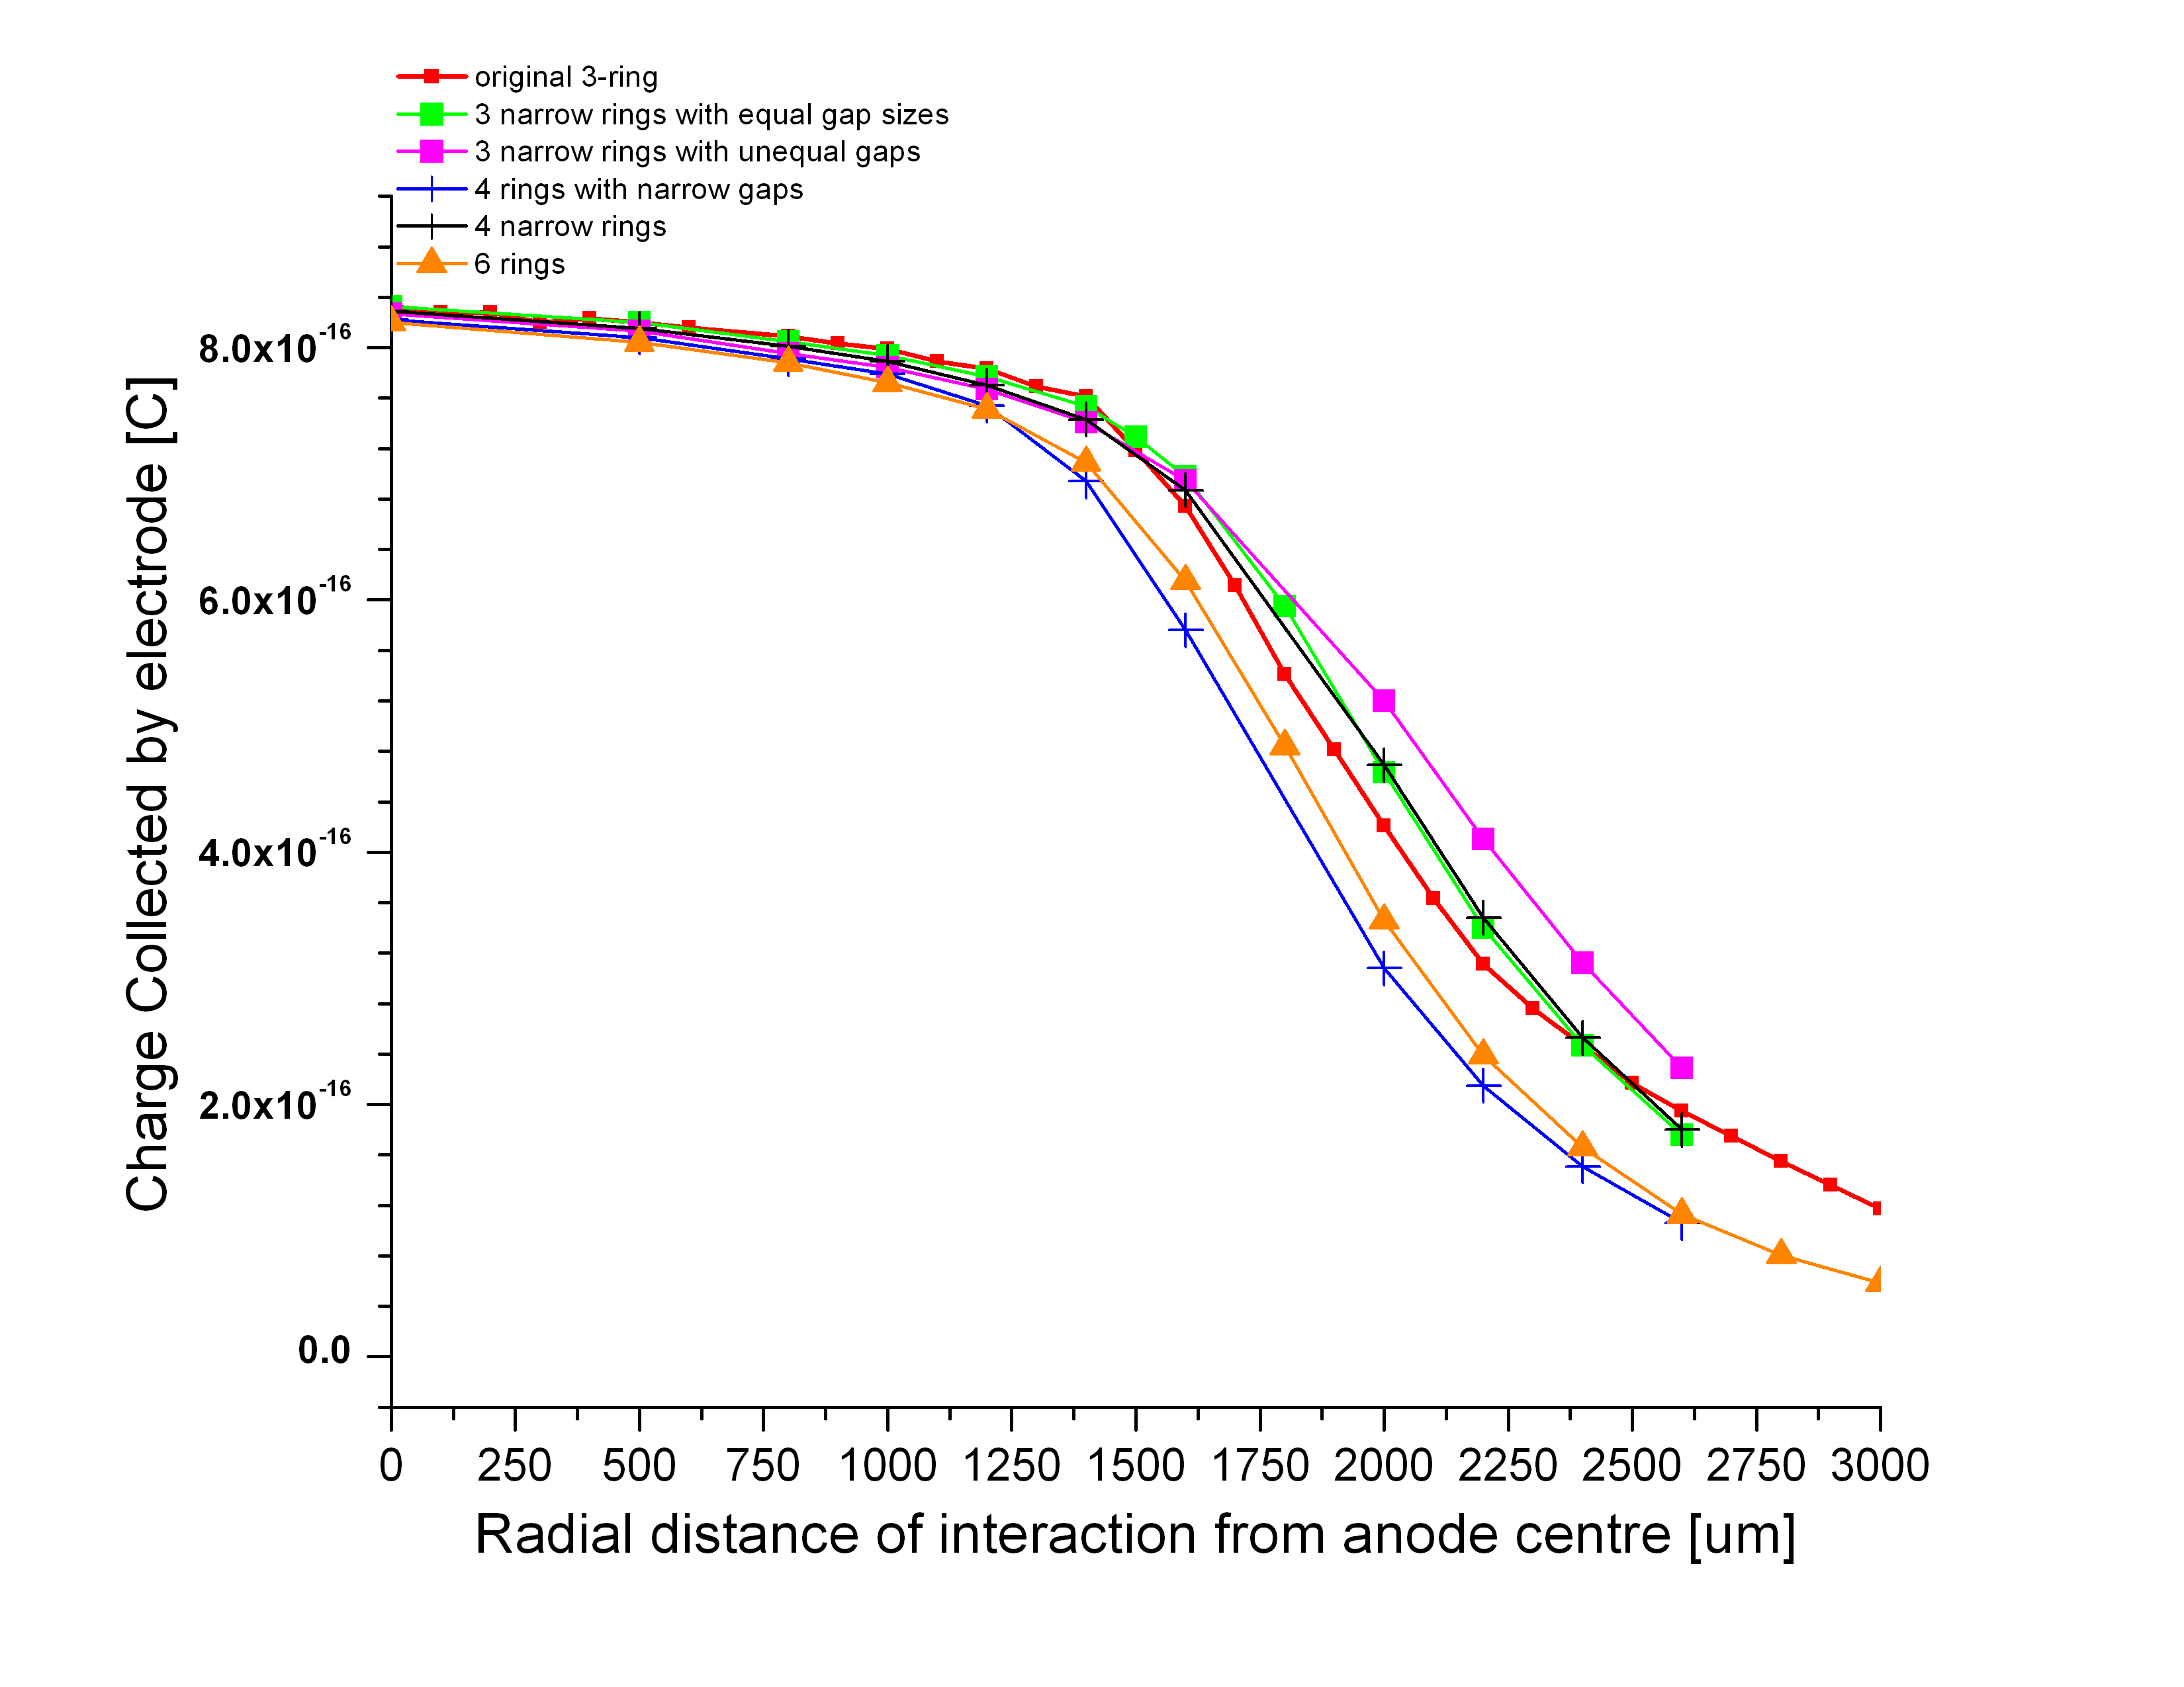
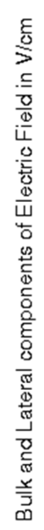

Simulation of varying Ring Geometry
Silicon drift detectors have 10+ rings over ~5mm diameter.
Coarse rings create ripples in E- field.
Do the minima of lateral field cause charge to be captured by Ring 1? Are finer rings better?
3-ring prototype
E-field ripples
3-ring, 0.5mm rings and gaps
3-ring, 0.25 rings, 0.75 gaps
3-ring, 0.25 rings, unequal gaps
4-ring, 0.5 rings, 0.25 gaps
4-ring, 0.25 rings, 0.5 gaps
6-ring, 0.25 rings and gaps
Ring 1
Ring 2
Ring 3
6-ring
Ring positions for two geometries
1
2
3
4
Less ripple
Anode
Ring 1
Ring 2
Ring 3
Notes:
As the response profiles show, the main problem limiting active radius is that charge is too easily collected by ring 1 instead of drifting all the way to the anode.
Biased rings create spatial ripples in electric fields. It was thought that minima in the lateral field might be allowing electrons to drop towards the ring face too early. A finer ring structure produces a more constant field point and silicon devices have 10 or more rings for this reason.
I tried 3, 4 and 6-ring devices, all with the same total diameter. The same total voltage drop is divided evenly across the whole radius.
6 is the maximum because of the problem of contacting very narrow rings.
As these profiles show, there is virtually no difference in their performance.

Slide 11
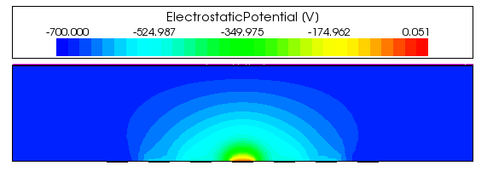
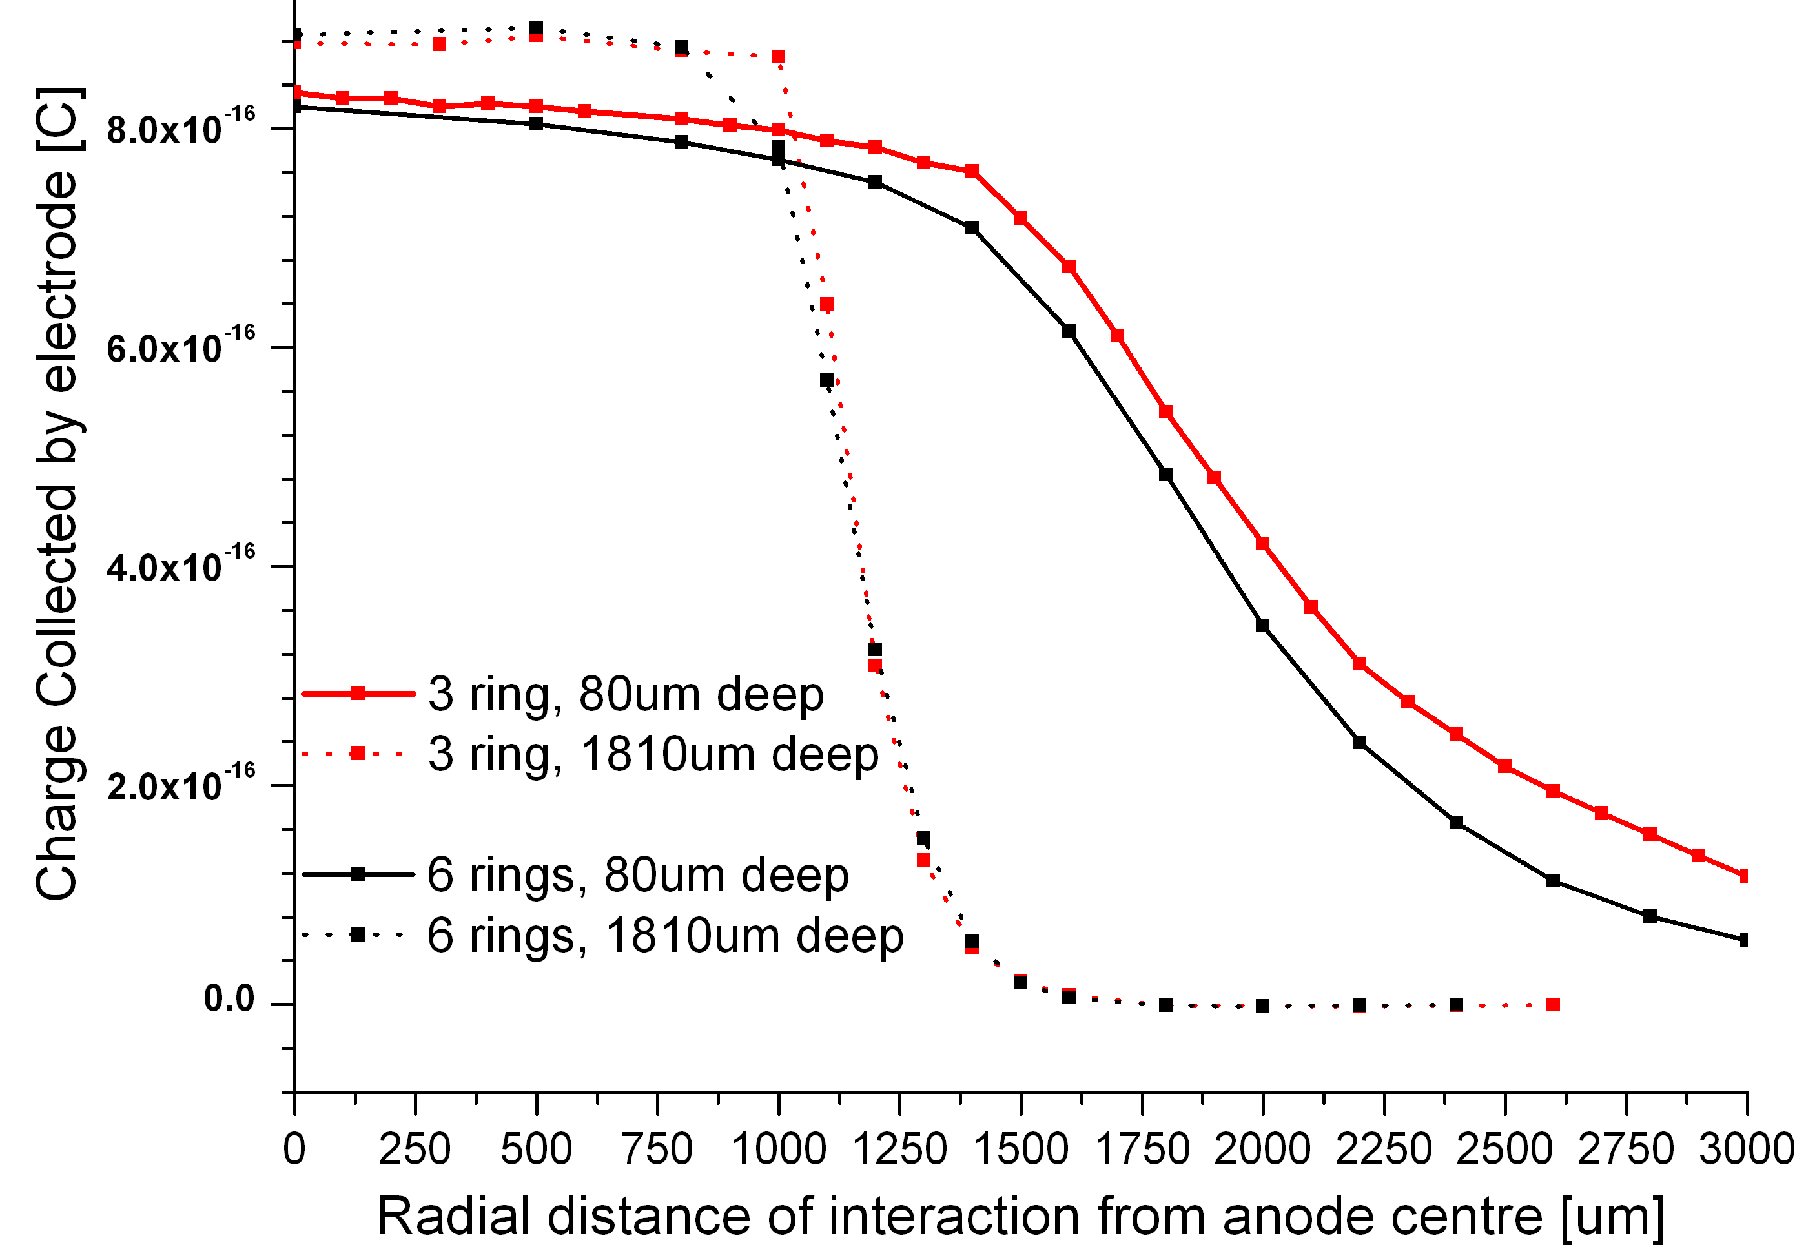
Simulation of varying interaction depth
Simulations were repeated at interaction depths of 80, 810, 1310 and 1810μm from the cathode
to represent different x-ray energies.
80 μm
Ring 1
Ring 2
Ring 3
1810 μm
-700
-525
-350
-175
0
For deeper (higher-energy) interactions:
Higher charge collection at centre
Smaller active area,
Steeper decline at edge of active area
= fewer incorrect counts, finer resolution.
Even for the deepest interaction,
where E-field ripples are greatest,
fineness of ring structure
has no effect.
Ring 2
Ring 3
Ring 2
Ring 3
Notes:
However, those were shallow interactions, at this depth.
The ripples in e-field are greater closer to the ring face. Flick back these ripple maps were taken at 1810um depth, here.
So next I tried varying the interaction depth and again compared the many ring geometries.
All devices showed a much smaller active area for deep or ‘high-energy’ photons because the charge has less chance to drift laterally towards the anode as the bulk field pulls it towards the anode-and-ring face. It ends up on ring 1 or 2.
However, a finer ring structure still makes no difference within fabrication constraints.

Slide 12
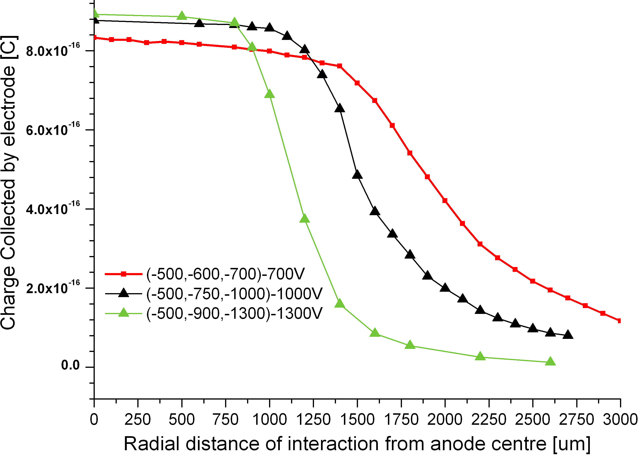
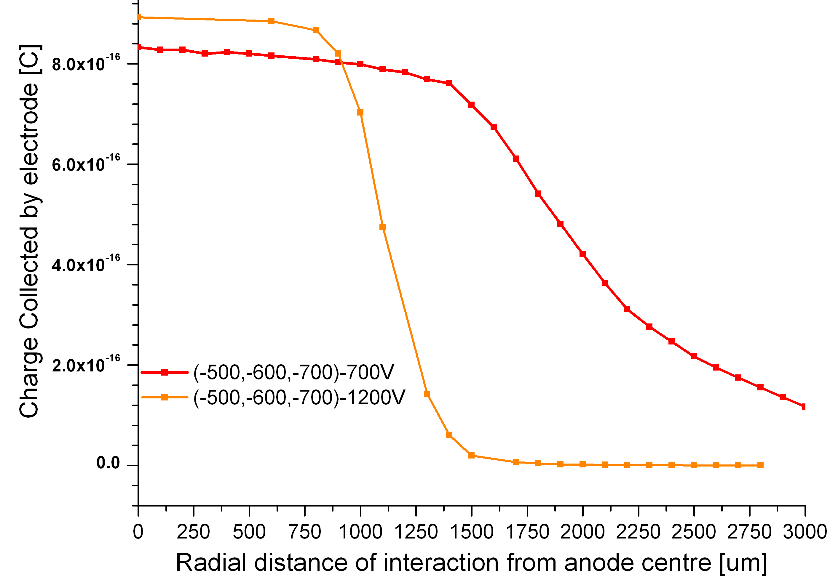
Simulation of varying Electric Field conditions I.
Right: increasing lateral and bulk field
with R3=Cathode voltage.
Below: increasing bulk field
with constant lateral field
Bias conditions
used experimentally
Anode
Ring 1
Ring 2
Ring 3
Higher charge collection at centre
Smaller active area,
Steeper decline at edge of active area
= fewer incorrect counts, finer resolution.
Notes:
Bias conditions beyond the voltages available in experiment were then studied.
Raising the bulk field alone reduced the active area, as expected.
Then the ring voltage intervals were increased from a hundred to 250 or 400V in the hopes that a stronger lateral field would allow more charge to drift past ring 1.
In fact the opposite occurred, as this shows. Active area declined.
The bulk field was increased too to maintain it equal to ring 3, which may be the reason.
Silicon devices commonly have their outer rings more negatively biased than the cathode. We will try such a scheme in the near future.

Slide 13
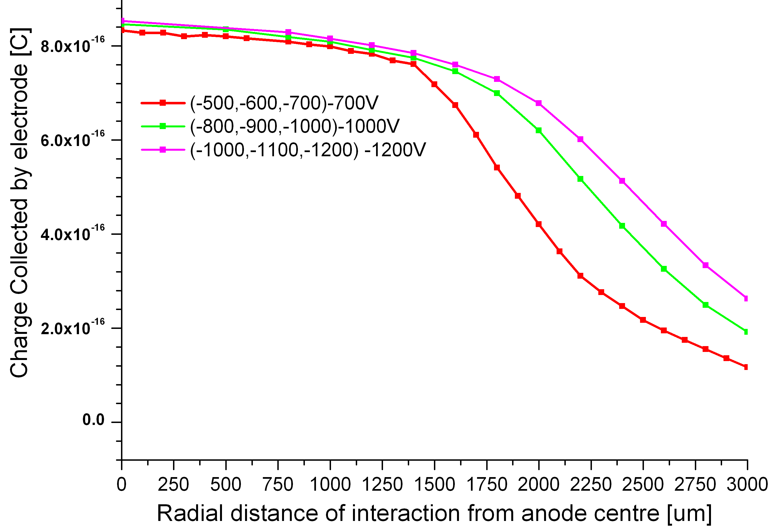
Simulation of varying Electric Field conditions II.
Effect of increased potential difference between anode and Ring 1.
with constant inter-ring differences.
No effect on charge collection at centre.
Larger active area,
Less Steep decline at edge
of active area
= more incorrect counts,
worse resolution.
Bias conditions used experimentally
Notes:
Another attempt to get charge past Ring 1 was to raise the potentail difference between ring 1 and the anode, keeping the same inter-ring intervals.
This did increase the active area but the additional counts are all misregistered ones, at too low an energy.
This would make resolution worse.

Slide 14
Conclusions
Experimental Results
The protoype device has high sensitivity and resolution limited by electronic noise to 3.3keV at room temperature. Its active radius extends beyond Ring 2 under the best bias combination available so far.
Increasing lateral field as a fraction of bulk (until R3=cathode voltage) increases active area and sensitivity.
Increasing both fields while maintaining their ratio causes further improvement.
Raising the bulk field alone does not improve performance.
Simulation results
Trends in charge collection and active area with bias were qualitatively reproduced under the same conditions used in experiment.
Changing the ring geometry does not affect performance (within the constraint that contacts cannot be bonded to rings narrower than 0.25mm)
Active area falls with increasing interaction depth.
Increasing the lateral and bulk field further (with R3=cathode voltage) OR bulk field alone decreases active area, raises sensitivity and improves resolution under conditions simulated so far.
Further increasing the anode−Ring 1potential difference degrades resolution.
Further work
More variations in bias conditions will be studied to optimise active area, sensitivity and resolution.
The CZT material model requires improvement to reproduce experimental results.
Notes:
That is progress to date.
In conclusion,
Our protoype device shows very promising performance. Its active area extends beyond ring 2 even under the limited range of voltages were were able to test. We identified trends with bias conditions that improve understanding of how this novel configuration works and inform our choice of parameters to model.
Simulations reproduce these trends in spatial response, though the shape of the response profile has not been accurately matched. The CZT material model requires improvement.
Changes in ring geometry seem to make no difference to performance within the limits for fabrication.
Active area is smaller for deeper, higher-energy interactions.
Novel bias schemes beyond those used in experiment have been studied and more trends identified. This work is continuing until the device and conditions are optimised.
The optimised device will then be fabricated and characterised with sources
And by microbeam if the opportunity arises.

Slide 15

Thank you for your attention.
Acknowledgements
To Dr M. Veale and Dr N. Tartoni for their assistnce with microbeam experiments.
References
[1] Amptek Inc.(2011) ‘FAST SDD® High Performance Silicon Drift Detector (SDD)’, http://www.amptek.com/products/fast-sdd-silicon-drift-detector/
[2] Lechner, P., et al (1996) 'Silicon drift detectors for high resolution room temperature X-ray spectroscopy', Nuclear Instruments & Methods in Physics Research Section A-Accelerators Spectrometers Detectors and Associated Equipment, 377 (2-3), pp. 346-351.
[3] Redlen Technologies, 123 – 1763 Sean Heights, Saanichton, Canada. http://redlen.ca/
[4] Alruhaili, A. (2013) Am-241 spectrum from CZT ring-drift detector. Unpublished data, University of Surrey.
[5] Diamond Light Source Ltd. Diamond House, Harwell Science & Innovation Campus, Didcot, Oxfordshire. http://www.diamond.ac.uk.
[6] Bell, S.(2011) ‘The development of a TCAD model of cadmium zinc telluride’. Report in partial
fulllment of EngD, University of Surrey and STFC Rutherford Appleton Laboratory.
Notes:
That is all so far. Thank you for listening.

Slide 17
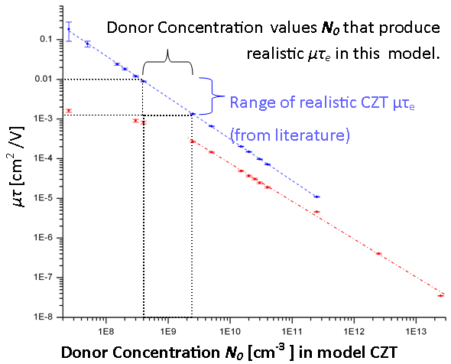
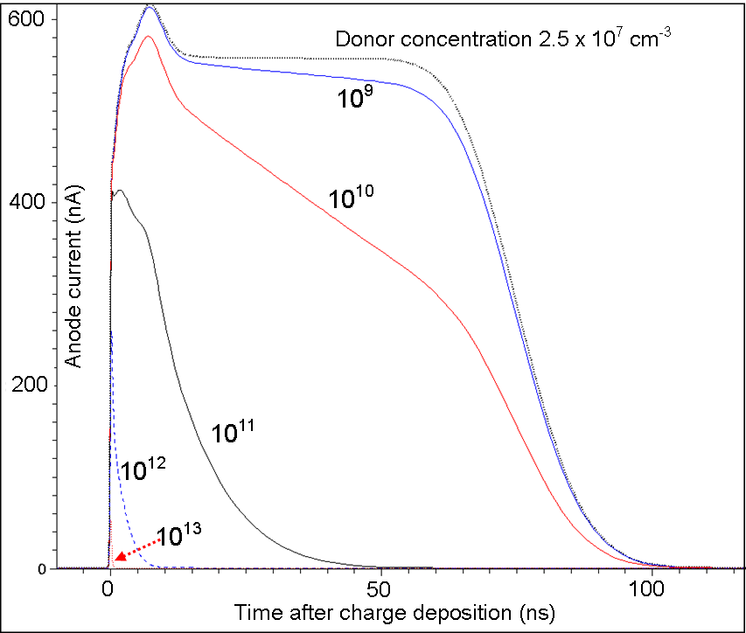
Modelling CZT Material with Sentaurus TCAD
TCAD model of CdTe was adapted by adding traps at 4 energies, based on literature.
[7] Bell, S.(2011)
Relative concentrations were chosen to give realistic high resistivity, determined by I-V simulation.
HENCE
Conclusion:
N₀ =10⁹ cm⁻³ was chosen
To create realistic μτe = 0.0040 cm² /V
Current pulses after ‘alpha-irradiation’
for several trap concentrations
Absolute concentrations were chosen to give realistic charge transport .
μτ was obtained by simulating alpha-irradiation.
μ was calculated by time-of-flight analysis.
Notes:
I had to adapt a built-in model of CdTe to give it the charge transport properties of CZT
A 2mm cube planar ohmic detector was modelled for the IV and ‘alpha’ simulations.
Charge was deposited at 10um depth from the cathode and the current/time signal of the anode was recorded. Current pulses were integrated to find the total charge collected. This was repeated at many bias voltages.
The Hecht equation describes the CCE as a function of the perpendicular distance x of the charge generation event from the cathode.
Hecht plots of CCE/voltage were fitted to calculate mutau-e. These sets of simulations were repeated at many trap concentrations to make this plot.
Time-of-flight assumes drift time= FWHM of square-topped current/time signal. Only valid for fairly high mobilities (low conc).

Slide 18
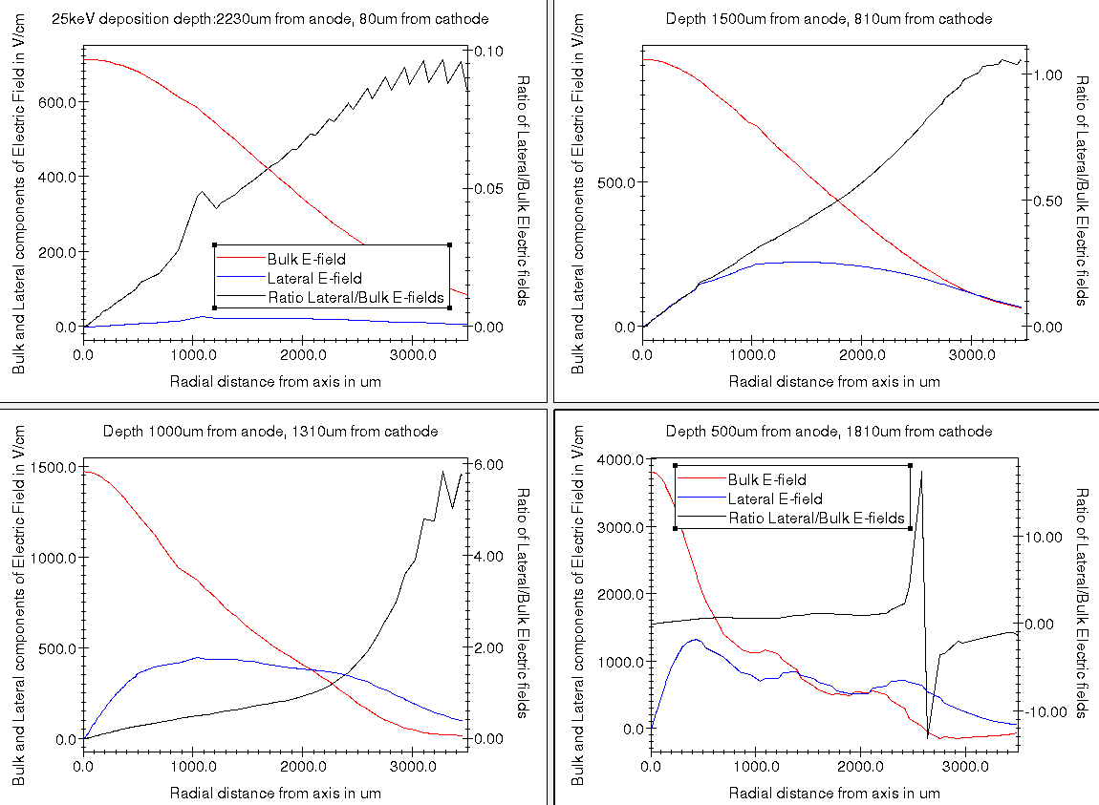
Original 3-ring geometry. (R1= -500,R2= -600, R3= -700) Cathode= -700V
Ring 1
Ring 2
Ring 3
Ring 1
Ring 2
Ring 3

Slide 19
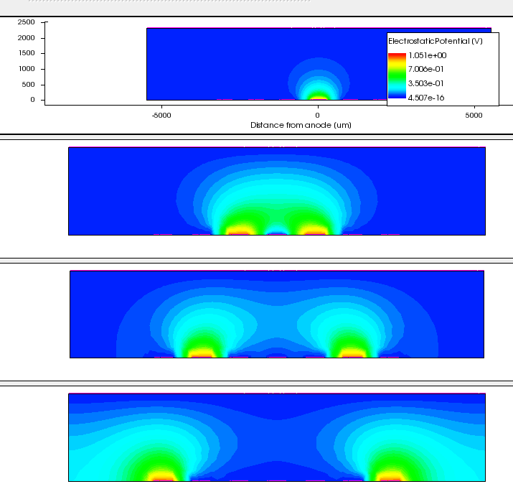
Weighting potential φ₀ of anode
The weighting potential of the anode rises from 0 to 1 between the innermost ring and the anode.
1.0
0.7
0.35
0
φ₀ of Ring 1
φ₀ of Ring 2
φ₀ of Ring 3

