Slide 1
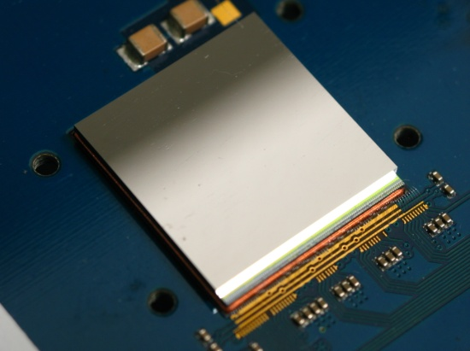
Imaging of Ra-223 with a small-pixel CdTe detector: potential for improved image quantification for radionuclide dosimetry
James Scuffham^{1,2}
Silvia Pani², Paul Seller³, Paul J Sellin², Matthew C Veale³, Matthew D Wilson³, Robert J Cernik⁴
1. Department of Nuclear Medicine, Royal Surrey County Hospital, Guildford, UK.
2. Department of Physics, University of Surrey, Guildford, UK
3. STFC Rutherford Appleton Laboratory, Didcot, UK
4. School of Materials, University of Manchester, UK

Slide 2

Prostate Cancer
Most prevalant cancer in men
(>40,000 diagnoses per year; 13% of all cancers; 25% of new cases in men)^{i}
Highest incidence in the 75-79 age group^{i}
81.4% survive more the 5 years^{i}
Commonly spreads to the bones in advanced disease
(~90% of patients with castration-resistant, prostate cancer (CRPC) have bone metastases)^{ii}
i – ONS Cancer Statistics Registrations, June 2013
ii - Scher H, et al. N Engl J Med. 2012;367:1187-1197, supplemental appendix.

Slide 3
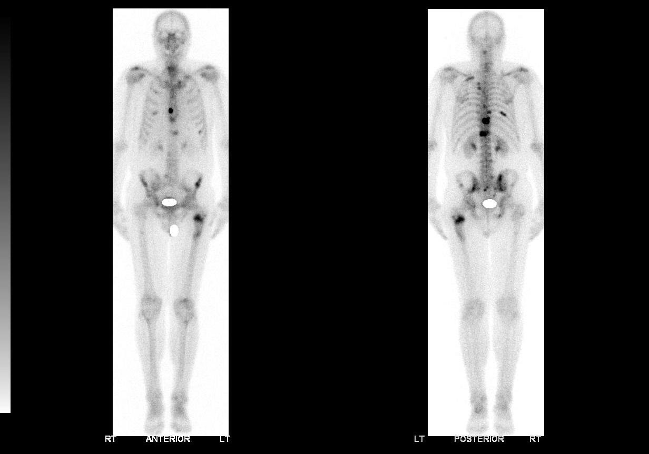
Bone metastases
Metastases are common in the ribs, spine, pelvis and hips
Can cause debilitating pain and severely impact quality of life
Treatments are palliative

Slide 4
Xofigo ^{R}
New radiopharmaceutical (²²³RaCl₂) by Bayer
Bone-seeking alpha-emitter
Licensed in the UK in Feb 2014 after promising clinical trial results:
Increased median overall survival of 3.6 months
Increased time to serious skeletal event (5.8 months)
Increased time to Alkaline Phosphatase progression (3.6 months)
100
80
60
Survival %
40
20
0
0
3
6
9
12
15
18
21
24
27
30
33
36
39
Months Since Randomisation

Slide 5
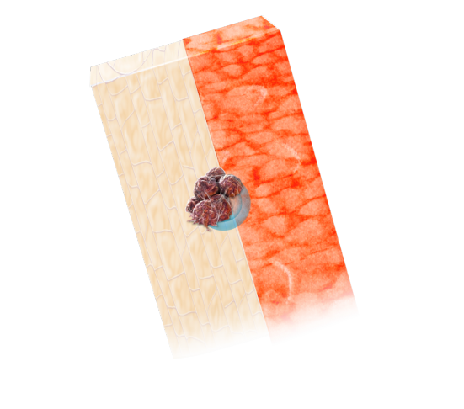

The Alpha Advantage
Marrow
Marrow
α emitter
β-emitter
Bone
Bone
Range of α-particle:
(short range – 2 to 10 cell diameters). High LET, increased chance of double-strand DNA breaks
Range of β-particle:
(long range – 10 to 1000 cell diameters)

Slide 6
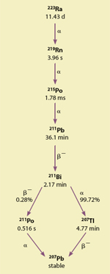
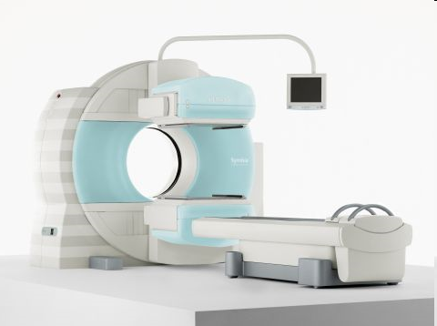
The Disadvantages
²²³Ra’s emissions are not optimal for imaging with conventional gamma cameras
Injected activities are generally
around 6MBq → very low external
dose rate (good for patients’ family,
not good for imaging!).

Slide 7
Why do we need imaging?
Currently very simplistic administration regimen based on patient weight (50kBq/kg)
BUT…patient weight does not necessarily correlate to tumour burden, radiopharmaceutical uptake, or even the patient’s bone marrow reserve
Therapy could be tailored to the individual patient by adjusting administered activity based on uptake and clearance in the bone
Need to image the biodistribution and clearance of radiopharmaceutical, as this varies greatly between patients
→ “Personalised medicine”

Slide 8
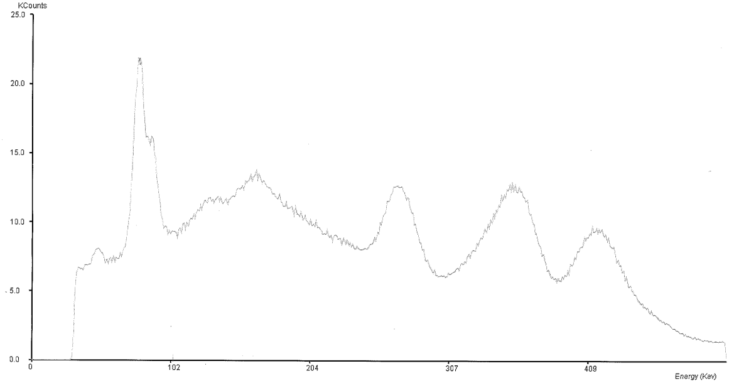
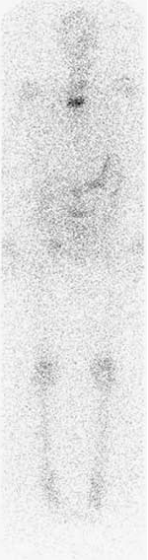

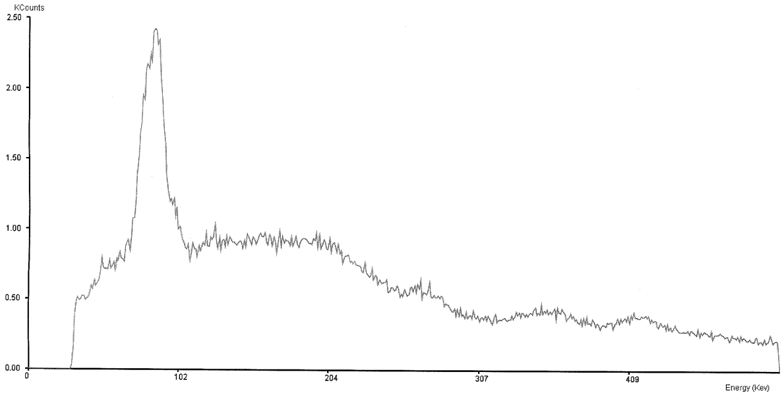
Imaging with gamma cameras
Typical Energy Spectra:
Typical Patient Images (MEGP):
“Low-energy” Collimators
“Medium Energy” Collimators
Hindorf et al, NMC 2012

Slide 9
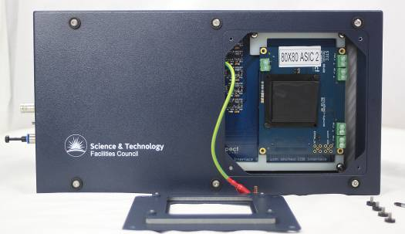
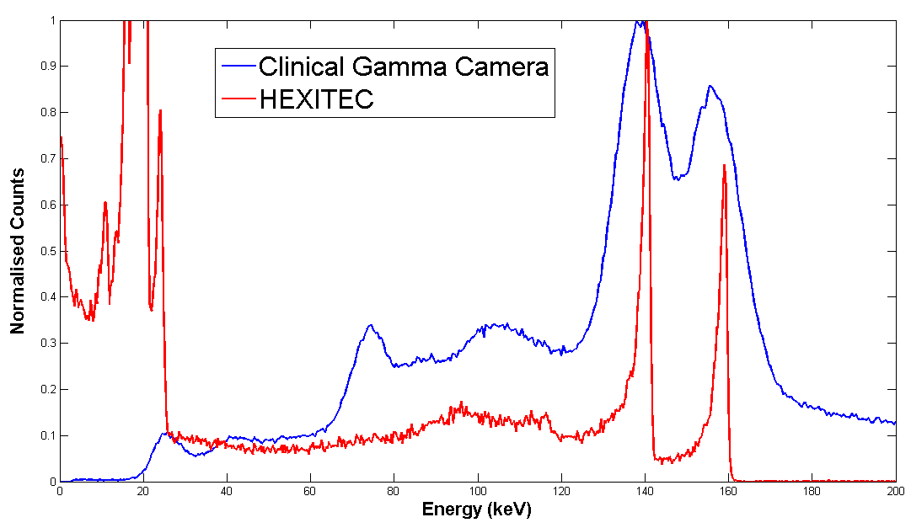
The HEXITEC Detector
1mm thick CdTe
80 x 80 pixels, 250μm pitch
5-200keV spectroscopy per pixel
10000 frames per second
-500V detector bias
Peltier cooling, room temperature operation
Corrections for charge sharing
Pixelwise energy and uniformity calibrations
Energy resolution 0.8% at 140keV (vs 9% for conventional gamma camera)

Slide 10
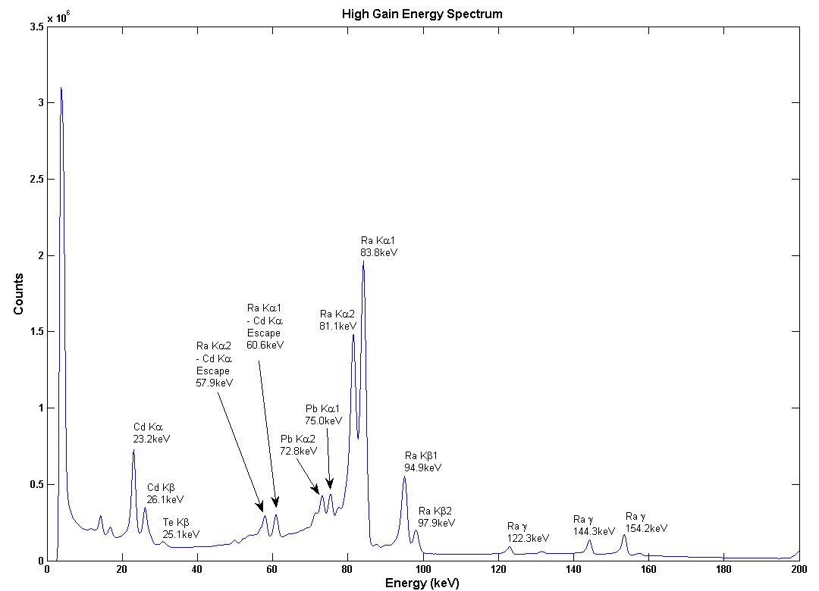
HEXITEC Ra-223 Spectrum
Glass vial containing ~6MBq Ra-223
3mm lead pinhole collimator
Spectrum collected over 15 hours
Rn L_{β1} 14.3keV
Rn K_{α1} 83.8keV
Rn Lγ 16.8keV
Rn K_{α2} 81.1keV
Rn K_{α1} – Cd K_{α} Escape 60.6keV
Rn K_{α2} – Cd K_{α} Escape 57.9keV
Rn K_{β1} 94.9keV
Rn K_{β2} 97.9keV
Ra-223 γ 144.3keV
Ra-223 γ 154.2keV
Ra-223 γ 122.3keV

Slide 11
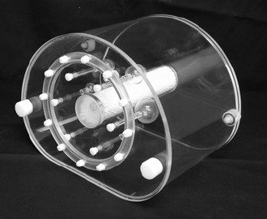
HEXITEC Imaging with Ra-223
“Body phantom” containing 6 spheres
(10, 13, 17, 22, 28, 37mm)
Spheres: 434kBq/ml
Cylinder: 2.4kBq/ml
Cold background
3mm lead pinhole collimator at 28cm from spheres
Planar acquisition, “tiled” with 4 stops
50mins “live time” per stop
Bias refresh (60s on, 4s off, 6s settle)
Energy calibration applied, form images with 85±5keV energy window
Stitch 4 tiles together

Slide 12
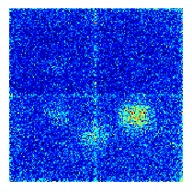
Imaging Results
4 (5?) spheres
visible
Low counts;
noisy image
Detector edge effects due to “stitching”.
Efficiency limited by pinhole collimation and distance from phantom

Slide 13
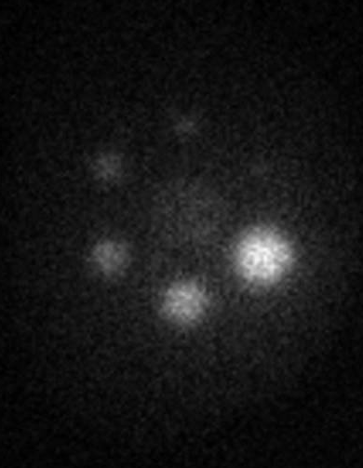
Comparison with gamma camera
GE Infinia SPECT/CT
“Medium Energy” parallel-hole collimators
50mins, 89.5±13.4%keV
5 (6?) spheres
visible?
Better statistics
Central compartment visible

Slide 14
HEXITEC Ra-223 conclusions
Spectroscopy is excellent
→ potential for improved quantitative imaging due to improved scatter rejection
Sensitivity with lead pinhole collimators too poor for clinical imaging
Need higher sensitivity collimators
Larger area detector would also be needed for clinical imaging

Slide 15
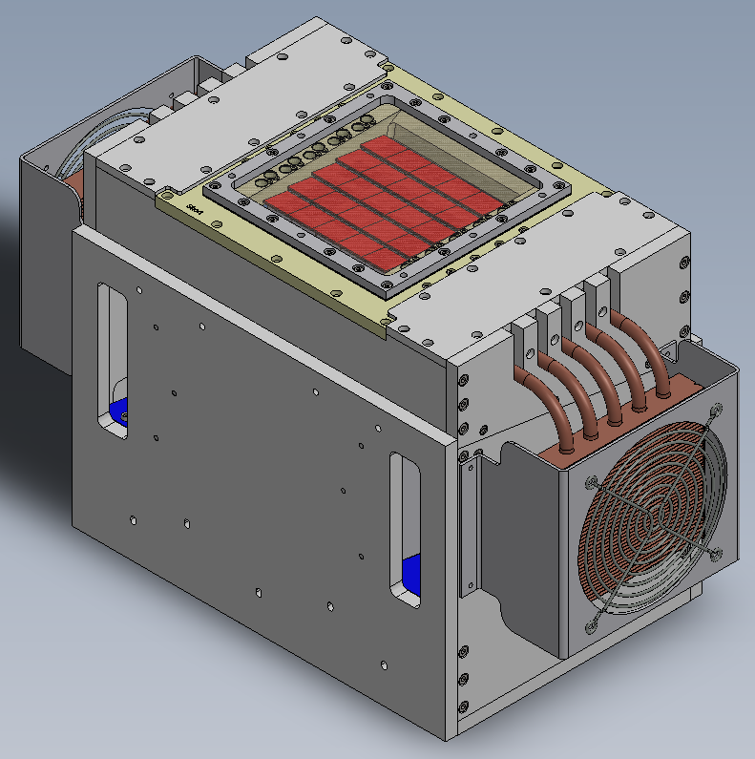
Ongoing work – RAL and Surrey
Simulation work to optimise parallel-hole collimator design for increased sensitivity for both Tc-99m and Ra-223
Planning to test
thicker CZT detector
material shortly
Large-area detectors
under
development
(Seller et al, this
morning at PSD)

