Slide 1
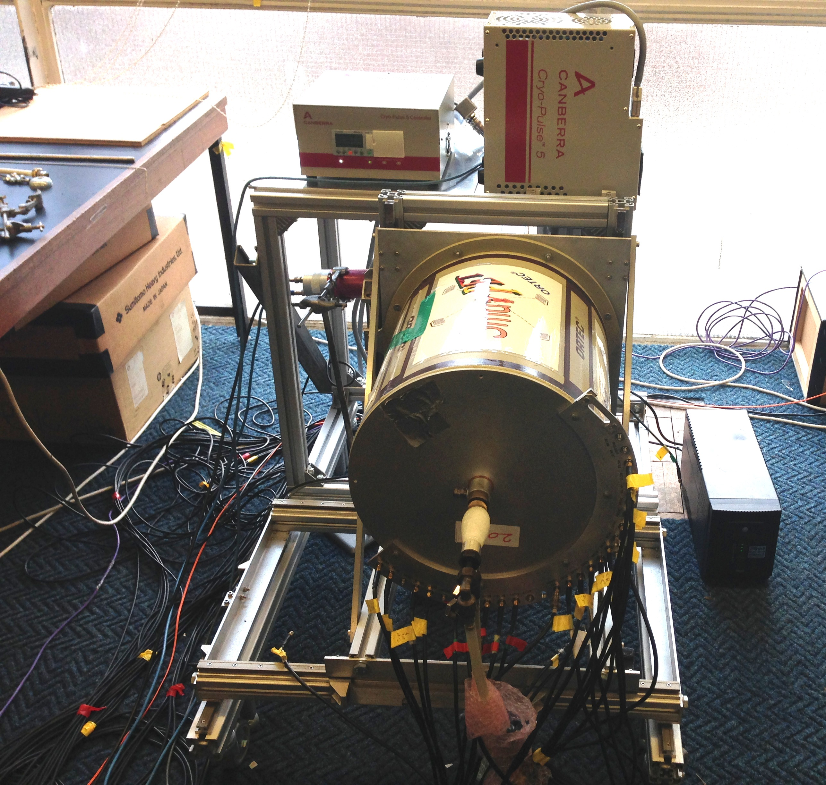
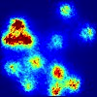

ProSPECTus: A Compton camera for medical Imaging
By Amina Patel

Slide 2
Contents
Background
Compton imaging
Detectors
Importance of position resolution
Simulation results
Summary

Slide 3
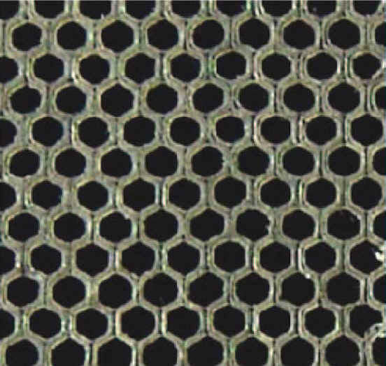
Motivation : Medical Imaging
Nuclear medicine techniques Functional images
ProSPECTus designed to overcome limitations in conventional Single Photon Emission Computed Tomography (SPECT) system.
Main Gamma Camera Components
Prevents co registry with Magnetic Resonance Imaging (MRI) scanners
Multiple Scans
High dose or Long scans

Slide 4
Compton Camera: Principles
Gamma ray interacts with both detectors
Energy deposited used to find out scattering angle via Compton scatter formula
Conic represents all possible source locations
Position interactions create cone axis
Many events lead to overlap of conics revealing source location -
2θ
Source
Location

Slide 5
ProSPECTus System : Scatter Detector
Material : Lithium drifted Silicon
Active area: 3500 mm²
13 contact strips on each face of width 5mm
Voxel size = position resolution ( 5 x 5 x 8 ) mm
8mm
71mm
Front
Back
Detector Performance :
Average intrinsic timing resolution at 511 keV : 16ns
Average Energy resolution @ 60keV : 1.5 keV

Slide 6
ProSPECTus System: Absorber
Material : High purity Germanium
Active area: ( 60 x 60 x 20 ) mm³
12 contact strips on each face of width 5mm
Voxel size = position resolution ( 5 x 5 x 20 ) mm
60mm
20mm
Front Face
Back Face
60mm
Detector Performance :
Average intrinsic timing resolution at 511 keV : 22 ns
Average Energy resolution @ 60keV : 2 keV

Slide 7
The ProSPECTus System
Prototype system
ProSPECTus

Slide 8
Modeling the ProSPECTus System
Investigate and improve Image quality capabilities of ProSPECTus
Image resolution quantitative assessment of image quality
ProSPECTus system modeled in GAMOS (GEANT4-based Architecture for Medicine-Oriented Simulations)¹
Creates output text file that contains required information in suitable format for image reconstruction code
¹A Compton camera application for the GAMOS GEANT4-based framework , L..J. Harkness, NIMA

Slide 9
Image Quality :Image Resolution
LEHS
LEHR

Slide 10
Image Quality : Pulse Shape Analysis (PSA)
Principle : Manipulates signals generated from contact strips to determine position of interaction
Two types :
Parametric
Generate a database of pulse shapes for each interaction position

Slide 11
Pulse Shape Analysis (PSA) : Parametric
Parametric PSA has two components :
Depth- Charge Collection
Precision in X and Y direction – Image charges
y
a) Depth: Charge Collection
Z= depth
x
Normalised Magnitude
Time (ns)
R. Cooper, Thesis

Slide 12
Pulse Shape Analysis :Parametric
a) Depth: Charge Collection
90 %
30 %
10%

Slide 13
PSA : Parametric
b) Precision in X and Y – Image Charges
e
e
e
e
h
e
h
h
h
h

Slide 14
PSA :Pulse Shape Database
Y
X
Coincident events:
¹³⁷Cs – 662 keV
Absorber Detector : 374 keV
Scintillator detector : 288 keV
Z
Absorber Detector

Slide 15
Position Resolution Investigations
Exact Position on Scatter with normal segmentation on Absorber ( no physics effect) : 26 mm
Exact Position on absorber detector with normal segmentation on Scatter detector ( no physics effects): 19 mm
Position sensitivity most important in the absorber detector
Simulations used to investigate lateral and depth position precision independently

Slide 16
Position Resolution Investigations
Depth Position Resolution Investigation: Absorber
Including physics effect
Position resolution
(mm)
Position Resolution in Depth (Z) mm

Slide 17
Position Resolution Investigations
Depth Position Resolution Investigation: Absorber
Including physics effect
Position resolution
(mm)
Position Resolution in Depth (Z) mm

Slide 18
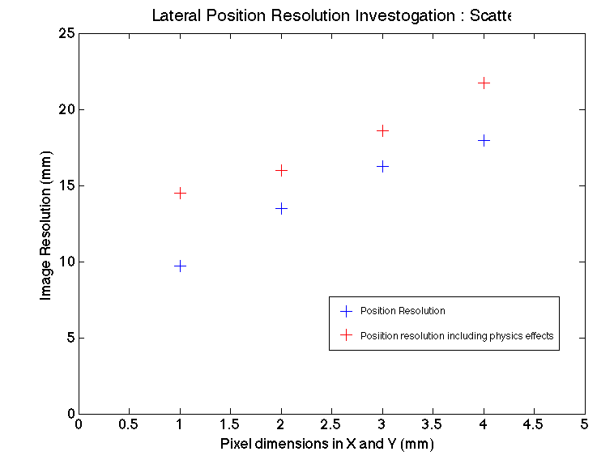
Position Resolution Investigations
Lateral Position Resolution Investigation: Scatter
(mm)
Pixel dimensions in X and Y

Slide 19
Position Resolution Investigation Conclusions
Improvement in position resolution will improve image resolution
Position resolution in depth has more impact than that in X and Y
Position resolution most important in absorber detector

Slide 20
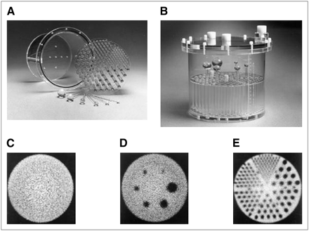
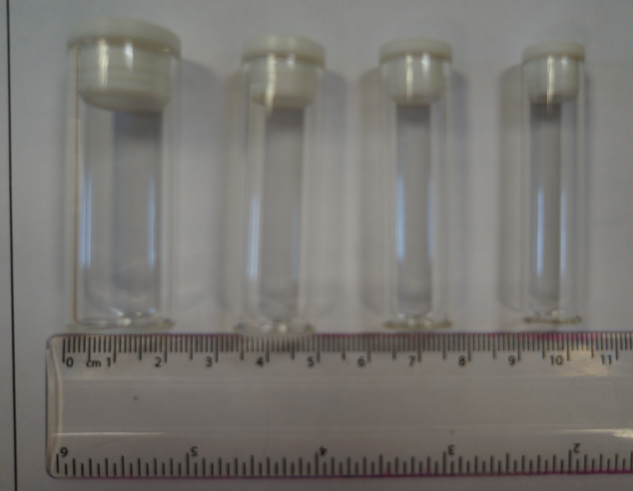
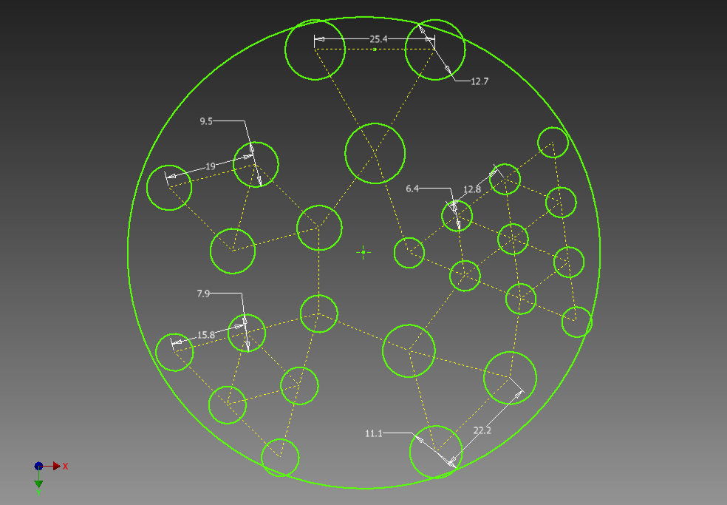
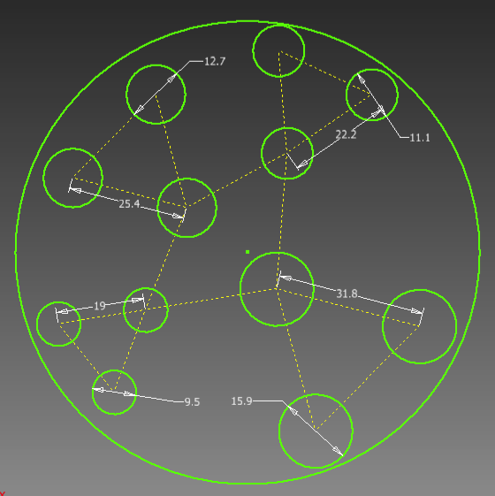
Image Quality : Phantom
¹³⁹Ce: 165 keV
Drilled holes for rods
50 mm
Rod diameters: 6.0, 8.0, 10.0, 11.0, 12.4 mm
Rod diameters: 9.5, 11.0, 10.0, 16.4 mm
120 mm
100 mm
60 mm
Perspex Cylinder
Sam : s.colosimo@liverpool.ac.uk
10 cm
10 cm

Slide 21
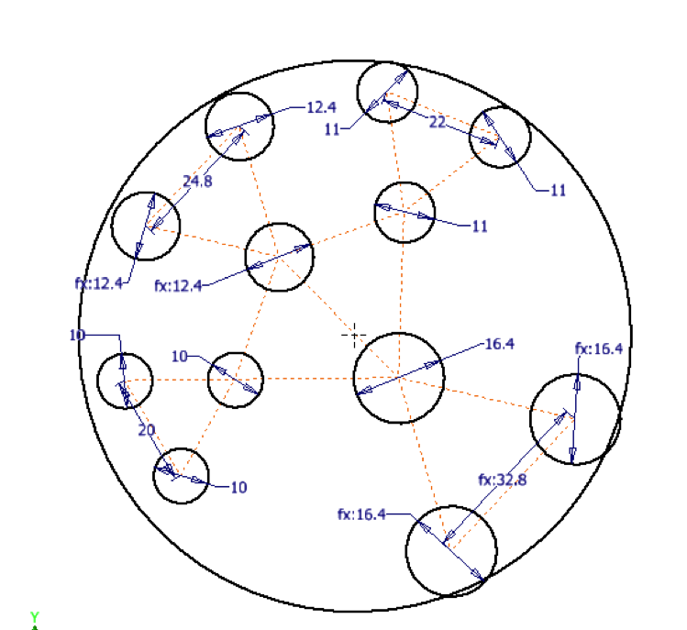
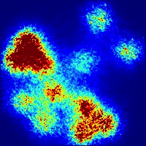
Image Quality : Phantom
Characteristic Position resolution
1mm³ Position resolution in absorber

Slide 22
Image Quality : Phantom
Characteristic Position resolution
1mm³ Position resolution in absorber

Slide 23
Summary/Future Work
Conclusion
Position resolution has significant influence on image quality
Pulse shape analysis techniques will be applied to the ProSPECTus absorber detector to improve image resolution
Phantom will be used to compare the ProSPECTus system to current SPECT systems
Current Work
Acquiring experimental images with point sources and phantom
Apply parametric PSA to data
Future Work
Generate a pulse shape database for the absorber detector
Develop PSA algorithms
Images with Technetium (141 keV) to be compared to SPECT images

Slide 24
Collaborators
L.J. Harkness-Brennan¹ , A.J. Boston¹ , H.C. Boston¹, S.Colosimo¹,J.R. Cresswell¹, J.Dormand^{1,} T.Hughes¹ D.S. Judson¹, P.J. Nolan¹, J.A. Sampson¹, N. Clague², J .Groves², J .Headspith², A .Hill², I.H. Lazarus², J. Simpson², W.E. Bimson³, G.J. Kemp³, and D.Gould⁴
¹ Department of Physics, The University of Liverpool, UK,
² STFC Daresbury Laboratory, UK
³ MARIARC, The University of Liverpool, UK
⁴ Royal Liverpool University Hospital, Liverpool, UK

Slide 25
Compton Efficiency: Previous Work
6.00E-03
Absolute Compton Efficiency
¹
Factor of 3 difference between simulated and experimental data.
GAMOS² Monte carlo simulations previously validated against Compton data and matched.
5.00E-03
4.00E-03
Efficiency (%)
3.00E-03
2.00E-03
1.00E-03
1. A. Sweeney. Compton Imaging for Homeland Security, Thesis 2014.
2. L.J. Harkness , A Compton camera application for the GAMOS GEANT4-based framework , NIMA 2012
0.00E+00
0
200
400
600
800
1000
1200
1400
1600
Energy (keV)

Slide 26
Compton Efficiency : Thresholds
Threshold ~15keV
( L.J.Harkness, Thesis 2010)

Slide 27
Compton Efficiency : Thresholds
( L.J.Harkness, Thesis 2010)

Slide 28
Compton Efficiency : Thresholds
Threshold
~ 6 keV
( L.J.Harkness, Thesis 2010)

Slide 29
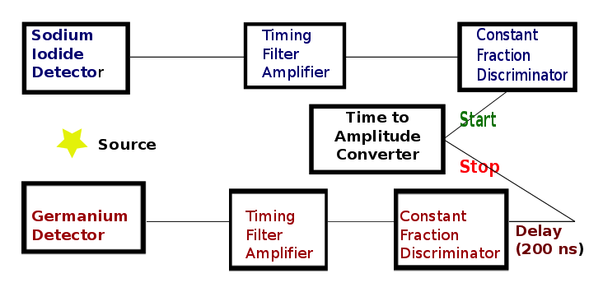
Compton Efficiency: Coincidence Window
²²NA
Done for energy range 80 keV – 511 KeeV
FWHM= Time Resolution ~ 15ns
Example TAC spectrum from
Notes:
Redo TAC PEAK in MATLAB ( axis bigger)

Slide 30
Coincidence Window Results

Slide 31
Image Quality : Pulse Shape Analysis (PSA)
Principle : Manipulates signals generated from contact strips to determine position of interaction
Two types : 1) parametric 2) generate a database of pulse shaped for each interaction position
Notes:
Add in Reference

Slide 32
Image Quality : Pulse Shape Analysis (PSA)
Principle : Manipulates signals generated from contact strips to determine position of interaction
Two types : 1) parametric 2) generate a database of pulse shaped for each interaction position
Notes:
Add in Reference

Slide 33
Image Quality : Pulse Shape Analysis
PSA investigations
GAMOS Simulated data (141 keV)
Absorber position resolution dominant
Position resolution 1mm³
Plan
Develop pulse shape analysis algorithms
Develop pulse shape database for Germanium detector

Slide 34
Motivation : Single Photon Emission Computed Tomography (SPECT)
Medical imaging
SPECT

Slide 36
Image Quality : Pulse Shape Analysis (PSA)
Principle : Manipulates signals generated from contact strips to determine position of interaction
Two types : 1) parametric 2) generate a database of pulse shaped for each interaction position
Depth: Charge
Collection
Lateral: Image Charges
3
4
5
6
7
Magnitude (keV)
Time (ns)
Time (ns)
Time (ns)
Time (ns)
Time (ns)
R. Cooper, Thesis
Notes:
Add in Reference

