Slide 1
A proton Computed Tomography based medical imaging system
M. Scaringella¹, M. Bruzzi^{2,3}, M. Bucciolini^{3,4,10}, M. Carpinelli^{8,9}, G. A. P. Cirrone⁵, C. Civinini³, G. Cuttone⁵, D. Lo Presti^{6,7}, S. Pallotta^{3,4,10}, C. Pugliatti^{6,7}, N. Randazzo⁶, F. Romano⁵, V. Sipala^{8,9}, C. Stancampiano⁵, C. Talamonti^{3,4,10}, E. Vanzi¹¹, M. Zani^{3,4}
¹Information Engineering Department, University of Florence, Florence, Italy
²Physics and Astronomy Department, University of Florence, Florence, Italy
³INFN - Florence Division, Florence, Italy
⁴Department of Biomedical, Experimental and Clinical Sciences, University of Florence, Florence, Italy
⁵INFN - Laboratori Nazionali del Sud, Catania, Italy
⁶INFN - Catania Division, Catania, Italy
⁷Physics and Astronomy Department, University of Catania, Catania, Italy
⁸Chemistry and Pharmacy Department, University of Sassari, Sassari, Italy
⁹INFN Cagliari Division, Cagliari, Italy
¹⁰ SOD Fisica Medica, Azienda Ospedaliero-Universitaria Careggi, Firenze, Italy
¹¹ Fisica Sanitaria, Azienda Ospedaliero-Universitaria Senese, Siena, Italy
PSD10 – 7-12 September – University of Surrey

Slide 2
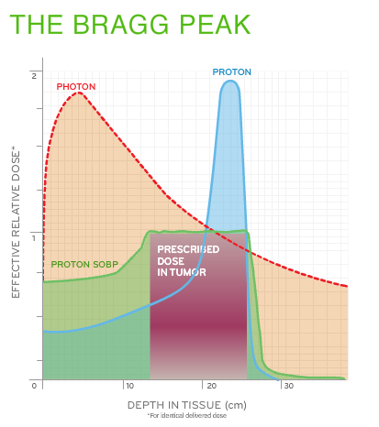
proton radiotherapy
ADVANTAGES
Protons release a high dose in a well defined region at the end of their range (Bragg peak) → sparing of healthy tissue
Range can be modulated by varying the proton energy
The released dose can be shaped to the target tumor through the weighted superposition of proton beams at different energies (Spread Out Bragg Peak - SOBP)
PRESENT LIMITATIONS
Uncenrtanties in the measurement of the Stopping Power distribution inside the tissue

Slide 3
motivations for a proton imaging system
Treatment planning:
Presently defined using X-CT
but protons and photons interact differently with
matter
pCT Direct measurement of the stopping power maps with the same particle used to irradiate
Patient positioning:
Presently this is done using conventional X ray tomographies (X-CT) taken before the proton treatment session and in a potentially different setup:
pCT Precision improvement if positioning and treatment could be done in one go

Slide 4
Tracks with multiple scattering
Measurements: entry and
exit position and angle, exit position
Proton true trajectory
Measurements:
entry position and angle
L’ → straight line with
confidence limits
L’
L → straight line with
confidence limits
L’’
L
L’’ curved trajectory with
Narrower confidence limits
Measurements: entry and
Exit position and angle +
Most Likely Path (MLP)
calculation

Slide 5
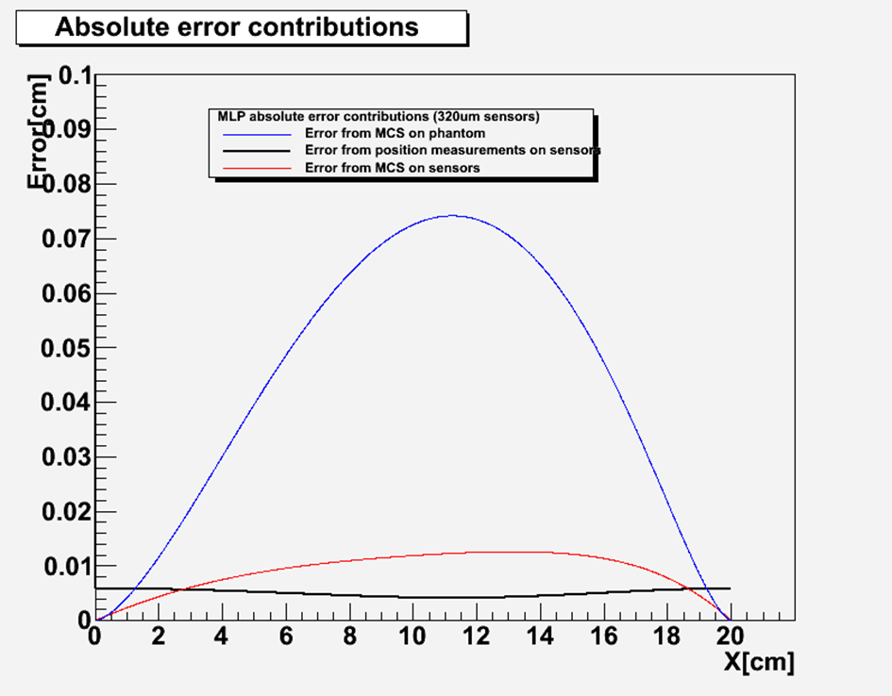
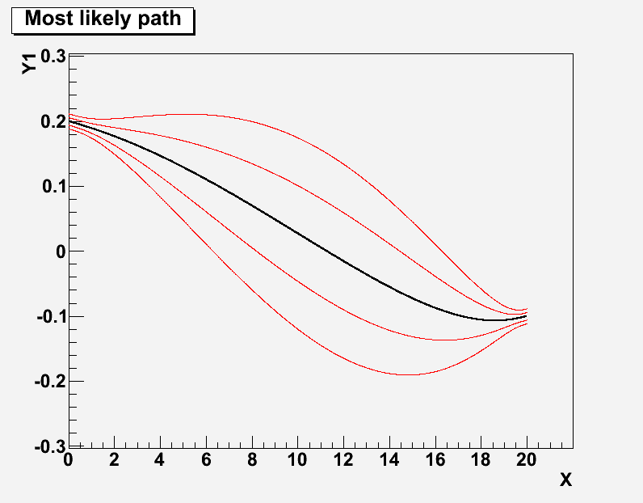
Most likely path error envelope
MLP example with 200MeV
kinetic energy protons in
20cm of water:
Entry: Y(0) = 0.2cm
Y’(0) = -10mrad
Exit: Y(20) = -0.1cm
Y’(20) = +10mrad
Silicon microstrip detectors:
320μm thick
200μm strip pitch
[cm]
200MeV in
90MeV out
[cm]

Slide 6
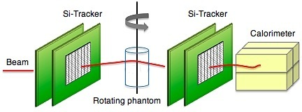
pCT apparatus
PARAMETER | VALUE
Proton beam kinetic energy | 250 -270 MeV
Proton beam rate | 1 MHz
Spatial resolution | < 1 mm
Electronic density resolution | <1%
Detector radiation hardness | >1000 Gy
Dose per scan | < 5 cGy
y
x
z
P₁
P₂
P₃
P₄
Single particle proton tracking: silicon strip detectors → MLP
Residual energy measurement: crystal calorimeter → energy loss
The single event information can be processed by reconstruction algorithms to produce the tomographic image

Slide 7
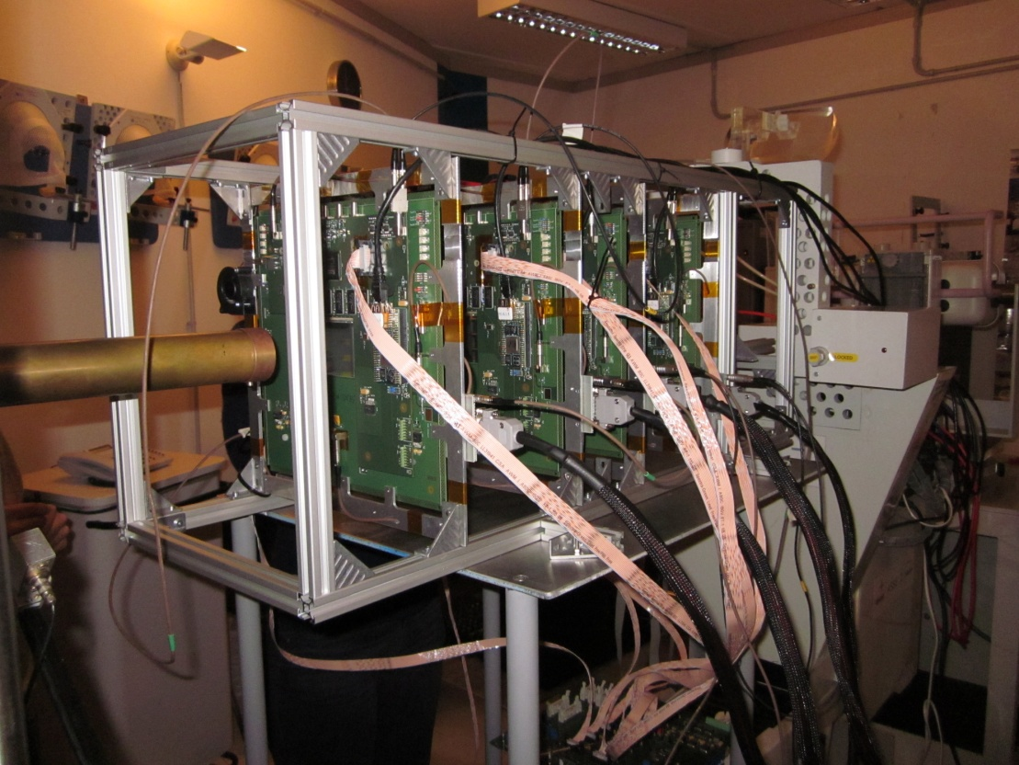
INFN-PRIMA collaboration: pCT apparatus
First test at INFN-LNS: May 2011
CATANA beam line:
62 MeV protons
Four x-y silicon microstrip based
tracking planes
Yag:Ce calorimeter
Proton entry and exit positions and directions
Proton residual energy

Slide 8
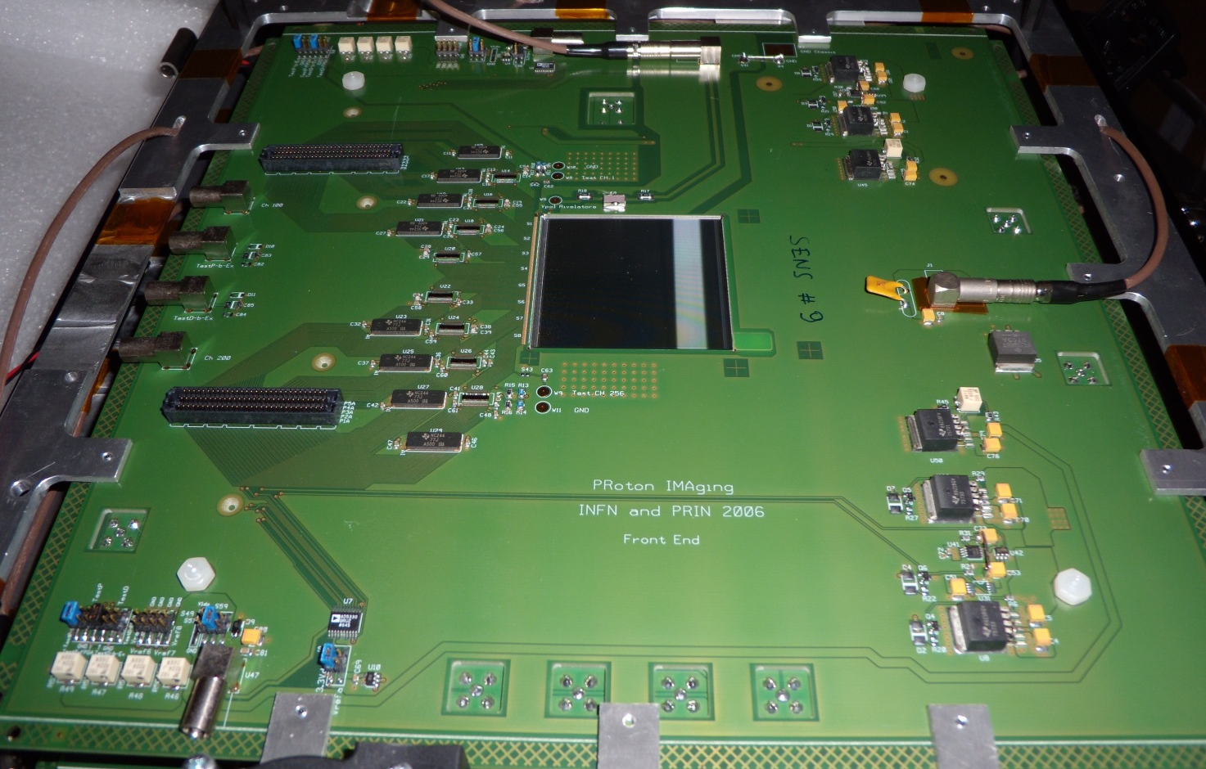
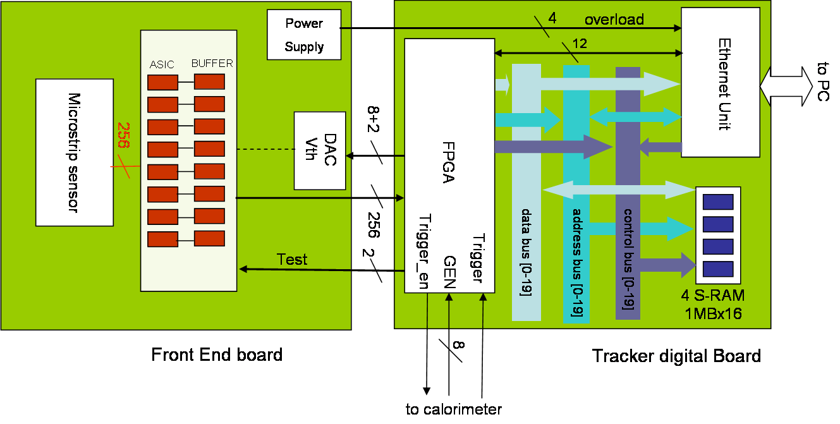
Tracker module
Digital board
Parallel strip read-out
Local data storing during measurement
Ethernet data download at measurement completion
Front-end board

Slide 9
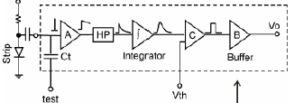
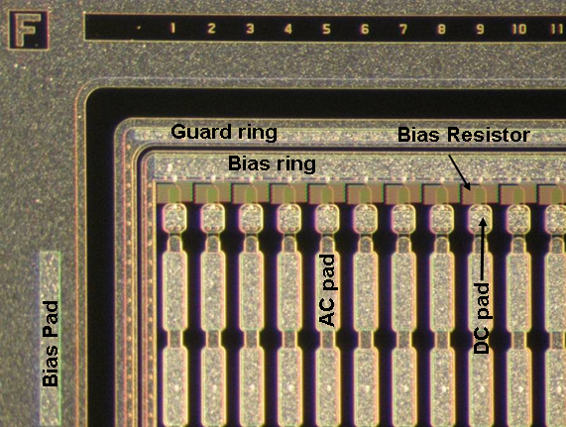
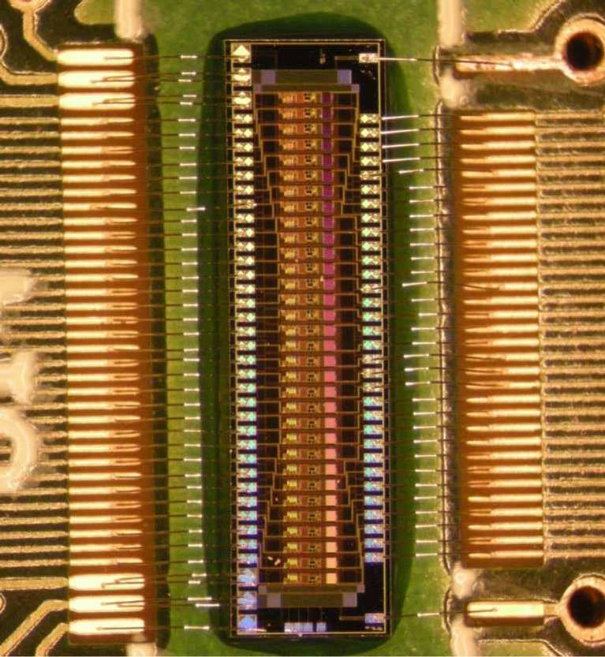
Si Sensor and Front-end ASIC
Binary read-out:
6.6 x 1.6 mm²
32 inputs - 32 outputs
670 mW power consumption
Vcc=+3.3 V
p on n
single sided
<100>
200μm thick
200μm strip pitch

Slide 10
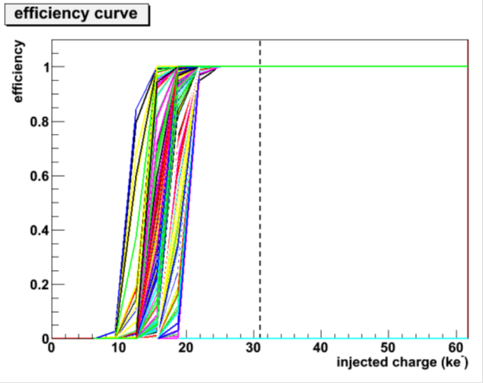
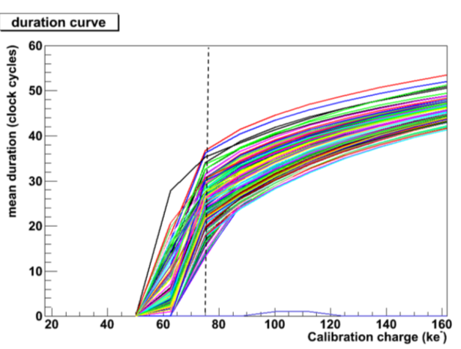
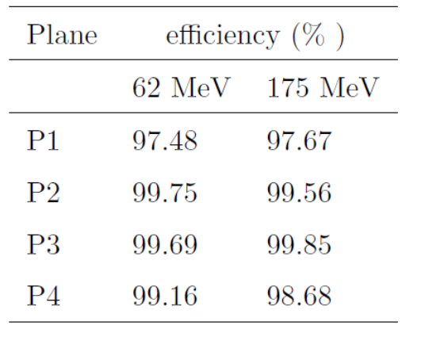
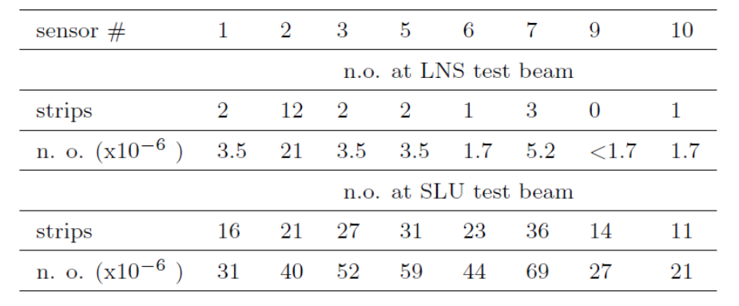
Tracker performance
62 MeV proton
minimum released charge
in 200μm of silicon
Signal duration
180 MeV proton
minimum released charge
in 200μm of silicon
Efficiency
Calibration
Noise occupancies
Data LNS+TSL

Slide 11
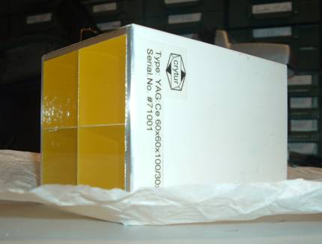
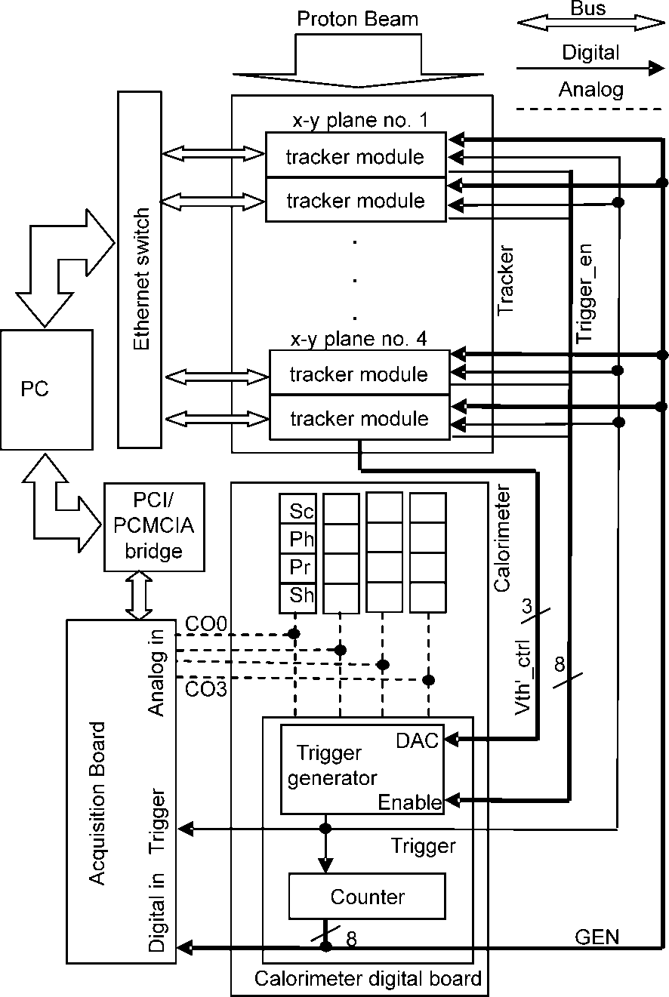
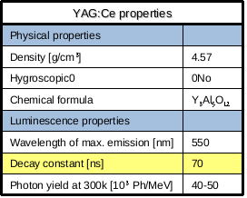
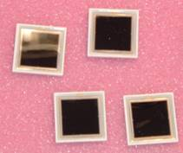
Calorimeter and DAQ
4 YAG:Ce
scintillating
crystals
30 x 30 mm² x 100mm
each
4 Photodiodes
18x 18 mm²

Slide 12
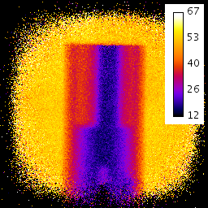
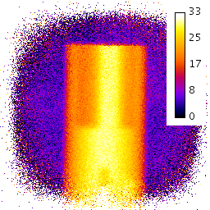
INFN-Prima: pCT image
20 mm
PMMA phantom
36 projection steps: 0° → 360°
An average of 950000 events per projection
E₀=62MeV INFN-LNS
Filtered Back Projection algorithm
Tomographic equation
(Wang, Med.Phys. 37(8), 2010: 4138)
20 mm
6 mm
4 mm
Unknown stopping power distribution (at E₀)
«projection»
E_{res}
Wang projection
Evaluation of the “projection” term (through numerical integration starting from NIST tables and using the measured E_{res})

Slide 13
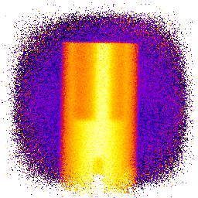

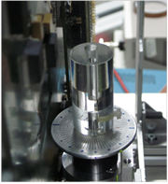
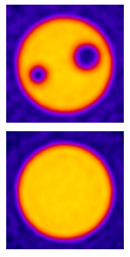
INFN-Prima: pCT image
Butterworth filter: order 4, cut-off 20/128 of the Nyquist freq. (Nyf=2.5mm⁻¹ )
No selection cuts has been applied to the data sample
noise: 2.4%
noise: 6.3%
E. Vanzi et al. The PRIMA collaboration: preliminary results in FBP reconstruction of pCT data –Nucl. Instr. Meth. A, 730 (2013), p. 184

Slide 14

INFN pCT upgrade
A system similar to the one already tested
  Microstrip tracker
  YAG:Ce calorimeter
But with a 50 x 200 mm² field of view
On-line data aquisition
1 MHz capability
Rectangular aspect ratio to perform tomographies in slices
Phantom
Beam pipe
Tracker planes
Silicon sensors
Calorimeter

Slide 15
Silicon microstrip detectors
36 p on n single-sided silicon microstrip detectors (HPK):
  51.2 x 51.2 mm² active area
  <100> crystal type
  320 μm thickness
  200 μm pitch
  256 channels
  I(Vfd)~2-3nA/cm²
Full Depletion Voltage (V)
No bad strips for all 36 detectors (9216 strips)

Slide 16
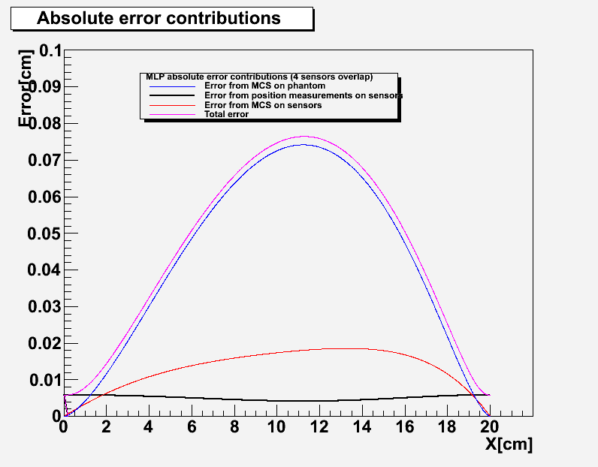
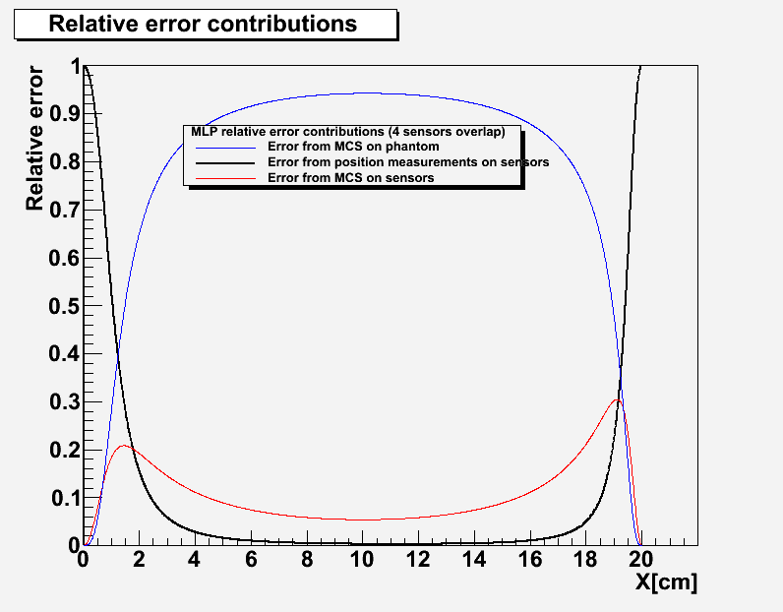
Microstrip sensors layout
X-view
207320μm
Mounted on the two sides of a PCB which houses the front-end and readout electronics.
Sensors are overlapped to assure hermeticity
55750μm
Y-view
207320μm
Errors in the overlap regions
~ 2.75% of the total tracker active area
55750μm

Slide 17
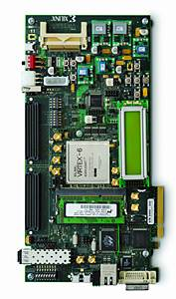
Tracker DAQ architecture
CALORIMETER DAQ
SSD 1
SSD 1
Trigger
gen
Trigger
enable
SSD 1
256
Front end 1
256
SS 1
SSD 1
256
Front end 1
256
SS 1
7
256
Front end 1
256
SS 1
256
Front end 1
256
SS 1
.
.
.
SM
.
.
.
SM
4 readout links
200(x8) Mbs
each
.
.
.
SM
SSD 6
.
.
.
SM
SSD 6
SSD 6
256
Front end 6
256
SS 6
SSD 6
256
Front end 6
256
SS 6
256
Front end 6
256
SS 6
256
Front end 6
256
SS 6
Trigger
serial link data/clk
200 Mbs
serial link data/clk
200 Mbs
6 readout links
200(x8) Mbs each
gen
tracker plane
serial link data/clk
200 Mbs
7
tracker plane
Trigger_en
tracker plane
tracker plane
The front end of each detector will read-out by a Xilinx Spartan 6 FPGA (SS)
When a trigger occurs the corresponding SS containing at least one hit will send the data to a central FPGA (SM)
The SM will then send tha data to the central acquisition board
Central acquisition
VIRTEX 6
Ethernet link

Slide 18
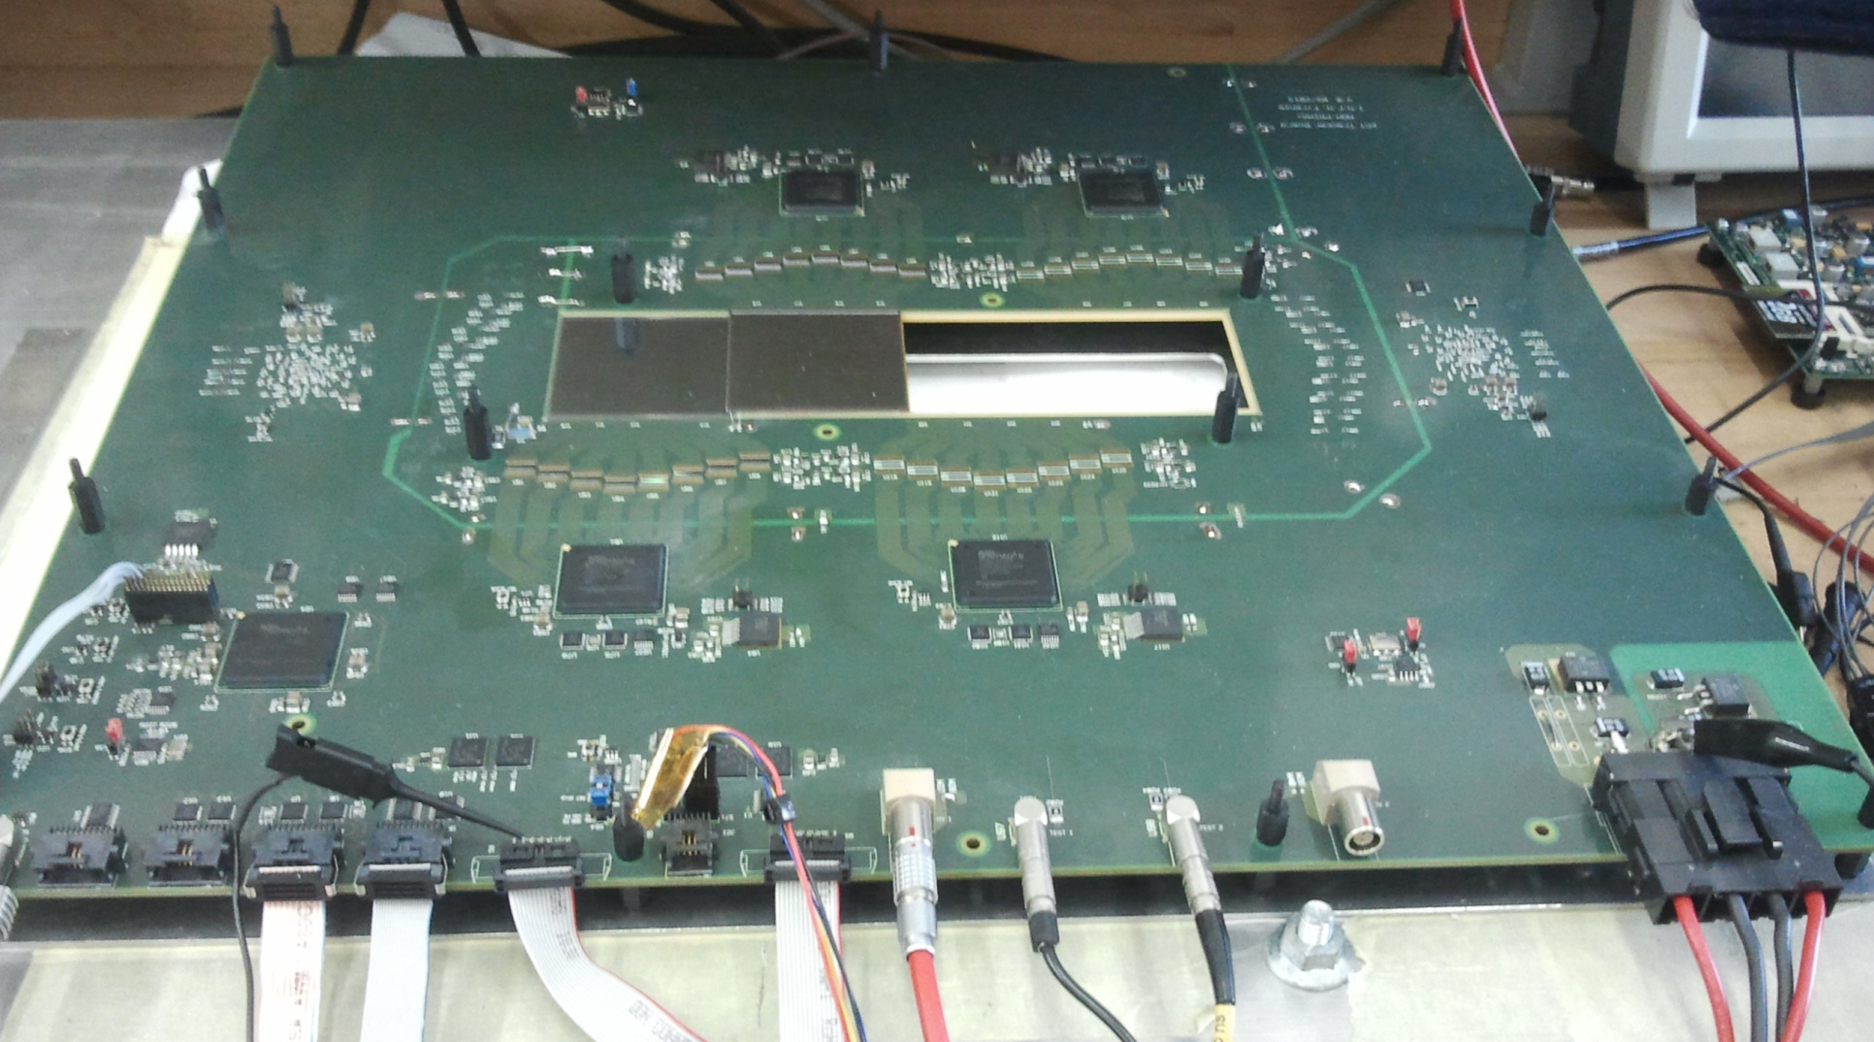
Tracker front-end board

Slide 19
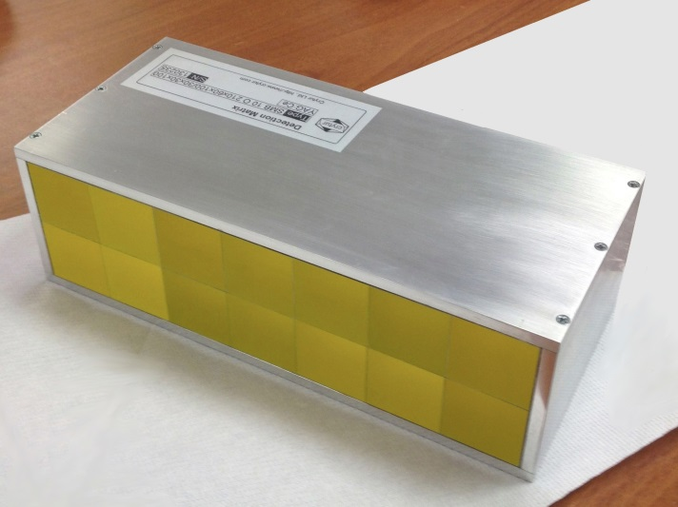
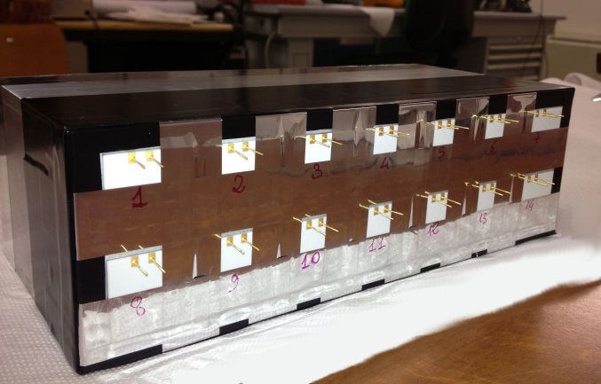
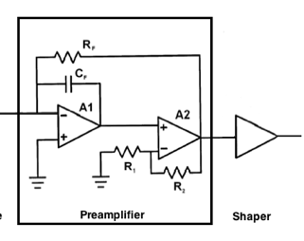
New calorimeter
Data Acquisition System
2x7 YAG:Ce Crystals Array
Size: 3x3x10cm³
FlexRIO
NI PXIe-7962R
CHASSIS NI PXIe-1071
Ad.Mod.
NI-5751
14 Analog Channels
Parallel read-out
Sampling: 5MS/s
24 Samples x event
RT Controller
NI PXI-8102
7Dig I/O GEN
Dig. Trigger
Disable Trigger
Silicon Photodiodes 1.8x1.8cm²
Tracker
Fast Charge Amplifier + Shaper
x14

Slide 20
Conclusions
A pCT device will be useful to increase the effectiveness of hadron therapy (patient positioning and treatment plan precision)
The ‘Prima’ collaboration has built a prototype (5x5cm²) capable of acquiring tomographic images
Tomographic images have been reconstructed using FBP
  0.9mm (FWHM) spatial resolution
  2.4% (r.m.s.) noise
An upgraded detector with an extended field of view necessary to perform pre-clinical studies has been designed and it is now under construction

