Slide 1
Digital fast neutron radiography of rebar in concrete
Katie Mitton, Malcolm J Joyce and Ashley Jones
Department of Engineering, Lancaster University UK, m.joyce@lancaster.ac.uk

Slide 2
Overview
Background
Monte–Carlo simulations
Experimental facilities and set up
Results
Conclusions
Further reading

Slide 3
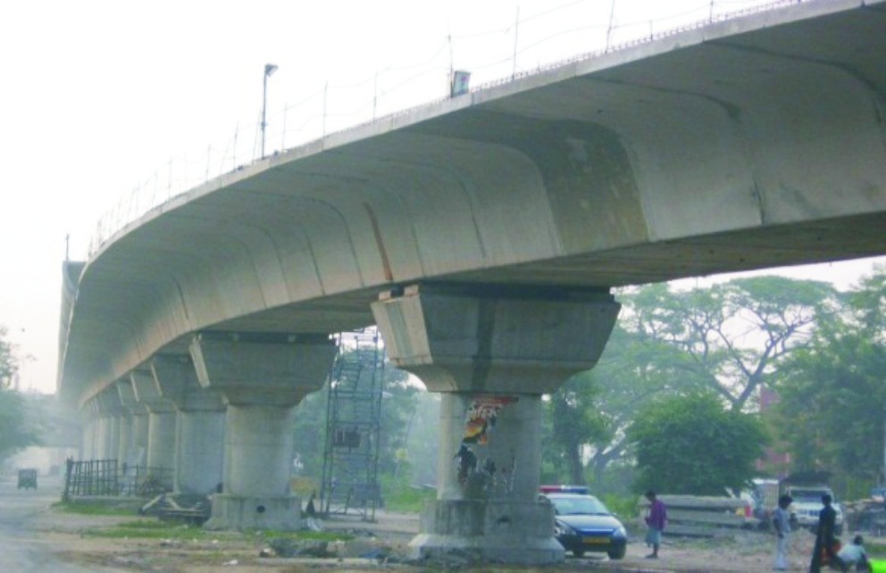
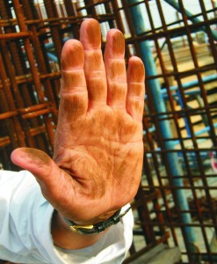
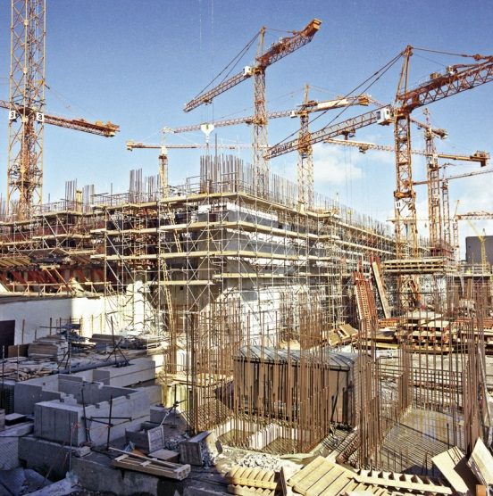
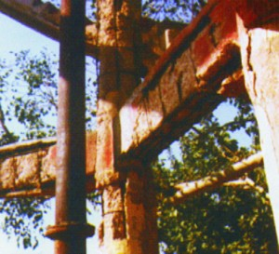
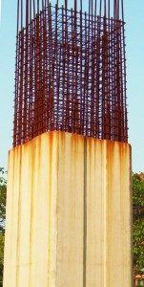
Background to the need for fast neutron assay of rebar in concrete
Macroscopic analysis with thermal neutrons can require:
  wholescale core drilling
  closure of structures under examination.
Not feasible where:
  Structure in regular use (bridges, roads etc.).
  Sacrificial samples are not available.
  Concrete is contaminated.

Slide 4
Background to the need for fast neutron assay of rebar in concrete
Earliest reports:
  1960’s moisture content via thermal neutron component.
Thermal neutron radiography:
  Transmission with emulsion screen for cement distribution and thickness of carbonated layers.
  Studies of water ingress, crack propagation, drying and porosity.
Most recent review Perfect et al. (2014).
Alternatives:
  Ground-penetrating radar (separation and radii of structures?)
  X- or γ-radiography (depth?)
Benefits of neutrons:
  Better at depicting voids, water and cracks than X-ray
  Penetration ability
But!
  Require ³He detectors
  Thermalisation
  Usually lab.-based

Slide 5
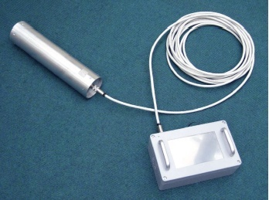
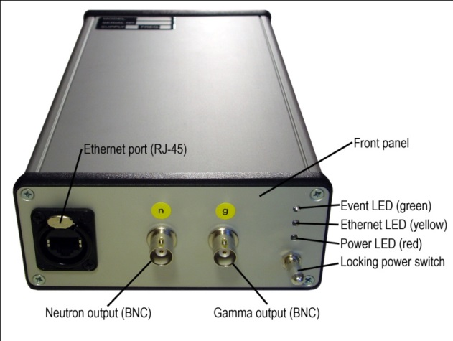
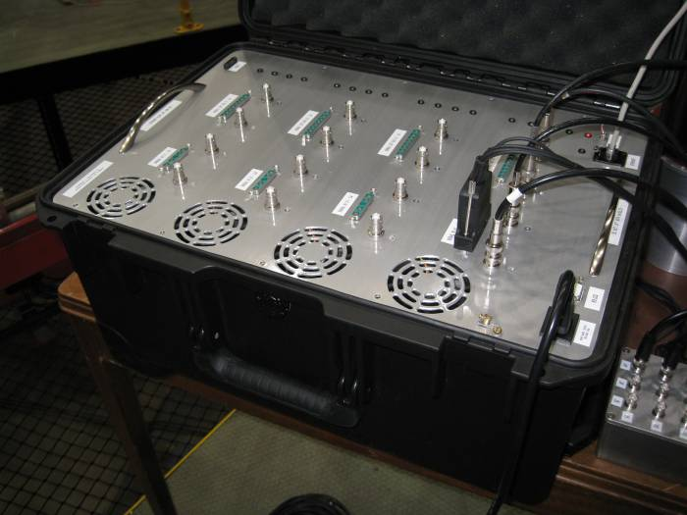
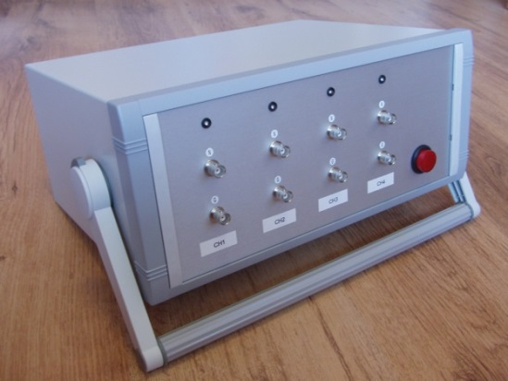
Experimental background & related instruments
Low-hazard scintillators for fast neutrons: EJ309
Real-time, digital pulse-shape discrimination
Real-time, fast neutron assay
Digital PSD instrument, M. J. Joyce et al., SPIE Defence & Security, Cardiff (2008).
M. J. Joyce et al., IEEE Trans. Nuc. Sci. 57 (5) 2625-2630 (2010).
M. J. Joyce et al., IEEE Trans. Nuc. Sci. 61 (3) 1340-1348 (2014).
M. J. Joyce et al., IEEE Trans. Nuc. Sci. 61 (4) 2222-2227 (2014).

Slide 6
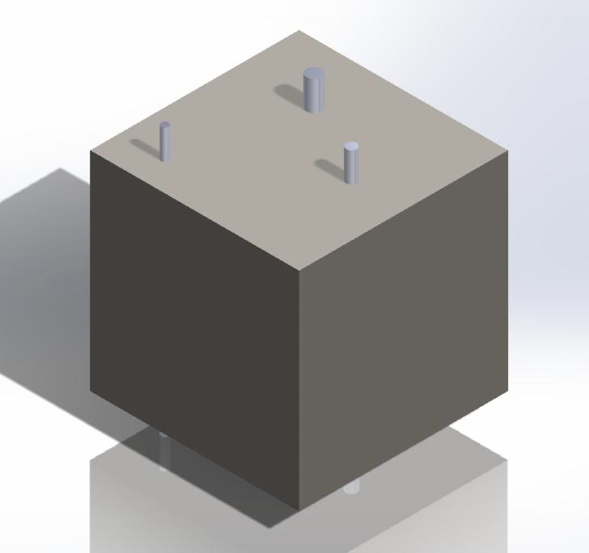
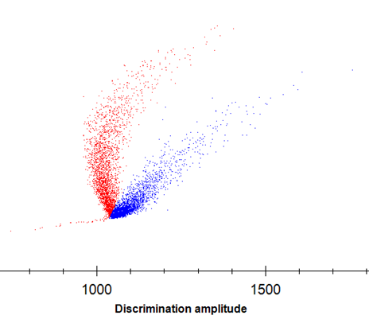
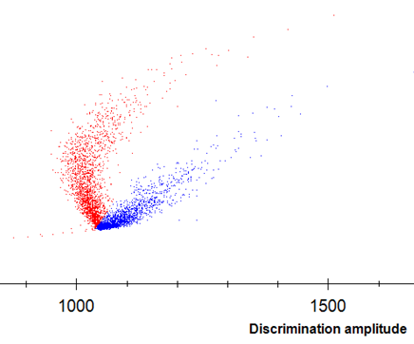
Concrete sample design
Two blocks of side 280 mm
One with rebar, one without
Mass 52.68 kg
Rebar Ø 10 mm, 14 mm and 20 mm

Slide 7
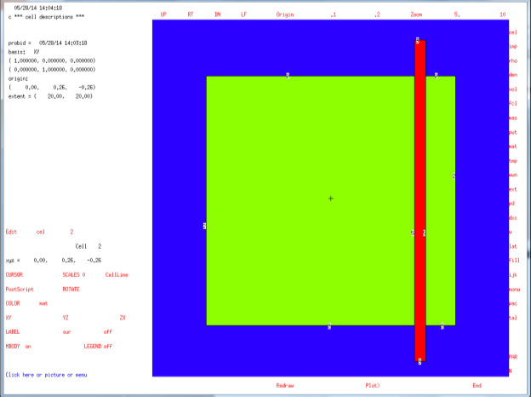
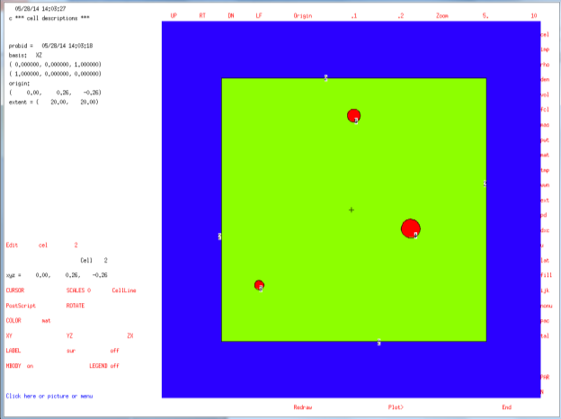

Monte-carlo simulations
²⁴¹Am-Be source
Measured neutron flux across each surface, with & without rebar
R= $\frac{Flux without rebar}{Flux with}=?$

Slide 8
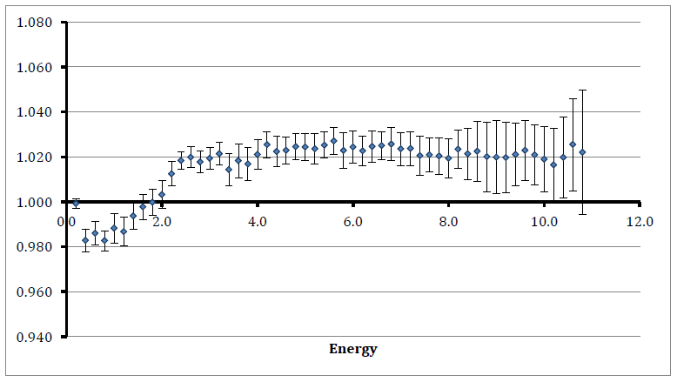
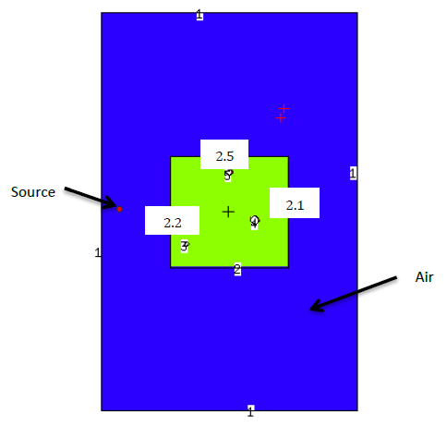
Monte–carlo results
B
Source geometry
A
Flux ratio versus energy for surface 2.1
R<1, E_{n}< 2 MeV,
R>1, E_{n}> 2 MeV
Effect negligible for other surfaces

Slide 9

Theoretical basis for fast neutron radiography
R= $\frac{Flux without rebar}{Flux with}$
A) For E_{n}< 2 MeV:
  Neutrons more easily scattered by hydrogen
  σ_{s}(Fe) ~ ½ σ_{s}(H)
  Neutron scattered to <0.5 MeV not seen by detector
  Hence: φ_{fast}(no rebar)<φ_{fast}(with rebar)
  Thus R < 1
B) For E_{n}> 2 MeV:
  Neutrons more easily scattered from iron
  σ_{s}(Fe) ~ 5σ_{s}(H)
  σ_{a}(Fe) ~ 75σ_{a}(H)
  So: φ_{fast}(no rebar)>φ_{fast}(with rebar)
  Thus: R > 1
Most probable energy ²⁵²Cf ~ 0.7 MeV
  Hence should see R < 1 in experimental data (region A)
  Note: we only detect neutrons φ_{fast} i.e. E_{n} > 0.5 MeV

Slide 10
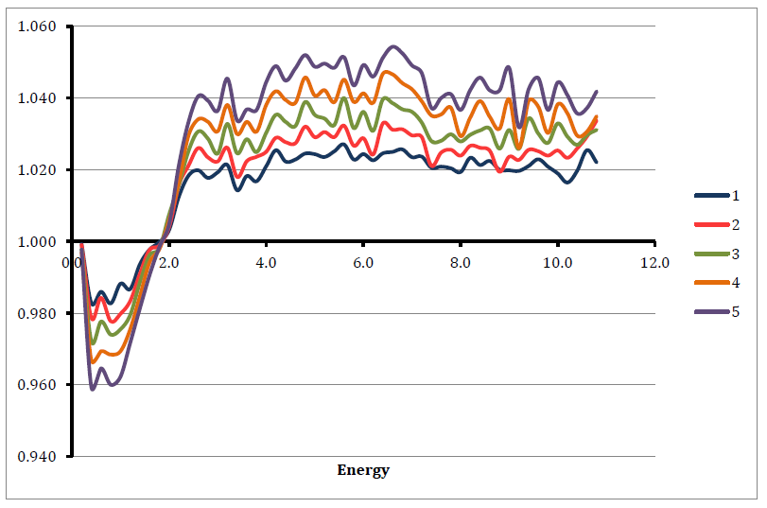
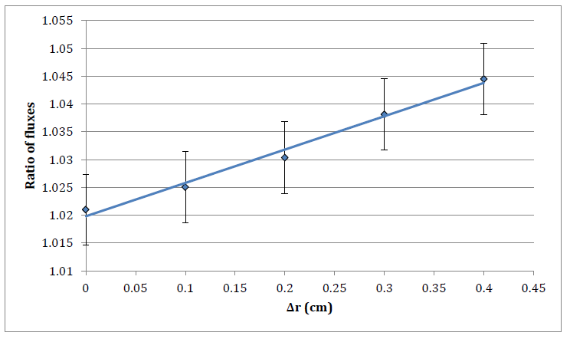
Monte-carlo results: rebar diameter
Flux ratio versus energy for surface 2.1 for increasing rebar radii (relationship with radius found to be linear).

Slide 11
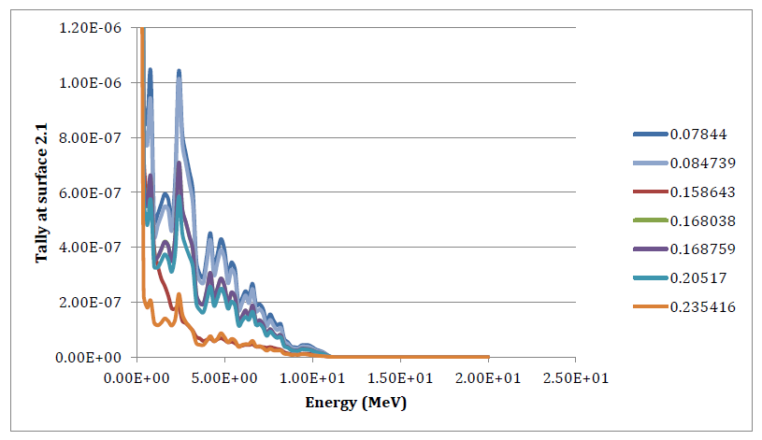
Monte-carlo results: concrete type
Flux ratio versus energy for surface 2.1 for increasing hydrogen content.

Slide 12
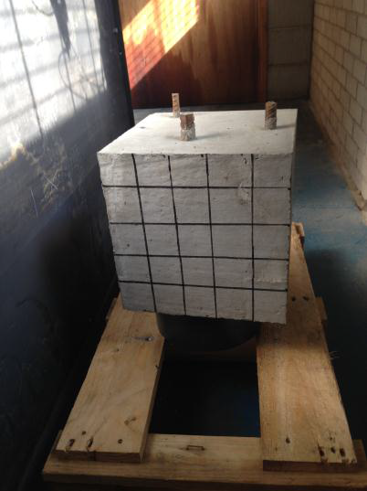
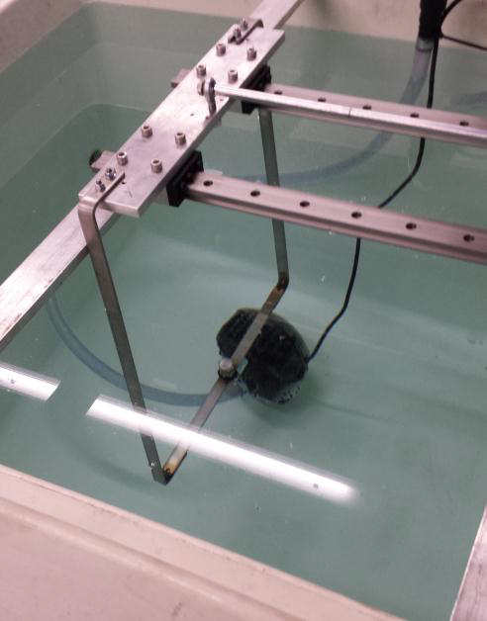
Experiments
Test sample with rebar
²⁵²Cf source and steel deployment gantry, 74 MBq, water jacket 1m³

Slide 13
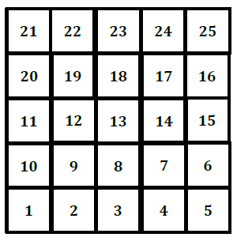
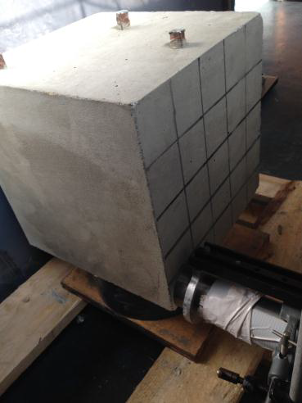
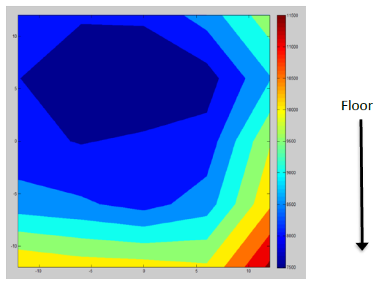
Results
Test sample with tungsten-collimated EJ301 detector in position #1.
Neutron counts without collimation for test sample containing rebar, 5-minute exposure

Slide 14
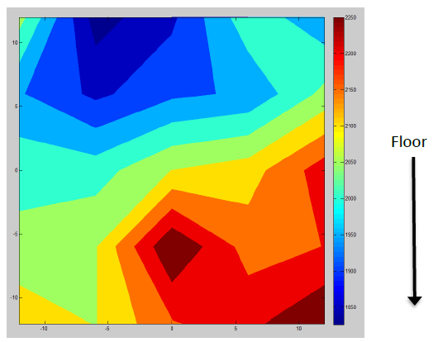
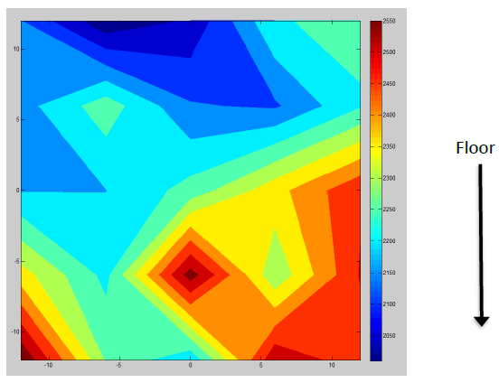
Results
Neutron counts with collimation for test sample, with rebar, 2-minute exposure
Neutron counts with collimation for test sample, no rebar, 2-minute exposure

Slide 15
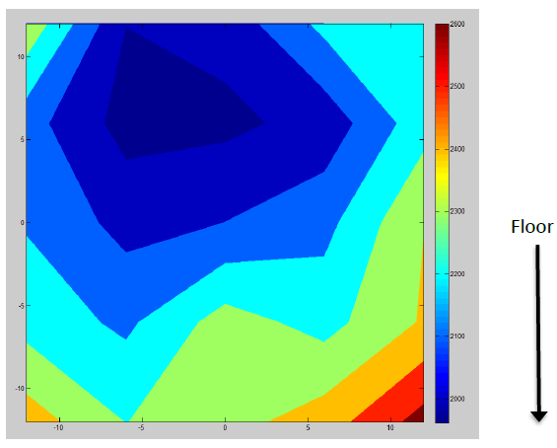
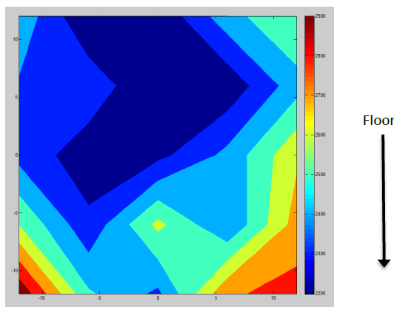
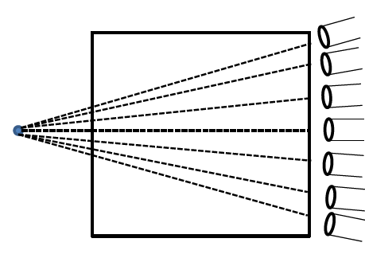
Results
Neutron counts with collimation for test sample, with rebar, 2-minute exposure, normalised for anisotropy
Neutron counts with collimation for test sample, no rebar, 2-minute exposure, normalised for anisotropy

Slide 16
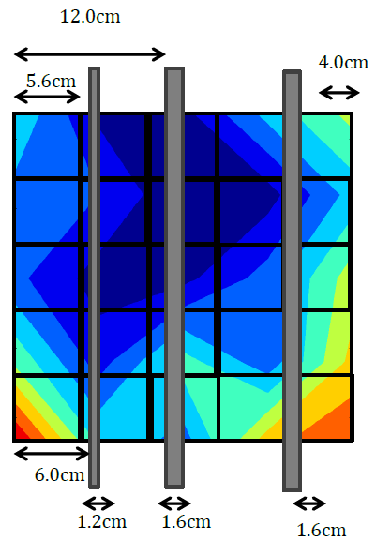
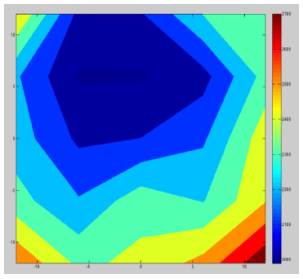
Results
Neutron counts with collimation for test sample, 2-minute exposure, normalised for anisotropy and 1/r², with rebar (left), no rebar (right).

Slide 17
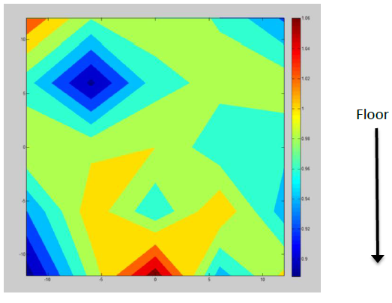
Conclusions
Some evidence of rebar presence @ 0.65% v/v
  Not definitive
  But R< 1 as predicted
Future work:
  Longer exposures
  Higher energies (AmBe?)
  Array of detectors
  Different collimator
  Develop forward model
  Account floor reflection

Slide 18
Thank you m.joyce@lancaster.ac.uk

Slide 19
Further reading
[1] J. Bhargava, Application of some nuclear and radiographic methods on concrete, (1971) Matériaux et Constructions, 4 (4), pp. 231-240.
[2] H. Berger, Neutron radiography, (1965) Elsevier Publishing Co., Amsterdam.
[3] H. Reijonen, S. E. Pihlajavaara, On the determination by neutron radiography of the thickness of the carbonated layer of concrete based upon changes in water content, (1972) Cement and Concrete Research, 2 (5), pp. 607-615.
[4] H. Justnes, K. Bryhn-Ingebrigtsen, G. O. Rosvold, Neutron radiography: An excellent method of measuring water penetration and moisture distribution in cementitious materials, (1994) Advances in Cement Research, 6 (22), pp. 67-72.
[5] R. Pugliesi, M. L. G. Andrade, Study of cracking in concrete by neutron radiography, (1997) Applied Radiation and Isotopes, 48 (3), pp. 339-344.
[6] F. C. De Beer, W. J. Strydom, E. J. Griesel, The drying process of concrete: A neutron radiography study,
(2004) Applied Radiation and Isotopes, 61 (4), pp. 617-623.
[7] Perfect, E., Cheng, C.-L., Kang, M., Bilheux, H.Z., Lamanna, J.M., Gragg, M.J., Wright, D.M., Neutron imaging of hydrogen-rich fluids in geomaterials and engineered porous media: A review, (2014) Earth-Science Reviews, 129, pp. 120-135.
[8] T. de Souza, Ground penetrating radar as an alternative to radiography, (2005) Insight: Non-Destructive Testing and Condition Monitoring, 47, pp. 414-415.
[9] X. Xu, T. Xia, A. Venkatachalam, D. Huston, Development of high-speed ultrawideband ground penetrating radar for rebar detection, (2013) Journal of Engineering Mechanics, 139, pp. 272-285.

