Slide 1
Paul Scherrer Institut
Bernd Schmitt
Jungfrau, Mönch and Eiger: Detector Development at the Swiss Light Source

Slide 2
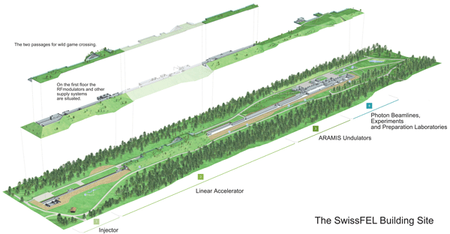
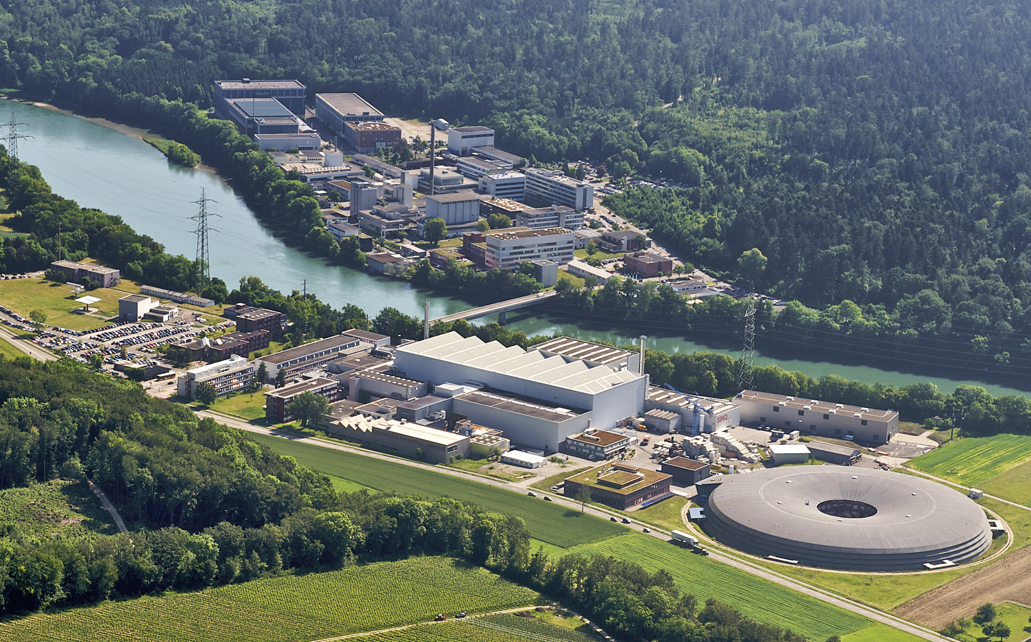
PAUL SCHERRER INSTITUT
PSI East
Aare
Our group is part of the SLS and our job is
to build detectors for specific applications at the SLS
and SwissFEL to allow users to do new or better science
PSI West
SLS
User facilities:
uSR, SINQ, SLS
~1500 Staff employees; 30Km from Zurich, task in ETH domain: run large scale user facilities

Slide 3
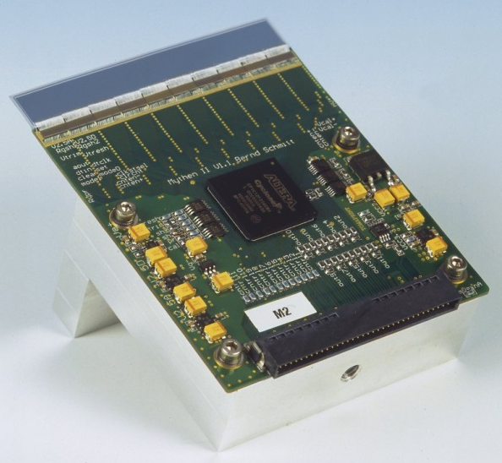
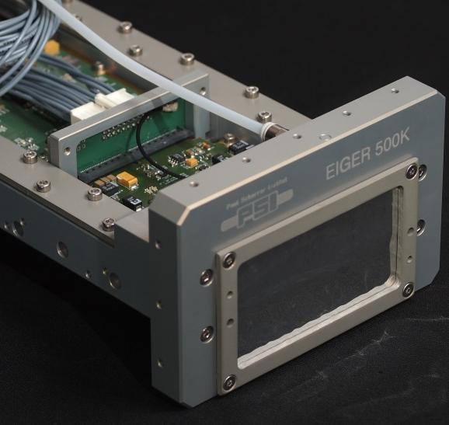
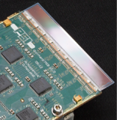
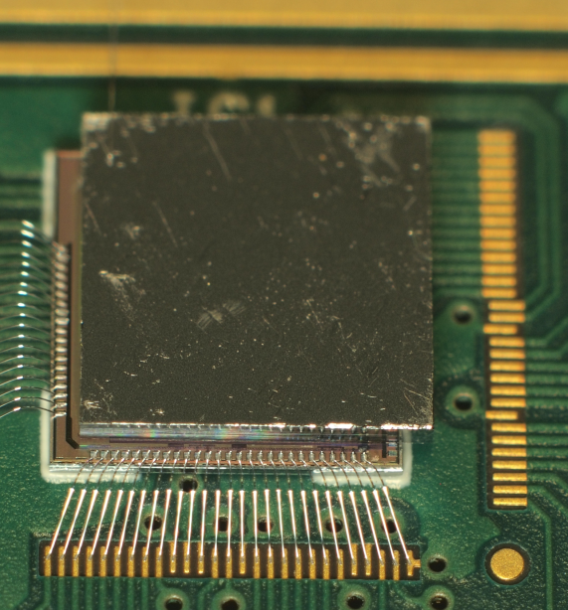
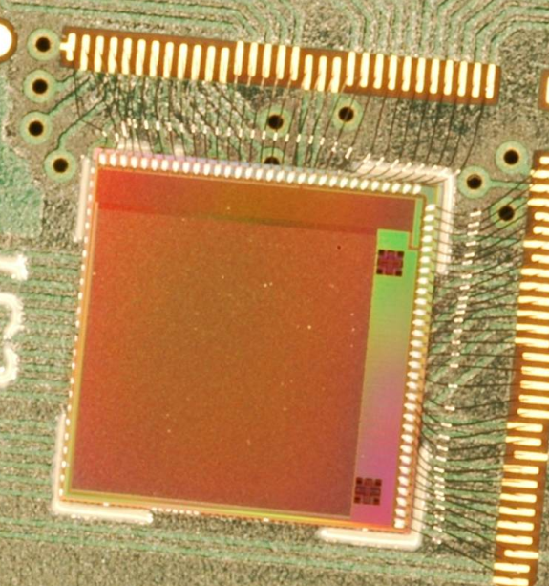


Hybrid Detectors @ SLS
Microstrips
Pixels
50 um
✗
75 um
25 um
Single
Photon
Counting
MYTHEN
EIGER
Charge
Integrating
GOTTHARD
JUNGFRAU
MÖNCH

Slide 4
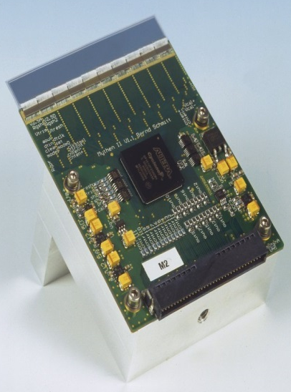
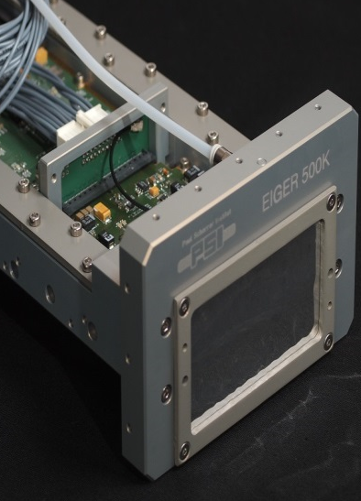




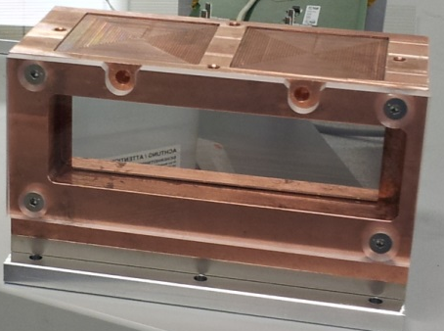
Hybrid Detectors @ SLS
Microstrips
Pixels
50 um
✗
✗
75 um
25 um
200 um
Single
Photon
Counting
See talk Alexander
Klyuev
MYTHEN
EIGER
Charge
Integrating
GOTTHARD
JUNGFRAU
MÖNCH
AGIPD

Slide 5
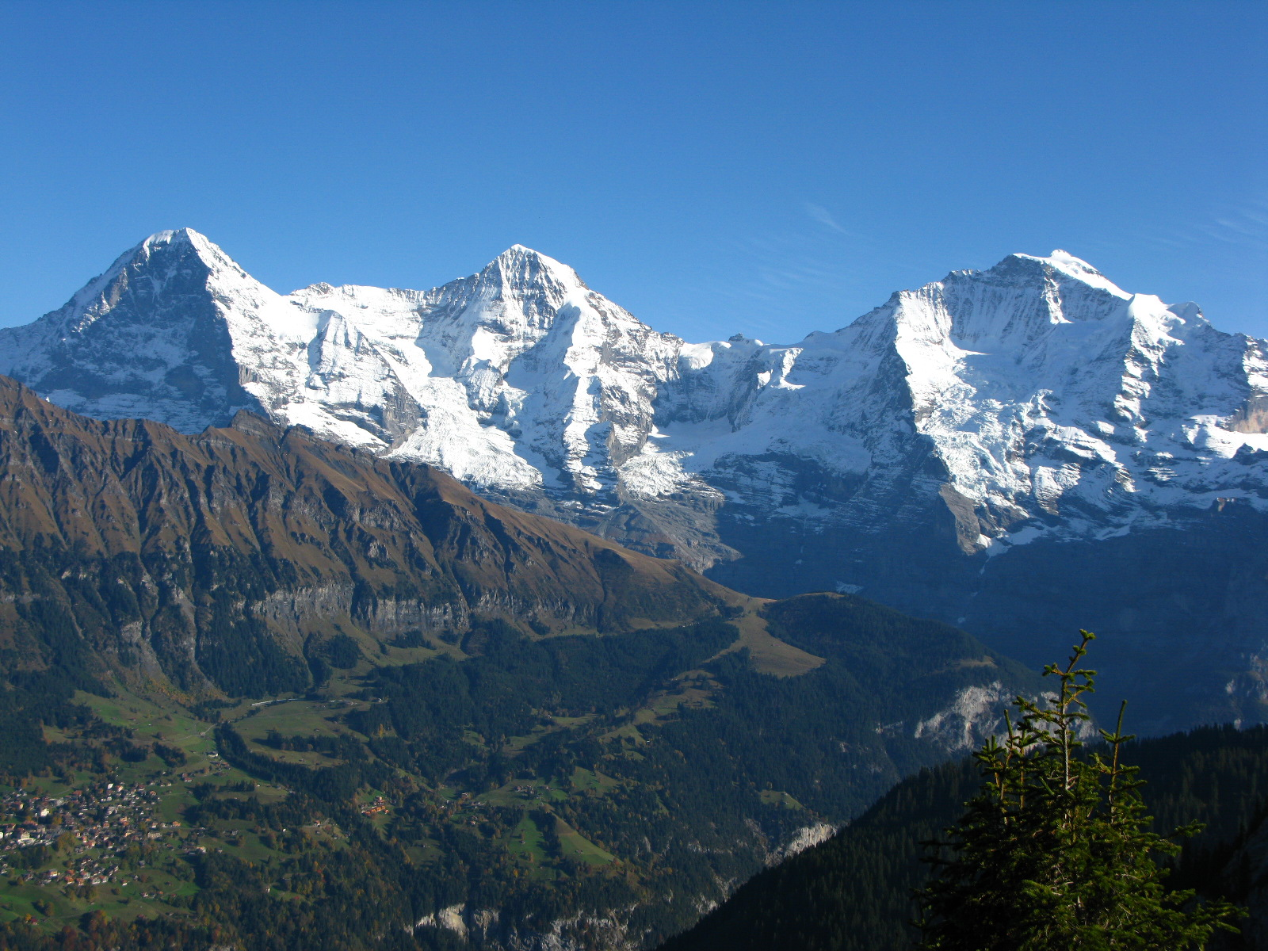
Swiss Mountains
Eiger Mönch Jungfrau
(3970 m) (4099 m) (4158 m)
Other famous mountains: Mythen, Pilatus and Gotthard…

Slide 6
Outline
Example Application: Protein Crystallography
Detector principles:
  single photon counting for synchrotrons
  charge integrating for XFELs and synchrotrons
The Eiger detector
The Jungfrau detector
The Mönch detector
Conclusions

Slide 7
Protein Crystallography

Slide 8
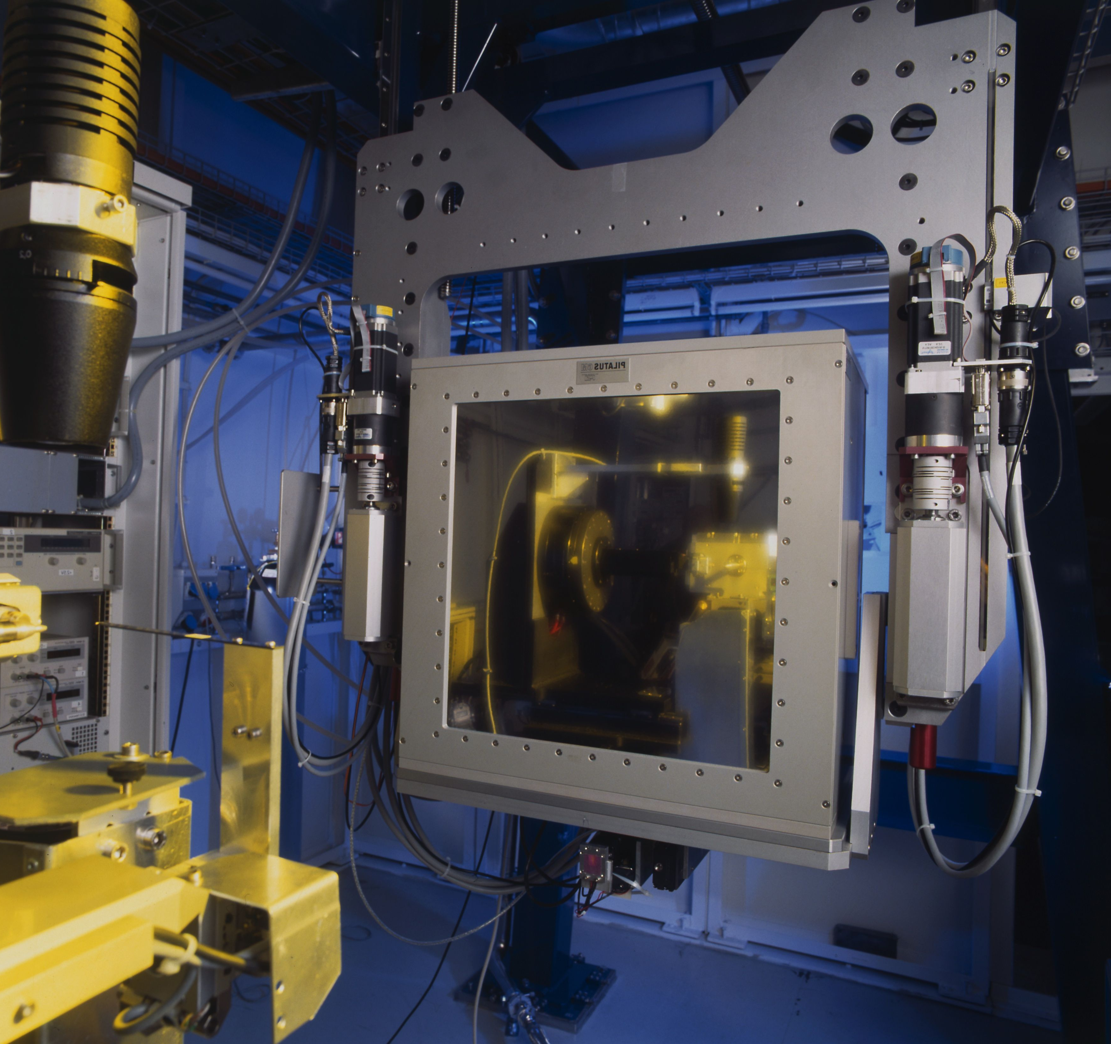
PilatusII6M at the Protein Crystallography Station
No of Modules
60, 12 x 5
Detector Size [mm]
431 x 448
Format
6’224’001 pixels
Pixel size
172 x 172 μm²
Dynamic range/pixel
20bits
Count rate/pixel
~ 1-3 MHz
Readout time
3.5 ms
Frame rate
12.5 Hz
made continuous shutter-less
operation possible at PX
Sold and further developed
By Dectris

Slide 9
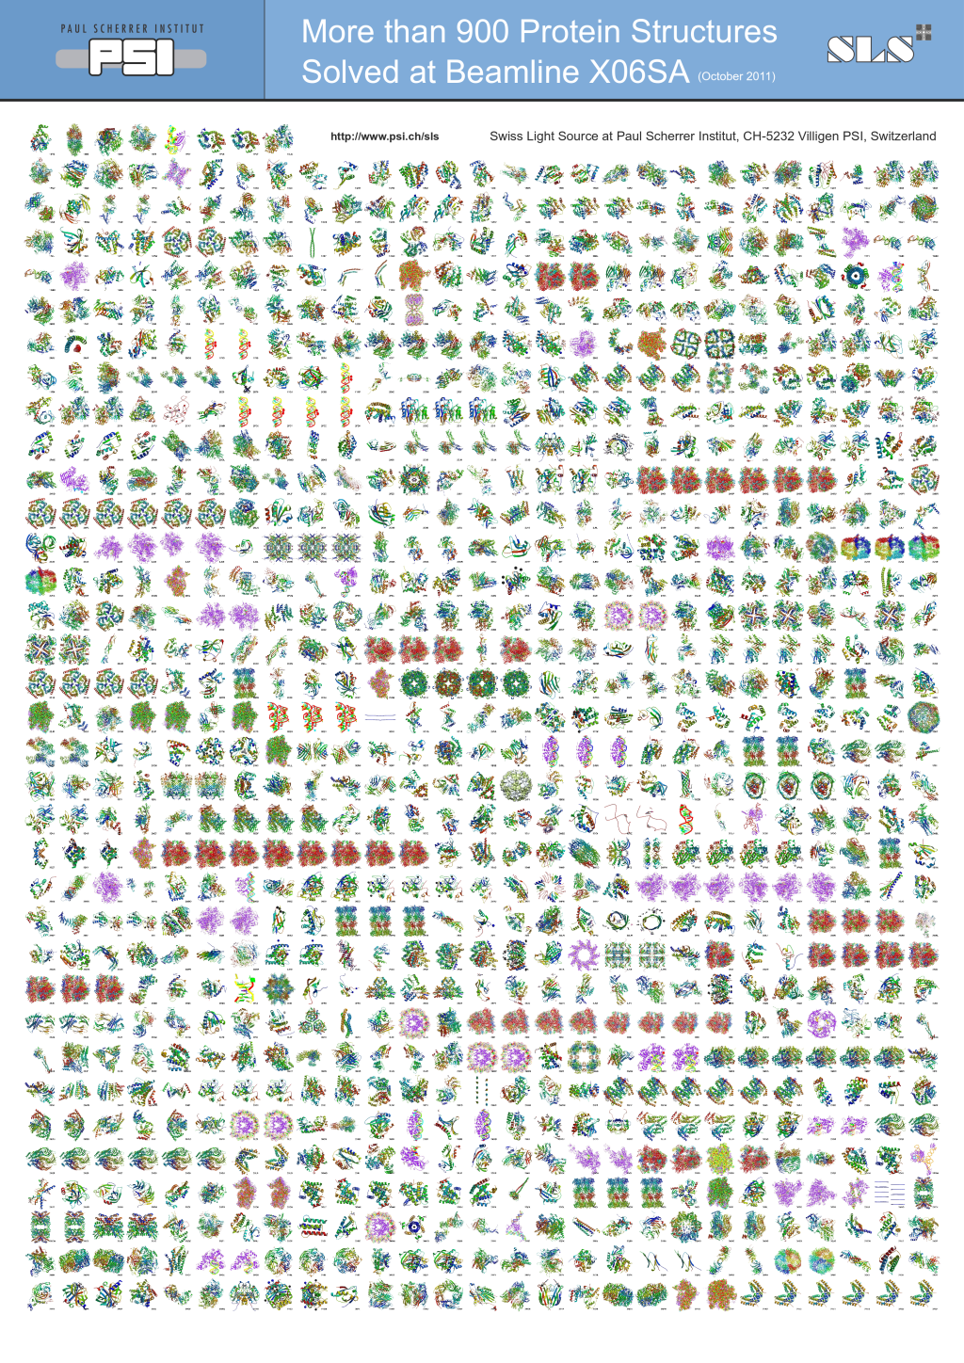
more than 900 protein structures solved at PXI beamline at SLS
~2/3 using PilatusII 6M
compiled by Sandro Waltersperger Oct 2011

Slide 10
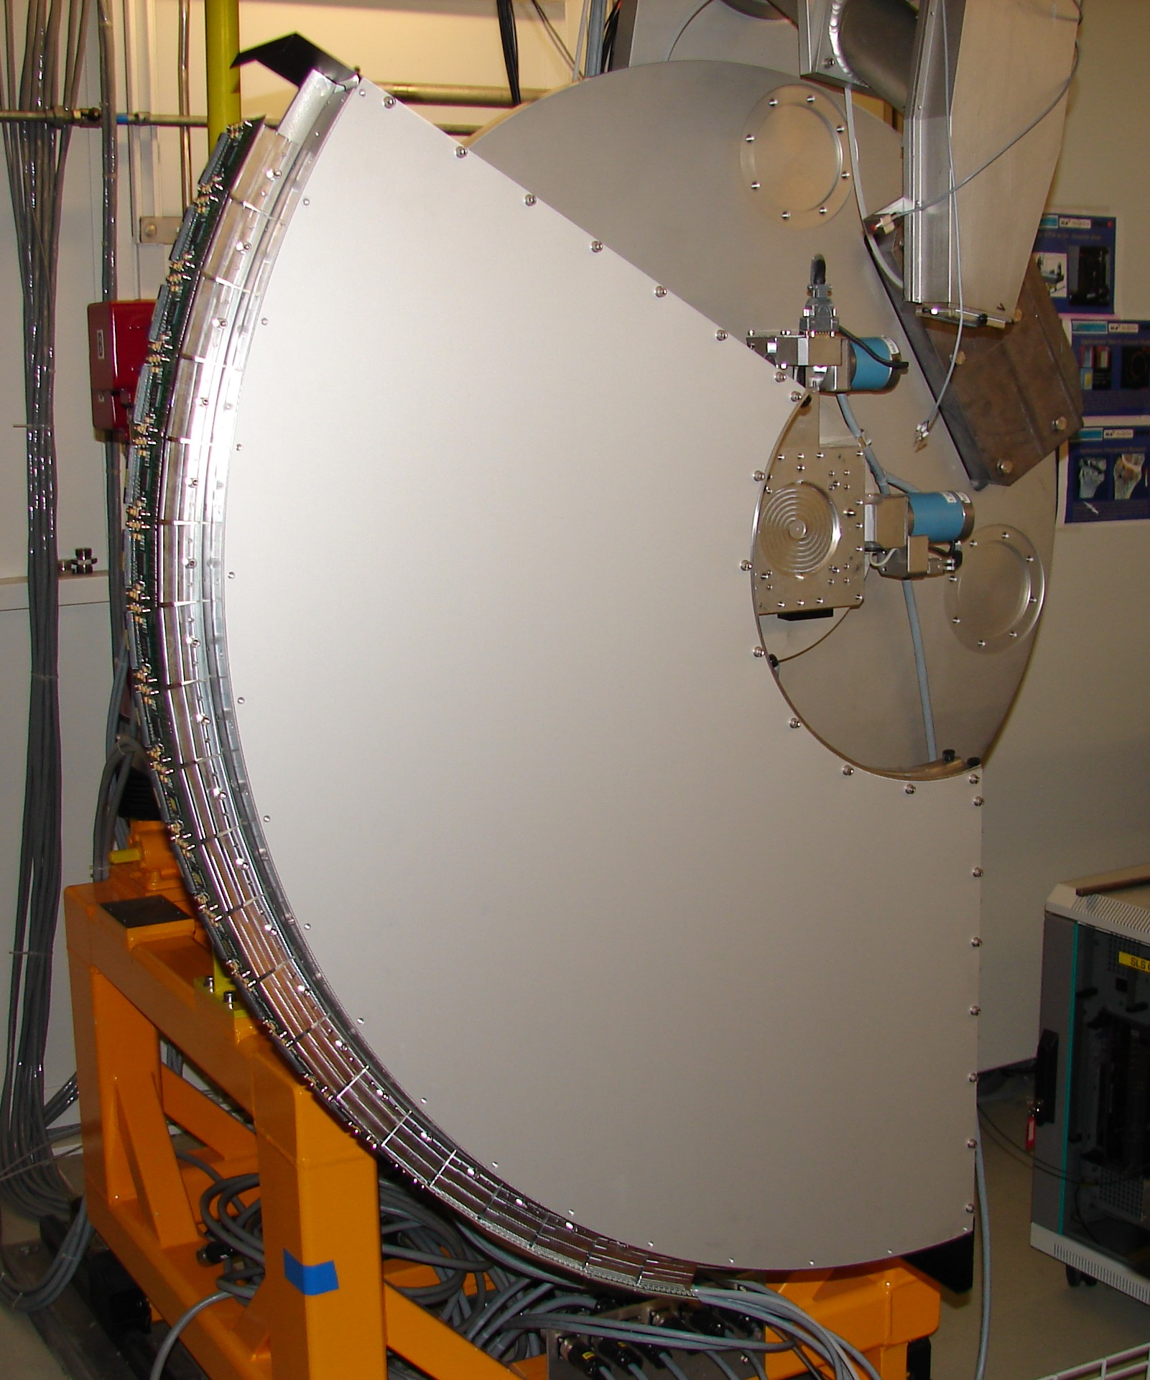
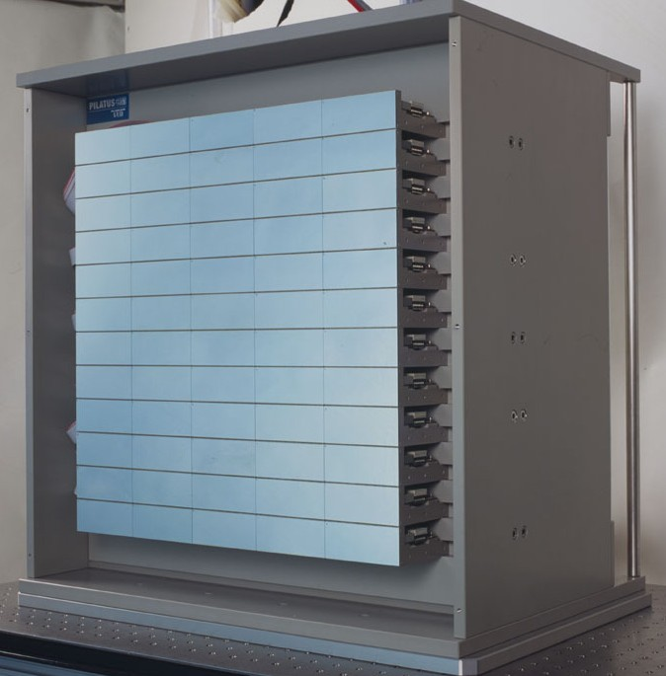
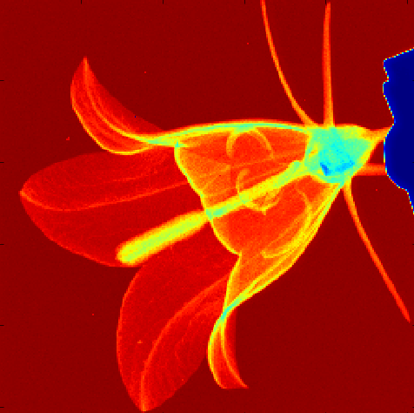
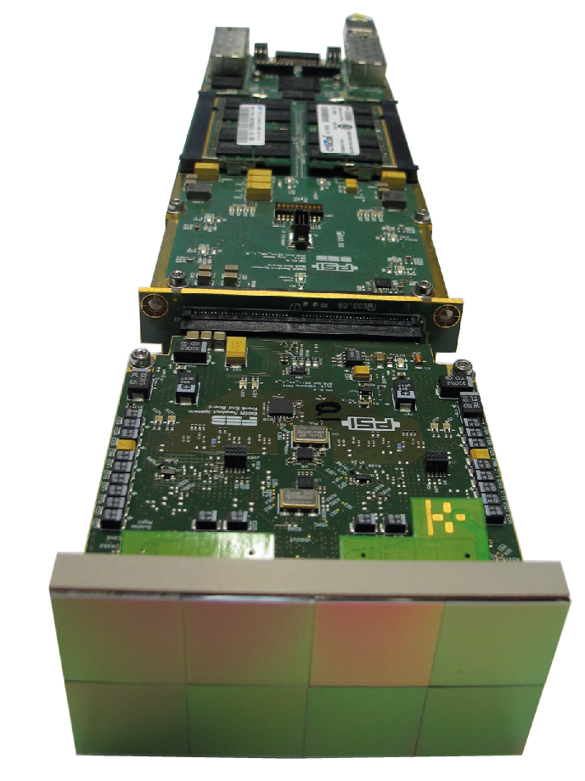
From single photon counting detectors at PSI…
MYTHEN
1k to 30k 50μm strips for
powder diffraction, small angle
scattering, medical imaging…
PILATUS
100k to 6M 172μm pixels
for protein crystallography, small
angle scattering, imaging …
EIGER
500k to 9M 75μm pixels, for small
angle scattering, CDI,
protein crystallography, imaging ....
+1
+1
+1
+1
Threshold
Threshold
Threshold
Amplifier and shaper
Amplifier and shaper
Amplifier and shaper
Digital
output
Digital
output
Digital
output
Sensor
Sensor
Sensor
Comparator
Comparator
Comparator
Counter
Counter
Counter

Slide 11

… to charge integrating detectors
10 ms
10 ms
Dynamic range: 10000
voltage swing usually ~1V
noise usually ~mV
1 photon ~10mV
100 photons dynamic range
Solution:
dynamic gain switching
XFEL
process
10¹¹ X-ray photons
<100 fs
main challenge for detector development:
dynamic range 10⁴ 12keV photons per pixel
  still with single photon resolution
Amplifier and reset
Gain switching
Sample and hold
Analog output
External ADC
Sensor
Notes:
¹¹

Slide 12
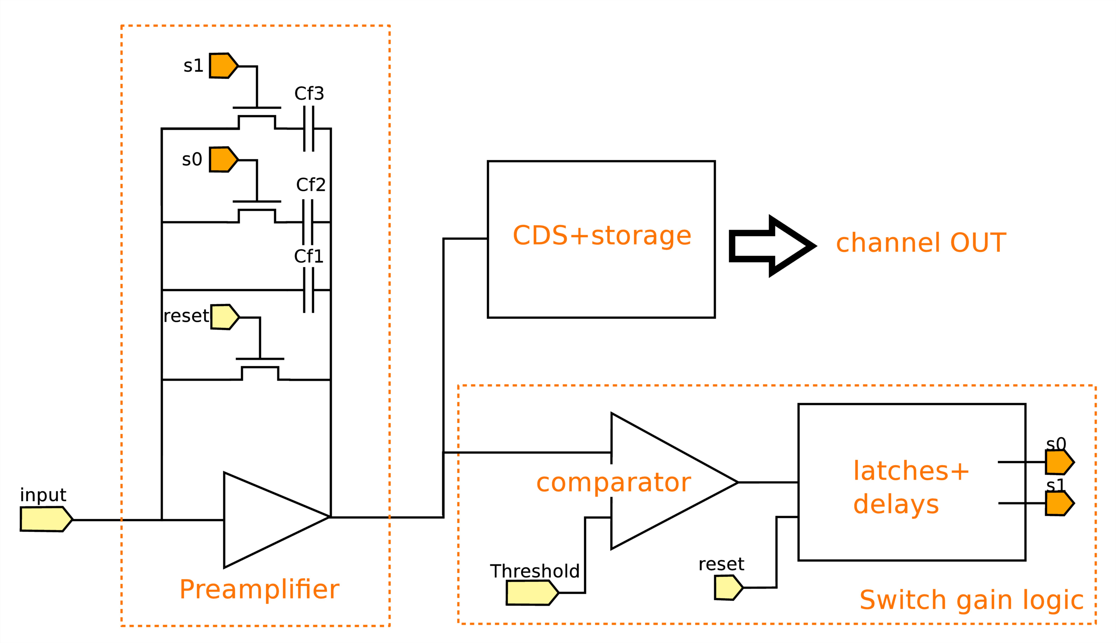
Preamplifier with gain switching
CSA in charge integrating configuration
3 feedback capacitors
Common for 1D and 2D, baseline for AGIPD, Gotthard, Jungfrau and Mönch
Logic after comparator to:
  Switch a 2nd time if 1st switch not enough
  Avoid a 2nd switch on spikes due to the 1st one
Switching has to be FAST (<10ns)
Simulation data

Slide 13
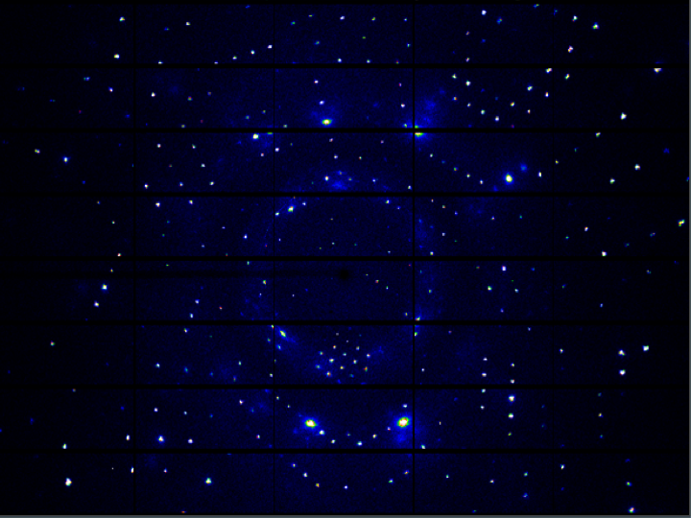
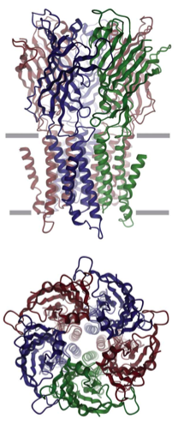
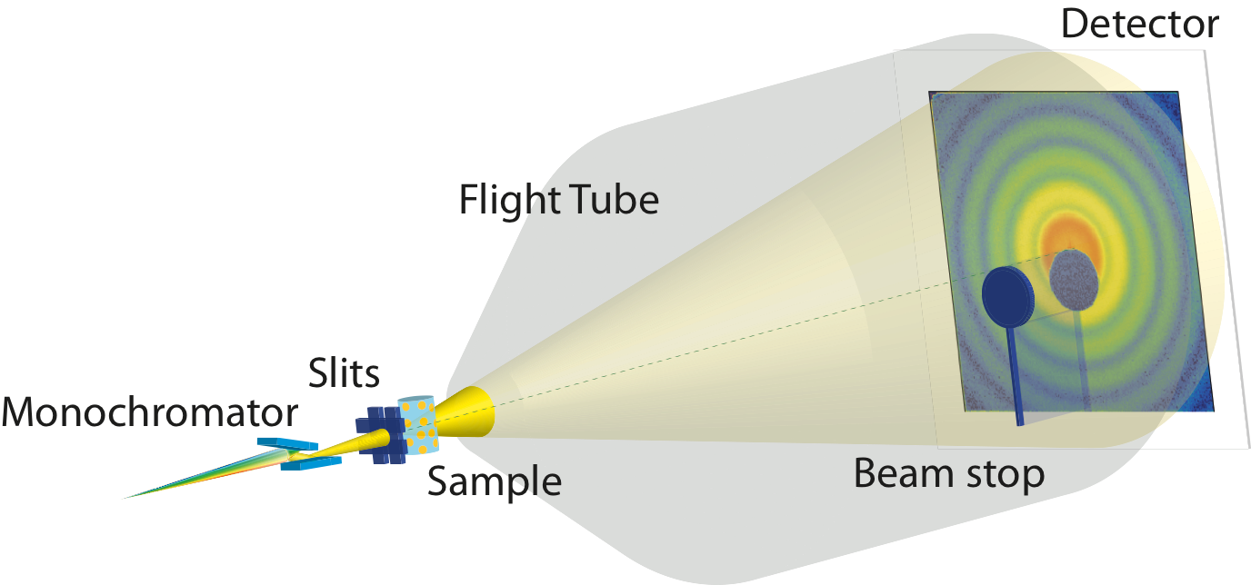
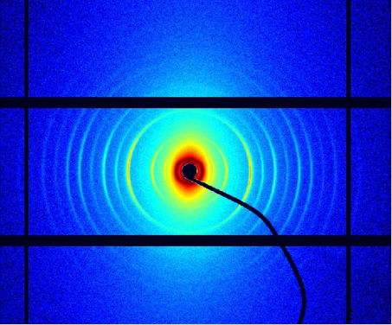
The Eiger Detector
Single photon counting hybrid pixel detector for synchrotron applications aimed towards diffraction experiments
  Applications at cSAXS:
    Scanning Coherent Small Angle X-ray Scattering
    Coherent Diffractive Imaging
  Protein Crystallography
Protein Crystallography
EIGER
Coherent Small Angle
X-ray Scattering
PILATUS 6M
PILATUS 2M
PILATUS 2M
EIGER: R. Dinapoli et al., Nucl. Instrum. Meth. A., 650, 11, 79-83, 2011

Slide 14
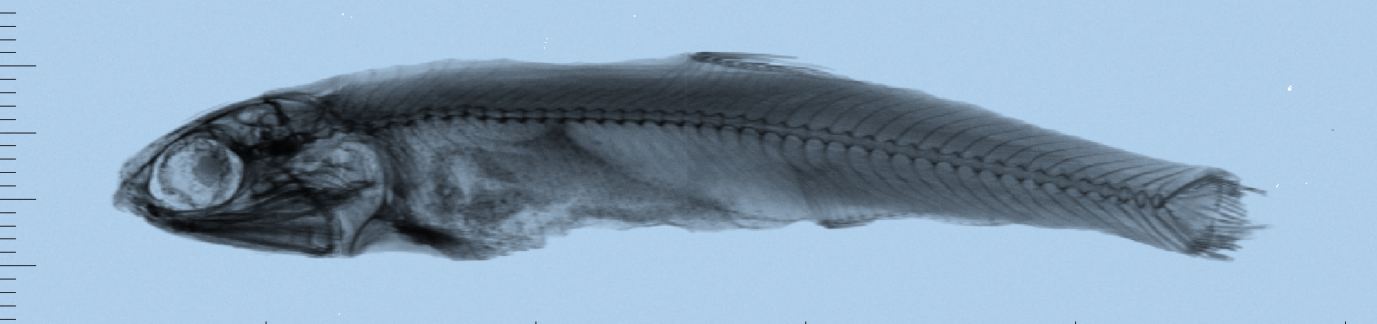
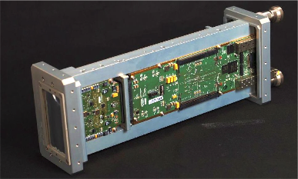
The Eiger Module: Eiger 500k
Sensor 4cm x 8cm,524k pixels
75 micron pixel size
Dead time free mode of operation
Electronics is separated in 2 half-modules
  High frame rates: up to 24 kHz at 4 bit
  12 kHz at 8 bit
  8 kHz at 12 bit
Readout architecture
  High speed data transfer: data is sent over
  10 GbE connections, one per half module
Data buffering
  8 GB of on board memory per module
  32 k frames for 4 counter bits
Firmware data processing
  Image summation
    extends the dynamic range from 4096
    (12 bits) to 4x10⁹ (32 bits)
  Rate correction
Image summation
Rate correction
14

Slide 15
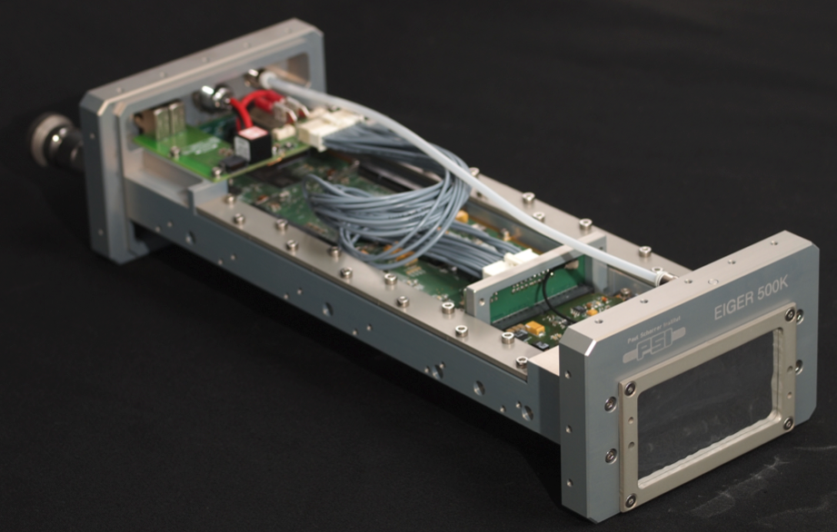
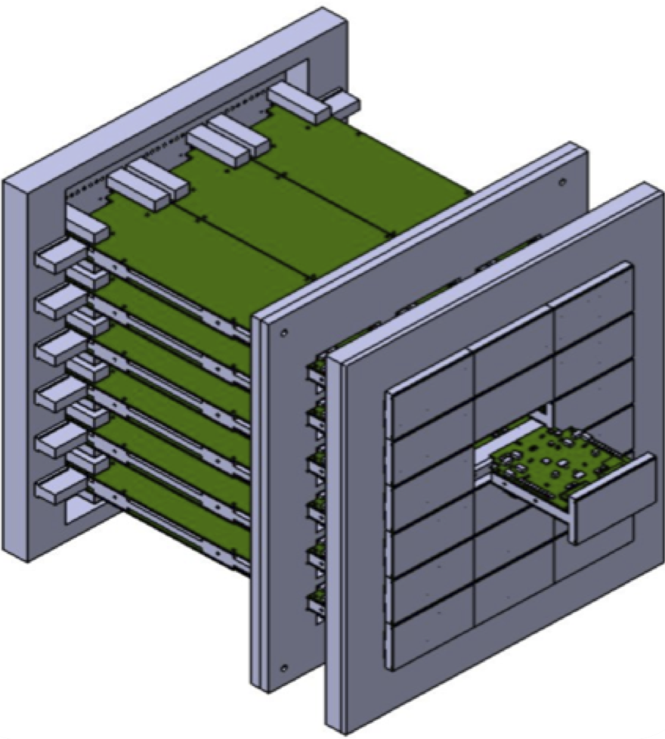
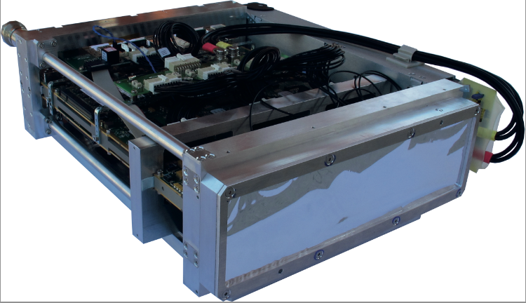
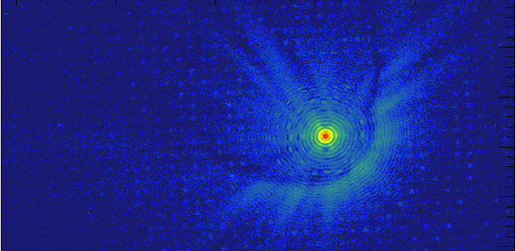
Eiger Systems
500k module
Multi-module detectors
2x4 chips, ~4x8 cm
First 500k in operation @ PSI
1.5 M
9 M
 | Number of pixels | On board storage (frames/4 bits) | Data rate¹ @ 12 kHz | Data rate² @ 1kH | Data rate³ @ 100 Hz | Data rate⁴ @ 10 Hz
Module | 524 k (512 x 1024) | ~32,740 | 50.3 Gb/s | 6.29 Gb/s* | 839 Mb/s* | 168 Mb/s*
9M Detector | 9.44 M (3072x3072) | ~32,740 | 906 Gb/s | 113 Gb/s | 15.1 Gb/s* | 3.02 Gb/s*
 | Pixel array | Size | Frame rate¹ | On board storage (frames/4 bits)
Module | 512 x 1024 | 38x77 mm² | 12 kHz | ~32,740
1.5M | 512 x 3072 | 38x238 mm² | 12 kHz | ~32,740
9M | 3072 x 3072 | 233x238 mm² | 12 kHz | ~32,740
Data processing is fully parallel on multi module systems
15
1) 8 bit, equivalent to ~4@22 kHz or ~12@8kHz

Slide 16
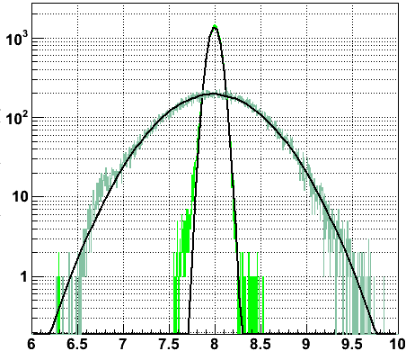
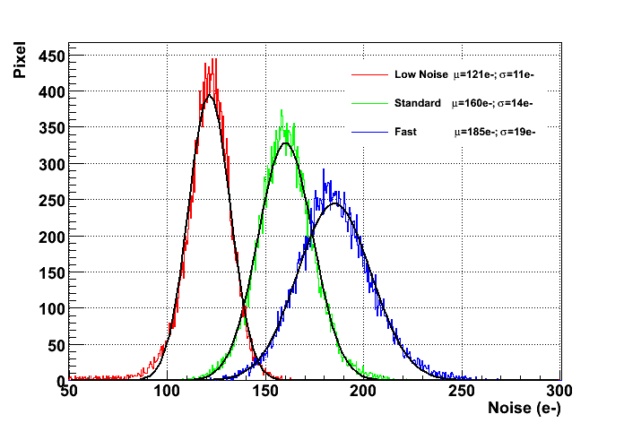
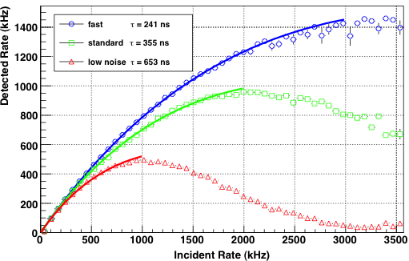
Electronic performance parameters
Threshold Dispersion
Operation Mode | Noise(e-) | Sigma (e-)
LowNoise | 121.1±0.07 | 10.7±0.06
Standard | 160.1±0.08 | 13.9±0.07
Fast | 185.0±0.1 | 18.7±0.09
Trimmed
σ=67 eV
Untrimmed
σ=479 eV
@14KeV

Slide 17
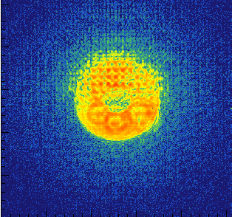
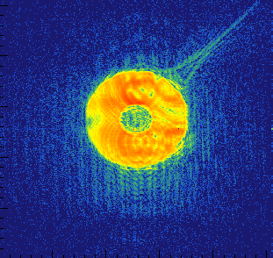

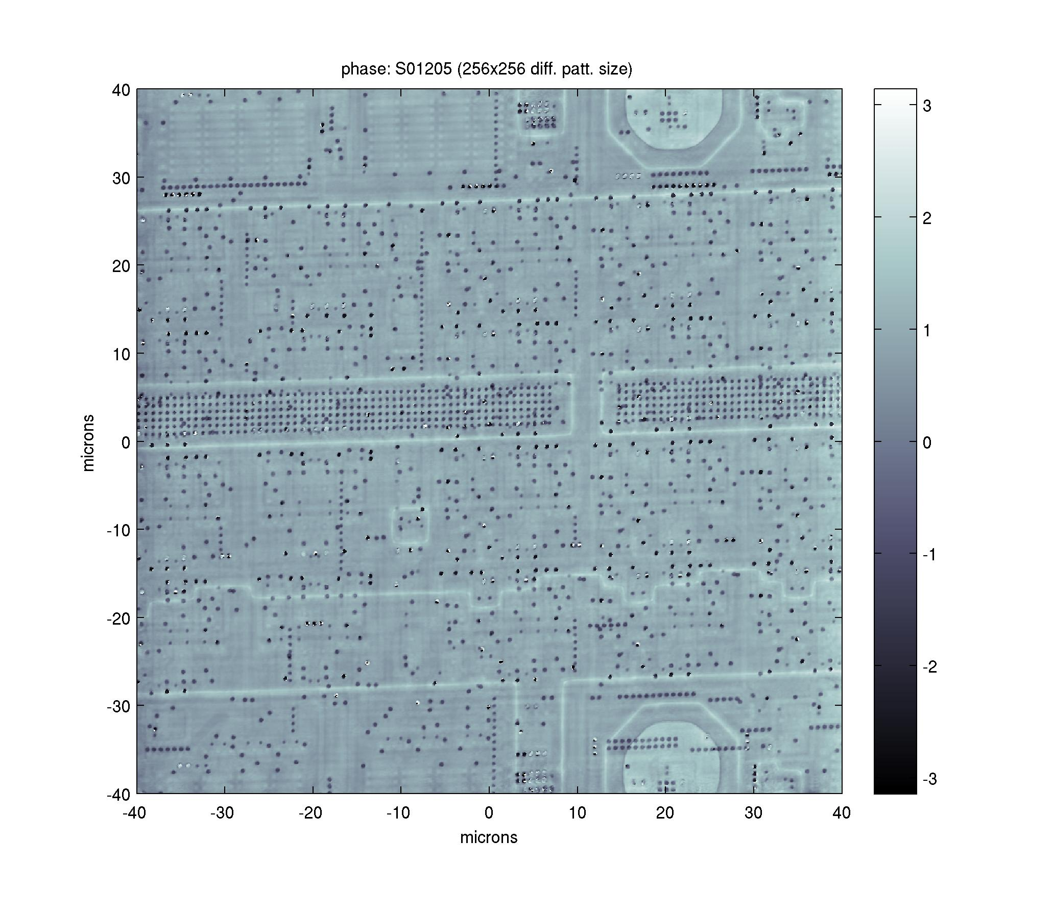
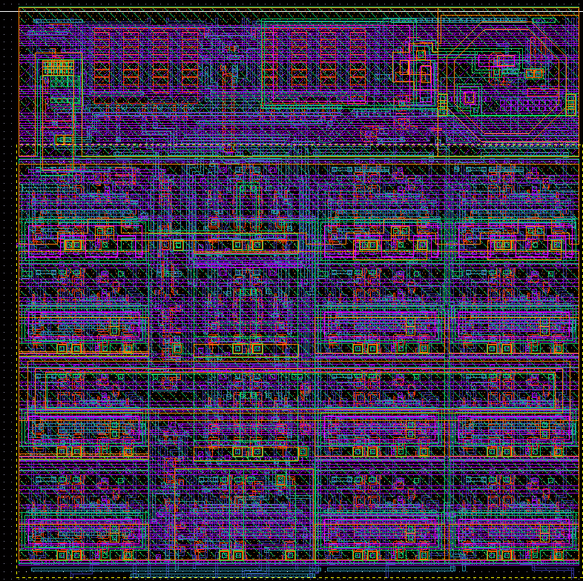

Eiger SELFIE: Ptychography of an Eiger chip
Diffraction pattern
from one ½ of a module
Coherent X-rays
FZP
OSA
Object
The object is raster scanned
with an out of focus beam
Diffraction patterns at
overlapping positions on the
object are recorded
The information in the overlap
is used to recover the phase
Both the attenuation and phase
shift in the object can be
reconstructed
Phase image
y (um)
Object: An Eiger readout chip
x (um)

Slide 18
Plans and summary for Eiger
Eiger will be our work horse in the coming few years
single module (an Eiger 500K) installed at cSAX beamline
other single module systems foreseen at other beamlines
9M currently in production (modules), installation foreseen for early 2014
will overcome frame rate and pixel size limitations of Pilatus
we are thinking of a 49M detector in vacuum at a fixed distance
for cSAXS not decided yet if this is an Eiger or Jungfrau detector

Slide 19
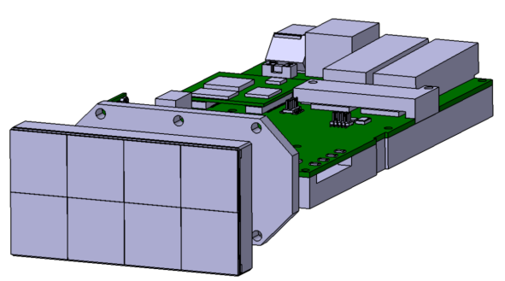
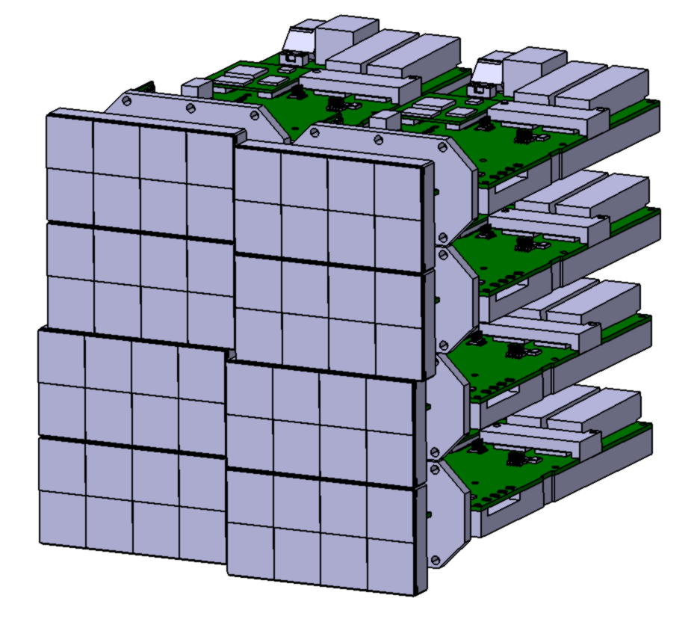
JUNGFRAU: a 2D detector for SwissFEL
adJUstiNg Gain detector FoR the Aramis User station
JUNGFRAU module:
Chip: 256 × 256 pixels, Pixel: 75 × 75 µm²
Dynamic range: 10⁴ 12keV photons per pixel
Module: 2 × 4 chips, 4 cm × 8 cm
Systems up to 16 Mpixel at SwissFEL
Readout:
Readout rate > 2 kHz
Linear count rate capability @ synchrotron:
    25 MHz/pixel
GOAL: detector for XFELs and synchrotrons
Module:
524 kPixel
8 modules:
4 MPixel
JUNGFRAU: A. Mozzanica et al., JINST, 9, C05010, 2014

Slide 20
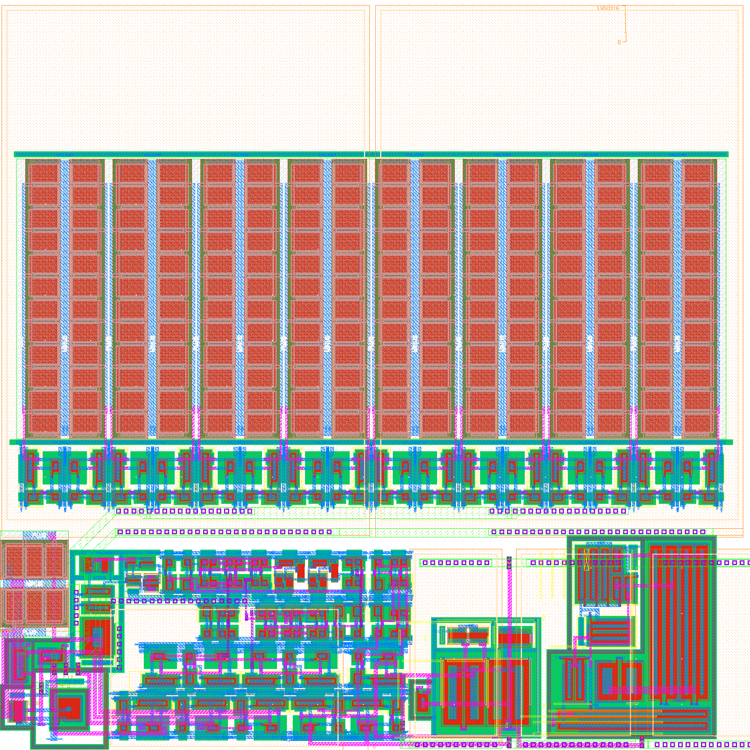
Jungfrau pixel architecture
MIM feedback cap.
covering the whole area
2 main challenges for small pixels
Power consumption per channel
  low power preamp and CDS
  power cycled off-pixel buffer
Space for feedback capacitor limited
  amplifier range optimization
  precharge of feedback capacitors
prototype pixel layout
work in progress
storage cells 16x
preamp
switch. +
precharge
logic
CDS
comparator
pixel buffer

Slide 21
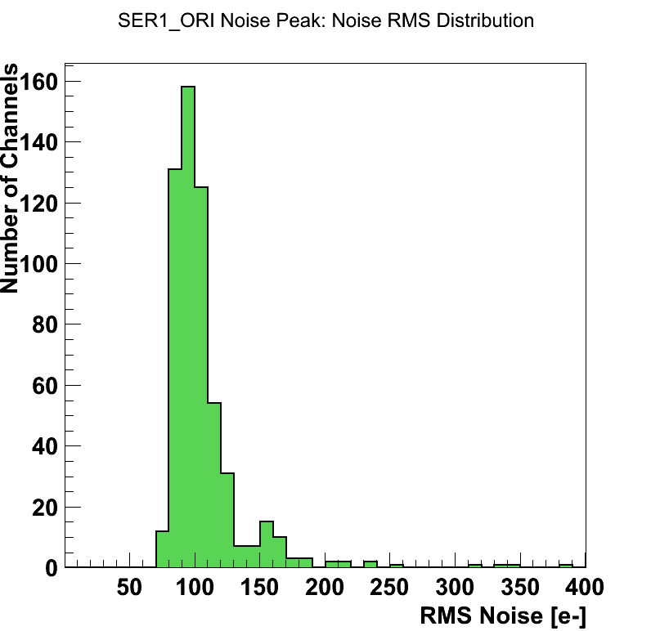
Noise Characterization
~ 100 e⁻
Total noise | ~ 100 e⁻
Preamplifier | ~ 91 e⁻
CDS | ~ 25 e⁻
Readout | ~ 31 e⁻
σ = 100 e⁻ → <400 eV
→ 5 σ < 2 keV

Slide 22
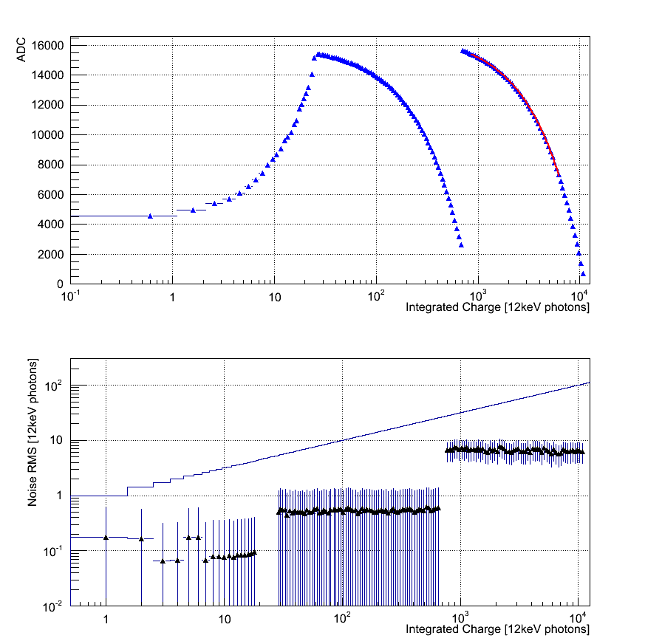
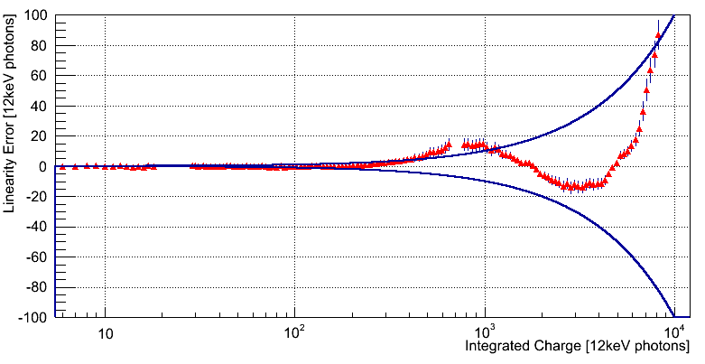
Automatic Gain Switching
Automatic gain switching:
White visible light illumination
Increasing integration time
Covers dynamic range of
> 4 orders of magnitude !
~30 ɣ
~700 ɣ
gain stage 0 (high)
gain stage 1
(medium)
gain stage 2
(low)
Noise < Poisson statistical limit
Linearity of response
1% deviation

Slide 23
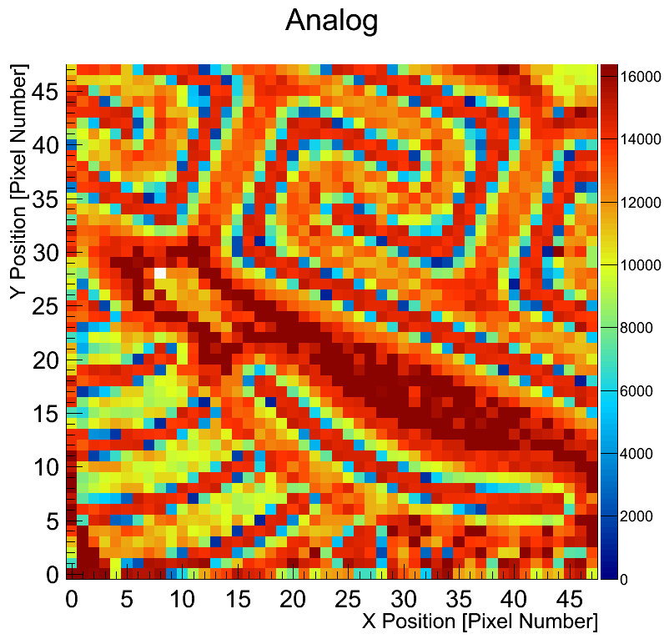
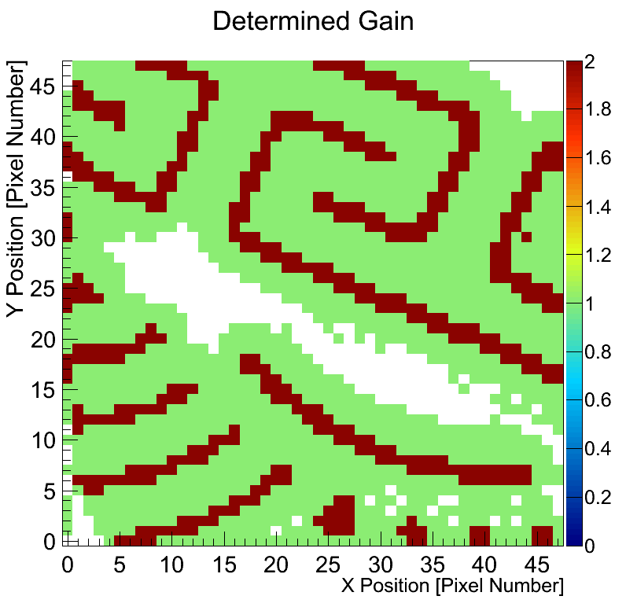
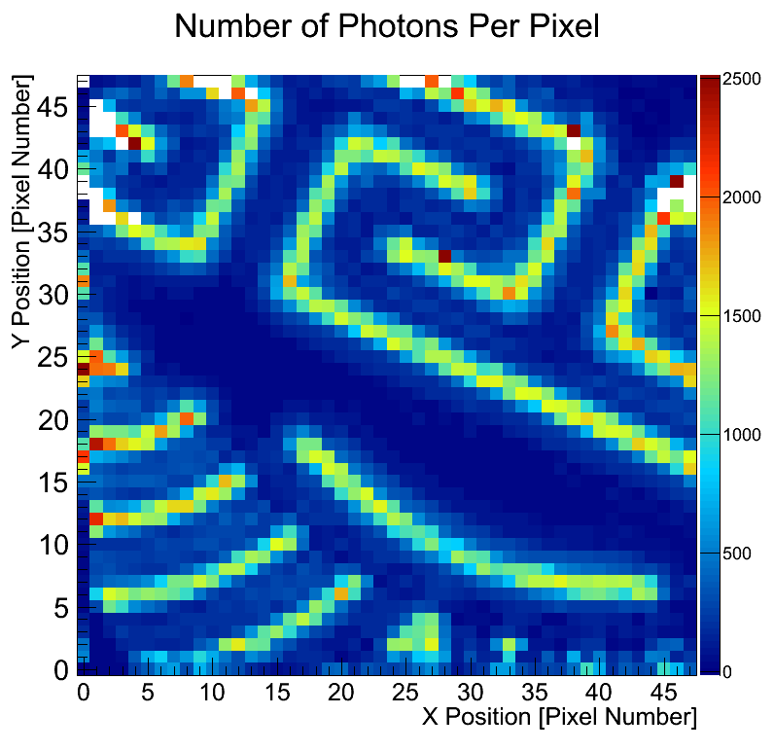
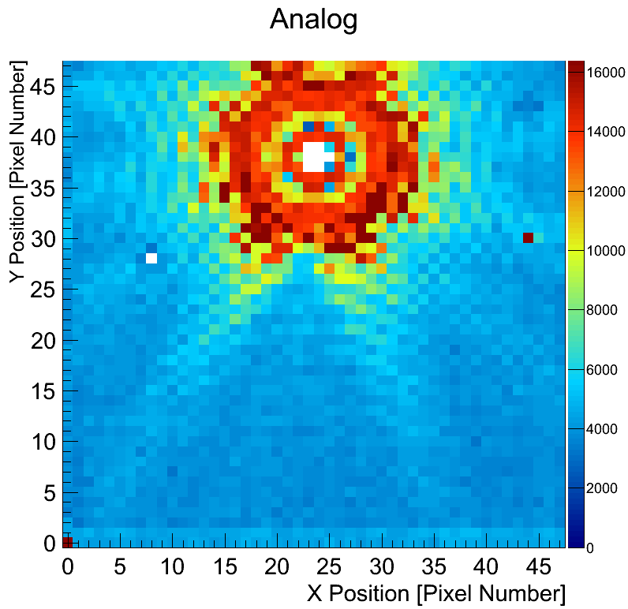
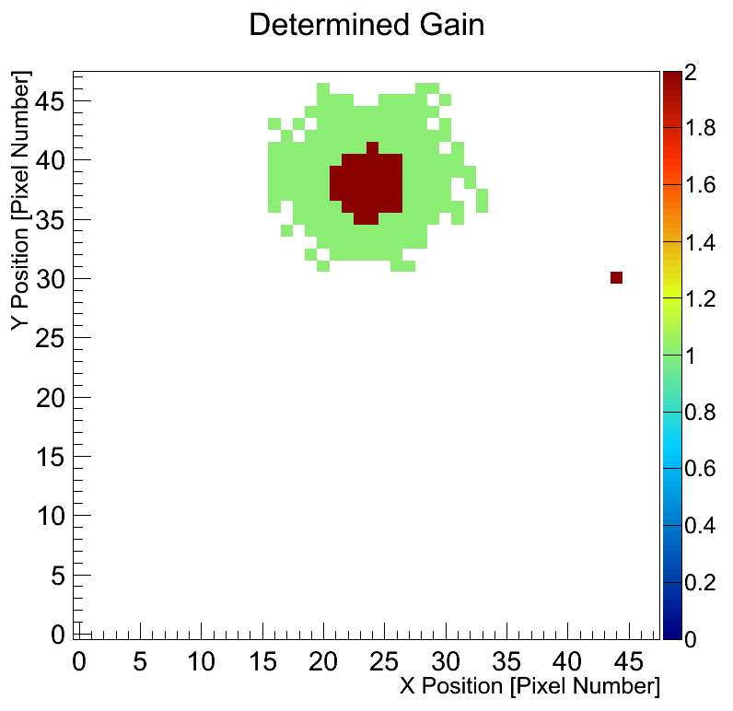
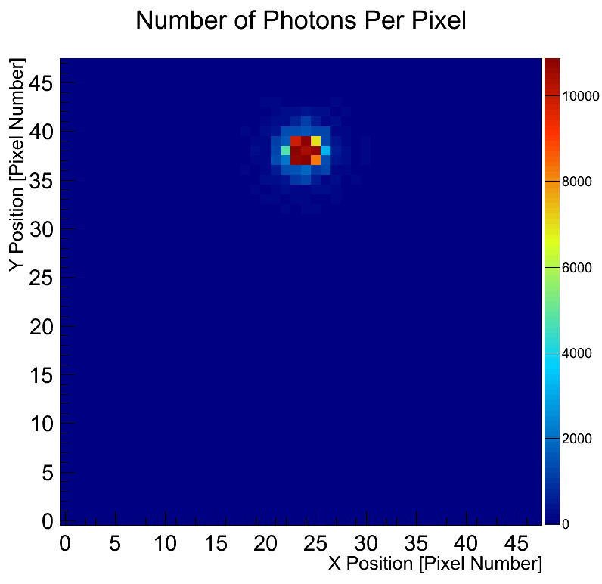
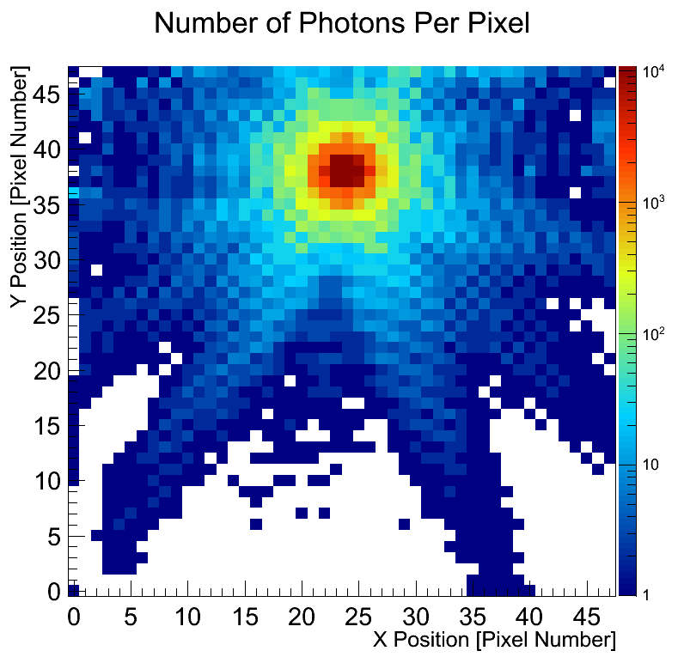
High Dynamic Range Imaging Via Gain Switching
IR laser through mask
laser light
chip
mask
IR laser blurred
logarithmic
Works well whether signal is concentrated on part of the chip …
… or if distributed all over the chip!

Slide 24
Summary Jungfrau
Small pixel size: 75 microns
High frame rate: 2kHz
High linear count rate capability:
  Dead time free 24MHz
  Quasi infinite for smaller integration times
  First big not count rate limited hybrid pixel detector
Foresee up to 16M pixel systems for SwissFEL and SLS
Low noise of 120 e⁻ (434 eV) low energies accessible:
  3 keV with single photon resolution
  Less without single photon resolution
  (sensor with thin entrance window)
High energies with scintillators

Slide 25
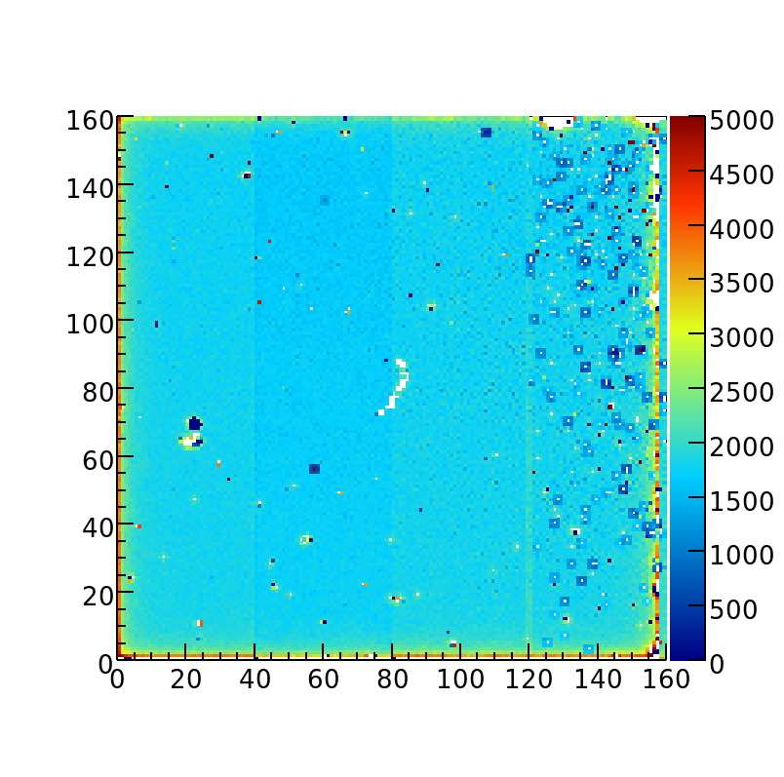
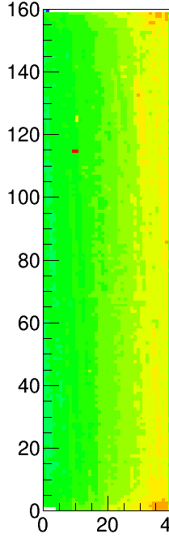



MÖNCH detector system
Hybrid pixel detector: 25x25 μm² pixel size
goal: low noise and high dynamic range thanks to dynamic gain switching
up to 600 12keV photons (or 2 x 10⁴ 400eV photons)
Optimization for different application possible:
  Imaging/Tomography
  resonant and nonresonant inelastic X-ray scattering
  Spectroscopy
  Laue Diffraction
2013,>95%
2014,>99.99%
Very first prototypes
Single chip processing
Low tolerance with UBM masks
Alignment imprecision
New holder
Improved UBM masks
Better alignment
New bump-bonder
More experience
4mm
Current Prototype: MÖNCH 02
Active area: 4x4 mm²
160x160 pixels
1x4 mm² optimized for Imaging
sensor
readout chip
PCB

Slide 26
Mönch pixel schematics
160 x 160 pixels divided into 4 groups:
group 1+2 fixed gains
  gain1: 15 12keV photons
  gain2: 100 12 keV photons
group 3+4 dynamic gain switching
  gain1: 15 12 keV photons
  gain2: 600 12 keV photons
CDS gain 1 and 4
C2
Control logic
C1
Discr.
V_{thr}
CDS.

Slide 27



The Mönch detector bump bonding
Pilatus 172 um
Eiger 75 um
Mönch 25 um
x5.3
x47
Bump bonding of 25 micron pixel works well with PSI
in-house process
Limit: 20 microns

Slide 28

Noise measurement
counts
Noise peak
of MÖNCH
400 eV
noise [eV]
Lowest noise of hybrid pixel detectors:
Noise of 30 electrons rms
3.7 sigma at 400eV
5 sigma at 540eV

Slide 29

Cluster charge Distribution

Slide 30

Charge integrating detectors: get full information
L
R
L
R
L
R
γ
γ
γ
γ
γ
γ
`
γ
L
R
γ
γ
L
R
γ
L
R
L
R
γ
γ
γ
50 micron pitch, 25 keV

Slide 31

Position dependent charge sharing
50%
50%

Slide 32
Position dependent charge sharing
50%
50%

Slide 33





Gotthard: position interpolation
To measure the spatial resolution a 2μm W slit has been scanned in 1μm steps in front of the strips
slit parallel to strips
Vertical beam size ~100μm
Strip pitch 20μm, 15keV beam
reconstructed vs motor positions
Simulation (Geant+TCAD)
2μm W slit
rotary stage
for slit alignment
residuals distribution (PSF)
X motor stage
1μm steps
X motor stage
1μm steps
σ=1.8μm
JJ slits

Slide 34



Interpolation in 1D
Kidney stone
12 keV beam
25 um pitch
with GOTTHARD
Interpolation
In 1D
25 um pitch
0.5 um bins

Slide 35

Summary/Outlook Mönch
Hybrid pixel detectors with 25 um (and less) pixel size are possible
Extremely low noise: 30 e⁻ Noise (previously only accessible with CCDs and MAPS)
  Single photon sensitivity down to ~ 400 eV
Small pixels allow position interpolation
  Current spatial resolution with interpolation: 3.3 um
Future MÖNCH developments:
MÖNCH03 is a full 1 by 1 cm² detector optimized
for imaging with the presented method
  Up to 160k pixels
  5 kFrames/s
MÖNCH 1.0 2 by 3 cm² tillable read-out chip for
detector modules
  Dynamic gain switching 20x10³ photons (@400eV)
Moench

Slide 36
Summary
Our single photon counting detectors are state of the art for many synchrotron applications thanks to large area and stability
  EIGER in advanced commissioning phase
  MYTHEN for XRPD
Charge integrating detectors with dynamic gain switching offer
performances close to photon counters and work at XFELs
  Single photon resolution at high gain
  Poisson limited over the full dynamic range
  No count rate limitations for SR experiments
  Low energies accessible with(out) single photon resolution
  Still a lot of calibration, optimization, validation for real experiments
Analog single photon readout expands the digital information
  Work only with low flux
  Energy dispersive detectors
  (sub)Micron-resolution by interpolation
  MÖNCH opens new possibilities in terms
  of energy and spatial resolution

Slide 37






http://www.psi.ch/detectors
The SLS Detector Group:
Anna Bergamaschi, Roberto Dinapoli, Dominic Greiffenberg, Dhanya Maliakal, Davide Mezza, Aldo Mozzanica, Christian Ruder, Lukas Schädler, Julia Smith, Bernd Schmitt, Xintian Shi, Gemma Tinti
Wir schaffen Wissen – heute für morgen
Open positions:
Postdoc for Mönch
Firmware for Eiger

