Slide 1
Energy dependence of detectors for 3D dosimetry of light ion beams
Hugo Palmans
MedAustron, Wiener Neustadt, Austria
and National Physical Laboratory, Teddington, UK

Slide 2
Overview
Need for measuring absorbed dose
Characteristics of ideal 2D and 3D detectors
Energy dependence of detector response to absorbed dose

Slide 3

Absorbed dose versus fluence
Most of this conference:$Φ$, $\frac{∂Φ}{∂E}$ or $\frac{∂^{2}Φ}{∂E∂θ}$
This presentation: $D_{med}=$ $\frac{d\overline{ε}}{dm}$
$ε=ε_{in}−ε_{out}+∆Q=$energy imparted
thermalisation
ionisation
chemical states
physical states

Slide 4
Need for accurate dosimetry
probability of tumour control
1.0
probability of severe complications
(x-rays)
0.8
probability of tumour control without severe
complications (x-rays)
probability of severe complications
0.6
(protons)
Probability
probability of killing tumour without severe
0.4
complications (protons)
0.2
0.0
0.0
20.0
40.0
60.0
80.0
100.0
Dose (Gy = J kg⁻¹)

Slide 5
Need for measuring absorbed dose
At the cellular level:
direct DNA damage: ionisation at nanoscale
indirect DNA damage: ionisation at microscale
other damage: tens of micrometers scale
bystander effects: millimetre scale
For photons and electrons:
biological effects ~ ionisation ~ absorbed dose
For protons and ions:
biological effects ~ ionisation * w_{i} ~ absorbed dose * w_{i} * w_{D}

Slide 6
Need for 3D dosimetry
  Homogeneity
  Target coverage
  Cold spots
  Out-of-field dose
  Integral dose

Slide 7
Requirements
  High spatial resolution
  Small dosimetric “voxels”
  Ease of operation, non-toxic
  Reasonable cost
  Fast readout
  Stable in time; reproducible
  Signal proportional to dose (or known functional relation)
  Dose rate independent, large dynamic range
  Orientation independent
  Water-equivalence
  Minimal/managable perturbing

Slide 8
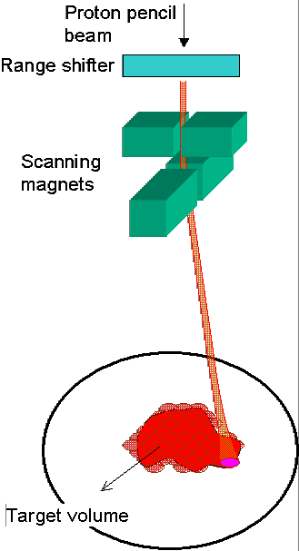
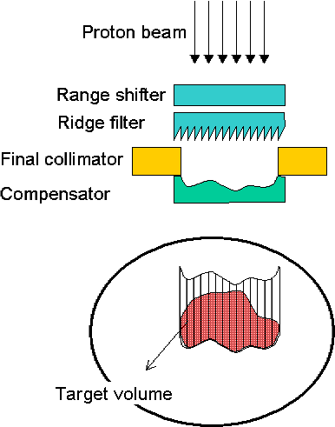
passive (scattered) – dynamic (scanned)
range modulator

Slide 9
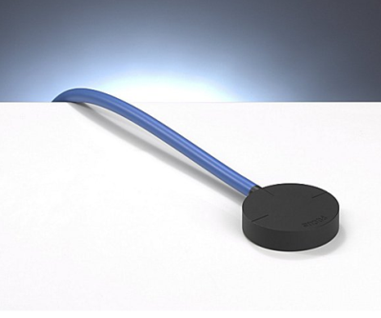
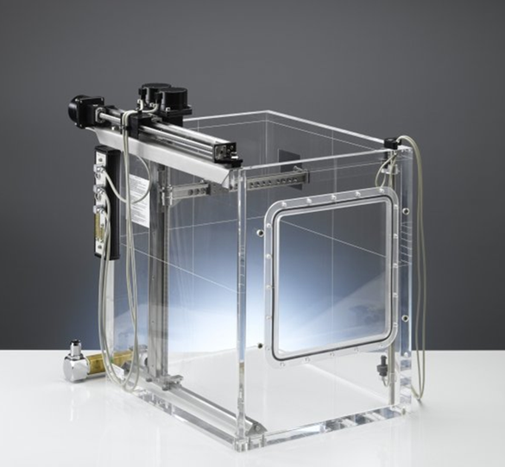
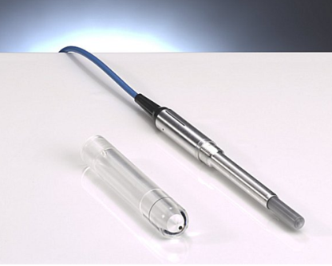
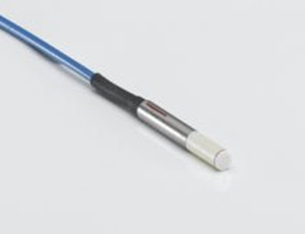
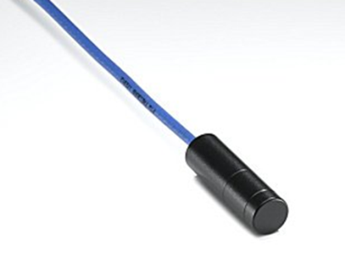
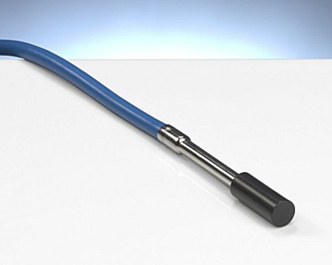
Scanning for passive beams
+

Slide 10
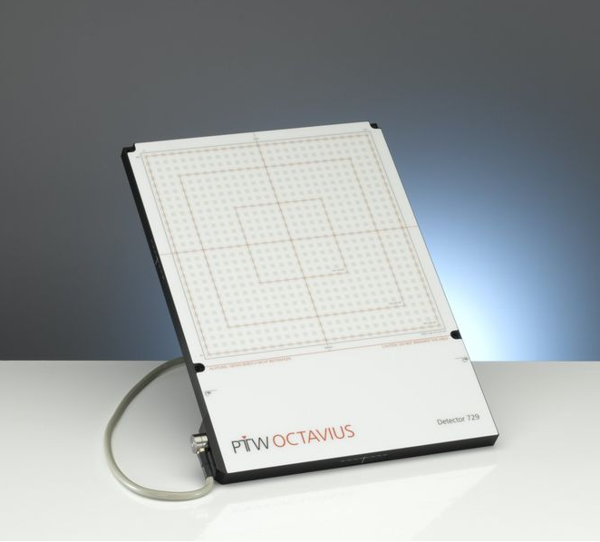
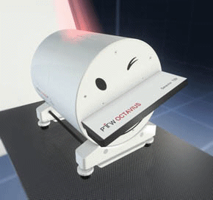
Arrays and 2D, 3D dosimeters for dynamic beams
→
→

Slide 11
Calorimetry (thermalisation)
D_{med}=c_{med}·ΔT
c
ΔT/D
α
(J·kg⁻¹·K⁻¹)
(mK·Gy⁻¹)
(m²·s⁻¹)
water
4180
0.24
1.44×10⁻⁷
graphite
710
1.41
0.80×10⁻⁴

Slide 12
Calorimeters - water vs graphite
0.6 mm
thermistor
0.5 mm

Slide 13
Water calorimeters – energy independent chemical heat defect?
protons
⁶⁰Co
(100 MeV)
(1MeV)
3,0
H⁺
OH•
2,0
G (100 eV⁻¹)
e¯_{aq}
OH¯
H₂
1,0
H₂O₂
H•
0,0
HO₂
10⁻¹
10⁰
10¹
10²
LET (keV.μm⁻¹)
Ross et al (1996) Phys. Med. Biol. 41:1
Brede et al (2006) Phys. Med. Biol. 51:3667

Slide 14
Graphite calorimeters – energy independent dose conversion?
?

Slide 15
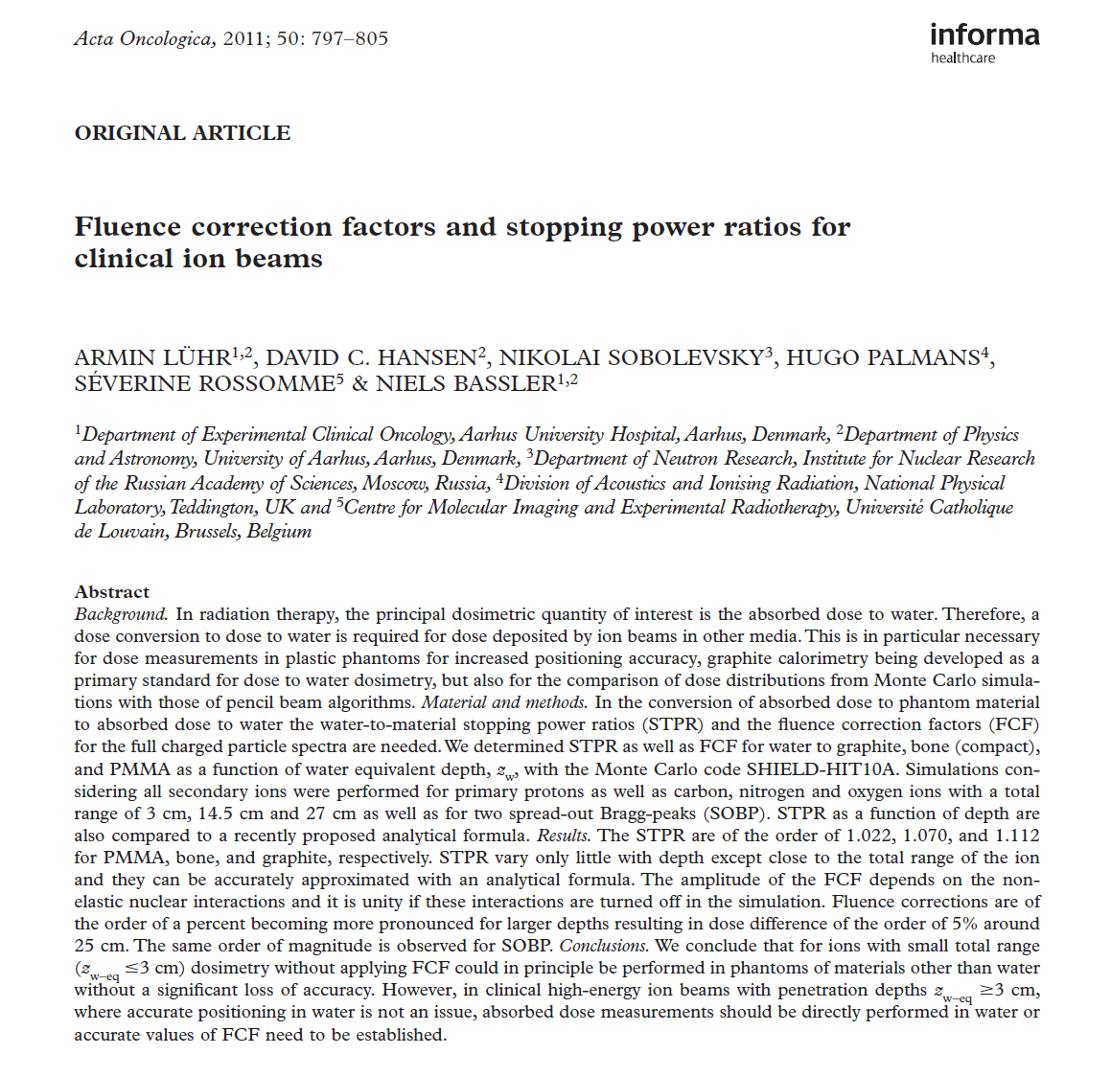
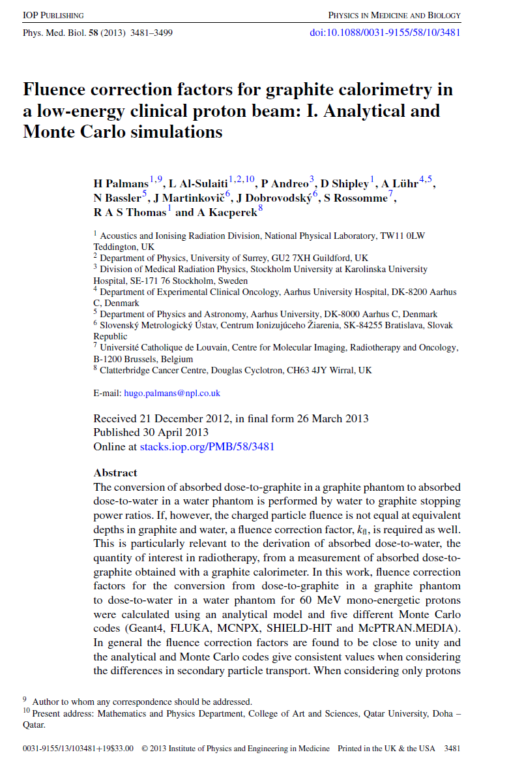
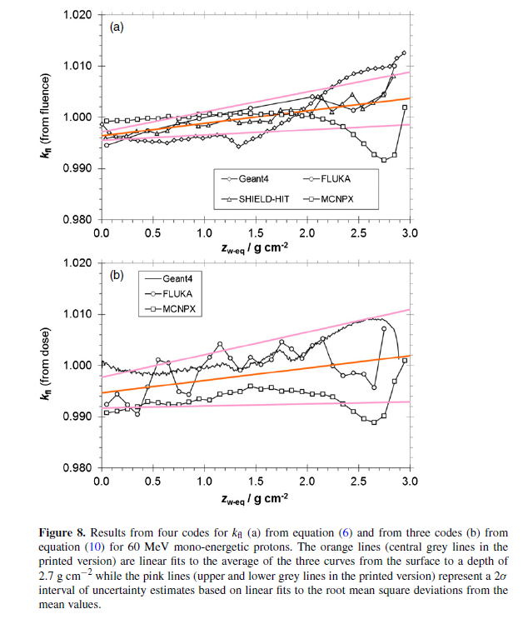
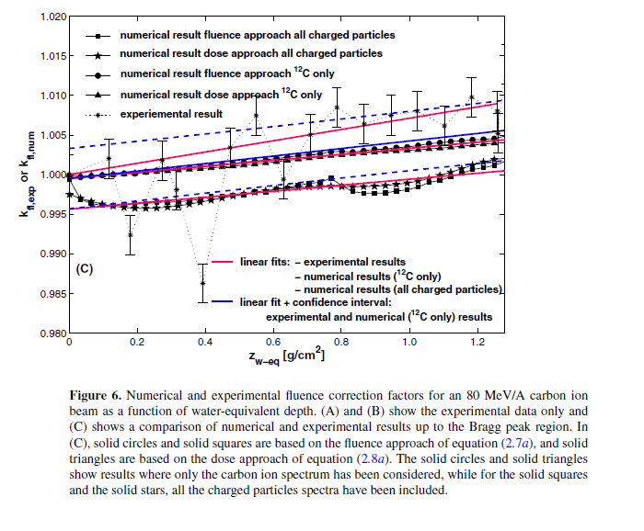
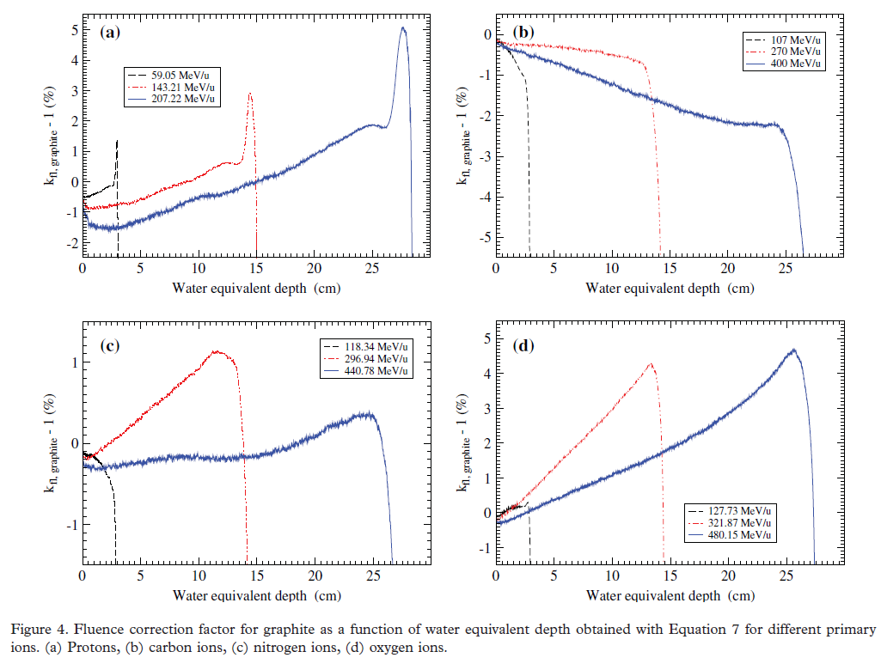
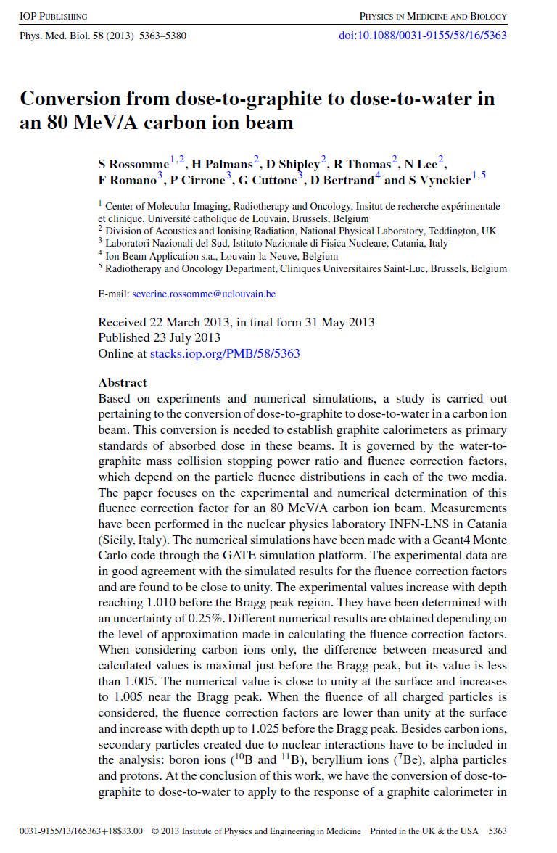

Slide 16


Ionization chambers

Slide 17
Dose determination with ion chamber
D
=
D
s
p
w
air
w,
air
Q
W
Q
W
D
=
=
air
m
e
ρ
V
e
air
air
Q: charge produced in the air of the chamber
W: mean energy required to produce an ion-pair in air
Unfortunately, for commercially available chambers, the volume V is not known with the necessary accuracy (would otherwise be a primary standard!).
We have to rely on methods other than “first principles”, which involve the use of ion chamber calibration factors

Slide 18
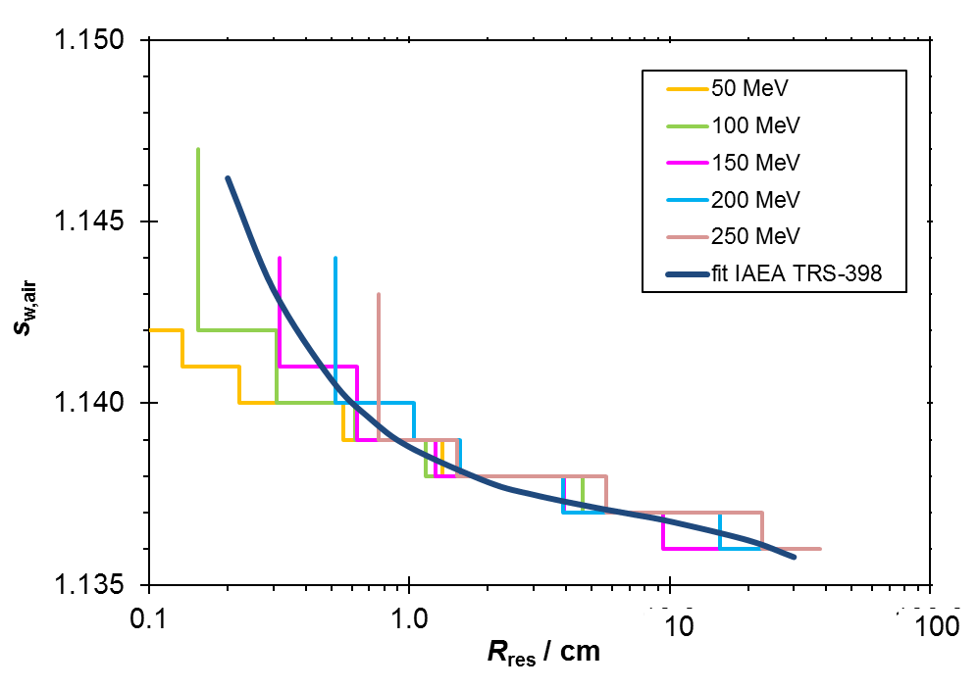
Water/air stopping power ratio
r
o,p
= 1mm
r
o,e
= 1mm
ICRU 49
ICRU 37
10³
1.30
-1
)
1.20
g
10²
2
(MeV cm
s
1.10
w,air
ρ
/
10¹
proton water
coll
protons air
S
electrons water
1.00
electrons air
sw,air protons
sw,air electrons
10⁰
0.90
10⁻⁶
10⁻⁴
10⁻²
10⁰
10²
Medin et al. 1997, Phys Med Biol 42:89
τ
= E
k
/E
rest

Slide 19
Perturbation correction factors
p
x
R_{sleeve}
water
R_{wall}
sleeve
R_{cav}
wall
air
R_{cel}
c.e.
z
Proton
z₀
(Gy)
70.0
2
60.0
50.0
40.0
per proton per cm
30.0
20.0
air
10.0
D
0.0
5.0
reconstruction
Difference pdd and
0.0
0.0
10.0
20.0
30.0
-5.0
Depth (mm)
Palmans 2011 Proc IDOS
IAEA-CN182-230
Palmans 2006 Phys Med Biol 51:3483

Slide 20
Ionisation chambers – overall conversion air to dose
Palmans, Dosimetry, in : Proton
Therapy Physics, Ed Paganetti

Slide 21
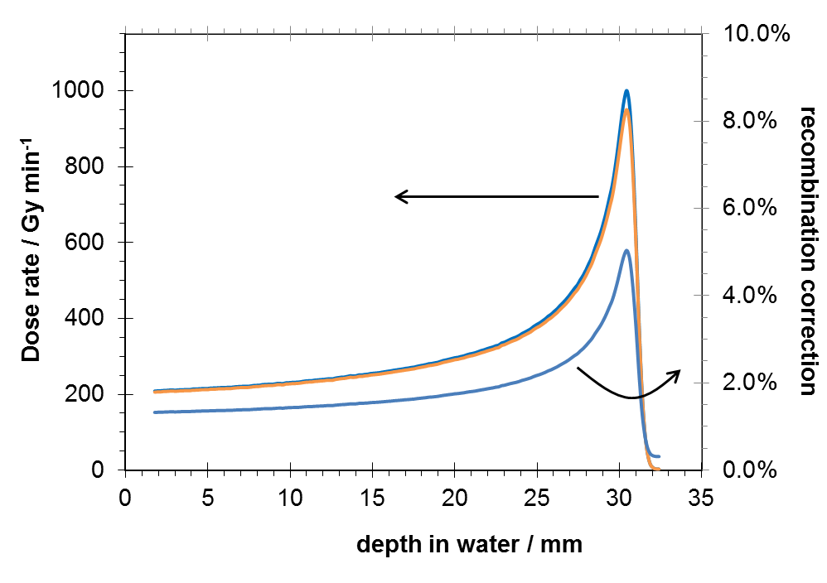


Ionisation chambers (& any ionisation detector) – charge recombination
Palmans et al 2006 NPL report DQL-RD003

Slide 22
Ion chambers - recombination
HT
CE
Initial recombination
Volume recombination
(pulsed) (continuous)
E
Charge multiplication

Slide 23
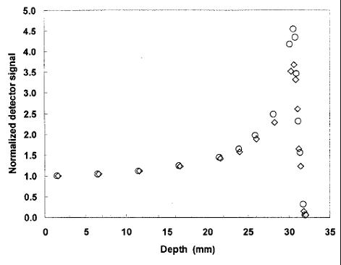
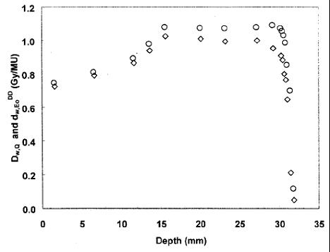
diamond detectors
Fidanzio et al 2002 Med Phys 29:669

Slide 24
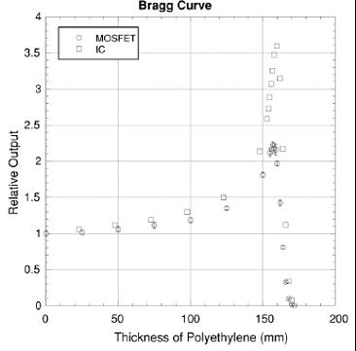
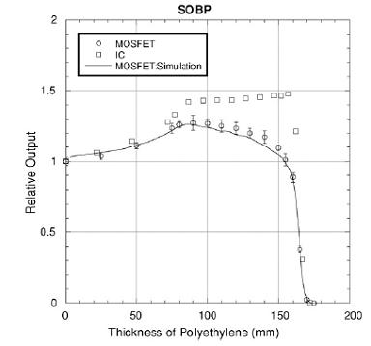
Silicon-based detectors
Kohno et al 2006 Phys Med Biol 51:6077

Slide 25
TLD - protons
Besserer et al 2001 Phys Med Biol 46:473
Notes:
For TLD a detailed experimental energy-response curve is determined by Besserer et al and can be explained by a complex model of track structure theory, charge mobility and distribution of traps and luminescent centres.

Slide 26
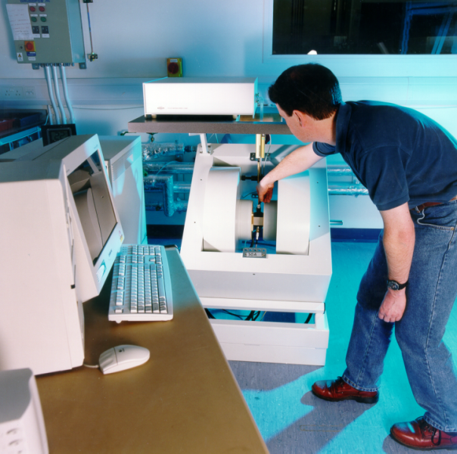
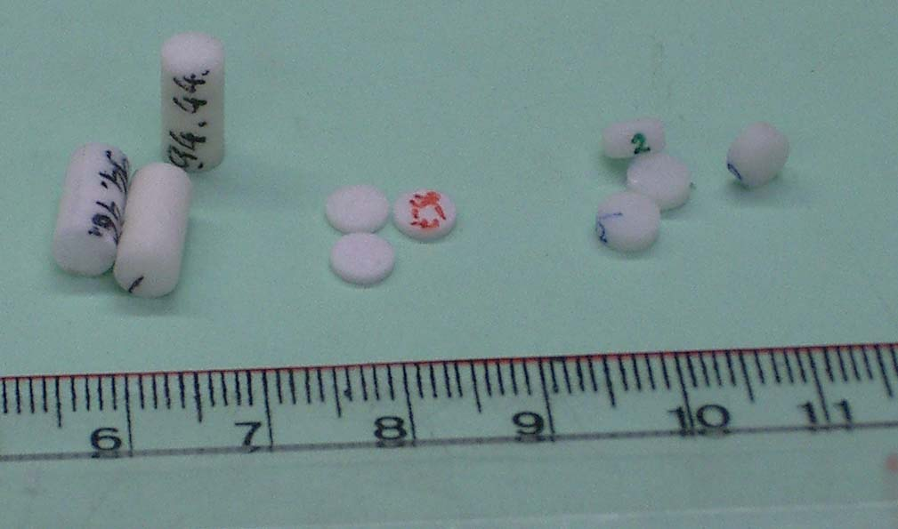
NPL therapy level alanine/EPR
Operates since 1991
Bruker ESP 300 X-band 9” magnet
Pellets
  90% alanine + 10% paraffin wax
  5 mm diameter
  0.5 mm and 2.5 mm nominal thickness
Measurement reproducibility of
2.5 mm pellets ~ 0.05 Gy

Slide 27
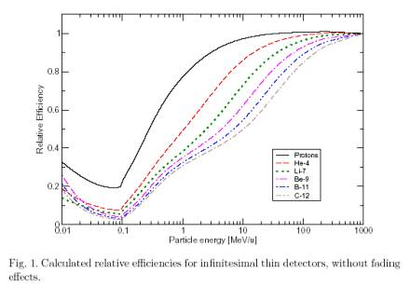
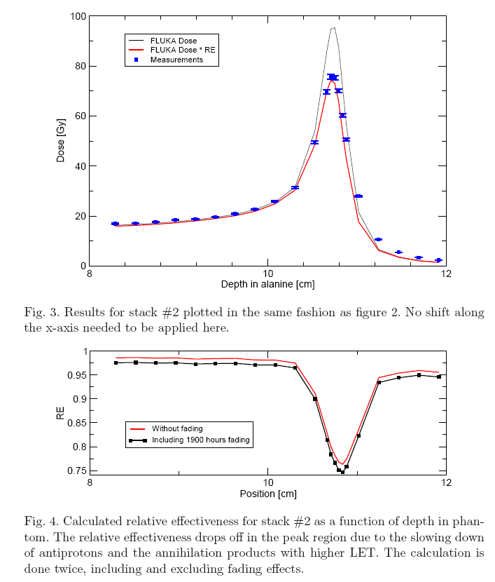
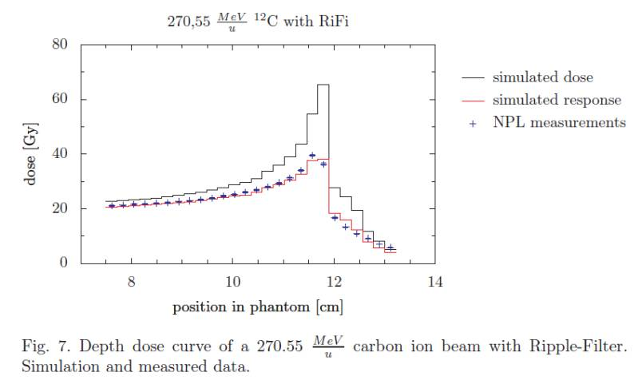
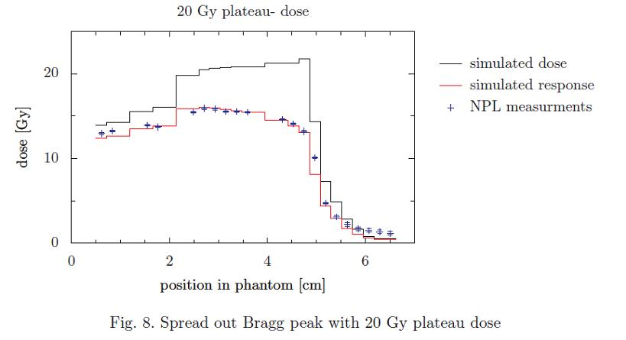
Alanine/EPR dosimetry
Bassler et al, NIMB 266 929-936, 2008
CERN anti-proton beam
Birmingham 15 MeV beam
Herrmann et al 2011 Med Phys 38:1859
GSI ¹²C ion beam

Slide 28
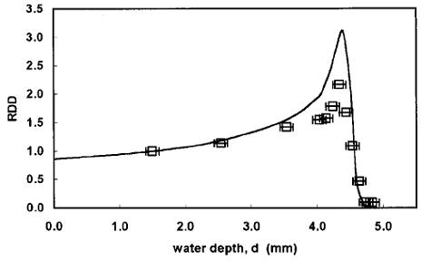

Radiochromic film
Piermattei et al 2000 Med Phys 27:1655

Slide 29
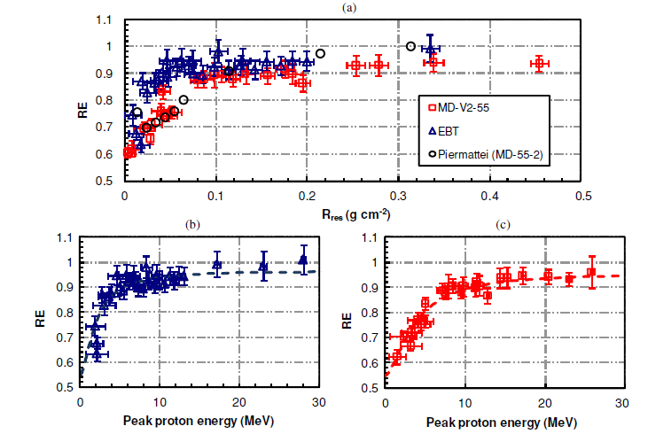
Radiochromic film – energy dependence
Kirby et al. 2010 Phys Med Biol 55:417

Slide 30
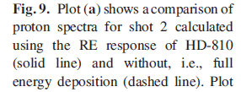
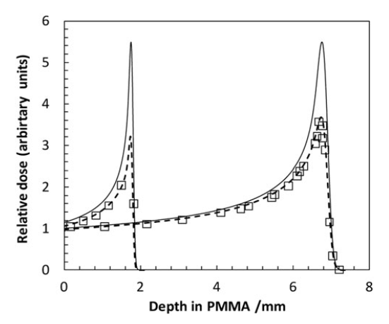
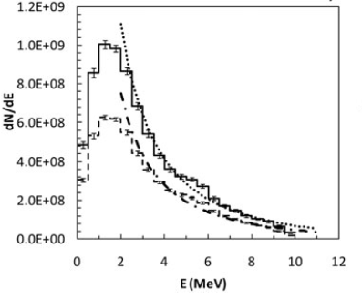
An interesting one… depth dose distribution for fluence determination
Pic laser induced beam
Kirby et al. 2011 Laser Part Beams 29:231

Slide 31
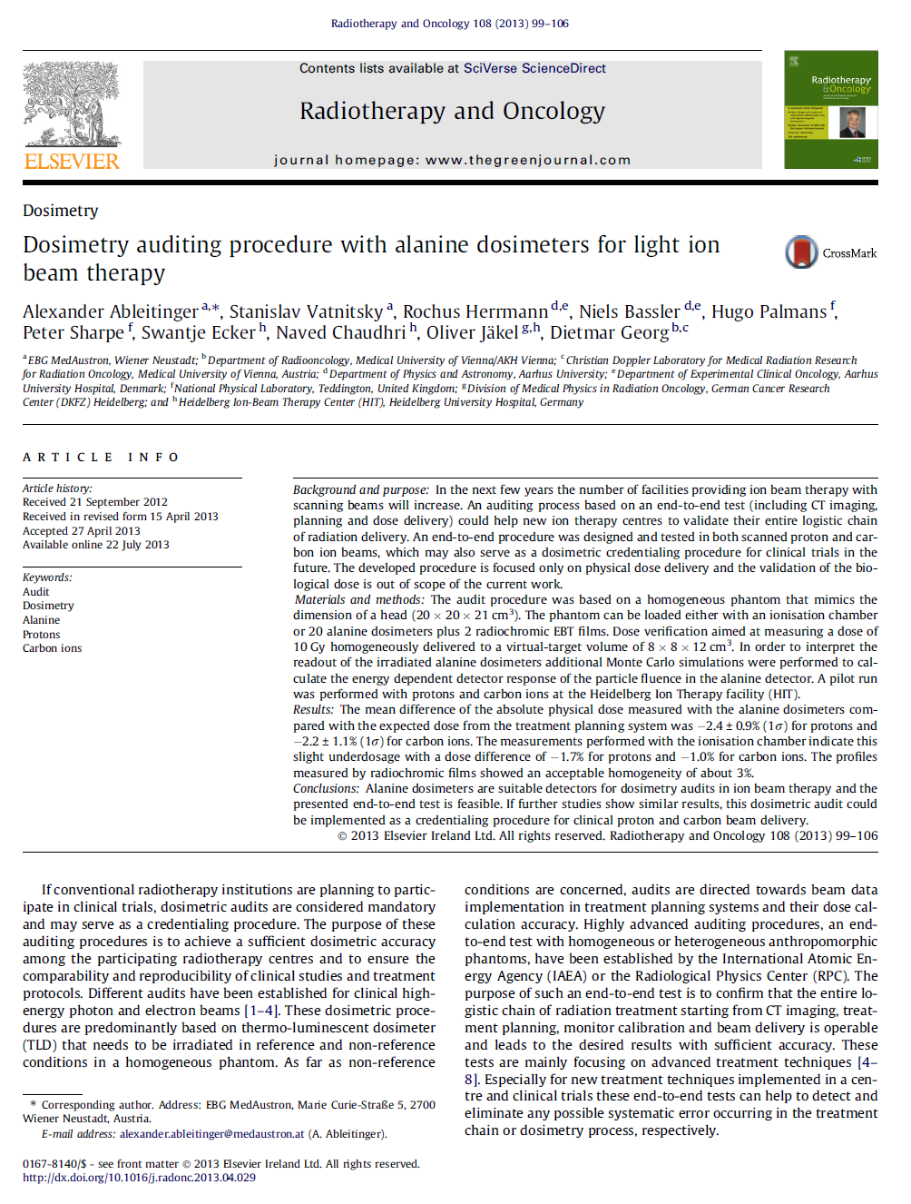
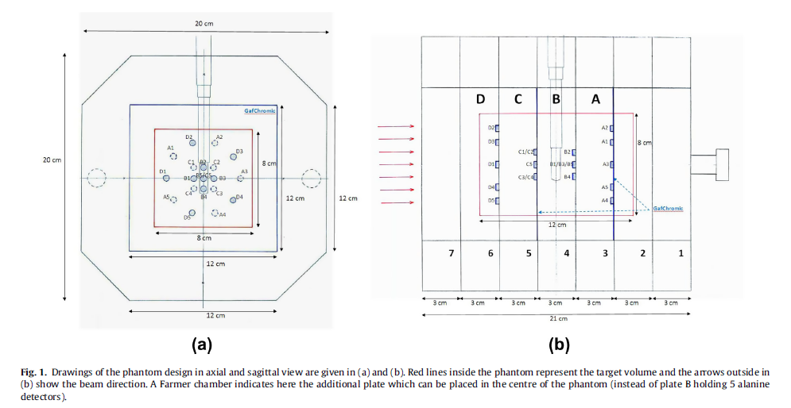
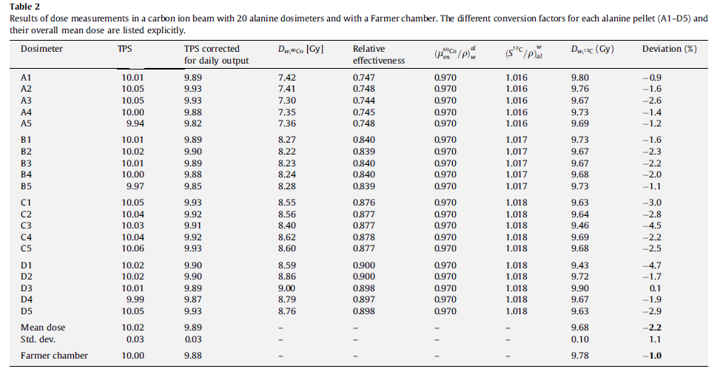
Alanine – plan verification

Slide 32
Polymer gels

Slide 33
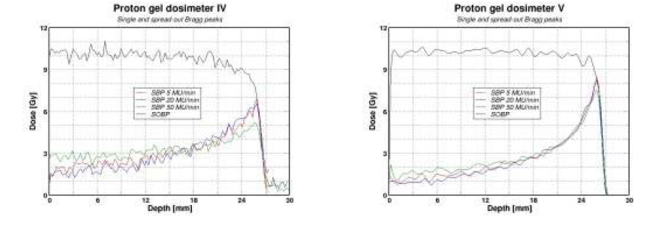
Polymer gel dosimetry
Palmans et al 2006 NPL report DQL-RD003

Slide 34
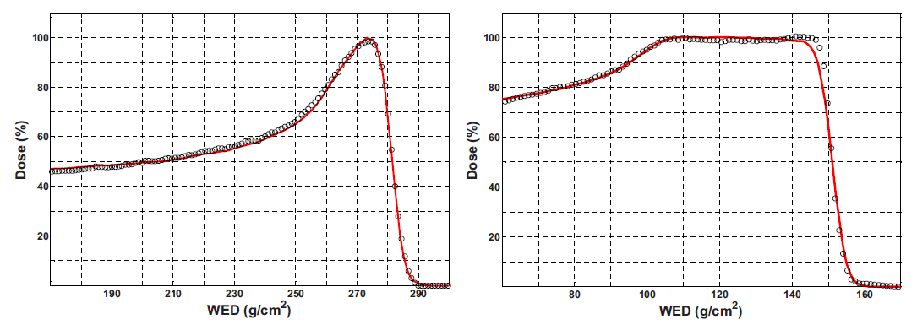
Polymer gel dosimetry
BANG3-Pro2:
Zeidan et al. 2010 Med Phys 37:2145

Slide 35
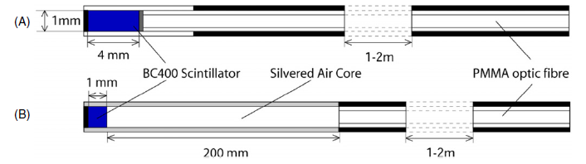
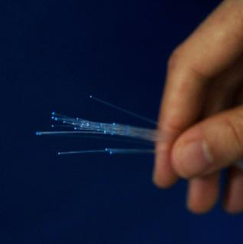
Plastic scintillators
Liu et al. 2011 Phys Med Biol 56:5805
A. Beierholm, Risoe
Goulet et al. 2012 Med Phys 39:4840

Slide 36
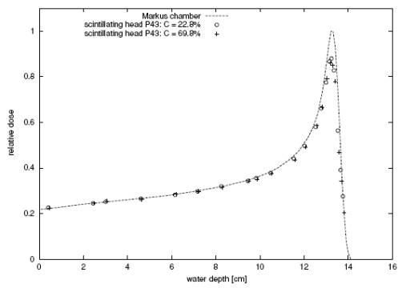
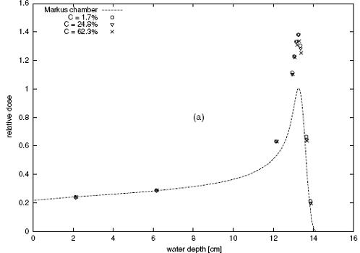
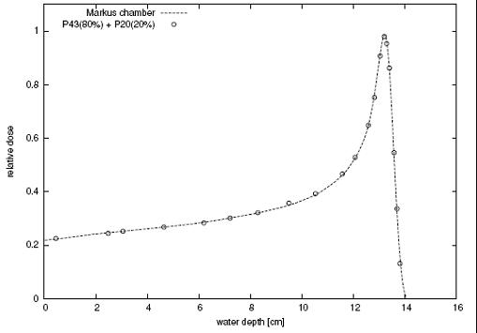
Scintillators
Safai et al. 2004 Phys. Med. Biol. 49:4637
Notes:
Another promising approach is illustrated here. People in PSI found that some scintillator mixtures under respond while others over respond so they mixed two of them in adequate proportions to obtain a perfect match with an ion chamber measurement. The problem is that it works only for this particular energy so it needs to be further investigated if a more universal detector can be based on such an approach.

Slide 37
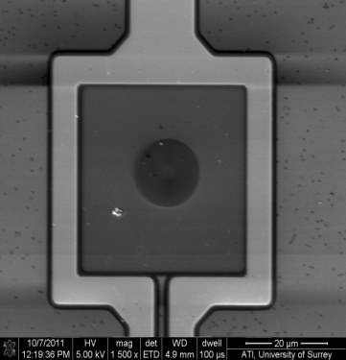
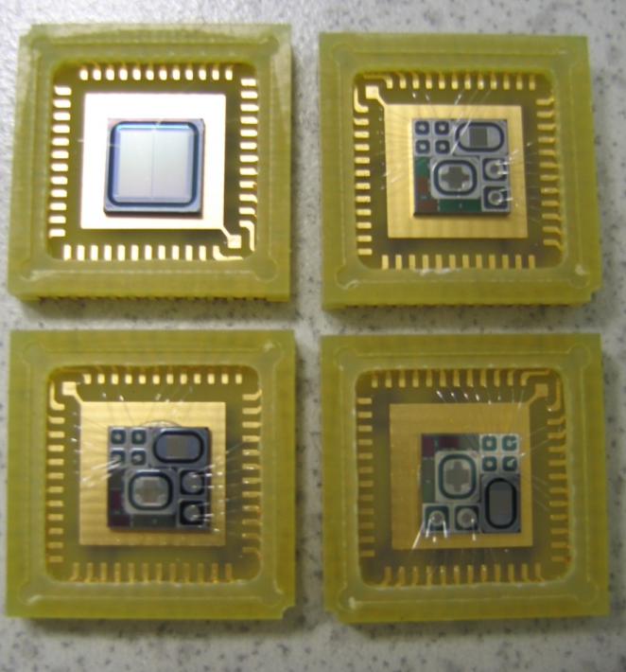
Microdosimetry…
Superconducting Absorber
TE Absorber SQUID
Junctions
Chip :
about 5x5 mm²
Andrea Pola, Politecnico di Milano
Seb Galer, NPL

Slide 38
Nanodosimetry…
Ion counter / PTB Startrack / INFN

Slide 39
Reading
C. P. Karger, O. Jäkel, H. Palmans and T. Kanai, “Dosimetry for Ion Beam Radiotherapy,” Phys. Med. Biol. 55(21) R193-R234, 2010
H. Palmans, A. Kacperek and O. Jäkel, “Hadron dosimetry” In: Clinical Dosimetry Measurements in Radiotherapy (AAPM 2009 Summer School), Ed. D. W. O. Rogers and J. Cygler, (Madison WI, USA: Medical Physics Publishing), 2009, pp. 669-722
H. Palmans, “Dosimetry,” In: Proton Therapy Physics, Ed. H. Paganetti (London: Taylor & Francis), 2011, pp. 191-219
H. Palmans, “Monte Carlo for proton and ion beam dosimetry,” In: Monte Carlo Applications in Radiation Therapy, Ed. F. Verhaegen and J Seco, (London: Taylor & Francis), 2013, pp. 185-199

Slide 40


