Slide 1
Development of the Balloon-Borne sub-MeV Gamma-ray Compton Camera Using an Electron-Tracking Gaseous TPC and a Scintillation Camera
Tetsuya Mizumoto
Department of Physics, Graduate School of Science, Kyoto University
contents
About SMILE experiment and the Electron Tracking Compton Camera (ETCC)
(30 cm)³ prototype ETCC
New readout circuit of the scintillation camera for SMILE-II

Slide 2
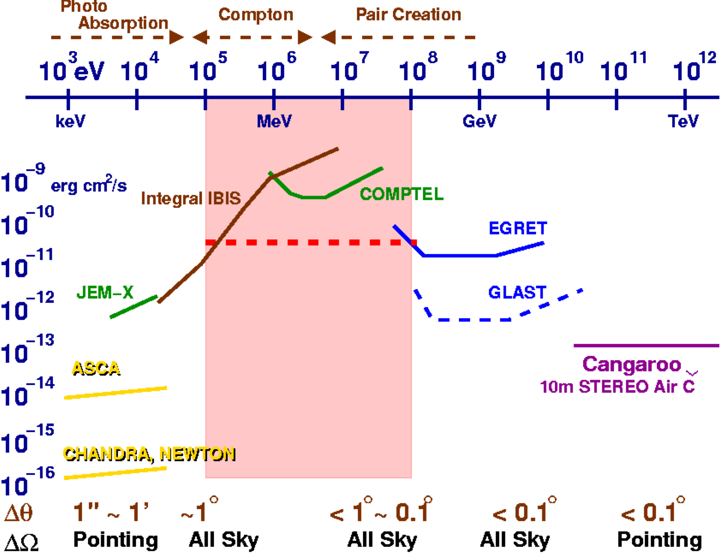
Motivation (sub-MeV/MeV gamma-ray astronomy )
Nucleosynthesis
SNR : Radio-isotopes
Galactic plane : ²⁶Al・⁶⁰Fe
Annihilation
Acceleration
GRB, Jet (AGN) : Synchrotron
+ Inverse Compton
Strong Gravitational Potential
Black Hole : accretion disk, π⁰
Etc.
Gamma-ray Pulsar, solar flare
Bad
erg / (cm² sec)
Sensitivity
1mCrab
EGRET
Air
Cherenkov
Fermi
Astro-H
Obs. Time : 10⁶ sec
Good
～１°
The observation of continuum component is also important.
Where are MeV gamma-ray objects?
There are many background events which obstruct the observations.
Wide-band detection
Large Field of View
Background rejection
Requirements for
the next-generation detectors are …

Slide 3
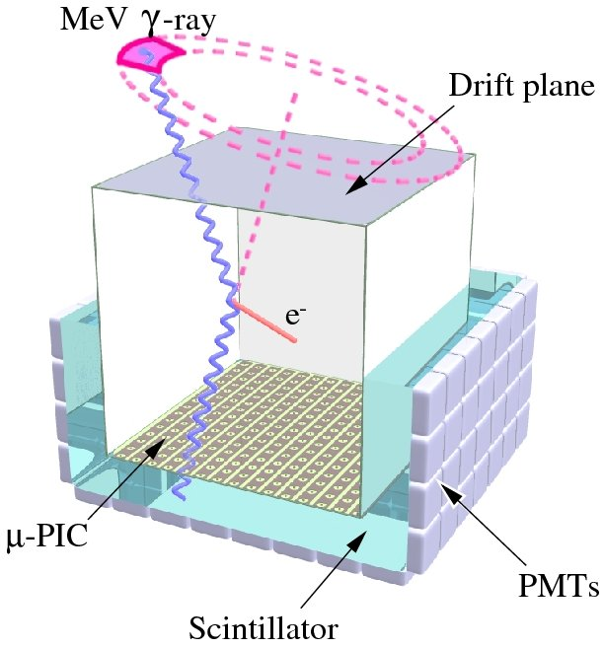
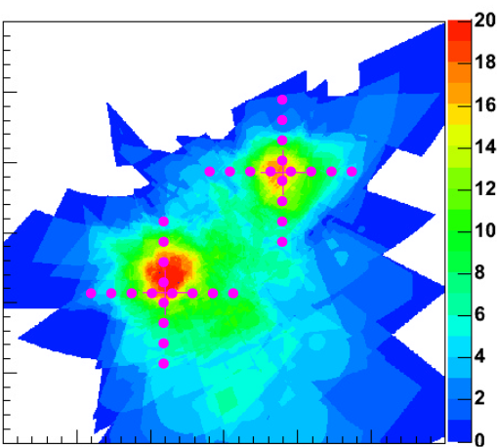
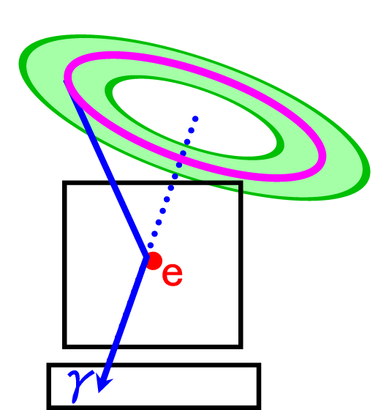
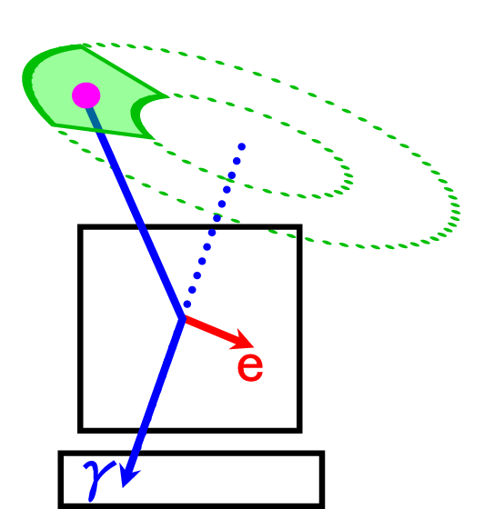
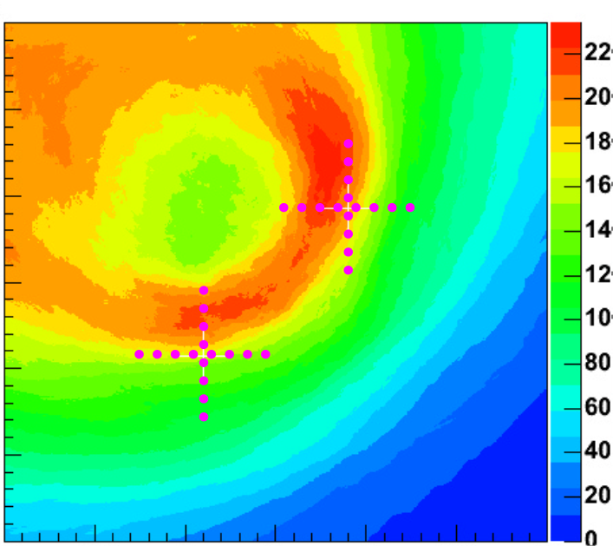
Electron-Tracking Compton Camera (ETCC)
with electron tracking
(ETCC)
without electron tracking
(COMPTEL)
α
Schematic view of ETCC
Gaseous TPC : Tracker
track and energy
of recoil electron
Scintillator : Absorber
position and energy
of scattered gamma
Reconstruct Compton scattering
event by event
1 photon ⇒ direction + energy
Large fielf of view (~3str)
Kinematical noise rejection (α)
Notes:
我々は、電子飛跡検出型コンプトンカメラを開発した。
We developed the Electron-Tracking Compton Camera. This detector

Slide 4
Sub-MeV gamma-ray Imaging
Loaded-on-balloon Experiment (SMILE)
10cm cube camera @ Sanriku (Sep. 1st 2006)
Operation test @ balloon altitude
Observation of
diffuse cosmic/atmospheric gamma
~400 photons during 3 hours
(100 keV~1MeV)
SMILE-I
30cm cube camera
Checking the imaging performance
by observing gamma rays from Crab/Cyg X-1
SMILE-II
40cm cube camera
Sub-MeV ~ MeV
Long duration observation with super pressure balloon
Adding pair-creation mode
50cm cube camera
All sky survey (load on a satellite)

Slide 5
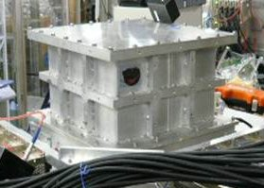
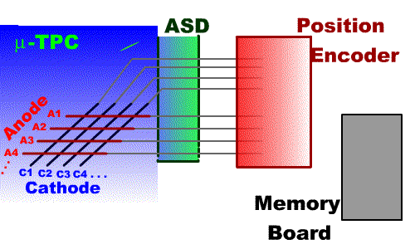
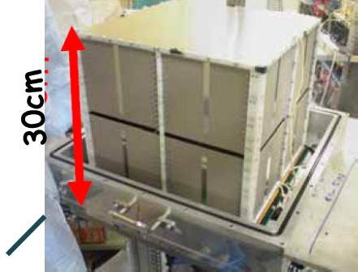
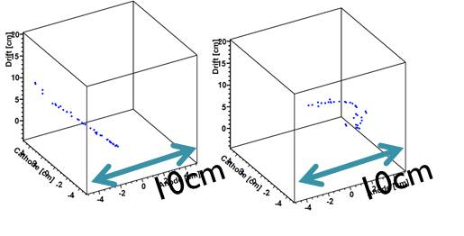
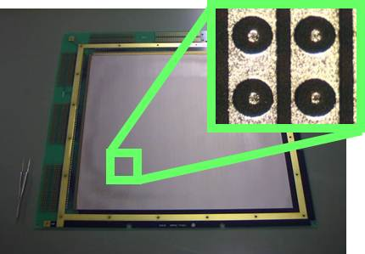
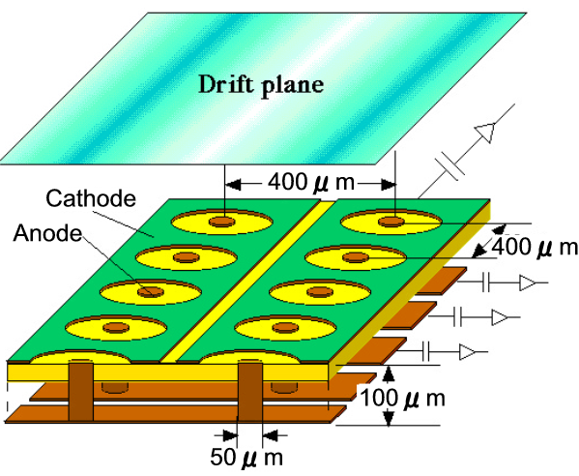
Gaseous TPC
(micro-TPC)
Gas : Ar 90% + C₂H₆ 10% 1atm, sealed
Gain : ~10⁶
Drift velocity (4 cm/μsec)
position resolution: 400μm
Electric Field
Pressure Vessel
micro PIxel Chamber(μ−PIC)
sliced proportional chambers
2D readout (400 μm pitch)
Large detection area : (30cm)²
Drift Cage
cosmic muon
recoil electron
Data of (10 cm)³ ETCC

Slide 6
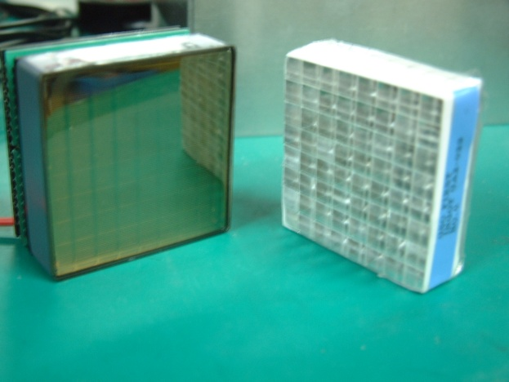
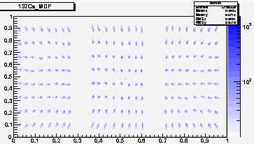
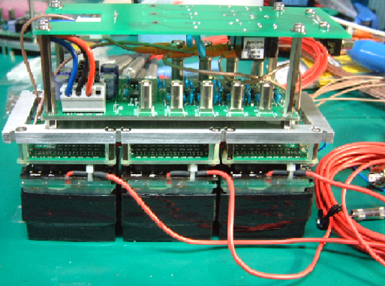
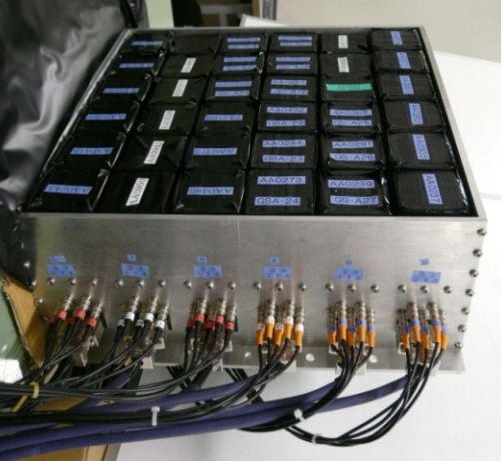
Scintillation Camera
Scintillator : GSO(Ce)
Pixel size : 6x6x13 mm³
Photo readout : multi anode PMT H8500
(Hamamatsu Photonics)
4 channels readout with resistor chain
¹³⁷Cs
Position imaging map
H8500
5cm
8×8 anodes
GSO 8×8 pixels
30cm
30cm
14cm
Absorber Unit
6×6 units

Slide 7
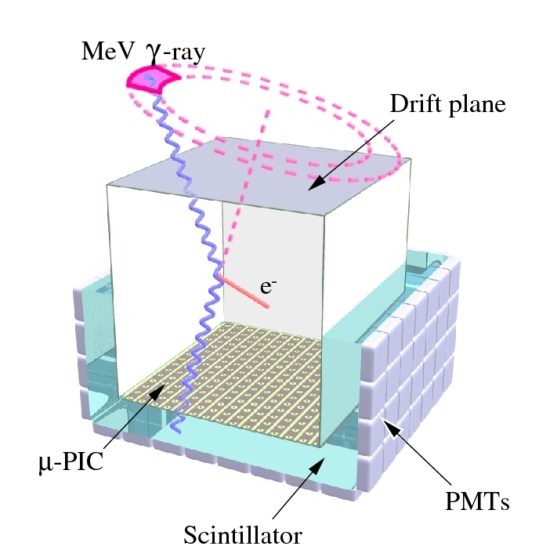
(30 cm)³ prototype ETCC

Slide 8
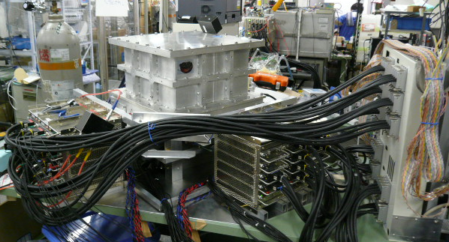
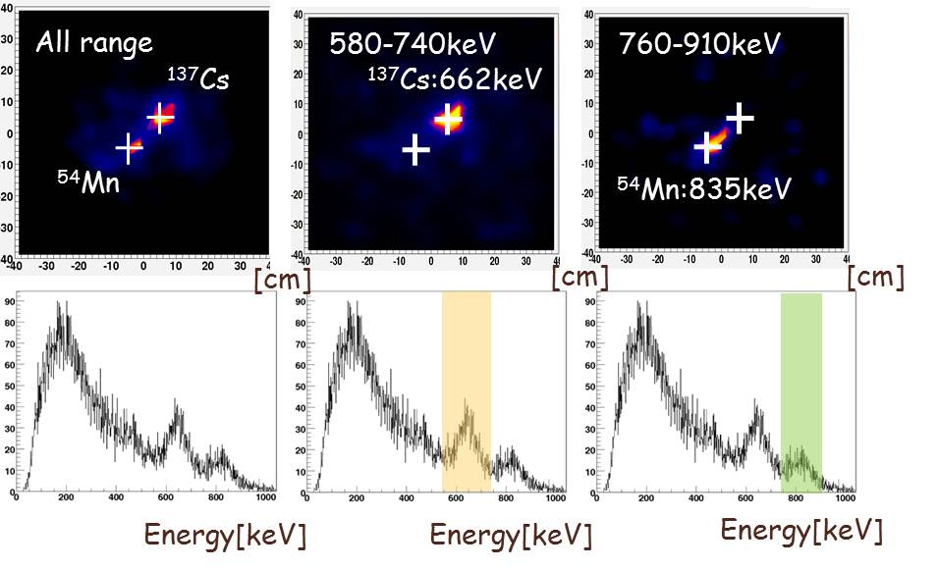
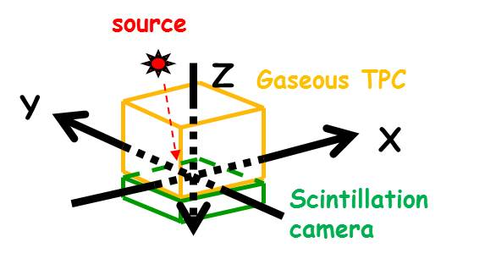
Imaging performance
(30cm)³ Gaseous TPC
40cm
¹³⁷Cs : 662keV, 1MBq (X,Y,Z) = (5, 5, -52) [cm]
⁵⁴Mn : 835keV, 1MBq (X,Y,Z) = (-5, -5, -52) [cm]
Scintillation Camera
(6×6 absorber units)

Slide 9
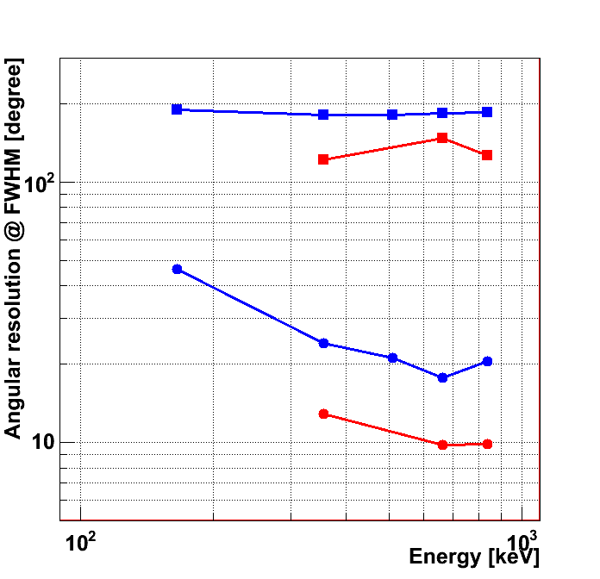
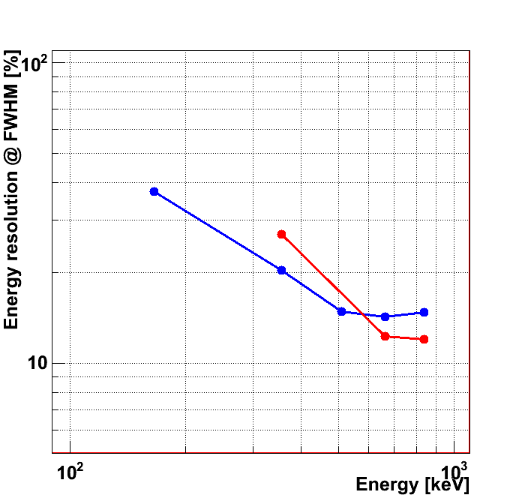
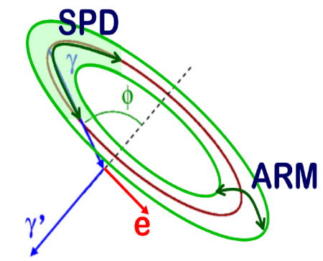
Angular and energy resolutions
SMILE-I
SPD
(30 cm)³ ETCC
(30 cm)³ ETCC
SMILE-I
SMILE-I
ARM
(30 cm)³ ETCC
SPD: 147[deg]
ARM: 9.8[deg]
DE/E: 12.3%
(FWHM) @662keV
183[deg]
17.7[deg]
14.3%
SMILE-I
ARM : Angular Resolution Measure
SPD : Scatter Plane Deviation

Slide 10
New readout circuit of the scintillation camera for SMILE-II

Slide 11
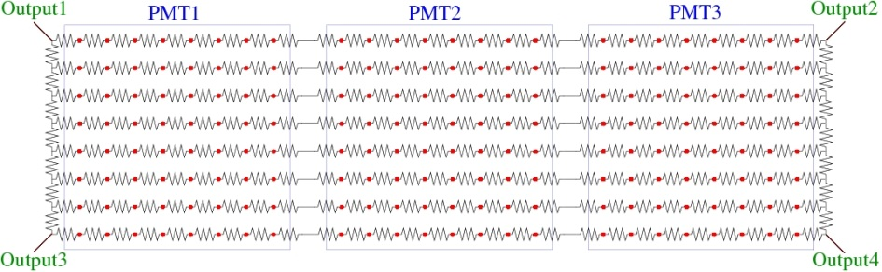
Readout System of Scintillation Cameras for SMILE-I
Use resistor chain to reduce the power consumption.
••• 192 anode outputs -> 4channel
Power consumption of the readout system
••• 1.71 W/channel
Energy resolution :
••• 11% (FWHM, at 662 keV)
Typical dynamic range :
••• 80keV – 800keV
readout circuit for SMILE-I.
for SMILE-II, we need
Wider dynamic range
192anodes/4ch -> 64anodes/4ch
Saving the power consumption
Use recent power saving electrical components
The same or higher energy resolution.
resistor chain
192 channels -> 4 channels
To meet these requirements,
we developed the new readout system.

Slide 12
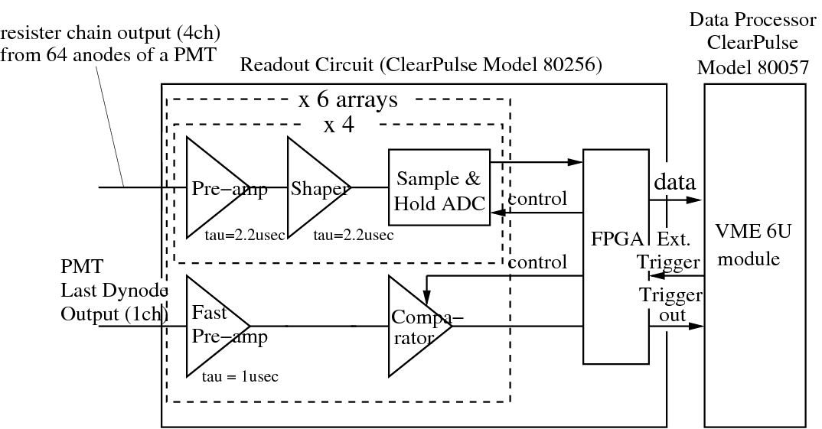
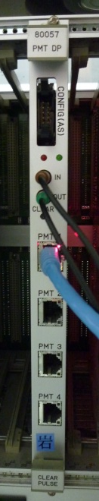
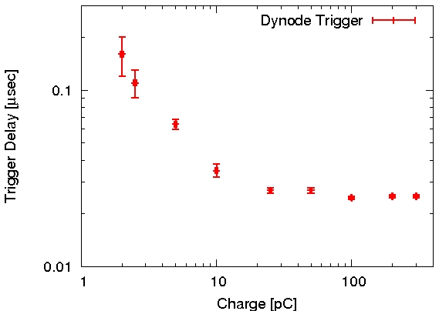
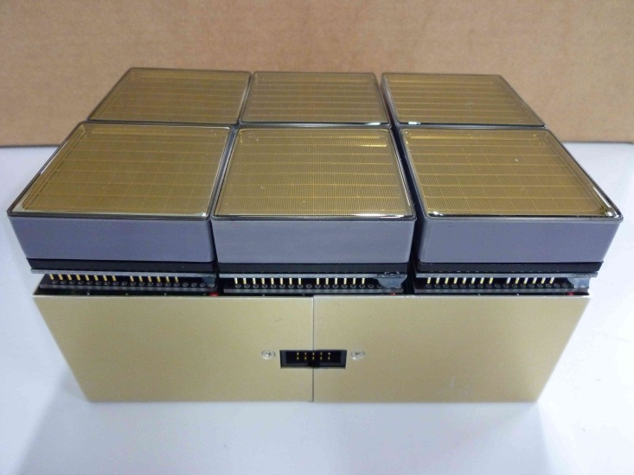
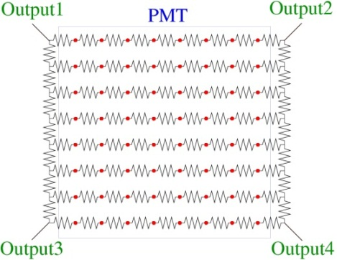
New Readout System of Scintillation Cameras for SMILE-II
We developed the new readout circuit of scintillation cameras with ClearPulse Co. Ltd.
• Use the resistor chain
(64 anodes /4 channels)
• Power consumption
0.41 W/channel
• 2×3 PMTs can be attached to one readout circuit.
• Use the output of the last dynode for the generation of the trigger of DAQ.
2×3PMTs
Readout
Circuit
resistor chain
The trigger delay and its change
are small enough for SMILE-II
64 anodes -> 4 channels

Slide 13
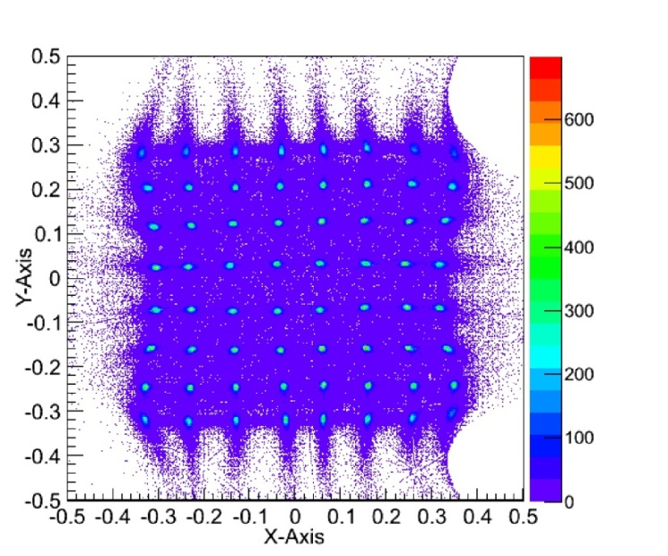
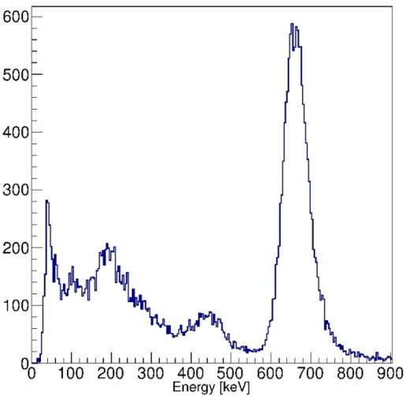
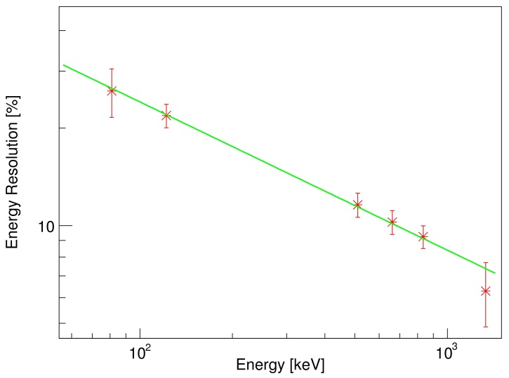
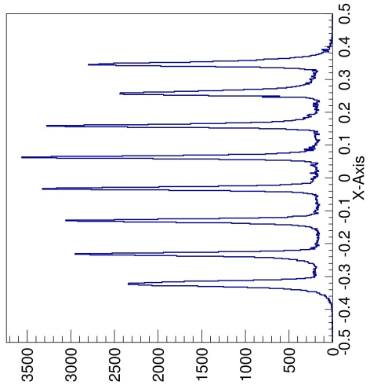
Performances of the new readout circuit
We checked the performance of the new readout circuit with a PMT (HV = -900V)
by using several irradiation sources.
Fig.1 : reconstructed
2-dimensional histogram (¹³⁷Cs)
Fig.3 : typical energy spectrum
of one pixel (¹³⁷Cs)
Fig.4 : Energy Resolution
(10.3±0.9% at 662keV )
•Reconstructed Image of absorption points is good.
•Peak-to-valley ratio 10:1 well separated
•Energy Resolution : 10.3±0.9% at 662keV.
It’s enough for SMILE-II.
•Energy dynamic range : 81 keV – 1332keV.
(SMILE-I dynamic range : 80 keV-800 keV).
Fig.2 : x-projection of a row (red circle) in Fig.1

Slide 14

conclusion
Developing the ETCC for MeV gamma ray astronomy.
Used a (10 cm)³ ETCC in SMILE-I (2006).
As the next step, we have been developing the (30 cm)³ ETCC
for SMILE-II.
Constructed a prototype (30 cm)³ ETCC, and checked its performance.
Developed a new low-power readout system of scintillation cameras
for SMILE-II, and checked its performance.
Power consumption ••• 0.41 W/channel
Dynamic range ••• 81keV - 1333 keV
Energy Resolution ••• 10.3 ± 0.9 % at 662 keV
SPD: 147[deg]
ARM: 9.8[deg] @662keV
DE/E: 12.3% (FWHM)
Available for SMILE-II
And the future work is …

Slide 15
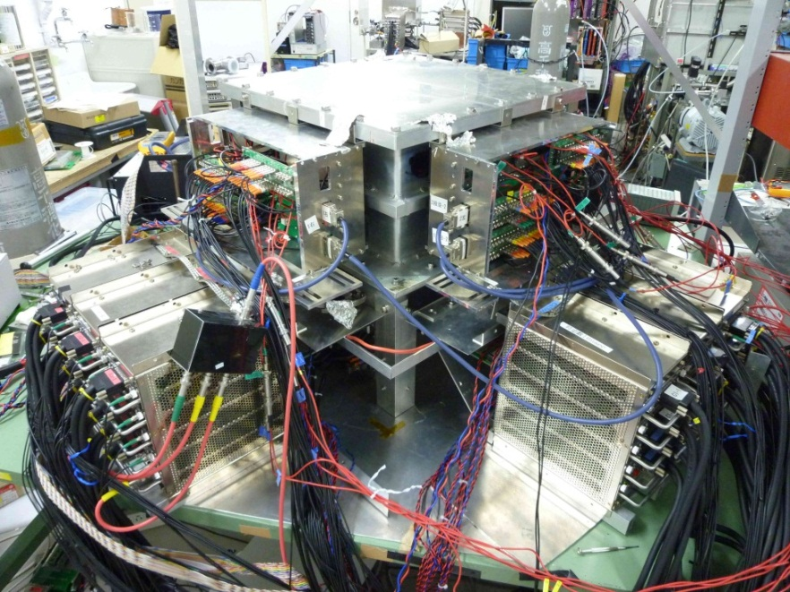
Future work
Development and performance study of the (30 cm)³ prototype ETCC
with bottom and side scintillation cameras (108 absorber units).
We will begin changing to the new readout system for the scintillation camera.
Side scintillation cameras
(3 × 6 absorber units per one face)
Bottom scintillation cameras
(6 × 6 absorber units)
Development of the (30 cm)³ flight-model ETCC for SMILE-II experiment.

Slide 16
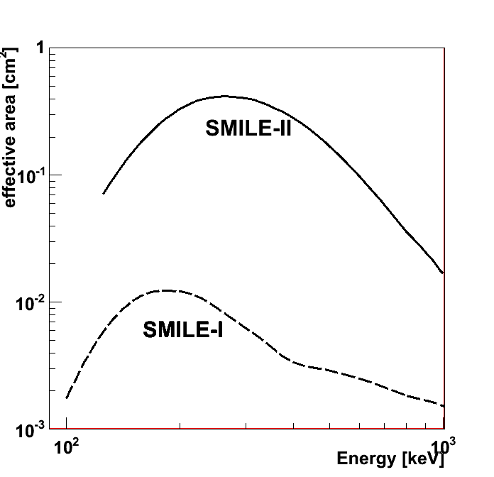
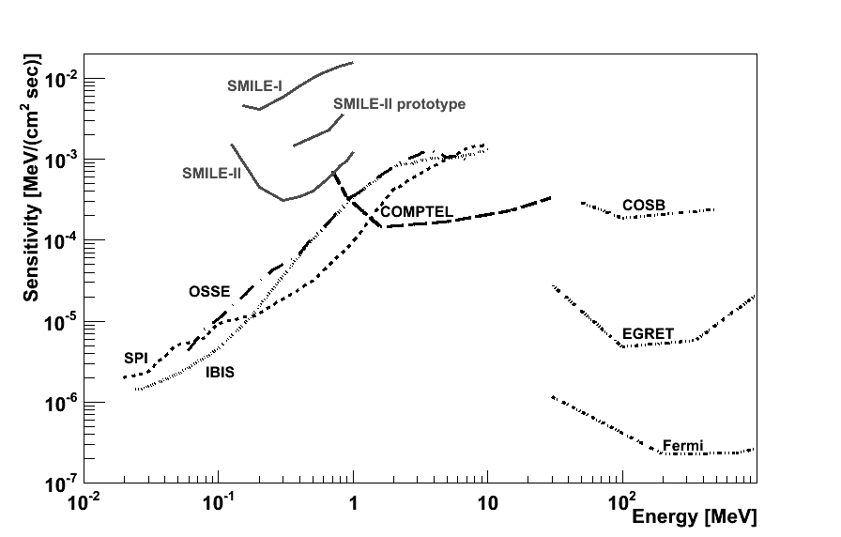
Future work
In SMILE-II, we will use 216 absorber units for the (30 cm)³ ETCC .
estimated effective area : 0.5cm².
(50 times larger than that of (10 cm)³ ETCC for SMILE-I)
Effective area
SMILE-I
sensitivity
SMILE-II
×50
To observe gamma rays from the Crab nebula at a 5 sigma confidence level in the 5 hour SMILE-II measurement, we are developing the (30cm) ³ flight-model ETCC using the result of the prototype ETCC.

Slide 17
End

Slide 18
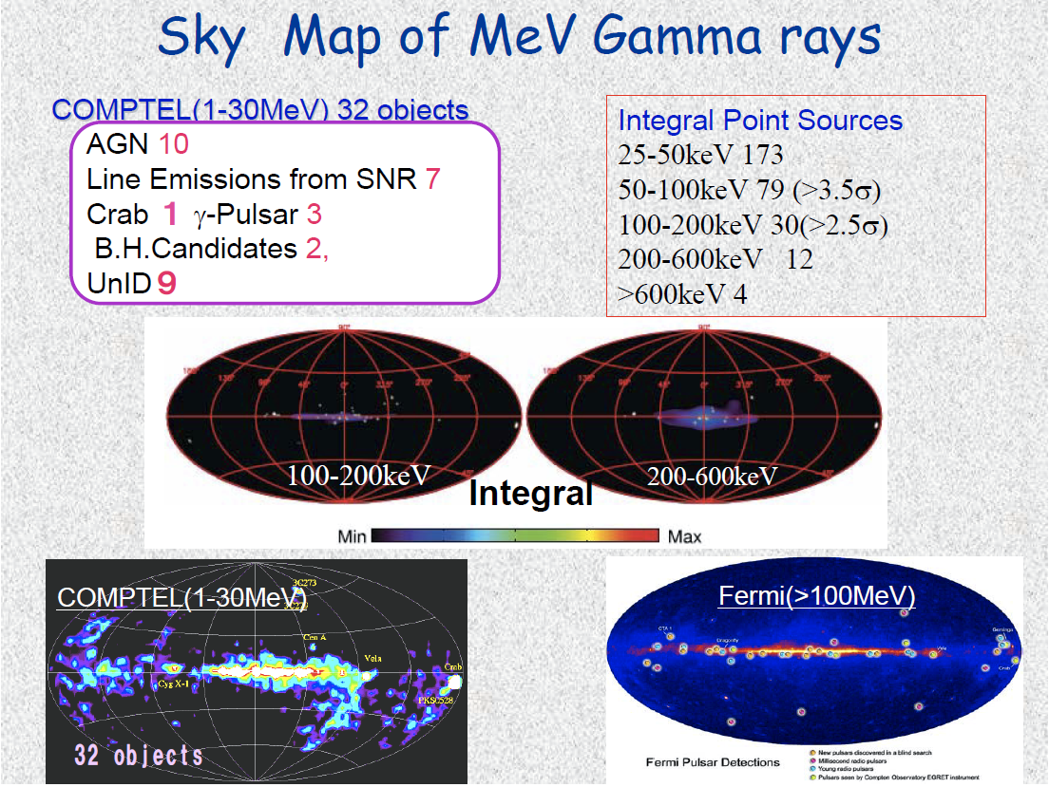
Motivation
Observation of MeV gamma-ray will provide us…
Nucleosynthesis
SNR : Radio-isotopes
Galactic plane : ²⁶Al・⁶⁰Fe
Annihilation
Acceleration
Jet (AGN) : Synchrotron
+ Inverse Compton
Strong Gravitational Potential
Black Hole : accretion disk, π⁰
Etc.
Gamma-ray Pulsar, solar flare
Bad
erg / (cm² sec)
Sensitivity
1mCrab
EGRET
Air
Cherenkov
Fermi
Astro-H
Obs. Time : 10⁶ sec
Good
～１°
The observation of continuum component is also important.
Where are MeV gamma-ray objects?
There are many background events which obstruct the observations.
Wide-band detection
Large Field of View
Background rejection
Requirements for
the next-generation detectors are …

Slide 19
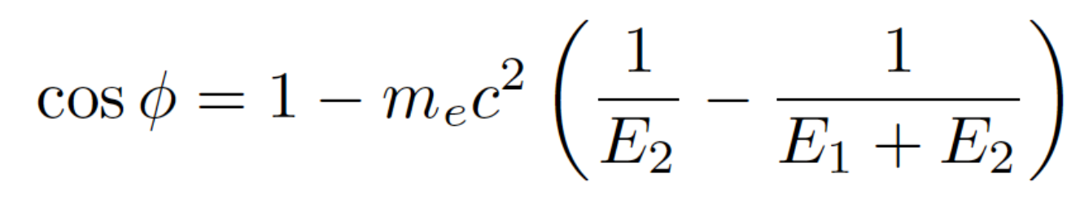
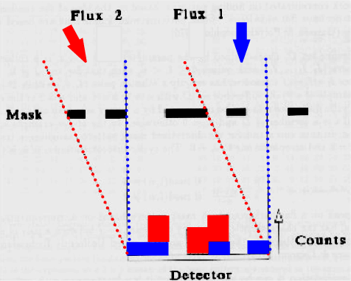
MeV gamma-ray imaging
source
Collimator + position-sensitive detector
⇒ OSSE (CGRO)
Coded Aperture Imaging
⇒ BAT (SWIFT), SPI (INTEGRAL)
Laue Lens
Compton imaging
⇒ COMPTEL (CGRO)
narrow FOV
background from collimator
Energy < 1MeV
PSD
wide FOV & good angular resolution
photons from outside of mask are background
imaging of the spread sources is difficult
Energy < 1MeV
narrow FOV & good angular resolution
mono-energy
Low-Z
wide Energy band
only event circle
no background rejection
High-Z
A new method with satisfying requirements
Single Compton

Slide 20
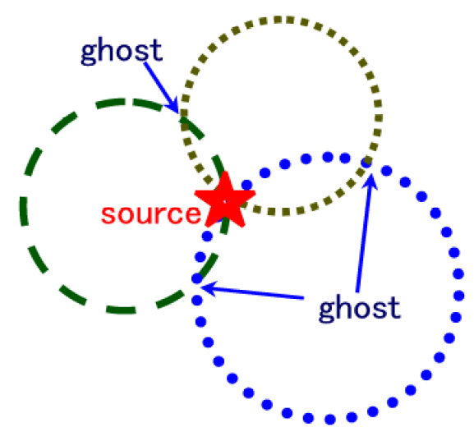
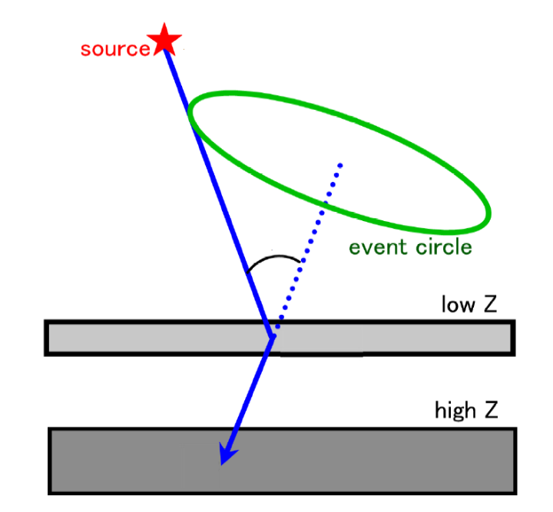
COMPTEL (CGRO:1991～2000)
Using Compton Scattering
E₀
energies of scattered gamma
and recoil electron
Energy of incident gamma
Scattering angle
φ
Liquid scinti.
Compton scattering point
& Absorption point
E₁
NaI(Tl)
E₂
Direction of scattered gamma
ignore the direction of recoil electron
Restrict the direction of incident
gamma-ray to a circle
The source position is determined fully
by piling up circles
require 3 γ at least

Slide 21
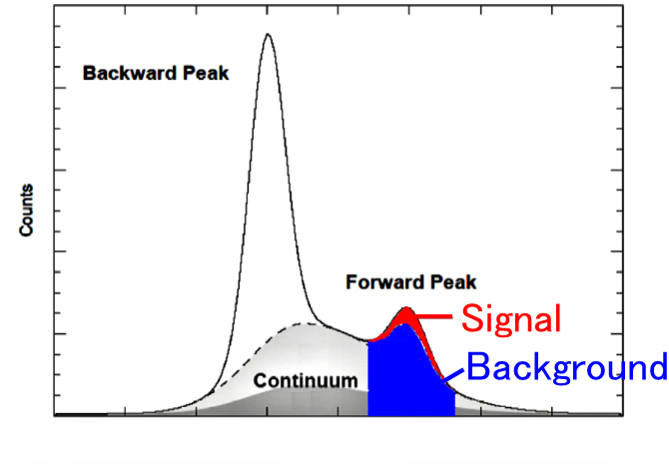
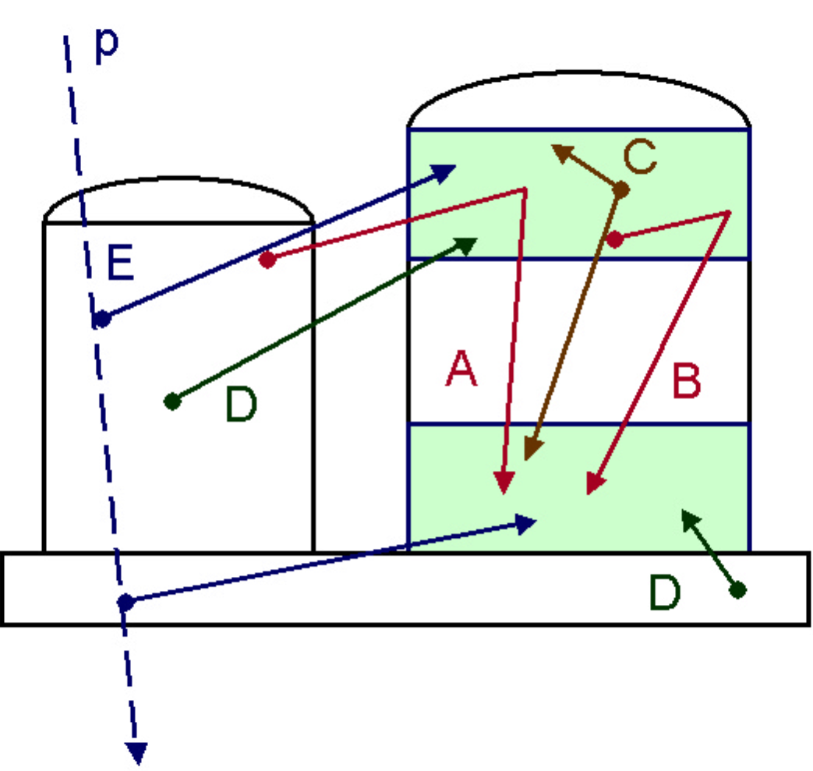
Background of COMPTEL
G.Weidenspointner, et.al. (A&A, 2001)
A：external γ
B：internal γ
C：two γ
D：random coincidence
E: proton-induced γ
Intrinsic
background
Other background
  neutron
  electron
  gamma from atmosphere
TOF of 2 detectors
backward
COMPTEL has rejected such background by the measurement of the Time Of Flight between 2 detectors.
forward
Background rejection was not complete
Bad S/N
-20
-10
0
10
[nsec]

Slide 22
Comparison with the usual Compton method
Electron-Tracking Compton
Usual Compton Imaging
(ETCC)
(COMPTEL)
Using the electron tracks
Not using the electron tracks
complete direction within
sector form error region
only event circle within
ring form error region
Simply overlay
Simply overlay
2 sources were
separated clearly
Hard to separate
2 sources
15
15
150 events
Y [cm]
Y [cm]
600 events
-15
-15
-15
X [cm]
15
-15
X [cm]
15
¹³⁷Cs(1MBq)×2, Advanced Compton
¹³⁷Cs(1MBq)×2, usual Compton

Slide 23
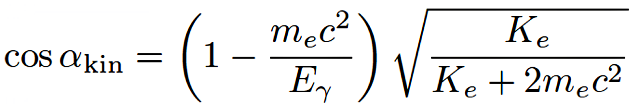
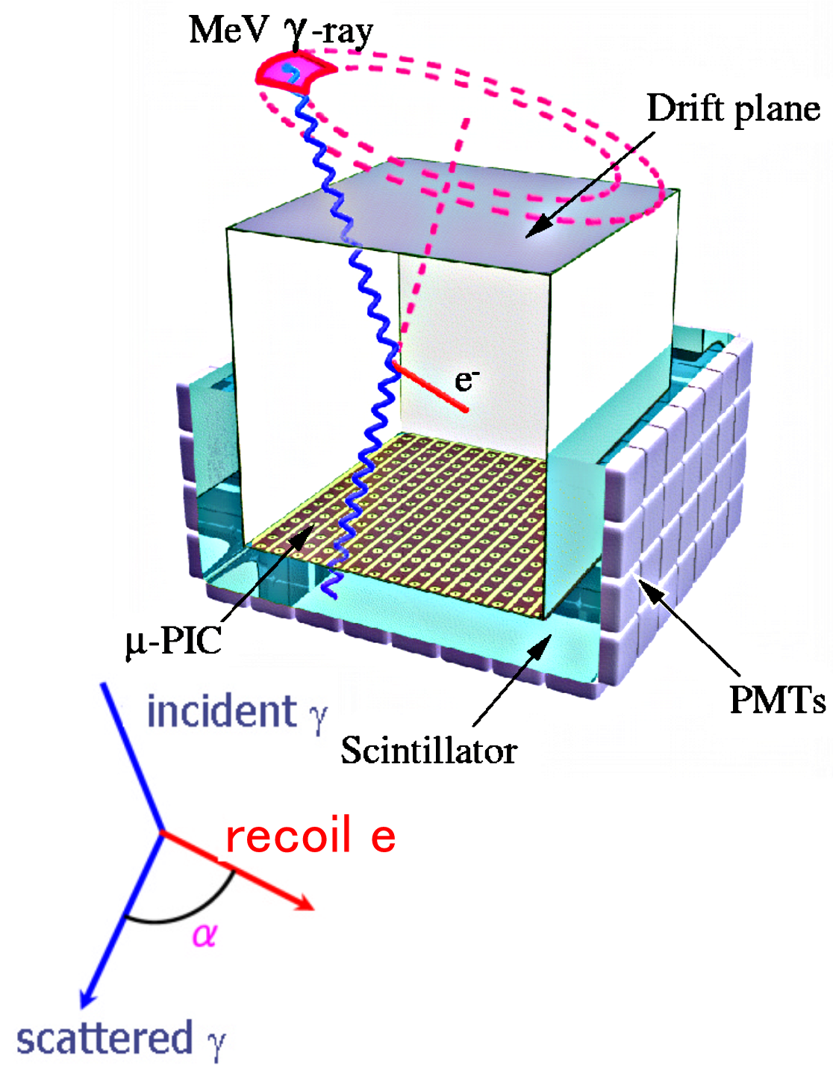
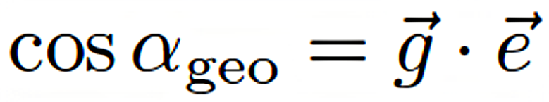
Electron-Tracking Compton Camera (ETCC)
Gaseous TPC : Tracker
track and energy
of recoil electron
Scintillator : Absorber
position and energy
of scattered gamma
Reconstruct Compton scattering
event by event
1 photon ⇒ direction + energy
Large FOV (~3str)
Kinematical background rejection
E_{γ} : Energy of scattered gamma-ray
K_{e} : Kinematic energy of recoil electron
m_{e}c² : Rest mass of electron
g : unit vector of scattering direction
e : unit vector of recoil direction

Slide 24
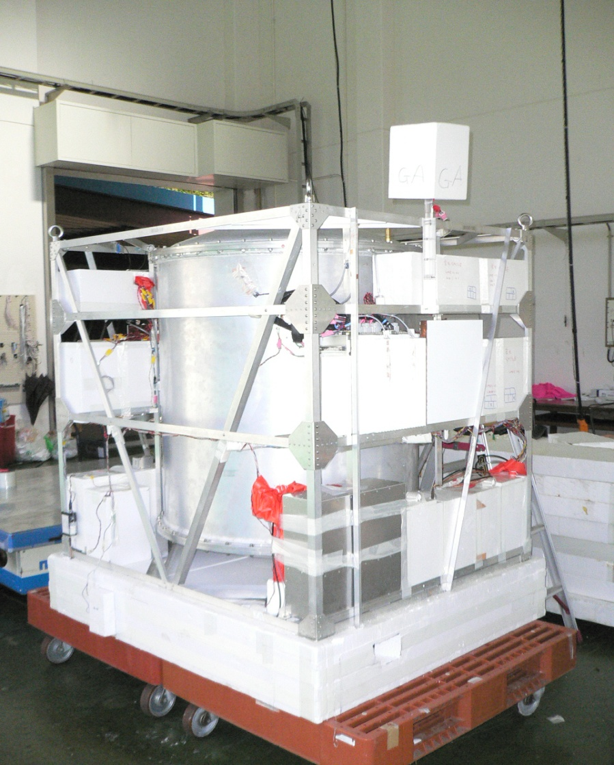
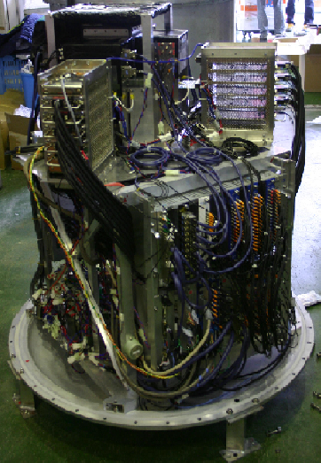
SMILE-I gondola
GA
Regulator
Plastic scinti.
Bessel
GSO
scinti.
Battery
TPC
preamplifier
Ballast
Battery
NIM module
Shaper
DAC
VME module
CPU
ADC
telemetry
scaler
Size : 1.45×1.2×1.55m³
Weight : 397 kg
Power : ~250 W
No posture control !!
FPGA encoding
board

Slide 25
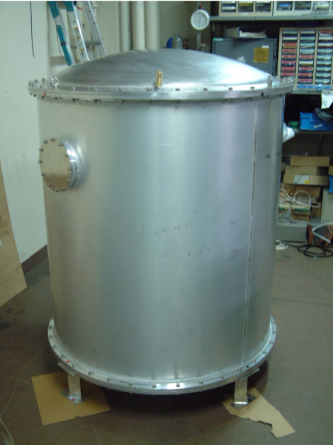
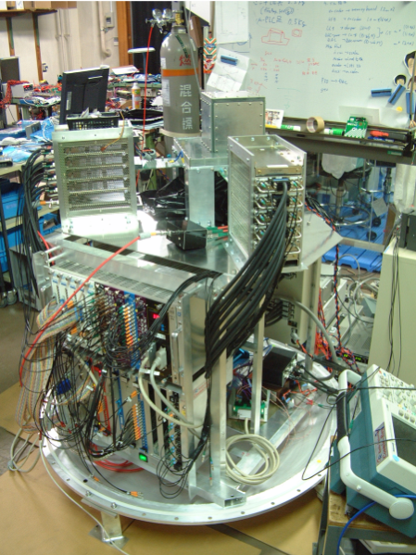
1st Flight SMILE
Gondola size: 1.45×1.2×1.55m³
Gondola weight: 397kg
Bessel: φ1×1.4m³
Power: ~350W
  in Bessel：220W
TPC
ASD
In Bessel (1 atm)
Detector, DAQ system, Storage, Thermometer,
Pressure gauge,
GPS, Clinometer
Flight Control
Telemetry,
Transponder,
Buoy, Radiosonde,
GPS, Thermometer,
Pressure gauge, etc.
φ~1m
1.4m
GSO
Out of Bessel
Battery & Regulator,
Thermometer,
Pressure gauge,
GPS antenna,
Geomagnetic aspectmeter
Balloon
B100 (100,000m³)
Weight 816kg
Buoyancy 888.2kg
NIM
encoder
VME

Slide 26

1st Flight SMILE
Gondola size: 1.45×1.2×1.55m³
Gondola weight: 397kg
Bessel: φ1×1.4m³
Power: ~350W
  in Bessel：220W
GA
TPC
Regulator
ASD
Bessel
In Bessel (1 atm)
Detector, DAQ system, Storage, Thermometer,
Pressure gauge,
GPS, Clinometer
Flight Control
Telemetry,
Transponder,
Buoy, Radiosonde,
GPS, Thermometer,
Pressure gauge, etc.
Battery
φ~1m
1.4m
GSO
Out of Bessel
Battery & Regulator,
Thermometer,
Pressure gauge,
GPS antenna,
Geomagnetic aspectmeter
Balloon
B100 (100,000m³)
Weight 816kg
Buoyancy 888.2kg
NIM
Ballast
Battery
encoder
VME

Slide 27


1st Flight SMILE
Gondola size: 1.45×1.2×1.55m³
Gondola weight: 397kg
Bessel: φ1×1.4m³
Power: ~350W
  in Bessel：220W
GA
TPC
Regulator
ASD
Bessel
In Bessel (1 atm)
Detector, DAQ system, Storage, Thermometer,
Pressure gauge,
GPS, Clinometer
Flight Control
Telemetry,
Transponder,
Buoy, Radiosonde,
GPS, Thermometer,
Pressure gauge, etc.
Battery
φ~1m
1.4m
GSO
Out of Bessel
Battery & Regulator,
Thermometer,
Pressure gauge,
GPS antenna,
Geomagnetic aspectmeter
Balloon
B100 (100,000m³)
Weight 816kg
Buoyancy 888.2kg
NIM
Ballast
Battery
encoder
1.55m
VME
1.20m
1.45m

Slide 28
Sensitivity of X/Gamma-ray observations
Bad
SMILE-I
erg / (cm² sec)
EGRET
Sensitivity
1mCrab
goal
Air
Cherenkov
Fermi
Astro-H
Obs. Time : 10⁶ sec
Good
～１°

Slide 29




GEM
F.Sauli
Gas
Electron
Multiplier
F.Sauli, CERN
Kapton
(d=50μm)
140μm
10cm
70μm
Cupper
(d=5μm)

