Slide 1

Preliminary results for Compton Imaging of the AGATA A006 detector
Mike Slee
PSD9-Aberystwyth
15/09/2011

Slide 2
Motivation
Data has been taken with the AGATA A006 detector to develop Compton imaging capabilities.

Slide 3
Overview
Introduction to AGATA
Introduce Gamma-ray tracking and Pulse Shape Analysis
Compton Imaging
Preliminary results of energy and position
Pulse Shape Analysis in greater detail

Slide 4
Introduction
Reconstructing data from a single 36 fold segmented High Purity Germanium (HPGe) AGATA crystal. Detector with good energy resolution.
Similar to using two single detectors, comparing data from two rings.
The advantage of using a large volume single crystal is a greater efficiency.

Slide 5
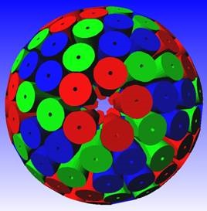
Introduction to AGATA
The AGATA project is part of the next generation of high resolution gamma spectroscopy arrays.
These arrays improve the photopeak efficiency to around 40% @ 1332KeV
Achieved by creating a 4 π ball of Germanium (Ge) composed of 180 HPGe crystals around the target, removing Bismuth Germinate (BGO) suppression shield.
Utilising gamma-ray tracking to reconstruct interactions of Compton scattered gamma-rays.
Compton
rejected
Full energy
accepted

Slide 6
Gamma-ray Tracking
Use a high fold segmented Germanium detector and utilise electronics to process the digital signal.
Using the information on the positions of the interaction points and the energies , the tracks of the gamma-rays can be reconstructed.
Able to extract energy, timing and spatial information on the interactions through Pulse Shape Analysis of signals.
Source

Slide 7
PSA
Pulse Shape Analysis makes use of the differences in signal shapes observed.
Shorter time for the charge carriers to reach electrode due to close proximity.
Important to have detailed understanding of the pulse shapes to have accurate gamma-ray tracking. One way to test this is to use Compton Image Reconstruction, this also has imaging applications.

Slide 8
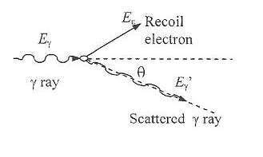
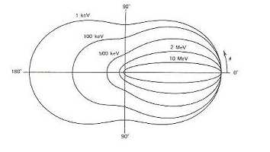
Compton Image reconstruction
This is based around the principles of Compton scattering, the most likely interaction mechanism for gamma-rays, in the energy range of 150 keV to 1.5 MeV.
(G.F Knoll, 2000)
The angle a gamma ray scatters can be predicted by the Klein-Nishina formula. This takes into account the rate of scattering events normalized to the incident intensity, the material density, the size and the efficiency of the detector.
(G.F Knoll, 2000)

Slide 9
Compton Image reconstruction
2 detectors. Front optimised for Compton scattering and the rear optimised for photo-electric absorption

Slide 10
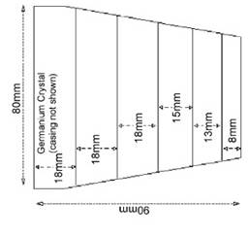

Interaction 2
Interaction 1
Cone
ɵ
Scatter
Absorber
Scatter angle
Energy deposited in the first interaction and total energy of gamma-ray determines the incident angle.
Where
Source

Slide 11
Cone Reconstruction

Slide 12
The three main sources of error are :
1) Finite energy resolution of detector.
2) Finite position resolution of the detector.
3) Non –zero momentum of the bound electron .
The first and third sources of error affect the determination of the opening angle of the cone and the final one affects the determination of the axis.
To reduce these errors a gamma-ray detector with excellent energy and position resolution is required.

Slide 13
Interaction 2
Interaction 1
Cone
ɵ
Scatter
Absorber
Scatter angle
Source

Slide 14
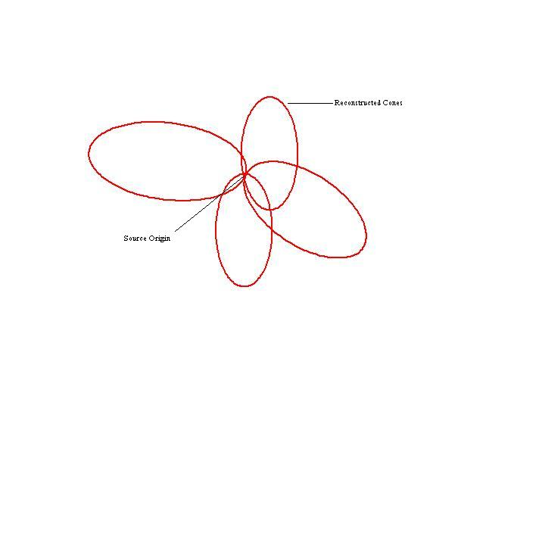
Cone Reconstruction

Slide 15
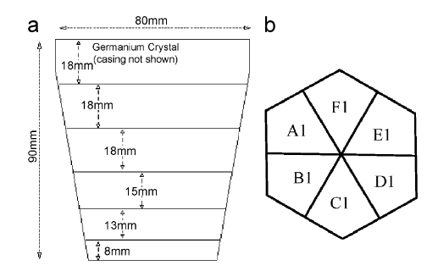
Experimental Method
Reconstructing data from a single AGATA crystal.
A 137 Cs source was placed directly below the centre (i.e. segment intersection point) of the crystal front face.
Preliminary position and energy results.

Slide 16
Experimental Method

Slide 17
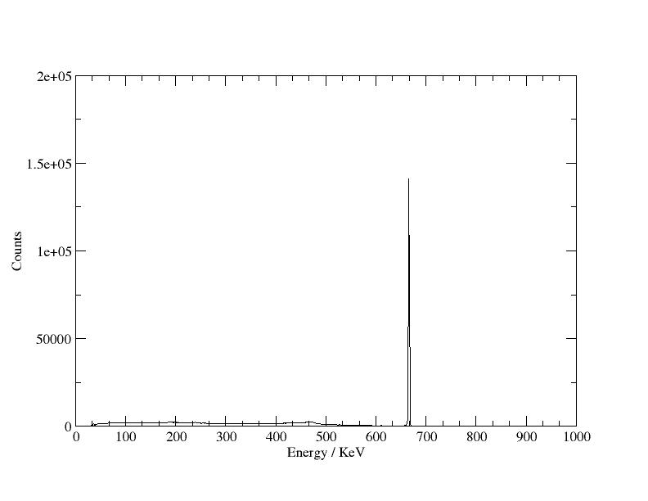
Energy Resolution
FWHM = 2.45 keV @662 keV

Slide 18
Energy matrix
energy second detector
To be completed
energy first detector

Slide 19
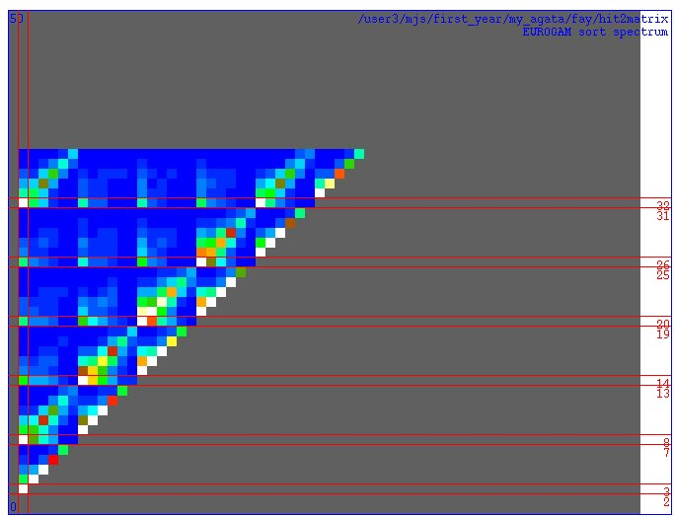
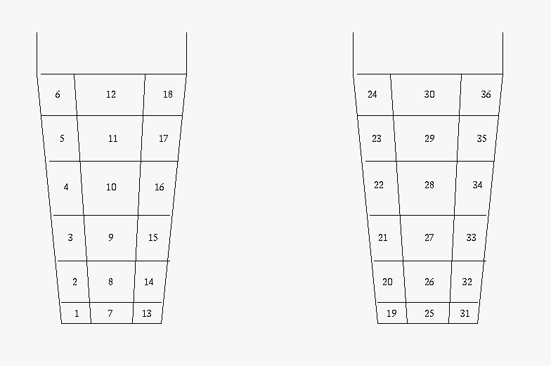
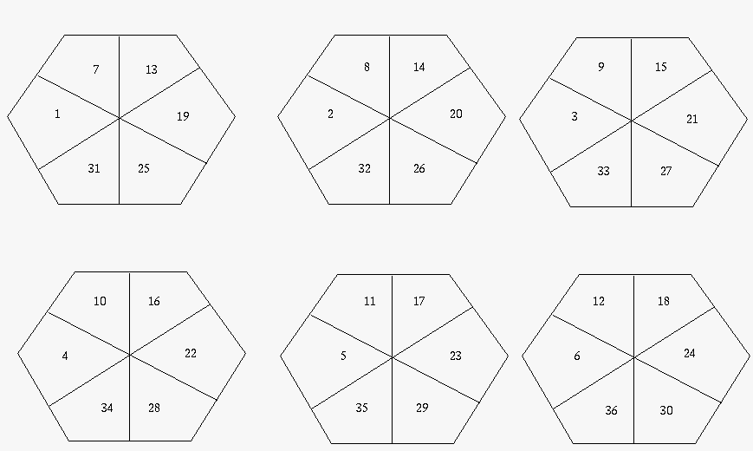
Interaction sites within the detector
Second hit segment
Segment Layout
First hit segment

Slide 20
Segment Layout

Slide 21
Pulse Shape Analysis
Charge pulse from gamma-ray interaction contains information on event .
Aim to study different approaches to position determination.
Future work is to analyse PSA using library methods and parametric methods.

Slide 22
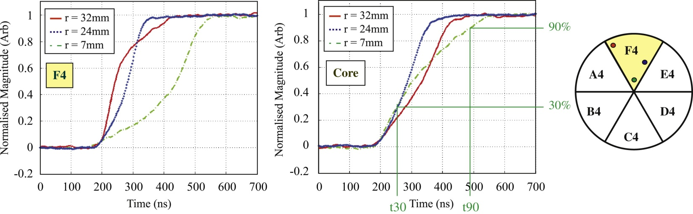
Parametric PSA
Analysis of the rise time (T30 – T90) and image charge asymmetry.
Pulses from the outer edge of the crystal respond quicker, electrons to outer cathode and holes to anode.
Analysis of the pulses enable the depth of interaction to be located.

Slide 23

T30 vs T90
T90
T30

Slide 24
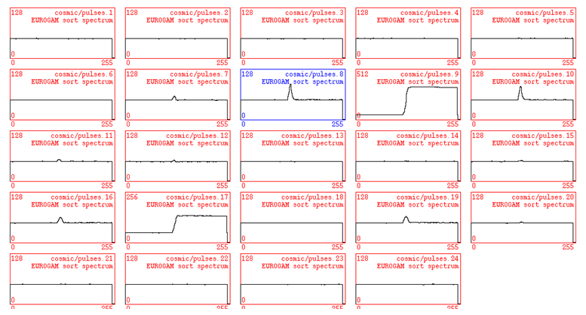
Parametric PSA
Image Charge
Real Charge

Slide 25
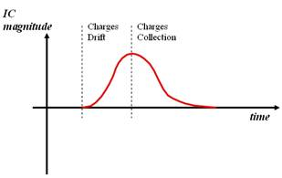
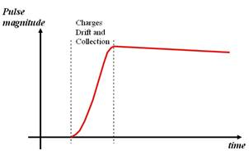
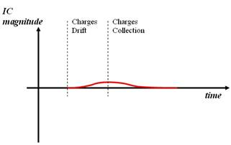
Parametric PSA
Image Charge asymmetry varies with lateral interaction position

Slide 26
Parametric PSA
Image Charge asymmetry varies with lateral interaction position

Slide 27
Parametric PSA
Image Charge asymmetry varies with lateral interaction position

Slide 28
BASIS
Event by event comparison of pulse shapes with a basis dataset.
χ² minimisation to find best match between observed pulse and generated dataset pulse.
Advantage of this method is the whole pulse analysed .
Better determination of position.

Slide 29
BASIS

Slide 30
Z slices
Y
Z

Slide 31
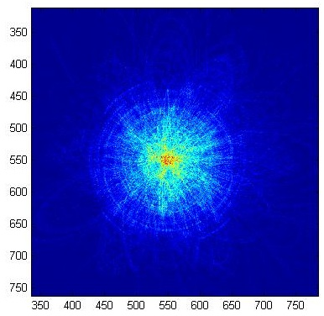
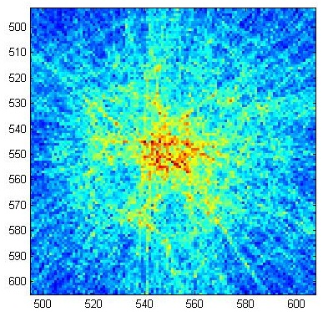
Reconstructed Image

Slide 32
Current and Further Work
Instead of using the centroid as the position of interaction in a segment use analysis of the pulse shapes and comparison of basis dataset to improve the position resolution.
Comparison of position resolution from different rings, greater distance creates a narrower cone.
Investigate the minimum number of cones required to create a coherent image.

Slide 33
Acknowledgements
A J Boston, H Boston, S J Colosimo, F Filmer, L J Harkness, M Jones, D S Judson, S Moon, D C Oxley, D P Scraggs, A Sweeney, C Unsworth and AGATA collaboration

