Slide 1


Pixellated CZT high-energy X-ray instrument
Paul Seller
RAL
Cd(Zn)Te X-ray detectors
80 x 80 pixel X-ray imaging system
Results and applications
Construction of larger area detectors
Notes:
I am going to talk about a Pixellated CZT based X-ray instrument we have built.
I will say Something about the problems in CZT
Explain the imaging system
Say something about results and applications
Explain the current development under way for larger areas.

Slide 2
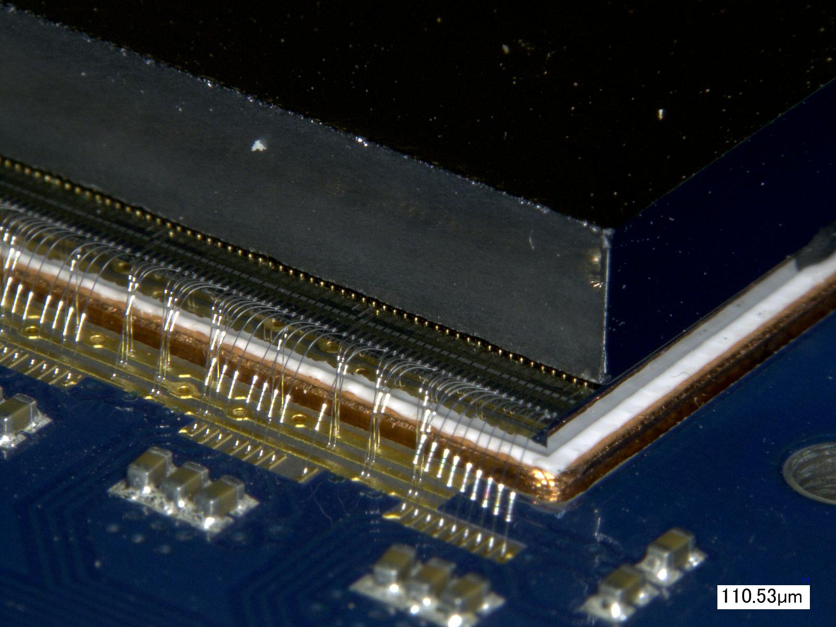
Cd(Zn)Te X-ray pixel detectors
3mm CZT gold stud bonded to ASIC and wire bonded to CoB
Notes:
At RAL we have bonded many CZT detector devices.
Here you see the CZT bump bonded with Gold stud and Silver glue dots to the 8080 readout ASIC.
This in turn is mounted on a copper inset and wire bonded to a Chip-on-Board card.

Slide 3
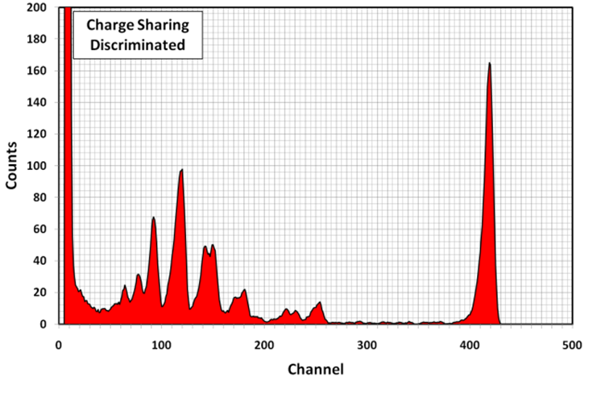
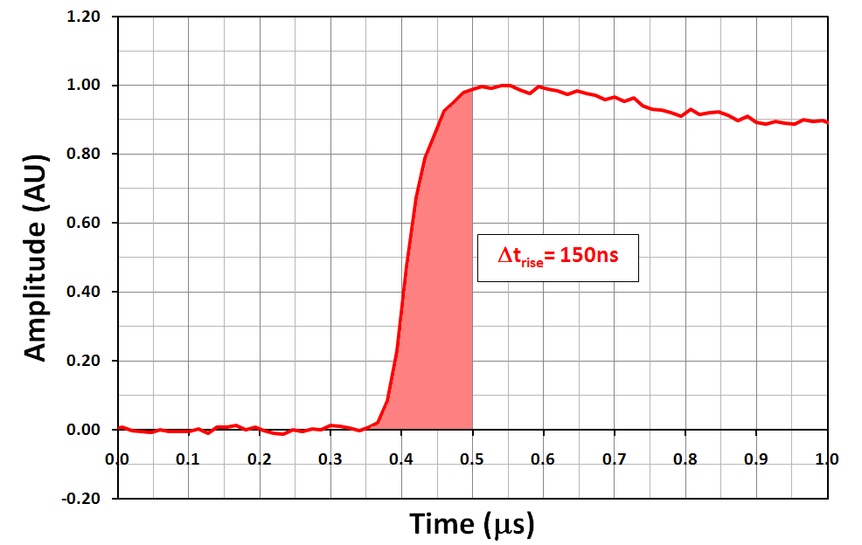
  Cd(Zn)Te detector limitations
Charge carriers can be ‘trapped’ in the bulk.
This is depends on depth of interaction so we use:
Small-Pixel-Effect.
holes
CZT Tailing
Q
electrons
i_{sig}
Carrier transit times typically can be 100-500ns in CZT
Limits shaping time of the signal processing (no ballistic deficit).
Notes:
X-rays converting in the CZT produce e-h pairs which drift in the applied electric field.
Both the e and h induced signal on the pixel pads.
The holes particularly can be trapped which causes loss of signal. Causing tailing in the spectra.
We use the so called small-pixel-effect. This effectively converts it into a single carrier sensitive device and reduces tailing.
The electrons and holes take several hundred ns to travel through the 2-3mm of CZT which limits readout speed.

Slide 4
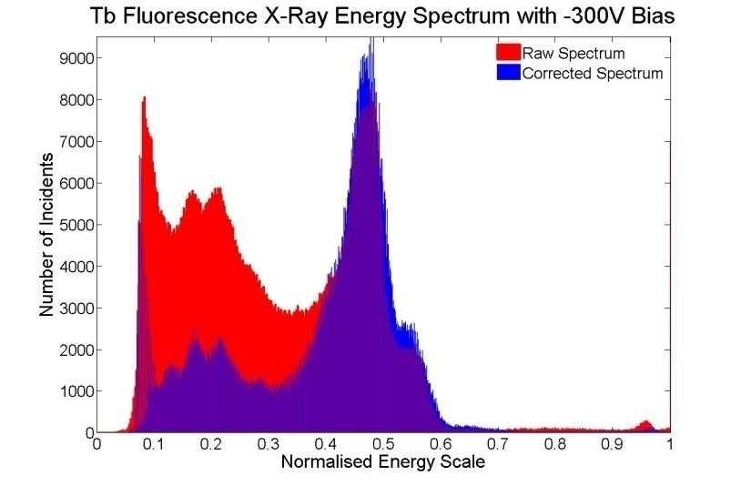
  Cd(Zn)Te detector limitations
+bias
X-ray
As q drifts in the electric field it also diffuses in all directions. This produces Charge Sharing between pixels and can give rise to ‘tailing’ or multiple hits in photon counting systems.
Florescence photons at small pixel sizes.
Charge
sharing
in CZT
e-
h+
P+ diodes
Small pixels require complex charge reconstruction algorithms
to get good spectral and spatial resolution.
Notes:
Another limitation is that charge carriers diffuse while they are drifting. This can typically be up to 100um.
This charge sharing causes blurring of the spectra as the charge is partly measured on several pixels.
Also Te and Cd fluoresce at about 25-30 keV which has a range of 60um
By adding the signals together you can reconstruct the good spectra but this requires processing.

Slide 5
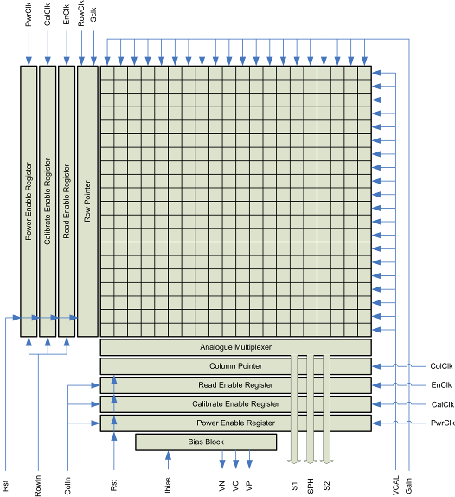
Cd(Zn)Te Spectroscopy ASIC
80x80 pixel arrays on one ASIC
250um x 250um pixels
Rolling shutter type readout
Analogue outputs
Range 5keV-200keV
AMS 0.35um CMOS
Notes:
These constraints have lead us to a geometry for our detector.
We have built a 8080 pixel detector with relatively large 250um pixels which still have small-pixel-effect.
This is readout in a rolling shutter fashion.
We readout all the analogue data for correction latter.
It has an energy range of 5-200keV

Slide 6
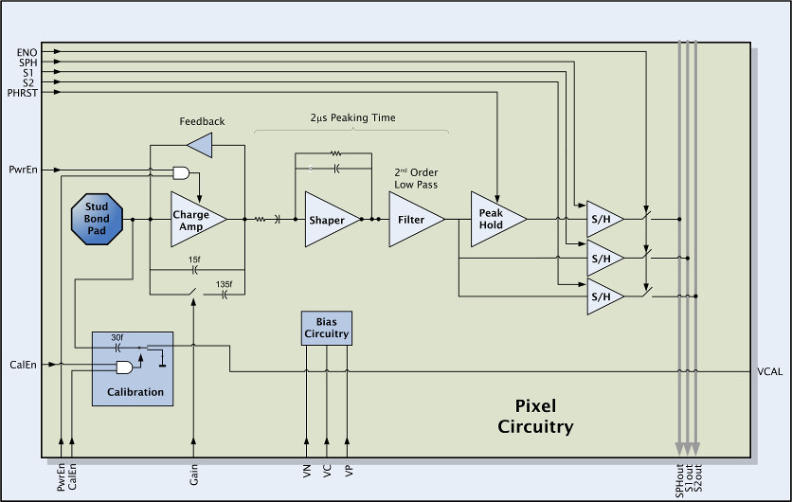
Cd(Zn)Te Spectroscopy ASIC Pixel
Notes:
We have a simple pixel with preamplifier,
Shaper using 2us shaping to we get low noise and no ballistic deficit from slow collection
Peak-hold to store the signal during a frame.

Slide 7
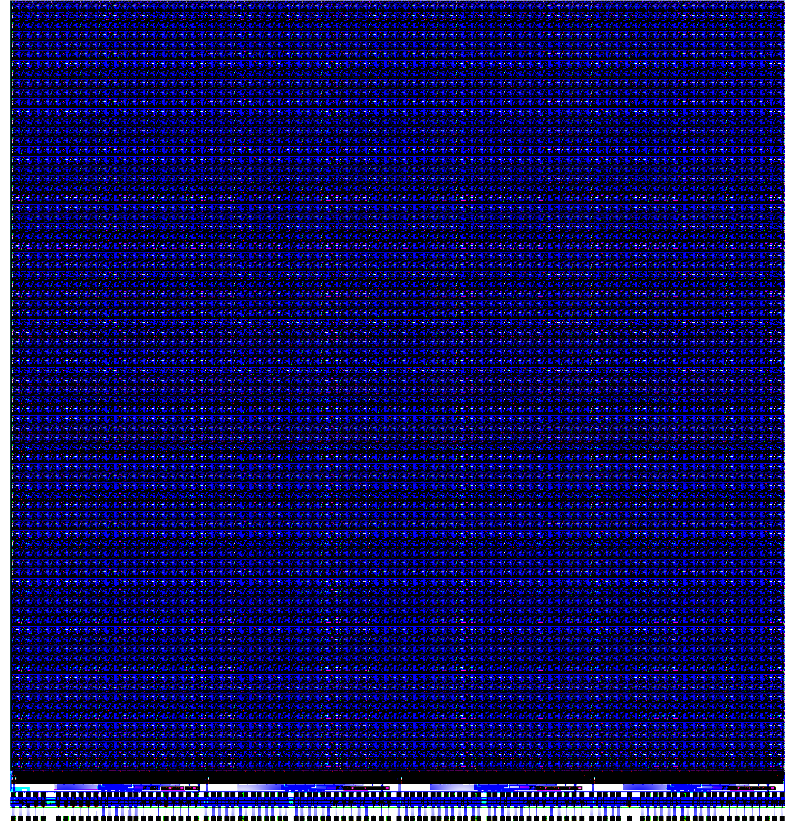
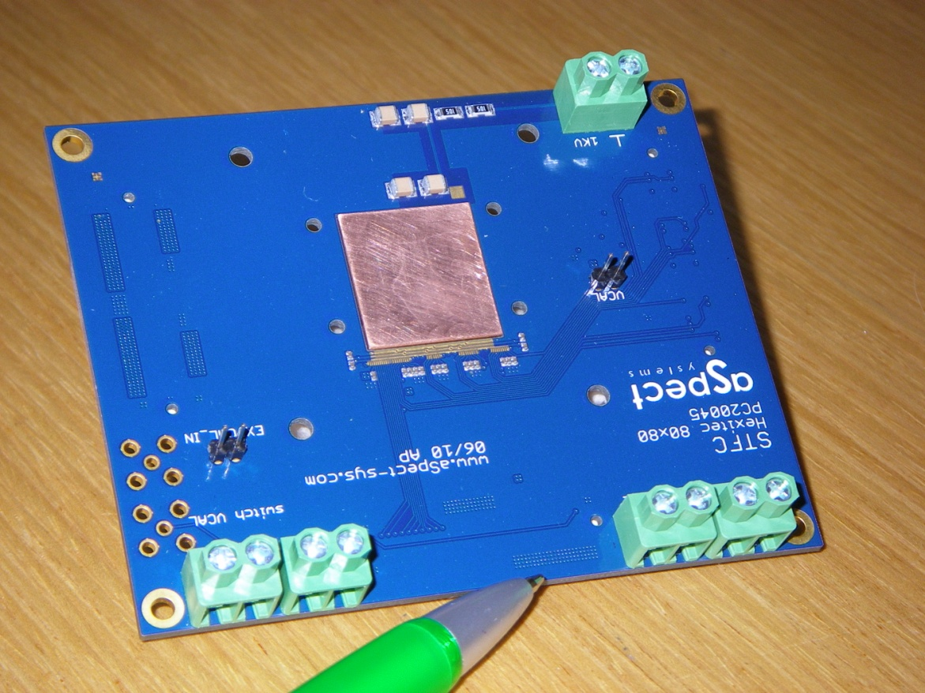
80 x 80 pixel ASIC and Readout Card with copper insert
4 blocks output at 20MHz/pixel
20x80x50ns =100us/frame
=10,000 frames/sec
Notes:
This is an image of the ASIC with 8080 pixels and the CoB with a copper insert which cools the ASIC.
We have 4 blocks of pixels in the ASIC.
It is readout at 20MHz which allows us to readout at 10,000 frames per second.

Slide 8
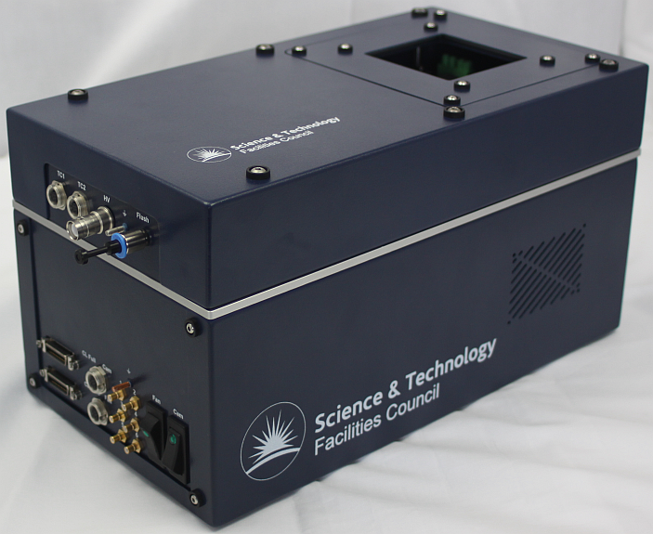
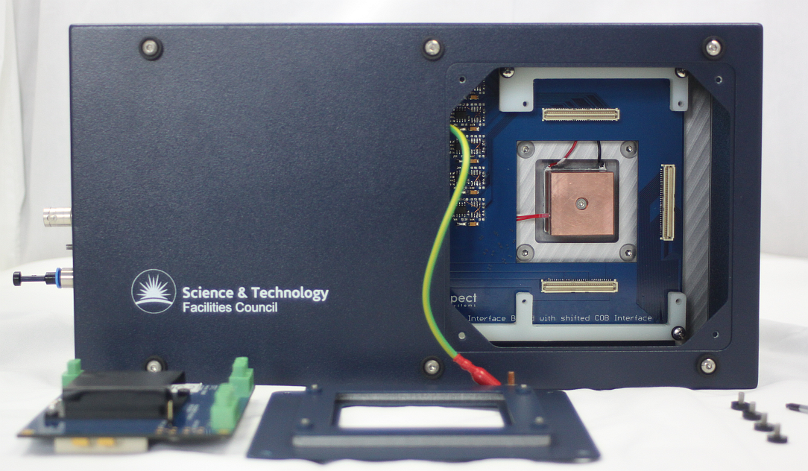
Enclosure with temperature stabilisation and Camera Link output.
Notes:
This CoB is plugged into an enclosure which contains a temperature stablaised copper block.
It also contains all the electronics to digitise and output data to a PC via Camera-Link.
Several of these systems are being used for different applications.

Slide 9
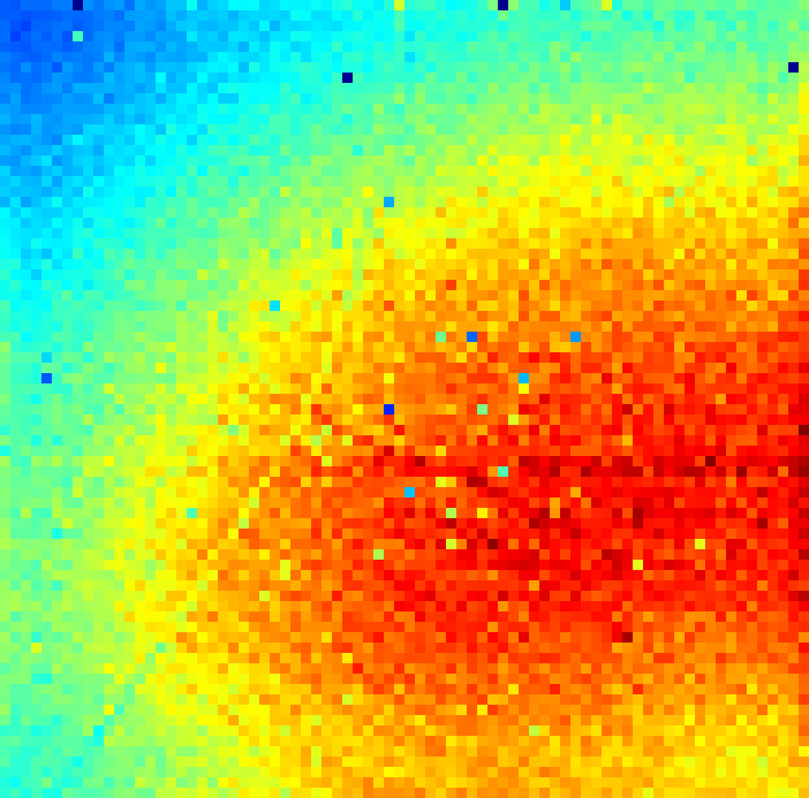
80 x 80 pixel 1mm Acrorad CdTe detector results
Pixel intensity map showing the number of events per pixel and the Am-241 spectrum from a typical pixel.
FWHM of the 60keV peak for pixels and variation in FWHM per pixel . Note the rotation of the image .
Notes:
This shows 80x80 pixel results, imaging an Am source with a 1mm CdTe detector.
Note the good spectra of Am at 60keV and Np daughters. The low count pixels are due to poor material not bad bonds.
Note the good noise uniformity and distribution of FWHM around 750eV

Slide 10
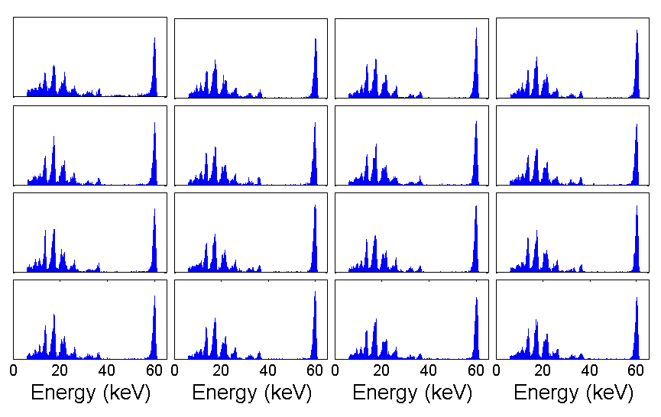
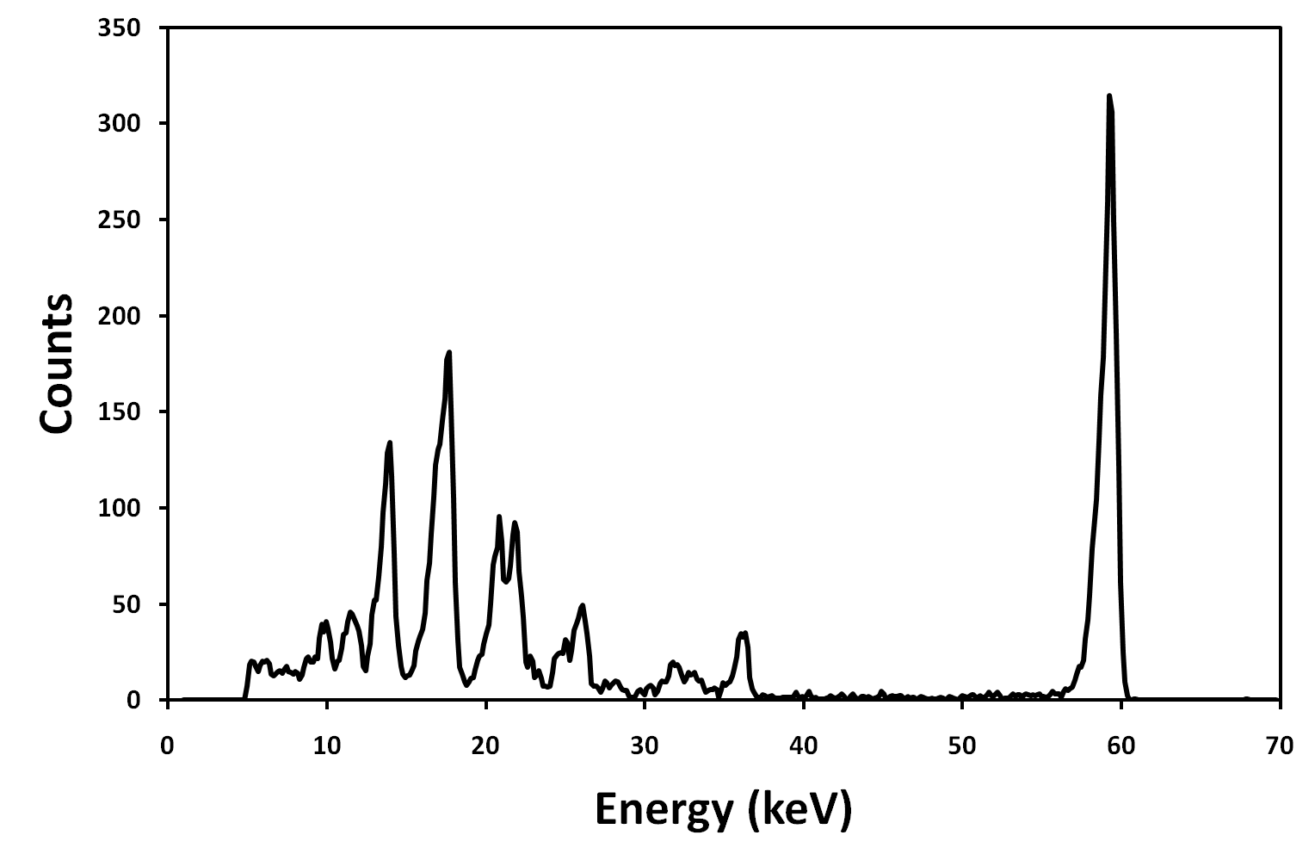
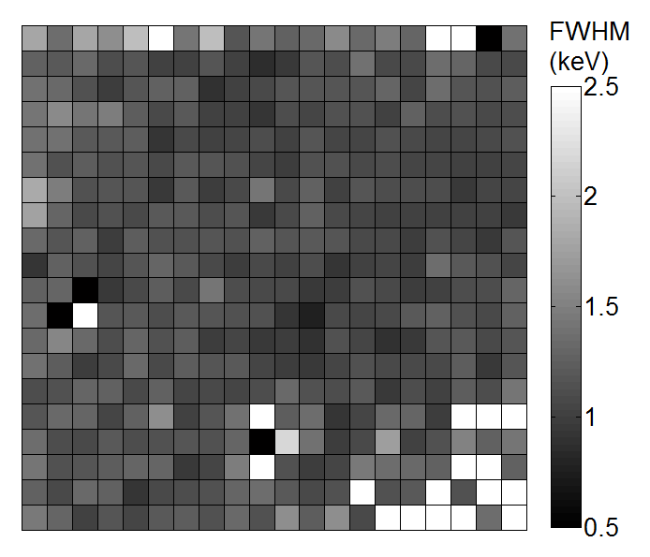
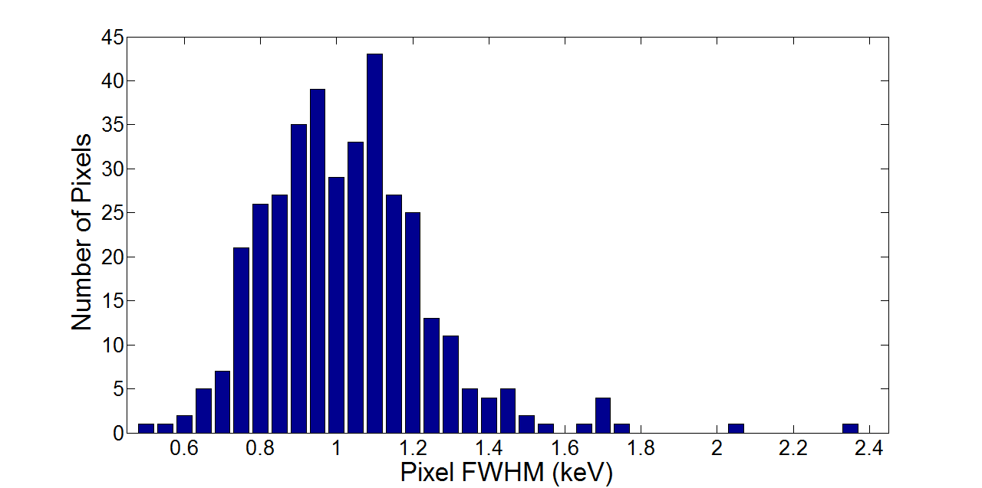
20 x 20 pixel 2mm Redlen CdZnTe detector results
Pixel map showing Am-241 spectrum from a typical pixels.
FWHM of the 60keV peak for pixels and variation in FWHM per pixel .
Notes:
This shows similar performance with a 2mm thick CZT but slightly worse FWHM due to higher leakage and charge sharing.
This is only 2020.
We are currently developing the 8080 CZT for the higher energy applications.

Slide 11
Applications with combined Energy and Position
Imaging applications
  Dual isotope SPECT
  Florescence imaging
  Astrophysics and solar X-ray, high altitude balloon project with NASA
Diffraction based techniques (white beam)
  TEDDI for material imaging
  Cancerous tissue identification of surgically removed collagen-adipose tissue.
  Drugs and explosives identification again using Energy Dispersive Diffraction and white beam source. (poster #45 tomorrow)
Notes:
We are using the system with several partners in applications that need the combined spectroscopy and imaging capability.
The imaging applications are:
As well as imaging we have several diffraction based applications.
Most diffraction techniques use monochromatic beam and image lattice using y=ndsin(0)
We use white beam and measure several diffractions at once but we can unpick this as we have the spectrum at each angle.
Teddi is a synchrotron technique to measure material, crystalline form, orientation and stress through the bulk of a material.

Slide 12
Nuclear medicine neurology and cardiology
  Surrey County Hospital data,Tc-99m spectrum and the distribution of the FWHM of the 141keV peak measured on each pixel.
Dual Isotope SPECT (Parkinson’s and Multiple System Atrophy.)
    Brain imaging with collimators and simultaneous dual isotope tracers .
    I-123 (dopamine transponders) and Tc-99m (perfusion) .
    Quality depends on separating the image of I at 159keV from Tc at 141keV .
Notes:
Surrey County Hospital have irradiated the detector with Tc99m and seen a very good spectra at 141keV.
They are studying Dual Isotope SPECT imaging to differentiate Parkinsons from MSA
They are image brain phantoms with collimators with simultaneous I and Tc tracers.
I images dopamine transponders and Tc images perfusion.
The image quality depends of separating the I at 159keV image from Tc at 140keV.
Clearly this is very good with this detector. A standard Anger camera has difficulty with this.

Slide 13
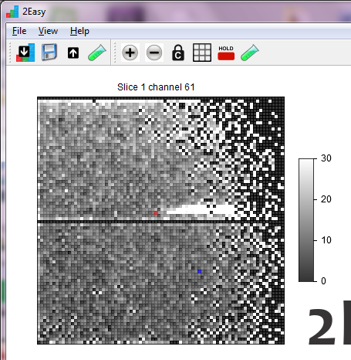
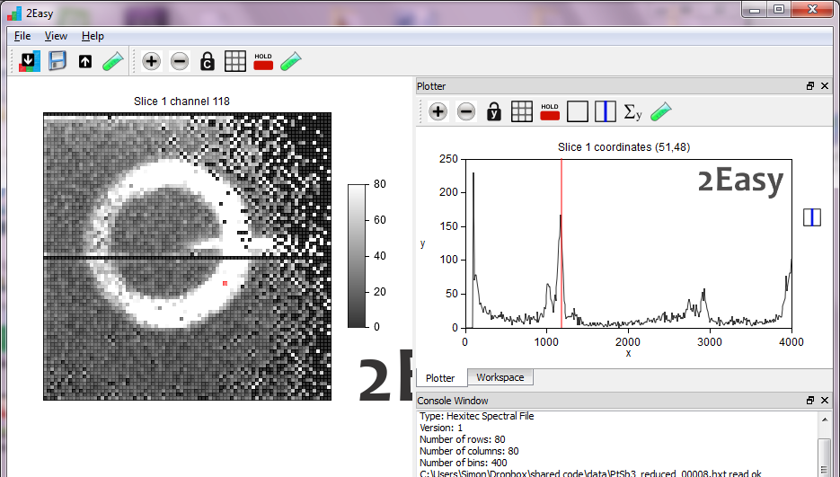
X-ray Fluorescence imaging in 3D
100um thick
X-ray ‘letter-box’
illumination
Pin
Hole
At most energies there is no image
Detector
3mm alumina shell used as Pt catalyst body.
Contaminated with Sb (Antimony).
(Manchester University data.)
At Sb k-edge (26keV) image appears
Notes:
At Manchester they used the system to image alumina catalyst shells contaminated with Antimony.
The letterbox illumination illuminated a section of the cylinder
At most energies there is no image.
At the k edge of the Antimony we can see the illuminated ring which shows the contamination.

Slide 14
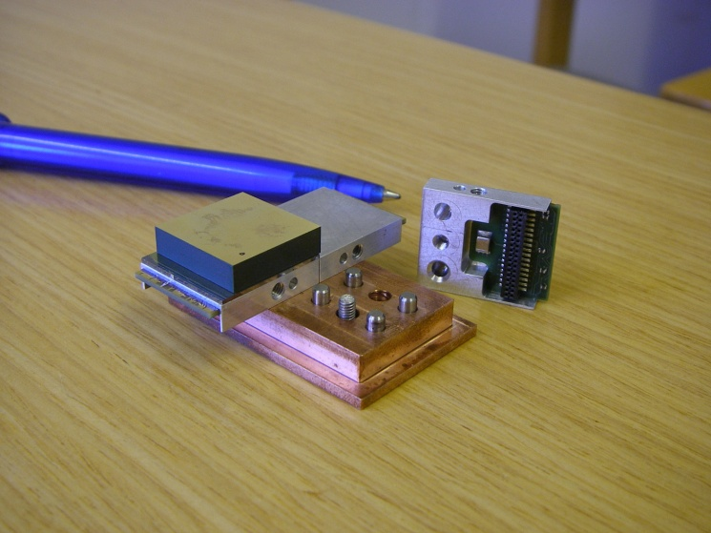
3-side butting of larger tiled array.
Detector
eg. CZT
Gold studs
Wire bond
ASIC
Heat sink
PCB
Detector
eg. CZT
Gold studs
ASIC
Heat sink
PCB
CZT detector and multi-element alignment system.
Notes:
With a single detector we can only image 20mm x 20mm.
It is difficult to make single bonded units bigger than this for several reasons.
We are currently making larger areas by mounting individual detectors and ASICs on a copper block for alignment and cooling.
We can mount 2xn detectors like this but we are currently making TSV through the silicon to bond at the back of the ASIC.
This will allow 4-side butting with small dead regions.

Slide 15
  Acknowledgements
  Cd(Zn)Te project
    M. Wilson
    M. Veale
    S. Bell
  ASICs
    M. Prydderch
    P. Murray
    M. Hart
    L. Jones
    S. Thomas
  Surrey University + Royal Surrey County Hospital (Nuclear medicine and k-edge)
    P. Sellin, J. Scuffham, S. Pani
  Manchester University( XRF imaging and TEDDI)
    B. Cernik, S. Jacques, C. Egan
  UCL (Diffraction for illicit materials)
    R. Speller, C. Christadoulou, C. Reid
  NASA (Astro-physics and solar imaging)
    B. Ramsey, J. Gaskin
Funding from EPSRC-Hexitec project and STFC-CfI.

Slide 16
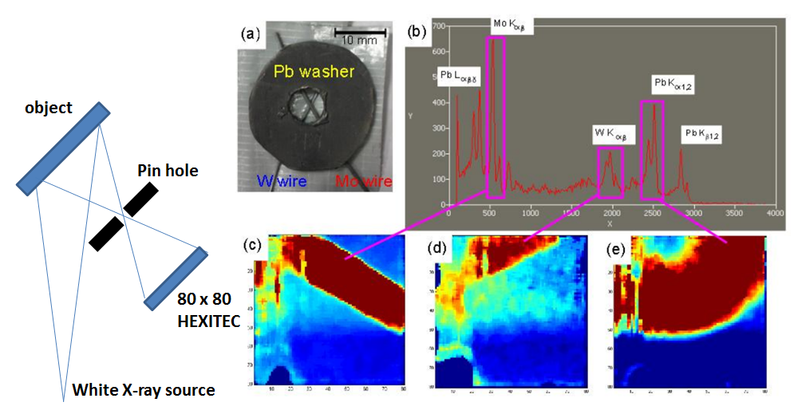
X-ray Fluorescence imaging
Test object is made up of Mo, W wires and Pb washer (17, 60, 74 keV)
Notes:
Manchester partners used a pin hole arrangement to image a white beam illuminated sample made of Pb, W and Mo.
The data was collected
Afterwards different parts can be imaged by selecting different energies in the data.

