Slide 1

The Adaptive Gain Integrating Pixel Detector
A 4.5 MHz camera for the European XFEL
Investigation of pixel detector designs for
X-ray Photon Correlation Spectroscopy
Julian Becker

Slide 2
Outline
The AGIPD
  XFEL challenges
  AGIPD design
HORUS
  What is HORUS?
  Processing chain
XPCS Simulations
  What is XPCS?
  Simulation procedure
  Figures of merit for different layouts
Summary and Outlook

Slide 3
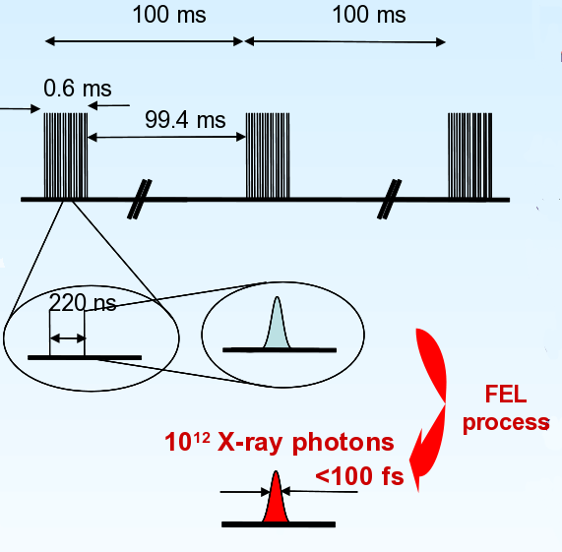
XFEL pulse trains
Special structure of pulse trains:
600 µs long pulse trains at a
repetition rate of 10 Hz
Each train consists of 2700 bunches with a separation of 220 ns
(SASE) Each bunch consists of
≈10¹² photons arriving <100 fs
Beam energy:
5 – 25 keV (depends on station)
12.4 keV (λ=0.1 nm) nominal design energy for AGIPD

Slide 4
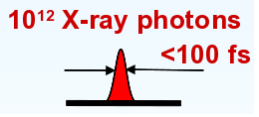
XFEL challenges
XFEL provides
Simultaneous deposition of all photons
Challenges
Single photon counting not possible
Dynamic range:
10⁴ photons/pixel with single photon sensitivity
Approach
Charge integration
Dynamic gain switching
3 gain stages
Single photon sensitivity in highest gain
High number of bunches
2700 bunches per train (600 µs)
Reading out of single frames during pulse train impossible
Analog memory in the pixel using the
>200 storage cells per pixel

Slide 5
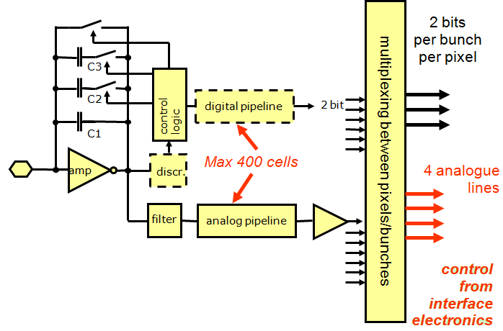
AGIPD design
Sensor
ASIC
Interface electronics
memory
memory

Slide 6
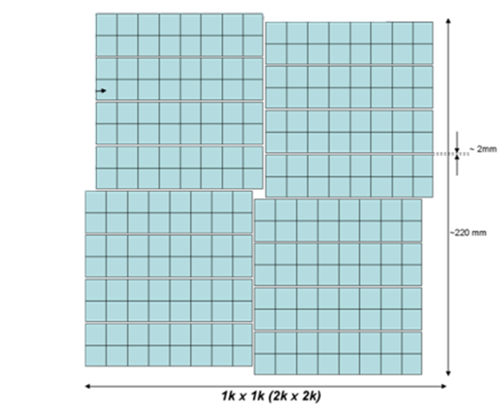
The detector layout
Specifications:
1 Mpixel
4 quadrants
4 modules per quadrant
1 module: 8 x 2 chips,
1 chip: 64 x 64 pixels
200 x 200 µm² pixel size
500 µm silicon sensor
Hole for direct beam
Upgradable to 4 Mpix
8 chips
2 chips
module
quadrant
single chip

Slide 7
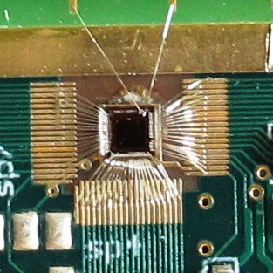
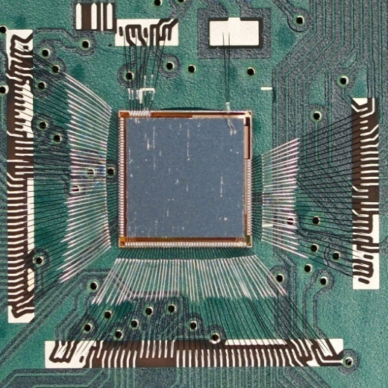
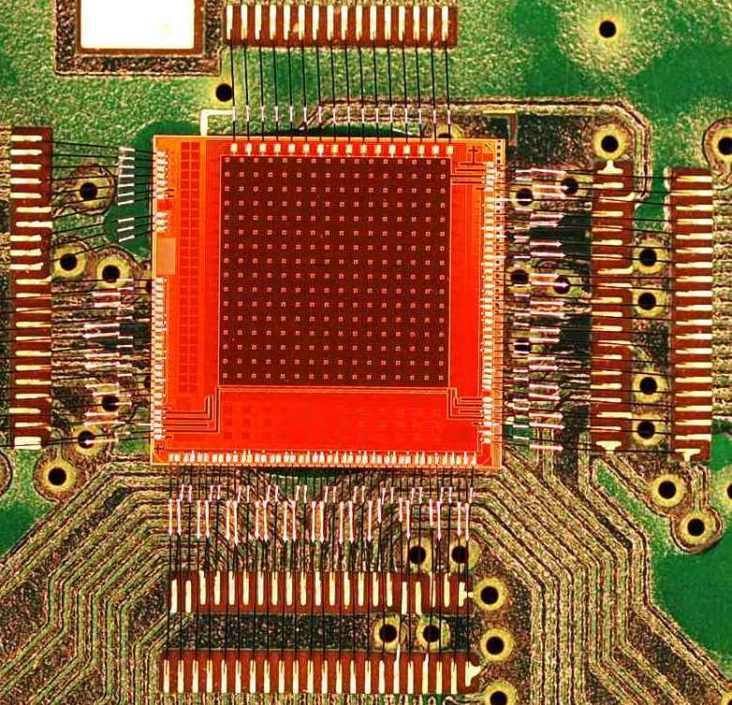
AGIPD test-chips (I)
AGIPD 0.1
AGIPD 0.2
AGIPD 0.3
No pixels yet
3 readout blocks consisting of:
Readout chain
(Preamp + CDS stage)
3 different kinds of leakage current compensation
16 x 16 pixels
100 storage cells/pixel
No leakage current compensation
Different combinations of preamps and storage cell architectures
16 x 16 pixels
200 storage cells/pixel
Radiation hard storage cell design
High speed serial control logic

Slide 8
AGIPD test-chips (II)
AGIPD 0.1
AGIPD 0.2
AGIPD 0.3
Linearity of the gain
Stress-test of the input gate at the preamp
Temporal behavior of the preamp and CDS stage
Energy calibration
Noise determination
Pixel-to-Pixel variations
Storage cells variations
First imaging
Radiation hardness of storage cells
Test of the high speed serial control logic
Test ongoing

Slide 9
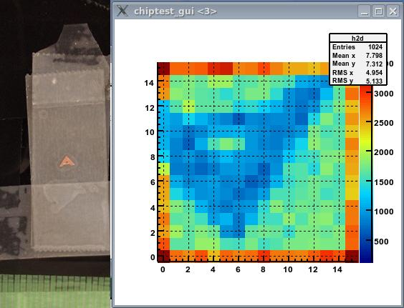
Imaging with AGIPD 0.2

Slide 10
Outline (II)
The AGIPD
  XFEL challenges
  AGIPD design
HORUS
  What is HORUS?
  Processing chain
XPCS Simulations
  What is XPCS?
  Simulation procedure
  Figures of merit for different layouts
Summary and Outlook

Slide 11
What is HORUS?
HORUS stands for:
Hpad Output Response fUnction Simulator
Collection of IDL routines
Designed to evaluate influences of certain design choices for AGIPD
Expanded to allow simulations of High-Z sensors and photon counting detectors (Medipix3) by D. Pennicard

Slide 12
Design of HORUS
HORUS is a transparent detector simulation tool-kit:
  User provides an (oversampled) ‘input image’ containing the number of photons in each pixel
  HORUS produces an output image, i.e. the number of detected photons in each pixel
  Simulation parameters/behavior can by adjusted by the user
  Additional functionality with special options

Slide 13
HORUS processing chain
Behavior of all steps can be modified
Intermediate results can be accessed
Incoming photon distribution
new in version 2.0
new in version 3.0
Photon interaction in sensor volume
Charge transport in sensor volume
Provided by user
Can be oversampled with respect to pixel size
Quantized if necessary
ASIC and FE electronics
Entry window
Mean free path of photons
Parallax
Compton/
Thomson scattering (3%)*
Fluorescence (4% of events)*
Requantized number of detected photons
Charge sharing
Plasma effects
Arbitrary CCE possible
Amplifier noise
Dynamic gain switching
Storage cells
AD conversion
Requantization threshold
* 12.4 keV photons and 500 µm silicon

Slide 14
Additionally HORUS is:
Using Monte Carlo and analytic elements:
  Analytic treatment of charge transport and plasma effects
NOT simulating the surrounding material (Bumps/ASIC/Module mechanics)
  Using a simplified sensor geometry
NOT tested with whole scale AGIPD
(doesn’t exist yet!), but:
  Simulation results for Medipix3 match well
  Test results from all AGIPD test chips are included

Slide 15
Outline (III)
The AGIPD
  XFEL challenges
  AGIPD design
HORUS
  What is HORUS?
  Processing chain
XPCS Simulations
  What is XPCS?
  Simulation procedure
  Figures of merit for different layouts
Summary and Outlook

Slide 16
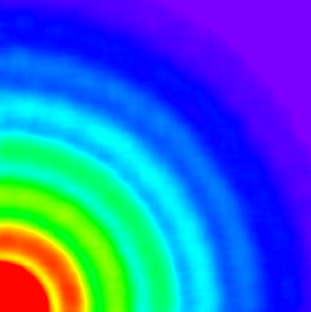
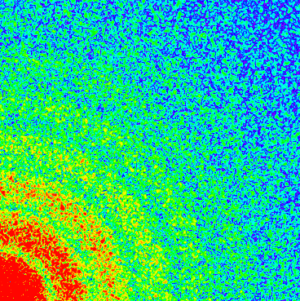
Scattering on many particles
Incoherent beam
Encodes average properties of the particles
Disordered sample
X-rays
Coherent beam
Acts like optical grating
Additionally encodes position of each particle as ‘speckles’ on the average value
Changes in the positions of the scattering particles change the positions of the speckles

Slide 17
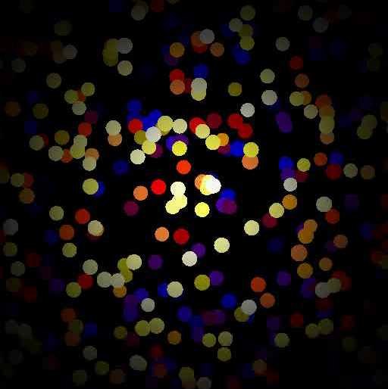
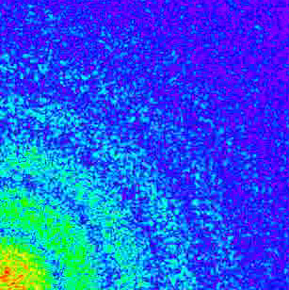
What is XPCS?
Log(Intensity) in detector plane
Real space
Investigation of fluctuations in diffraction images
e.g. molecular dynamics in soft matter
Pump-probe XPCS
Many more applications

Slide 18
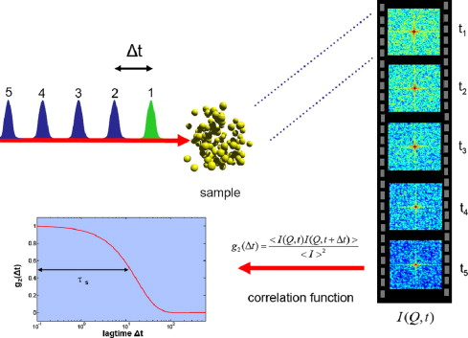
How XPCS is performed
Probe sample sequentially with non-destructive XFEL pulses
Analyze image series using intensity autocorrelation
(g₂ function)
Functional form determined by interaction mechanism
Extract time constant
Non-destructiveness requires large
low intensity XFEL pulses
-> resulting speckles will be small

Slide 19
Detector requirements for XPCS
4 µrad angular resolution
  80 µm pixel size at 20m distance
  AGIPD Pixel size is 200 µm
Single photon sensitivity
  Provided by AGIPD
Very high frame rate
  Single pulse imaging possible with AGIPD
Acquisition of image sequence
  More than 300 images stored per train

Slide 20
XPCS Simulations
Generate and evolve real space system
Calculate complex wave form in the detector plane (Fourier transform)
Scale and quantize wave form to produce discrete photon distribution
Use the photon distribution in the detector simulation (HORUS)
Evaluate output data and derive a figure of merit

Slide 21
Key simulation parameters
Linear sequence of 300 images
5 independent pulse trains
Infinite coherence length (long./lat.)
Small angle scattering approximations
Incoherent noise of 10⁻² γ/pixel/frame
Speckle size of ≈ 150 µm FWHM
  At 20m distance: ≈ 13 µm FWHM beam

Slide 22
Figures of merit (I)
Signal to noise ratio of the g₂ function
  Analytic expression available for low intensities
  Has been successfully used for many years
Relative error of the correlation constant
  Relevant physical parameter
  Essential for error determination on derived parameters like hydrodynamic functions etc.

Slide 23
Region of interest
Quadrant of 200 µm pixels
(AGIPD, MAAT)
Small ROI
Large ROI
Quadrant of 100 µm pixels
(RAMSES)
Region of Interest
MAAT =
AGIPD + aperturing to 100 µm effective pixel size
Limited by pixel density
Limited by total area

Slide 24
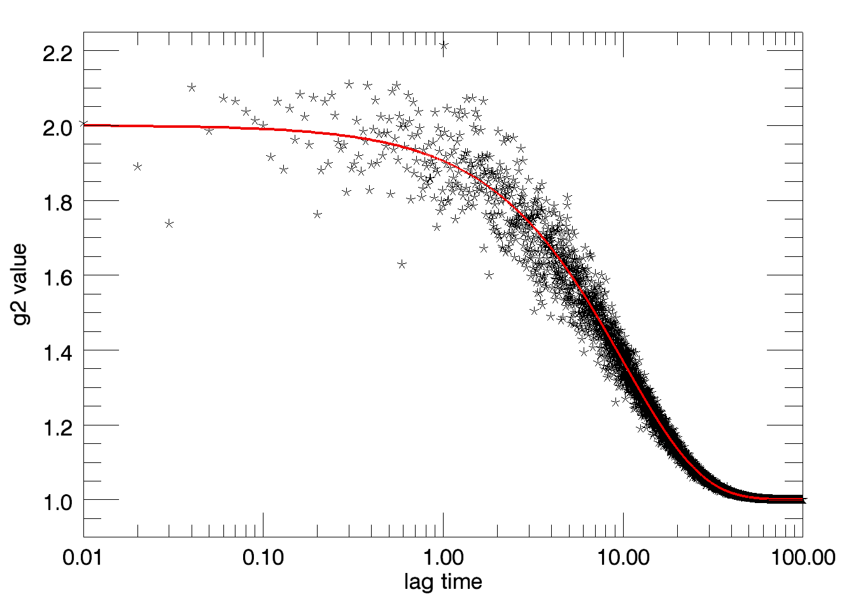
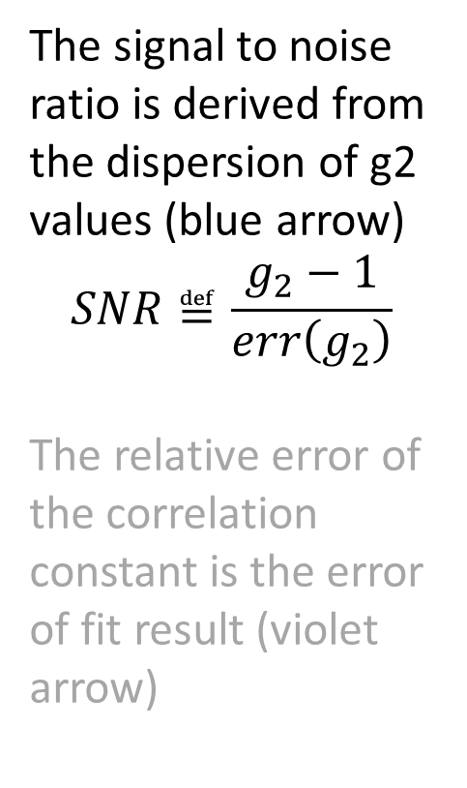
Figures of merit (II)
The signal to noise ratio is derived from the dispersion of g2 values (blue arrow)
$$SNR≝\frac{g_{2}−1}{err\left(g_{2}\right)}$$
The relative error of the correlation constant is the error of fit result (violet arrow)

Slide 25
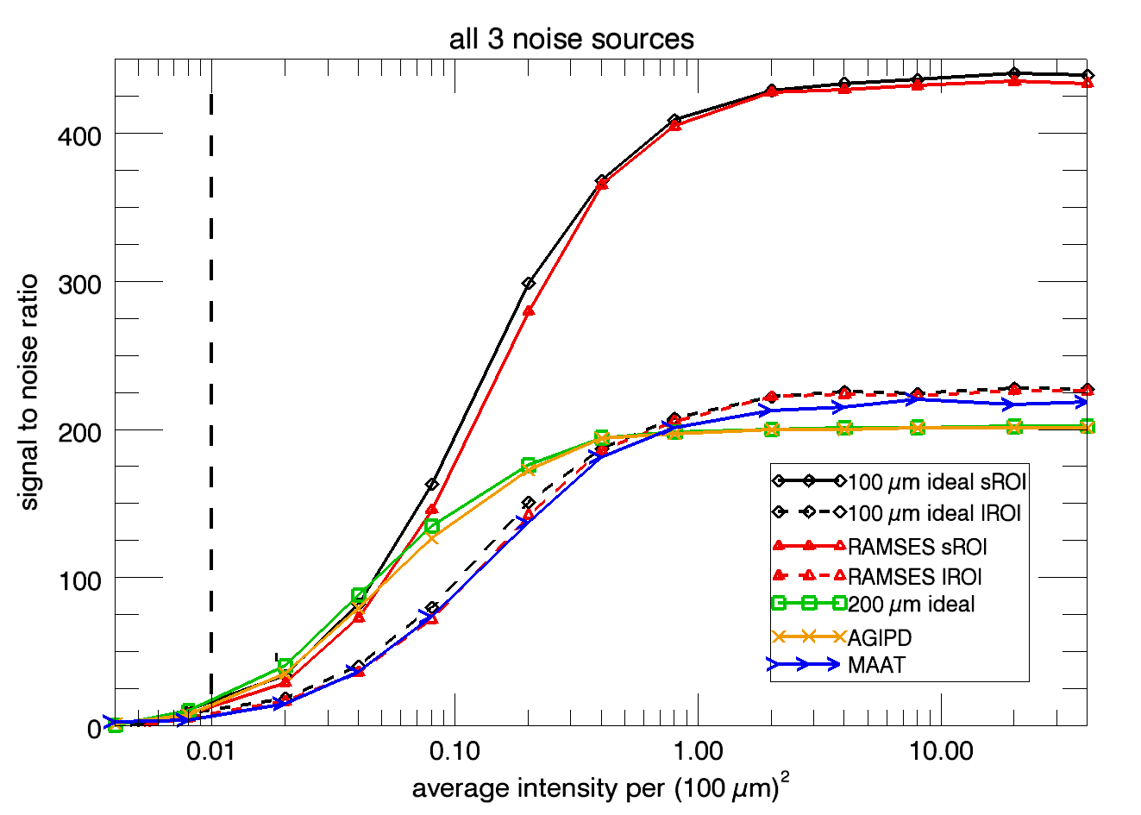
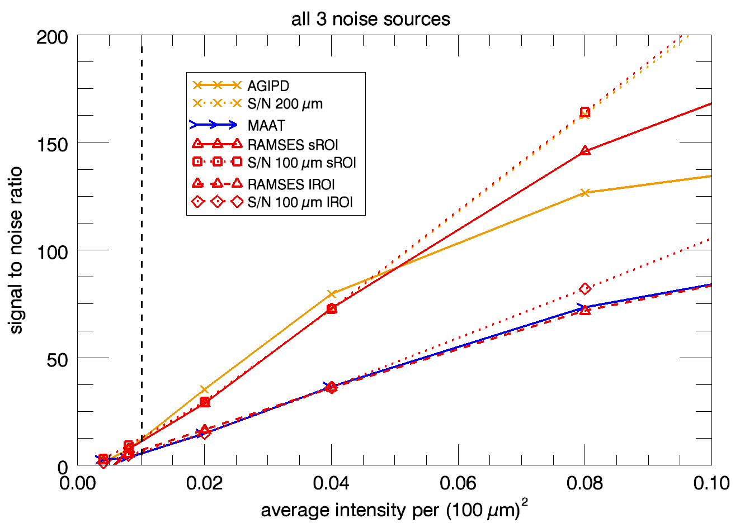
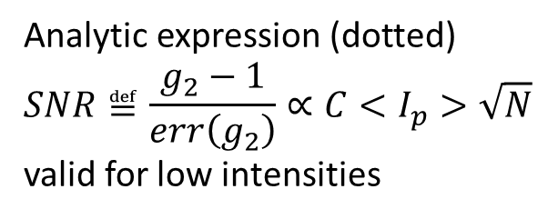
Signal to noise ratio
Higher values indicate better quality
Noise level at dashed vertical line
S/N saturates around <I> ≈ 1
At low intensities 200 µm pixel systems have higher S/N
than 100 µm systems
Analytic expression (dotted)
$$SNR≝\frac{g_{2}−1}{err\left(g_{2}\right)}∝C<I_{p}>\sqrt{N}$$
valid for low intensities

Slide 26
Figures of merit (III)
The signal to noise ratio is derived from the dispersion of g2 values (blue arrow)
The relative error of the correlation constant is the error of fit result (violet arrow)

Slide 27
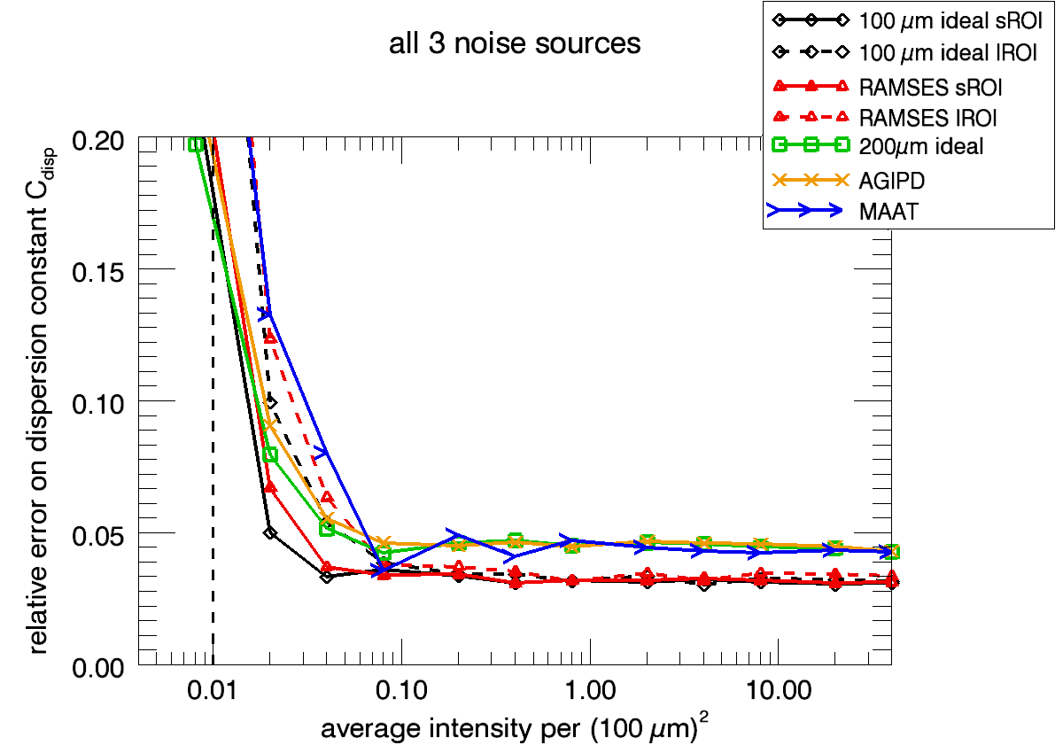
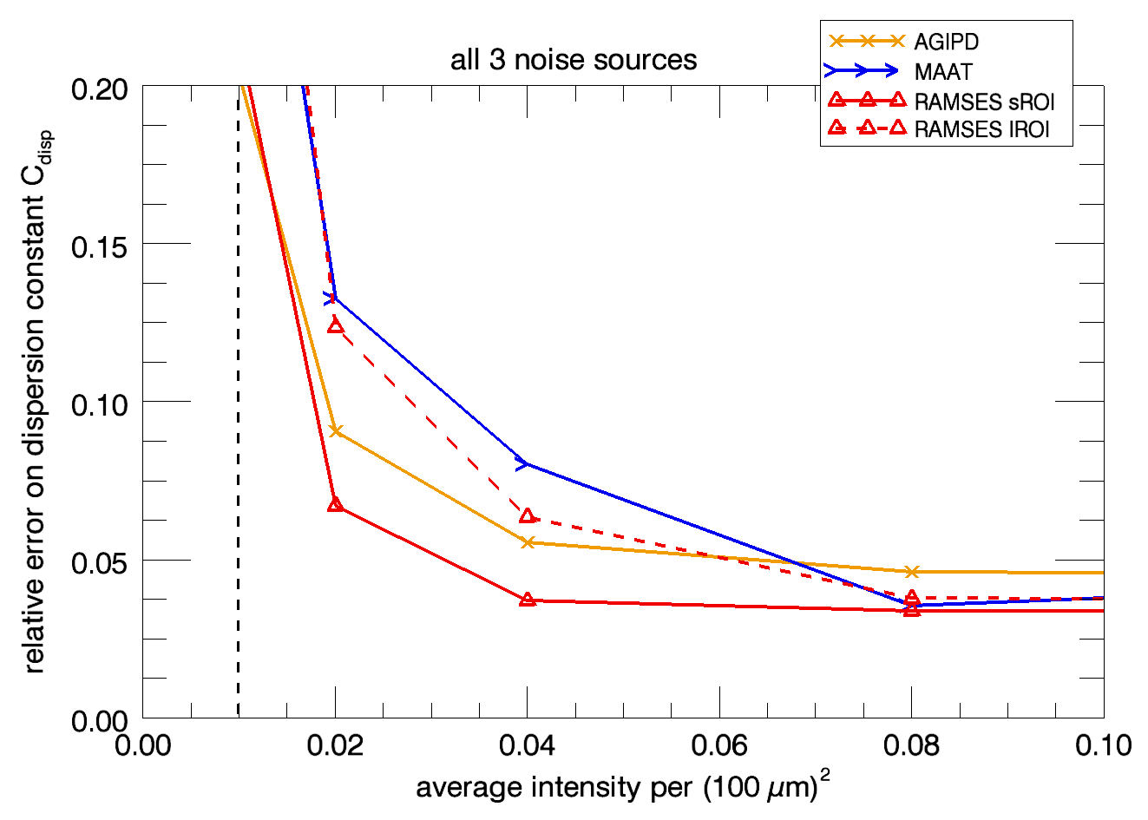
Relative error
Lower values indicate better quality
Noise level at dashed vertical line
Error saturates around <I> ≈ 0.1
Lower saturation value for small pixels
AGIPD lower than RAMSES for large
ROI and low intensity
No analytic expression available
Relevant quantity for further data evaluation (diffusion constants, hydrodynamic functions, etc)

Slide 28
Conclusions for XPCS
XPCS insensitive to FEL fluctuations (not shown)
Aperturing not beneficial at low intensities
S/N and relative error behave differently
Both saturate, but at different intensities
Better performance of AGIPD at low intensities comp. to 100 µm pixel version
Paper under review
preprint: http://arxiv.org/abs/1108.2980

Slide 29
Summary
Progress on AGIPD test chips
  Verified basic circuit blocks
  Verified gain switching
  First imaging capability demonstrated
Progress on HORUS code
  Included Compton/Thomson scattering
  Included fluorescence
Published first results on XPCS
AGIPD suitable for XPCS

Slide 30
Acknowledgements
AGIPD Collaboration
DESY
Julian Becker
Peter Goettlicher
Heinz Graafsma
Helmut Hirsemann
Stefanie Jack
Sabine Lange
Alessandro Marras
Ulrich Trunk
PSI
Roberto Dinapoli
Dominic Greiffenberg
Beat Henrich
Aldo Mozzanica
Bernd Schmitt
Xintian Shi
Univ. Bonn
Marcus Gronewald
Hans Krueger
Univ. Hamburg
Robert Klanner
Joern Schwandt
Jiaguo Zhang
We’re looking for PostDocs on:
AGIPD calibration
Low energy Detectors
Contact Heinz.Graafsma@desy.de
HORUS was initially designed by:
Guillaume Potdevin, TU Munich

