Slide 1


Imaging and spectroscopic performance studies of pixellated CdTe Timepix detector
Dima Maneuski
Vytautas Astromskas, Erik Fröjdh, Christer Fröjdh, Eva Gimenez-Navarro,
Julien Marchal, Val O'Shea, Graeme Stewart, Nicola Tartoni, Heribert Wilhelm,
Kenneth Wraight, Rasif Modh Zain.

Slide 2
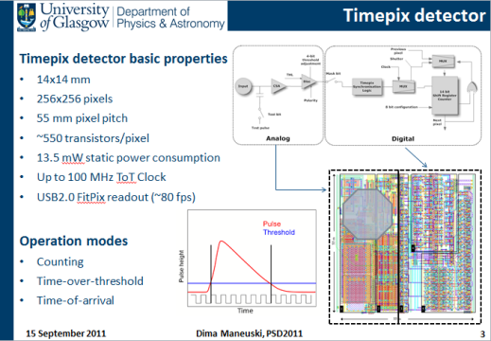
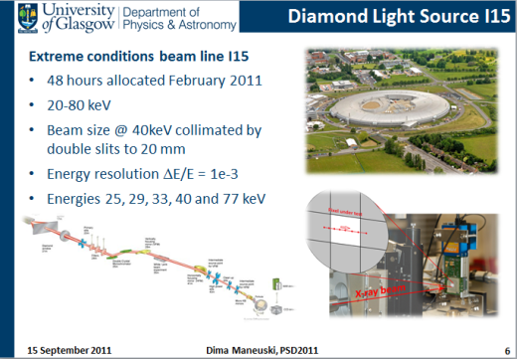
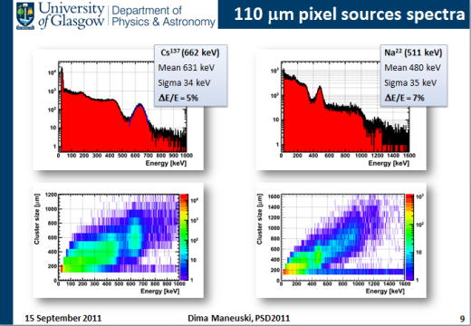
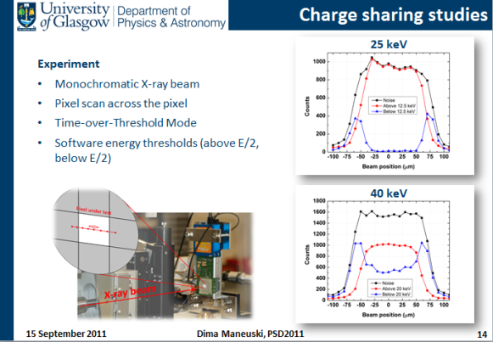
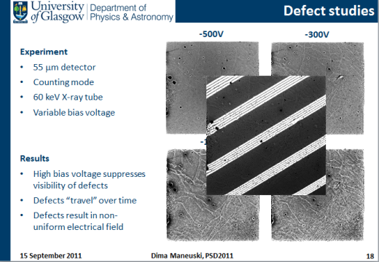
Table of contents
Presentation plan
Introduction
CdTe Timepix detector
Energy calibration
Diamond Light Source experiment
Laboratory X-ray tube experiment
Results
Energy resolution
Imaging performance
Charge sharing
Defects studies
Conclusions

Slide 3
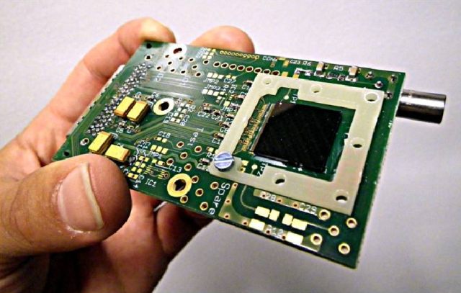
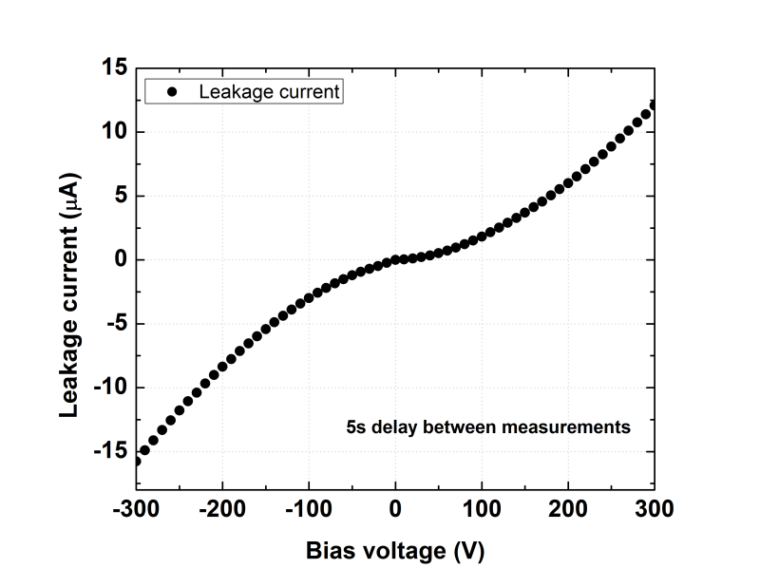
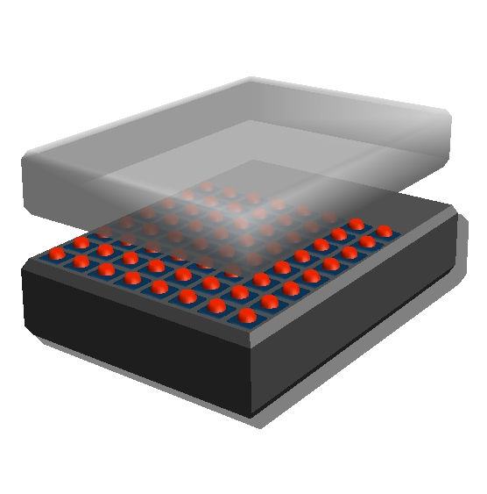
CdTe sensor
Basic CdTe sensor properties
CdTe from ACRORAD
Bump-bonded to Timepix by FMF Freiburg
1 mm thickness
55 and 110 μm pixel pitch
Ohmic contacts (Pt)
µ_{e}τ_{e}= 1.95 10⁻³ cm²/Vs
µ_{h}τ_{h}= 0.75 10⁻⁴ cm²/Vs

Slide 4
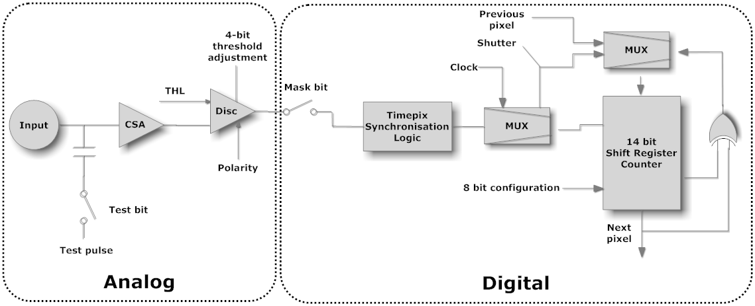
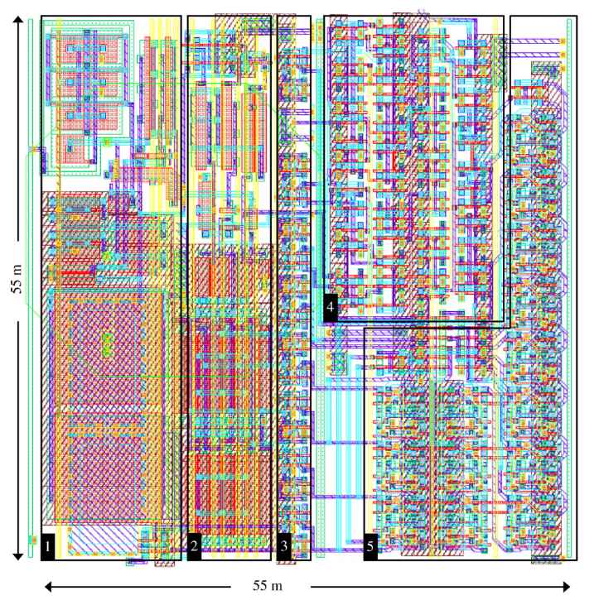
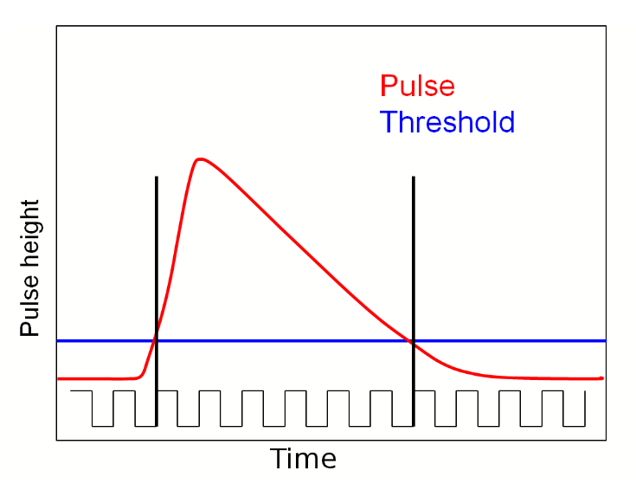
Timepix detector
Timepix detector basic properties
15 x 6 x 2 cm assembly size
Detector 14x14 mm, 256x256 pixels
55 μm pixel pitch
~550 transistors/pixel
13.5 mW static power consumption
Up to 100 MHz ToT Clock
USB2.0 FitPix readout (~80 fps)
Operation modes
Counting
Time-over-threshold
Time-of-arrival

Slide 5

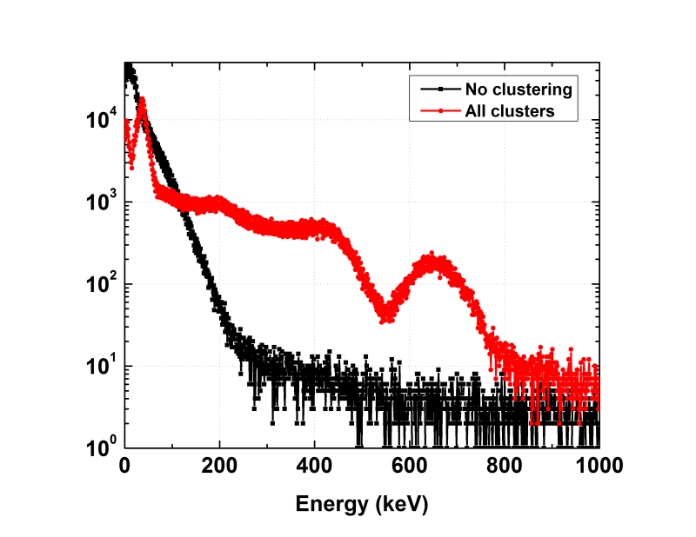



Signal clustering
Charge sharing
Fluorescence (Cd K-absorption edge – 26.7 keV, Te K-absorption edge – 31.8 keV)
Clustering is essential (software)
Clusters are between 55 and 2500 μm for 4 – 1000 keV

Slide 6
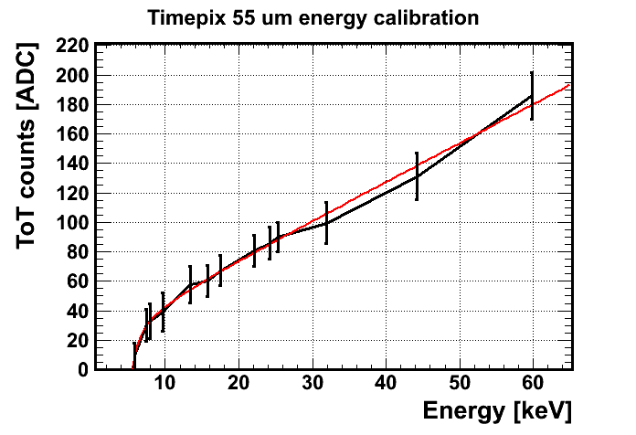
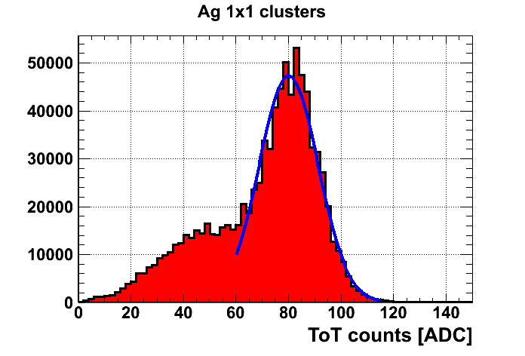
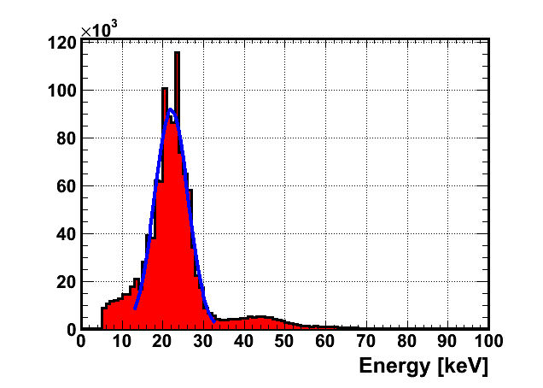

Energy calibration
Energy calibration procedure
48 MHz Timepix clock
Single clusters identified
Non-linear function fitted
For energies > 100 keV
  All clusters for calibration work better
  Linear part of calibration only is needed
For example
$$ToT=a∙E+b−\frac{c}{t−E}$$

Slide 7
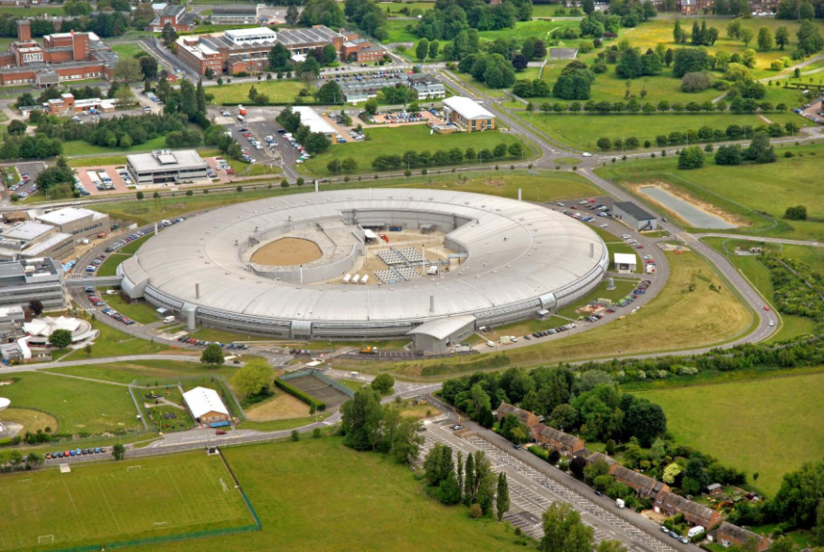
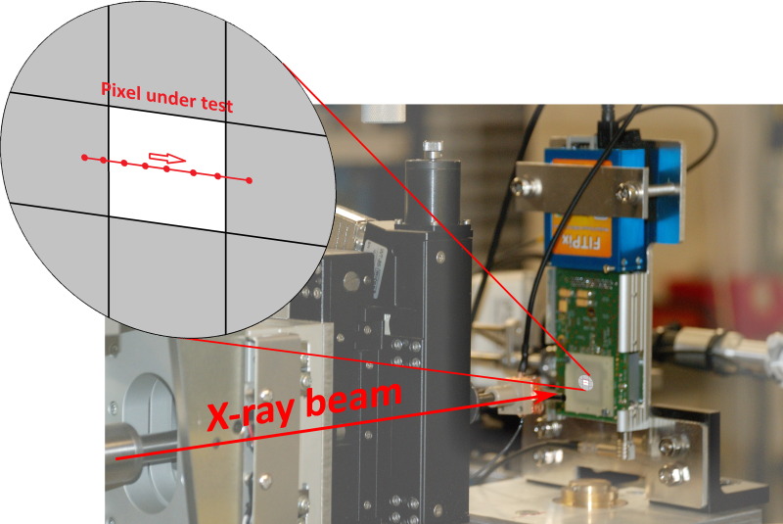
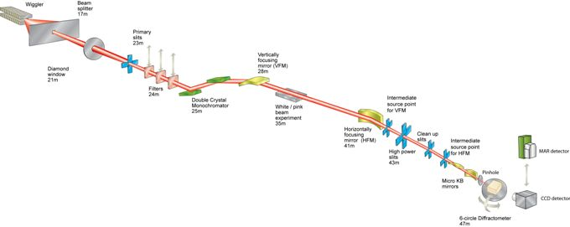
Diamond Light Source I15
Extreme conditions beam line I15
48 hours allocated February 2011
20-80 keV
Beam size @ 40keV collimated by double slits to 20 μm
Energy resolution ΔE/E = 1x10⁻³
Energies 25, 29, 33, 40 and 77 keV

Slide 8
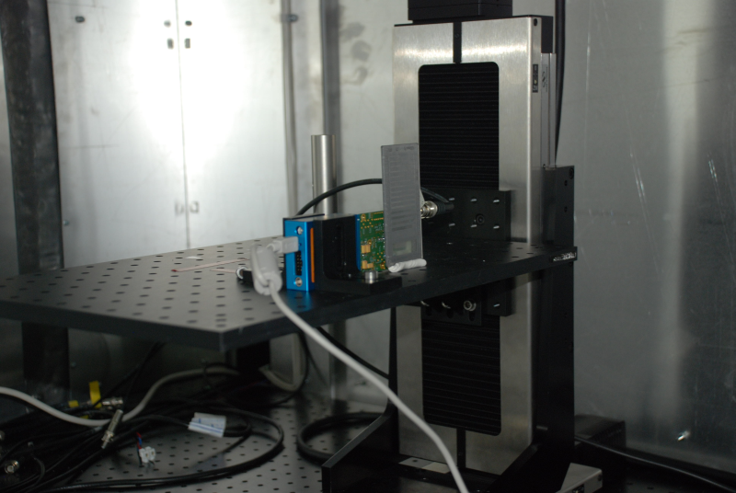
Laboratory X-ray tube setup
Experimental setup
55 and 110 μm detectors
Tungsten X-ray tube
Up to 50 keV
Up to 50 mA current
Various fluorescence metals (Ti, Ni, Cu, Zr, Ag, In, Sn)
Variable X-ray source (Rb, Mo, Ag, Ba, Tb, Am²⁴¹)
Also Co⁵⁷, Na²², Cs¹³⁷, Co⁶⁰
PbNr slit for imaging
X-rays
Default detector settings
-300V bias voltage
48 MHz Timepix clock

Slide 9
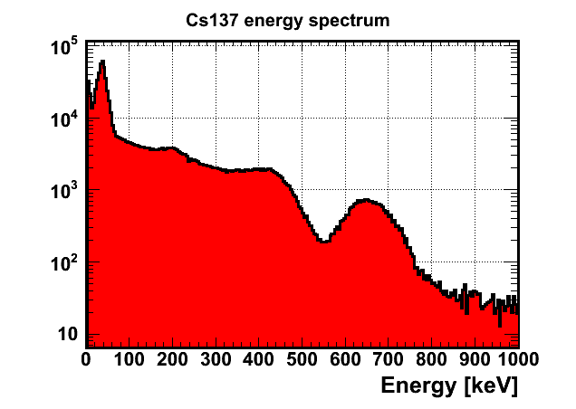
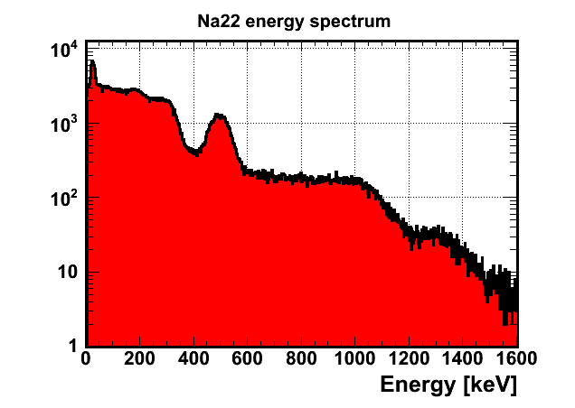
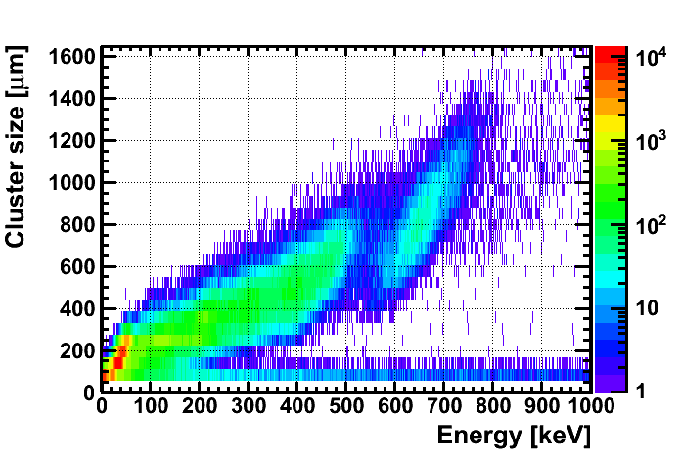
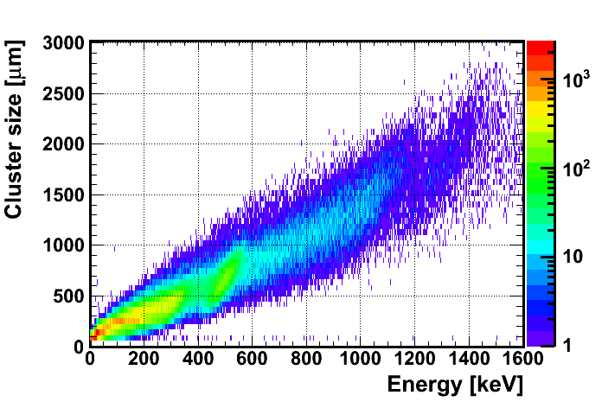
55 μm pixel sources spectra
Cs¹³⁷ (662 keV)
Mean 651 keV
Sigma 55 keV
ΔE/E = 8%
Na²² (511 keV)
Mean 494 keV
Sigma 50 keV
ΔE/E = 10%

Slide 10
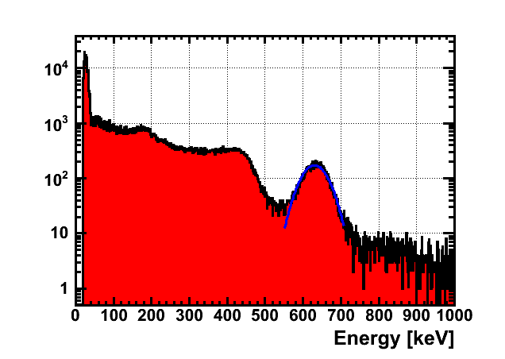
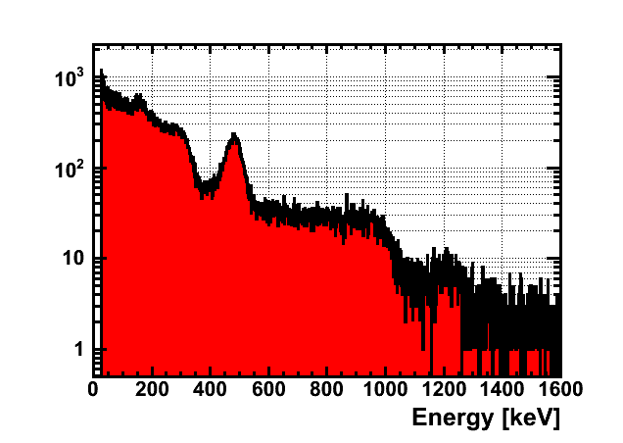
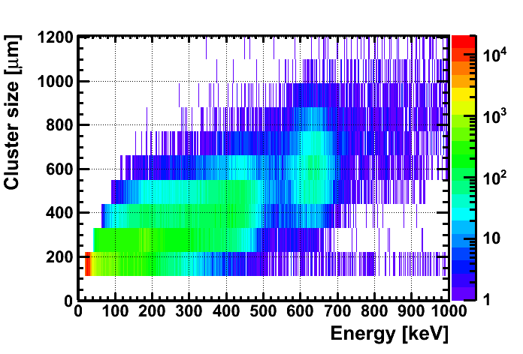
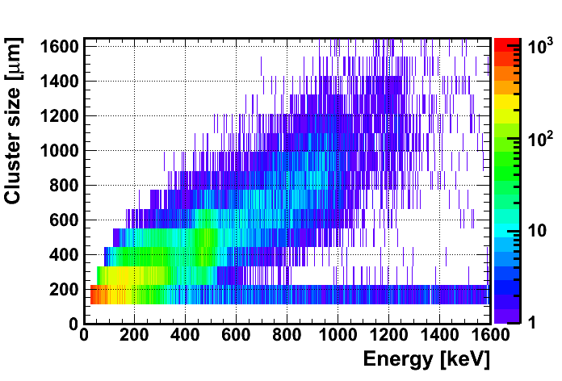
110 μm pixel sources spectra
Cs¹³⁷ (662 keV)
Mean 631 keV
Sigma 34 keV
ΔE/E = 5%
Na²² (511 keV)
Mean 480 keV
Sigma 35 keV
ΔE/E = 7%

Slide 11
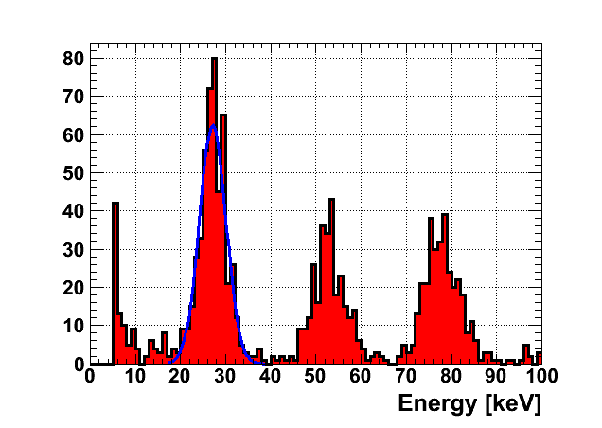
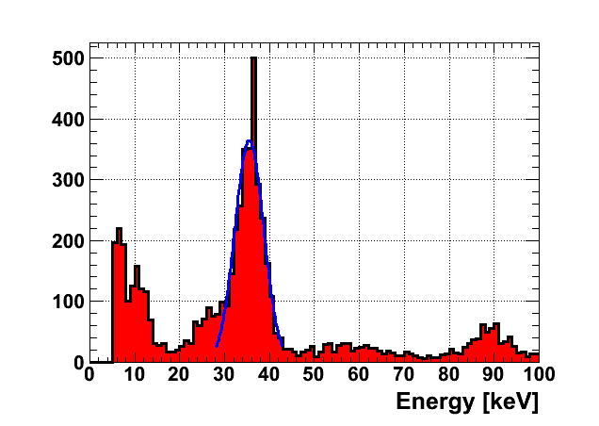
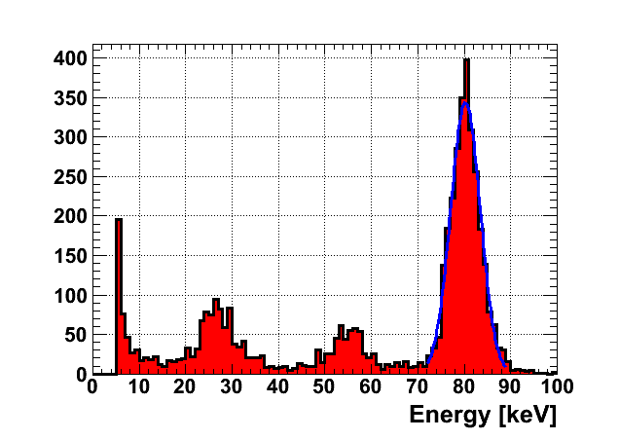
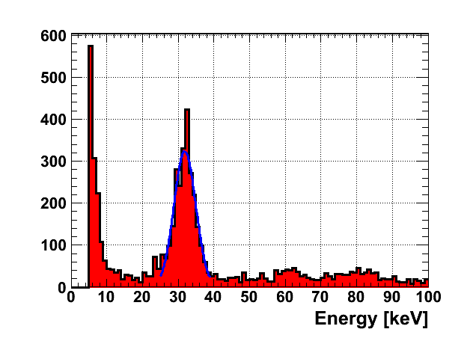
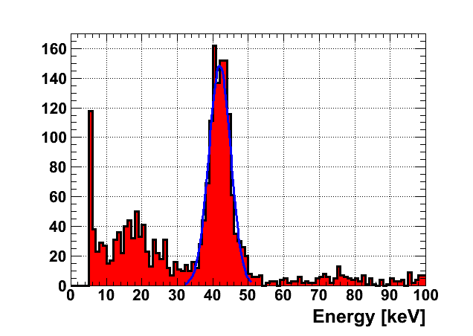
110 μm pixel energy resolutions Diamond
25 keV
33 keV
77 keV
Mean 80.2 keV
Sigma 3.3 keV
ΔE/E = 4%
29 keV
40 keV

Slide 12
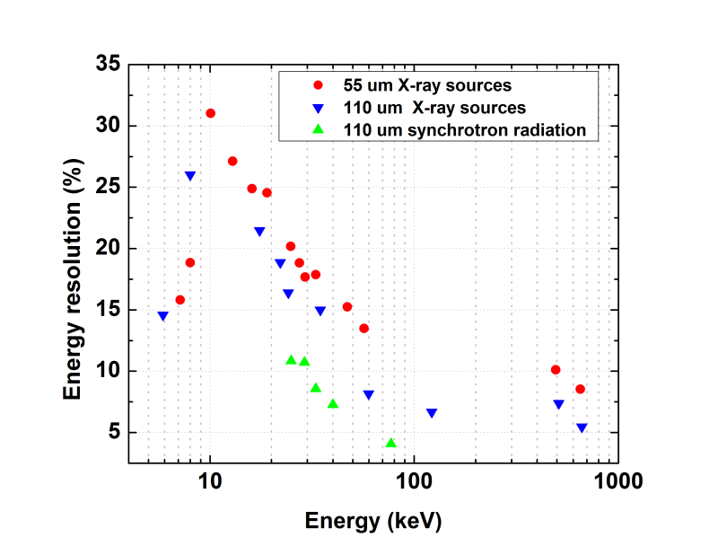
Energy resolutions 55 & 110 μm pixel
Energy resolution for 110 μm pixel pitch is systematically better than for 55 μm pixel
@60 keV 7% vs. 13%
@662 keV 5% vs. 8%
Most likely due to additional pixel-2-pixel non-uniformities

Slide 13
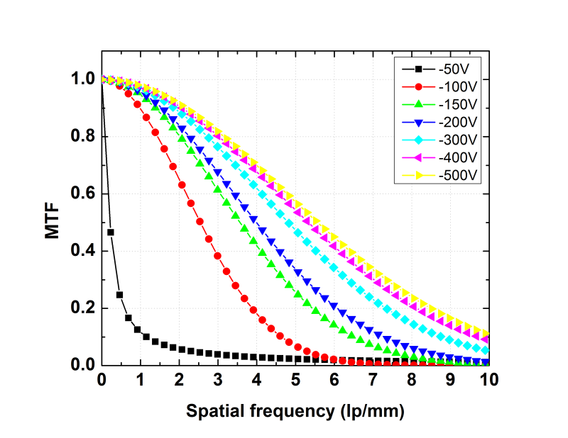
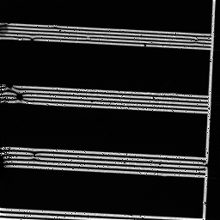
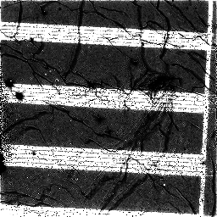
Imaging performance (MTF’s)
Experiment
60 keV X-ray tube
55 μm pixel detector
Counting mode
-300V
-50V
Results
Optimal bias for imaging is > 400V
MTF varies 10-20% between regions in the sensor even @ high biases

Slide 14
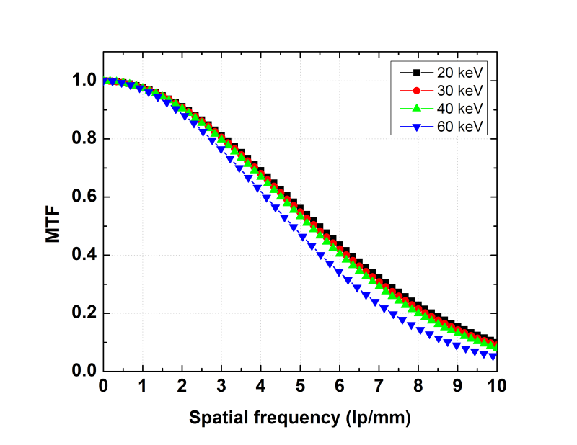
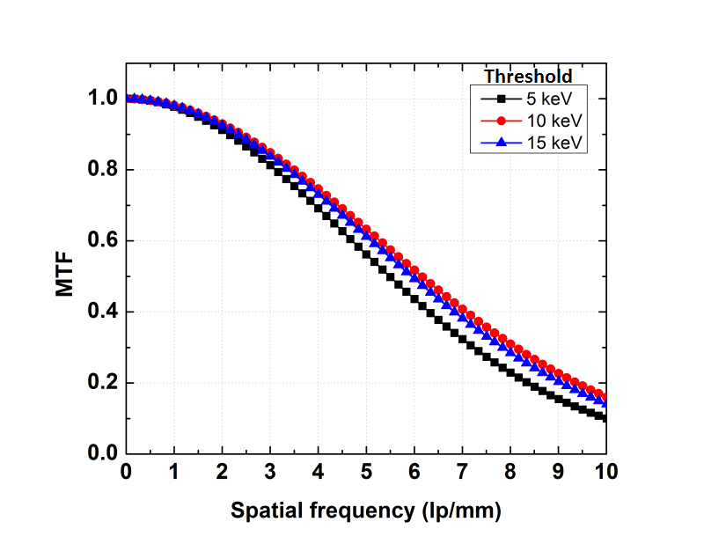
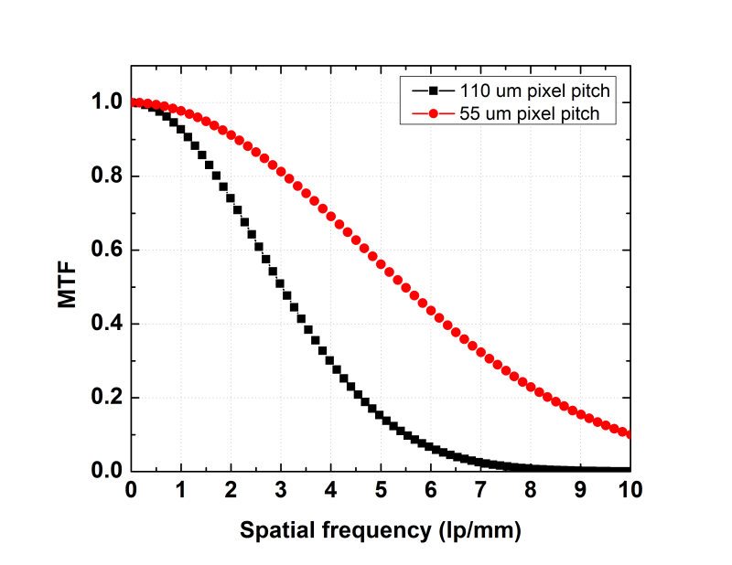
Imaging performance (MTF’s)
Experiment
Counting mode
Various energies @ -300V
Various thresholds (Noise 5 keV, E/2, 3/4E)
55 μm vs. 110 μm pixel pitch
Various X-ray tube energies
Results
~15% difference between 20 keV and 60 keV @ 5.0 lp/mm
<10% difference between 5 and 15 keV threshold @ 20 keV @ 5.0 lp/mm
Most likely due to non-optimal CdTe bias voltage
MTF is better by > x2 for 55 um @ 4 lp/mm
X-ray tube energy 20 keV
55 μm vs. 110 μm MFT

Slide 15
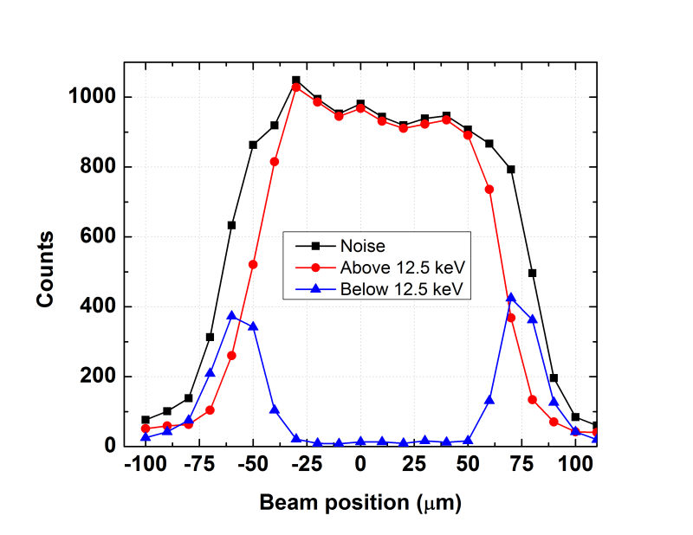
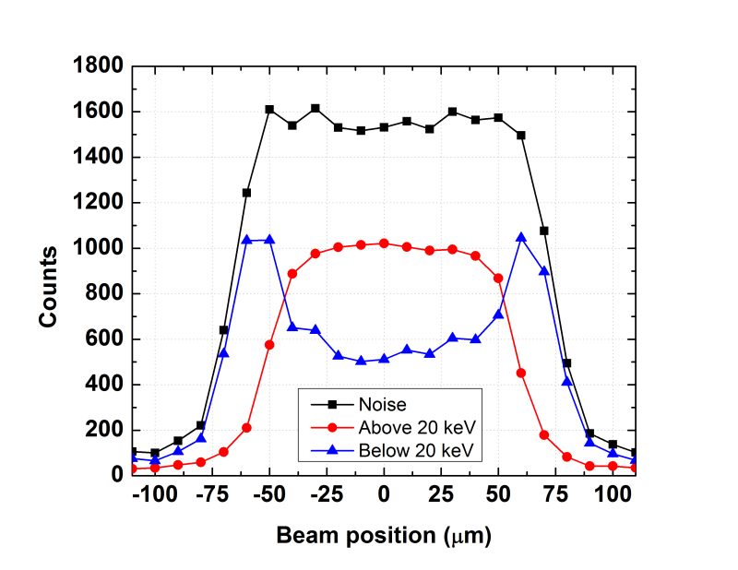
Charge sharing studies
25 keV
Experiment
Monochromatic X-ray beam
Pixel scan across the pixel
Time-over-Threshold Mode
Software energy thresholds (above E/2, below E/2)
40 keV

Slide 16
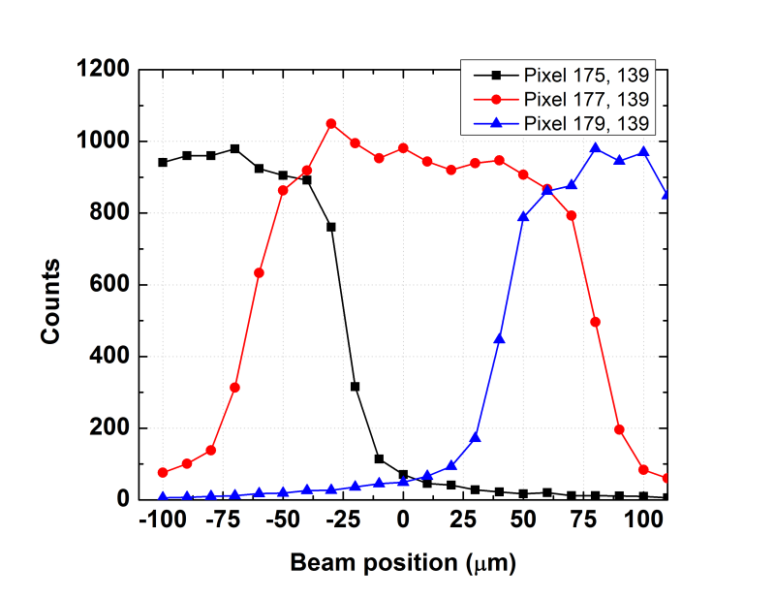
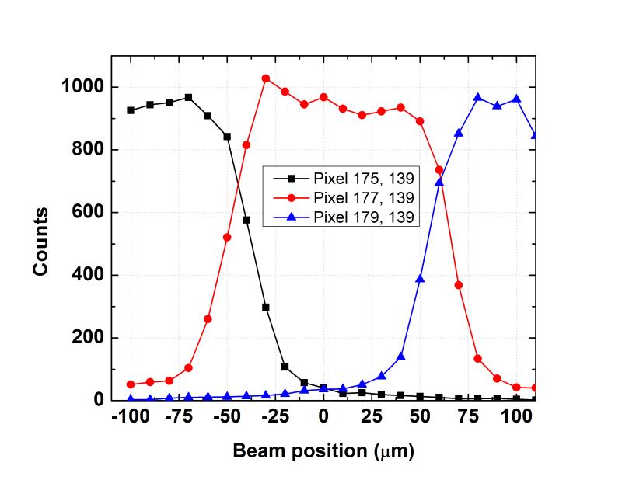
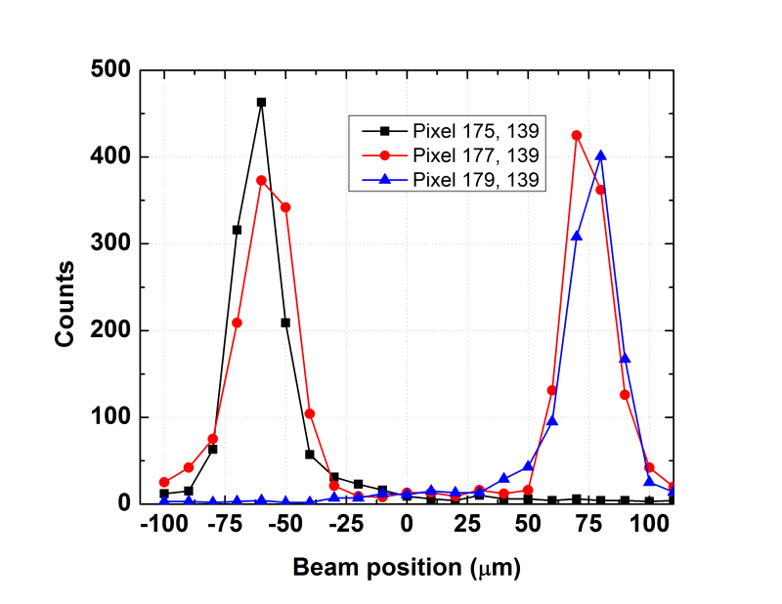
25 keV pixel scan
Threshold above noise (>5 keV)
Energy-2-counts conversion
Superimposed count profiles from neighbouring pixels (x-1, x, x+1)
Threshold applied
Threshold above E/2 (>12.5 keV)
Threshold below E/2 (< 12.5 keV)

Slide 17
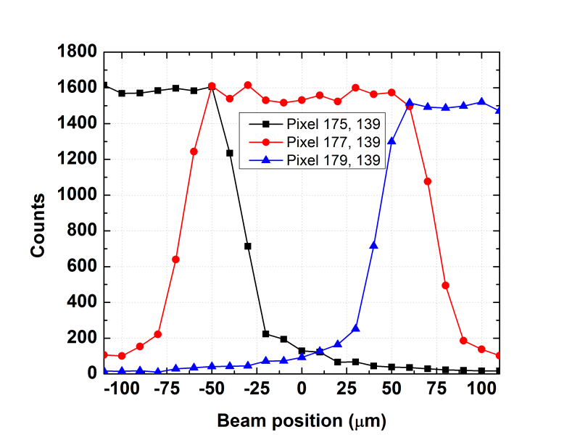
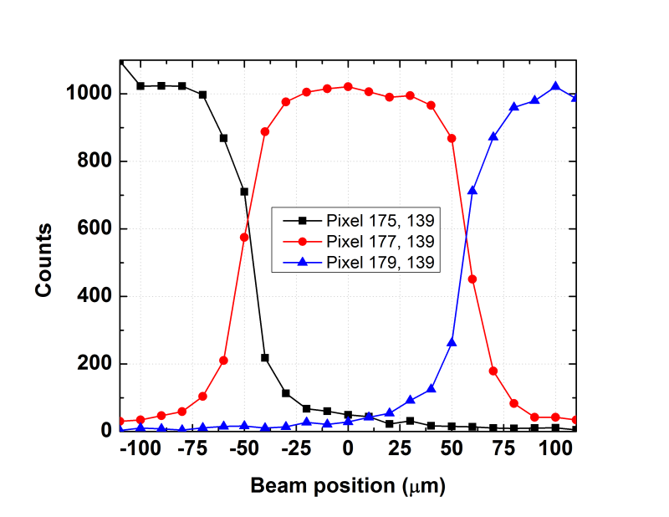
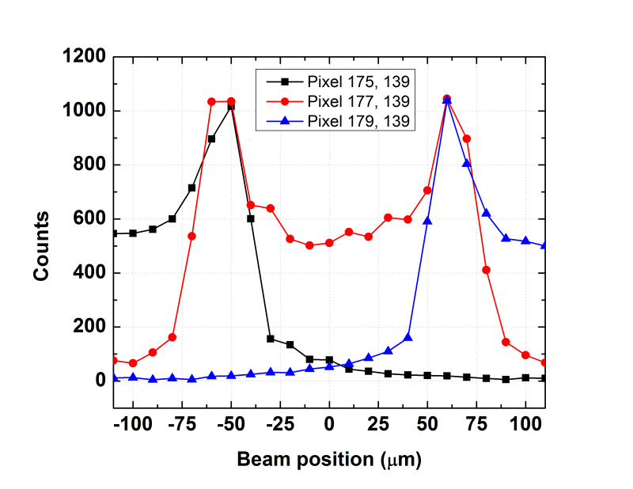
40 keV pixel scan
Threshold above noise (>5 keV)
Energy-2-counts conversion
Superimposed count profiles from neighbouring pixels (x-1, x, x+1)
Threshold imposed
Threshold above E/2 (>20 keV)
Threshold below E/2 (< 20 keV)

Slide 18
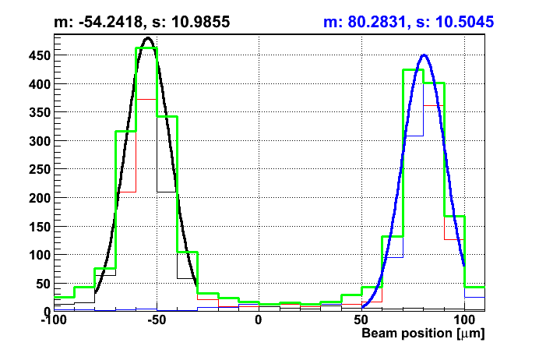
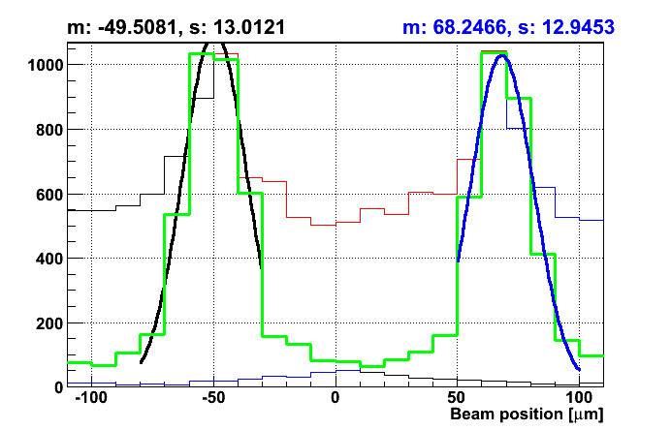
25 keV vs. 40 keV
Energy 25 keV, threshold below E/2
Charge sharing only
Energy 40 keV, threshold below E/2
Charge sharing + fluorescence

Slide 19
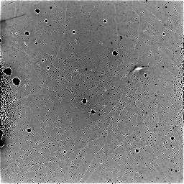




Defect studies
-500V
-300V
Experiment
55 μm detector
Counting mode
60 keV X-ray tube
Variable bias voltage
14 mm
-150V
-50V
Results
High bias voltage suppresses visibility of defects
Defects “travel” over time
Defects result in non-uniform electrical field

Slide 20




Defect studies
+500V
+300V
Results
Different defects are visible
Defects “travel” and “pulse” over time
Defects result in non-uniform electrical field
Afterimage remains for sometime (bias switch on/off/reverse doesn’t help)
+150V
+50V
14 mm

Slide 21

Conclusions
Conclusions
55 μm and 110 μm pixel CdTe Timepix detectors were compared for imaging and spectroscopic applications
        X-ray tube and sources spectra and MTF’s
        Diamond light source spectra, charge sharing
Analysis of CdTe defects
        Positively/negatively charged defects
        E-field distortions imaged
Future work
        Per-pixel energy calibration -> better energy resolution
        Optimal bias -> better imaging
        Fancy correction algorithms
A lot of ideas for potential applications
        Wakefield accelerator
        Radioisotope production
        ????

