Slide 1
Development of a gamma-ray imager using a large area monolithic 4x4 MPPC array for a future PET scanner
Takeshi Nakamori
T. Kato, J. Kataoka, T. Miura, H. Matsuda (Waseda U),
K. Sato, Y. Ishikawa, K. Yamamura, N. Kawabata (Hamamatsu),
H. Ikeda, G. Sato (ISAS/JAXA), K. Kamada (Furukawa Co., Ltd.)
12 September 2011
Position Sensitive Detectors 9 @ Aberystwyth

Slide 2
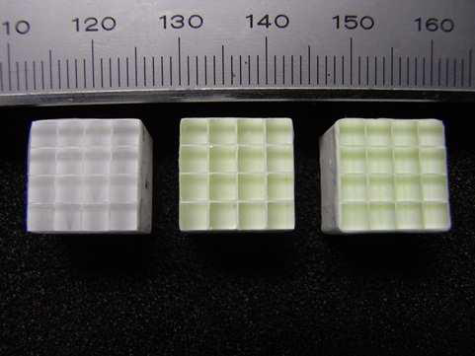
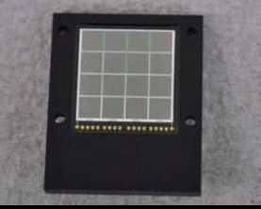
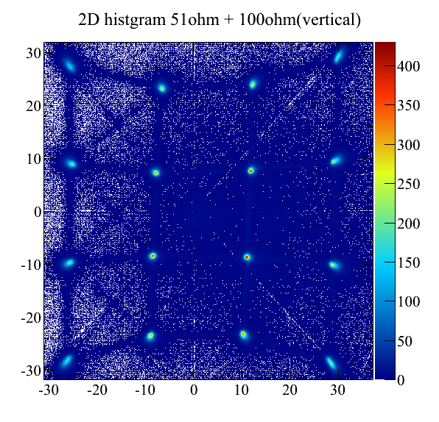
Contents
2
PET and Semiconductor sensors
Performance of the MPPC array
Charge division readout
Other applications
Summary

Slide 3
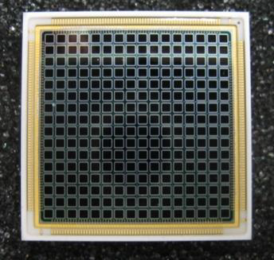
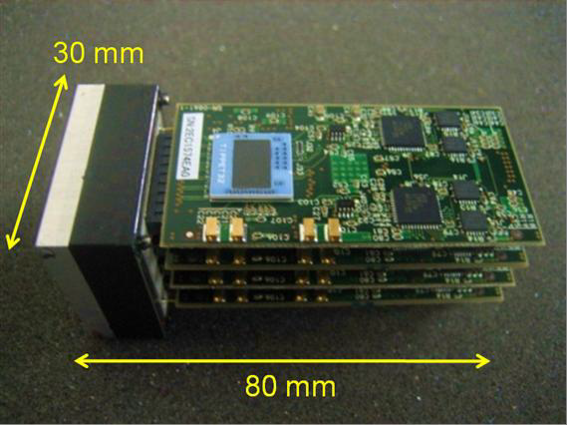
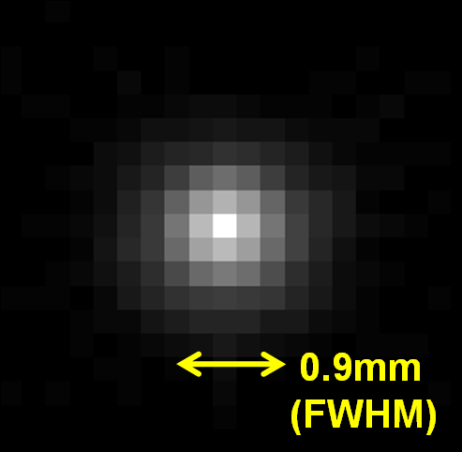
PET and our approach
3
Positron Emission Tomography : e⁺e⁻ → γγ imaging
Semiconductor photosensors are promising & successful
Compactness, low power, mass productivity, easy handling…
Insensitive to magnetic fields
APD-PET project
→ Realized large number of channels, fine/complex configurations
→ “DOI-PET”
→ “MRI-PET”
TOF
→ dedicated LSI (Koizumi+10)
→ sub-mm resolution (Kataoka+10)
→ >a few ns time res. (Matsuda)
MPPC can overcome !!
DOI
16x16 APDs
PET module
²²Na image
TOF & DOI information
improve position accuracy
Kataoka+10

Slide 4
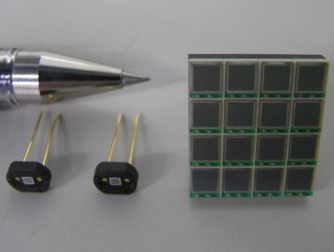
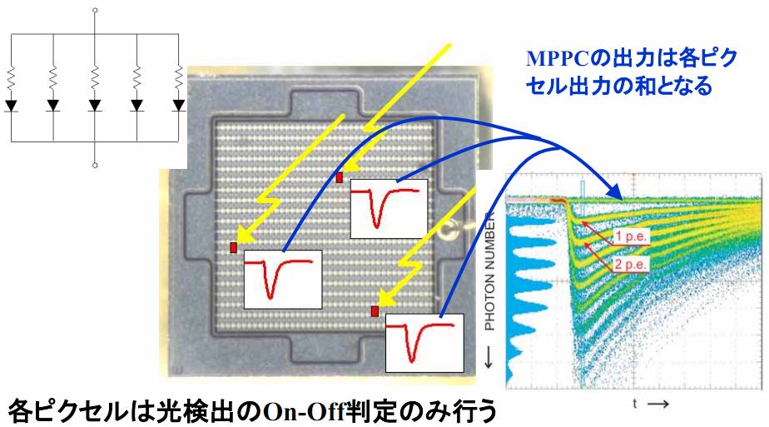
Muti-Pixel Photon Counter
4
2D-array of APDs operated in Geiger mode
Charges proportional to the number of fired APDs
low bias voltage (<100V)
high gain (10⁵⁻⁶)
Insensitive to magnetic field

Slide 5
Characteristics summary
5
 | PMT | PD | APD | MPPC
Gain | 10⁵⁻⁶ | 1 | 50-100 | 10⁵⁻⁶
Q.E. (PDE) | >25 | >80 |  | >25
Volume | large | small
Interfered by B | Yes | No
Structure | complex | simple
Power Consumption | high | low
MPPC vs APD
better for PET
higher gain, doesn’t need CSAs
  much better S/N
  much better timing resolution (suit for TOF-PET, next slide)
less photo-detection efficiency
  worse energy resolution (see Poster [20] by Miura )
narrower dynamic range due to the limited number of pixels
  need linearity correction

Slide 6
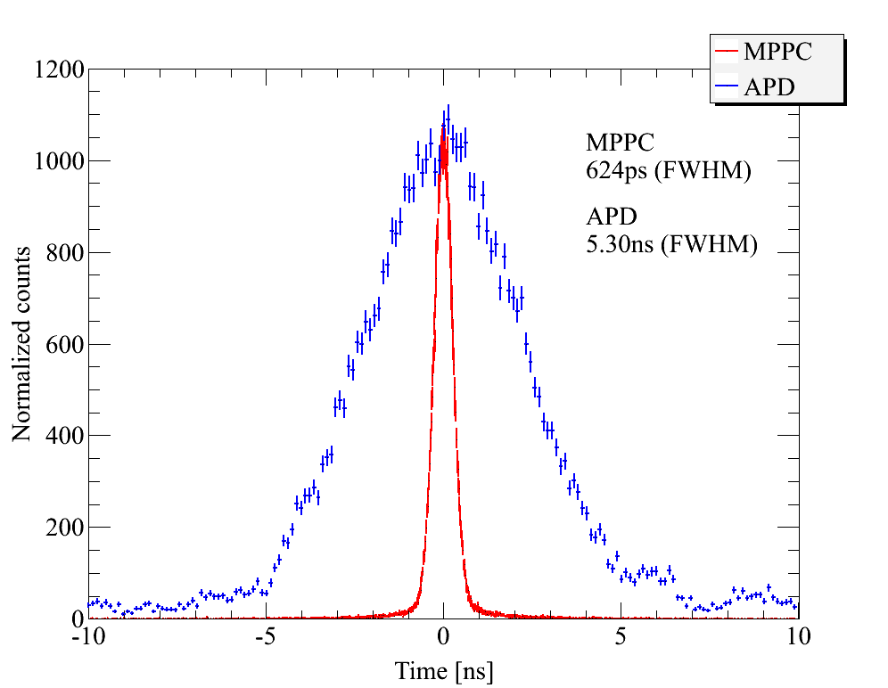
TOF Timing resolution
6
LYSO
LYSO
²²Na
APD : Charge Sensitive Amp.
MPPC: Current Amp.
MPPC or
APD
CFD
TAC
MCA
CFD
delay
MPPC (G=9x10⁵):
624ps (FWHM)
APD (G=50):
5300ps (FWHM)
APD
Kato
MPPC
APDs always require CSA
that limits time resolution.

Slide 7
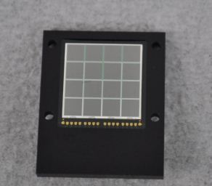
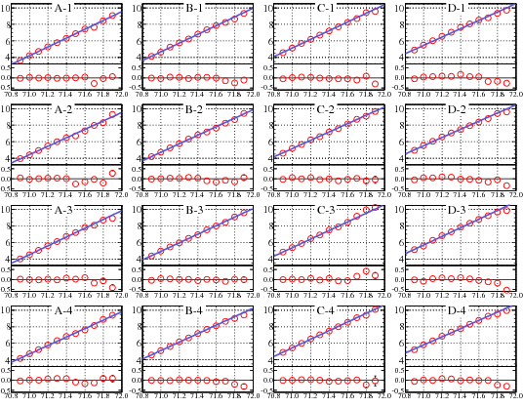
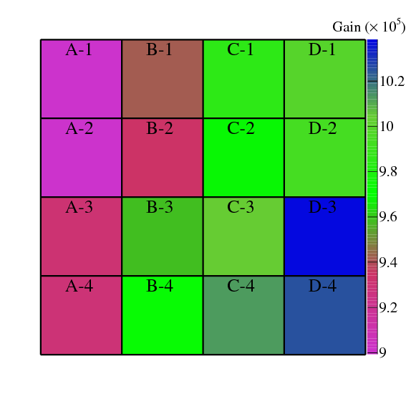
The Monolithic Array
7
Kato+11, NIM A
4x4 array with 3x3 mm2 pixel
0.2 mm gap
50 um type (3600 APDs/pixel)
16 anodes, common cathode
A bit high dark count rate ~2Mcps @ 20 ºC
(this was the first prototype: ~400 kHz in recent products)
10
4
Gain map (71.9V, 0 ºC )
Gain (10⁵)
7.2%
70.8
72.0
ave. gain = 9.7x10⁵
Bias Voltage (V)

Slide 8
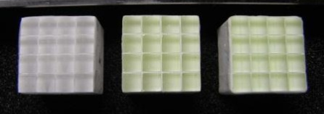
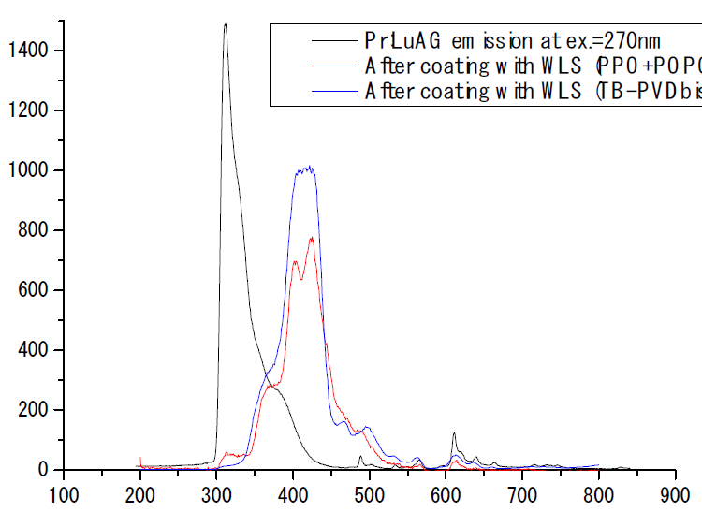
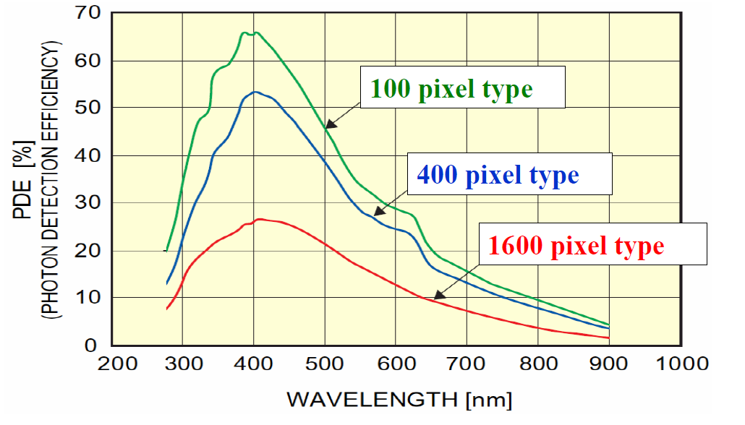
Scintillator array
8
ρ = 7.1g/cc
τ = 40ns
25 kph/MeV
ρ = 6.7g/cc
τ = 20ns
20 kph/MeV
3x3x10 mm³ crystals
4x4 arrays
0.2 mm-thick BaSO₄ reflector
LYSO(Ce)
LuAG(Pr)
LuAG(Pr) + WLS coating
LYSO
LuAG
LuAG+WLS
faster (better time res.)
(HPK; 1x1 mm² type)
310nm
420nm
Kamada+10
(in this work)
Relative light yield
Pr:LuAG
Pr:LuAG+WLS
Wavelength (nm)

Slide 9
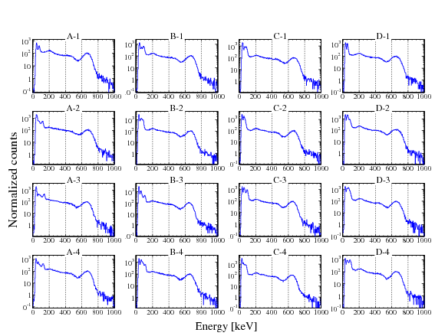
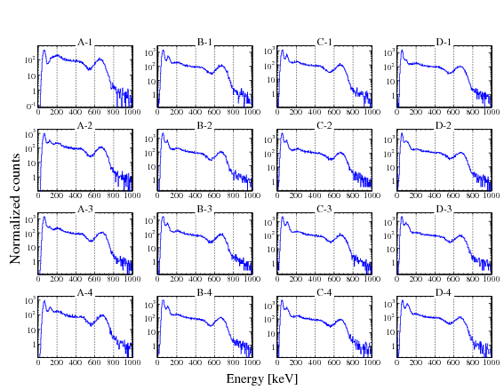
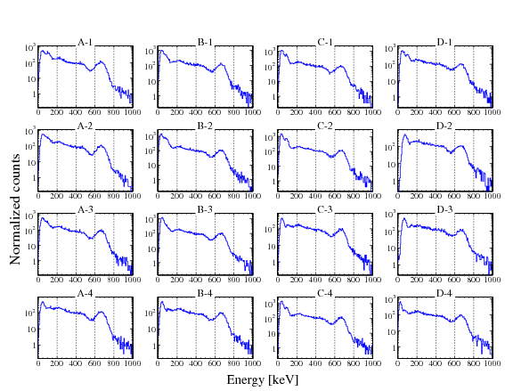
Energy spectra
9
¹³⁷Cs source, 0 ºC, 71.9V
w/o current amplifier
Linearity corrected
Discrete readout with Q-ADC
Energy resolution for 662 keV:
LYSO
LYSO :13.8%
LuAG :14.7%
LuAG+WLS :14.0%
LuAG
LuAG+WLS
Kato+11

Slide 10
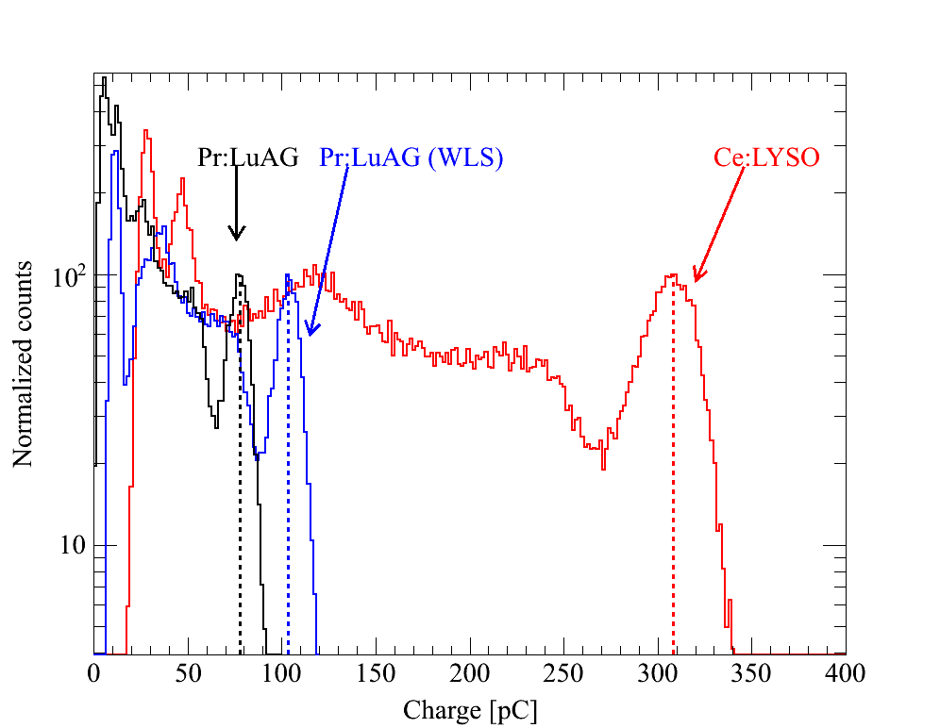
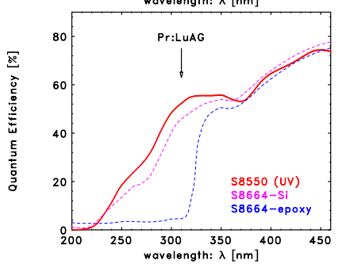
Charge spectra
10
Kato+11
Yoshino+11
channel A-1
310nm
Q.E. of UV-enhanced APD
WLS enhanced the light yields detected by ~30%
Still much less than LYSO
Yet we prefer LuAG for better timing resolution
“UV-enhanced MPPC” could be a solution

Slide 11
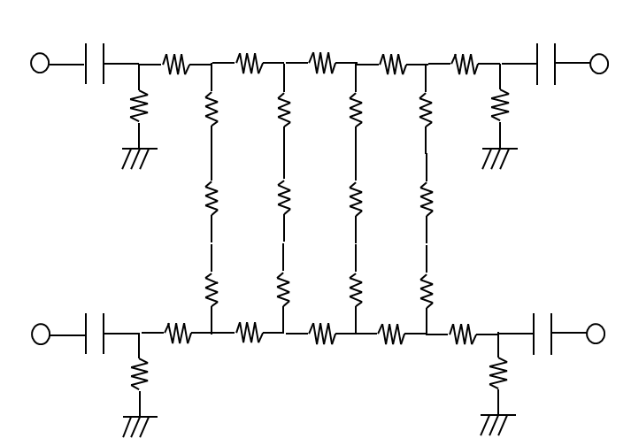
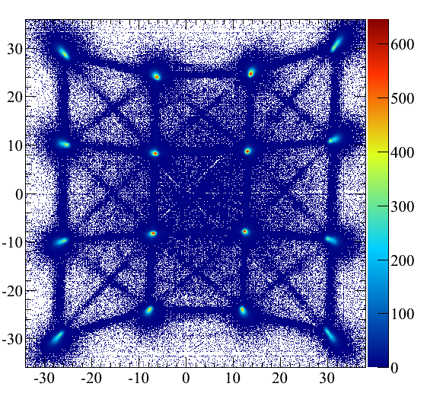
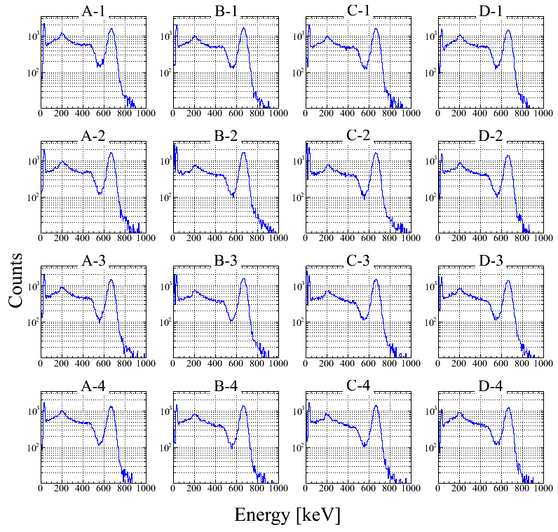
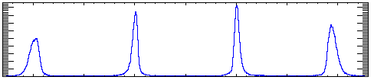
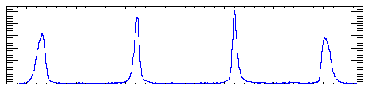
Charge division readout
11
Can reduce the number of read out
Often applied for MAPMT
0 ºC, 71.9V, LYSO array, ¹³⁷Cs
Interaction positions are nicely resolved
Spectra from each pixel extracted
ave. FHWM ~ x:0.274, y:0.263 mm
ave. ΔE/E ~ 9.9 %(FWHM)
Y position (arb. unit)
LYSO
Kato
X position (arb unit)

Slide 12
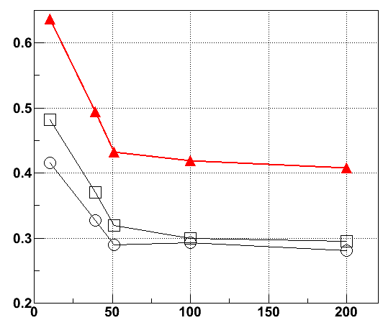
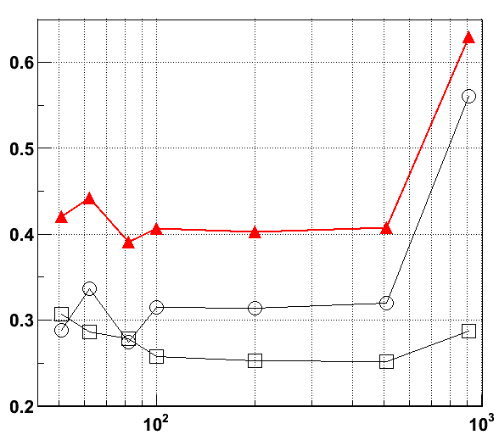
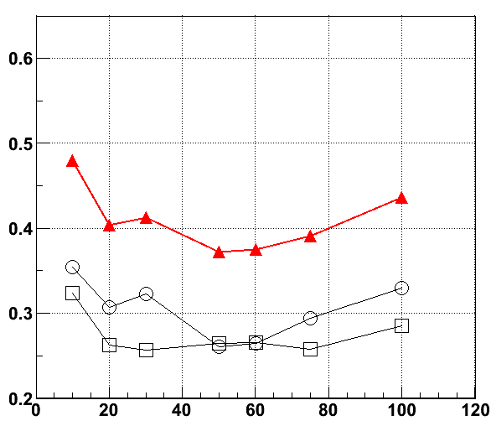
Optimization of R-chain
12
Rx
Minimize averaged FWHM (mm) from X- and Y-projection :
Too many degrees of freedom
Just tried 3 criteria with Rx and Ry
σ_{r} = sqrt(σ_{x}²+σ_{y}²)
Ry
(Rx, Ry)= (51Ω, 100Ω) is the best here,
but there could be better ones…
Rx
0.6
(Rx=Ry)
(Rx=39Ω)
(Rx/Ry=1/2)
80 Ω
51 Ω
r
r
r
averaged FWHM (mm)
y
x
x
x
y
0.2
y
0
200
10²
10³
0
100
Rx (Ω)
Ry (Ω)
Rx (Ω)

Slide 13
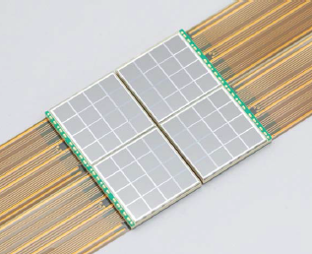
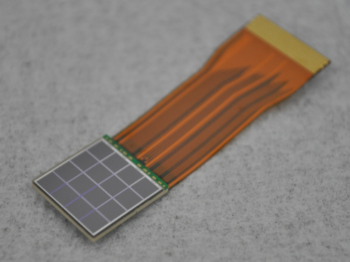
Our efforts
S
13
MPPCs
development
PET application
TOF
DOI
dedicated “fast” LSI
Miura+
Matsuda+11 (in prep)
Better pos. res.
signal precision
Waveform-DAQ
Sub-mm LYSO array
Buttable 8x8
Kato+11 (in prep)
Gamma-ray measurement
BG surpression
4x4 + FPC
Phoswitch counter
Low threshold
Miura+
Waveform-DAQ
Coincidence technique
Poster [20] by Miura

Slide 14
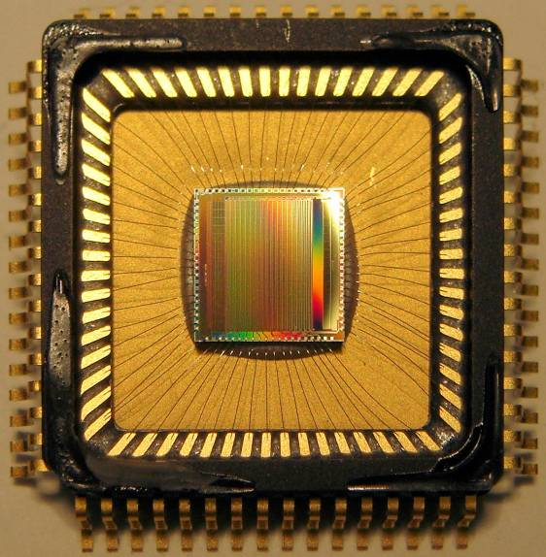
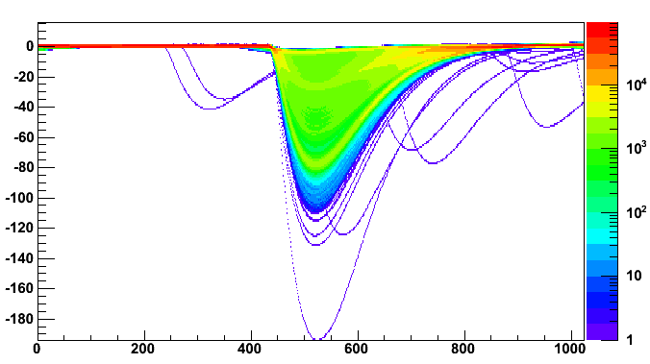
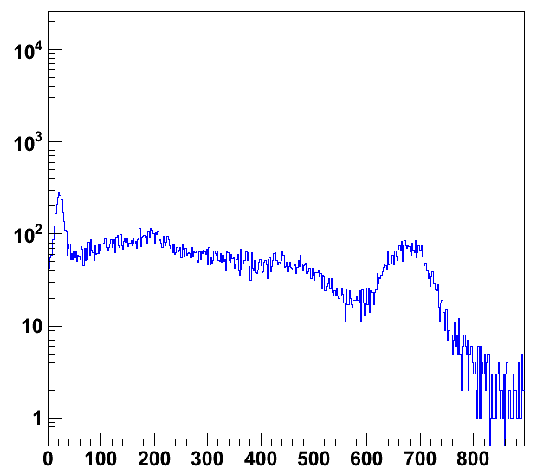
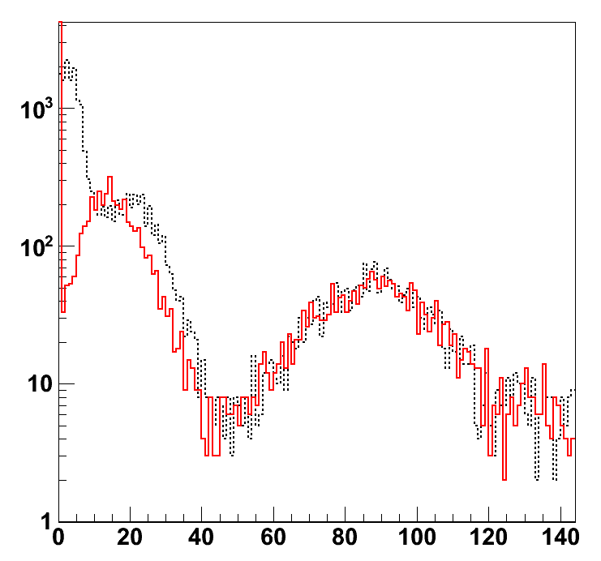
Waveform acquisition
14
Domino Ring Sampler 4 : Fast analog memory LSI
developed for particle experiments (MEG, MAGIC,..)
  Low cost, low power : 140 mW/8ch
  fast sampling : Max 5 GHz, 1 V/12 bit
(S. Ritt+)
Applicable to (DOI-)PET !
Demonstration
Suit for large number of channels
Digital filtering & noise reduction
Capable of pulse shape discrimination
etc… lots of potential
3x3mm² MPPC + LYSO
w/ current amp.
20 ºC, G=7.5e5
Spectra obtained
Noise level reduced
¹³⁷Cs
¹⁰⁹Cd
22 keV
Voltage (mV)
662keV
88 keV
¹³⁷Cs
Q-ADC
waveform
(digital filtered)
Time (ns)
Energy (keV)
Energy (keV)

Slide 15
Summary
15
MPPC is a promising photosensor, especially for TOF-PET scanner
We developed a monolithic 4x4 MPPC array to be applied for PET
We showed the performance of the array as a gamma-ray detector
LYSO(Ce) is better than LuAG(Pr) at this moment, even with the wavelength shifter
We also demonstrated the charge division readout which works well.
Lots of wonderful results will be published soon !

