Slide 1
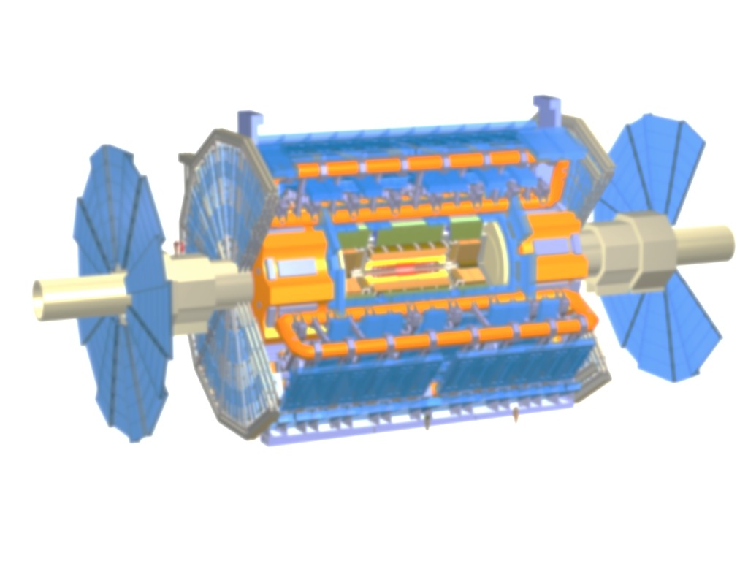

Track based Alignment of the ATLAS Inner Detector Tracking System
Jochen Schieck
Ludwig-Maximilians-Universität München
und
Excellence Cluster Universe
for the ATLAS Collaboration
9th International Conference on Position Sensitive Detectors
Aberystwyth 12th - 16th, September 2011

Slide 2
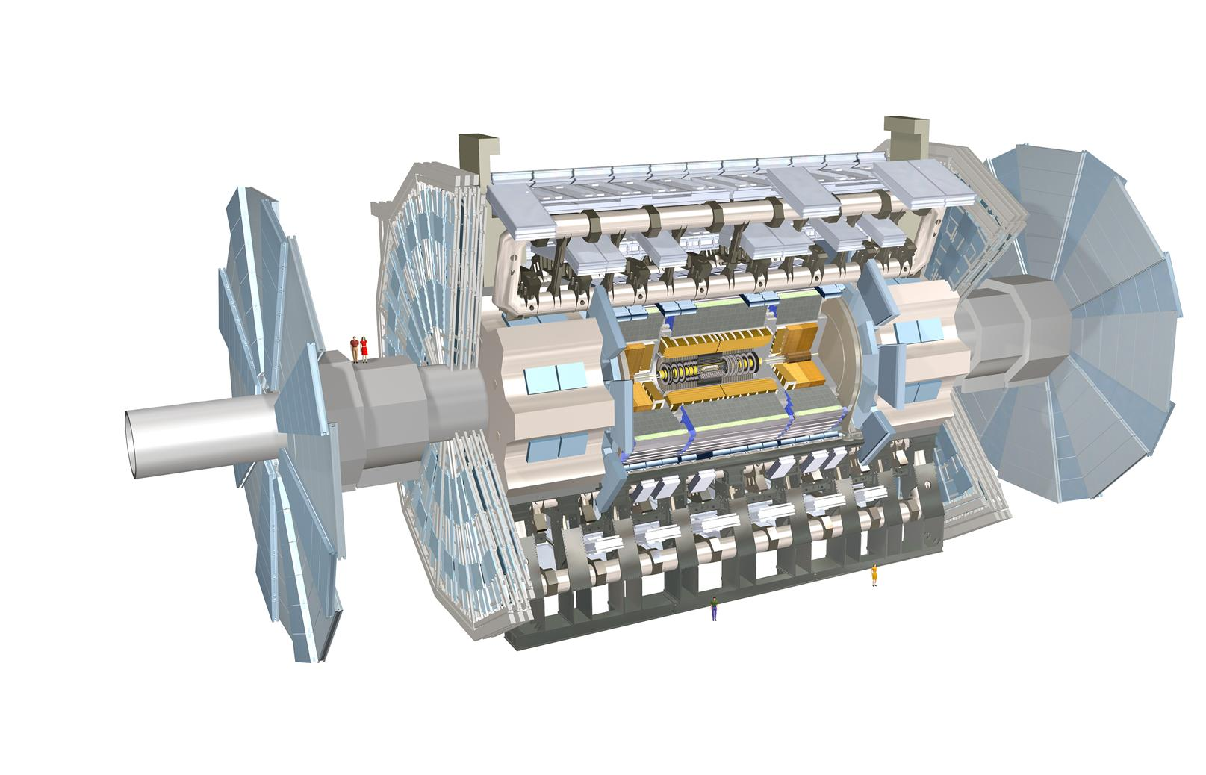
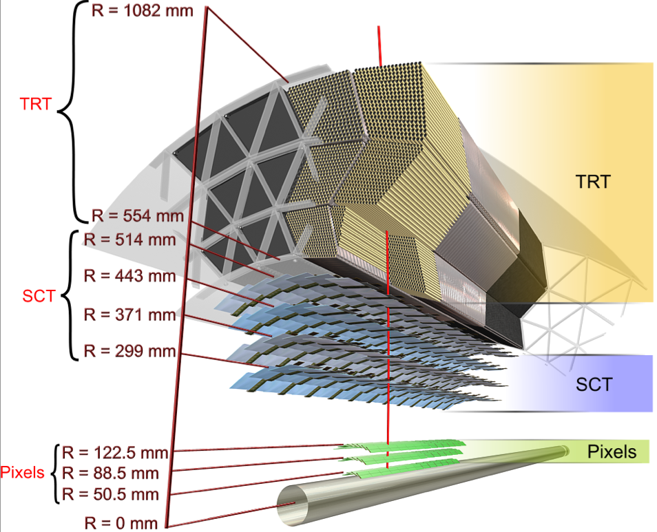
The ATLAS Detector
You are
here
ATLAS Inner Detector (ID) main tracking device of ATLAS
  consists of Pixel, Silicon strip (SCT) and drift tube (TRT) detectors
  single hit resolution between 10 μm (Pixel) and 130 μm (TRT)
Notes:
Note:
The performance in the Endcaps the resolution increases by ~20% and multiple scattering contributes double

Slide 3
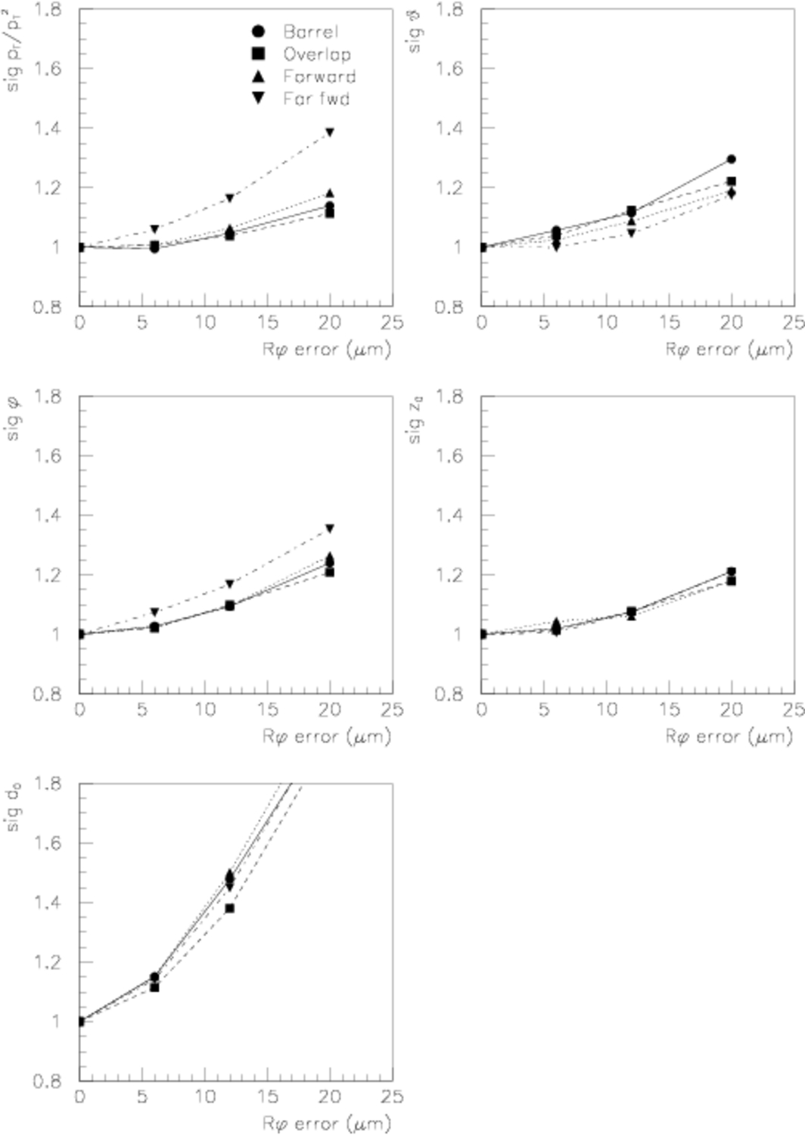
Requirements from Tracking
construction and installation precision ~100 μm
track parameter resolution should not be degraded by more than 20%
  7 μm precision in RΦ for Pixel
  12 μm precision in RΦ for SCT
ultimate precision can be achieved with track based alignment procedure only
hardware based system (FSI) available in the SCT to monitor fast movements of support structures
ATLAS
ID TDR
momentum
impact parameter
Notes:
up to 1um precision for W mass measurement

Slide 4
How to align a Detector
# of hits
residual
residual = distance between
hit and the fitted track

Slide 5
How to align Detector
# of hits
imagine the real detector
looks like this:
but we think it
is like this:
if we had the
correct knowledge:
residual
⇨ minimize residuals with respect to the module’s positions

Slide 6
How to align a Detector
# of hits
residual
residual = distance between
hit and the fitted track

Slide 7
How to align Detector
# of hits
imagine the real detector
is misaligned, but we think it
is perfect
residual
⇨ minimize residuals with respect to the module’s positions

Slide 8
How to align Detector
# of hits
but we think it
is like this:
imagine the real detector
looks like this:
if we had the
correct knowledge:
residual
⇨ minimize residuals with respect to the module’s positions

Slide 9
Track based alignment procedure
a_{i}
collect residual distributions for each module and minimize with respect to the alignment parameters
module-to-module correlations are taken into account by nested dependence on track parameters:
increased convergence
speed
derivative of the residual w.r.t. track
derivative of the track parameters w.r.t.
alignment parameters
derivative of the residual w.r.t. the alignment parameters

Slide 10
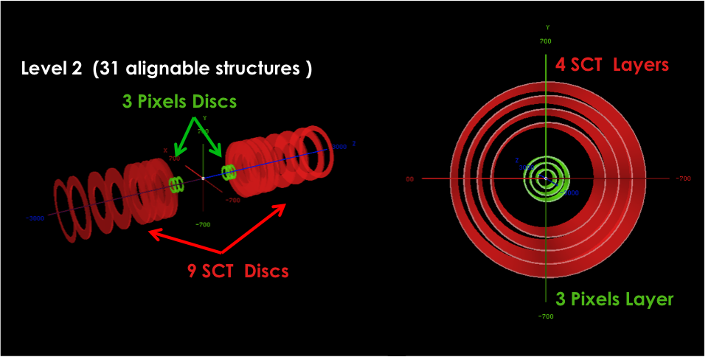
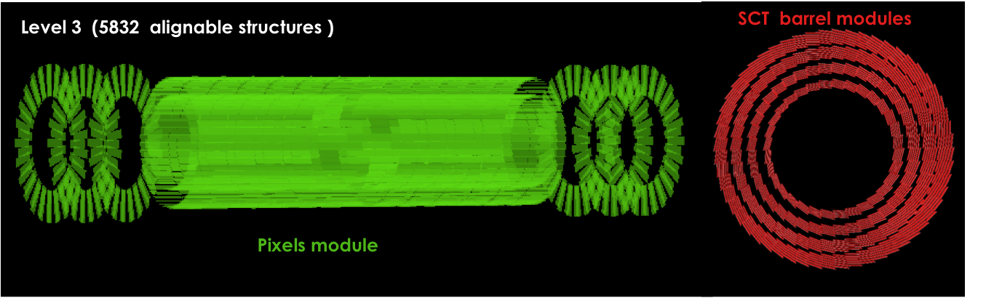
Track based alignment procedure
start from survey information (Pixel)
perform hierarchically alignment following detector structure
align up to 6 degrees of freedom (d.o.f.) per structure
  35k d.o.f for Pixel and SCT
  (6 d.o.f. per module)
  700k d.o.f for TRT
  (2 d.o.f. per straw)
iterative procedure
  10-20 steps for production of complete alignment set
test2

Slide 11
Input to the Alignment Algorithm
high p_{T}–tracks to minimize multiple scattering effects
  tracks from collision events
    enough tracks during collisions produced –statistics no problem
    large time consumption due to repeating reconstruction of tracks in iterative alignment
    production of reduced data stream with selected high p_{T}-tracks containing ID and track related information only
  tracks from cosmic ray events
    different track topology
    tracks connect top and bottom of ID
    hardly any illumination of endcap

Slide 12
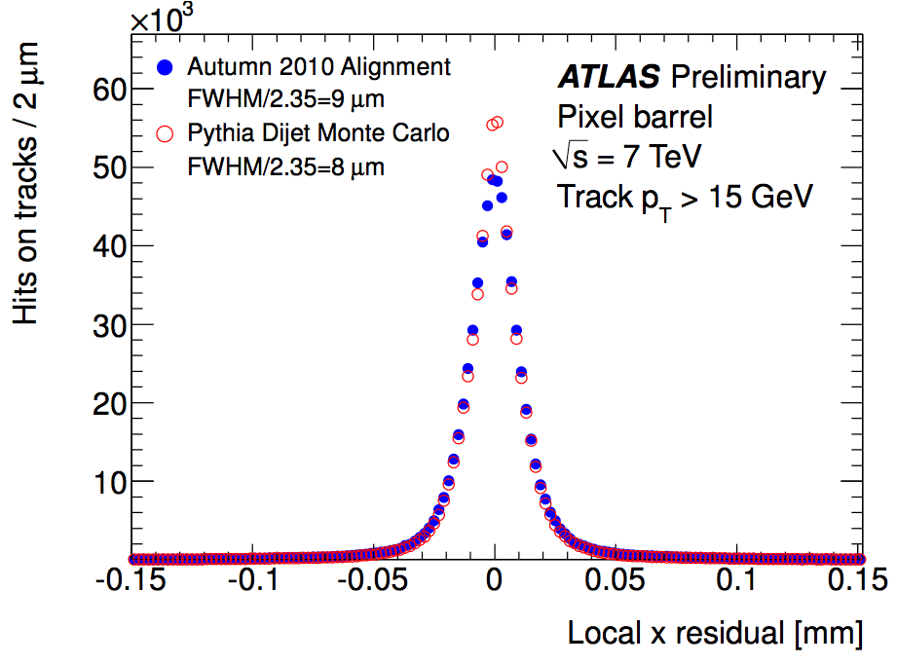
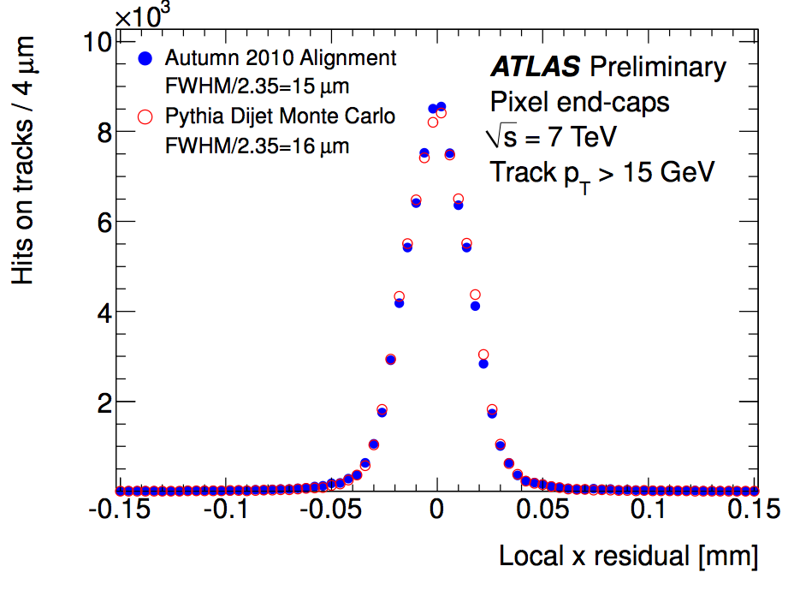
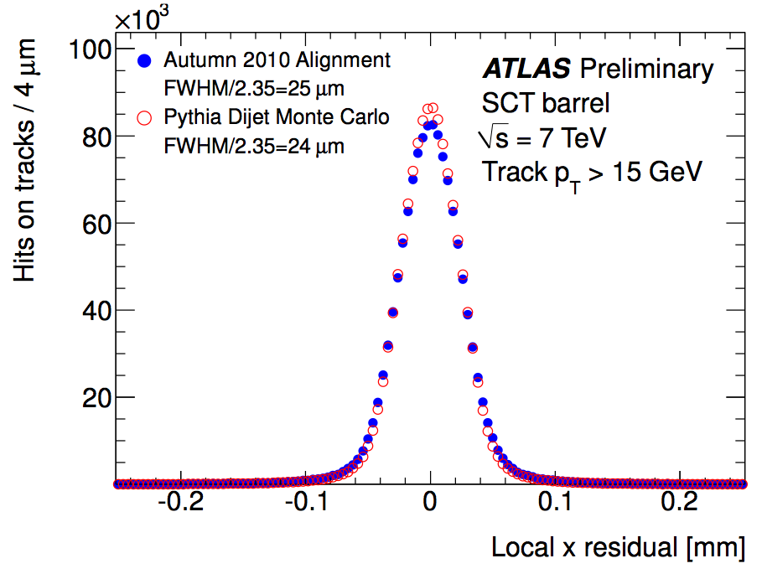
Residual Distribution
alignment minimizes the Χ² all measurement residuals
  alignment returns residual distribution which is almost consistent with MC residual distribution with perfect geometry
  this is a necessary but not sufficient condition
  resulting Χ²-value may end up at a local Χ²-minimum (or valley – weak modes of the solution)

Slide 13
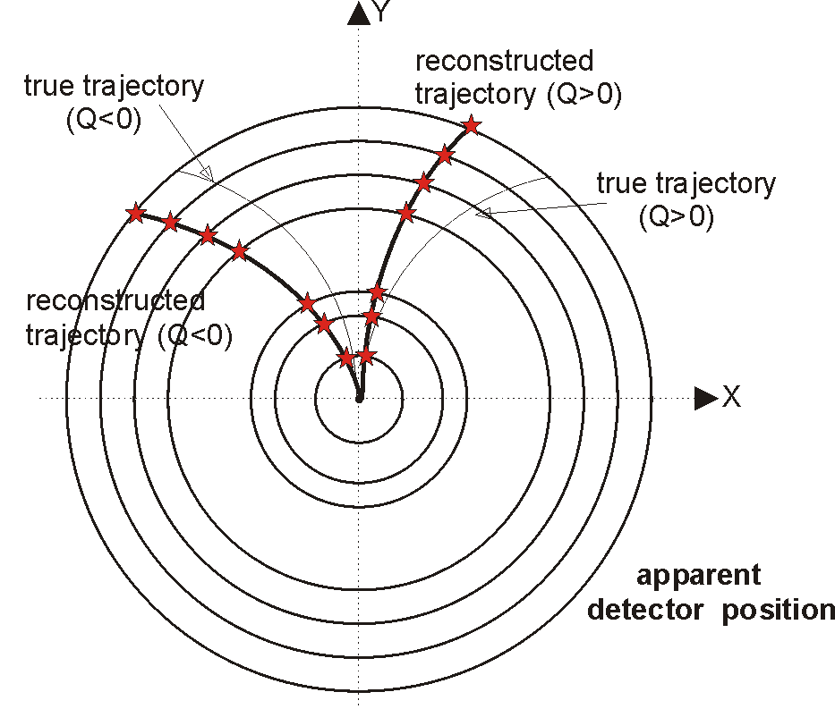
ID Alignment – Quality Assurance
estimate alignment performance using control plots not based on residual distributions
  main focus on the improvement of the momentum scale
ATLAS
Simulation
ATLAS-PHYS-PUB-2009-080

Slide 14
Overall Position of Detector
alignment procedure returns internally consistent set of alignment constants
  6 d.o.f. (= overall position of detector) cannot be determined from alignment procedure
  initial position determined by requiring minimal module-by-module deviation from the perfect geometry
keep average position consistent for alignment updates (keep beam spot position constant)
  ID may be misaligned with respect to the solenoidal magnetic field (relative tilt)

Slide 15
Solenoid Field Tilt
y
B-Field
x
z
Endcap A
Endcap C
measure the invariant mass variation with respect
to PDG-value (ΔM) as function of Φ
  tilt of the magnetic field is reflected in Φ-dependent J/ψ-mass
  rotation around the x-axis by 0.55 mrad reduces Φ-dependence significantly

Slide 16
E/p Momentum Constraint
identical calorimeter response for e⁺ and e⁻
E/p measurement sensitive to charge asymmetric bias on p-measurement (like curl or sagitta distortions)
measure E/p (η,Φ) and use offset between e⁺ and e⁻ to constrain track momentum in alignment

Slide 17
Improved Mass resolution using E/p constraint
mass resolution of Z significantly reduced with E/p constraint tracks used in the alignment procedure
data performance nearly reproduces MC predictions

Slide 18
Improved Mass resolution using E/p constraint
E/p constraint removed Φ-dependence of Z-mass

Slide 19
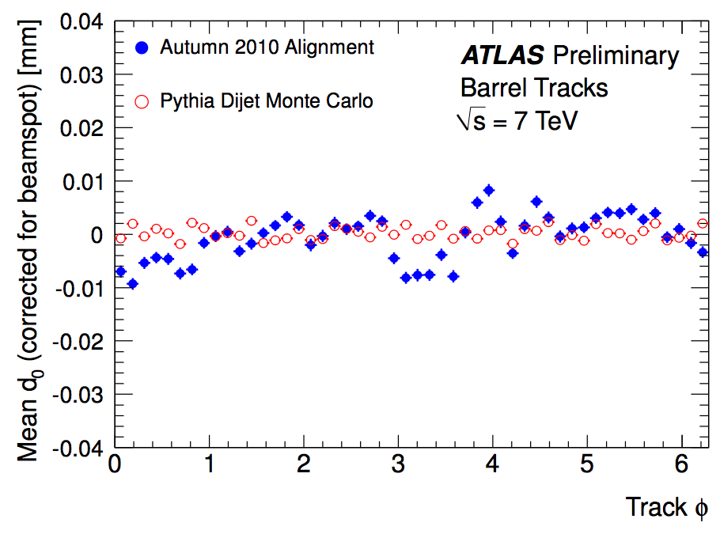
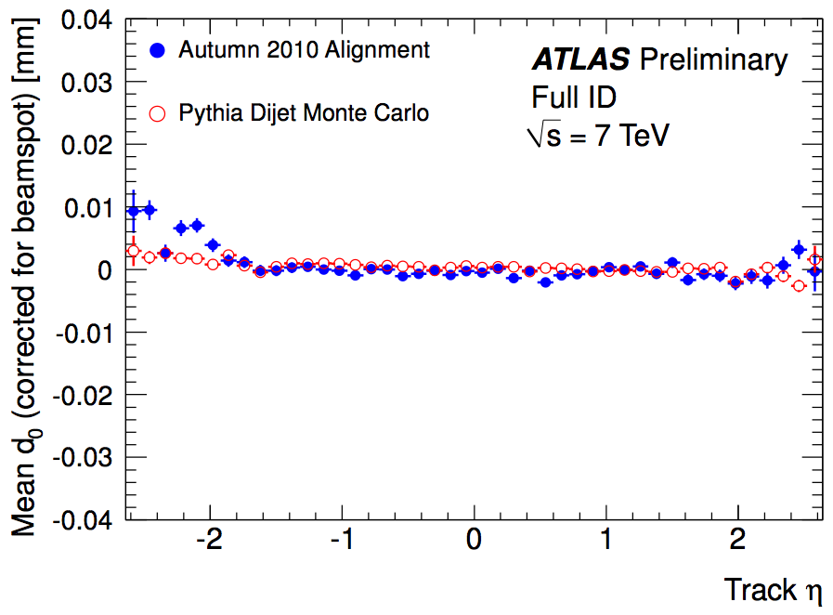
Effect on Impact Parameter Measurement
input tracks for alignment constraint to originate from primary vertex (d₀= 0)
impact parameter measurements as a function of η and Φ indicate residual misalignments
  Δd₀ up to 10 μm
impact on impact parameter based measurements expected

Slide 20
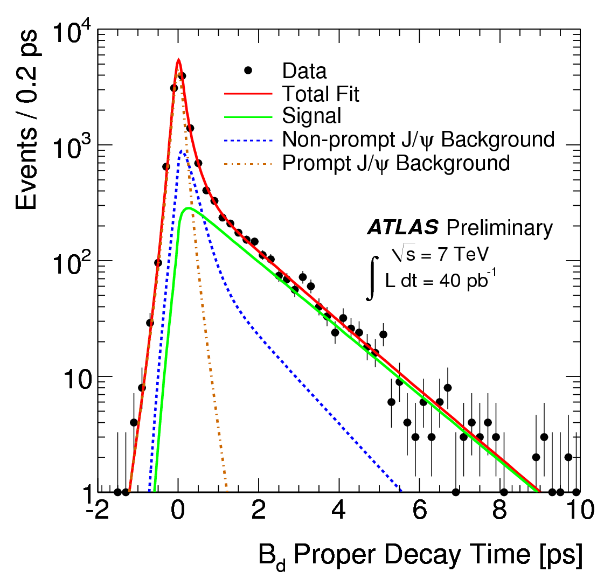
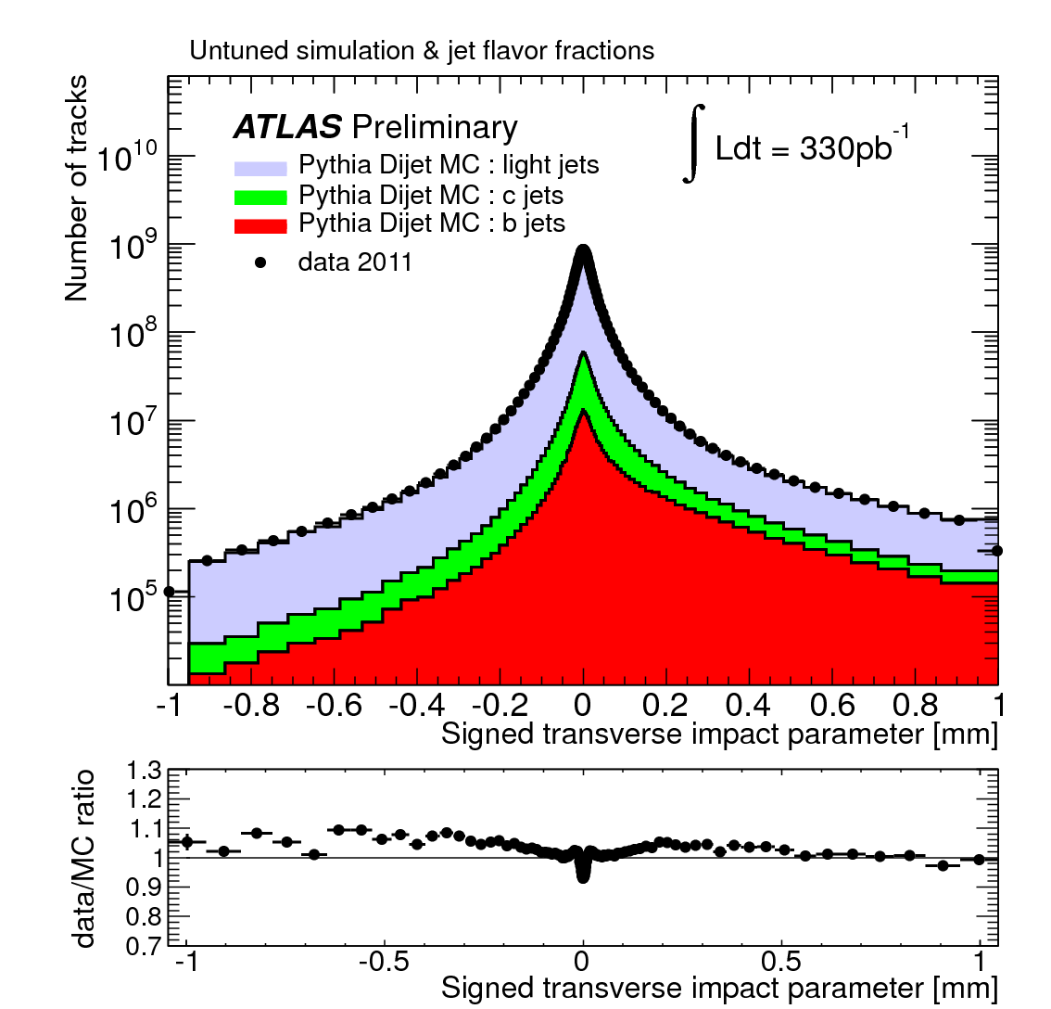
Impact Parameter based Measurements
ATLAS-CONF-2011-092
ATLAS-CONF-2011-102
exclusive B_{d} lifetime measurement
τ_{Bd}=1.51±0.04+0.04 ps
(PDG: 1.519±0.007 ps)
(0.04 ps ~ 20 um for 10 GeV B-Meson)
impact parameter based b-flavour tagging
negative part of signed impact parameter (=resolution) returns up to 10% difference to Monte Carlo

Slide 21
Some Final Remarks
production of alignment constants is time and computing intense
  several iterations with track (finding and) reconstruction required
  reduced data format (e.g. data stream with hits of high p_{T}-tracks only) improves turnaround and speeds up validation
cosmic tracks are highly valuable for alignment performance
  consider trigger of cosmic tracks during data taking
minimizing residuals is the easy part
  focus early on measurements sensitive to global distortions

Slide 22
Summary
alignment of ATLAS ID uses track based alignment
  minimization of residuals with respect to alignment parameters
residual distribution almost identical to MC with perfect geometry
  residual minimization necessary but not sufficient
momentum measurement considerably improved by
  realignment of B-field with respect to the ID
  require identical E/p measurement for e⁺ and e⁻
measurement of average offset of impact parameter d₀ better than 10 μm

Slide 23
Bonus Material

Slide 24
The ATLAS Inner Detector
subdetector | r (cm) | element size | resolution ( X * Y) | hits/ track (Barrel) | channels
Pixel (Silicon) | 5-12.5 | 50μm * 400μm | 10μm * 115μm | 3 | 80x10⁶
SCT (Silicon Strip) | 30-52 | 80μm * 12cm (stereo) | 17μm * 580μm | 4 | 6x10⁶
TRT (straw tubes) | 56-107 | 4mm * 74cm | 130μm | 30 | 0.4x10⁶

Slide 25
Time Dependence of Alignment
single set of alignment constants used for 2011 data
small (<10 μm) changes visible
  changes related to mechanical interventions (ie. power cut)
pixel stable during data taking period
Notes:
179939 & 180149 there was a cooling system failure
180481 & 180614 there was a power cut
180710 & 182284 there was a LHC technical stop where the cooling & power was turned off
182519 & 182726 a fire alarm went off and as a result the cooling system was required to be shut down
182787 & 183003 the toroidal magnetic field was dumped

Slide 26
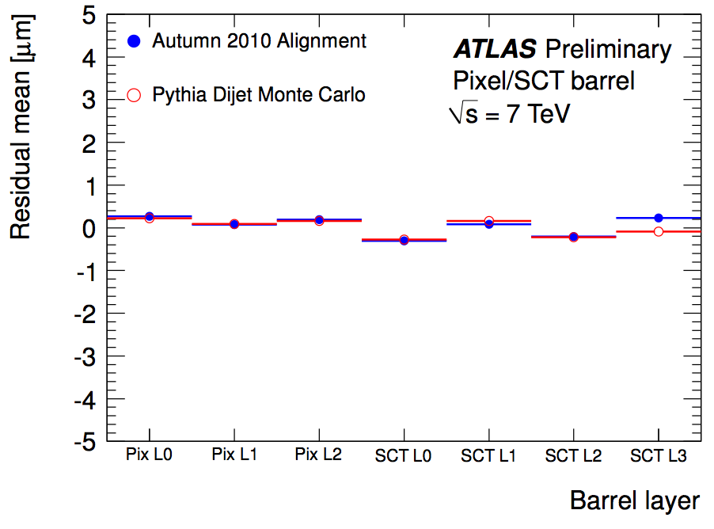
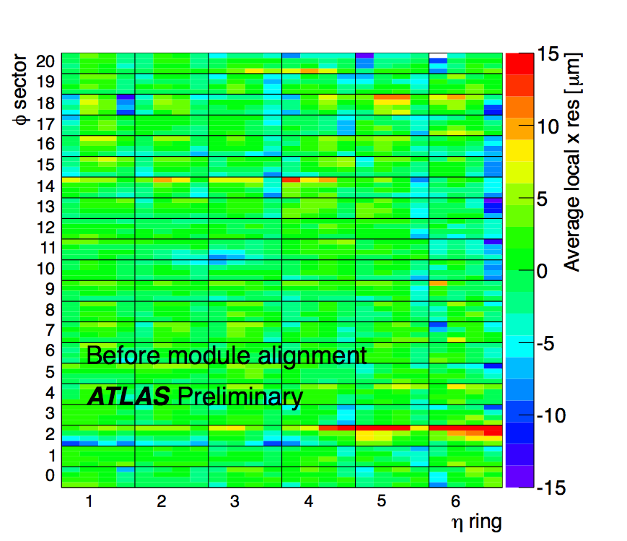
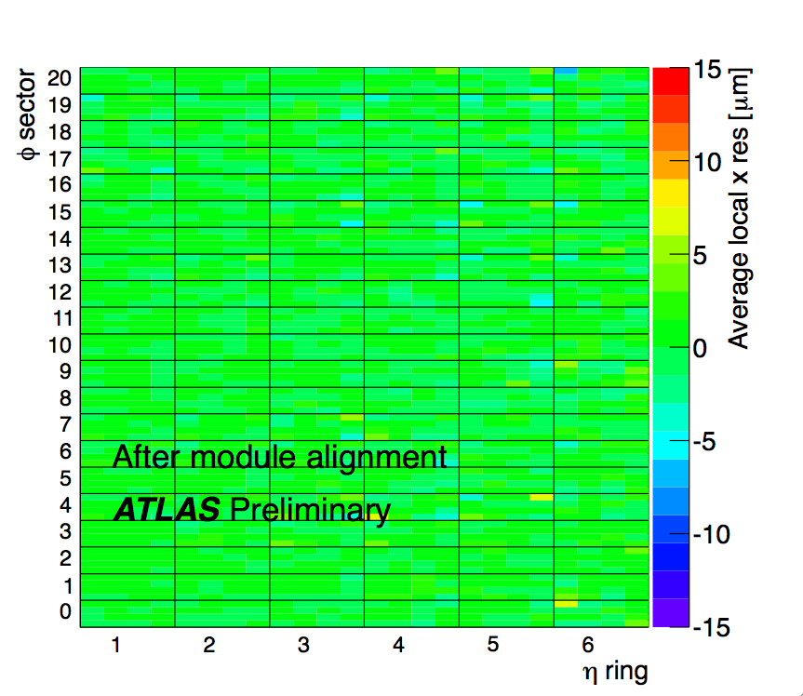
Residual Distribution
mean value of residual distribution consistent with expectations from Simulation
significant improvement achieved by alignment using individual module DoFs

