Slide 1
The development of x-ray imaging for airport security, defence and medical markets
John McGrath
9th International Conference on
POSITION SENSITIVE DETECTORS
Aberystwyth
12th September 2011

Slide 2
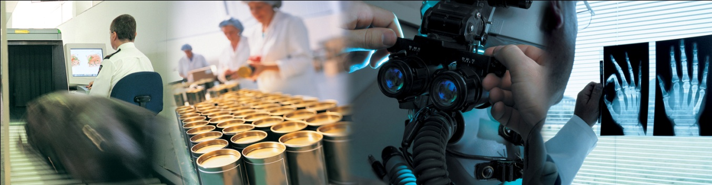
Mission
To be the leading provider of digital colour x-ray imaging enabling direct materials identification in the security, medical, industrial inspection and defence markets

Slide 3
Profile
Founded in 2003 as spin out from Durham University
Based in North East England, UK and California, USA
More than 140 families of patents over entire value stream
Acquired Nova R&D Inc, a Californian corporation in June 2010
Employ over 60 people in US and UK including 19 PhD’s
ISO 9001 accreditation for all internal design and manufacturing processes
Business Model : End user products for niche applications and technology solution provider to OEM’s in conventional markets

Slide 4
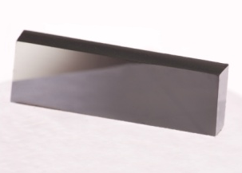
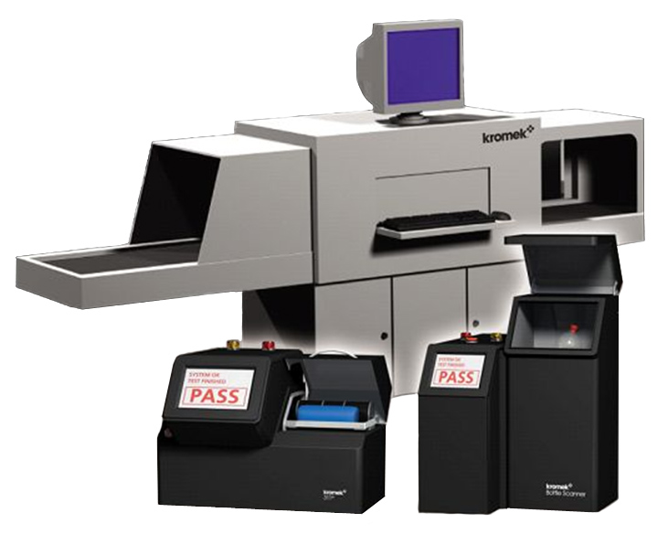
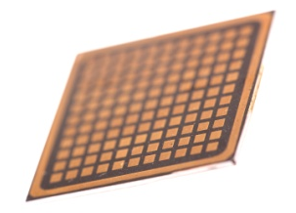
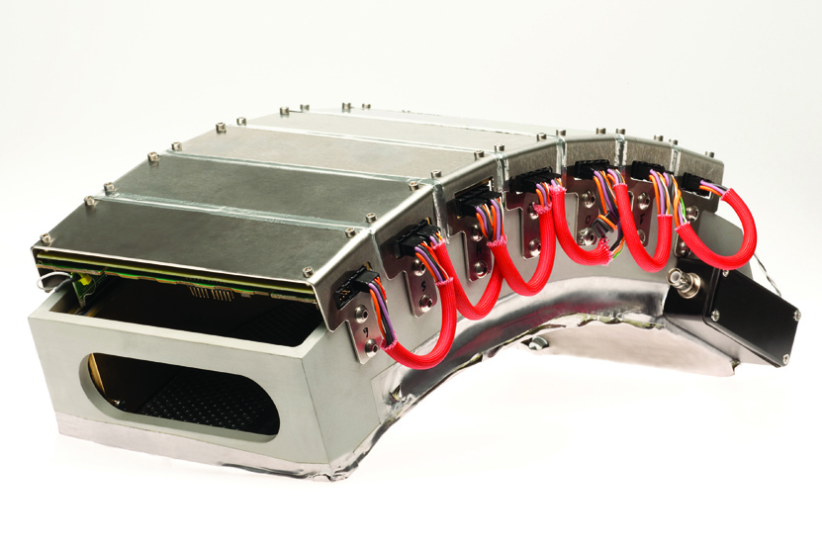
Product strategy
End user products for niche applications and technology solution provider to OEM’s in conventional markets
Materials
Substrates and detector grade material
Platform Integration + Products
Selective high value-added system prototypes exploiting advantages of Kromek detectors
Detectors
Pixellated and planar detectors with electronics
Sub-systems
Application specific sub-system assemblies with Kromek detectors

Slide 5
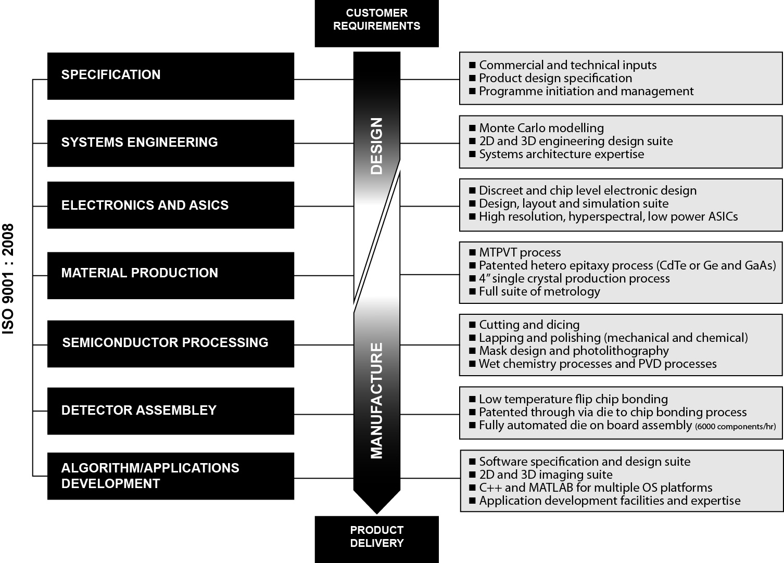
Kromek’s core capability offering

Slide 6
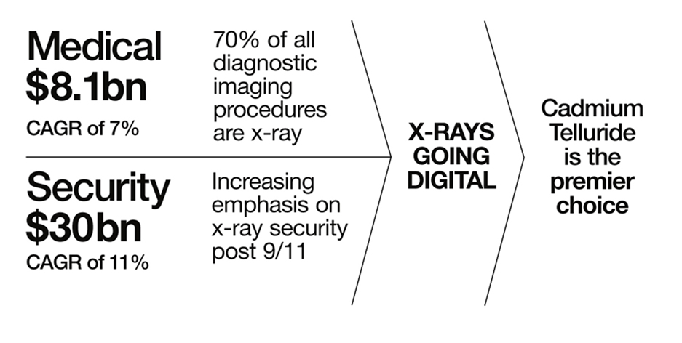
The importance of x-rays

Slide 7
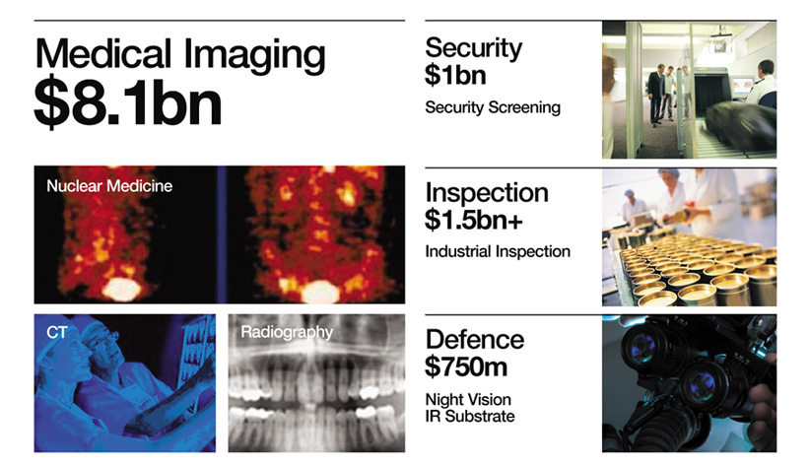
Large markets

Slide 8
Current programmes
Medical
Multispectral CT detector subassembly development (OEM)
Detection module for non-invasive colorectal scanning capsule (OEM)
Multimodal x-ray imaging and breast CT (UMASS – NIH, USA )
Security
Liquid explosive detection system (ECAC Type B)
Spectral imaging system for baggage screening (Type C&D)
Sheet explosive and powder detection system
Industrial
3D imaging for large object scanning (OEM)
High resolution x-ray imaging camera for semiconductor inspection (OEM)
Defense
Large volume CZT detector development for gamma ray detection
Low power high resolution spectroscopic ASIC for gamma ray detection (OEM)
2 Phase II SBIR programmes

Slide 9
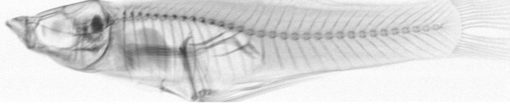
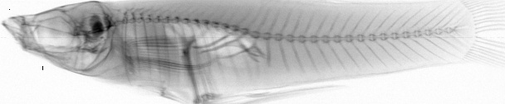
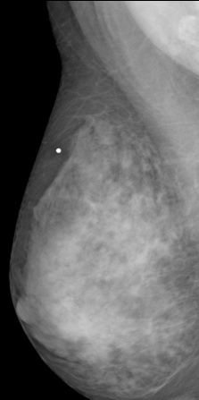
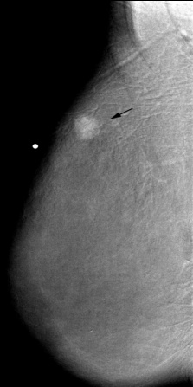
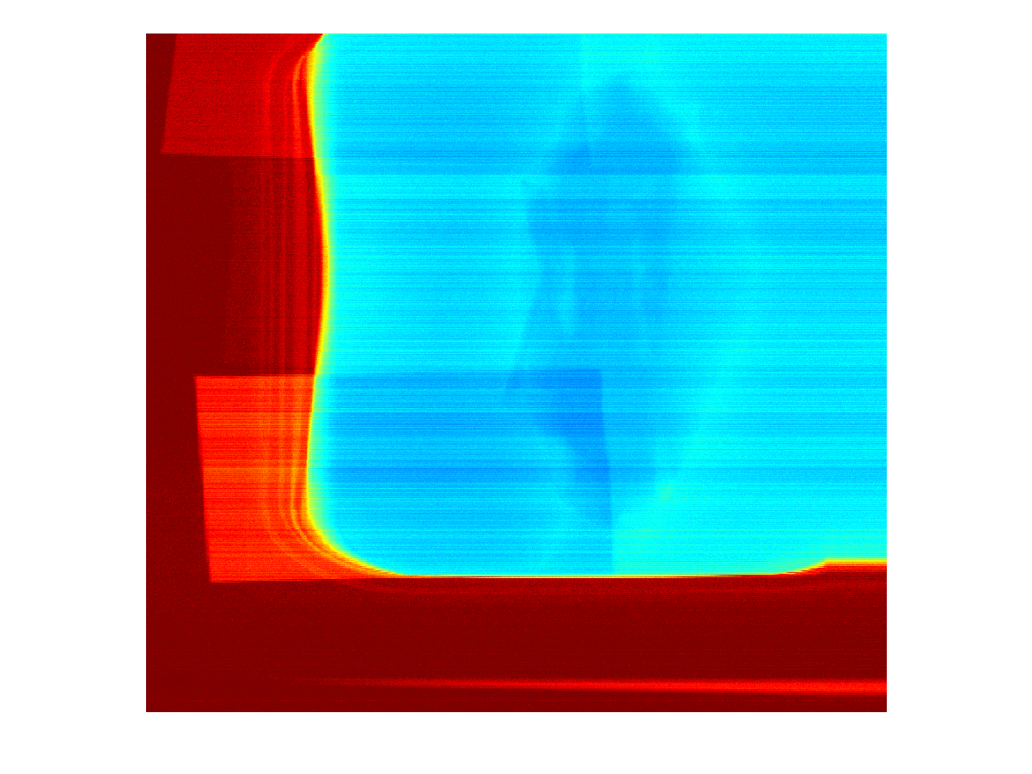
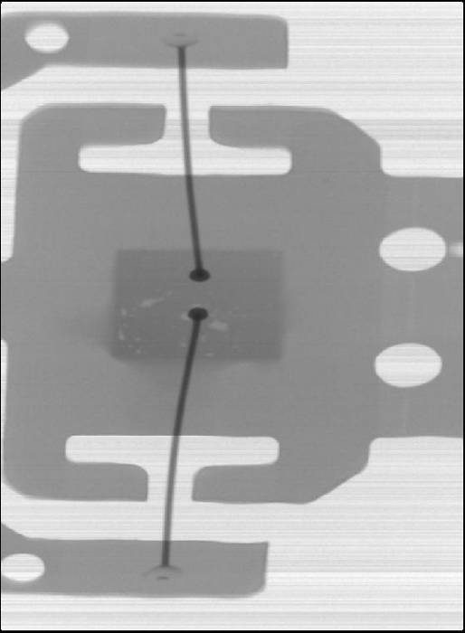
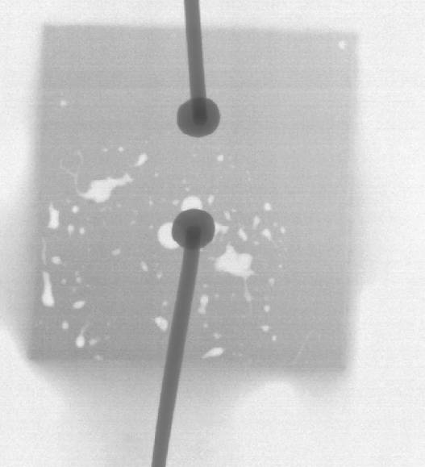
Illustrations of Kromek technologies
Small Animal Imaging
Multispectral x-ray images for explosive detection
50keV
80keV
100keV
Cancer Detection
Hyper-spectral Imaging for defect and anomaly detection
Contrast Enhanced Breast Imaging
Plastic strips in butter tub
Electronic connection showing solder voids visible through connectors

Slide 10
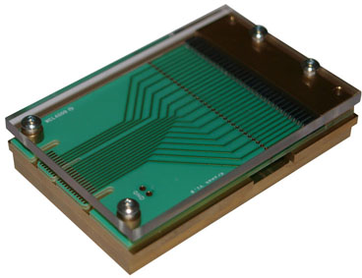
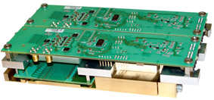
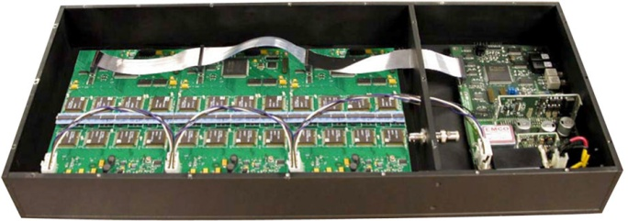
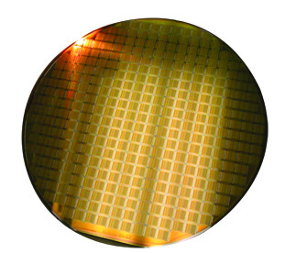
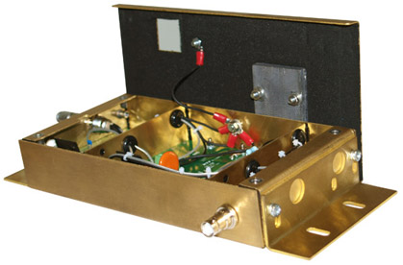
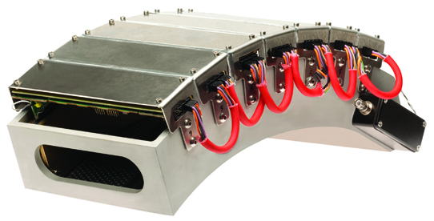
Examples of Kromek OEM products

Slide 11
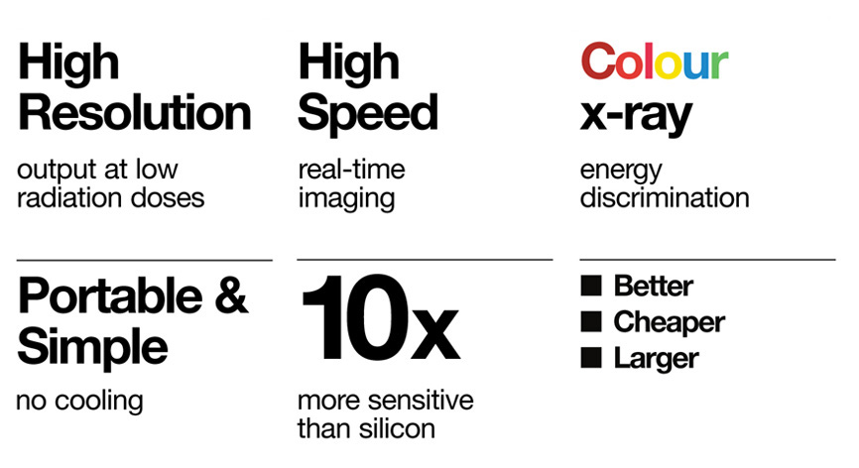
Advantages of CdTe systems

Slide 12
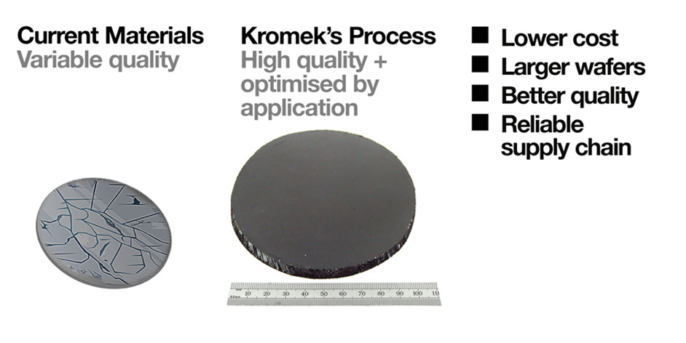
Advantages of Kromek materials

Slide 13
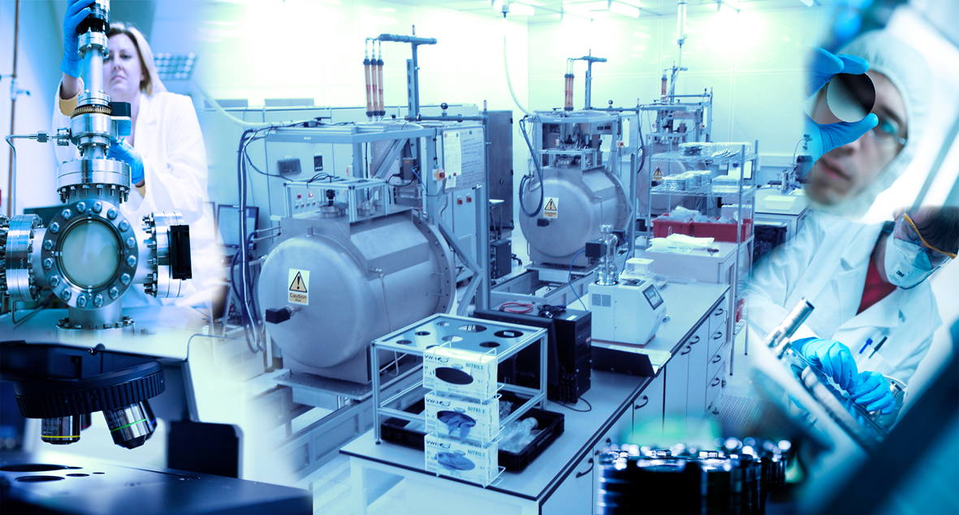
State-of-the-art operations

Slide 14
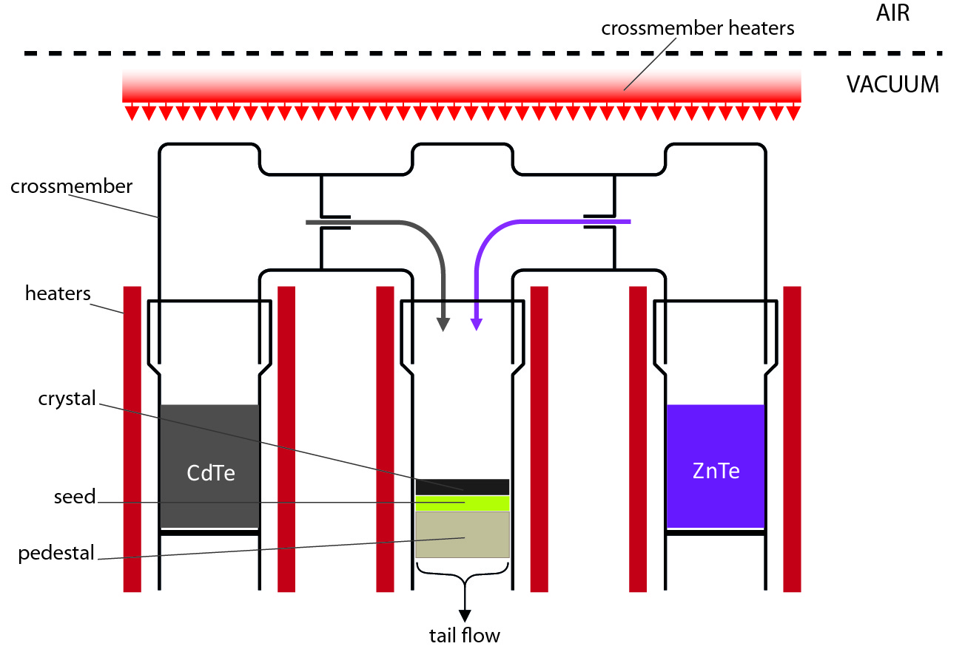
Multi-tube Physical Vapour Transport
source
crystal
source
crystal

Slide 15
Modelling – Monte Carlo and FEM
A comprehensive modelling tool that can be used for detector design and analysis.
Production and Transport of Radiation
Ionisation of the Semiconductor
Separation and Acceleration of Electrons and Holes by the Electric Field
Transport of Charge Carriers within the semiconductor and induction of charge on the electrodes ( formation of charge pulse)
Amplification and Processing of the Charge Pulse
This can be achieved in 3 steps;
Geant4
COMSOL (Finite Element Method for Device Modelling)
LABVIEW (Post Signal Processing)

Slide 16
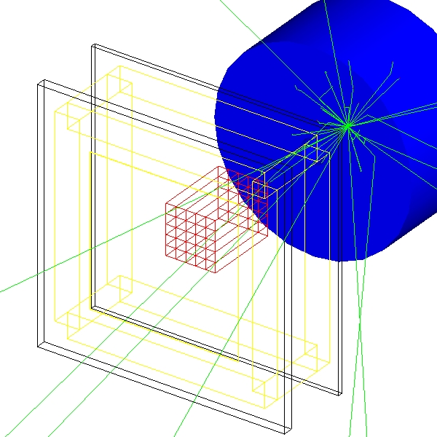
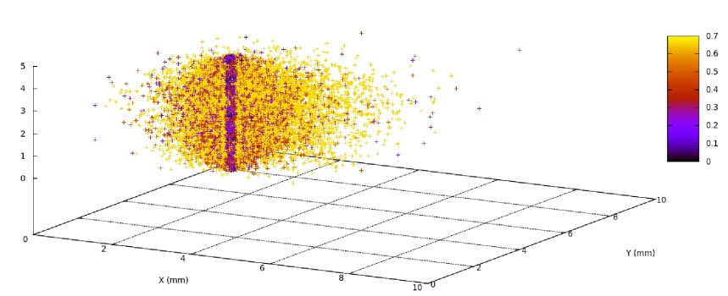
Modelling – Monte Carlo and FEM
Monte Carlo Modelling for Detector modules
For full dectector designs- industrial, medical and security.
Energy Deposition
Interaction positions

Slide 17
FEM- Comsol
Because of the complexity of these devices direct mapping of pulse shapes is impractical. The charge-carrier continuity equation must be solved for each point, this becomes prohibitive for complex electrode structures.
Prettyman introduced a new method for mapping charge pulses by solving the adjoint carrier equation which yields a time and position dependent map that contains all possible charge pulses that can be produced by the detector for charge generated at discrete locations.

Slide 18
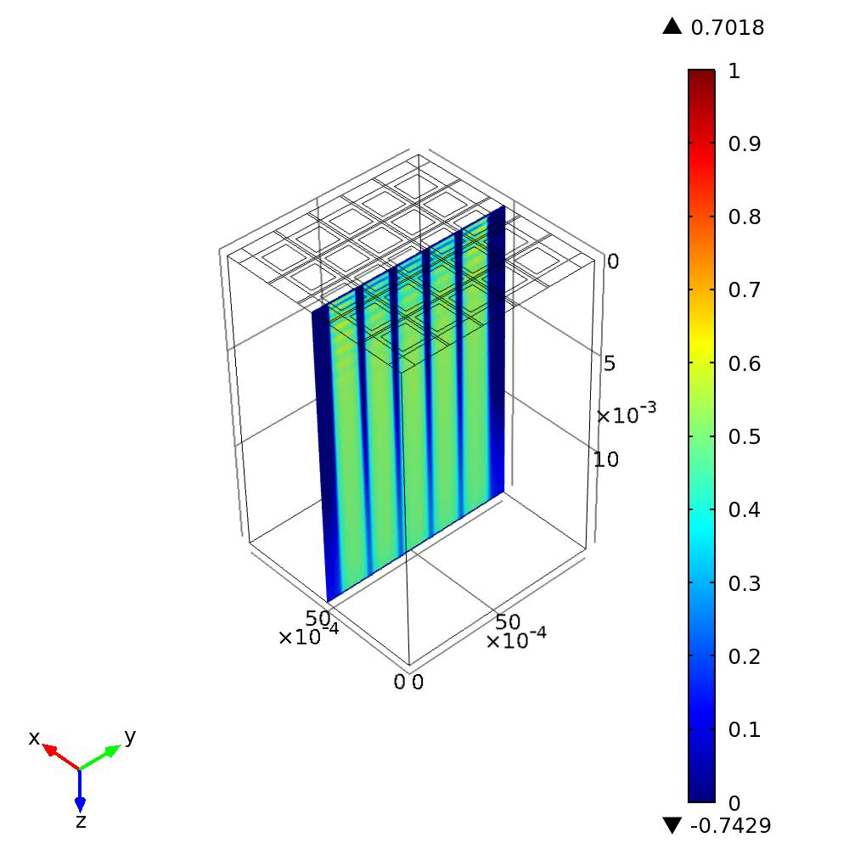
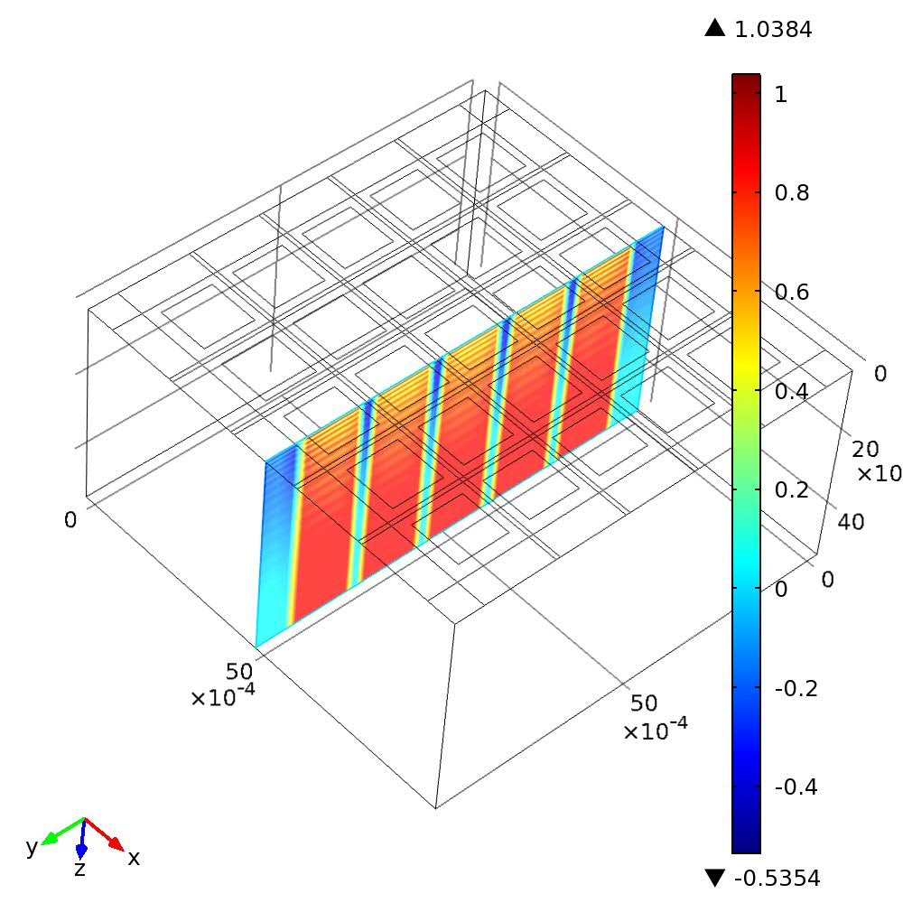
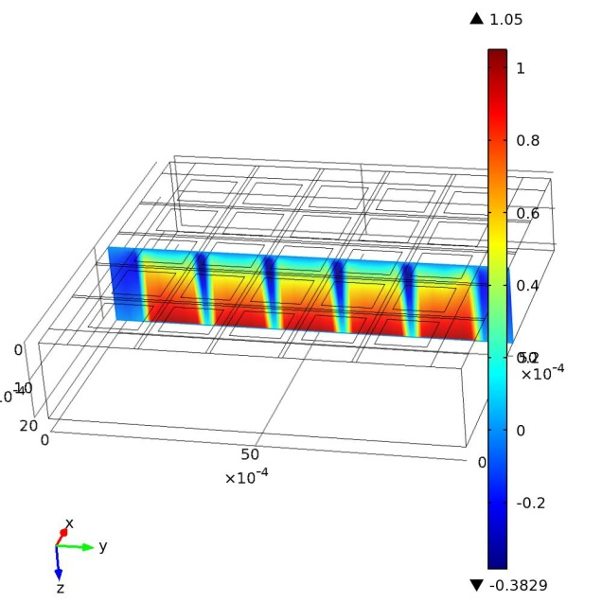
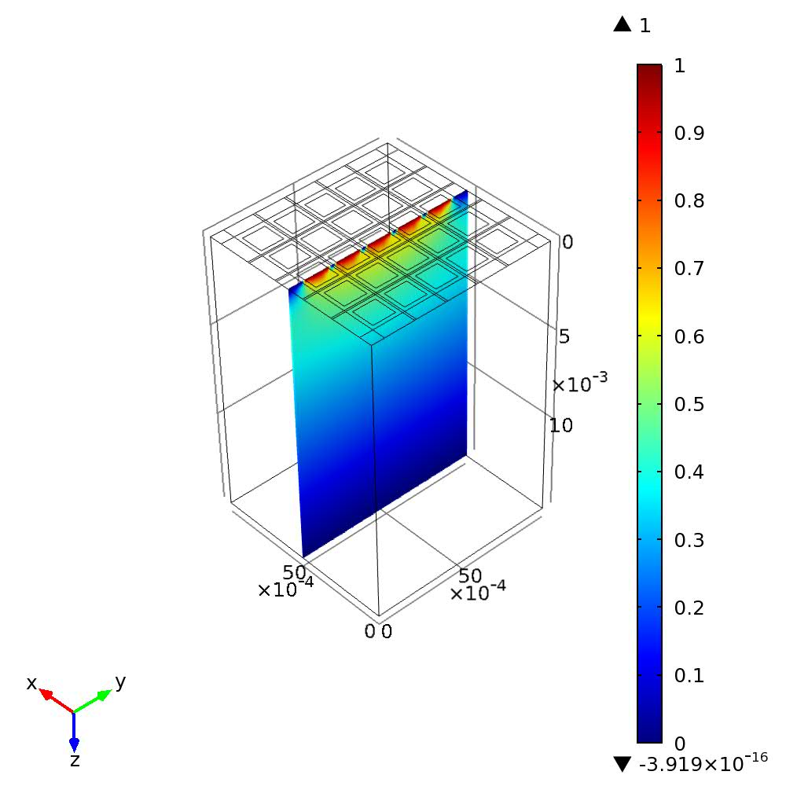
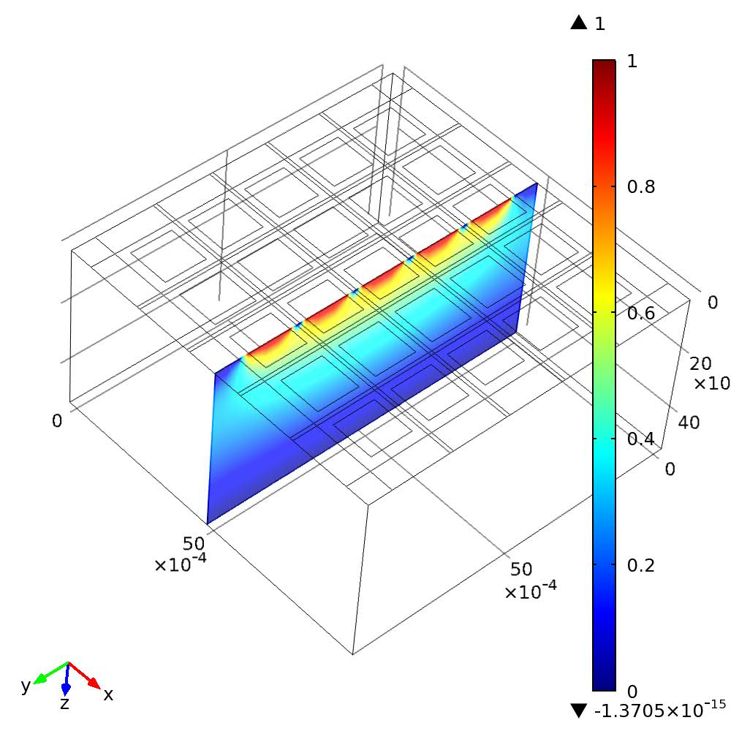
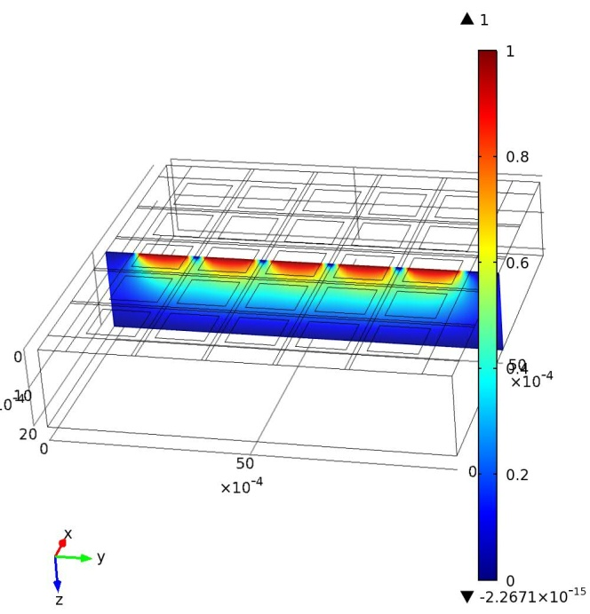
Charge Induction Efficiency Maps
15mm 5mm 2mm

Slide 19
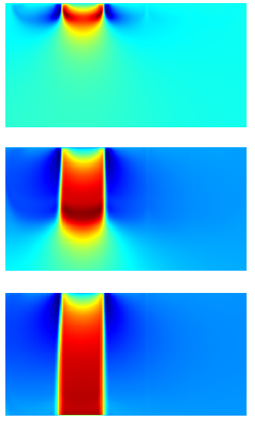
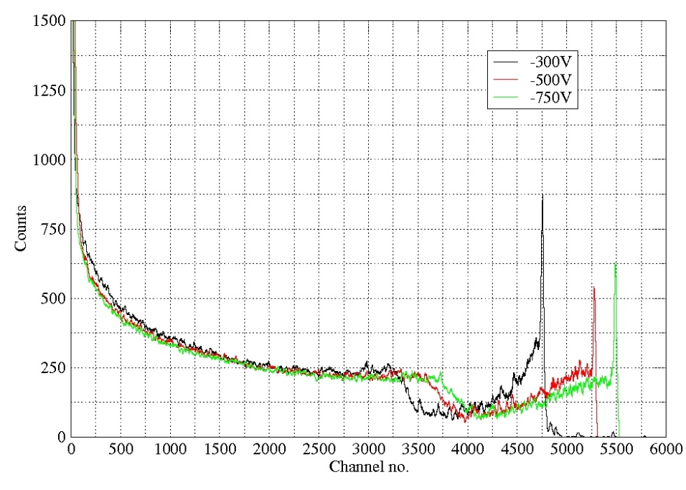
Experiment vs Simulation
2mm, 5mm and 15mm thick detectors
Largest at present 20x20x15mm
15mm needs DOI correction because of limited electron lifetime and diffusion
5mm needs DOI because of Weighting Potential effects
Using RENA ASICs from Nova – good for spectroscopy
As reverse bias is increased, the CIE gets closer to 1 hence the photopeak moves right.
Large depth dependency in the CIE remains, hence there is a long tail on the photopeak.
CIE at -300V, 0.1, 0.5, 1μs

Slide 20
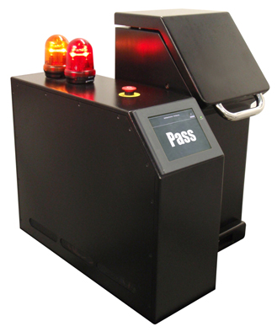
Kromek IdentifierTM – liquid explosive bottle scanner
Identifies the presence of hazardous liquids in containers (liquids, aerosols and gels)
Industry’s lowest false alarm rate
Scans all type/shapes container (coloured, clear and opaque glass, plastic, metal and cardboard)
Scans in less than 20 secs
Easy to use one-touch operation
Simple PASS/FAIL display
Threat database easily upgraded

Slide 21
Automatic liquid recognition
50keV
80keV
100keV
Multispectral x-ray image of 2 bottles inside a bag at three different energy levels
One bottle contains hydrogen peroxide (white circled) and other alcohol
ADMiTTM algorithm can accurately identify material independent of the volume or thickness in convoluted and multilayered environments
.

Slide 22
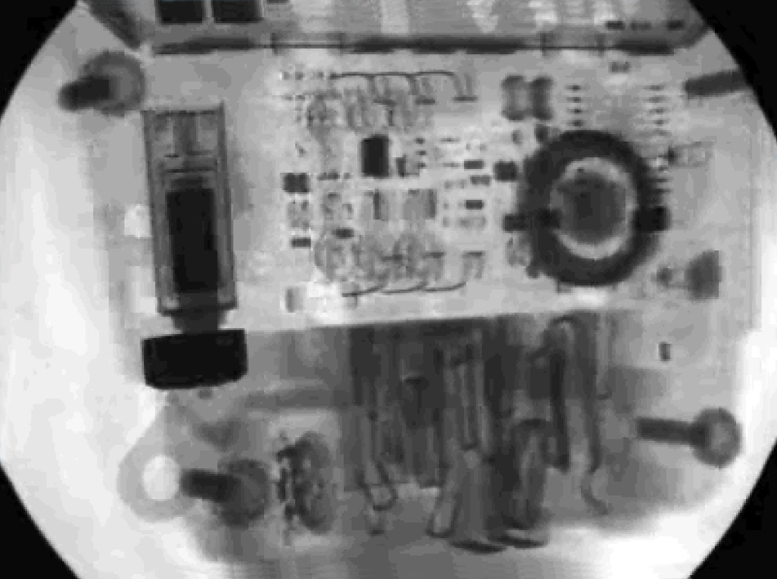
XRA TM multi-view platform
X-Ray Animation (XRA) new imaging IP will radically improve threat detection

Slide 23
XRA TM multi-view platform
3D Imaging with materials recognition
Multiple fan beams from a single source
Exploits the physiological phenomenon of monocular movement parallax to create three dimensional view of object.
Allows separation of layered or hidden parts
Images combined to produce an animated 3D view of the object
Gathers spectral x-ray information, uses Kromek proprietary algorithms to determine material constituents of the object & correlates material assignments via voxel analysis

Slide 24
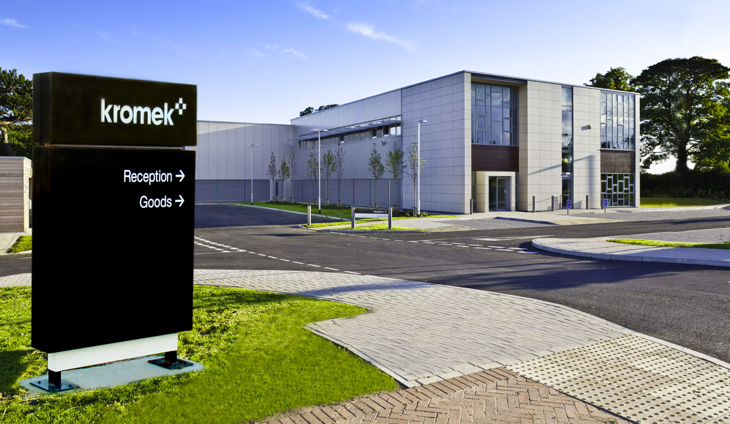
Kromek Ltd
NETPark
Thomas Wright Way
Sedgefield
County Durham
TS21 3FD
T: +44 (0) 1740 626060
F: +44 (0) 1740 626061
E: sales@kromek.com
W: www.kromek.com

