Slide 1
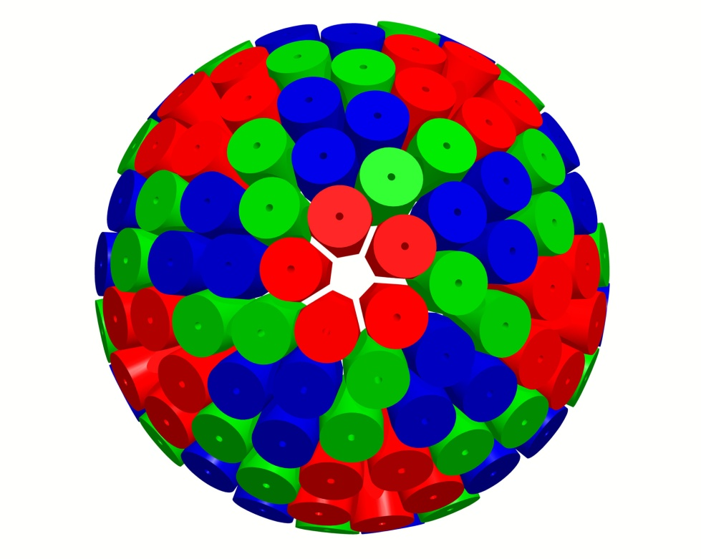
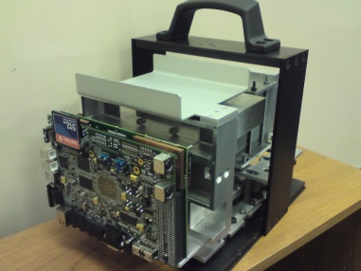

Position Sensitive Detectors for Nuclear Structure Physics and their Applications
Helen Boston
H.C.Boston@liverpool.ac.uk
http://ns.ph.liv.ac.uk/imaging-group/

Slide 2
Content of the Talk
Introduction to Nuclear physics
Types of array
  TIGRESS array
  AGATA
  AIDA
Applications of detectors spun off from NP
Conclusion
H.C.Boston@liverpool.ac.uk

Slide 3
Introduction
Nucleus is unique, strongly interacting many-body system
UK Nuclear Physicists are involved with investigating
  Nuclear Structure
  Nuclear Astrophysics
  Hadron physics
  Phases of nuclear matter
  Theory
Experiments require semiconductor instrumentation development
A natural path of this evolving instrumentation has been on
designing and implementing position sensitive detectors
Position sensitive detectors for nuclear structure,
nuclear medical imaging and portable
spectrometers for use in security and decommissioning
H.C.Boston@liverpool.ac.uk

Slide 4
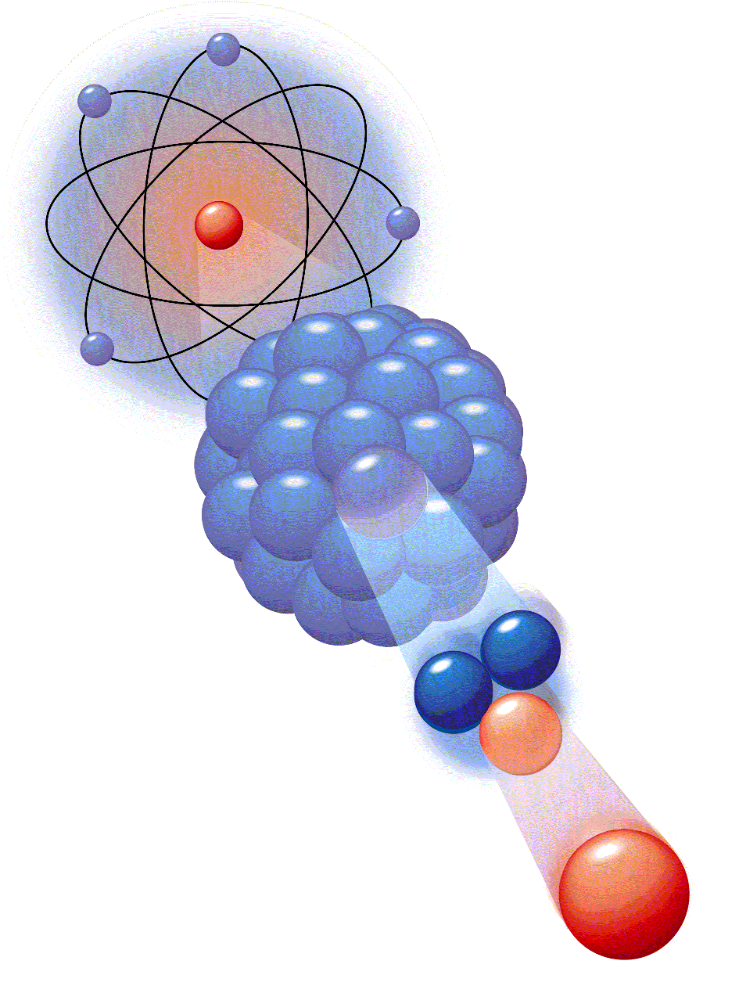
Questions being Investigated in NS Field
Nuclear Physics Research – very diverse
Modern nuclear physics aims at extending
our understanding of the atomic nucleus
in two key directions:
towards smaller distances by investigating the structure of the
constituents of nuclei – nucleons and mesons
towards larger scales by exploring the very limits of matter –
Isospin N/Z (neutron-rich), Mass (superheavy nuclei), Temperature and Spin
In parallel nuclear physicists apply this understanding to other areas of scientific study (e.g. nuclear astrophysics – production of elements and the energy sources in stars and explosive astrophysical sites) or to everyday applications (e.g. nuclear medicine – diagnostic or treatment purposes, homeland security,
environmental monitoring)
Precision γ-ray spectroscopy with large
position sensitive detectors arrays
H.C.Boston@liverpool.ac.uk

Slide 5
Experimental Conditions and Challenges
FAIR
SPIRAL2
SPES
REX-ISOLDE
EURISOL
ECOS
Low intensity
High backgrounds
Large Doppler broadening
High counting rates
High γ-ray multiplicities
High efficiency
High sensitivity
High throughput
Ancillary detectors
Need instrumentation
H.C.Boston@liverpool.ac.uk

Slide 6

Where we work
Lots of activity and opportunities
Accelerator facilities
GSI, FAIR
JYVASKYLA
YALE
GANIL
TRIUMF
CERN
INFN
LLN
LBL
ANL
ANU
MSU
ORNL
ITHEMBA
No UK Facility!

Slide 7

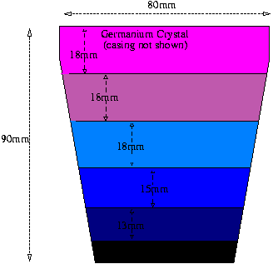

Position Sensitive Detectors in NP
Highly segmented detectors are used in conjunction with pulse shape analysis and gamma ray tracking to get a better insight into the structure of atomic nuclei
Using signal decomposition planar detectors have the possibility of better position resolution
H.C.Boston@liverpool.ac.uk

Slide 8
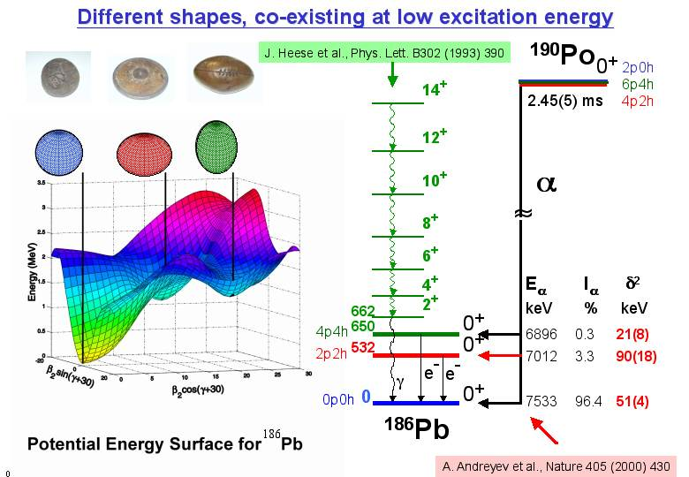
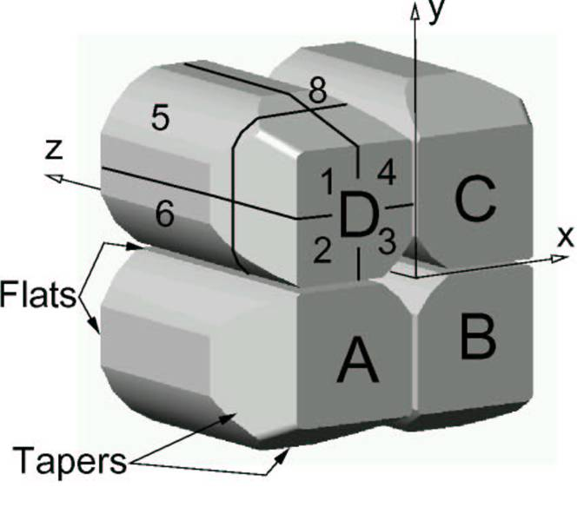
TIGRESS
The TRIUMF ISAC Gamma Ray Escaped Suppressed Spectrometer –
TIGRESS - was one of the first segmented arrays being used in NP
Each detector four HPGe crystals electronically segmented x8
Compton suppression achieved with BGO
Coulex experiments, d,p reaction and fusion evaporation reactions
investigated with stable and radioactive beams
H.C.Boston@liverpool.ac.uk

Slide 9
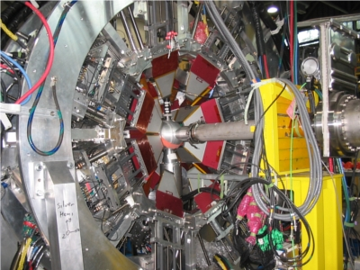
TIGRESS
The TRIUMF ISAC Gamma Ray Escaped Suppressed Spectrometer –
TIGRESS - was one of the first segmented arrays being used in NP
Each detector four HPGe crystals electronically segmented x8
Compton suppression achieved with BGO
Coulex experiments, d,p reaction and fusion evaporation reactions
investigated with stable and radioactive beams
H.C.Boston@liverpool.ac.uk

Slide 10

Future Arrays
Next generation γ-ray spectrometer based on gamma-
ray tracking
First “real” 4π germanium array ➔ no Compton
suppression shields
Versatile spectrometer with very high efficiency and
excellent spectrum quality for radioactive and high
intensity stable beams
Advanced GAmma Tracking Array - AGATA
H.C.Boston@liverpool.ac.uk
Notes:
What is it?
Why tracking?

Slide 11














AGATA
(Design and characteristics)
4π γ-array for Nuclear Physics Experiments at European accelerators providing radioactive and stable beams
Main features of AGATA
Efficiency: 43% (M_{γ} =1) 28% (M_{γ} =30)
today’s arrays ~10% (gain ~4) 5% (gain ~1000)
Peak/Total: 58% (M_{γ}=1) 49% (M_{γ}=30)
today ~55% 40%
Angular Resolution: ~1º →
FWHM (1 MeV, v/c=50%) ~ 6 keV !!!
today ~40 keV
Rates: 3 MHz (M_{γ}=1) 300 kHz (M_{γ} =30)
today 1 MHz 20 kHz
180 large volume 36-fold segmented Ge crystals in 60 triple-clusters , 12
pentagonals
Shell of Ge with inner radius of 23.5cm will consist of 230kg of Germanium
Solid angle coverage of 80%
Digital electronics and sophisticated Pulse Shape Analysis algorithms allow
operation of Ge detectors in position sensitive mode → γ-ray tracking
Notes:
Summary
List few items
Agata very powerful instrument for nuclear spectroscopy
Exciting science programme subject of this meeting
Aim to propose and start realisation of the full AGATA from 2008

Slide 12
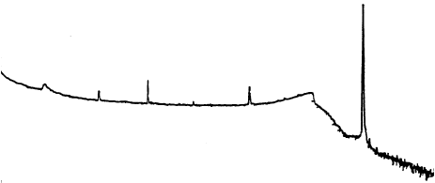
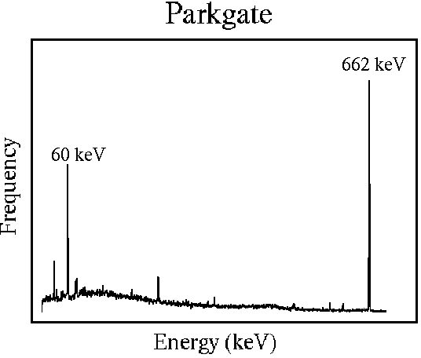
The Concept
The Concept
Without Compton suppression shields
Compton continuum.
=> Large peak to total ratio
Less solid angle coverage
=> Big drop in efficiency
With BGO shielding
Path of γ-ray reconstructed to form full energy event
=> Compton continuum reduced
=> Excellent efficiency ~50% @1MeV
=> Greatly improved angular resolution (~1⁰) to reduce Doppler effects
With highly segmented detectors
H.C.Boston@liverpool.ac.uk

Slide 13
Position Sensitive Detectors
Highly segmented detectors
Each event x, y, z, t, E
x, y, z determined with PSA (IC + RC)
Experimental pulse shapes are compared to theoretical
basis
- Impossible to scan 180 detectors
- Simulation can be adapted as neutron damage occurs
Tracking: Compton scatter formula relates scatter
angle to energy deposited
- Allows reconstruction of FEE
- Increases P/T
- Optimum use of HPGe coverage
H.C.Boston@liverpool.ac.uk

Slide 14
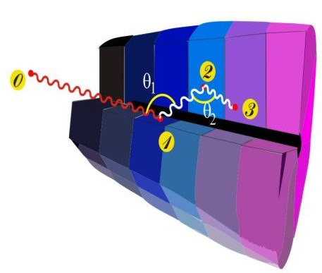
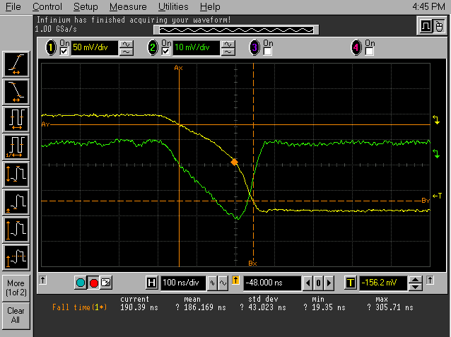
Ingredients of γ-Tracking
4
1
Identified
interaction points
Reconstruction of tracks
e.g. by evaluation of permutations
of interaction points
Highly segmented
HPGe detectors
(x,y,z,E,t)_{i}
γ
·
·
·
Pulse Shape Analysis
to decompose
recorded waves
·
2
3
Digital electronics
to record and
process segment signals
reconstructed γ-rays
H.C.Boston@liverpool.ac.uk
Notes:
What has to be done to perform tracking
What are the ingredients
Detectors highly segmented, encapsulated, cryostats
Electronics Digital
PSA to extract Energy Time and Position
Algorithm development particularly for position
Area where effort is required Thorsten Kroell. See him.
Tracking algorithms, reconstruction of the events for full array
Obtain full energy
Many technical development in all areas.

Slide 15
Pulse Shape Analysis (PSA): X Y position
Image charge asymmetry varies as a function of lateral interaction position
- Calibration of asymmetry response
Pixilation 5x5x20mm becomes 1mm³
e
e
e
e
h
e
h
h
h
h

Slide 16
Pulse Shape Analysis (PSA): DoI
Location of the depth of interaction position within detector gathered by parameterisation of the information from the pulse shape
100%
50%
0%
T90
T50
ΔE
T30
H.C.Boston@liverpool.ac.uk

Slide 17
Gamma Ray Tracking
Path of γ-ray reconstructed to form full energy event
=> Compton continuum reduced
=> Excellent efficiency ~50% @1MeV
=> Greatly improved angular resolution (~1⁰) to reduce Doppler effects
With highly segmented detectors
Basic assumptions w.r.t.
energy and Klein
Nishina
  1st interaction deposits most energy
  Scatter will be forward focused
H.C.Boston@liverpool.ac.uk

Slide 18
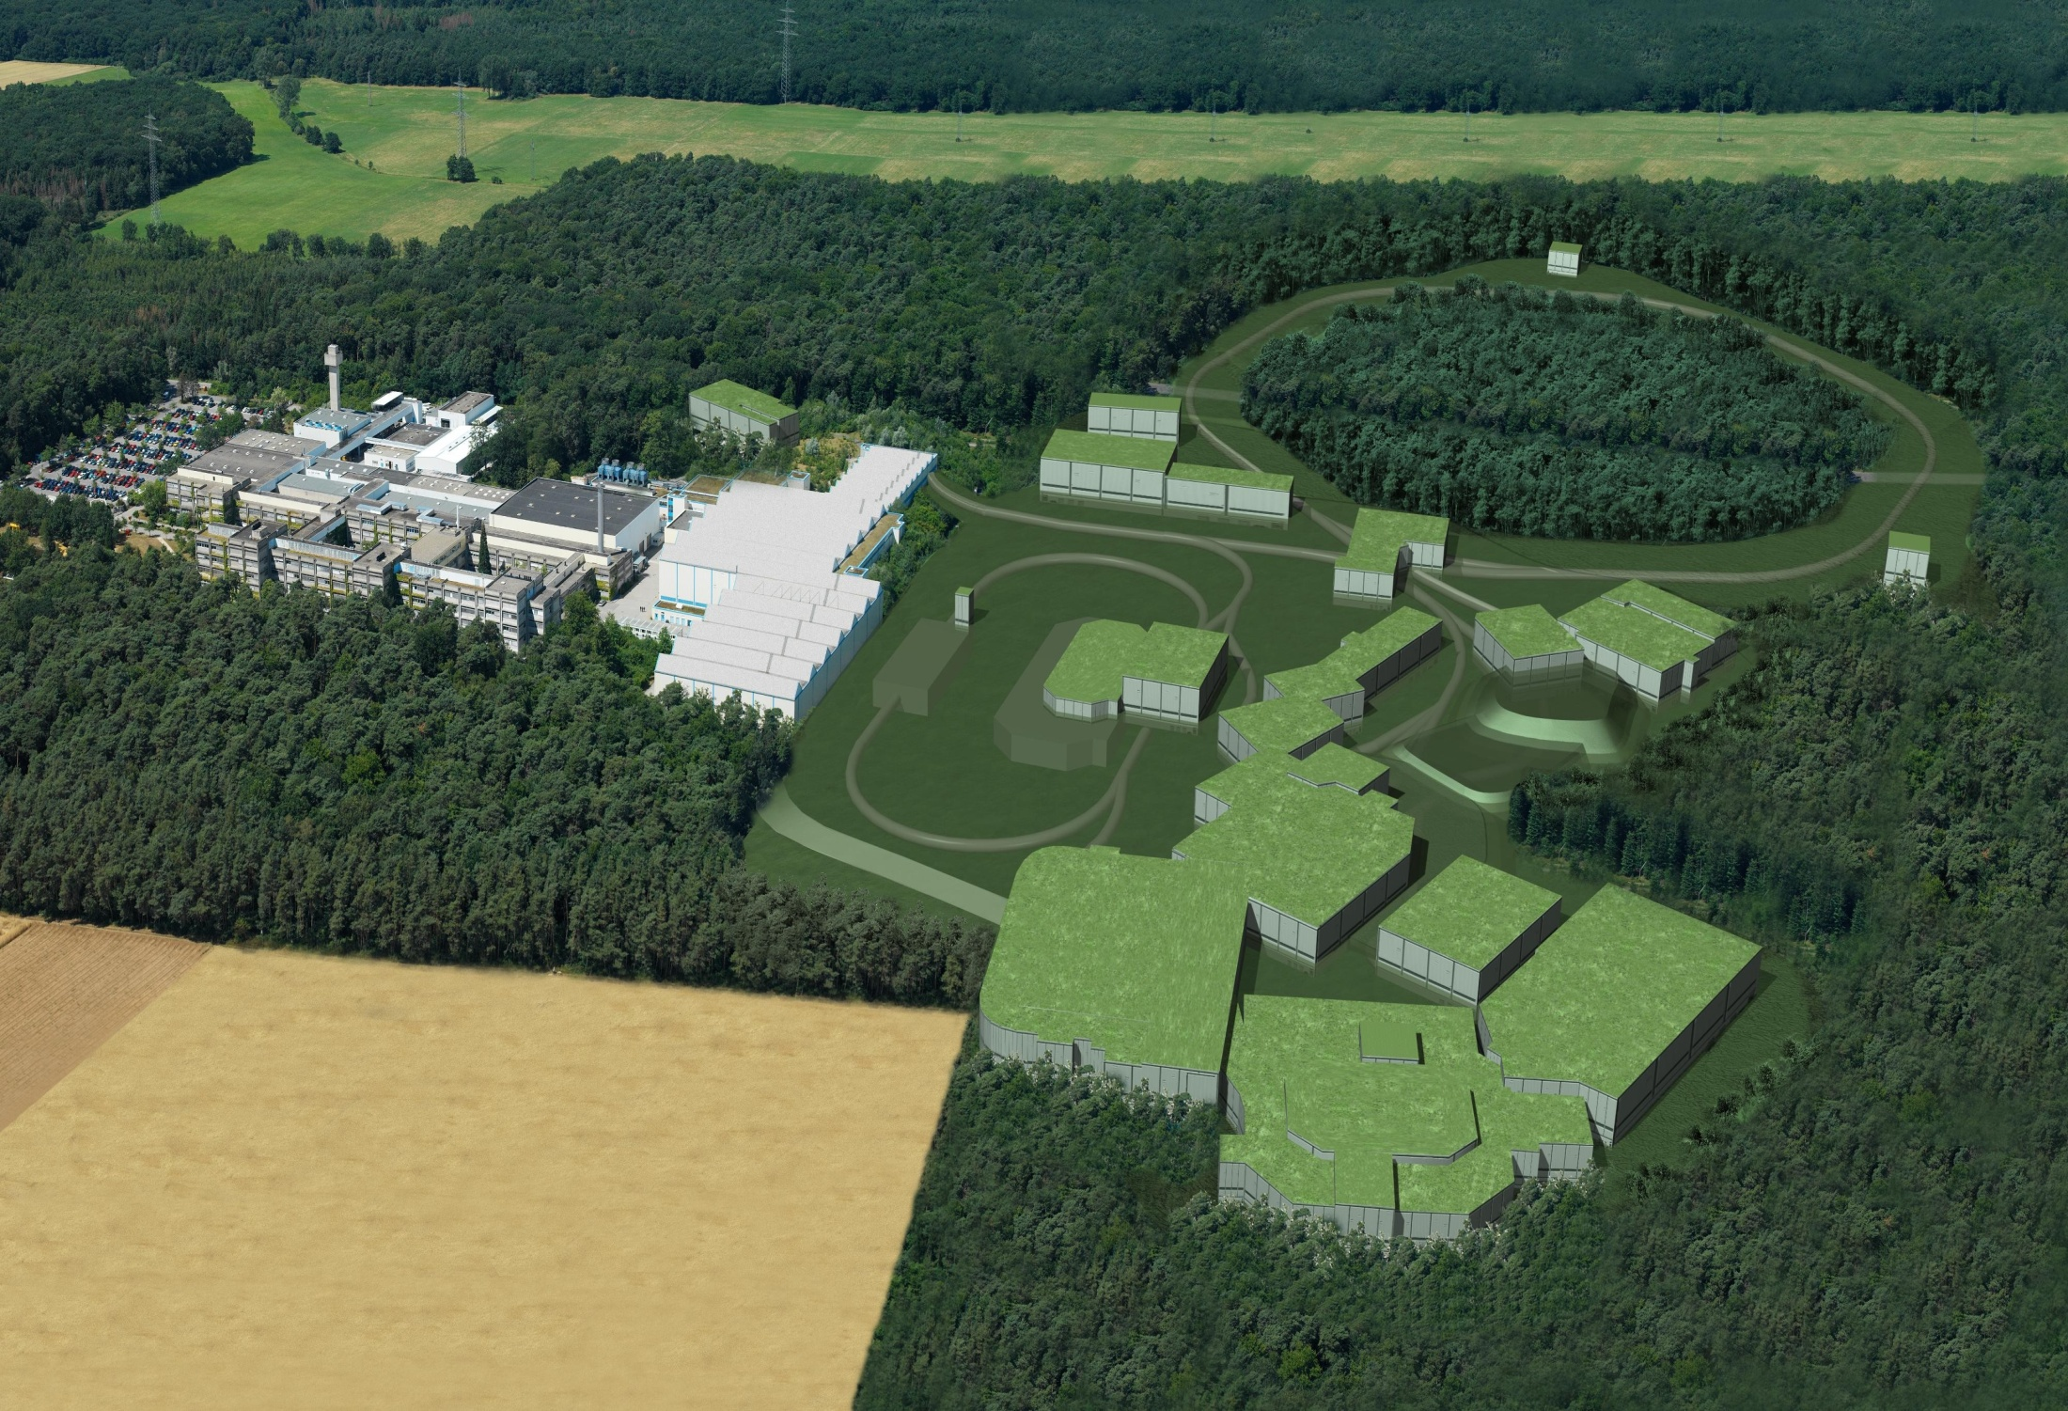
FAIR: Facility for Antiproton and Ion Research
Broad range of
radioactive beams up to
1.5 - 2 GeV/u;
up to factor 10 000 in
intensity over present
Antiprotons 3 - 30 GeV
Four major research areas:
Nuclear Structure, Astrophysics and Reactions: NuSTAR
Hadron spectroscopy UK: PANDA
Compressed nuclear matter
Plasma and Atomic Physics

Slide 19
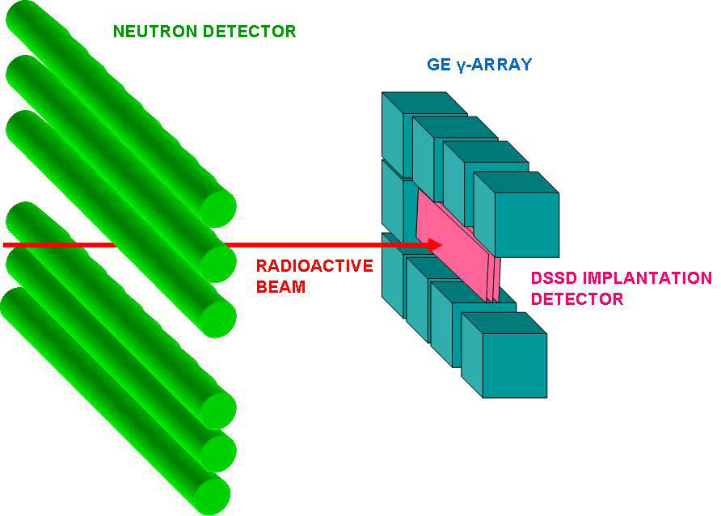
Advanced Implantation Detector Array
AIDA for use at DESPEC at FAIR
SuperFRS, Low Energy Branch (LEB)
Exotic nuclei – energies ~ 50 – 200MeV/u
Implanted into multi-plane, highly segmented DSSD array
Implant – decay correlations
Multi-GeV DSSD implantation events
Observe subsequent p, 2p, α,
β, γ, βp, βn … low energy
(~MeV) decays
Measure half lives, branching
ratios, decay energies …
Tag interesting events for
gamma and neutron detector
arrays
H.C.Boston@liverpool.ac.uk

Slide 20
Implantation DSSD Configurations
Two configurations proposed:
8cm x 24cm
“cocktail” mode
many isotopes measured
simultaneously
b) 8cm x 8cm
concentrate on particular isotope(s)
high efficiency mode using:
total absorption spectrometer
moderated neutron detector array
H.C.Boston@liverpool.ac.uk

Slide 21
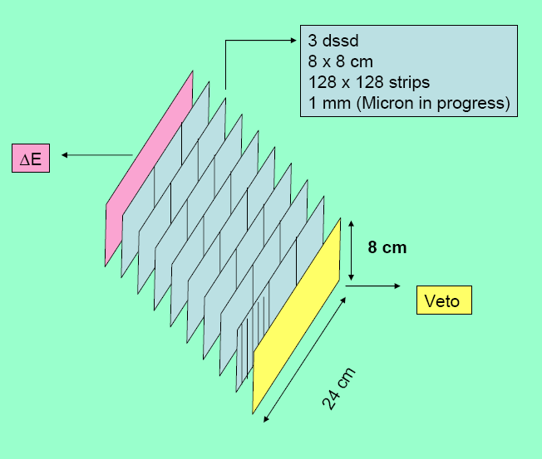
AIDA: DSSD Array Design
8cm x 8cm DSSDs
common wafer design for 8cm x 24cm and 8cm x 8cm configurations
8cm x 24cm
3 adjacent wafers – horizontal strips series bonded
128 p+n junction strips, 128 n+n ohmic strips per wafer
strip pitch 625μm
wafer thickness 1mm
ΔE, Veto and up to 6 intermediate planes
4096 channels (8cm x 24cm)
overall package sizes (silicon, PCB, connectors, enclosure … )
~ 10cm x 26cm x 4cm or ~ 10cm x 10cm x 4cm
H.C.Boston@liverpool.ac.uk

Slide 22
Implantation – Decay Correlation
DSSD strips identify where (x,y) and when (t₀) ions implanted
Correlate with upstream detectors to identify implanted ion type
Correlate with subsequent decay(s) at same position (x,y) at times
t₁(,t₂, …)
Observation of a series of correlations enables determination of
energy distribution and half-life of radioactive decay
Require average time between implants at position (x,y) >> decay
half-life depends on DSSD segmentation and implantation
rate/profile
Implantation profile
σ_{x} ~ σ_{y} ~ 2cm, σ_{z} ~ 1mm
Implantation rate (8cm x 24cm) ~ 10kHz, ~ kHz per isotope (say)
Longest half life to be observed ~ seconds
Implies quasi-pixel dimensions ~ 0.5mm x 0.5mm
H.C.Boston@liverpool.ac.uk

Slide 23
Applications
Medical Imaging – 3D functional image of cancers or
neurological diseases < 600keV
  Positron Emission Tomography (PET)
  Single Photon Emission Computed Tomography (SPECT)
Energy range 60keV – 20MeV
Security – 3D spectroscopic image to show what and where
  Distinguish
  PorGamRays
Environmental imaging
  BAE systems
  AWE – Threat reduction
Nuclear decommissioning
  NNL
Most use Compton Camera method – 3D imaging
H.C.Boston@liverpool.ac.uk

Slide 24
What is Positron Emission Tomography?
Radionuclide decays by positron emission, β⁺
Positron emitted with initial kinetic energy
Positron will slow down in medium
Comes in to close contact with a free or weakly bound electron and for a very short time they become a Positronium atom, with the positron as the nucleus
As the positron is antimatter to the electron catastrophic annihilation occurs
Energy of each particle released in process as two back to back 511 keV photons to conserve momentum
Positron
Positronium
511 keV’s
Electron
Heart
Lungs
Detector ring
Spine

Slide 25
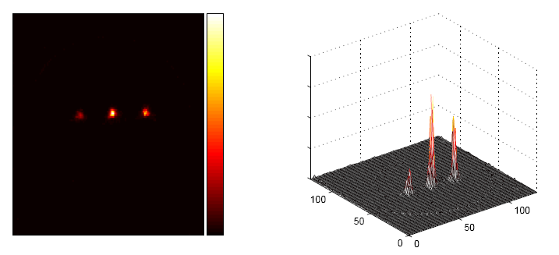
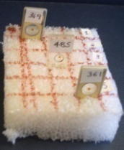
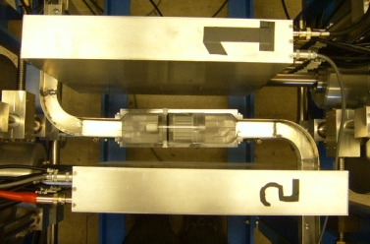
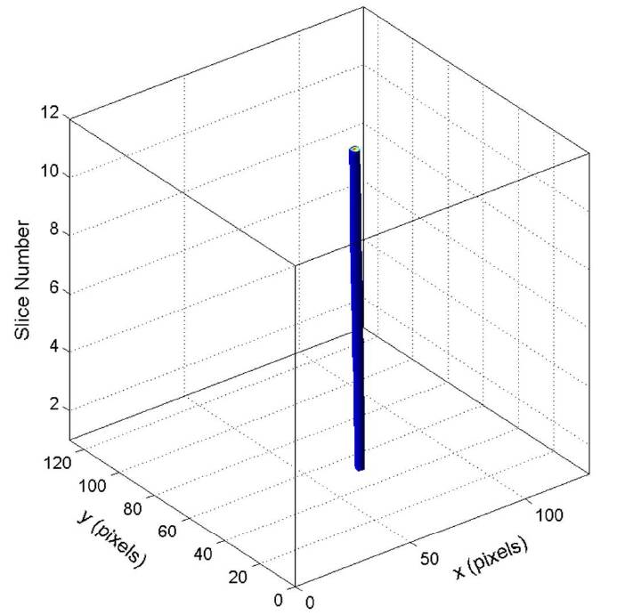
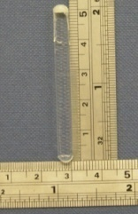
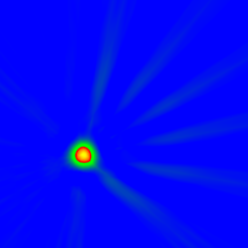
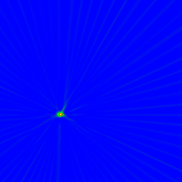
PET Imaging with SmartPET
60mm
511keV
60mm
511keV
FWHM = 9.5mm
FWHM = 1.2mm
FWHM _{line} ~
2.90(0.17)mm
No PSA
With PSA
FBP reconstruction of ²²Na
NIM A606 issue 3 (2009) 523-532
NIM A604 Issue 1-2 (2009) 343-346
H.C.Boston@liverpool.ac.uk

Slide 26
What is Single Photon Emission CT?
Currently a gamma camera is used,
  Scintillator material
  Mechanical collimation
Limitations;
  Sensitivity due to presence of
  collimators
  Energy resolution – only single
  energies can be imaged or well
  separated energies
  Energy of gamma ray used must be
  kept low - 140keV ^{99m}Tc
  Aberrations because of rotation
  misalignment
  Large number of events needed to
  create image to get acceptable signal
  to noise ratio
Computer
X-position
Y-position
Pulse height
analyser
Reconstructed
image
Z-signal
Electronics
Photomultiplier tubes
NaI(Tl) crystal
Parallel hole
Lead collimator
Actual emitting body
Will not operate in magnetic field
H.C.Boston@liverpool.ac.uk

Slide 27
SPECT Imaging
How can we remove this requirement for collimation?
  Use position sensitive segmented semiconductor detectors which inherently have electronic collimation
    Finer position of interaction information
    Greater sensitivity ~100x
    Greater range of energies (60keV – 2MeV)
      Opens up other radioisotopes for use in medical imaging but can also use system in non medical imaging capacity
  Use Compton camera process
Volumetric 3D image – No rotation
Can use semiconductors in magnetic field – MRI co-registry possible
H.C.Boston@liverpool.ac.uk

Slide 28
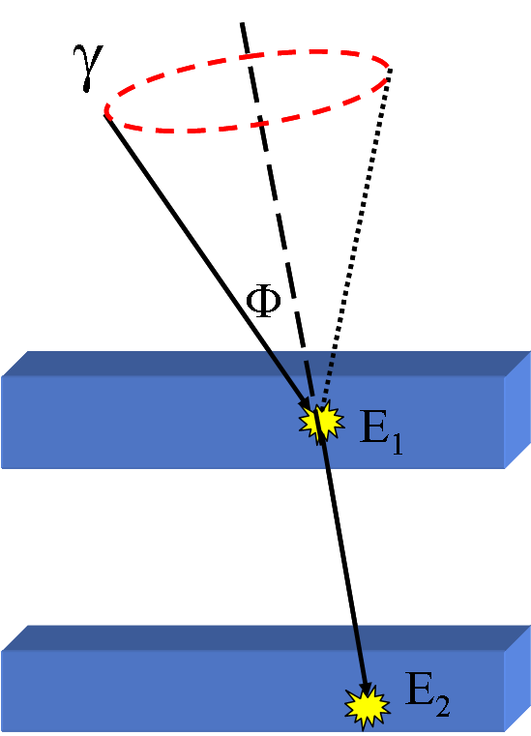
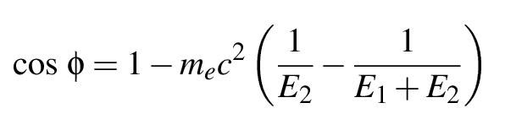
Compton Camera Principles
NIM A580 Volume 2 (2007) 929-933
2 position sensitive detectors
Energy information from the detectors
allows the creation of a cone, the base
of which represents the possible sites
of origin
E₀ = E₁ + E₂
IEEE conference proceedings (2009) 624-628
Image created from many events, with
the location of the source where most
cone overlaps occur
Scatterer
Analyser

Slide 29
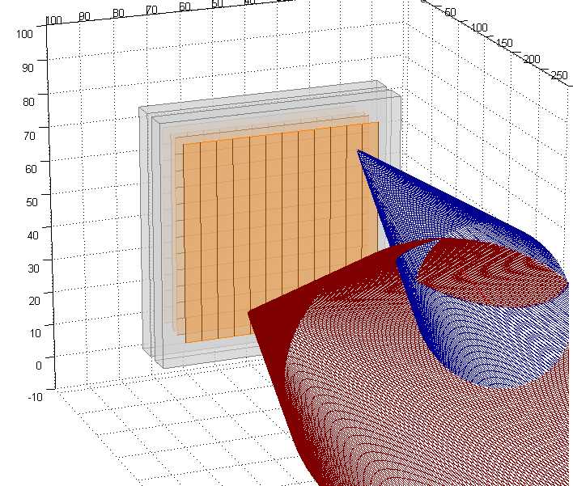
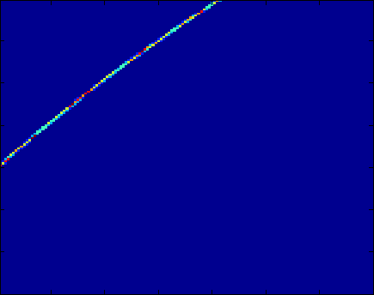
Image Reconstruction
Projection of cones in z plane
Overlapping gives emission
position
Matlab output of the system
Two SmartPET detectors
NIM A573 (2007) 95-98
H.C.Boston@liverpool.ac.uk

Slide 30
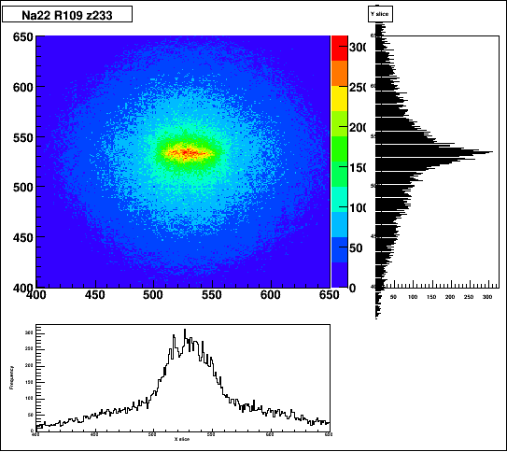
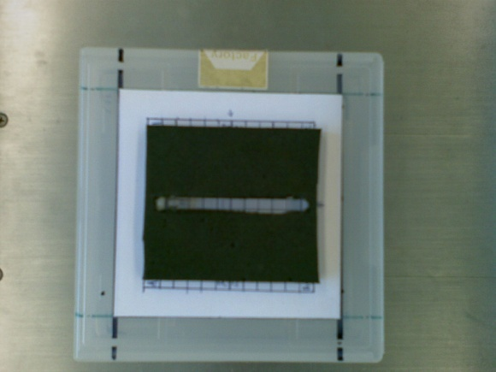
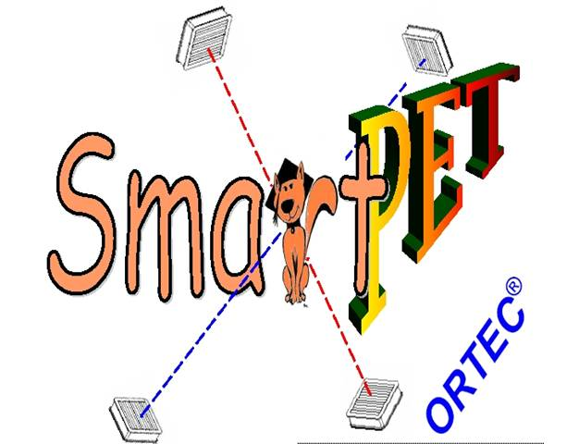

Line Source
Intensity
mm
Line source – Glass vial 50 x 2.5mm ²²Na
Analytic reconstruction x = 52mm y = 4 mm
-80 -30 0 30 80 130
300
200
100
0
-130 -80 -30 0 30 80 130
Intensity
mm
300
200
100
0
-130 -80 -30 0 30 80 130
mm
H.C.Boston@liverpool.ac.uk

Slide 31
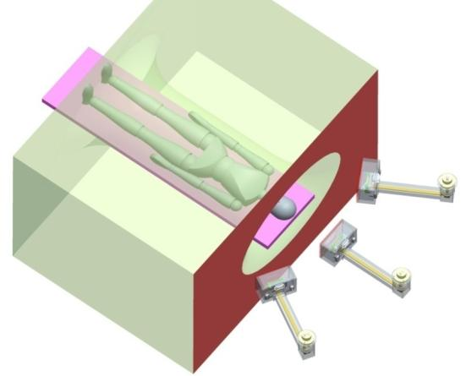
ProSPECTus
Interdisciplinary project with physicists, MARIARC, Royal Liverpool University Hospital
£1.1M knowledge exchange project
Compton camera for SPECT with capabilities in MRI scanner
  9mm Si(Li) scatterer
  20mm HPGe analyser
Siemens MAGNETOM 1.5T symphony scanner
NIM A604 Issue 1-2 (2009) 351-354
International Conference on applications of nuclear techniques. AIP conference proceedings Volume 1194 (2009) 90-95
H.C.Boston@liverpool.ac.uk

Slide 32

Security: The Distinguish Project
Explosives (illicit substances) contain characteristic combinations of light elements
- carbon, nitrogen, oxygen, hydrogen
Emission of characteristic gamma rays stimulated by neutron interrogation
- Oxygen : 6.13MeV
- Carbon : 4.43MeV
- Nitrogen : 5.11MeV, 2.31MeV, 1.64MeV
Pulsed Fast Neutron Analysis (PFNA)
- gamma-ray detection and imaging
- digital processing techniques
Notes:
Nuclear engineers, nuclear physicists, tomographic imaging – scanning of cargo and domestic baggage

Slide 33
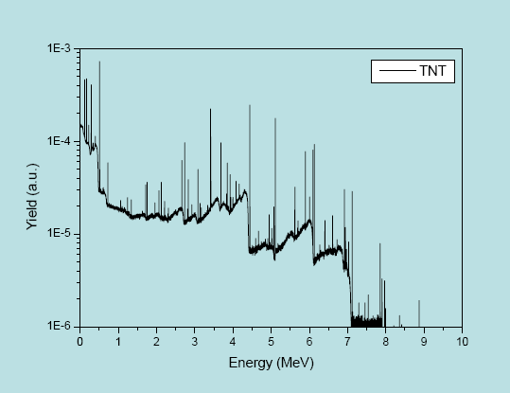
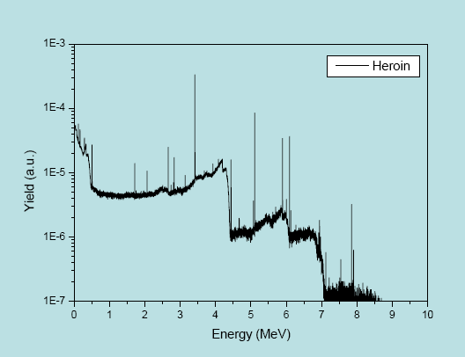
Material Identification
Identification of illicit material primarily through gamma-ray fingerprinting
- capture gamma rays
- inelastic scatter gamma rays
Characteristic prompt gamma rays from light elements
Notes:
Fingerprint

Slide 34

The Concept
DISTINGUISH (PFNA)
neutron detector
luggage
γ-ray detectors
pulsed neutron source
Notes:
Pulse time = 5 microseconds wide , neutron energy = 14meV
Activate object – prompt gamma emission from inelastic scattering will b e detected providing fingerprint
Use Compton camera principle direct imaging of elemental composition can be accomplished
Detection of scattered neutron recoils provides tomographic image

Slide 35
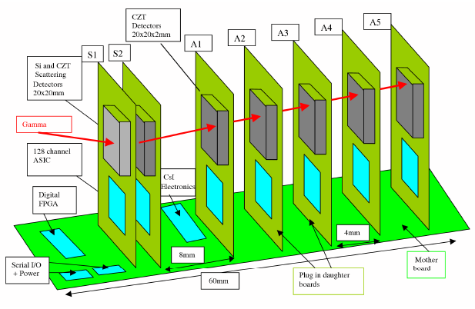
Environmental and Decommissioning Assaying
What, where, how much?
BAE submarine nuclear reactor, terrorist threat reduction,
national nuclear laboratory
Produce images to gauge possible contamination using a
portable gamma ray spectrometer
Layers of CZT
The PorGamRayS
project is developing a
portable gamma-ray
spectrometer with
Compton imaging
capability (60keV –
2MeV)
H.C.Boston@liverpool.ac.uk

Slide 36
Conclusion
Innovations to detector technology from Nuclear Physics leads
to benefits in society
Detector development in Nuclear Physics coupled with PSA
and gamma ray tracking leads to a better insight into the
internal structure of the nucleus
Applications include medical imaging, secuirty, nuclear
decommissioning and environmental assaying
Different types of position sensitive semiconductor detectors
required depending on the application
  Higher efficiency leads to higher throughput of
  patient or lower doses
  3D image shows what and where in space radioactive
  material is
H.C.Boston@liverpool.ac.uk

Slide 37




Acknowledgements
A.J. Boston⁽¹⁾, P. Cole⁽¹⁾, J.R.Cresswell⁽¹⁾ ,
J. Dormand ⁽¹⁾, F. Filmer⁽¹⁾, L.J. Harness⁽¹⁾, M. Jones⁽¹⁾ , D.S. Judson ⁽¹⁾, P.J. Nolan⁽¹⁾ , D.C.Oxley ⁽¹⁾, D.P. Scraggs⁽¹⁾, A. Sweeney⁽¹⁾ ,
I. Lazarus⁽²⁾, J. Simpson⁽²⁾ , R.J. Cooper⁽³⁾, A. Andreyev⁽⁴⁾ , A. Cellar⁽⁴⁾ , D. Gould⁽⁵⁾ , W. Bimson⁽⁶⁾, G. Kemp^{(6),} T. Davidson ⁽⁷⁾
(1) Department of Physics, University of Liverpool, UK
(2) STFC Daresbury, Warrington, Cheshire, UK
(3) University of Tennessee, Knoxville, TN, USA
(4) Vancouver General Hospital, Vancouver, Canada
(5) Royal Liverpool University Hospital, Liverpool, UK
(6) MARIARC, University of Liverpool, UK
(7) School of Physics, University of Edinburgh, UK

Slide 39
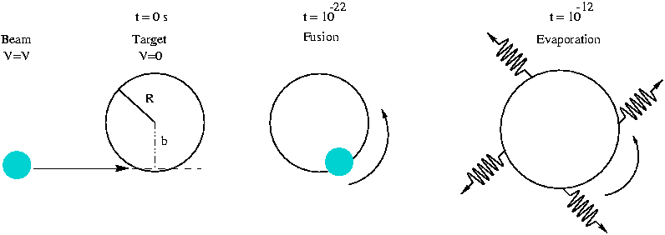
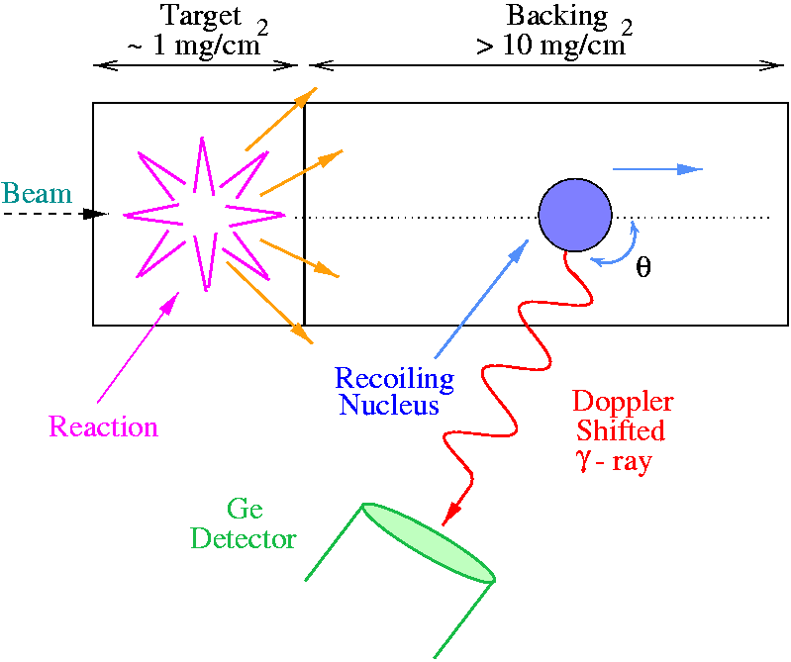
Doppler Broadening

Slide 40
Questions being Investigated
What are the limits of nuclear existence? What is the
heaviest element we can make and where does the
neutron-dripline lie?
Do new forms of collective motion occur far from the
valley of the nuclear stability?
How does nuclear structure evolve at the highest
angular momentum just before the fission limit?
Need powerful state of the art detectors for
H.C.Boston@liverpool.ac.uk

Slide 41
TIGRESS
TRIUMF ISAC Gamma Ray Escaped Suppressed
Spectrometer – TIGRESS
Versatile γ-ray spectrometer
Clover detectors – each crystal 8 segments 1 core signal
BGO detectors around each detector to suppress
Compton scattered events
_{hcb}
H.C.Boston@liverpool.ac.uk

Slide 42
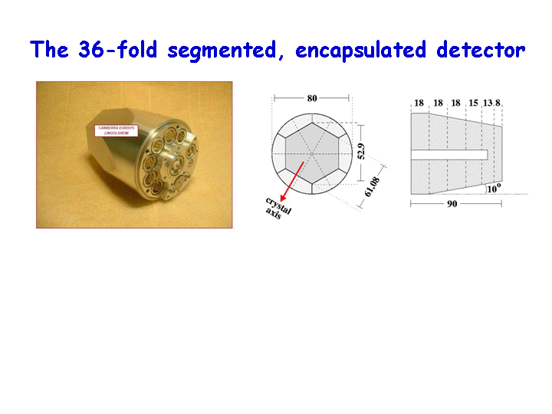
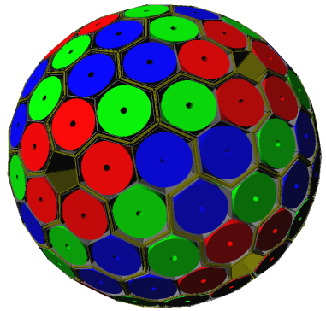
The AGATA Concept
Spherical array of 180 asymmetric HPGe detectors
Each detector has a 36-fold segmented outer
Contact ( FWHM ~ 2keV @ 1.3MeV)
The crystal ;
  90mm long
  40mm Maximum
  diameter (10º taper)
P⁺
n⁺
back
+4000V
front
Completed array - HPGe covers
full 4π solid angle
H.C.Boston@liverpool.ac.uk

Slide 43
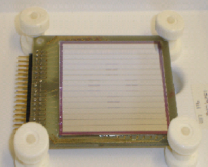
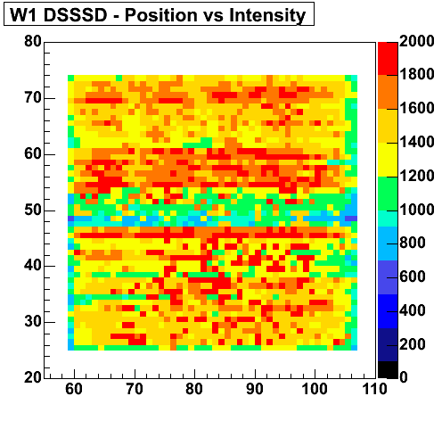
What Next?
Replace the scattering SmartPET detector with a Silicon detector
Active Volume; 50 x 50 x 0.5mm³
32 strips
3mm pitch
RAL preamps
Si detector characterised
  ²⁴¹Am source – 60keV γ-rays
  1mm collimation beam moved 1mm steps in x-y
  Preamp signal had to be amplified before it would trigger digital system
With the exception of one channel (Ch25 – not instrumented) uniform response

Slide 44
Types of Image Reconstruction
Iterative Reconstruction
Analytic
  Simple back projection of cones
  Real time
  Suffers from artefacts
Iterative
  Yields higher quality images – knowledge of system and how it would respond
  Not real time – (algorithm development now making realtime a possibility)
Stochastic
  Significantly improved performance for distributed sources
  Not real time
H.C.Boston@liverpool.ac.uk

