Slide 1
Silicon Strip Detectors for the ATLAS HL-LHC Upgrade
Paul Dervan
The University of Liverpool
On behalf of the ATLAS Upgrade Community

Slide 2
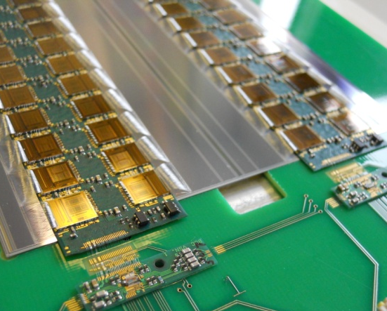
Outline
Introduction to the Upgrade
Layout
Si Sensors
    Design
    Performance
Hybrid
Modules
  Performance
Staves

Slide 3
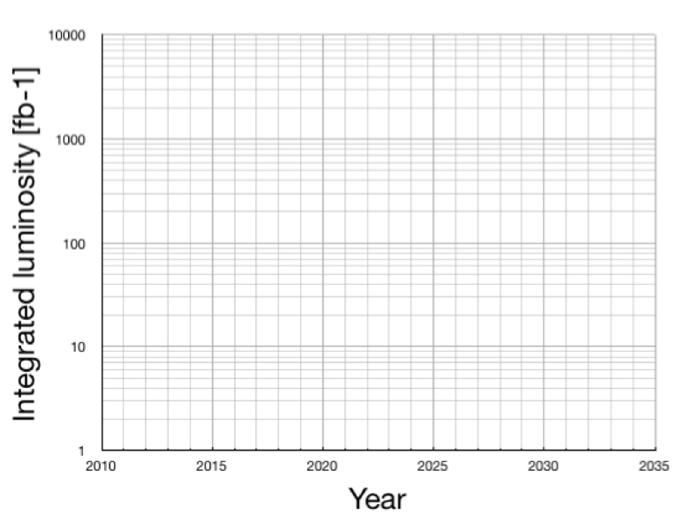
ATLAS Inner Tracker Upgrades
Phase 0
  New Beam pipe w/additional pixel layer (IBL)
Phase 1
  Possibility of replacement of entire pixel system
Phase 2 (HL-LHC, previously sLHC)
    Replacement of current transition radiation tracker (TRT) and strip tracker with an all silicon tracker
    Focus of this talk
PHASE 0
PHASE 1
PHASE 2
2000-3000
200-400
100-200
HL-LHC
5-10
LHC shutdown
today: ~ 2.5 fb⁻¹
Ten time increase in luminosity

Slide 4
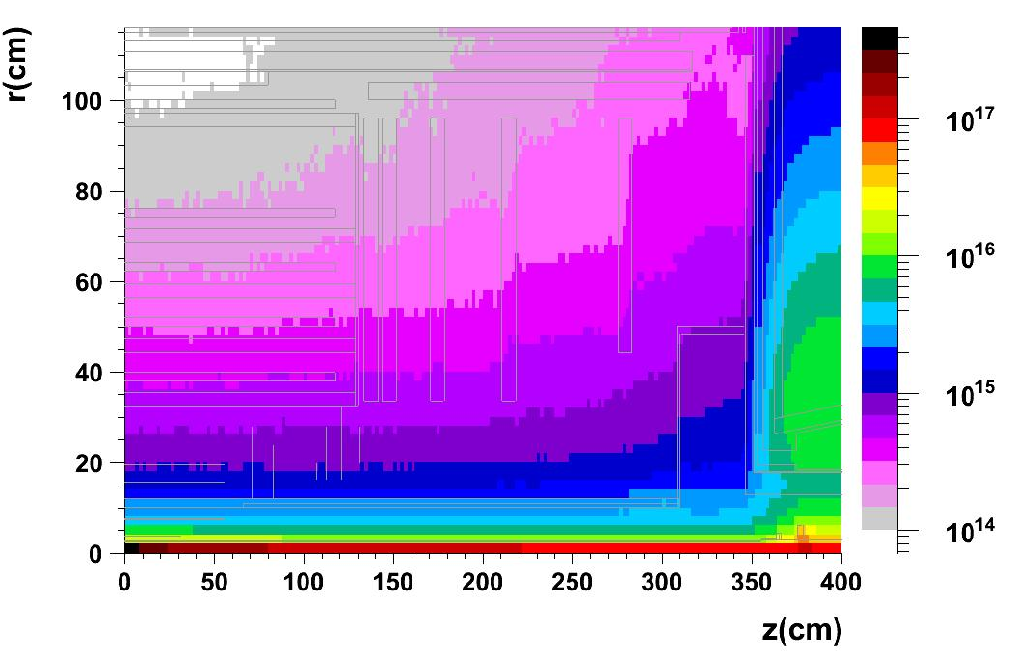
ATLAS Phase II Tracker Upgrade
1 MeV n_{eq} cm²
Challenges facing HL-LHC silicon detector upgrades:
Higher occupancies
  Finer Segmentation
Higher particle fluences
  Increase Radiation Tolerance
Larger Area (~200 m²)
  Cheaper Sensors
Long
Strips
Short
Strips
Pixels
Fluence estimates up to few 10¹⁶ particles/cm²
Gives Grad (10 MGy) doses to components
Fluence estimates include a 2x “safety” factor for prediction uncertainties

Slide 5
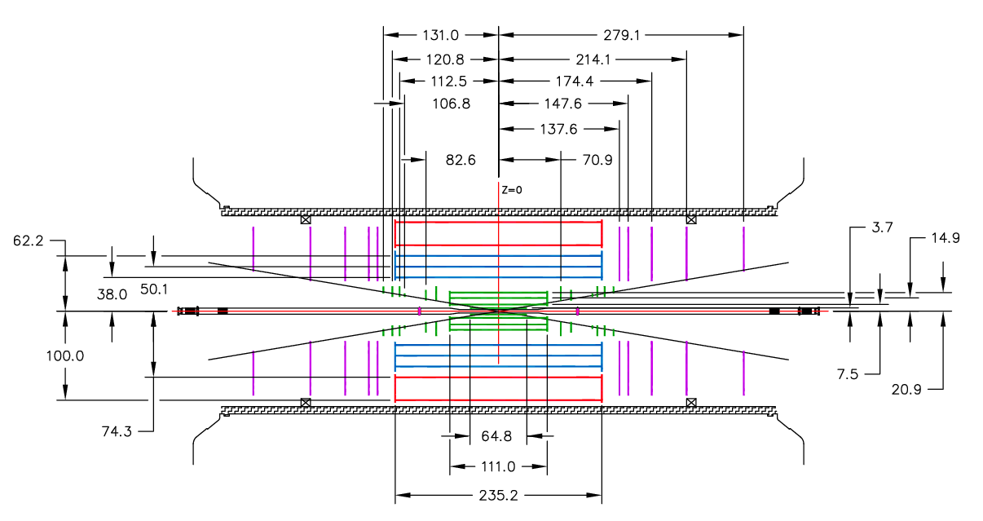
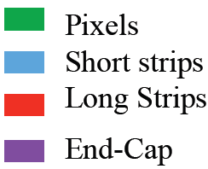
ATLAS Phase II Tracker Upgrade
Short Strip (2.4 cm) μ-strips (stereo layers):
Long Strip (4.8 cm) μ-strips (stereo layers):
r = 38, 50, 62 cm Up to 1.2x10¹⁵ 1MeV n_{eq}/cm²
r = 74, 100 cm Up to 5.6x10¹⁴ 1MeV n_{eq}/cm²

Slide 6
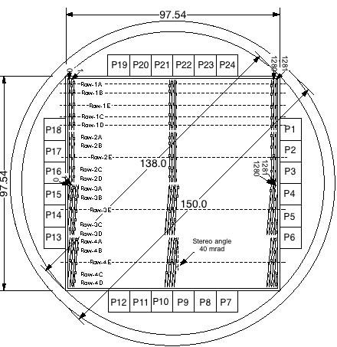
Radiation Hard Sensors
n⁺-strip in p-type substrate (n-in-p)
  Collects electrons like current n-in-n pixels
    Faster signal, reduced charge trapping
  Always depletes from the segmented side
    Good signal even under-depleted
  Single-sided process
    ~50% cheaper than n-in-n
    More foundries and available capacity world-wide
Collaboration of ATLAS with Hamamatsu Photonics (HPK) to develop 9.75x9.75 cm² devices (6 inch wafers)
  4 segments (2 axial, 2 stereo), 1280 strip each, 74.5 mm pitch, ~320 mm thick
  FZ1 <100> and FZ2 <100> material studied
  Miniature sensors (1x1 cm²) for irradiation studies
Guard Ring
Bias Ring
SiO₂
n⁺
p-spray/stop
p⁻ bulk
Al
p⁺

Slide 7
Full Size Sensor Evoluation
 | Specification | Measurement
Leakage Current | <200 µA at 600 V | 200– 370nA
Full Depletion Voltage | <500 V | 190 – 245V
Coupling Capacitance (1kHz) | >20 pF/cm | 24 – 30pF
Polysilicon Resistance | 1.5+/-0.5MΩ | 1.3 -1.6MΩ
Current through dielectric | I_{diel} < 10 nA | < 5nA
Strip Current | No explicit limit | < 2nA
Interstrip Capacitance (100kHz) | <1.1pF/cm (3 probe) | 0.7 – 0.8pF
Interstrip Resistance | > 10x R_{bias}~15 MΩ | >19 GΩ
See J. Bohm, et. al., Nucl. Inst. Meth. A, Vol. 636 (2011) S104-S110 for details
All specifications already met!!

Slide 8
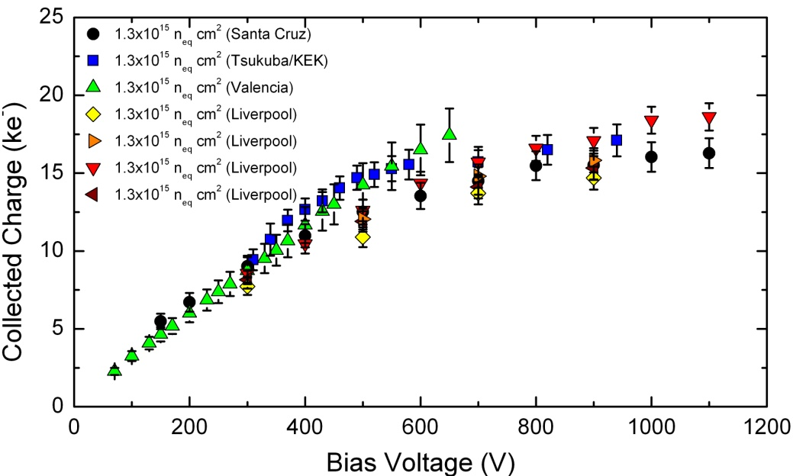
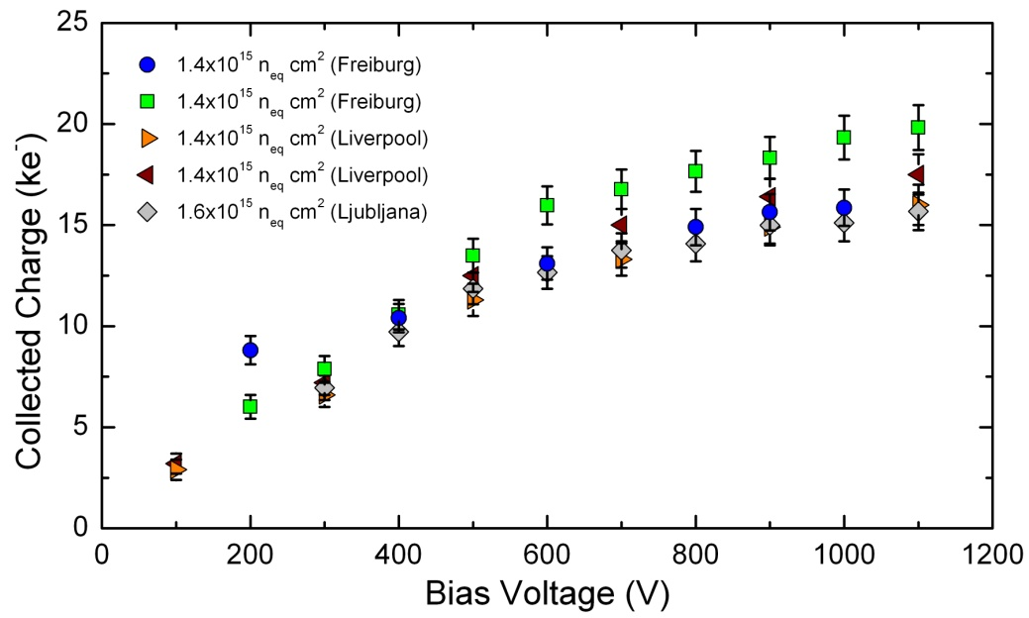
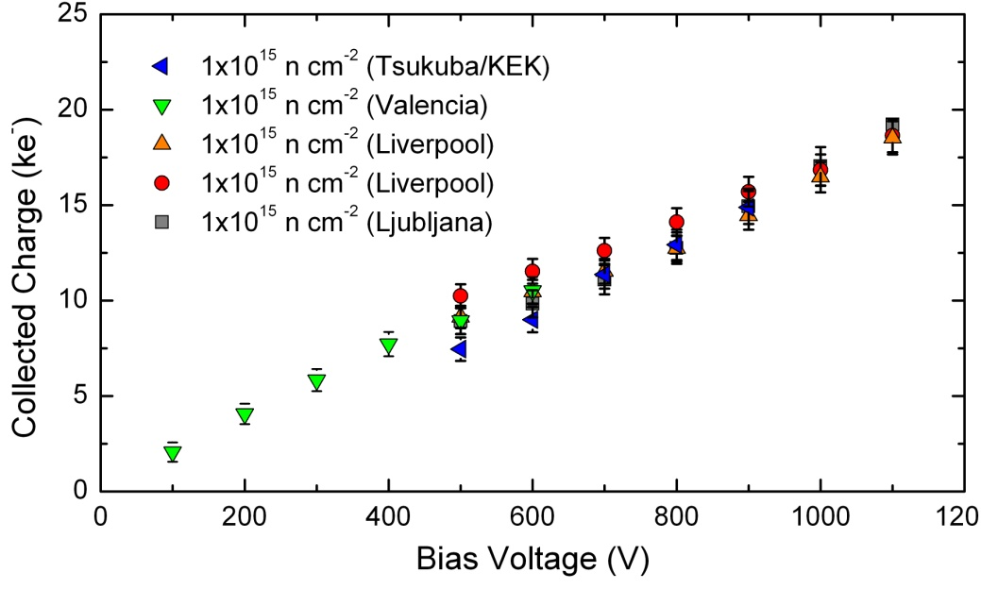
Charge Collection results
10:1 Signal-to-Noise
10:1 Signal-to-Noise
Protons
Pions
Miniature devices irradiated to strip barrel fluences with neutrons, pions, protons
Charge collection measured with ⁹⁰Sr b-source
  Consistent results between different groups/equipment
S/N greater than 10:1 for strip sensor types with expected noise performance
  ~600-800 e⁻ short strips, ~800-1000 e⁻ long strips
  See H. Sadrozinski, et.al., Nucl. Inst. Meth. A, doi:10.1016/j.nima.2011.04.0646 for details
10:1 Signal-to-Noise
Neutrons

Slide 9
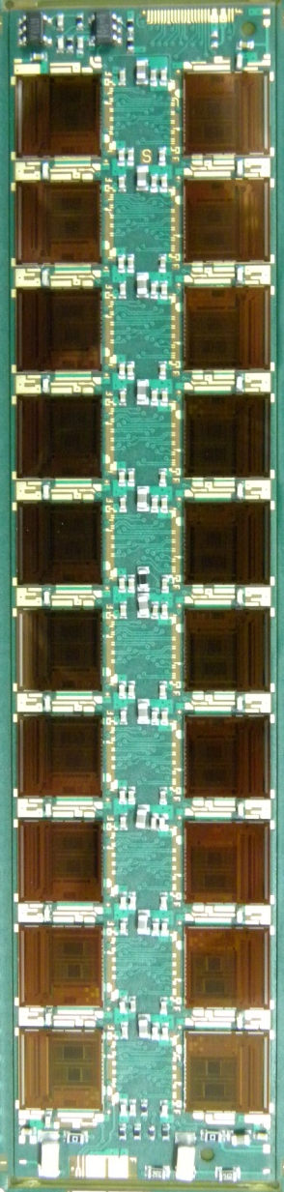
Stave Hybrid – Layout and Electrical Detail
Mshunt control and Digital I/O
Hybrid is designed to accommodate 20 x ABCN-25 readout ASICs (2 columns of 10)
Layout topology matches ATLAS07 large area sensor and serially powered Bus cable
  ASICs placed to match sensor pitch and bond pad profile
  Hybrid Power and Digital I/O bond fields at opposite ends
Circuit exploits features of ABCN-25
  Bi-directional data paths
  Embedded distributed shunt regulators (for serial powering)
    Requires external control circuit
Hybrid Power and sensor HV filtering
(spec’d to 500V)
Notes:
9

Slide 10
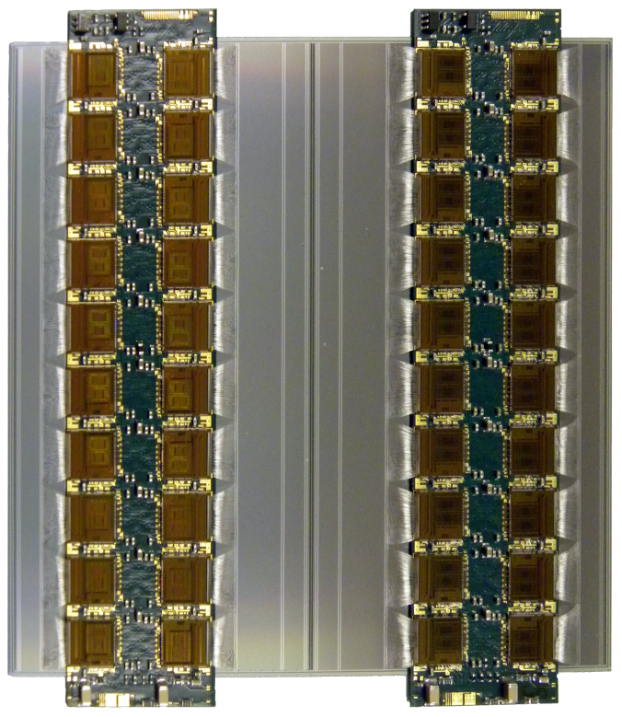
Stave Hybrid – Layout and Electrical Detail
Design is driven by minimising material
Hybrid is substrate-less and with no connectors
  Glued directly on to the sensor
    Provides mechanical support and thermal management
  All off-module connections made via wire bonds
Use of minimal glue layers for both ASIC and hybrid attachment
  Improves thermal paths and again reduces material
Pitch adapters not used, direct ASIC-to-Sensor wire bonding
  Constrains relative placement w.r.t. sensor to better than 80µm
Notes:
10

Slide 11
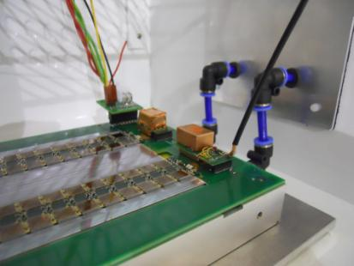
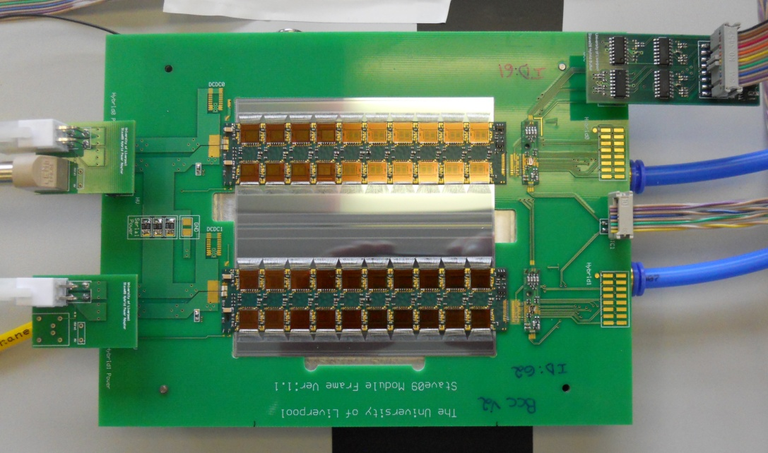
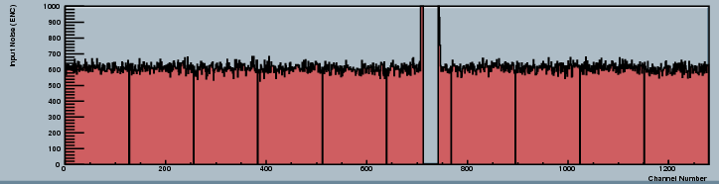

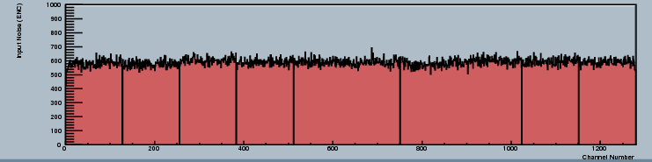

Stave Module Tests
DC-DC converters
Serial Powering
Input noise: 590e⁻
Column 0
Column 0
Hybrid 62
AC Coupled Clock/Command
Column 1
Serial Power Chain
Input noise: 599e⁻
Column 2
Hybrid 61
Column 3
Column 1
Input noise: 588e⁻
Stave modules are tested in PCB frames
  Cheap, flexible test bed for different power/shielding/grounding configurations
Parallel powering, serial powering, and DC-DC converters have all been evaluated
  With proper grounding/shielding, all these configurations give expected noise performance
Column 2
Input noise: 599e⁻
598e
Column 3
 | Parallel | Serial | DC-DC
Hybrid 62 | 590 e⁻ 596 e⁻ | 590 e⁻ 599 e⁻ | 595 e⁻ 603 e⁻
Hybrid 61 | 585 e⁻ 591 e⁻ | 588 e⁻ 599 e⁻ | 585 e⁻ 591 e⁻

Slide 12
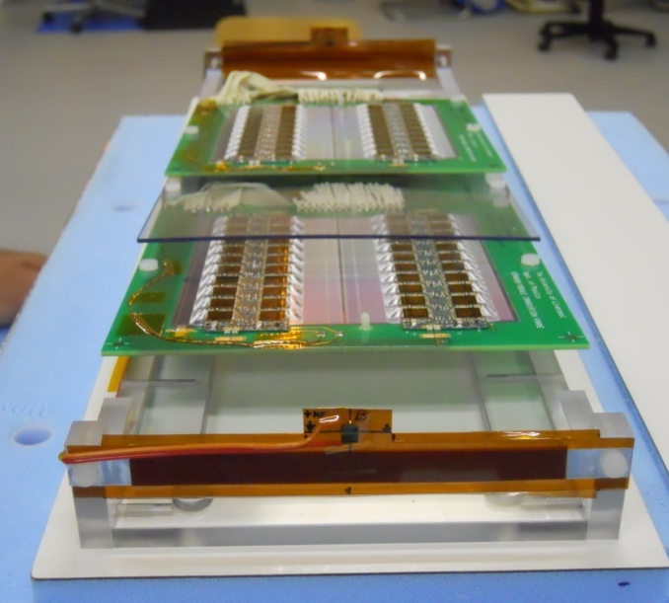
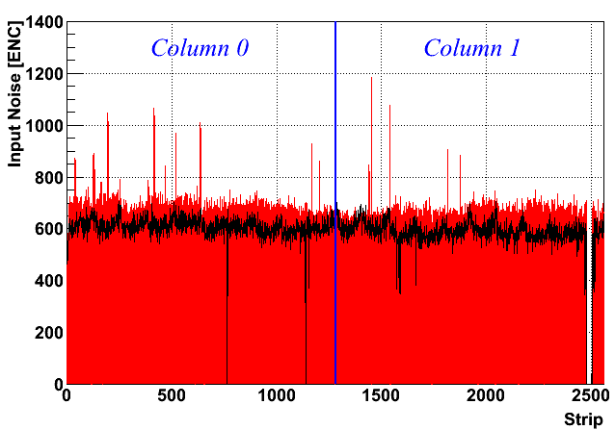
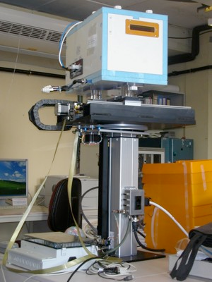
Stave Module Irradiation
Irradiated at CERN-PS irradiation facility
  24 GeV proton beam scanned over inclined modules
  Module biased, powered, and clocked during irradiation
  Total dose of 1.9x10¹⁵ n_{eq} cm⁻² achieved
    Max predicted fluence for barrel modules is 1.2x10¹⁵ n_{eq} cm⁻²
Sensor and module behave as expected
  Noise increase consistent with shot noise expectations
AL Foil
AL Foil
Noise | Column 0 | Column 1
Pre-Irrad | 610 e⁻ | 589 e⁻
Post-Irrad | 675 e⁻ | 650 e⁻
Difference | 65 e⁻ | 61 e⁻
Expected | 670 e⁻ | 640 e⁻
Pre-irradiation
Post-irradiation
Motorized, Cooled Irradiation Stage

Slide 13
Stave – Geometry and components
ABCN-25 readout ASIC
  40 per module
  960 per stave (>120k channels)
Kapton flex hybrid with auxiliary boards
  BCC ASIC (multi drop & point-to-point I/O)
  Serial Power protection
Serial powering of modules
Embedded Kapton bus cable
  End of stave card
Stave mechanical core
Auxiliary Board(s)
Sensor
Module with 2 x flex
Single flex
12 modules/side of stave (24 total)
120mm
1200mm
Bus cable
Carbon fiber
facing
Carbon honeycomb
Hybrid + Sensor
Coolant tube structure
Readout IC’s

Slide 14
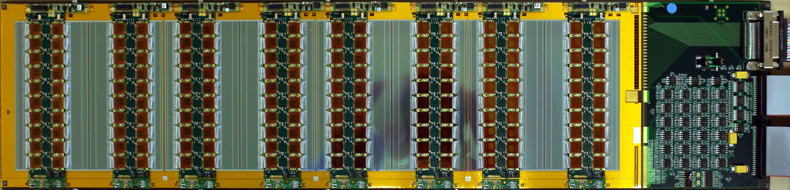
Stavelet
power and power control
Serial Power Protection PCBs or DC-DC Converters
EOS Card
AL Foil
AL Foil
data and hybrid communication
BCC PCBs
Bus Cable
Shortened stave built as electrical test-bed
  Shielding, grounding, serial and DC-DC powering, …
First stavelet serial powered
  Power Protection Board (PPB) has automated over-voltage protection and slow-controlled (DCS) hybrid bypassing
  DC-DC stavelet under construction
Uses Basic Control Chip (BCC) for data I/O
  Generates 80MHz data clock from 40MHz BC clock
  160Mbit/s multiplexed data per hybrid
DC-DC converter
Motorized, Cooled Irradiation Stage

Slide 15
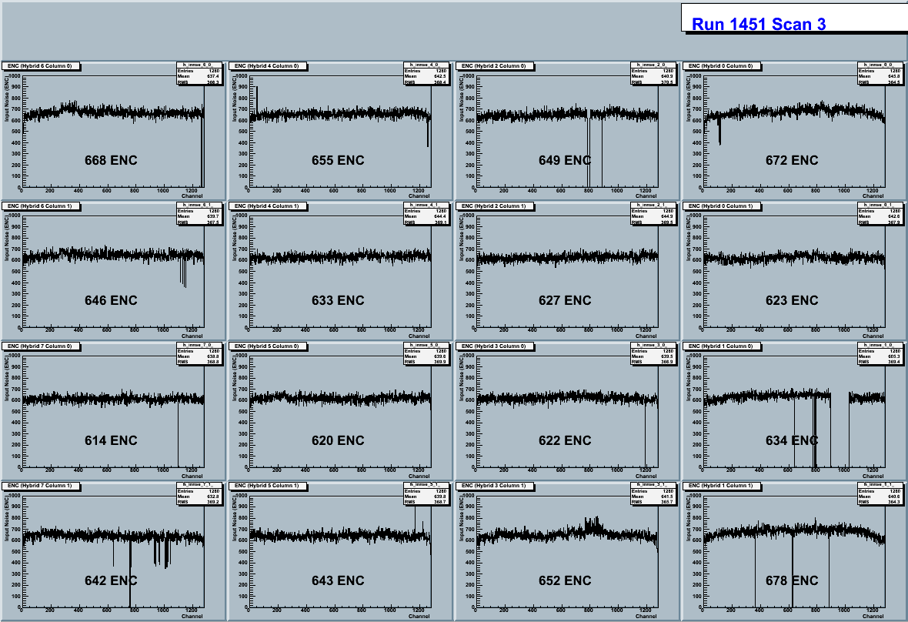
Serial Powered Stavelet Electrical Results
Uses on-hybrid shunt control circuit
Stavelet noise approaching single module tests
  Roughly ~20 e⁻ higher
  Bypassing hybrids does not affect noise performance
All technologies necessary for serial powering of stave have been prototyped and shown to work (and compatible with 130 nm CMOS)
  Constant current source, SP protection and regulation, multi-drop LVDS
    Currently optimizing location of components, size of SP chains
Minimal impact on material budget
  Estimated to be ~0.03% averaged over the stave
Stavelet Noise using Serial Power
AL Foil
Column of chips
AL Foil
Modules
Motorized, Cooled Irradiation Stage

Slide 16
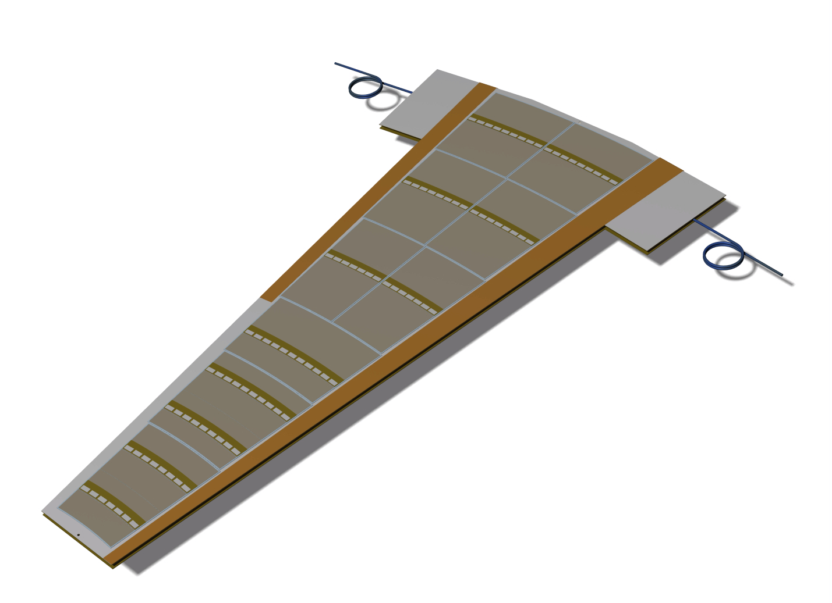
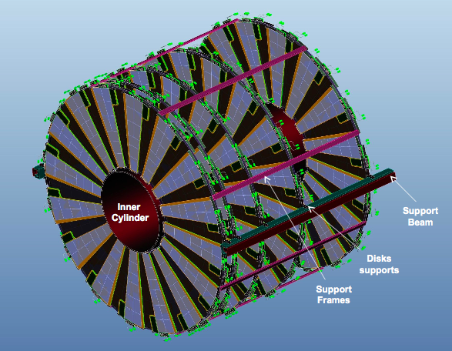
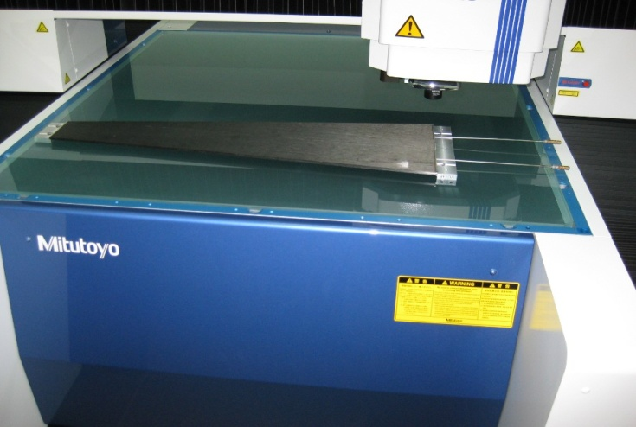
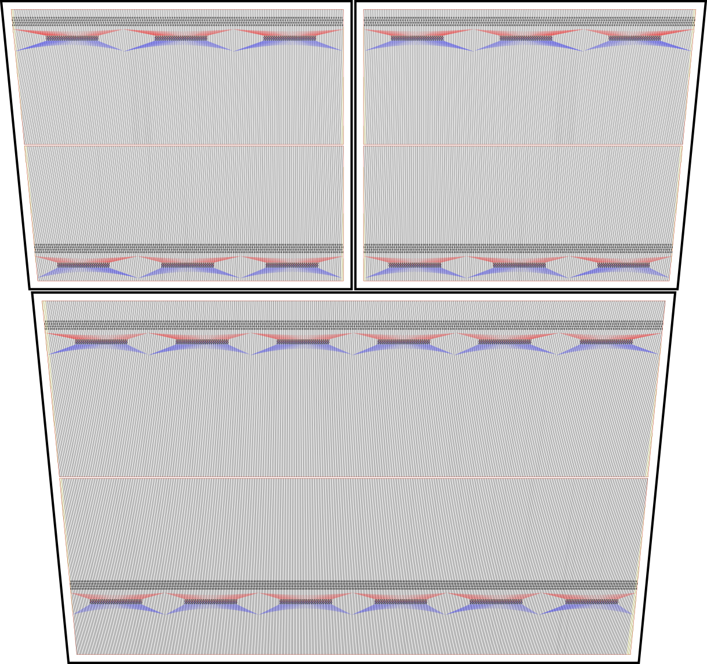
Petal Endcaps
The petal concept follows closely the barrel stave concept
5 discs on each end cap with 32 petals per disc
  6 Sensor rings
First petal cores have been produced
  Flat to better than 100 μm
First endcap hybrids tested
  Same performance as barrel hybrid
n-in-p sensor prototypes submitted to CNM to make petal-let using 4” wafers
AL Foil
AL Foil
8.60 cm
8.07 cm
Motorized, Cooled Irradiation Stage

Slide 17
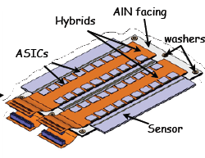
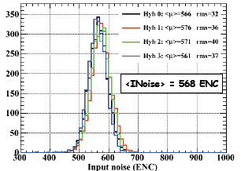
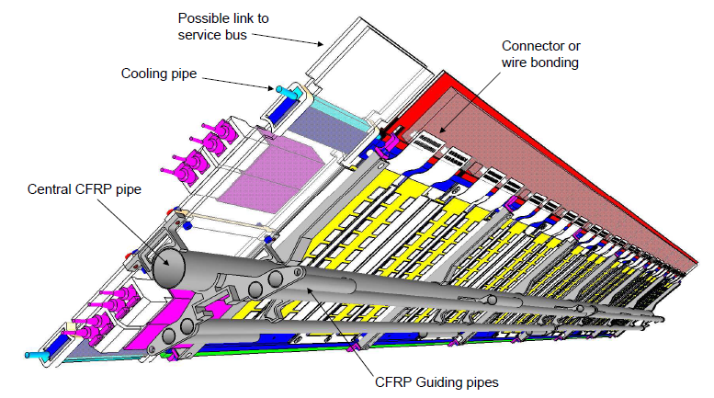
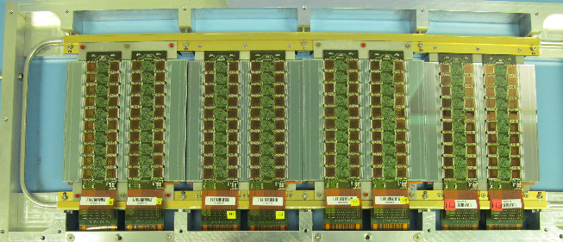
Alternative Solution: Super Module
Modular concept: cooling, local structure, service bus, power interface are decoupled from the modules
Overlapping coverage in Z
Rework – Possible up to the commissioning after integration
Design includes carbon-carbon hybrid bridge
  Hybrid could be also glued as for stave modules to reduce material
AL Foil
AL Foil
Motorized, Cooled Irradiation Stage

Slide 18
Conclusions
AL Foil
The current ATLAS TRT and silicon strip tracker must be replaced with an all-silicon tracker for HL-LHC operation (planned to be assembled by 2020)
The R&D program of components has made significant progress:
  Full-size prototype planar strip detectors have already been fabricated at Hamamatsu Photonics (HPK) which meet the final specifications
  Working baseline and alternative module prototypes have been made and shown to work after irradiation
Full-size stave/super-module prototypes are planned to be finished this year with the next generation of the 130 nm ASICs for the strip tracker under design
AL Foil
Motorized, Cooled Irradiation Stage

