Slide 1
Development of a camera for imaging of prompt gamma rays in measurements of proton beam range
P.Busca^{1,2}, C.Fiorini^{1,2}, R.Peloso^{1,2}, M.Basilavecchia³, T.Frizzi³, D. Prieels⁴,
J. Smeets^{5*}, F. Stichelbaut⁴, A. Benilov⁴, F. Roellinghoff⁴
¹Politecnico di Milano and INFN, Milano, Italy
²XGLab, Milano, Italy
⁴ Ion Beam Applications S.A., Louvain-la-Neuve, Belgium
⁵ Department of Nuclear Metrology, Université Libre de Bruxelles, Brussels, Belgium
Work supported in part by the European Union Seventh Framework Program (FP7/2007-2013) under grant agreements nos. 241851 (ENVISION) and 264552 (ENTERVISION).
HICAM gamma detector developed within the EC contract n.LSHC-CT-2006-037737.
*supported by the Belgian FNRS (aspirant)
Notes:
B

Slide 2
Proton therapy
Bragg-peak
particle (proton) therapy has a growing role in cancer treatment.
possibility to release the maximum of the dose in the target site, limiting the dose to normal tissue
relative dose
γ
p
depth
the measurement of the proton beam range in the target is very important: real range of proton beams in patients may contain uncertainties of up to 10-15 mm (uncertainties on tissue composition, density, organ motions, patient positioning, etc).

Slide 3
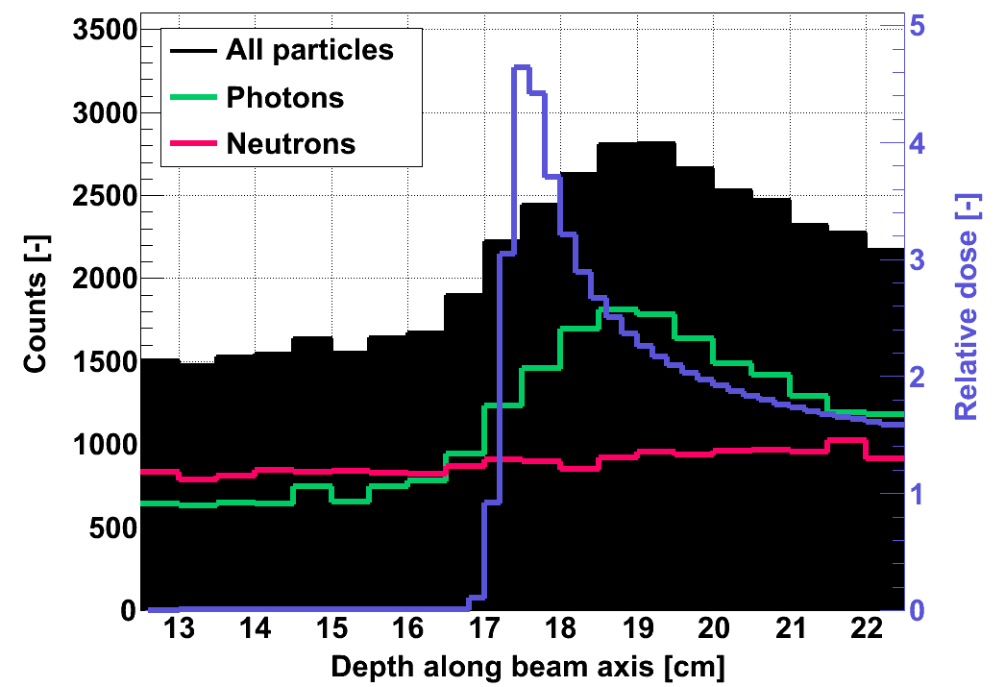
One method to measure proton beam range is based on the measurement of prompt gamma rays (energies up to 10MeV) emitted by excited nuclei during proton irradiation.
(F. Stichelbaut, Y. Jongen, 39th Meet. of the Particle Therapy Co-Operative Group, San Francisco, October 2003)
p beam
prompt
γs
p beam
target
Monte Carlo
simulation

Slide 4
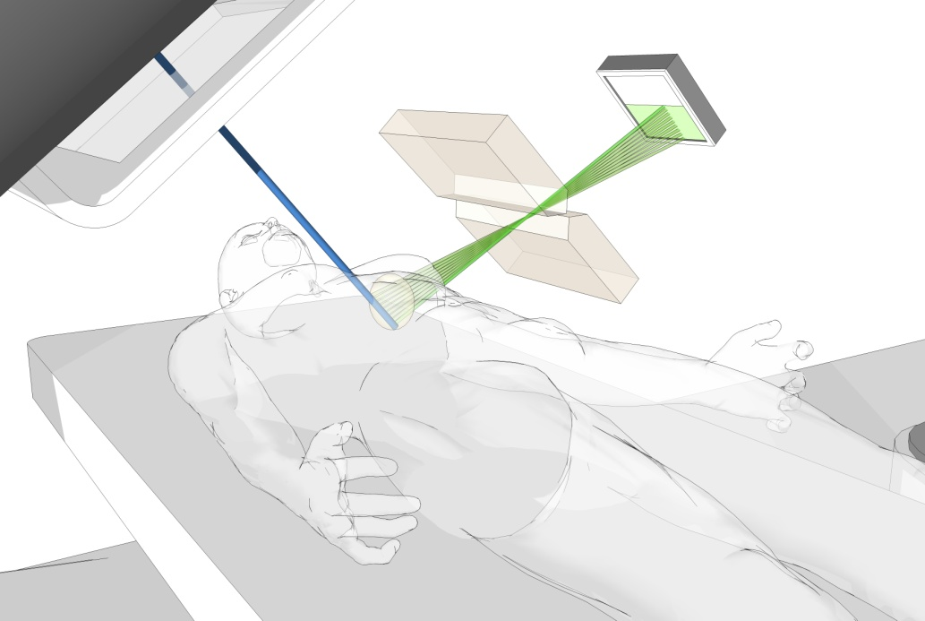
Practical concept of a prompt gamma camera which allows checking in real-time the range of a single pencil beam with a ‘mm’ accuracy
(D. Prieels, J. Smeets, F. Stichelbaut, A. Benilov, J.C. Dehaes, A. Dubus, F. Roellinghoff, 50th Meet. of the Particle Therapy Co-Operative Group (Philadelphia), May 2011

Slide 5
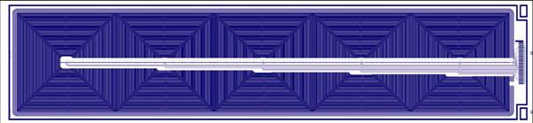
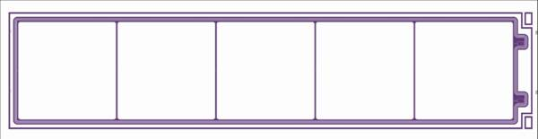
HICAM:HIgh resolution gamma CAMera
Research project from European Community
(www.hi-cam.org)
Anger camera principle
Silicon Drift Detectors
- CsI(Tl) scintillator
- SDDs photodetectors
- 5x6cm² and 10x12cm² formats
intrinsic resolution~1mm
compactness
drift
scintillation entering side
Notes:
24 Novembre 2008
5
B

Slide 6
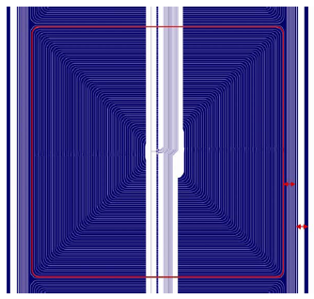
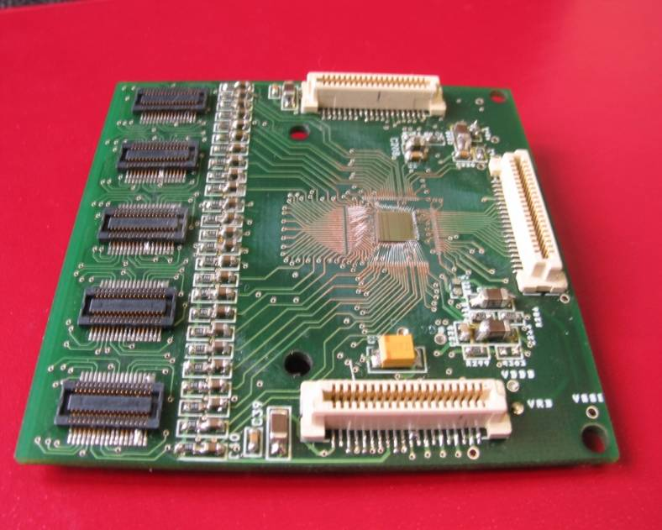
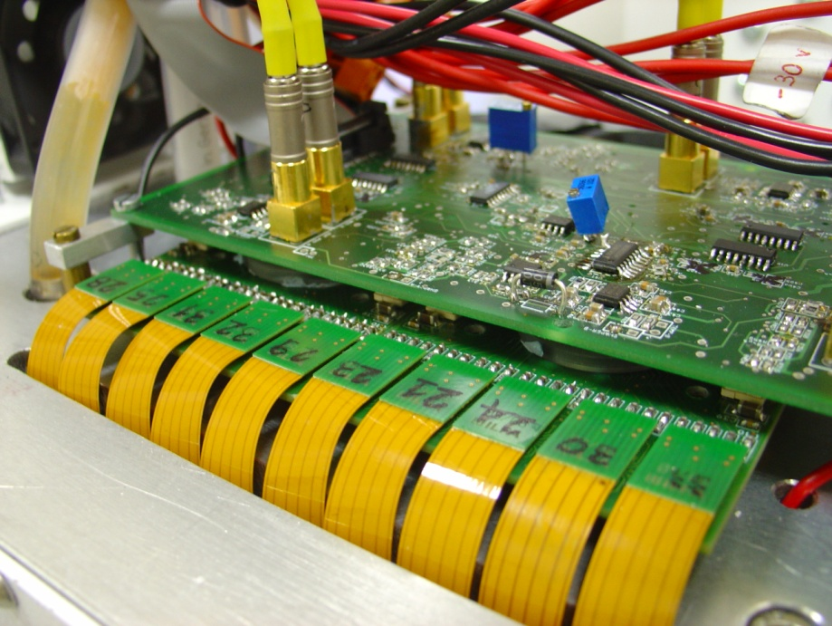
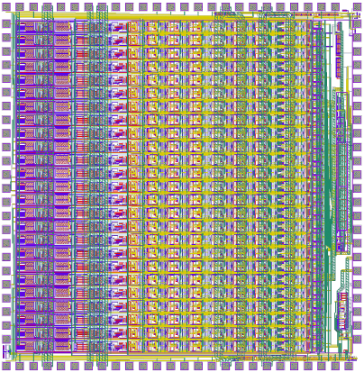
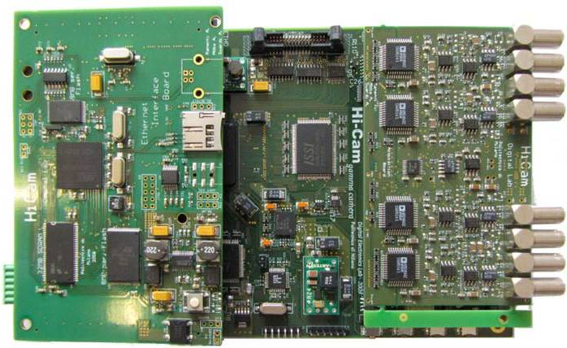
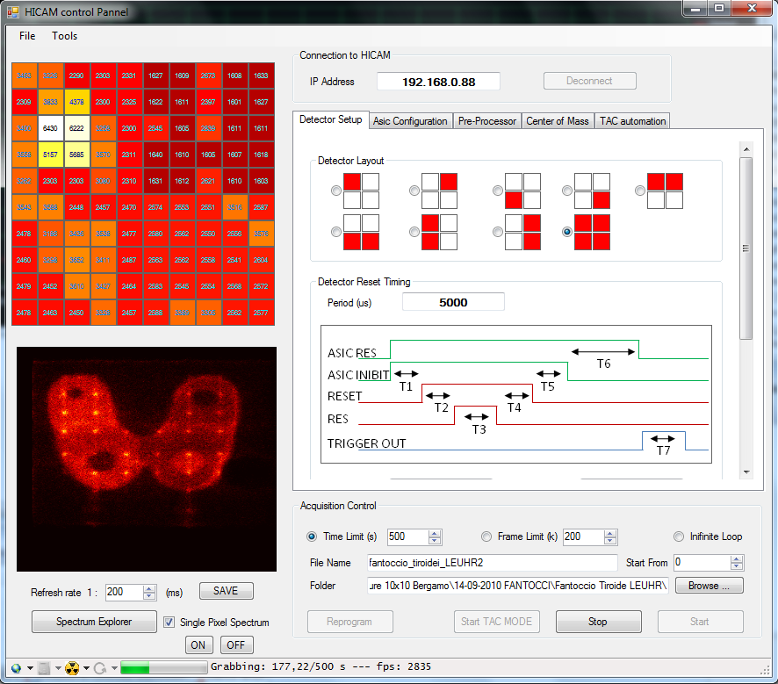
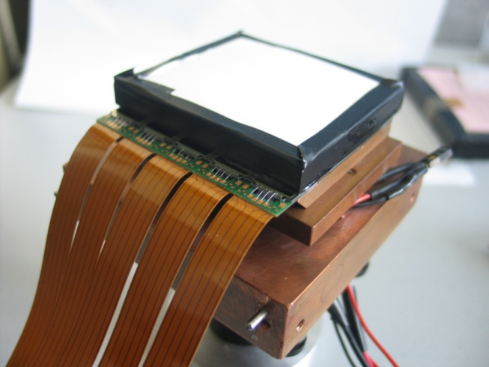
The HICAM gamma camera development
(R.Peloso, et al., “The HICAM Gamma Camera”, Nuclear Science Symposium Conference Record (NSS/MIC), 2010 IEEE)

Slide 7
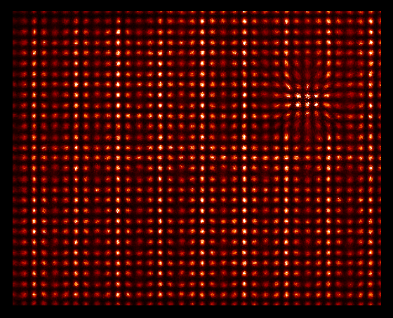
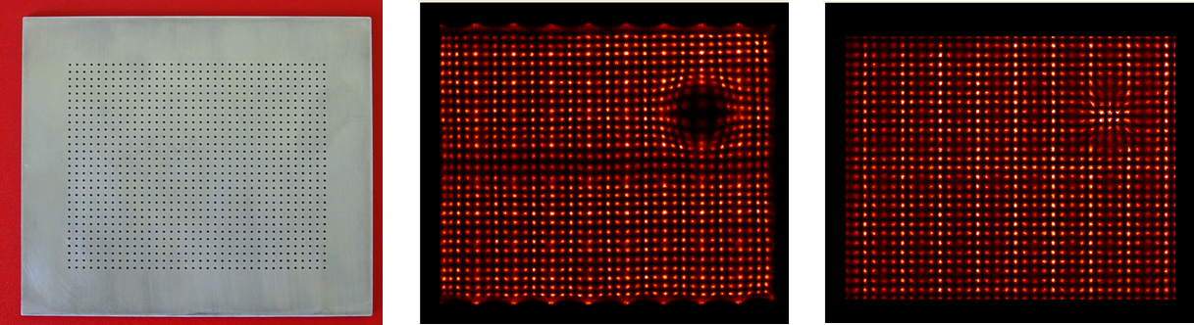
Imaging performances with ⁹⁹Tc (140keV)
8,7 cm
⇒ intrinsic resolution= 0.8mm
10,8 cm
corrected for linearity and uniformity
Grid
LEUHR parallel hole collimator
⁹⁹Tc
Hole Ø=1mm
Pitch=3mm
Notes:
A
B

Slide 8
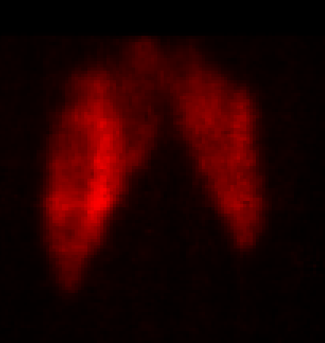
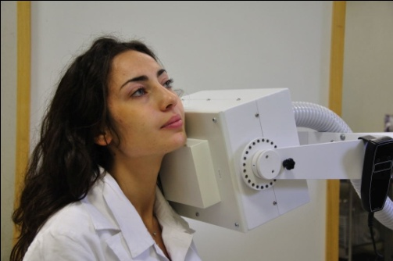
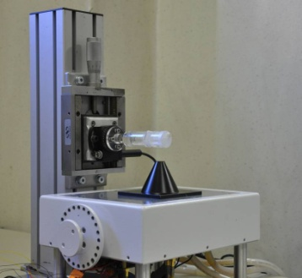
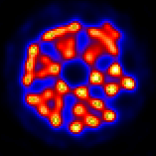
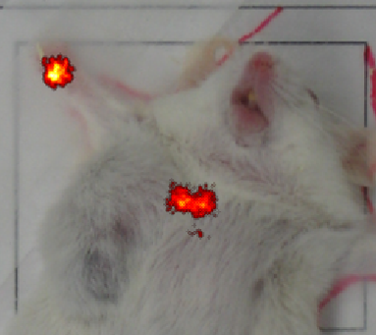
Applications of the HICAM gamma camera
(P.Busca, et al., “Applications of the HICAM Gamma Camera”, Nuclear Science Symposium Conference Record (NSS/MIC), 2010 IEEE)
Notes:
The hicam camera was tested in differents reserch fields and the obtained result will be presented on Thursday

Slide 9
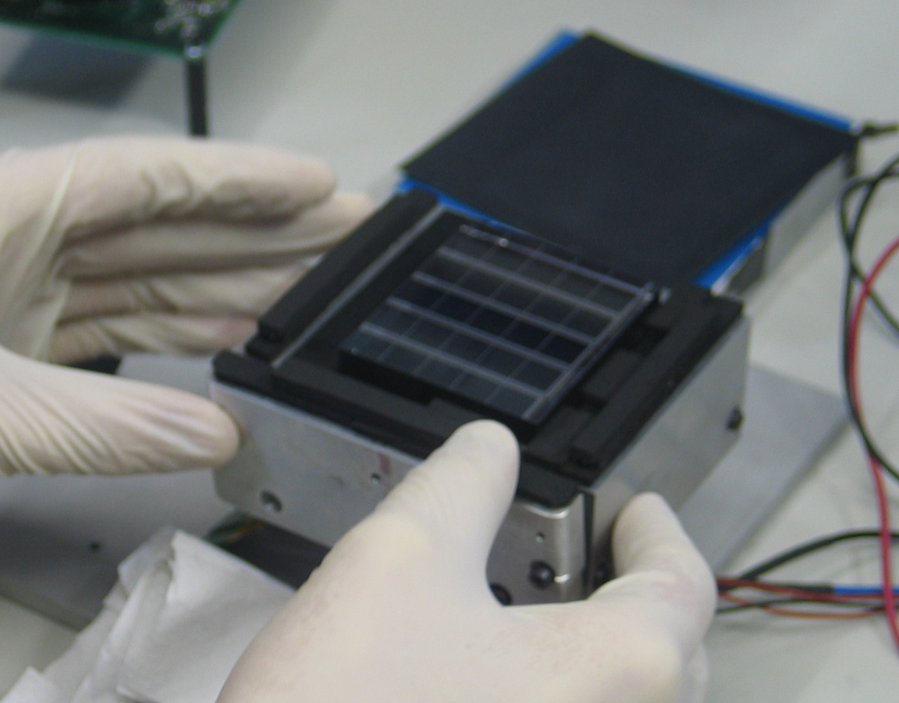
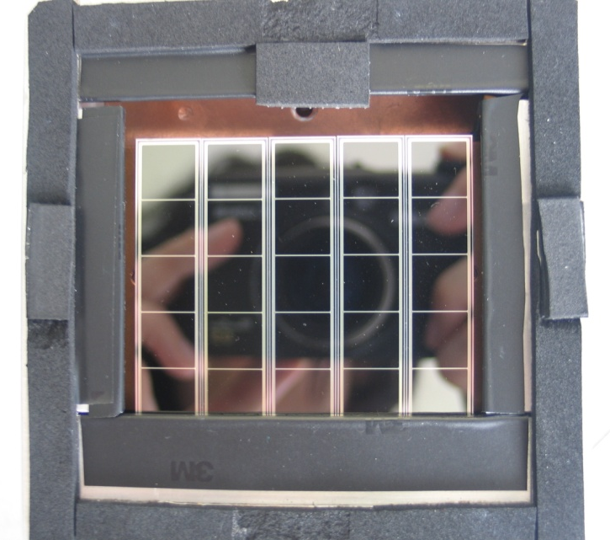
Modification of the 5x6cm²
HICAM gamma camera
for high-energy (1-10MeV)
imaging
1cm thick LYSO scintillator
(η~37%@1MeV, ~22%@5MeV)
light collection purposely limited (i.e. all absorbing surfaces) to match readout ASIC dynamic range (designed for 200keV)
(⇒ ~ 5e-/keV, vs. 30ph./keV from LYSO)

Slide 10
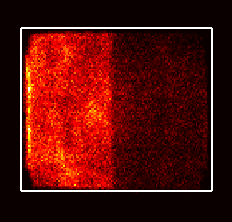
Laboratory characterization of the camera
1D profile calculation along X:
integration on the Y direction
(1mm bin)
Source: ⁶⁰Co (1.17MeV, 1.33MeV)
Y
Camera FOV
source
lead block
X
lead block thickness=3cm
Area considered for profile calculation

Slide 12
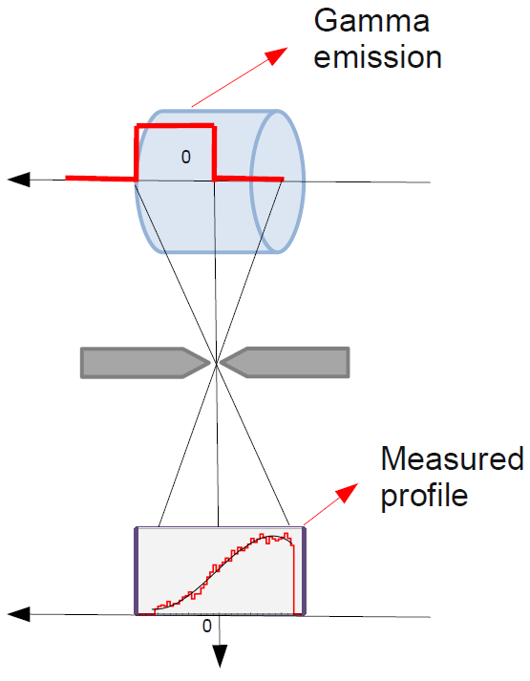
Proton range measurements:
the experimental set-up
p beam
slit collimator
opening: 6mm

Slide 13
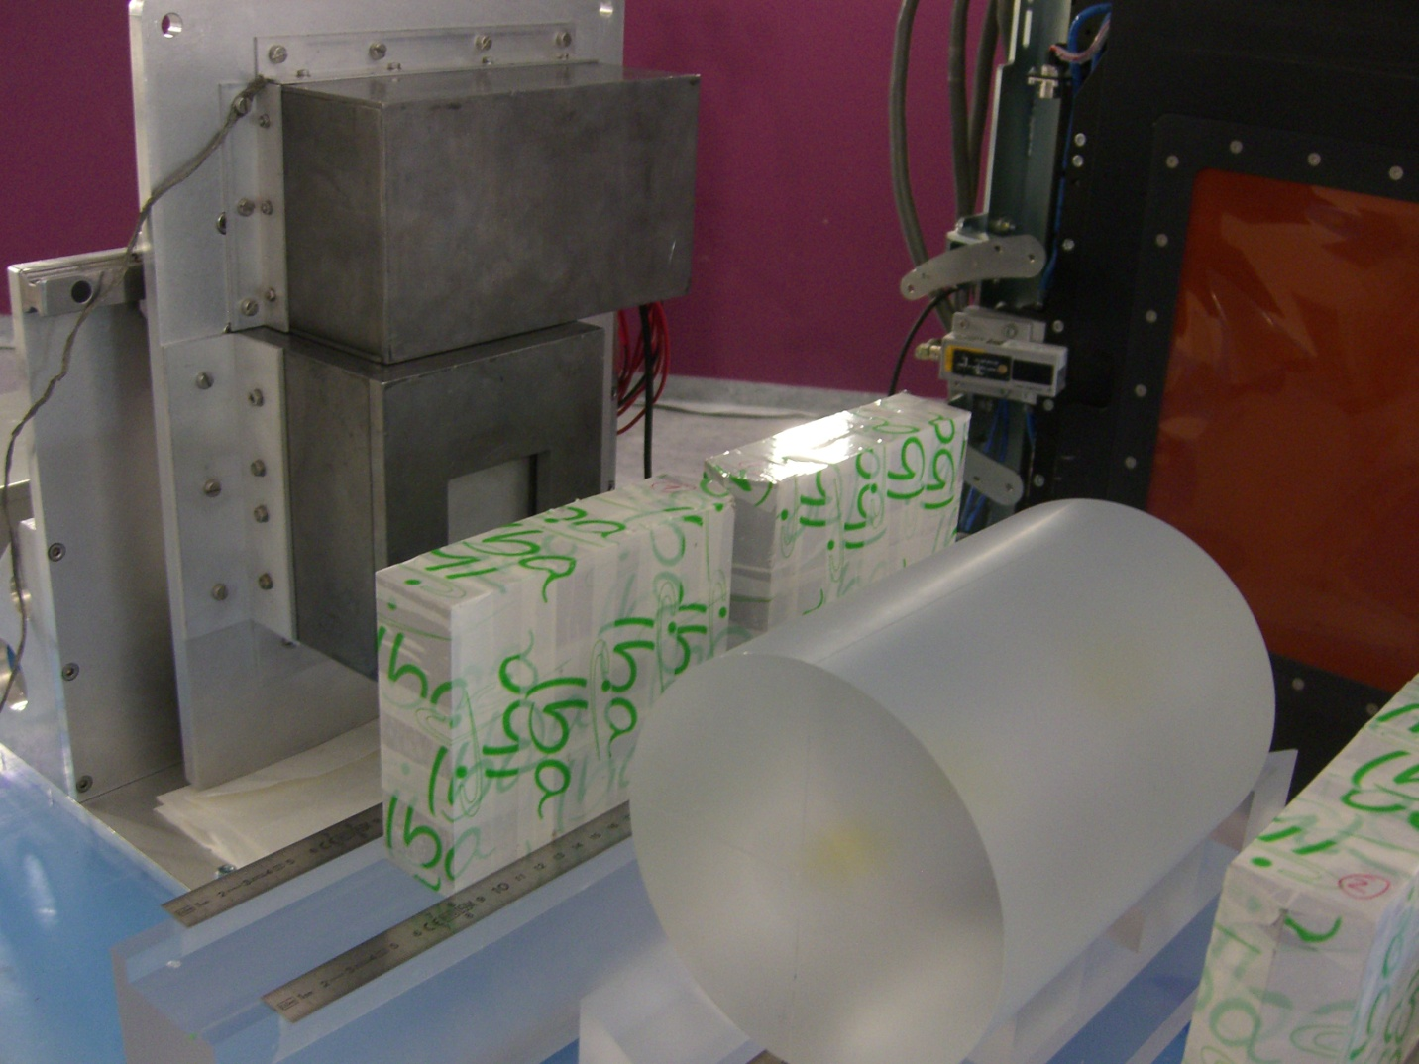
electronics
HICAM
camera
γ-rays
proton
beam
slit collimator
PMMA target

Slide 14
Measured energy spectrum
LYSO
background
3-7MeV
range
used in
reconstruction

Slide 15
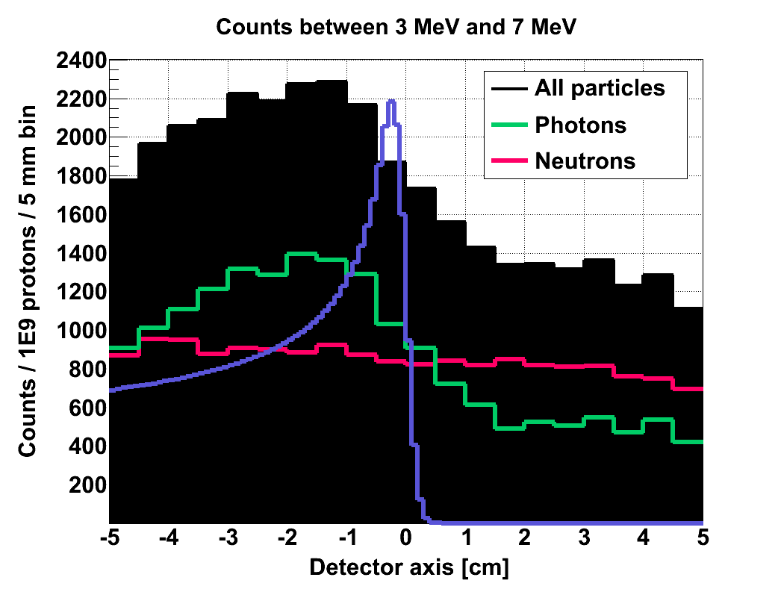
Measured profiles
Beam energy: 160MeV
camera
position
+ 4cm
slits closed
(neutrons + uncorrelated photons)
camera
position
- 4cm
camera
centered
subtraction
central profile
is fitted and
monitored
while moving the
target (and the Bragg-peak)
simulation

Slide 16
100MeV protons
(preliminary analysis)
-10mm
+10mm
each acquisition:
5min.
7·10¹⁰ protons

Slide 17
Shift accuracy
reference value
X₁₀
X₀
X₋₁₀

Slide 18
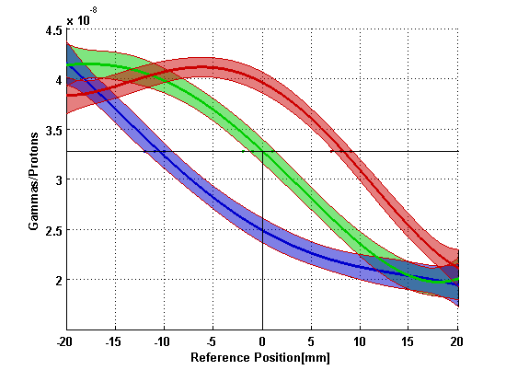
Precision
reference value
reference position
fitting error

Slide 20
Precision vs. statistics
7·10¹⁰ protons

Slide 21
160MeV protons
(preliminary analysis)
each acquisition:
2min.
1.7·10¹⁰ protons

Slide 22
1.7·10¹⁰ protons

Slide 23
Conclusions
Measurements of prompt gammas correlated to proton range were successfully made using the HICAM gamma camera
Although not optimized for 1-10MeV energy range (low efficiency, low scintillator light collection), satisfactory accuracy and precision (in the ‘mm’ range) were first measured
Future work
Further data analysis also to correlate results to dose expected in patient treatment.
Measurements to be repeated also with other protons energies (230MeV).
Gamma camera to be modified/redesigned to improve efficiency and speed

Slide 24
