Slide 1

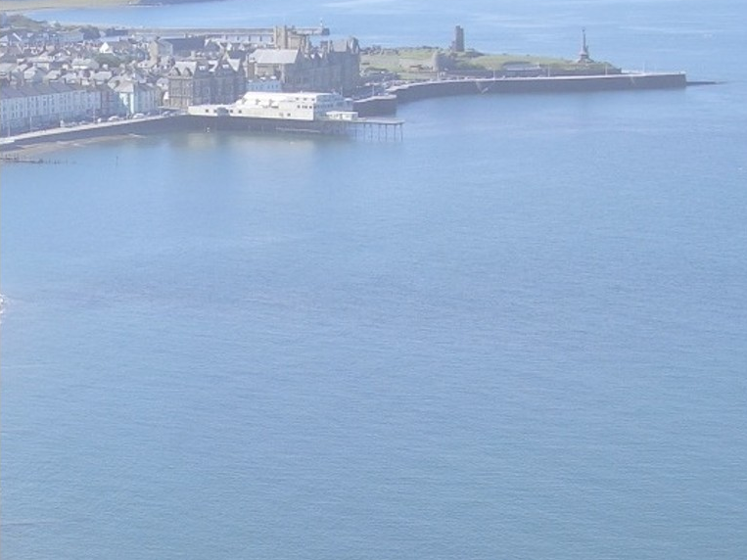
Welcome to Aberystwyth
Dave Langstaff

Slide 2
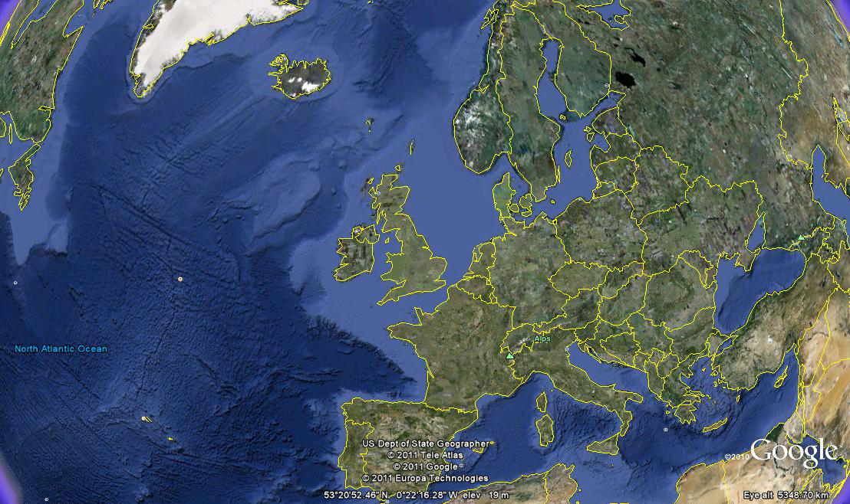

Slide 3
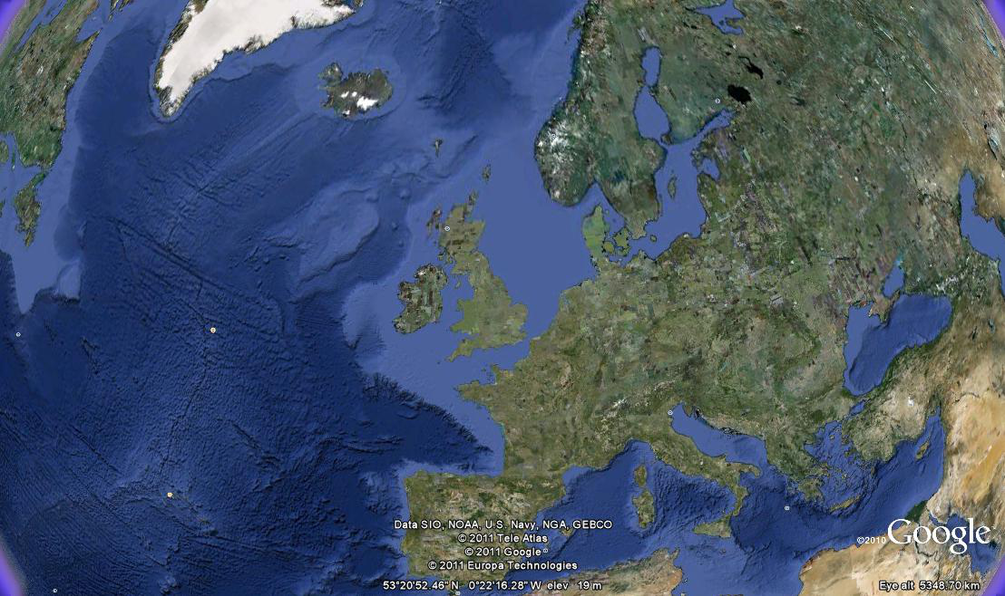

Slide 4
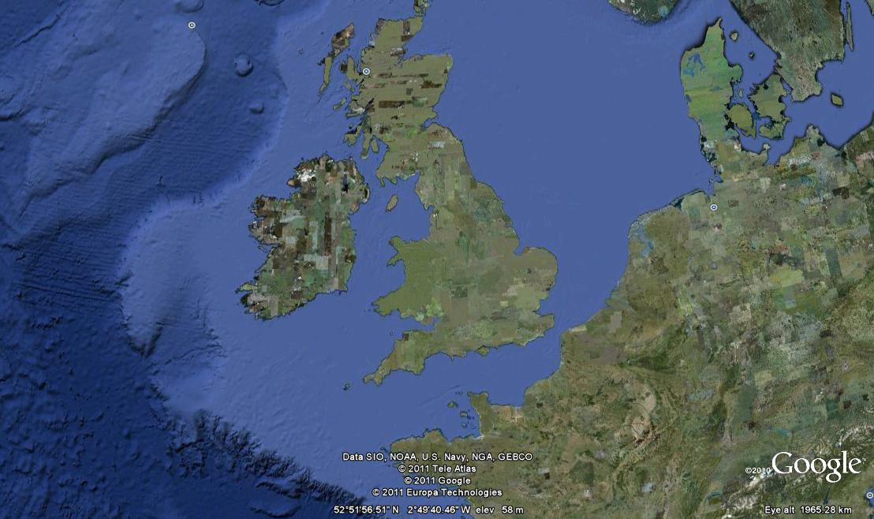

Slide 5
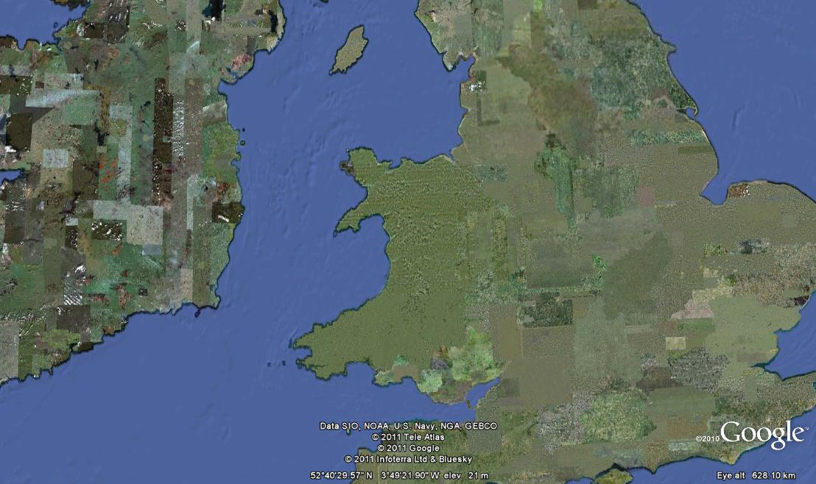

Slide 6
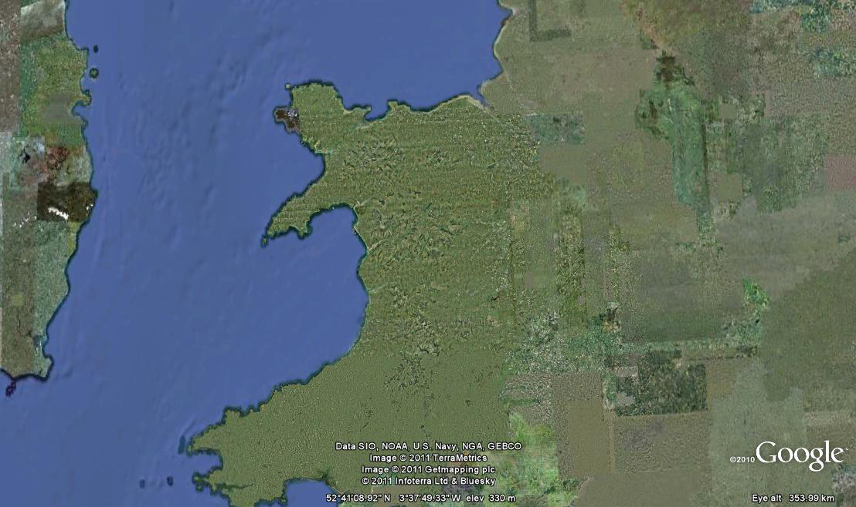

Slide 7
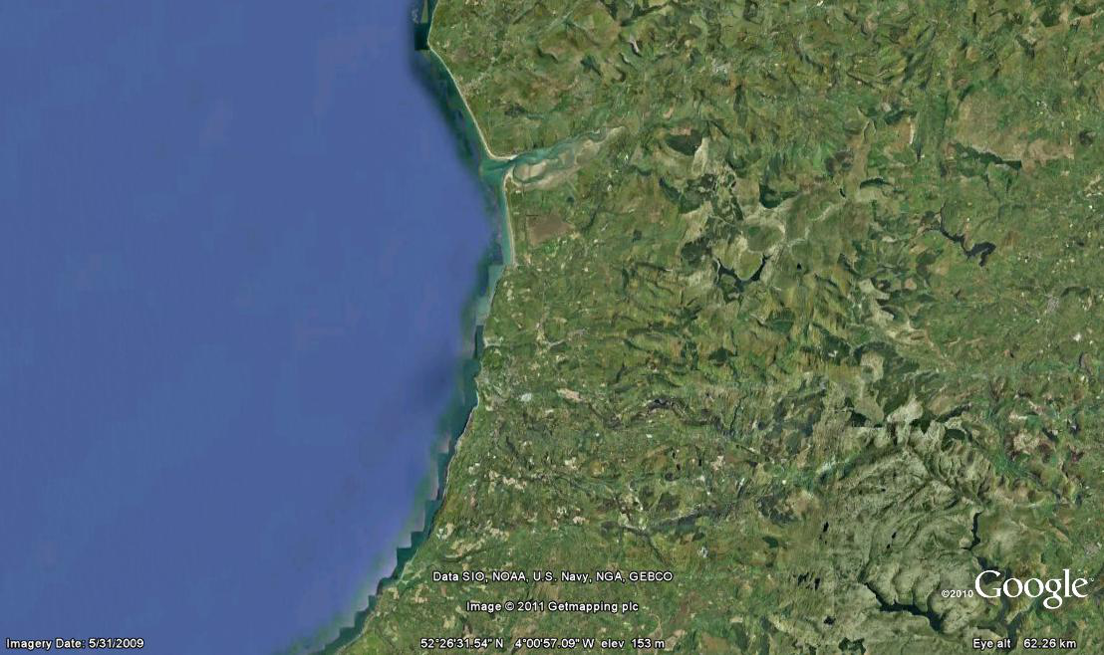

Slide 8
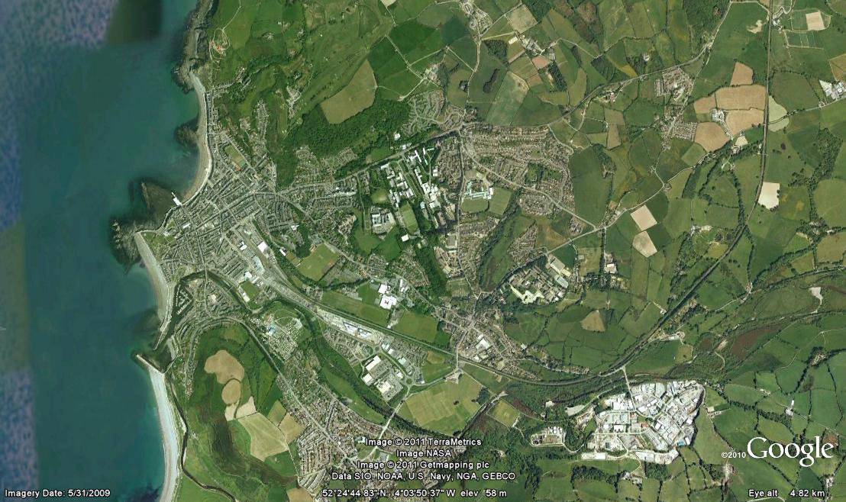

Slide 9
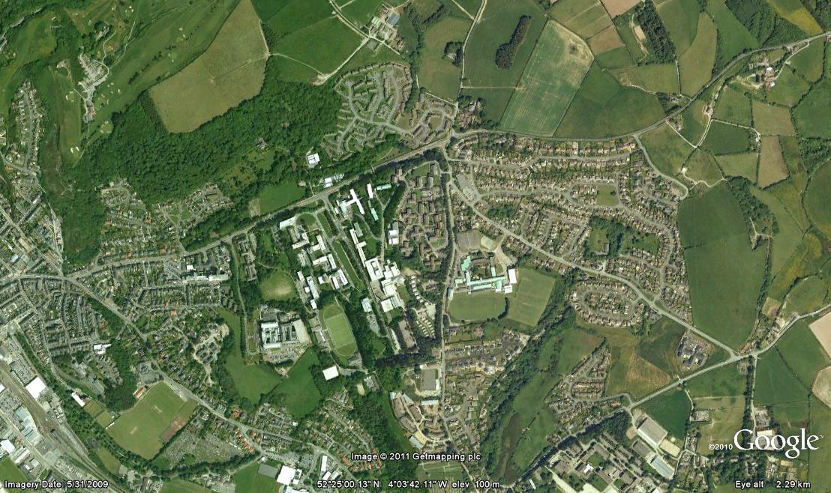

Slide 10
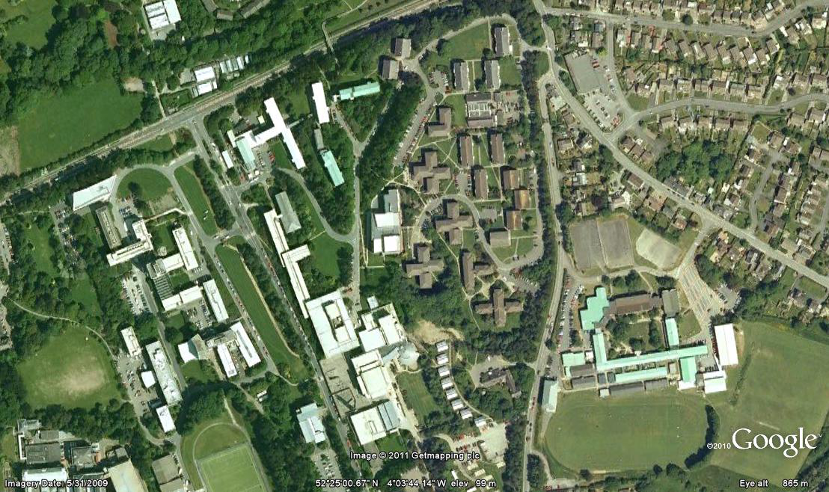

Slide 11
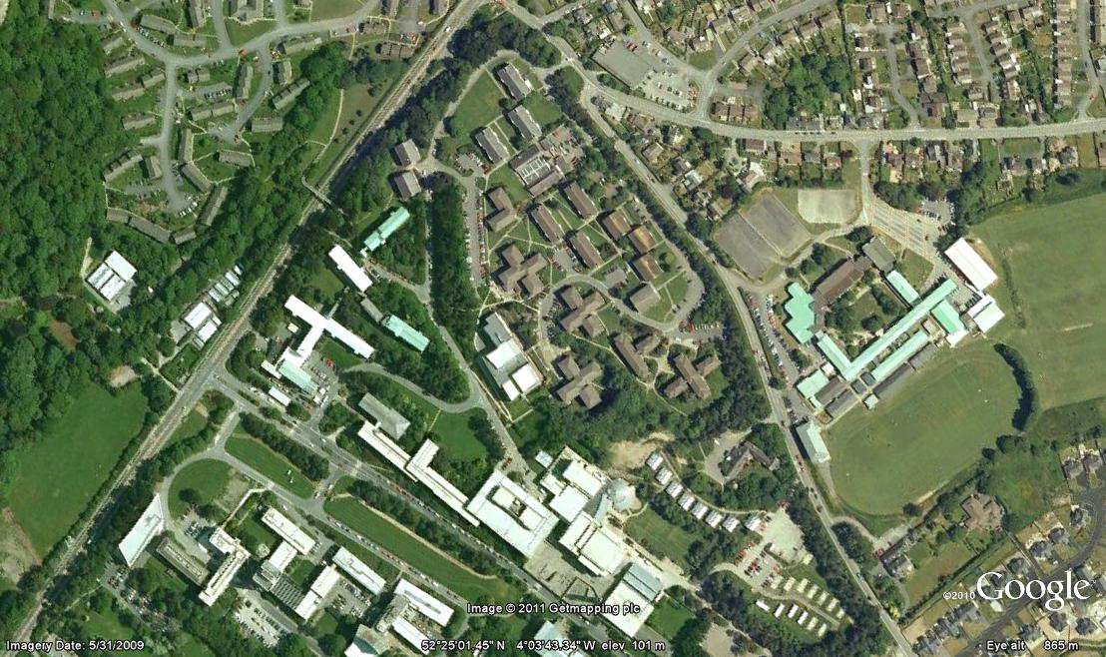

Slide 12
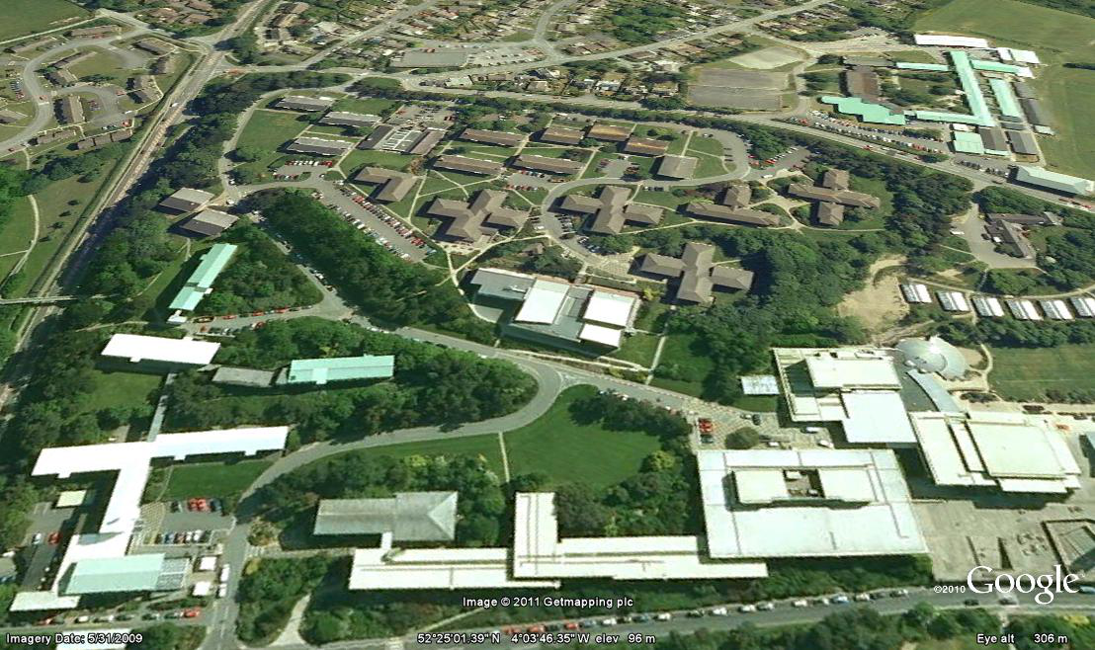

Slide 13
A12

Slide 14
A12
Medrus

Slide 15
Rosser Hall
A12
Medrus

Slide 16
Rosser Hall
Arts
Centre
A12
Medrus

Slide 17
Programme : Monday
Positron Emission Tomography
Photon Detectors for Synchrotron Radiation
Lunch
Knowledge Transfer and Commercial Opportunities
Hot buffet & welcome from the Vice Chancellor of Aberystwyth University.

Slide 18
Programme : Tuesday
X-Ray and Gamma Detectors
Detectors for Particle Physics
Lunch
Europlanet Workshop on Detectors for Astronomy and Planetary Science
BBQ and Welsh Beer Tasting.

Slide 19
Programme : Wednesday
Poster Session
Transfer by bus to Old College
Detectors for Particle Physics
Lunch in Old College
Advances in Pixel Detectors
Detectors for FELs

Slide 20
Programme : Thursday
Medicine, Life Sciences and Biology
Detectors for high radiation environments
Lunch
Detectors for Nuclear Physics
Advances in Pixel Detectors
Gas Based Detectors
Conference Dinner

Slide 21
Programme : Friday
Detectors for AstroPhysics
Detectors for Particle Physics
Closing Remarks

Slide 22





Industrial Exhibition

Slide 23
Wi-Fi Access on Campus
EDUROAM
- Use your normal login details
Visitors Network
- Select rh-ymwelwyr network
- Use key on card provided in info pack

Slide 24
Conference Dinner Menu
Menu choices on form in welcome pack
Packed lunch on Friday ?

Slide 25
Enjoy your stay ☺

