Slide 1


Performance of a high throughput multichannel detector for life science applications
Space Research Centre
J S Lapington¹ and T Conneely^{1,2}
University of Leicester
Photek Ltd.

Slide 2
Outline
System Concept
Applications
HiContent Prototype – design and results
IRPICS - a 256 channel detector system
  Integrated system design
  Detector design
  Electronics design and measurements
Conclusions

Slide 3
System concept
A High Content detector for life-science applications
Imaging or simultaneous event detection
High density multi-anode readout
Low noise, single photon counting
Picosecond timing for time resolved spectroscopy
Parallel, high throughput multi-channel electronics
Integrated detector and electronics
Adaptable, multi-purpose digital processing

Slide 4





HiContent & IRPICS Collaboration
HiContent
A scaled-up high content photon-counting detector for life science applications
IRPICS
Information-rich photon imaging of cells
Space Research Centre
4
Notes:
Jon Lapington - Photonex 2007
#4
This project aims to develop a detector system specifically designed to address the requirements of optical proteomics; to be capable of high content analysis at high throughput. The goal is to integrate a multi-channel, high time resolution, photon counting system into a single miniaturized detector system with integrated electronics (>99% smaller per pixel),an engine for the next generation of biomedical tools.

Slide 5
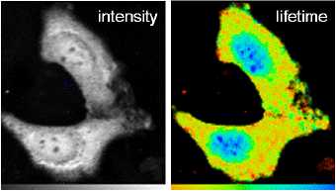
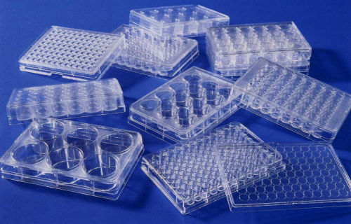
Applications in
High Content Proteomics
Proteomics
  The study of protein interactions in vivo
High Content
  High speed, automated, multi-parametric biological research
  Highly parallel measurements using temporally and spatially resolved methods
Time resolved spectroscopies
  Fluorescence lifetime imaging
  Fluorescence correlation spectroscopy
  Fluorescence polarization anisotropy
FLIM
FCS
Other applications:
  Optical tomography
  Confocal microscopy
e.g. High throughput bioassay for drug discovery using:
Multi-channel detector + fibre optics + multiwell plates
Notes:
Fluorescence correlation spectroscopy (FCS) performs ‘single molecule’ assays in ultra-small confocal volumes (typically 1 femtolitre).
Unlike other fluorescence techniques, the parameter of interest is not the emission intensity itself, but rather spontaneous intensity fluctuations, characterized by the time between individual detected photons, caused by the minute deviations of the small system from thermal equilibrium.
In general, all physical parameters that give rise to fluctuations in the fluorescence signal are accessible by FCS. It is, for example, rather straightforward to determine local concentrations, mobility coefficients or characteristic rate constants of inter- or intramolecular reactions of fluorescently labeled biomolecules in nanomolar concentrations.
Although the time resolution of single photon counting detectors can be in the picosecond regime, their longer recovery time biases the measurements away from fast subsequent photons.
The detector we are developing can be be reconfigured to trade independent channel count for a degree of simultaneous event handling which will help to circumvent this bias,

Slide 6
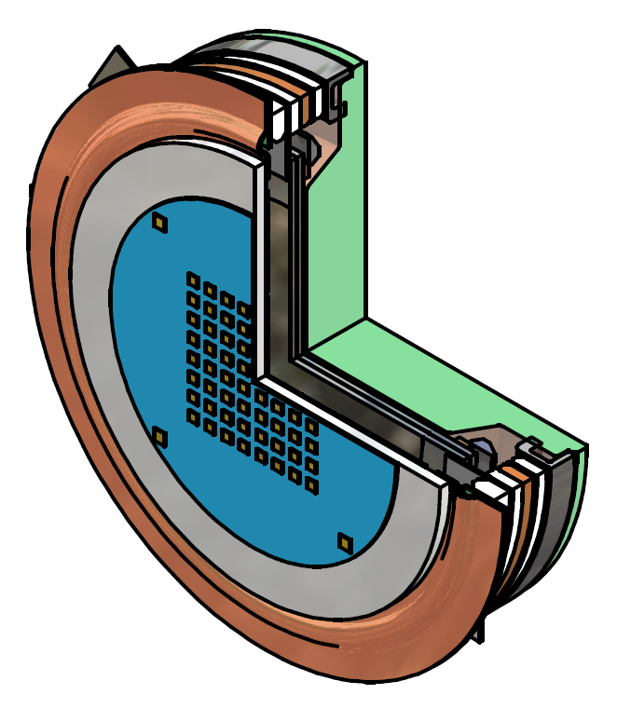
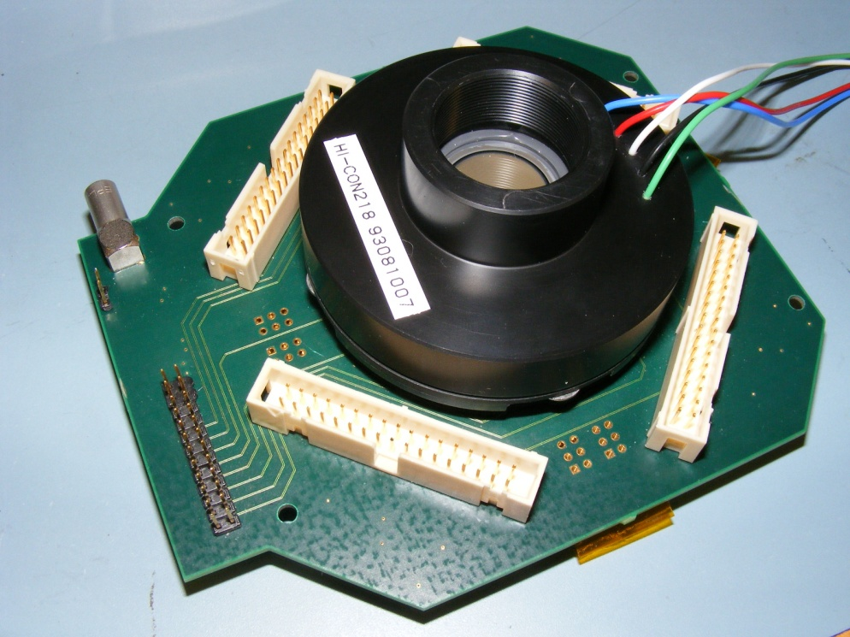
HiContent Prototype
Small pore MCPs
  chevron stack of 18 mm MCPs
  3 μm pore diameter, 10⁶ gain
  <100 ps pulse rise time
8 x 8 multi-anode readout
  Multilayer ceramic construction
  1.6 mm pitch
Custom 64 channel front-end electronics
  NINO preamplifier/discriminator
  8 channel ASIC
  designed for ALICE ToF RPC
  Time walk correcton using time-over-threshold
Commercial TDC module
  Caen V1290A VME module
  4 HPTDC chips
  32 channel, 25 ps binsize
  HPTDC built specifically for NINO

Slide 7
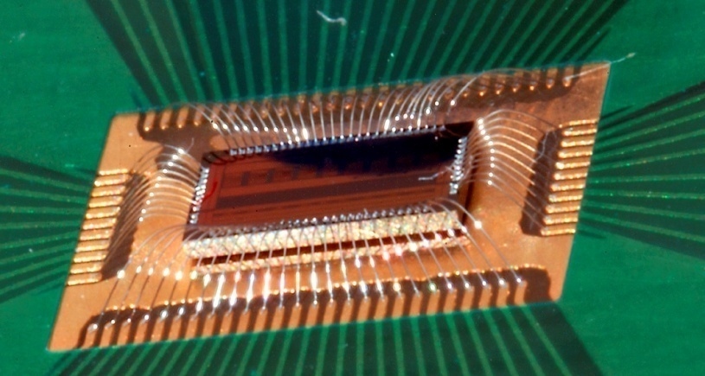
CERN NINO amplifier-discriminator
Parameter | Value
Peaking time | 1ns
Signal range | 100fC-2pC
Noise (with detector) | < 5000 e- rms
Front edge time jitter | < 25ps rms
Power consumption | 30 mW/ch
Discriminator threshold | 10fC to 100fC
Differential Input impedance | 40Ω< Zin < 75Ω
Output interface | LVDS

Slide 8
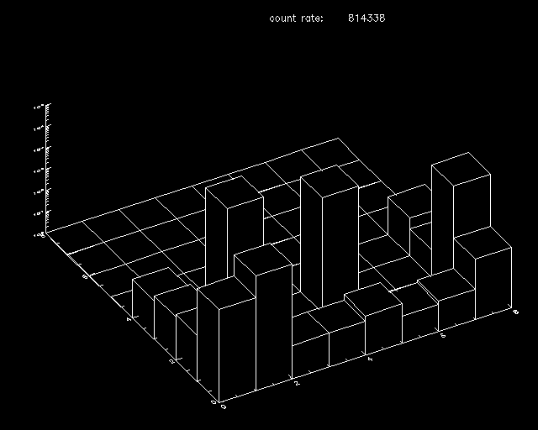
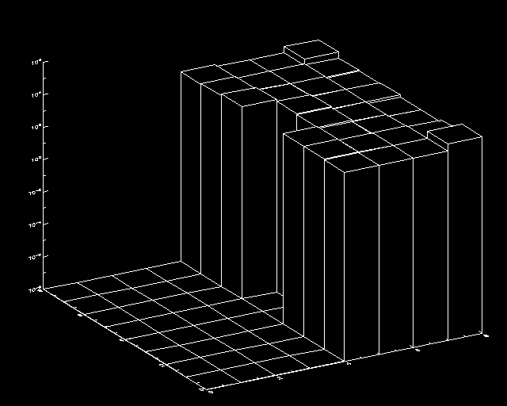
Prototype – first results
4 electronically stimmed channels
Low disriminator threshold – 48mV
Detector uniformly illuminated
N.B. Log amplitude plot
2 pixels missing – pogo pin connection problem

Slide 9
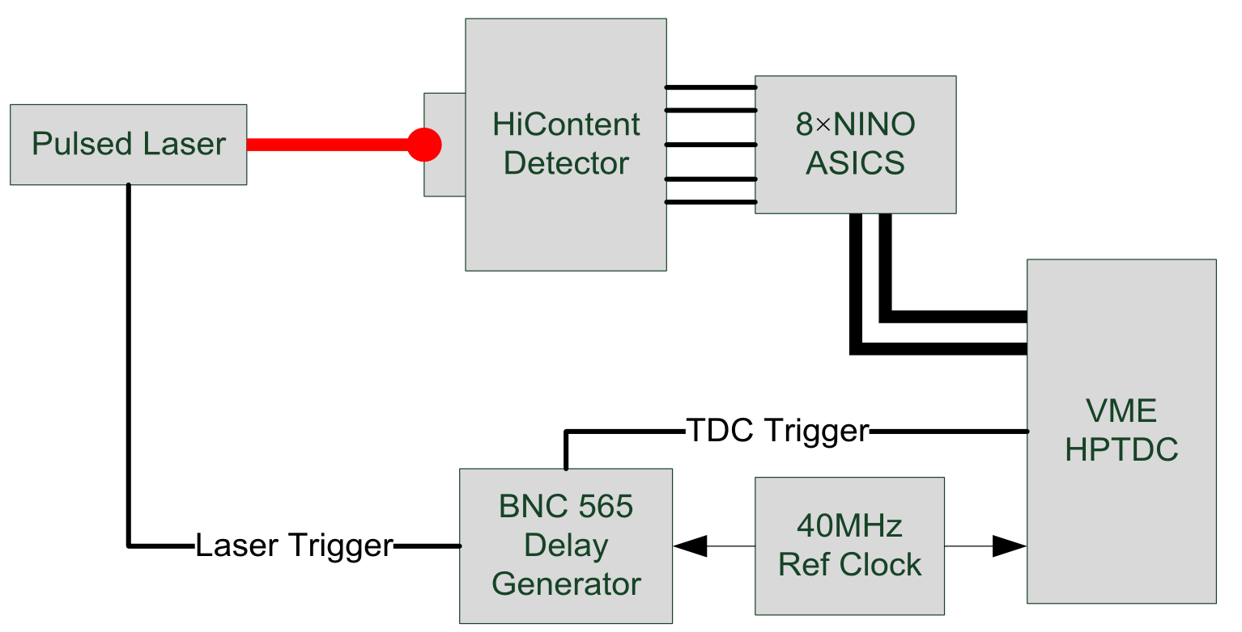
HiContent – Timing Jitter
Photek LPG-650
CAEN V1290A

Slide 10
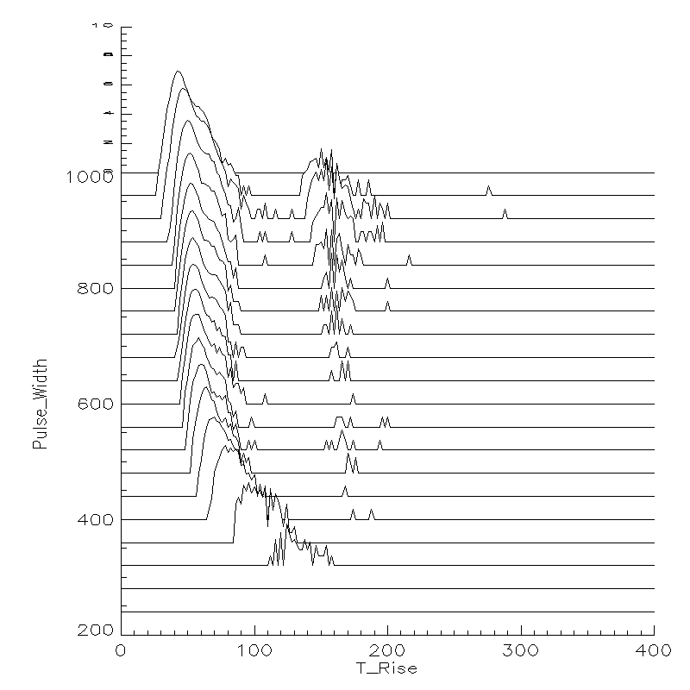
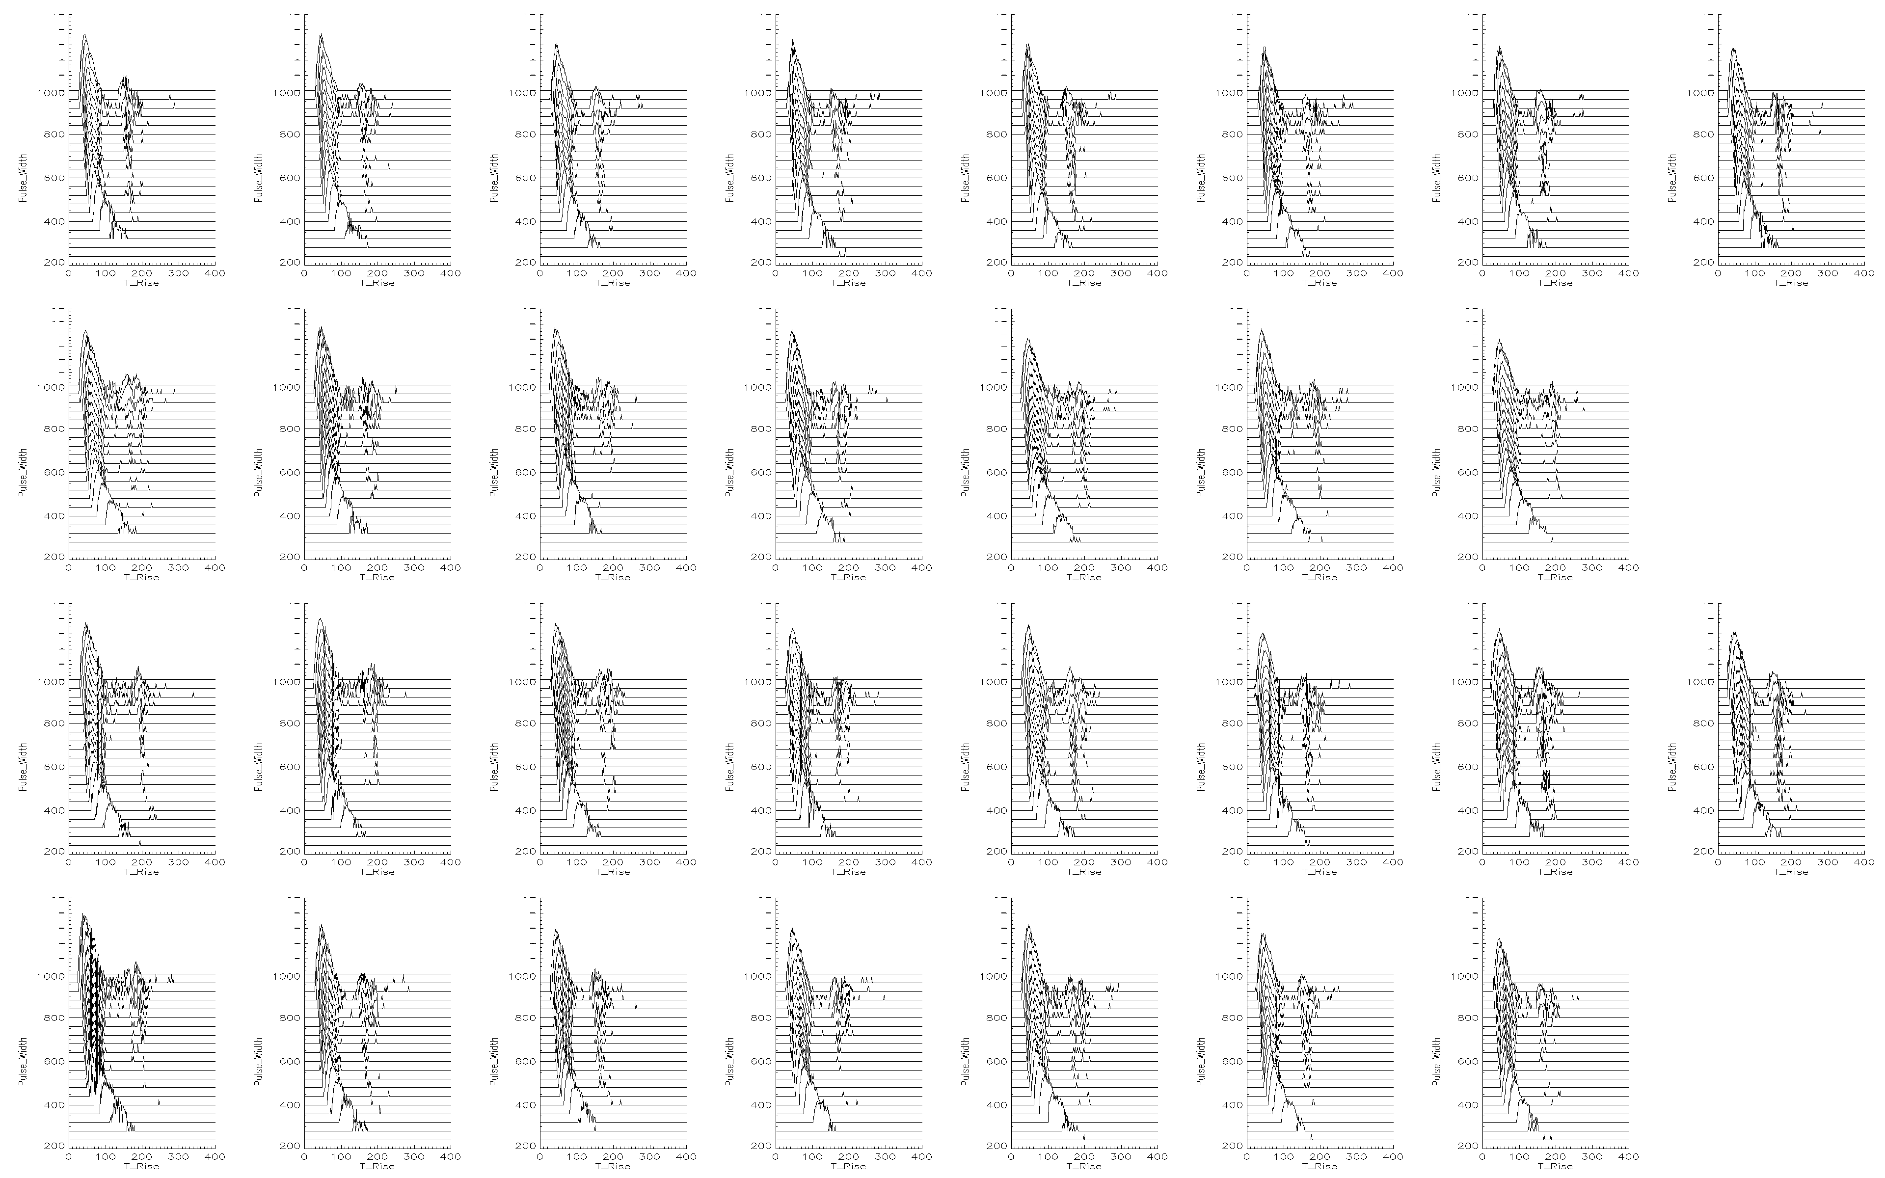
Time over threshold vs T-rise
Pulsed laser illuminating whole detector (data from 32 ch only)
Laser reflection
25 ps per div

Slide 11
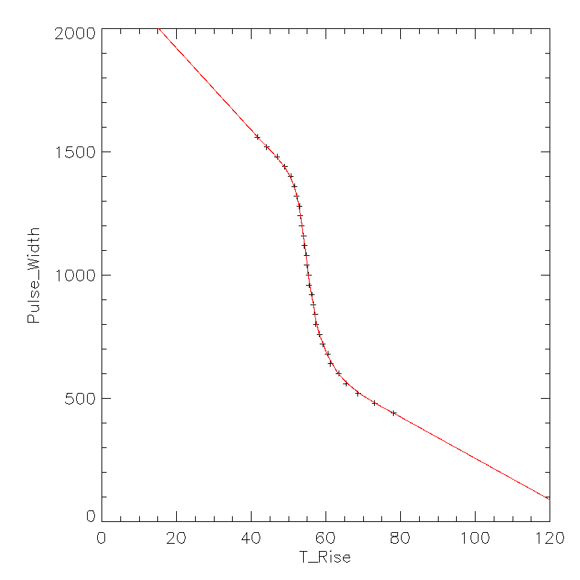
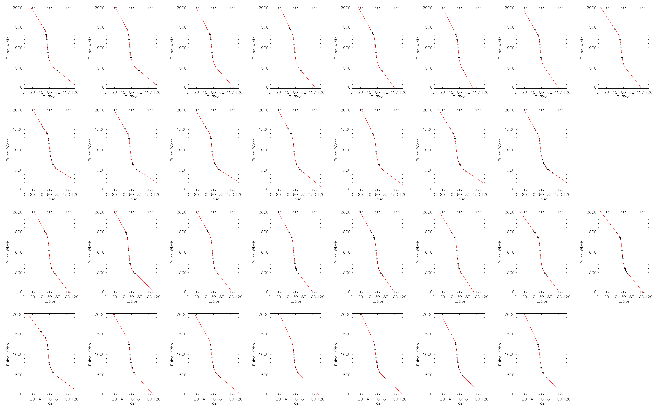
Amplitude walk correction
Simultaneous correction for amplitude walk and time offsets between channels – using LUT

Slide 12
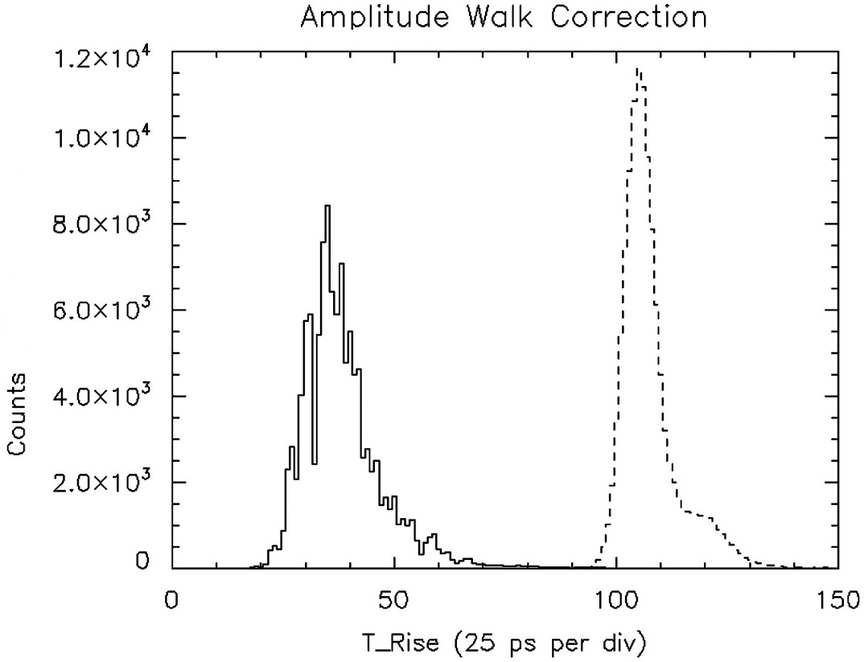
Hi-Content – Timing Jitter Results
Time correlated single photon counting from the laser illuminated detector
The solid line shows the uncorrected data
The “amplitude walk” corrected histogram is shown as a dashed line
Corrected histogram represents time jitter 78 ps rms (narrow peak of 2 gaussian cpts)
Subtracting the measured laser trigger jitter of 65 ps -> 43 ps rms
43 ps is the system jitter plus the laser pulse width
Laser pulse is approximately ~45 ps.

Slide 13
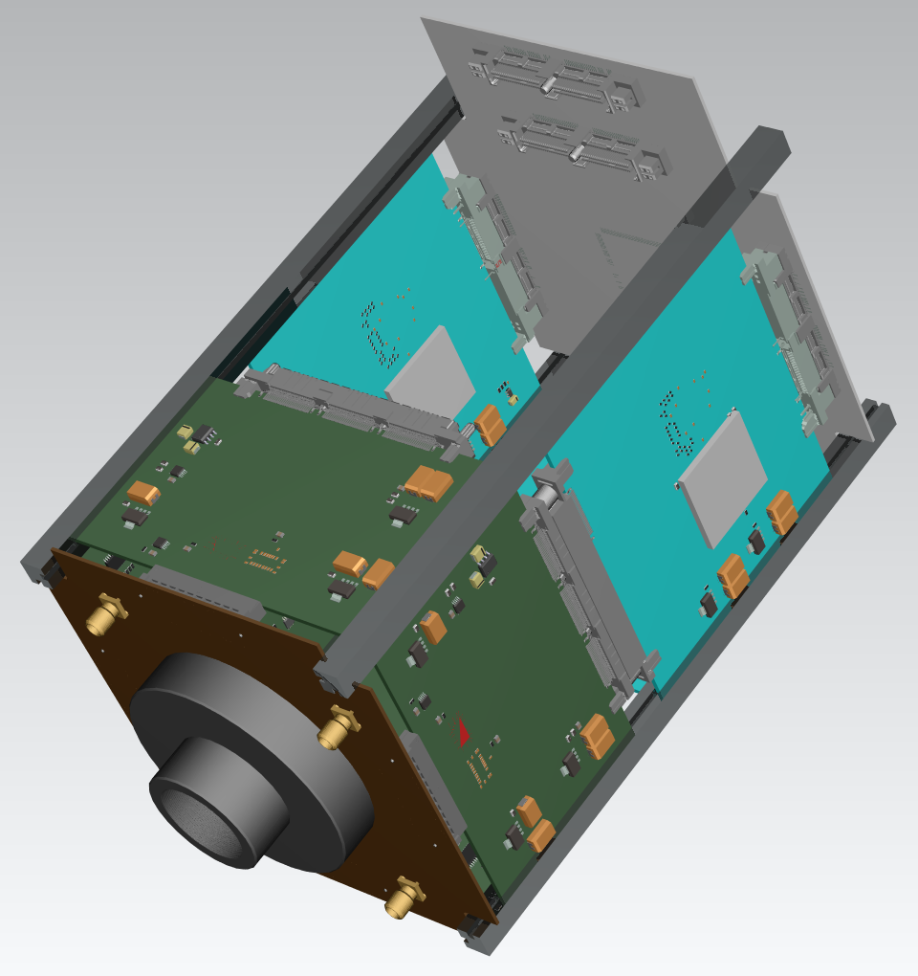
IRPICS - a 256 channel detector system
Integrated detector and electronics
  100 x 100 x 150 mm³ footprint
  Optical microscope mount
40 mm detector
  32 x32 pixel² readout
  0.88 mm pixel pitch
  Initially 2 x 2 pixel² per channel
Modular electronics
  Custom32 channel low power NINO
  4 x 64 channel NINO/HPTDC modules
  256 channels at 100 ps bin size
  Expandable up to 1024 channels
  FPGA-based DPU with USB interface

Slide 14
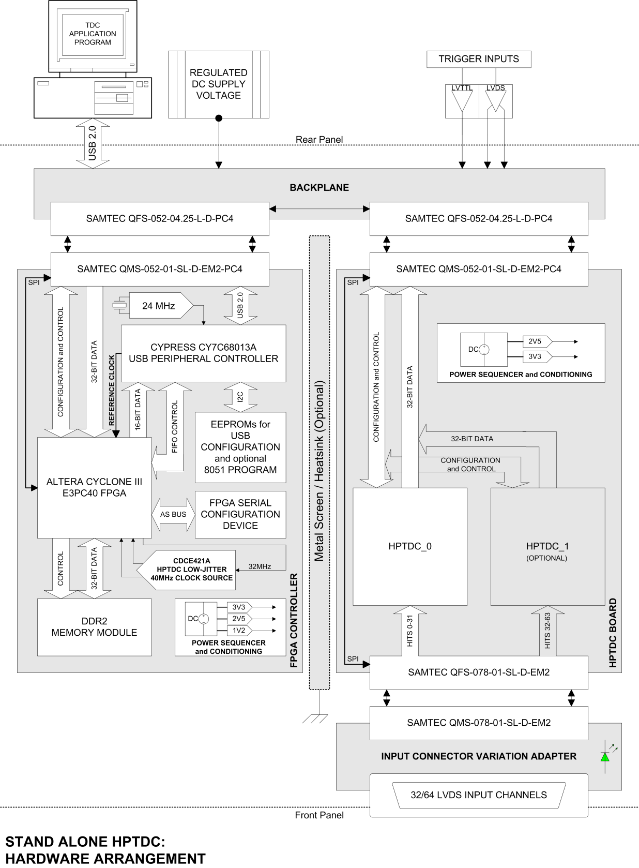
System block diagram

Slide 15
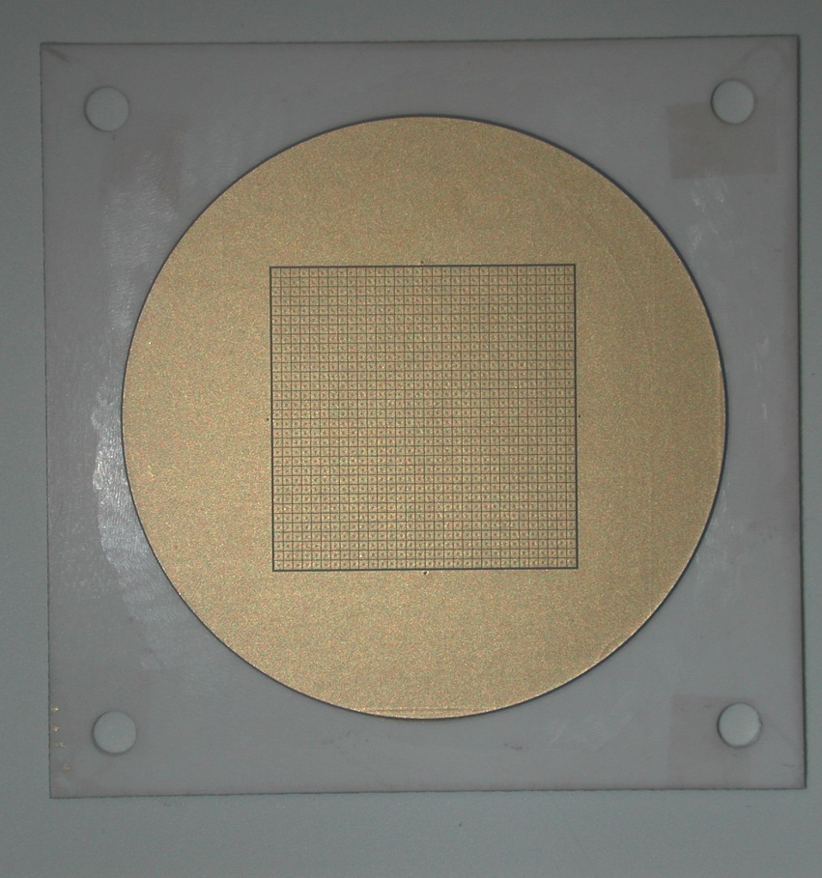
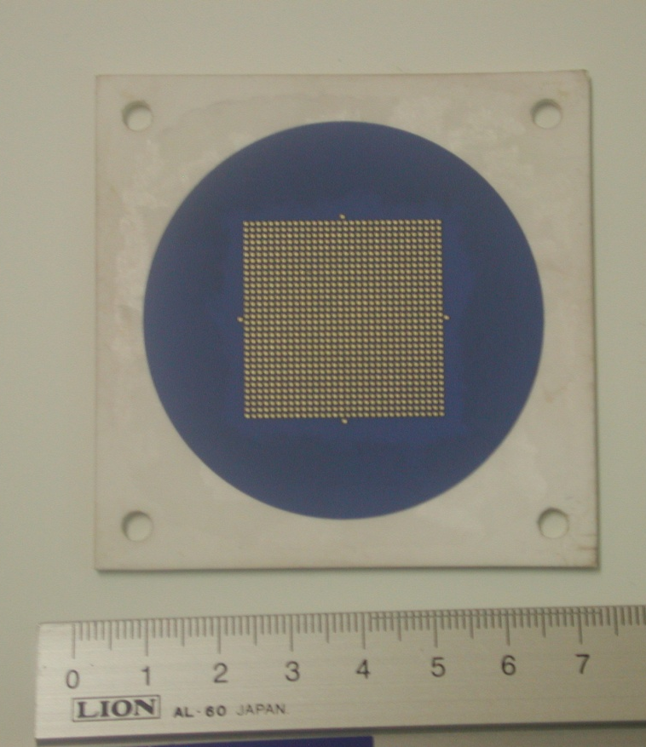
IRPICS Detector
Detector size increased to 40 mm diameter
MCP pore size increased to 5 micron diameter
Multilayer ceramic anode format increased to 32 × 32
Multi-anode readout - 0.88 mm pitch
1024 channel interconnect using anisotropic conductive film with solder bumps – 100% success at 0.2 ohm
The detector is currently in production at Photek
Internal
External
Manufactured by Rui D’Oliveira, CERN
Notes:
15

Slide 16
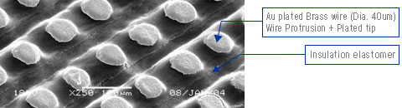
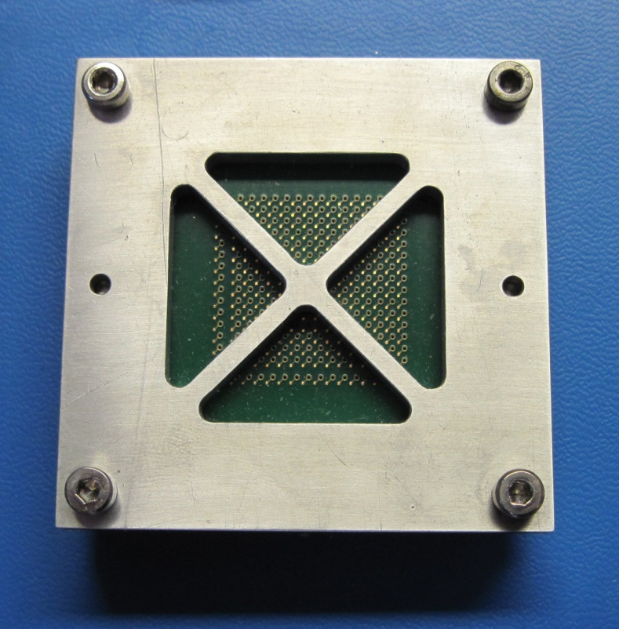
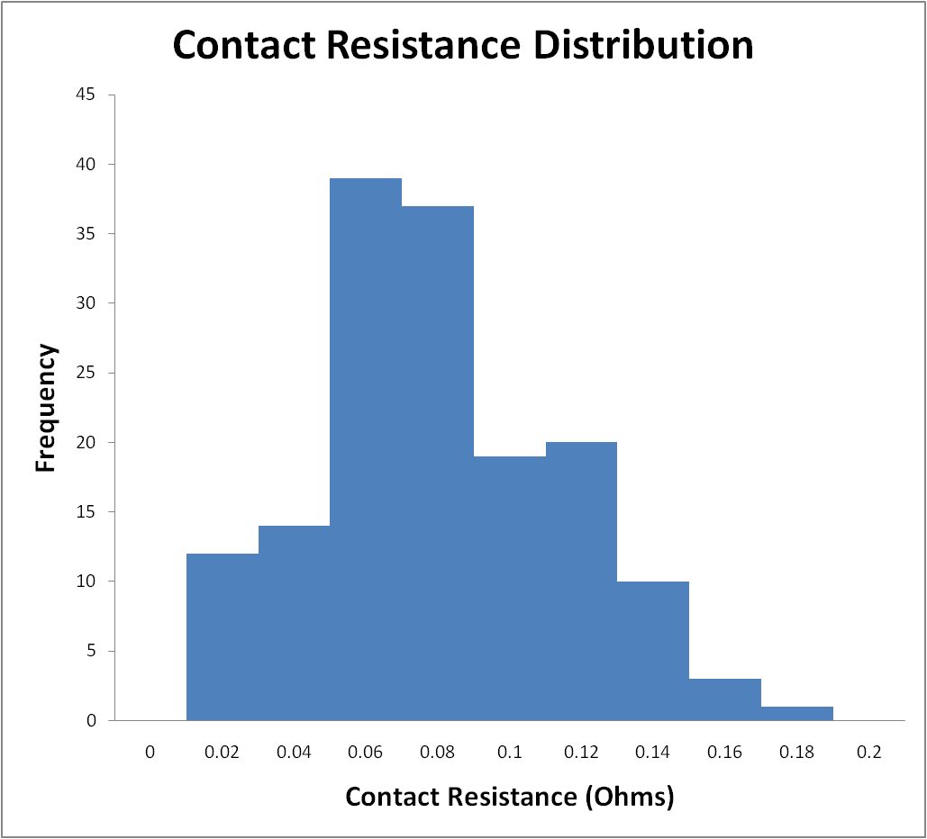
Detector/electronics interconnect
Baseline – originally spring loaded pin array
  LGA socket pressure problematic
  25g /pin = 25kg
Shin-Etsu anisotropic conductive film alternative investigated
  Type MT-P
  Regular array of conductive wires
  0.1 mm pitch
  Embedded in silicone matrix
  Wires protrude at surface
Test fixture to measure the contact resistance
  representatively sized 0.4 mm pads
  two PCBs clamped together
  distribution of resistances for 155 contacts
  100% < 0.2 ohms
  demountable

Slide 17
NINO32 ASIC specification
Custom 32 channel device designed for IRPICS
Based on 8-channel NINO originally designed for ALICE-TOF
Lower power consumption - 10 mW/ch
2 designs – one with inbuilt LVDS biasing, one without
Optimised design for easy lay-out
IRPICS 250 nm CMOS technology
Number of Channels | 32 – chip pin out allowing for 64 channels configuration
Power consumption | 10 mW / channel
Peaking time | 700 ps
Discriminator threshold | 20 to 100 fC
Input resistance | 30 to 100 Ω
Front edge time jitter | 4 to 25 ps rms
Additional features | Calibration circuitry + OR circuits

Slide 18
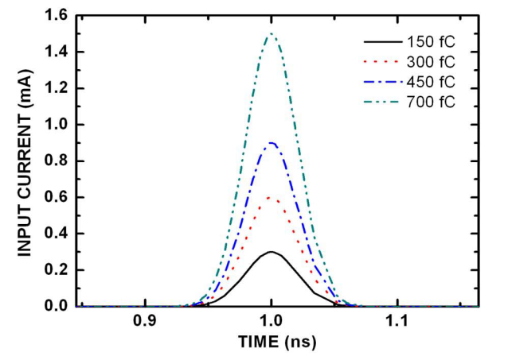
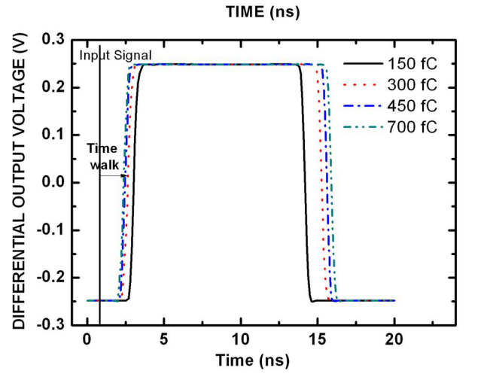
Time-over-threshold amplitude-walk correction
Simulation showing output for varying input signal charges
Time-walk decreases as input charge increases
HPTDC
NINO has pulse stretcher function to match HPTDC
Input
Output

Slide 19
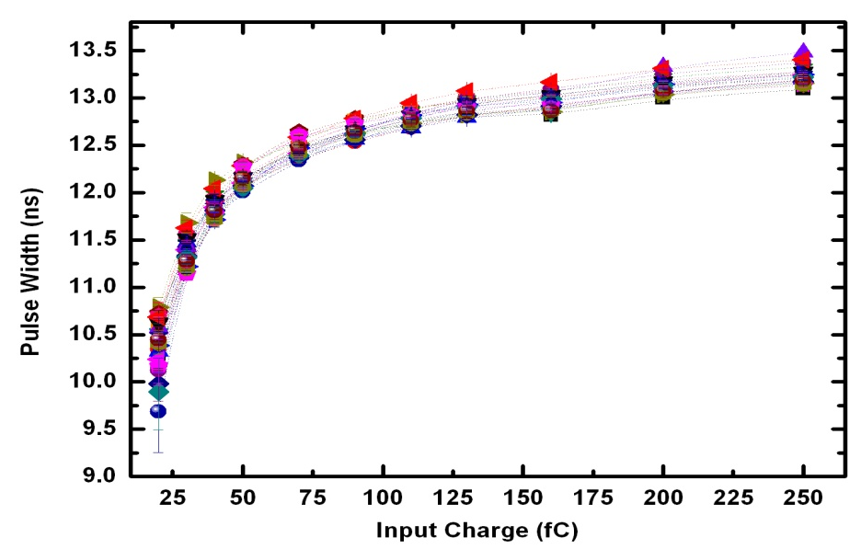
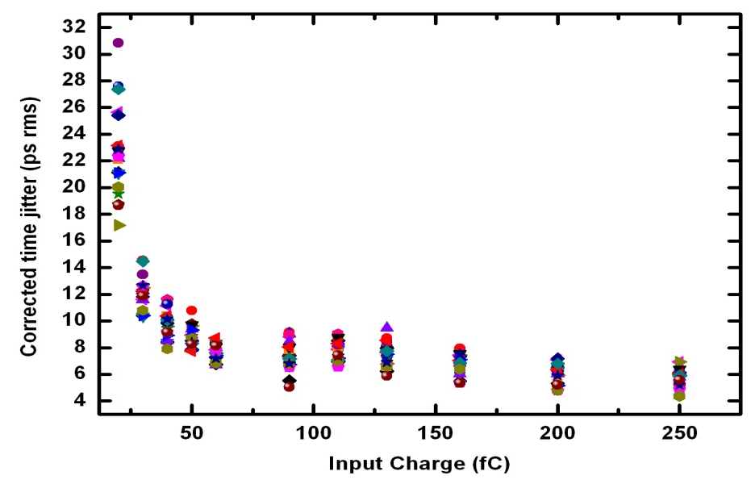
NINO32 electronic characterization
Pulse width versus input charge
All 32 channels shown
Corrected Time jitter on the output pulse – all channels
1000 pulse measurements at each input charge
Amplitude walk correction applied

Slide 20
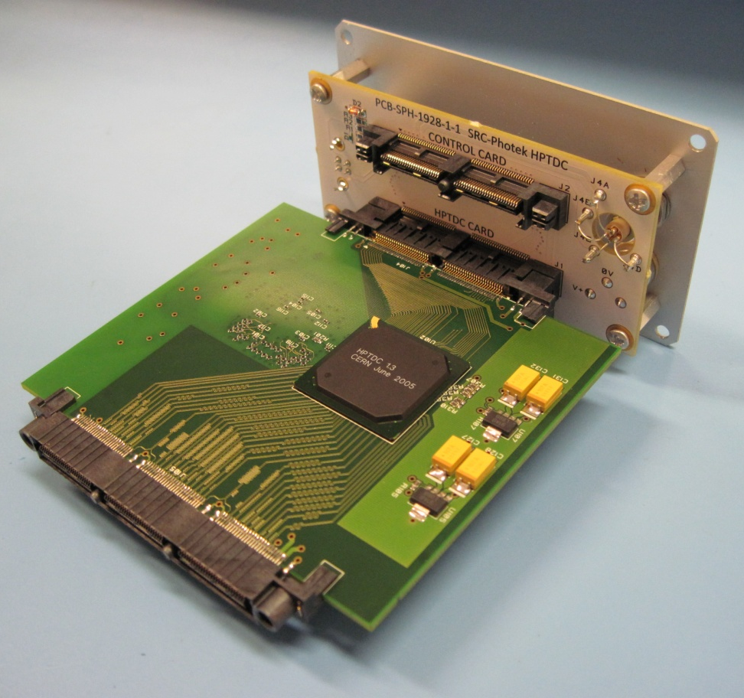
HPTDC Module
64 channel HPTDC module manufactured
Modular architecture
  Backplane supports multiple HPTDC cards
FPGA-based digital processing card
  provides control and data processing
USB 2.0 PC interface
  control and data acquisition
Available as stand-alone module (Photek Ltd.)

Slide 21
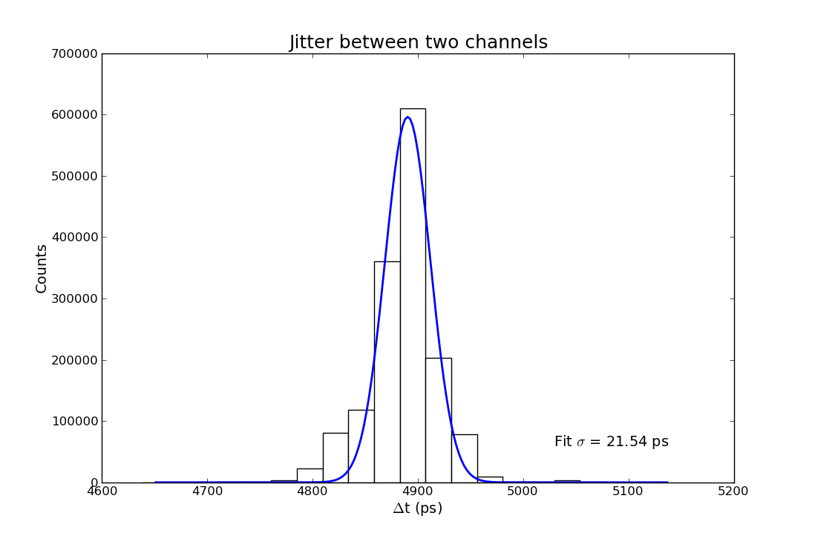
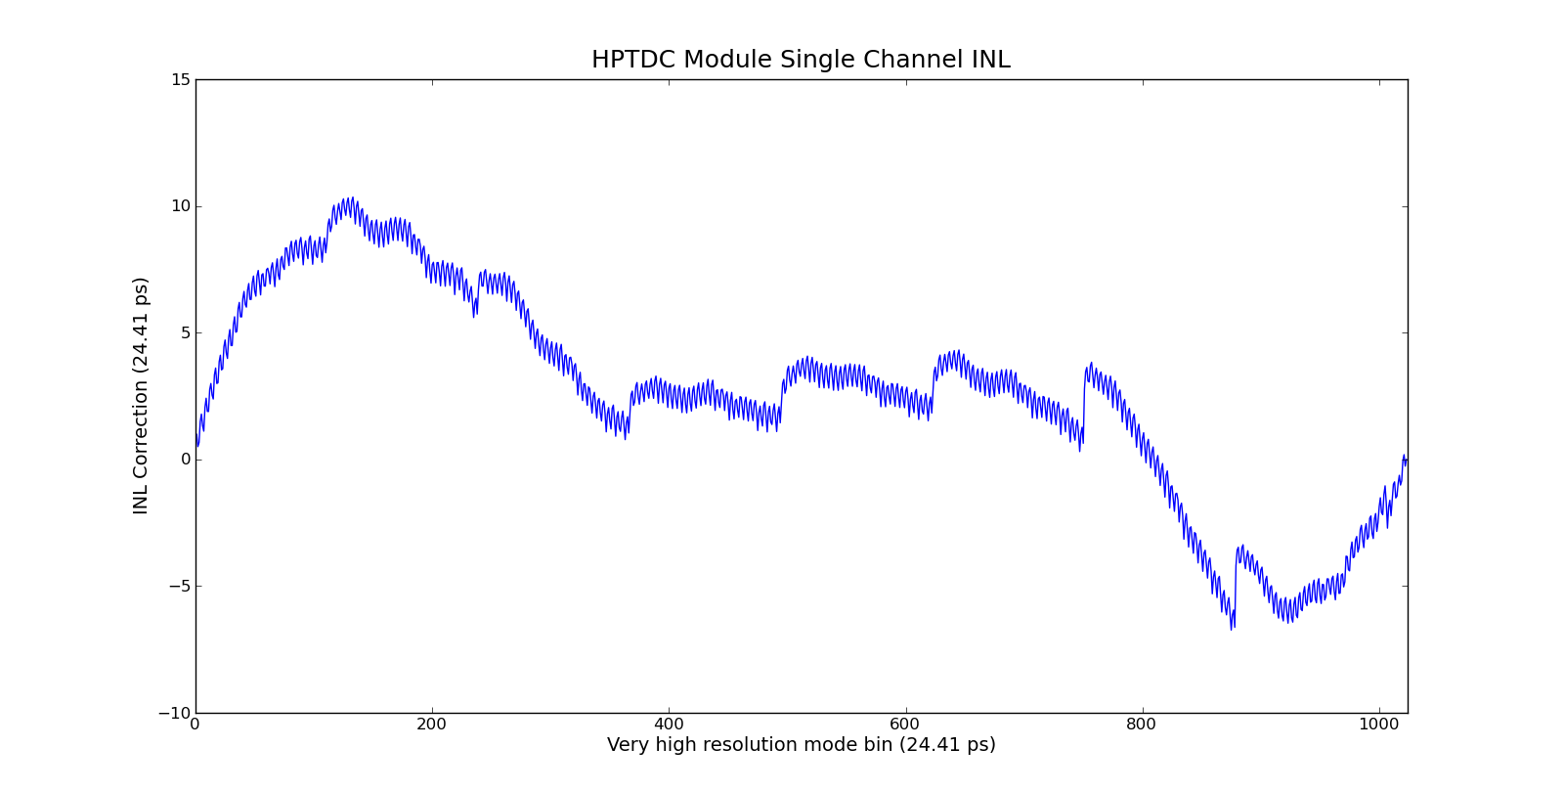
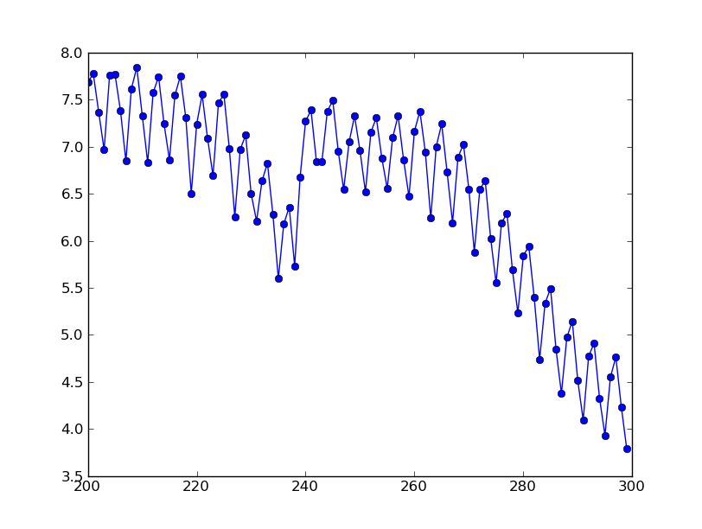
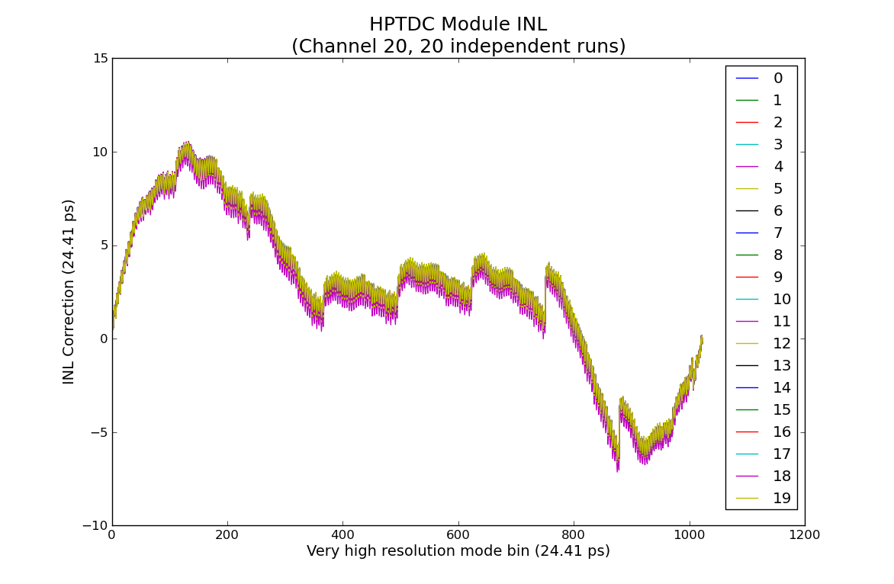
HPTDC module performance
time jitter between 2 channels
electronically generated pulse
  Fed to two channels simultaneously.
  measured time jitter of 21.54 ps rms
INL characterized
  Features at 4 and 128 bins
  12 hour stability
  Correction using FPGA LUT

Slide 22
Current status
40 mm detector designed, being assembled
32 x 32 multilayer readout manufactured
  Currently being brazed to detector flange
Modular electronics
  64 channel NINO32 front-end card – boards manufactured, being assembled
  64 HPTDC manufactured and under test
  Digital processing card manufactured and tested
System testing – 1st quarter 2012

Slide 23
Conclusions
8 x 8 Multi-anode MCP detector
  Manufactured and lab tested
  Demonstrated <50 ps timing resolution
  2 unrelated detector failures have limited progress
  field trials being planned soon
32 x 32 IRPICS detector being manufactured
  Multilayer ceramic manufacture complete
  Detector currently in assembly
  ACF demountable detector interconnect proven
  32 channel low power NINO ASIC proven
  All IRPICS electronic boards designed
  TDC board and FPGA board manufactured and in test
  System testing expected first quarter 2012
Initial applications:
  High throughput FLIM, Wide-field FLIM, FCS, confocal microscopy using TI DMD

Slide 24

Acknowledgements
George Fraser – Space Research Centre, Leicester
Pierre Jarron & colleagues – Microelectronics Group, CERN
Rui de Oliveira, CERN for manufacture of the multilayer ceramic readout
Funding from STFC and BBSRC
The HiContent and IRPICS collaboration
Space Research Centre

Slide 25
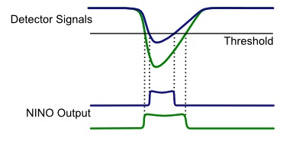
NINO – Time over threshold discriminators

Slide 26
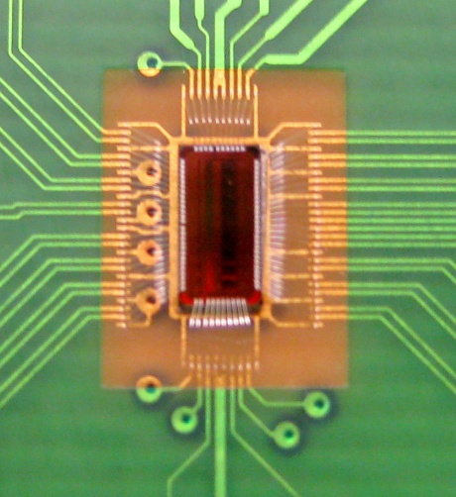
Electronics – NINO Amplifier/Discriminator
Originally an 8 channel differential amplifier/discriminator, using a Time-over-Threshold technique
32 channel version developed for IRPICS detector
Excellent time resolution <10 ps RMS jitter on the leading edge
Differential LVDS outputs for common-mode noise rejection
High Dynamic Range, 30 fC to 2 pC

Slide 27
NINO – Charge measurement

Slide 28
NINO – Amplitude walk

Slide 29
HiContent Project
“A Scaled-up High Content Photon-Counting Detector for Life Science Applications”
Three year “Technology Transfer” project fund by UK Science and Technology Funding Council
Collaborators: Leicester, CERN, Manchester, GCI, Photek
Migrate detector and electronics technologies from Space and Particle Physics to new fields
Technologies: MCP detector design, image readouts, multi-channel ASIC electronics, high throughput data processing
Life sciences applications requiring high sensitivity, precision event timing, and throughput enhancement

Slide 30
And the next phase - IRPICS Project
“Information Rich Photon Imaging of Cells”
Follow-on development of HiContent project
3 year timescale – BBSRC funded
Collaborators: Manchester, Leicester, CERN
Specification and performance
  32 × 32 pixel² readout
  1024 readout channels
  20 ps event timing
  Max event rate/channel - 10 Mcounts/sec
  ~100 Mcount/s total (limited by current MCP technology)
Develop application specific FPGA-based backend intelligent digital processing

Slide 31
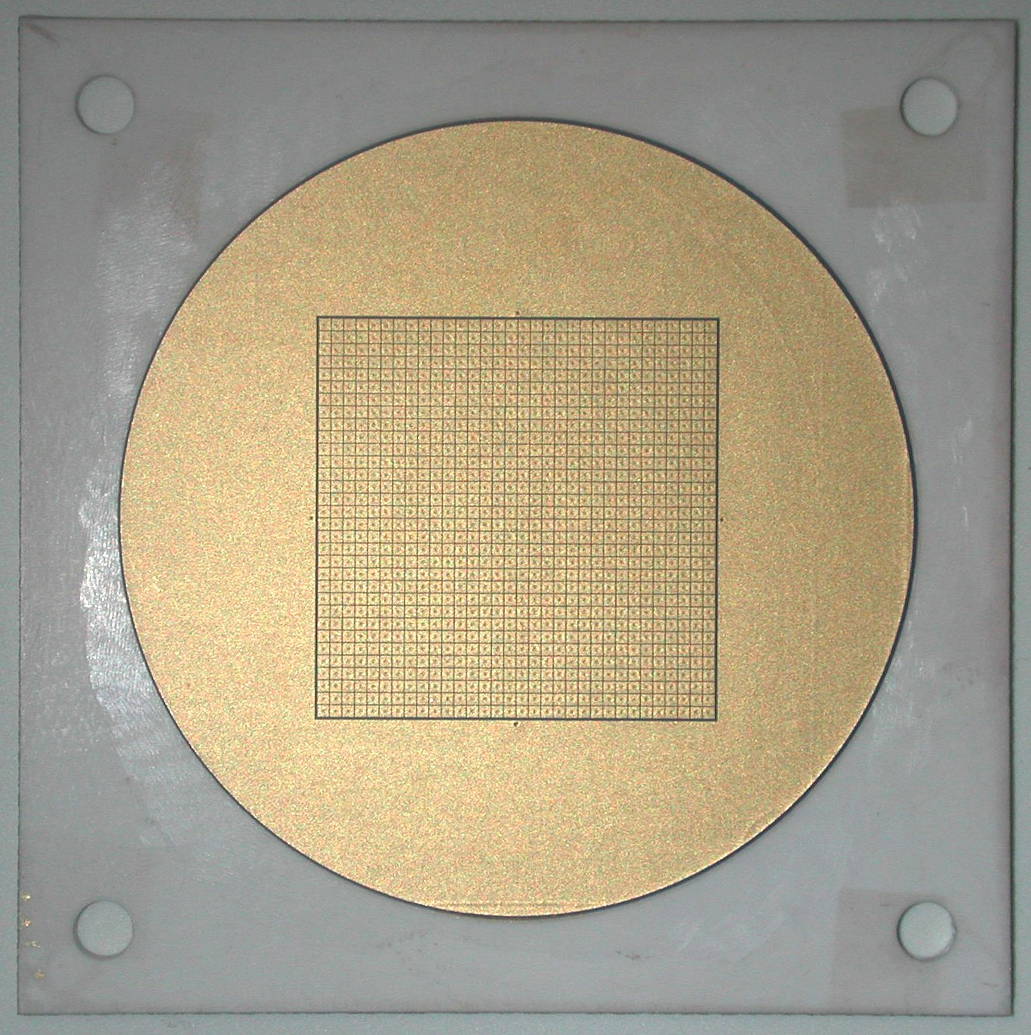
Figure 1. A photograph of the inside face of the IRPICS MLC readout. The 32 x 32 pixel² array is surrounded by a guard anode. The detector flange is brazed on to the unmetallized surface outside the guard anode diameter (photo courtesy of Antonio Teixeira, CERN).

Slide 32
