Slide 1
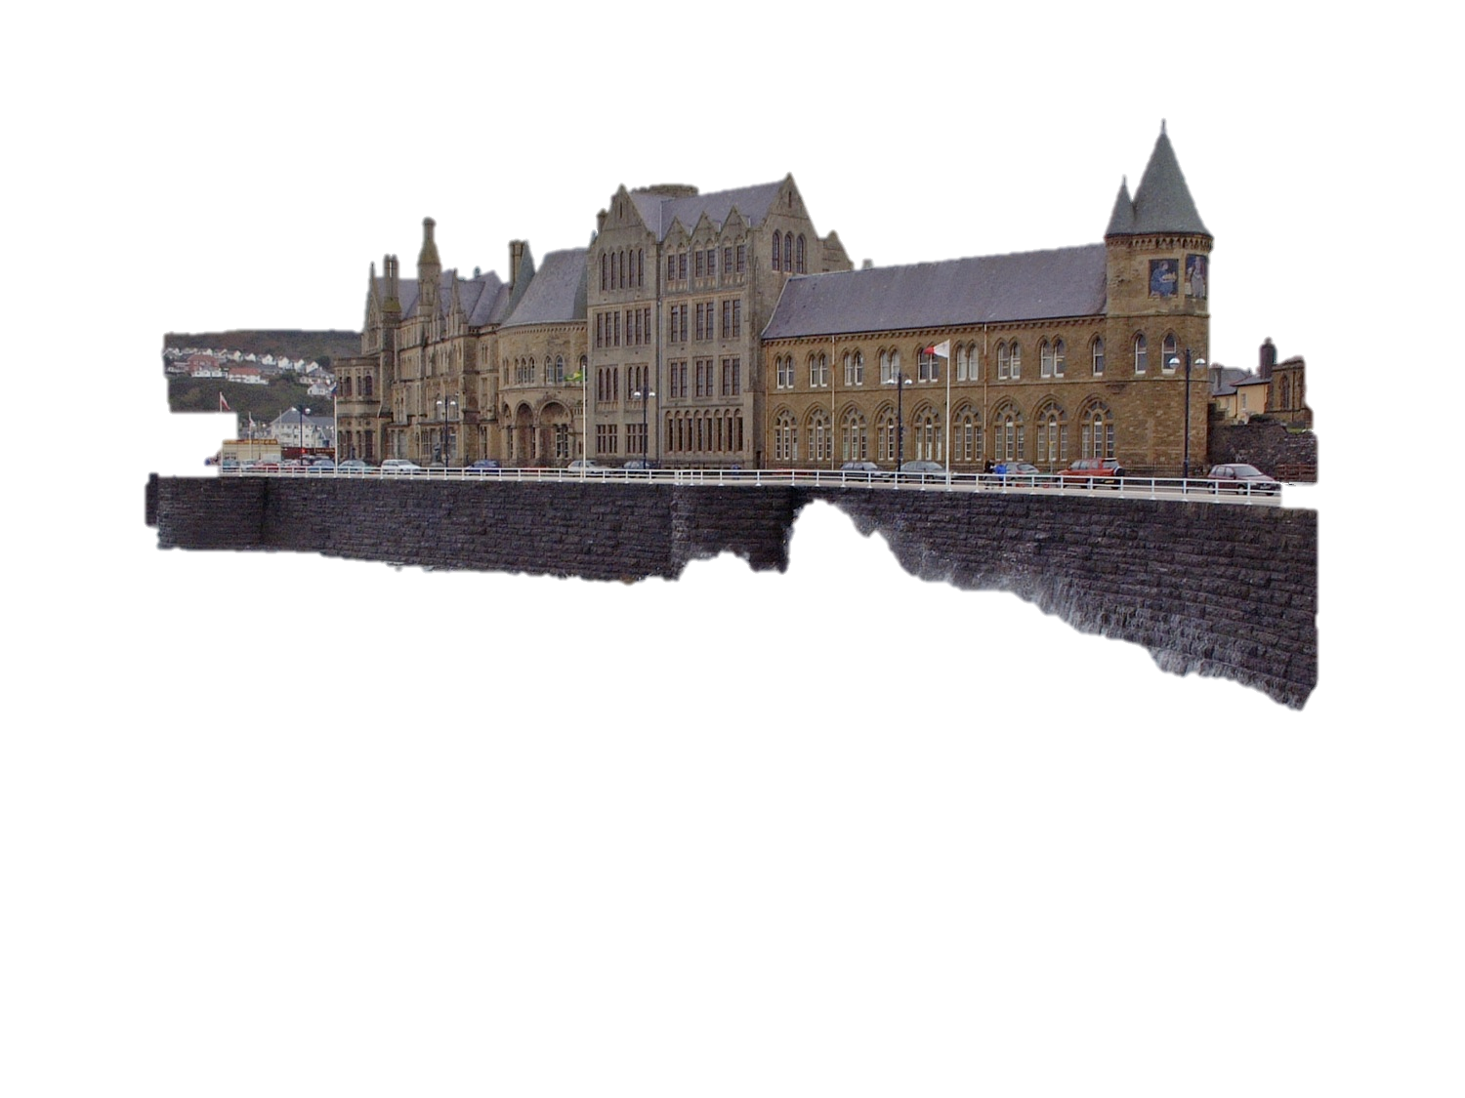



LHC Detectors overview
Emphasis on ATLAS
Beniamino Di Girolamo
CERN

Slide 2
Outline
The LHC experiments and their sub-detectors
The details: I had to make a choice
  Emphasis on vertex detectors and intermediate trackers
  Little on data acquisition and trigger, computing
    Extensive bonus material to cover some of these extremely important aspects
  Trying to show intriguing aspects. More classical performance in many talks in this conference
Chose to show a few physics results to illustrate how well the detectors are functioning
Few words on future upgrades
Conclusions
What did not fit here you can be found in the Bonus Material

Slide 3
A variety of technologies
The aim of this talk is to give a feeling of the LHC detector performance, but…
…also show you how many different solutions have been found using a variety of technologies for Position Sensitive Detectors and more
LHC instruments could easily fit all detectors described in instrumentation books
At the end we will also see what is foreseen in future and no surprise: exploiting even more techniques
  And even more acronyms

Slide 4
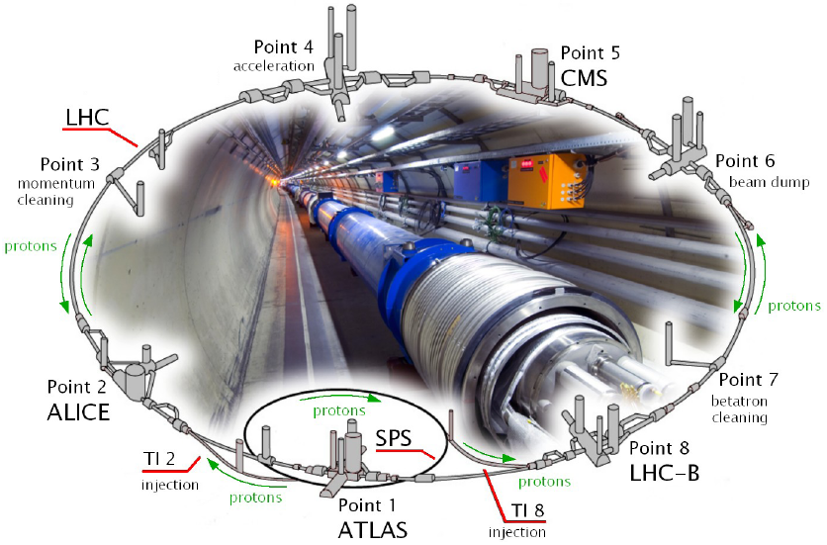
The LHC experiments
TOTEM
LHCf

Slide 5
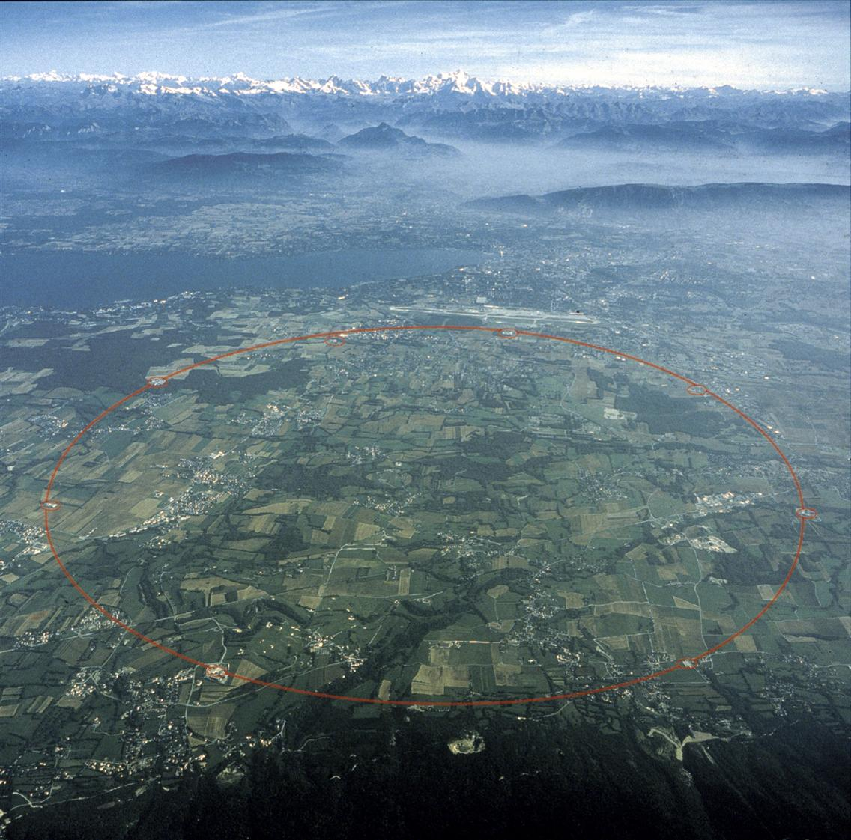
ATLAS

Slide 6
Requirements
ATLAS and CMS to be as “general purpose” as possible and as hermetic as possible
  All possible physics channels from known to unknown
  The dream of measuring everything with a surrounding sphere
ALICE measuring on a MeV to GeV dynamic range
  Heavy ions focus
  Paying attention to material budget
LHCb dedicated to b physics
  A forward detector
TOTEM and the ATLAS forward detectors
  Looking at luminosity, diffractive physics
LHCf looking at π⁰ to calibrate high energy cosmic rays experiments
  A nice example of variety of technology: two almost identical detectors

Slide 7

General purpose detectors
A closer look

Slide 8
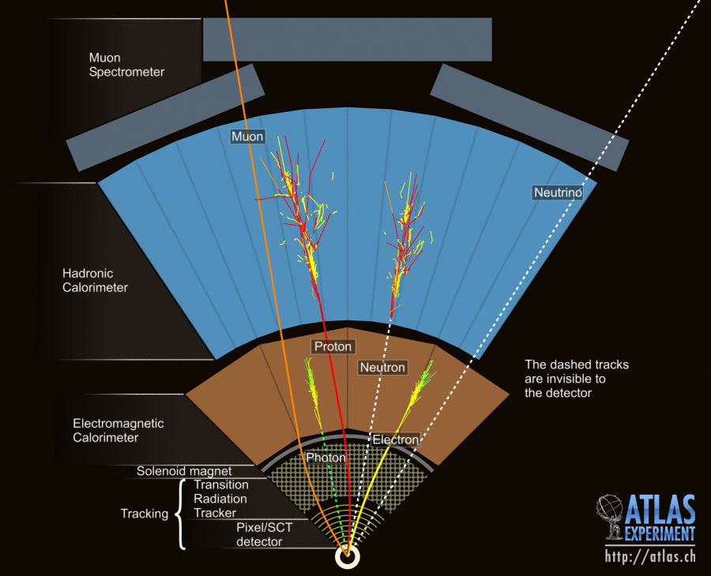
The dream of full coverage

Slide 9

ATLAS
44 m
25 m
7000 tons

Slide 10


Slide 11
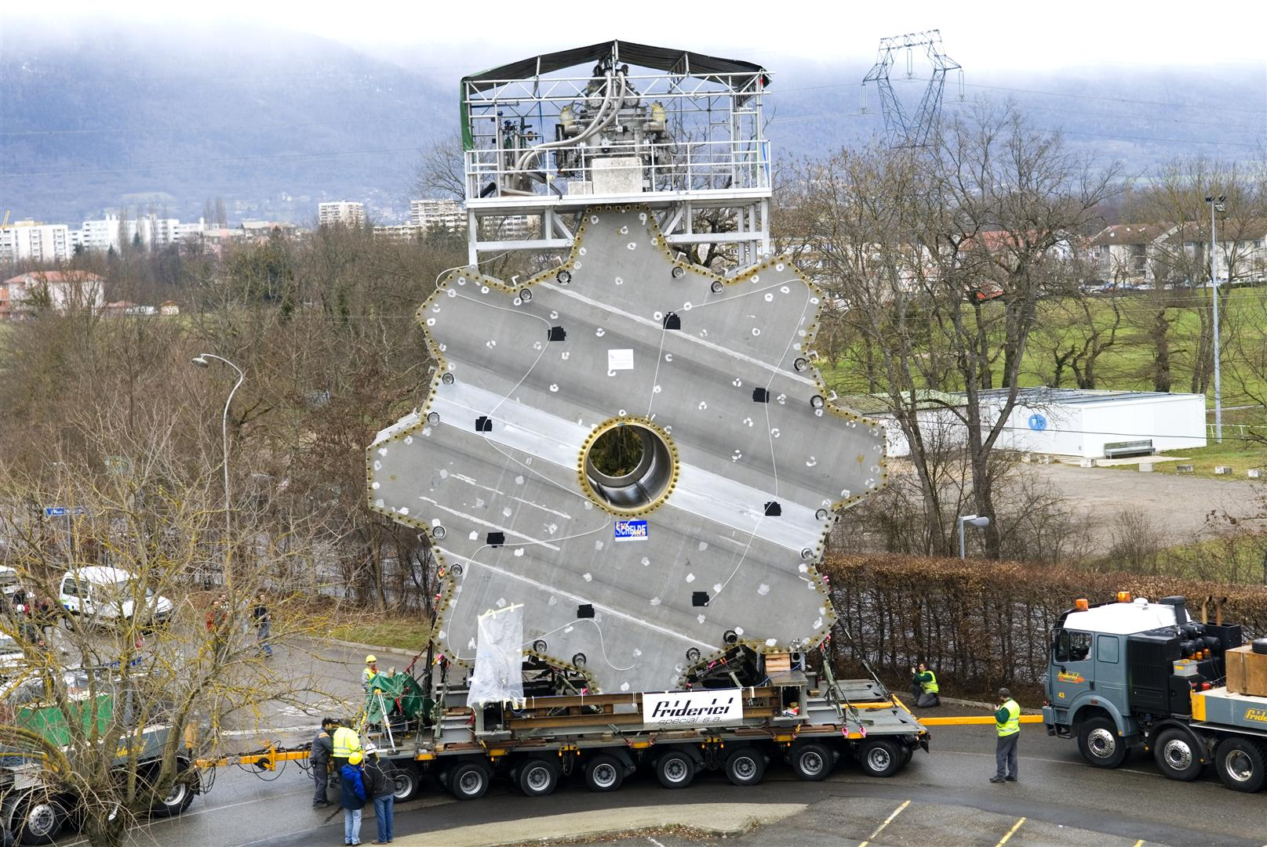

Slide 12
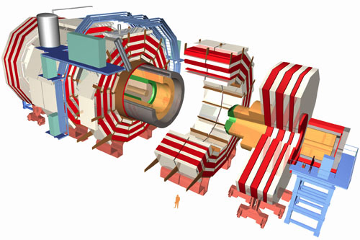
CMS
3.8T Solenoid
ECAL
HCAL
IRON YOKE
15 m
Muon System Endcap
(CSC+RPC)
TRACKER
21.6 m
12500 tons

Slide 13
Specialized detectors
A closer look

Slide 14
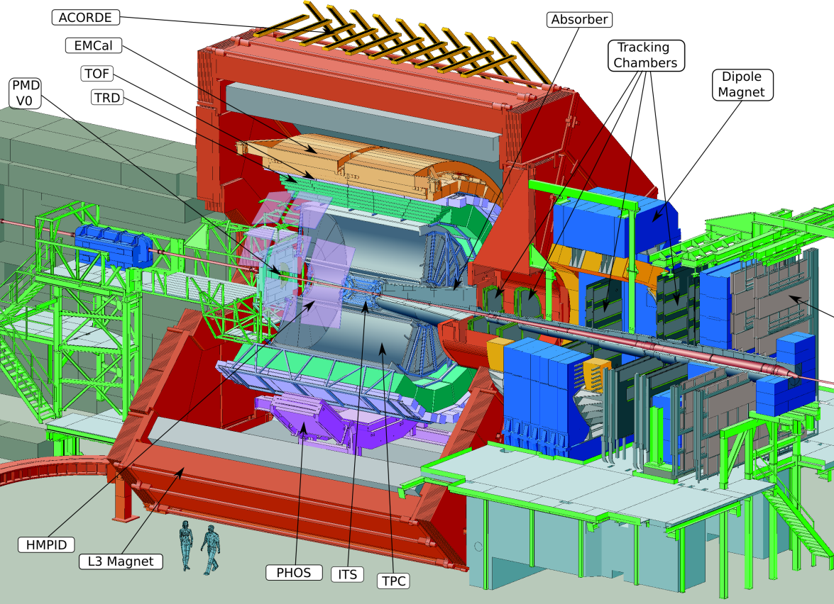
ALICE
16 m wide
26 m long
10000 t

Slide 15
Main facts about ALICE
Many sub-detectors!
Design evolved with time and knowledge from running HI physics detectors
Measurements from MeV to GeV
  Low material budget!
Need of particle identification
Need of muon tracking with a fancy absorber
Extremely light supporting structure for the detectors inside the 0.5 T magnet

Slide 16
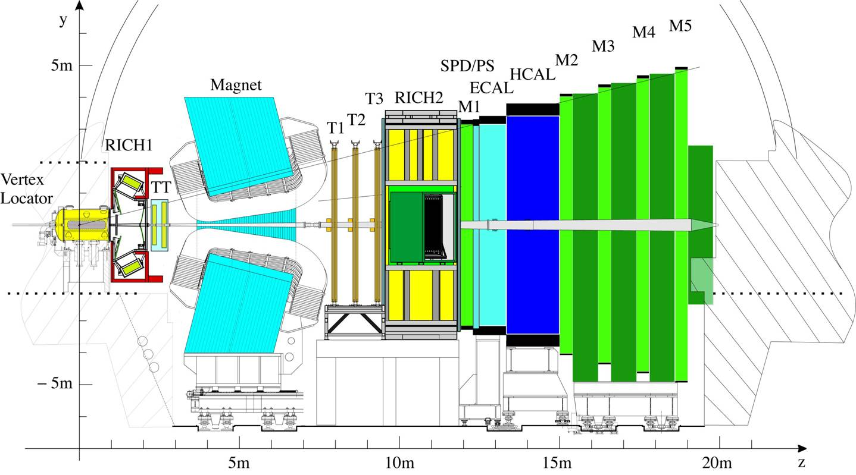
LHCb

Slide 17
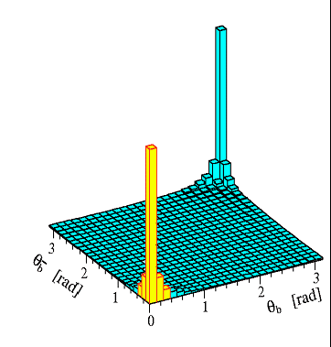
Main facts about LHCb
B and D physics at the LHC are forward/backward
  The interacting partons have different x
  The produced pair are boosted forward or backward, together
    The detector can look only at one side, and get both b, very useful as we have both the signal b and the tagging b in the acceptance
Single arm spectrometer
  Very good vertex detector
  Dipole magnet for accurate
  momentum measurement
  Good particle ID over a large
  momentum range
  Should fit in an existing LEP cavern...

Slide 18
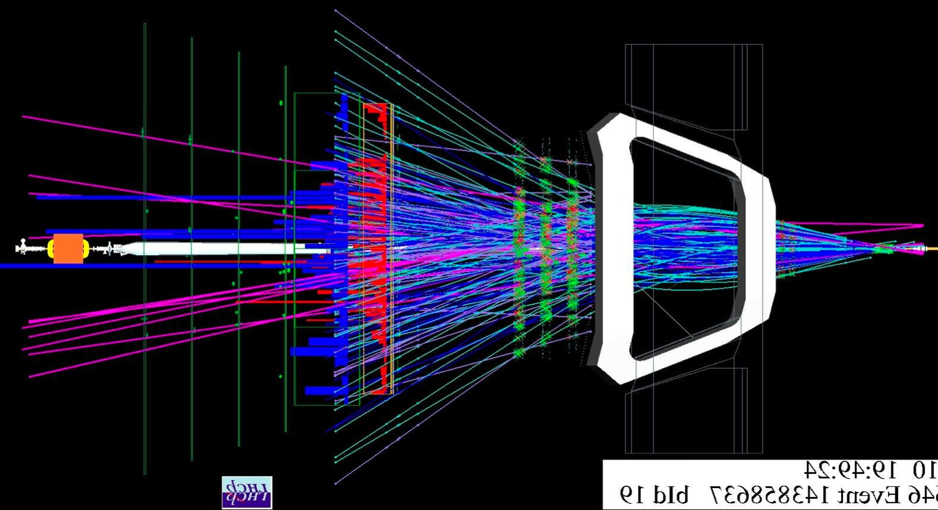
A typical LHCb event
The concept works!

Slide 19
Forward detectors
A closer look

Slide 20
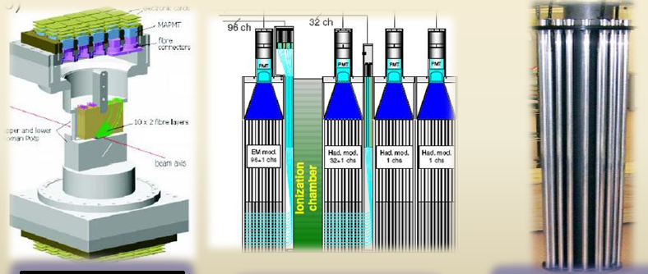
ATLAS Forward
10.6 < | η | < 13.5
| η | > 8.3
5.6 < | η | < 5.9
2.1 < | η | < 3.8
SciFi tracker
W+quartz rods calorimetry
Cherenkov rad.
Scintillators

Slide 21
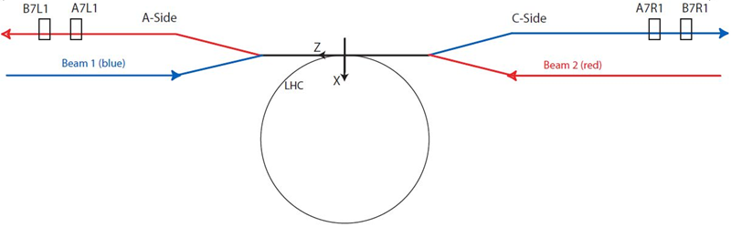
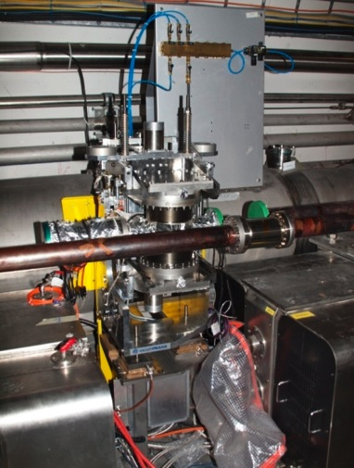
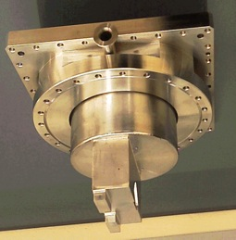
ATLAS: ALFA detector
system – 4 stations, 2 (A-side) + 2 (C-side)
each station – 2 Roman Pots approaching the beam vertically – from below and above
1 main detector and 2 overlap detectors in each Roman Pot; tracker-type detectors
4m
~ 237m
station
left & right
overlap detectors
main detector
Roman Pot

Slide 22
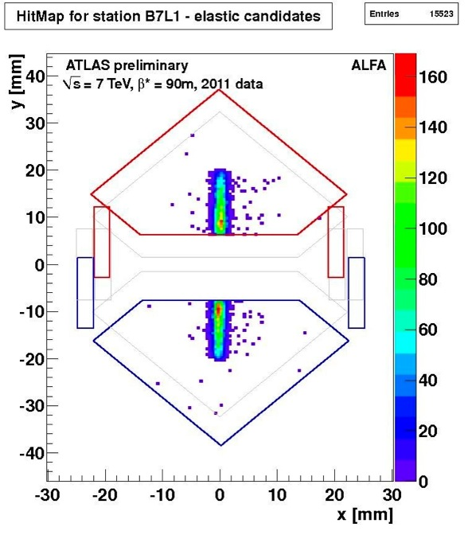
ATLAS: ALFA results
Results from data taking at β* = 90 m optics, detectors at 10 σ from the beam (~ 7 mm)

Slide 23
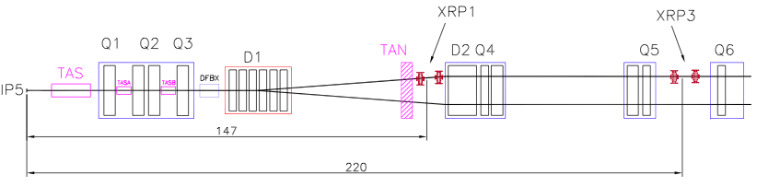
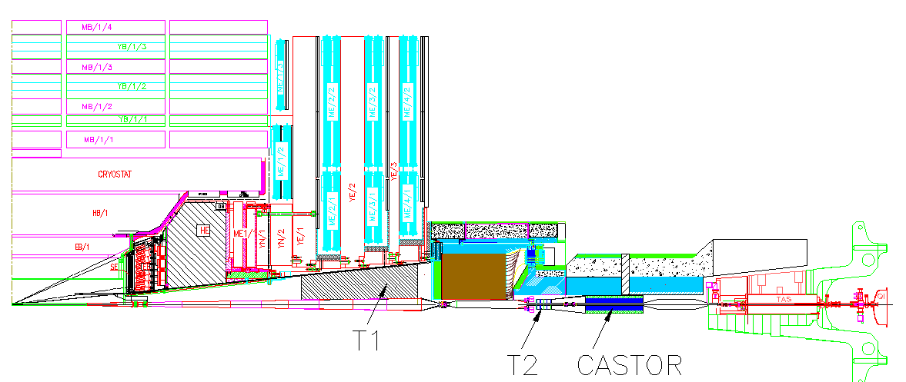
TOTEM
Inelastic Telescopes:
T1: 3.1 < |η| < 4.7
T2: 5.3 < |η| < 6.5
T1: CSCs
T2: GEMs
CMS
HF
10.5 m
T1
T2
~14 m
Roman Pots:
RPs147
RPs220
Si strips
Same scheme on both sides of IP5

Slide 24
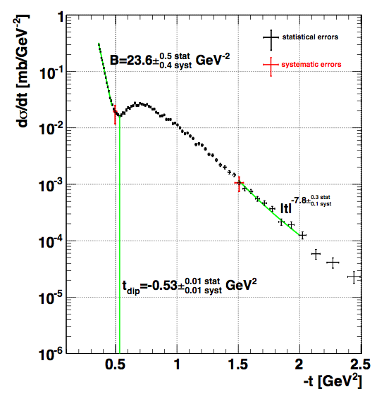
TOTEM: Elastic pp scattering
Differential cross section for pp scattering
Confirmed the move of the diffractive dip at increasing √s
  First look at pp since ISR time
  B increases in exp(-B|t|)
  Power law confirmed for higher t
Higher the t: deeper the look inside the proton
It differs from models
  Getting really interesting
TOTEM Note: CERN-PH-EP-2011-101

Slide 25
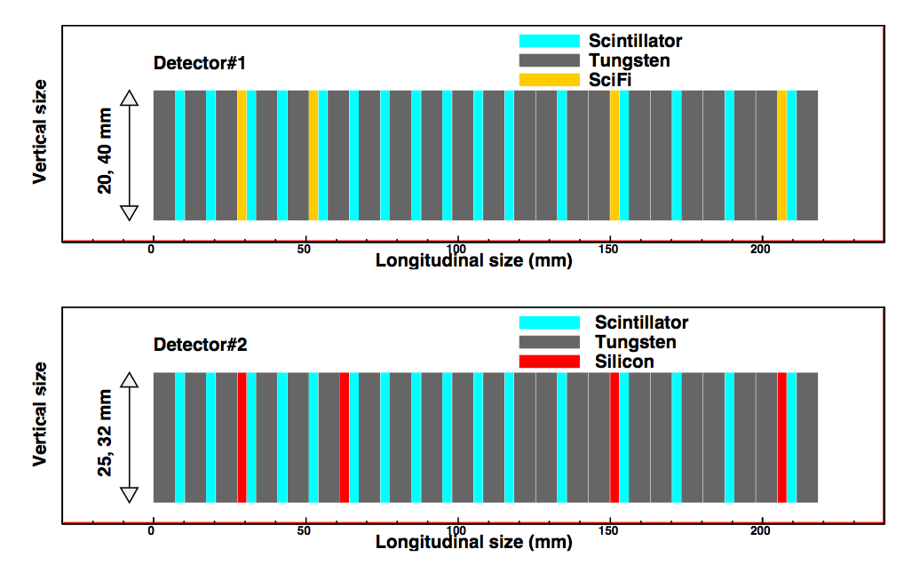
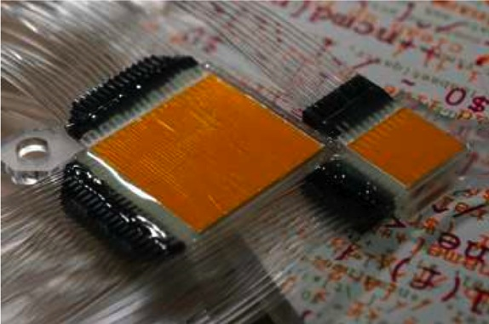
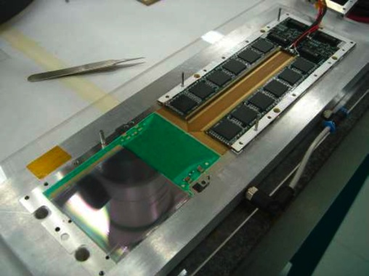
LHCf
W sampling shower calorimeters (44 X₀ and 1.7 λ)
At ± 140 m from IP1 in TAN absorbers, only neutral particles
Tungsten and scintillator layers
Position sensitive layers
  Scintillating fibers with MAPMT readout on one side and Si sensors on the other

Slide 26
Vertex detectors
A lot of Silicon

Slide 27
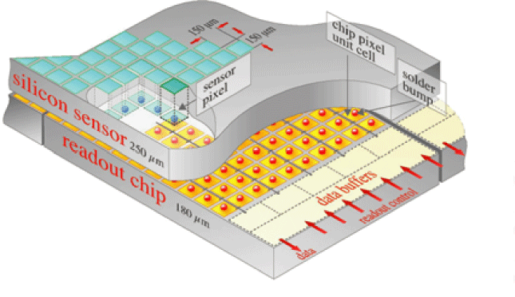
Vertex detectors
Silicon has been the choice of the experiments
Large pixel detectors are used in ALICE, ATLAS, CMS
A strip detector is used by LHCb: the Vertex LOcator
Silicon strip layers are deployed at larger radii
  ATLAS uses a straw-tubes tracker as intermediate tracker before calorimetry
Concentrating on Pixel: hybrid pixels for all
Requirements:
  Radius for the innermost layer and radii of the rest
  Number of layers
  Readout electronics
  Granularity
  Radiation tolerance
  Material budget (for all, but ALICE has special needs)

Slide 28
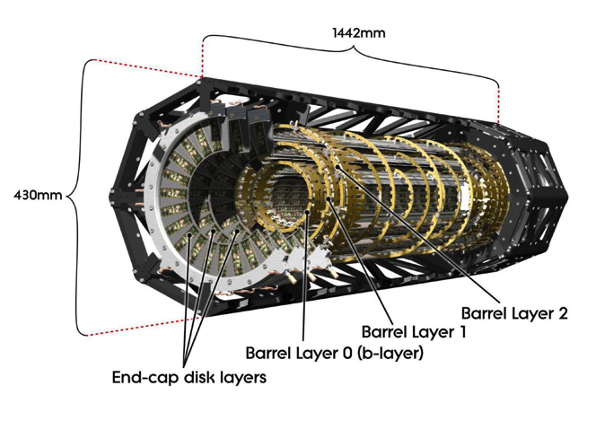
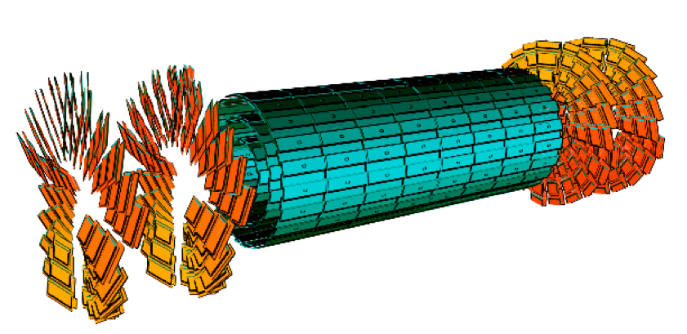
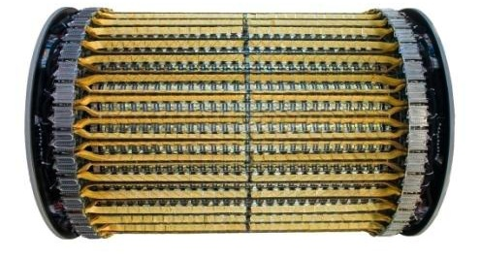
The Pixel + VELO detectors

Slide 29
The Pixel master table
 | Pixel size |  | Sensor Thickness (X₀) | ASIC Thickness (X₀) | Layers |  | beam-pipe inner radius | spatial resolution
 | z [μm] | rφ [μm] | [μm] (%) | [μm] (%) | [#] | radii [mm] | [mm] | [μm]
ALICE | 425 | 50 | 200 (0.21) | 150 (0.16) | 2 | 39-76 | 29 | 100 (z) 12 (rφ)
ATLAS | 400 | 50 | 250 (0.27) | 180 (0.19) | 3 | 50.5-88.5-122.5 | 29 | 115 (z) 10 (rφ)
IBL | 250 | 50 | 200 (0.21)* | 100 (0.11) | 1 | 33.25 | 23.5 | 79 (z) 10 (rφ)
CMS | 150 | 100 | 285 (0.30) | 180 (0.19) | 3 | 44-73-102 | 29 | ~ 15
* IBL: decided to aim at using two technologies: planar sensors (200 μm) and 3D sensors (230 μm)
Even though it seems IBL would have less material than ALICE Pixel, in reality ALICE has done an enormous effort to reduce material on services. ALICE has 13 X₀ up to the end of the TPC!
The type of sensors differ, p-in-n for ALICE, n-in-n for ATLAS and CMS and LHCb VELO (with one n-in-p module installed)
All using 250 nm CMOS ASICs
The operating temperatures (⁰C) are +25 (ALICE), -20 (ATLAS), +18 (CMS), -5 (VELO)

Slide 30
The outer layers
CMS has a full silicon inner detector: 2 tons!
ATLAS decided to invest in particle identification with straw tubes and radiators for transition radiation measurement
  Advantage of inclusive isolated electron measurement, powerful tool for electron and photon studies in conjunction with e.m. calorimetry
ALICE added silicon drift detectors between pixel and strips: need of extend 2-dim measure in radius
Overall the biggest Inner Detectors ever built

Slide 31
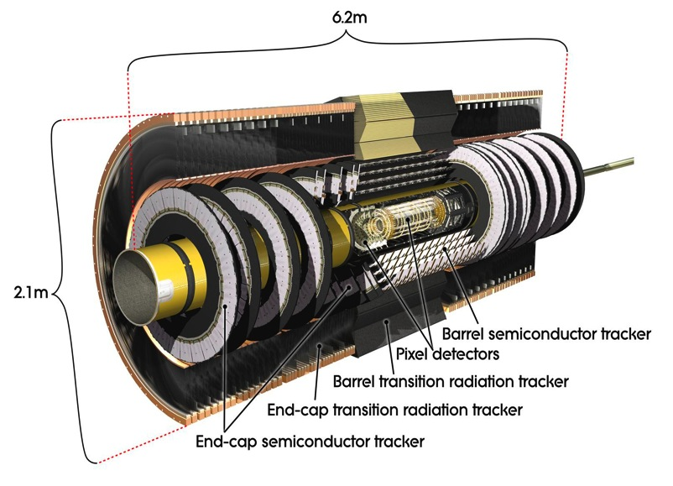
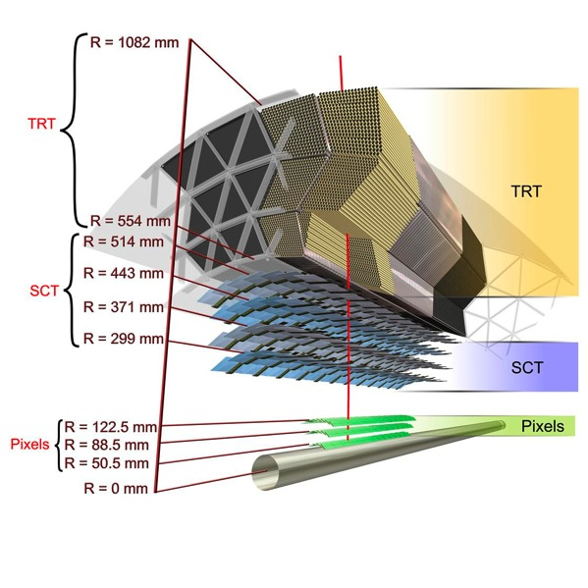
ATLAS Inner Detector
2 T solenoidal magnetic field
Acceptance |η|<2.5
(transition radiation tracker |η|<2)
Momentum resolution
σ(p_{T})/p_{T} = 0.05% p_{T} [GeV/c] ⊕ 1%
Impact parameter resolution (0.25<|η|<0.5)
σ(d₀) = 10 μm ⊕140 μm / p_{T} [GeV/c]

Slide 32
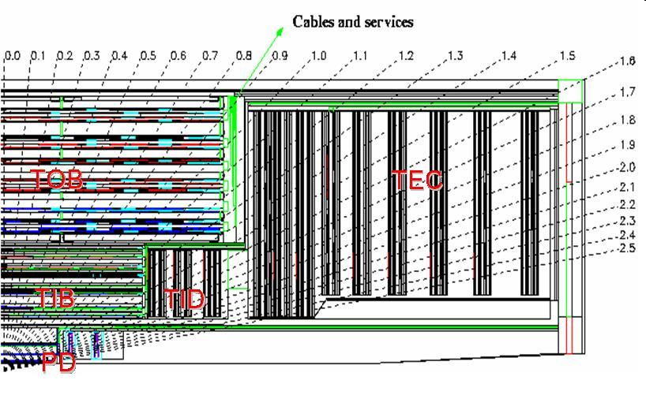
CMS Strip tracker
Modules:
  3112 + 3024 Thin modules (ss +ds)
  5496 + 3600 Thick modules (ss +ds)
Silicon:
  6,136 Thin sensors = 48m²
  18,192 Thick sensors = 162m²
210 m² of silicon microstrip sensors
FE Electronics:
75,376 APV chips
9,648,128 strips ≡ electr. Channels
Tracker Inner Barrel (TIB ): 4 layers: 2 Rφ (2D), 2 Rφ-Stereo (3D)
Tracker Outer Barrel (TOB): 6 layers, : 4 Rφ (2D), 2 Rφ-Stereo (3D)
Tracker Inner Disks (TID ): 3*2 disks, : 1 Rz (2D), 2 Rz-Stereo(3D)
Tracker EndCap (TEC): 9*2 disks, : 4 Rz (2D), 3 Rz-Stereo(3D)
Each Track has at least
10 high precision measurements for Pt and 4 in Θ
Coverage: | η | < 2.5

Slide 33
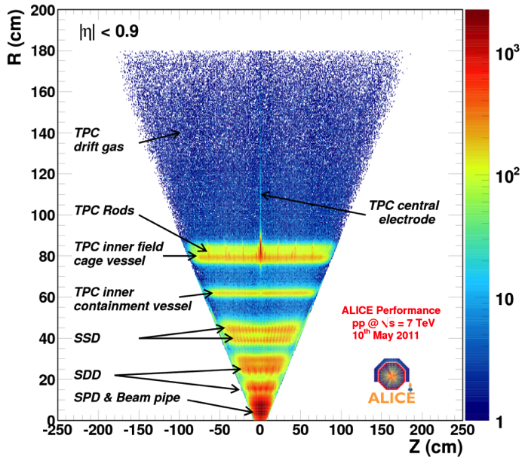
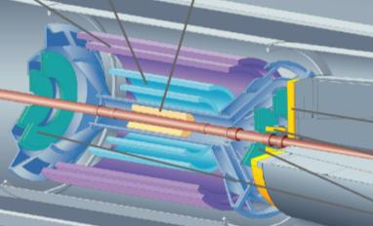
ALICE ITS
ITS: 3 different silicon detector technologies
Material budget measured with γ conversions
Strip Drift Pixel

Slide 34
The silicon detectors master tables
 | Strips | Layers |  | spatial resolution
 | pitch [μm] | [#] | radii [mm] | [μm]
ALICE | 95 | 2 | 380-430 | 830 (z) 20 (rφ)
ATLAS | 80 | 4 | 299 to 514 | 580 (z) 17 (rφ)
CMS | 80-183 | 3 | 255 to 1080 | 23-52 (rφ)
 | Pixel | Drift | Strips |  | Pixel | Drift | Strips
 | Area [m²] |  |  |  | # channels [x 10⁶]
ALICE | 0.2 | 1.3 | 5 |  | 9.8 | 0.13 | 2.6
ATLAS | 1.8 |  | 61 |  | 80.4 |  | 6.3
CMS | 1 |  | 198 |  | 66 |  | 9.3
VELO |  |  | 0.2 |  |  |  | 0.17

Slide 35
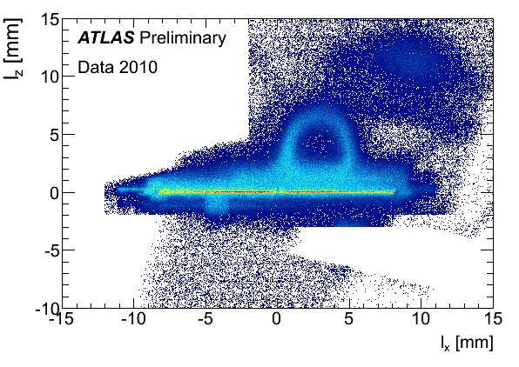
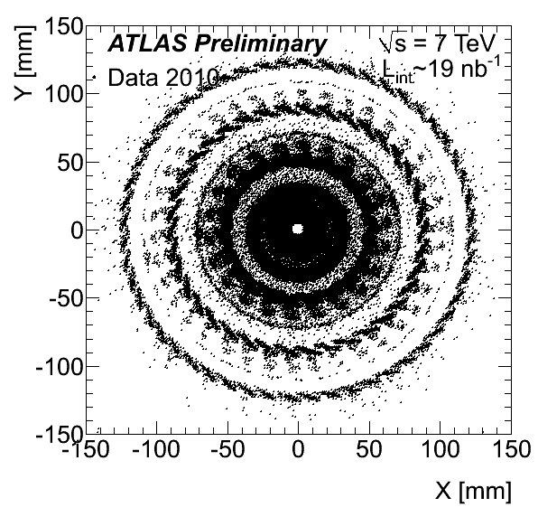
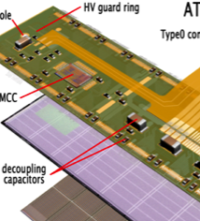
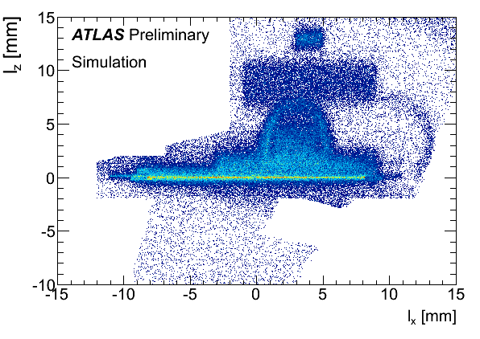
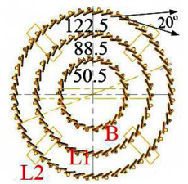
ATLAS Pixel having fun with tracks
Secondary vertices map for hadronic interactions
  Imaging of the detector
How data describes the reality!
Detector drawing

Slide 36
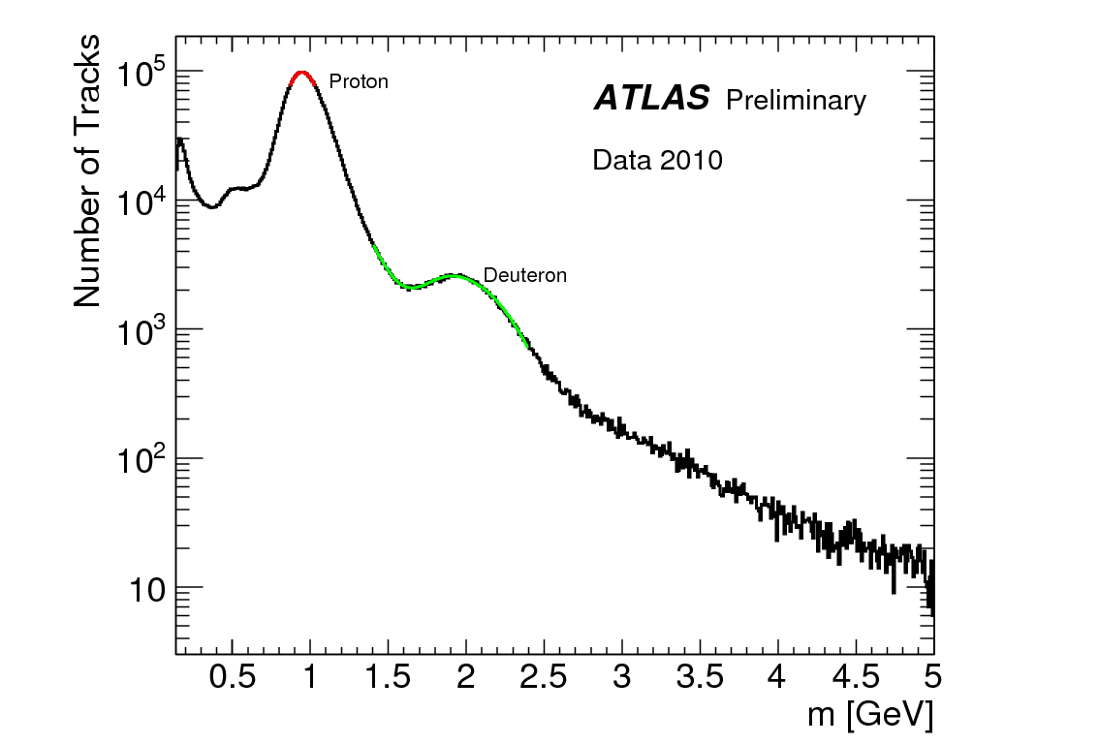
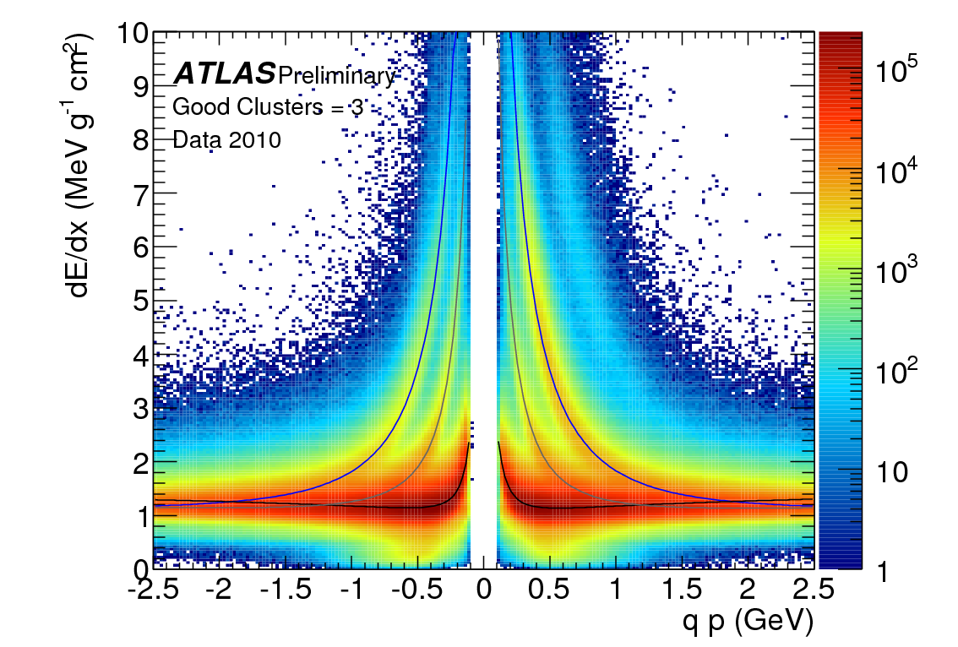
dE/dx in Silicon: ATLAS Pixels
p
K
d
φ→K⁺K⁻
π
σ ~ 12%
Mass determination inverting
Bethe-Bloch energy loss relation

Slide 37
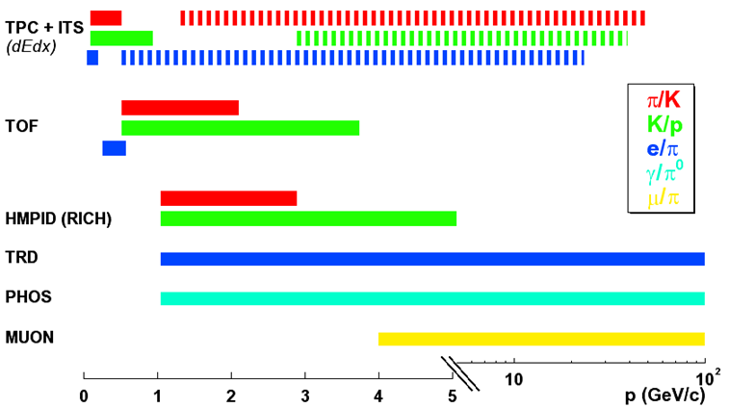
PID in ALICE
PHOS, EMCAL
‘stable’ hadrons (π, K, p): 100 MeV < p < 5 GeV (several 10 GeV)
  dE/dx in silicon (ITS) and gas (TPC) + time-of-flight (TOF) + Cherenkov (HMPID)
decay topologies (K, Λ, φ, Ω, D)
  K and Λ decays beyond 10 GeV
leptons (e, μ), photons η,π⁰
  electrons TRD: p > 1 GeV, muons: p > 5 GeV, π⁰ in PHOS, EMCAL: 1 < p < 80 GeV

Slide 38
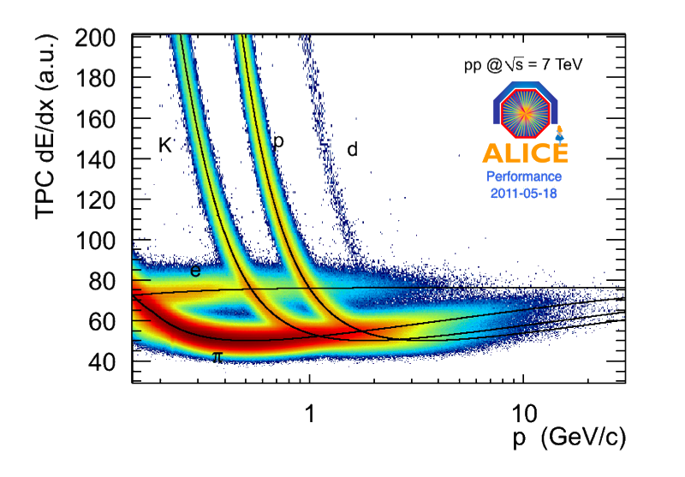
ALICE TPC: dE/dx
10 bit ADC: Dynamic range up to 26×MIP. σ ~ 5%

Slide 39
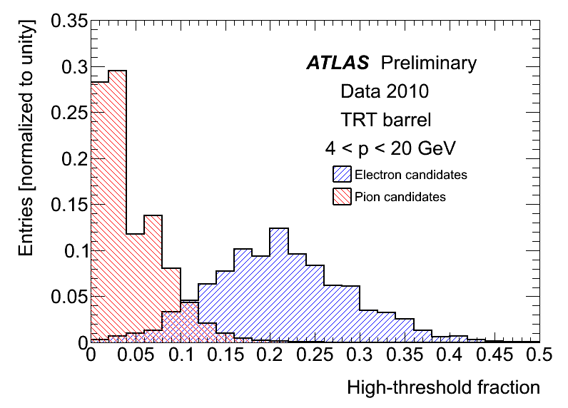
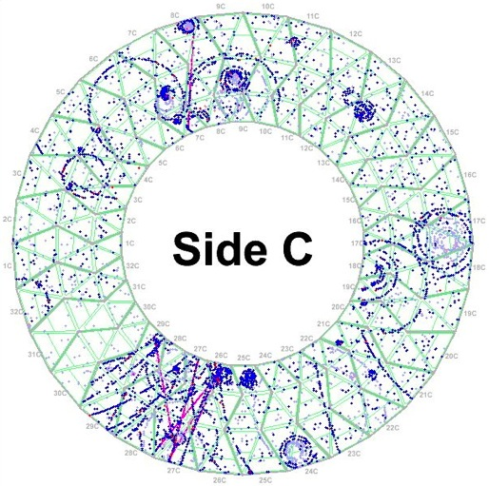
ATLAS TRT: transition radiaton at work
Barrel shown here, same for endcaps
ALICE has equally nice results

Slide 40
A quick look at results
“It will be hard to make everything work quickly”

Slide 41
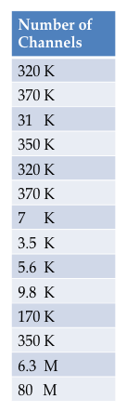
ATLAS status

Slide 42
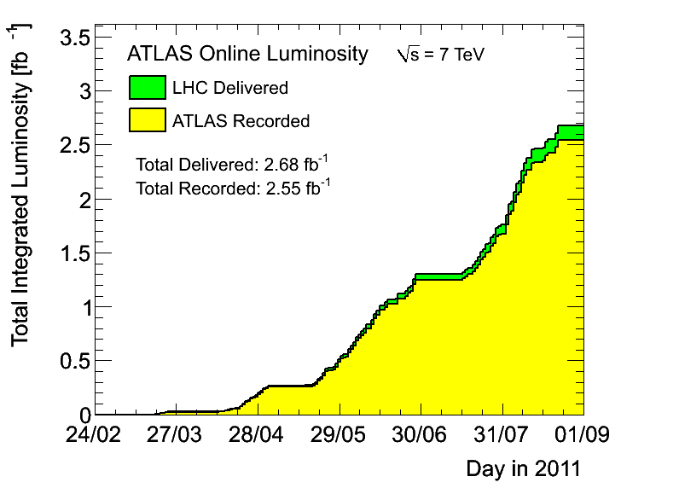
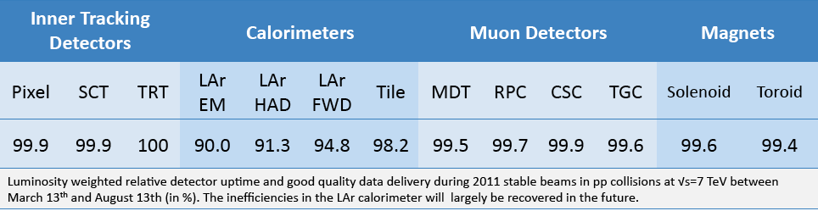
ATLAS data taking efficiency
Max inst lumi. : 2.37x10³³ cm⁻² s⁻¹
Delivered luminosity: 2.68 fb⁻¹
ATLAS ready recorded: 2.55 fb⁻¹
Preliminary uncertainty on 2011 luminosity 4.5%
Data taking efficiency: ~95%
Fraction of good quality data per detector

Slide 43
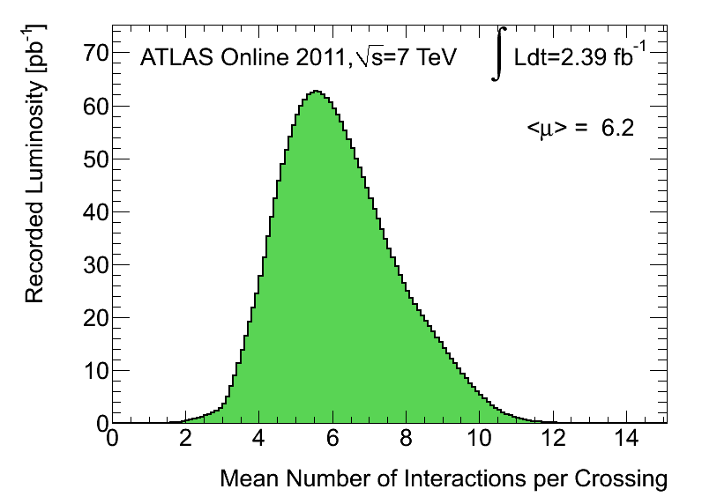
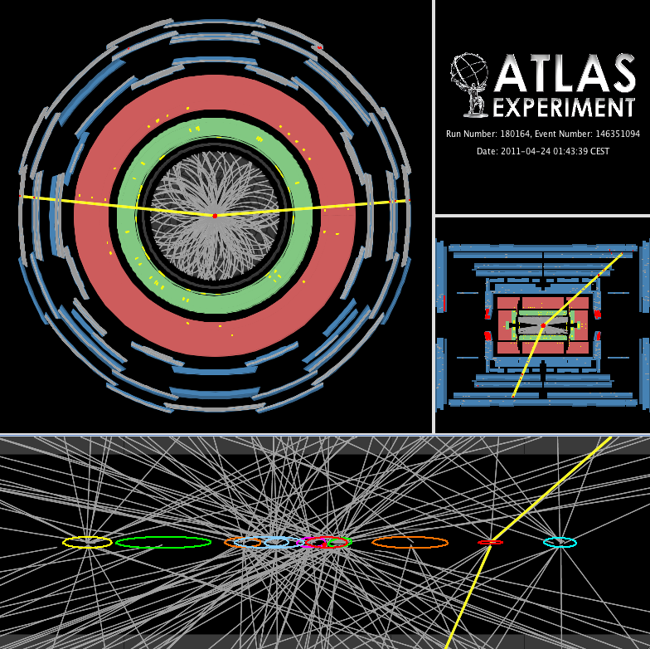
ATLAS pile-up
Event with 11 vertices and 1 Z
Average Pile Up in 2011 : 6.0 Coll/BC
Max Pile Up : 10-12 Collisions/BC
Issue for:
  Missing energy
  Lepton Isolation (mainly calorimetric)
  Jet Energy Scale and resolution
  Vertexing
  CPU time and event size

Slide 44
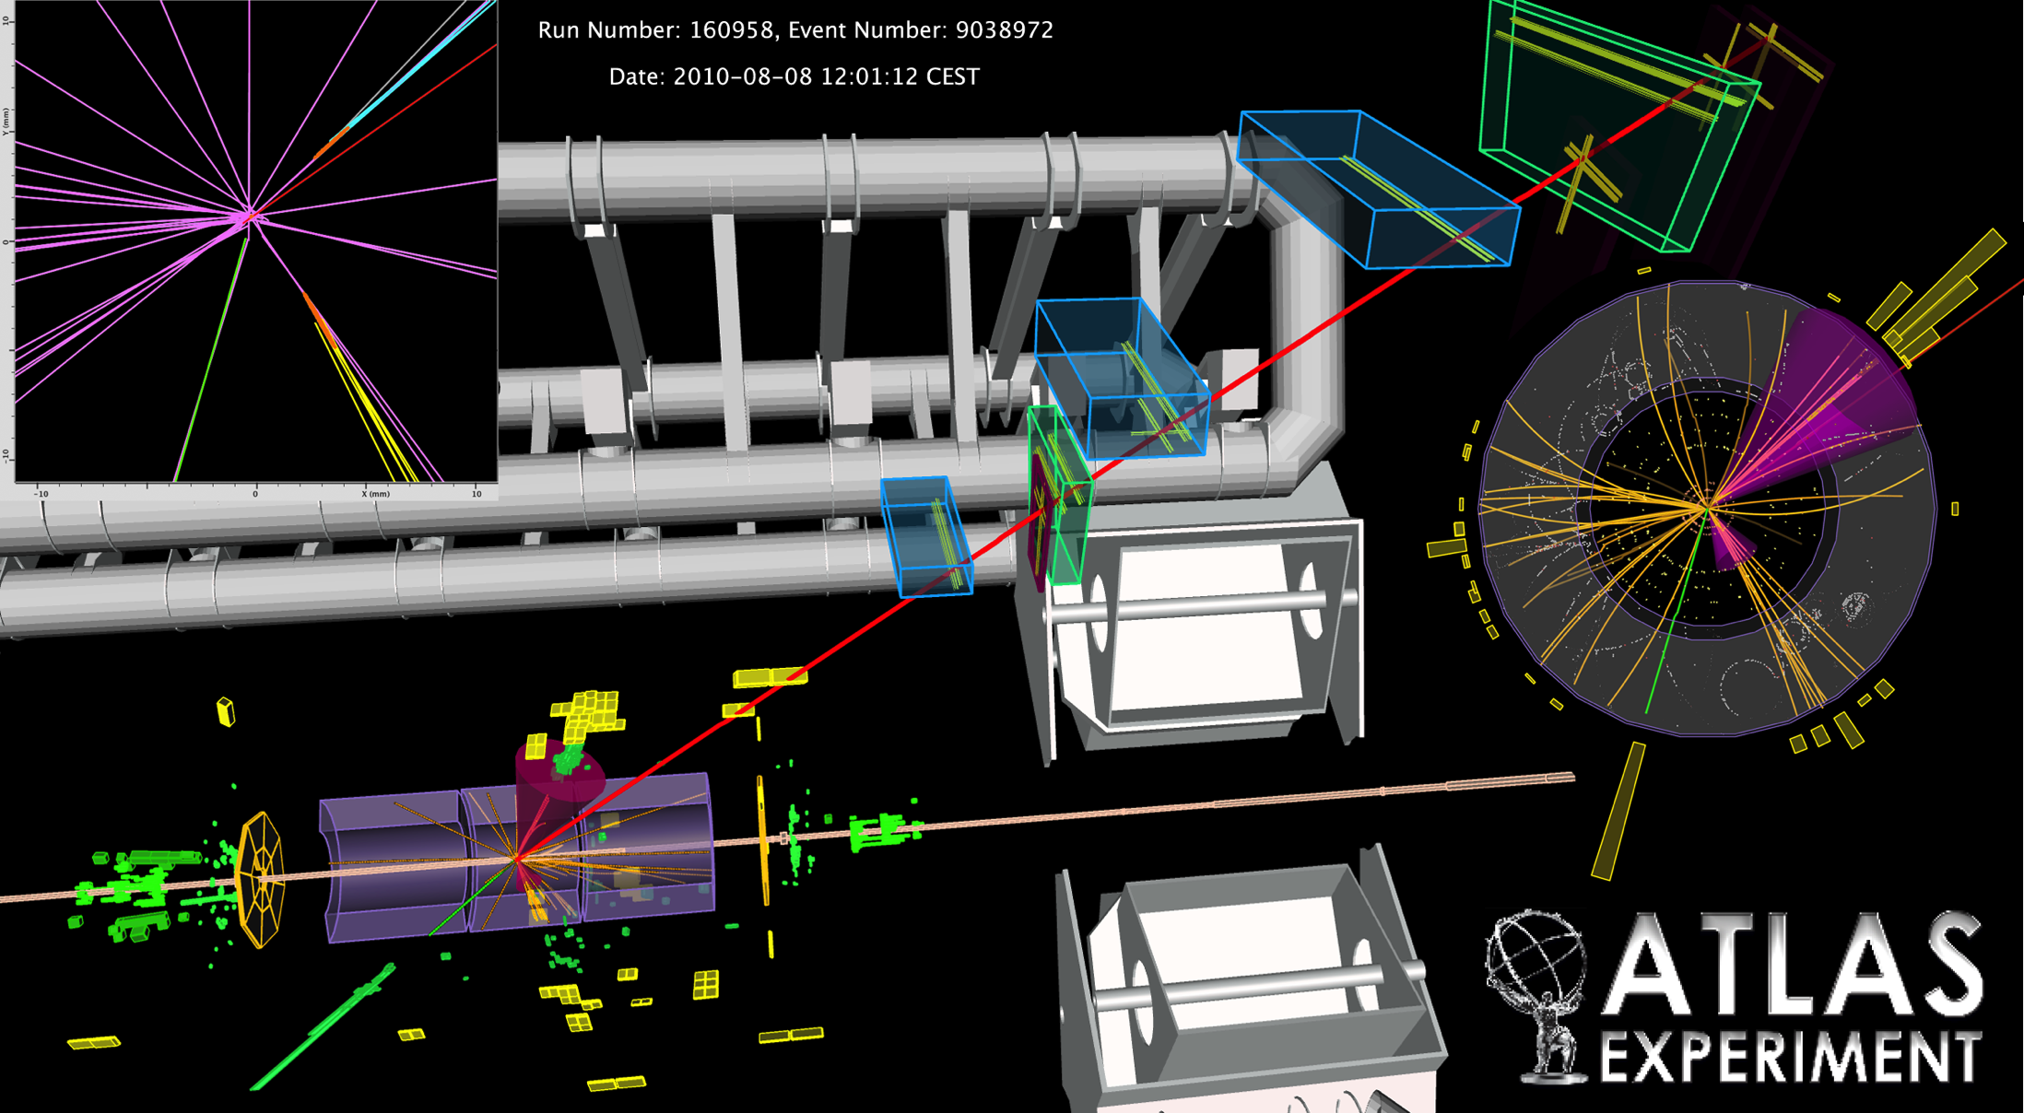
Few event displays

Slide 45
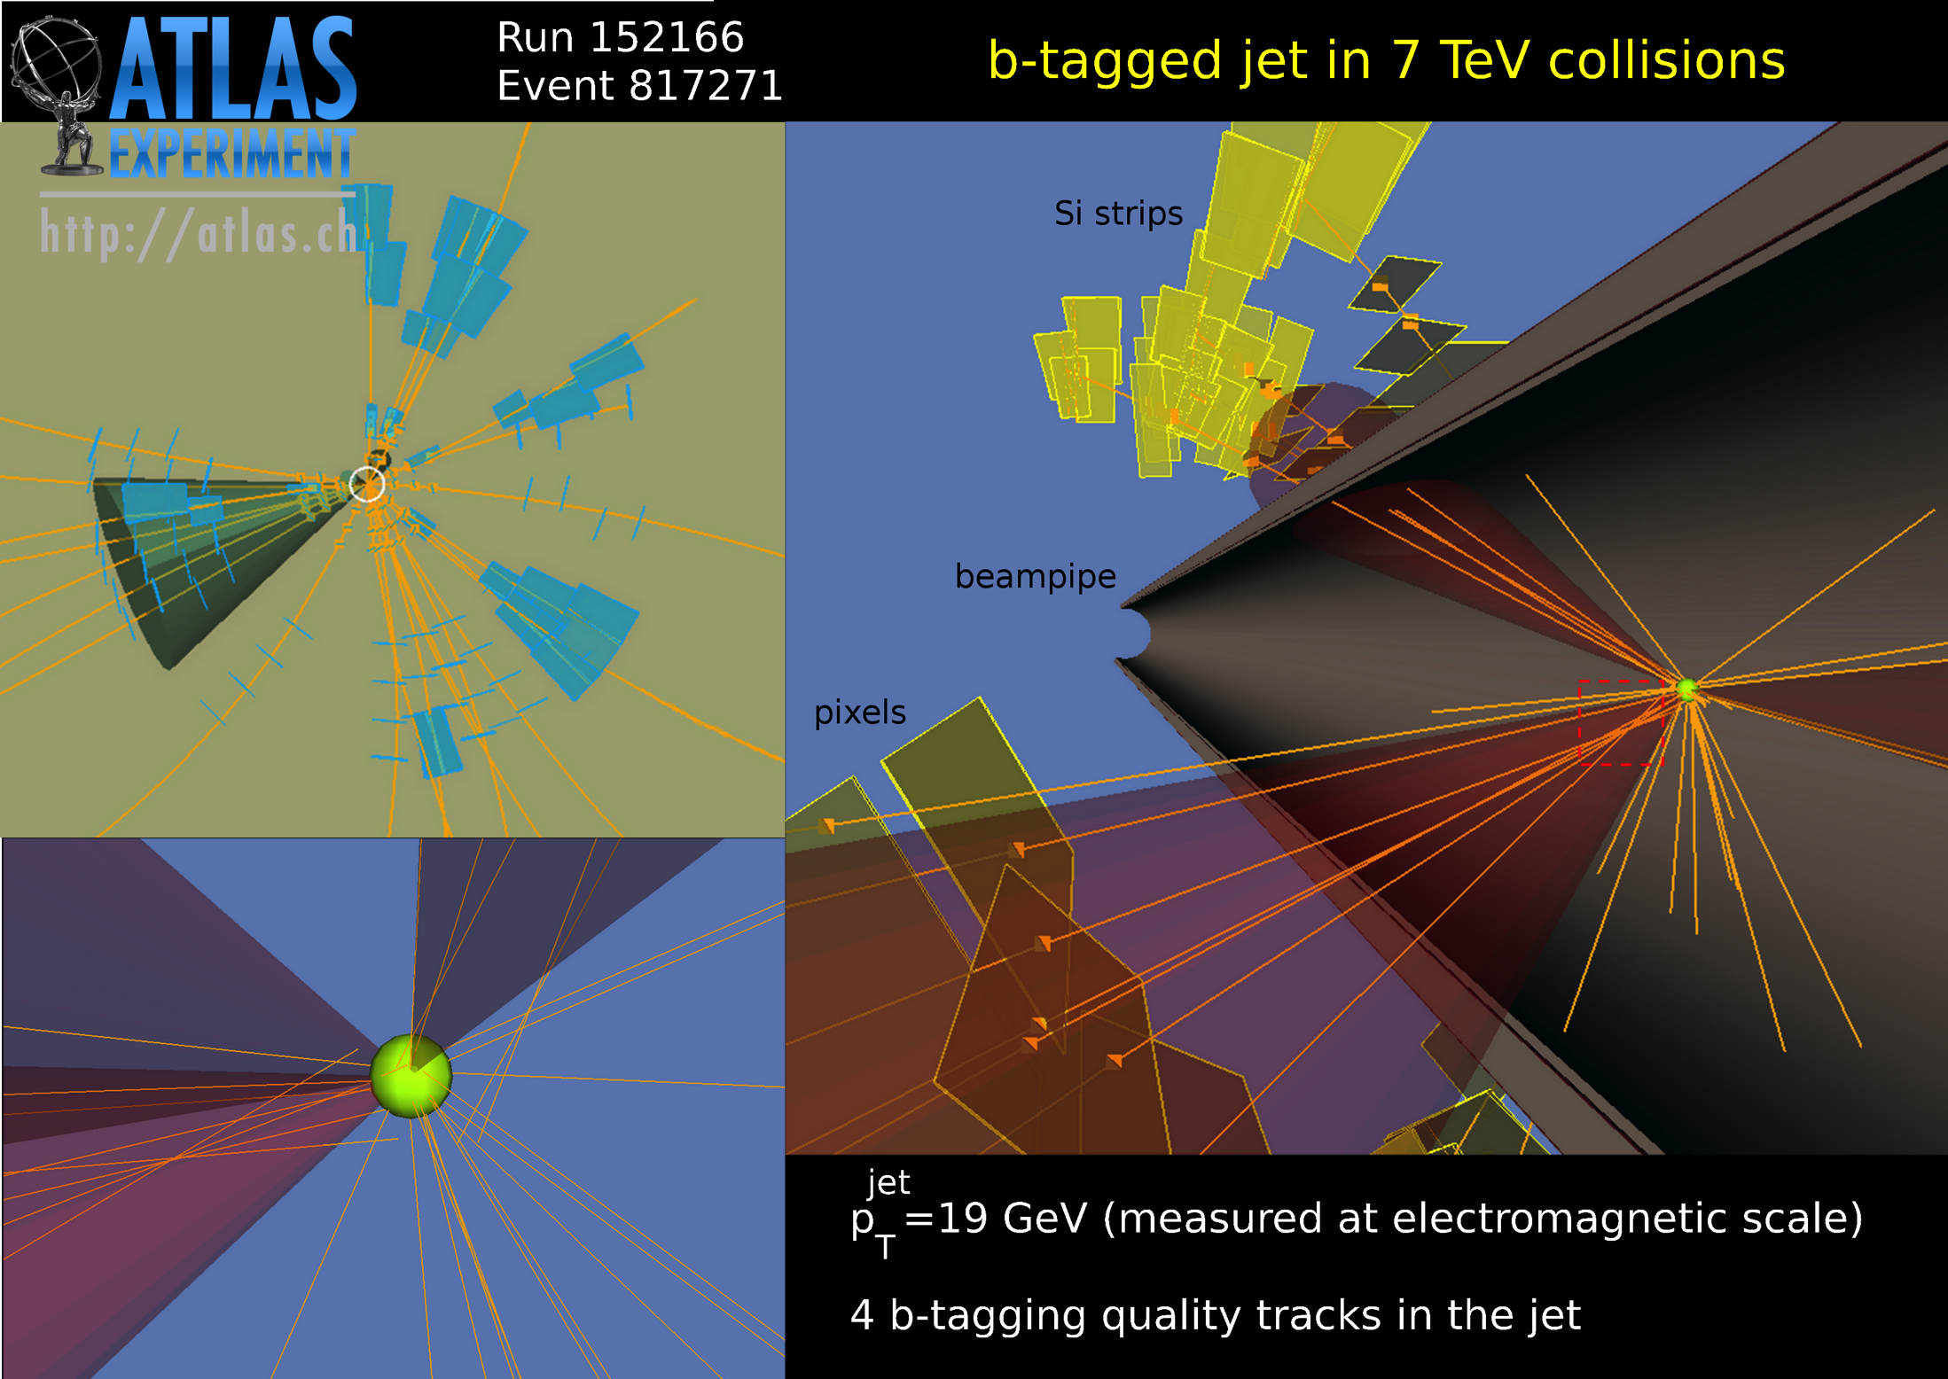

Slide 46
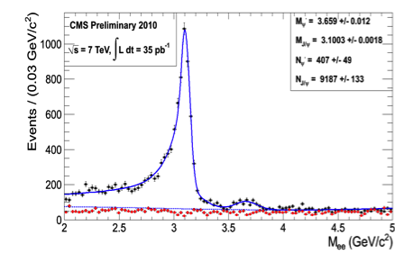
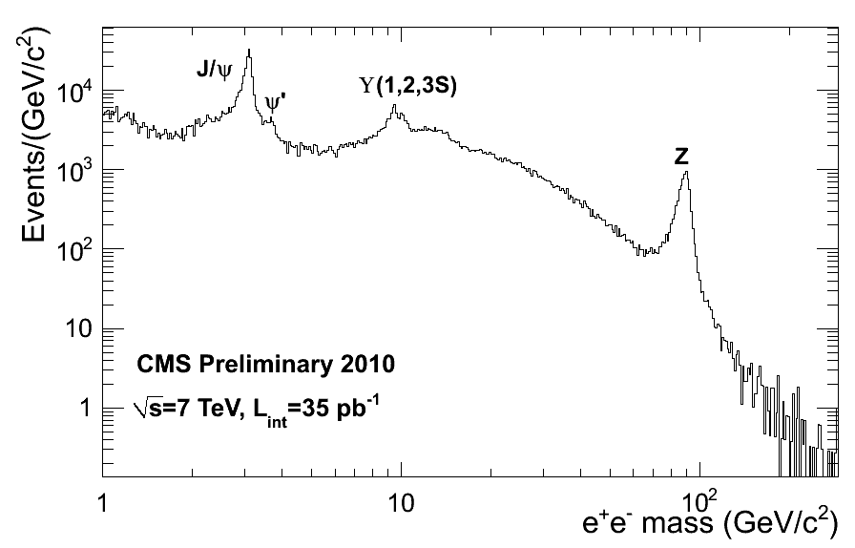


CMS ECAL, photon and electron performance
Di-electron mass spectrum

Slide 47




CMS tracking and muon performance
Thanks to high flexibility of trigger system!
Excellent tracking resolution and alignment shows in resolution of M_{μμ}

Slide 48
ATLAS: SM cross-sections

Slide 49



ATLAS Higgs cross-sections

Slide 50


ATLAS: H->γγ
Cleanest channels for very low Mass Higgs and simple signature
Needs:
  Good di-photon mass resolution
  Determination of primary vertex
  Good Photon Id.
  γ/Jet, γ/π⁰ discrimination
Need to understand backgrounds with high precision with Data Driven techniques
  QCD γγ production
  γ-Jet and Jet-Jet production
No indication of significant excess, therefore limits on SM Higgs production cross-section

Slide 51

ATLAS Higgs combination
The combined upper limit on the SM Higgs boson σ divided by the SM expectation vs. m_{H} indicated by the black solid line
SM m_{H} excluded at 95% C.L.:
146 < m_{H} < 232 GeV
256 < m_{H} < 282 GeV
296 < m_{H} < 466 GeV
Fun just starting!

Slide 52
Thinking about the future
Yes, already

Slide 53

LHC upgrades and how detectors follow

Slide 54

ATLAS: IBL in Phase0
The major project of Phase0
  Installation of a reduced diameter beam pipe (47 mm) and the innermost Pixel layer: the Insertable B-Layer
Improvement of b-tagging capabilities and redundancy to cope with future occupancies and radiation damage

Slide 55




ATLAS IBL
Innovative
  Reduced thickness for sensor and ASIC
  Planar and 3D silicon sensors

Slide 56
Upgrades in Phase 1 and 2
ATLAS and CMS: increase in interaction rates and keeping an eye on physics results
  Phase 1
    ATLAS: Muon system, L1&2 trigger, Calorimetry
    CMS: Pixel, trigger, DAQ, beam instrumentation and luminosity, infr.
  Phase 2
    ATLAS: Trigger, some Muon chambers, endcap and forward calorimetry, calorimeter readout for trigger, new Inner Detector
    CMS: new Inner Detector, readout of Muon system, calorimetry readout, trigger electronics
ALICE and LHCb: enlarge measuring capabilities
  ALICE: Inner Tracker, Muon Forward Tracker, new forward calorimetry, particle identification improvement, TPC readout upgrade, trigger and DAQ
  LHCb: move to 40 MHz readout, new VELOPIX, new Si tracker, PID improvements at low momenta, calorimeter readout
  Both aiming at Phase 1

Slide 57


When being puzzled is good
6 December 2009
Switching on 80M Pixel for the first time, √s = 0.9 TeV
Is that so simple?
I looked clearly worried to see beam effects
ATLAS channels increased by one order of magnitude
30 March 2010
We did again, √s = 7 TeV
I thought we we’re getting used to it
I was worrying for few moments then all went fine

Slide 58
Conclusions
I’m greatly indebted to the Organizing Committee
  Preparing such a talk is very challenging, but extremely interesting
I’m greatly indebted to all LHC experiment colleagues
  Many provided tons of material, impossible to mention all (already too many slides)
Lessons learned: we were too worried that between switching on and getting results too much time was needed
  It went much smoother
  We’re getting lots of results
LHC performed really well and our DAQ, Trigger and Computing have been following well the challenge
Now: waiting for even more results!

Slide 59

ATLAS&CMS looking forward

Slide 60

Higgs in ATLAS

Slide 61

Higgs in CMS

