Slide 1
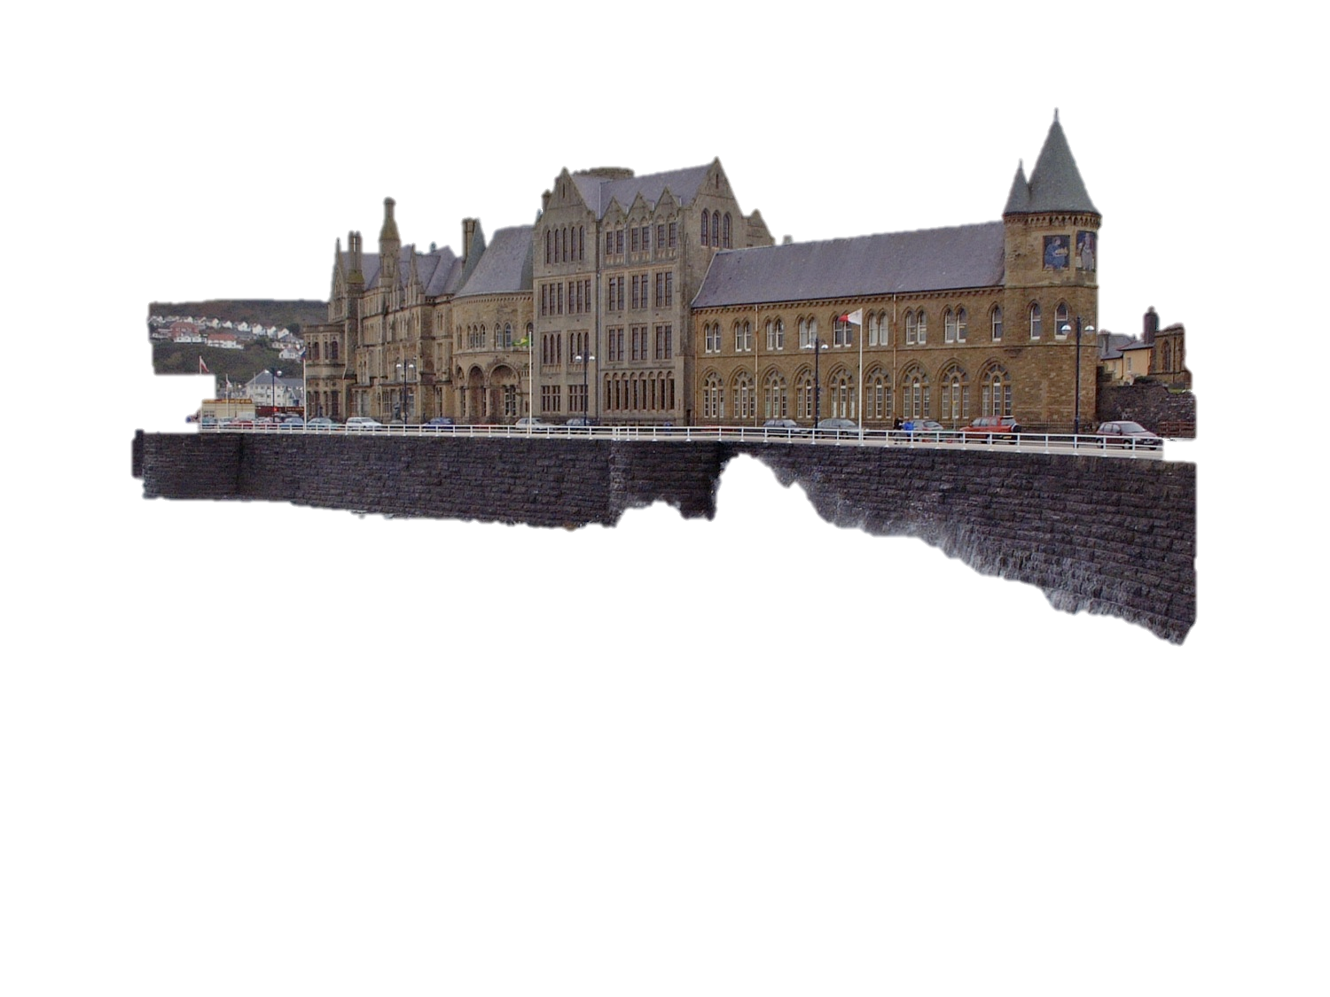



LHC Detectors overview
Emphasis on ATLAS
Bonus material
Beniamino Di Girolamo
CERN

Slide 2
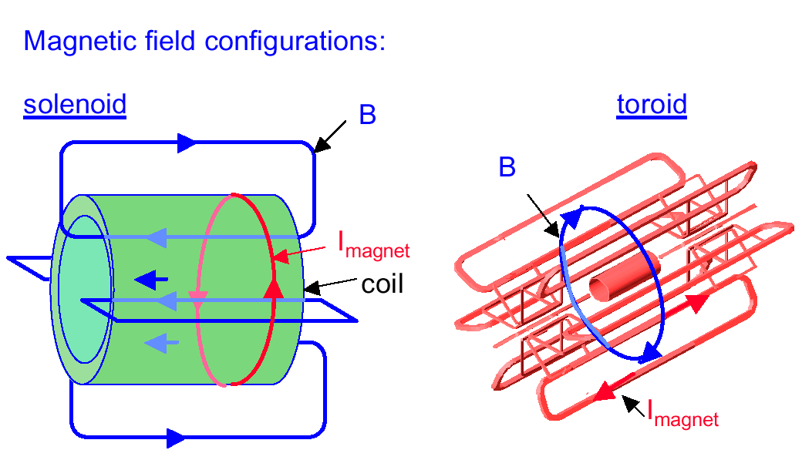
Magnetic configurations
Different choices: CMS smaller, but heavier

Slide 3
Complementary approaches
ATLAS ≡ A Toroidal LHC ApparatuS
CMS ≡ Compact Muon Solenoid
MAGNET (S)
Air-core toroids + solenoid in inner
cavity (4 magnets)
Calorimeters in field-free region
Solenoid
Only 1 magnet
Calorimeters inside field
Si pixels+ strips
TRT → particle identification
B=2T
σ/p_{T} ~ 3.8x10⁻⁴ p_{T} ⊕ 0.015
Si pixels + strips
No particle identification
B=4T
σ/p_{T} ~ 1.5x10⁻⁴ p_{T} ⊕ 0.005
TRACKER
EM CALO
Pb-liquid argon
σ/E ~ 10%/√E uniform
longitudinal segmentation
PbWO₄ crystals
σ/E ~ 2-5%/√E
no longitudinal segm.
HAD CALO
Fe-scint. + Cu-liquid argon (10 λ)
σ/E ~ 50%/√E ⊕ 0.03
Cu-scint. (> 5.8 λ +catcher)
σ/E ~ 100%/√E ⊕ 0.05
MUON
Air → σ/p_{T} ~ 10 % at 1 TeV standalone
(~ 7% combined with tracker)
Fe → σ/p_{T} ~ 15-30% at 1 TeV
standalone (5% with tracker)

Slide 4
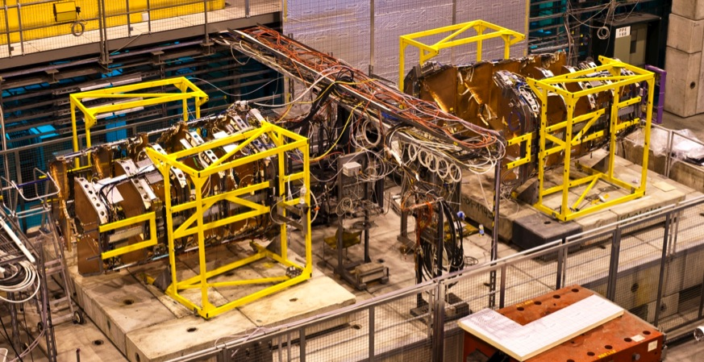
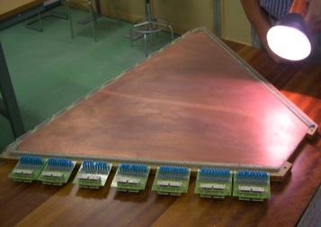
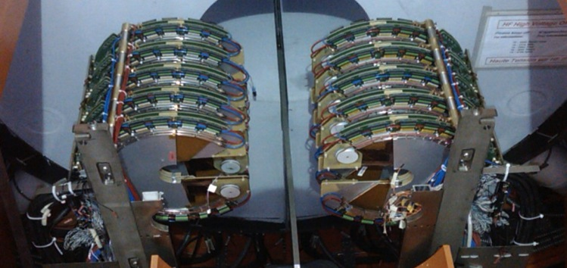
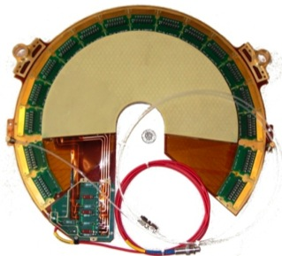
TOTEM telescopes
T1
At ±10.5m from IP5
T1: 3.1 < |η| < 4.7
Cathode strip Chamber
T2
At ~ ± 14 m from IP5
T2: 5.3 < |η| < 6.5
Triple Gas Electron Multiplier

Slide 5
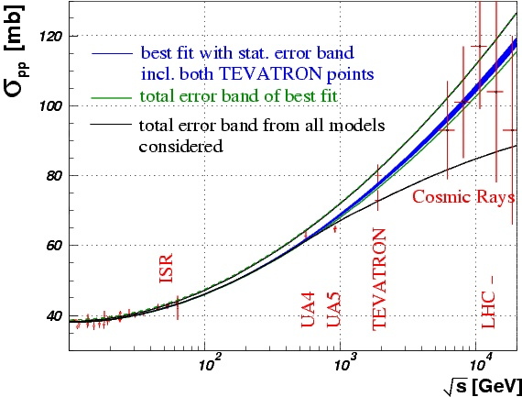
TOTEM Physics Objectives
TOTEM is dedicated to the measurement of the total cross section, elastic scattering and diffraction dissociation at the LHC.
total cross section
Measure the total cross-section σ_{tot} independently of the luminosity (Optical Theorem)
Current models predict large uncertainty at the LHC energies (90-130 mb)
Aim of TOTEM: ~1% accuracy
4-momentum transfer squared
Observables
rate of elastic events
rate of inelastic events
Notes:
The total cross section will be measured with the luminosity independent method based on the simultaneous measurement of low momentum transfer elastic scattering and of the rate of inelastic interactions with fully inclusive trigger.
Elastic scattering events will be detected with the Roman pot technique using a suitable optics obtained by properly tuning the quadrupoles in the intersection region. The system of dipoles foreseen in the intersection region to first combine and then separate the proton beams will be used to measure the momentum of the protons which are diffractively scattered.

Slide 6
Measurement of Forward Protons
Measuring scattering at small angles >>
Proton detection far away from IP
Extrapolating at t=0 >>
Approach the beam as much as possible (Edgeless Detectors)
How to correlate the measurement in the roman pots with the scattering in IP?
Proton transport in the magnet lattice
Θ_{y}
Θ*
y
beam centre
y*
s
L (effective length)
v (magnification)
D (dispersion)
IP
215m
220m
Magnetic lattice
Detector
transverse coordinate
depend on the tuning of the magnet lattice
ξ=Δp/p fractional momentum loss in the collision
Deep knowledge of the magnet lattice tuning is needed
Special Beam Optics “ease” the measurements
TOTEM

Slide 7
Vertex: High luminosity, high multiplicity
The choice is natural to keep the occupancy at few % level
The limit for deploying pixels at large radii: cost
Granularity
  Smaller in rφ: magnetic field direction
  Larger in z in ATLAS: pattern recognition helped by outer layers
  Space requirement for electronics
Geometry
  As close to beam pipe as possible for the central barrel region
  LHCb needs a forward geometry with stations along z for VELO
  ATLAS and CMS have disks for the forward region
  ATLAS has the outer part of the tracker, after strips, with straw-tubes
  ALICE has silicon drift detectors between pixel and strips

Slide 8
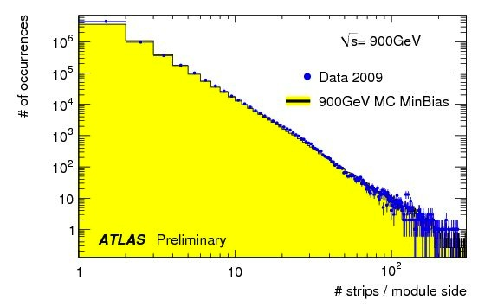
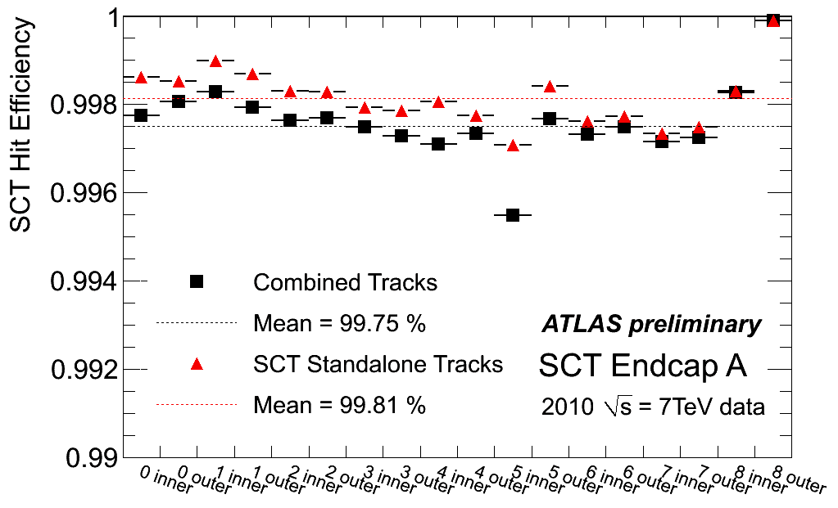
ATLAS: Hit Strips, Efficiency, Occupancy
N(vertex) | Avg. Occupancy (Barrel, innermost layer)
5 | 0.41 %
10 | 0.66 %
15 | 0.89 %
2010 | Run Type | Max. Occ.
09. Apr | Cosmics | 4%
09. Apr | Beam, non colliding | 6%
25. Apr | Squeezed beam, colliding | 20%
10. Jun | Single high occ. event | 32%
29. Oct | Bunch trains | 20%
09. Nov | Heavy Ion | 37%

Slide 9
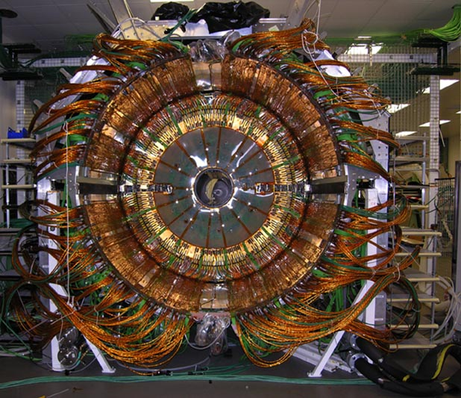
CMS Tracker

Slide 10
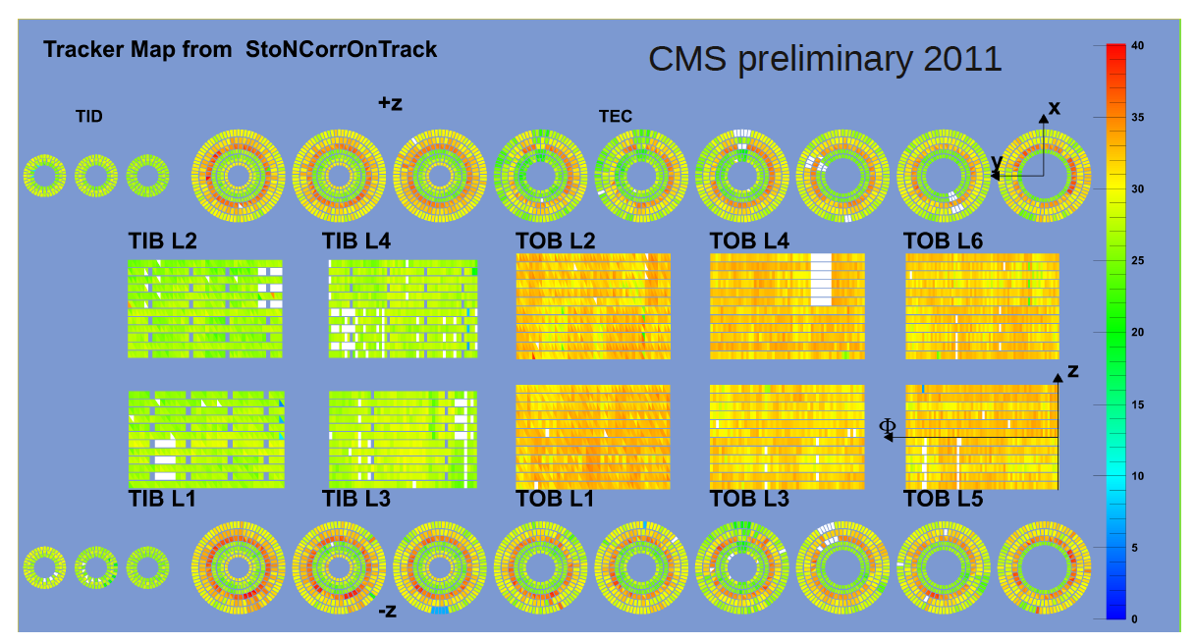
CMS Tracker: S/N distribution
S/N~20 for thin silicon (300 μm); S/N~30 for thick silicon (500 μm)

Slide 11
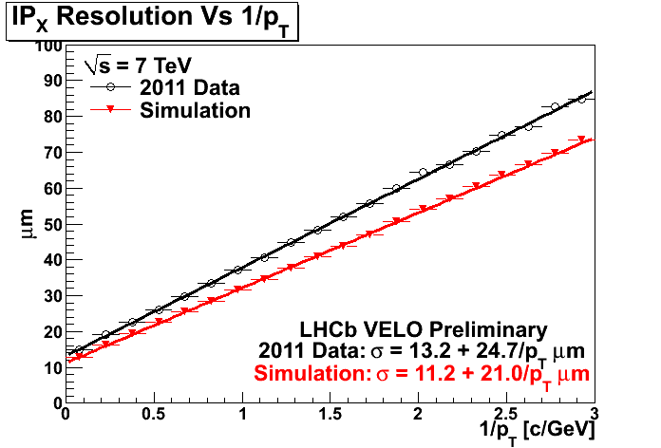
LHCb VELO: IP resolution
B daughters

Slide 12
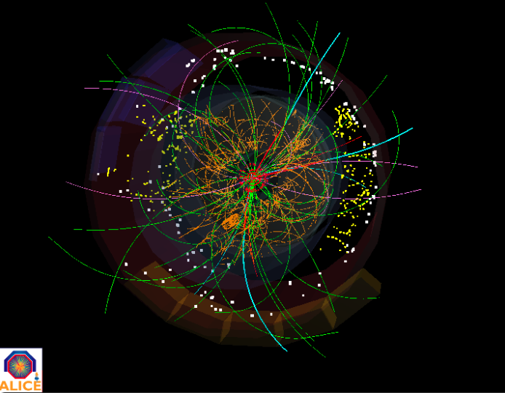
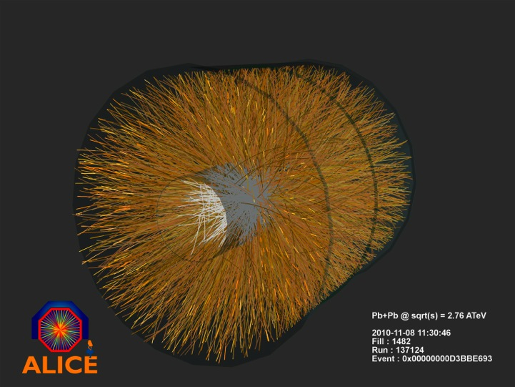
ALICE ITS: event display
p – p collisions (2010 – 2011)
900 GeV (300 K + 8 M events MB)
2.36 TeV (40 K events)
2.76 TeV (70 M events MB)
7 TeV ( 800 M events MB in 2010)
7 TeV ( 550 M events MB in 2011)
Pb – Pb collisions (2010)
2.76 TeV/nucleon (≈ 30 M events MB)

Slide 13
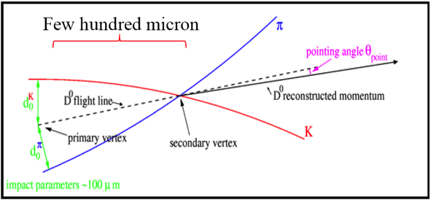
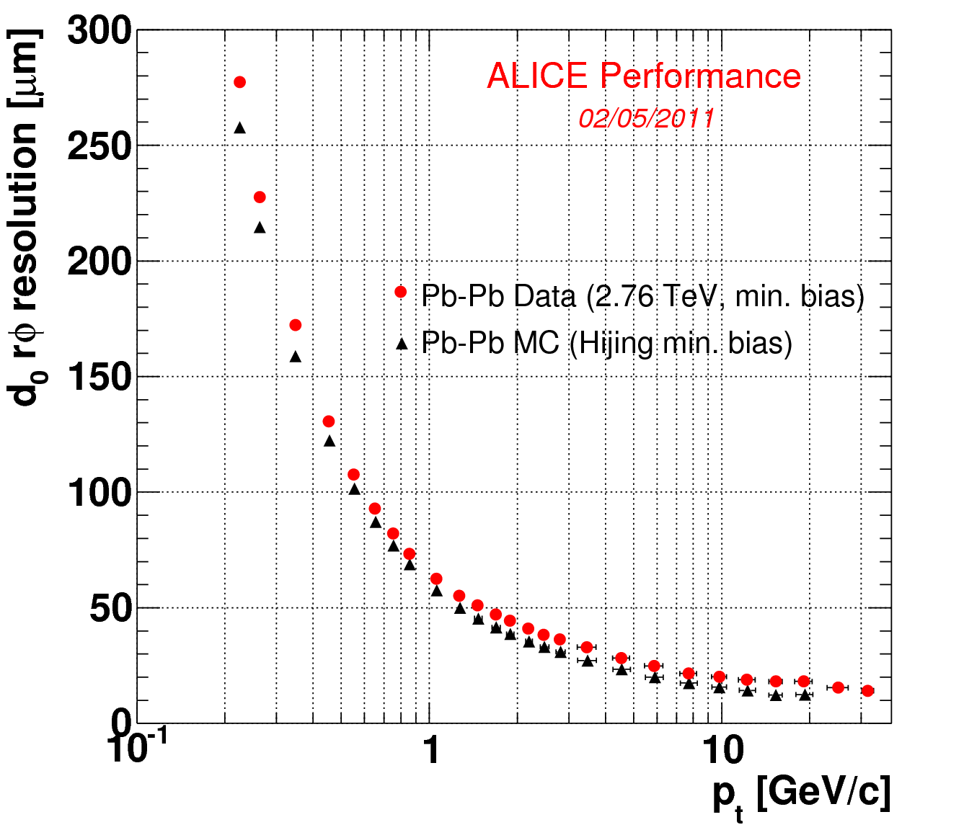
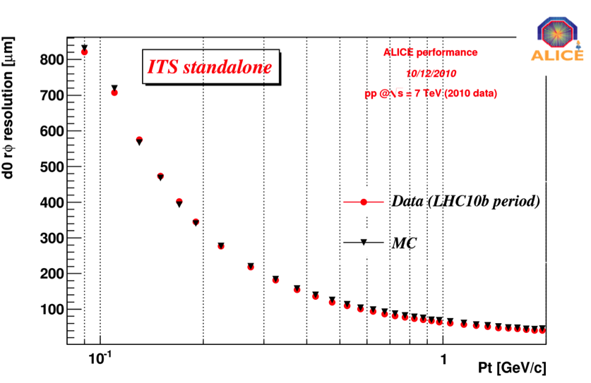
ALICE ITS: Transverse impact parameter
A key plot to quote the tracker performance in terms of track and vertex reconstruction is the transverse impact parameter in the bending plane: d₀(rφ)
  Distance between the track projection and the vertex position reconstruction in the bending plane
The material budget mainly affect the performance at low p_{t} (multiple scattering)
The point resolution of each layers drives the asymptotic performance

Slide 14
Radiation levels for Si detectors
 | TID [kGy] | Fluence 1 MeV neq [cm-2] | Time [y]
ATLAS Pixel | 500 | 1.0E+15 | 10
ATLAS Strips | 100 | 2.0E+14 | 10
CMS Pixel | 840 | 3.0E+15 | 10
CMS Strips | 70 | 1.6E+14 | 10
ALICE Pixel | 2.7 | 3.5E+12 | 10
LHCb VELO | 50 | 1.3E+14 | 1

Slide 15
ALICE TPC: impressive!
A TPC is the perfect detector for HI collisions
  the whole volume is active
  minimal scattering due to minimal radiation length (field cage, gas)
  easy pattern recognition (continuos tracks)
  PID information from ionization measurements (very powerful especially in the low energy region where energy loss ∝1/β²; p ≤ 1GeV/c)
  transversal diffusion of the drifting electrons may be minimized by choosing a gas mixture with ωτ>1 and a configuration with B and E fields parallel
… but …
  relatively slow (at least as compared to most LHC detectors): Maximum readout speed is dominated by electron drift time (and event sizes)

Slide 16
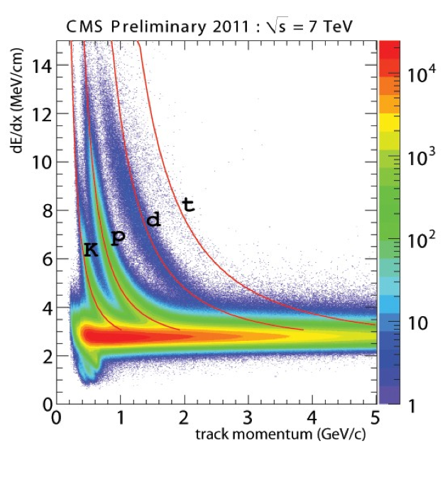
PID in Silicon: CMS strips
The dE/dx measurement of a track is obtained from all values of the hits (~10 points).
Kaons, protons, deuterons and tritium are visible.
Red lines are Bethe-Bloch expectations extrapolated from a fit of the proton line.
Small deviation at large dE/dx from saturation.

Slide 17
Calorimetry and Muon systems
A variety of technologies

Slide 18
Different choices
ATLAS, CMS and LHCb have e.m. and hadron calorimetry based on different technologies
  LHCb and ALICE: the advantage of designing later, re-using part of ATLAS and CMS technologies
CMS has the calorimetry in magnetic field
  A clear need of containing dimensions not to have a even more challenging 4 T solenoid
  Very elegant, compact and dense e.m. calorimeter based on PbWO₄
  Challenging readout for the hadronic calorimeter and reduced dimensions, brass-scintillator with WLS fibres
ATLAS approach more conservative
  Elegant LAr-based calorimetry with barrel cryostat shared with solenoid
  Central hadronic calorimetry based on Fe-Scintillator with WLS fibres with a novel geometry
More similarities for ATLAS and CMS Muon chambers

Slide 19
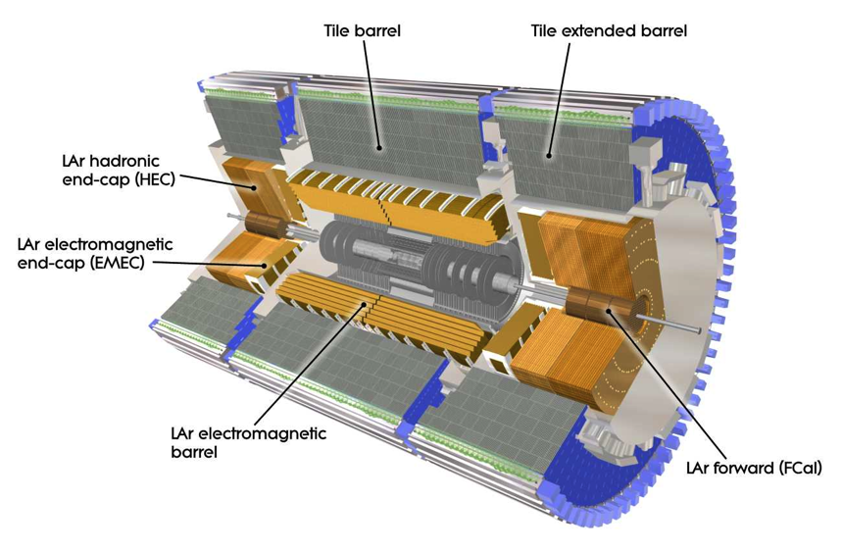
The ATLAS calorimetry
electrons: using information
from the calorimeter,
tracker and matching between
them ; using 3 series of cuts for
identification selection with
increasing jet rejection power
photons: energy clusters in the EM calorimeter not matched to a track, or matched to a conversion vertices (for converted photons) ; using two series of selection cuts with increasing fake rate power
Jets: calorimeter topological clusters using anti-KT (cone-like) algorithm of cone R=0.4,0.6 Jets are reconstructed using weighting techniques to correct for the “non compensating” ATLAS calorimeters (response of hadrons lower than electrons) and to energy losses in front and between the calorimeters.
Missing transverse energy E_{T}^{miss}:
Includes contributions from ET deposits in the calorimeters, corrections for energy losses in the cryostat and measured muons.

Slide 20
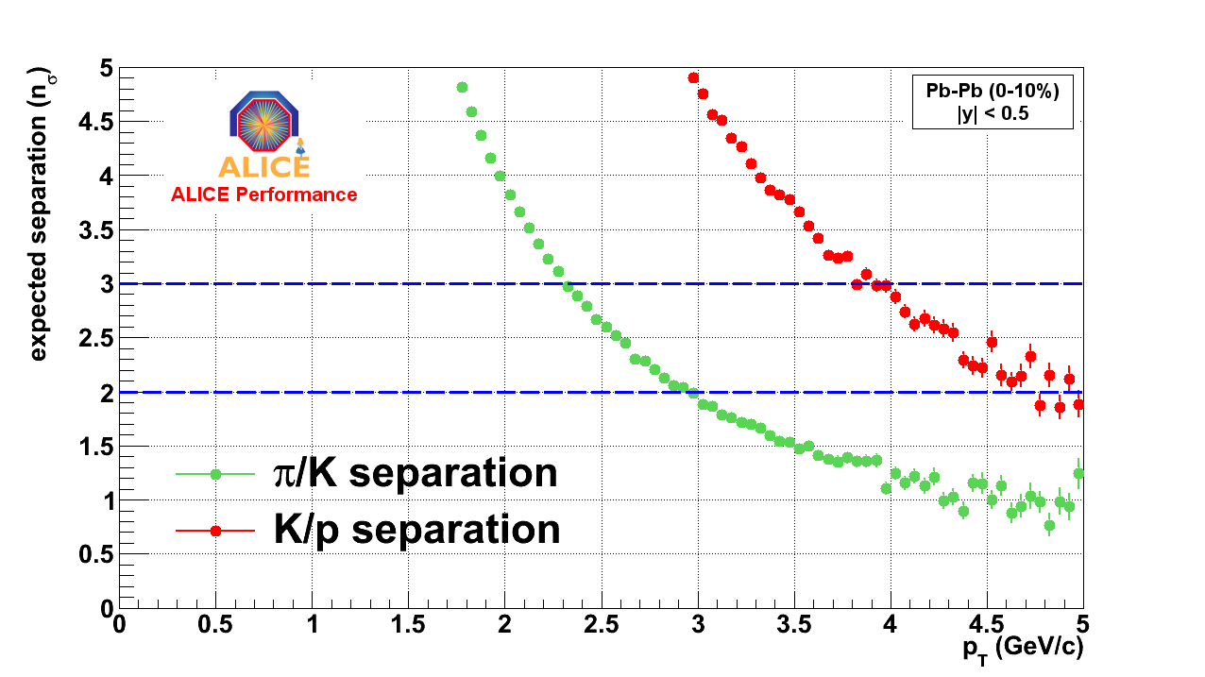
PID with ALICE TOF
Double gap RPC detector
Central Pb-Pb collisions
|y| < 0.5
2σ π/K separation up to 3 GeV/c
2σ K/p separation up to 5 GeV/c
system time resolution in Pb-Pb (~85ps) – better than in p-p (~110ps)

Slide 21
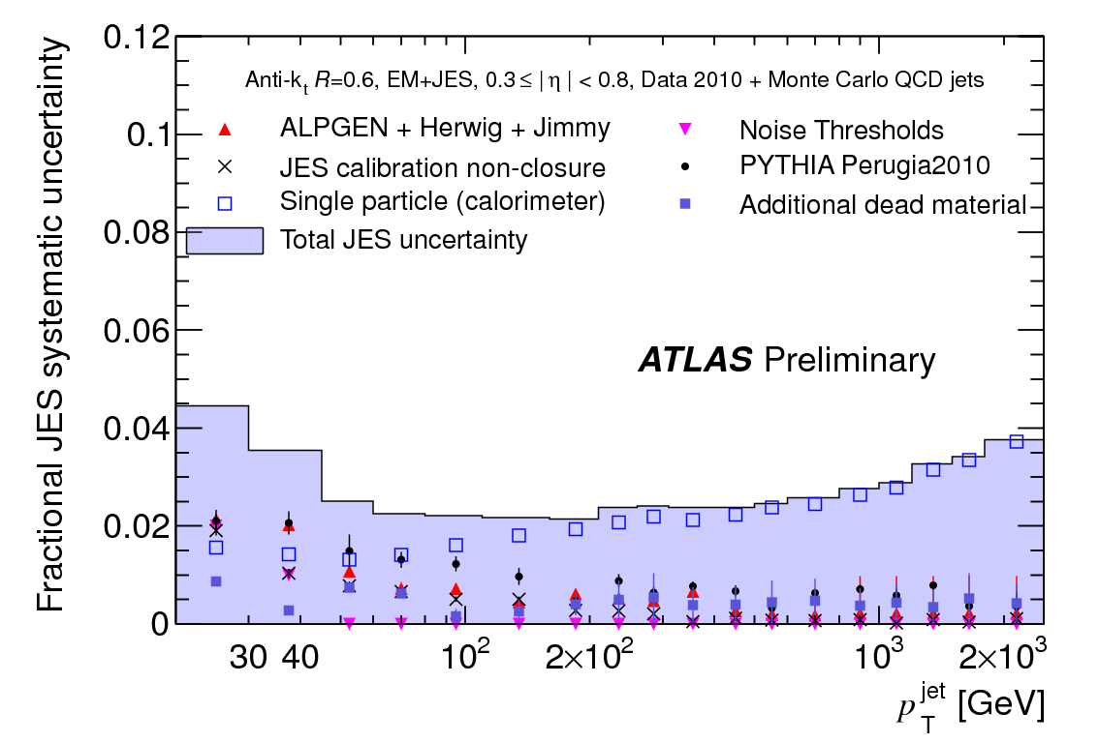
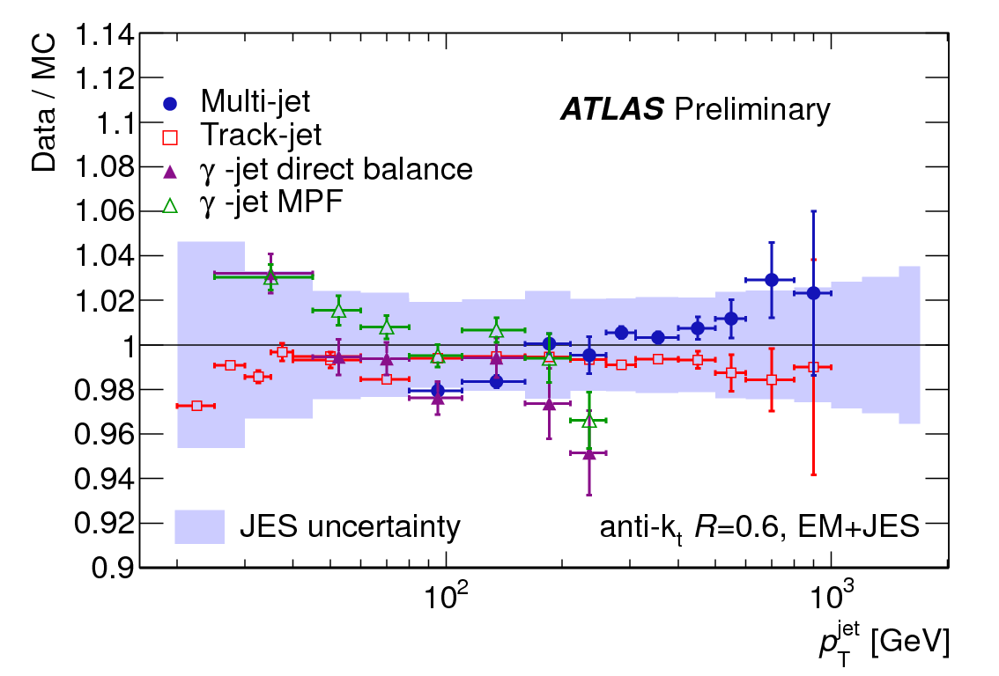
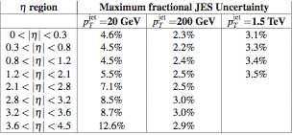
ATLAS Jets: energy scale uncertainty
Estimate jet energy scale (JES) uncertainty on data (Jets with P_{T}>20 GeV).
Different sources of systematic uncertainties studied in detail.
Data/MC ratio for different in situ
techniques test the JES
ATLAS-CONF-2011-032
2.5%
barrel region
JES and uncertainty evaluated up to 3.5 TeV, |η|<4.5

Slide 22
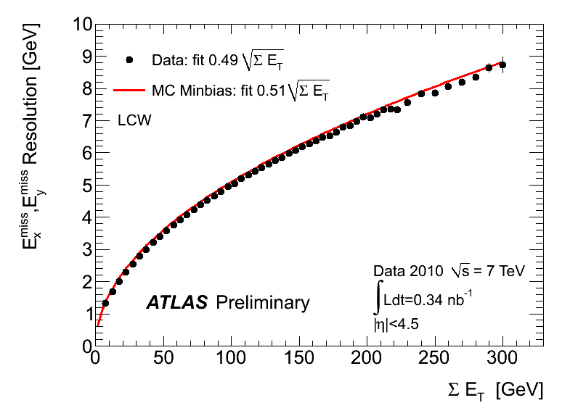
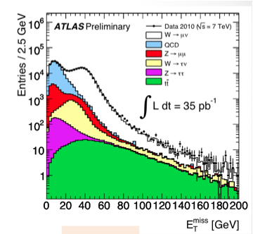
ATLAS Jet energy, E_{T}^{miss} resolution
Different calibration schemes exist for the
hadronic energy deposits in calorimeters
with corrections for non compensating
calorimeters and inactive materials.
E_{T}^{miss} sensitive to calorimeter performance (in terms of noise, dead cells, miscalibrations e.t.c) and beam backgrounds and cosmics
ATLAS-CONF-2010-057
Resolution on data consistent with simulation
Relative uncertainty (Data/MC) of 10%
example of
E_{T}^{miss} tested on
data in inclusive
lepton samples

Slide 23
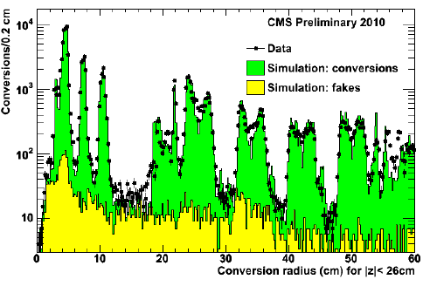
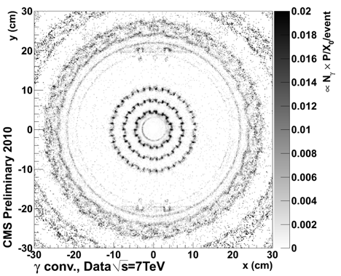
CMS ECAL, photon and electron performance
ECAL provides very good energy resolution down to low energies
Performance in agreement with expectations
At high ET the scale in the barrel region is now set by the π⁰ calibration (correct to 1%); 3% shift in the endcap region
Good knowledge of material budget (conversions, NI)
Beniamino Di Girolamo - CERN
PSD9 - Aberystwyth - 12-16 September 2011
23

Slide 24
Particle identification
Not only gas detectors

Slide 25
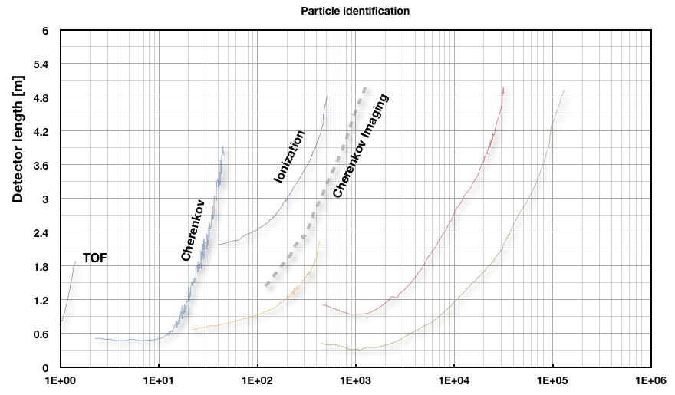
PID in one slide
Κ,π
K/π
π,e
π,e
γ
Low E, TOF measures p,v ➔ m
Higher E, Cherenkov threshold v > c/n discriminates between particles
For γ ~ 100 identification via dE/dx
Cherenkov angle measurement cos θ > 1/nβ
For high γ the transition radiation

Slide 26
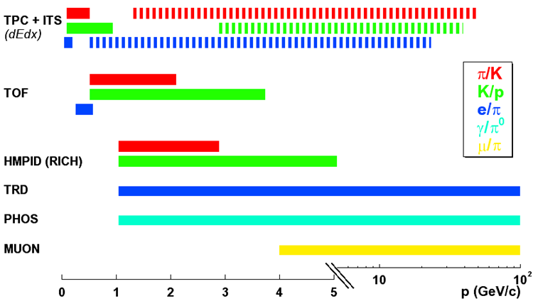
PID in ALICE
PHOS, EMCAL
‘stable’ hadrons (π, K, p): 100 MeV < p < 5 GeV (several 10 GeV)
  dE/dx in silicon (ITS) and gas (TPC) + time-of-flight (TOF) + Cherenkov (HMPID)
decay topologies (K, Λ, φ, Ω, D)
  K and Λ decays beyond 10 GeV
leptons (e, μ), photons η,π⁰
  electrons TRD: p > 1 GeV, muons: p > 5 GeV, π⁰ in PHOS, EMCAL: 1 < p < 80 GeV

Slide 27
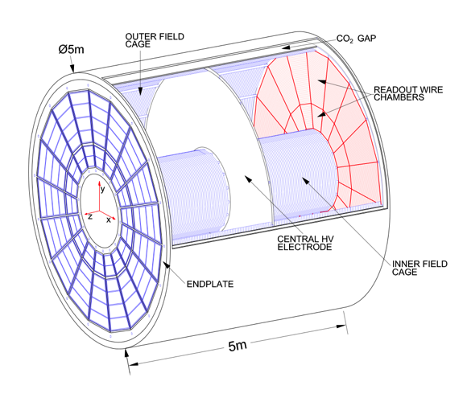
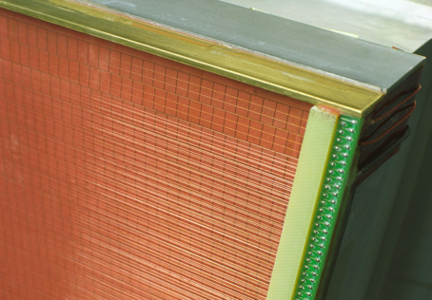
ALICE TPC details
Gas volume ∼92 m³
Material budget 3% X₀ at η=0
72 (=18×2×2) Readout chambers: MWPCs with cathode pad readout
Low mass, high precision field cage
Gas mixture: Ne, CO₂ (90-10)
Maximum electron drift time (250 cm drift) : ∼92 μs
557 568 read out pads and FEE channels
Detail of one readout chamber

Slide 28
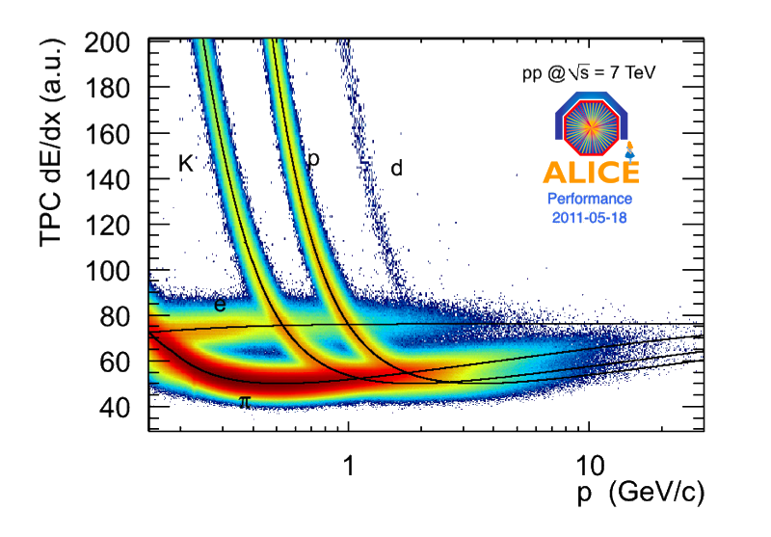
ALICE TPC: dE/dx
10 bit ADC: Dynamic range up to 26×MIP. σ ~ 5%

Slide 29
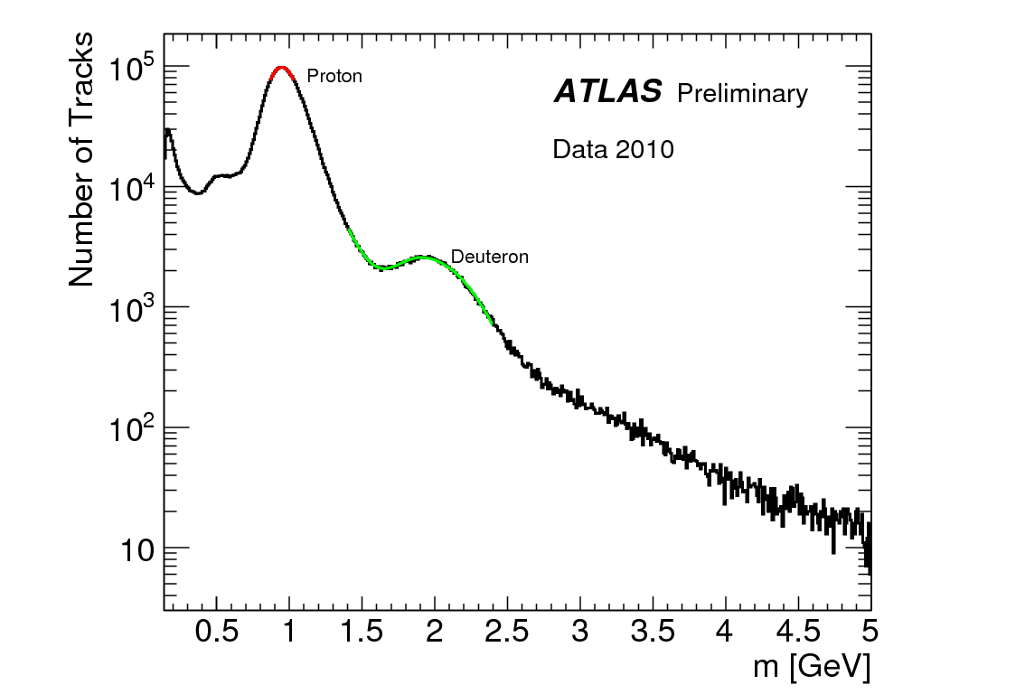
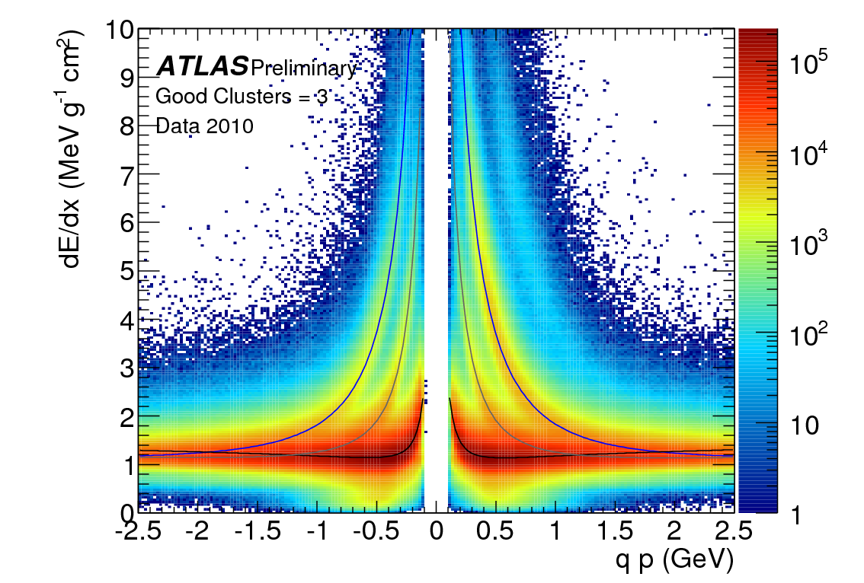
dE/dx in Silicon: ATLAS Pixels
p
K
d
φ→K⁺K⁻
π
σ ~ 12%
Mass determination inverting
Bethe-Bloch energy loss relation

Slide 30
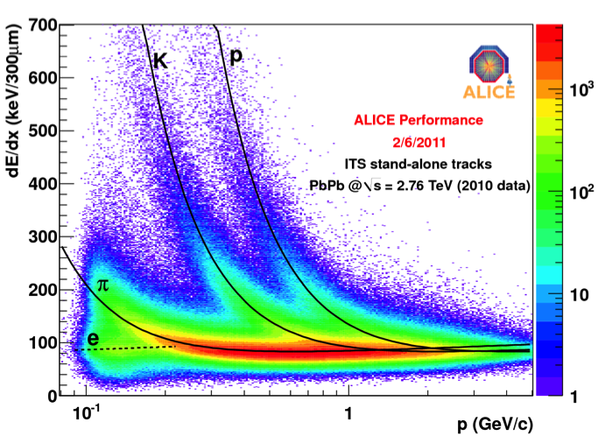
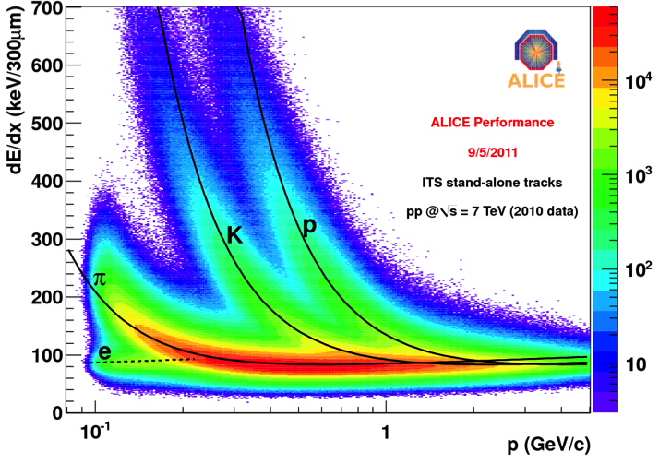
PID in Silicon: ALICE ITS
4 out of 6 silicon layers with analogue information (SDD and SSD)
Energy loss (dE/dx)
Truncated mean to account for long tails in the Landau distribution
Tracks path length correction
Results for particle identification in p-p and Pb-Pb data
ITS standalone tracks
Hadron separation below 100 MeV/c
Good pions / kaons separation up to 0.5 GeV/c
Good pions and protons separation up to 1 GeV/c

Slide 31
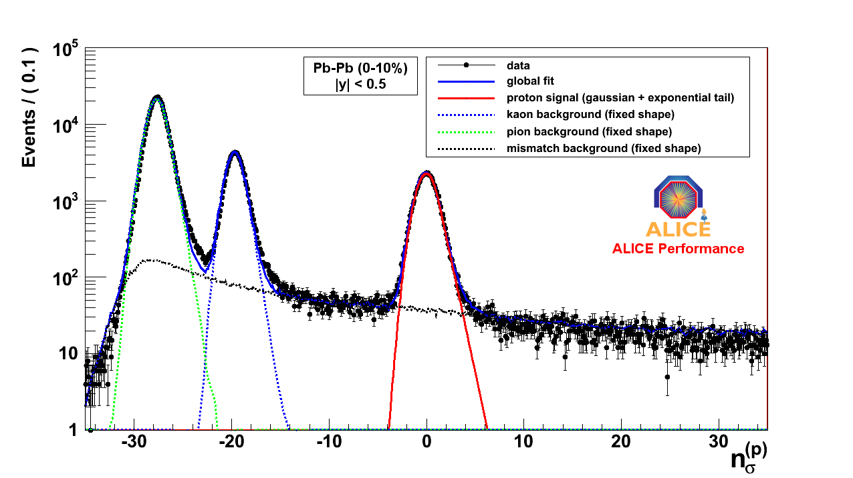
ALICE TOF PID
Raw yields: a global fit of Time-Of-Flight signal - mass hypotesis i (π, K, p) constrains the integral of the fit to the total number of entries in the TOF PID
Central Pb-Pb collisions
|y| < 0.5
pions
kaons
protons
mismatch background
on the % - level
Protons : 0.95 < p_{T} < 1.05 GeV/c

Slide 32
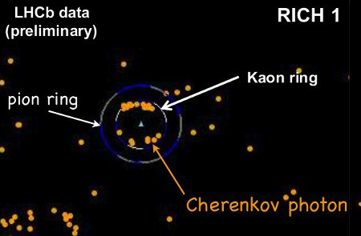
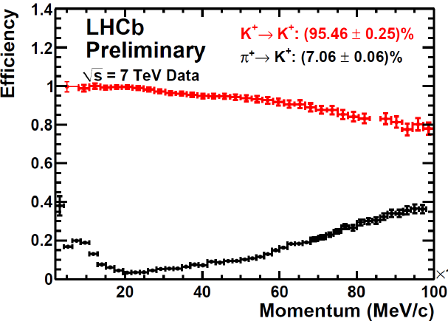
LHCb: π/K separation
Particle identification with the RICH
  About 500 HPD devices, 32x32 cells each.
    ½ million cells!
  A charged particle produces Cherenkov photons, that are located on a ring centred around the track’s position
  2 detectors, the first one with 2 radiators
    Gives π/K separation
    for a large momentum
    range
  Careful alignment required
    The HPD are sensitive to magnetic field
    Variation of the gas refractive index with temperature...

Slide 33
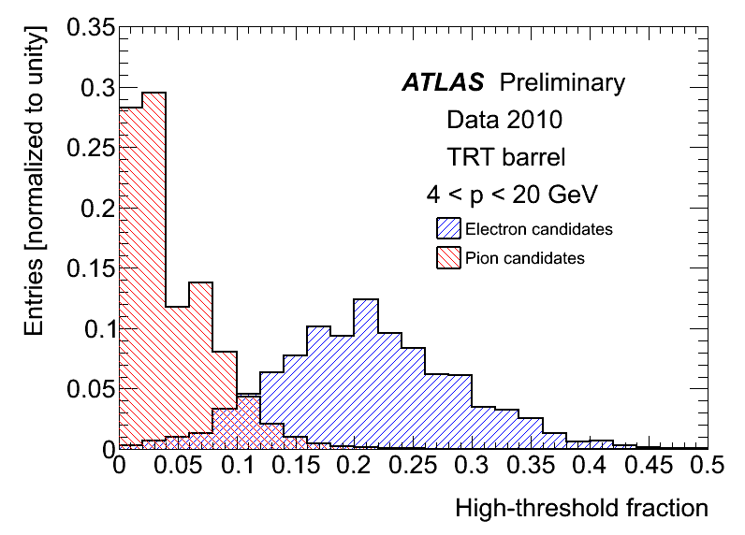
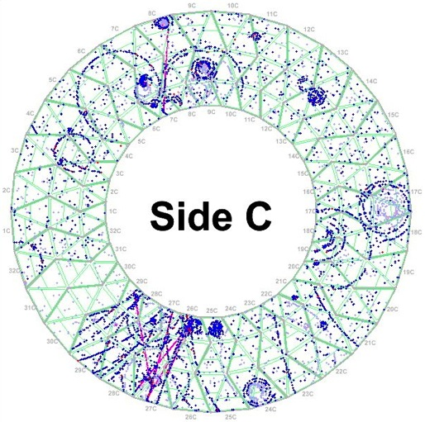
ATLAS TRT: transition radiaton at work
Barrel shown here, same for endcaps
ALICE has equally nice results

Slide 34
ALICE: Material Budget
γ-ray image of ALICE
photon conversion vertices
Notes:
pre-preg

Slide 35
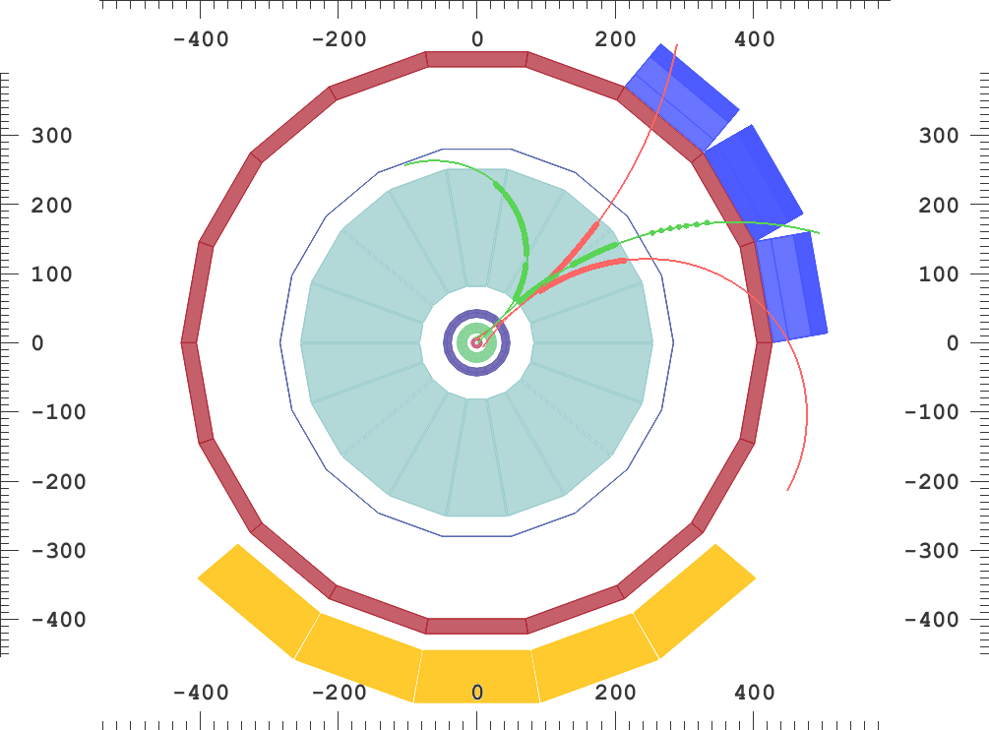
ALICE π⁰ and η (and γ) Reconstruction
pp → π⁰ + X_{n}
γγ
e⁺e⁻e⁺e⁻
(m_{π0} = 0.135 GeV/c², BR = 0.988)
pp → η + X_{n}
γγ
e⁺e⁻e⁺e⁻
(m_{η} = 0.548 GeV/c², BR = 0.393)
e⁺
e⁻
3 independent measurements:
Conversions, PHOS, EMCAL
run 104792, event 2248

Slide 36
ALICE: π⁰ Reconstruction in EMCAL
Reconstruction of πº invariant mass in semi-central Pb-Pb collisions

Slide 37
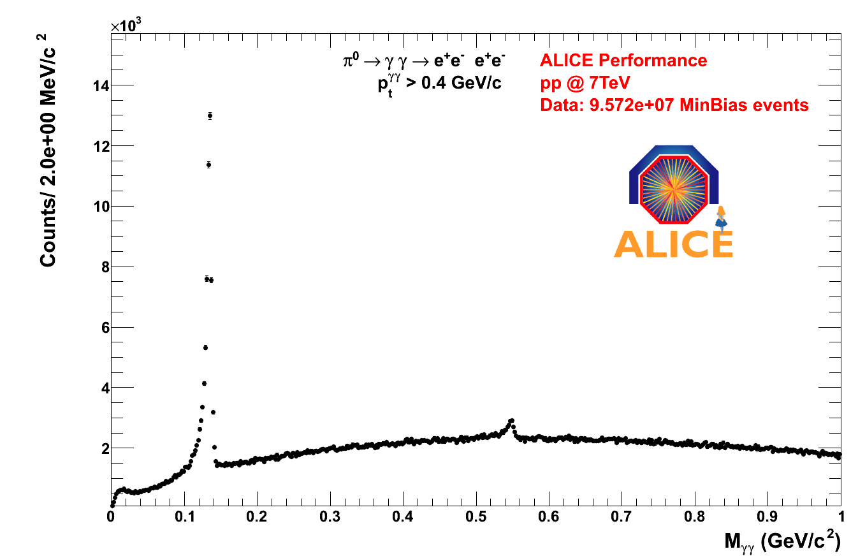
ALICE: π⁰ and η from conversions
π⁰
η

Slide 38
Inventory of Gas detectors
Muon detection and more
Inventory by W. Riegler

Slide 39
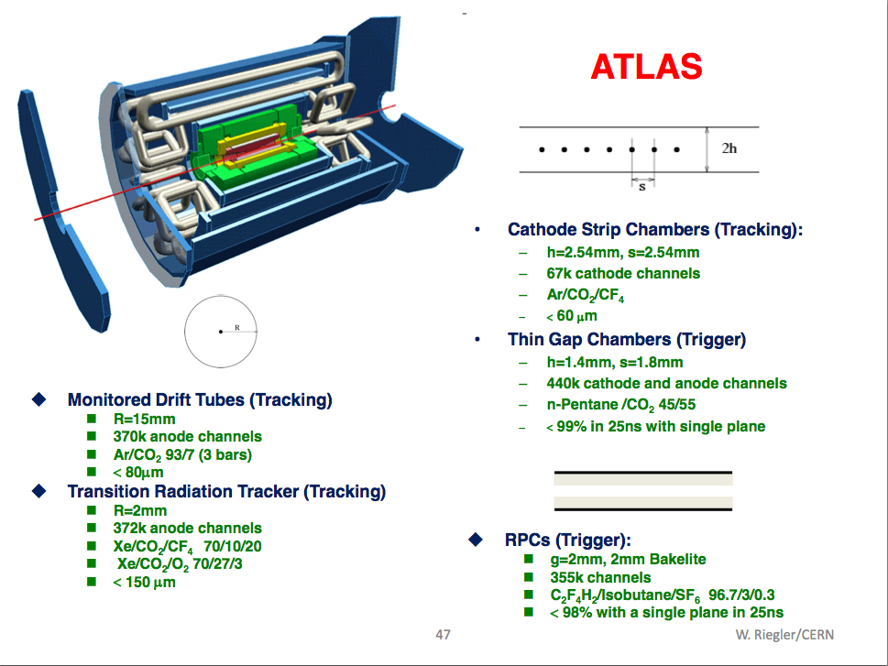

Slide 40
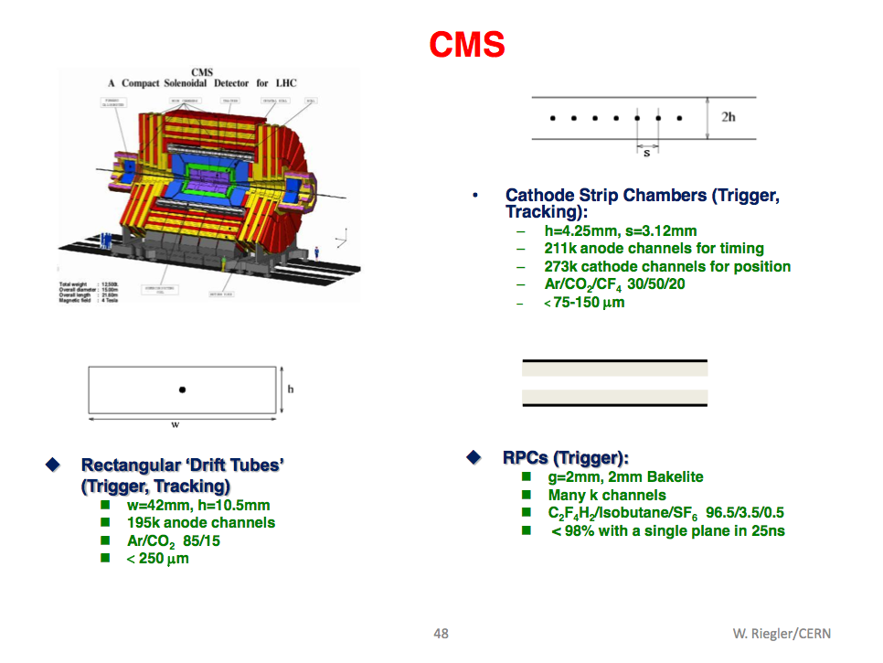

Slide 41
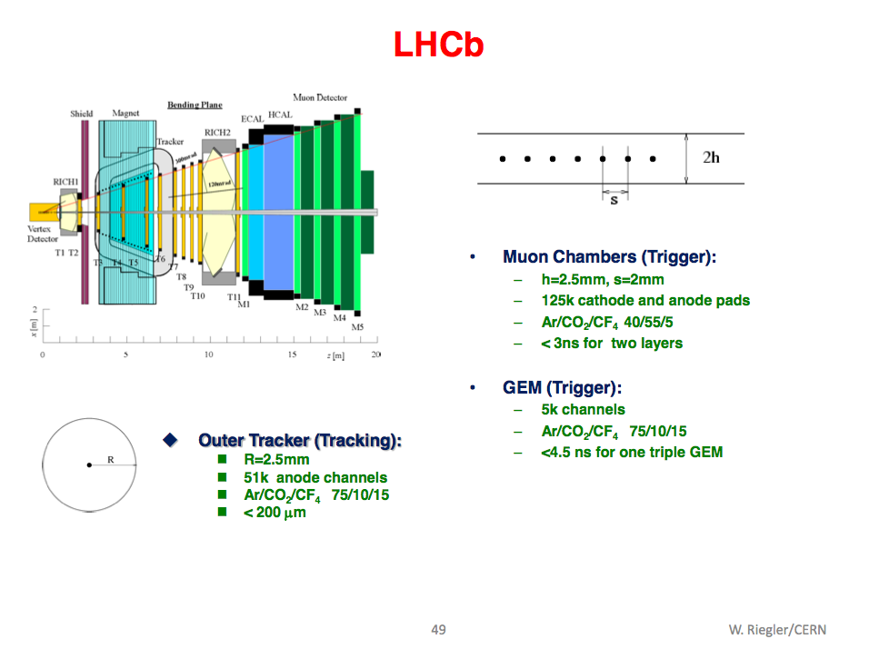

Slide 42
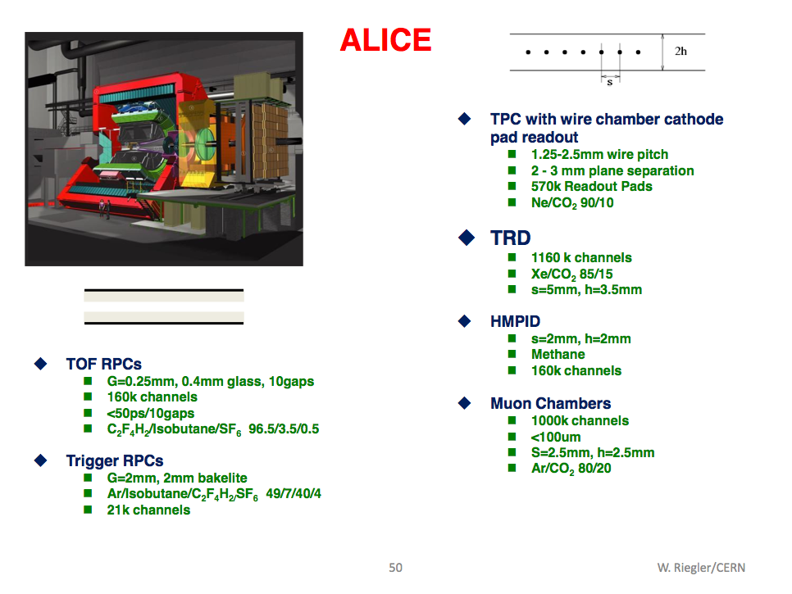

Slide 43
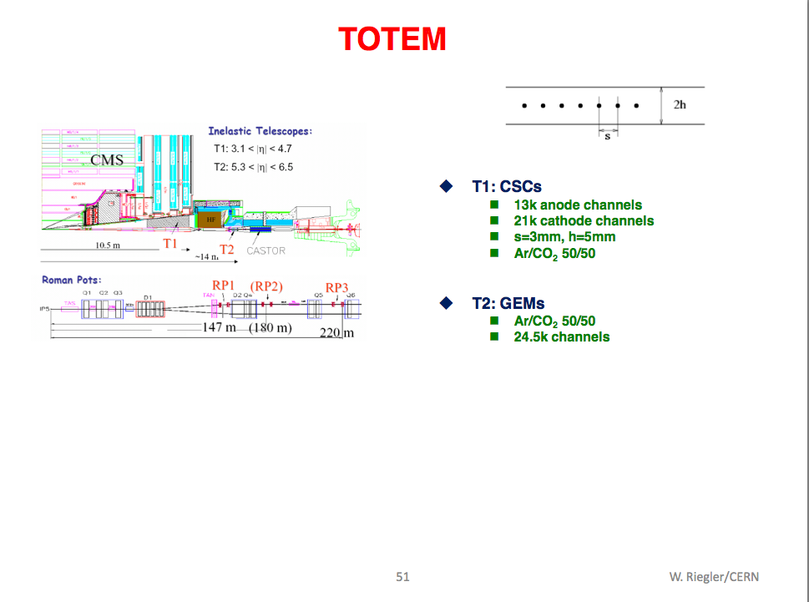

Slide 44
CMS status

Slide 45
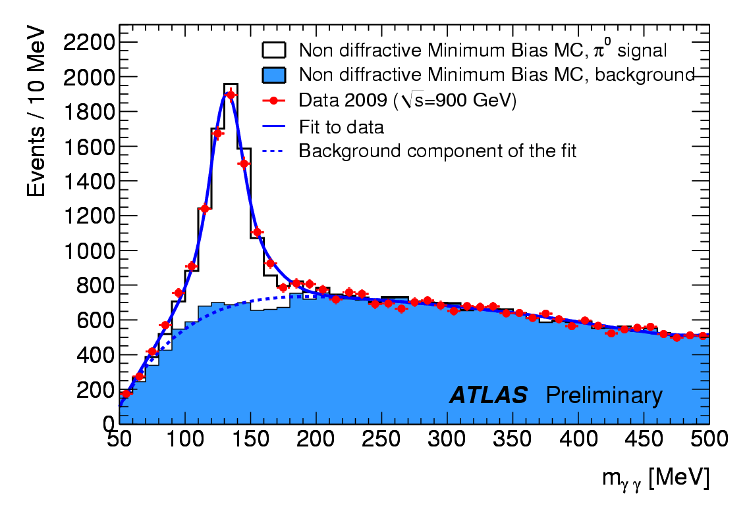
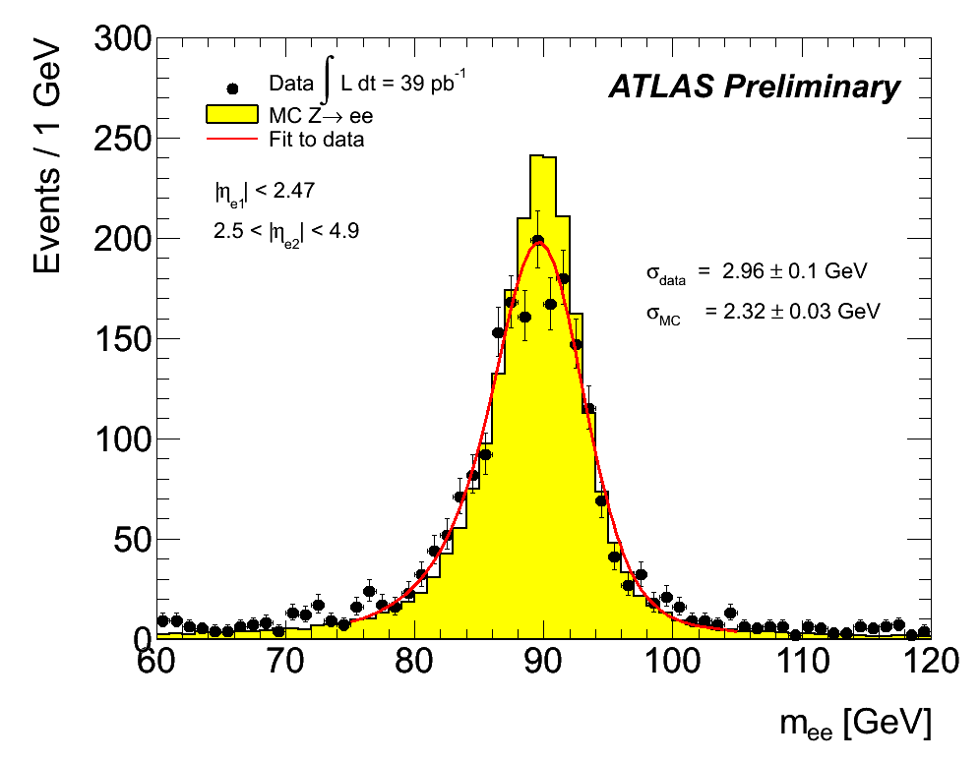
ATLAS: e.m. energy scale
EM scale: initial study/validation from test beam measurements
Checked on π⁰→γγ event (2%)
Rescaled with Z→e⁺e⁻ events (1-2%)
Central forward region Z→e⁺e⁻ mass
reconstruction identification of electrons
at |n|>2.5 beyond tracker acceptance
Events with 2 electrons with E_{T}>20 GeV
with one electron found in the central region
and the other in the forward.
Apply the em energy scale corrections
ATLAS-CONF-2010-006
Capability to reconstruct and
identify e± in the forward region

Slide 46
ATLAS “calibration” particles

Slide 47

Heavy ions in ATLAS

Slide 48
Heavy ions in ATLAS
First direct observation of Jet Quenching
First publication on J/Psi suppression and Z production in HI at LHC.
  Both papers sent to journals before Xmas 2010.
New:
  Measurement of relative yield (wrt most central bin) of W production in HI vs centrality
  + many other new measurements (jet quenching, particle flow etc.)
Atlas Preliminary
Atlas Preliminary

Slide 49
Forward physics detectors
Far from IP

Slide 50

The TOTEM Roman Pot Station
Four Roman Pot Station on both sides of IP5 (± 147m and ± 220m)
Each station is made of two units
Roman Pot Unit
beam injection
stable beams
sensors in garage position
10σ beam
Horizontal Pot Vertical Pots BPM
sensors in data taking position
Beam pipe
Notes:
In its retracted position the Roman pot leaves the full aperture of the vacuum chamber free for the beam, as required at the injection stage when the beam is wide. Once the final energy is attained and the circulating beams are stable, the Roman pot is moved toward the machine axis by compressing the bellow, until the inner edge of the detector reaches a distance of the order of few millimeters from the beam. There is no interference with the machine vacuum.

Slide 51



The TOTEM Edgeless Sensor
Pitch adapter on detector
VFAT / APV25 compatible
VTS
CTS
Technology
Very High Resistivity Si n-type <111>, 300um thick, Vdep ~20V
Standard planar technology fabrication
Dicing with diamond saw
AC coupled strip (punch-through)
Design
Single sided detector, 512 microstrips (pitch 66um)
strips at 45° from the “sensitive” edge
Voltage Terminating Structure (VTS) on non sensitive edges
Current Terminating Structure (CTS) on sensitive edges (50 μm)
~50 μm
Only 50μm from end of strip to end of sensor!!!

Slide 52

Protons, background and radiation dose
Tracks distribution in the vertical RPs (left) and horizontal RP (right).
(note: different colour scale in the two panels)
Radiation dose highest in the horizontals due to diffraction
Higher dose foreseen in the Stations at 147m
Peaked at the detector’s edge and leads to differences of >10⁴ in accumulated dose in the same sensor!!!
Problem: how to determine the life time of the sensors?

Slide 53

LUCID detector principle

Slide 54
LUCID results
The instantaneous luminosity measured by LUCID at 7 TeV for 8 different colliding bunches in the machine.
The plot shows that the time development of the different bunches is different. The bunch-to-bunch variations in the luminosity is up to 40% at the start of the fill

Slide 55


ATLAS ZDC
The ZDC has been designed and optimized for low luminosity HI run (nominal L=10²⁷ cm⁻² s⁻¹ and nominal bunch spacing= 100 ns) :
  Event characterization via the detection of the spectator neutrons
  Orientation of the reaction plane
  Minimum bias trigger
  Luminosity monitoring measuring the rate of the mutual electromagnetic dissociation in the neutron channel
In the picture correlation between the total transverse energy deposited in ATLAS calorimeters and the amplitude signal from the ATLAS ZDC.
  The correlation seen corresponds to the interplay between hadronic interations of the colliding nuclei and Coulomb interactions of the colliding nuclei in Ultra-Peripheral Collisions

Slide 56
H->γγ
No significant excess seen
  New Limit≈(4.2-15.8)×SM
CL
2011 data
PCL
2011 data

Slide 57

ATLAS: Higgs combination

Slide 58

LHCb results: new decay modes
  First observation of
  Branching ratio
    BR( )/BR( ) = 3.0 ± 0.6 ± 0.4
LHCb preliminary

Slide 59




LHCb: CP asymmetries
Raw asymmetries are clear: particle/antiparticle
Selection optimized
for A_{CP}(B⁰→Kπ)
Asymmetry = -0.095 ± 0.011
B⁰
Selection optimized
for A_{CP}(B_{S}⁰→πK)
Asymmetry = 0.28 ± 0.08
B⁰_{S}
  A_{CP}(B_{S}⁰ →π⁺K⁻) = 0.27 ± 0.08 (stat) ± 0.02 (syst) (preliminary)
    First evidence of CP violation in B_{S}→πK

Slide 60



ALICE: D⁰ and D⁺ reconstruction in Pb-Pb
Pb – Pb collisions (2010)
2.76 TeV/nucleon (≈ 30 M events MB)
How to find a charm decay in such an environment?
Thanks to the Inner Tracking System impact parameter resolution this is possible

Slide 61

ATLAS trigger operations
Trigger organized in 3 levels
  LVL1 (50 KHz): Hardware
  LVL2 (4 KHz): Software on reduced granularity (regions of interest)
  EF (≈300 Hz): Based on Offline Reconstruction Full Granularity
Rates of physics objects very well understood and under control.
Recorded physics rate ≈300 Hz

Slide 62

ATLAS: Analysis jobs on the GRID
10Gb/s peak during data and MC processing (although 2GB/s design)
>1000 users analyzing data on the GRID
Totality of data and MC reprocessing during LHC data/taking

Slide 63
ATLAS upgrades
Phase1 – 2017/18 – 2x design Luminosity
  Increase of cavern background: fix muon spectrometer
    Innermost forward wheel with improved rate capabilities and insertion in L1 trigger. Candidates: MDT, TGCs, μMegas
  LAr calorimeter: high rate in forward region
    Placing a warm calorimeter in front of FCAL. Cu absorber and diamond sensors on ceramic
  L1&L2 trigger upgrade
    Topological trigger for L1
    Fast track finding and fitting at L2
Phase2 – 2022 – 5x design luminosity
  Magnets, muon, calorimeters mostly OK
  Changes
    Trigger and DAQ
    Some Muon chambers for high bkg rate
    Possible endcap and forward calorimeters
    New calorimeter readout for trigger upgrade
    New Inner Detector

Slide 64
CMS upgrades
Phase1 – 2017/18 – 2x design Luminosity
  New 4-layers Pixel: limitations at 2E34 cm⁻² s⁻¹, inner regions need replacement after 350 fb⁻¹. Material reduction
  Trigger upgrade: regional calorimeter trigger, μTCA-based infrastructure for higher BW, faster FPGA and additional channels for muon trigger
  DAQ to adress larger data size and readout channels
  Beam Instrumentation and luminosity monitoring
  Common infrastructure: beam pipe, safety systems, shielding
Phase2 – 2022 – 5x design luminosity
  Building on Phase1 upgrade work
  Replacement of the Inner Detector
    R&D on sensors, CO₂ cooling, power distribution, trigger functionality
  Work on Muon system: replacement of ASICs with FPGA for CSCs, new chambers to extend RPC η range (R&D on GEMs)
  Calorimeter readout: replace HPD with SiPM, more rad-hard PMTs and with MAPMTs (thinner window); depth segmentation in HB/HE
  Trigger electronics upgrades: 2x latency, L1 tracking integration

Slide 65
ALICE upgrades
Motivations
  Open physics issues not addressed by current setup: increase of coverage and measurement capabilities
    Heavy flavour production, hadronization, p and nuclei small-x, large range rapidity correlations
Inner Tracking System and Muon Forward Tracker
  Heavy flavour baryons, charm coverage at low p_{T}, b-tagging for muons, measurements of exclusive B-decays
  Modification of beam pipe and integration of the MFT with the ITS
  Technology change proposal for MFT: monolithic pixels
  Reduction of beam pipe diameter and innermost layer at 20-22 mm
  Reduction of material budget and pixel size (20-30 μm in rφ, possibly in z)
  3 pixel layers followed by 3-4 strip layers
  Trigger capabilities (L2 ~ 100 μs): topological trigger, fast-OR and fast-SUM at L0/L1 (1.2 μs/7.7 μs)
  Increased acceptance (|η| > 0.9)

Slide 66
ALICE upgrades
Forward e.m. calorimeter (FOCAL)
  Low-x in pA, AA, photon/pion discrimination
  Large rapidity coverage (2.5 < η < 4.5)
  π⁰/γ discrimination at ~ 200 GeV/c, high granularity, at ~ 350 cm from IP
  Si+W based calorimeter, Si pads or pixels
Particle ID upgrade (VHMPID)
  Extend p_{T} range to O(20) GeV/c
  Focusing RICH with spherical or parabolic mirror; C₄F₁₀ radiator; photon detector MWPC with CH₄ using CsI photocathode or thick GEM and CsI coating; same readout as HMPID
TPC readout upgrade
  Faster gas, increased readout speed: increased rate capabilities
DAQ and HLT upgrades
  More sophisticated and selective triggers

Slide 67
LHCb upgrades in ~ 2018
Goal for the first phase s to reach 5 fb⁻¹ before the 2nd LHC shutdown
Need of increasing L0 efficiency at increasing luminosity
  40 MHz DAQ readout rate and fully software trigger
Rebuild of all silicon detectors (now 1 MHz readout)
  New VELOPIX (Diamond 55 μm square pixels, TimePIix FE)
  Strip detector with 30 μm pitch
  OT straws ok, replace IT and TT Si-strip with Si-strip and new FE at 40 MHz or 250 μm SciFi tracker with far SiPMT
May be remove too occupied detectors
  RICH1-aerogel, M1, SPD and PS
Improve PID at low momenta
  Replace HPD with MAPMTs for readout and 40 MHz ASICs
  TORCH: TOF based on 1 cm quartz plate for PID of p < 10 GeV hadrons cmbined with DIRC technology
Calorimeters: replace FE
Muons already at 40 MHz, remove M1, place for TORCH
  Investigations on MWPC ageing and rate limitations
In this way expand the physics program:
  Lepton flavour physics
  Electroweak physics
  Exotic searches

