Slide 1


The Argontube, a R&D liquid Argon Time Projection Chamber
Christoph Rudolf von Rohr
Albert Einstein Center for Fundamental Physics
Laboratory for High Energy Physics
University of Bern
On behalf of:
I. Badhrees, A. Ereditato, S. Janos, I. Kreslo, M. Messina, S. Haug, B. Rossi, C. Rudolf von Rohr, T. Strauss, M. Weber, M. Zeller

Slide 2
Content
Principle of a LAr TPC
Large volume LAr TPC (100kT)
The Argontube
  Facts and figures
  MC-simulation of cosmic muons
  Readout system
  Providing HV
Module test of Argontube (latest development)
Next steps
(Liquid argon -> LAr)

Slide 3
Principle of a LAr TPC
Properties:
Side view:
3D-Tracking device
Fully homogeneous detector
Only two readout planes
Readout electronically
LAr provides scintillation light (5000 photons/mm at 128nm)
Deposited energy proportional to collected charge (6000 e⁻/mm)
Drift speed 2 mm/μs with E=1kV/cm
(For minimum ionising muons)
Wire planes
e⁻
E
γ
Ar⁺

Slide 4
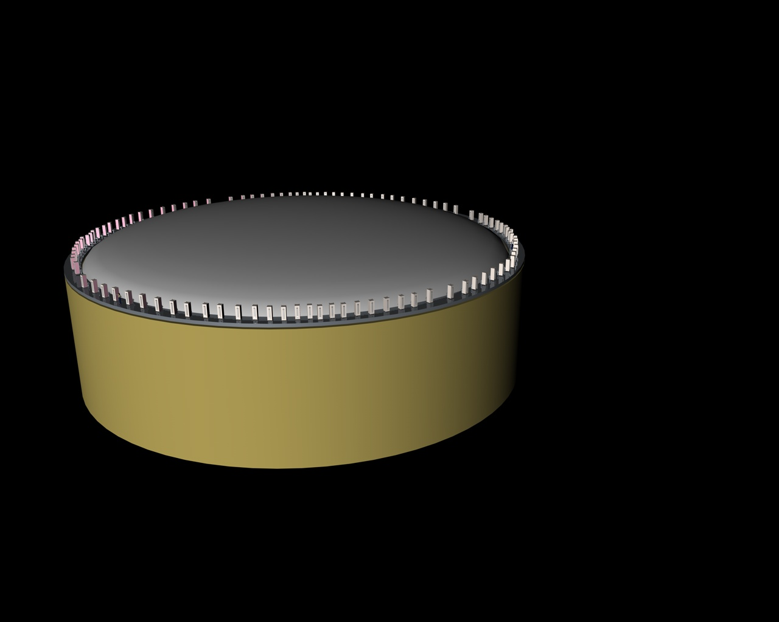
Glacer 100kT LAr TPC
Possible measurements
Neutrino oscillation
  CP-violation
  Supernova neutrinos
  Mass hierarchy
Proton decay (GUT)
d≈70 m
h =20 m
Passive perlite insulation

Slide 5
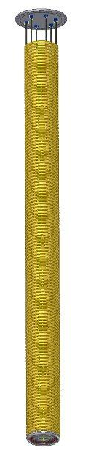
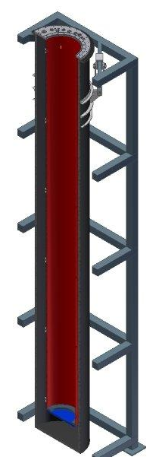
The Argontube
Goals of Argontube:
Proof feasibility of 5m drift length
  Cathode voltage of 500kV
  Signal to noise ratio >10
  Impurities in LAr <0.1ppb
Technical studies
  Tracks of 5m
  Purity measurements
  Electron diffusion measurement
  Test new readout systems
Physics studies
  Muon decays (energy spectrum)
  Gamma rays from LinAc (Igor Kreslo)

Slide 6
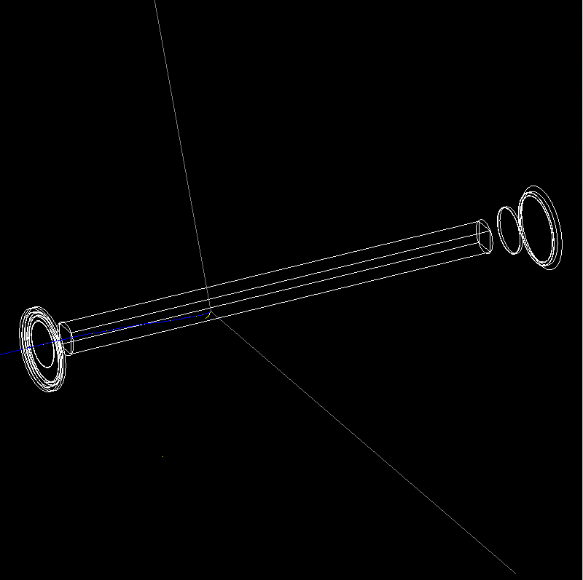
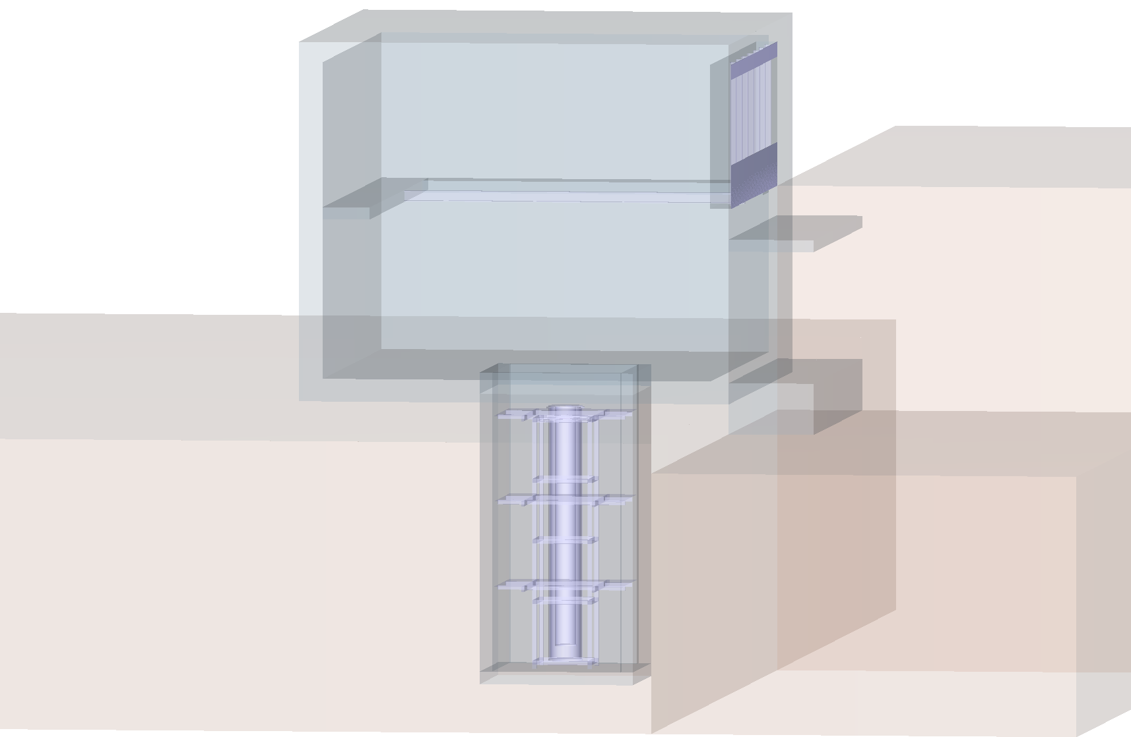
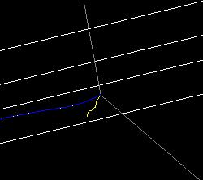
Monte Carlo of cosmic muons (GEANT4)
MC Parameters
Muon decay event
Active mass: 280kg
Simulation time: 90.8s
Muon hit rate: 78.4s⁻¹
Muon decay rate: 1.8s⁻¹

Slide 7
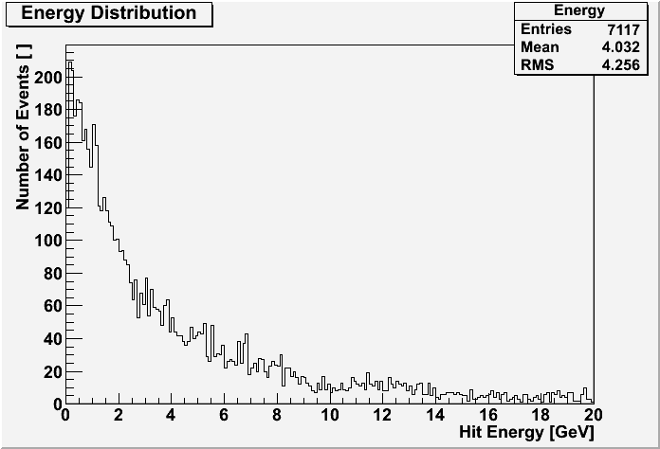
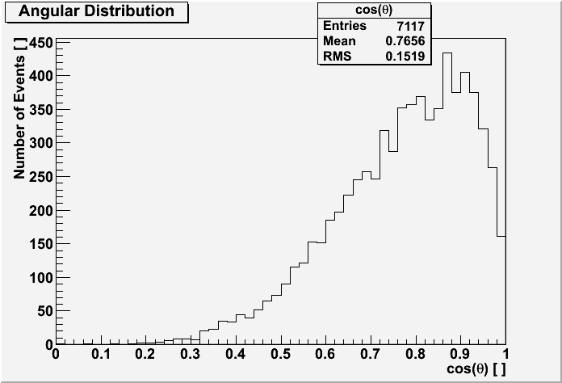
Monte Carlo of cosmic muons (Geant4)

Slide 8
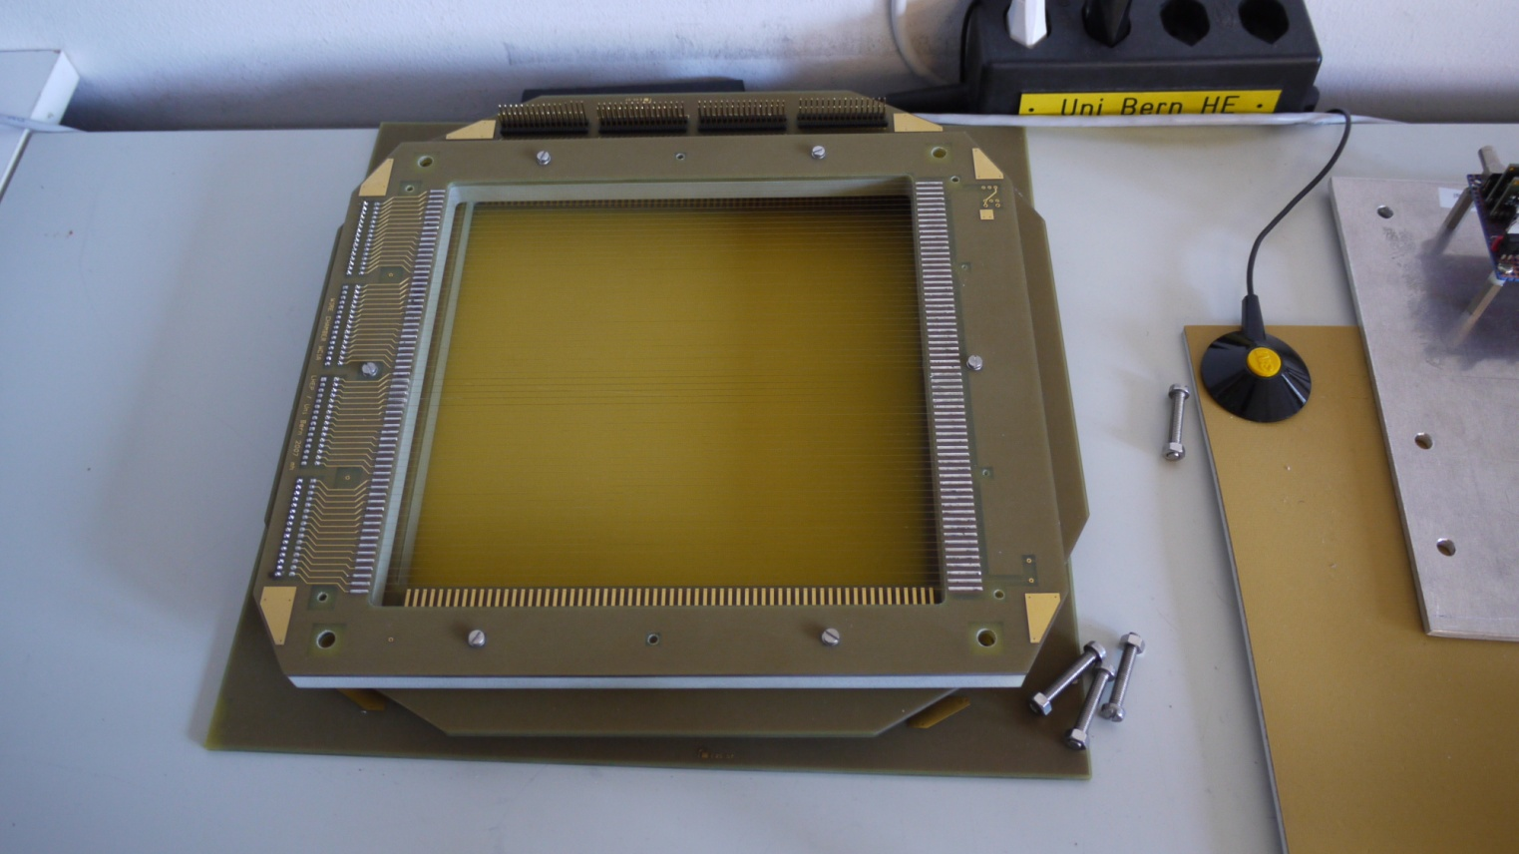
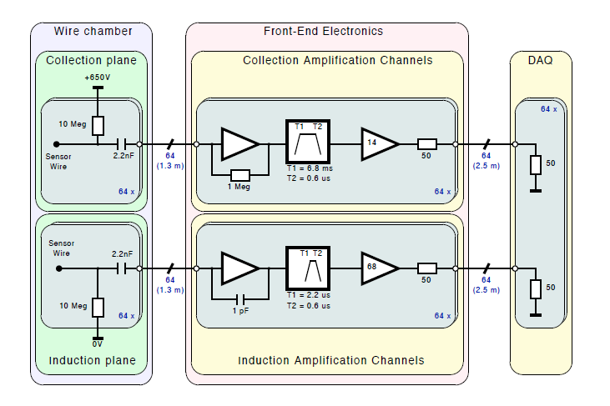
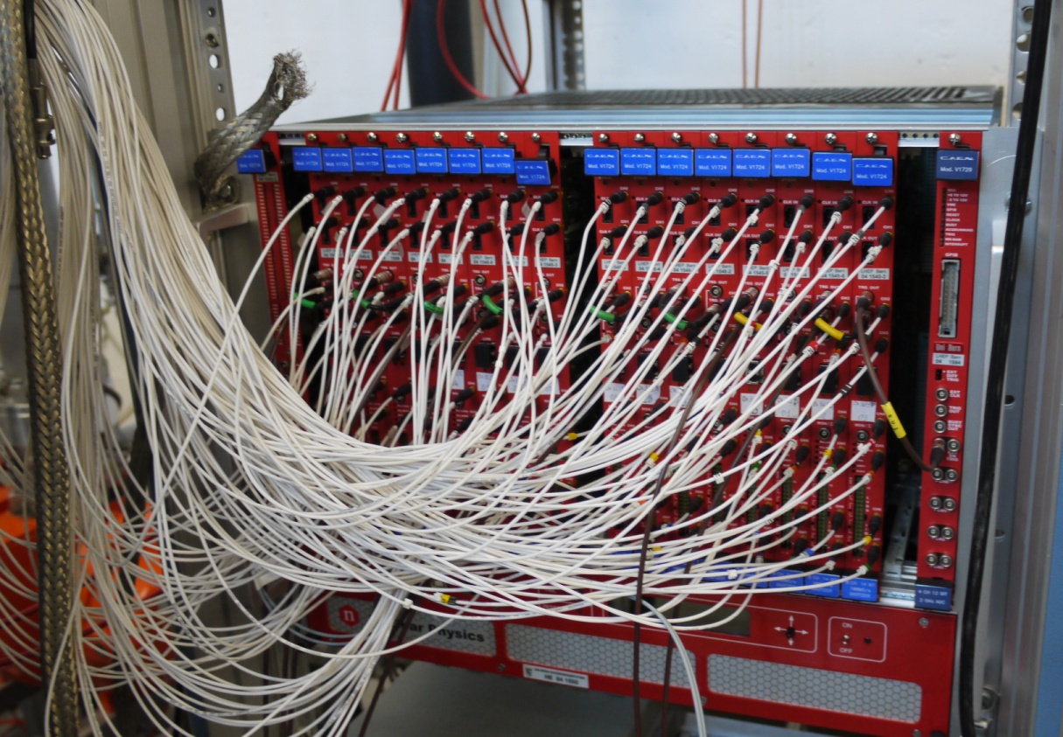
Readout System
Readout plains (x,y-plane) transverse coordinate resolution >3x3mm²
ADC time sampling >10ns (0.1mm resolution on time coordinate)
20cm
20cm
ADCs

Slide 9
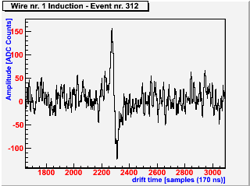
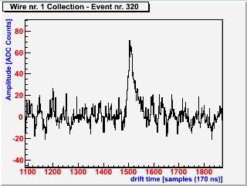
Output signal
Induction wire
Collection wire
Measures induction current
Bipolar signal
Measures collected charge
Polar signal

Slide 10
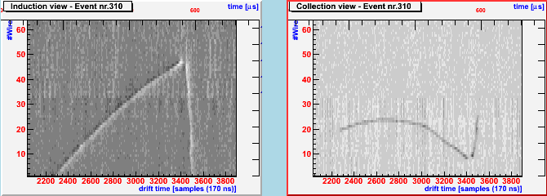
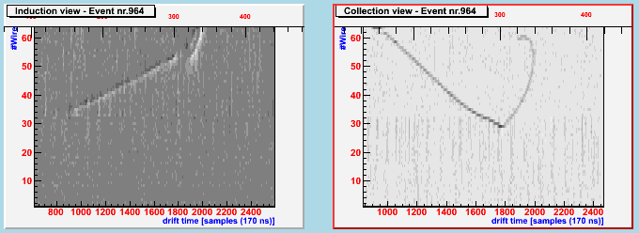
Output signal (muon decay events)

Slide 11
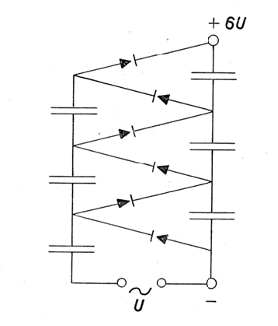
Technical issue: Voltage
Problem:
To feed 100 to 500kV into a vessel with argon atmosphere is hard to achieve
Solution:
Feed in only 4kV AC
Produce voltage inside the TPC using a Greinacher/Cockcroft-Walten circuit

Slide 12
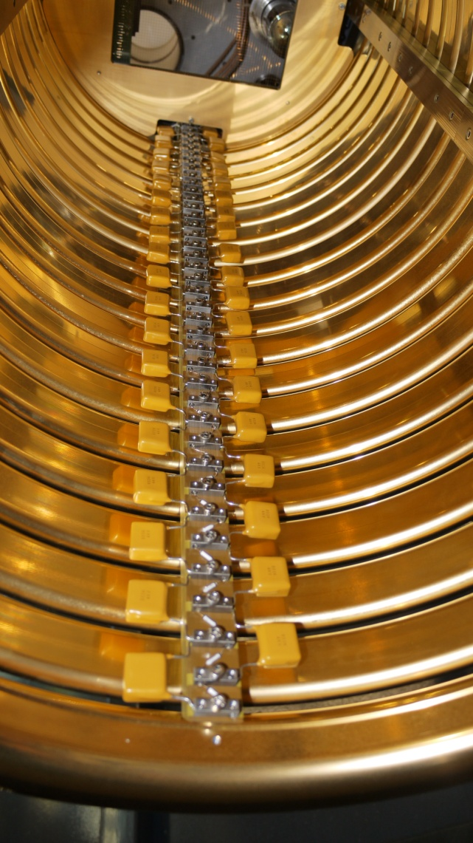
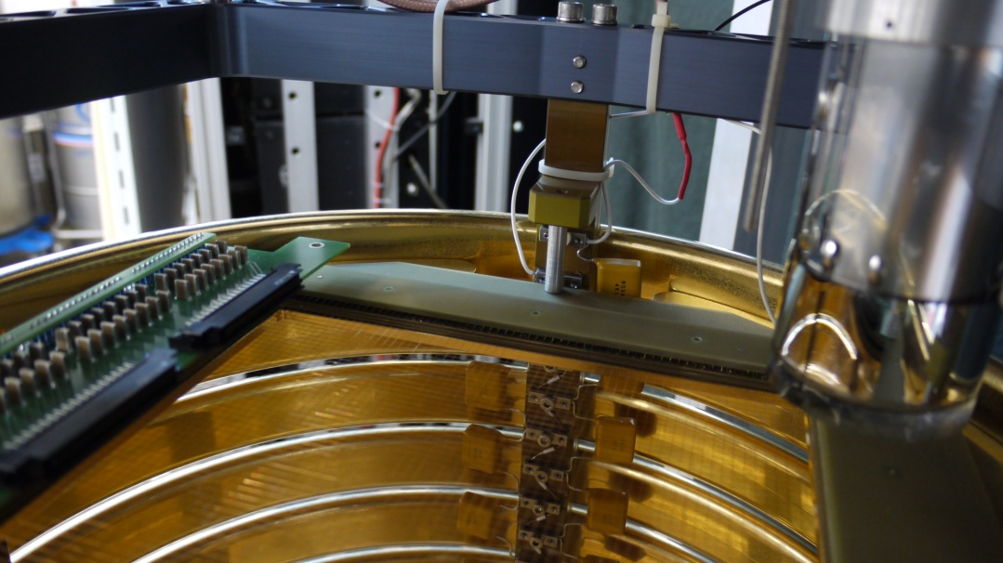
Greinacher/Cockcroft-Walten circuit

Slide 13
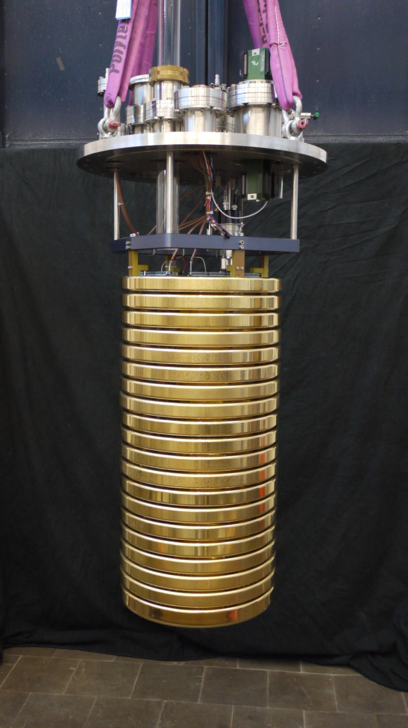
Module tests of Argontube
Tests of …
… redesigned field shaping rings
… new mechanical parts
… Greinacher/Cockcroft-Walten circuit with 19 stages
Results of the tests:
Uniform electric field
Structure is stable
Cathode voltage of 76kV DC has been reached (1kV/cm)
Voltage was very stable
76cm

Slide 14
Next steps
Some more module tests of 76cm drift
  Try to protect circuit from discharges
  Optimising procedures
  Test of new amplifiers
First assembly of the 5m TPC before end of this year
... and make it work!

Slide 15
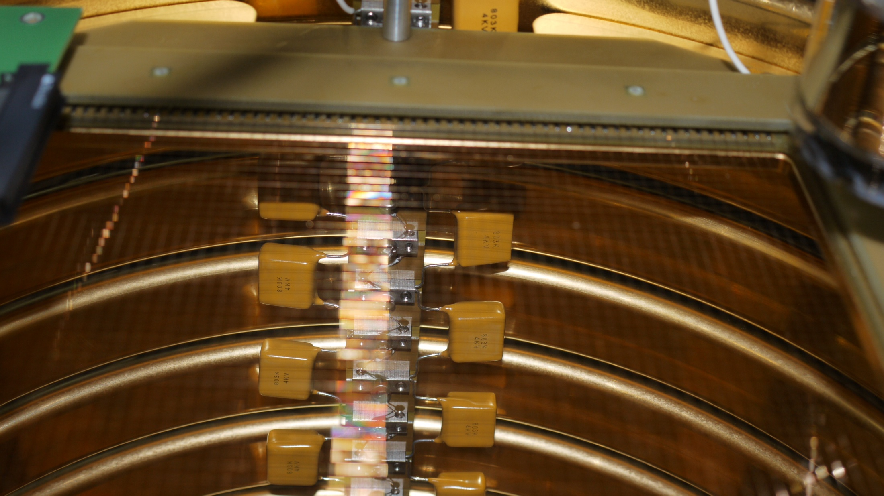
Thank you for your attention!

Slide 16
Backup slides:

Slide 17
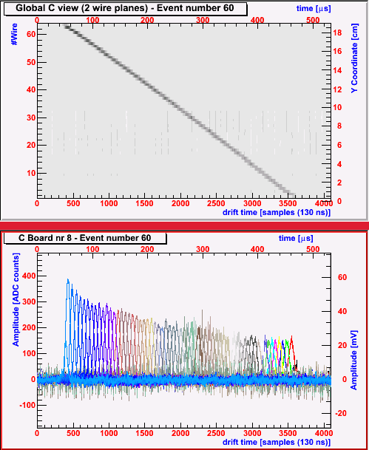
Technical issue: Purity of LAr
Issue:
Electronegative molecules capture electrons (lower charge life time)
Needed:
Charge life time > 2.5ms, less than 0.1ppb impurities
Achieved:
Laser measurements: charge life time ~2ms (too small chamber)

Slide 18
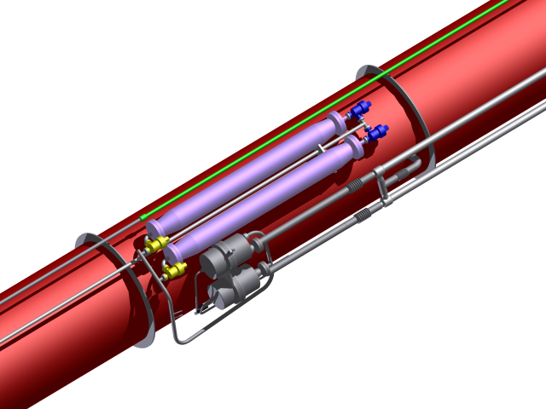
Technical issue: Purity of LAr
Recirculation system
  Pneumatic pumps
  Oxy- and Hydrosorb filters
  100 l/h rate of pump

Slide 19
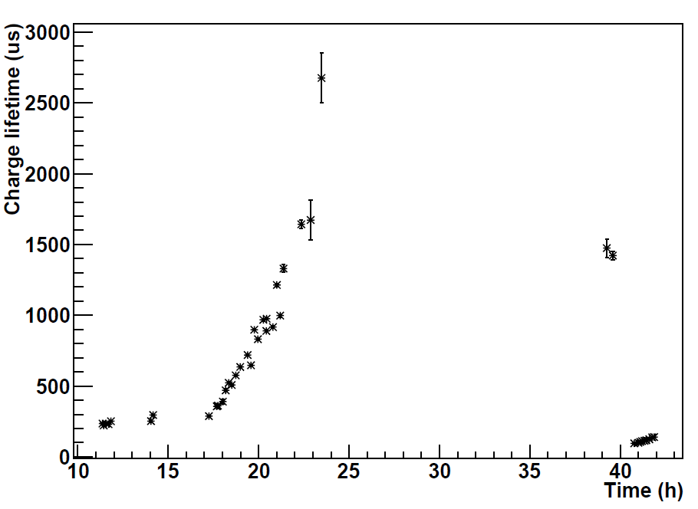
Purity Measurement

Slide 20
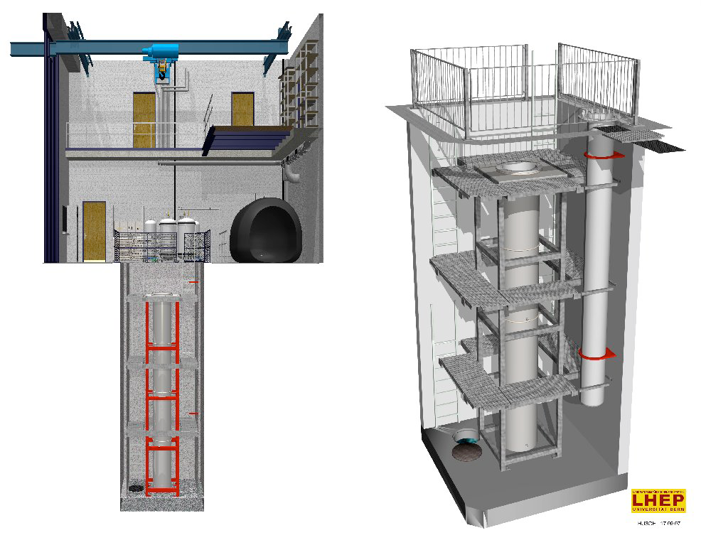
The Argontube
Dimensions of Argontube
Drift length: 5m
Cathode Voltage: 500kV
Active volume: 0.2m³
Active mass: 280kg
Full drift time: 2.5ms
Temperature: 87K
Outer volume: 1.2m³
Inner volume: 1.1m³

Slide 21
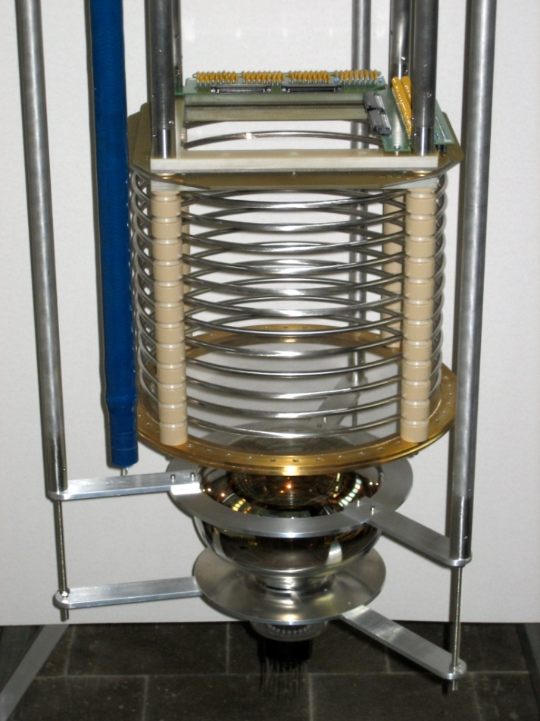
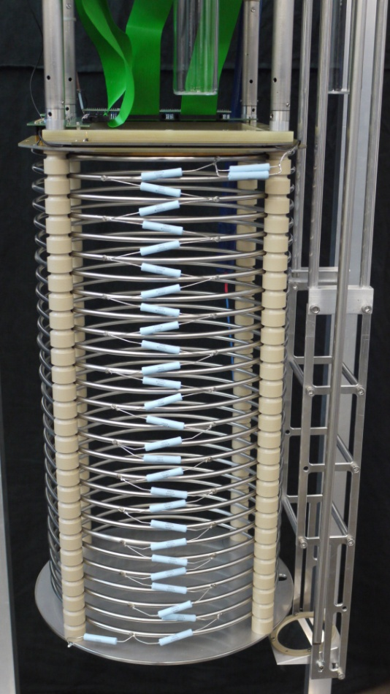
Evolution of LAr TPCs in Bern
Medium Argontube
Medium Argontube +
25cm
57cm

