Slide 1
Performance of the present
ALICE Inner Tracking System and studies for the upgrade
9th International Conference on Position Sensitive Detectors
Aberystwyth 12th - 16th September 2011
Giacomo Contin
Universita’ degli Studi di Trieste & INFN Sezione di Trieste
On behalf of the ITS collaboration in the ALICE experiment at LHC

Slide 2
Summary
System overview and tasks
Hardware features
Physics performance in p-p and Pb-Pb
Outlook on the ITS upgrade studies

Slide 3
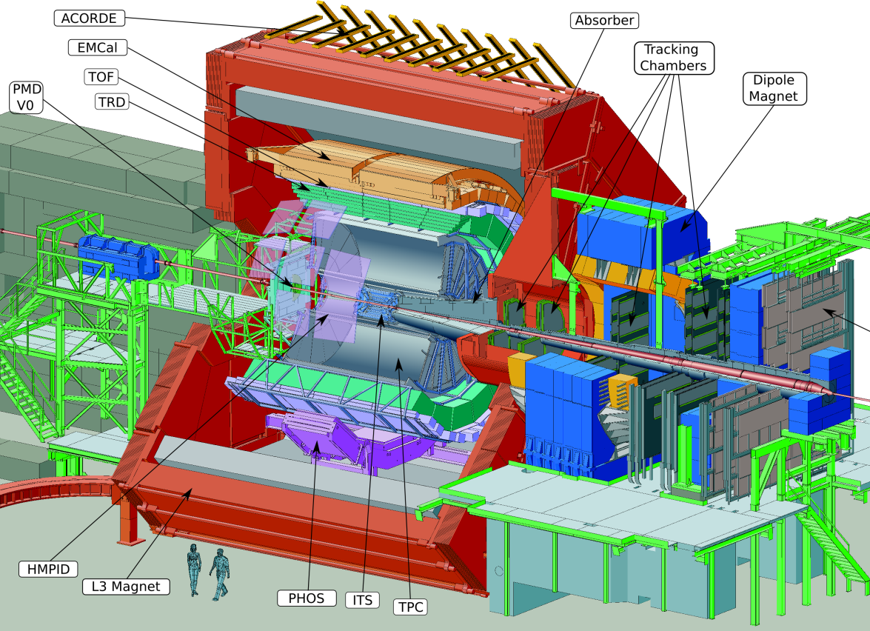
The ALICE experiment
Dedicated heavy ion experiment at LHC
Study of the behavior of strongly interacting matter under extreme conditions of high energy density and temperature
Proton-proton collision program
    Reference data for heavy-ion program
    Genuine physics (momentum cut-off < 100 MeV/c, excellent PID, efficient minimum bias trigger)
Barrel Tracking requirements
Pseudo-rapidity coverage |η| < 0.9
Robust tracking for heavy ion environment
  Mainly 3D hits and up to 150 points along the tracks
Wide transverse momentum range (100 MeV/c – 100 GeV/c)
  Low material budget (13% X₀ for ITS+TPC)
  Large lever arm to guarantee good tracking resolution at high p_{t}
PID over a wide momentum range
Combined PID based on several techniques: dE/dx, TOF, transition and Cherenkov radiation

Slide 4
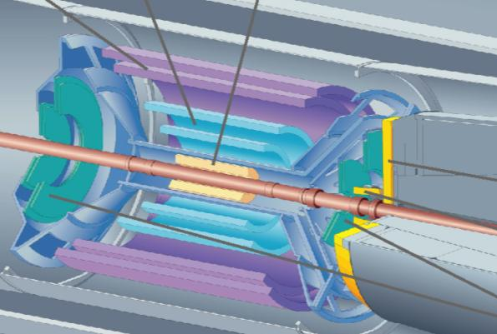
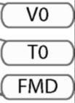

ALICE
Central Barrel
2 π tracking & PID
Δη ≈ ± 1
Detector:
Size: 16 x 26 meters
Weight: 10,000 tons
Collaboration:
> 1000 Members
> 100 Institutes
> 30 countries
4

Slide 5
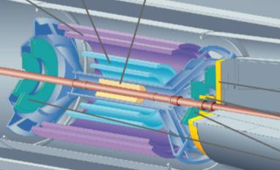
The ALICE Inner Tracking System
ITS: 3 different silicon detector technologies
The ITS tasks in ALICE
Secondary vertex reconstruction (c, b decays) with high resolution
  Good track impact parameter resolution < 60 µm (rφ) for p_{t} > 1 GeV/c in Pb-Pb
Improve primary vertex reconstruction, momentum and angle resolution of tracks from outer detectors
Tracking and PID of low p_{t} particles, also in stand-alone
Prompt L0 trigger capability <800 ns (Pixel)
Measurements of charged particle pseudo-rapidity distribution
  First Physics measurement both in p-p and Pb-Pb
Detector requirements
Capability to handle high particle density
Good spatial precision
High efficiency
High granularity (≈ few % occupancy)
Minimize distance of innermost layer from beam axis (mean radius ≈ 3.9 cm)
Limited material budget
Analogue information in 4 layers (Drift and Strip) for particle identification in 1/β² region via dE/dx
Strip Drift Pixel

Slide 6
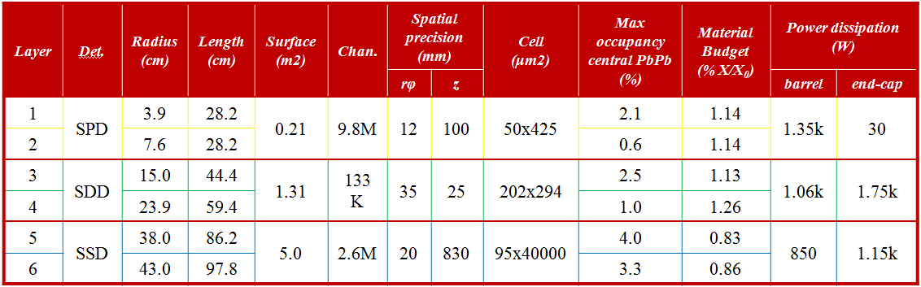
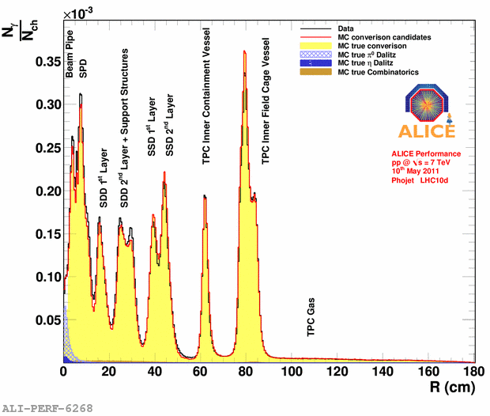
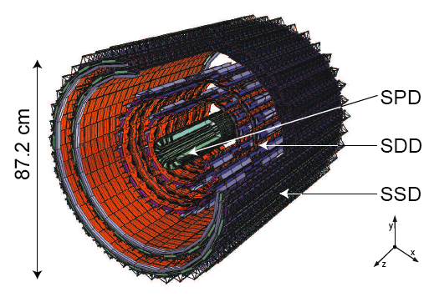
The ITS parameters
v
v
v
v
Accurate description of the material in MC

Slide 7
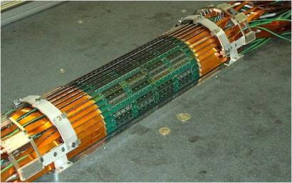
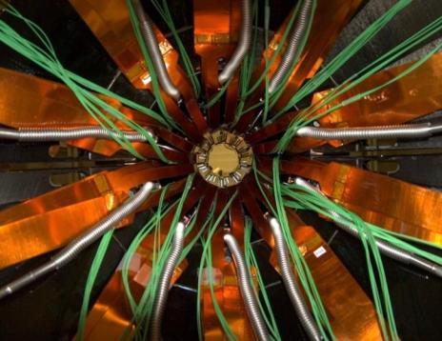
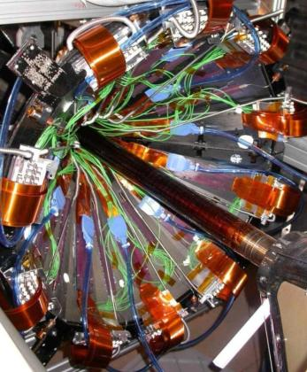
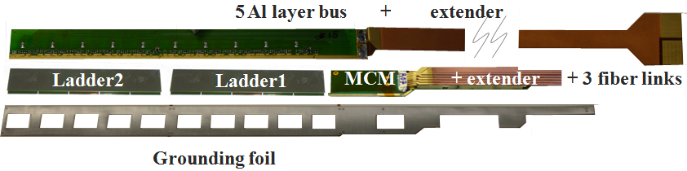
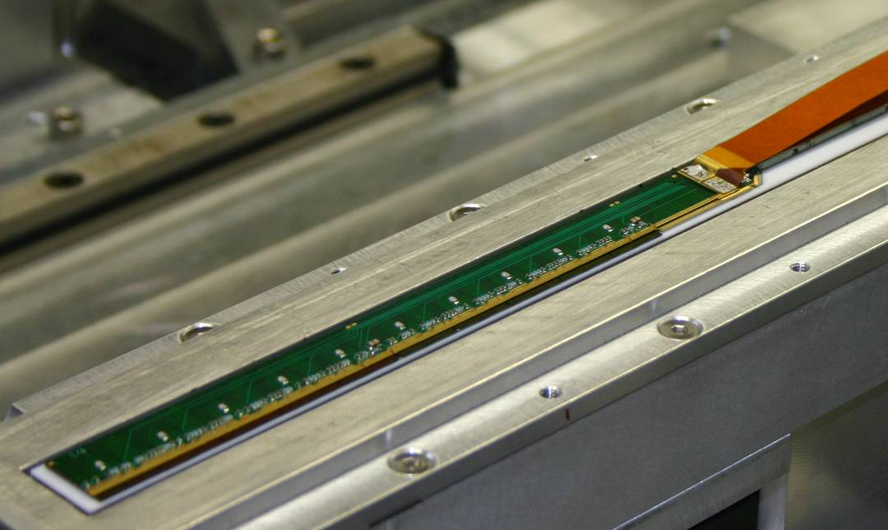
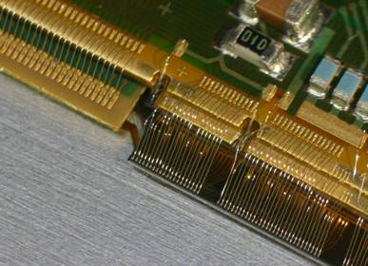
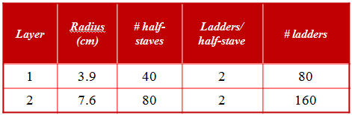
SPD - Silicon Pixel Detector
2 layers of pixels grouped in 2 half barrels mounted face to face around the beam pipe
Half-barrel: outer surface
beam pipe
Half-stave
Total surface: ~0.24m²
Power consumption ~1.4kW
Evaporative cooling C₄F₁₀
Operating at room temperature
Fast two-dimensional readout (256µs)
High efficiency (> 99%)
L0 trigger capability
Material budget per layer ~1% X₀
≈ 1200 wire-bonds

Slide 8
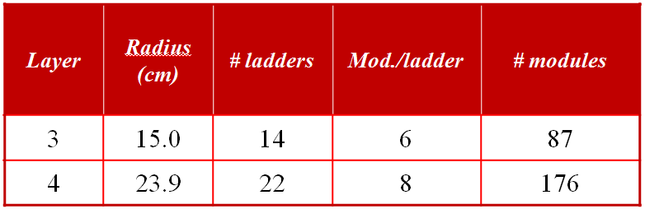
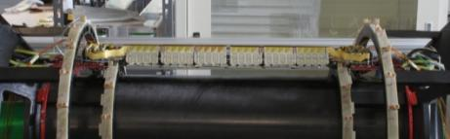
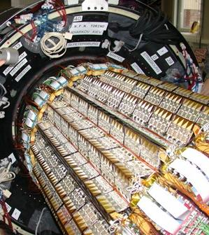
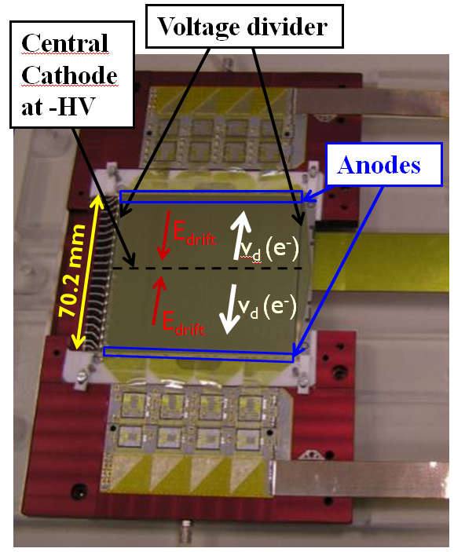
SDD - Silicon Drift Detector
Cables to power supplies and DAQ
Cooling (H₂O) tubes
SDD Barrel
Carbon fiber support
←HV supply
Front-end electronics (4 pairs of ASICs)
Amplifier, shaper, 10-bit ADC, 40 MHz sampling
Four-buffer analog memory
← LV supply
Commands
Trigger
→ Data

Slide 9
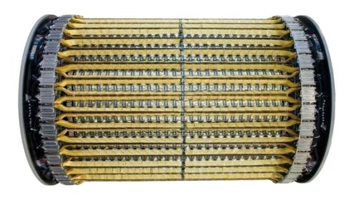
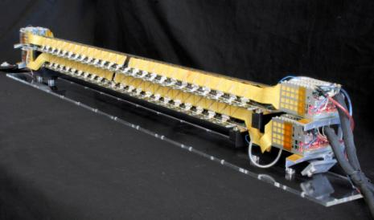
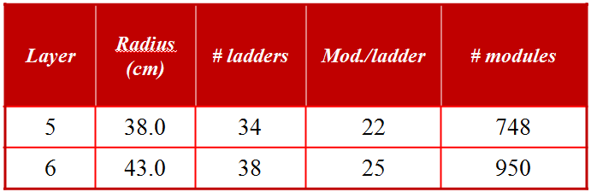
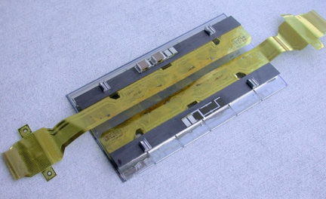
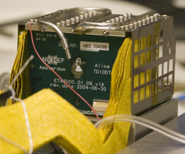
SSD - Silicon Strip Detector
carbon fibre support
module pitch: 39.1 mm
Al on polyimide laddercables
Hybrid:identical for P- and N-side
Al on polyimide connections
6 front-end chips HAL25
water cooled
Sensor:
double sided strip:
768 strips 95 um pitch
P-side orientation 7.5 mrad
N-side orientation 27.5 mrad
End ladder electronics

Slide 10
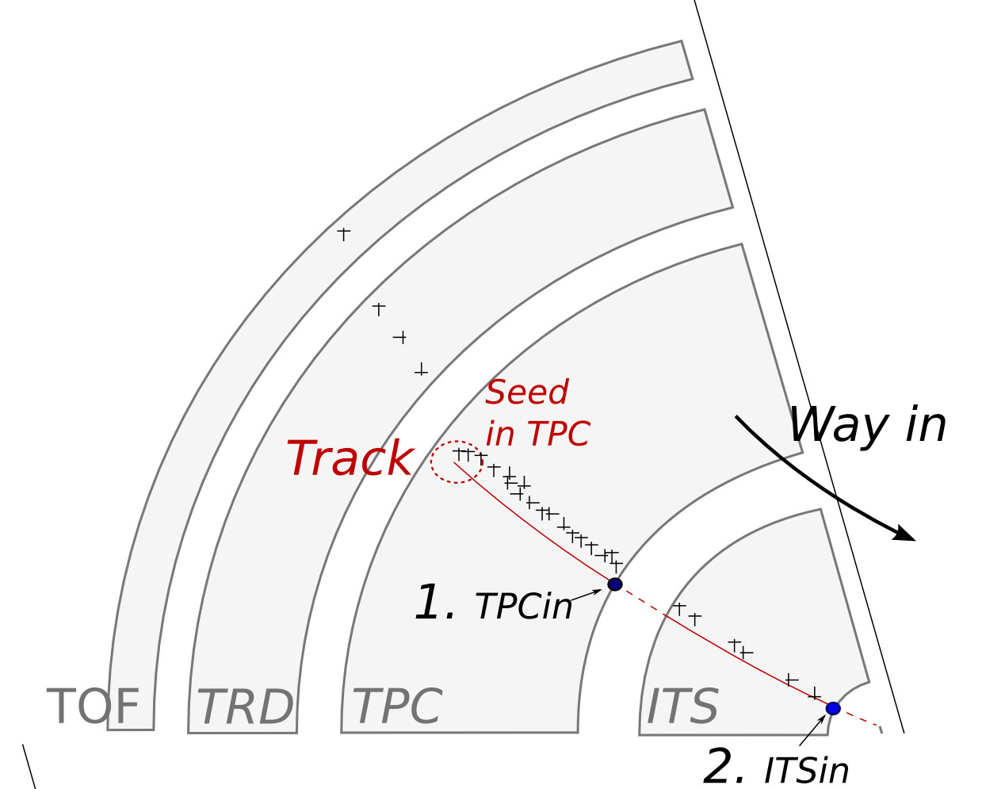
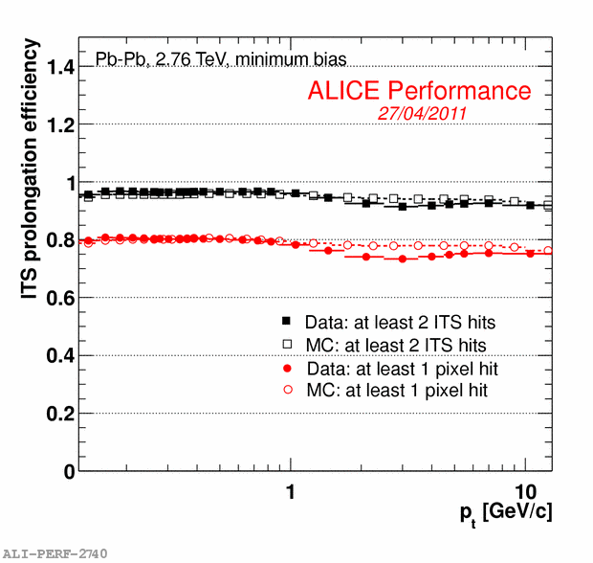
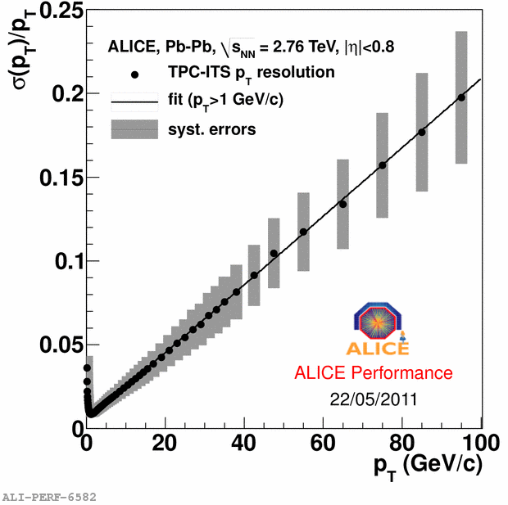
Tracking strategy and performance
“Global”
Vertex with SPD (tracklets method)
Seeds in outer part of TPC @lowest track density
Inward tracking from the outer to the inner TPC wall
Matching the outer SSD layer and tracking in the ITS
Outward tracking from ITS to outer detectors → PID
Inward refitting to ITS → Track parameters OK
Refining vertex with optimal resolution (tracks method)
p_{t} resolution
“ITS stand-alone”
Recovers not-used hits in the ITS layers
Aim: track and identify particles missed by TPC due to p_{t} cut-off, dead zones between sectors, decays
  p_{t} resolution <≈ 6% for a pion in p_{t} range 200-800 MeV/c
  p_{t} acceptance extended down to 80-100 MeV/c (for π)
TPC-ITS prolongation efficiency

Slide 11
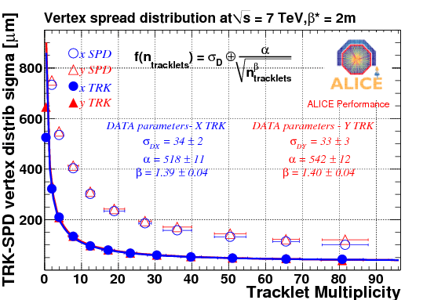
Vertex reconstruction
Vertex from SPD tracklets
Procedure:
“SPD Vertex” from all possible pairs of 2 aligned hits, in a fiducial window (in φ, η)
“SPD tracklet” defined by a pair of hits aligned with the reconstructed vertex
Used to:
Monitor the interaction diamond position quasi-online
Initiate barrel and muon arm tracking
Measure charged particle multiplicity
High efficiency & poorer resolution
Vertex from reconstructed tracks
Procedure:
Straight line approximation of the reconstructed tracks in the vicinity of the vertex.
More accurate vertex with optimal resolution
Used to:
Reconstruct secondary vertices
Estimate the vertex resolution
Poorer efficiency & high resolution
Vertex spread distribution in p-p: comparison of the two methods
The asymptotic limit estimates the size of the luminous region, seen for the vertices reconstructed with tracks.
Notes:
Selection of charged particles with p_{t} > 50 MeV/c
The asymptotic limit estimates the size of the luminous
region, seen for the vertices reconstructed with tracks
(filled markers).
The resolution is extrapolated
for most central (5%) Pb-Pb
collisions (orange box).

Slide 12
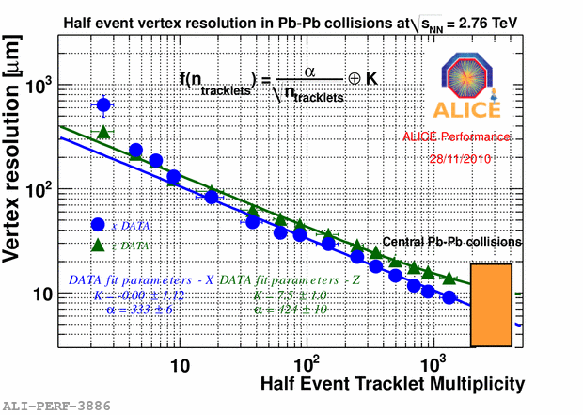
Vertex reconstruction: Resolution
Vertex resolution in Pb-Pb collisions at √s = 2.76 TeV as a function of half of the tracklets multiplicity of the event
Vertex resolution estimation in Pb-Pb
Method to evaluate resolution on the vertex position:
The track sample is randomly divided into two
A primary vertex is reconstructed for each of the sub-sample
The difference between this two vertices is the measure of the resolution as a function of the half tracklets multiplicity
The resolution is extrapolated for most central (5%) Pb-Pb collisions
Notes:
The asymptotic limit estimates the size of the luminous
region, seen for the vertices reconstructed with tracks
(filled markers).
The resolution is extrapolated
for most central (5%) Pb-Pb
collisions (orange box).

Slide 13
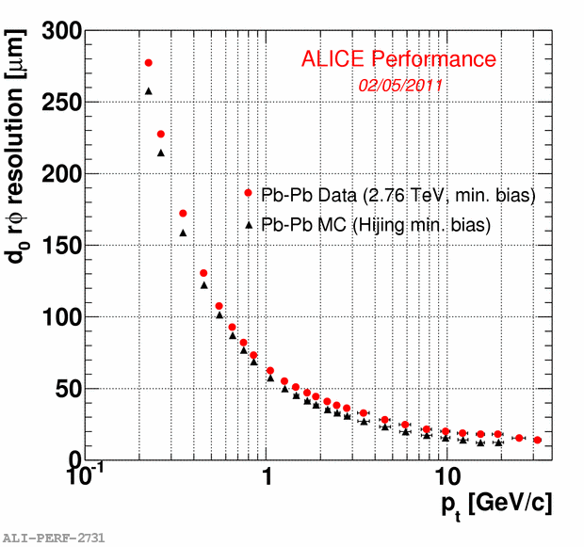
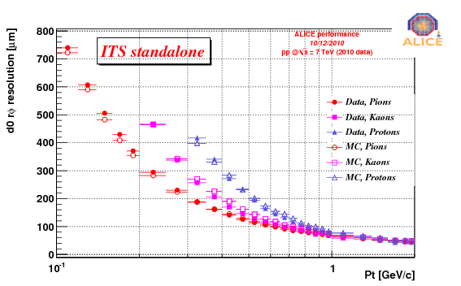
ITS Performance: Impact parameter resolution
The transverse impact parameter in the bending plane: d₀(rφ) is the reference variable to look for secondary tracks from strange, charm and beauty decay vertices
good resolution needed to separate from primary
rec. track
e
Primary
Vertex
B
d₀
X
Pb-Pb
p-p
< 100 MeV/c
affected by material budget at low p_{t}
below 75 µm for p_{t} > 1 GeV/c
good agreement data-MC (~10%)
the point resolution of each layers drives the asymptotic performance
ITS standalone enables the tracking for very low momentum particles (80-100 MeV/c pions)
Notes:
in the bending plane: d₀(rφ)

Slide 14
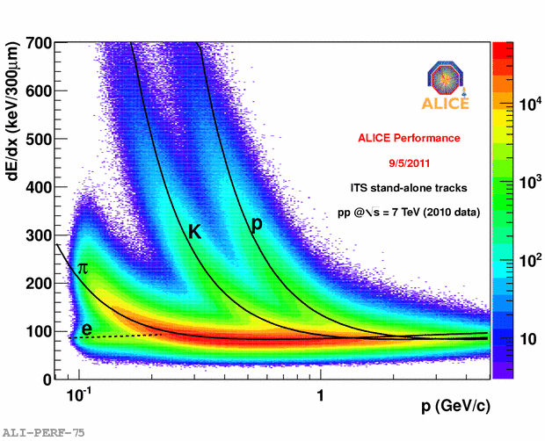
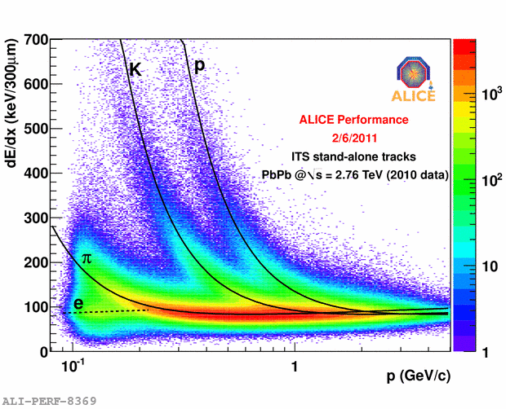
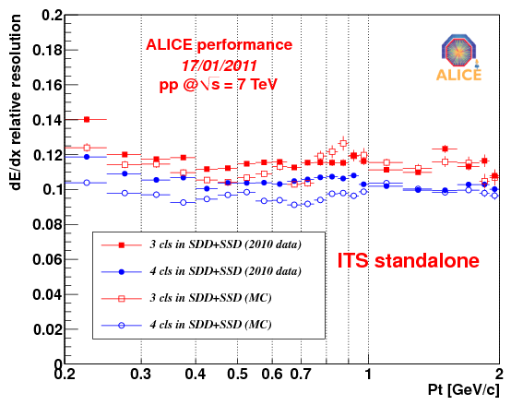
ITS Performance: Particle Identification
The dE/dx measurement:
Analogue read-out of four deposited charge measurements in SDD & SSD
Charge samples corrected for the path length
Truncated mean method applied to account for the long tails in the Landau distribution
The PID performance:
PID combined with stand-alone tracking allows to identify charged particles below 100 MeV/c
p-K separation up to 1 GeV/c
K-π separation up to 450 MeV/c
A resolution of about 10-15% is achieved
p-p
p-p
Pb-Pb

Slide 15
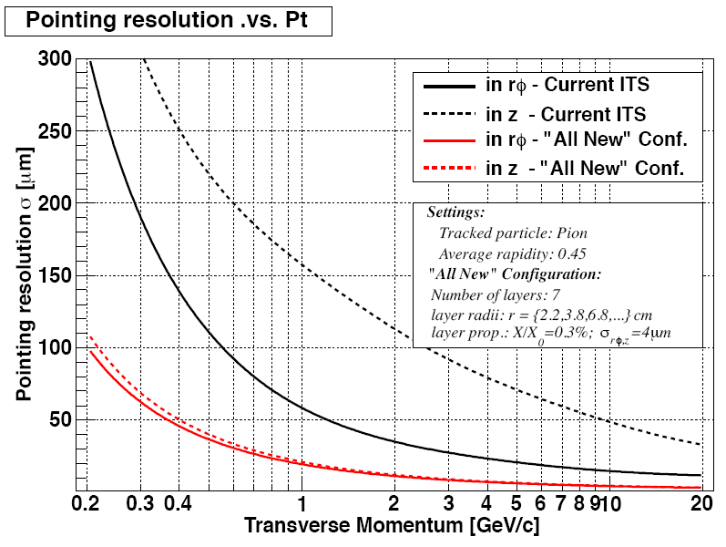
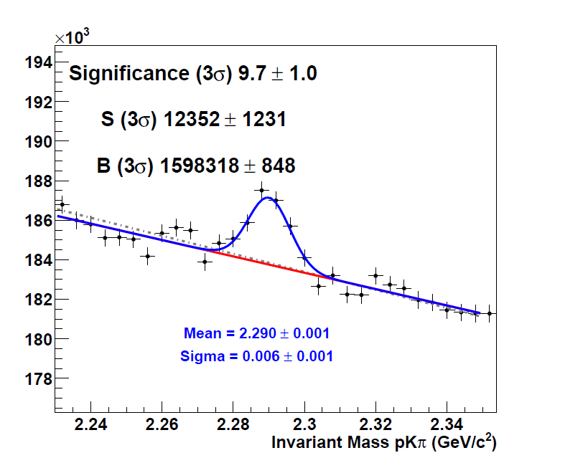


ITS Upgrade
Physics Motivations and Simulations Studies
The main physics goals for the ITS upgrade:
    improve the charmed baryonic sector studies
    access the exclusive measurement of beauty hadrons
They can be achieved by:
    improving the impact parameter resolution by factor 2-3 to identify short displaced secondary vertices
    implementing a topological trigger functionality
    exploiting PID in the trigger down to lower p_{t}
Simulations with different ITS parametrizations
Pb-Pb
$$Λ_{c}→\text{p}Κπ$$
(p_{t}$Λ$ > 4 GeV/c)
Current ITS
No signal
Upgrade simulation

Slide 16
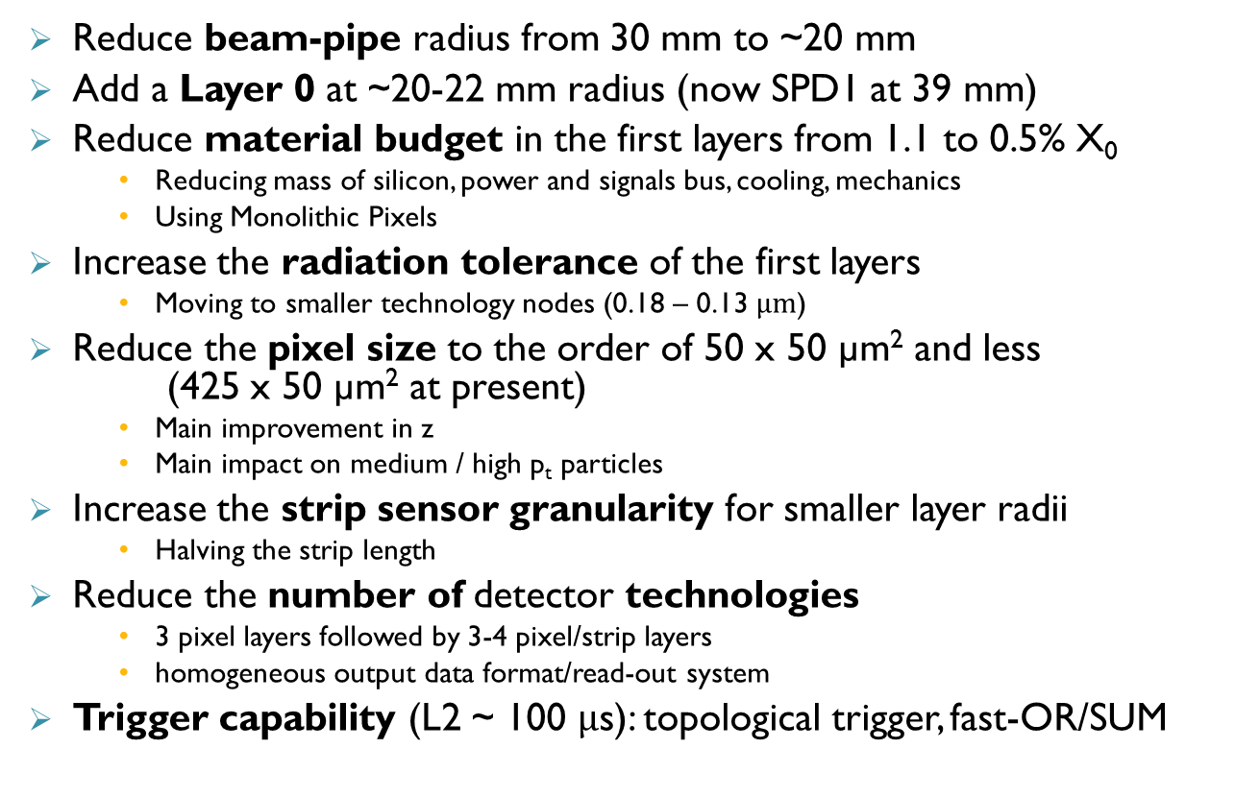
ITS Upgrade - Technical goals
Reduce beam-pipe radius from 30 mm to ~20 mm
Add a Layer 0 at ~20-22 mm radius (now SPD1 at 39 mm)
Reduce material budget in the first layers from 1.1 to 0.5% X₀
    Reducing mass of silicon, power and signals bus, cooling, mechanics
    Using Monolithic Pixels
Increase the radiation tolerance of the first layers
    Moving to smaller technology nodes (0.18 – 0.13 $µm$)
Reduce the pixel size to the order of 50 x 50 µm² and less (425 x 50 µm² at present)
    Main improvement in z
    Main impact on medium / high p_{t} particles
Increase the strip sensor granularity for smaller layer radii
    Halving the strip length
Reduce the number of detector technologies
    3 pixel layers followed by 3-4 pixel/strip layers
    homogeneous output data format/read-out system
Trigger capability (L2 ~ 100 $µ$s): topological trigger, fast-OR/SUM

Slide 17
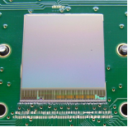
ITS Upgrade - Technology Implementation
Requirements:
increased spatial resolution
readout time < 50 µs
radiation tolerant (2 Mrad, 2x10¹³ n_{eq})
low power design (250 mW/cm²)
minimized material budget
Pixel detector technologies
Hybrid pixels
    100 µm sensor + 50 µm ASIC
    30 µm x 100 µm pixels
    Flip-chip with 10 µm x 10 µm bump bonds
    Smaller input pads and parasitic capacitance
Monolithic pixels
    50 µm ASIC
    20 µm x 20 µm pixels
    options for CMOS sensor:
        rolling-shutter read-out
        sparsified read-out
        drift-based in submicron
“ULTIMATE” prototype

Slide 18
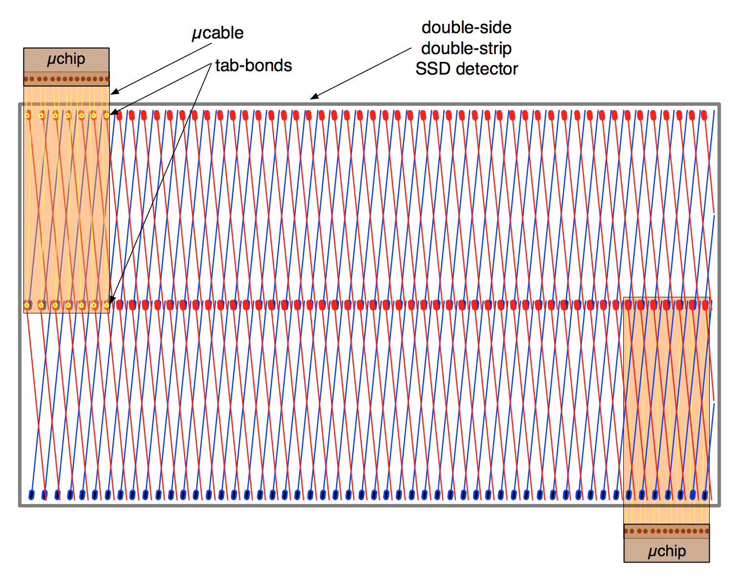
ITS Upgrade - Technology Implementation
New design advantages:
occupancy ~ 50% → lower radii
better ambiguity resolution
increased S/N ratio → better PID
digital output and faster read-out
Strip detector technology
Silicon strip
    half-length strips (20 mm)
    small pitch interconnection (44 µm)
    ADC on-chip
    fast digitized data transmission
    larger input dynamic range
… to be implemented in view of the 2017-2018 LHC shutdown!

Slide 19
Conclusions
The ALICE Inner Tracking System performance is well in agreement with the design requirements and the simulations
The achieved impact parameter resolution allows to reconstruct the charmed decay secondary vertices
Standalone capability allows to track and identify charged particles with momenta down to 100 MeV/c
The possibility to improve the physics performance of an upgraded ITS has been studied
Several options for the pixel and strip technology implementation are being investigated and developed

Slide 20
Thanks for your attention

Slide 21
Backup slides

Slide 22
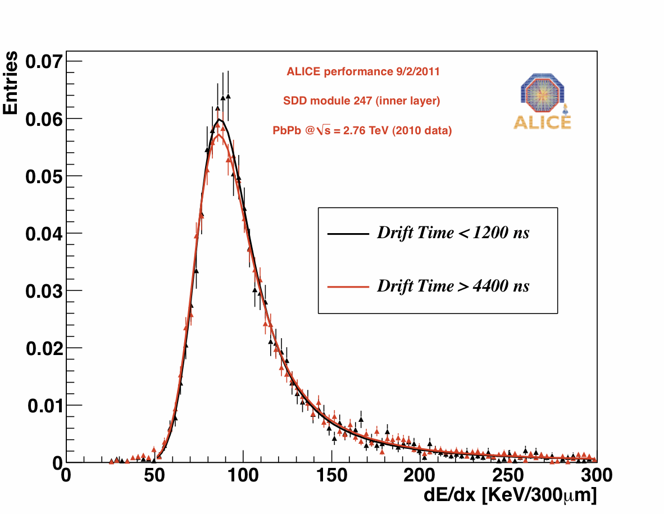
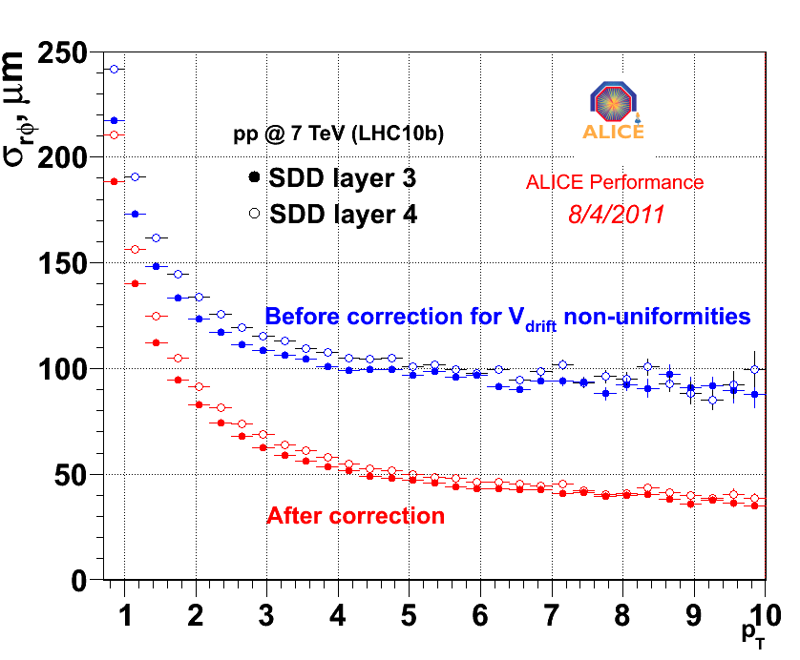
SDD calibration
SDD at nominal resolution

Slide 23


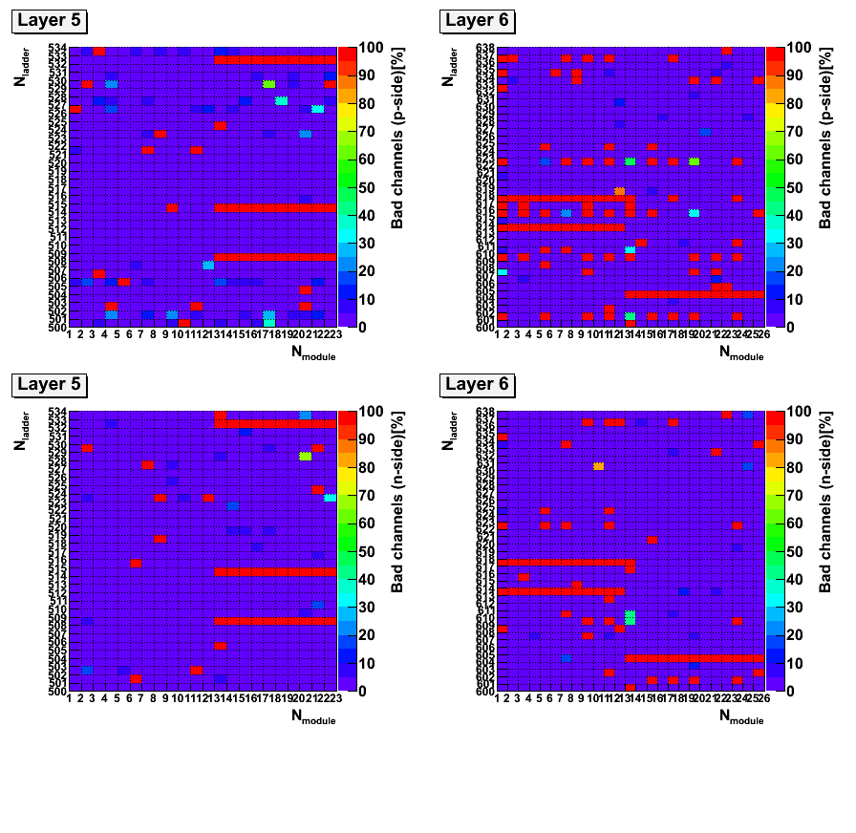
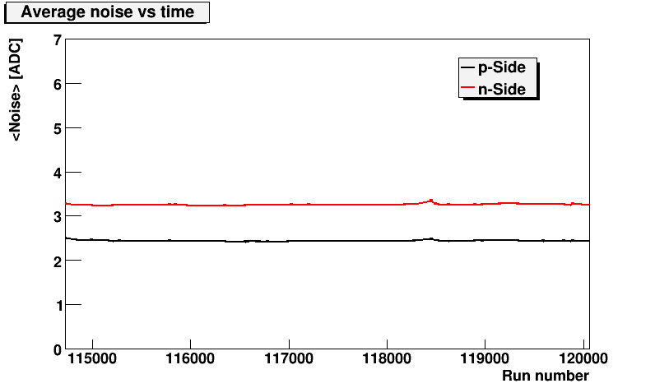
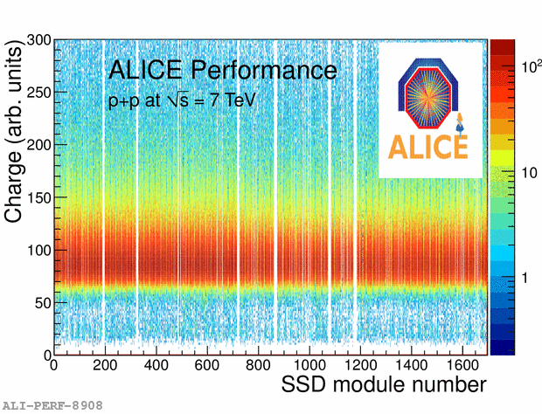
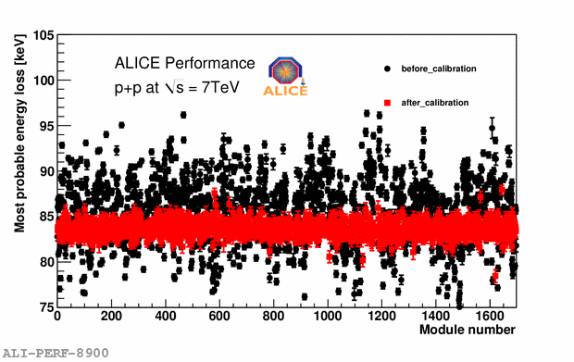
SSD calibration
Bad Channel Map
Calibration
The measured intrinsic noise of the 2.6 million SSD channels is used to:
assess the detector efficiency
guarantee the required signal-to-noise ratio
monitor the SSD stability
Cluster charge distribution measured from collision data with all the SSD modules
the gain can be calibrated at the module level
Online Calibration
Intrinsic noise: time evolution
Gain map tuning: after the calibration, the MPVs are stable within a few %

Slide 24
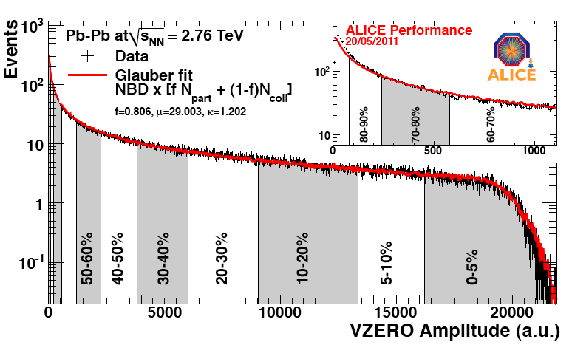
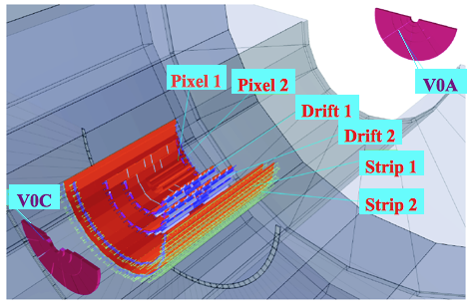
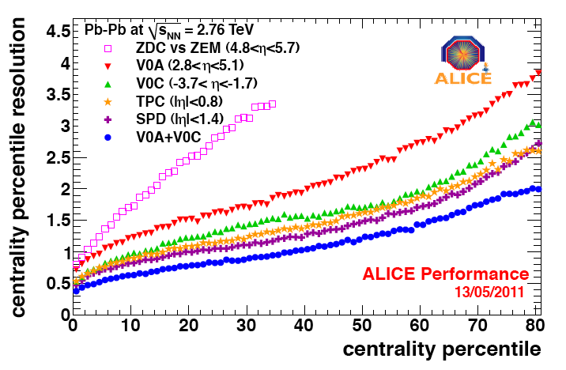
Centrality
2.8<η<5.1
-3.7<η<-1.7

Slide 25
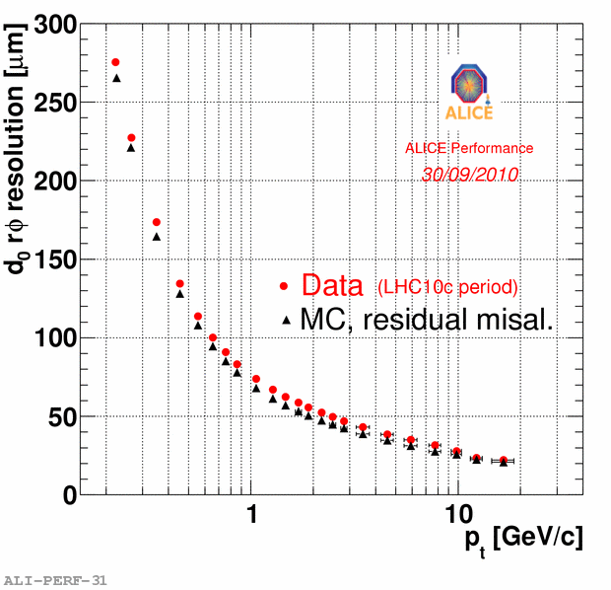
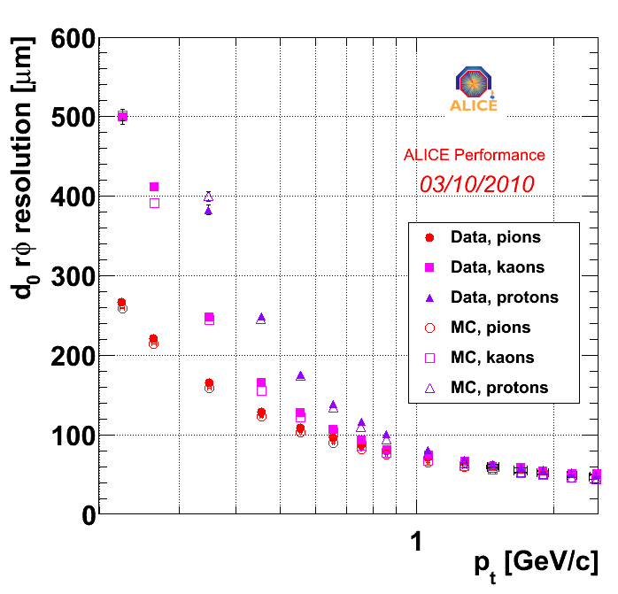
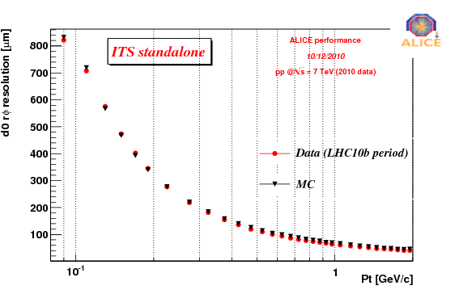
Impact parameter in p-p, global and ITS standalone
p-p
p-p
p-p
p-p
< 100 MeV/c
< 100 MeV/c

Slide 26


D0
Upgrade simulation
Current ITS
No signal

