Slide 1



Planar semiconductor Compton imaging using pulse shape analysis
Anthony Sweeney
Position Sensitive Detectors 9
Aberystwyth 2011

Slide 2
Outline
Motivation
Compton camera principles
Pulse shape analysis
Initial result
Silicon Detector
Future work

Slide 3
Motivation
Homeland security
Nuclear decommissioning
Existing systems are limited

Slide 4
Compton camera principles

Slide 5
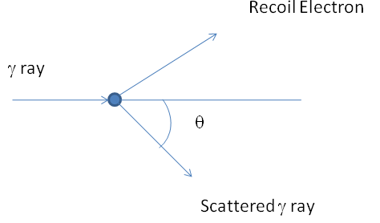


Compton scattering
Major factors in Compton cameras:-
Energy resolution
Position resolution within the detector
Doppler broadening

Slide 6
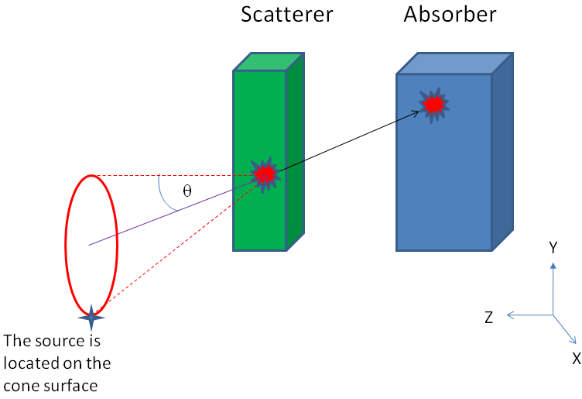
Compton camera
Compton camera made up from two detectors, scatter detector and absorber.
Energy of the incident gamma ray can be found by adding the energy deposited in both detectors.
The position of interaction within the detectors are used to fix the cone apex.
Opening angle of the cone is calculated using the Compton scattering formula.
The source lies somewhere on the surface of the cone.

Slide 7
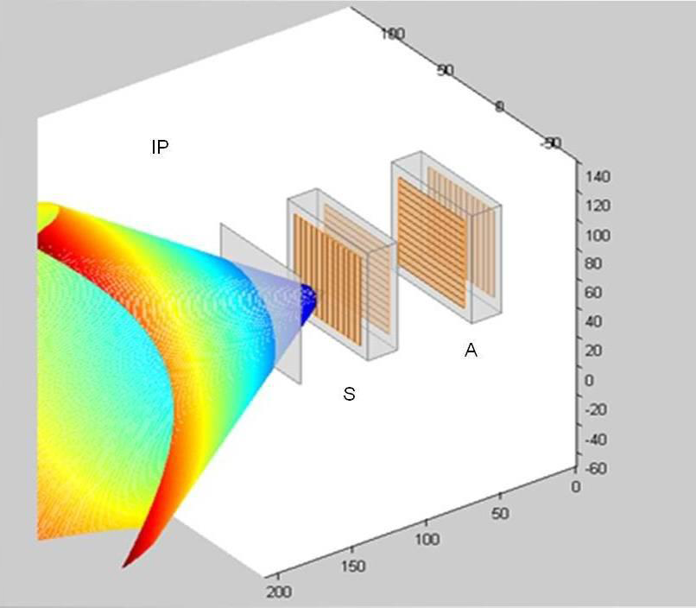
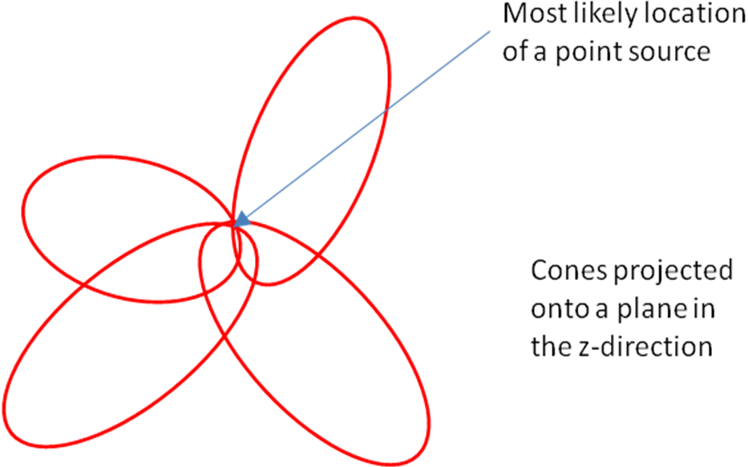
Compton image reconstruction
x
y
Units mm
z

Slide 8
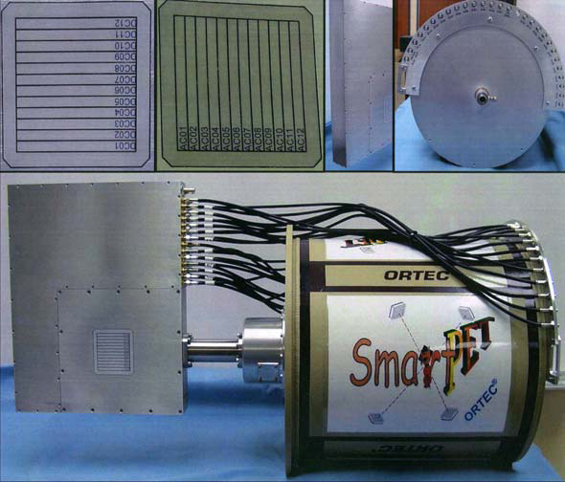
Detectors used
Two high purity germanium double sided strip detectors manufactured by Ortec with an active area of 60x60x20mm.
24 strips per detector, 12 on each side giving 144 voxels of 5x5x20mm.
Individual charge sensitive preamplifiers for each channel.
The preamplifier outputs are digitised through CAEN V1724 cards.
Typical energy resolutions of 2 to 3keV are seen at 662keV for all strips of both detectors.

Slide 9
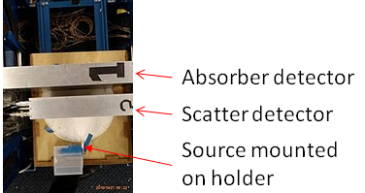
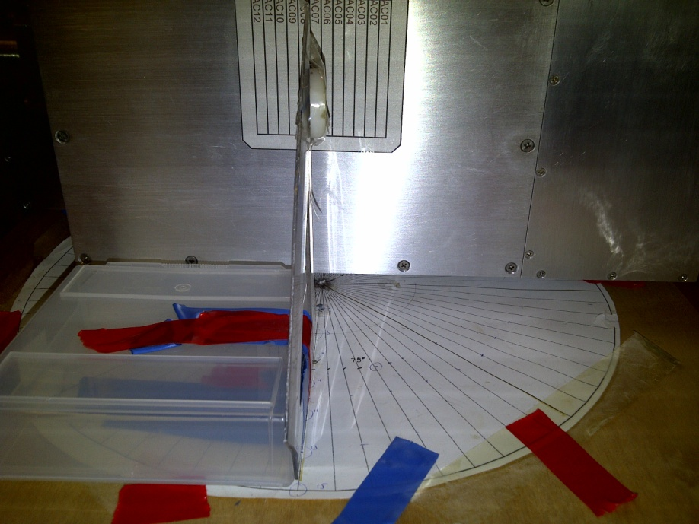
Detector and source positions
Detectors are mounted 5.5cm apart with the centres aligned.
Separation chosen as a compromise between data collection time and final image resolution.
A ¹³⁷Cs point source of 0.26MBq activity was positioned 5cm away from the centre of the scatter detector.
Trigger on a coincident event between both detectors within a 100ns time window.

Slide 10
Data selection: Fold
Fold 1
Single interactions within the scatter detector and subsequently the absorber detector are needed for reconstruction.
Fold is the number of strips which contain energy for one side of the detector.
Only fold one events from both sides of both detectors are selected.
Each event selected will now only have interacted within one voxel of each detector.
AC
DC
γ
Fold 2

Slide 11
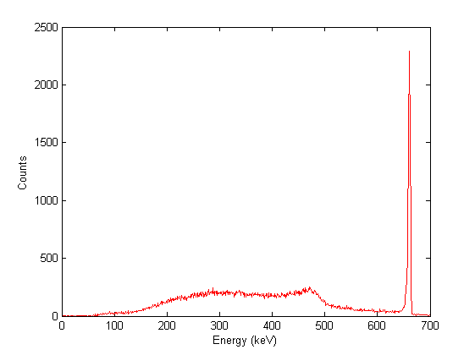
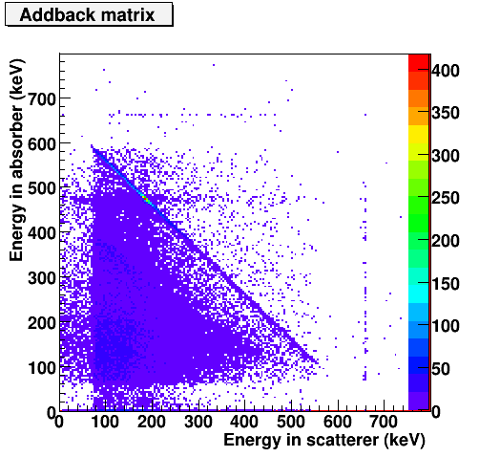
Data selection: Addback
Less energy is deposited in the scatter detector than the absorber.
A spectrum can be created using the fold selected events.
The photopeak seen in this spectrum can be used to identify the source.
Only events within the photopeak of interest will be reconstructed.
Here the ¹³⁷Cs 662 keV photopeak can be seen clearly with an energy resolution of 3.7keV.

Slide 12
Pulse shape analysis (PSA)

Slide 13
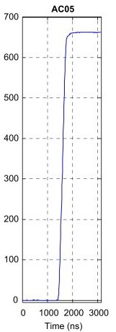
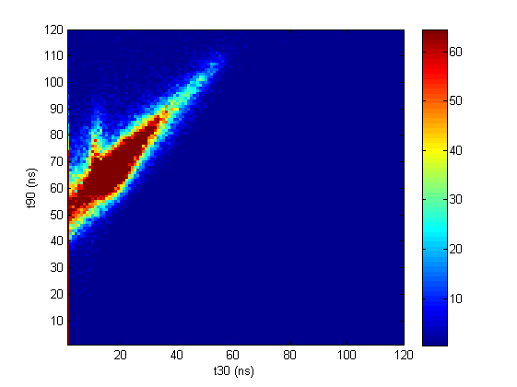
Depth of interaction
Typical charge collection times of 200ns are seen with the detectors used.
Risetimes are dependant upon the time taken for charge carriers to be collected at their respective contacts.
30% of the total rise time provides information on the primary carrier (t30).
90% of the total rise time provides information on the complete charge collection (t90).
Plotting t30 against t90 for all events on one side of one detector a depth of interaction can be measured.
Voxel size reduced to 5x5x4mm after 5 regions are selected.
t90
E
AC face
D
A
C
B
B
C
A
D
E
t30
DC face
keV

Slide 14
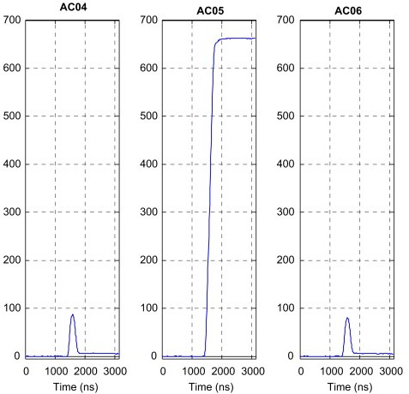
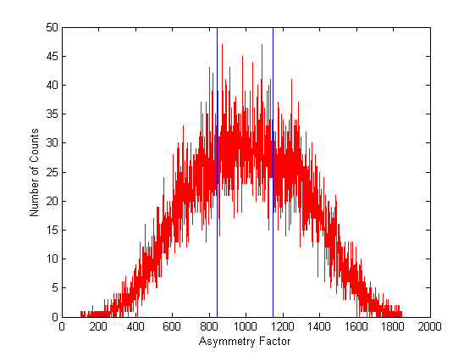

Image charge asymmetry
Charge is induced in strips neighbouring those carrying pulses, these are image charges.
The size of the image charges can be used to calculate an asymmetry factor.
Plotting this factor, a position within the real charge carrying strip can be found in X and Y for each event.
Using the assumption that there is equal probability for interaction at any point in the strip, the width of the strip can be subdivided into 3, 5 or as many divisions as required.
keV

Slide 15
Initial results

Slide 16
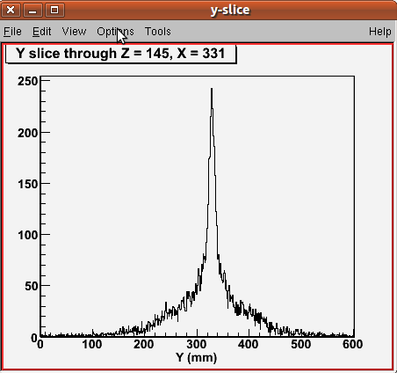
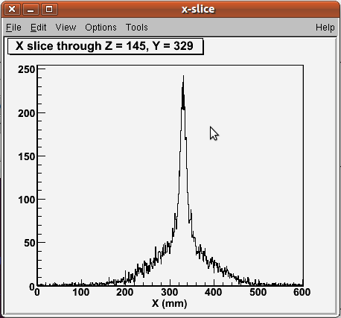
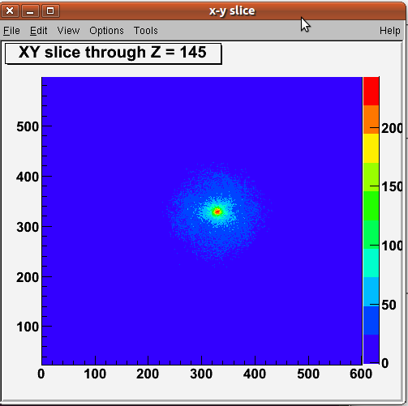
Compton image with depth of interaction
Image with depth of interaction PSA applied.
Voxel size 5x5x5mm.
Resolution is taken as an approximate full width half maximum of a cut through the X and Y axis.
Approximate image resolution is 19mm in X and 17mm in Y.
5558 cones were used for this reconstruction.

Slide 17
Silicon detector

Slide 18
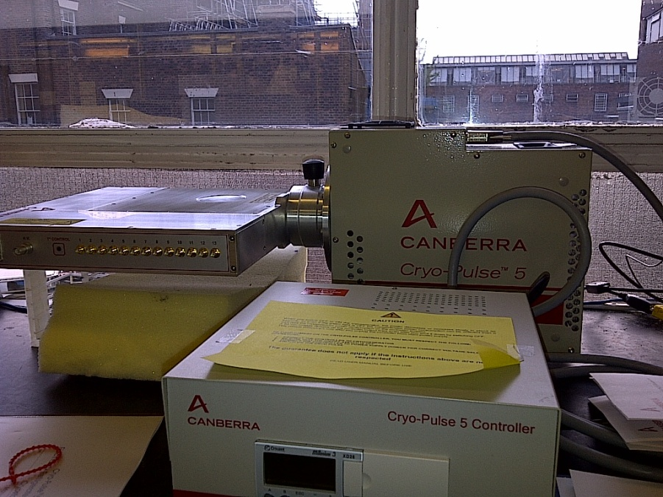
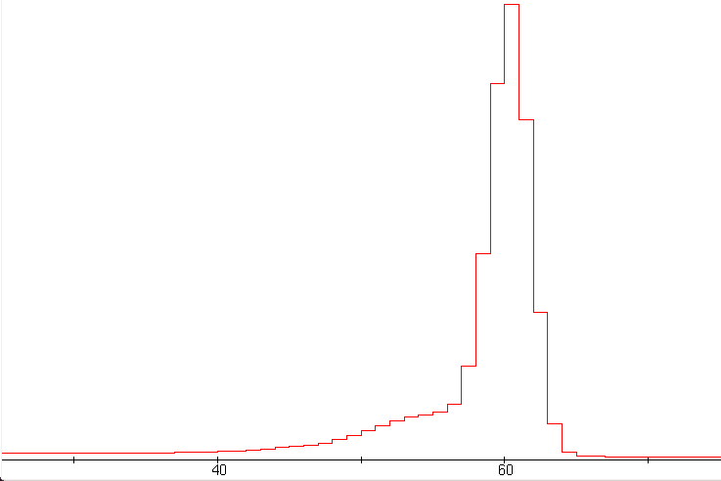
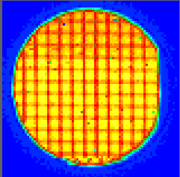
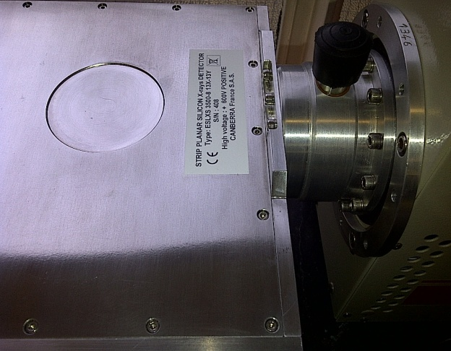
Silicon Detector
Manufactured by Canberra.
Mechanically cooled.
Circular wafer, 8mm thick with an active diameter of 66mm.
Double sided strip detector, with 13 strips per side of varying sizes.
26 charge sensitive pre amplifiers.
Average energy resolution across all strips is 1.5 keV at 60 keV.
One strip is non functional.
Raster scans have been completed on both detector faces and the edge.
Energy (keV)

Slide 19
Future work

Slide 20
Future work
Asymmetry pulse shape analysis will be applied to the data.
New firmware is being tested for the CAEN V1724s.
Compton data will be collected with the silicon detector acting as the scatter detector.
A 5mm thick HPGe detector will be scanned and tested to provide an additional scatter detector opening the possibility of a three detector Compton camera system.
Tests onsite at Aldermaston.

Slide 21
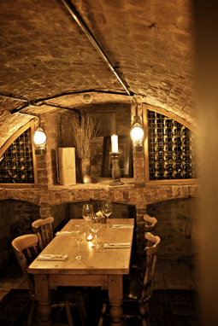
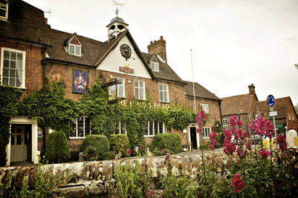

Slide 22
Contributors
Andrew J. Bostonª, Helen C. Bostonª, John R. Cresswellª, Jamie Dormandª, Mark Ellis^{b}, Laura J. Harknessª, Martin Jonesª, Daniel S. Judsonª, Paul J. Nolanª, David C. Oxleyª, David P. Scraggsª, Mike J. Sleeª, Amandeep Thandi^{b}
ªDepartment of Physics, University of Liverpool, Liverpool, L69 7ZE, United Kingdom ^{b}Atomic Weapons Establishment (AWE), Aldermaston, Reading, RG7 4PR, United Kingdom

Slide 23
Data flow
 | Counts | % total | % accepted | % F(1,1,1,1)
Total | 1952163
Accepted | 947188 | 48.52
F(1,1,1,1) | 208550 | 10.68 | 22.02
Photopeak | 14289 | 0.73 | 1.51 | 6.85
Imaged (PSA) | 5558 | 0.28 | 0.59 | 2.67

Slide 24
Analogue results (collection time vs image resolution)
Detector seperation (cm) | FWHM X (mm) | FWHM Y (mm) | Cones per second
3 | 24 | 22 | 22
5 | 17 | 19 | 12

