Slide 1

Semiconductor detectors for Compton imaging in nuclear medicine
Laura Harkness
ljh@ns.ph.liv.ac.uk
PSD9 Conference, Aberystwyth, 12th September 2011

Slide 2

Outline
Nuclear medicine
Compton imaging
Design Criteria
A High Purity Germanium detector
A Si(Li) detector

Slide 3
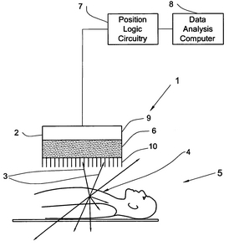
  Nuclear medicine - SPECT
Single Photon Emission Computed Tomography (SPECT)
Diagnosis/monitoring of cancer and neurological conditions
Biological information complements MRI structural information
Mechanical collimator 1 x 10 ⁻⁴
Scintillator detector with photomultiplier tubes
Radiopharmaceutical accumulates in organ of interest
Gamma-rays emitted from organ and detected outside body by gamma camera
Patient injected with radiopharmaceutical

Slide 4
  Compton imaging in medicine
Conventional SPECT
Compton imaging
Source
E₀
θ
E₁
θ
E₂
Gamma-rays detected by a gamma camera
Inefficient detection method
Use 1 gamma ray in every 3000
Incompatible with MRI
Gamma-rays detected by a Compton camera
Use 1 gamma ray in every 30
Semiconductor detectors compatible with MRI

Slide 5
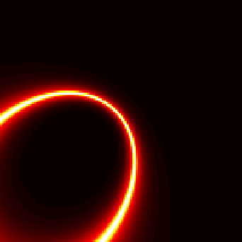
How does it work?
Gamma rays interact in both detectors (scatterer and absorber)
The path for each gamma ray is reconstructed as a cone
Source located at max cone overlap
Source
E₀
θ
E₁
θ
E₂

Slide 6
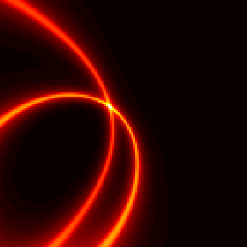
How does it work?
Gamma rays interact in both detectors (scatterer and absorber)
The path for each gamma ray is reconstructed as a cone
Source located at max cone overlap
Source
E₀
θ
E₁
θ
E₂

Slide 7
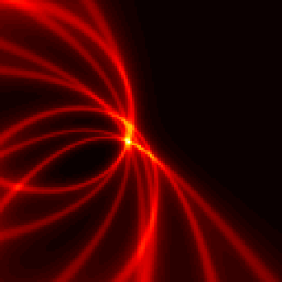
How does it work?
Gamma rays interact in both detectors (scatterer and absorber)
The path for each gamma ray is reconstructed as a cone
Source located at max cone overlap
Source
E₀
θ
E₁
θ
E₂

Slide 8
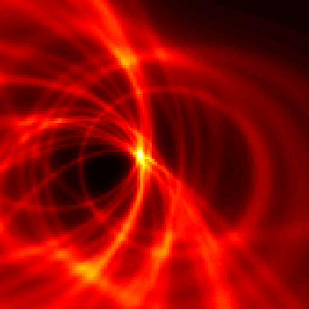
How does it work?
Gamma rays interact in both detectors (scatterer and absorber)
The path for each gamma ray is reconstructed as a cone
Source located at max cone overlap
Source
E₀
θ
E₁
θ
E₂

Slide 9
Design Criteria
L J Harkness et. al, AIP Conf Proc (2009) 1194, 90-95
System for use with current medical radionuclides, with high sensitivity and excellent image quality
Sensitivity is a factor of:
  Detector materials, thicknesses and configuration geometry
  Low energy noise thresholds in scatterer detector
Image resolution is a factor of :
  Energy resolution
  Detector position resolution
  Doppler broadening
  Detector uniformity
Semiconductor Detectors ☺

Slide 10
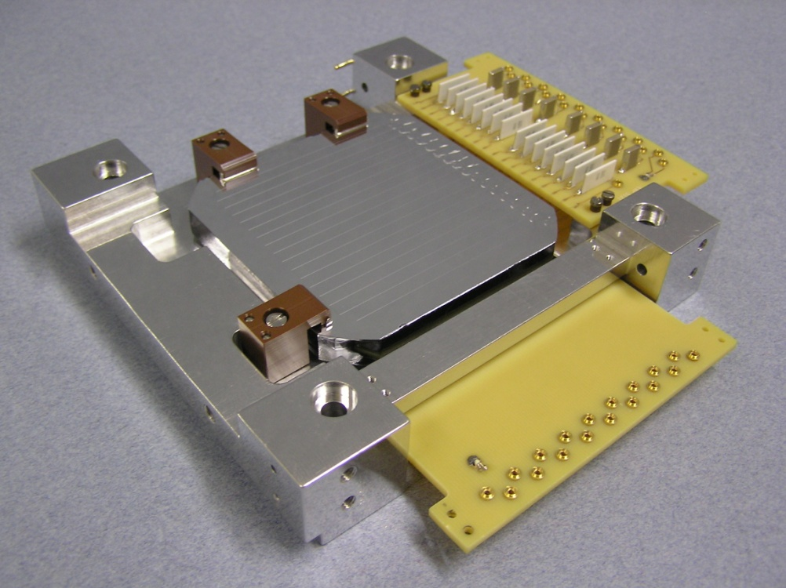
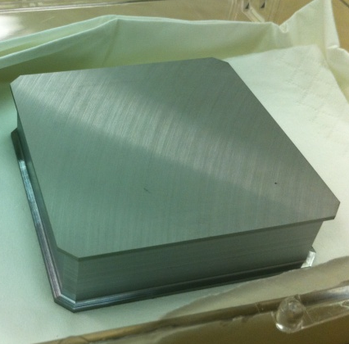
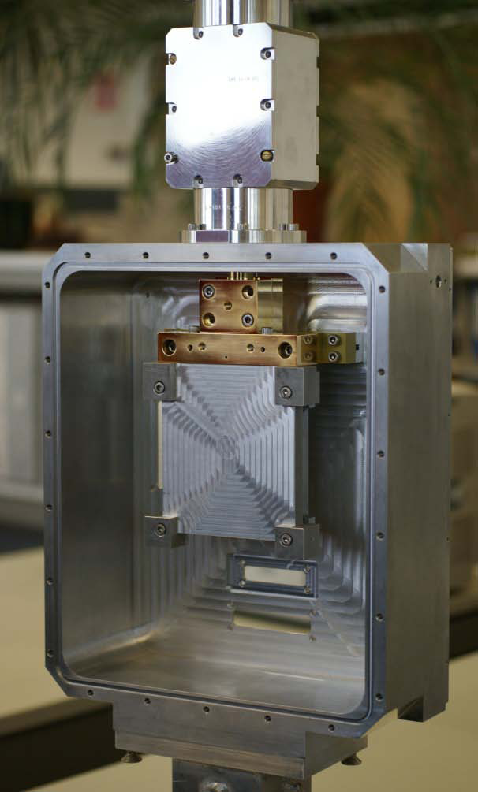
  Final design
L J Harkness et. al, NIMA (2009) 604
L J Harkness et. al, NIMA (2011) 638
Optimised for imaging 141 keV gamma rays¹ from ^{99m}Tc
DSSD Si(Li) scatter detector (two available: 8 mm and 9 mm thick)
DSSD HPGe absorber detector, 20 mm thick
Should operate at the edge of an MRI scanner²
Final system: 9 mm thick Si(Li) detector and HPGe detector housed in a single cryostat custom-built by STFC Daresbury Laboratory
Photo
Courtesy of Semikon
Photo
Courtesy of ORTEC

Slide 11
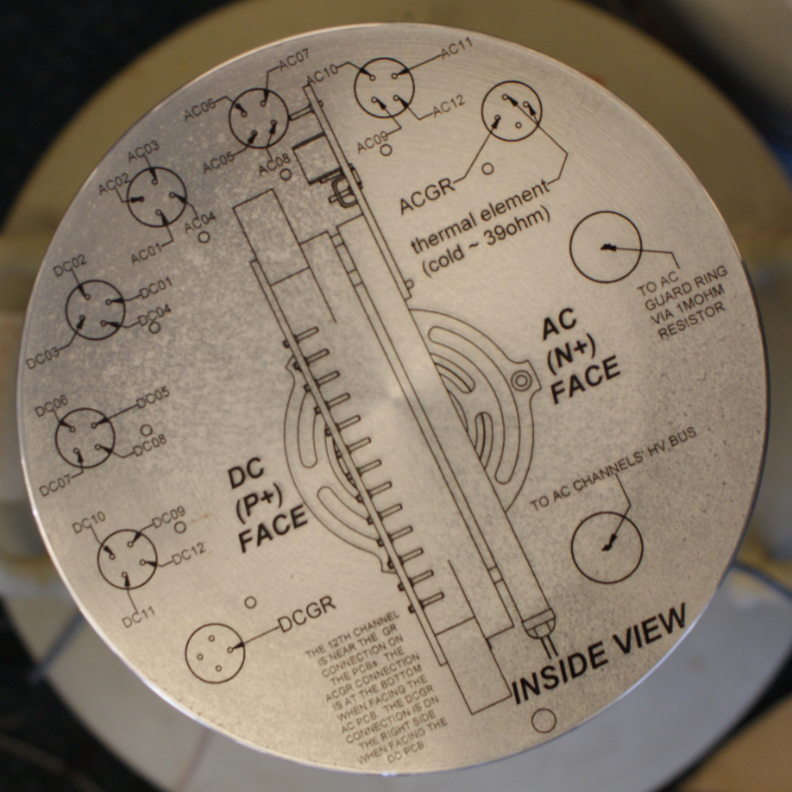
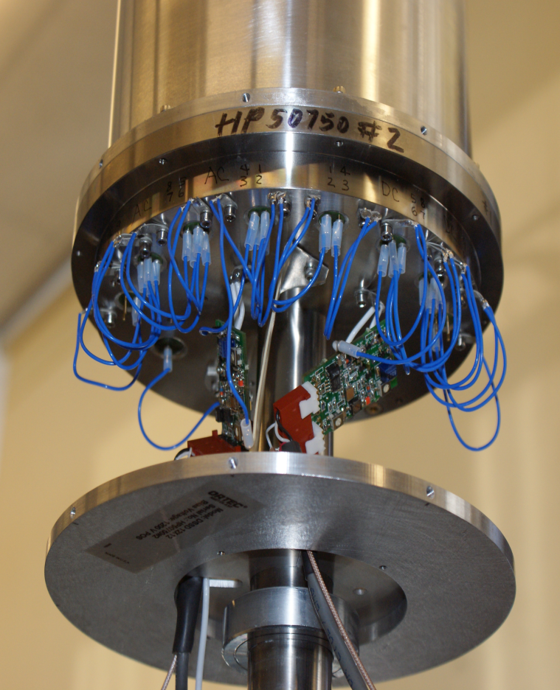
HPGe Absorber detector
MRI images
Each face has 12 strips (60 x 5) mm
1 test preamplifier for each face of the detector

Slide 12
HPGe Performance Tests
MRI images
FWHM measured at 122 keV using a ⁵⁷Co source
Measurements taken for each channel with:
  The source near the AC face of the detector
  The source near the DC face of the detector
Specified performance at 122 keV:
  Average FWHM <= 1.7 keV
  All channels FWHM <= 2.3 keV
  No more than 2 strips per side > 1.8 keV

Slide 13
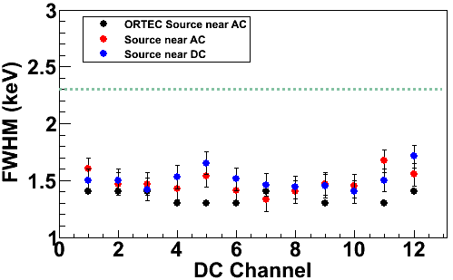
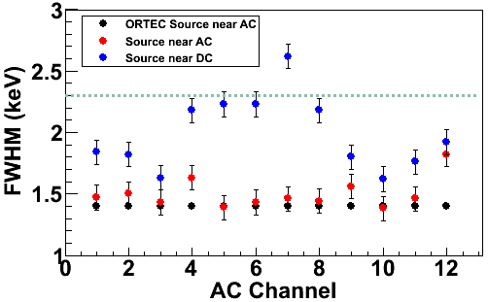
Energy Resolution at 122 keV
MRI images
Source near AC face: All channels acceptable (< 2.3 keV)
Source near DC face: All channels acceptable except AC07
Accepted

Slide 14
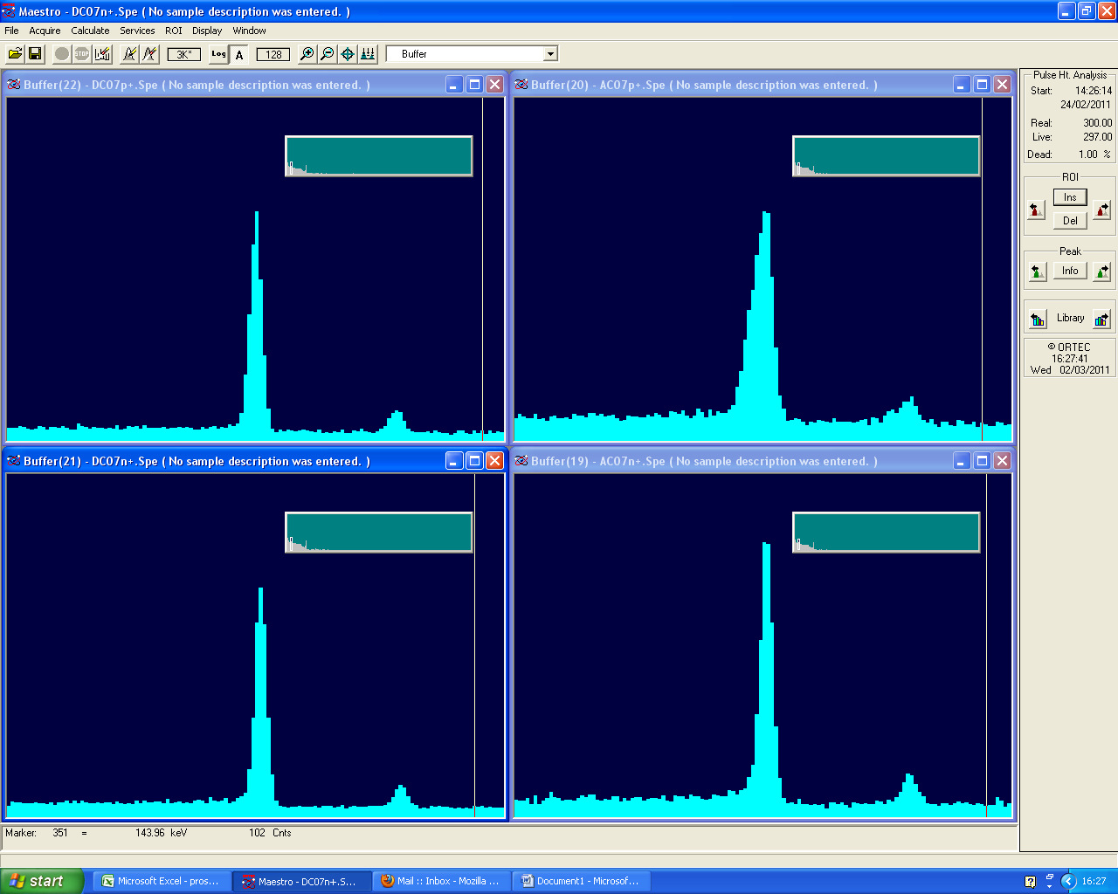
Energy Resolution at 122 keV
MRI images
Channels | Source incident on face | Range (keV) | Mean (keV)
DC | AC | 1.33 - 1.67 | 1.48
 | DC | 1.40 - 1.71 | 1.51
AC | AC | 1.38 - 1.82 | 1.50
 | DC | 1.62 - 2.62 | 1.99
Counts
Low Energy Tail?
Specification: Max 2.3 1.7
Energy (keV)

Slide 15
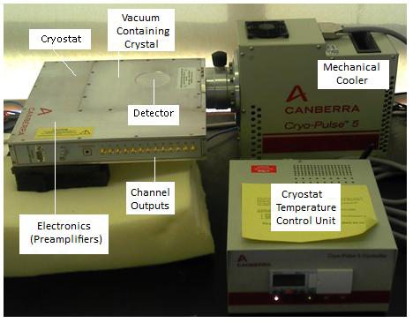
Si(Li) detector
Canberra Si(Li) DSSD detector 13 strips on each face
8 mm thick, 66 mm diameter
Cryogenically cooled using a CryoPulse CP5 cooler
Energy resolution of all strips measured to be (1.4 to 1.6) keV at 59.4 keV using ²⁴¹Am (excluding channel 14)

Slide 16
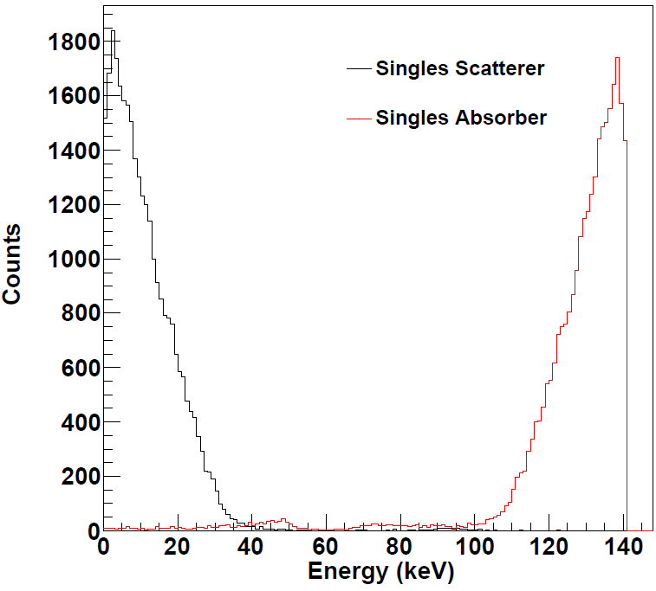
Detector noise levels
L J Harkness et. al, IEEE NSS/MIC Proc (2009)
For imaging 141 keV gamma rays, less than 40 keV is deposited in the scatter detector
Low energy threshold applied reduces the sensitivity
Low noise scatter detector essential in minimising event loss
Geant4 Simulation
5keV
Noise levels for DC strips measured to be 2 keV and for AC strips to be (2.5 to 4.5 ) keV

Slide 17
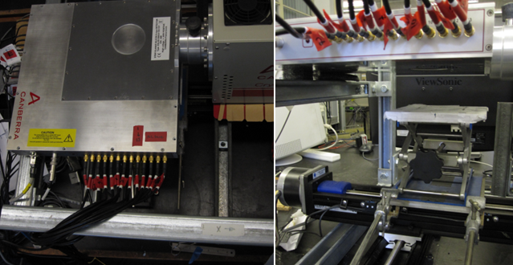
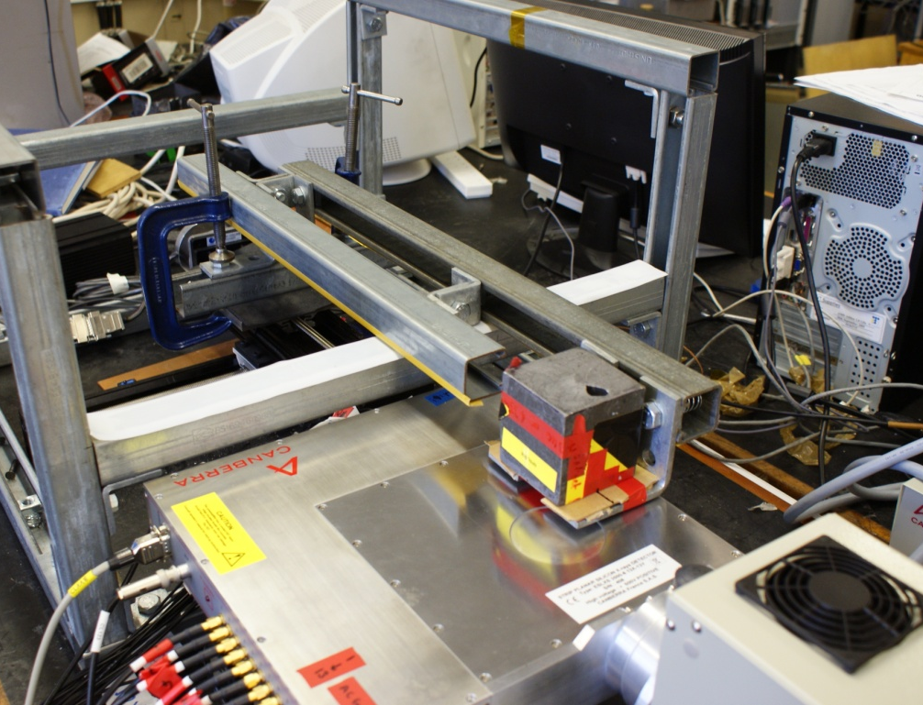
²⁴¹Am Surface Scan
1 mm collimated ²⁴¹Am source scanned in 1 mm steps across a (76 x 76) mm grid giving 5929 positions
Data taken with the source incident on the DC face then the AC face
DC face
AC face
DC Surface scan
AC Surface scan

Slide 18
²⁴¹Am Surface Scan
Data recorded from all 26 channels using Gretina Digitizer cards
DC channels used to trigger the acquisition
Events only recorded when energy deposited in at least one DC channel was more than the energy threshold (~10 keV)
 | Incident on DC face | Incident on AC face
Scan step duration (s) | 40 | 45
Count Rate (s⁻¹) | 200 | 288
Total Run time (h) | 66 | 82

Slide 19
²⁴¹Am Surface Scan: Event Processing
An 8 keV energy gate was set around the 59.4 keV photopeak
Events categorised according to fold - the number of channels that record net charge over energy threshold (10 keV for DC channels)
Intensity plots were produced for energy gated events for fold[DC,AC] type events, e.g. fold [1,1].
 | Incident on DC face |  | Incident on AC face
 | DC | AC | DC | AC
Fold 1 (%) | 84.47 | 87.49 | 84.47 | 87.88
Fold 2 (%) | 11.18 | 9.62 | 11.18 | 9.53
> Fold 2 (%) | 4.35 | 2.89 | 4.35 | 2.59

Slide 20
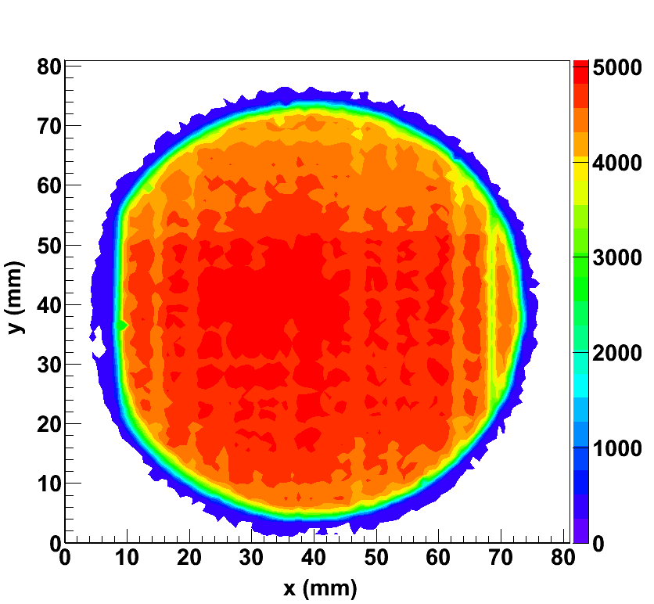
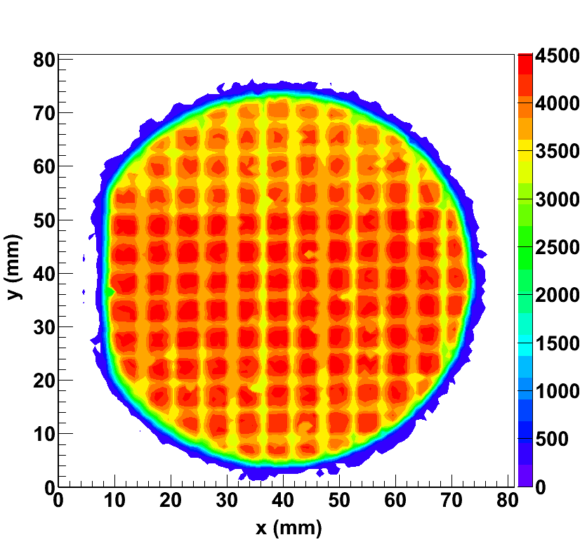
DC face Intensity Plots
Counts reduced by ~8%
a) Energy Gated
b) Energy Gated Fold [1,1]
Reduced Counts between DC12 & DC13
AC01
DC01
DC01
AC13
DC01
DC13

Slide 21
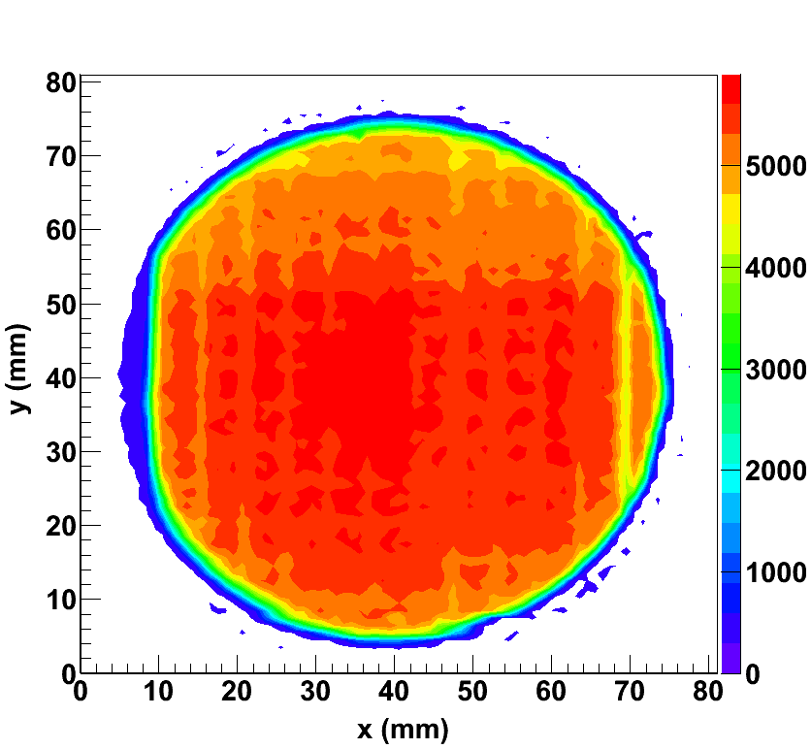
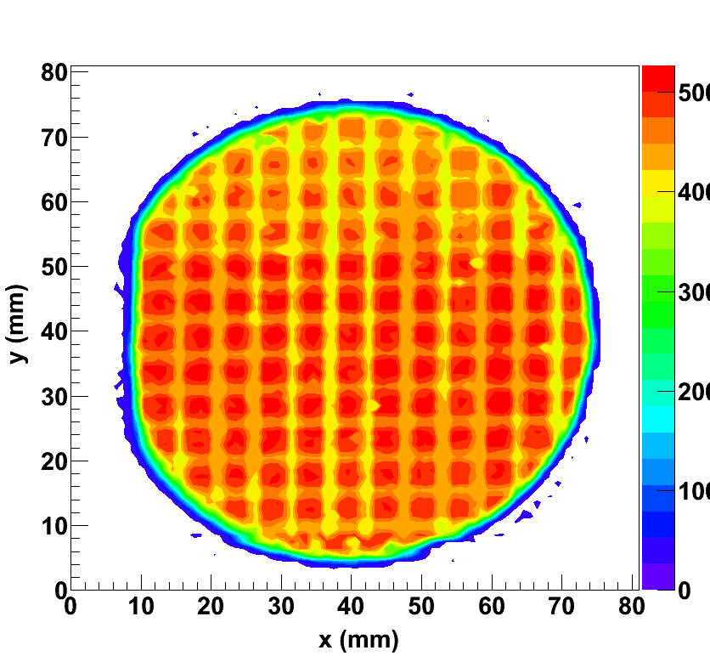
AC face Intensity Plots
Counts reduced by ~8%
a) Energy Gated
b) Energy Gated Fold [1,1]
Reduced Counts between DC12 & DC13
AC01
DC01
DC01
AC13
DC01
DC13

Slide 22
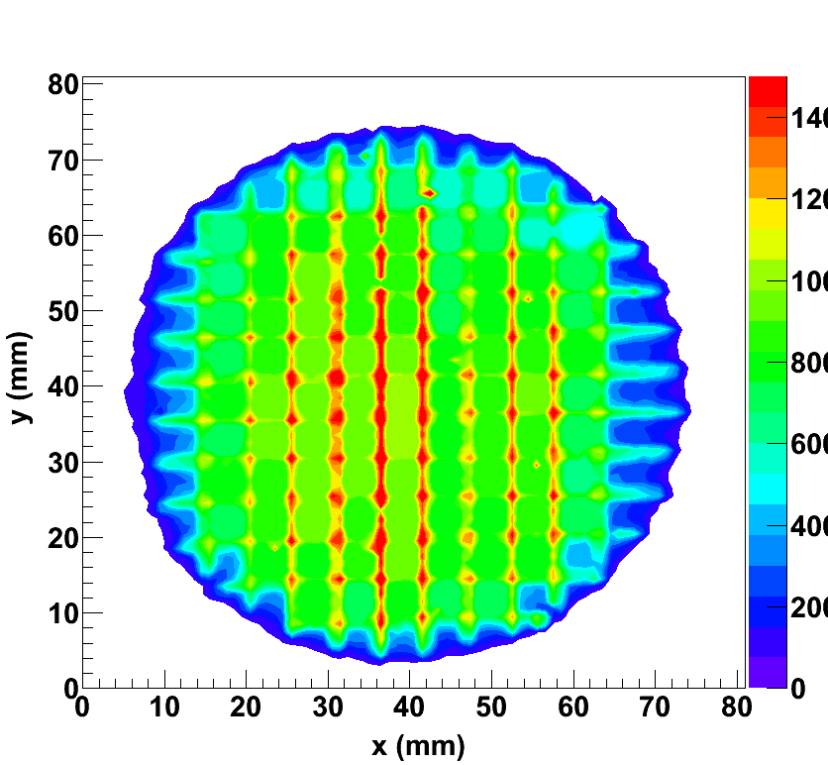
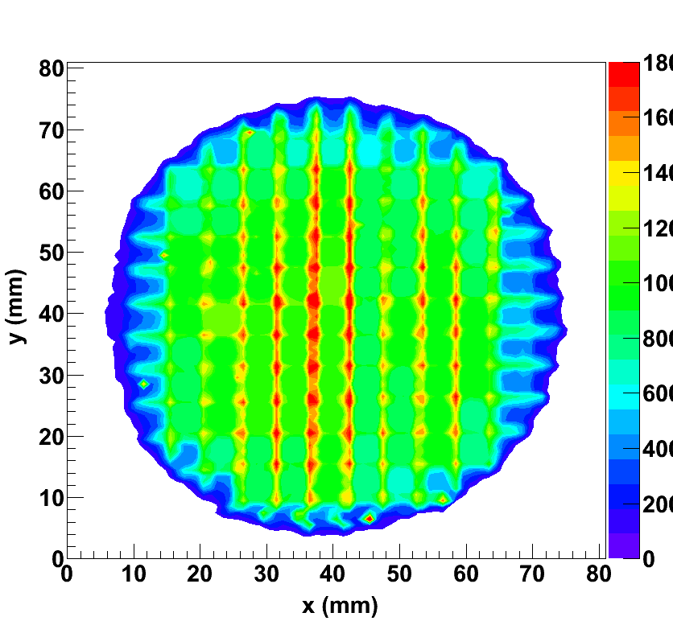
Multiple Pixel Intensity Plots
a) DC surface scan
b) AC surface scan
AC01
AC13
DC01
DC13

Slide 23
Current Status and Future Work
HPGe absorber detector: acceptable for Compton imaging. Surface and side scan measurements planned
Further analysis of the Si(Li) detector surface scan results
ProSPECTus cryostat: vacuum testing underway
ProSPECTus Si(Li) detector: acceptance tests imminent
First ProSPECTus imaging measurements –Winter 2011
ProSPECTus imaging with MRI system – 2012

Slide 24
The ProSPECTus Collaboration
Department of Physics, The University of Liverpool, UK
AJ Boston, HC Boston, JR Cresswell, DS Judson, PJ Nolan, JA Sampson, DP Scraggs, A Sweeney
STFC Daresbury Laboratory, UK
I Burrows, N Clague, M Cordwell, J Groves, J Headspith, A Hill, IH Lazarus, V Pucknell, J Simpson
MARIARC, The University of Liverpool, UK
B Bimson, G Kemp
Special Thanks to Hannah Kennedy

Slide 25
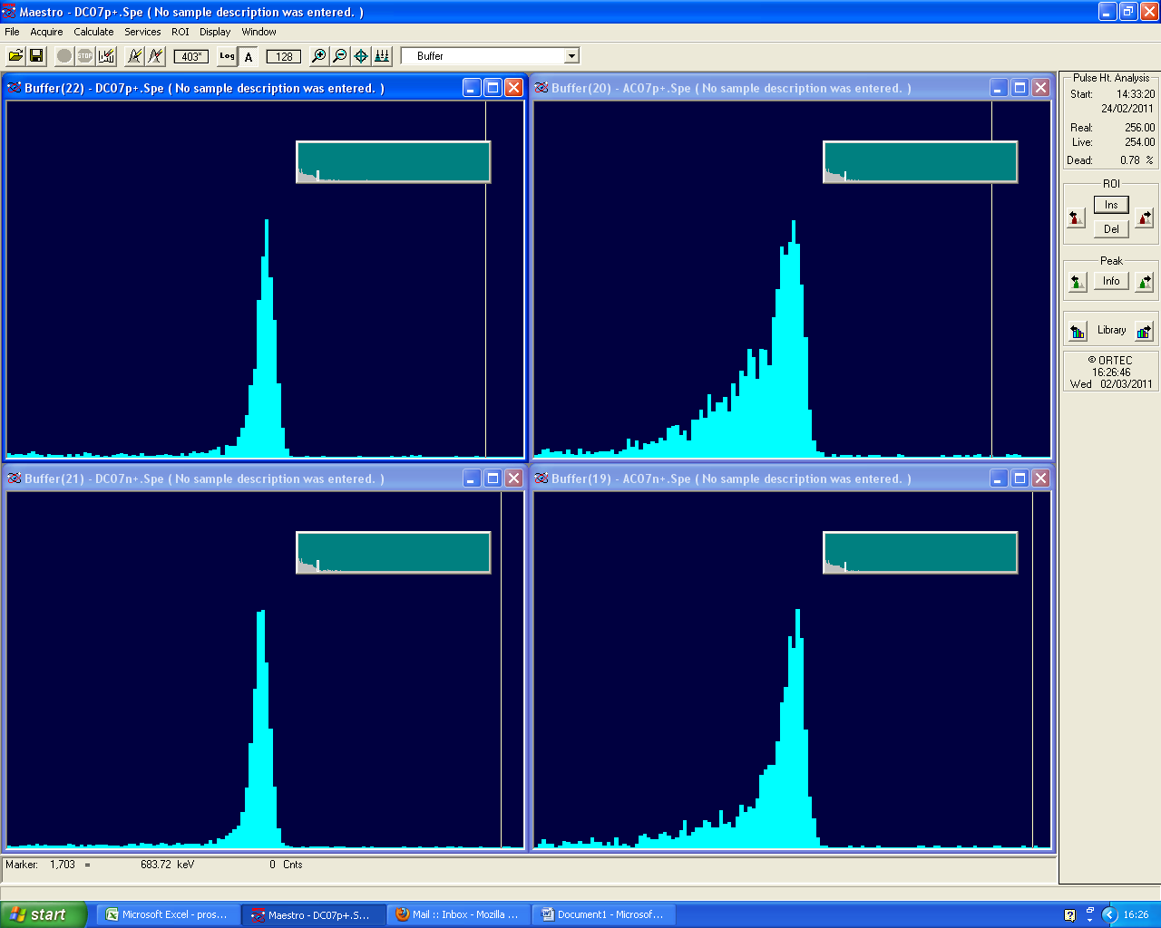
However, at 662keV...
Low energy tailing observed in AC channels when the ¹³⁷Cs source irradiates each face
Electron trapping in the detector? – a precision surface scan is required
At medical imaging energies (141 keV), tailing is present only when source is incident on the DC face
Therefore, can either readout energy from AC channels only or always irradiate the AC face without degradation in performance
AC
Counts
DC
AC
DC
Energy (keV)

