Slide 1
Previous (London) Conferences on Position Sensitive Detectors
(see http://www.psd9.aber.ac.uk/previous-psd-conferences.html)
PSD8, Glasgow 2008
PSD7 Liverpool, 2005
PSD6, Leicester, 2002
PSD5, UCL London, 1999
PSD4, Manchester, 1996
PSD3, Brunel, London, 1993
PSD2, Imperial, London, 1990
PSD1, UCL, London, 1987

Slide 2
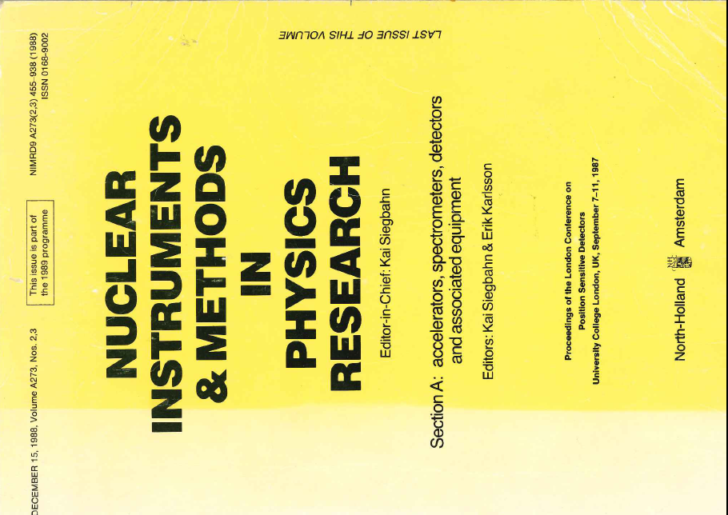
Previous Conferences
(see http://www.psd9.aber.ac.uk/previous-psd-conferences.html)
NIM:A V604,1-2 (2009)
NIM:A V573, 1-2 (2007)
NIM:A V513, 1-2 (2003)
NIM:A V477, 1-3 (2002)
NIM:A V392, 1-3 (1997)
NIM:A V348, 2-3 (1994)
NIM:A V310, 1-2 (1991)
NIM:A V273, 2-3 (1988)
Nucl. Instrum. Meth. A273 (1988) 630-635:
A LOW POWER CMOS VLSI MULTIPLEXED AMPLIFIER FOR SILICON STRIP DETECTORS, P. P. Allport, P. Seller and M. Tyndel.

Slide 3

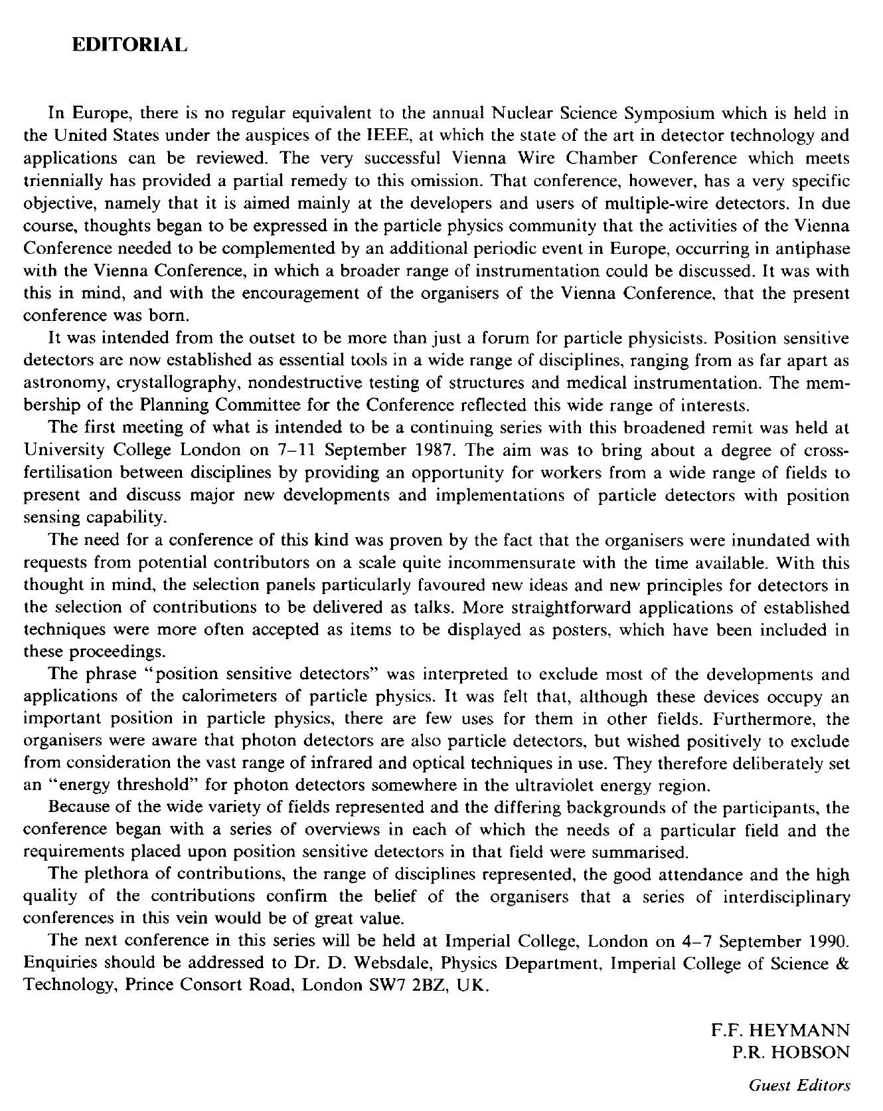

Slide 5
Some Observations
Typically numbers attending the conference have fluctuated from ~120 to ~240 delegates
There are usually around 130 contributions roughly equally divided between oral and poster presentations
Participation is mainly from Europe, America and Asia with usually over 20 nations sending delegates
The range of communities represented has grown as the conference has evolved, making it now a unique interdisciplinary event internationally in the field of position sensitive detector research and development

