Slide 1
High resolution SFOV gamma camera systems
John Lees
University of Leicester

Slide 2
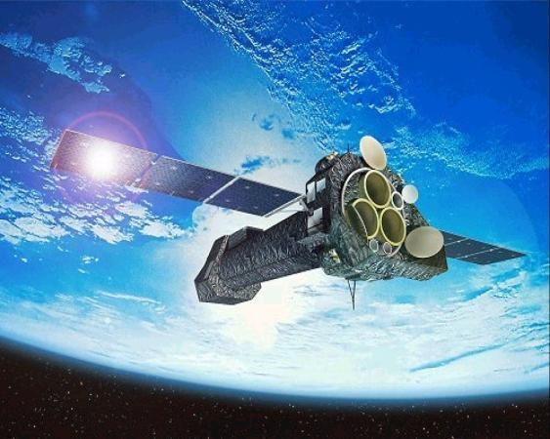
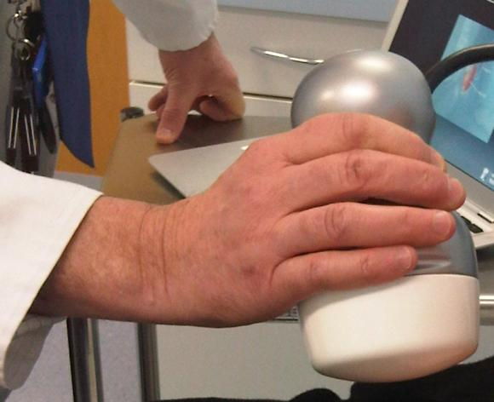
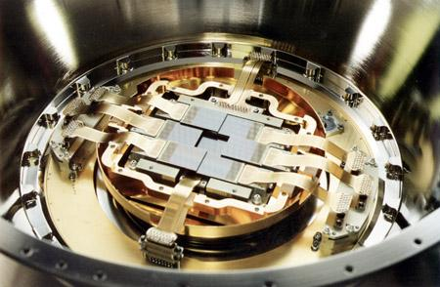
UoL Space Research Centre
Technologies and Expertise
Optical, UV, X-rays, gamma rays
Charge Coupled Devices: CCD
XMM-Newton: EPIC

Slide 3
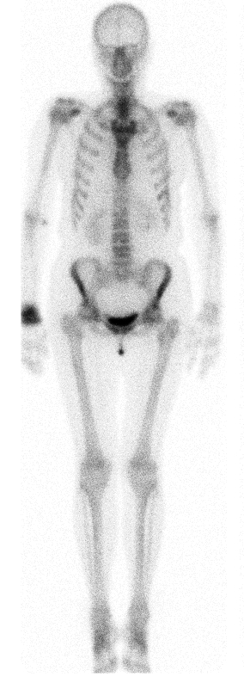
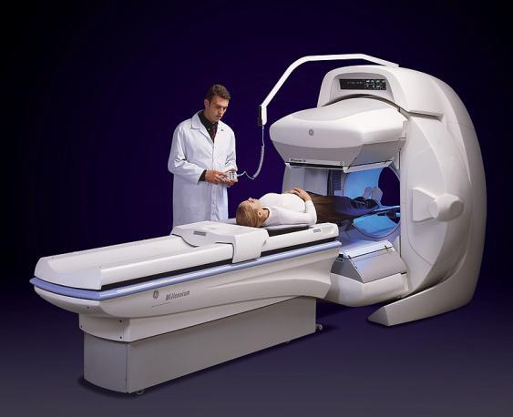
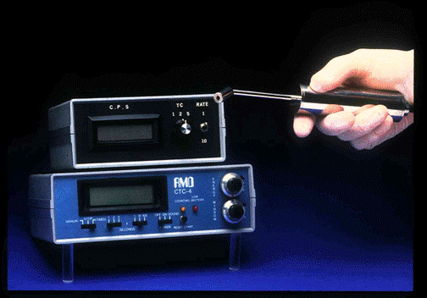
Gamma Cameras and Probes
A dual head gamma camera A nuclear probe detector

Slide 4
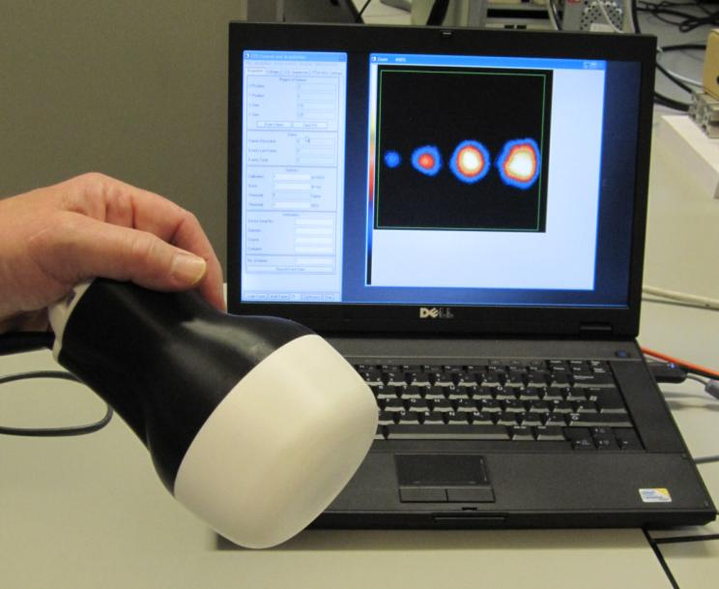
Mini Gamma Ray Camera (MGRC)
Scintillator coated CCD
Complementary to “standard” Gamma Camera
High spatial resolution (<1mm)
Energy range 30-160 keV.
International Patents
Hand held potential
Point of care testing

Slide 5
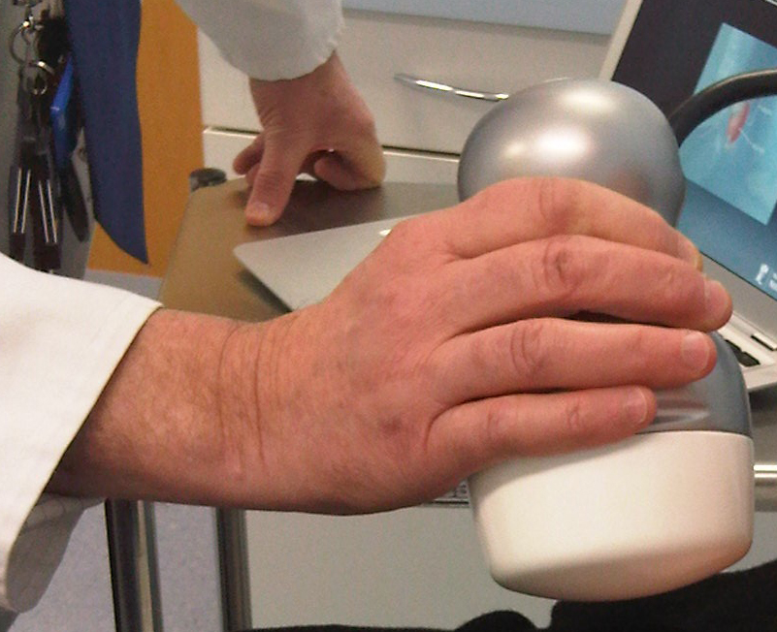
Mini Gamma Ray Camera (MGRC)
e2v CCD 97 BI
16 µm pixels
512 x 512 pixels
8 mm x 8 mm
Pinhole collimators:
FOV 40mm x 40mm

Slide 6
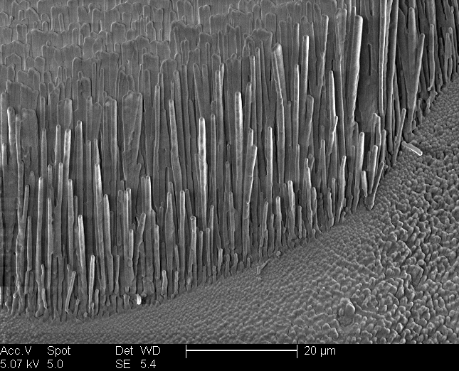

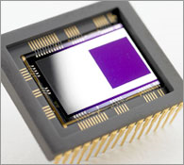
Camera Schematic
Columnar CsI
Each column acts as a “light pipe”
The mini gamma camera

Slide 7
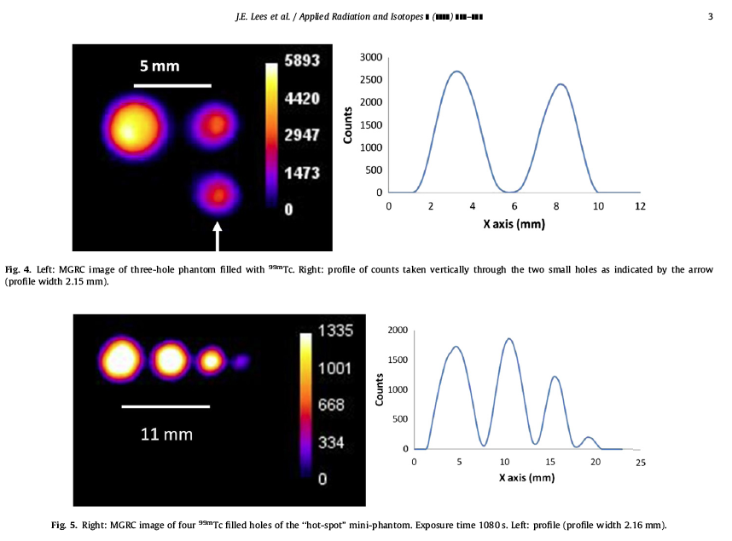
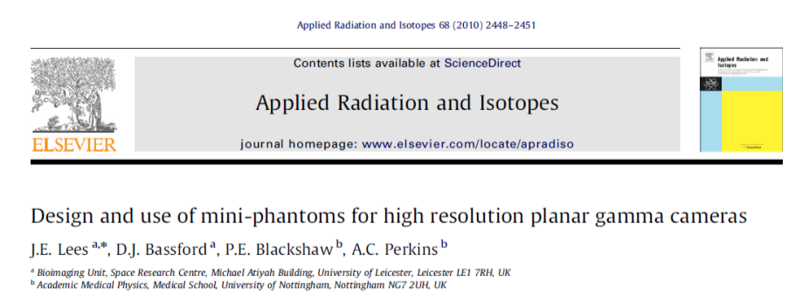
Phantoms

Slide 8
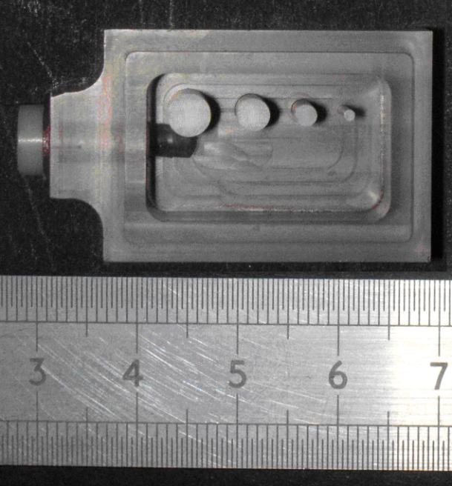
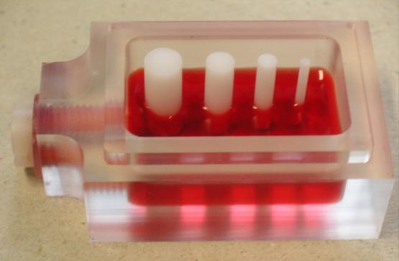
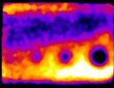
Mini-Phantom

Slide 9
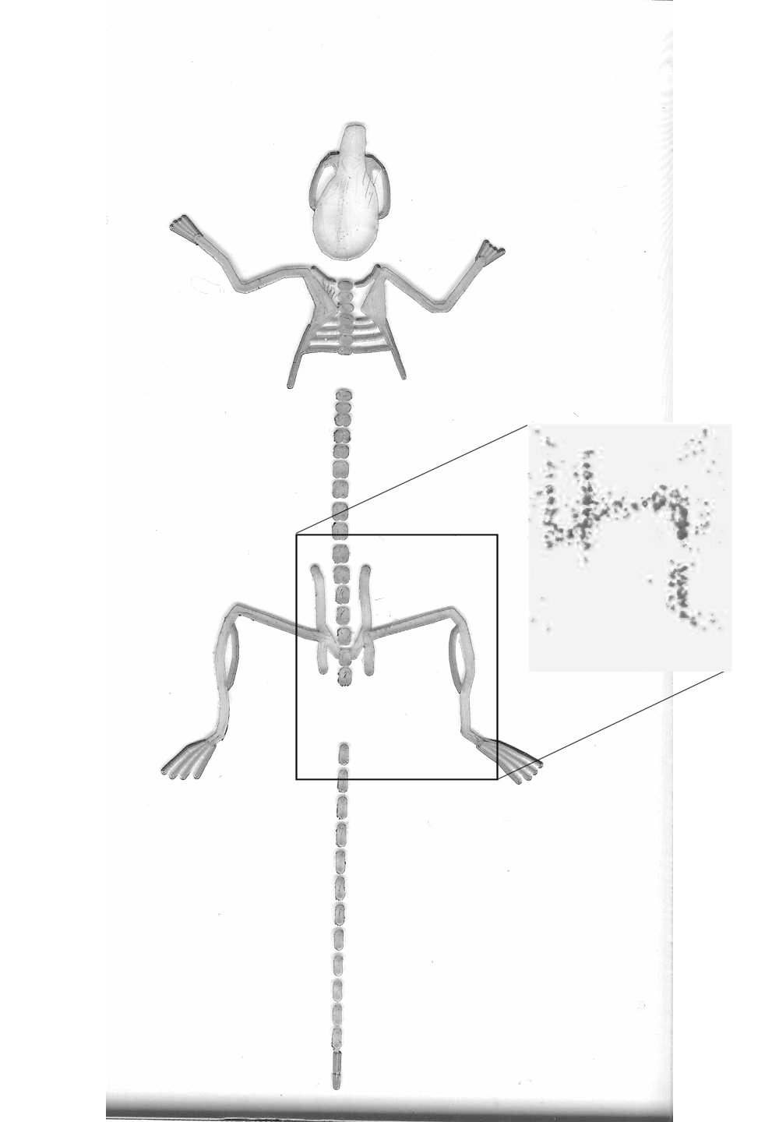
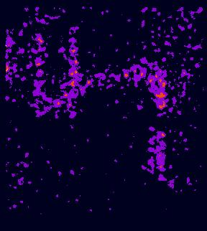
Phantoms
^{99m}Tc image of leg and hips
Mouse phantom

Slide 10
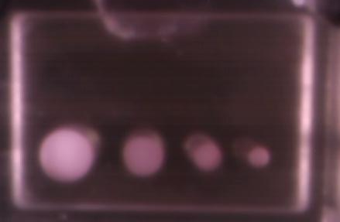

Comparison with WBGC
Hot spot Phantom ^{99m}Tc
15 mm
15 mm

Slide 11
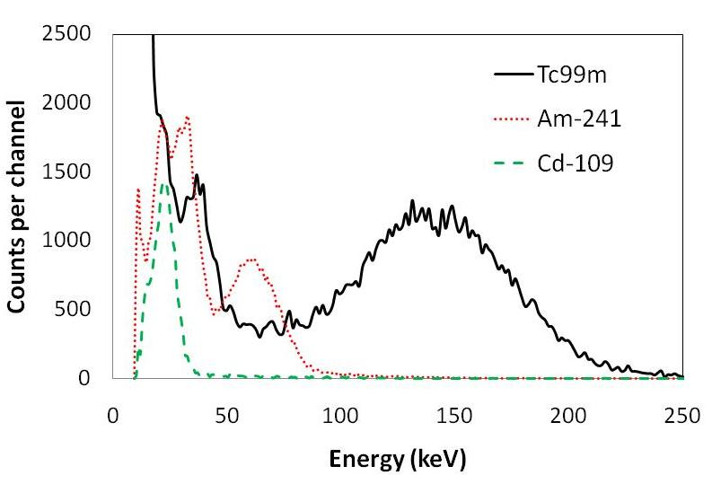
MGRC performance
Sub-mm spatial resolution ~0.9mm @ 25mm
Interesting Energy Resolution

Slide 12
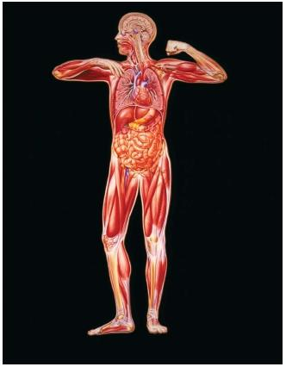
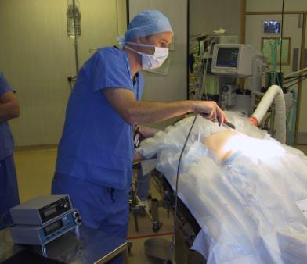
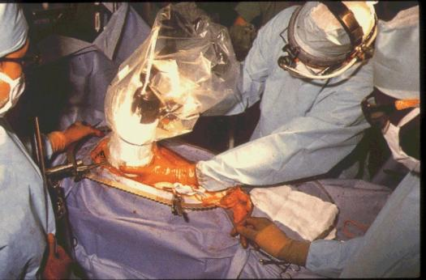
Clinical Applications & Evaluation
Nasal clearance
(drug delivery studies)
lacrimal drainage
(eye)
thyroid morphology
Sentinel node detection
(breast)
Sentinel node detection
skin (melanoma)
General surgical exploration
in bone (osteoid osteoma) tumour detection, (colon, ovary).
Joint imaging

Slide 13
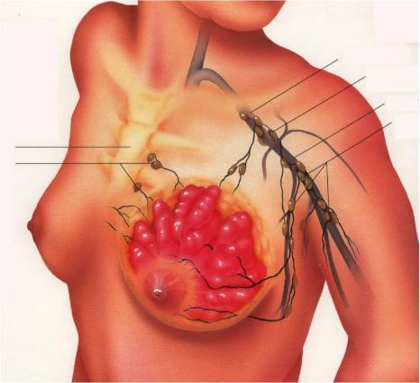
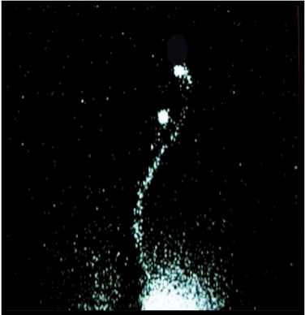
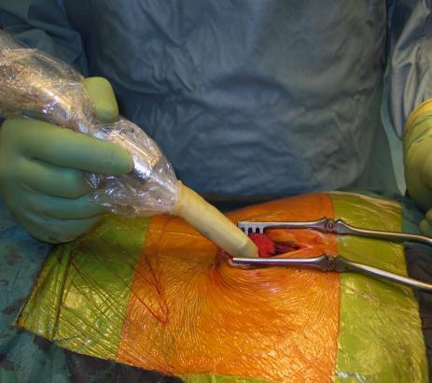
Sentinel Node Detection
RCS New Start Programme 2007-2008:
Sentinel Lymph Node Biopsy Training Programme
Regionally run programme aimed at all members of the breast care team.

Slide 14
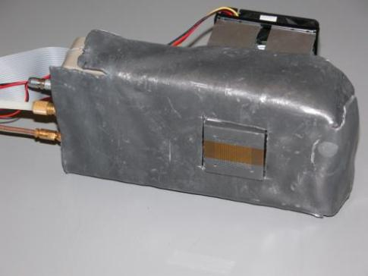
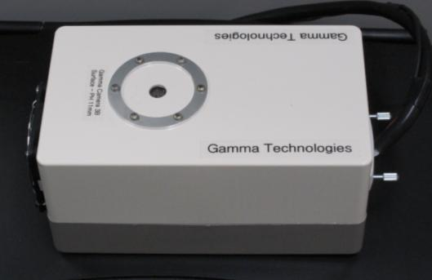
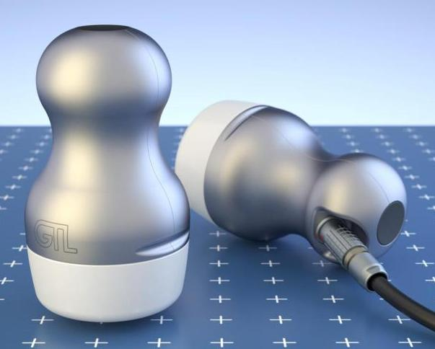
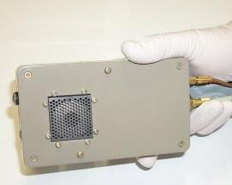
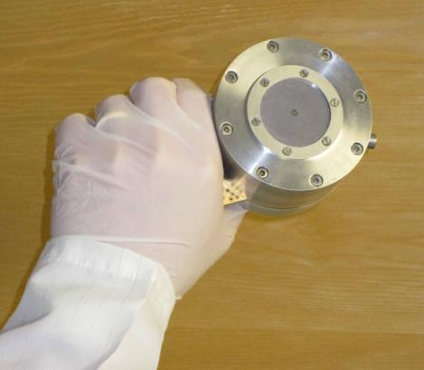
Design evolution - MGRC

Slide 15
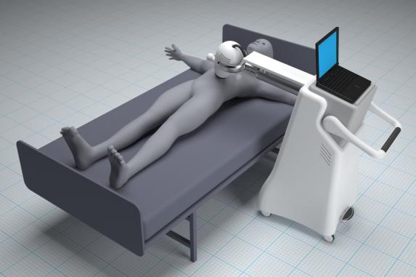
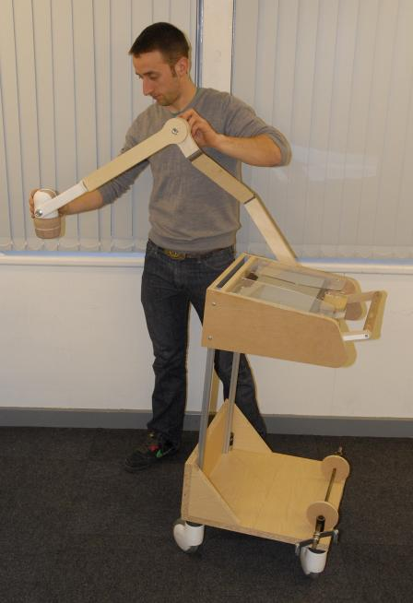
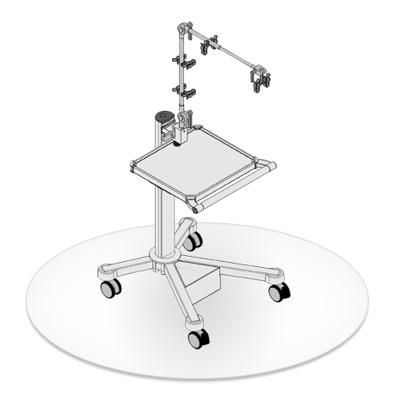
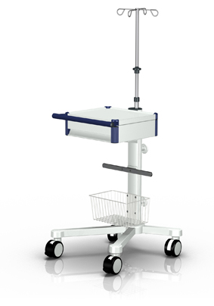
Clinical prototype design

Slide 16
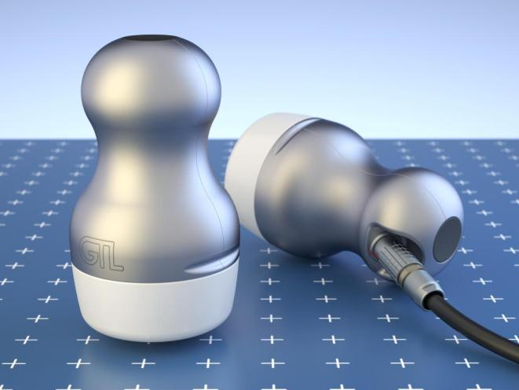
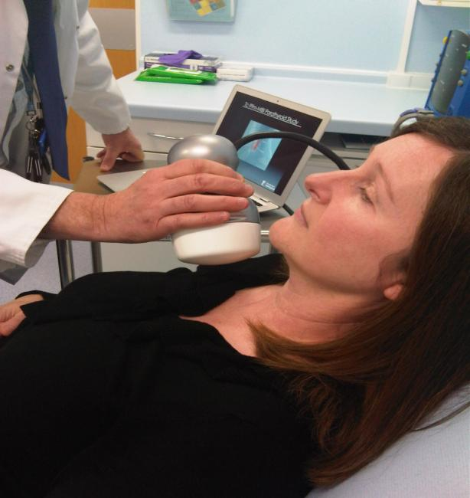
Clinical prototype design
MGRC in clinical setting
MGRC prototype

Slide 17
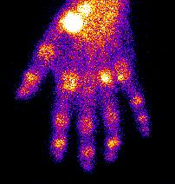
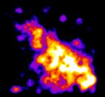
Clinical trial, QMC Nottingham
Tc-99m-HDP bone imaging in patient
Conventional gamma camera HR Mini gamma camera

Slide 18
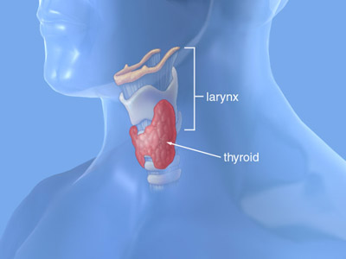
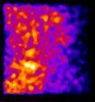
Tc-99m-MIBI Parathyroid Study

Slide 19
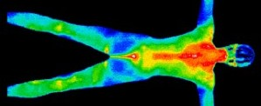

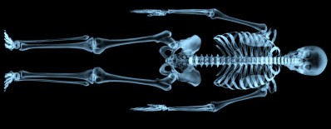
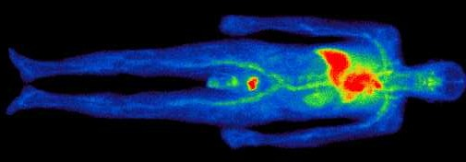
Multi-wavelength approach
The Milky Way
Man
Near-Infrared
Optical
X - rays
Gamma rays

Slide 20
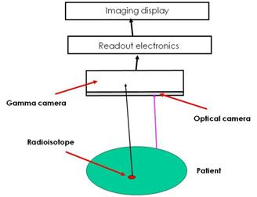
Hybrid camera
A combined optical and gamma camera system
Co-aligned optical and gamma camera
Minimises parallax
Minimises image
registration problems

Slide 21
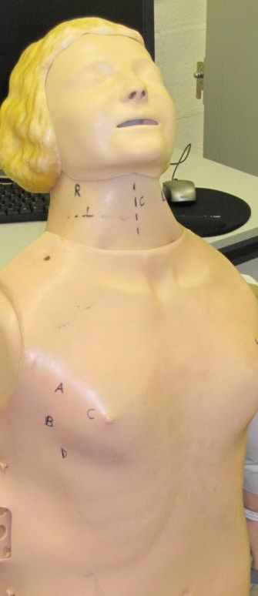
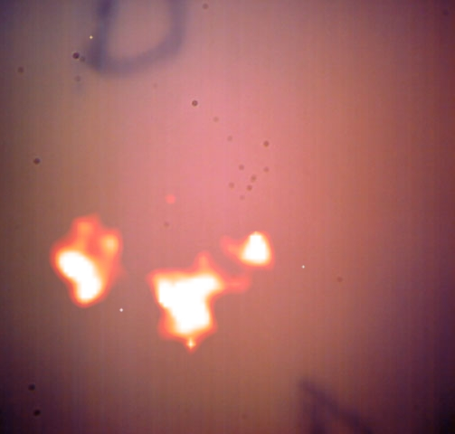
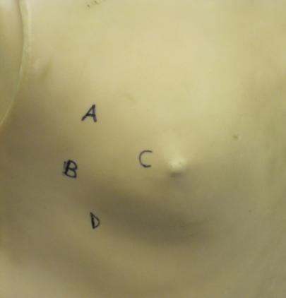
Lymph node phantom

Slide 22
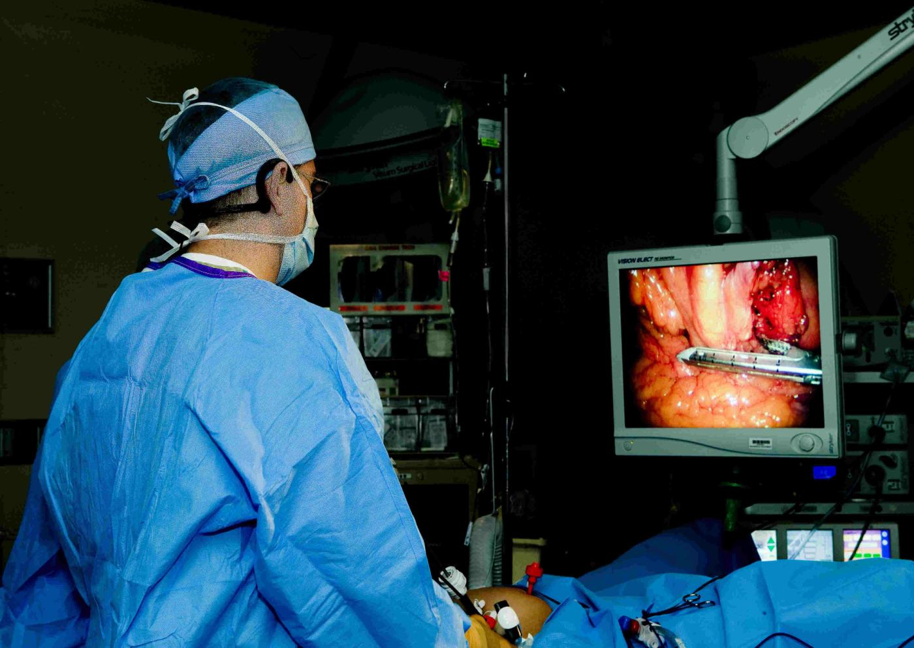
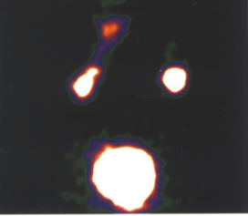
Hybrid Imaging

Slide 23
Benefits of SFOV Cameras
High spatial resolution (<1mm)
Energy range 30-160 keV.
Hand held potential
Point of care imaging
Intra-operative imaging will
Improve patient management
Increase surgical confidence
Reduce surgery time
Reduce cost of treatment

Slide 24
Acknowledgements
Space Research Centre, Leicester
David Bassford, Oliver Blake, Tony Abbey,
George Fraser, Duncan Ross, Chris Bicknell
Massimiliano Canali
University of Nottingham
Alan Perkins and Elaine Blackshaw
De Montfort University
Peter Ford and Lee Cottrell

