Slide 1


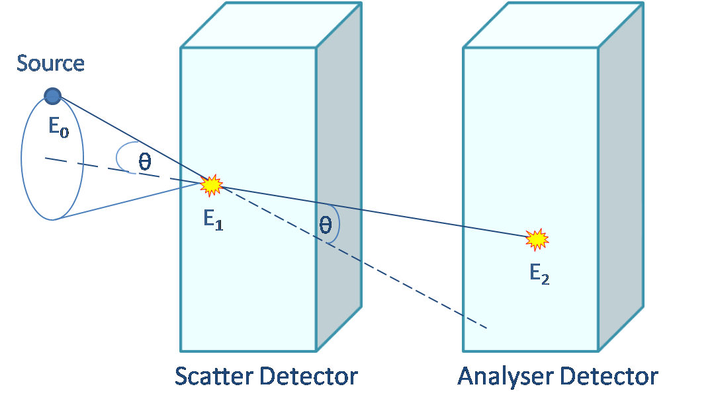
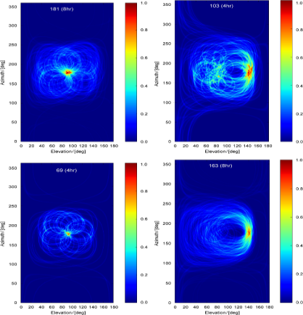
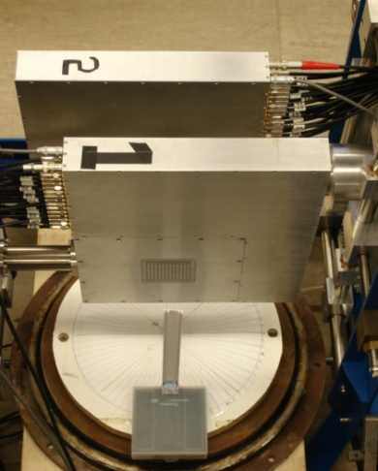
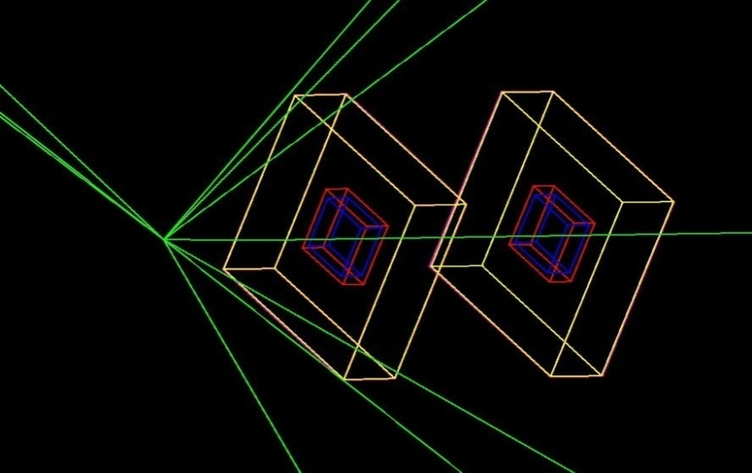
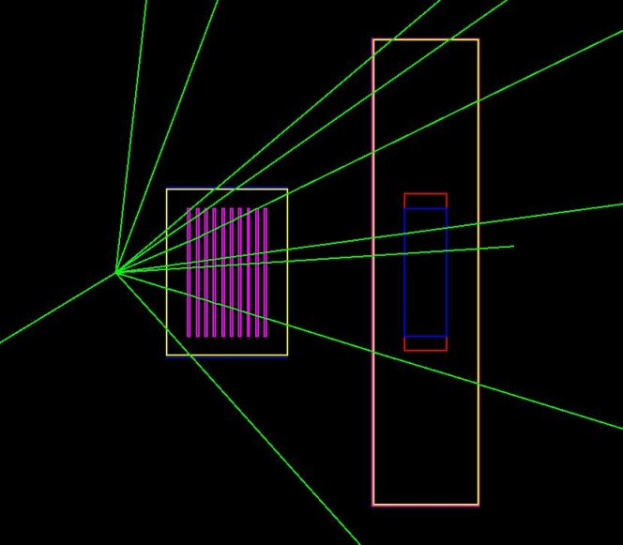
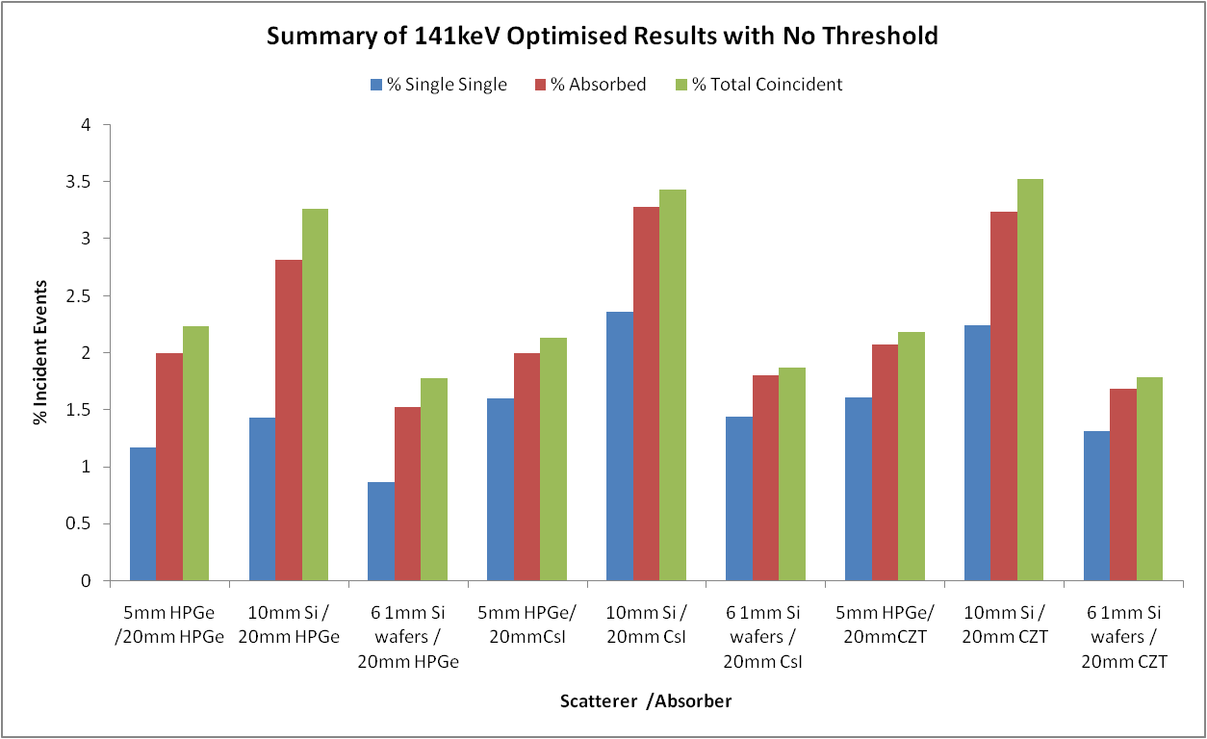
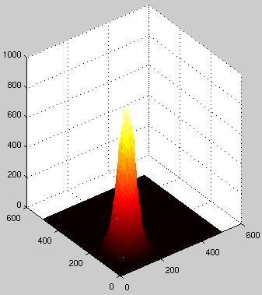
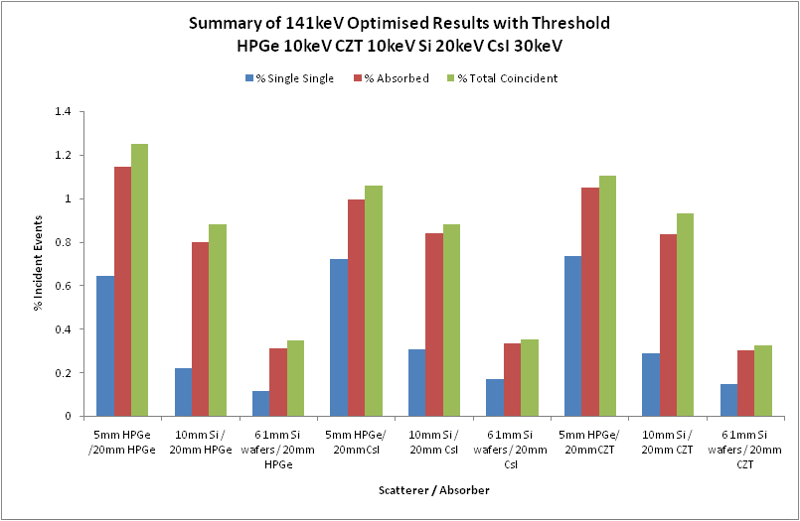


Optimisation of a Dual Head Semiconductor Compton Camera using Geant4
L.J. Harknessª, A.J. Bostonª, H.C. Bostonª, R.J. Cooperª, J.R. Cresswellª, A.N. Grintª, P.J. Nolanª, D.C. Oxleyª, D.P. Scraggsª, T. Beveridge^{b} , J. Gillam^{b} , I. Lazarus^{c}
a) Department of Physics, University of Liverpool, Oliver Lodge Laboratory, Liverpool, L69 7ZE, UK
b) School of Physics and Materials Engineering, Monash University, Melbourne, Australia
c) STFC Daresbury Laboratory, Warrington, Cheshire, UK
Introduction
Position sensitive High Purity germanium detectors are the sensor of choice for gamma-ray detection in the field of nuclear physics due to their excellent intrinsic energy resolution and the potential for excellent spatial resolution using segmentation and pulse shape analysis techniques [1]. Development of a geometrically optimised Compton camera for medical applications is currently underway, which will exploit the characteristics of position sensitive semiconductor detectors. Previous work done by the group has shown the potential of semiconductor Compton camera systems but show limitations to the current imaging equipment [2]. Such limitations arise because SmartPET [3] has been designed and developed for the 511keV Positron Emission Tomography (PET) experiments, rather than the medically important 141keV Compton camera experiments for Single Positron Emission Tomography (SPECT).
Compton Camera
Geant4 Simulation and Optimisation
A Compton camera utilises two position sensitive detectors to reconstruct the path of incident gamma-rays using Compton kinematics.
A simulation package for a semiconductor Compton camera has been written using the Geant4 toolkit [4]. The simulation has been compared with experimental data acquired from the HPGe planar SmartPET detectors, so confidence can be gained of the simulation validity. The peak to total values and absolute efficiency curves (right) showed excellent agreement. It is suggested that discrepancies result from known charge loss behaviour in the detector, which is not modelled in the Geant4 simulation.
Cone beam reconstruction techniques are used to generate images, where the most intense regions result from the greatest overlap in cones and therefore the location of the source of radiation. Previous experiments carried out at the University of Liverpool with the SmartPET imaging system in Compton camera mode show promising results above 244keV [2].
Total Efficiency Curve for one SmartPET detector
The package is flexible to allow various detector materials in many configurations to be investigated. The main focus of investigation is being carried out on three scatter materials and three absorber materials:
Scatterer
HPGe
Si(Li)
Multiple Si layers
Important characteristics for the scatter detector are good position and energy resolution and high Compton scattering probability at 141keV. The absorber detector material should have a high photoelectric absorption cross section with good position and energy resolution.
The coincident hit information from the detectors is output by the simulation and analysed in ROOT. A noise threshold can be applied to produce results which more realistically reflect experimental variables. Infinitely good position and energy resolution is implied in the analysis.
Absorber
HPGe
CZT
CsI
Left: Reconstructed images of ¹⁵²Eu point source for 3cm (top) and 5cm (bottom) separation at 0°
Right: The SmartPET detectors in Compton camera Configuration with source at 0°
Geant4 Simulation visualisation of 2 SmartPET detectors (blue), guard ring (red) and aluminium can (yellow). Isotropic source gamma-rays are shown in green.
Results
The optimum configuration is found when the largest fraction of incident events are recorded, in particular those that result from a single interaction in each detector and lead to full absorption.
For a HPGe scatter detector, the optimum thickness was found to be 5mm
For multiple Si scatter detectors, the optimum configuration was 6 1mm thick detectors with a separation of 2mm
For a Si(Li) scatter detector the optimum thickness was found to be 10mm
Results showed 10-20mm to be a suitable thickness for all absorber materials
To achieve the optimal Compton camera configuration, many parameters can be controlled within the simulation. The primary variables are :
Scatter detector material and thickness
Absorber detector material and thickness
Source to scatter detector distance
Scatter detector to absorber detector distance
Angle of absorber detector relative to scatter detector
Geant4 Simulation visualisation of multiple Si scatter detectors and a SmartPET detector
When no threshold is applied to the simulated data, the results show 10mm Si to be the best scatter detector material, coupled with either 10mm CsI or CZT. These combinations have the largest values of coincident absorption events which are a result of a single interaction in each detector.
Future Work
Results show that HPGe is the optimum material of choice for the scatter detector of a medical Compton camera, coupled with any of the simulated absorbers. This is appropriate when considering only the efficiency of the system, however other important factors are to be considered:
Energy resolution of the detectors
Doppler broadening effects from the detectors
Position resolution of the detectors
Practicality of setup
When suitable thresholds are applied, Si becomes a less favourable scatter detector material, and the optimum configuration is shown to be 5mm HPGe with any of the simulated absorbers.
To test the importance of these attributes, simulated point source images will be produced using the cone beam reconstruction algorithms in place, (for example, right). The images will be produced using simulated data that will be altered to account for the energy resolution and Doppler broadening effects. The Full-Width-Half-Maximum (FWHM) values of the point spread function produced will be calculated and compared for the various configurations.
The optimum Compton camera configuration will have a combination of excellent efficiency and image resolution.
High sensitivity SPECT (0.05%)
[1] D. Bazzacco, Nucl. Phys. A 746 (2004) [2] H.C. Boston, et al., NIM A 579 (2007) [3] R.J. Cooper, et al., NIM A 579 (2007) [4] S. Agostinelli, et al. NIM A 506 (2003)
Thanks to J. Gillam for his SmartPET Compton camera images and to the members of the Geant4 User’s Forum

