Slide 1
A new design of MPGD:
Micro-Mesh Micro Pixel Chamber
(M³-PIC)
A.Ochi*, Y.Homma, T.Dohmae, H.Kanoh, T.Keika, S.Kobayashi, Y.Kojima, S.Matsuda, K.Moriya, A.Tanabe, K.Yoshida
Kobe University

Slide 2
Introduction
Introduction to μ-PIC
Design of new M³-PIC
Advantages using micro mesh

Slide 3
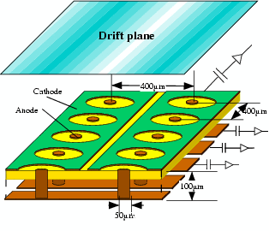
Introduction to μ-PIC
M³-PIC is based on μ-PIC
  μ-PIC：micro pixel gas chamber
  Large area with PCB tech.
  pitch :400μm
  high gas gain
  small discharge damage
MSGC
μ-PIC
Maximum
gain
1700(with capillary)
15000
Stable Gain
1000
7000
Long time
>30 days
Area
10×10cm²
30×30cm²
Pitch
200μm
400μm
(300μm possible)
uniformity（σ）
~35%
4%
Invented by A.Ochi and T.Tanimori
( NIMA 471 (2001) 264)
Application: X-ray imaging, Gamma camera,
Medical RI tracing, etc.

Slide 4
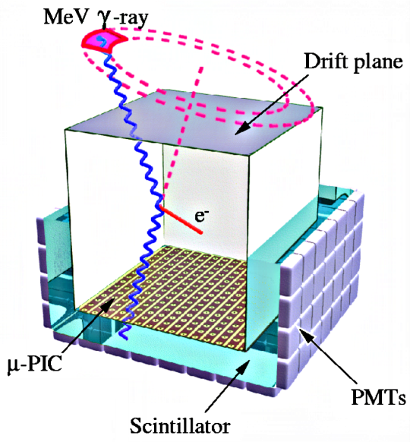
Introduction to μ-PIC (cont’d)
Applications --- Micro TPC → Gamma ray camera
(ETCC: Electron-Tracking Compton Camera)
Gaseous TPC
with micro-electrodes
Recoil Electron :
3D Sequential Track ->Direction,
Energy
α
Scintillation Camera
Less cost than semiconductor
Scattered Gamma-ray :
Energy, Direction
X, Y from m-PIC
＋
Z from timing
Tanimori, et al, 2004
３D Track

Slide 5
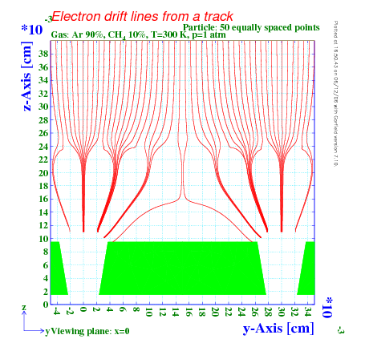
Design of M³-PIC
Micro pixel chamber (μ-PIC)
+
With micro mesh
  Higher gain in stable operation (~5x10⁴)
  Low ion backflow (<1%)
Drift plane
1cm
Drift/detection area
(Filled by gas)
Support wire
Cathode
Anode
400μm
Micro Mesh
165μm
100μm
230μm
70μm

Slide 6
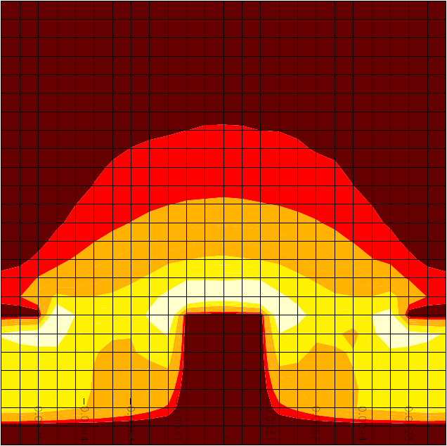
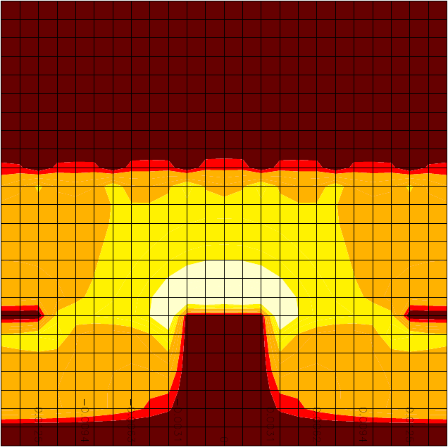

Advantages using micro mesh
E-field strength on μ-PIC
Higher gas gain will be attained safely (10⁴⁻⁵)
  High electric field is formed larger area around the anode
  Without increase of e-field near cathode edge
    Electron emission from cathode edge is reduced
    Streamer from anode is quenched
Reduction of positive ion backflow
  μ-PIC: ~30%
  M³-PIC: < 1%
Cathode
Substrate
Anode
E-field strength on Μ³-PIC
Mesh
Cathode
Substrate
Anode
Anode

Slide 7
Setup and operation tests
Setup
Gas gain measurements
Ion backflow measurements

Slide 8
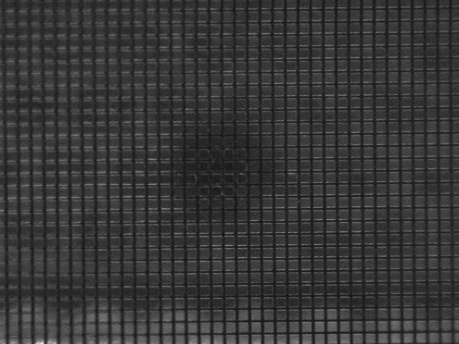
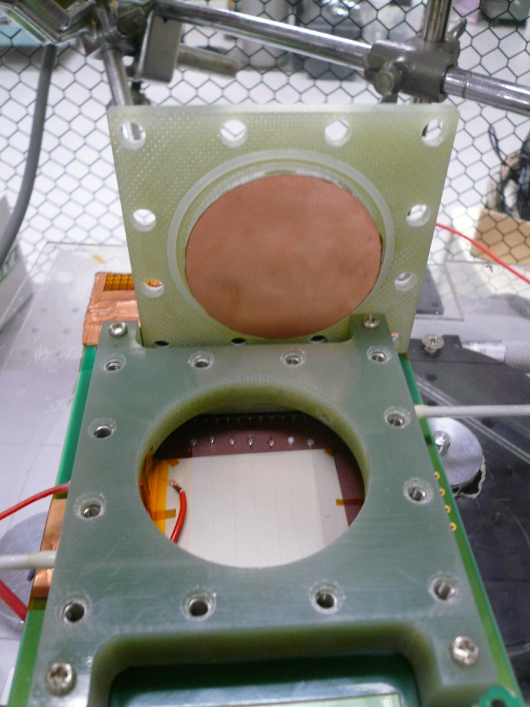
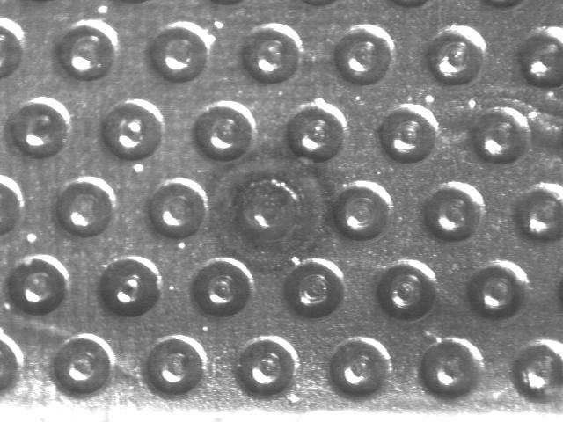
Setup
Micro scope pictures
for same place
(different focus point)
0.5mm
Micro mesh mounted on μ-PIC by hand.
Size of μ-PIC = 3cm x 3cm.

Slide 9
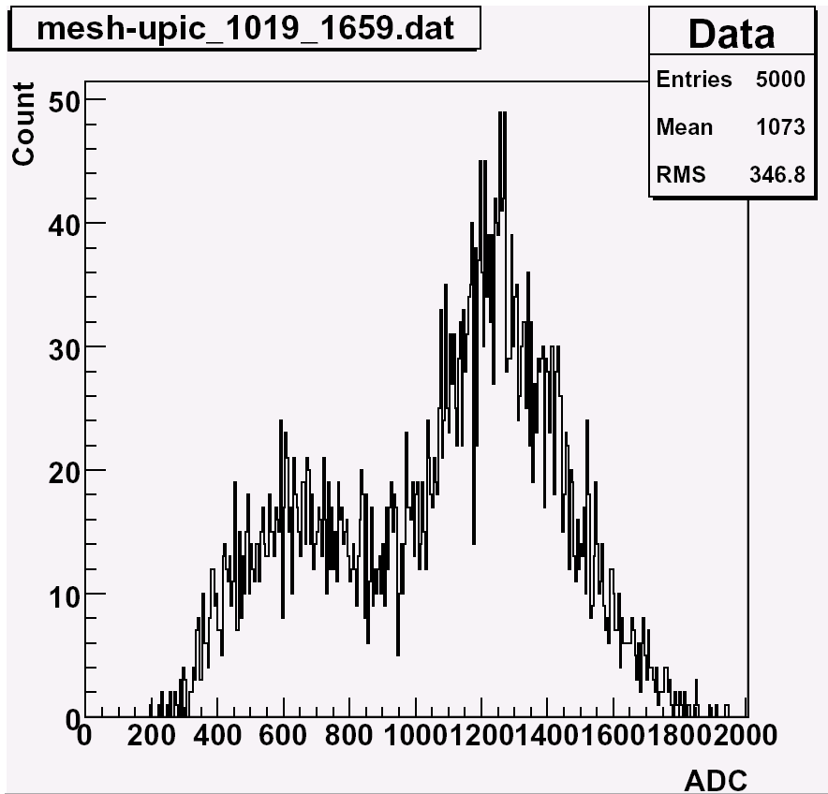
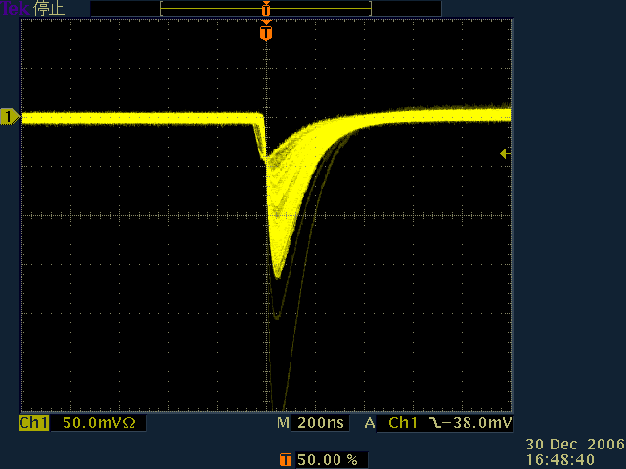
Gas gain measurements
Gain dependency on
    Anode voltage (=Va)
    Mesh voltage (=Vm)
    Drift field (=(Vd-Vm)/1cm)
Drift Plane
Vd
1cm
Mesh
Vm
165 μm
100μm
Cathode
Anode
Signal
Va

Slide 10
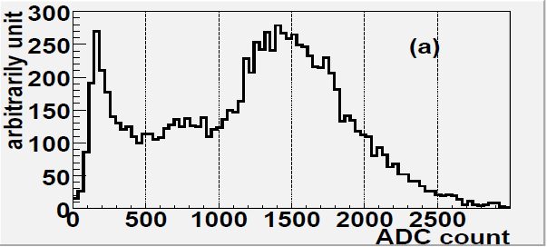
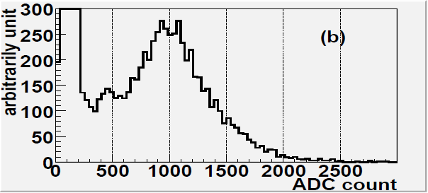
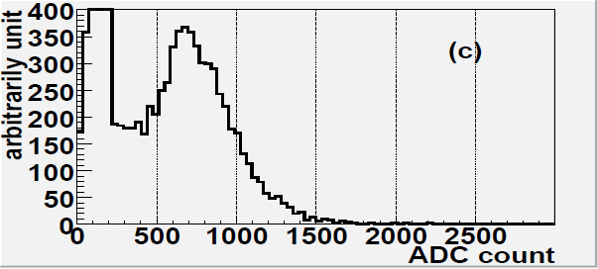
Gain dependence of drift field
Higher drift field
  Lower electron collection efficiency on anode
  Gain decrease
  Energy resolution worse
    No escape peak found in 2kV/cm
Maximum gain
  100V/cm < E_d < 500V/cm
  E_d below 100V/cm
    → Ion-electron recombination
E_drift = 300V/cm
E_drift = 1kV/cm
E_drift = 2kV/cm

Slide 11
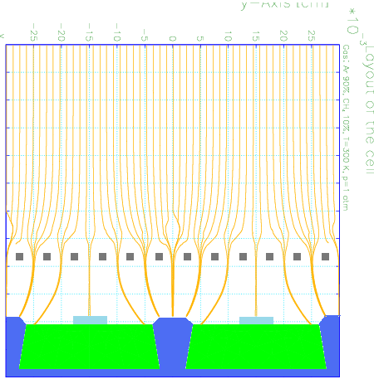
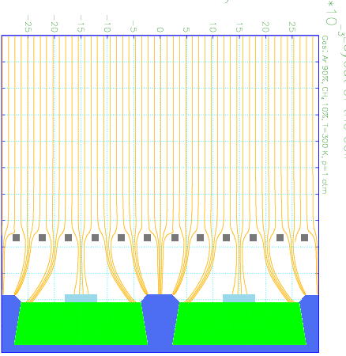
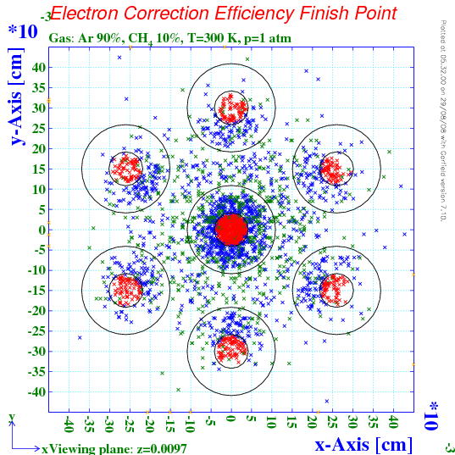
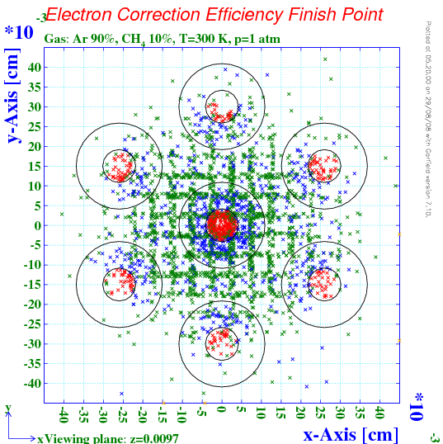
Electron drifts toward anode (simulation)
E_drift = 300V/cm
E_drift = 1kV/cm
Electrons are absorbed in the mesh or cathodes when electric field in drift region is higer.
mesh
mesh
cathode
cathode
anode
anode

Slide 12
Gain dependence on Vm and Va
E_drift = 300V/cm
Maximum gain : 5 x 10⁴
Gap of mesh: 165μm
Mesh thickness: 5μm
Gas: Ar:C2H6 = 50:50

Slide 13
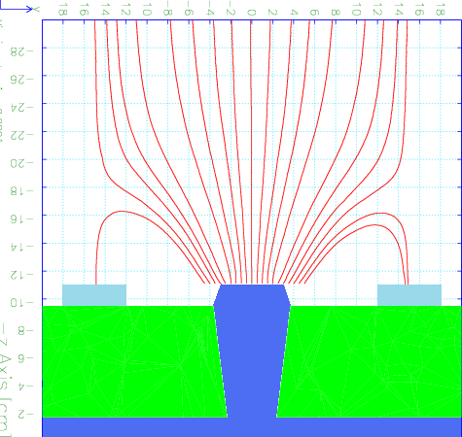
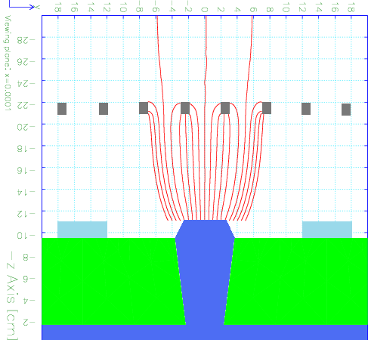
Ion backflow (IBF)
Ion backflow: The fraction of total avalanche-generated ions reaching to drift region.
Serious problem for TPC readout
Ion drift lines from anodes
μ-PIC (no mesh)
M³-PIC
Low IBF
Simulation
Simulation

Slide 14
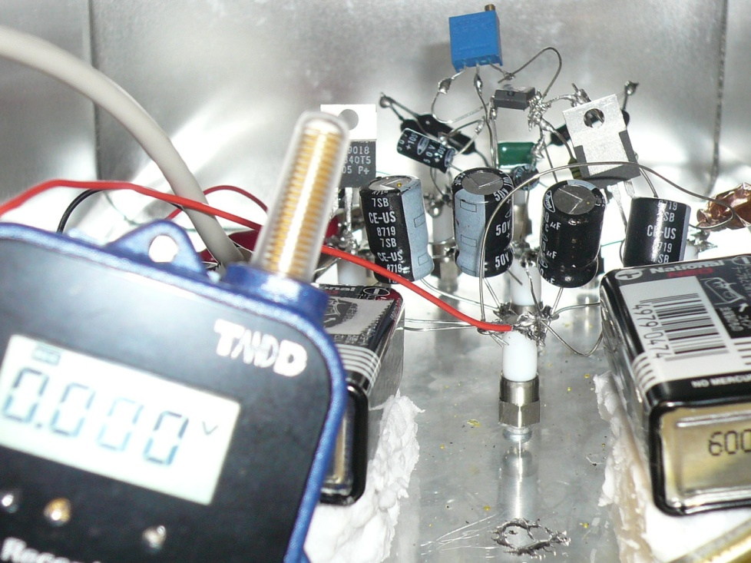
Setup for ion backflow measurements
Pico-ammeter is inserted in Drift and Anode line
IBF = ( I_drift/I_anode)
Wireless data taking for keeping insulation
β (Sr⁹⁰)
Drift Plane
A
Vd
(-100V~-1kV)
Mesh
(5μm or 20μm)
Pico ammeter
Cathode
Vm
(-150V~350V)
100μm
Data collection
by wireless
Anode
A
Va
(~500V)
Pico ammeter

Slide 15
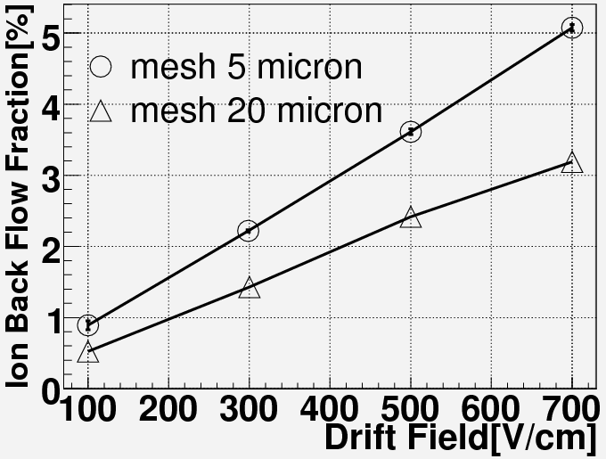
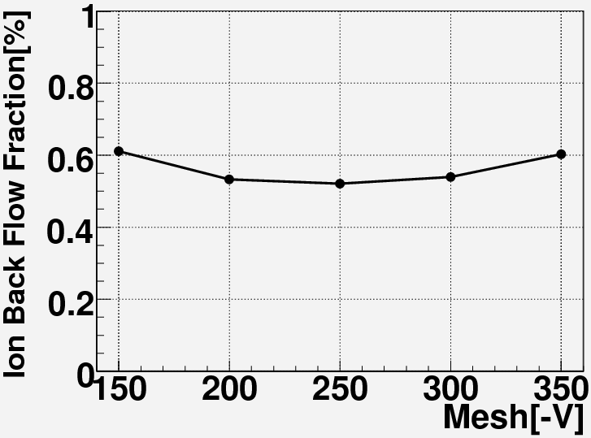
IBF of M³-PIC
IBF dependence on drift field and mesh thickness
IBF dependence on mesh voltage
Vm = -250V
E_drift = 100V/cm
Mesh 20 micron
Gas: Ar 90% + C₂H₆ 10%
Gain = 10⁴ for these tests
Liner dependence of IBF on drift field
Small IBF for thicker mesh
Optimum point of mesh voltage
Minimum IBF = 0.5%

Slide 16
Summary
New MPGD design: M³-PIC was developed
  Combined with μ-PIC and micro mesh
  Ideal electrical fields are formed around anodes for gas avalanche
Prototype was manufactured and tested
Maximum gain of 5 x 10⁴ has been attained at present
  A few time larger than the gain of simple μ-PIC
Minimum IBF of 0.5% has been attained at present
Future Prospects
Optimization of structure parameters (mesh gap, mesh thickness … etc.) and operation parameters (HV, gas etc.)
Combination with existence large area μ-PIC
  Testing imaging and tracking capabilities
  Long term operation test

