Slide 1

Radioactive isotope formation in 3D-informed O-C shell mergers
Joshua Issa, Falk Herwig, Steve Mojzsis,
Marco Pignatari, & Kai Matsunaga
Astrophysics with Radioactive Isotopes 2026

Slide 2
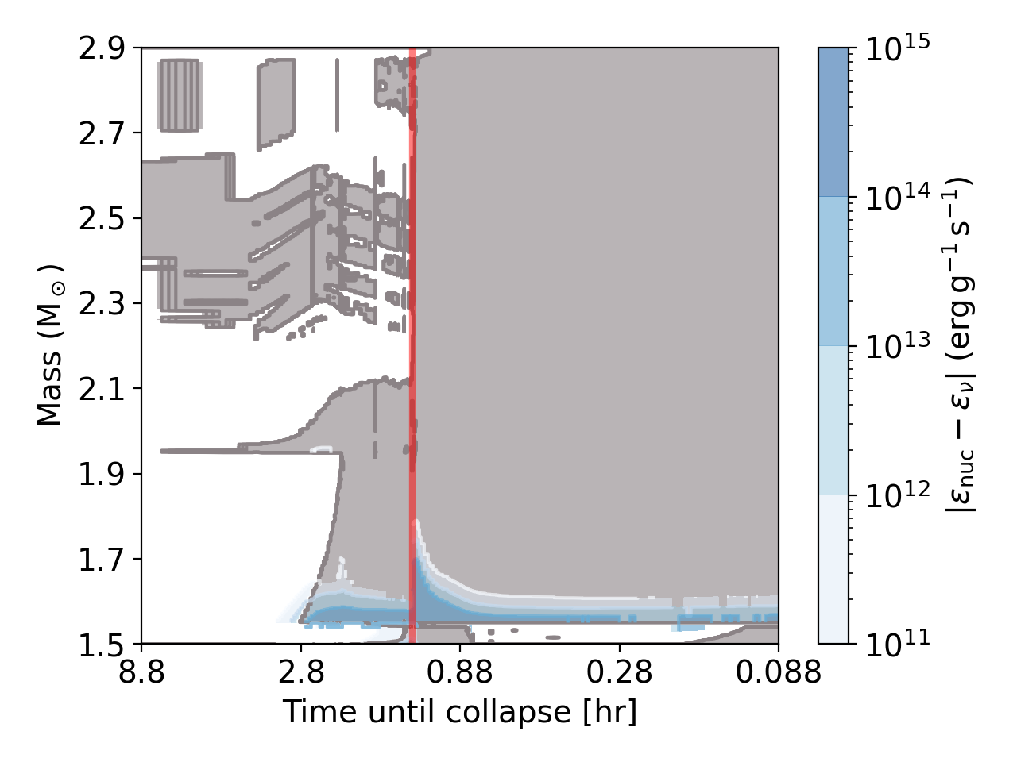
What are O-C* Shell Mergers
Oxygen-carbon shell mergers are late events (last hours!) where a single convective shell spans multiple burning temperatures (see Luca & Lorenzo’s talks)
O-burning products are increased and C-burning products are decreased in these events
C shells
O-C shell
C shell
O shell
*OC and CO are different labels for the same event
1
Notes:
Merged region
C shell
O shell

Slide 3
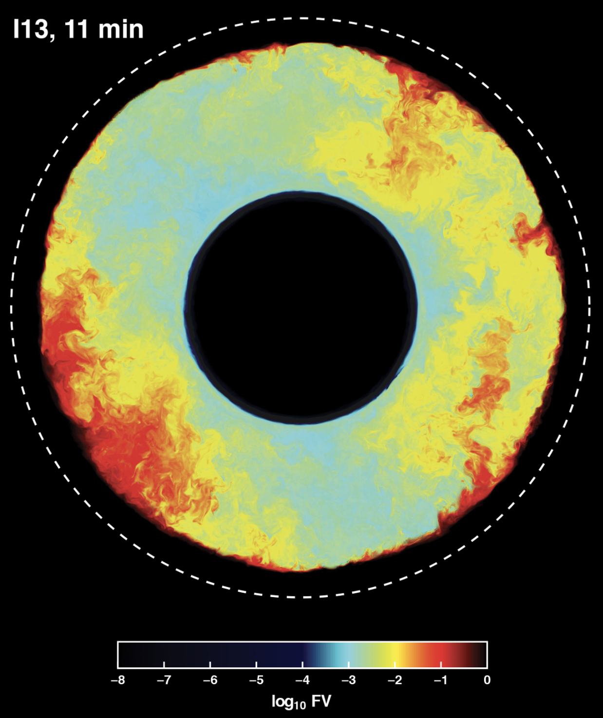
O-C Shell Mergers are 3D Mixing Events
3D hydrodynamic simulations have shown that the merger significantly deviates from 1D predictions (Jones+ 2017, Andrassy+ 2020, Rizzuti+ 2024)
Non-radial perturbations, faster velocities, a gradient towards the convective boundary, and even the mechanism of merging
Andrassy+ 2020
2

Slide 4
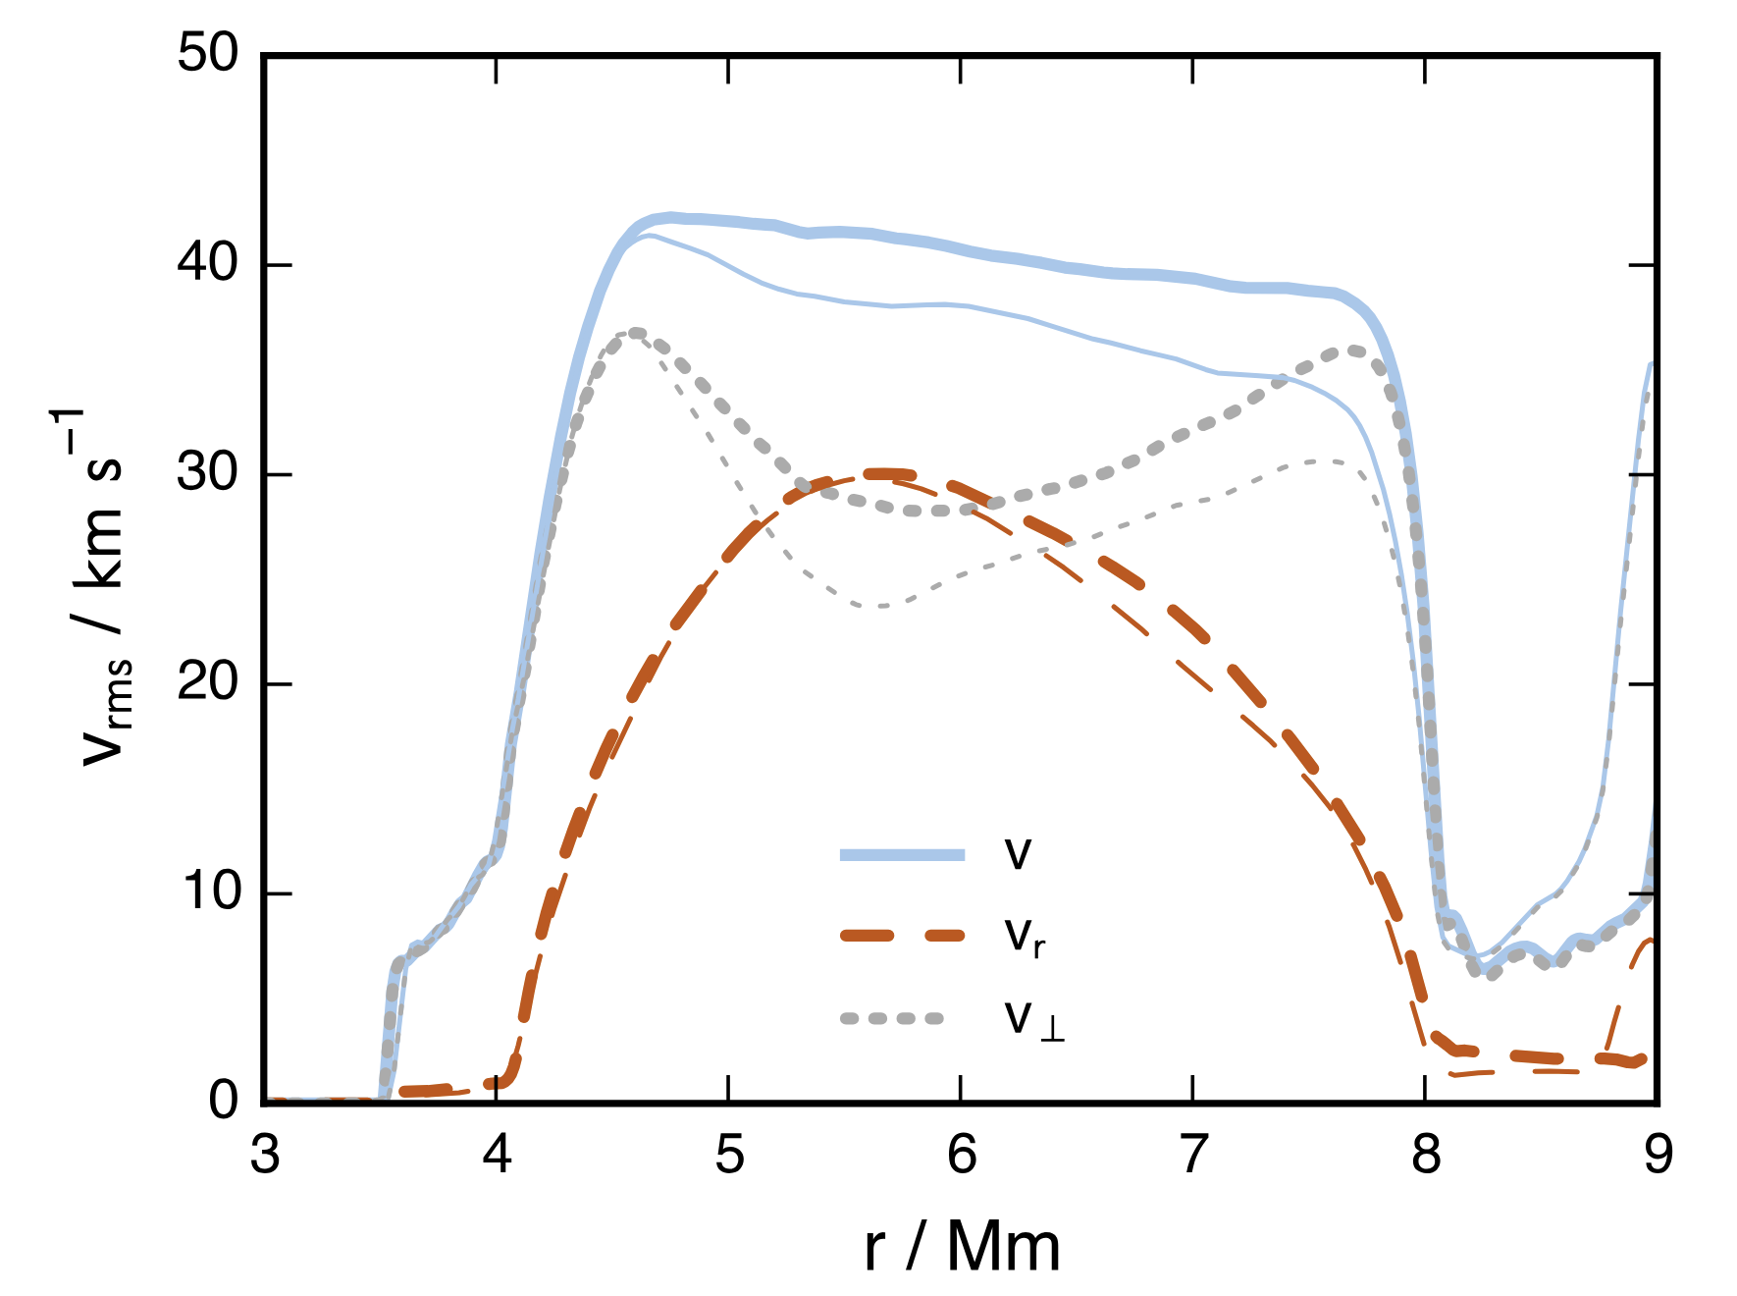
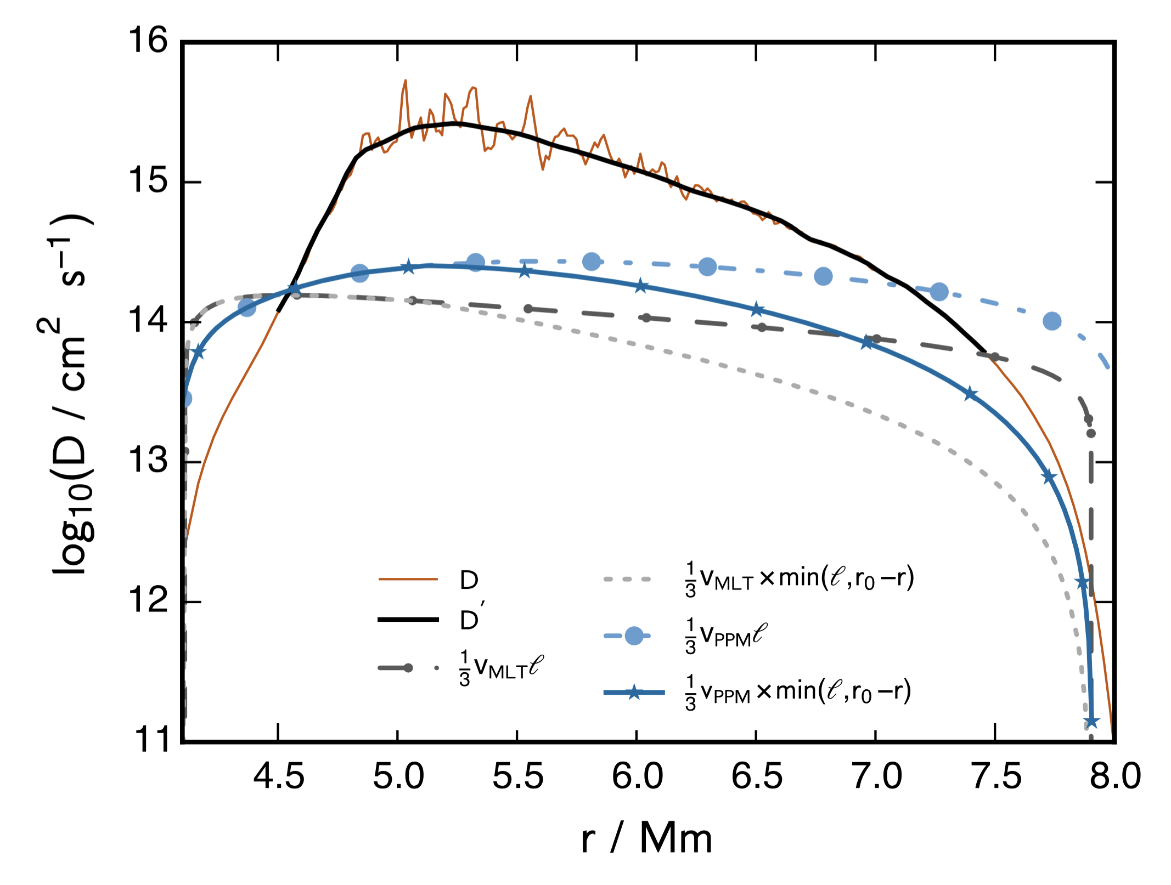
Really: 1D Mixing Prescriptions Are Wrong
3D fluid velocities are not only radial
3D radial mixing is quite different to 1D
3D result
1D prediction
Jones+ 2017
3

Slide 5
Really: 1D Mixing Prescriptions Are Wrong
3D fluid velocities are not only radial
3D radial mixing is quite different to 1D
3D result
1D prediction
Jones+ 2017
3

Slide 6
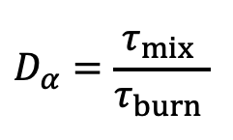
Why Mixing Matters: Convective-Reactive Burning
When C and Ne material are ingested into O-burning temperatures, the mixing and burning occur on similar timescales
This allows for different parts of the O shell to produce different isotopes preferentially (Issa+ 2026a)
$$D_{α}=\frac{τ_{mix} }{τ_{burn} }$$
4

Slide 7
Many Isotopes are Sensitive to Mixing!
Because of the convective-reactive environment, the shell merger region is able to synthesize a wide range of isotopes
p nuclei, light odd-Z, and many radioactive species
Issa+ 2026a
Issa+ 2026b
Issa & Herwig 2026
5

Slide 8
Pre-SN Formation of Radioactive Isotopes
Issa & Herwig 2026
Many radioactive isotopes production in the O-C shell merger
How much does mixing matter? What’s the role of the mass cut? What about explosive nucleosynthesis?
6

Slide 9
Using 3D Hydro Results in 1D Models
We post-process the O shell of a 15 M☉ Z=0.02 with different mixing profiles
3D hydro suggests:
  Faster mixing speeds & downturn at boundary
  Different merging rates
  Potential dips in mixing speed
We investigate 24 scenarios in total
7

Slide 10
Using 3D Hydro Results in 1D Models
We post-process the O shell of a 15 M☉ Z=0.02 with different mixing profiles
3D hydro suggests:
  Faster mixing speeds & downturn at boundary
  Different merging rates
  Potential dips in mixing speed
We investigate 24 scenarios in total
7

Slide 11
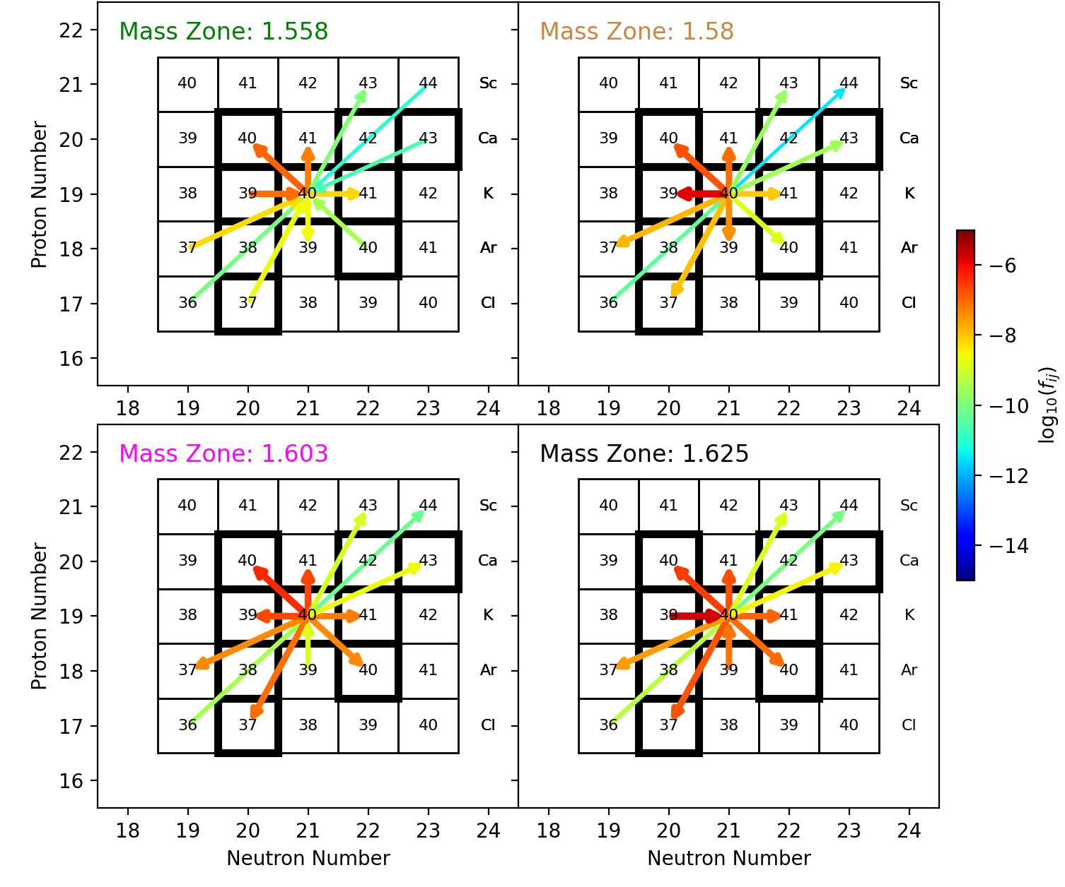
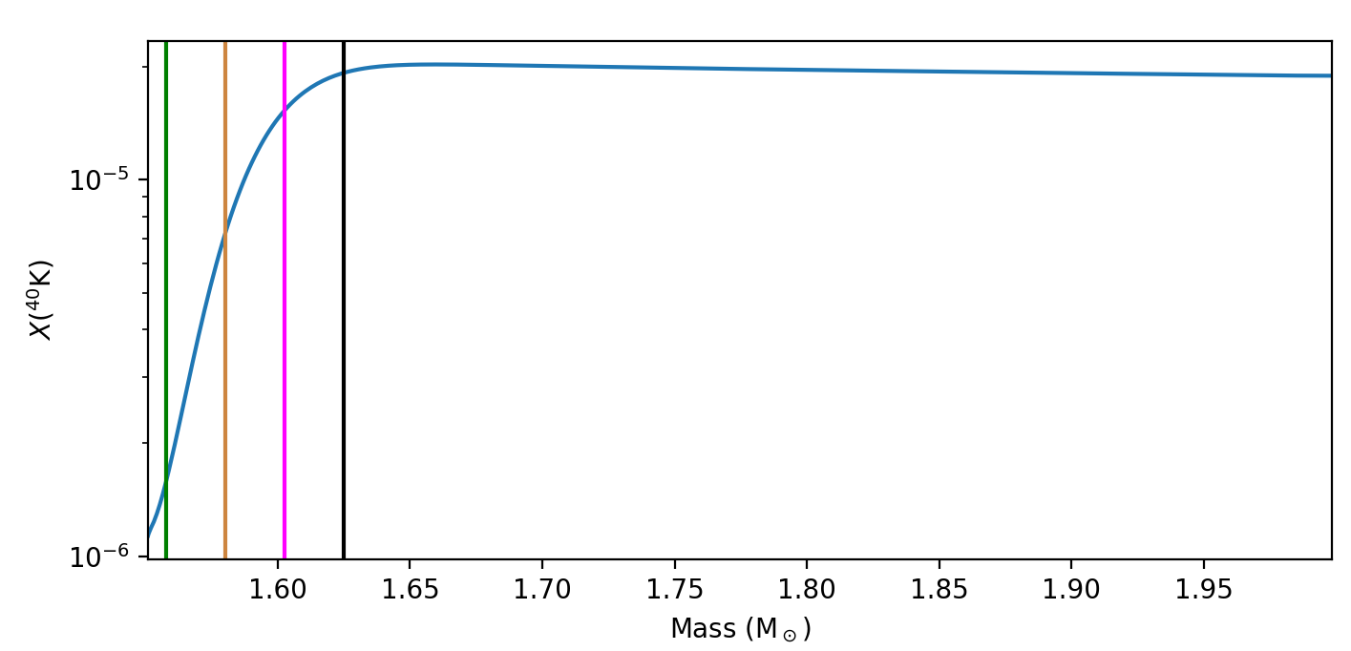
Nucleosynthesis is Zone-Dependent
Inhomogeneous isotope distribution in the shell
Reaction rates change direction and strength across the shell
8

Slide 12
Nucleosynthesis is Zone-Dependent
Inhomogeneous isotope distribution in the shell
Reaction rates change direction and strength across the shell
8

Slide 13
Mixing Changes Which Reactions Matter
1D-predicted mixing profile
50x enhancement + downturn
Issa+ 2026b
Mixing speed says how much a species moves before it reacts & separates the sites for reactants and products
This leads to different reaction pathways for different mixing prescriptions
9

Slide 14
Mixing Changes the Location of Burning
As mixing speeds increase, the location where timescales are equal shifts deeper into the shell
Although some isotopes have different paths, ⁴⁴Ti is made by a single reaction chain in all cases: ³⁸Ar(⍺,𝛾)⁴²Ca(n,𝛾)⁴³Ca(p,𝛾)
⁴⁴Sc(p,n)⁴⁴Ti
Mixing changes the temperatures that these reactions occur by 100s of MK
10

Slide 15
Boosting Mixing Does Not Boost Production Monotonically
Non-monotonic with mixing speed
Monotonic with mixing speed
11

Slide 16
Results are Sensitive to Carbon Shell Ingestion
3x enhancement + downturn
3x enhancement + downturn
12

Slide 17
Radioactive Isotopes Feature Large Range
Pre-explosive production of radioactive isotopes is sensitive to changing mixing prescriptions
⁴⁴Ti has the largest range of isotopes considered here:
4.8 orders of magnitude
13

Slide 18
Merger Production Can Match the Explosion
Compared to the explosive yield of the 15 M☉ Z=0.02 model, pre-explosive mixing uncertainties are larger
²²Na, ⁴⁰K, ⁶⁵Zn are produced in the merger
⁴⁴Ti, ⁵¹Cr, and ^{59,60}Fe are boosted by the merger but also explosion
  Unclear how explosion would affect mixing results
14

Slide 19
Impact of Mass Cut is Isotope Dependent
Mass cut inside O shell
Mass cut including Si shell
The location of the mass cut does not change the range much in our pre-SN production for ²²Na, ⁴⁰K, ⁴⁴Ti, and ^{59,60}Fe
Side effect: pre-explosive ⁴⁴Ti can be boosted without changing final ⁵⁶Ni yields
15

Slide 20
Shell Mergers Impact Rocky Exoplanets
Shell mergers don’t preserve solar ratio of ⁴⁰K and K
Difference in ⁴⁰K could change rocky exoplanet heating (refer to Steve’s talk)
Issa+ 2026b
16

Slide 21

Shell Mergers Impact Rocky Exoplanets
1.74
1.54
1.34
1.14
0.94
0.74
0.54
$$[{}_{ }^{40}K/K]$$
Shell mergers don’t preserve solar ratio of ⁴⁰K and K
Difference in ⁴⁰K could change rocky exoplanet heating (refer to Steve’s talk)
Issa+ 2026b
16

Slide 22
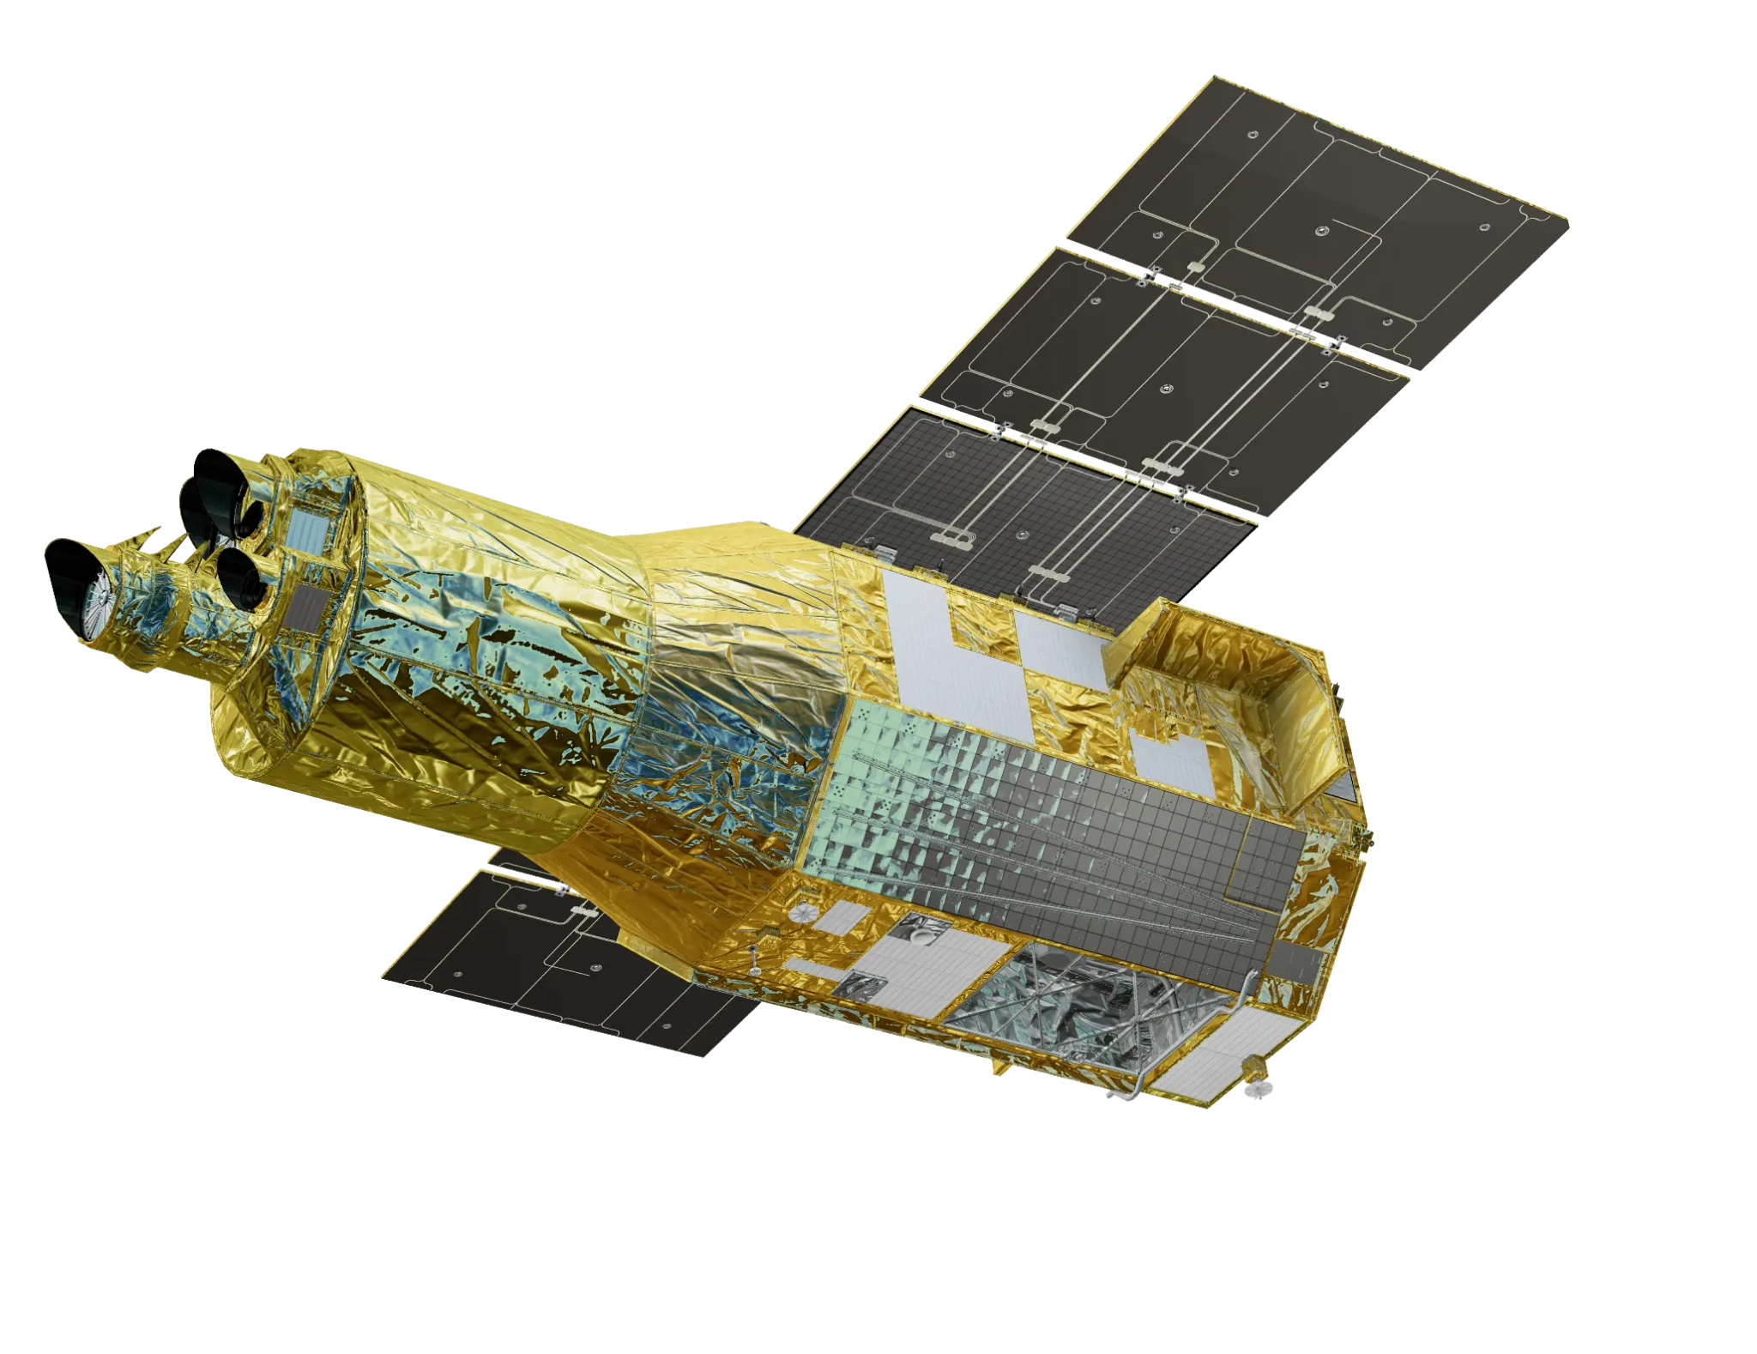
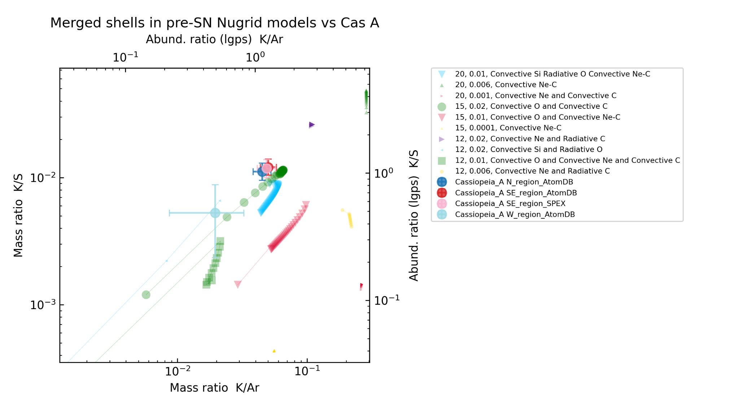
Can Cassiopeia A Constrain Mixing?
XRISM
Shell merger?
Cas A seems to have had a shell merger (Sato+ 2025, Audard+ 2025)
There are many types of shell mergers that are possible
O-C shell merger profile matches well with Cas A observations
Explosive
PRELIMINARY
17

Slide 23
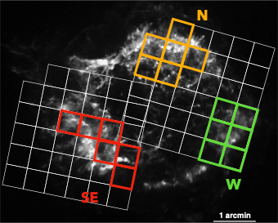
Can Cassiopeia A Constrain Mixing?
XRISM
Shell merger?
Cas A seems to have had a shell merger (Sato+ 2025, Audard+ 2025)
There are many types of shell mergers that are possible
O-C shell merger profile matches well with Cas A observations
Explosive
PRELIMINARY
17

Slide 24
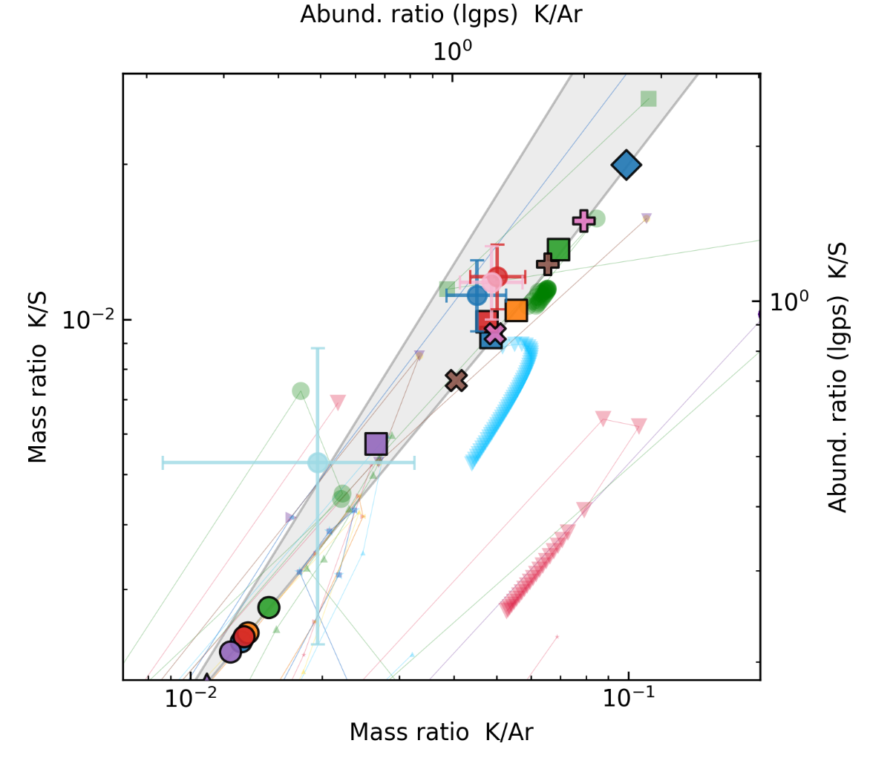
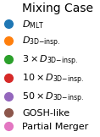
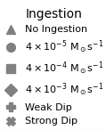
Cas A Could Constrain Mixing Physics
Some of our pre-explosive 3D-informed models match with the XRISM observations: constraints on mixing physics
Explosive shell merger profiles are also close
These models could also explain ⁴⁴Ti in Cas A (see Luca’s talk)
PRELIMINARY
18

Slide 25
Mixing Matters for Radioactive Isotopes
3D-informed mixing impact nucleosynthesis predictions
Identification of relevant reactions is impact by mixing prescription
Isotopic yields don’t follow solar distribution
Cassiopeia A (and other SNRs) may be sites to constrain progenitor physics
19

Slide 26
References
Andrassy, R., F. Herwig, P. Woodward, and C. Ritter. “3D Hydrodynamic Simulations of C Ingestion into a Convective O Shell.” Monthly Notices of the Royal Astronomical Society 491 (January 2020): 972–92. https://doi.org/10.1093/mnras/stz2952.
Audard, Marc, Hisamitsu Awaki, Ralf Ballhausen, et al. “Chlorine and Potassium Enrichment in the Cassiopeia A Supernova Remnant.” Nature Astronomy, December 4, 2025, 1–10. https://doi.org/10.1038/s41550-025-02714-4.
Jones, S., R. Andrassy, S. Sandalski, A. Davis, P. Woodward, and F. Herwig. “Idealized Hydrodynamic Simulations of Turbulent Oxygen-Burning Shell Convection in 4π Geometry.” Monthly Notices of the Royal Astronomical Society 465 (March 2017): 2991–3010. https://doi.org/10.1093/mnras/stw2783.
Issa, Joshua, Falk Herwig, Pavel A. Denissenkov, and Marco Pignatari. “Impact of 3D Macrophysics and Nuclear Physics on the P-Nuclei in O–C Shell Mergers.” The Astrophysical Journal 997, no. 1 (2026): 41. https://doi.org/10.3847/1538-4357/ae1efb.
Issa, Joshua, Falk Herwig, Stephen J. Mojzsis, and Marco Pignatari. “3D Macro Physics and Light Odd-Z Element Production in O-C Shell Mergers: Implications for 40K Production and Radiogenic Heating Inventories of Rocky Exoplanets.” The Astrophysical Journal 997, no. 2 (2026): 314. https://doi.org/10.3847/1538-4357/ae2ad1.
Issa, Joshua, and Falk Herwig. “Pre-Supernova O-C Shell Mergers Could Produce More 44Ti than the Explosion.” arXiv:2512.17705. Preprint, arXiv, January 26, 2026. https://doi.org/10.48550/arXiv.2512.1770.
Rizzuti, F., R. Hirschi, V. Varma, et al. “Shell Mergers in the Late Stages of Massive Star Evolution: New Insight from 3D Hydrodynamic Simulations.” Monthly Notices of the Royal Astronomical Society 533 (September 2024): 687–704. https://doi.org/10.1093/mnras/stae1778.
Sato, Toshiki, Kai Matsunaga, Hiroyuki Uchida, et al. “Inhomogeneous Stellar Mixing in the Final Hours before the Cassiopeia A Supernova.” The Astrophysical Journal 990 (September 2025): 103. https://doi.org/10.3847/1538-4357/aded14.

Slide 28
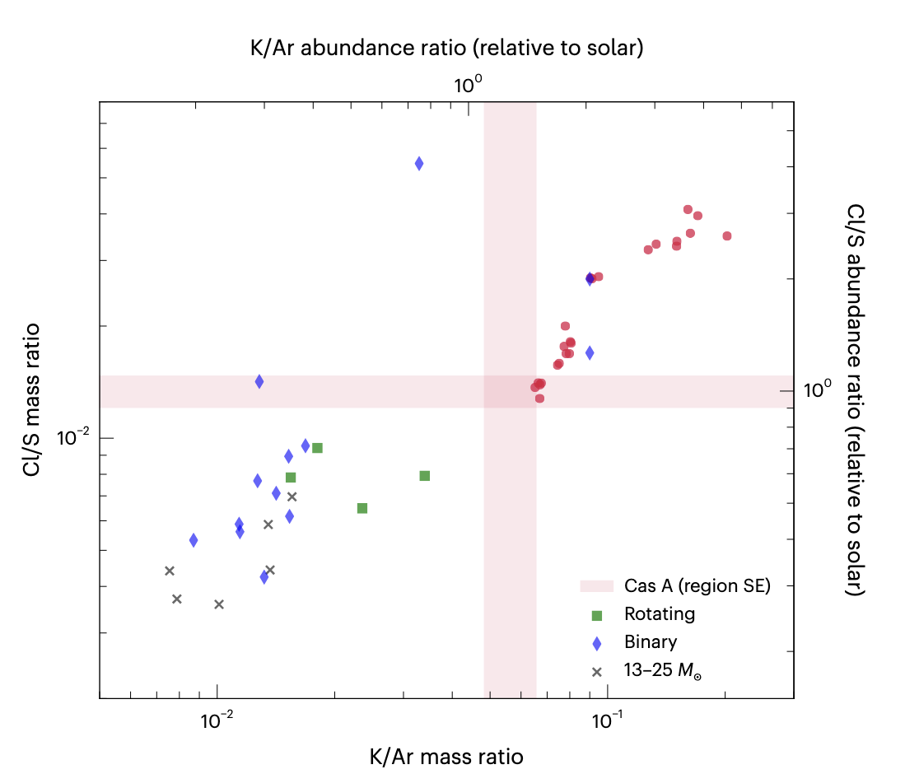
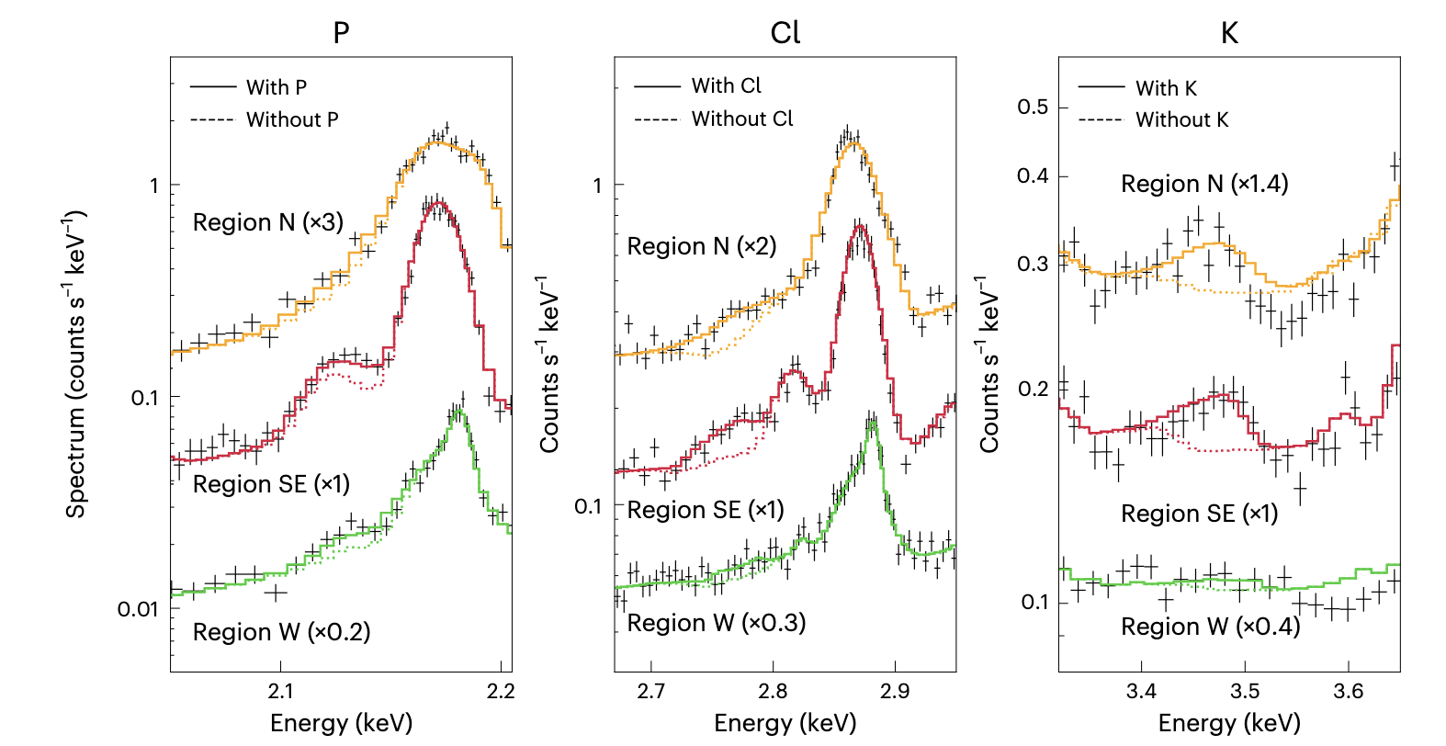
Why XRISM Argues for Cas A Shell Merger
Audard+ 2025
K and Cl are clearly seen in N and SE regions of Cas A
Shell merger models (red circles) match these observations better than non-merger, rotating, and binary massive stars
B1

Slide 29
⁴⁴Ti vs Observations vs Other Models
Mass cut including Si shell
Mass cut inside O shell
Issa & Herwig 2026
Our merger results can also be larger than 3D neutrino driven explosions
We find that with 3-10x enhancement scenario we can replicate Cas A observations
B2

Slide 30
Extrapolating Yields
The simulations are for 110 seconds and only of the O shell
We extrapolate what the yields could be by taking the ratio of our model to the NuGrid model in the O shell and using that to artificially alter the yields
This approach neglects all stellar structure changes that may happen, which might matter a lot (see Roberti & Pignatari 2025, https://doi.org/10.1051/0004-6361/202556941).
Further work needs to be done on seeing how boosting convection would change stellar evolution
B3

