Slide 1
Study of the alpha-nucleus optical potential through (α,n) reactions in the mass range relevant to the γ-process
Accelerator-based experiments for the p-process from Vravron to Budapest and beyond
György Gyürky
Institute of Nuclear Research (Atomki)
Debrecen, Hungary

Slide 2
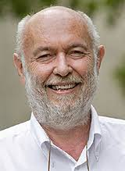

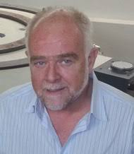


Some speakers:
Claus Rolfs
Marcel Arnould
Franz Käppeler
Sotiris
Harissopulos
Wolfgang Hammer
Endre Somorjai

Slide 3
Some experimental (and related) topics
Gamma-induced reactions
New α-OMP (P. Demetriou)
Level densities, γ strength functions
Capture reactions

Slide 4
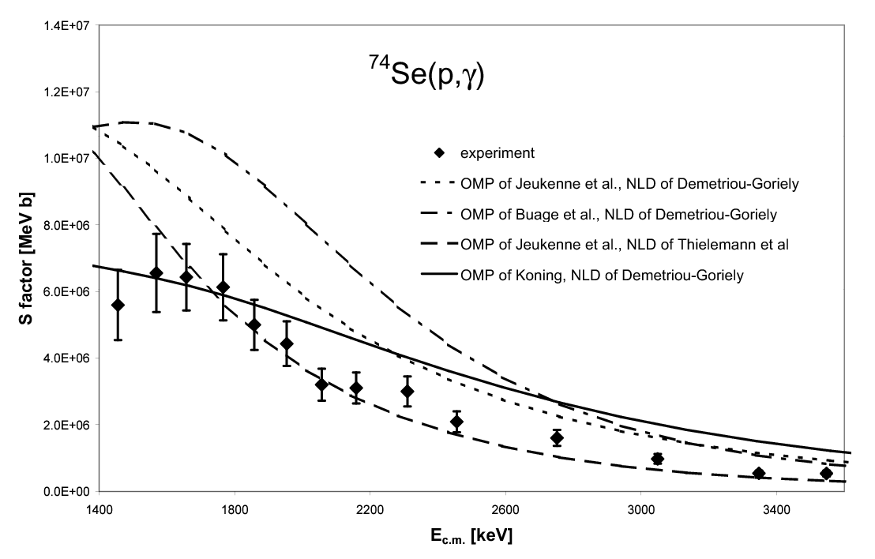
From Atomki: p-induced reactions with activation

Slide 5
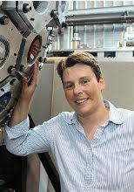
(n,γ) cross sections
AMS
RIB (inverse kinematics)
Dawn of storage ring
rp-process
νp-process
Iris Dillmann

Slide 6
From Atomki: α-induced reactions
¹⁵²Eu + α

Slide 7
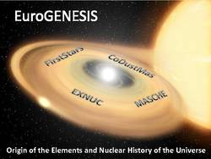
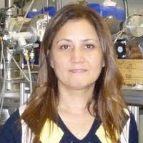
p-process nucleosynthesis (γ-process, rp-process, νp-process, ν-process )
Nuclear structure aspects
Experimental situation: increasing interest (DRAGON@TFIUMF, Cologne)
Hauser-Feshbach and reaction rates
p-process data evaluation (Kadonis)
Nalan Özkan

Slide 8
From Atomki: extension of activation, growing database
characteristic X-ray
detection
¹⁶⁹Tm(α,γ)¹⁷³Lu

Slide 9
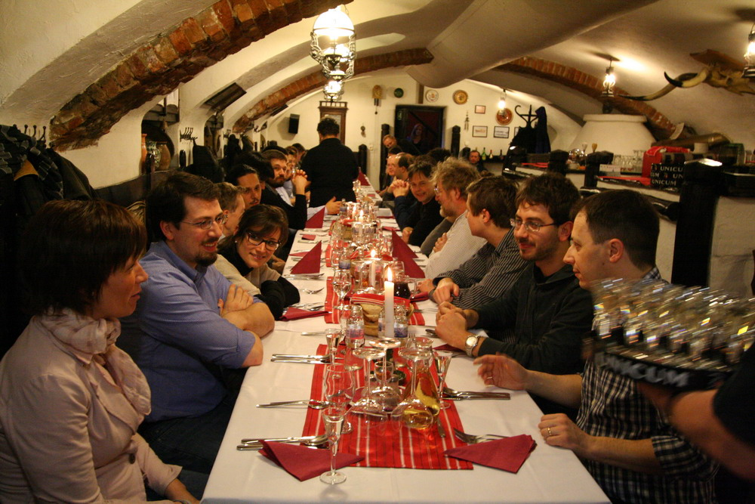
Astrophysical sites and processes for p-nuclide synthesis (e.g., γ-, rp-, ν-, νp-, pn-processes and neutrino-winds)
Experimental and theoretical nuclear physics for the p-nuclide production
Open questions in nuclear physics and astrophysics for the s- and r-processes
Observational constraints on heavy element nucleosynthesis
Galactic chemical evolution studies for heavy element production
Experimental techniques relevant for heavy element nucleosynthesis

Slide 10
From Atomki: KADoNIS-p, scattering ...
ATOMKI
α-OMP
version I.

Slide 11
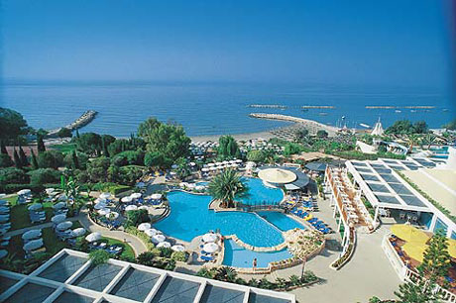

p-process astrophysical calculations
experimental efforts
The νp process: production of p nuclei & related nuclear reaction sensitivities
Calculations of reaction rates for the p process & their uncertainties
Experimental investigations of reaction rates in regular and inverse kinematics
⁹²Mo region!!!
Artemis Spyrou

Slide 12
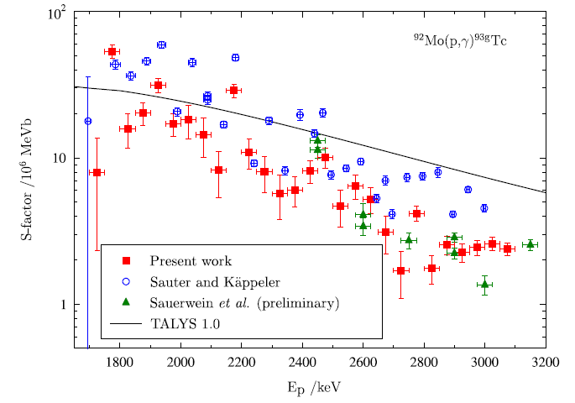
From Atomki: extension of activation
Thick target yield
measurement
⁹²Mo(p,γ)⁹³Tc
Study of α-OMP in a (p,α) reaction
⁶⁴Zn(p,α)⁶¹Cu

Slide 13
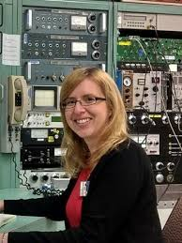
nuclear physics contributions (nuclear structure, Hauser-Feshbach models, cross section measurements)
γ-induced reactions (HIγS Facility)
Storage ring results
n-induced reactions (LANSCE)
Anna Simon

Slide 14
From Atomki: (α,γ) in the heaviest mass range
¹⁹⁷Au(α,γ)²⁰¹Tl
¹⁹¹Ir(α,γ)¹⁹⁵Au

Slide 15

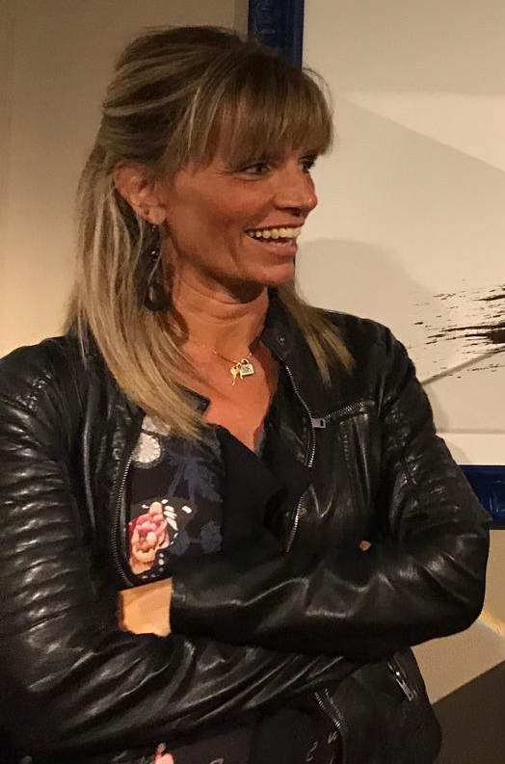
Nuclear physics/experiments related to p-process nucleosynthesis
Stellar models and nucleosynthesis
Meteorites and radioactives
Presolar grains
Chemical evolution
Nicely growing cross section database
Claudia Travaglio

Slide 16
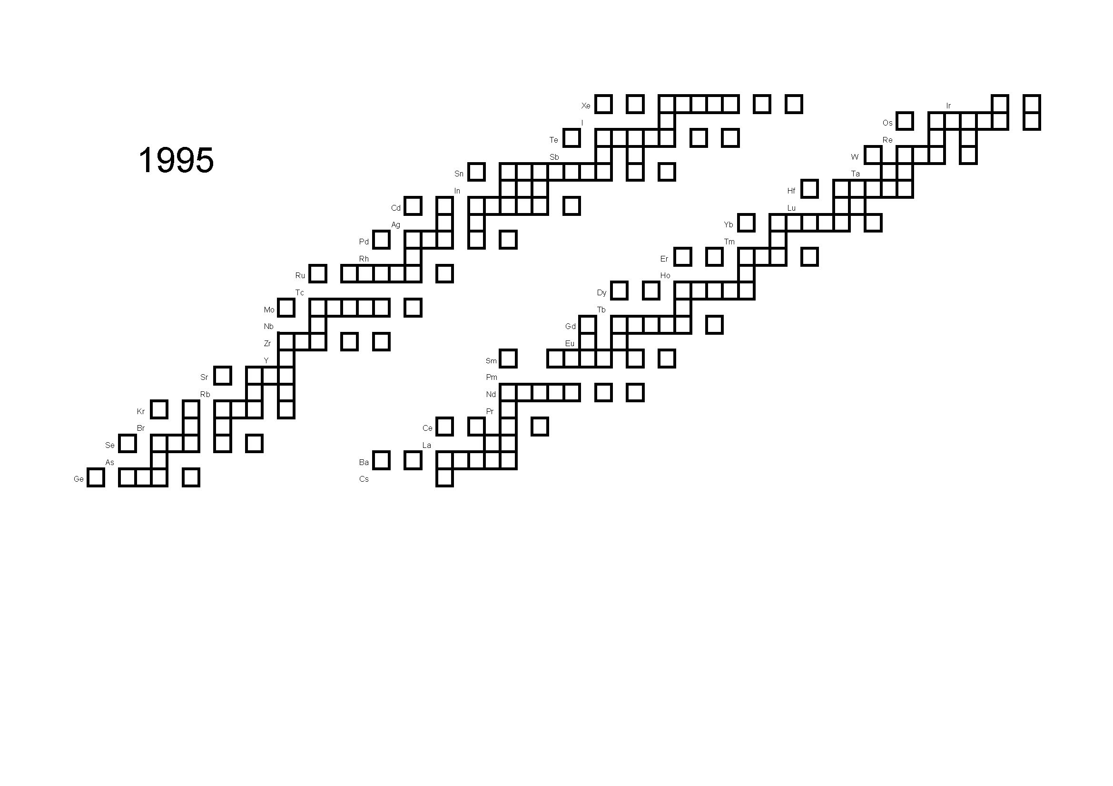

Slide 17
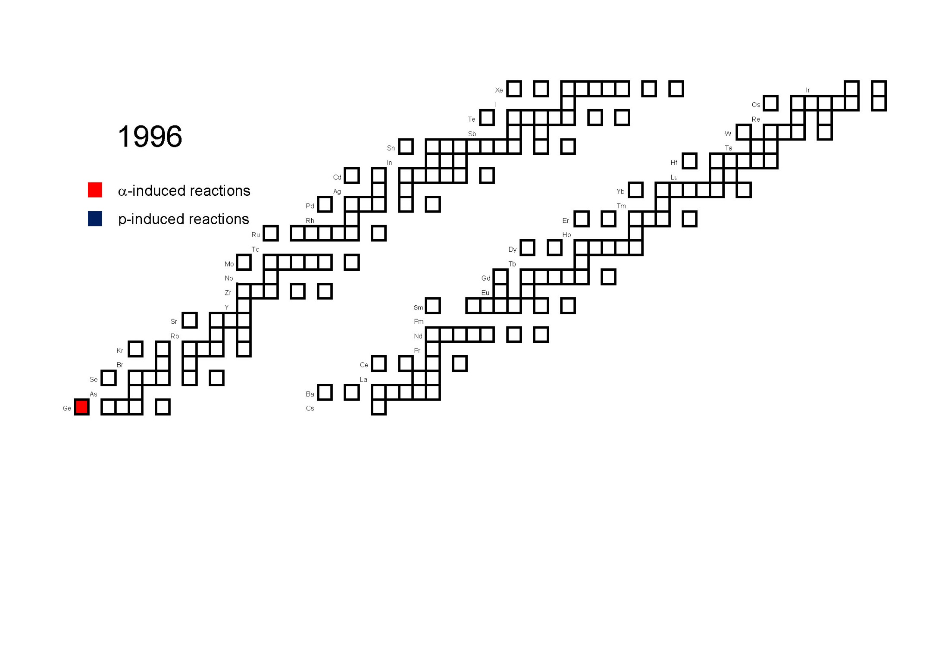

Slide 18
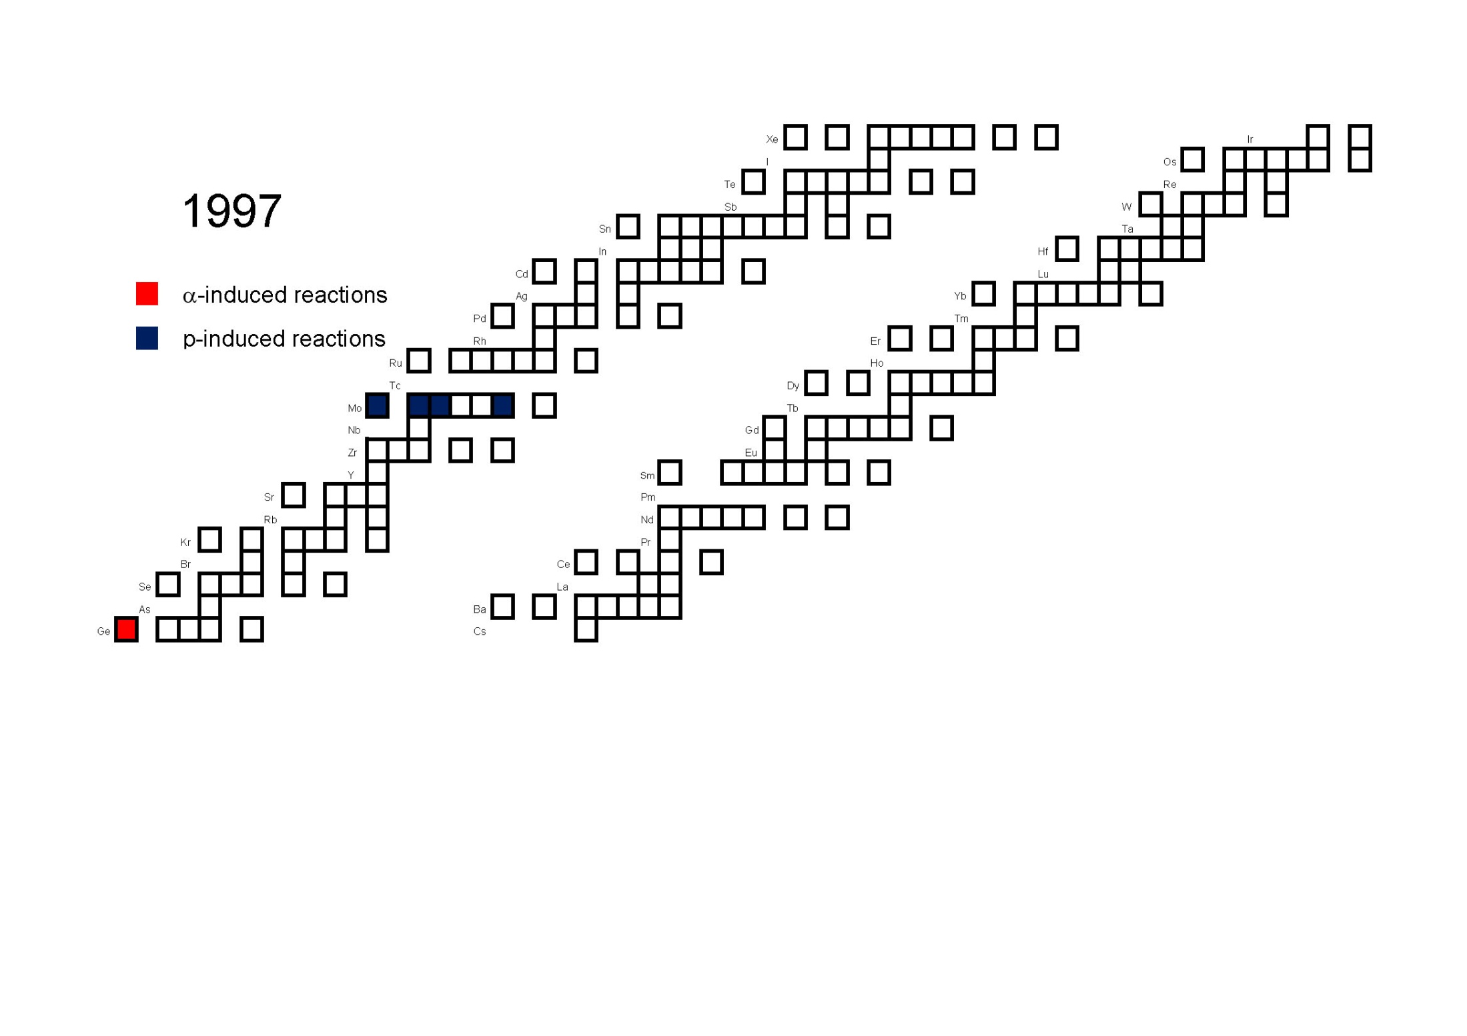

Slide 19
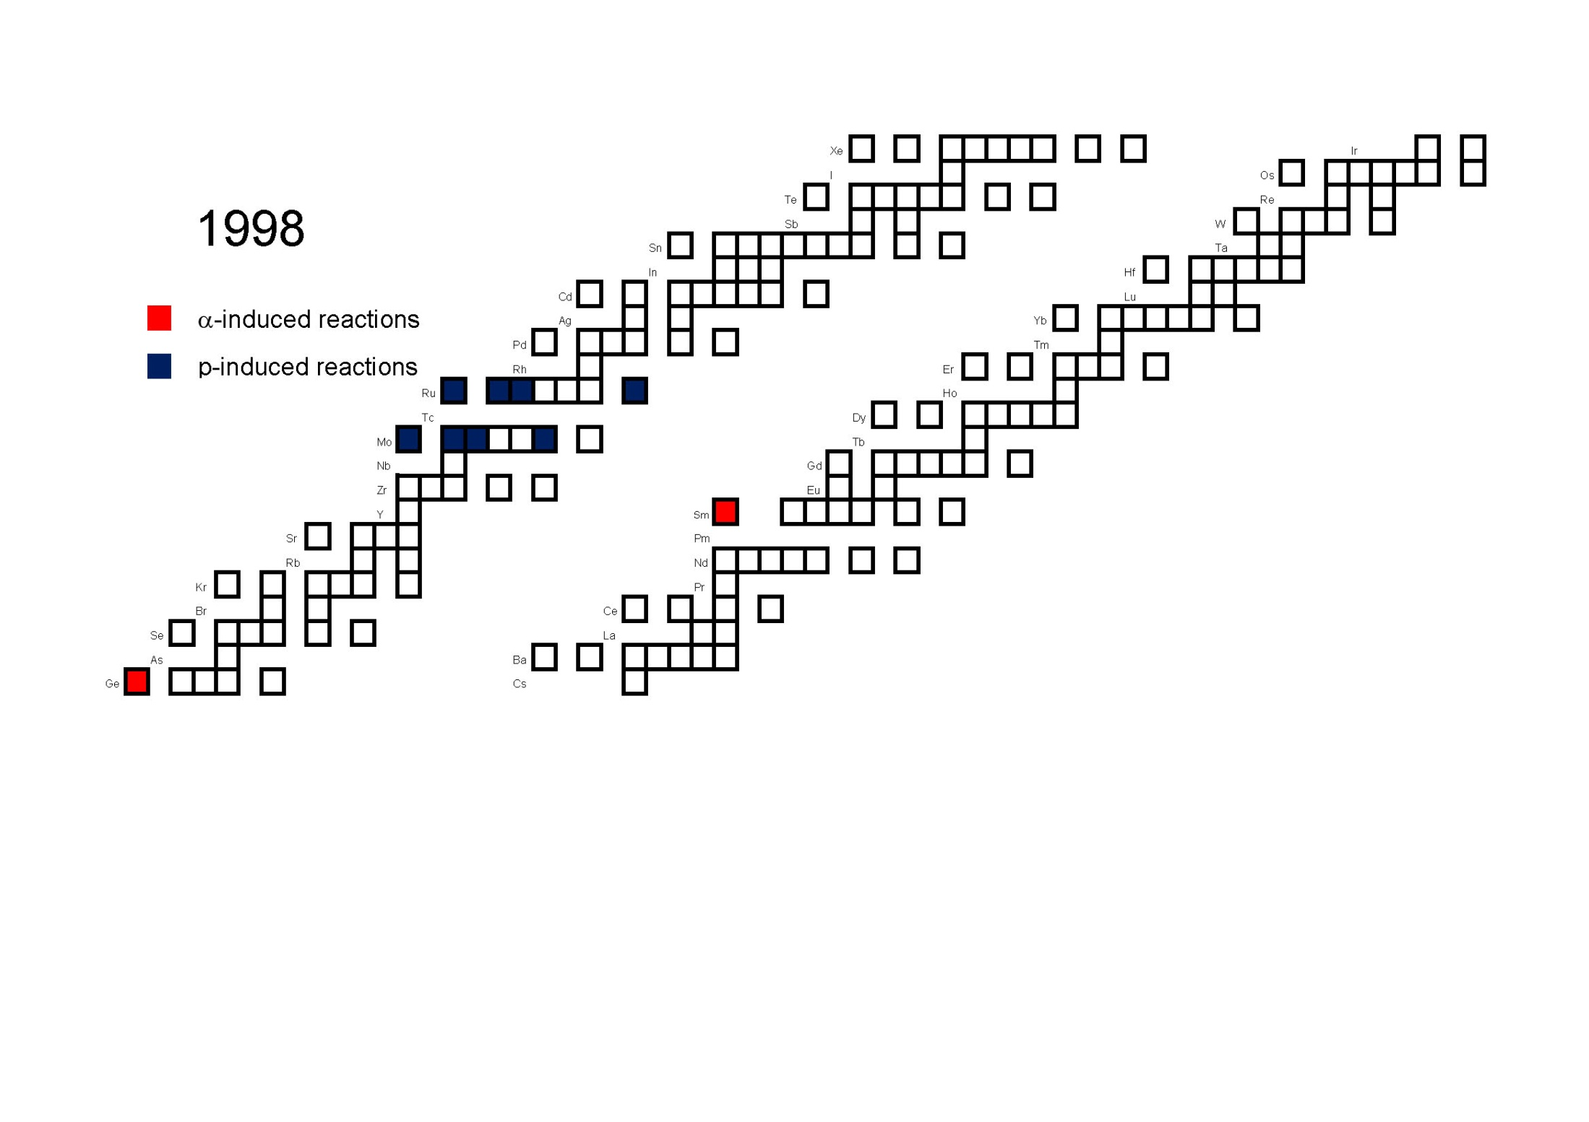

Slide 20
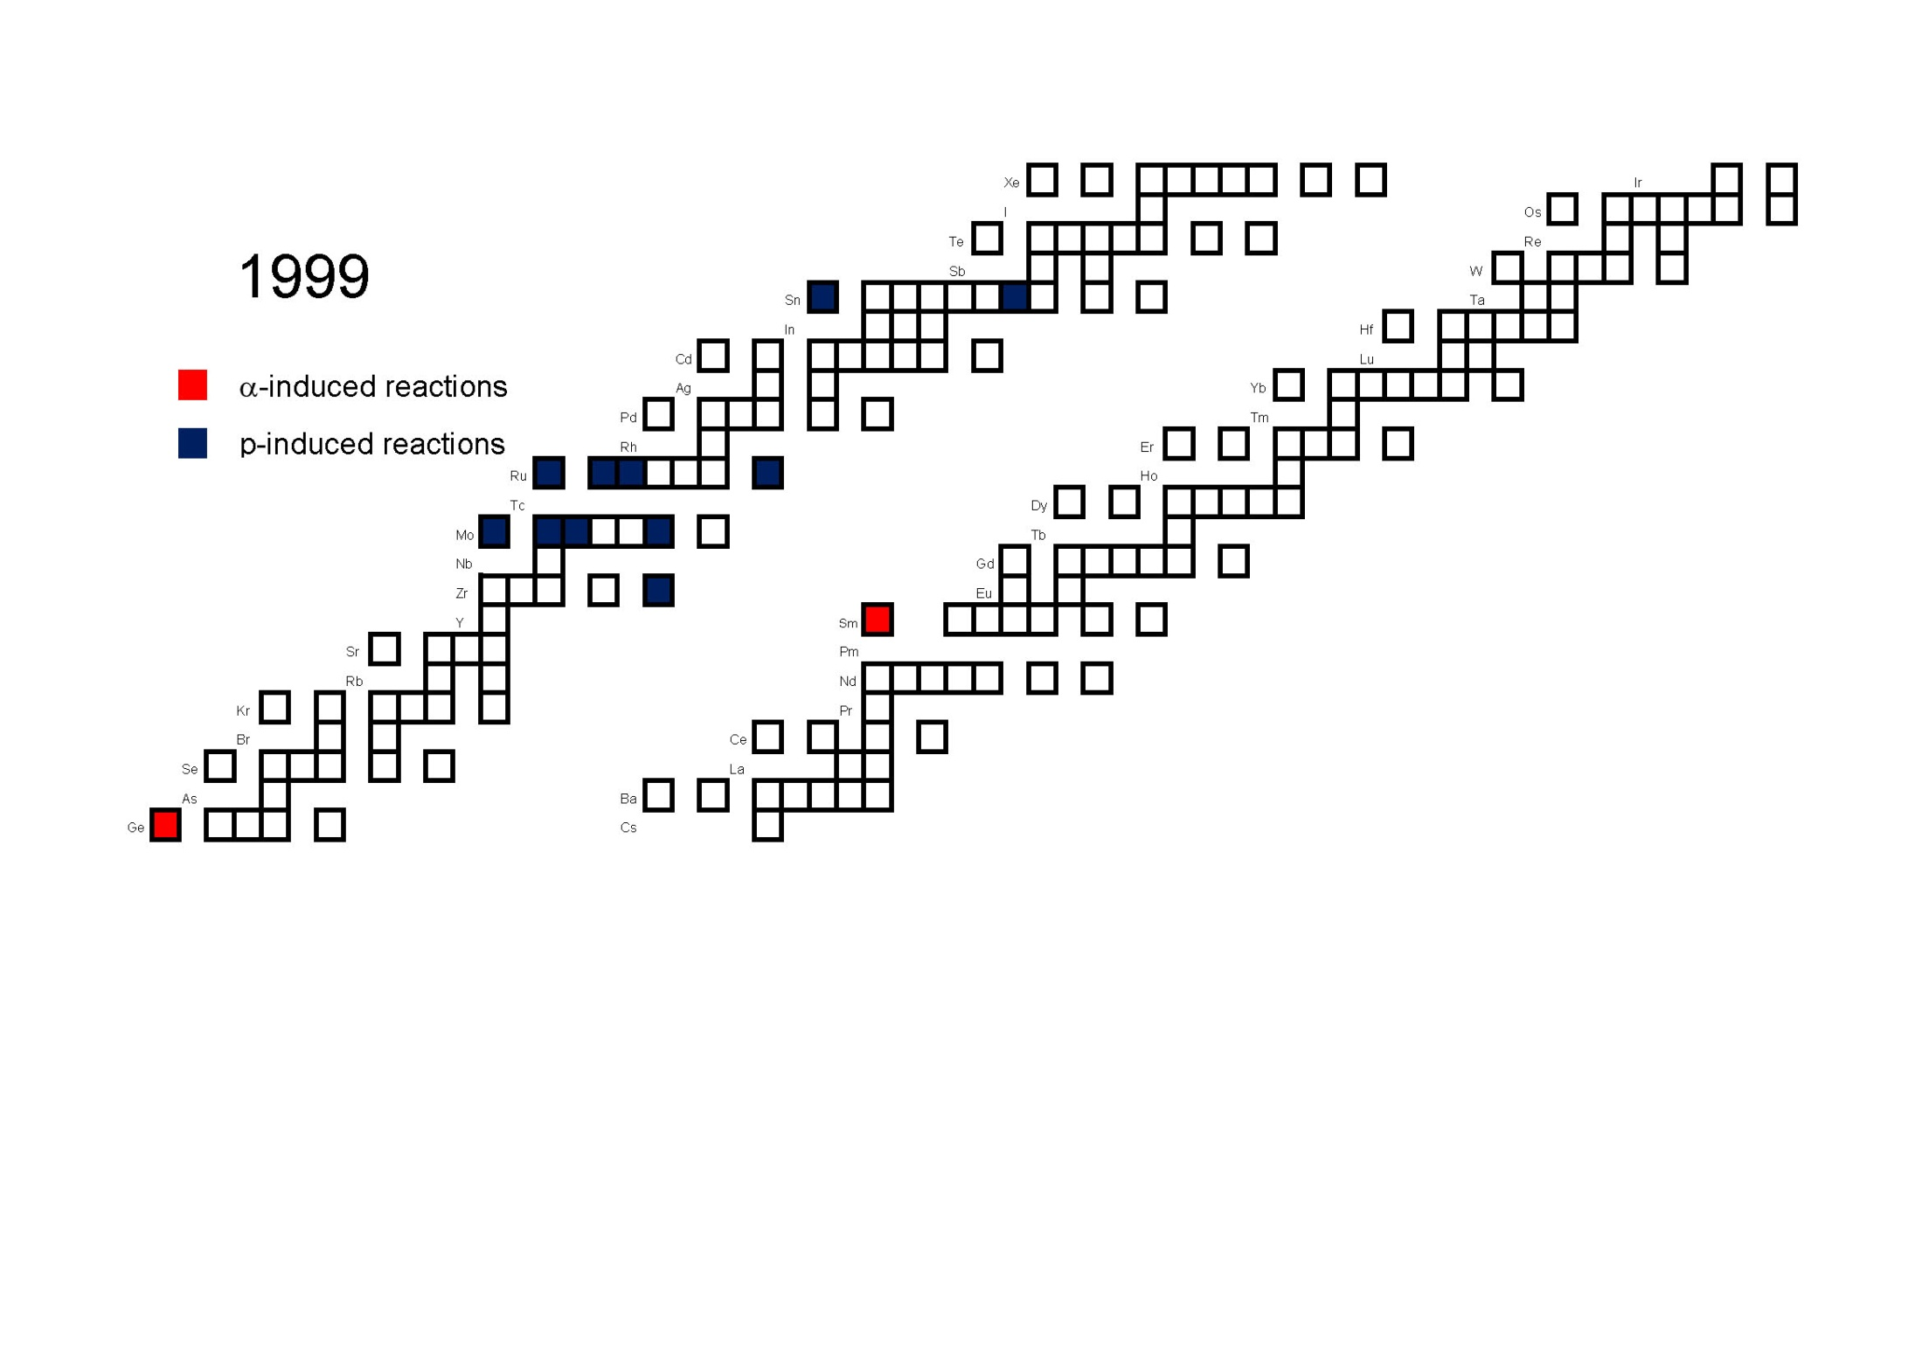

Slide 21


Slide 22
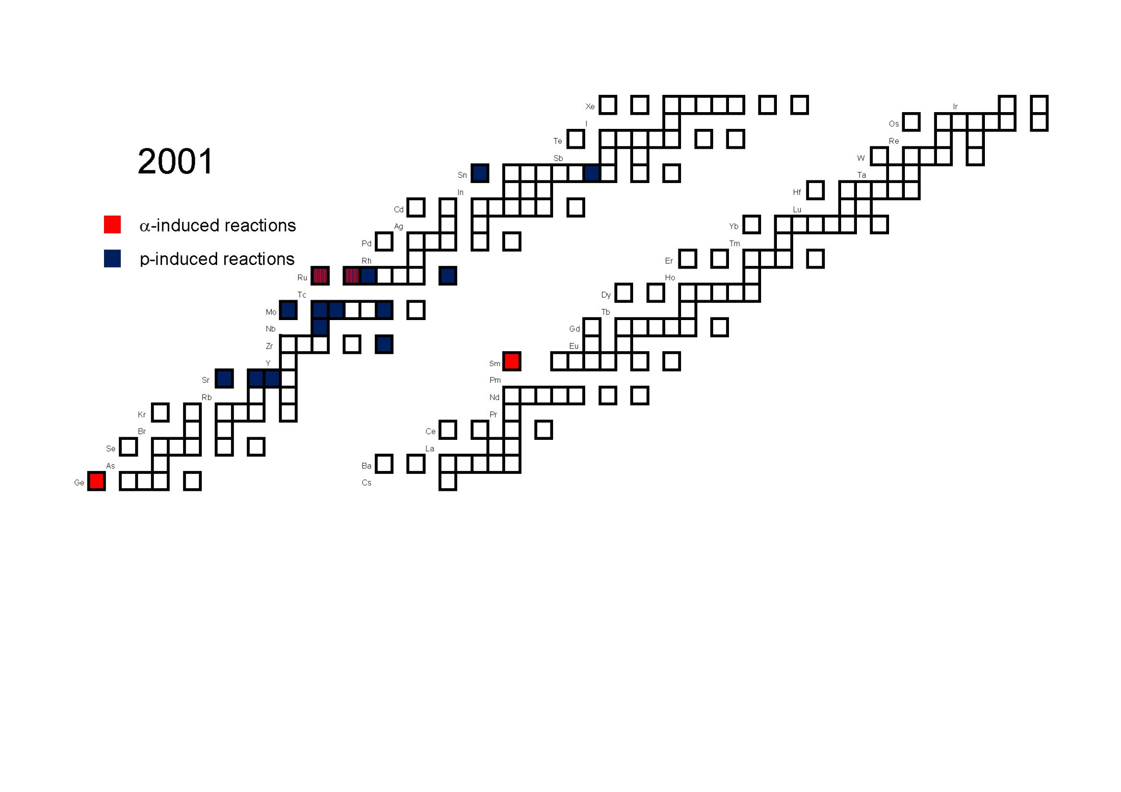

Slide 23
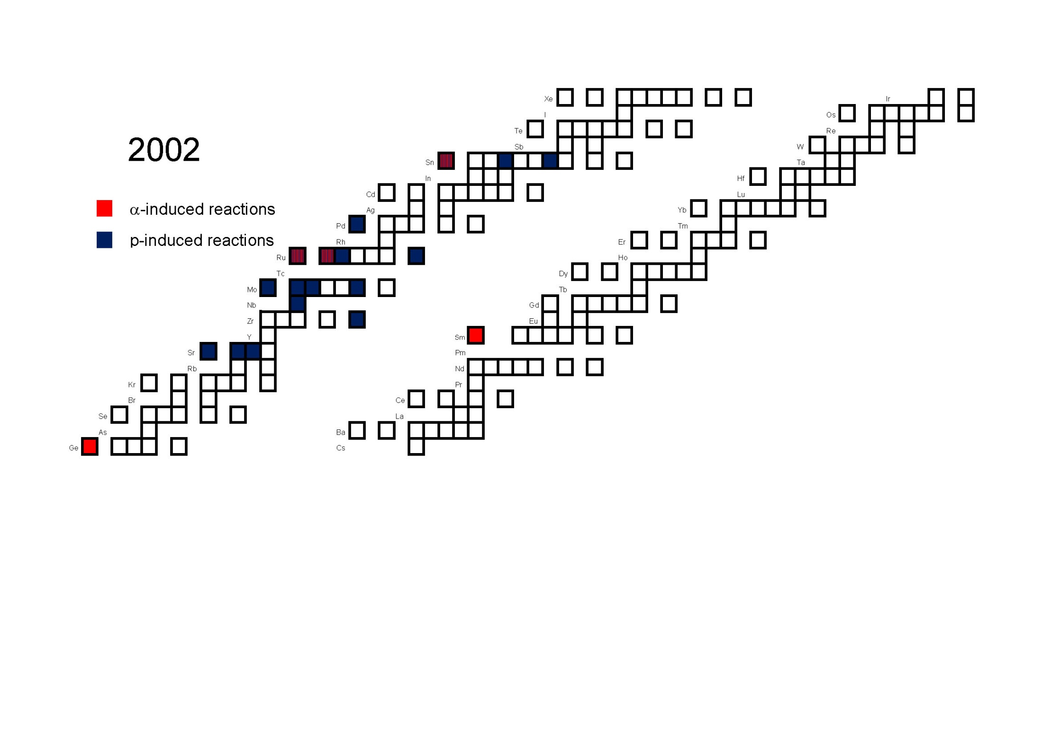

Slide 24


Slide 25
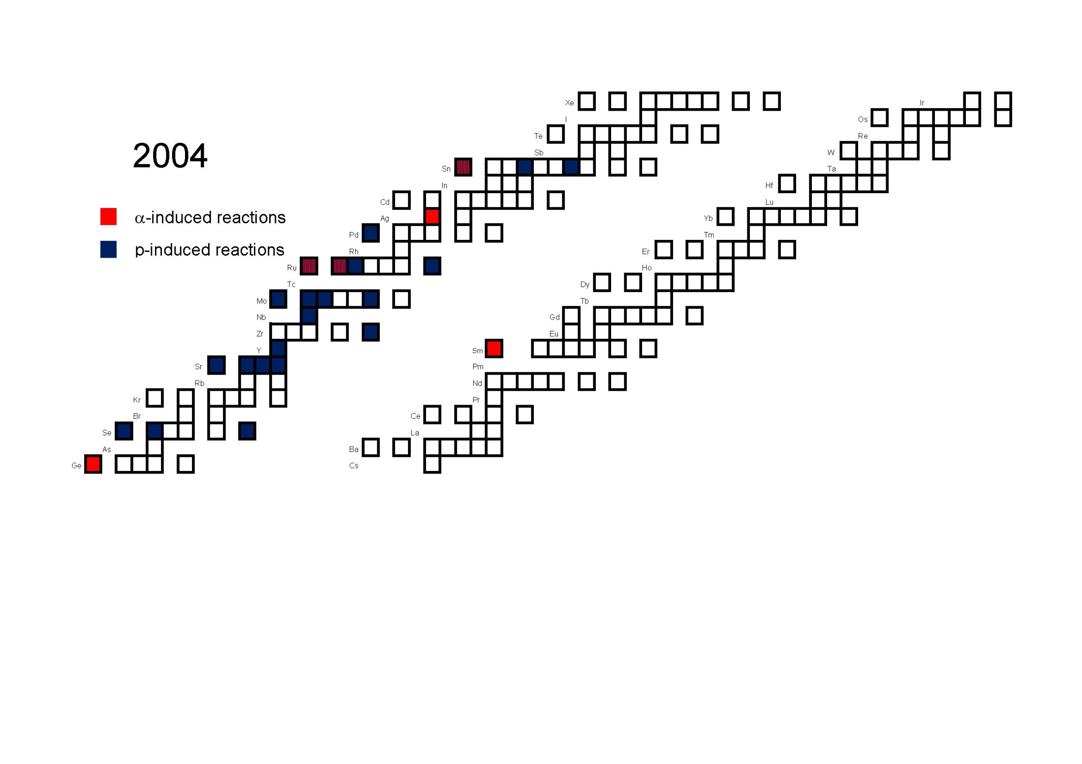

Slide 26
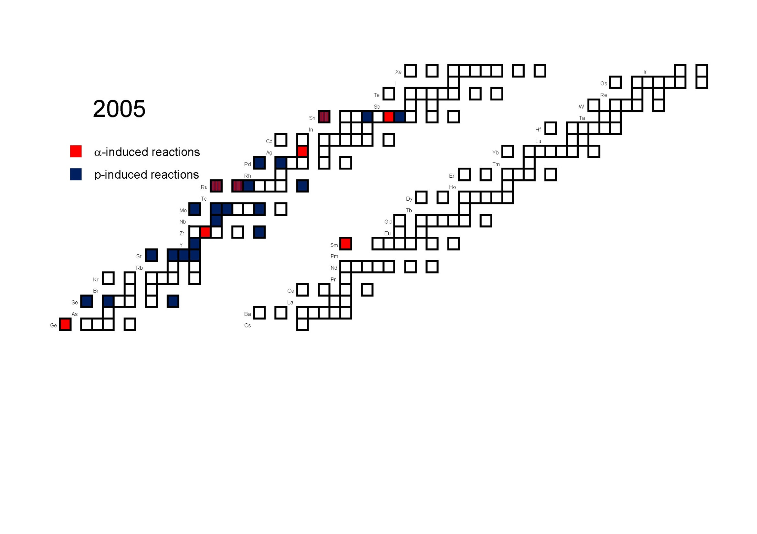

Slide 27
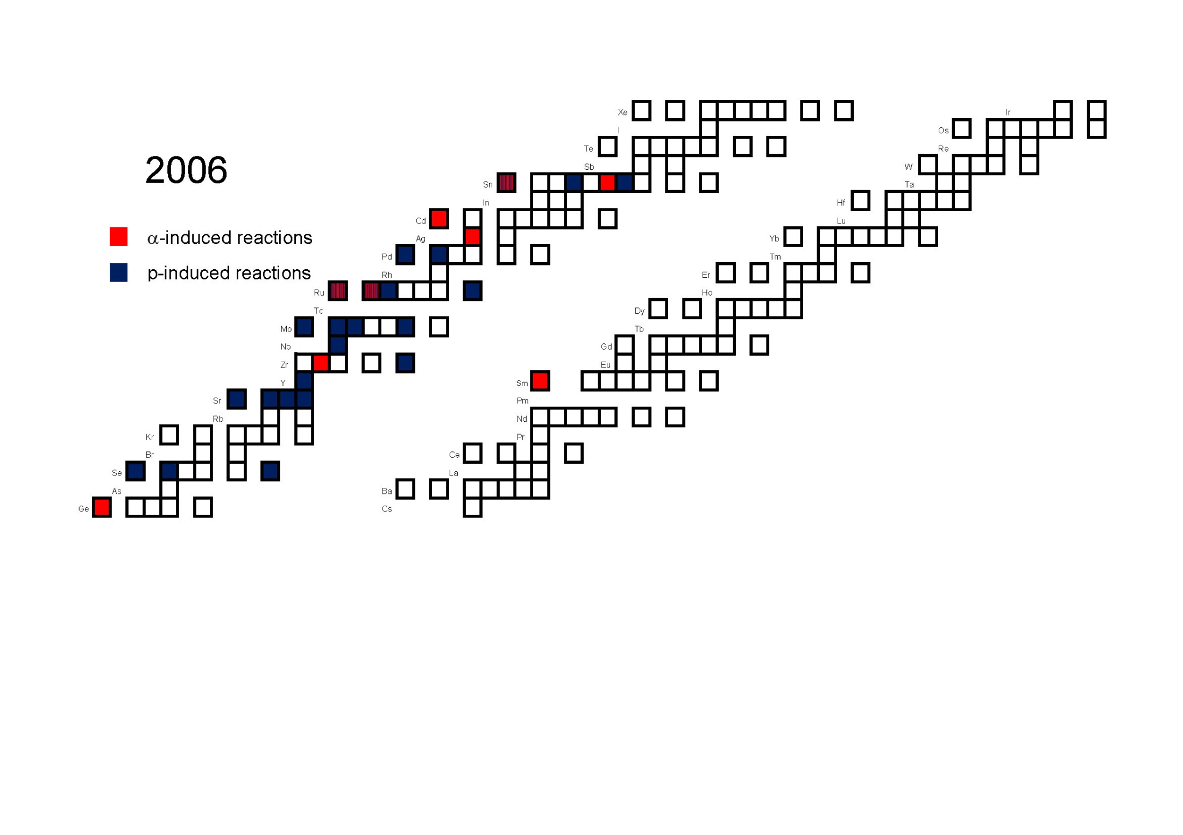

Slide 28
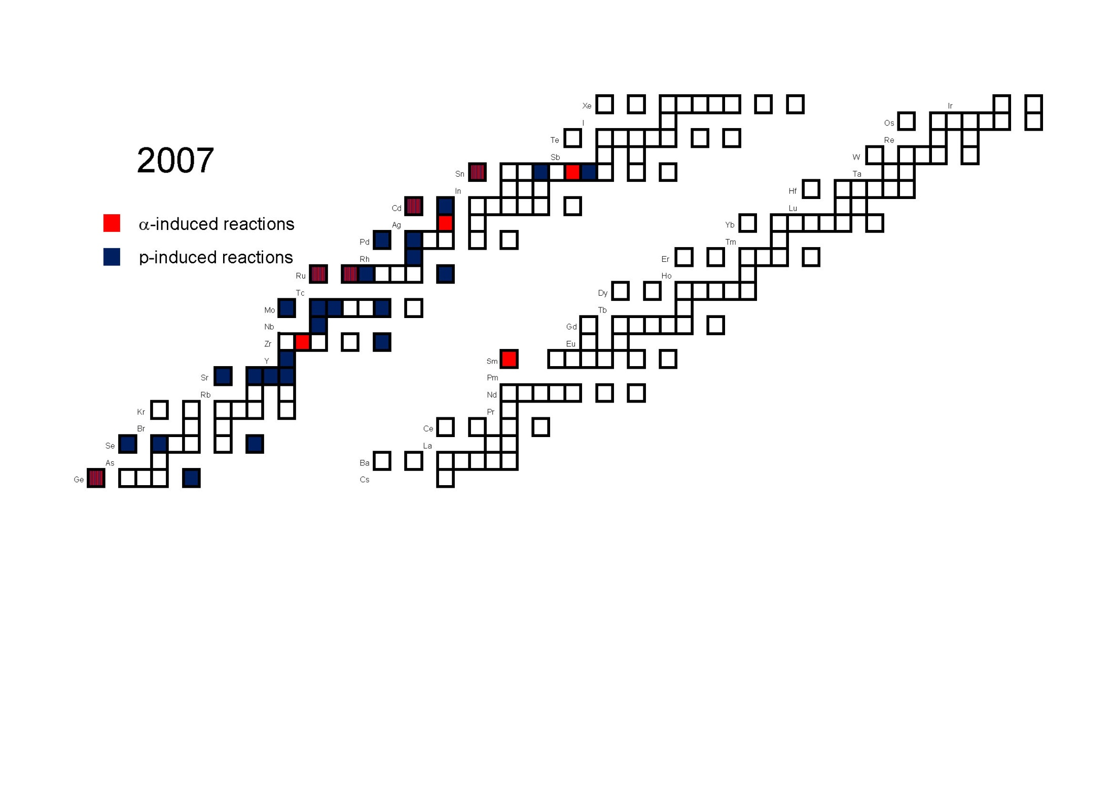

Slide 29
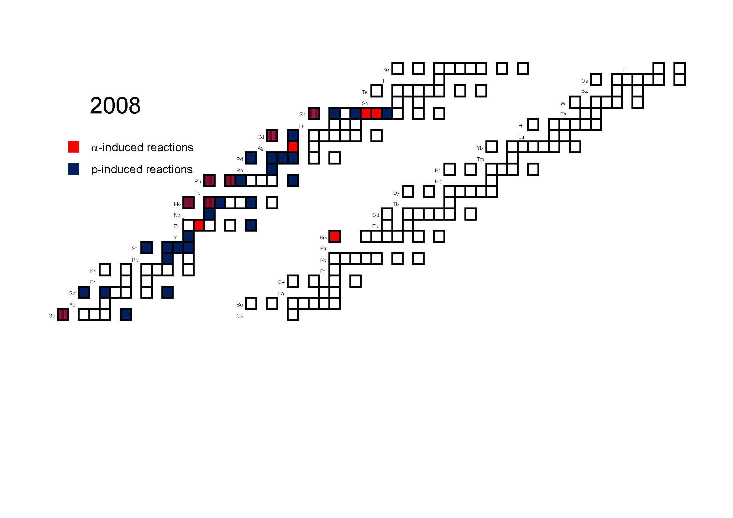

Slide 30
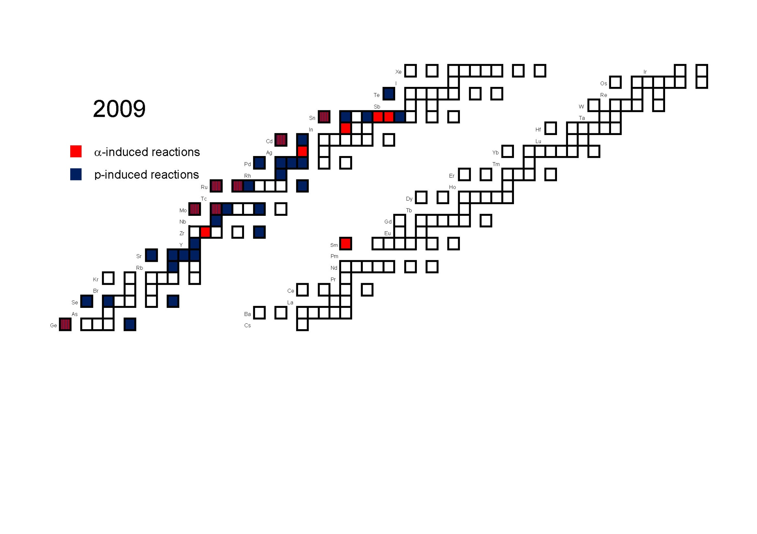

Slide 31
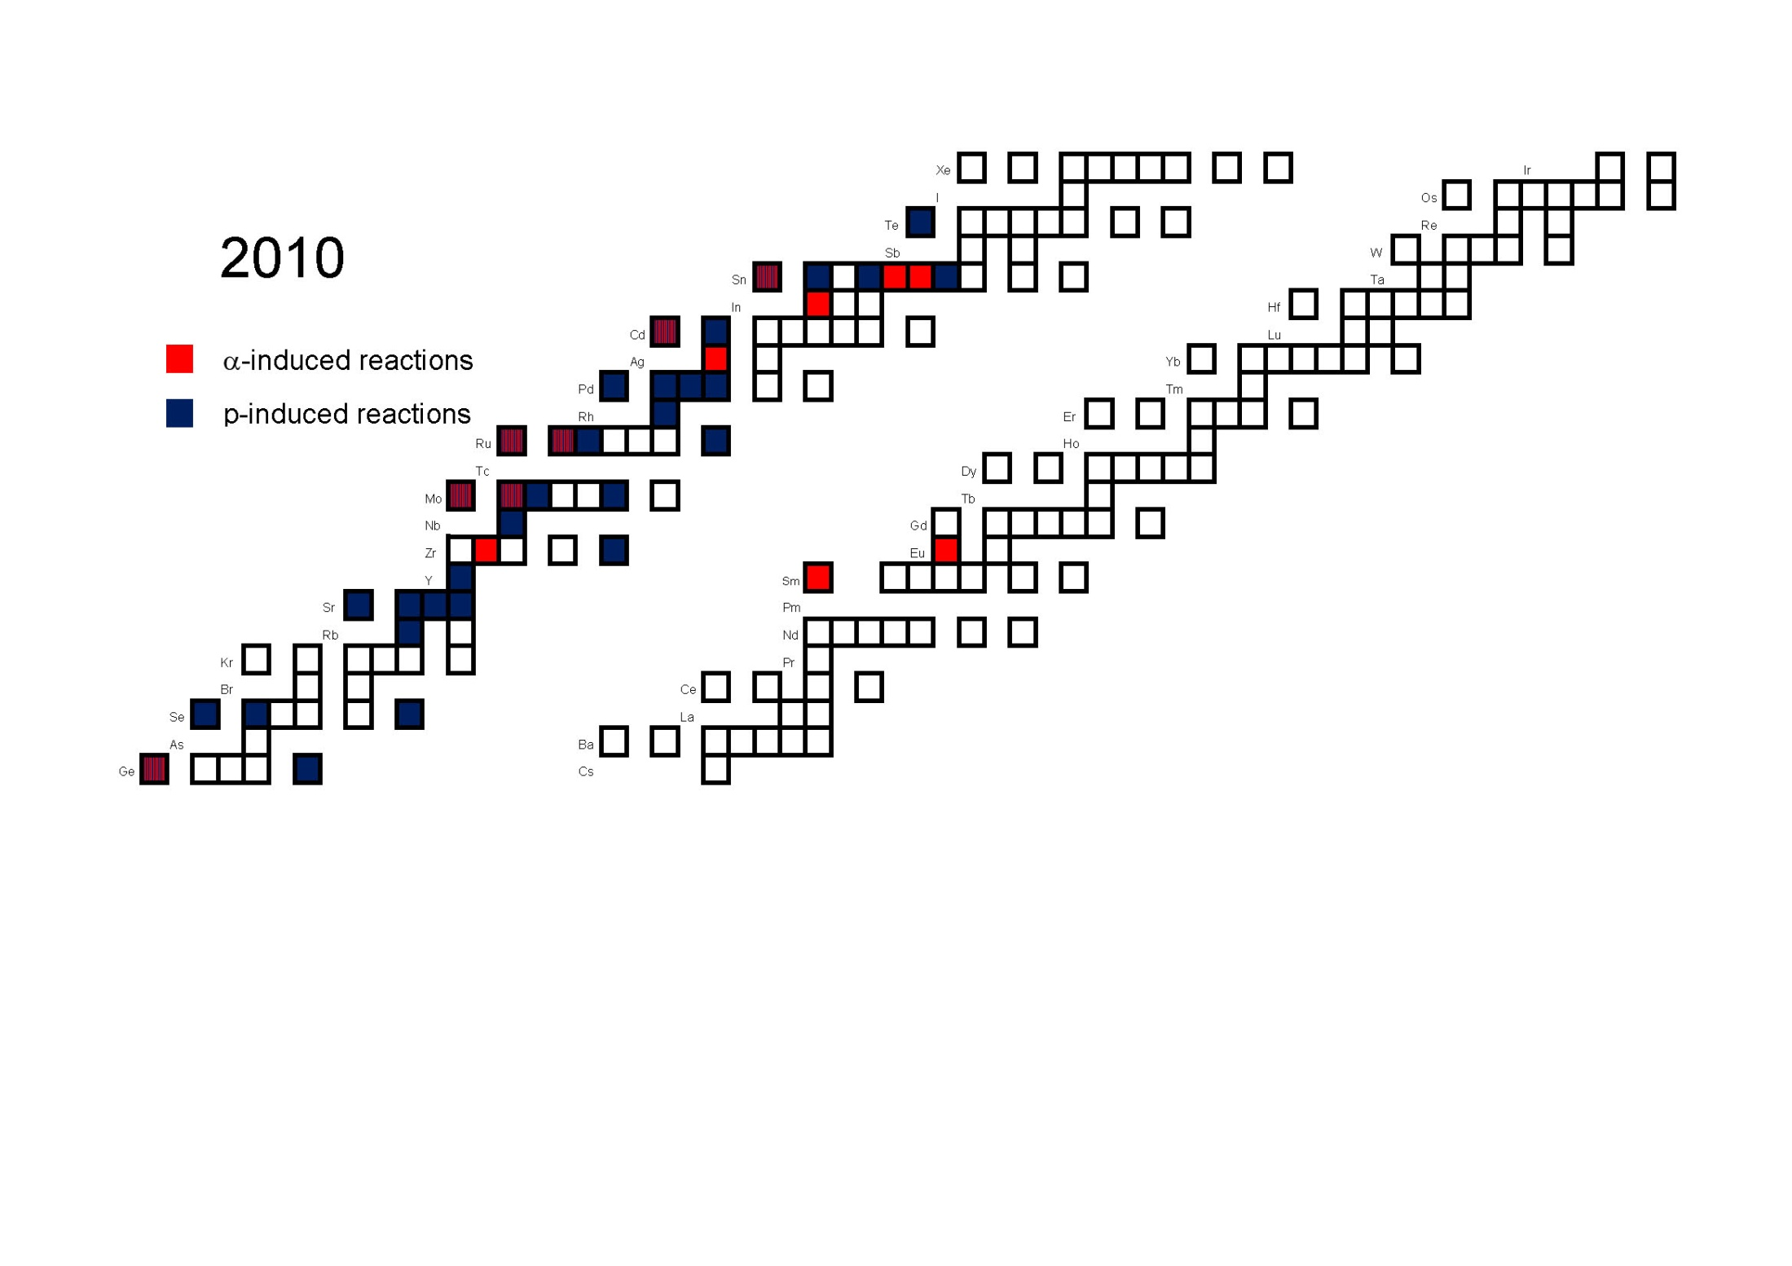

Slide 32
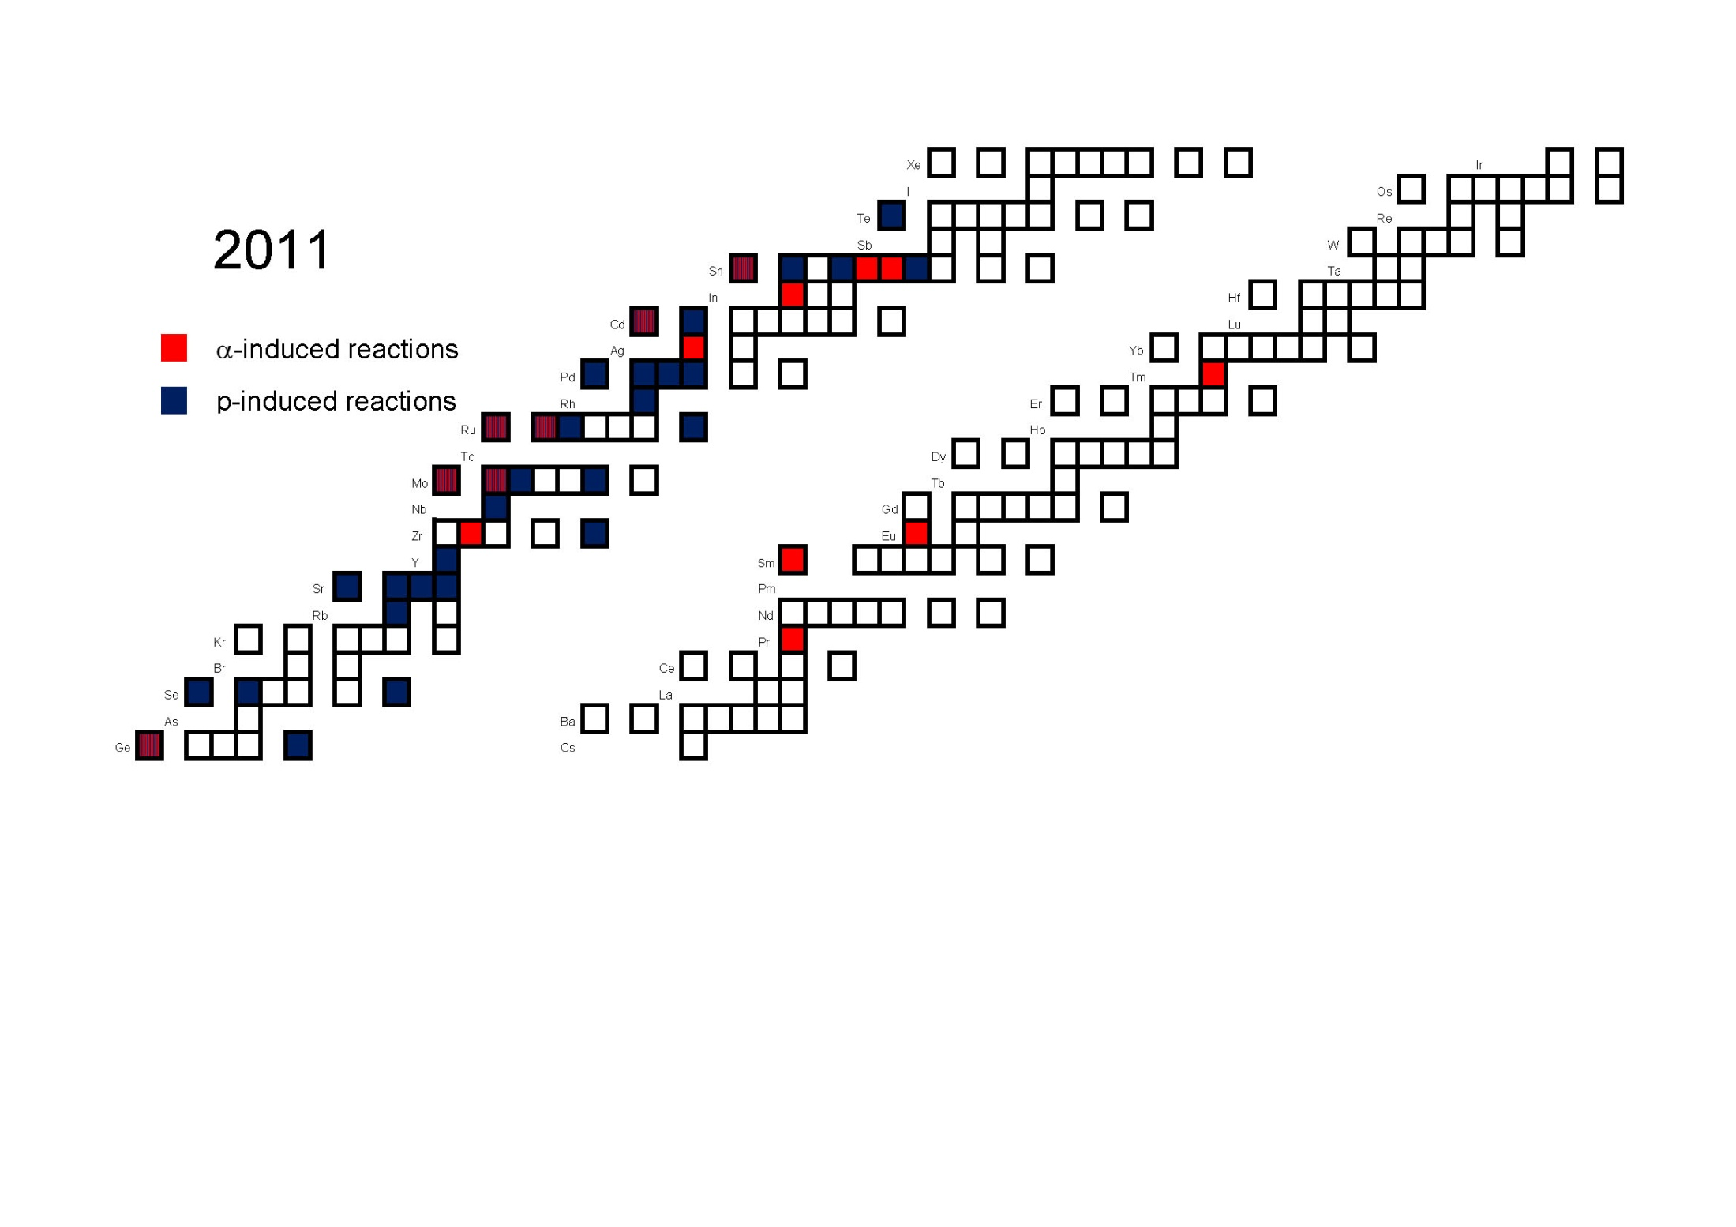

Slide 33
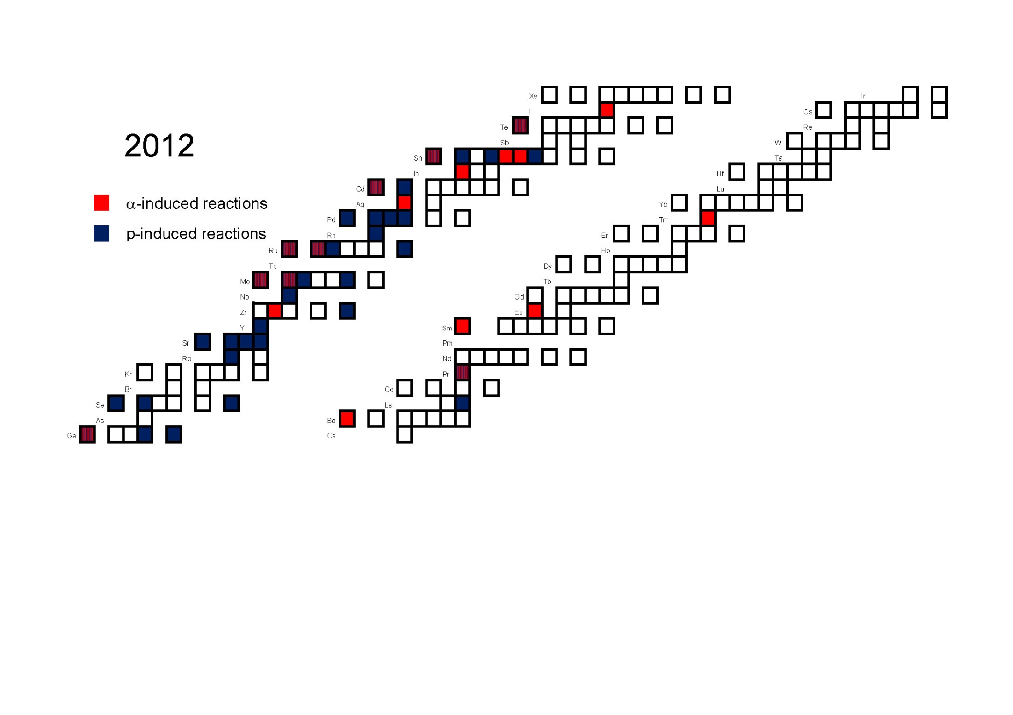

Slide 34
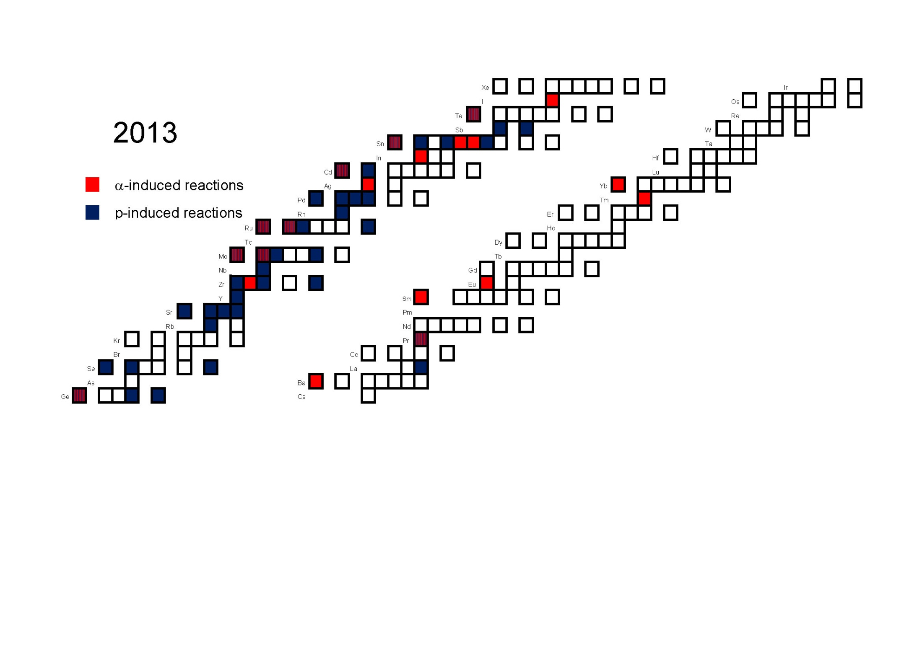

Slide 35
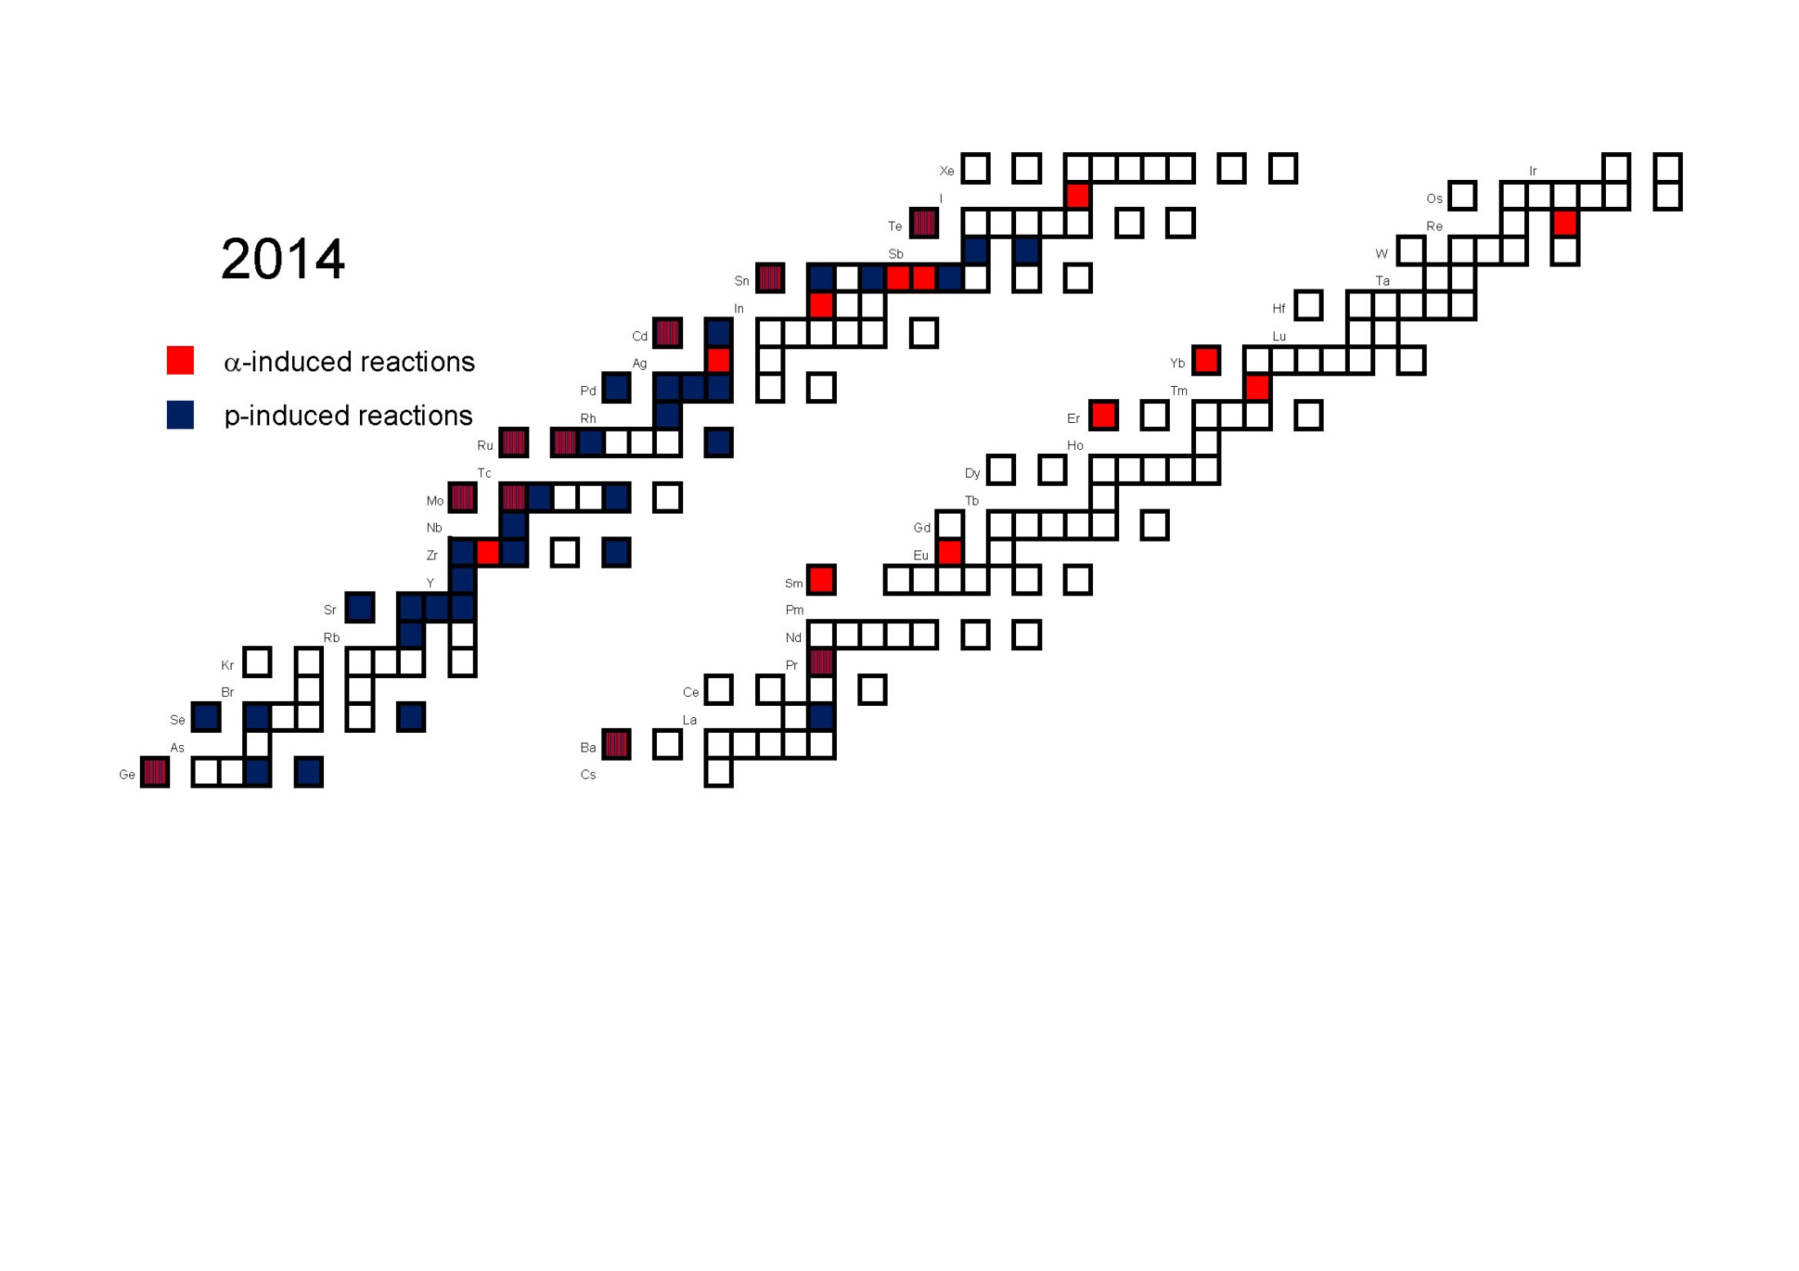

Slide 36
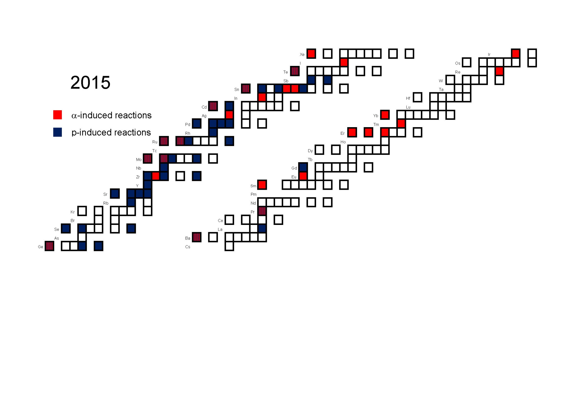

Slide 37
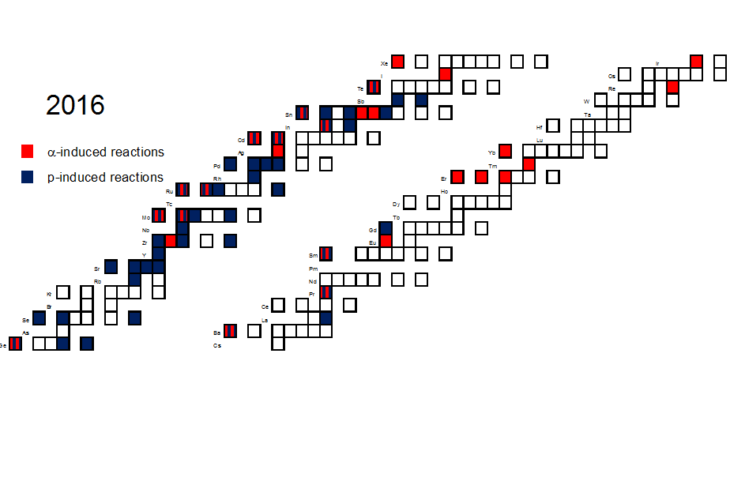

Slide 40
From Atomki: ATOMKI-V2 alpha-nucleus optical potential
Based on reaction data
Pure barrier transmission model
Avoids problem with uncertain WS tail

Slide 41
And here we are in Budapest, 2024...
Experiments around
γ-induced reactions
Particle capture
Moving away from stability
Elastic scattering
Key nuclear quantities

Slide 42
γ-induced reactions
This is how γ-process goes...
Technically challenging
Thermal excitation ⇒ only indirect astrophysical relevance
Provides nuclear physics information

Slide 43
γ-induced reactions, various approaches
HIγS facility
See the talks of Adriana Basu and
Dario Lattuada

Slide 44
Inverse (capture) reactions in direct kinematics
Nicely growing experimental database
Direct relevance (detailed balance), nuclear parameters
Activation: powerful, but limited
In-beam: detector arrays, summing crystals
See the talks of Svenja Wilden and John McDonaugh

Slide 45
Inverse (capture) reactions in inverse kinematics
Way to go beyond stability
Storage rings, recoil separators, in-beam gamma-detection
See the talks of Artemis Tsantiri

Slide 46
Elastic alpha-scattering
„Classical” way of studying the optical potential
... which turned out to be a crucial parameter
... and not known at astrophysical energies
Towards radioactive isotopes in inverse kinematics!
See the talks of Daniel Galaviz, Charles Soto and Peter Mohr

Slide 47
Other reaction types, like (α,n)
No direct p-process relevance, but
sensitive to som nuclear parameters, like the α-OMP
and may be relevant to e.g the weak r-process
See the talks of Martin Müller, Zsolt Mátyus and Peter Mohr

Slide 48

Summary
P-process workshops are cool
Small community of nice people
With new problems, exciting ideas, valuable results and steady progress
Solar System
p-nuts

Slide 49
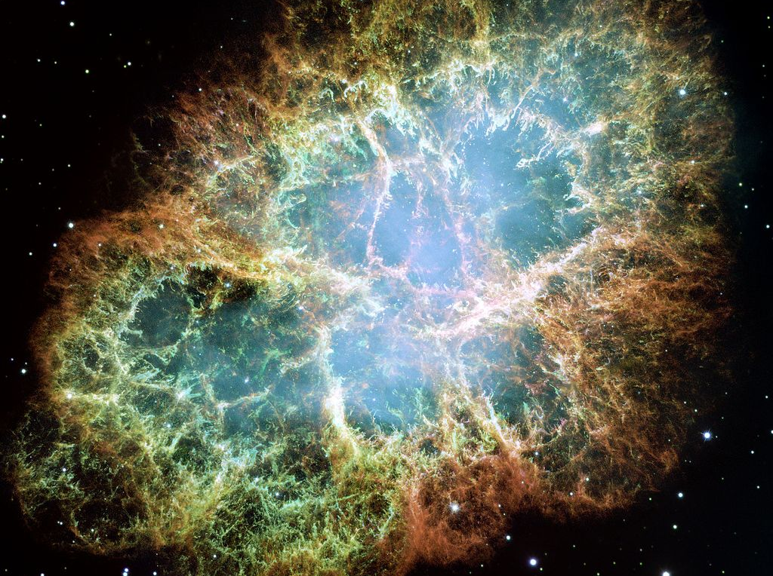
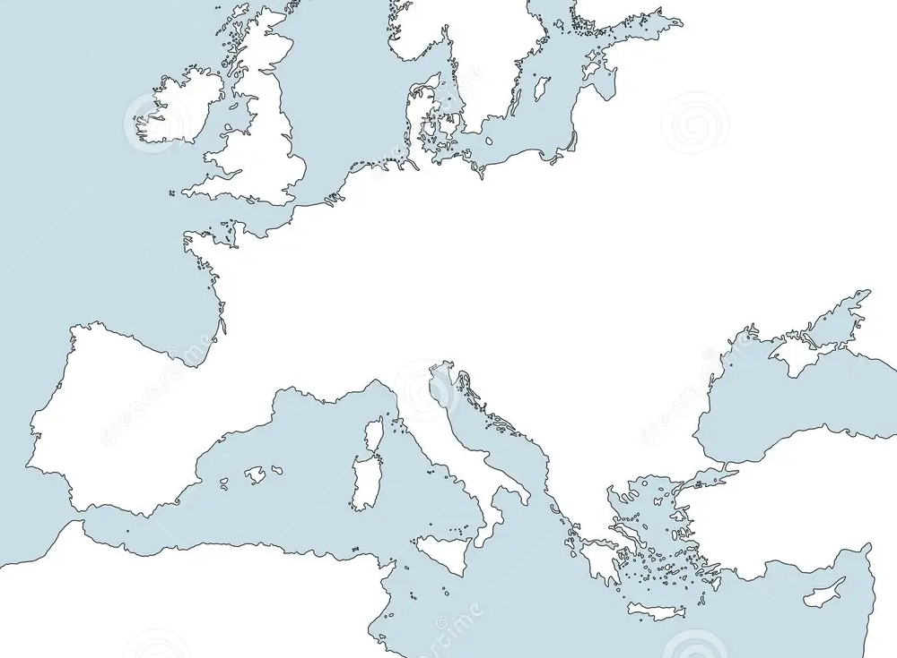
Thank you for your attention!
?
? ?
?
9
2
4
1
7
6
8
3
5

