Slide 1


Convective-reactive nucleosynthesis in O-c shell mergers
With a focus on the 𝛾-process
Joshua Issa
Falk Herwig, Pavel Denissenkov
8th p-process workshop | October 16, 2024

Slide 2
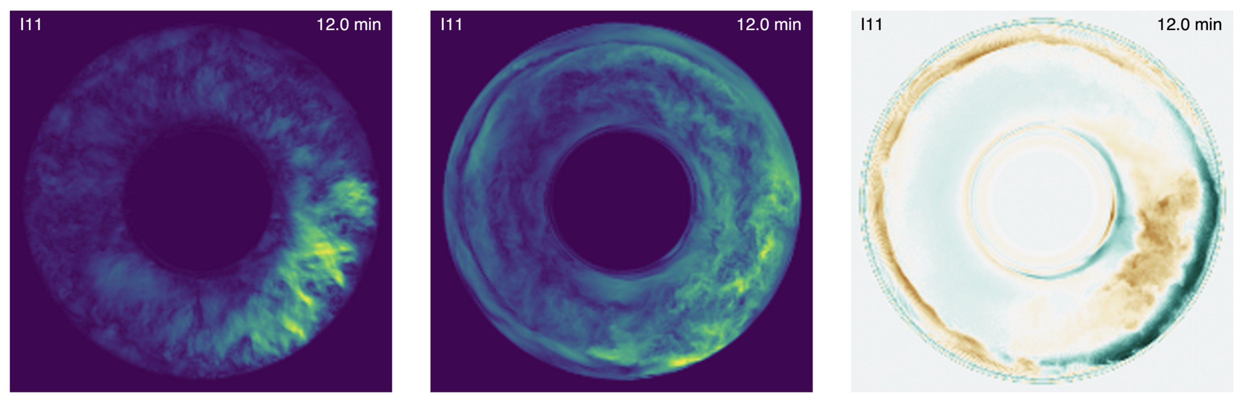
O-C shell mergers: 3d + SN
(Andrassy et al, 2020)
radial Mach num
tang. Mach num
rel. density perturbations
3D hydrodynamics show non-spherical, non-radial instabilities key for SNe (Andrassy et al, 2020)
1

Slide 3
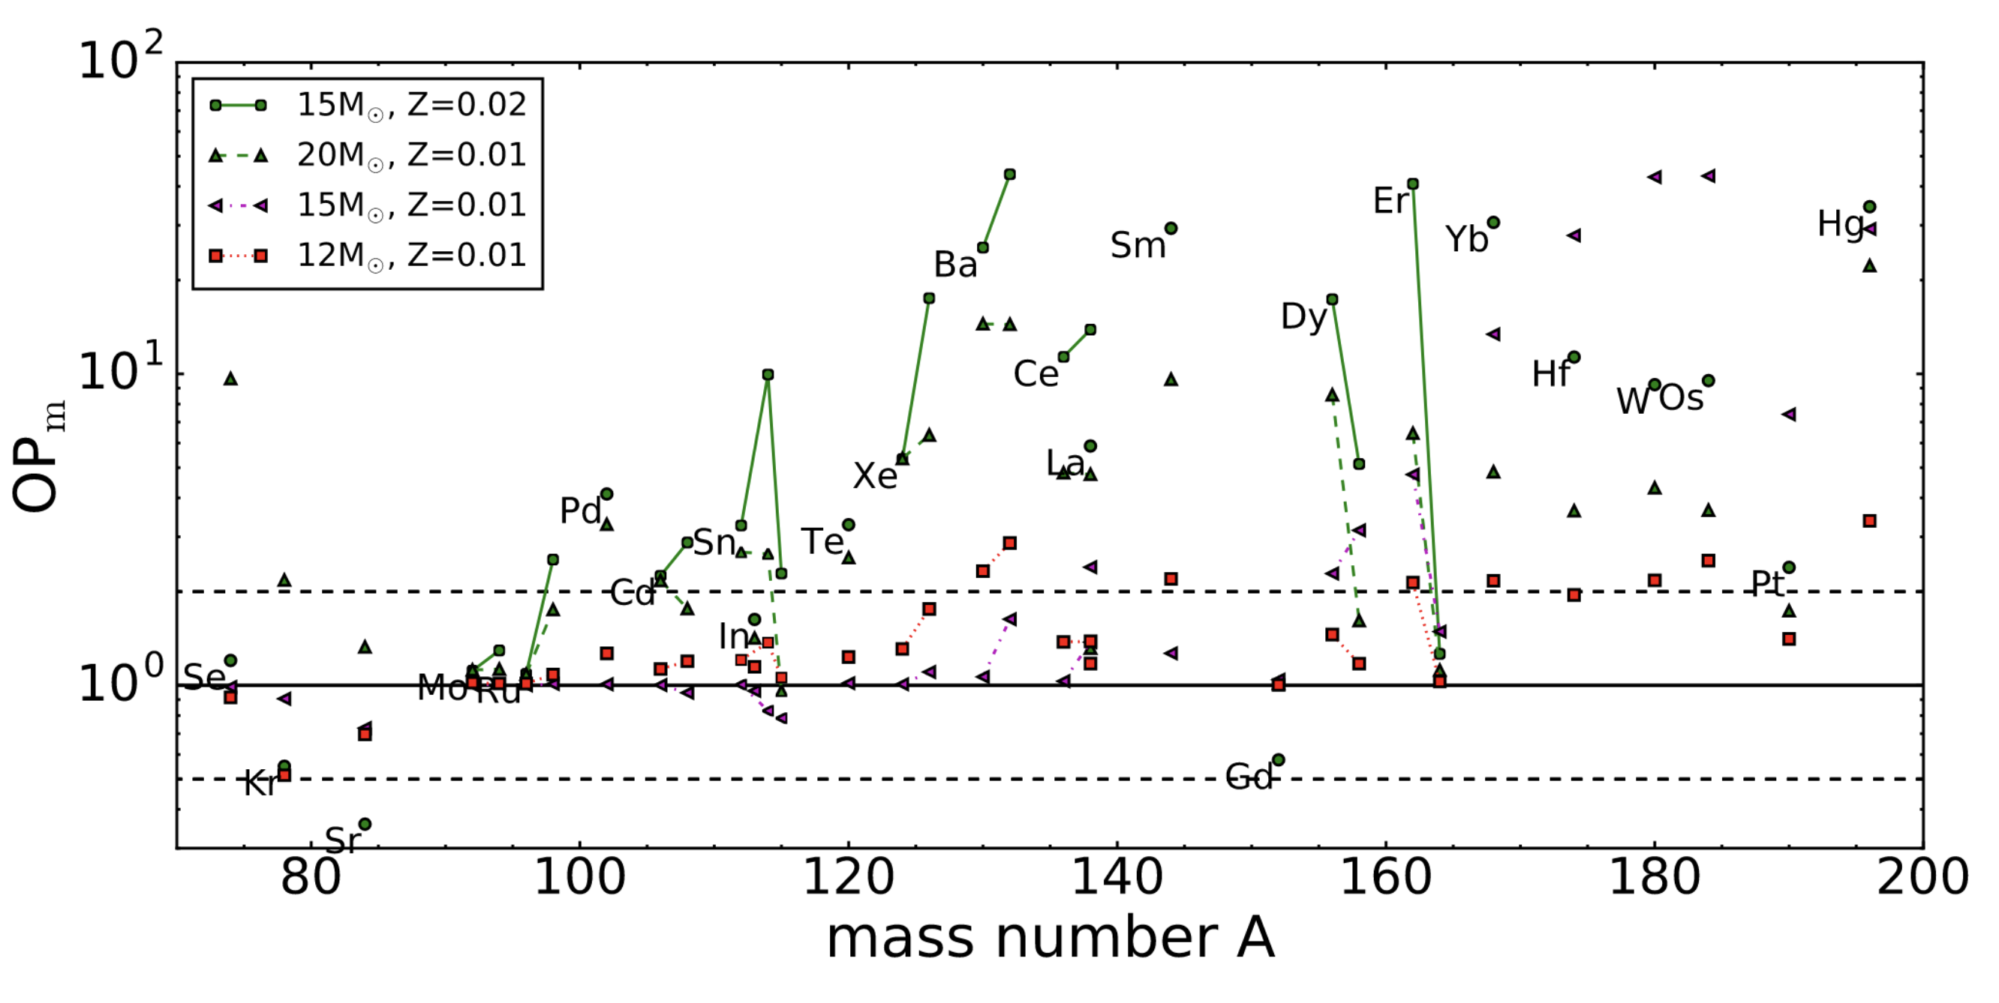
O-C shell mergers: nucleosynthesis
(Ritter et al, 2018a)
Odd-Z light element production (Ritter et al, 2018a)
Conditions for p-nuclei production (Rauscher et al 2002 + Ritter et al 2018a + Roberti et al 2024)
2

Slide 4
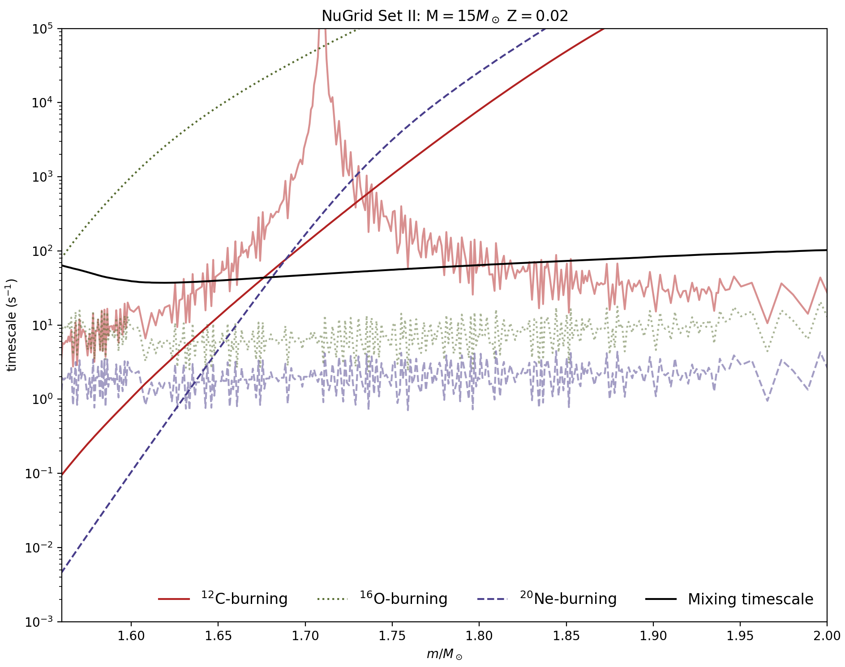

Convective+reactive
Burning timescale can be comparable or faster than the mixing timescale
Species are not well-mixed in the convective zone
Can be produced in one mass zone and burned in another
Burning timescale
Reaction e-folding timescale
$${τ=\left(\frac{d\left(ρN_{A}\left\langle σv\right\rangle \right)}{dr}\right)}^{−2}{÷D}_{MLT}$$
3

Slide 5
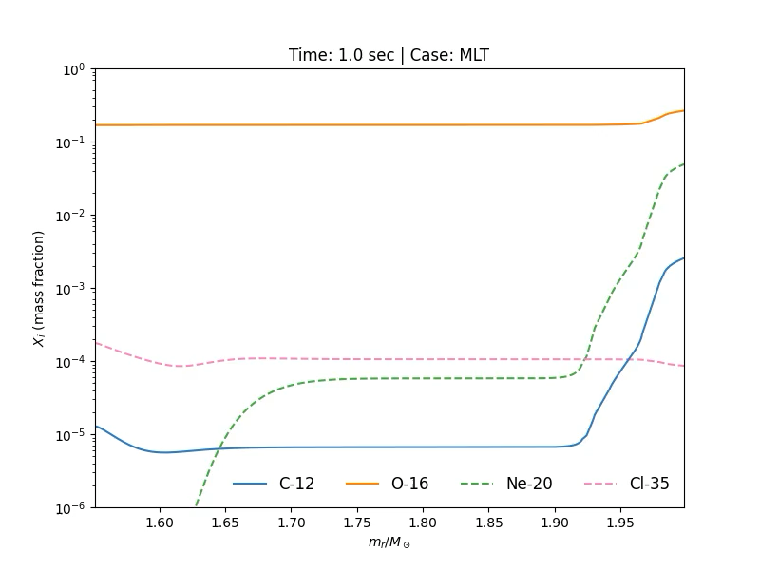
Post-processed model
mppnp post-processing of 15M☉ Z=0.02 model from Ritter et al (2018b) starting right before the merger for 110 seconds
Constant ingestion rate of 4.17 x 10⁻³ M☉s⁻¹
4

Slide 6
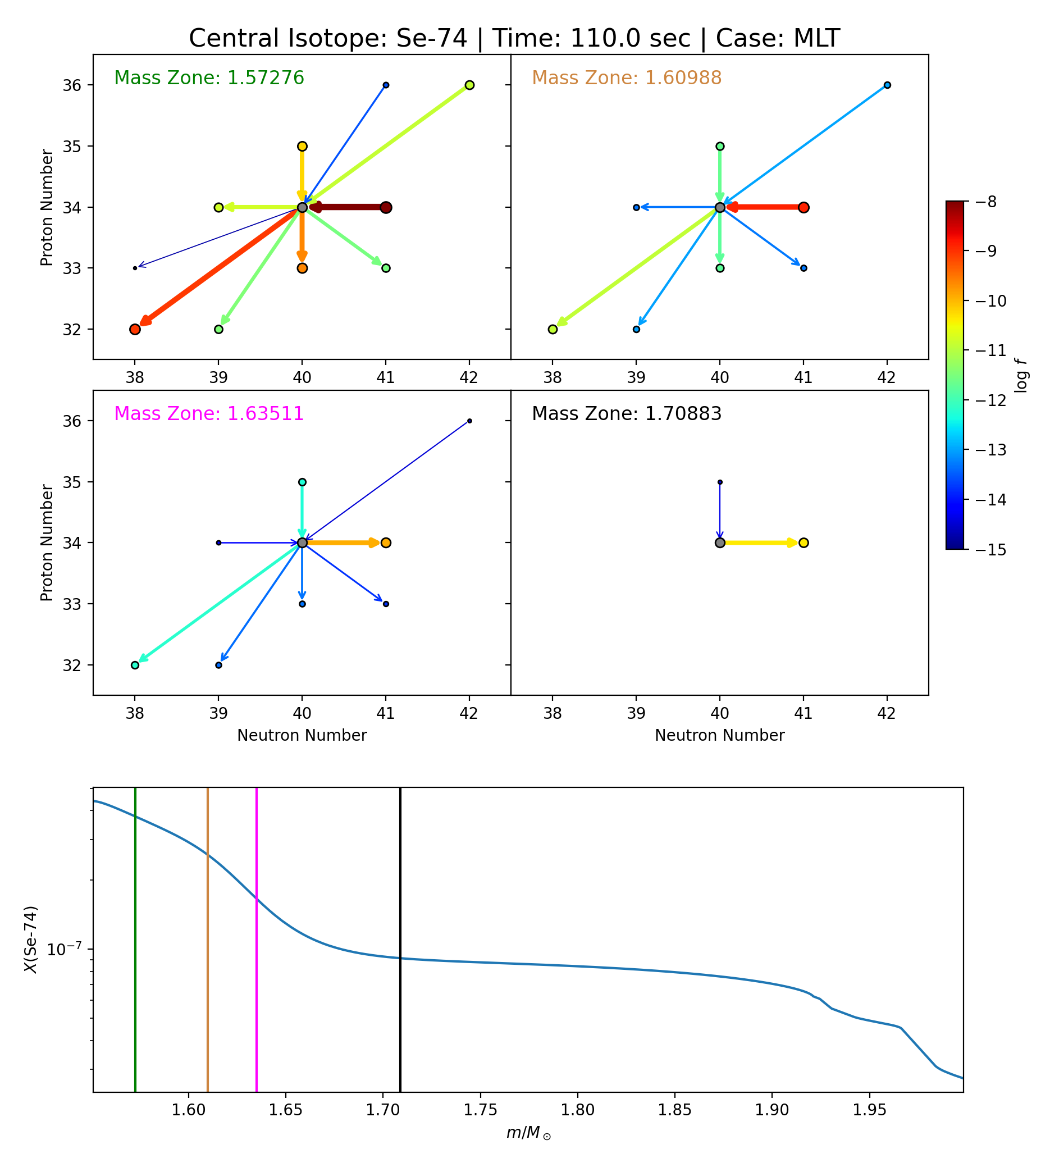
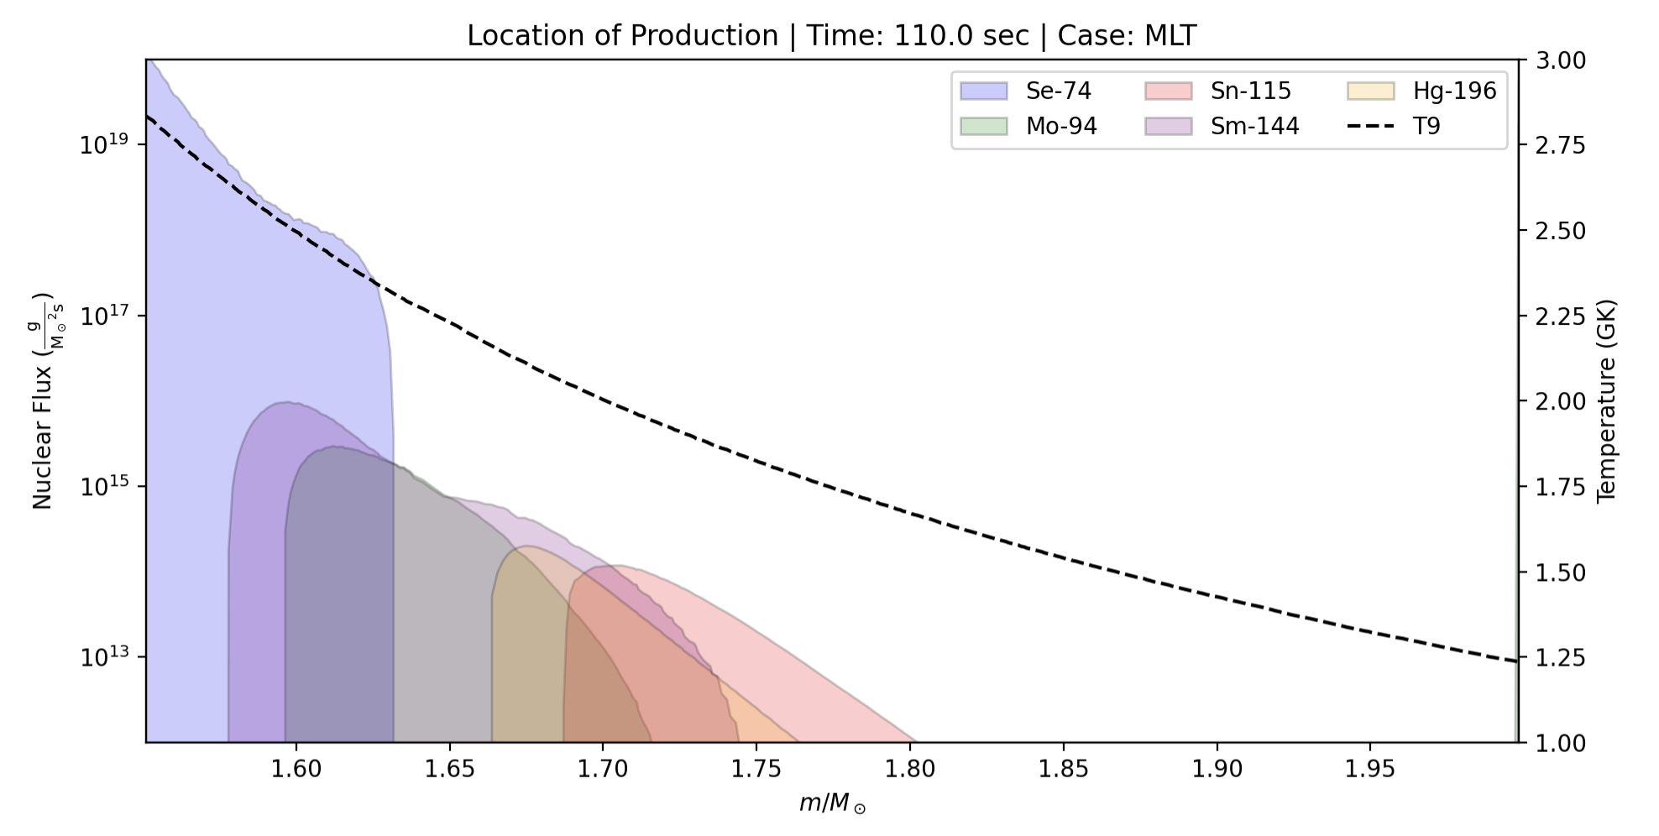
𝛾-process
Species in the O-shell will undergo different reactions depending on their position in the shell
5

Slide 7
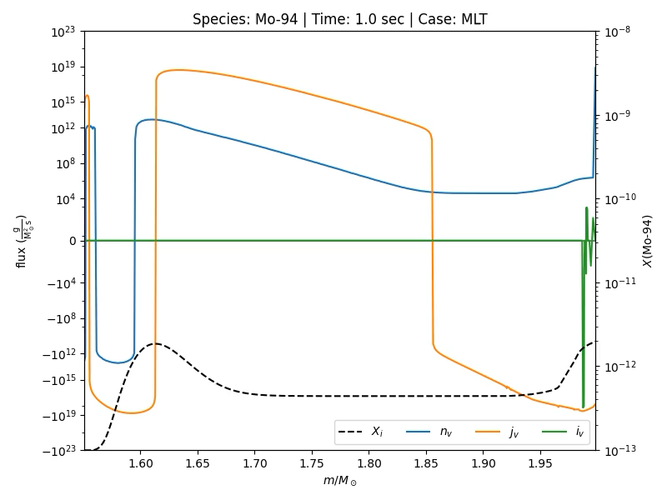
Convective+reactive in action
There are three things that species can experience in the shell:
1. Convection (orange)
2. Nuclear burning (blue)
3. Ingested from C-shell (green)
This shows where in the convective-reaction environment a species is coming from
6

Slide 8
Ingredients for p-production
Different stellar environments
3D hydrodynamic mixing profile, efficiency, and response to ingestion
P-Nuclei
Seed composition of the C-shell
Nuclear rate uncertainties
7

Slide 9
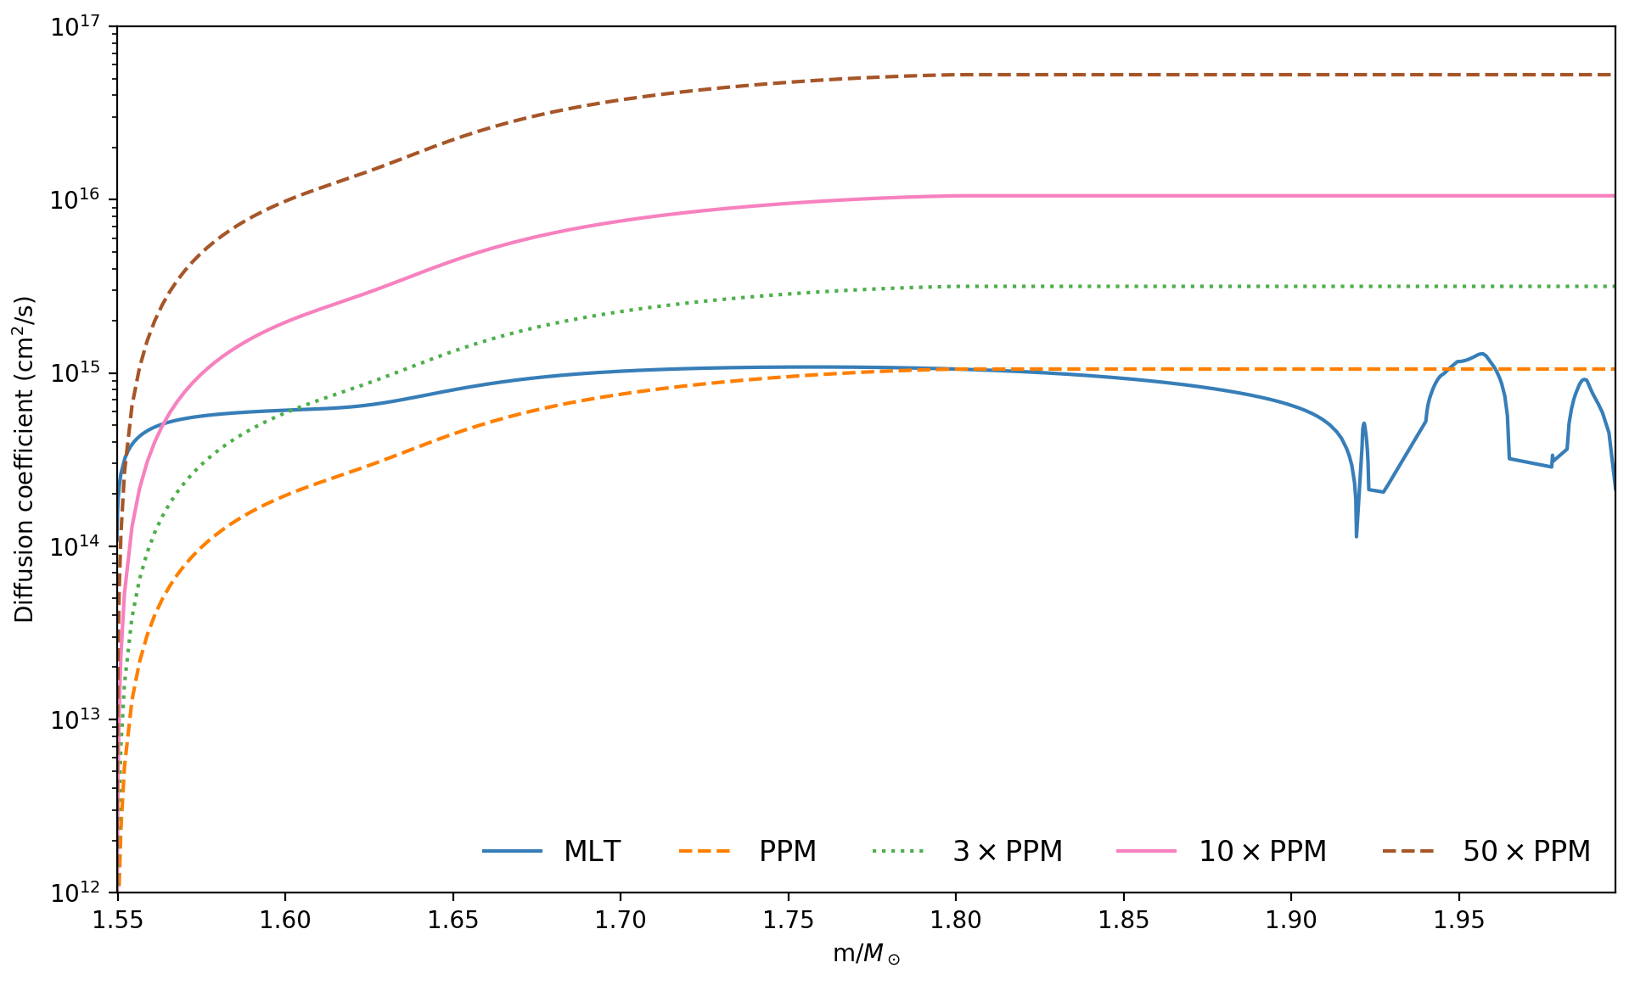
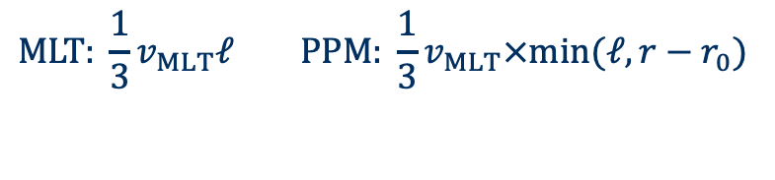
3D hydro informed mixing
Jones et al (2017): 3D hydro sims of O-shell burning (without merger)
Radial mixing decreases as flow approaches lower boundary compared to MLT prediction
Recipe to apply correction to MLT convective diffusion coefficient
In addition: 3D hydro predicts overall higher convective velocities
$$MLT: \frac{1}{3}v_{MLT}ℓ PPM: \frac{1}{3}v_{MLT}×min⁡(ℓ, r−r_{0})$$
8

Slide 10
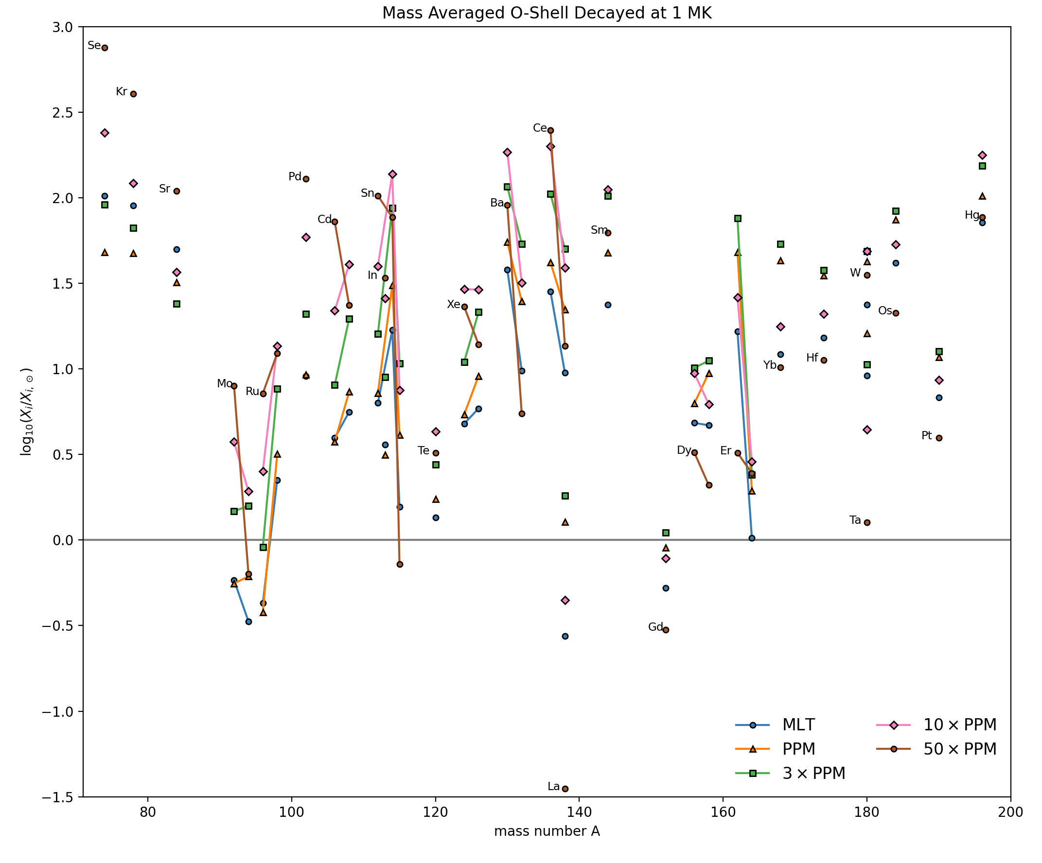
3D-informed mixing increases p-process production
The 3D inspired convective profile increases the production of p-nuclei
The increase is non–monotonic with mixing speed, and affects pairs differently
Production can be increased by 1.5 dex
9

Slide 11
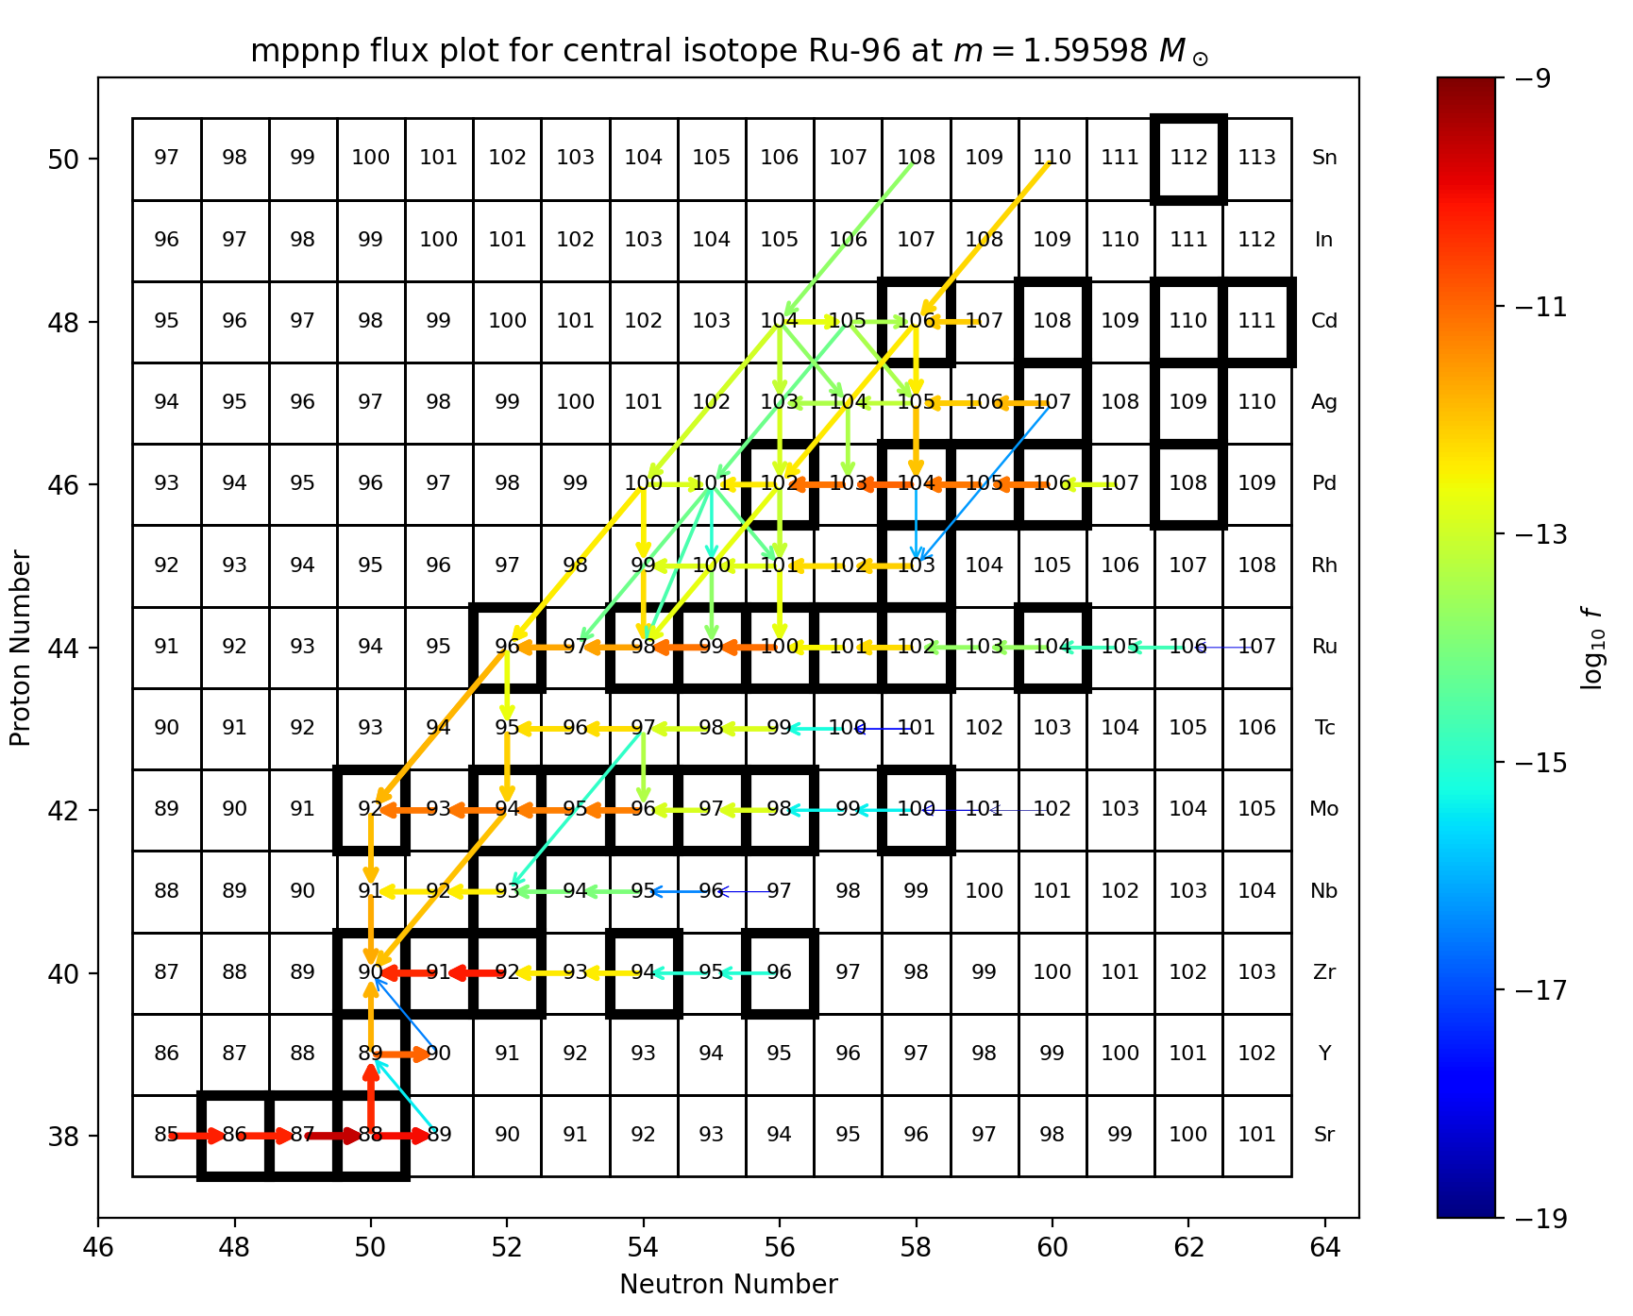
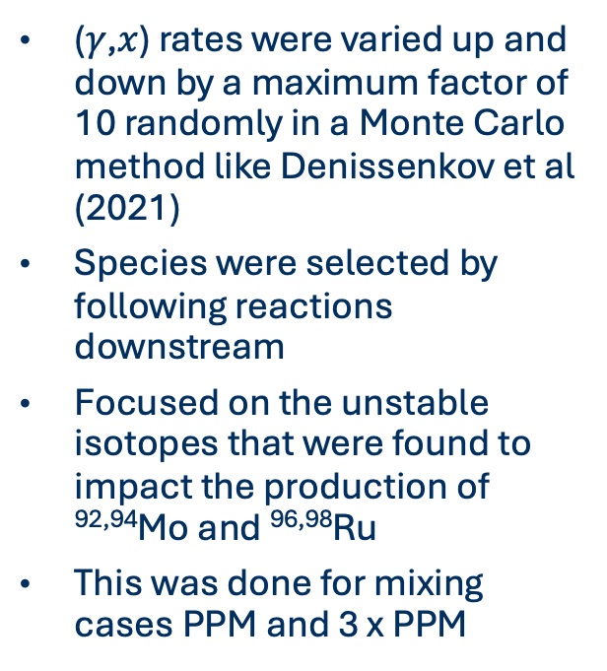
Nuclear uncertainties
(𝛾,$x$) rates were varied up and down by a maximum factor of 10 randomly in a Monte Carlo method like Denissenkov et al (2021)
Species were selected by following reactions downstream
Focused on the unstable isotopes that were found to impact the production of ^{92,94}Mo and ^{96,98}Ru
This was done for mixing cases PPM and 3 x PPM
10

Slide 12
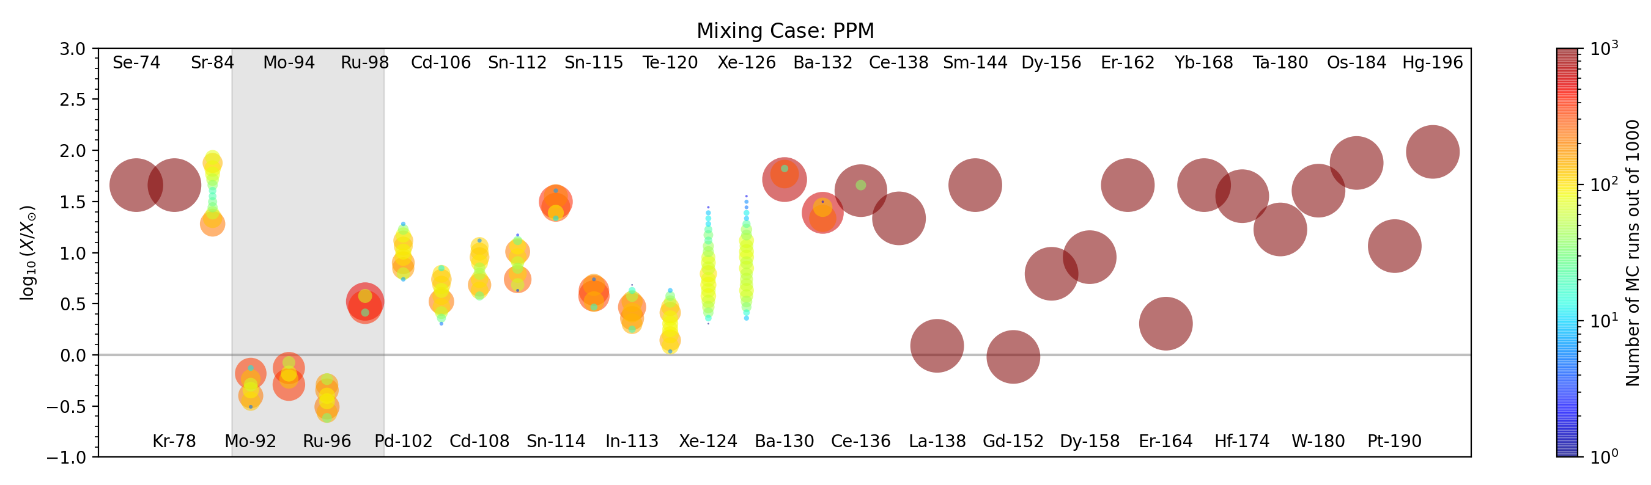
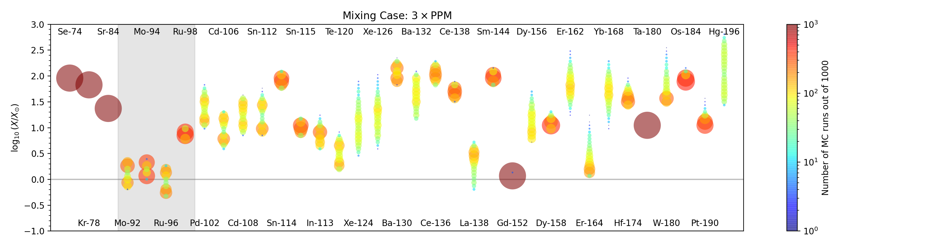
Nuclear uncertainty impact for ^{92,94}Mo and ^{96,98}Ru
The different mixing speeds identify a noticeably different set of important isotopes
Nuclear uncertainty impact can be dependent on mixing assumptions
11

Slide 13
Reaction correlations depend on 3D convective Mixing properties
Mixing Case: PPM
Mo-92 | Mo-94 | Ru-96 | Ru-98
Mo-93 (𝛾,n) | Mo-93 (𝛾,n) | Ru-97 (𝛾,n) | Ru-97 (𝛾,n)
 |  | Pd-100 (𝛾,⍺) | Rh-101 (𝛾,p)
 |  |  | Pd-100 (𝛾,p)
 |  |  | Pd-100 (𝛾,⍺)
Mixing Case: 3 x PPM
Mo-92 | Mo-94 | Ru-96 | Ru-98
Mo-93 (𝛾,n) | Mo-93 (𝛾,n) | Ru-97 (𝛾,n) | Ru-97 (𝛾,n)
 |  |  | Pd-100 (𝛾,p)
 |  |  | Pd-100 (𝛾,⍺)
12

Slide 14
Summary
Production of p-nuclei depends on seeds, environment, nuclear uncertainty, and hydro
In convective-reactive nucleosynthesis depends on convective mixing which depends on the 3D structure
3D informed mixing enhances p-process production in a non-monotonic way
Nuclear uncertainties rely on mixing properties

Slide 15
References
[1] Andrassy, R., F. Herwig, P. Woodward, and C. Ritter. “3D Hydrodynamic Simulations of C Ingestion into a Convective O Shell.” Monthly Notices of the Royal Astronomical Society 491 (January 1, 2020): 972–92. https://doi.org/10.1093/mnras/stz2952.
[2] Ritter, C., R. Andrassy, B. Côté, F. Herwig, P. R. Woodward, M. Pignatari, and S. Jones. “Convective-Reactive Nucleosynthesis of K, Sc, Cl and p-Process Isotopes in O-C Shell Mergers.” Monthly Notices of the Royal Astronomical Society 474 (February 1, 2018a): L1–6. https://doi.org/10.1093/mnrasl/slx126.
[3] Rauscher, T., A. Heger, R. D. Hoffman, and S. E. Woosley. “Nucleosynthesis in Massive Stars with Improved Nuclear and Stellar Physics.” The Astrophysical Journal 576 (September 1, 2002): 323–48. https://doi.org/10.1086/341728.
[4] Roberti, L., M. Pignatari, C. Fryer, and M. Lugaro. “The γ-Process Nucleosynthesis in Core-Collapse Supernovae. II. Effect of the Explosive Recipe.” Astronomy and Astrophysics 686 (June 1, 2024): L8. https://doi.org/10.1051/0004-6361/202449994.
[5] Ritter, C., F. Herwig, S. Jones, M. Pignatari, C. Fryer, and R. Hirschi. “NuGrid Stellar Data Set - II. Stellar Yields from H to Bi for Stellar Models with MZAMS = 1-25 M⊙ and Z = 0.0001-0.02.” Monthly Notices of the Royal Astronomical Society 480 (October 1, 2018b): 538–71. https://doi.org/10.1093/mnras/sty1729.
[6] Jones, S., R. Andrassy, S. Sandalski, A. Davis, P. Woodward, and F. Herwig. “Idealized Hydrodynamic Simulations of Turbulent Oxygen-Burning Shell Convection in 4π Geometry.” Monthly Notices of the Royal Astronomical Society 465 (March 1, 2017): 2991–3010. https://doi.org/10.1093/mnras/stw2783.
[7] Denissenkov, Pavel A., Falk Herwig, Georgios Perdikakis, and Hendrik Schatz. “The Impact of (n,γ) Reaction Rate Uncertainties of Unstable Isotopes on the i-Process Nucleosynthesis of the Elements from Ba to W.” Monthly Notices of the Royal Astronomical Society 503 (May 1, 2021): 3913–25. https://doi.org/10.1093/mnras/stab772.

Slide 16
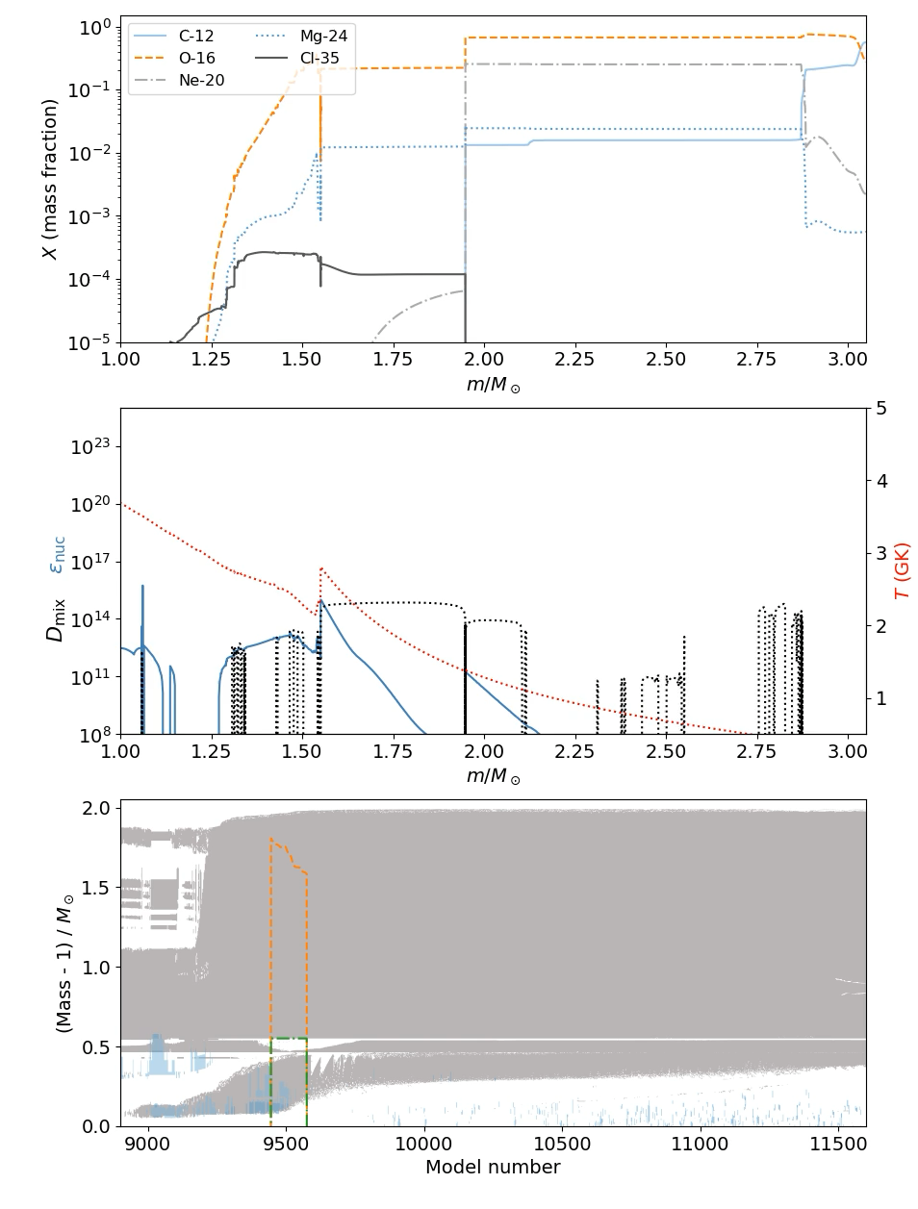
Nugrid Set II 15M☉ Z=0.02
The temperature pre-merger in the O-shell and bottom of C-shell (m=1.55-2M☉) are between T = 1.23-2.8 GK

Slide 17
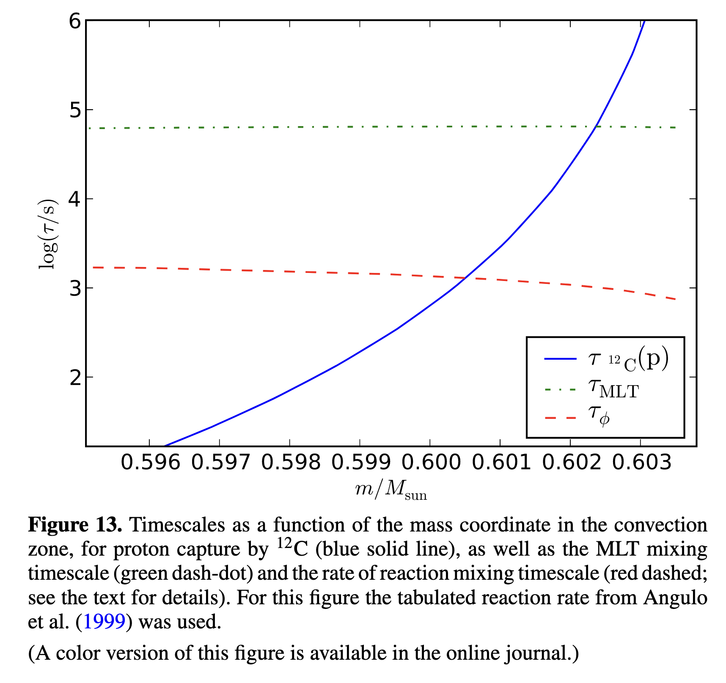
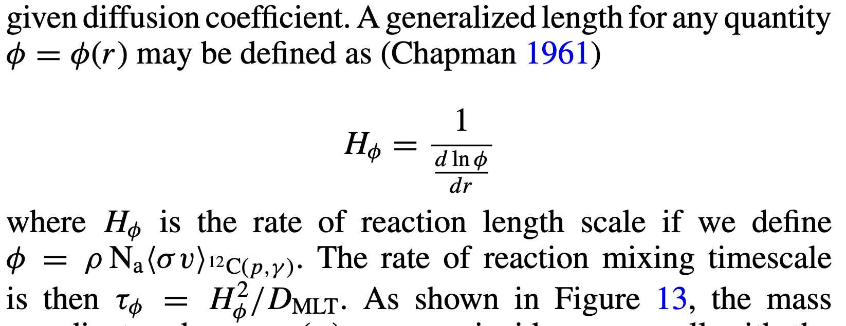
Reaction e-folding timescale
Herwig, Falk, Marco Pignatari, Paul R. Woodward, David H. Porter, Gabriel Rockefeller, Chris L. Fryer, Michael Bennett, and Raphael Hirschi. “CONVECTIVE–REACTIVE PROTON–12C COMBUSTION IN SAKURAI’S OBJECT (V4334 SAGITTARII) AND IMPLICATIONS FOR THE EVOLUTION AND YIELDS FROM THE FIRST GENERATIONS OF STARS.” The Astrophysical Journal 727, no. 2 (January 2011): 89. https://doi.org/10.1088/0004-637X/727/2/89.

Slide 18
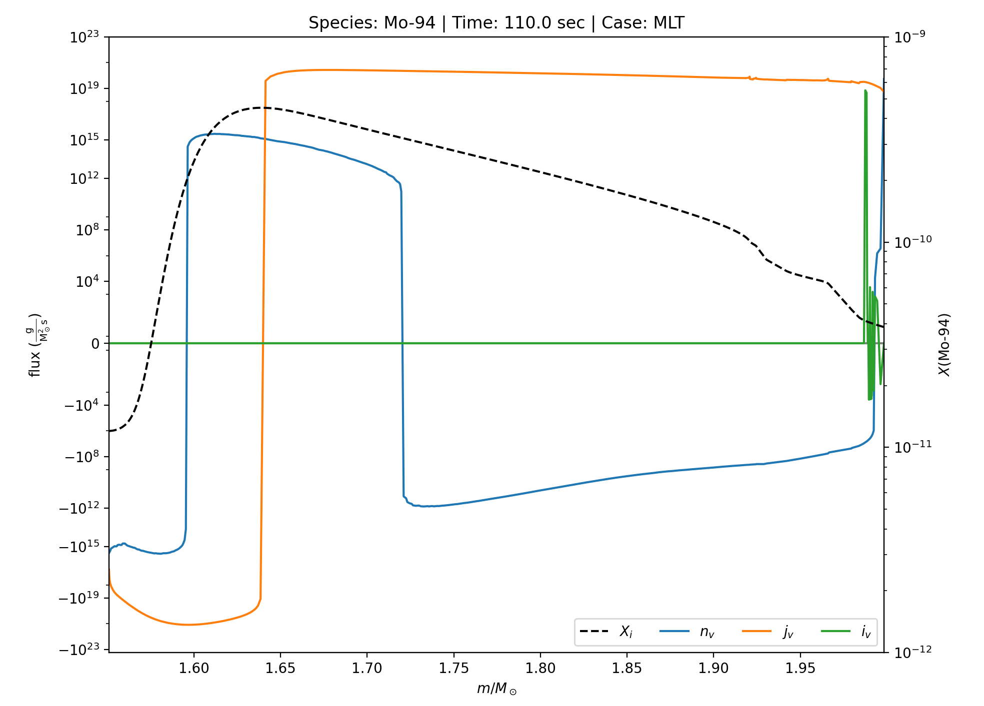
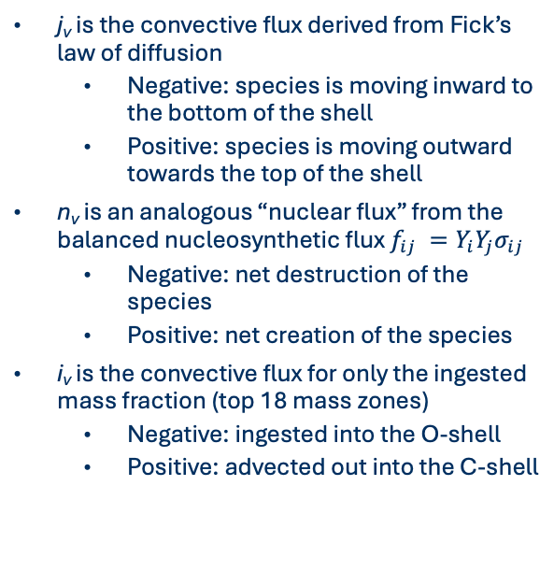
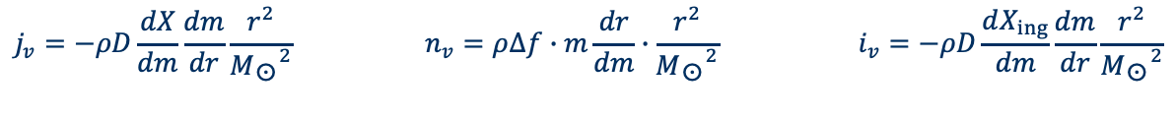
Flux plot explanation
j_{v} is the convective flux derived from Fick’s law of diffusion
  Negative: species is moving inward to the bottom of the shell
  Positive: species is moving outward towards the top of the shell
n_{v} is an analogous “nuclear flux” from the balanced nucleosynthetic flux $f_{ij} =Y_{i}Y_{j}σ_{ij}$
  Negative: net destruction of the species
  Positive: net creation of the species
i_{v} is the convective flux for only the ingested mass fraction (top 18 mass zones)
  Negative: ingested into the O-shell
  Positive: advected out into the C-shell
$${j_{v}=−ρD\frac{dX}{dm}\frac{dm}{dr}\frac{r^{2}}{{M_{☉}}^{2}} n}_{v}=ρ∆f∙m\frac{dr}{dm}∙\frac{r^{2}}{{M_{☉}}^{2}} i_{v}=−ρD\frac{dX_{ing}}{dm}\frac{dm}{dr}\frac{r^{2}}{{M_{☉}}^{2}}$$

Slide 19
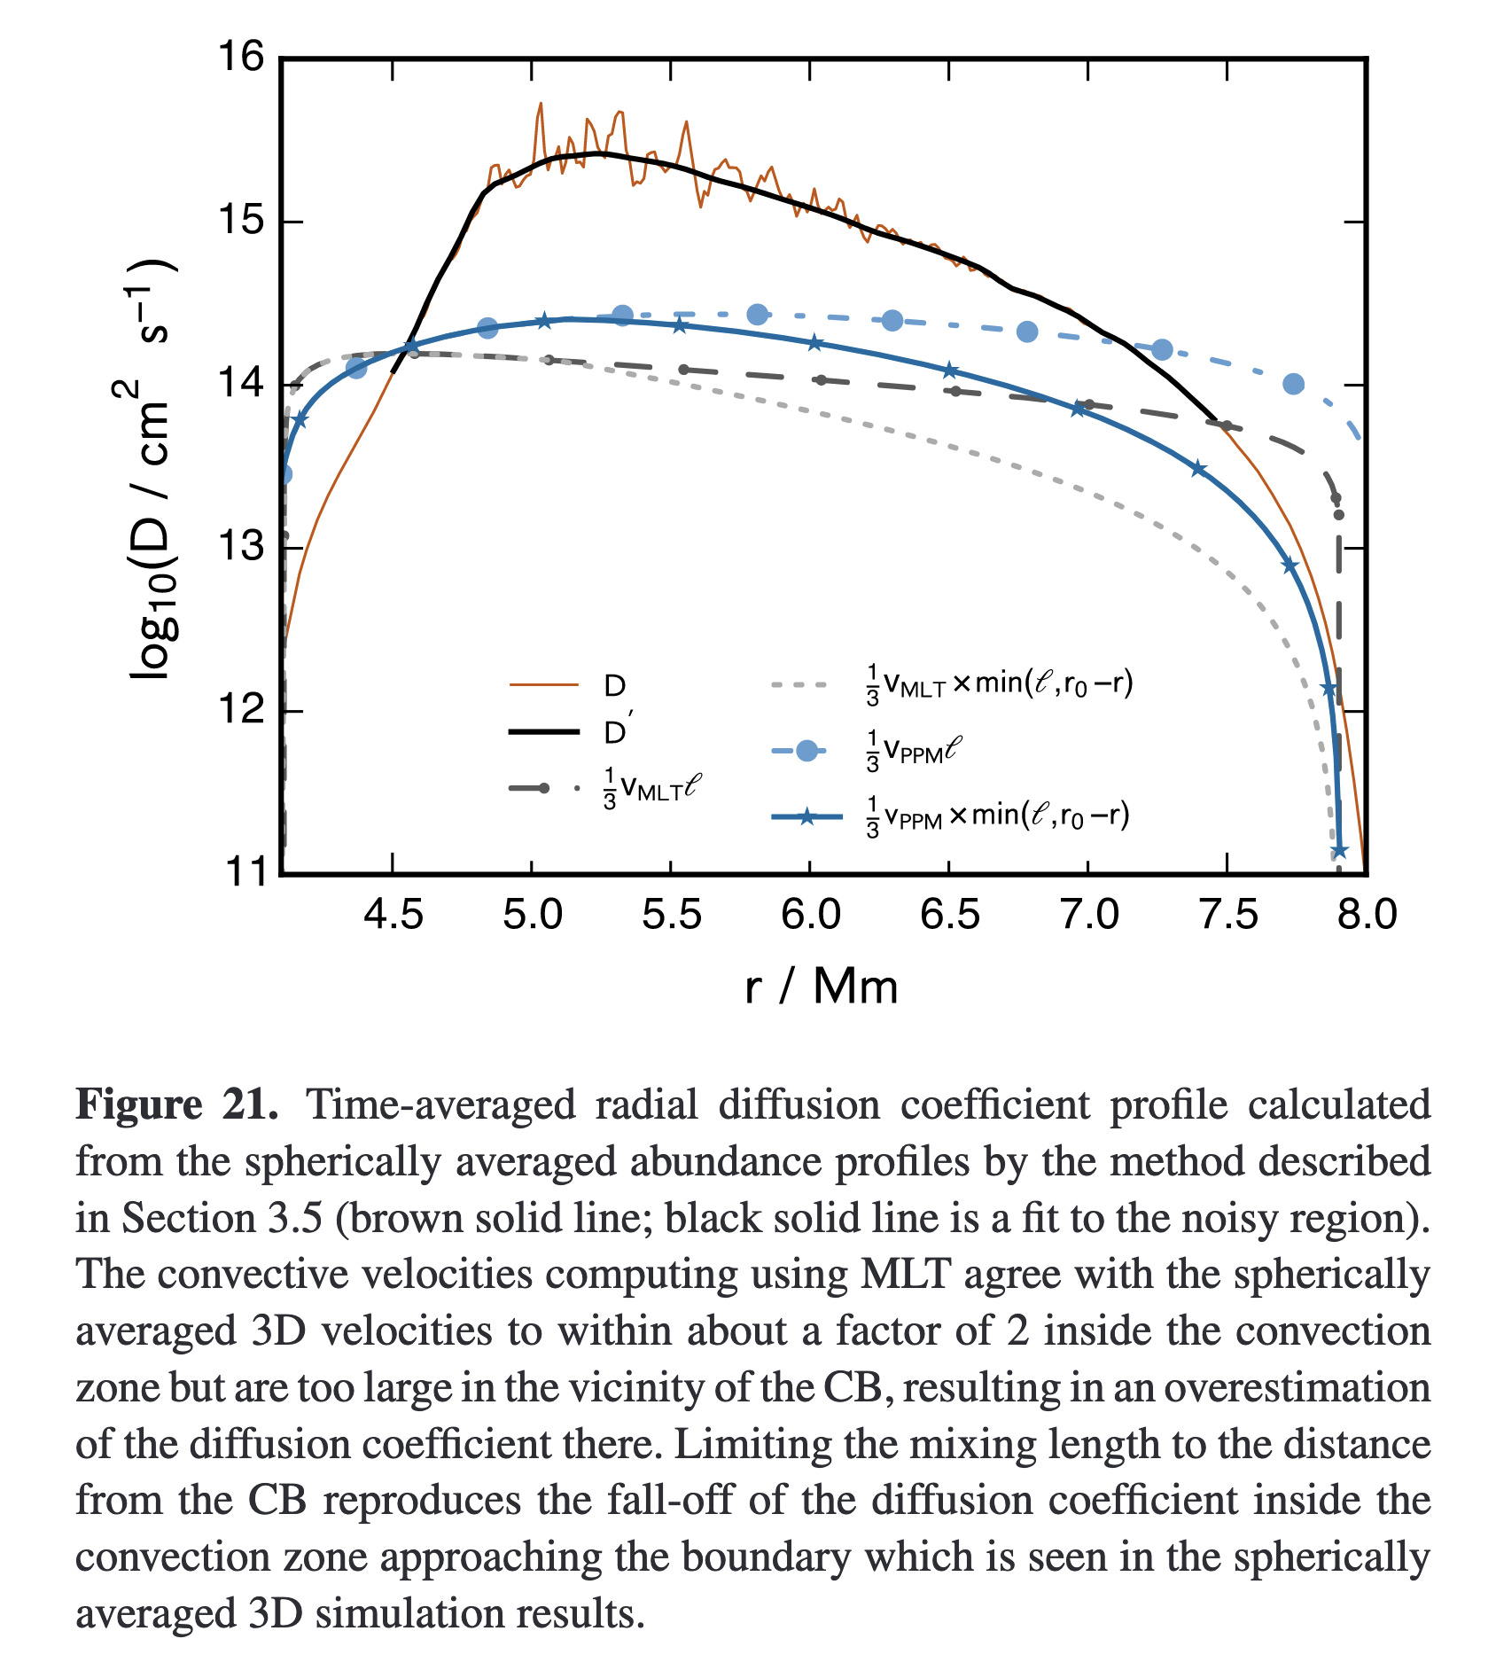
3d informed hydrodynamics
(Jones et al, 2017)
Mixing length theory suggests that material is advected a full pressure scale height even when the maximum radial distance is less than that
Instead, let’s take the minimum between the pressure scale height and the distance to the convective boundary
3D spherical average (black line) is qualitatively matched when this minimum is introduced

Slide 20
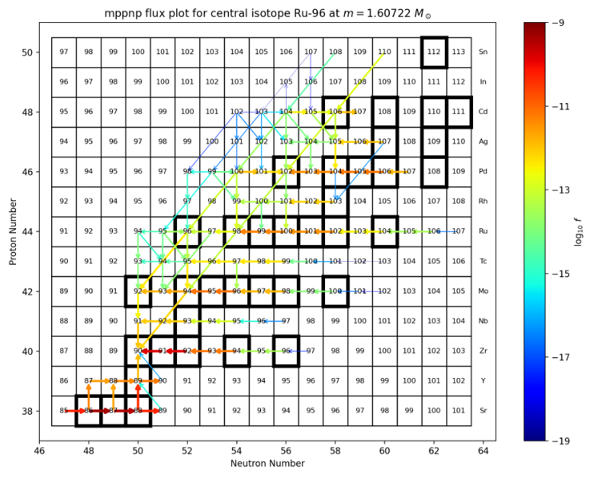
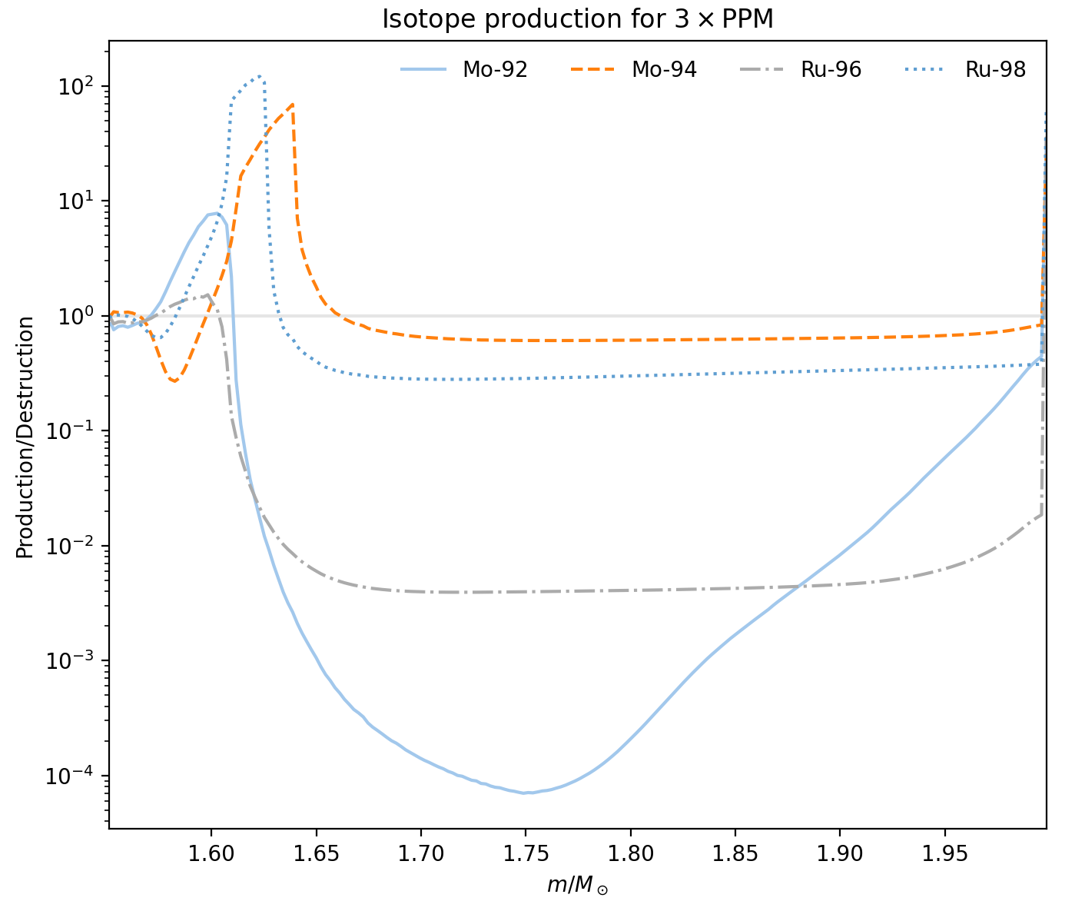
Selecting for monte carlo
To identify species to vary reactions, for each individual mass zone I follow the flow of the nucleosynthetic fluxes of the species that are within 10-100% of the maximum contribution recursively until I find a species that is being destroyed 10x more than it is being produced (as these are likely being advected into the mass zone)

Slide 21
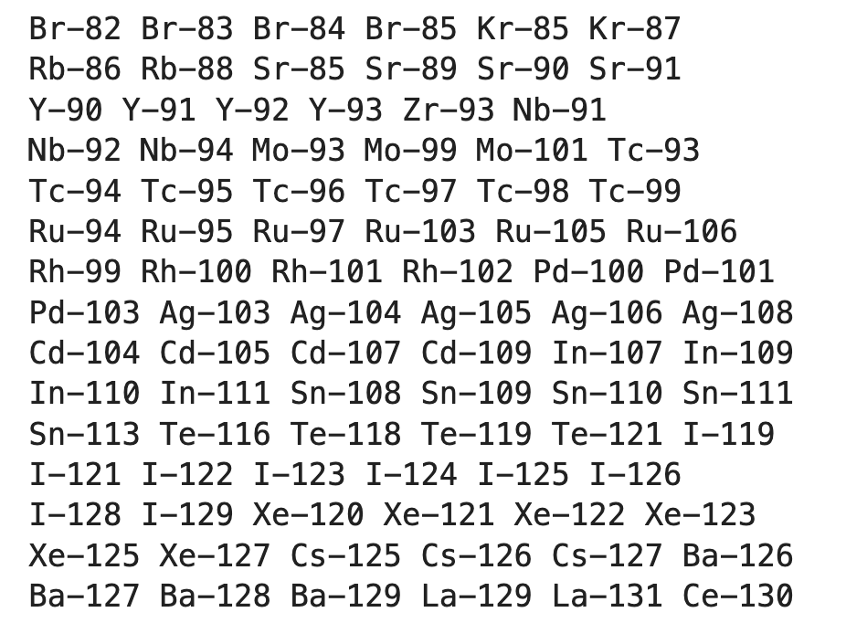
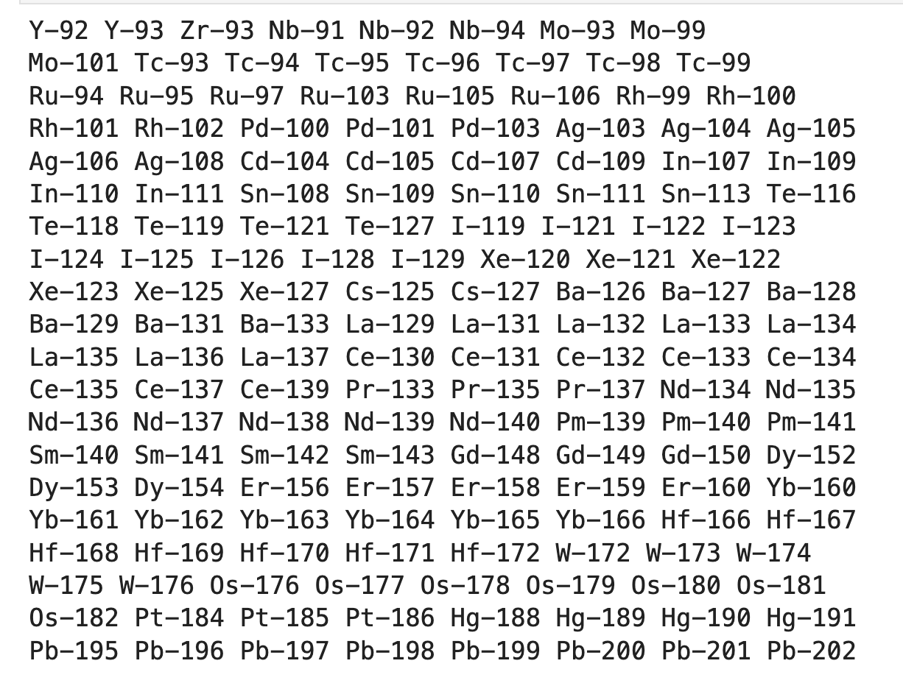
Selected unstable species
Mixing Case: PPM
Mixing Case: 3 x PPM

Slide 22
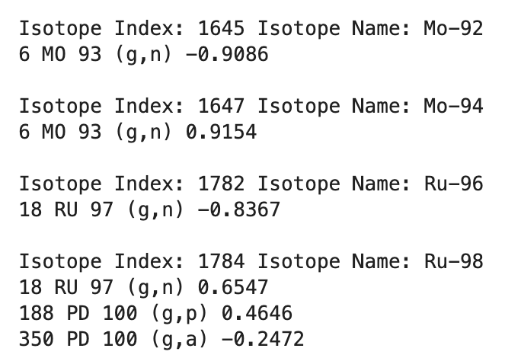
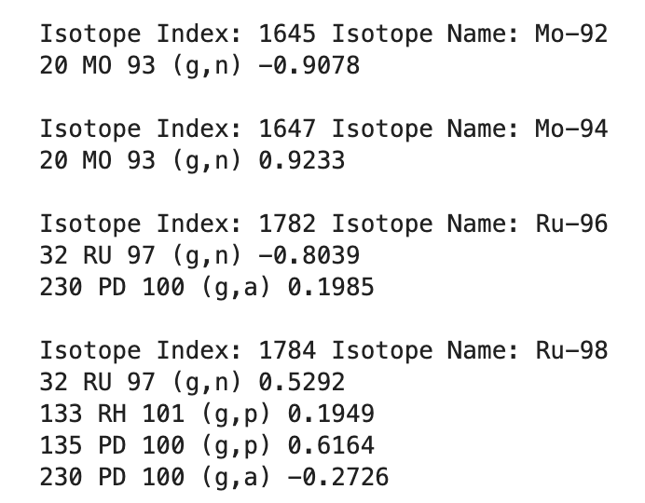
Reaction rate correlations

