Slide 1
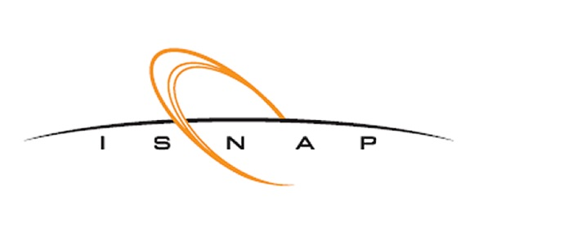


Updates on p-process Related Measurements Using the Summing Technique with HECTOR
John McDonaugh
University of Notre Dame

Slide 2
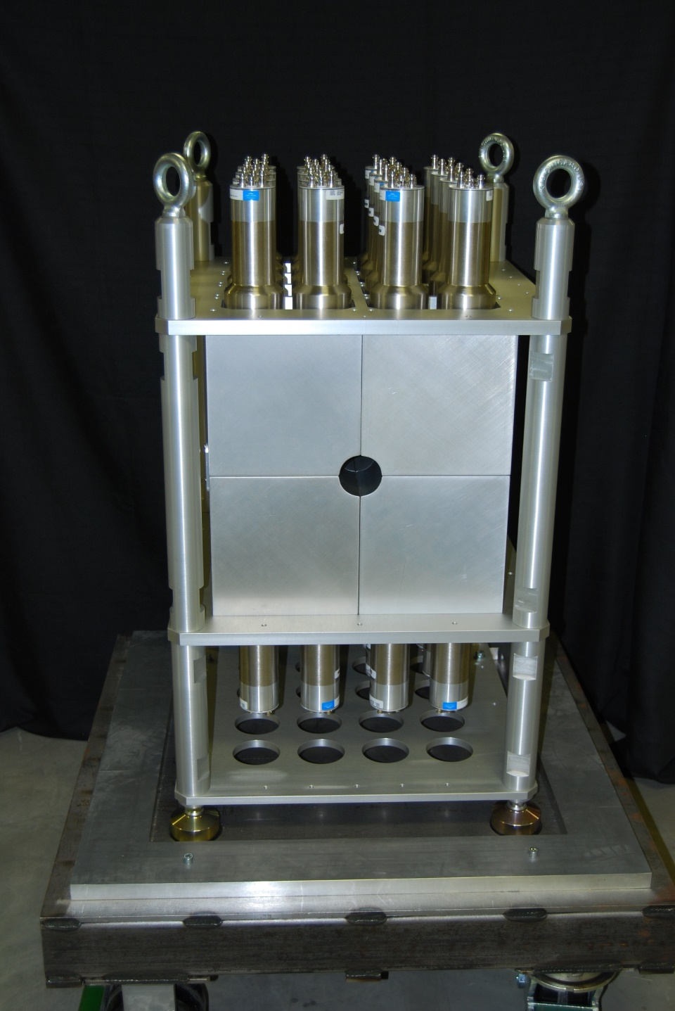
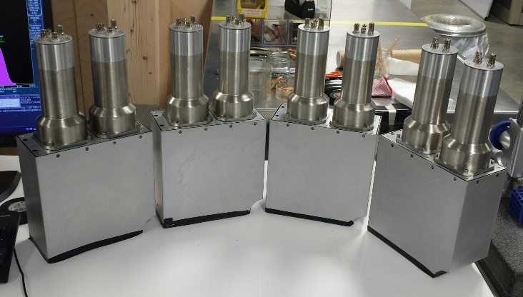
HECTOR-High EffiCiency TOtal absorption spectrometeR
Is a 4𝝅 γ-Summing Spectrometer
  Comprised of 16 segments of NaI(Tl)
  crystal size: 4”x8”x8”
  2 PMTs for light collection
Al Casing around crystal
60mm bore hole
‹#›

Slide 3
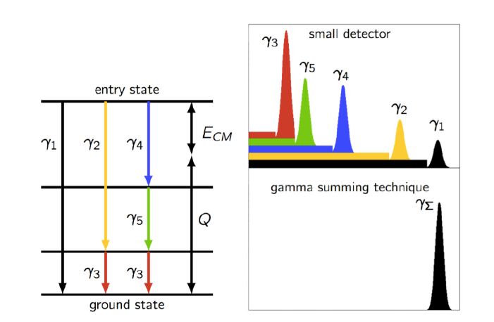

γ-Summing Technique
Find all the γ-rays that feed into the ground state and then correct for angular distribution, efficiency, and branching ratios
γ-ray energies summed to incident energy:
Easy distinction for reaction events
‹#›

Slide 4
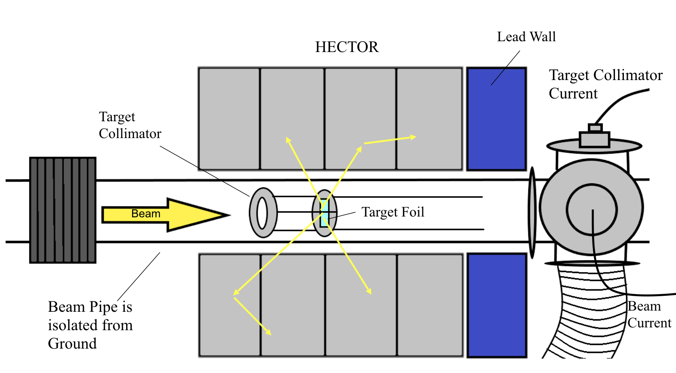
General Experimental Setup
Targets are placed in the middle of HECTOR for maximum sum-peak efficiency
Gold Collimator is placed in front of the Target to ensure only the Target is hit with the beam
Beam pipe is isolated from the rest of the setup to act as a Faraday cup for beam integration
Lead walls can be placed before and/or after HECTOR to cut down beam background
‹#›

Slide 5
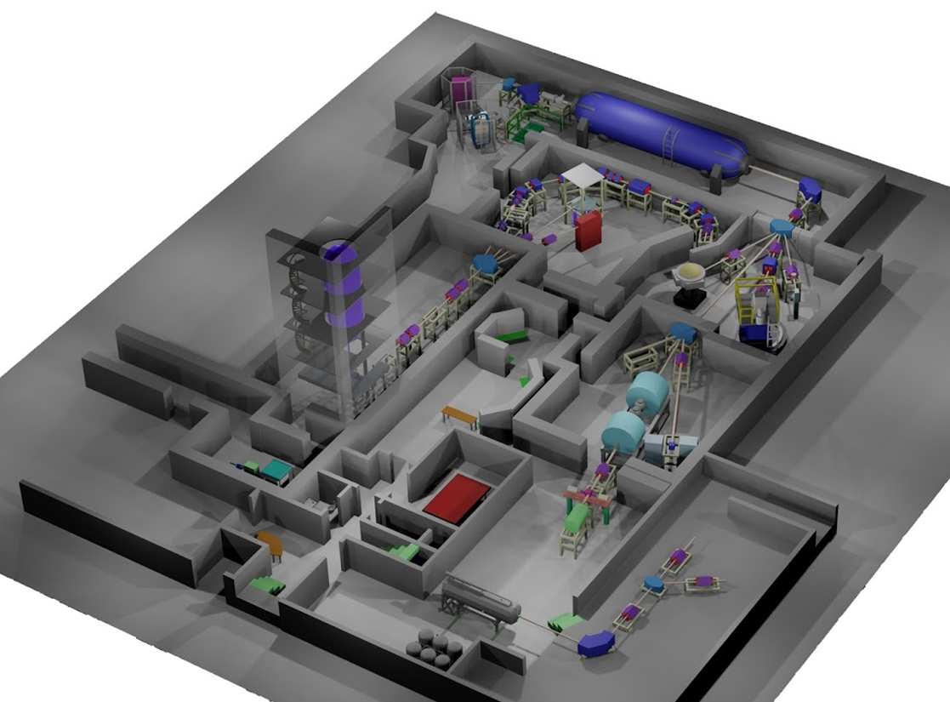
Nuclear Science Lab (NSL)
Three Accelerators
  FN (Tandem Accelerator)
    2 - 10 MV
    Avg beam intensity ~10 uA of protons
    Helium Ion Source
    SNICS - Source of Negative Ions by Cesium Sputtering
  5U (Single Ended Accelerator)
    200 kV - 4 MV
    50-100uA of protons
    Gas Source
FN
5U
Solid Target Line
R2D2 Line
‹#›

Slide 6
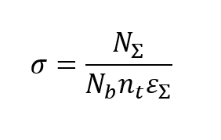
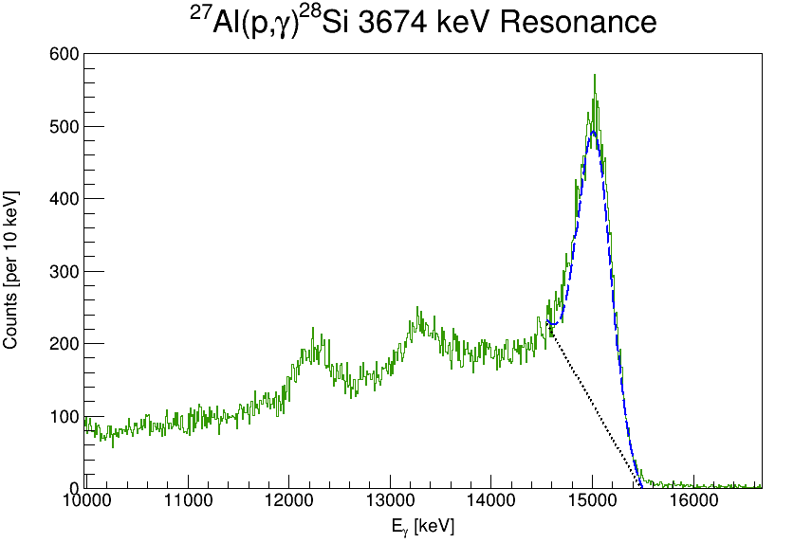
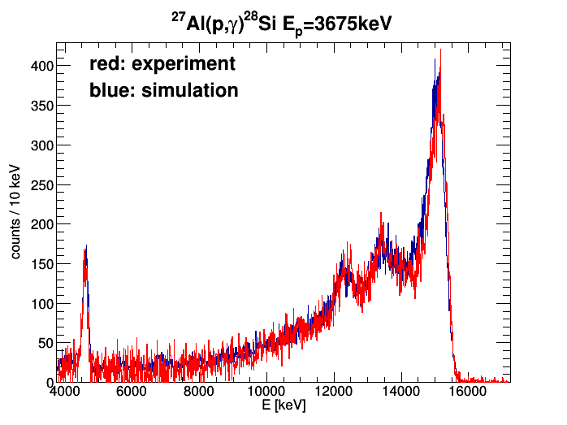

General HECTOR Analysis
Cross-section using γ-summing technique:
# Events in Sum Peak
E_{X} = E_{CM} + Q
Summing Efficiency:
Geant4 Simulations
# Beam Particles: Beam Pipe configured to be a Faraday Cup
Target Thickness:
RBS or SEM
C.S. Reingold, et al. European Physical Journal A 55 (2019).
Olivas-Gomez et al., European Physical Journal A 58 (2022) 57
‹#›

Slide 7
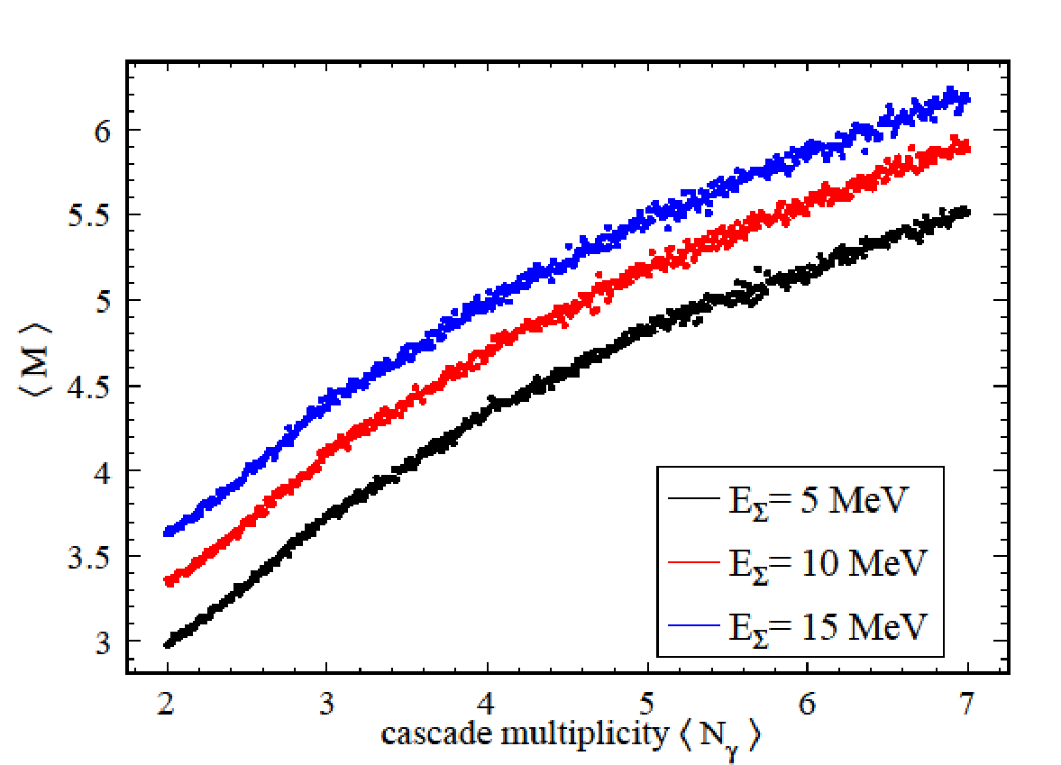
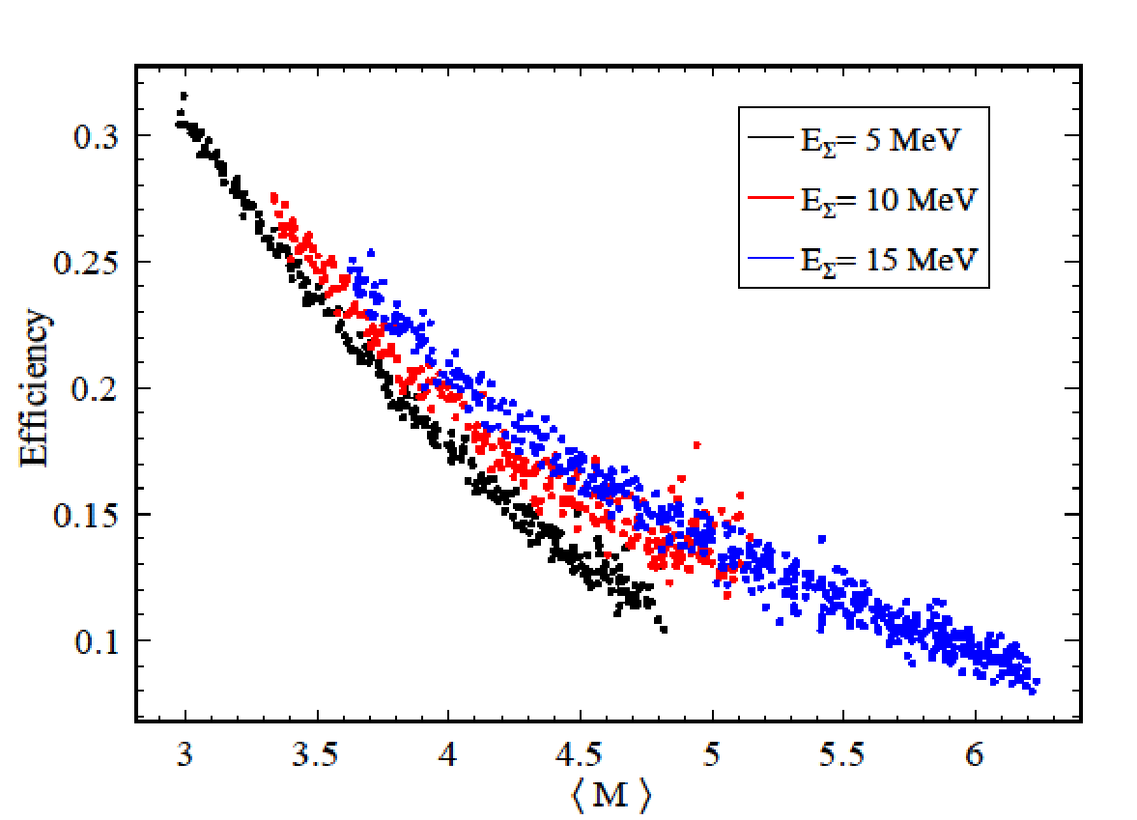
Geant4 Simulations and Summing Efficiencies
GEANT4 Monte Carlo simulations are used to find efficiencies
𝜀_{Σ} dependent on energy and number of γ-rays, N_{γ}
<N_{γ}> ∝ <M>
A range of <N_{γ}> can be simulated till the simulation and data <M> match
C.S. Reingold, et al. European Physical Journal A 55 (2019).
Olivas-Gomez et al., European Physical Journal A 58 (2022) 57
‹#›

Slide 8
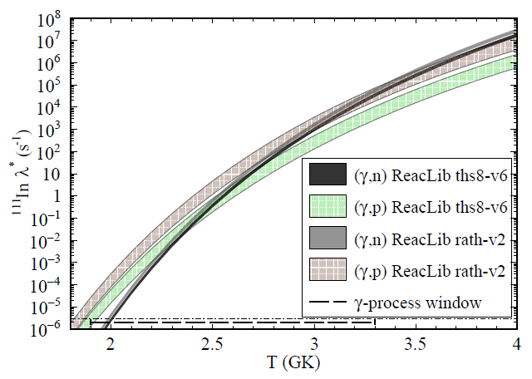
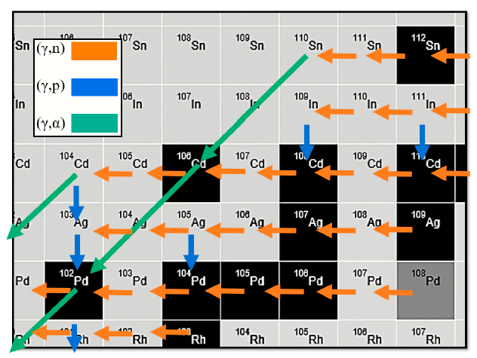
Constraining ¹¹¹In (γ,p)/(γ,n) Branching Point
(γ,p)/(γ,n) competition could occur anywhere between 2.3-3.5 GK depending on model
Proton capture measurements for ¹⁰²Pd, ¹⁰⁸Cd, and ¹¹⁰Cd were measured over 3-8 MeV to help constrain the temperature of the competition
‹#›

Slide 9
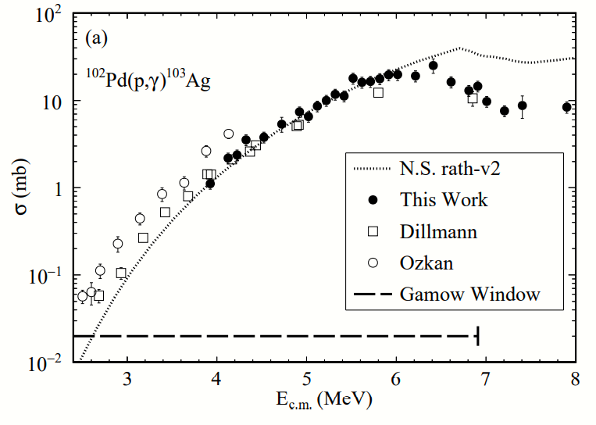
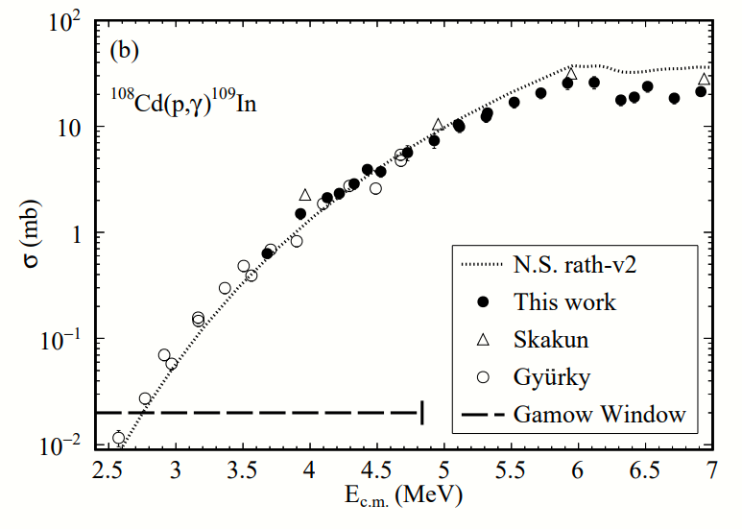
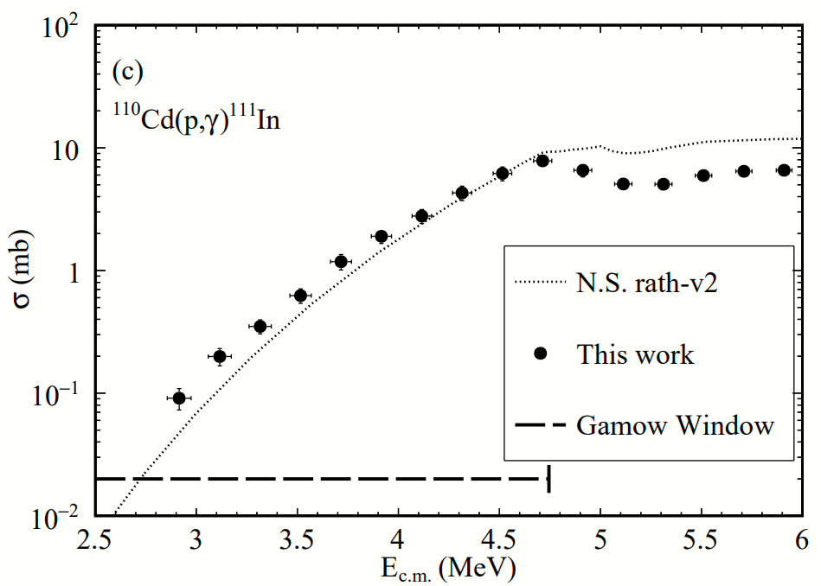
Constraining ¹¹¹In (γ,p)/(γ,n) Branching Point (cont)
‹#›

Slide 10
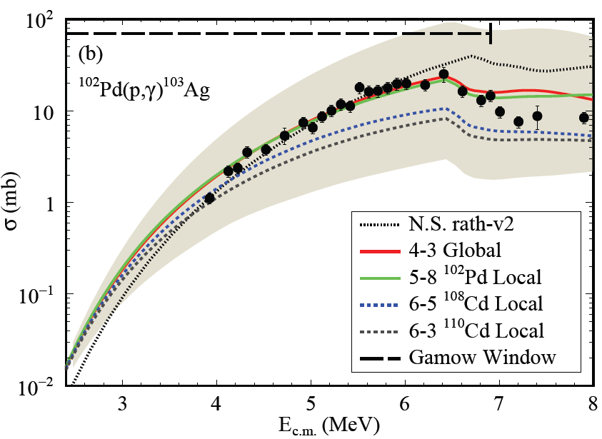
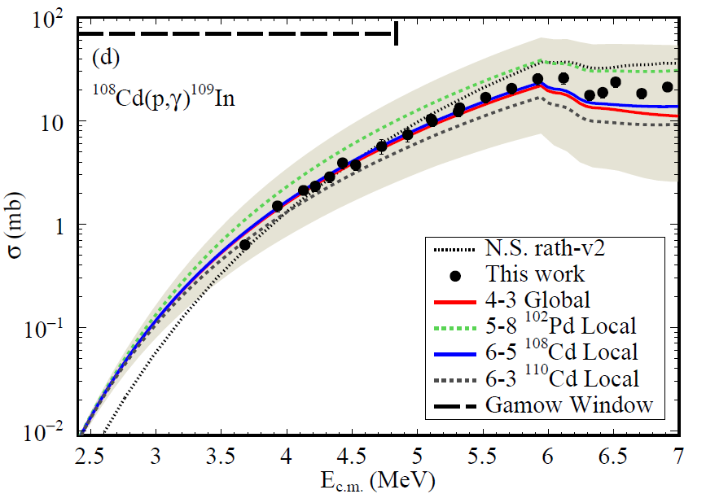
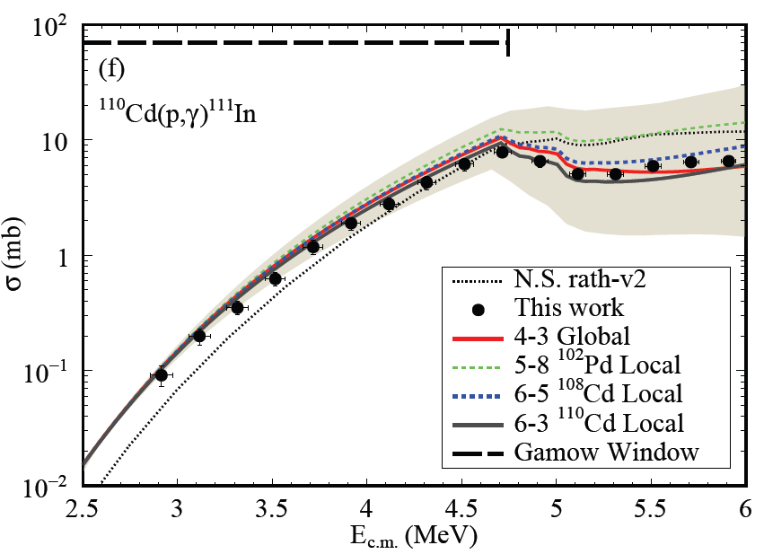
Constraining ¹¹¹In (γ,p)/(γ,n) Branching Point (cont)
LD-gSF
‹#›

Slide 11
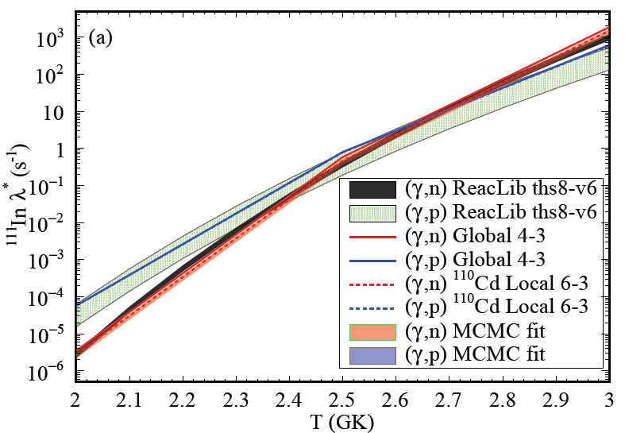
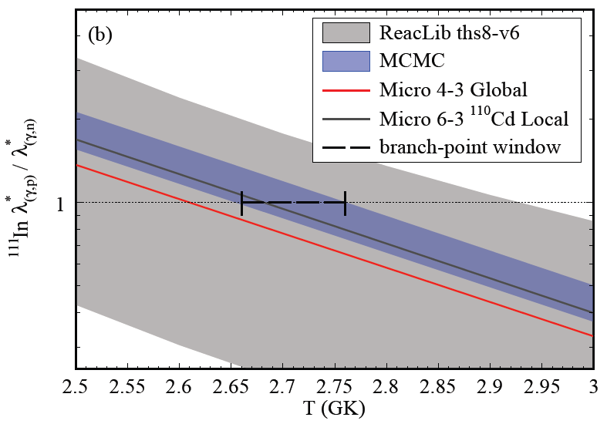
Constraining ¹¹¹In (γ,p)/(γ,n) Branching Point (cont)
‹#›
Notes:
2.71 ± 0.05 GK
MCMC is the Markov chain Monte Carlo approach for finding the best parameters of LDL(GC-NLD) damping parameters and asymptotic parameter, and E1(KU-γSF)&M1(BA-γSF) transitions’ centroids,width, and strength for the gSF.

Slide 12
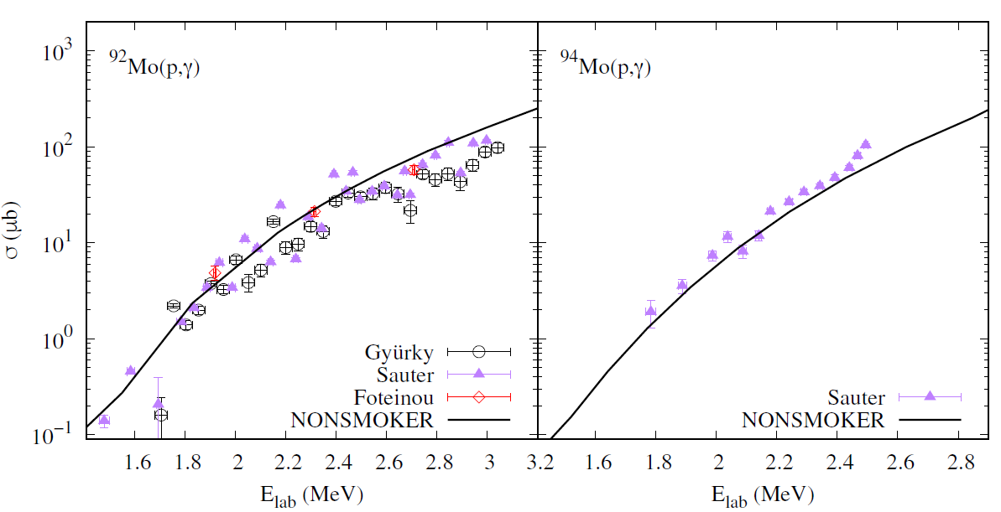
^{92,94}Mo(p,γ)^{93,95}Tc Measurements
Previous data suggests that at lower energies these reactions have some kind of structure
‹#›

Slide 13
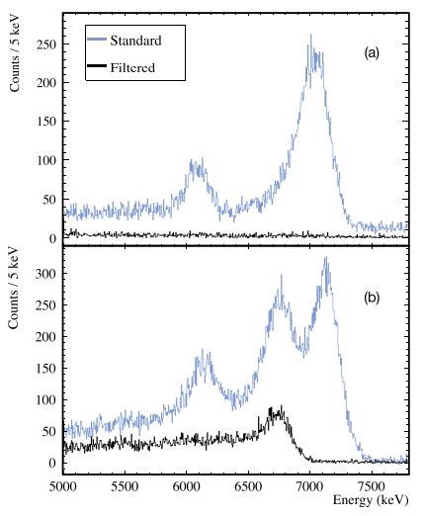
^{92,94}Mo(p,γ)^{93,95}Tc Measurements
Lower energy points overlap with ¹⁹F(p,⍺γ)¹⁶O
We can take advantage of the difference in decay between ¹⁶O and our reaction of interest
  ¹⁶O* has N_{γ}=1 (~6.1 MeV and ~7.1 MeV)
  Sum Peaks typically have <N_{γ}>≈4
We can filter out the unwanted events by cutting out the following events:
  Events with M=1 and deposit E > 6 MeV
  Events with M=2-3, crystals neighbor each other and deposit E > 6 MeV
Blank Au Backing
⁹⁴Mo(p,γ)⁹⁵Tc
Kelmar, et al. Phys. Rev. C 109 (2024) 035805
‹#›

Slide 14
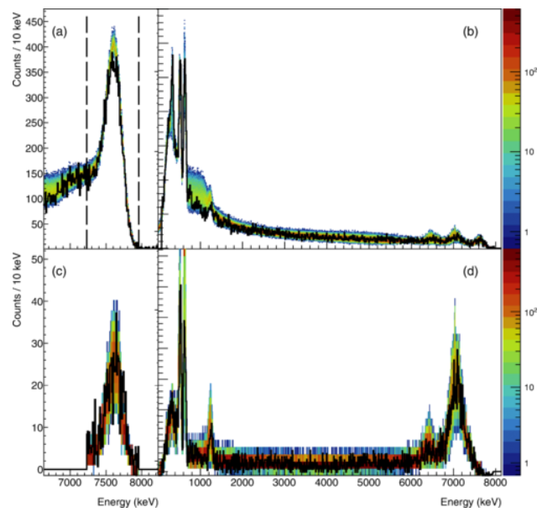
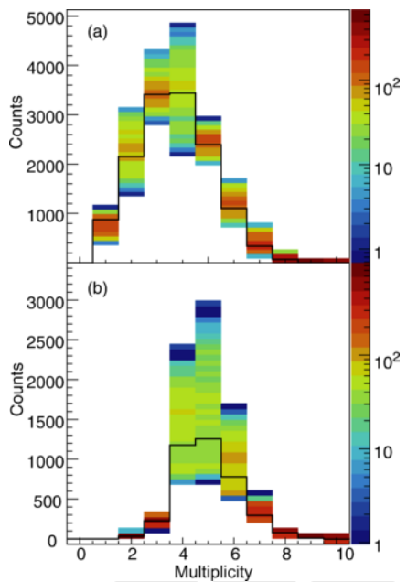
^{92,94}Mo(p,γ)^{93,95}Tc New Efficiency Calculation Approach
We need to account for the offline Fluorine filter’s effect on efficiency
  The filter is sensitive to the decay path fed into the cascades
  We get the correct efficiency by:
    matching the strength of individual γ-rays seen
    Match <M> distribution we see in data
All events
Events accepted by the filter
Kelmar, et al. Phys. Rev. C 109 (2024) 035805
‹#›

Slide 15
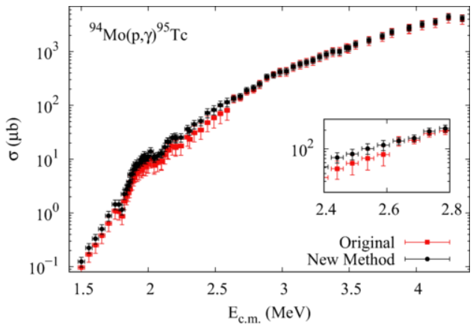
⁹⁴Mo(p,γ) Difference in Cross-Sections with and without Filter
The cross-sections for ⁹⁴Mo(p,γ) were calculated using both with and without the new filter technique
Above 2.6 MeV outside of the Fluorine overlap show both methods yield the same result
In the overlap region of Fluorine, below 2.6 MeV, an artificially lower cross-section is obtained when using the non-filter method
Kelmar, et al. Phys. Rev. C 109 (2024) 035805
‹#›

Slide 16
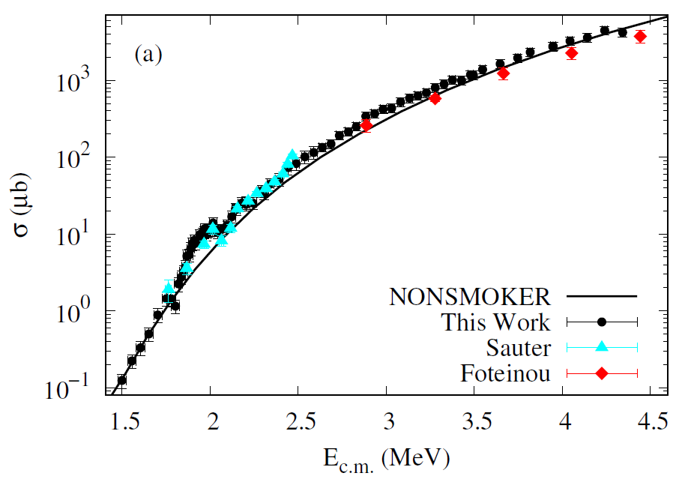
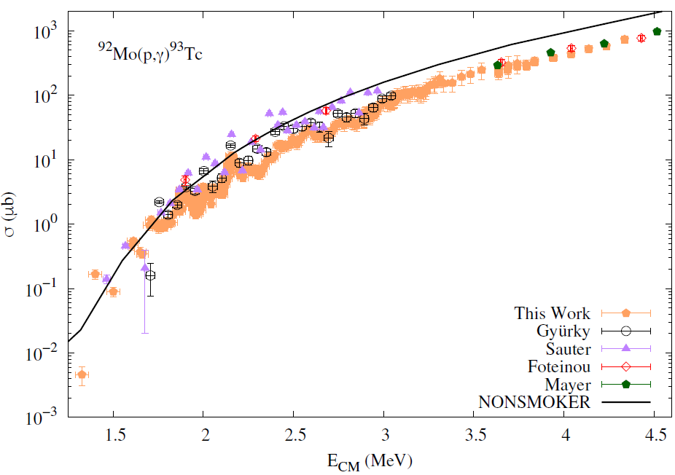
^{92,94}Mo(p,γ)^{93,95}Tc Cross-Sections
⁹²Mo(p,γ)⁹³Tc
⁹⁴Mo(p,γ)⁹⁵Tc
Data indicates two enhancements in the cross section around 1.9-2.2 MeV, each about 160 keV in width
Kelmar, et al. Phys. Rev. C 109 (2024) 035805
Simon et al., in preparation for PRC
‹#›

Slide 17
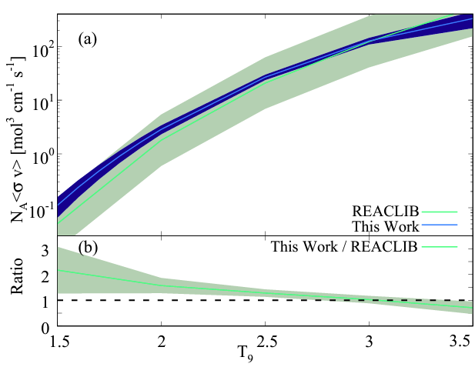
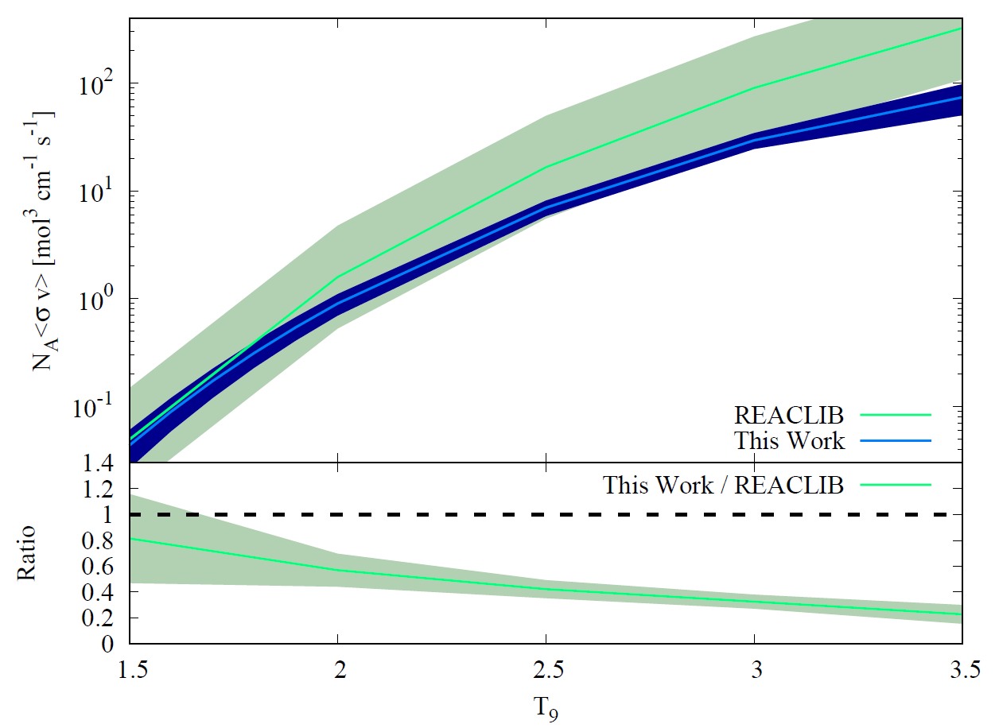
^{92,94}Mo(p,γ)^{93,95}Tc Reaction Rates
⁹⁴Mo(p,γ)
⁹²Mo(p,γ)
Kelmar, et al. Phys. Rev. C 109 (2024) 035805
Simon et al., in preparation for PRC
‹#›

Slide 18
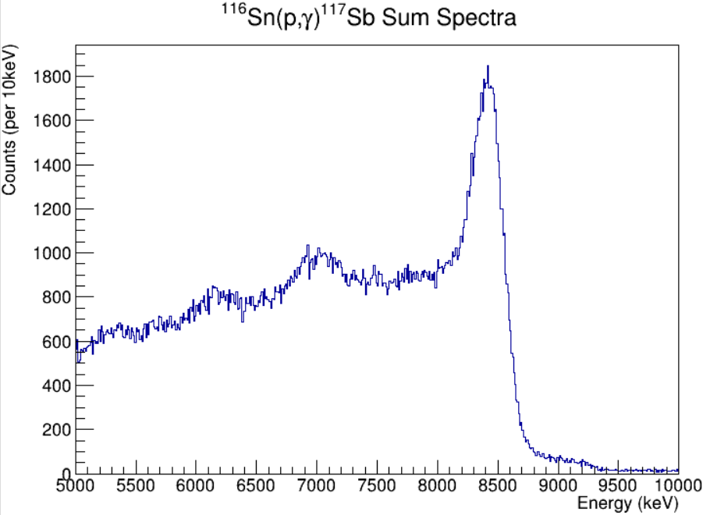
^{112,114,116}Sn and ¹⁰⁸Pd (p,γ) Measurements
Current HECTOR efforts are in trying to constrain the ¹²⁰Te(γ,𝛼)/(γ,n) branching point
  Measurements of ^{112,114,116}Sn(p,γ) were measured
    Energy range from 2.5 MeV to 7 MeV in 250 keV steps
    Split between two accelerators at NSL
  ¹¹²Sn(𝛼,γ) was also just measured in Sept 2024
  Due to beam induced background limitations ^{114,116}Sn(𝛼,γ) will be reattempted at the end of Nov 2024
There is overlap with the ¹⁹F(p,𝛼γ)¹⁶O lines and so the offline filter developed for Mo is also being used for this data set
E_{beam}=4MeV
¹⁹F(p,⍺γ)¹⁶O Lines
¹¹⁶Sn(p,γ) Sum Peak
PRELIMINARY
‹#›

Slide 19
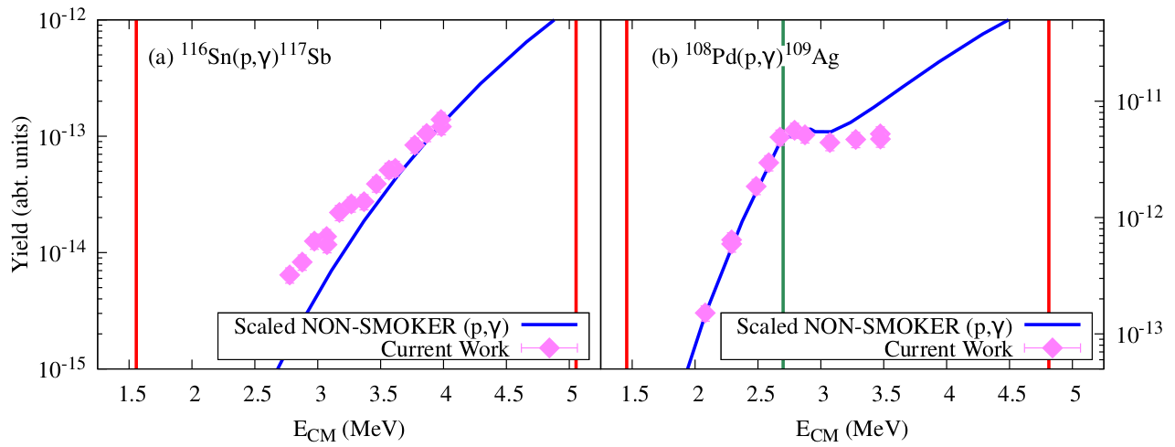
¹¹⁶Sn(p,γ) & ¹⁰⁸Pd(p,γ) Yields
PRELIMINARY
PRELIMINARY
‹#›

Slide 20
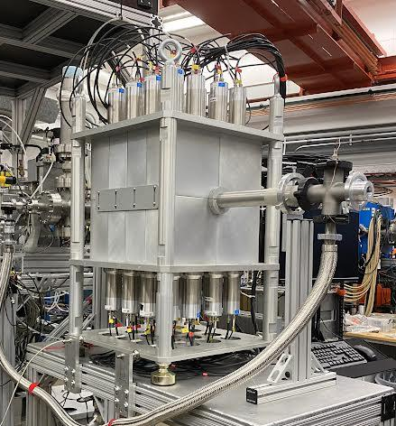
Summary
HECTOR is good for p-process related measurements with utilizing the γ-Summing Technique
Several reactions were measured recently around the A=100-110 mass region with HECTOR
The newly developed filter for contamination from ¹⁹F(p,𝛼γ)¹⁶O allows HECTOR to push measurements to lower energies
‹#›

Slide 21
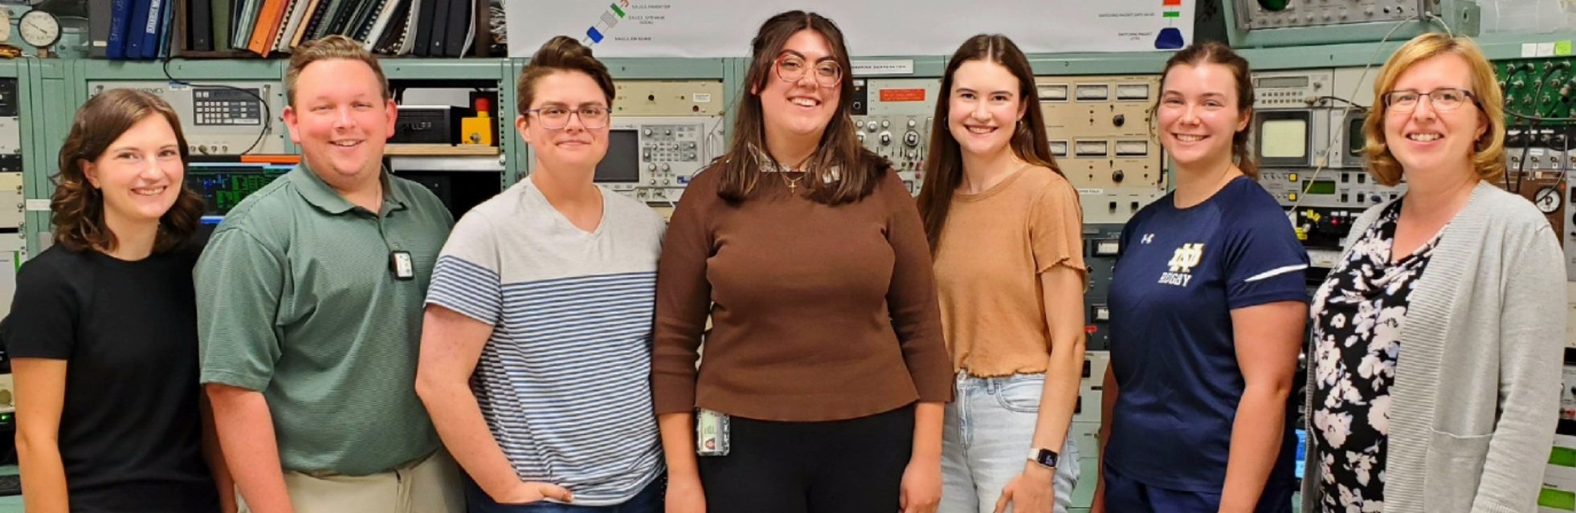

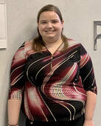
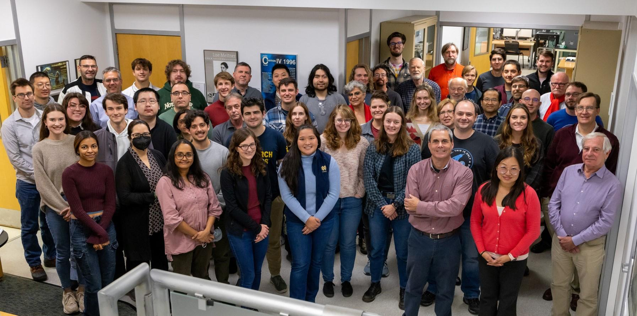
Acknowledgements
This work is supported by National Science Foundation (NSF) under grant numbers PHY-2011890 and PHY-2310059
‹#›

