Slide 1
Total reaction cross sections: a basic building block for astrophysical reaction rates
Peter Mohr
HUN-REN Institute for Nuclear Research (Atomki)
H-4001 Debrecen, Hungary
in collaboration with many colleagues and friends:
Zs. Fülöp, Gy. Gyürky, Z. Halász, G. G. Kiss, Zs. Mátyus, E. Somorjai, T. N. Szegedi, T. Szücs, D. Galaviz and many more
p-process workshop – Budapest 2024

Slide 2
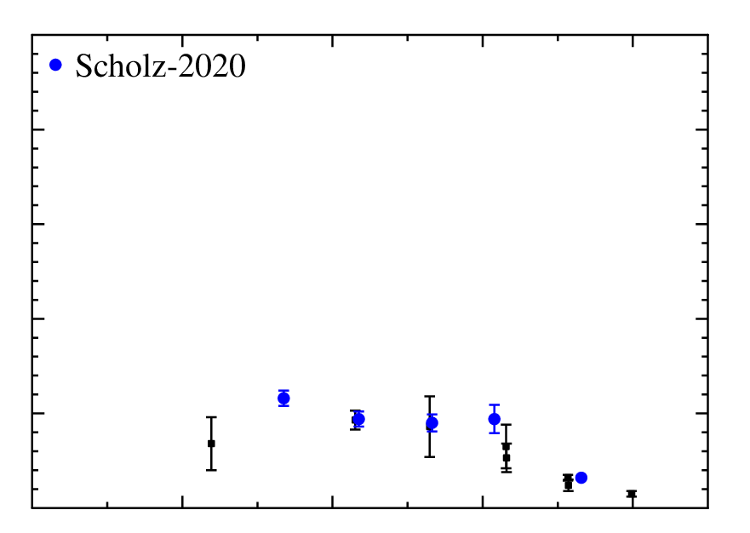
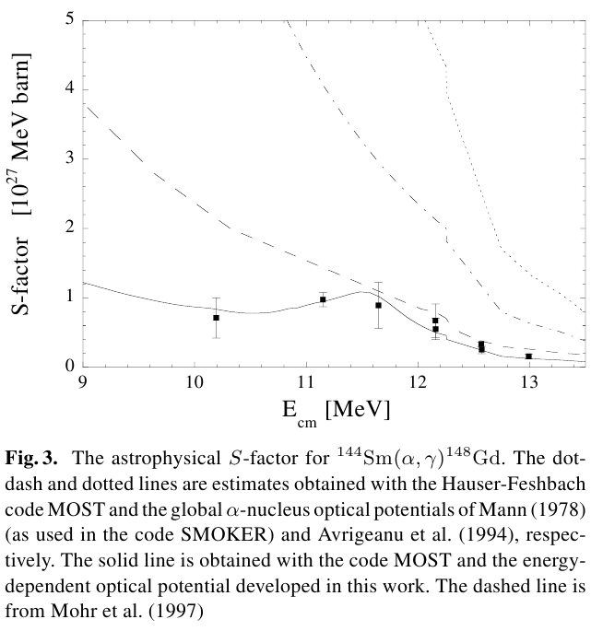
The famous example ¹⁴⁴Sm(α,γ) ¹⁴⁸Gd
global potentials
- derived from (α,α)
- often poor for (α,γ)
local potentials
- from ¹⁴⁴Sm(α,α)
- perfect for (α,α)
- reasonable f. (α,γ)
adjusted potentials
- adjusted to (α,γ)
- perfect for (α,γ)
- often poor for (α,α)
T₉ = 2.5
E. Somorjai et al., A&A 333, 1112 (1998); first preliminary data presented in Budapest 1994

Slide 3
Outline
Some basics on the optical model and the calculation of reaction cross sections in the statistical model
The essential ingredient for the total reaction cross sections σ_{reac} of α-induced reactions:
α-nucleus optical model potential (AOMP)
The new Atomki-V2 α-nucleus potential:
- see also talks by Zs. Mátyus and Gy. Gyürky
Comparison of data from different projectiles and targets: reduction scheme
Application to X + ²⁰⁸Pb and outlook X + ¹²C (¹²C+¹²C)

Slide 4
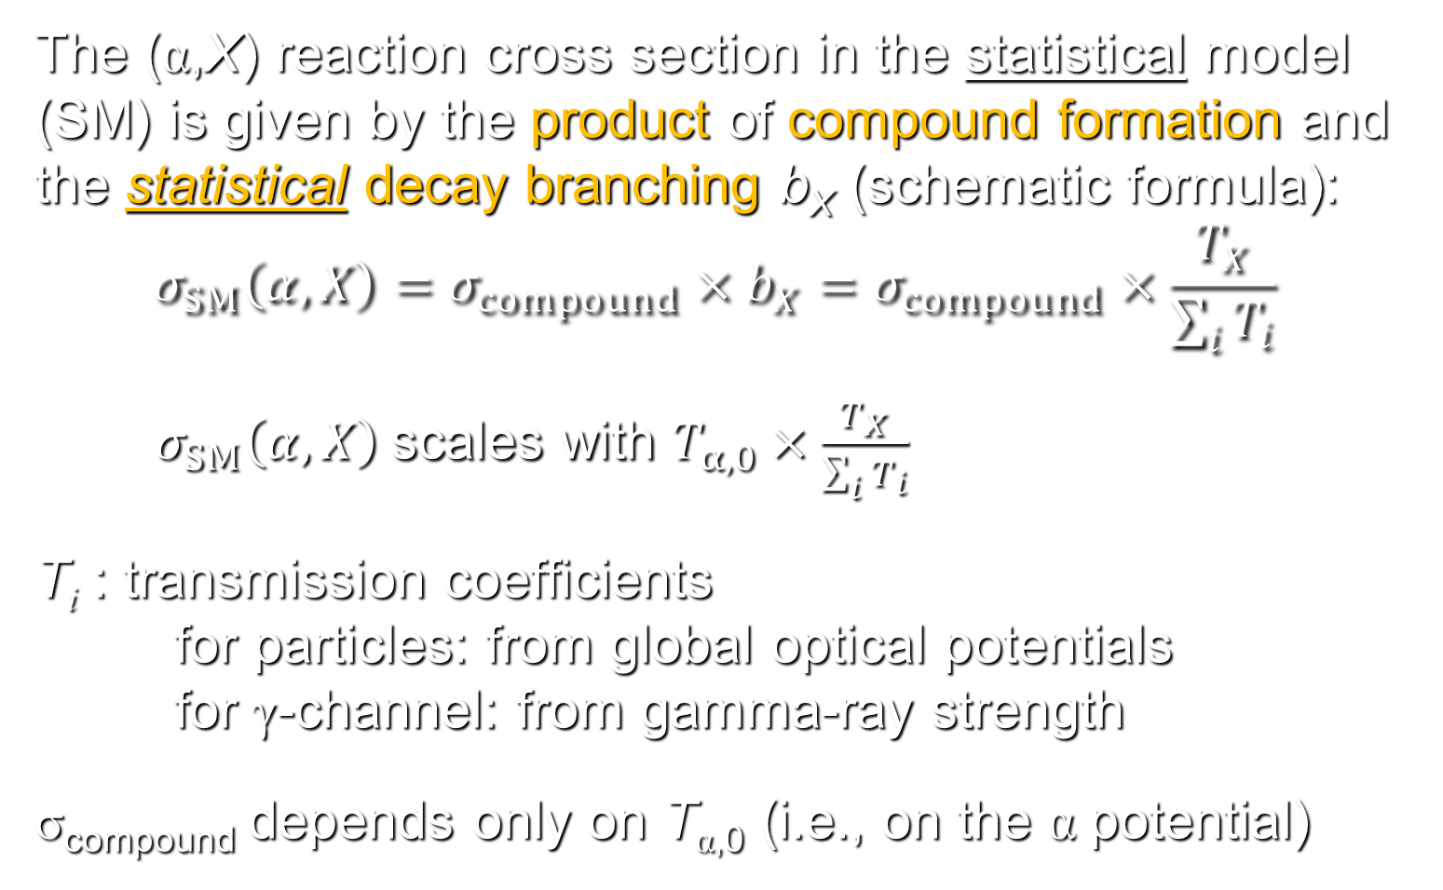
Basic formalism (1): the statistical model
The (α,X) reaction cross section in the statistical model (SM) is given by the product of compound formation and the statistical decay branching b_{X} (schematic formula):
$$σ_{SM}\left(α,X\right)=σ_{compound}×b_{X}=σ_{compound}×\frac{T_{X}}{\sum_{i}{T_{i}}}$$
$σ_{SM}\left(α,X\right)$scales with $T_{α,0}×\frac{T_{X}}{\sum_{i}{T_{i}}}$
T_{i} : transmission coefficients
for particles: from global optical potentials
for γ-channel: from gamma-ray strength
σ_{compound} depends only on T_{α,0} (i.e., on the α potential)

Slide 5
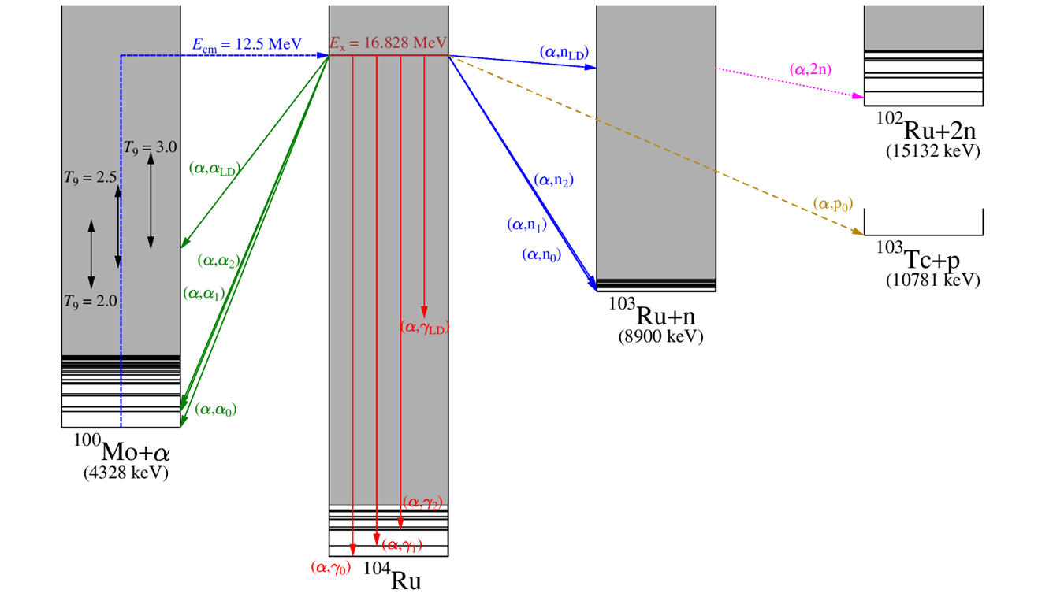
Role of the level density in the statistical model (1)
E_{cm} = 12.5 MeV: level density in ¹⁰⁴Ru at E_{x} = 16.8 MeV - must be high enough; physics, NOT a TALYS option!!!
Example:
¹⁰⁰Mo(α,X) at E_{cm} = 12.5 MeV

Slide 6
Role of the level density in the statistical model (2)
T_{i} : all transmission coefficients depend implicitly on the
chosen level density ρ_{LD} (here it is a TALYS option!)
e.g.: T_{γ} = T_{γ,0} + T_{γ,1} + T_{γ,2} + … +
+ ∫T_{γ}(E_{γ}) ρ_{LD}(E_{x}) dE
typically: discrete levels T_{γ,0} … T_{γ,10}
level density above 10th excited state

Slide 7
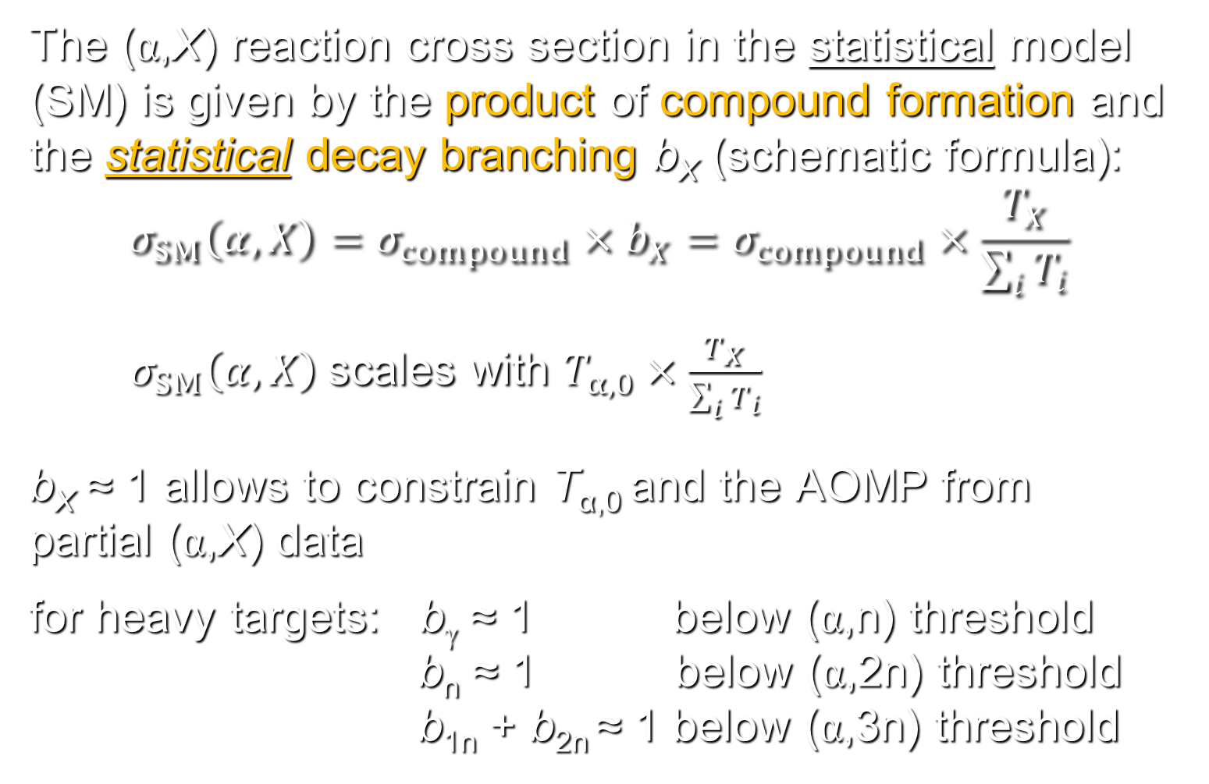
Basic formalism (2): special cases
The (α,X) reaction cross section in the statistical model (SM) is given by the product of compound formation and the statistical decay branching b_{X} (schematic formula):
$$σ_{SM}\left(α,X\right)=σ_{compound}×b_{X}=σ_{compound}×\frac{T_{X}}{\sum_{i}{T_{i}}}$$
$σ_{SM}\left(α,X\right)$scales with $T_{α,0}×\frac{T_{X}}{\sum_{i}{T_{i}}}$
b_{X} ≈ 1 allows to constrain T_{α,0} and the AOMP from partial (α,X) data
for heavy targets: b_{γ} ≈ 1 below (α,n) threshold
b_{n} ≈ 1 below (α,2n) threshold
b_{1n} + b_{2n} ≈ 1 below (α,3n) threshold

Slide 8
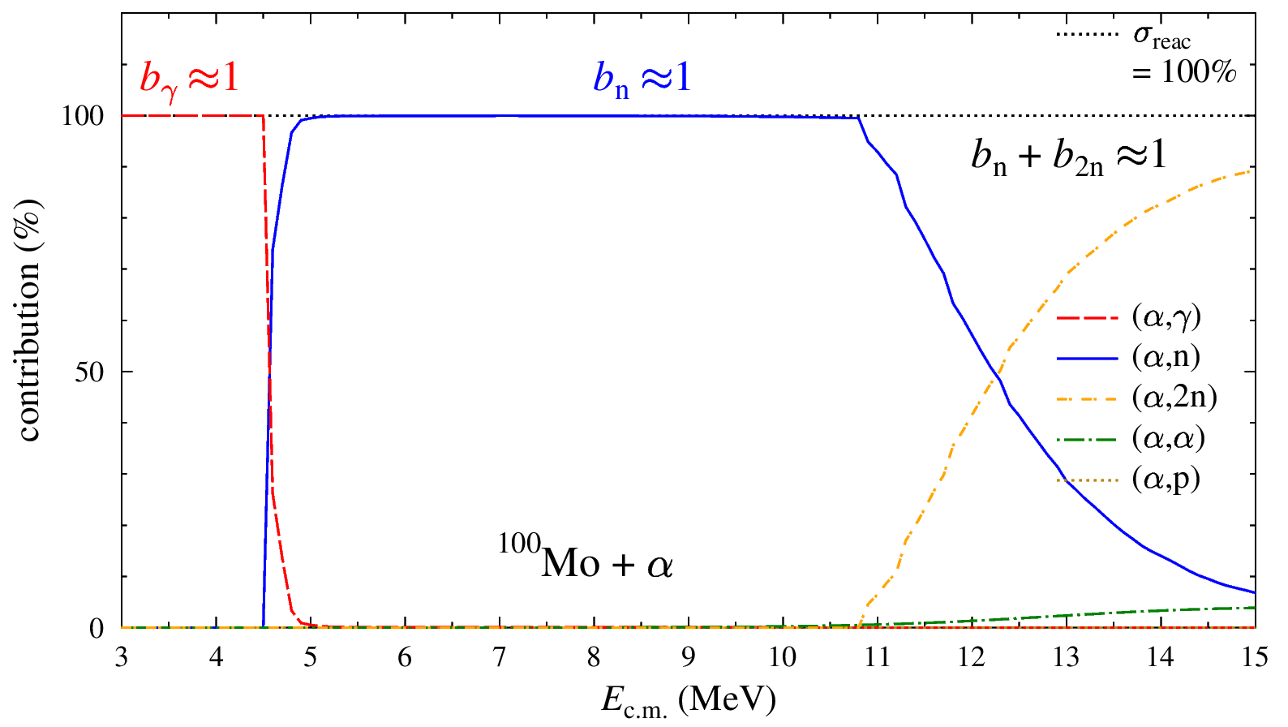
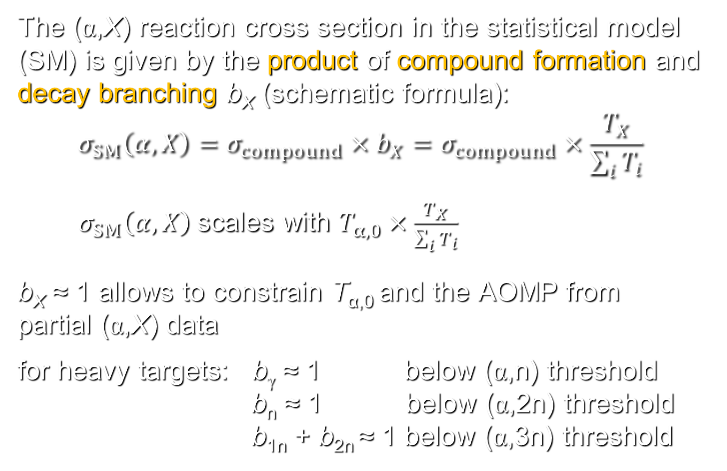
Basic formalism (2): special cases
The (α,X) reaction cross section in the statistical model (SM) is given by the product of compound formation and decay branching b_{X} (schematic formula):
$$σ_{SM}\left(α,X\right)=σ_{compound}×b_{X}=σ_{compound}×\frac{T_{X}}{\sum_{i}{T_{i}}}$$
$σ_{SM}\left(α,X\right)$scales with $T_{α,0}×\frac{T_{X}}{\sum_{i}{T_{i}}}$
b_{X} ≈ 1 allows to constrain T_{α,0} and the AOMP from partial (α,X) data
for heavy targets: b_{γ} ≈ 1 below (α,n) threshold
b_{n} ≈ 1 below (α,2n) threshold
b_{1n} + b_{2n} ≈ 1 below (α,3n) threshold
(α,n)
threshold

Slide 9
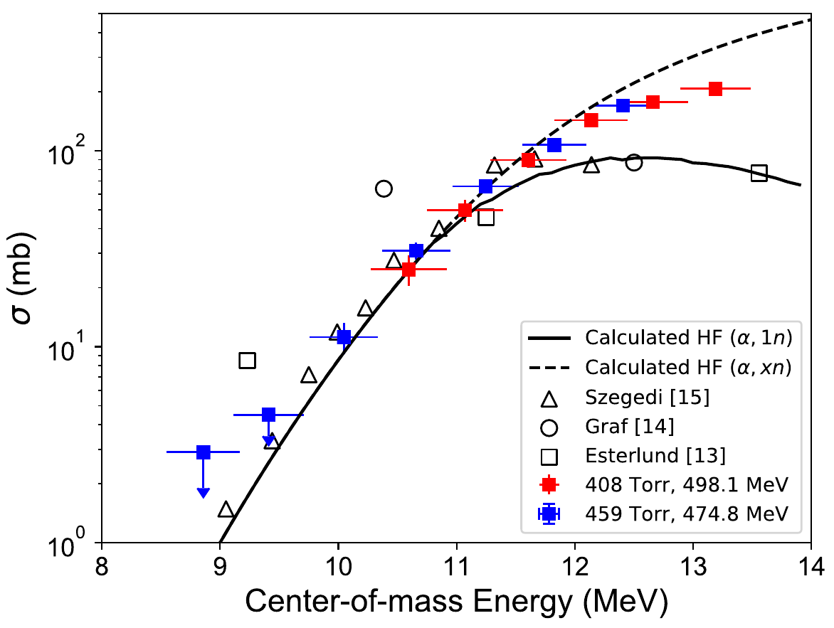
Comparison to experiment: ¹⁰⁰Mo + α
activation: (α,1n)
MUSIC-type exp.:
Z=42 → Z+2=44
(α,γ)+(α,1n)+(α,2n)
(α,2n)
threshold
Ong et al., Phys. Rev. C 105, 055803 (2022)
Szegedi et al., Phys. Rev. C 104, 035804 (2021) – see also talk by Gy. Gyürky

Slide 10
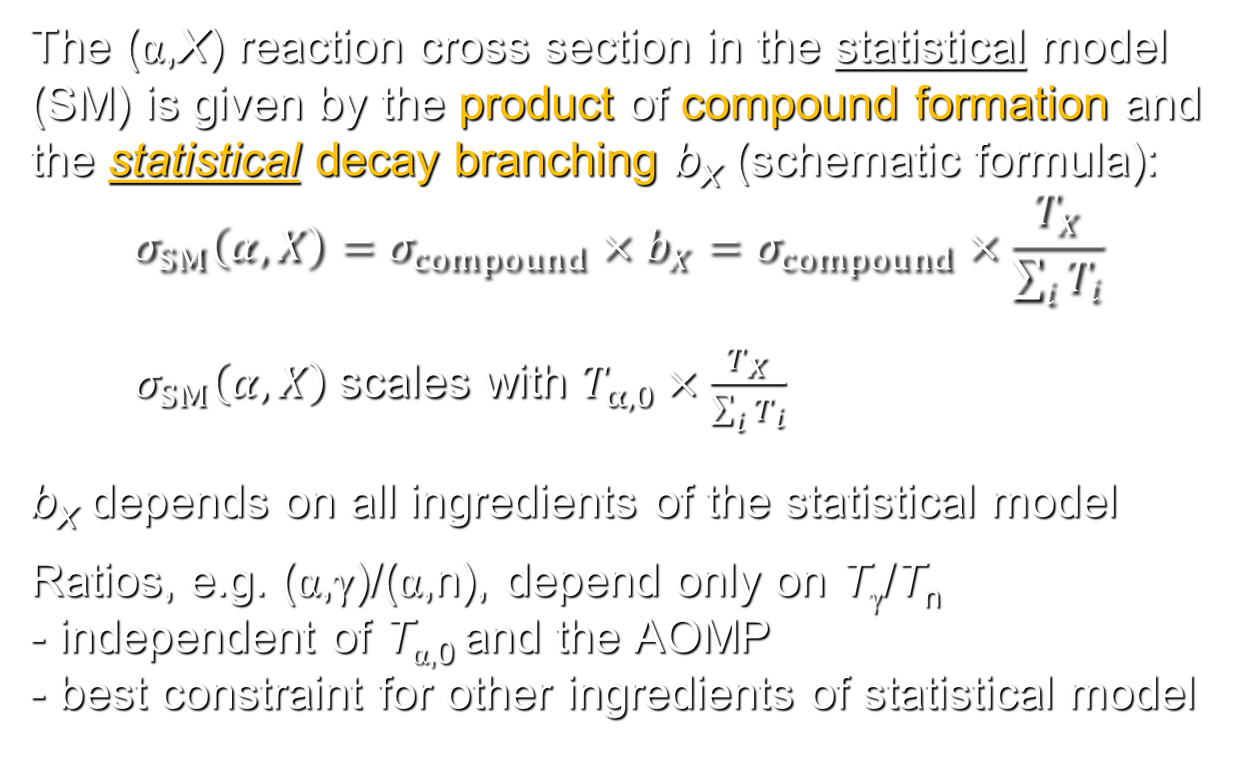
Basic formalism (3): special cases
The (α,X) reaction cross section in the statistical model (SM) is given by the product of compound formation and the statistical decay branching b_{X} (schematic formula):
$$σ_{SM}\left(α,X\right)=σ_{compound}×b_{X}=σ_{compound}×\frac{T_{X}}{\sum_{i}{T_{i}}}$$
$σ_{SM}\left(α,X\right)$scales with $T_{α,0}×\frac{T_{X}}{\sum_{i}{T_{i}}}$
b_{X} depends on all ingredients of the statistical model
Ratios, e.g. (α,γ)/(α,n), depend only on T_{γ}/T_{n}
- independent of T_{α,0} and the AOMP
- best constraint for other ingredients of statistical model

Slide 11
Basic formalism (4): astrophysical consequences
p- or γ-process:
required: (γ,α) rates for neutron-deficient targets
calculated from (α,γ) rates via detailed balance
calculated (α,γ) rates essentially sensitive to AOMP
weak r-process:
required: (α,n) rates for neutron-rich targets
calculated (α,n) rates essentially sensitive to AOMP
the AOMP is the most important ingredient for the calculation of α-induced reaction rates in both (very different) astrophysical scenarios!

Slide 12
A word of caution: (α,n) or (α,1n) ?
The so-called (α,n) reaction rate is:
- the sum over (α,1n) + (α,2n) + … in NON-SMOKER
(also in most entries in REACLIB)
- the (α,1n) rate in TALYS (also in STARLIB)
- the (α,1n) rate is only a minor contribution for very
neutron-rich nuclei (e.g., in the r-process)
- the Z → Z+2 rate can be calculated from TALYS
see e.g. P. Mohr et al., ADNDT 142,101453 (2021)
Which rate is required for nucleosynthesis networks?
Often codes do not distinguish between the (α,1n)
and (α,2n) channels; here inclusive NON-SMOKER
rates or Z → Z+2 rates from TALYS should be used.

Slide 13
A word of caution: (α,n) or (α,1n) ?
The so-called (α,n) reaction rate is:
- the sum over (α,1n) + (α,2n) + … in NON-SMOKER
(also in most entries in REACLIB)
- the (α,1n) rate in TALYS (also in STARLIB)
- the (α,1n) rate is only a minor contribution for very
neutron-rich nuclei (e.g., in the r-process)
- the Z → Z+2 rate can be calculated from TALYS
see e.g. P. Mohr et al., ADNDT 142,101453 (2021)
Which rate is required for nucleosynthesis networks?
Often codes do not distinguish between the (α,1n)
and (α,2n) channels; here inclusive NON-SMOKER
rates or Z → Z+2 rates from TALYS should be used.

Slide 14
A word of caution: (α,n) or (α,1n) ?
The so-called (α,n) reaction rate is:
- the sum over (α,1n) + (α,2n) + … in NON-SMOKER
(also in most entries in REACLIB)
- the (α,1n) rate in TALYS (also in STARLIB)
- the (α,1n) rate is only a minor contribution for very
neutron-rich nuclei (e.g., in the r-process)
- the Z → Z+2 rate can be calculated from TALYS
see e.g. P. Mohr et al., ADNDT 142,101453 (2021)
Which rate is required for nucleosynthesis networks?
Often codes do not distinguish between the (α,1n)
and (α,2n) channels; here inclusive NON-SMOKER
rates or Z → Z+2 rates from TALYS should be used.

Slide 15
A word of caution: (α,n) or (α,1n) ?
The so-called (α,n) reaction rate is:
- the sum over (α,1n) + (α,2n) + … in NON-SMOKER
(also in most entries in REACLIB)
- the (α,1n) rate in TALYS (also in STARLIB)
- the (α,1n) rate is only a minor contribution for very
neutron-rich nuclei (e.g., in the r-process)
- the Z → Z+2 rate can be calculated from TALYS
see e.g. P. Mohr et al., ADNDT 142,101453 (2021)
Which rate is required for nucleosynthesis networks?
Often codes do not distinguish between the (α,1n)
and (α,2n) channels; here inclusive NON-SMOKER
rates or Z → Z+2 rates from TALYS should be used.

Slide 16
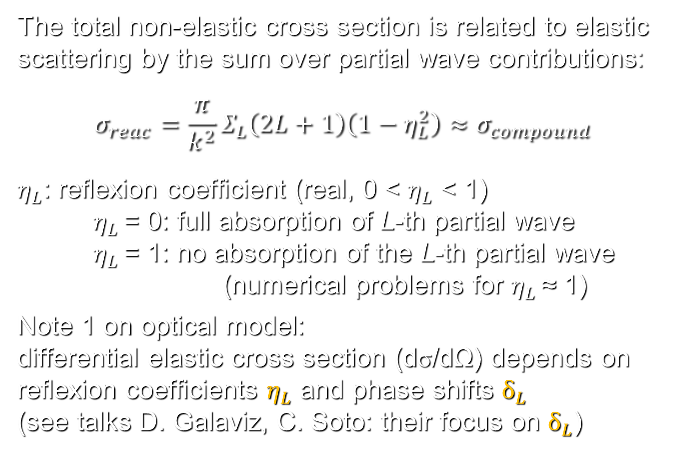
Basic formalism (5): total cross section
The total non-elastic cross section is related to elastic scattering by the sum over partial wave contributions:
$$σ_{reac}=\frac{π}{k^{2}}Σ_{L}\left(2L+1\right)\left(1−η_{L}^{2}\right)≈σ_{{compound}_{}}$$
$η_{L}$: reflexion coefficient (real, 0 < $η_{L}$ < 1)
$η_{L}$ = 0: full absorption of L-th partial wave
$η_{L}$ = 1: no absorption of the L-th partial wave
(numerical problems for $η_{L}$ ≈ 1)
Note 1 on optical model:
differential elastic cross section (dσ/dΩ) depends on reflexion coefficients $η_{L}$ and phase shifts $δ_{L}$
(see talks D. Galaviz, C. Soto: their focus on $δ_{L}$)

Slide 17
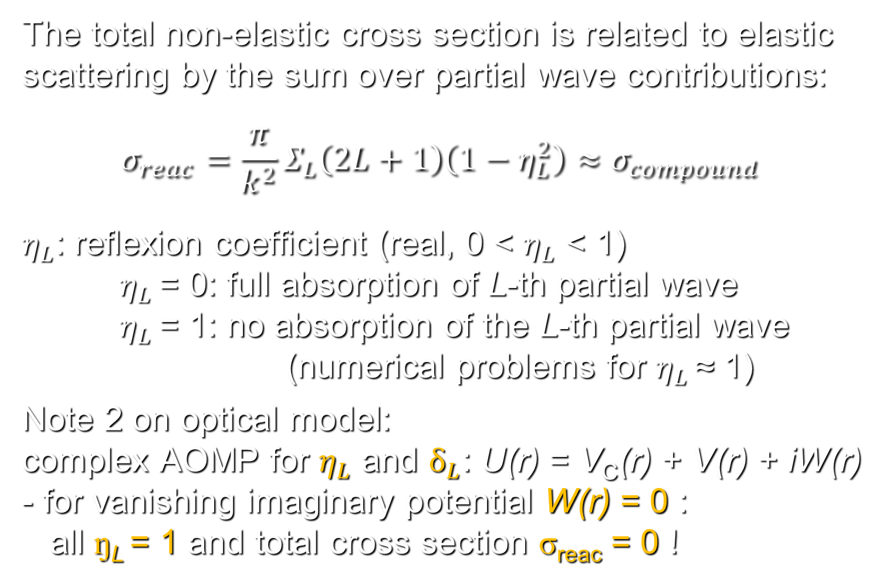
Basic formalism (4): total cross section
The total non-elastic cross section is related to elastic scattering by the sum over partial wave contributions:
$$σ_{reac}=\frac{π}{k^{2}}Σ_{L}\left(2L+1\right)\left(1−η_{L}^{2}\right)≈σ_{{compound}_{}}$$
$η_{L}$: reflexion coefficient (real, 0 < $η_{L}$ < 1)
$η_{L}$ = 0: full absorption of L-th partial wave
$η_{L}$ = 1: no absorption of the L-th partial wave
(numerical problems for $η_{L}$ ≈ 1)
Note 2 on optical model:
complex AOMP for $η_{L}$ and $δ_{L}$: U(r) = V_{C}(r) + V(r) + iW(r)
- for vanishing imaginary potential W(r) = 0 :
all ŋ_{L} = 1 and total cross section σ_{reac} = 0 !

Slide 18
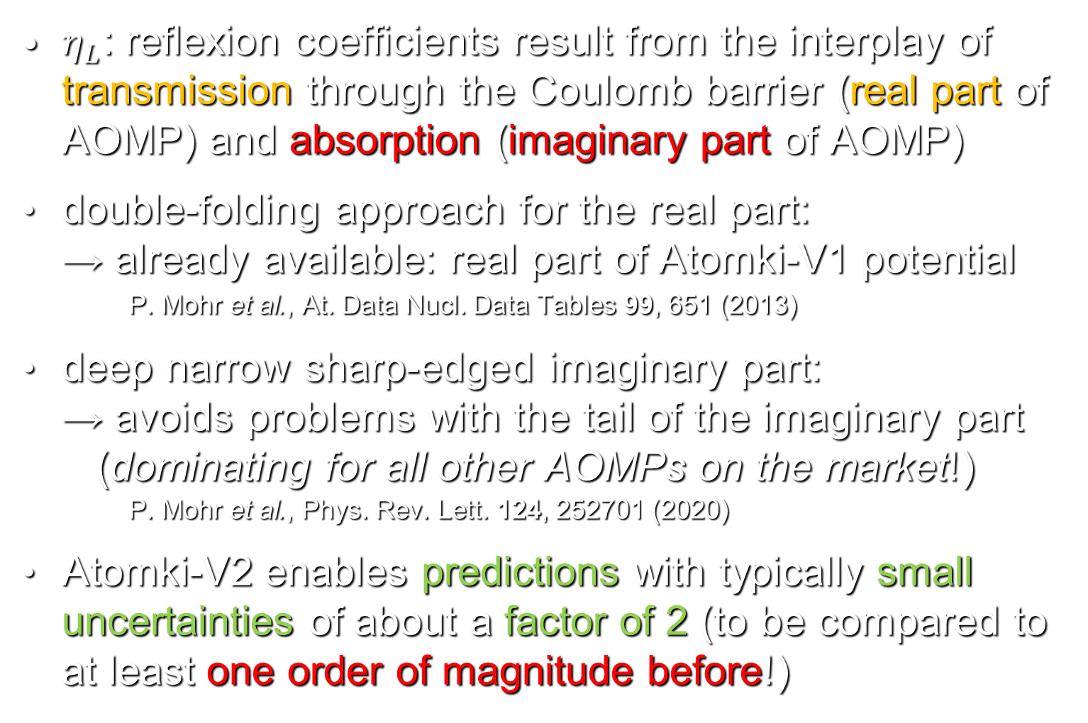
The new Atomki-V2 α-potential
$η_{L}$: reflexion coefficients result from the interplay of transmission through the Coulomb barrier (real part of AOMP) and absorption (imaginary part of AOMP)
double-folding approach for the real part:
→ already available: real part of Atomki-V1 potential
P. Mohr et al., At. Data Nucl. Data Tables 99, 651 (2013)
deep narrow sharp-edged imaginary part:
→ avoids problems with the tail of the imaginary part
(dominating for all other AOMPs on the market!)
P. Mohr et al., Phys. Rev. Lett. 124, 252701 (2020)
Atomki-V2 enables predictions with typically small uncertainties of about a factor of 2 (to be compared to at least one order of magnitude before!)

Slide 19
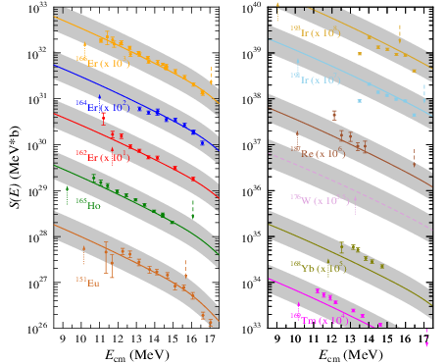
Results from the Atomki-V2 AOMP
In all cases
(¹⁵¹Eu-¹⁹¹Ir):
- prediction
OK within a
factor of 2!
- energy
dependence
excellent
(essential
for reaction
rates!)

Slide 20
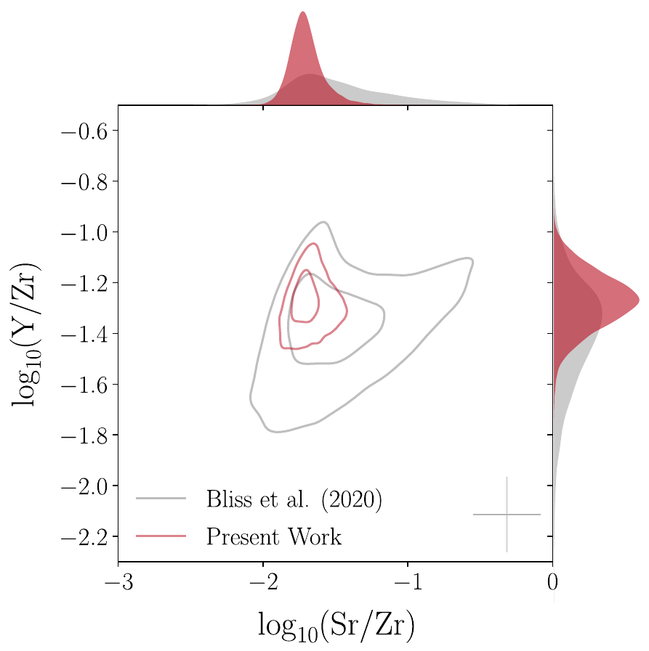
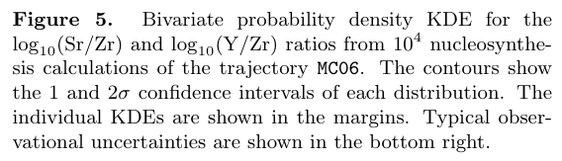
Nucleosynthesis in the weak r-process (Psaltis-2022)
1σ and 2σ
contour plots
Ratio Y/Zr vs. Sr/Zr
for trajectory MC06:
Ratio Y/Zr vs. Sr/Zr
for trajectory MC06:
Bliss-2020:
dominant nuclear uncertainties
Ratio Y/Zr vs. Sr/Zr
for trajectory MC06:
Bliss-2020:
dominant nuclear uncertainties
Present work:
observational and nuclear uncertainties at similar level
observational uncertainty

Slide 21
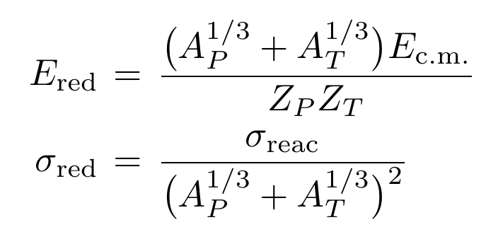
Comparison of different projectiles and targets
simple reduction scheme by Gomes:
Phys. Rev. C 71, 017601 (2005)
Reduced energy E_{red} is scaled according to Coulomb barrier between the colliding nuclei with Z_{P} and Z_{T}
Reduced cross section σ_{red} is scaled according to the geometrical sizes of projectile (A_{P}) and target (A_{T})

Slide 22
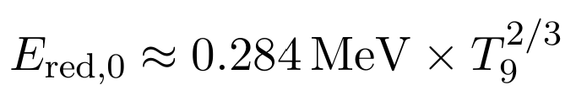
Comparison of different projectiles and targets
simple reduction scheme by Gomes:
Phys. Rev. C 71, 017601 (2005)
Close relation between energy E₀ of Gamow window and reduced energy E_{red} (weakly dependent on A, Z):

Slide 23
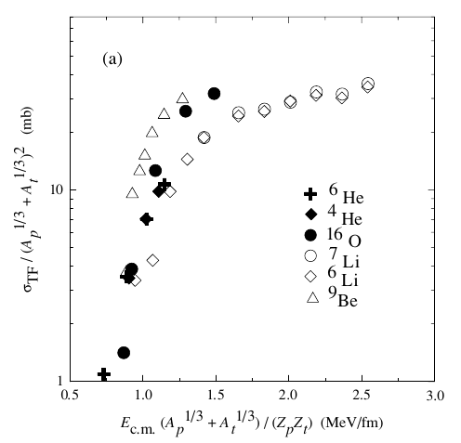
Examples for reduced cross sections: Gomes-2005
Data for X + ⁶⁴Zn: Phys. Rev. C 71, 017601 (2005)
higher σ_{red} for ⁶He, less pronounced also for ^{6,7}Li, ⁹Be

Slide 24
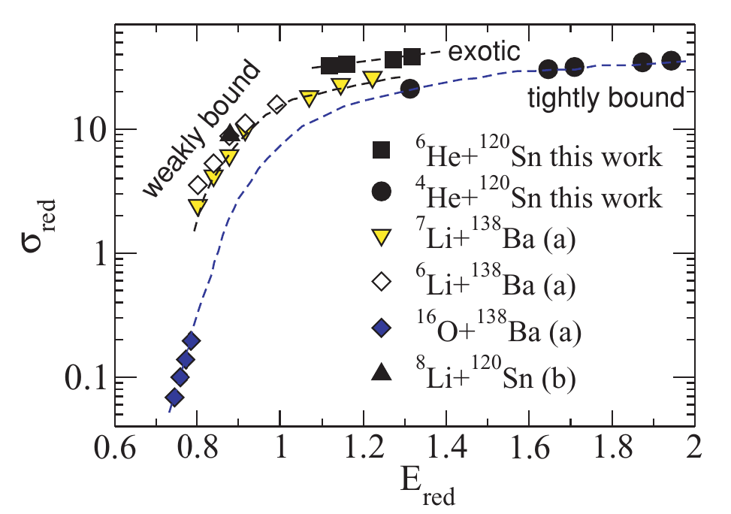
Examples for reduced cross sections: DeFaria-2010
Data for various systems: Phys. Rev. C 81, 044605 (2010)
highest σ_{red} for exotic halo projectiles (⁶He)
moderately enhanced σ_{red} for weakly bound projectiles

Slide 25
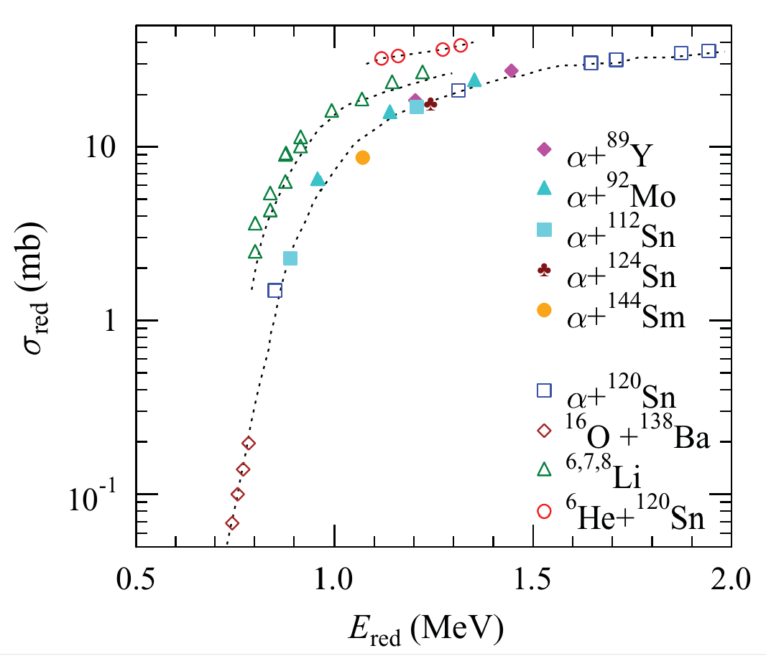
Examples for reduced cross sections: Mohr-2010
focus α-induced reactions: Phys. Rev. C 82, 047601 (2010)
same conclusions as before

Slide 26
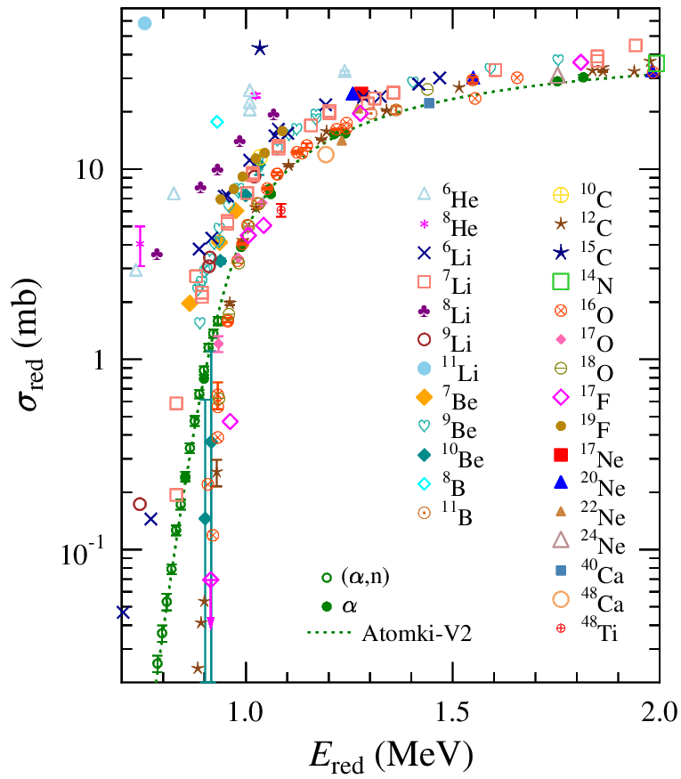
Compiled data for X + ²⁰⁸Pb: Mohr-2024
Data for ²⁰⁸Pb and various projectiles:
Europ. Phys. J. 60:193 (2024)
Grouping confirmed
- tightly bound
- weakly bound
- exotic (halo)
But: situation is by far more complex than thought before
Problem: very steep energy dependence

Slide 27
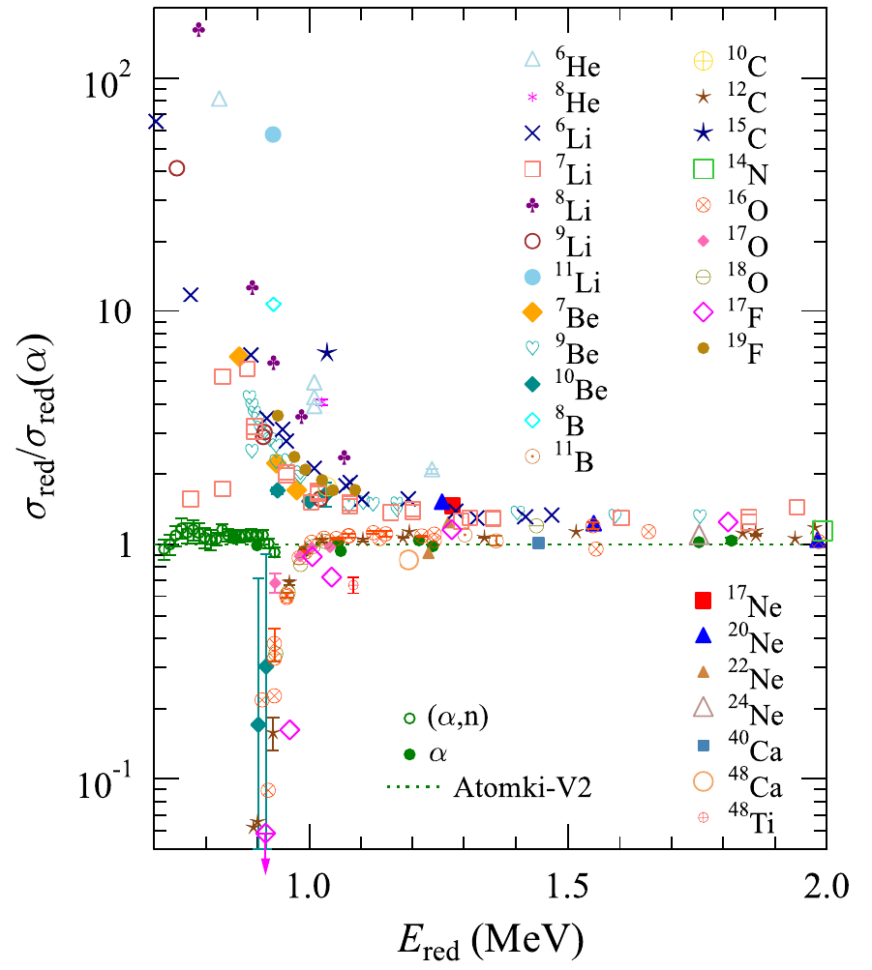
Compiled data for X + ²⁰⁸Pb: Mohr-2024
Data for ²⁰⁸Pb and various projectiles:
Europ. Phys. J. 60:193 (2024)
Grouping confirmed
- tightly bound
- weakly bound
- exotic (halo)
Problem: very steep energy dependence
Solution: show ratios to reference ²⁰⁸Pb+α using Atomki-V2

Slide 28
Compiled data for X + ²⁰⁸Pb: Mohr-2024
Data for ²⁰⁸Pb and various projectiles:
Europ. Phys. J. 60:193 (2024)
Grouping confirmed
- tightly bound
- weakly bound
- exotic (halo)
New group of tightly bound projectiles:
σ_{red}/σ_{red}(α) << 1
(not noticed before)
evidence for low-energy hindrance?

Slide 29
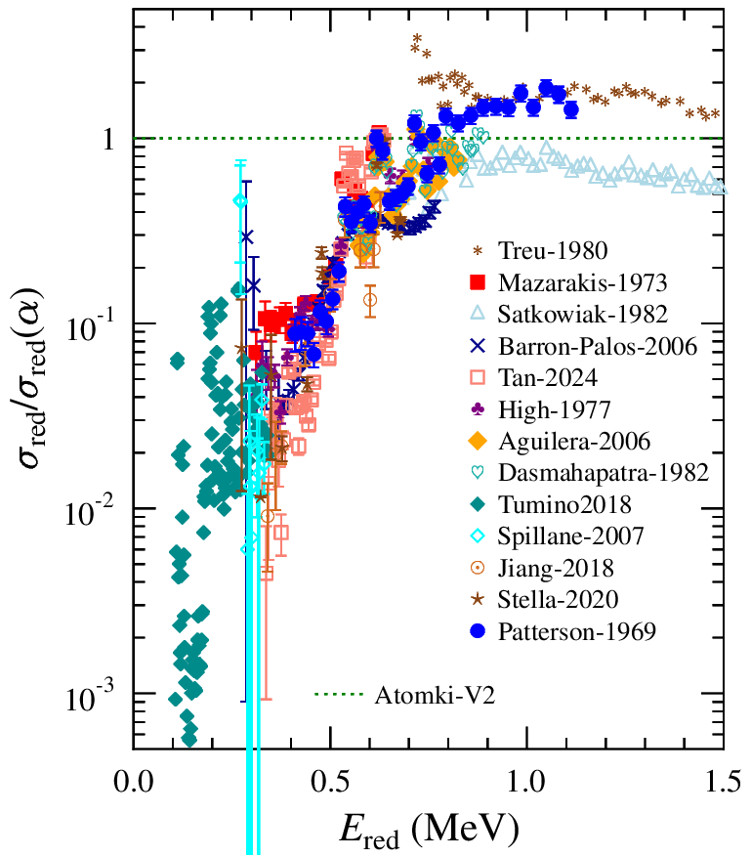
Application to ¹²C + ¹²C
Reference: ³⁶Ar+α
Ratio shows trend towards small σ_{red} for low energies
But difficult to draw strong conclusions on energy dependence

Slide 30
Conclusions
the AOMP is essential for the calculation of reaction rates for (α,X) reactions
the AOMP can be constrained by well-chosen experiments like (α,n) and (α,γ)
Atomki-V2 AOMP provides cross sections and rates with estimated uncertainties of a factor of ≈2
- to be verified for unstable target nuclei
systematics of total reaction cross sections for heavy targets using the σ_{red} vs. E_{red} reduction scheme
Does this systematics help for ¹²C + ¹²C ?

Slide 31
Thank you very much for your attention!

Slide 32
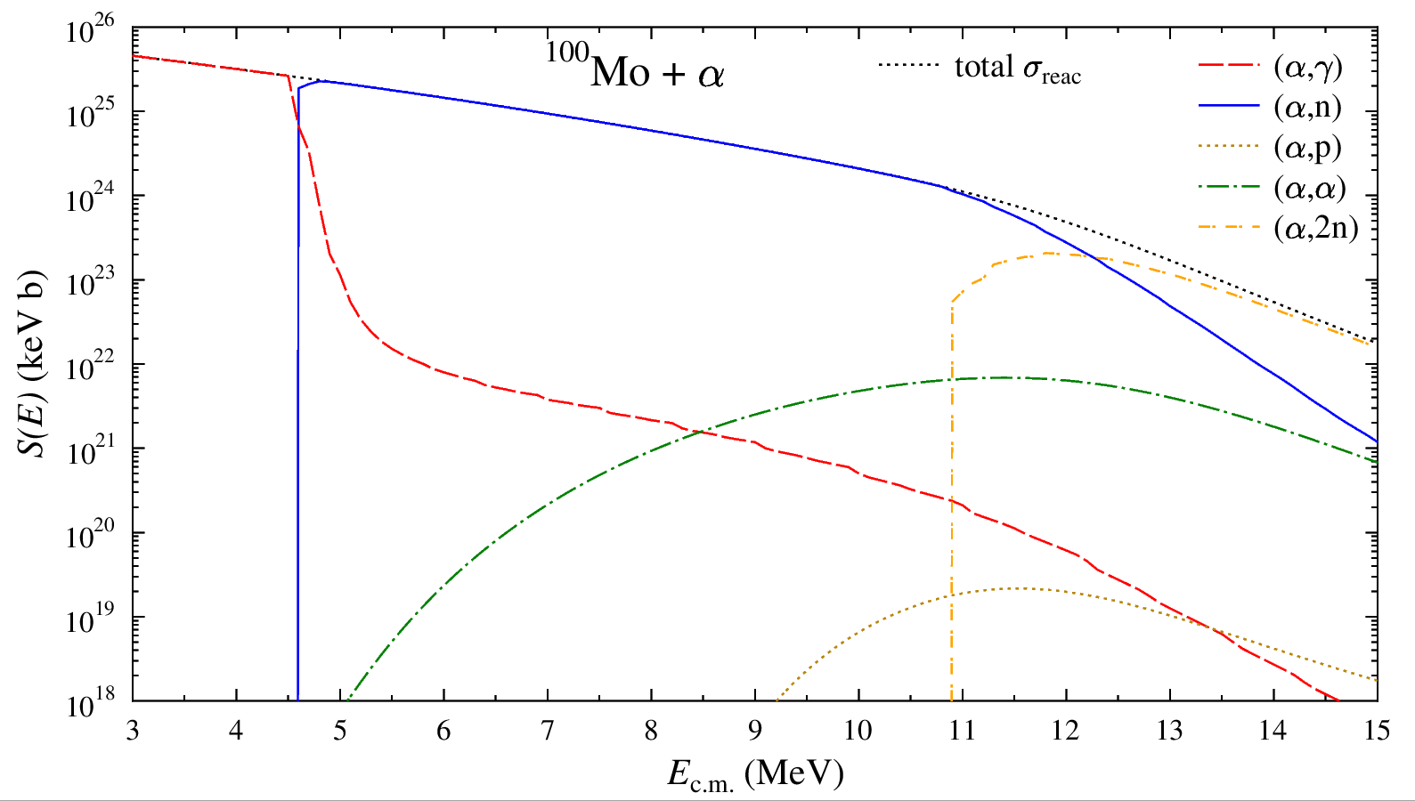
Basic formalism (2): special cases
The (α,X) reaction cross section in the statistical model (SM) is given by the product of compound formation and decay branching b_{X} (schematic formula):
$$σ_{SM}\left(α,X\right)=σ_{compound}×b_{X}=σ_{compound}×\frac{T_{X}}{\sum_{i}{T_{i}}}$$
$σ_{SM}\left(α,X\right)$scales with $T_{α,0}×\frac{T_{X}}{\sum_{i}{T_{i}}}$
b_{X} ≈ 1 allows to constrain T_{α,0} and the AOMP from partial (α,X) data
for heavy targets: b_{γ} ≈ 1 below (α,n) threshold
b_{n} ≈ 1 below (α,2n) threshold
b_{1n} + b_{2n} ≈ 1 below (α,3n) threshold
(α,n)
threshold
(α,2n)
threshold

Slide 33
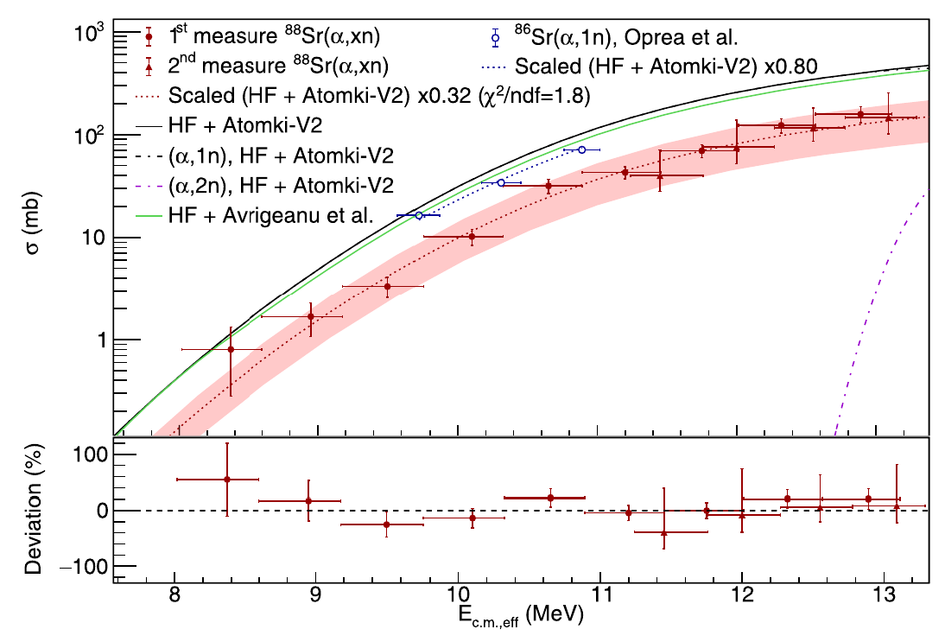
The only outlier ⁸⁸Sr: cross section
Experiment ⁸⁸Sr+α: ANL, MUSIC chamber
Fougères et al., Phys. Rev. C 109, 065805 (2024)
Atomki-V2 overestimates the data by a factor of 3

Slide 34
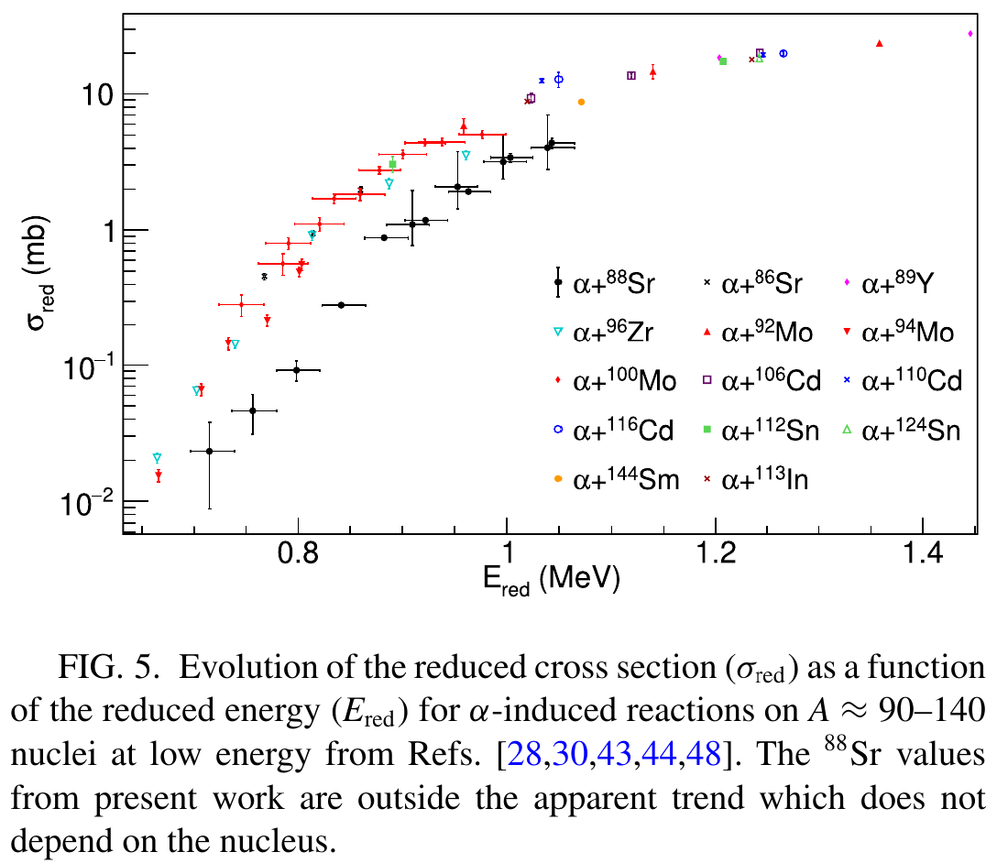
The only outlier ⁸⁸Sr: reduced cross section
Experiment ⁸⁸Sr+α: ANL, MUSIC chamber
Fougères et al., Phys. Rev. C 109, 065805 (2024)
experimental data are lower than trend by factor of 3

Slide 35
α-potential for barrier transmission model (BTM)
only real part required
double-folding approach:
- few parameters
- fine-tuned to elastic scattering data
→ already available: real part of Atomki-V1 potential
P. Mohr et al., At. Data Nucl. Data Tables 99, 651 (2013)
barrier transmission model (BTM) in combination with real part of Atomki-V1 provides total cross sections σ_{reac} with small uncertainties
but: BTM provides only total σ_{reac} of α-induced reactions, but not the partial σ(α,γ), σ(α,p), σ(α,n), σ(α,2n), etc.

Slide 36
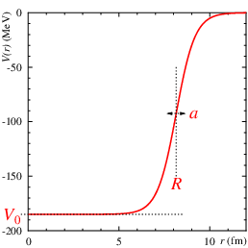
Example for α-nucleus potential (a very simple AOMP)
McFadden/Satchler, Nucl. Phys. 84, 177 (1966):
very simple 4-parameter potential
Woods-Saxon parameterization:
- real depth: V₀ = 185 MeV
- radius: R = R₀ x A_{T}^{1/3} = 8.1 fm
R₀ = 1.4 fm
- diffuseness : a = 0.52 fm
- imaginary depth: W₀ = 25 MeV
Typical findings:
- works well above barrier
- overestimates sub-barrier cross sections

Slide 37
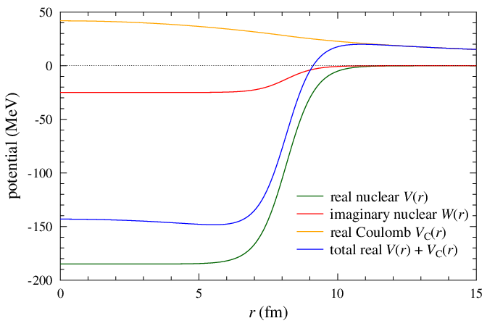
α-nucleus potential (simple example: McFadden)
V_{C}(r)
W(r)
V(r)+V_{C}(r)
V(r)
now: focus on barrier

Slide 38
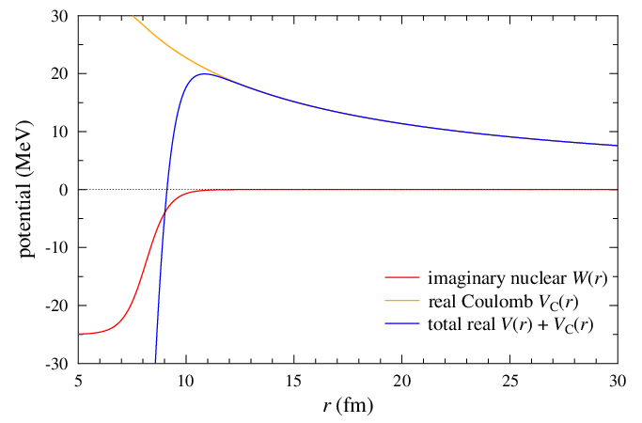
α-nucleus potential: barrier
E far above the barrier
ŋ_{L} ≈ 0: full absorption
1 - ŋ_{L}² ≈ 1; σ_{reac} ≈ 1200 mb
T_{α}: essentially sensitive
to the range of W(r),
but insensitive to V(r)
V(r)+V_{C}(r)
W(r)

Slide 39
α-nucleus potential: barrier
E ≈ 18 MeV (slightly below barrier)
V(r)+V_{C}(r)
W(r)
ŋ_{L} ≈ 0.97 - 1: weak absorption
1 - ŋ_{L}² <≈ 0.05; σ_{reac} ≈ 17 mb
T_{α}: sensitive to range of W(r)
and to V(r) around barrier

Slide 40
α-nucleus potential: barrier
E ≈ 14 MeV (below the barrier)
V(r)+V_{C}(r)
W(r)
ŋ_{L} ≈ 0.99995 - 1.0
1 - ŋ_{L}² <≈ 10⁻⁴ ; σ_{reac} ≈ 32 μb
T_{α}: sensitive to W(r) and to V(r)
in wider range around barrier

Slide 41
α-nucleus potential: barrier
E ≈ 10 MeV (far below barrier)
( ≈ Gamow window!)
V(r)+V_{C}(r)
W(r)
ŋ_{L} ≈ 0.999999999 - 1.0
1 - ŋ_{L}² <≈ 10⁻⁹ ; σ_{reac} ≈ 1.8 nb
T_{α}: mainly sensitive to W(r) at
very large radii r >> 10 fm!

Slide 42
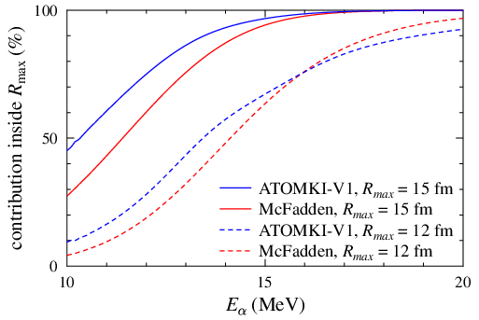
Contributions inside 12 or 15 fm
radii:
¹⁹⁷Au: 5.4 fm
⁴He: 1.7 fm
R₁+R₂: ≈ 7 fm
McFadden/Satchler:
W₀ = -25 MeV
W(r=12 fm) = -15 keV
W(r=15 fm) = -50 eV

Slide 43
Contributions inside 12 or 15 fm
radii:
¹⁹⁷Au: 5.4 fm
⁴He: 1.7 fm
R₁+R₂: ≈ 7 fm
McFadden/Satchler:
W₀ = -25 MeV
W(r=12 fm) = -15 keV
W(r=15 fm) = -50 eV
at 20 MeV:
- almost 100% of σ_{reac} from inside 15 fm
- more than 90% of σ_{reac} from inside 12 fm

Slide 44
Contributions inside 12 or 15 fm
radii:
¹⁹⁷Au: 5.4 fm
⁴He: 1.7 fm
R₁+R₂: ≈ 7 fm
McFadden/Satchler:
W₀ = -25 MeV
W(r=12 fm) = -15 keV
W(r=15 fm) = -50 eV
at 10 MeV:
- less than 50% of σ_{reac} from inside 15 fm !
- less than 10% of σ_{reac} from inside 12 fm !

Slide 45
Call for an alternative approach
question: does compound formation really occur at large radii r >> 10 fm far outside the target?
(where the imaginary W(r) is not at all constrained!)
idea: apply widely used model for heavy-ion fusion
(barrier transmission model, BTM)
- calculate tunneling from outside to interior in a
purely real potential V(r) + V_{C}(r)
- assume full absorption after tunneling
- ignores compound formation outside the target
- avoids imaginary part and related uncertainties
P. Mohr, Int. J. Mod. Phys. E 28, 1950029 (2019)
P. Mohr et al., Phys. Rev. Lett. 124, 252701 (2020)

Slide 46
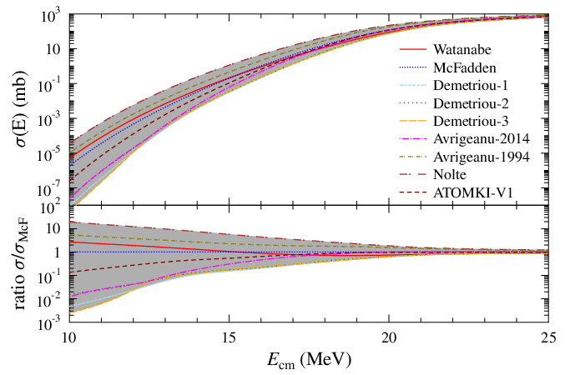
Total ¹⁹⁷Au + α cross section for different α-potentials
at 10 MeV:
more than 3 orders of magnitude!!!
at 25 MeV:
factor <2
T₉ = 2.5

Slide 47
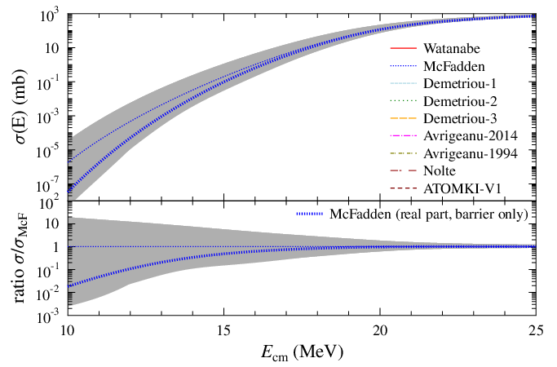
Total ¹⁹⁷Au + α cross section for different α-potentials
optical model vs. barrier transmission
barrier transmission model at 10 MeV:
1-2 orders of magnitude lower
barrier transmission model at 25 MeV: similar
T₉ = 2.5

Slide 48
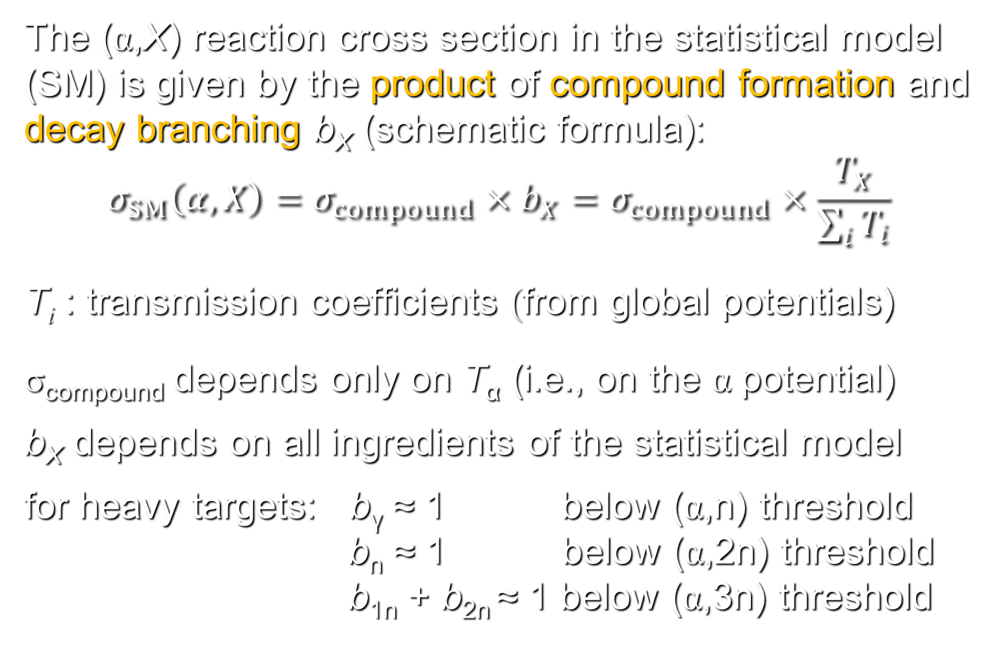
Basic formalism (2): statistical model for exit channels
The (α,X) reaction cross section in the statistical model (SM) is given by the product of compound formation and decay branching b_{X} (schematic formula):
$$σ_{SM}\left(α,X\right)=σ_{compound}×b_{X}=σ_{compound}×\frac{T_{X}}{\sum_{i}{T_{i}}}$$
T_{i} : transmission coefficients (from global potentials)
σ_{compound} depends only on T_{α} (i.e., on the α potential)
b_{X} depends on all ingredients of the statistical model
for heavy targets: b_{γ} ≈ 1 below (α,n) threshold
b_{n} ≈ 1 below (α,2n) threshold
b_{1n} + b_{2n} ≈ 1 below (α,3n) threshold

Slide 49
Back to statistical model: the Atomki-V2 potential
Atomki-V2 is a complex optical model potential
- can be used in statistical model codes (TALYS)
- allows for calculation of partial (α,X) cross sections
- uses the well-established real part of Atomki-V1
Atomki-V2 mimics barrier transmission model
- uses a deep, narrow, sharp-edged imaginary part
(with Woods-Saxon parametrization:
W₀ = 50 MeV, R₀ = 1.0 fm, a = 0.1 fm)
astrophysical reaction rates calculated for 4359 target nuclei from Z = 26 (Fe) to Z = 83 (Bi), including all partial rates (α,γ), (α,p), (α,n), (α,2n), (α,3n), etc.
P. Mohr et al., At. Data Nucl. Data Tables 142, 101453 (2021)

Slide 50
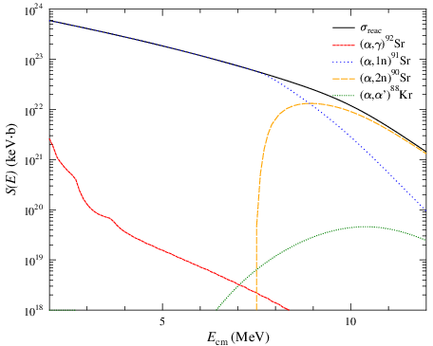
Example ⁸⁸Kr + α (moderately neutron-rich)
1) Cross section (S-factor) for σ(α,X)
dominating:
(α,1n) and (α,2n)

Slide 51
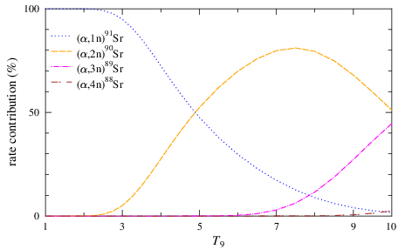
Example ⁸⁸Kr + α (moderately neutron-rich)
2) Contributions to Z → Z+2 reaction rate:
dominating:
(α,1n) and
(α,2n)

Slide 52
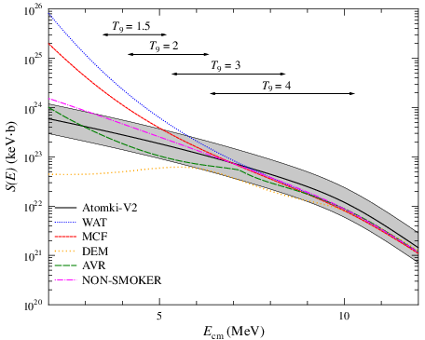
Example ⁸⁸Kr + α (moderately neutron-rich)
3) Cross section (S-factor) for different α-potentials:
huge differences:
below 5 MeV (T₉ = 3)

Slide 53
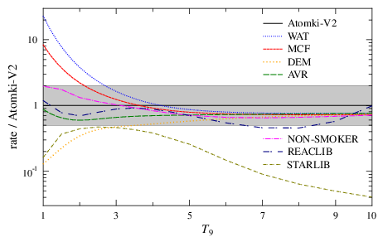
Example ⁸⁸Kr + α (moderately neutron-rich)
4) Z → Z+2 reaction rates for different α-potentials:
huge differences:
below T₉ = 3
(α,1n) only!

Slide 54
Astrophysical scenarios for α-induced reactions
p- or γ-process:
production of neutron-deficient p-nuclei by (γ,n), (γ,p), (γ,α) reactions in supernova explosions (types Ia or II)
reaction rates of (γ,α) reactions from reverse (α,γ) rates using detailed balance
weak r-process:
production of neutron-rich nuclei up to Z ≈ 40, A ≈ 100
(α,n) reactions may increase Z faster than β⁻-decay
to be precise:
rate for Z → Z+2 is most important which corresponds to the sum over (α,γ) + (α,1n) + (α,2n) + (α,3n), etc.

Slide 55
Nucleosynthesis in the weak r-process
use typical conditions for neutrino-driven winds:
Y_{e}, entropy per baryon, expansion timescale
Bliss et al., Astroph. J. 855, 135 (2018)
study nucleosynthesis along the above astrophysical trajectories with MC sampling of nuclear rates
note: large uncertainty of factor 10 for (α,n) rates!
Bliss et al., Phys. Rev. C 101, 055807 (2020)
repeat above calculations with the new rates from
Atomki-V2
note: uncertainties reduced to a factor of 2
Psaltis et al., Astroph. J., submitted (arXiv:2204.07136)

Slide 56
Outline
Some basics on the optical model and the calculation of reaction cross sections in the statistical model
The essential ingredient for α-induced reactions:
α-nucleus optical model potential (AOMP)
Models under discussion:
- optical model:
calc. of total σ_{reac} from complex α-nucleus potential
- barrier transmission model:
calc. of total σ_{reac} from real α-nucleus potential
- statistical model:
distributes total σ_{reac} among partial σ(α,X) channels

Slide 57
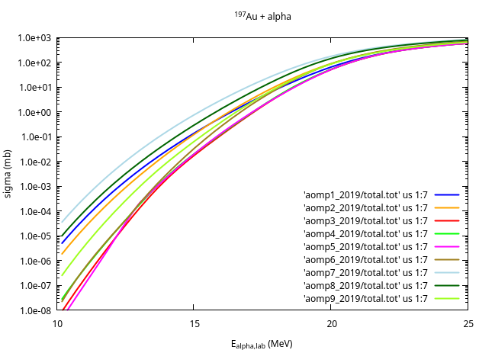
Total ¹⁹⁷Au + α cross section for different α-potentials
Optical model
(complex AOMPs)
at 25 MeV:
factor 2
at 10 MeV:
more than 3 orders of magnitude!!!
T₉ = 2.5

Slide 58
Some further aspects for Atomki-V2
energy dependence of optical potential
dispersion relation:
coupling between real and imaginary part of potential
double-folding approach:
- chosen DDM3Y interaction
- chosen HFB+Skyrme densities
applicability of the barrier transmission approach:
- fusion enhancement from coupling to low-lying
states
- fusion hindrance suggested in several cases
e.g. the astrophysically relevant ¹²C+¹²C fusion

Slide 59
How to measure α + ¹⁹⁷Au ? – nuclear physics
convenient mechanical and chemical properties
mono-isotopic target ¹⁹⁷Au
activation technique applicable to several channels:
¹⁹⁷Au(α,γ)²⁰¹Tl: T_{1/2} = 73.0 hours, Q = -1.54 MeV
¹⁹⁷Au(α,n)²⁰⁰Tl: T_{1/2} = 26.1 hours, Q = -9.74 MeV
¹⁹⁷Au(α,2n)¹⁹⁹Tl: T_{1/2} = 7.4 hours, Q = -16.80 MeV
analysis of many reaction channels is essential to constrain all parameters of the statistical model
Mohr et al., PRC 95, 015807 (2017)
combined X-ray and γ-ray spectroscopy necessary for ¹⁹⁷Au(α,γ)²⁰¹Tl cross section: measuring time > 500 h !

Slide 60
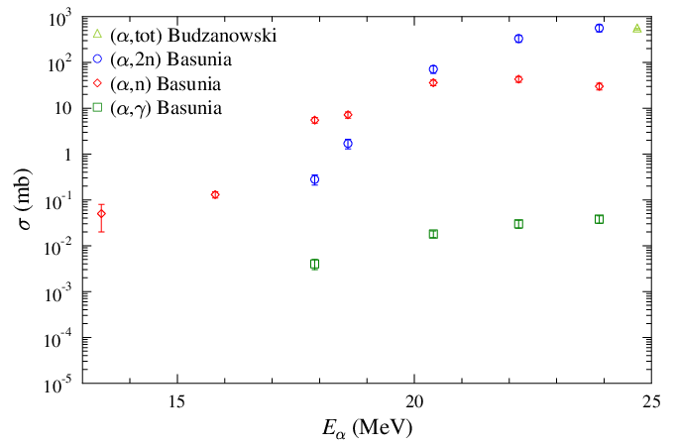
Experimental results (from literature)

Slide 61
Why measure α + ¹⁹⁷Au ? – astrophysics
nucleosynthesis of neutron-deficient p-nuclei:
sensitive to (γ,α) and (γ,n) reaction rates
Woosley and Howard, ApJS 36, 285 (1978)
stellar (γ,α) rates best constrained by lab (α,γ) data
Rauscher, Nucl. Phys. News 28,12 (2018)
Mohr et al., EPJA 32, 357 (2007)
extrapolation of experimental data to Gamow window mainly sensitive to α-nucleus potential
Somorjai et al., A&A 333, 1112 (1998)
few data for very heavy nuclei (¹⁹⁷Au: Z = 79)
- high Coulomb barrier → small cross sections

Slide 62
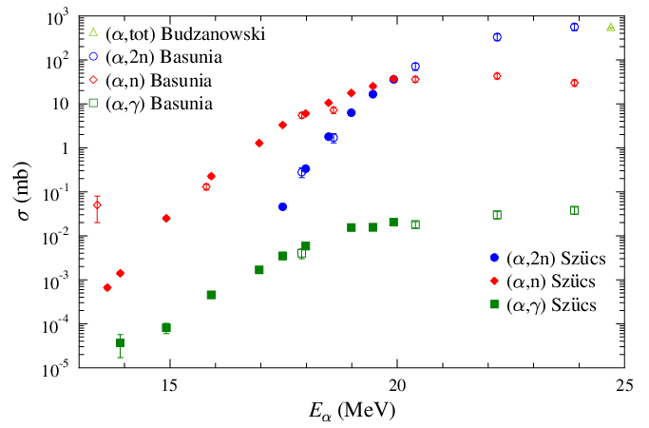
Experimental results (including our new data)

Slide 63
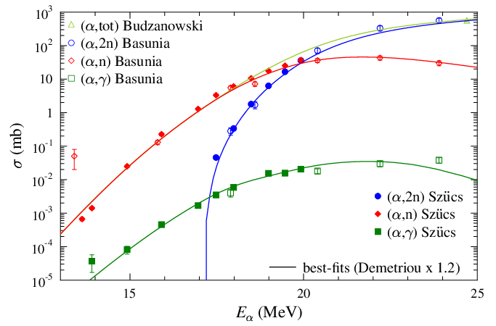
Experimental results compared to TALYS calculations

Slide 64
Results of statistical model calculations (TALYS)
α-nucleus potential: well constrained
- best fit from Demetriou-V3 (real part scaled by 1.2)
- almost the same χ² from Avrigeanu-2014
unfortunately: other ingredients not really constrained
- nucleon-OMP
- γ-ray strength
- level density
reason: significant uncertainties in the γ-ray and X-ray branchings in all channels
nice result - if we trust these calculations …

Slide 65
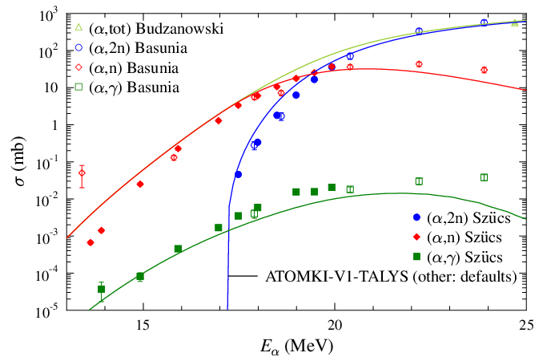
Exp. results vs. TALYS: ATOMKI-V1

Slide 66
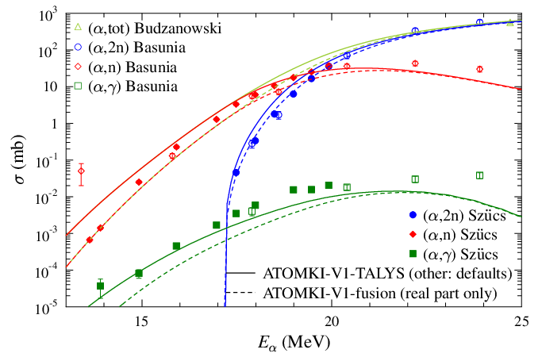
Exp. results vs. TALYS and fusion model: ATOMKI-V1
better at low
energies

Slide 67
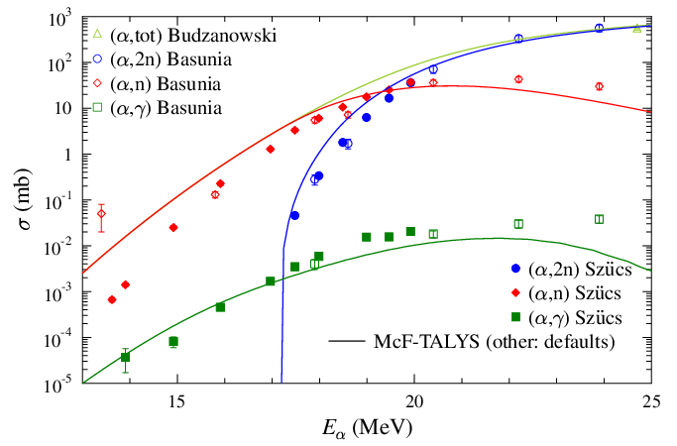
Exp. results vs. TALYS: McFadden

Slide 68
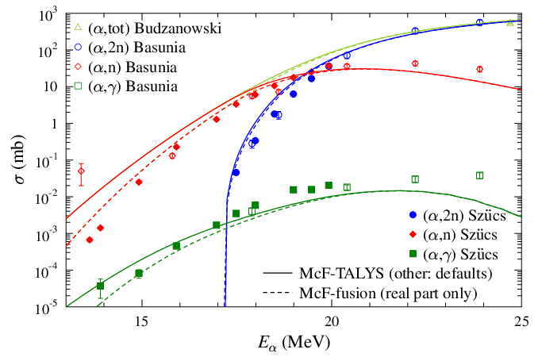
Exp. results vs. TALYS and fusion model: McFadden
better at low
energies

Slide 69
Conclusions
improved data for ¹⁹⁷Au(α,γ), ¹⁹⁷Au(α,n), ¹⁹⁷Au(α,2n) from the new activation experiment
standard analysis (TALYS) favors α-potentials by Avrigeanu-2014 and Demetriou (V3, factor 1.2)
at energies of the Gamow window far below the Coulomb barrier (≈10 MeV): TALYS results uncertain
delicate sensitivity to the tail of the imaginary potential W(r) at large radii (r >> 10 fm) far outside the target
fusion-type models (real potential only!) can be used to reduce uncertainties → lower limit for rates?
uncertainties may be larger than thought before,
but we have better understanding of the problem

